Slide 1
PERFECT POSTURE
Group 38
Apoorva Josyula
Julianna Gecsey
Rohan Kanianchalil
ECE 445 SP21
Notes:
Julianna

Slide 2
Introduction
“Work from Home” lifestyle has swept across the world to help curb the rise of COVID pandemic, but a new pandemic is being created in return.
Notes:
Julianna

Slide 3
Problems
01
92% Reported
02
01
Existing Products
02
03
Kyphosis
03
Chiropractors have noticed significant increase of posture issues since start of COVID
Either rely on a physical brace or focus on one aspect of the spine
Spinal deformities that alter the natural angle of a healthy spine curve
Notes:
Julianna

Slide 4
Objectives
Wearable
Feedback
Train
Create an easy to wear device that tracks a user’s sitting posture
Give direct feedback to users when their posture is off
Allow users to track and see their posture progress
Notes:
Julianna

Slide 5
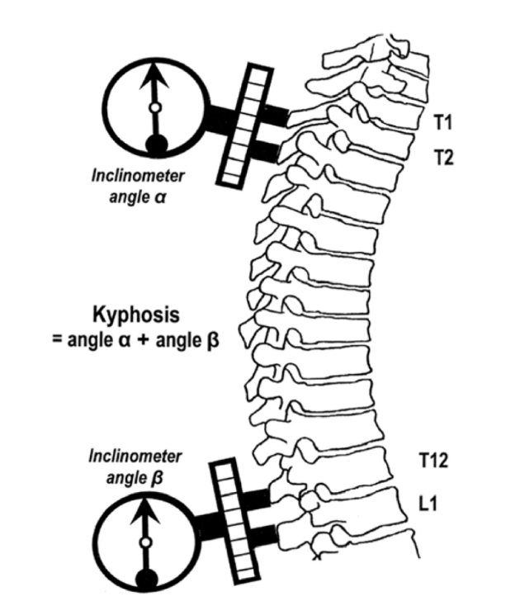
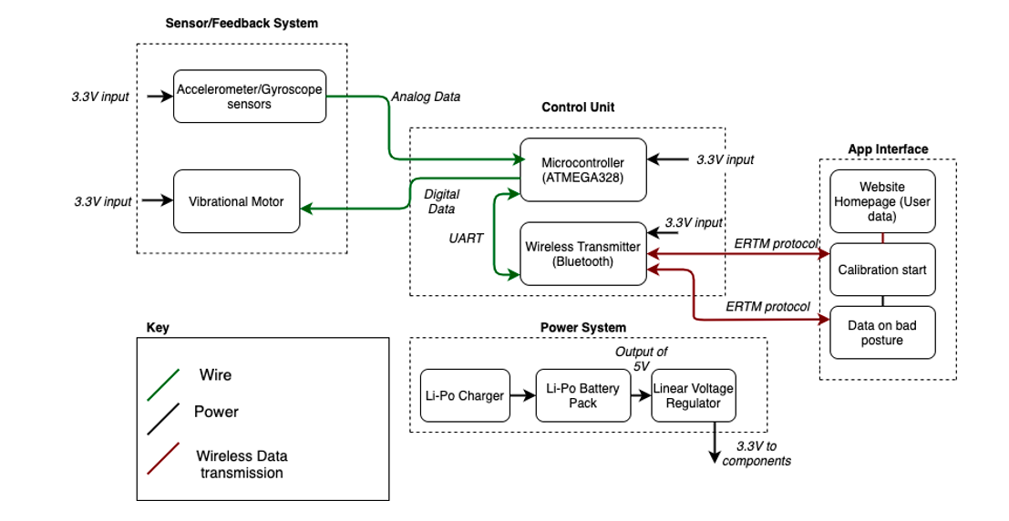
System Overview
Fig 1: Kyphosis Angle Measurement
Fig 2: Block Diagram
Notes:
Rohan

Slide 6
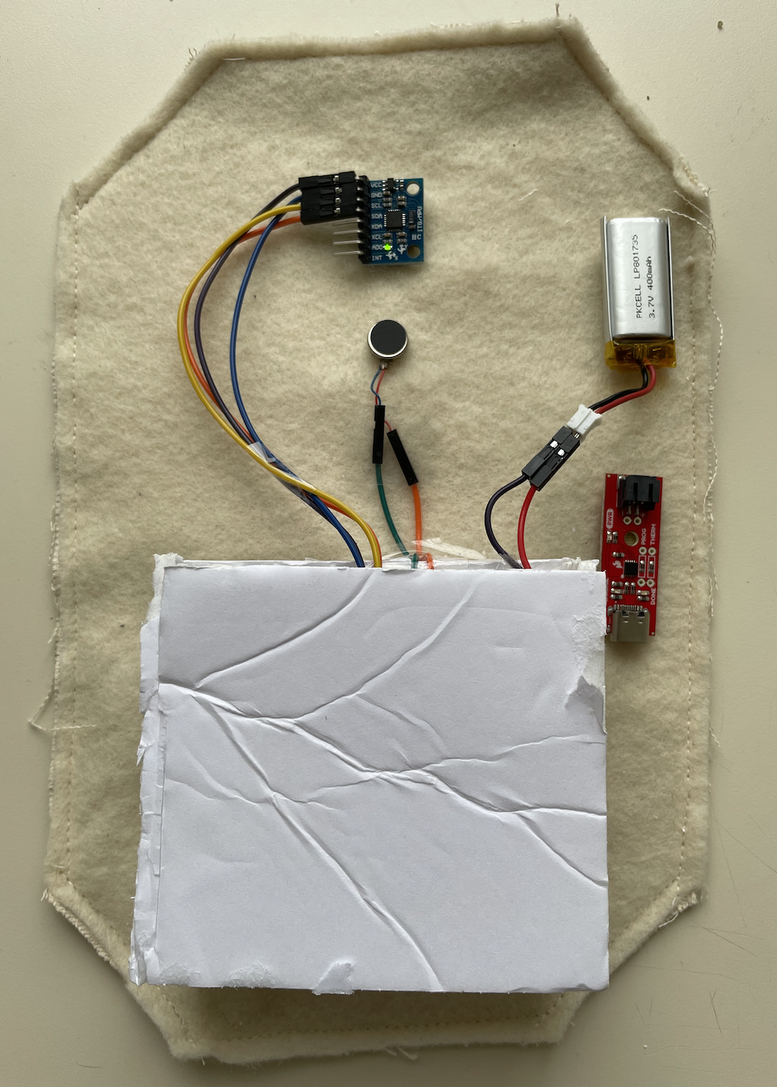
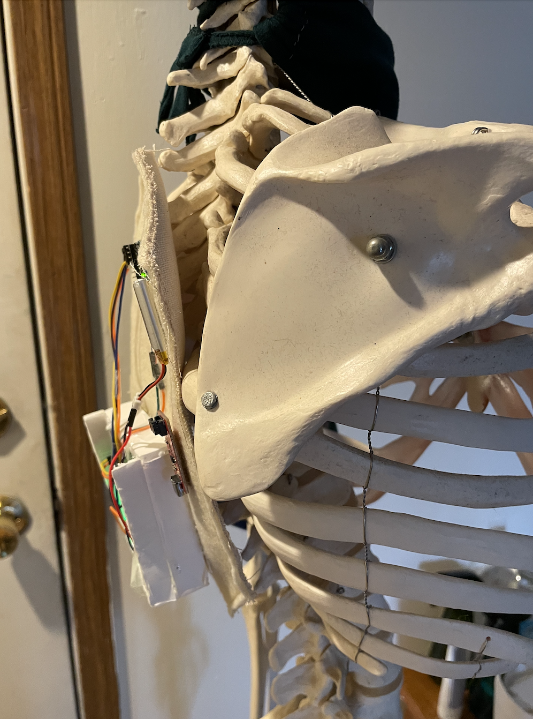
Physical Implementation
Sensor
Li-Po Battery
Vibrational Motor
Li-Po Charger
Control Unit
Notes:
Rohan

Slide 7
Ethics and Safety
Ethics
Safety
01
03
Ethics
Safety
02
04
We are gathering information from the user that they may want private
Weight of the actual device
Proper Usage of Medical Devices
This is being placed on the users skin
Notes:
Rohan

Slide 8
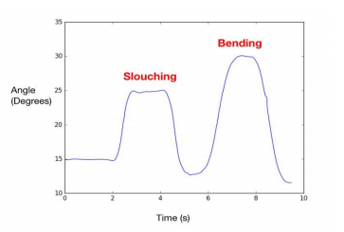
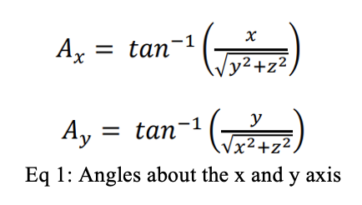
Sensor Feedback System
Gyroscope/Accelerometer
Sensors to determine if spinal curvature is correct
Filter equation used to convert raw pitch and yaw angles to tilt angles
Fig 3. Angle values reading slouching
Notes:
Apoorva

Slide 9
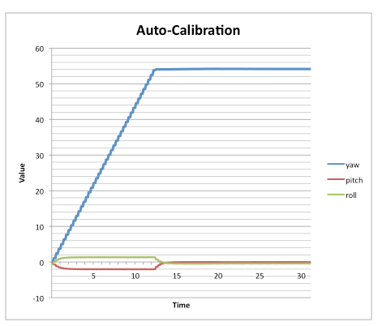
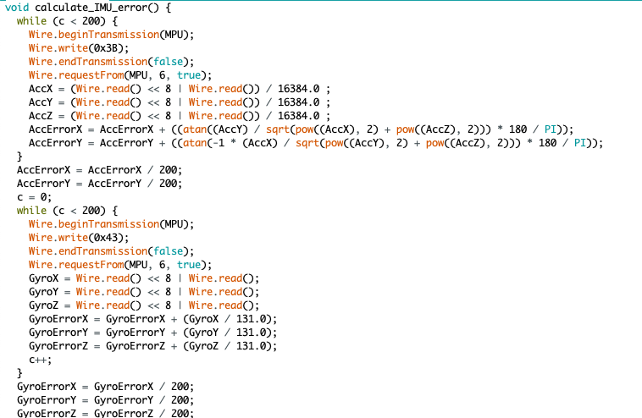
Sensor Feedback System
Drift Issues
Fig 2. Graph of gyro drifting
Fig 3. Code to compensate for error
Notes:
Apoorva

Slide 10
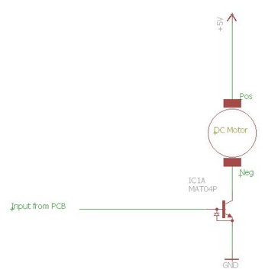
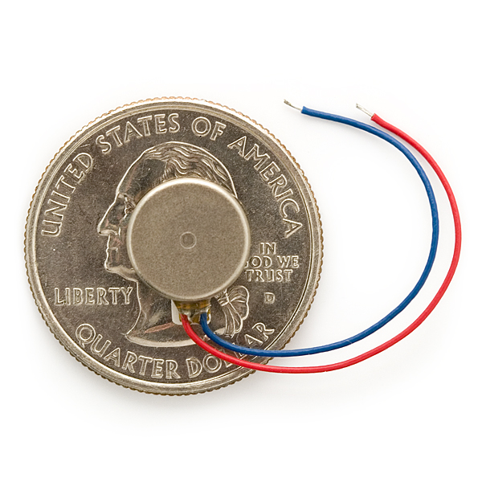
Sensor Feedback System
Vibrational Motor
01
03
Physically alert user to when their posture has changed
Sends 10 second digital signal after slouch has been detected
Fig 5: Vibrational Motor Circuit
Two minute buffer period for posture fix
Fig 4: Size Comparison
Notes:
Apoorva

Slide 11
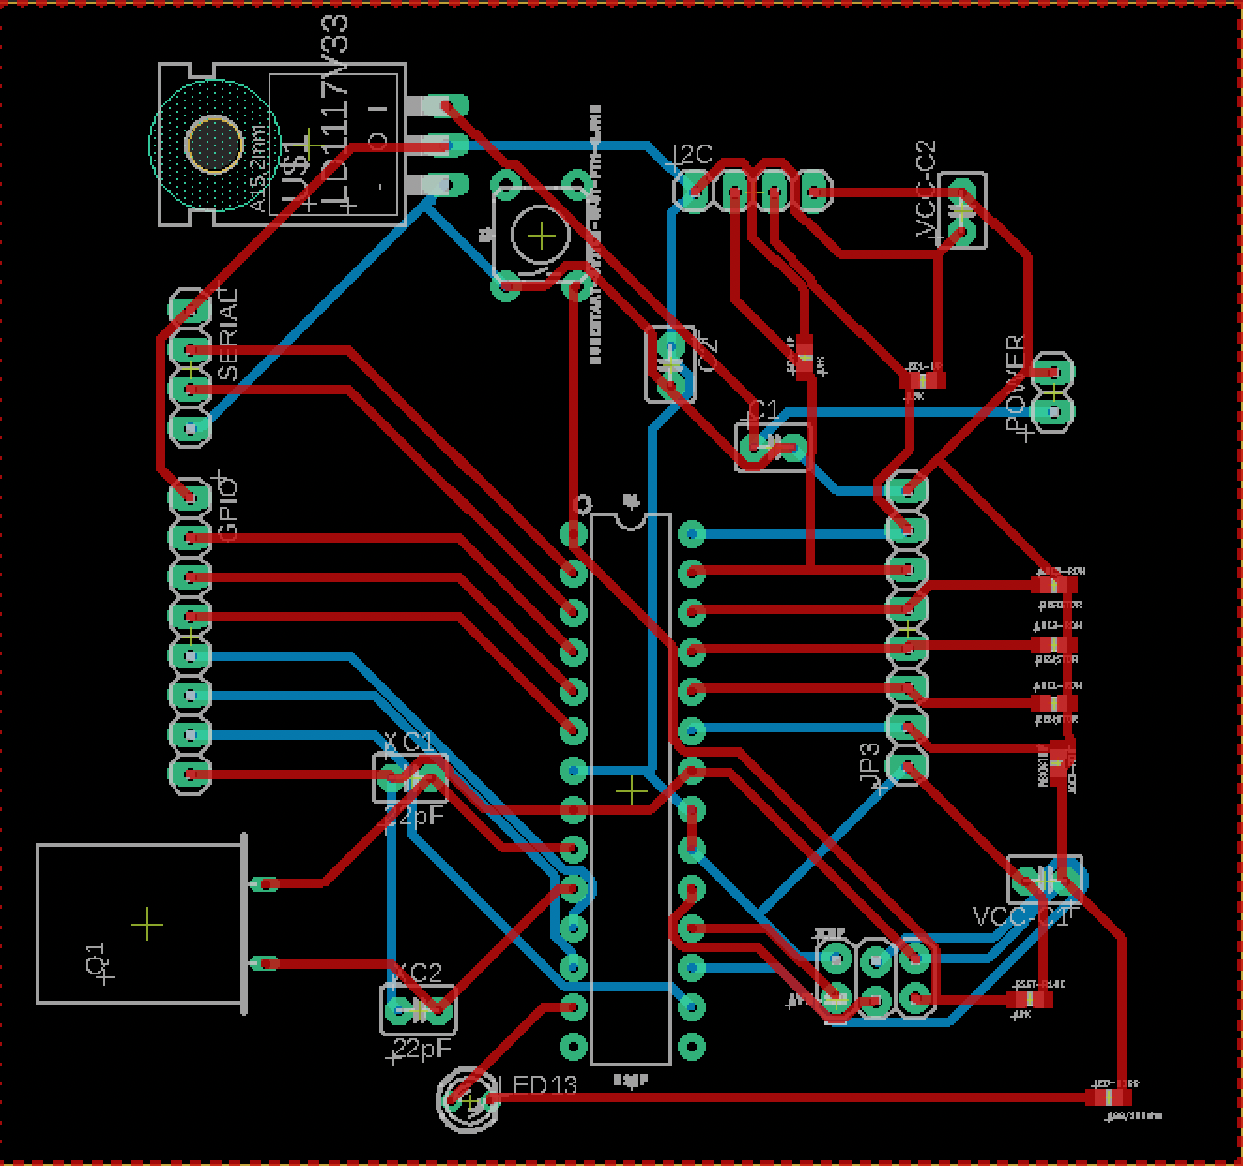
Control Unit
Microcontroller PCB
Atmega328pu used as main chip
Supplying power other components to overall system 3.3V
Additional pull-up resistors added to SLA/SCA to communicate through I2C bus with two sensors
Communication with Bluetooth module via UART
Fig 6: PCB Design
Notes:
Julianna

Slide 12
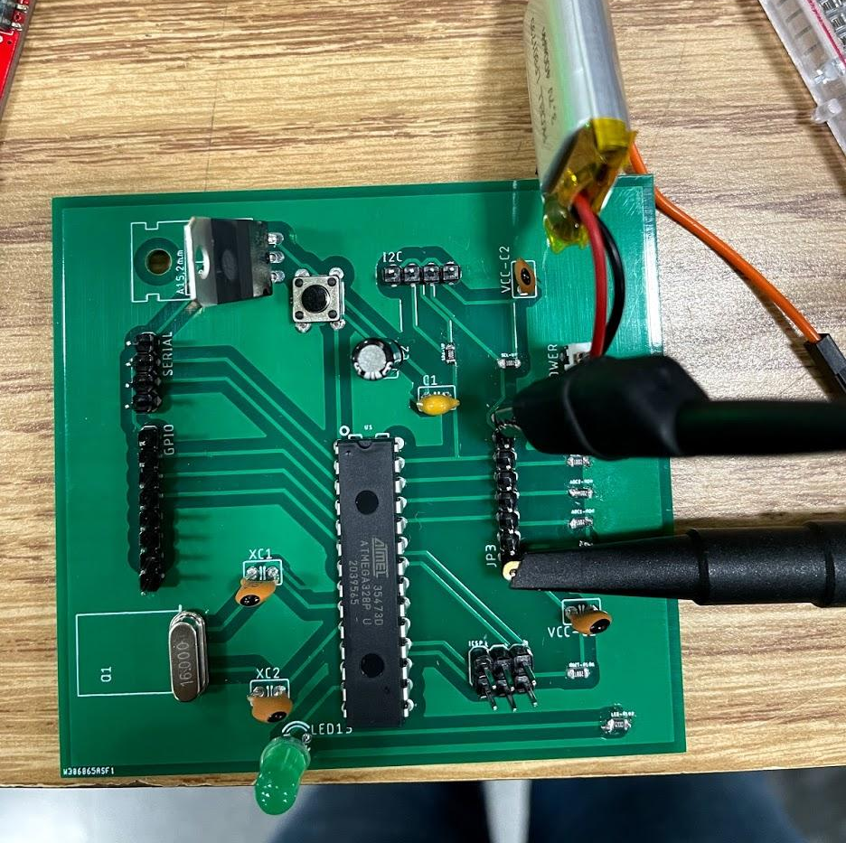
Control Unit
Embedded Programming Issues
Linear Voltage Regulator
AMTEGA328P
ISP Pins
Notes:
Julianna

Slide 13
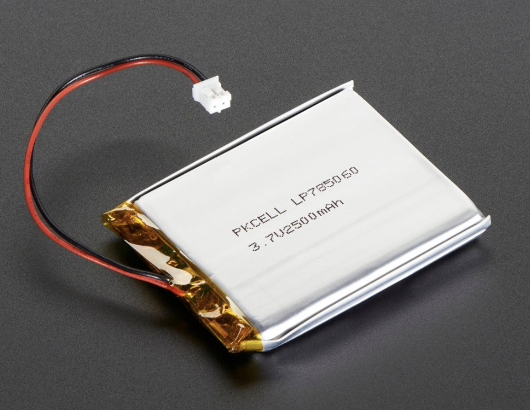
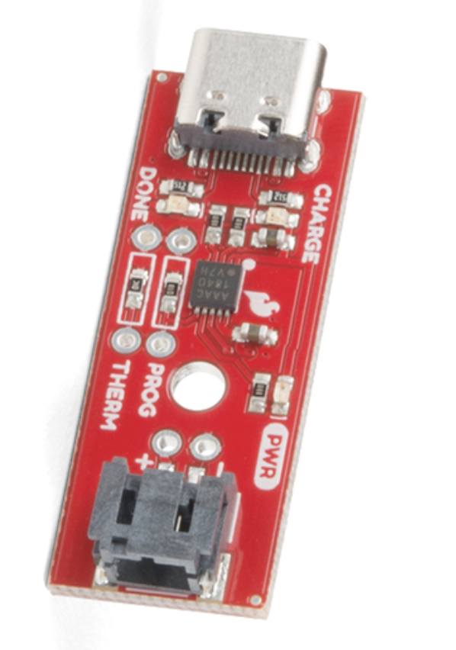
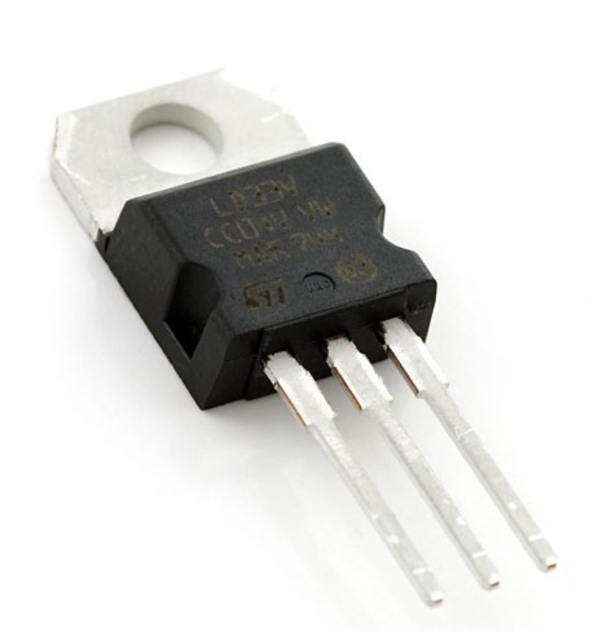
Power Supply
Lithium-Polymer Battery
01
Lithium-Polymer Charger
Linear Voltage Regulator
03
3.7V output at 2500mAh
Fig 7: Li-Po Battery
Attached to allow user to recharge at rate of every 4 hours
Placed on PCB
Supplies 3.3V to rest of components
Fig 9: Li-Po Charger
Fig 8: Linear Voltage Regulator
Notes:
Apoorva

Slide 14
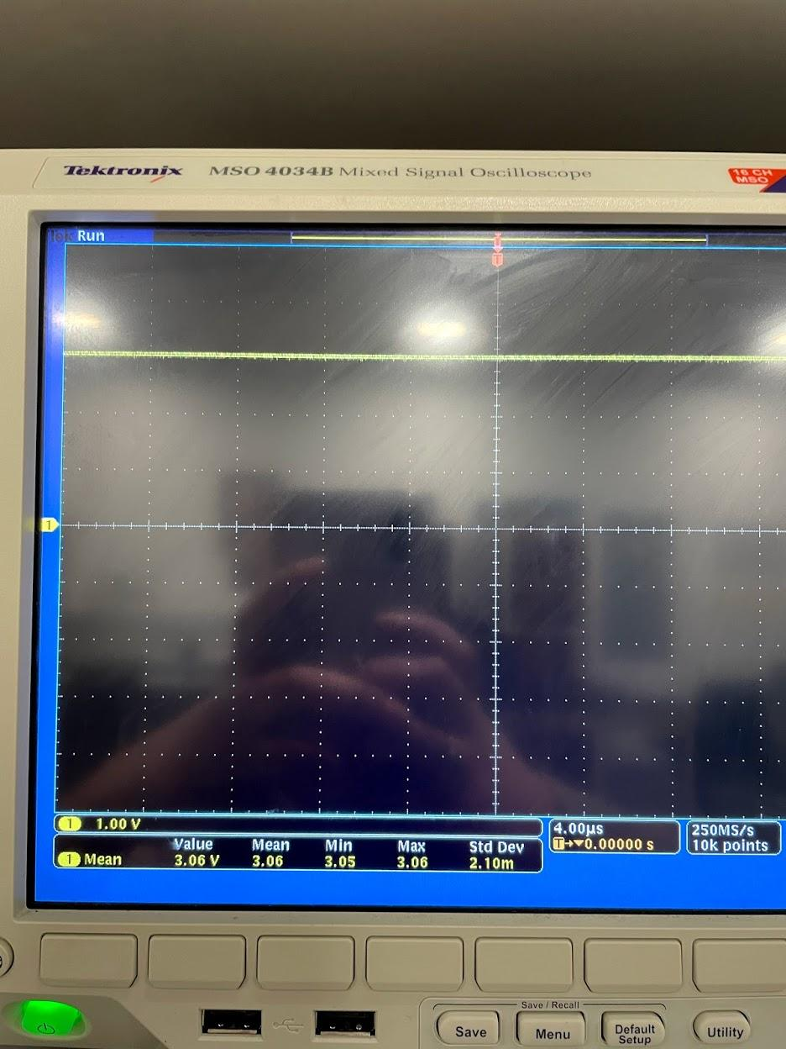
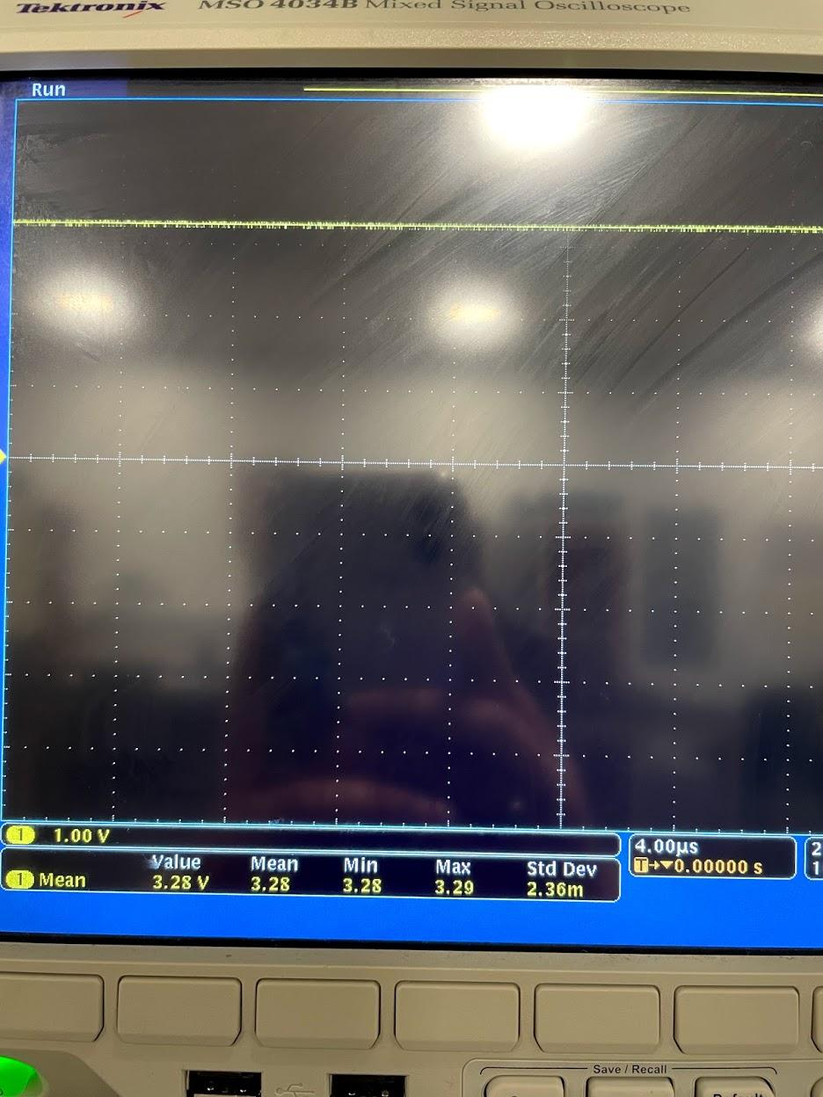
Power Supply
Battery Supply Issues
Fig 10. Vout of circuit with 3.7V battery supply
Fig 11. Vout of circuit with 5V battery supply
Notes:
Apoorva

Slide 15
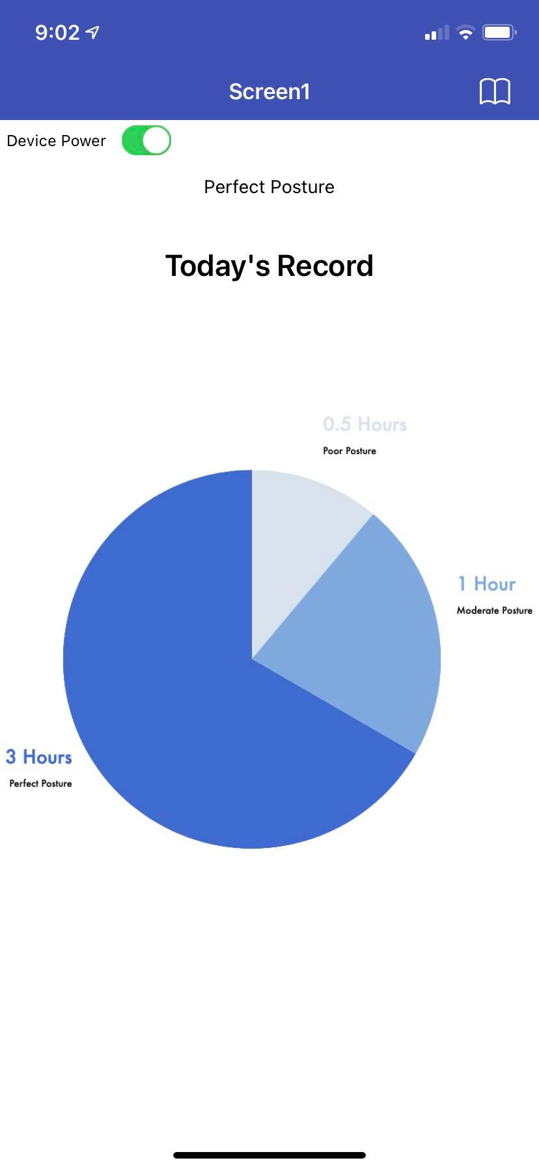
App Interface
Bluetooth Connected to Mobile Device
Store individual posture data through MongoDB per session
Results graphed to visually see progress per session
Fig 12. User Interface
Notes:
Rohan

Slide 16
Reliability of System
 | Bad Posture | Posture Correct
Vibrated | 12 | 6
No Vibration | 4 | 12
False Positivity Rate: 30%
Table 1: Tested Reliability Table
Notes:
Rohan

Slide 17
Successes & Challenges
Notes:
Julianna

Slide 18
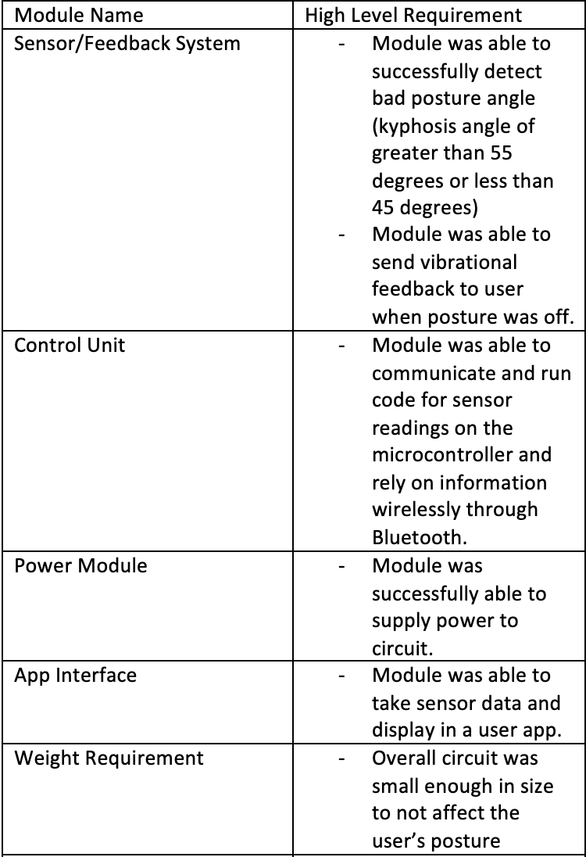
Verification
Table 2. Requirements of System
Notes:
Julianna

Slide 19
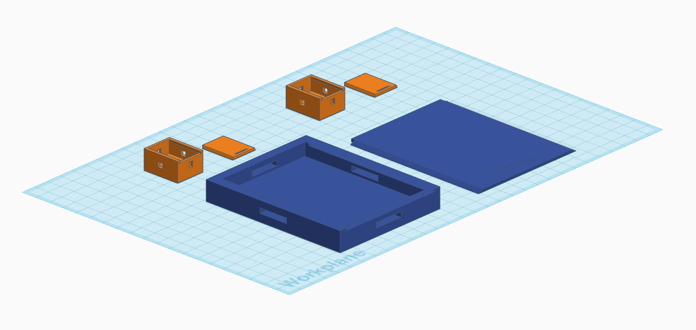
Future Work
Weight Considerations:
3D Printed material for lightweight cases
Control Unit Reduced in Length
E-Textiles:
Fabric flexible enough to wear, but stable for sensors to read better values
Fabric should be simple enough to use by oneself
Fig 13. 3D model of sensor cases
Notes:
Apoorva:

Slide 20
THANKS
Do you have any questions?

