Slide 1
Waste Segregation System
Electrical & Computer Engineering
Group 55
Syed Ahmed Raza, Rutva Pandya, Konark Dhingreja

Slide 2
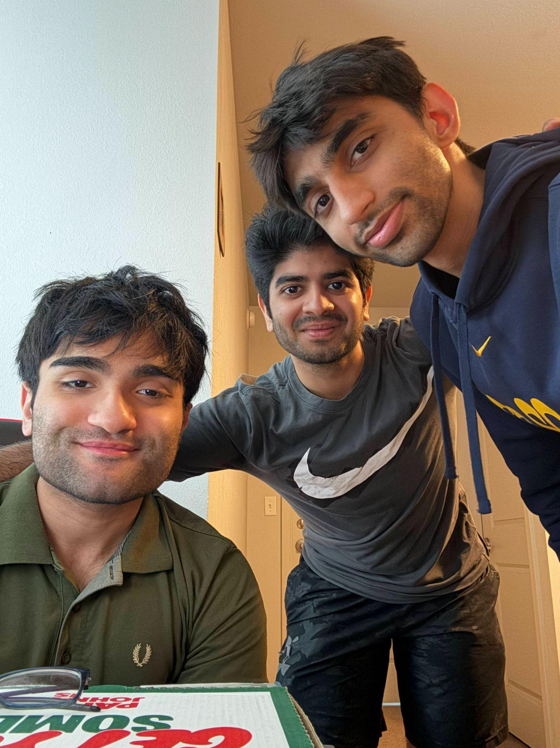
SYED
RUTVA
KONARK
Our Team
Responsible for Microprocessor Logic & Communication Between Different Parts
Responsible for Computer Vision Model Implementation
IMAGE
Responsible for Motor Selection & Power Subsystem
ELECTRICAL & COMPUTER ENGINEERING
GRAINGER ENGINEERING

Slide 3
Introduction
Our project is a smart waste-sorting bin that uses Computer Vision and Sensors to automatically identify and sort trash into Metal, Plastic, Glass, or Non-Recyclables. By reducing manual sorting and contamination, it makes waste disposal more efficient, accurate, and eco-friendly.
ELECTRICAL & COMPUTER ENGINEERING
GRAINGER ENGINEERING

Slide 4
Objective
PROBLEM
Improper waste segregation leads to recyclable materials being dumped in landfills, reducing the effectiveness of recycling efforts. Manual sorting is slow, error-prone, and inefficient at the source. There's a clear need for an automated solution that can accurately sort waste during disposal.
SOLUTION
Our solution is an AI-powered smart bin that uses image classification to detect and sort waste into the correct category—recyclable, compostable, or landfill—in real-time. This minimizes human error, improves recycling rates, and promotes sustainable waste management at the source.
ELECTRICAL & COMPUTER ENGINEERING
GRAINGER ENGINEERING

Slide 5
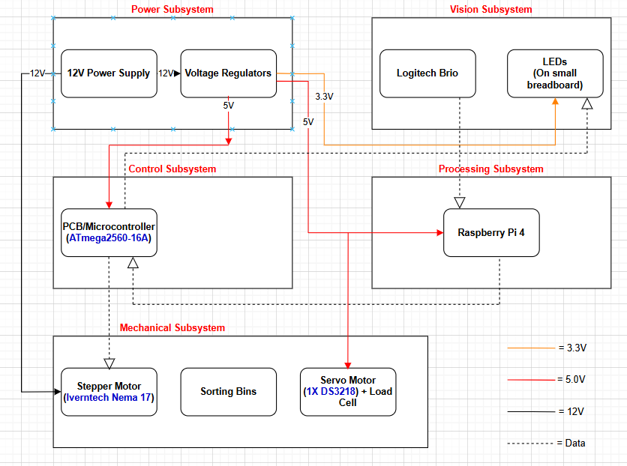
Block Diagram
ELECTRICAL & COMPUTER ENGINEERING
GRAINGER ENGINEERING

Slide 6
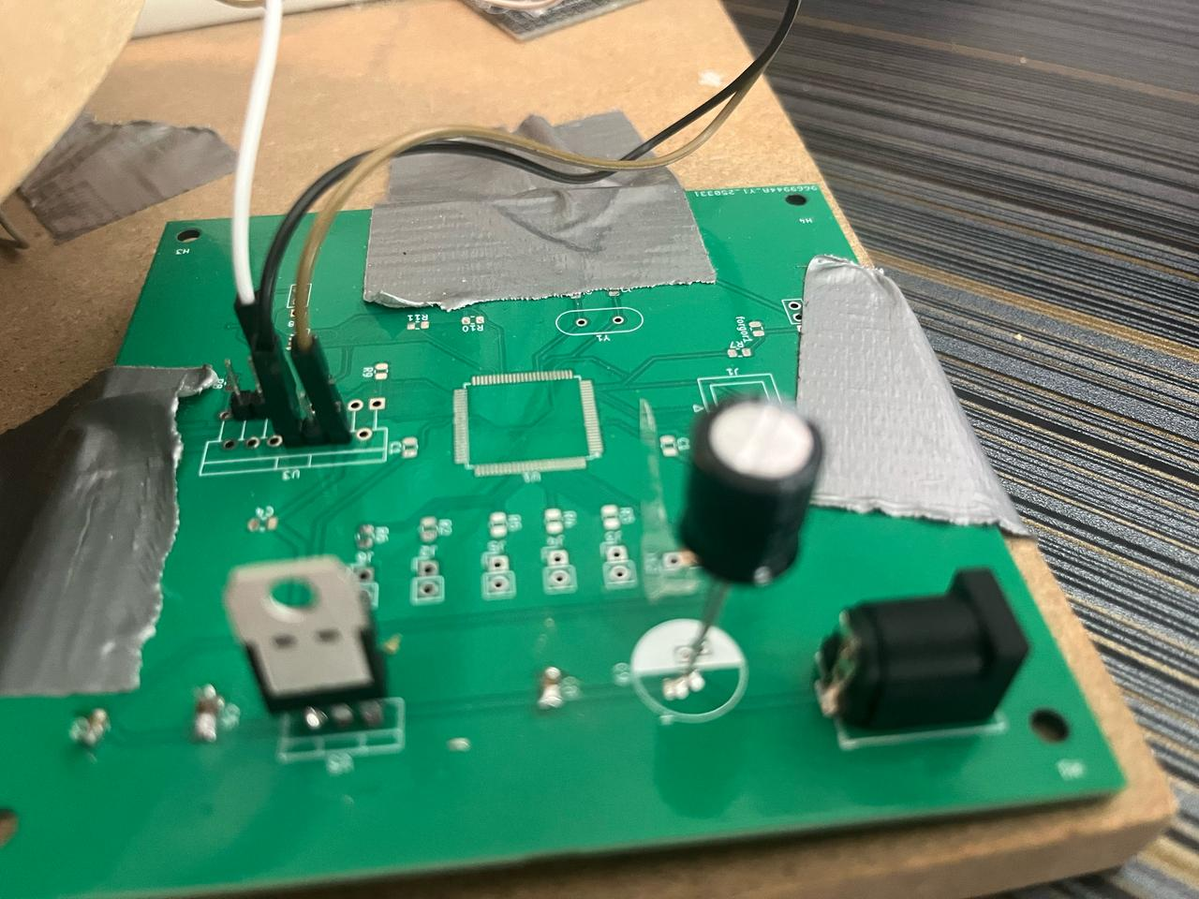
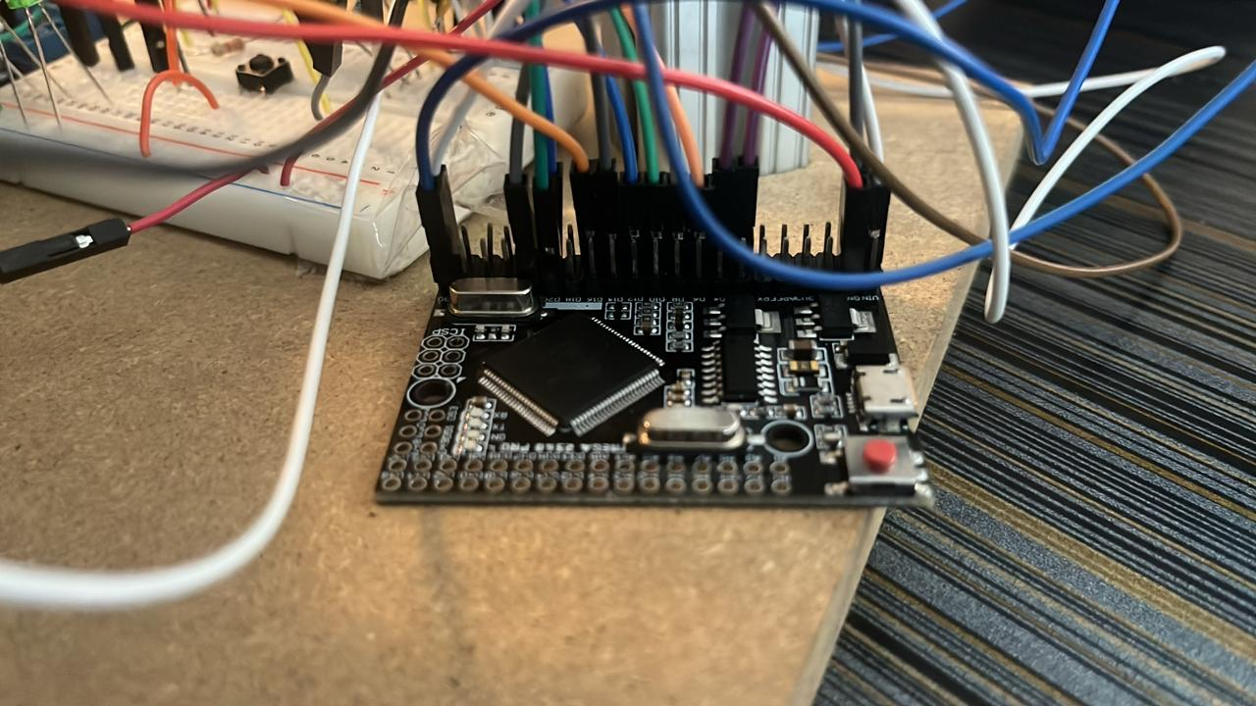
Power & Control Subsystem
Power Subsystem
We implemented a power subsystem from our PCB utilizing a barrel jack connector which gives us a steady 12V which is then passed through a 470uF capacitor to work as a heat sink. This voltage is then finally passed through a l7805 voltage regulator to give us 5V.
Control Subsystem
We used an ATMega2560 pro as our control subsystem. Due to timing constraints, we have had to resort to using the Development board rather than a soldered on ATMega2560.
IMAGE / GRAPHIC
IMAGE / GRAPHIC
ELECTRICAL & COMPUTER ENGINEERING
GRAINGER ENGINEERING

Slide 7
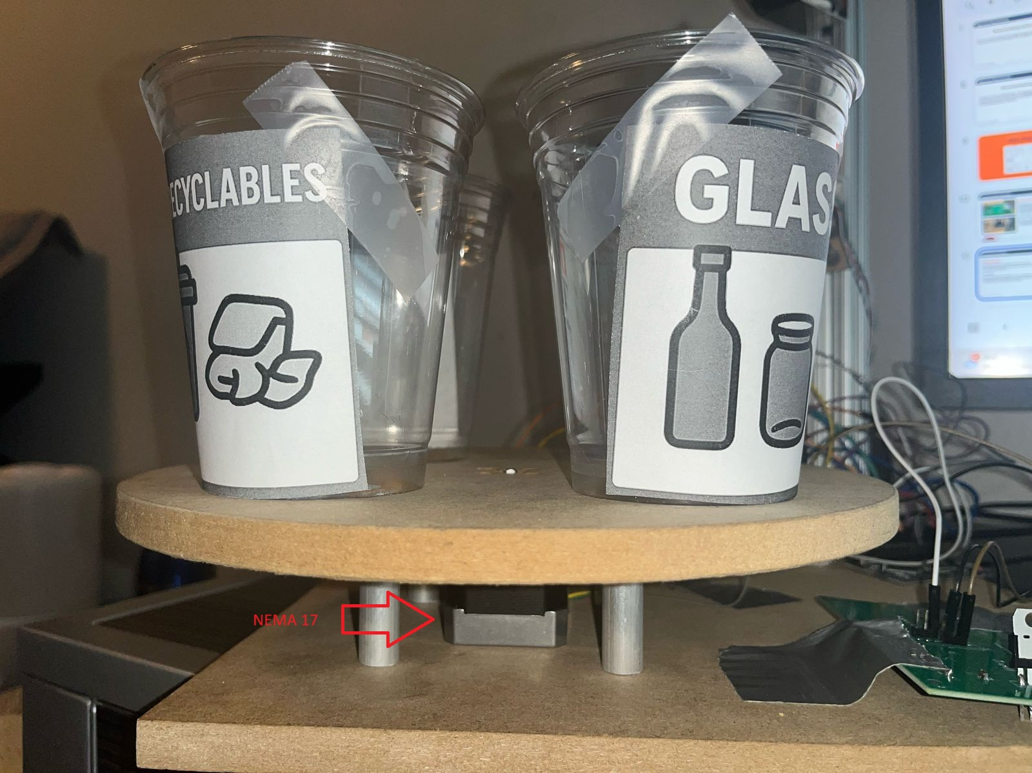
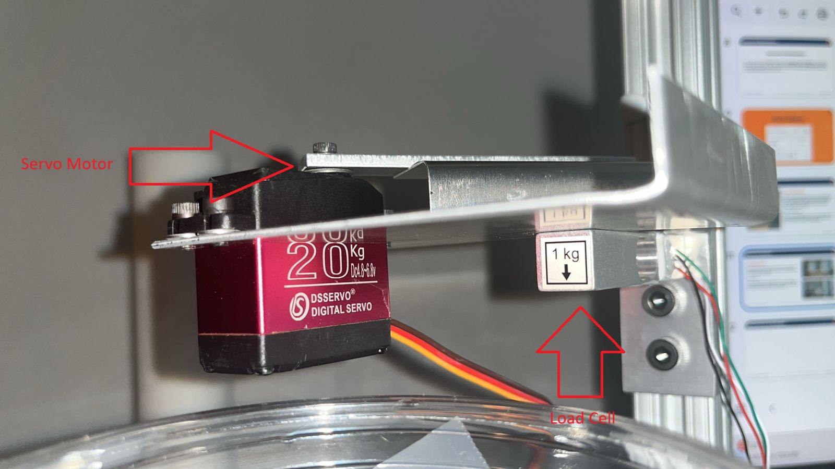
Mechanical Subsystem
Stepper Motor
We made the choice to use the Nema 17 stepper motor as this gave us the perfect amount of torque to move all the bins and the platforms they lied on.
Servo Motor
We decided to go with the DS3218 servo motor (180 degree programmable). This is one of the most used servo motors on the market and it proved reliable for our project.
Load Cell
We use a 1kg load cell to detect any changes in weight. Once there has been a change, signals are then sent to the Atmega to interpret.
IMAGE / GRAPHIC
IMAGE / GRAPHIC
ELECTRICAL & COMPUTER ENGINEERING
GRAINGER ENGINEERING

Slide 8
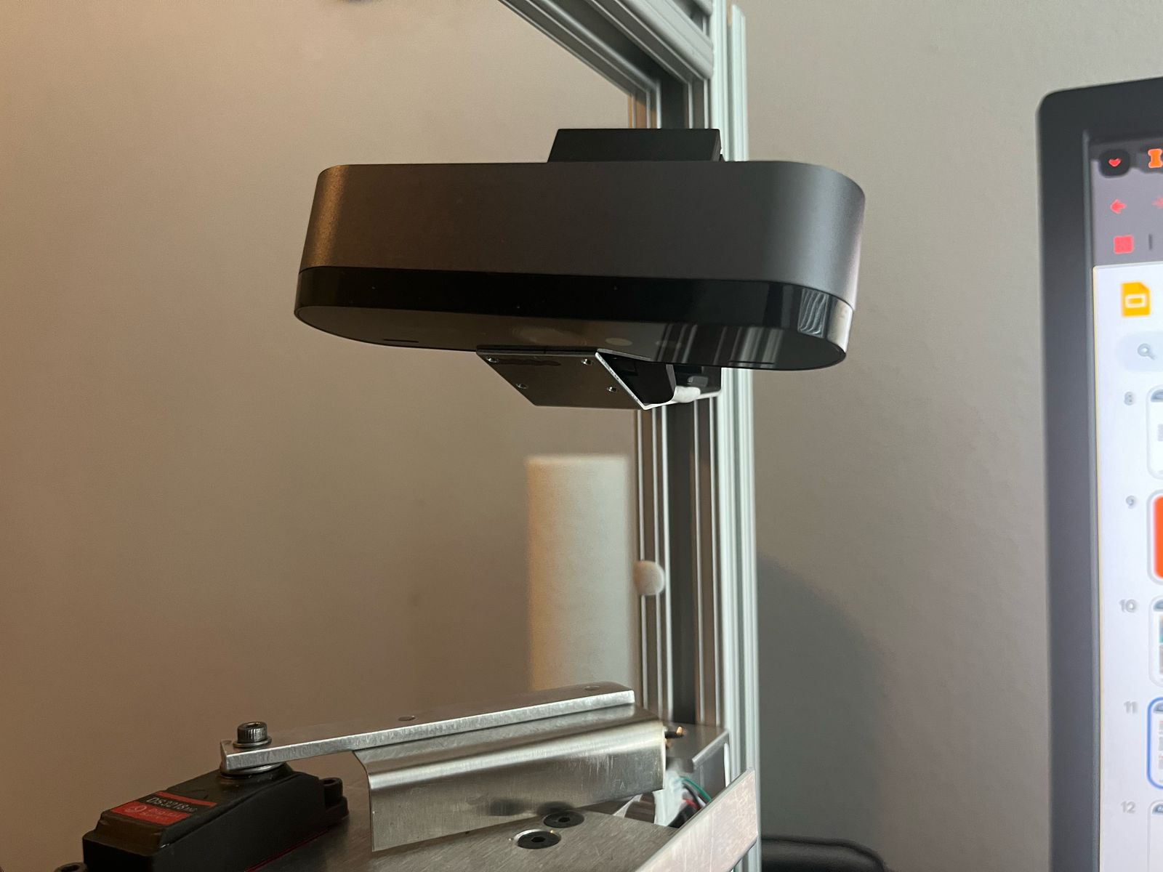
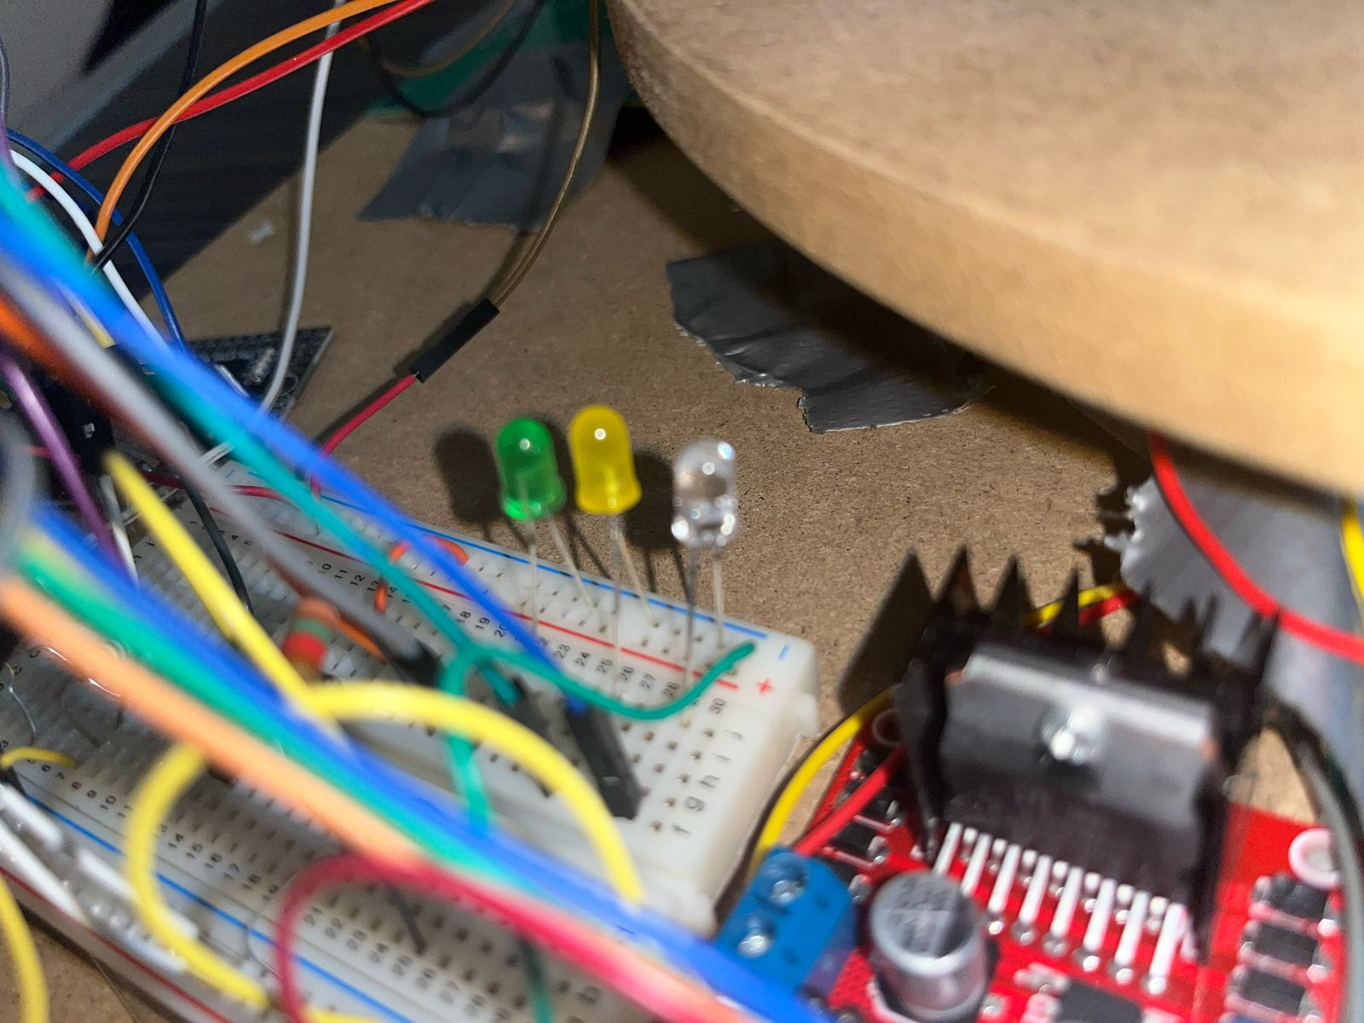
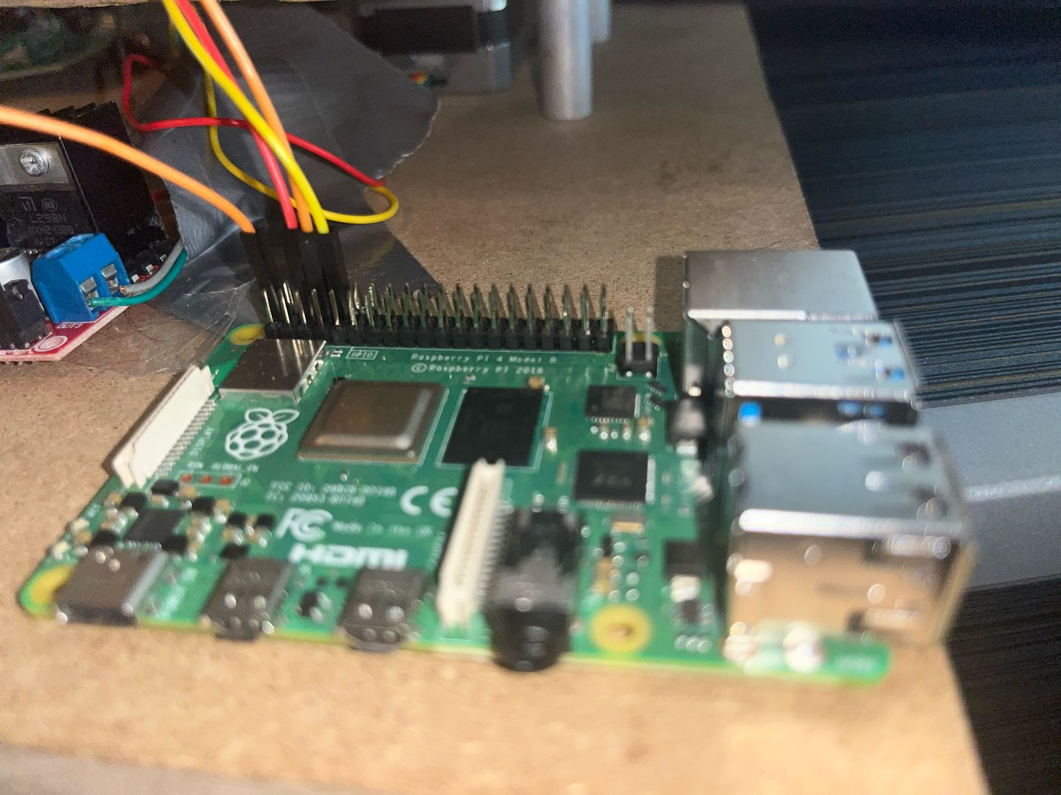
Vision & Processing Subsystem
Camera
We decided to go with the Logitech Brio to take pictures of our waste as this provided a 1280 x 720 resolution, fast feedback, and stable mounting.
LEDs
We are using 3 LEDs (green, yellow, and blue) to represent the state of our system. Having LEDs on a breadboard proved to be both simple and efficient.
Raspberry Pi 4
We used the Raspberry Pi 4 as our processing unit to classify images using an ML model. We decided not to use the ATMega2560 Development Board for such a task as it simply did not provide enough processing power.
ELECTRICAL & COMPUTER ENGINEERING
GRAINGER ENGINEERING

Slide 9
High-Level Requirements
Accurate Waste Classification
The Machine Learning model must classify waste materials into their respective categories (plastic, metal, glass, non-recyclables) with at least 85% accuracy under standard indoor lighting conditions. This accuracy rate was carefully estimated based on the scope of this project and to account for the shards sized waste we will be testing.
ELECTRICAL & COMPUTER ENGINEERING
GRAINGER ENGINEERING

Slide 10
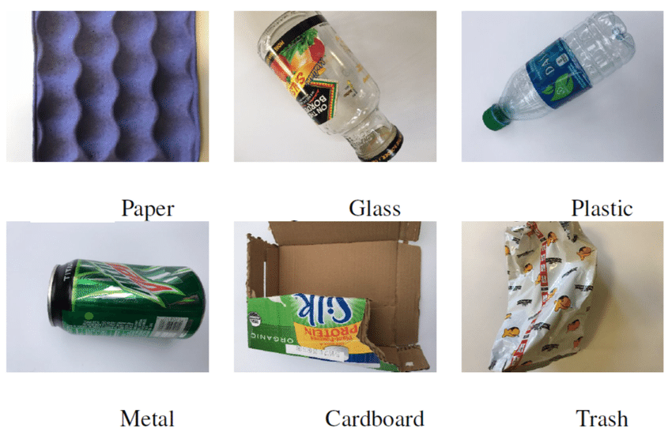
TrashNet Dataset
CHART / GRAPH
Sample Images From Trashnet Dataset
ELECTRICAL & COMPUTER ENGINEERING
GRAINGER ENGINEERING

Slide 11
Training Pipeline
Dataset Split
Stratified Split: 70% Train, 15% Test, 15% Validation
Model Training
Trained MobileNetV2 Model on Training Data to update Classifier Head
Fine-Tuning
Use a Custom Dataset of 30 images to Adapt to Environment
Training Pipeline to Obtain Custom-Trained Waste Segregation Model
ELECTRICAL & COMPUTER ENGINEERING
GRAINGER ENGINEERING

Slide 12
Model Performance & Dataset Statistics
CHART / GRAPH
Table 1: Dataset distribution and per-class accuracy using MobileNetV2
ELECTRICAL & COMPUTER ENGINEERING
GRAINGER ENGINEERING

Slide 13
High-Level Requirements
Efficient Sorting Mechanism
The Mechanical Arm and rotating bin system must successfully route classified items to their designated bins within 5 seconds, ensuring smooth and efficient operation. We estimate the classification process to take between 1 - 1.5s while the mechanical action would take 2 - 3s, resulting in the 5 second estimate for the entire process.
ELECTRICAL & COMPUTER ENGINEERING
GRAINGER ENGINEERING

Slide 14
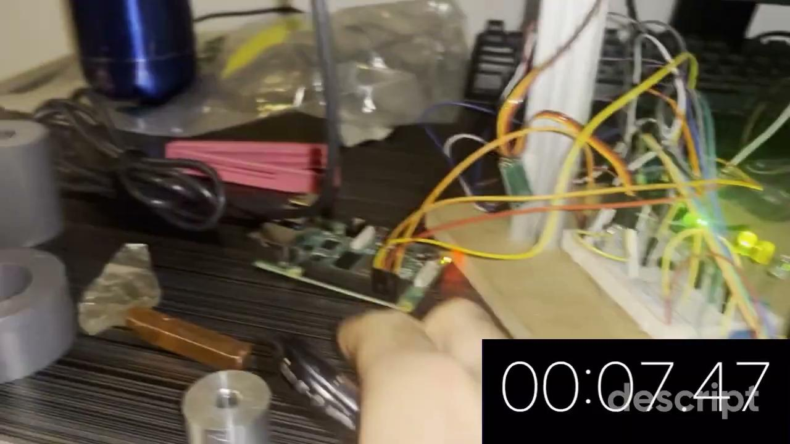
Demonstration of 5 second classification
ELECTRICAL & COMPUTER ENGINEERING
GRAINGER ENGINEERING

Slide 15
High-Level Requirements
Reliable Jam Detection and Error Handling
The system must detect blockages or jams within 2 seconds and automatically halt operations while providing a visual alert to the user through our LEDs indicating the status of the system.
ELECTRICAL & COMPUTER ENGINEERING
GRAINGER ENGINEERING

Slide 16
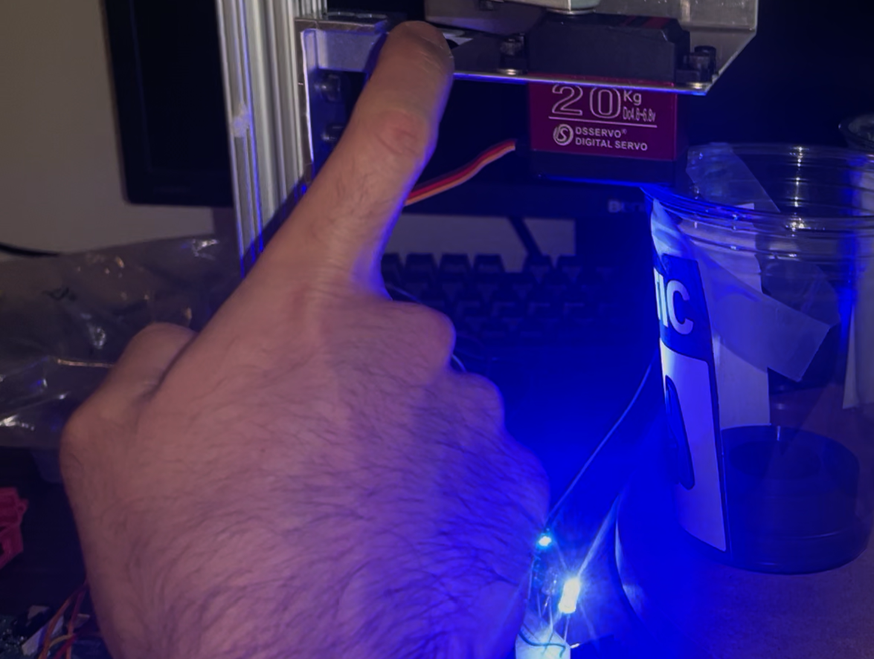
Emulating a Jam with having my finger pressed on the load cell
Blue LED = Jam Detected
ELECTRICAL & COMPUTER ENGINEERING
GRAINGER ENGINEERING

Slide 17
High-Level Requirements
Safe and User-Friendly Operation
The system must have physical barriers and emergency stop functionality to prevent user interaction with moving parts. The power system must operate within safe voltage and current limits, ensuring protection against electrical hazards. In the event of an emergency stop, the entire system must be stopped within 2 seconds to prevent harm.
ELECTRICAL & COMPUTER ENGINEERING
GRAINGER ENGINEERING

Slide 18
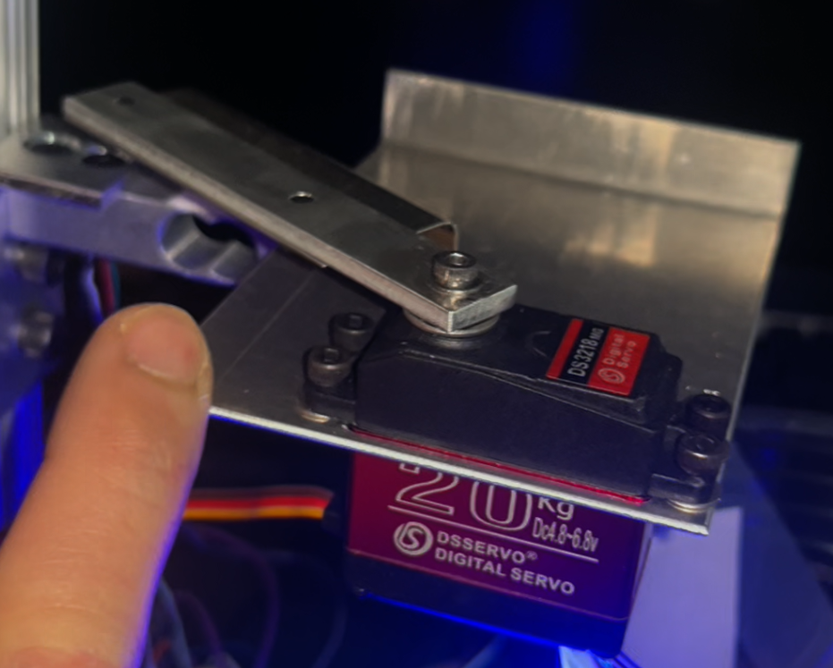
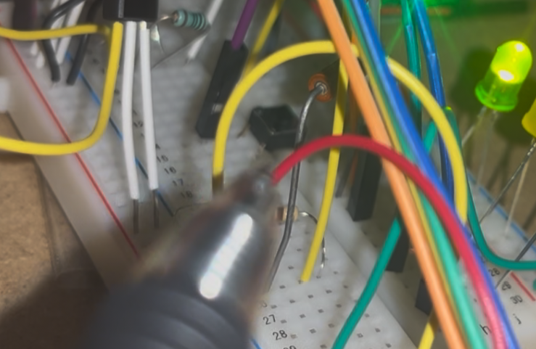
Power & Control Subsystem
Safety Barriers
Ensures no waste falls out and nobody interferes with the segregation process.
Kill Switch
Button in the middle which kills power to all parts of the system. Needs manual restart to use the system again.
IMAGE / GRAPHIC
IMAGE / GRAPHIC
ELECTRICAL & COMPUTER ENGINEERING
GRAINGER ENGINEERING

Slide 19
Requirements & Verification
Vision Subsystem
Requirements
Verification
Capturing High Quality 1280x720 Images
Used a 4K Logitech Brio Camera
The TensorFlow Lite model must classify waste items with at least 85% accuracy
Benchmarked MobileNetV2 Model on Trashnet Dataset to achieve average accuracy of 88%
System correctly updates status LEDs based on operational states
Manually triggered each state to verify the corresponding LED response
ELECTRICAL & COMPUTER ENGINEERING
GRAINGER ENGINEERING

Slide 20
Requirements & Verification
Power Subsystem
Requirements
Verification
Provide a 12V Power Supply using a Barrel Jack connector on PCB
Measured Input Voltage Using Multimeter
Create a 12V to 5V Converter needed to power Mega2560 Pro Development Board
Development Board Successfully Powered & Voltage Verified Using Multimeter
Implement an Emergency Stop Button that Cuts Power to Motors within 2 seconds of Activation
Tested During Ongoing Disposal Process & Successfully Stopped Motor Function
ELECTRICAL & COMPUTER ENGINEERING
GRAINGER ENGINEERING

Slide 21
Requirements & Verification
Processing Subsystem
Requirements
Verification
Classification must be completed within 1.5 seconds to ensure efficient real-time operation
Used Timestamp Logging to measure processing time per classification
The CPU utilization on the Raspberry Pi 4 shall remain below 80% during inference to avoid performance bottlenecks
Used a System Monitor while running Inference to Record CPU Usage under 80% on Average
ELECTRICAL & COMPUTER ENGINEERING
GRAINGER ENGINEERING

Slide 22
Requirements & Verification
Control Subsystem
Requirements
Verification
The PCB Must Securely Mount All Components and Withstand Minor Vibrations Without Disconnection
Successfully Ran All Motors & Disposed of Waste Items of Different Weights & Sizes Without Affecting Performance
ELECTRICAL & COMPUTER ENGINEERING
GRAINGER ENGINEERING

Slide 23
Requirements & Verification
Mechanical Subsystem
Requirements
Verification
Servo Motor Must Push Object into Correct Bin Within 3 Seconds of Receiving Signal
Sent a Signal to the Servo Motor & Measured the Time Taken for Object to be Pushed Over Multiple Trials
Stepper Motor Must Complete Rotation to Target Bin Within 3 Seconds
Sent Movement Signals to the Motor & Measured the Time Taken for Rotations Over Multiple Trials
Servo Motor Must Apply Enough Force to Move Objects of up to 500g Into Waste Bin
Tested Objects of Varying Weights & Successfully Segregated Items into Appropriate Bins
ELECTRICAL & COMPUTER ENGINEERING
GRAINGER ENGINEERING

Slide 24
Challenges
Component Replacement from Nema 11 to Nema 17
Build Quality Issues With 1kg Load Cell
ATMega2560 Shortage & Difficulty Soldering
Servo motor Arm Reprogramming & Positioning
ELECTRICAL & COMPUTER ENGINEERING
GRAINGER ENGINEERING

Slide 25
Conclusion
Robust Safety Features
- Jam detection, emergency shutdowns
- Protects users from moving parts like glass
Scalable Deployment-Ready Design
- Compact, cost-effective build
- Simple user interface: plug-&-play operation
Real-World Deployment
Optimal performance
- Classifies with target accuracy of ≥ 85%,
- End-to-end sorting in < 5 seconds
ELECTRICAL & COMPUTER ENGINEERING
GRAINGER ENGINEERING

Slide 26
Future Works
Improve Dataset & Model Training
Cloud Connectivity & Alerts
Sustainability Metrics Dashboard
Increase classification accuracy with even more diverse, real-world waste samples
Enable wireless communication (WiFi, Bluetooth) for real-time system monitoring, jam alerts, and maintenance notifications.
Add a dashboard interface to visualize waste types sorted, usage trends, and estimated environmental impact.
Ideas to expand capabilities & effectiveness
ELECTRICAL & COMPUTER ENGINEERING
GRAINGER ENGINEERING

Slide 27
Questions & Feedback
Thank You!
We Value Your Feedback
Any Questions?
ELECTRICAL & COMPUTER ENGINEERING
GRAINGER ENGINEERING

