Slide 1
Ground Breaking Next-Gen Pet Smart Door
ECE 445 Team #2
Norbert Szczotka, Jeffrey Deng, Matthew Wei
11/30/2023

Slide 2
Agenda
Overview
Design
PCB Design
Results
Questions
ELECTRICAL AND COMPUTER ENGINEERING
GRAINGER ENGINEERING

Slide 3
Overview
ELECTRICAL AND COMPUTER ENGINEERING
GRAINGER ENGINEERING

Slide 4
Overview
Problem
Inconvenience of traditional pet doors
Have you ever had to leave work or school to let dog outside?
Pay dog-sitters and give them access to your home?
Incurring additional costs
ELECTRICAL AND COMPUTER ENGINEERING
GRAINGER ENGINEERING

Slide 5
Overview
Solution
Designed to convenience both pets and owners
Motion-detection technology
Real-time camera monitoring
Remote accessibility
Full door open and close functionality
ELECTRICAL AND COMPUTER ENGINEERING
GRAINGER ENGINEERING

Slide 6
Requirements
High Level Requirements
1. Sensors are able to detect motion on both sides of the wall. Camera will remain on for said duration as long as the pet is detected within the scope of the sensor’s field. Camera also must be able to connect to wifi and stream proper video to be extracted for the app’s use.
2. The user app must be able to communicate with the motors sending and receiving signals between the 2 systems within 2 seconds. The user will be able to make the decision to open or close the door via the application by monitoring the camera feed that displays the location of their pet.
3. The door should be able to open and close within 5 seconds in order to prevent the pet from waiting too long to enter or other unwanted guests to come into the house after opening. This door design should be sturdy enough to handle any pets that hit or bump the door while waiting for the door to open or while passing through.
ELECTRICAL AND COMPUTER ENGINEERING
GRAINGER ENGINEERING

Slide 7
Design
ELECTRICAL AND COMPUTER ENGINEERING
GRAINGER ENGINEERING

Slide 8
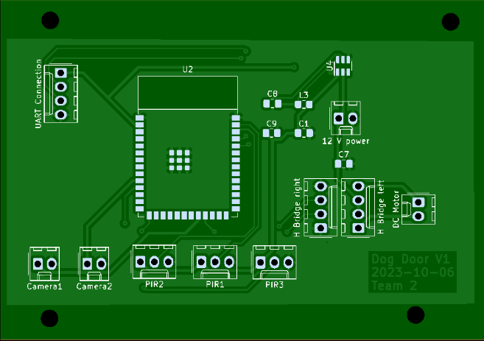
Design
Original Design
ESP32-S3-WROOM microcontroller
3.3V and 5V regulators
PIR sensor inside door for safety
Front and back camera
Quad Encoder DC Motor
ELECTRICAL AND COMPUTER ENGINEERING
GRAINGER ENGINEERING

Slide 9
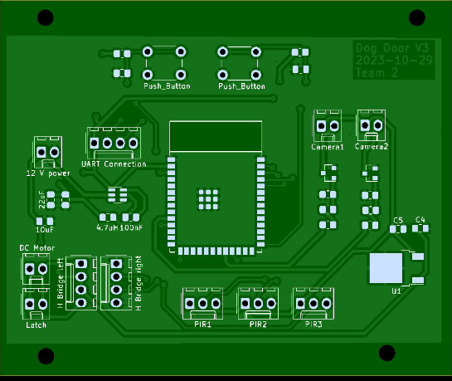
Design
Revisions
MOSFET design changes
Removed and readded power converter
Added H-bridge for motor driver
Added programming buttons for microcontroller
ESP32-S3-WROOM Dev Board
Powered via micro-USB
5V from lab power supply to camera
ELECTRICAL AND COMPUTER ENGINEERING
GRAINGER ENGINEERING

Slide 10
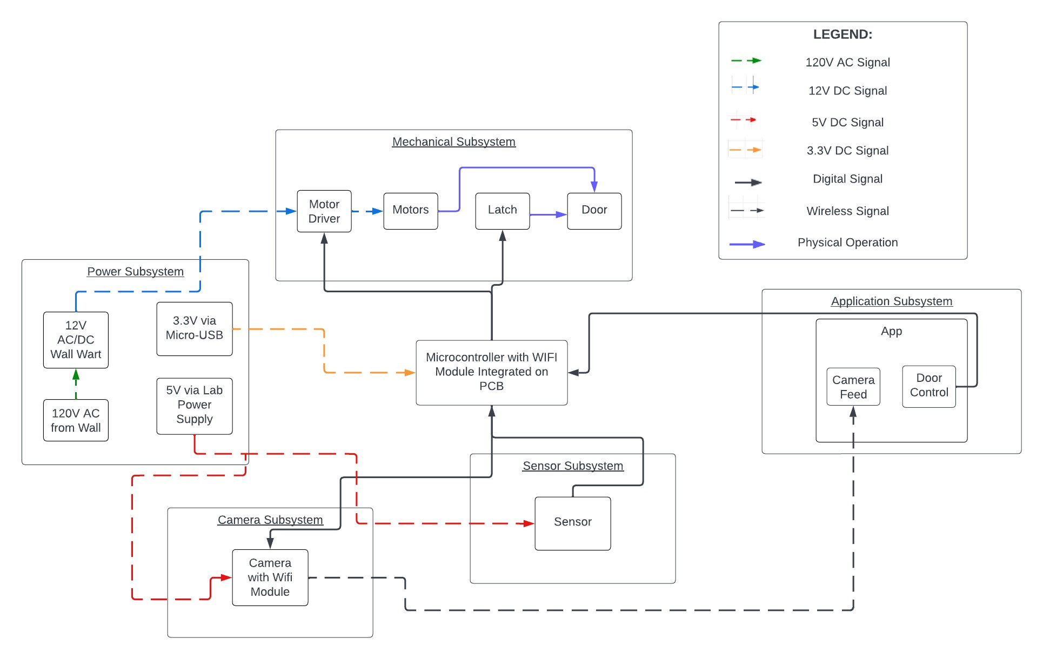
Design
Block Diagram
5 different subsystems:
Power
Mechanical
Camera
Sensor
Application
ESP32-S3-WROOM
ELECTRICAL AND COMPUTER ENGINEERING
GRAINGER ENGINEERING

Slide 11
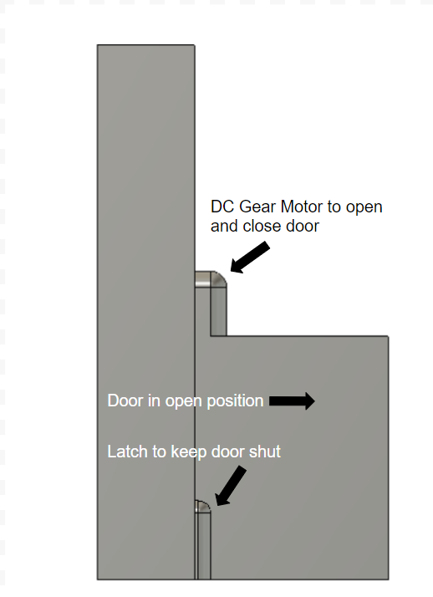
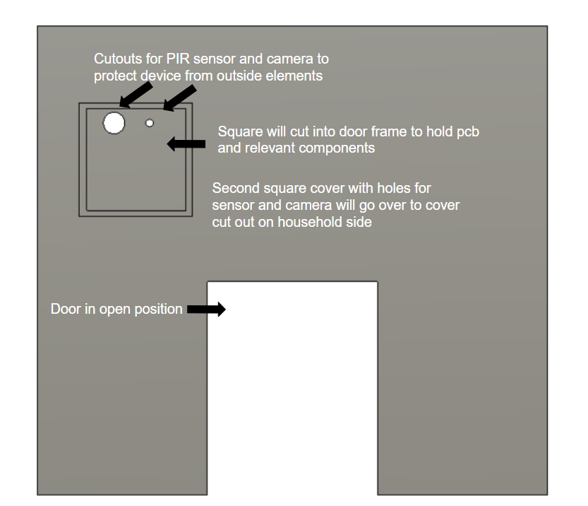
Design
Physical Design
ELECTRICAL AND COMPUTER ENGINEERING
GRAINGER ENGINEERING

Slide 12
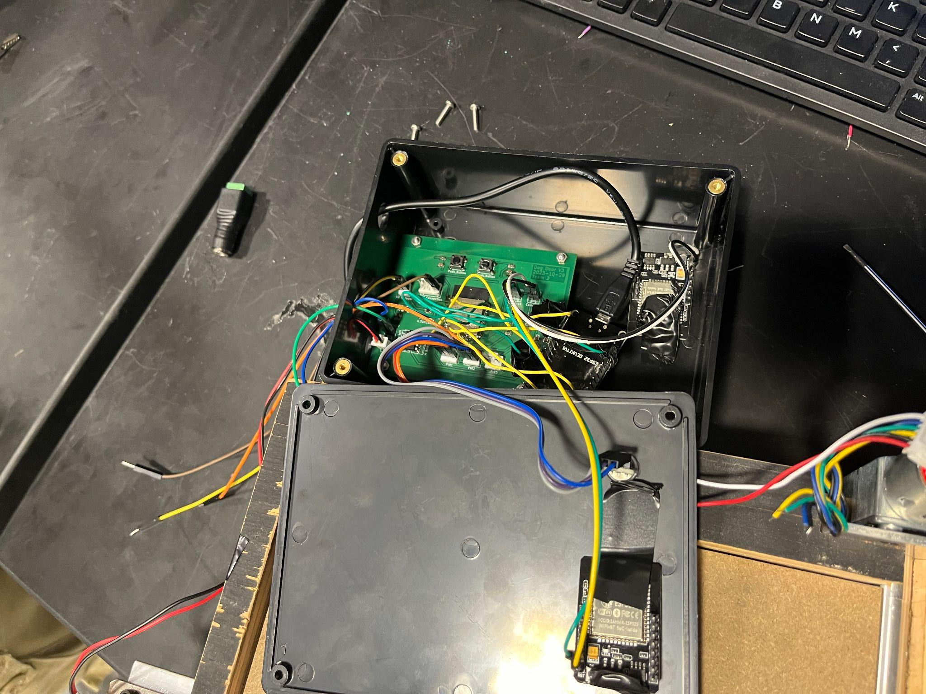
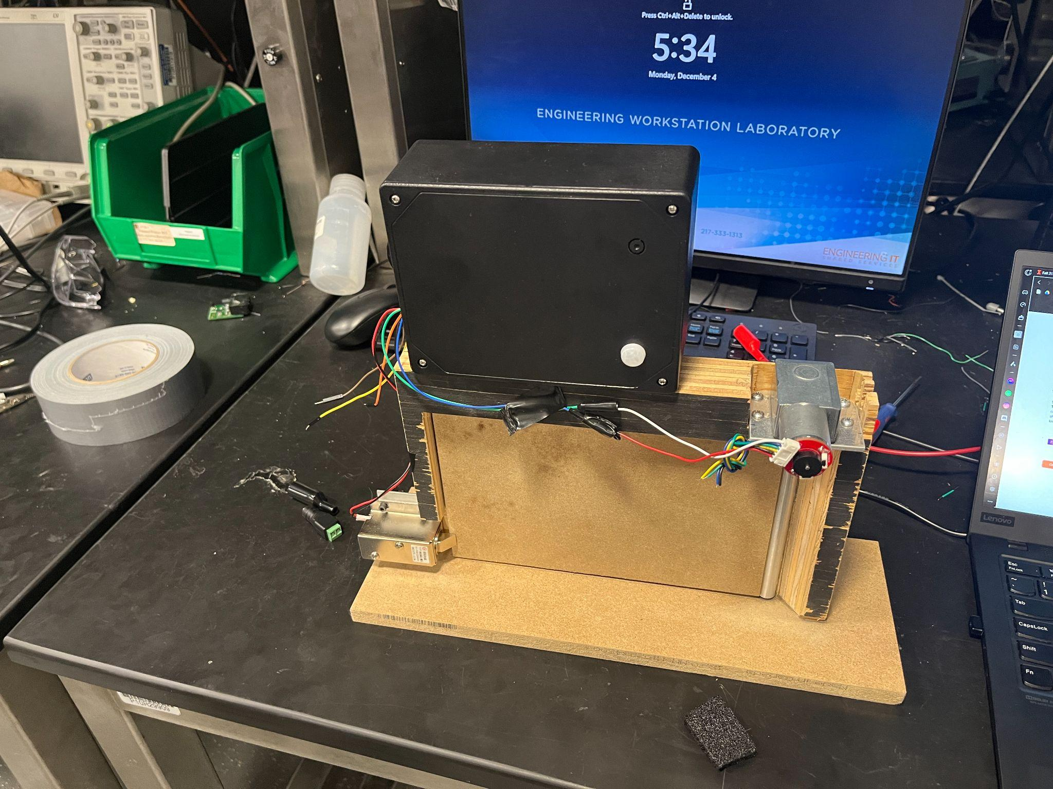
Design
Final Product
ELECTRICAL AND COMPUTER ENGINEERING
GRAINGER ENGINEERING

Slide 13
PCB Design
ELECTRICAL AND COMPUTER ENGINEERING
GRAINGER ENGINEERING

Slide 14
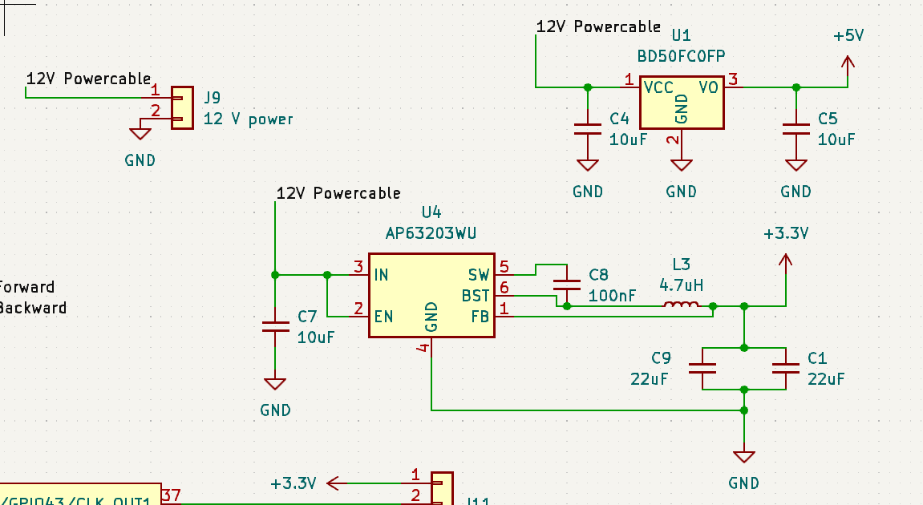
PCB
12 V External Power Supply
2 voltage converters (3.3 V and 5 V)
Power
ELECTRICAL AND COMPUTER ENGINEERING
GRAINGER ENGINEERING

Slide 15
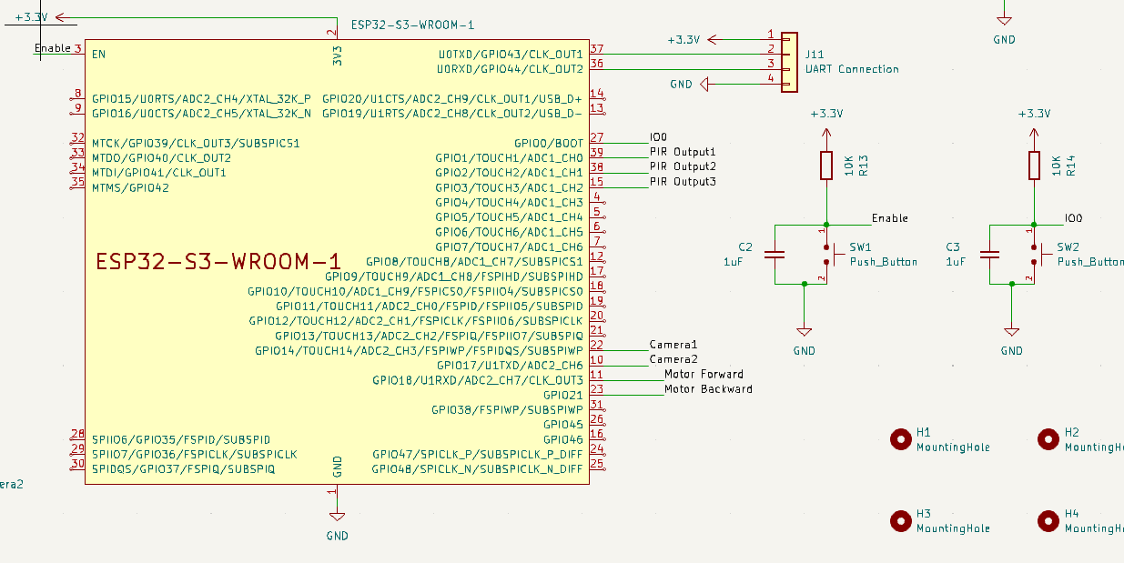
PCB
3 inputs, 4 outputs
3 for sensors
2 for camera
2 for motor
EN and RST pins for programming
Microcontroller
ELECTRICAL AND COMPUTER ENGINEERING
GRAINGER ENGINEERING

Slide 16
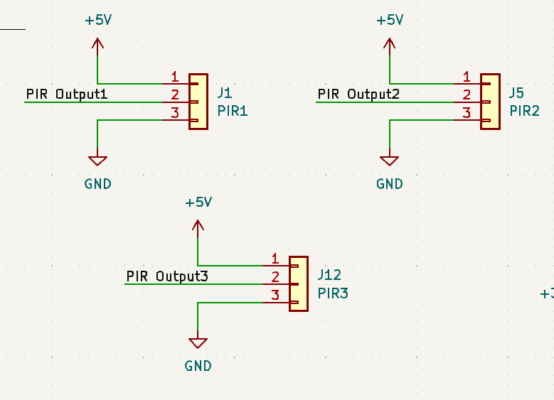
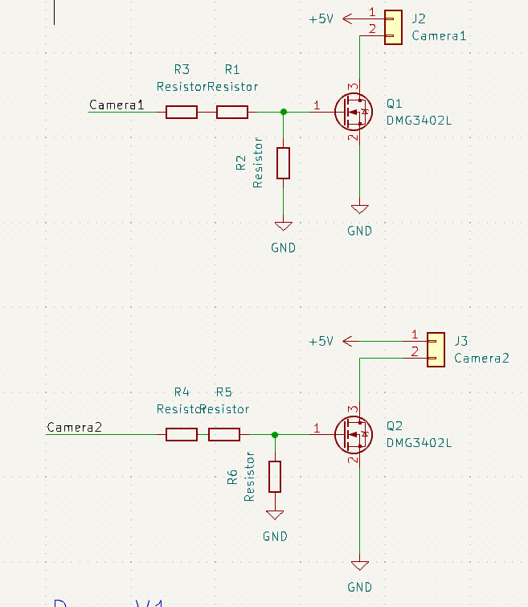
PCB
Sensor output once high
Microcontroller output triggers MOSFET
Camera is powered and turns on
Sensors and Camera
ELECTRICAL AND COMPUTER ENGINEERING
GRAINGER ENGINEERING

Slide 17
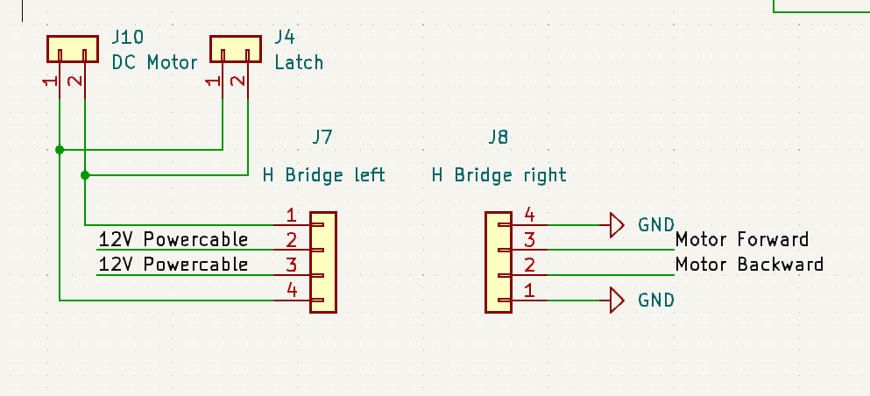
PCB
H-Bridge for voltage to motor driver
Bidirectional motor driver to open and close door
Latch to keep door shut
Motor Driver
ELECTRICAL AND COMPUTER ENGINEERING
GRAINGER ENGINEERING

Slide 18
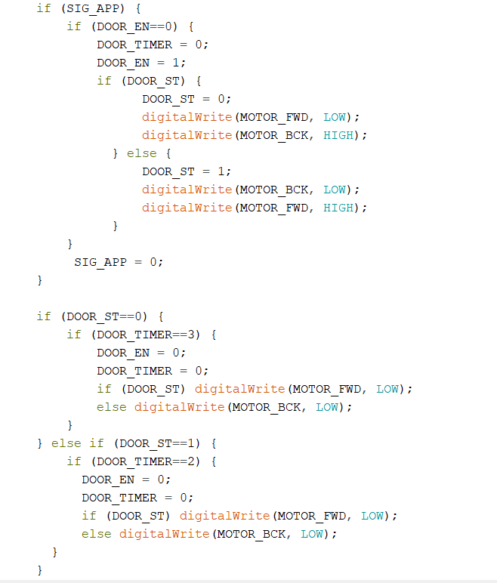
Software
Counters to act as timers for subsystems
Sensor detection keeps a high signal for 2 minutes
Keep door from closing when motion detected
Motor signals on for 2 seconds
Keeps track of state and position
Receives information from application
Microcontroller
ELECTRICAL AND COMPUTER ENGINEERING
GRAINGER ENGINEERING

Slide 19
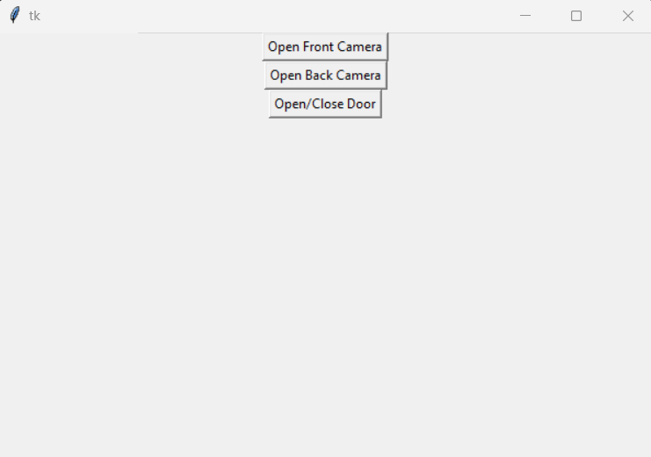
Software
Simple application coded in Python
3 buttons
Camera buttons open up to live stream of camera feed
Send get request with HTTP communication protocol to microcontroller
Application
ELECTRICAL AND COMPUTER ENGINEERING
GRAINGER ENGINEERING

Slide 20
Results
ELECTRICAL AND COMPUTER ENGINEERING
GRAINGER ENGINEERING

Slide 21
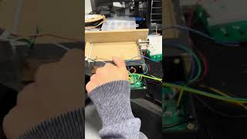
Results
Video Demo
ELECTRICAL AND COMPUTER ENGINEERING
GRAINGER ENGINEERING

Slide 22
Results
What Went Well?
Most subsystems worked properly
Camera
Sensors
Motor and door
Application
Team communicated and met appropriate deadlines
Debugging went well
ELECTRICAL AND COMPUTER ENGINEERING
GRAINGER ENGINEERING

Slide 23
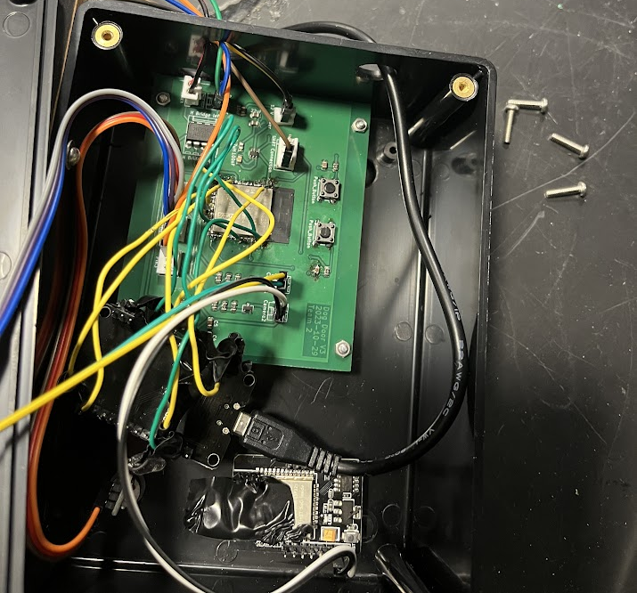
Results
What Went Wrong?
Incorrect schematic design decisions
Changes had to be made after PCB order was made
Microcontroller was not able to be programmed by PCB
Power converter for 5 V stopped working
Had to get rid of third sensor to accommodate
ELECTRICAL AND COMPUTER ENGINEERING
GRAINGER ENGINEERING

Slide 24
Results
Next Steps?
Notification for detection
Camera turn-on speed (better camera?)
Better camera resolution
Video on constant display on application
Implement on mobile app
Fix previous errors in our final demonstration
ELECTRICAL AND COMPUTER ENGINEERING
GRAINGER ENGINEERING

Slide 25
Questions?
ELECTRICAL AND COMPUTER ENGINEERING
GRAINGER ENGINEERING

Slide 26
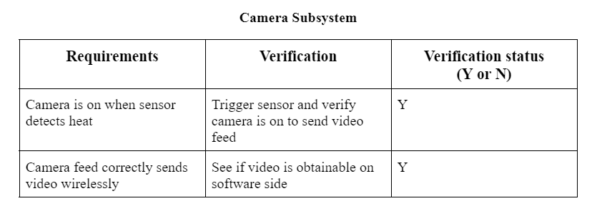
Appendix
Camera RV Table
ELECTRICAL AND COMPUTER ENGINEERING
GRAINGER ENGINEERING

Slide 27
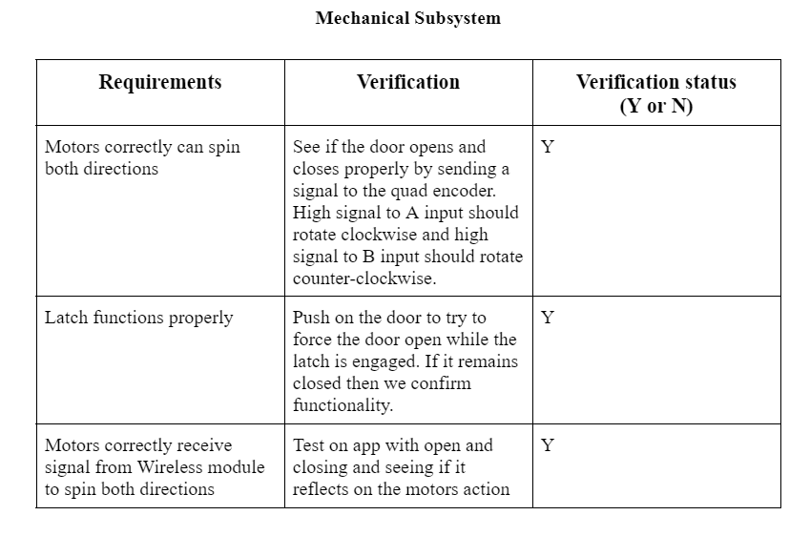
Appendix
Mechanical RV Table
ELECTRICAL AND COMPUTER ENGINEERING
GRAINGER ENGINEERING

Slide 28
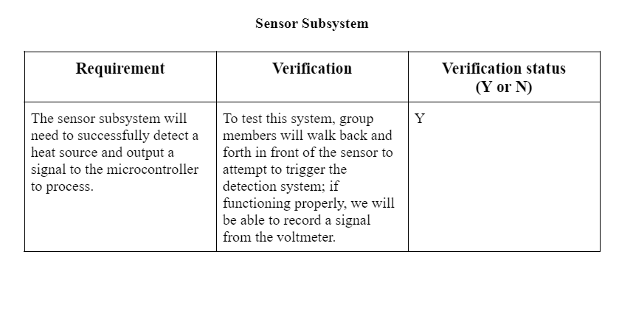
Appendix
Sensor RV Table
ELECTRICAL AND COMPUTER ENGINEERING
GRAINGER ENGINEERING

Slide 29
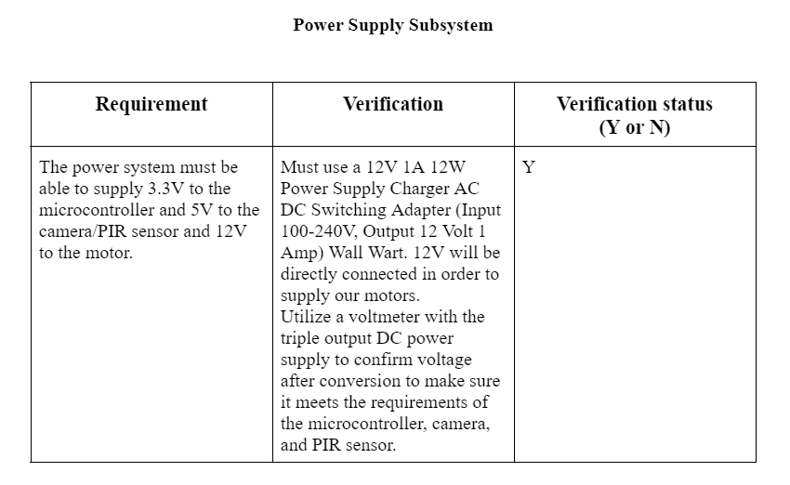
Appendix
Power RV Table
ELECTRICAL AND COMPUTER ENGINEERING
GRAINGER ENGINEERING

Slide 30
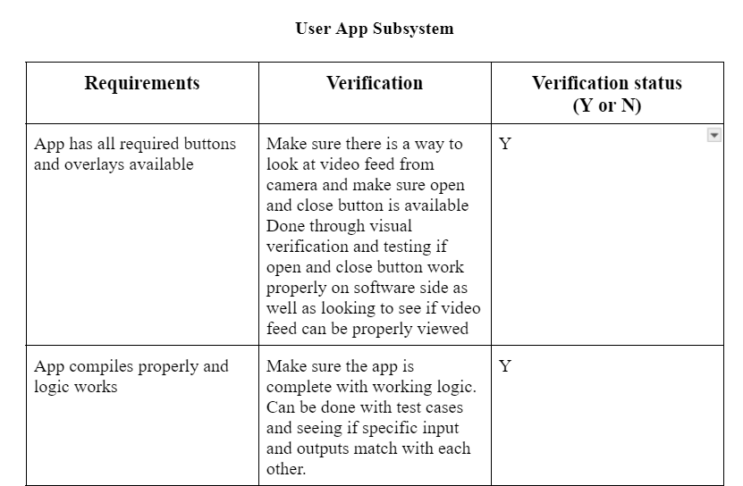
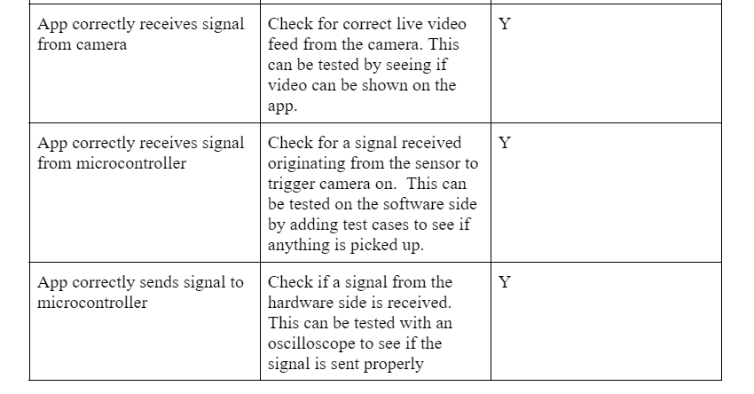
Appendix
User Application RV Table
ELECTRICAL AND COMPUTER ENGINEERING
GRAINGER ENGINEERING

Slide 31
Appendix
Camera
ELECTRICAL AND COMPUTER ENGINEERING
GRAINGER ENGINEERING

Slide 32
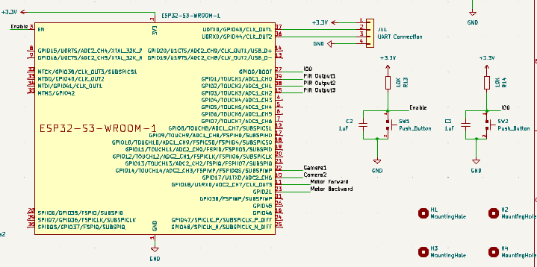
Appendix
Microcontroller
ELECTRICAL AND COMPUTER ENGINEERING
GRAINGER ENGINEERING

Slide 33
Appendix
Motor
ELECTRICAL AND COMPUTER ENGINEERING
GRAINGER ENGINEERING

Slide 34
Appendix
Sensor
ELECTRICAL AND COMPUTER ENGINEERING
GRAINGER ENGINEERING

Slide 35
Appendix
Power
ELECTRICAL AND COMPUTER ENGINEERING
GRAINGER ENGINEERING

Slide 36
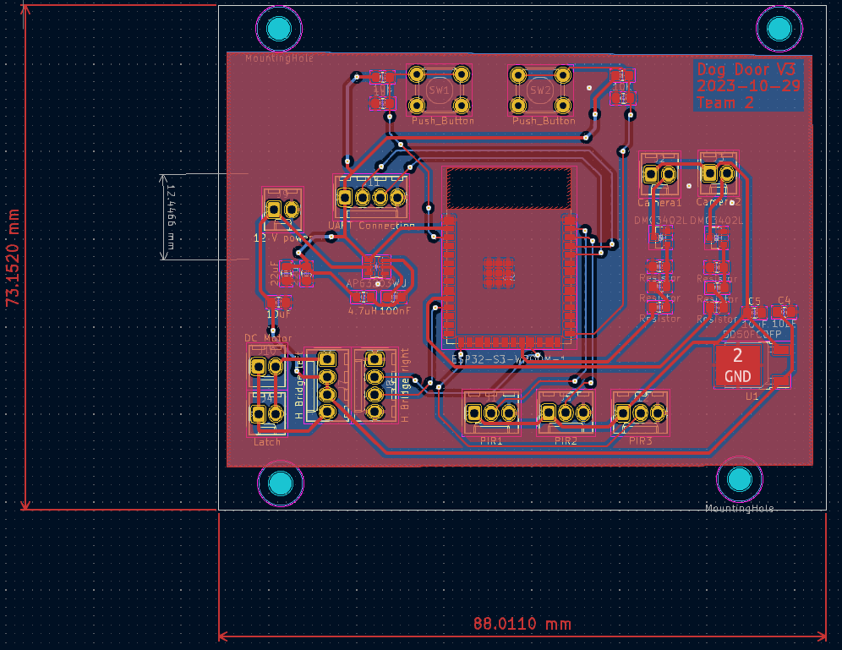
Appendix
PCB Layout
ELECTRICAL AND COMPUTER ENGINEERING
GRAINGER ENGINEERING

