Slide 1
MicroClimate: Home-Scale Cultivation Controls
Electrical & Computer Engineering
Group 2: Aadarsh Mahra, Smit Purohit, Jeff Taylor
May 2nd, 2023
Notes:
Aadarsh

Slide 2
Introductions
Aadarsh Mahra
Software Lead
Senior, Computer Engineering
Smit Purohit
Hardware Lead
Senior, Computer Engineering
Jeff Taylor
Team Lead
Senior, Computer Engineering
Horticulture Minor
ELECTRICAL & COMPUTER ENGINEERING
GRAINGER ENGINEERING
Notes:
Aadarsh, then Smit, then Jeff

Slide 3
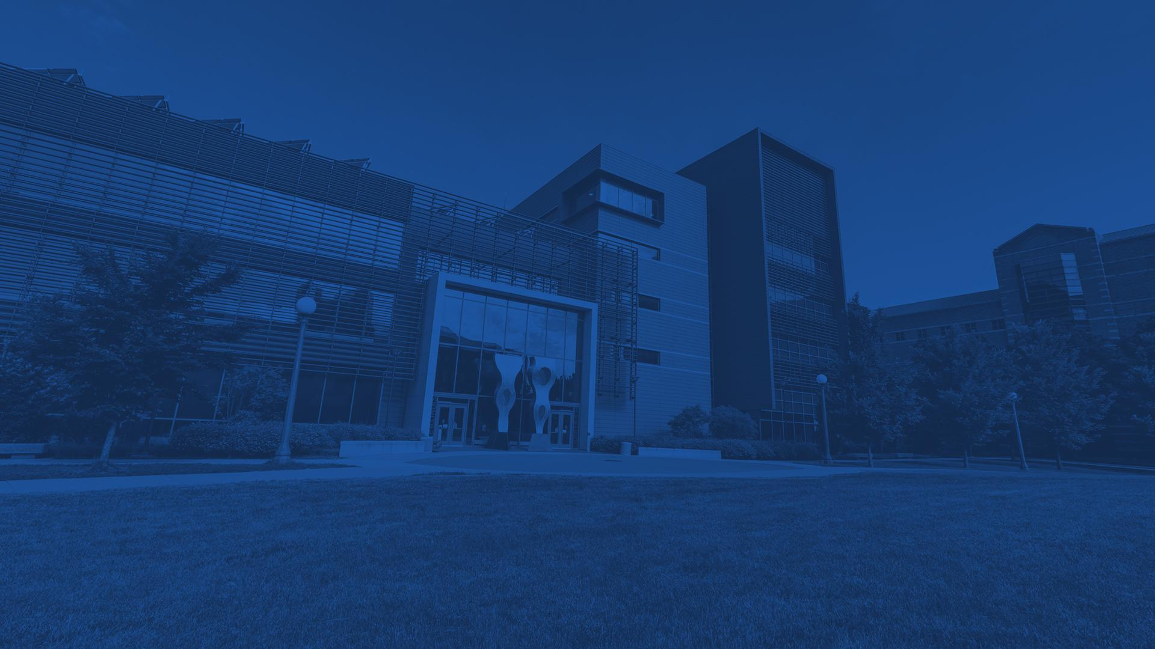
What is MicroClimate?
An environmental monitoring and management system for the Vapor Pressure Deficit, a measure of temperature and humidity, of a closed growing environment using off-the-shelf appliances.
ELECTRICAL & COMPUTER ENGINEERING
GRAINGER ENGINEERING
Notes:
Jeff

Slide 4
Objective
Plants sense the world just like us, and they grow best in ideal environmental conditions. These conditions change as the plant matures.
Solutions for managing a plant’s environment exist at commercial scales in greenhouses and indoor agriculture facilities. These systems are cost and scale-prohibitive for the hobbyist grower and academic researcher.
MicroClimate seeks to be an affordable, easy-to-use system for monitoring and controlling the environment of crops grown indoors at small scales.
ELECTRICAL & COMPUTER ENGINEERING
GRAINGER ENGINEERING
Notes:
Jeff

Slide 5
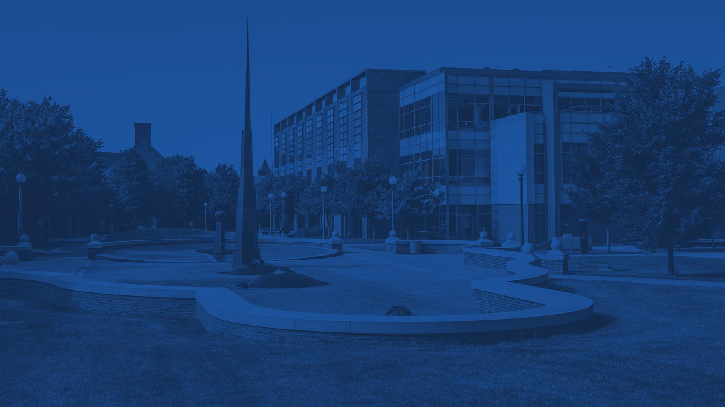
Build and Requirements
A technical breakdown of how the subsystems were designed and assembled, and the definitions of success.
ELECTRICAL & COMPUTER ENGINEERING
GRAINGER ENGINEERING
Notes:
Jeff

Slide 6
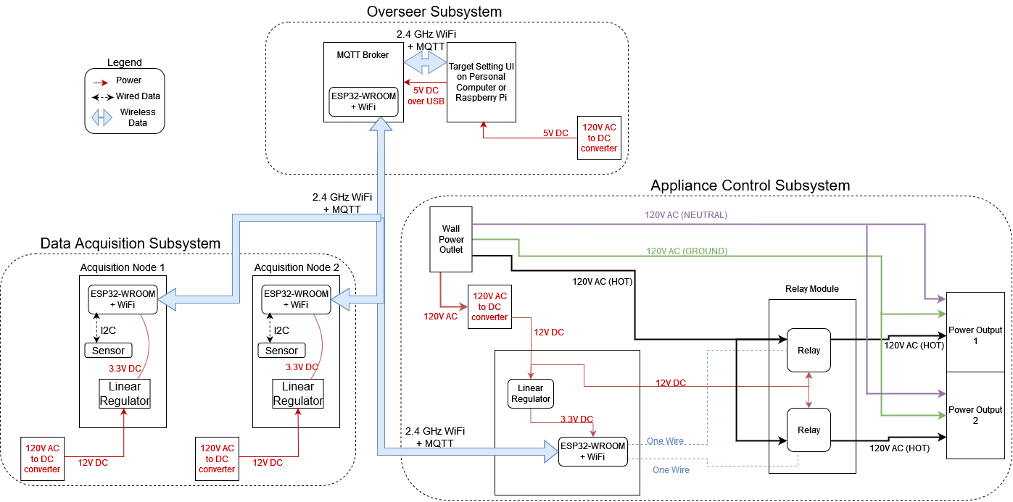
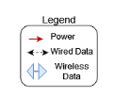
Block Diagram
ELECTRICAL & COMPUTER ENGINEERING
GRAINGER ENGINEERING
Notes:
Jeff, then Aadarsh, then Smit
Mention esp32wroom, WiFi+MQTT

Slide 7
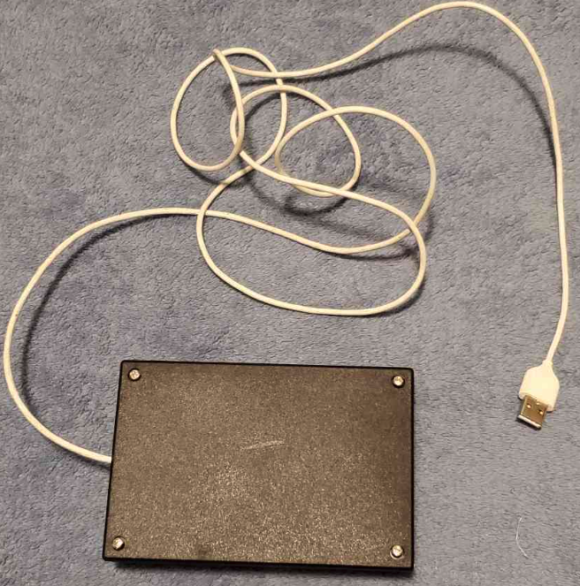
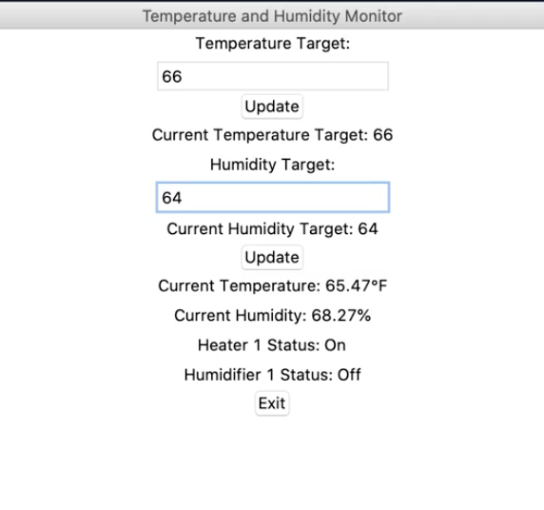
System Build
Appliance Control Node
Overseer and UI
ELECTRICAL & COMPUTER ENGINEERING
GRAINGER ENGINEERING
Notes:
Smit

Slide 8
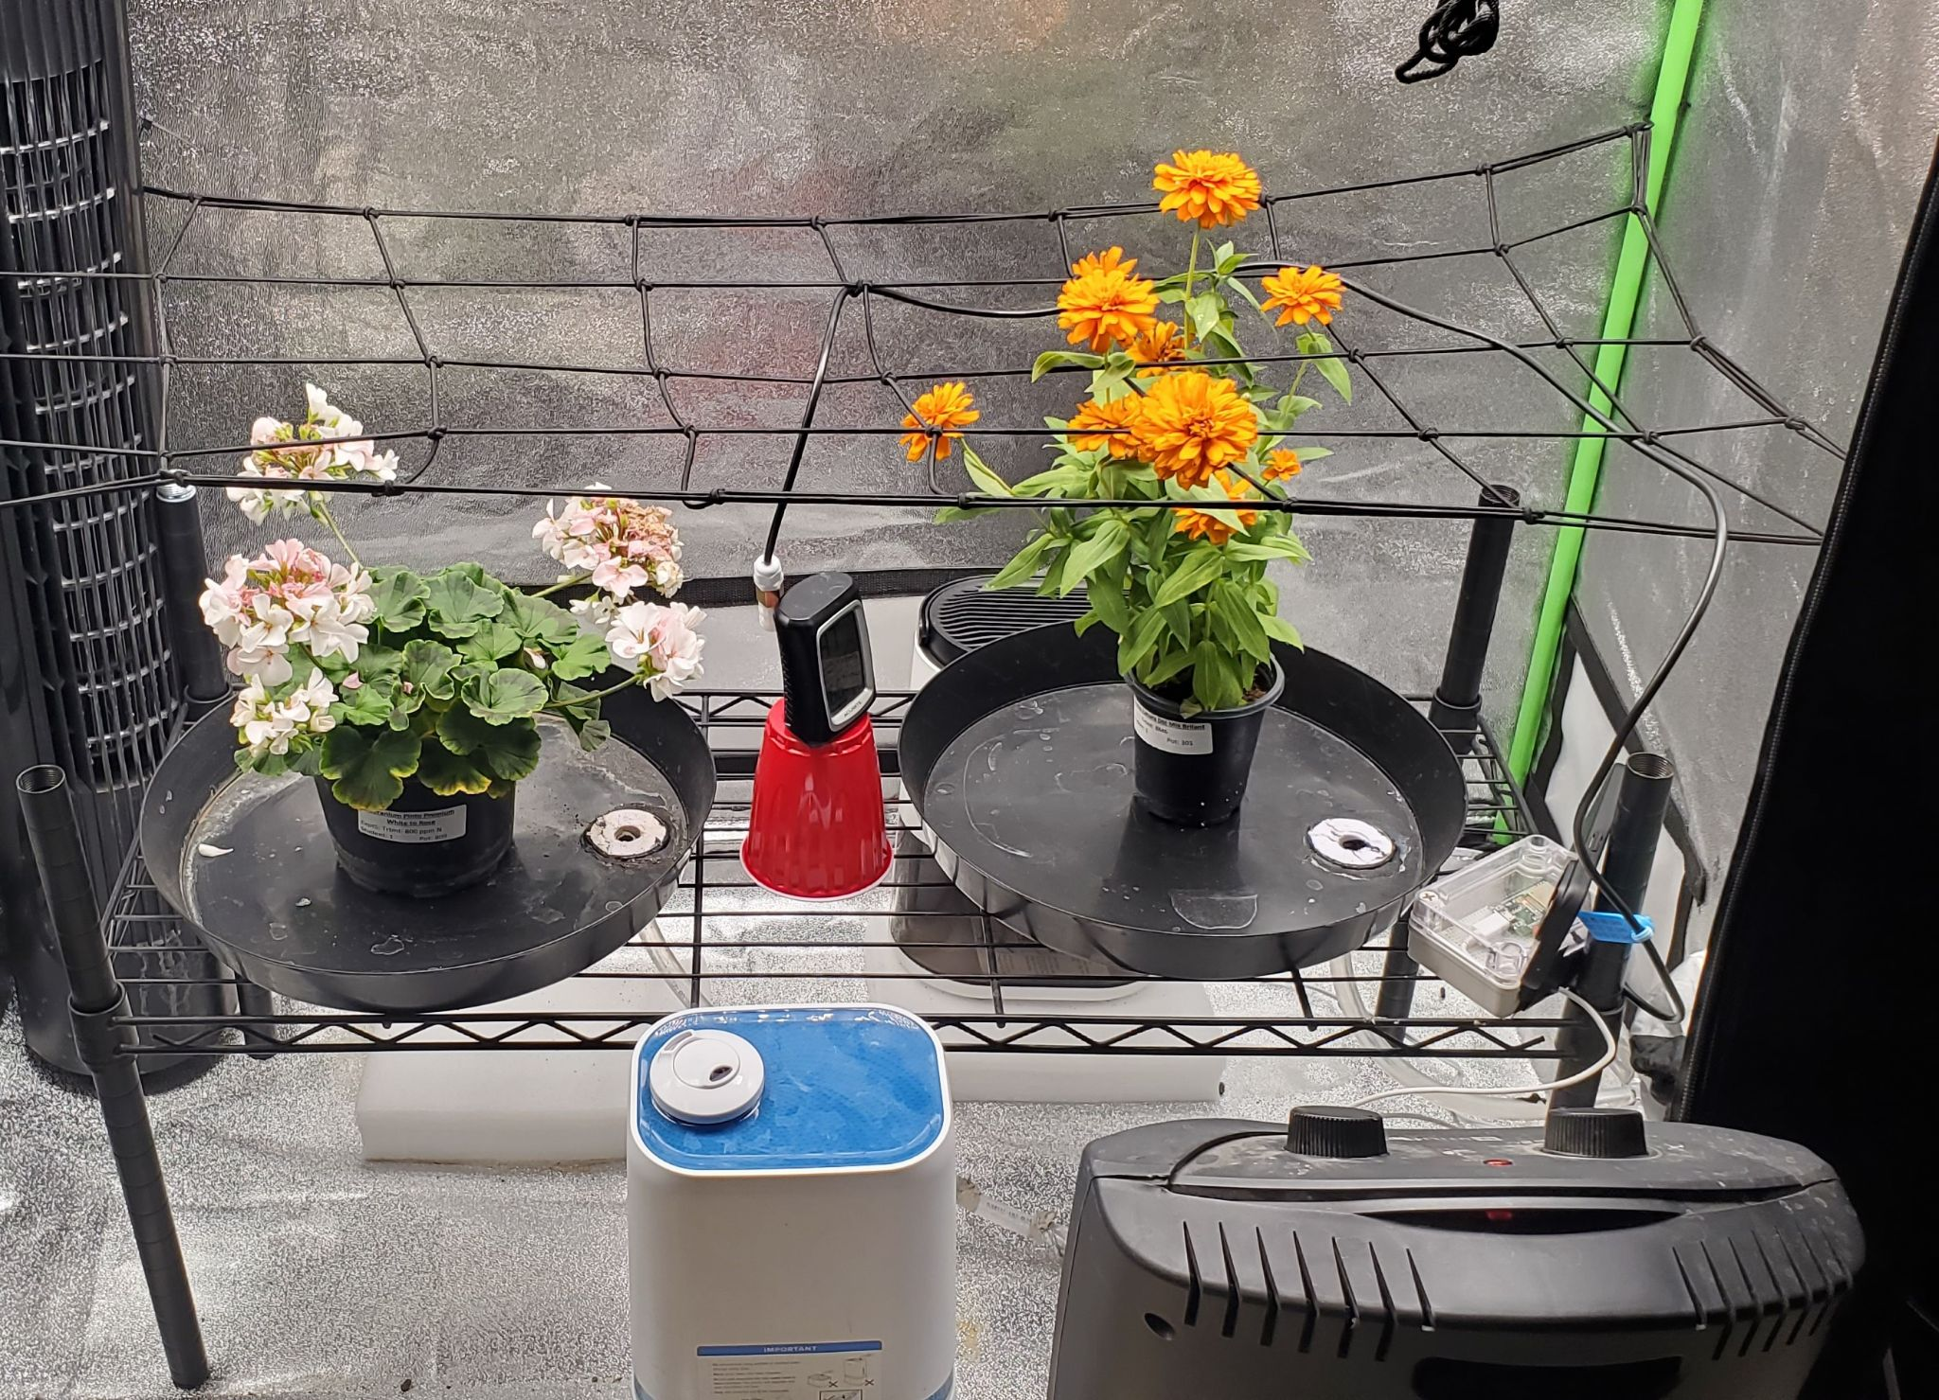
System Build
Sensor Probe
Data Acq. Node
Humidifier
Heater
ELECTRICAL & COMPUTER ENGINEERING
GRAINGER ENGINEERING
Notes:
Aadarsh

Slide 9
High-Level System Requirements
User interface shows the environment’s temperature and humidity, and actuators’ status, and allows for user-set temperature and humidity targets.
After reaching a set environment target, the temperature and humidity of our closed environment must stay within a fixed range of our target values.
Overall system latency is appropriate for the timescale of cultivation; any change to system state (temperature/humidity changes, control signal is updated) is reflected across all subsystems within 60 seconds
ELECTRICAL & COMPUTER ENGINEERING
GRAINGER ENGINEERING
Notes:
Aadarsh

Slide 10
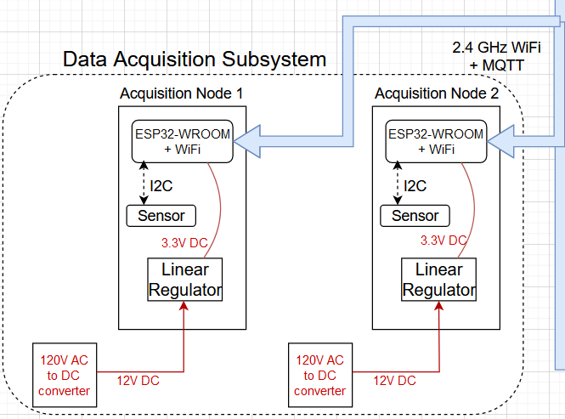
Data Acquisition Subsystem Overview
Data Acquisition Functionality Summary
Be flexibly placed within growing environment
Senses the environment’s temperature and humidity
Transmits sensed data to Overseer Subsystem every 10 seconds
IMAGE / GRAPHIC
ELECTRICAL & COMPUTER ENGINEERING
GRAINGER ENGINEERING
Notes:
Jeff

Slide 11
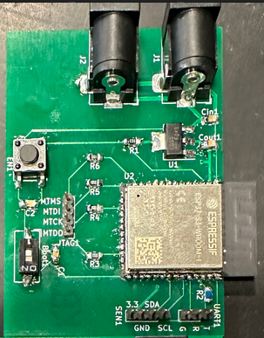
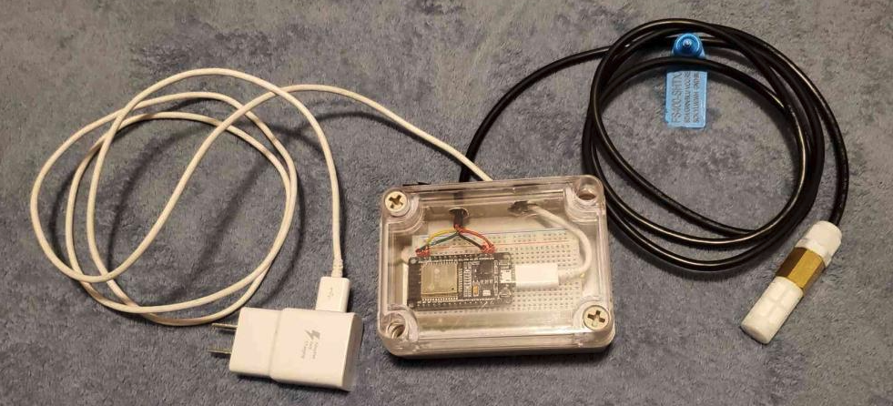
Data Acquisition Subsystem Overview
Design and Fabrication
Custom PCB with ESP32-WROOM MCU
Takes 12V power via barrel jack and allows for passthrough to additional nodes
I2C-based temperature and humidity sensor
High-humidity resistant enclosure, electrical tape to ensure tight seal
ELECTRICAL & COMPUTER ENGINEERING
GRAINGER ENGINEERING
Notes:
Jeff

Slide 12
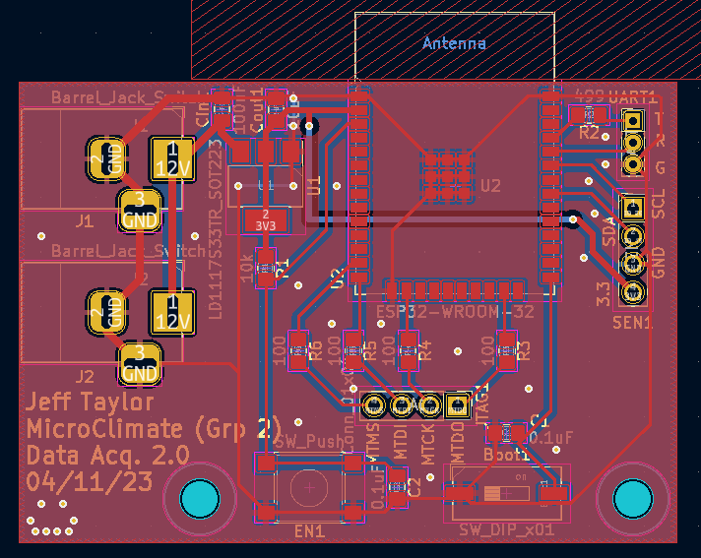
Data Acquisition Subsystem Requirements
Must sample the environment at a rate greater than 3 samples/minute.
Must sample the temperature and humidity of the environment with an accuracy within 5% of real values.
Must send recorded temperature and humidity data to Overseer Subsystem with MQTT within 30 seconds.
ELECTRICAL & COMPUTER ENGINEERING
GRAINGER ENGINEERING
Notes:
Jeff

Slide 13
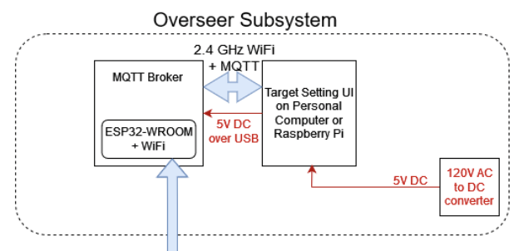
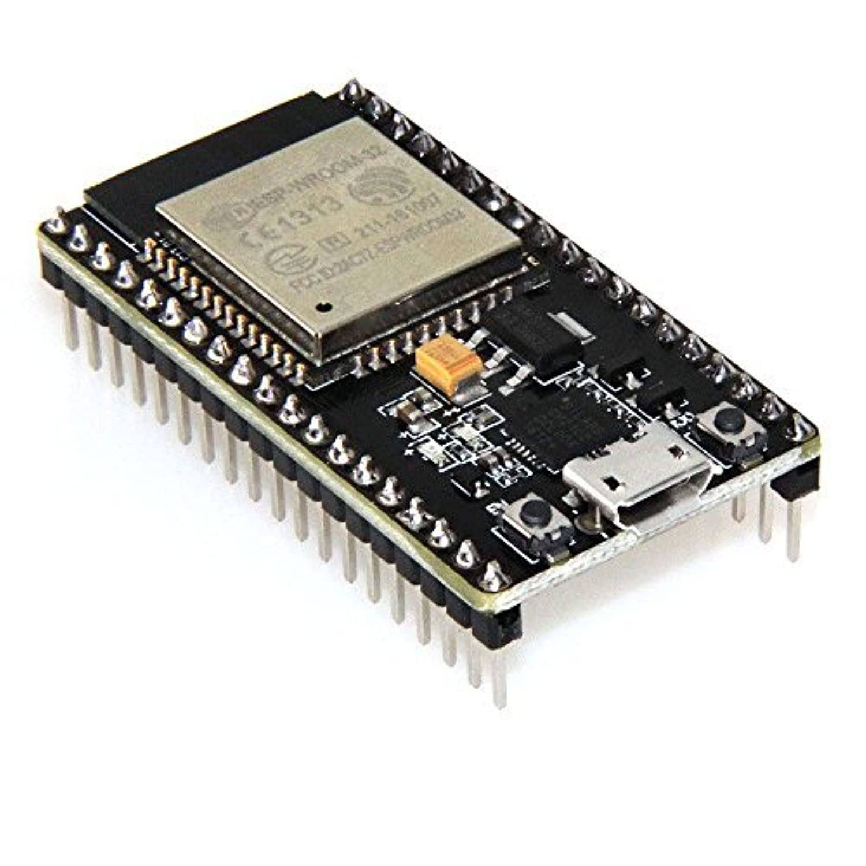
Overseer Subsystem Overview
Overseer Subsystem Functionality Summary
Communications heart of the system
Computes instruction based on current humidity and temperature, and humidity and temperature targets.
Users can set their targets via a user interface.
Design and Fabrication
ESP32-WROOM development board that acts as an MQTT broker and computes control instructions.
Powered via microUSB from wall or laptop
User interface that allows for user input
Can run on any PC with Python interpreter
IMAGE / GRAPHIC
ELECTRICAL & COMPUTER ENGINEERING
GRAINGER ENGINEERING
Notes:
Aadarsh

Slide 14
Overseer Subsystem Requirements
User Interface sends updates to broker within 30 seconds 95% of the time.
User Interface receives updates from the Data Acquisition subsystem within 30 seconds 95% of the time.
The broker computes and publishes the correct control instruction to Appliance Control within 30 seconds of the Data Acquisition publish.
ELECTRICAL & COMPUTER ENGINEERING
GRAINGER ENGINEERING
Notes:
Aadarsh

Slide 15
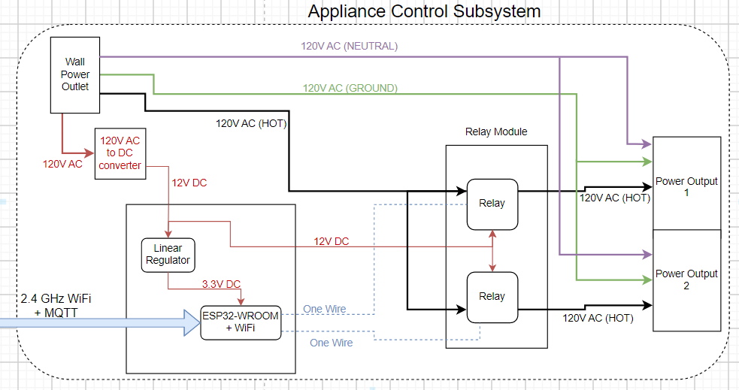
Appliance Control Subsystem Overview
Appliance Control Functionality Summary
Enables/disables power to outlets based on control signals
Design and Fabrication
PCB with ESP32-WROOM that sends control signals through a wire to relays on a separate Relay Module PCB
PCB routes 12V input power to Relay Module PCB
IMAGE / GRAPHIC
IMAGE / GRAPHIC
ELECTRICAL & COMPUTER ENGINEERING
GRAINGER ENGINEERING
Notes:
Smit

Slide 16
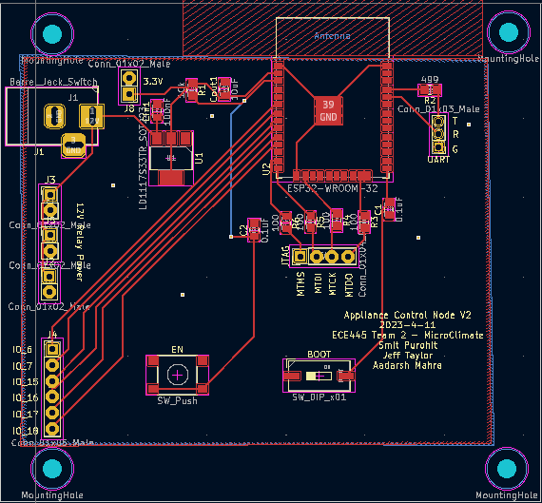
Appliance Control Subsystem Requirements
Must be able to enable or disable output power to an outlet.
Must provide power to allow appliances to work at full capacity.
Must use control signals from Overseer subsystem using WiFi and MQTT protocol to set enable or disable outlets within 30 seconds.
Must send output status signals at least every 20 seconds.
ELECTRICAL & COMPUTER ENGINEERING
GRAINGER ENGINEERING
Notes:
Smit

Slide 17
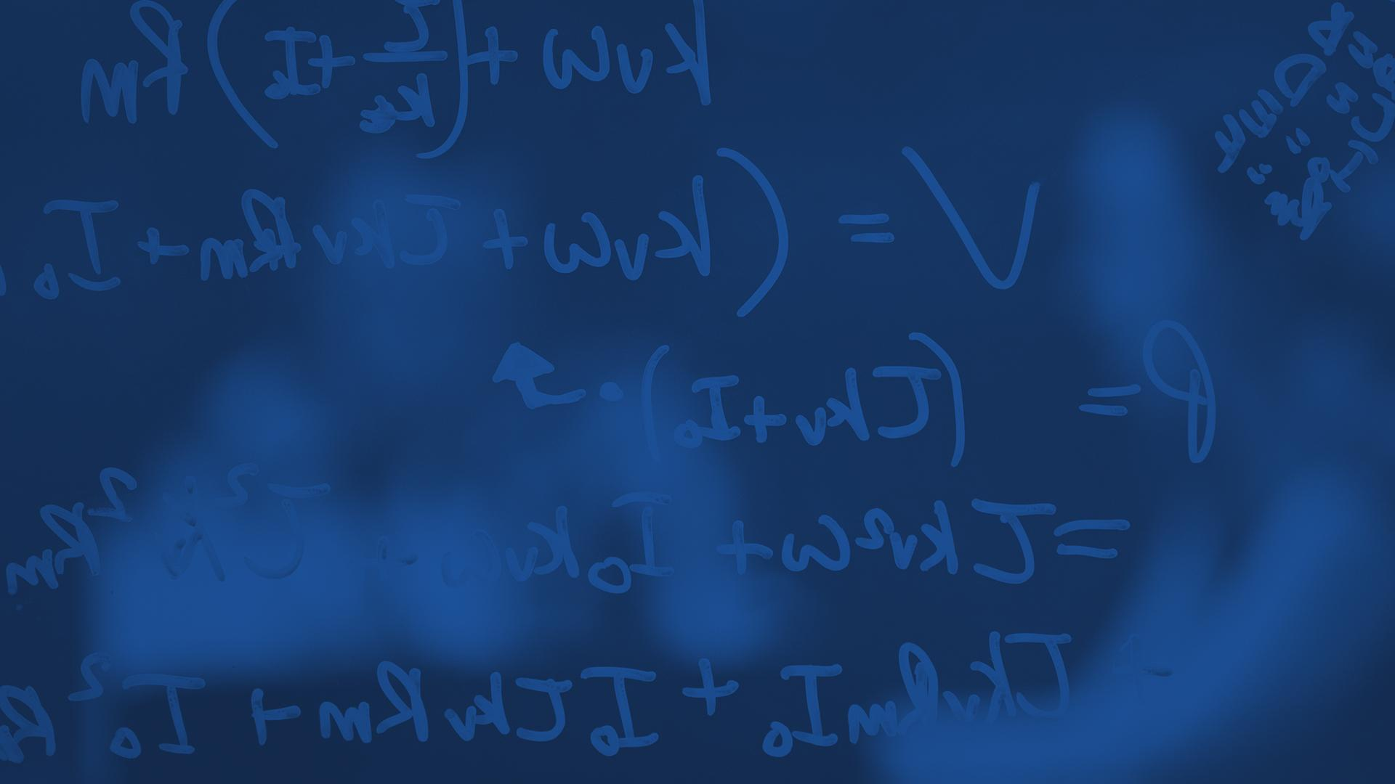
Functional Results
Facts, data, and analysis of the functionality of MicroClimate.
ELECTRICAL & COMPUTER ENGINEERING
GRAINGER ENGINEERING
Notes:
Smit

Slide 18
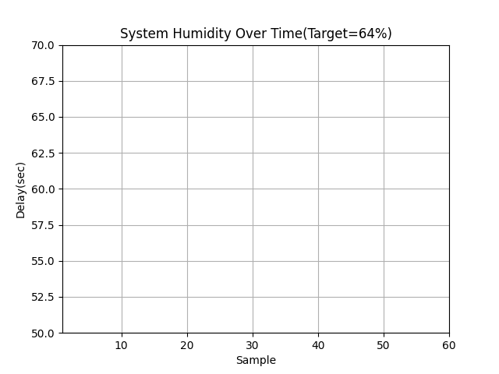
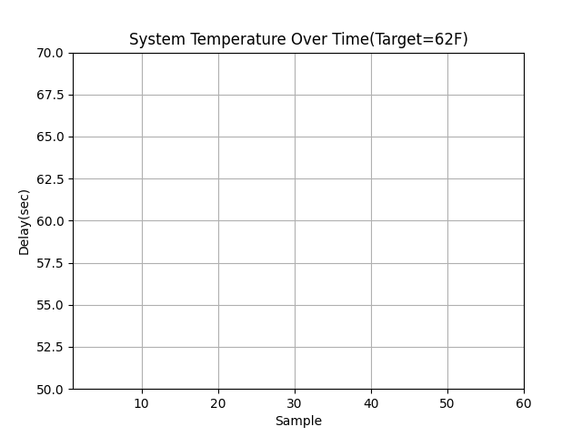
Project Build and Results
MicroClimate System Performance: Setpoints
 | Target | Avg. Error | % Time within 3°F, 4% RH
Temperature | 62°F | 3.746% | 95.24%
Humidity | 64 %RH | 3.138% | 96.83%
ELECTRICAL & COMPUTER ENGINEERING
GRAINGER ENGINEERING
Notes:
Smit

Slide 19
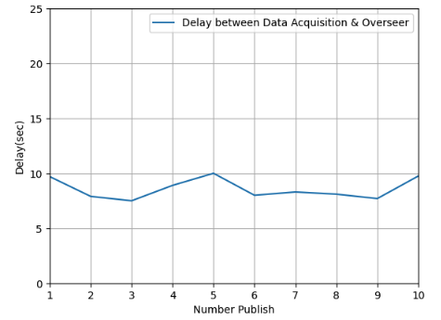
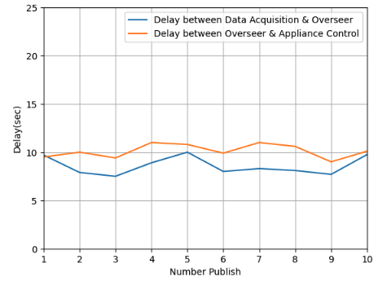
MicroClimate System Performance: Latency
Data Acquisition -> Overseer
Overseer -> Appliance Control
ELECTRICAL & COMPUTER ENGINEERING
GRAINGER ENGINEERING
Notes:
Aadarsh

Slide 20
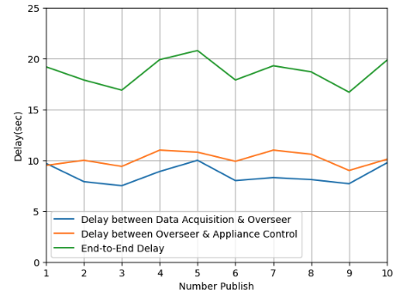
MicroClimate System Performance: Latency
Data Acq -> Overseer (sec) | Overseer -> App. Control (sec) | End-to-End (sec)
9.7 | 9.5 | 19.2
7.9 | 10.0 | 17.9
7.5 | 9.4 | 16.9
8.9 | 11.0 | 19.9
10.0 | 10.8 | 20.8
8.0 | 9.9 | 17.9
8.3 | 11.0 | 19.3
8.1 | 10.6 | 18.7
7.7 | 9.0 | 16.7
9.7 | 10.1 | 19.85
7.80 sec | 9.21 sec | 17.01 sec
End-to-End Latency
Average Time ->
ELECTRICAL & COMPUTER ENGINEERING
GRAINGER ENGINEERING
Notes:
Aadarsh

Slide 21
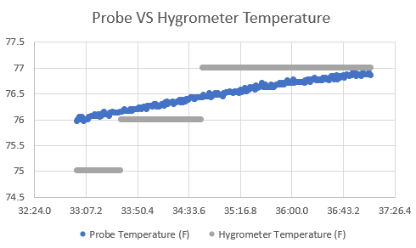
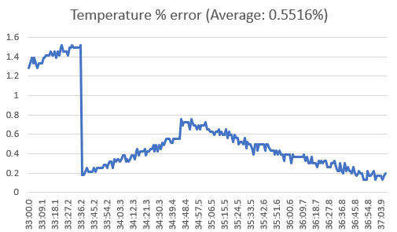
Data Acquisition: Temperature Sensing Accuracy
ELECTRICAL & COMPUTER ENGINEERING
GRAINGER ENGINEERING
Notes:
Jeff

Slide 22
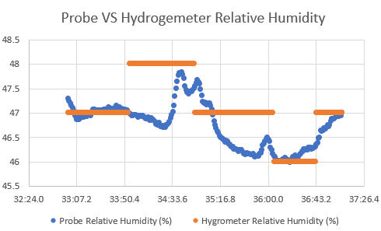
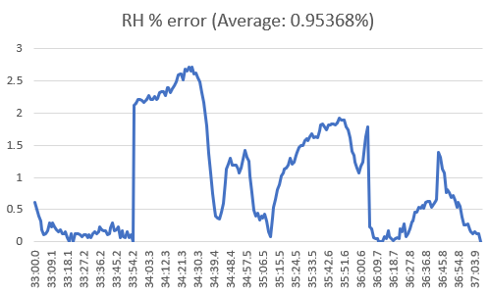
Data Acquisition: Humidity Sensing Accuracy
ELECTRICAL & COMPUTER ENGINEERING
GRAINGER ENGINEERING
Notes:
Jeff

Slide 23
Analysis and Conclusions
Looking back, post-development.
ELECTRICAL & COMPUTER ENGINEERING
GRAINGER ENGINEERING
Notes:
Aadarsh

Slide 24
Design Changes
Original Design
2+ Data Acquisition Nodes
“Network” of sensors
Direct interpretation of VPD user inputs to environmental targets
Wired Design between Broker and User Interface PC
Use a Raspberry Pi for the User Interface to input Target Values
Current Design
One Data Acquisition Node
Extensible design, max of 10
Temperature and humidity user targets
Can still target VPD, requires user
Wireless Communication between Broker and User Interface via MQTT
Run the User Interface on any Computer connected to our Access Point
ELECTRICAL & COMPUTER ENGINEERING
GRAINGER ENGINEERING
Notes:
Aadarsh

Slide 25
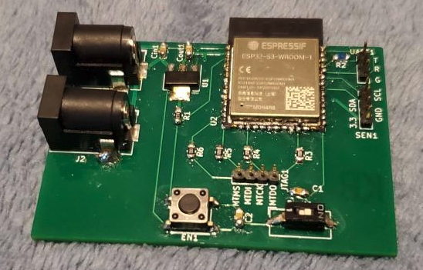
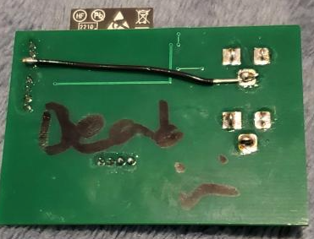
Challenges
Integration
MQTT libraries with broker code for Arduino lack quality documentation
Overseer Subsystem
Clients kept dropping out
Control systems: unset variables cause issues
Data Acquisition Subsystem
I fried the PCB during testing
Pin spacing issues
Common ground
Appliance Control Subsystem
Extracting stranded 12 gauge cable from an extension cord
Using said wire
Switch wiring - wrong component!
Fitting PCB, relays into enclosure
ELECTRICAL & COMPUTER ENGINEERING
GRAINGER ENGINEERING
Notes:
aadarsh, then jeff, then smit

Slide 26
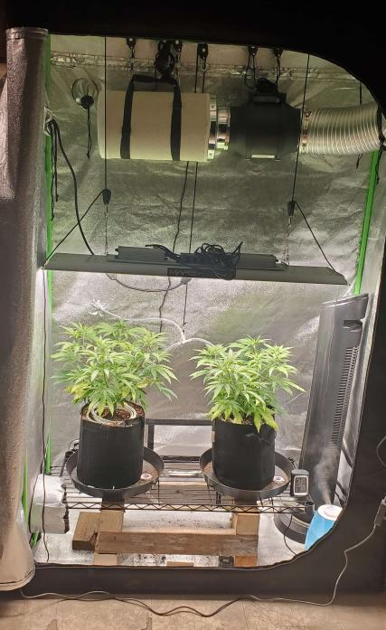
Successes: All high-level and subsystem requirements are met.
Full System Integration
Appliances respond correctly to changes in system temperature and humidity in a timely manner
Accuracy
Sensors correctly measure environment temperature and humidity
Appliances respond accordingly to instructions
Latency
End-to-end delay for a single instruction is below 60 seconds.
IMAGE
ELECTRICAL & COMPUTER ENGINEERING
GRAINGER ENGINEERING
Notes:
Smit

Slide 27
Ethical and Safety Concerns
Ethics
Users of MicroClimate must abide by all local ordinances when growing
There is a possibility of harm that can occur to users due to the nature of our Appliance Control node
Safety upgrades are the next improvement
Safety
Appliance Control node handles 120 VAC
GFCI outlet
Electrical Hazard
Fire Hazard
Off-the-shelf appliances may be inherently unsafe
Buy quality heaters with fall-over detection, temperature detection
ELECTRICAL & COMPUTER ENGINEERING
GRAINGER ENGINEERING
Notes:
Smit

Slide 28
Conclusions
Lessons Learned
Fail Early, Fail Often
Hands-on experience helps drastically when designing any project
Safety is important during all stages: design, assembly, testing, and deployment
MCU memory limitations are important when considering which one to use
Wireless Communication over WiFi can be finicky
Redesigning the System
More powerful MQTT broker
Battery powered Data Acquisition nodes
Different wireless communication protocol
ZigBee, ESPNOW
ELECTRICAL & COMPUTER ENGINEERING
GRAINGER ENGINEERING
Notes:
Jeff

Slide 29
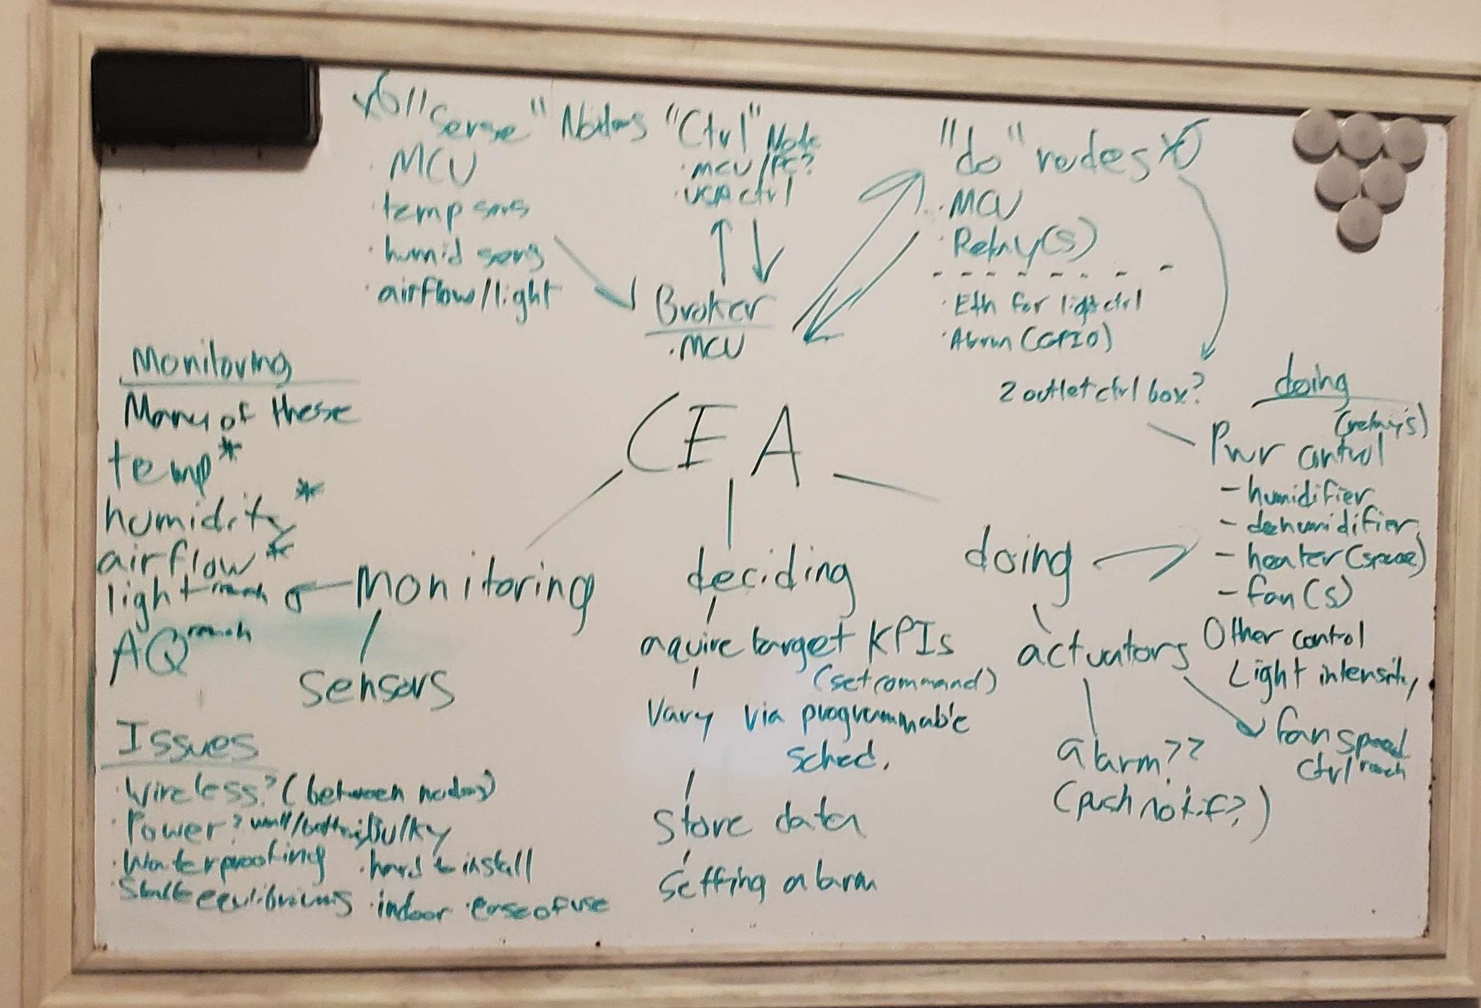
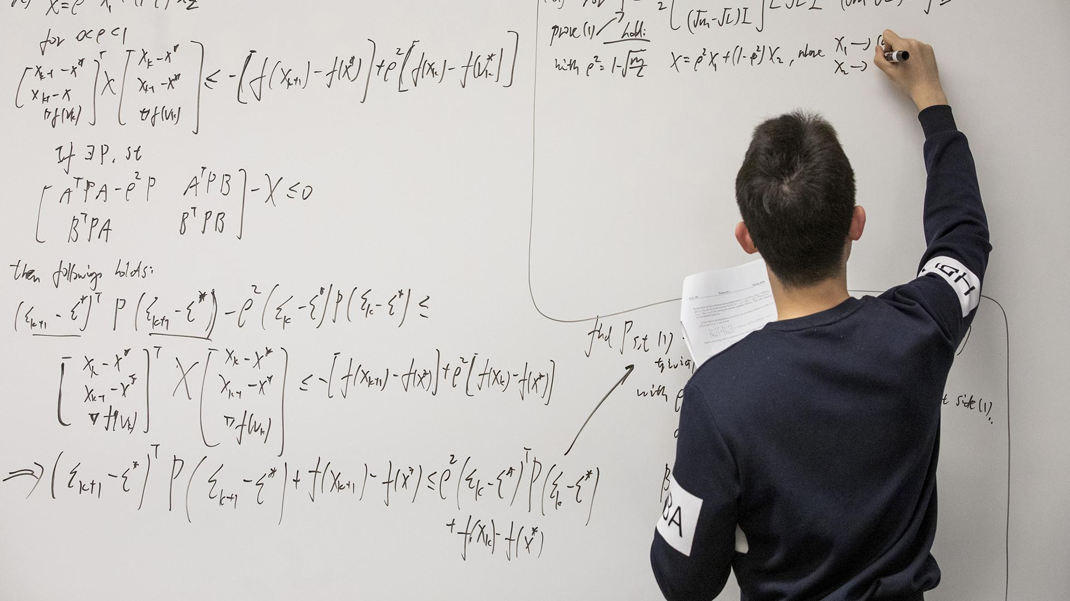
Further Work
Direct interpretation of VPD to temperature and humidity targets
Improved UI: data logging, scheduling
Redesign physical design of appliance control for safety
More nodes: appliance control, data acquisition
On-the-fly node discovery
Additional specialized nodes
Air quality sensing
Light sensing
Irrigation management
ELECTRICAL & COMPUTER ENGINEERING
GRAINGER ENGINEERING
Notes:
Aadarsh

Slide 30
Thank you! Questions?
Special thanks to our amazing and encouraging TA, Ugur Akcal
Contact Information
Aadarsh Mahra - Software Lead. amahra2@illinois.edu
Smit Purohit - Hardware Lead. smitp2@illinois.edu
Jeff Taylor - Team Lead. jt19@illinois.edu
ELECTRICAL & COMPUTER ENGINEERING
GRAINGER ENGINEERING
Notes:
Jeff

