Slide 1
ECE 445 Senior Design Laboratory:
Team 78: CFA Flying Area Accuracy Determination
Juliana Temple (EE, jtemple4)
Bella Altenbach (EE, ialten2)
Alex Hu (CE, alexxh2)

Slide 2
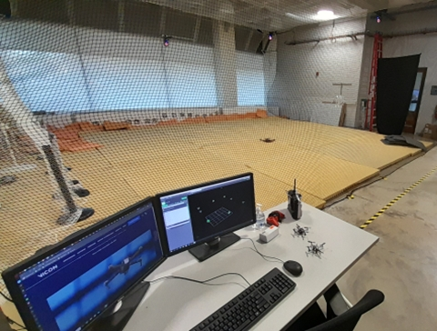
Introduction (J)
1
Intelligent Robotics Lab
What goes on in the lab
Special thanks to John Hart
Vicon Tracker 3 Software and Cameras
9 Near-infrared cameras at the top
of the arena
370 points of data per second
Current Model accurate within 1 mm to true location
Notes:
-first a special thanks to john hart Our pitched project proposal involved analyzing the accuracy and consistency of the current position tracker used specifically in the IRL(intelligent robotics lab) flying arena.
-Shown above is the arena layout surrounded by netting and 9 near infrared cameras located all around the top of the arena.
These cameras output about 370 points of data per second into the software setup and the current model is accurate to just within 1mm to true location.

Slide 3
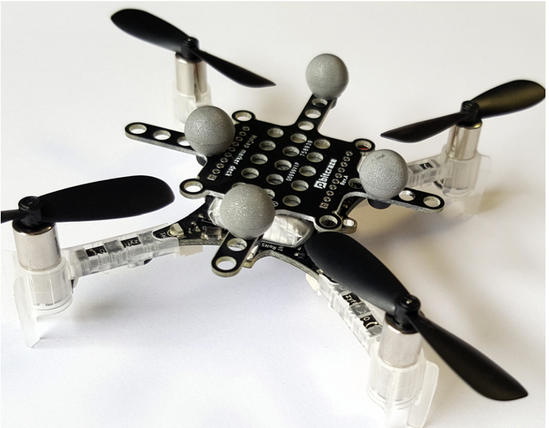
Problem (J)
2
To track flying objects, usually drones, the lab
utilizes reflective balls.
Styrofoam balls painted with reflective
paint.
Vicon Manual States that accuracy to true
location is within 1 mm.
Is this accurate at all places throughout the
arena?
Re-calibrate cameras to better survey the arena.
Notes:
As mentioned our solution is to track flying objects, in most cases drones are used in the lab but currently just using erflective balls as markers. Since the current accuracy is within 1mm the lab is wondering if we can find a tracker that is more accurate which is why we are using thee infrared leds. We then want to ensure that all spots in arena are getting accurate data or atleast identity the dead zones were data isn't tracked. When dead zones are found our solution was to rercalibrate the cameras inorder to minimize these spots and collect the best data.

Slide 4
Solution (hardware and Vicon)(B)
3
PCB allows for comparison between LEDs and Reflective Balls
Near-IR LEDs (780nm): Active Marker, “TRUE” LOCATION
Reflective Balls: Passive Marker, “OBSERVED” LOCATION
ATmega328-P microcontroller to illuminate the LEDs in different configurations
Vicon tracker 3 Software communication
Define 2 separate objects sharing the same center point
Object 1: 780 nm LEDs
Object 2: Reflective Balls
Minimize percent error as much as possible in the construction
Notes:
The objective of the hardware is too design a board that uses reflective balls and an orientation of infared LEDS simultaneously so that they have the same center of location read by the vicon tracker 3 software.
We had designed 3 different Led orientations controlled by the ATMEGA microprocessor and switches, 1st orientation lighting up the inner 2 LEds, the 2nd orientation lights up the outer 4 leds, while the 3rd uses all 8 leds.
We wanted to ensure simultaneous readings in real time in order to further minimize percent error
This was done by defining in the Vicon software the Leds as an object and reflective balls as its own object so the data outputted could be separated

Slide 5
Solution (software process)(A)
4
Software needed to accomplish 3 main goals to analyze the data
Parse and clean the .csv file output by the Vicon Tracker Software to be analyzed.
Calculate the percent error between the LED’s and reflective balls at every frame.
Use the percent errors and positional data to create graphs to determine the accuracy of the LEDs
Notes:
EXplain why these subsystems are required (TA notes)

Slide 6
Subsystems

Slide 7
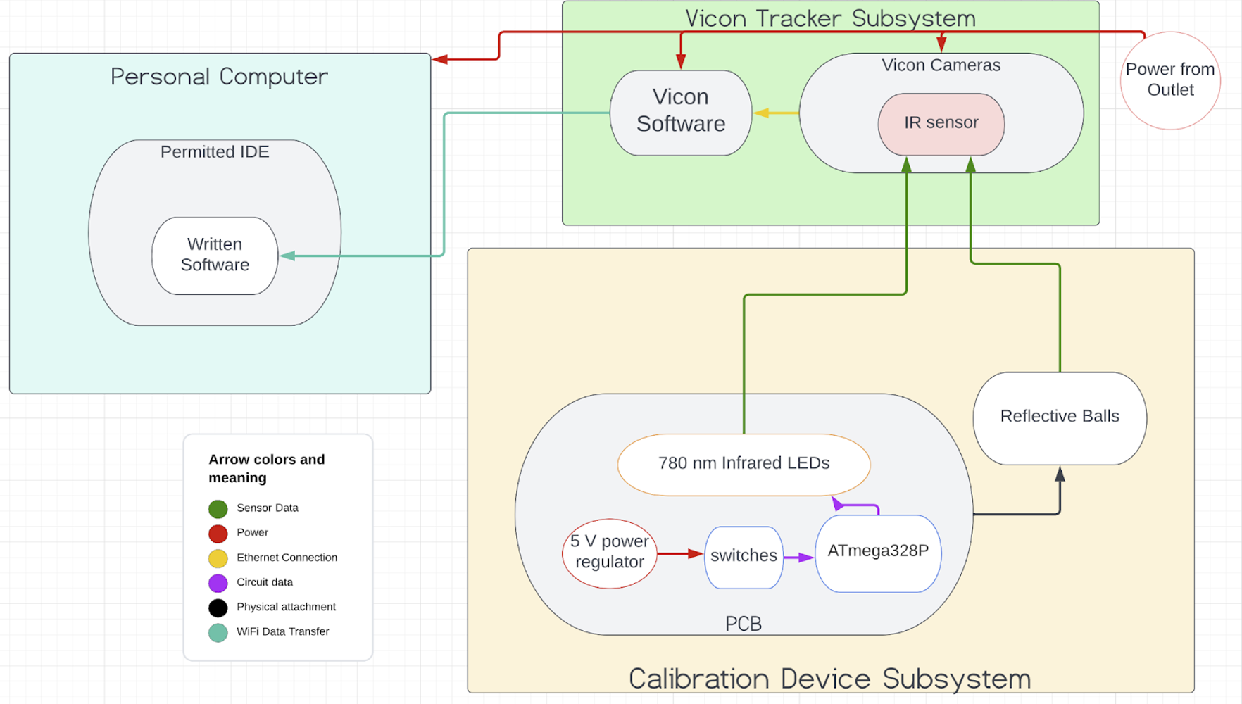
Block Diagram(B)
5
3
2
1
Notes:
BReak down the subsystems (explain why we have each )

Slide 8
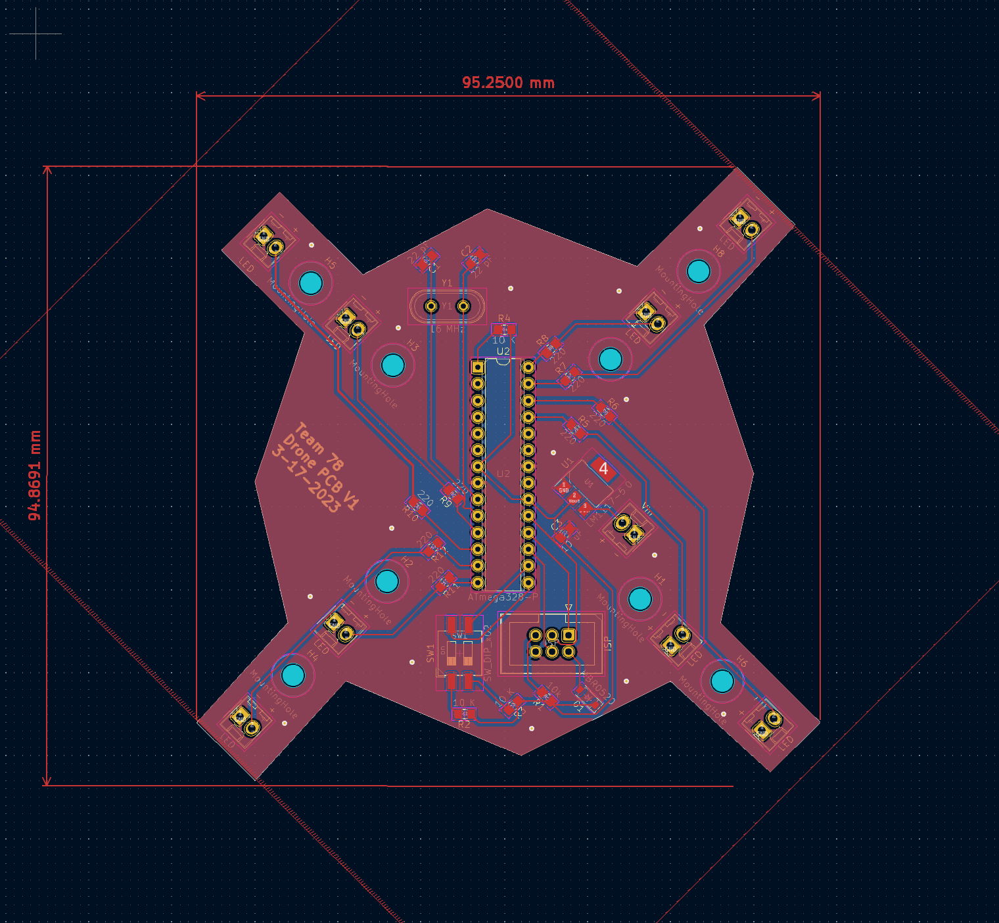
Subsystem 1 (PCB)(B)
6
Elements of PCB
8 LEDs (780 nm)
3 different configurations
8 Mounting Holes
3 different configurations of reflective balls
Two Switches
All off, half on (4 LEDs), or all on (8 LEDs)
ATmega328-P
28 I/O pins, SPI programming
Voltage Regulator
Step down to 5 V from 9 V battery
16 MHz Oscillating Crystal
Various Capacitors and Resistors

Slide 9
Final Product PCB (B)
7
Configuration 1
Configuration 2
Configuration 3

Slide 10
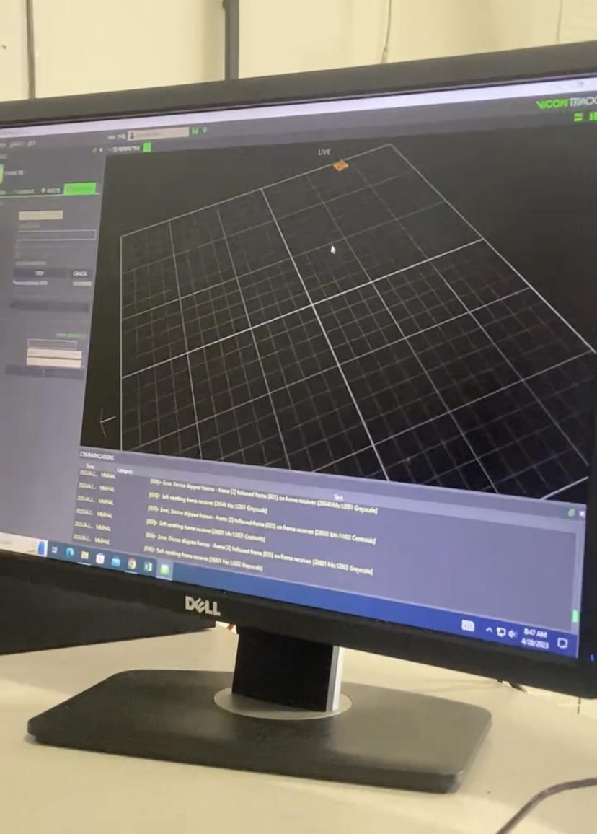
Subsystem 2 (Vicon Tracker 3)(B)
8
Software
Allows multiple objects to be created and tracked.
Center point of objects automatically calculated per frame.
Exports Data as a CSV file.
Cameras
Flashes near-infrared light of 780 nm.
370 points of data per second (370 frames per second).
9 in total, on the perimeter of the arena ceiling.
Shared by everyone doing research in the lab

Slide 11
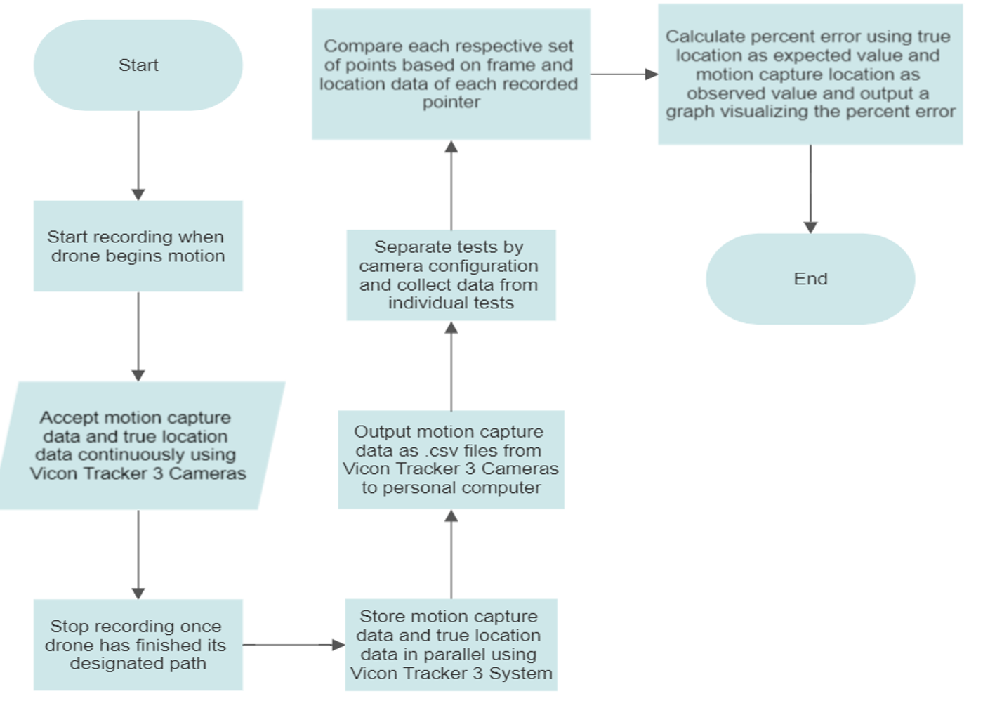
Subsystem 3 (Software) (A)
9
Purpose
Needed a way to calculate the percent error between center point of the LED object and Reflective Balls Object and analyze into a graph
Programmed and compiled on personal laptop for more freedom of downloading programs
Logistics
Language: Python (comfort)
Libraries: Pandas (parsing data)
NumPy (cleaning data)
Matplot (plotting data)

Slide 12
Data Collection and Analysis

Slide 13
Two Objects Created in Vicon Software (B)
10
780 nm LEDs object
Reflective Balls Object

Slide 14
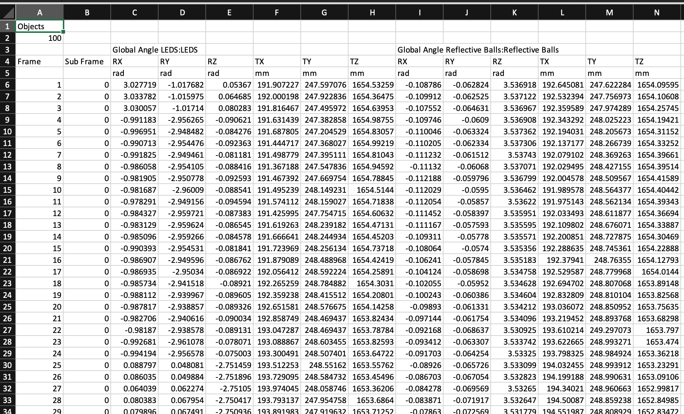
Example Exported CSV File (A)
11
Data we use for analysis

Slide 15
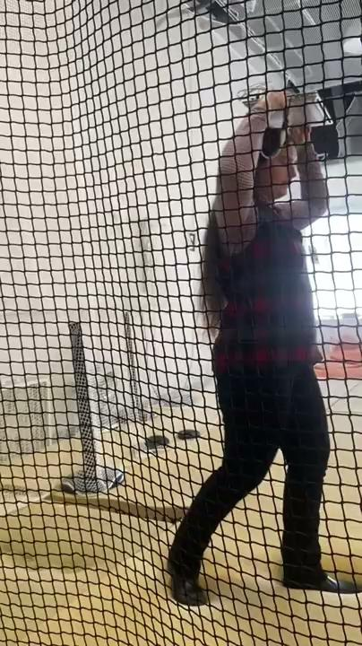
Process of Data Collection (A)
12
Video demonstrates the movement of the LED’s and reflective balls together around the Flying Arena and the data getting picked up by the Vicon Tracker 3 Software. Data then gets outputted and analyzed as graphs.

Slide 16
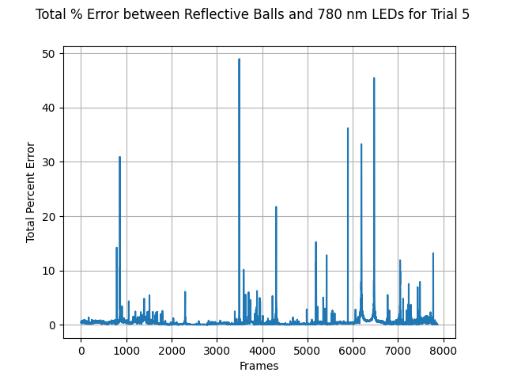
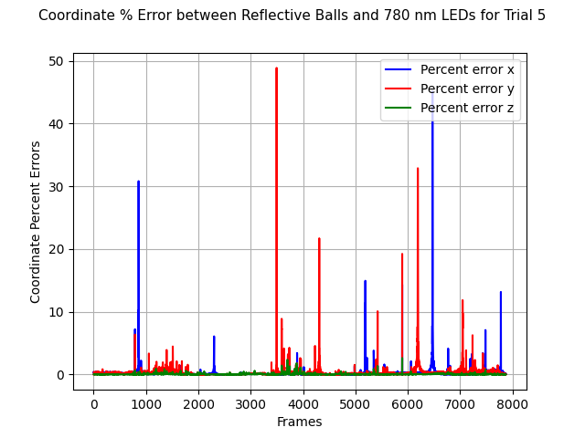
Demo Results (A)
13
Percent Error graphs from trials (most of % error from x and y coordinates, only spikes and no blocks of high percent error)

Slide 17
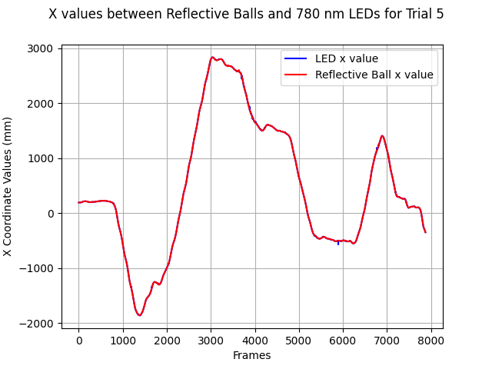
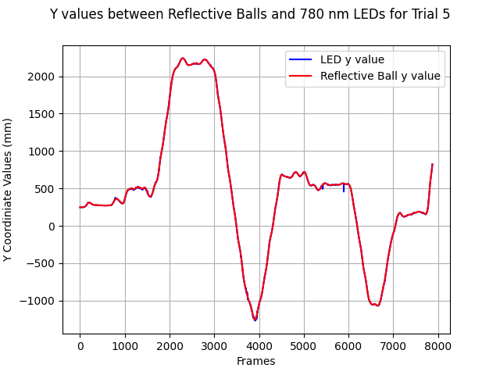
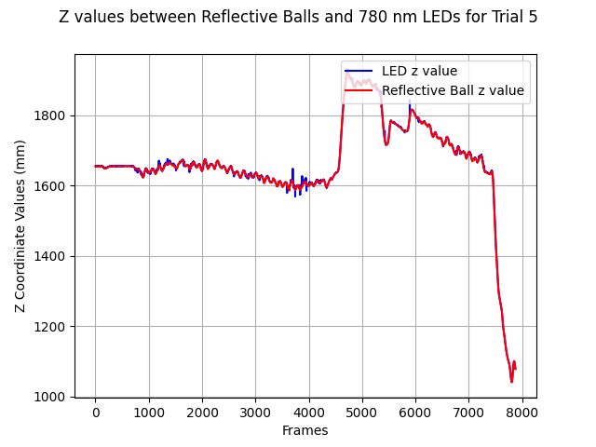
Demo Results (A)
14
Coordinate position graphs from trials (xyz coordinates all match up well, z values matched up the closest)

Slide 18
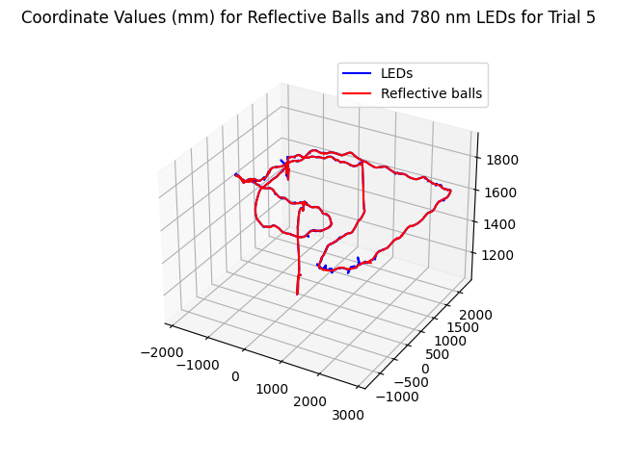
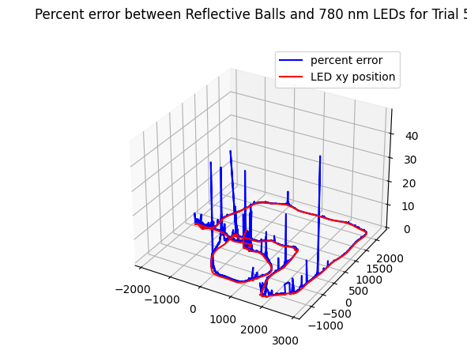
Demo Results (A)
15
3D graphs from trials (found dead spots near left side of Flying Arena, seen in % error graph)

Slide 19
Challenges and Conclusions

Slide 20
Software Tolerances (A)
16
Trial # | Median Percent Error
1 | 1.5141
2 | 0.5050
3 | 0.5052
4 | 0.6054
5 | 0.3411

Slide 21
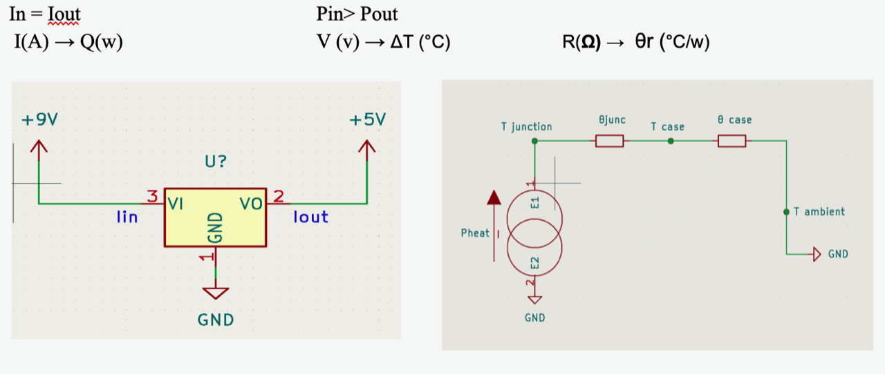
Hardware Tolerances (J)
17
Tested:
Voltage regulator
Near-IR LEDs (Von=2v)
Each cost $11
ATmega (Vout=5v )
Thermal stress analysis:
Kirchoffs: V=IR Law of cooling: ΔT= kQ
Notes:
The following parts were tested, for the voltage regulator we did a thermal circuit analysis on the PCB. According to kirchhoff's law V=IR and Newton's law of cooling ΔT= kQ there exists a relationship between the following variables.
Seeing this and the following diagram we must ensure that the temperature at the junction( Tjunc) will be lower than the working temperature of the component found in datasheet 125 °C [5]. Also ensured that inputting 9V successfully outputed 5v.
The Infrared LEDs were tested using simple Kirchhoff's law using a power supply and multimeter, according to the data sheets, the LED forward voltage is 2v and the atmega outputs 5v so we calculated that a 220 ohm resistor should be implemented.

Slide 22
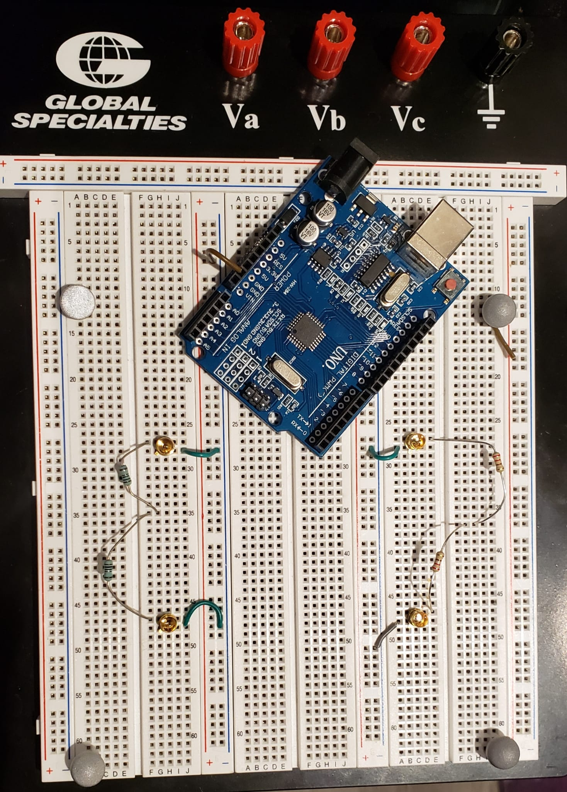
Interference Between Reflective Balls and LEDs (B)
18
Not able to test the multiple configurations without manually moving the LEDs and Reflective Balls

Slide 23
“Deadzones” and Camera Calibration (B)
19
“Deadzones” around the back left corner of the arena (possibly due to windows or many objects).
Calibrate cameras to make the origin of the Vicon Software closer to this corner.
Repeat testing until the percent error is more even throughout the arena.

Slide 24
Conclusion: Project Continuation (J)
20
New PCB design for the led interfering with the reflective ball.
Measuring the minimum distance to avoid interference.
Calculating how increasing the PCB wing lengths affects the stress.
Notes:
Moving forward a lot of progress has been made in designing and debugging to see what to correct in future designs.
To continue a new pcb design would have to be made to account for the led interfering with the reflective ball. So figuring out the minimum distance needed between the two types of locators to not interfere would have to be tested.
Additionally calculating how increasing the pcb wing lengths affects the stress of the board to accommodate the minimum distance
Overall this project was very useful to gain insight into the process of orgranzing and creating a project and there is a clear path ahead for continuation and finalizing this concept.

