Slide 1
Smart Vitamins
Andrew, Horace, Dhruv

Slide 2
Problem?

Slide 3
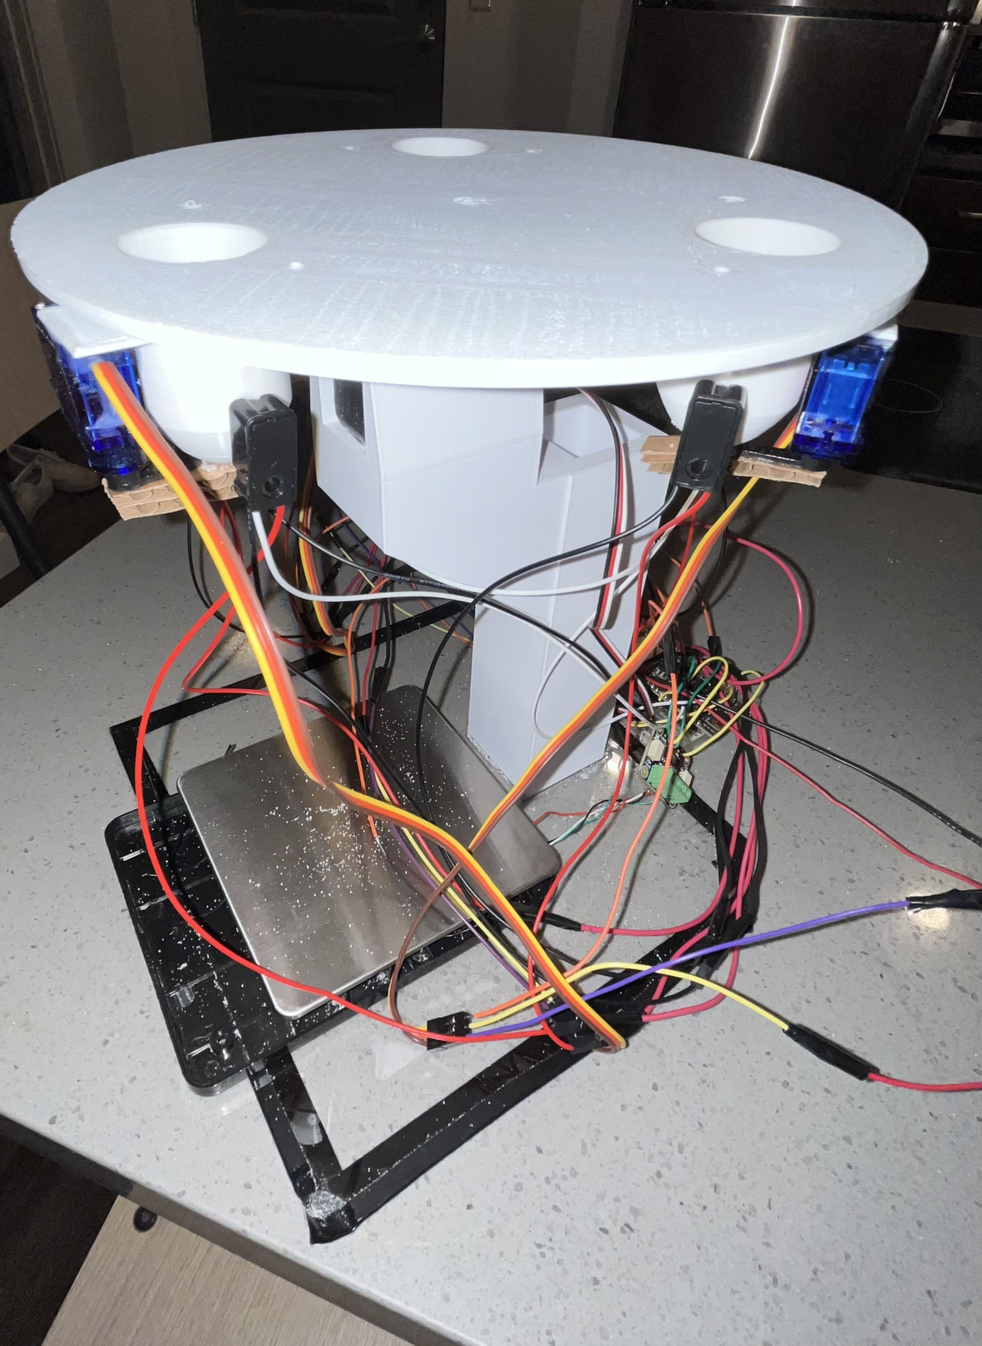
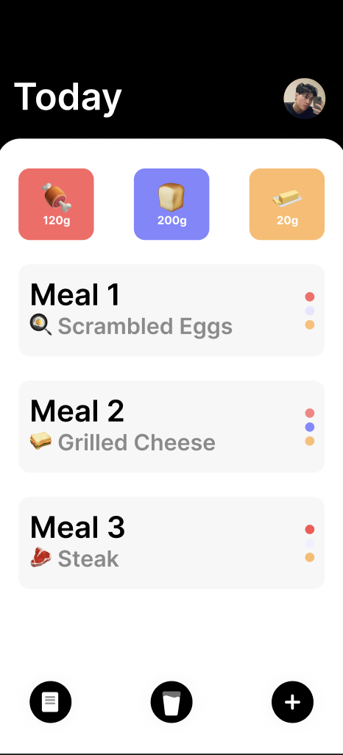
Solution
App: Tracks lacking micronutrients based off of daily diet
Device: Makes powder mix based off information from the app

Slide 4
High-Level Requirements
The supplement mix maker should be able to make the correct mix with a 15 mg margin for each ingredient.
The mix maker should be able to wirelessly interface with applications on other devices and should receive the correct mix recipes 80% recipes.
The user will be notified when any storage compartment is below 15% of capacity.

Slide 5
Design - Components
180° Servo
Three
IR Sensors
Three Pairs
Continuous Servo
One
ADC Converter
One
Load Cell
One

Slide 6
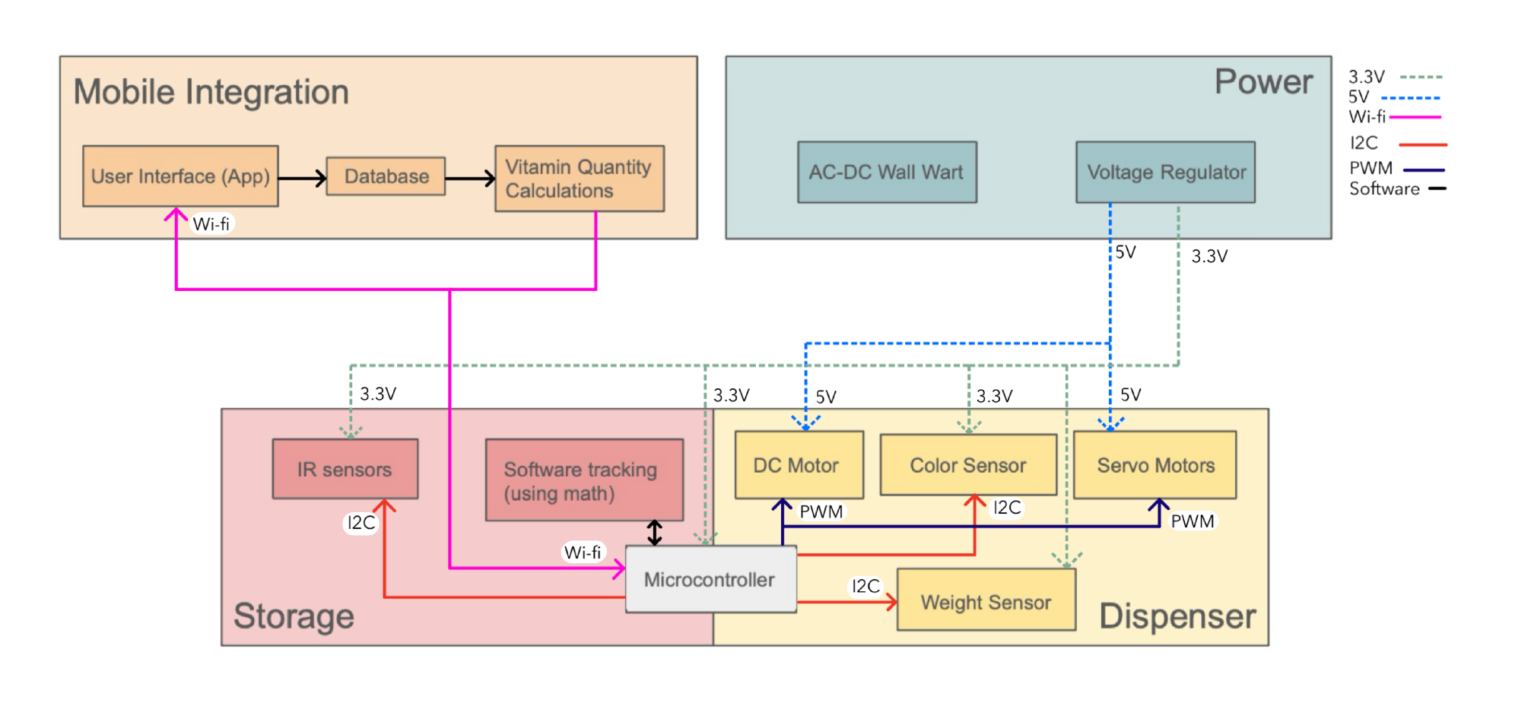
Design - Block Diagram

Slide 7
Design - Safety Thresholds
Identifying micronutrients that we can safely administer
Vitamin/ Mineral | Womens Recommended Intake | Mens Recommended Intake | Upper Limit
Vitamin C | 75 milligrams | 90 milligrams | 2,000 milligrams
Choline | 425 milligrams | 550 milligrams | 3,500 milligrams
Calcium | 1,000 milligrams | 1,000 milligrams | 2,500 milligrams
Potassium | 2,600 milligrams | 3,400 milligrams | Unknown
Phosphorus | 700 milligrams | 700 milligrams | 4,000 milligrams
https://www.hsph.harvard.edu/nutritionsource/vitamins/

Slide 8
Design - Software (Mobile Integration)
Hardware
Server

Slide 9
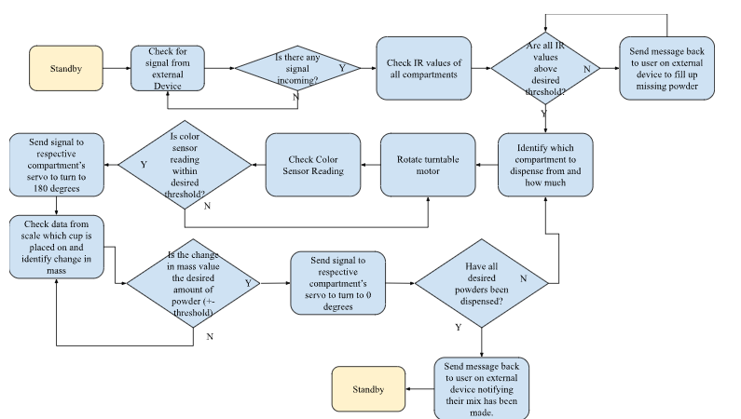
Design - Software (Hardware)

Slide 10
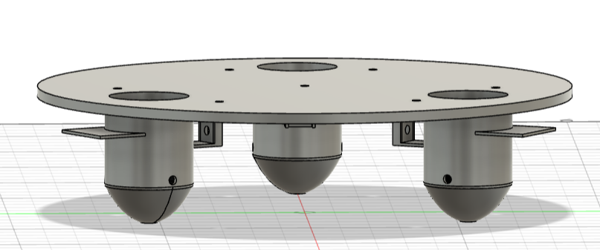
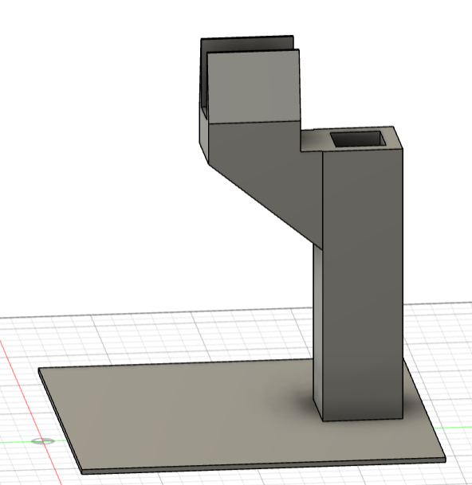
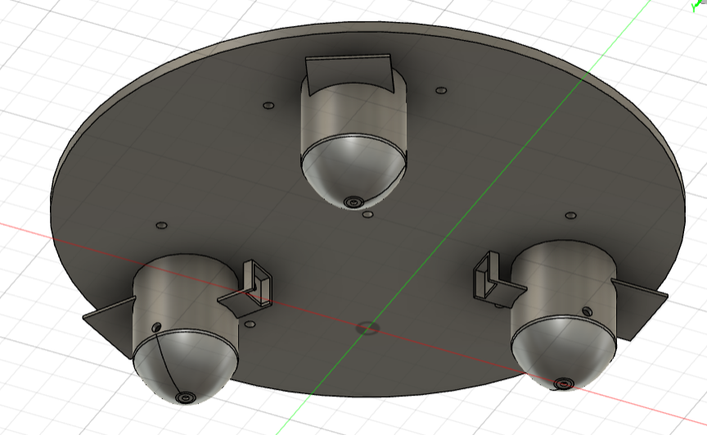
Design - Physical

Slide 11
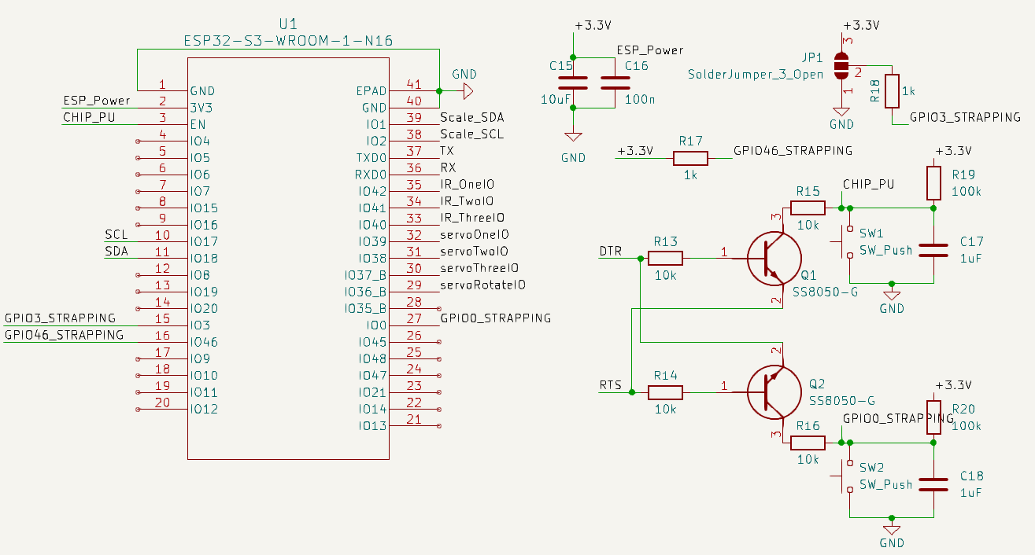
Design - ESP32

Slide 12
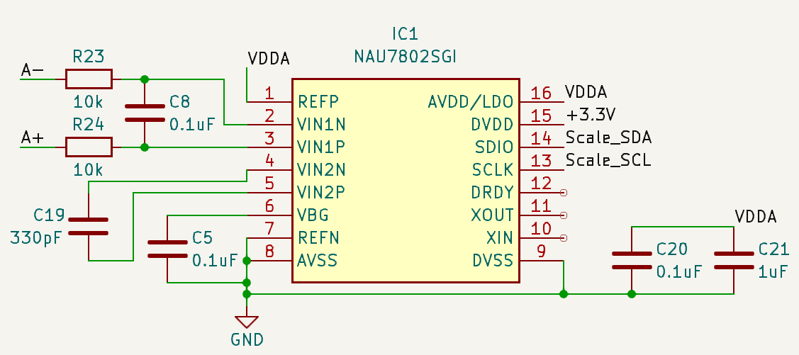
Design - Weight Sensor

Slide 13
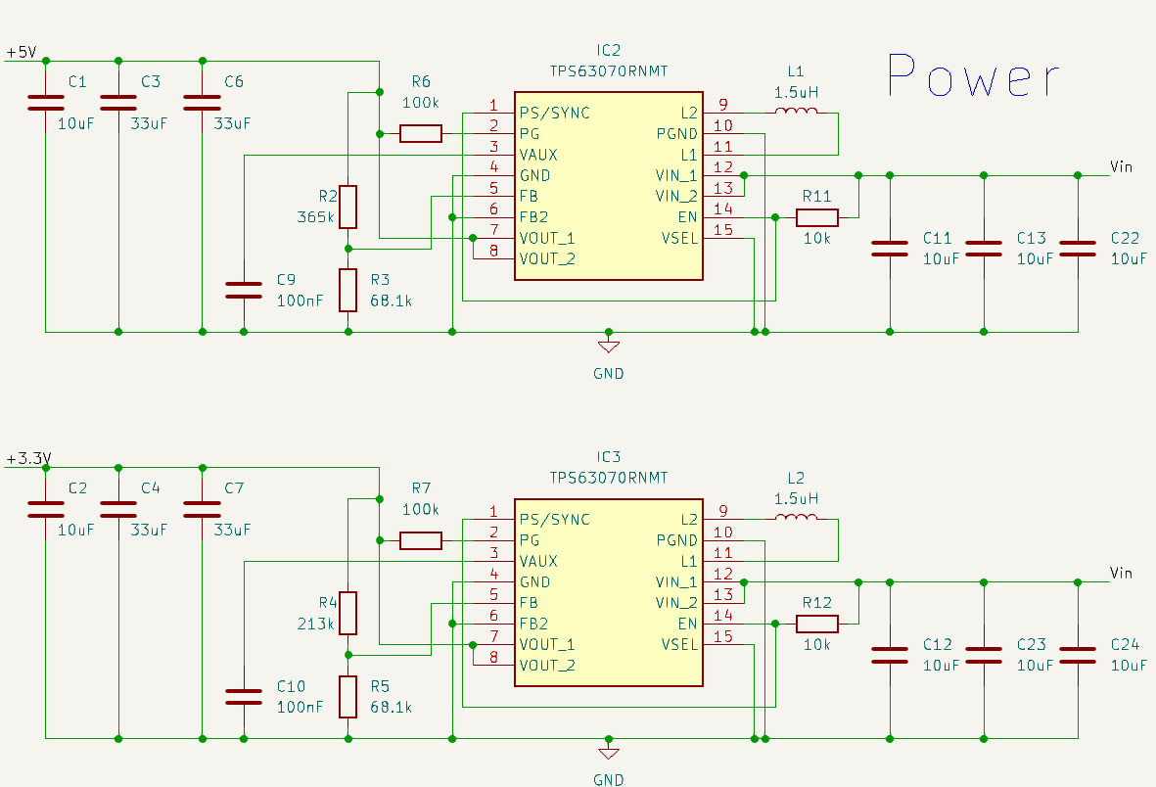
Design - Power

Slide 14
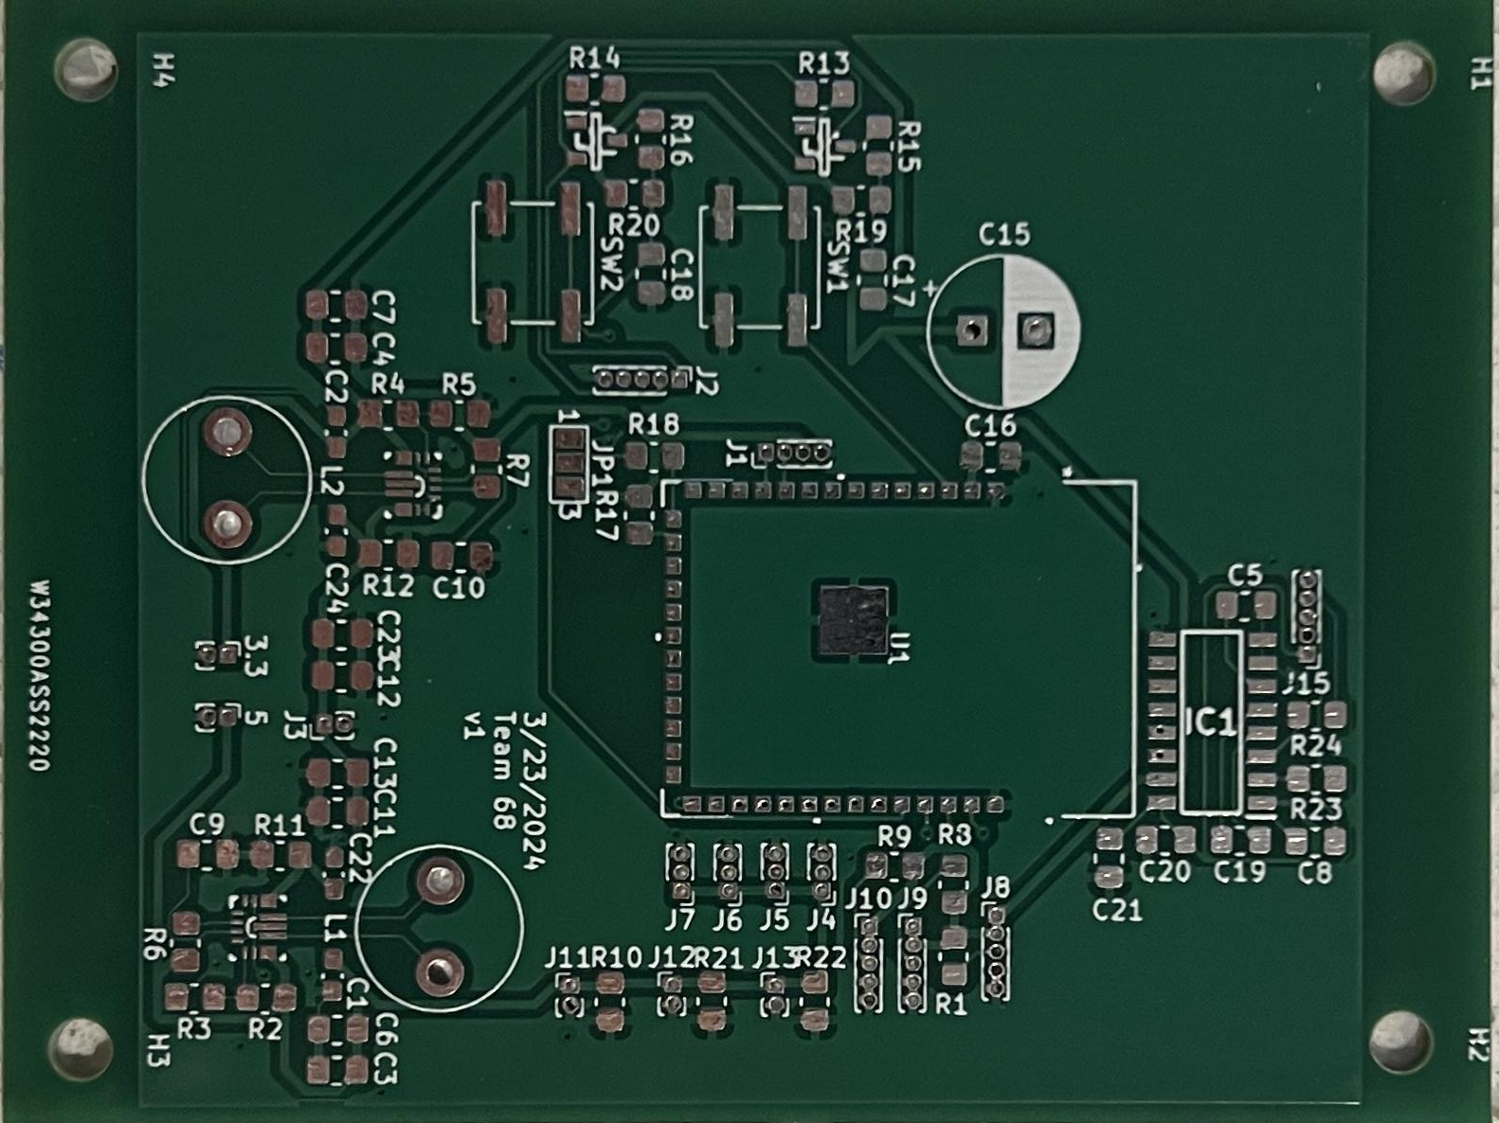
Design - PCB Version 1

Slide 15
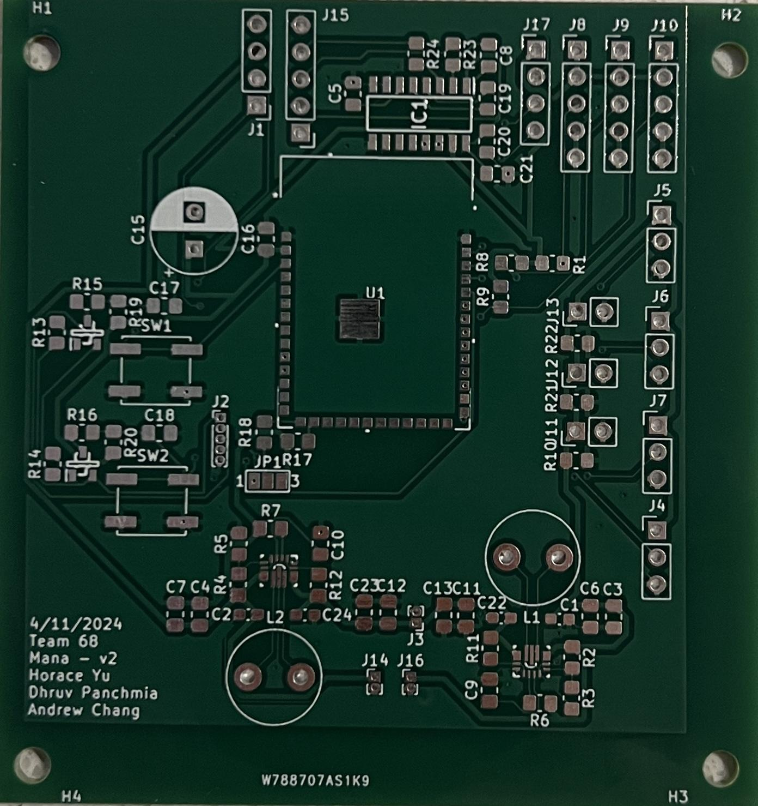
Design - PCB Version 2

Slide 16
RV - Mobile Integration
Requirements | Verification
When prompted with an input food item, the database must return: 1 JSON File *Micronutrients Present (units in IU and mg) Vitamin C Vitamin B3 Vitamin B6 Macronutrients Present Protein (grams) Carbohydrates (grams) Fat (grams) Calories (kCals) With a success rate of 90% *Specific micronutrients chosen for MVP for higher daily upper limits | Using the mobile app, submit a meal (i.e. pasta, chicken, etc.) Verify that the app returns the macro and micronutrients of the meal Repeat for all foods stored in the database Verify that 90% of the foods requested returned a valid JSON file

Slide 17
RV - Mobile Integration
Requirements | Verification
When prompted to make a drink, the system must be able to accurately recommend a list of supplements based on what the user is lacking in their diet with an 80% success rate. | Using the mobile app, submit 2 sample meals Request today’s drink mix Verify that the app analyzes today’s meals and returns the vitamins and minerals that weren’t present in today’s meals Verify that the app returns a blend that supplement what the user was lacking Repeat 10 times and verify that step 4 held true 8 out of the 10 times.

Slide 18
RV - Mobile Integration
Requirements | Verification
When a drink order has been confirmed in the mobile app, the software must be able to communicate with the hardware by sending control signals over wifi with an 80% success rate | Verify that the app is paired with the device Request today’s drink mix Verify the doses are accurate and within the safe range Confirm and request the drink Verify that the device processes the request and dispenses a drink Repeat 10 times and verify that step 5 held true 8 out of the 10 times.

Slide 19
RV - Storage
Requirements | Verification
System must be able to recognize when a compartment has reached 15% of its capacity | Put excess amount of powder (well over 15% of compartment capacity) into the storage compartment Check log for verification that the sensor registers powder as above threshold. Remove powder until it is below 15% of compartment volume. Check log for verification that the sensor doesn’t register any powder as above threshold. Repeat for any remaining compartments.

Slide 20
RV - Storage
Requirements | Verification
System must be able to correctly identify when a container is running low 80% of the time | Repeat Requirement 1’s verification procedure steps 1-4 10 times. Verify that 8 of the 10 tests were successful. Repeat steps 1-2 for any remaining compartments.

Slide 21
RV - Dispenser
Requirements | Verification
System must be able to dispense each powder within a 15 mg tolerance *This was first written early in the design process. We later found that it was much more feasible dispensing 250 mg of powder to test this. We are also verifying this with an external scale that we have brought. | Send a signal to dispense 30mg of powder from the desired storage compartment. Let the dispensing process reach completion. Check log for weight sensor and note down change in weight from before and after dispensing process. Check the difference from 30mg and the value noted in step 3 and ensure said difference is within our desired 15mg tolerance. Repeat steps 1-4 for remaining storage compartments.

Slide 22
RV - Dispenser
Requirements | Verification
System must be able to rotate and align onto the correct storage compartment. *We were unable to get the color sensor to consistently display correct RGB values, and to remedy this, we decided to do away with the color sensor and just rotate the servo to preset degrees which provides the same functionality. | Send a signal to dispense powder from the desired storage compartment. Let the machine rotate until reaching full stop. Check log for color sensor and make sure it is within 10% of RGB value for the LED’s intended RGB value. Repeat steps 1-3 for all containers with different start positions for turn mechanism and different external lighting factors.

Slide 23
RV - Power
Requirements | Verification
System must be able to supply 5VDC +/- 5% and 3.3VDC +/- 5% | Hook up power output of buck and LDO to digital multimeter and test voltage ratings. Verify that from the buck converter output the voltage is between the range of 3.465~3.135 volts using an oscilloscope. Verify that the linear regulator output voltage is between the range of 5.25~4.75 volts using an oscilloscope.

Slide 24
Power Scope Caps
3V3 Output
5V Output

Slide 25
RV - Power
Requirements | Verification
System must be able to provide up to 1.5A of current while maintaining 12V | Place a 8 ohm resistance across the 12V rail and ground and measure the voltage across the resistor

Slide 26
Achievements
The supplement mix maker should be able to make the correct mix with a 15 mg margin for each ingredient.
The mix maker should be able to wirelessly interface with applications on other devices and should receive the correct mix recipes 80% recipes.
The user will be notified when any storage compartment is below 15% of capacity.

Slide 27
Issues Encountered
PCB
Buck Converter enable pin
Insufficient Current
Servos
Unreliable position tracking
Load Cell
Too much variance in output

Slide 28
Next Steps
Debug dispensing subsystem code
Optimize dispenser to fall in 10% tolerance range
Rework power topology to support 1.5A of current

Slide 29
Thank you!

