Slide 1
A.I.Dan
A ChatGPT Integrated Virtual Assistant
Team 25: Brahmteg Minhas, Andrew Scott, Leonardo Garcia

Slide 2
Introduction
About the Team
Brahmteg: Computer Engineering Major working in software post graduation
Andrew: Electrical Engineering major, minors in CS, MatSE. Continuing my education in MatSE
Leo: Electrical Engineering Major
ELECTRICAL & COMPUTER ENGINEERING
GRAINGER ENGINEERING

Slide 3
Objective
A.I.Dan- A ChatGPT integrated Virtual Assistant
All existing virtual assistants use a search engine to retrieve data.
Search engines present multiple information sources from the web
ChatGPT is an AI language model that can respond to questions, have conversations, and generate text.
Our final project A.I.Dan is the bridge between both.
By creating a device that integrates ChatGPT with a virtual assistant. We are able to nullify the weaknesses of both tools. Integrating ChatGPT into a virtual assistant yields a better tool for getting information and tailored responses to user questions.
ELECTRICAL & COMPUTER ENGINEERING
GRAINGER ENGINEERING
Notes:
Leo

Slide 4
Introduction
About A.I.Dan
A.I.Dan is a virtual assistant that uses ChatGPT to respond
Ask it a question verbally (like Alexa), and it’ll talk back
Can also display code segments
ELECTRICAL & COMPUTER ENGINEERING
GRAINGER ENGINEERING
Notes:
Leo

Slide 5
Video Demo
ELECTRICAL & COMPUTER ENGINEERING
GRAINGER ENGINEERING
Notes:
Brahmteg

Slide 6
Review of Original Design
ELECTRICAL & COMPUTER ENGINEERING
GRAINGER ENGINEERING

Slide 7
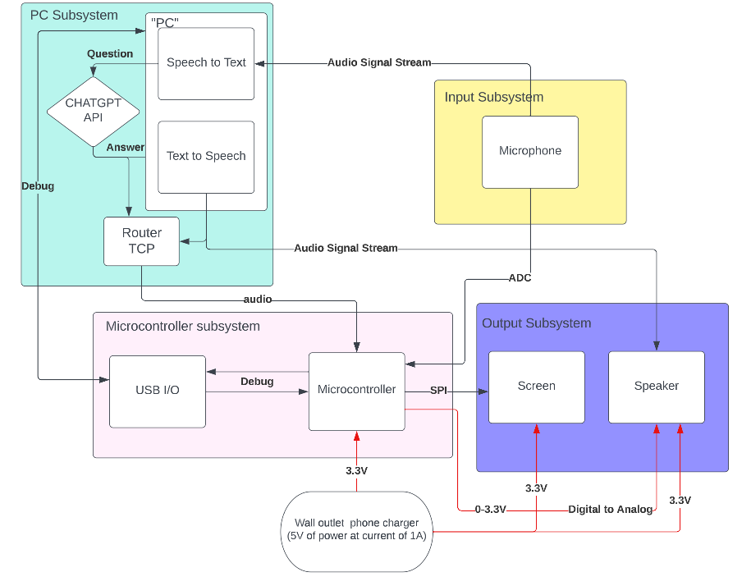
Block Diagram
ELECTRICAL & COMPUTER ENGINEERING
GRAINGER ENGINEERING
Notes:
leo

Slide 8
Review of original design
Physical Design
Small Screen
PC
Mic
Speaker
Box mount
Final design
PC
Tkinter interface
individual testing protocols
ELECTRICAL & COMPUTER ENGINEERING
GRAINGER ENGINEERING
Notes:
Leo

Slide 9
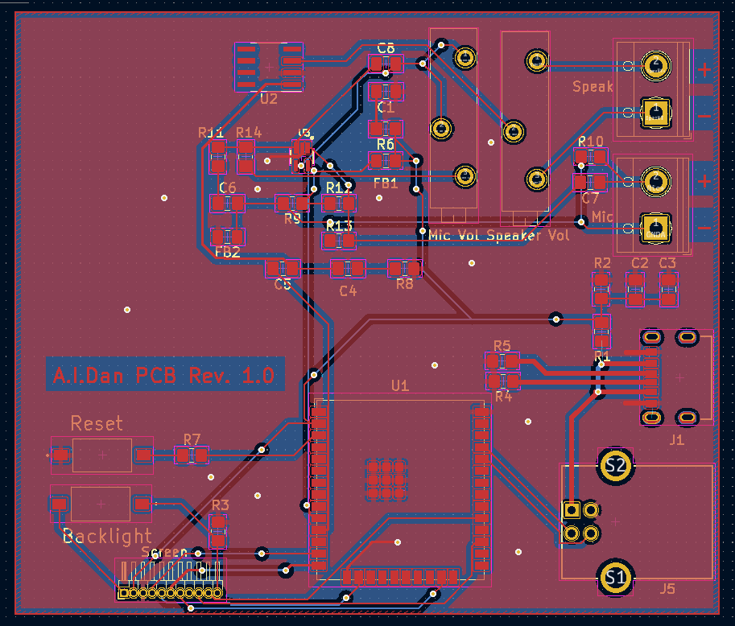
PCB Design
ELECTRICAL & COMPUTER ENGINEERING
GRAINGER ENGINEERING
Notes:
Andrew

Slide 10
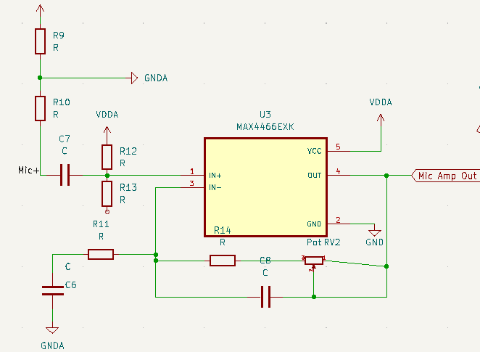
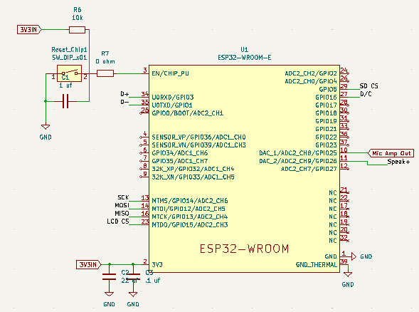
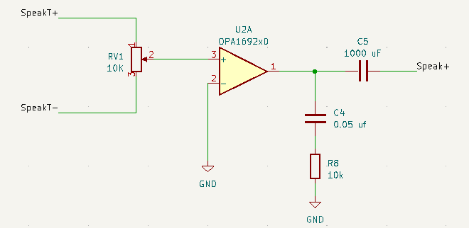
PCB Design
ELECTRICAL & COMPUTER ENGINEERING
GRAINGER ENGINEERING
Notes:
Andrew

Slide 11
Description of Build and Functional Results
ELECTRICAL & COMPUTER ENGINEERING
GRAINGER ENGINEERING

Slide 12
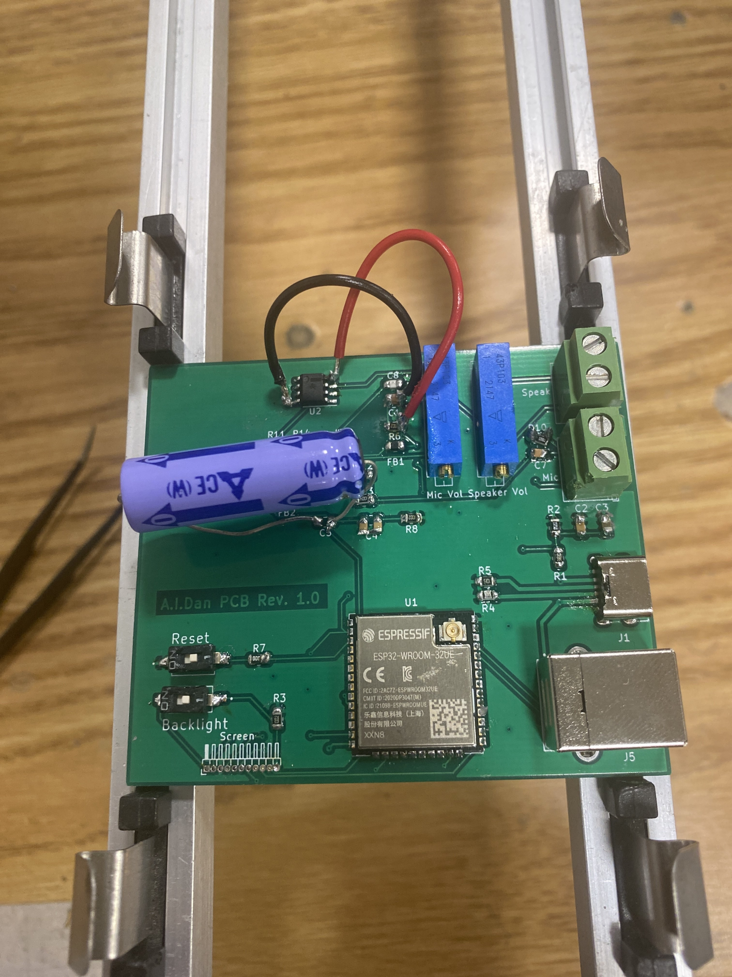
Hardware Results
PCB
Following successful testing, the PCB became undetectable through the USB Interface.
Currently, the board is not incorporated into the final project.
ELECTRICAL & COMPUTER ENGINEERING
GRAINGER ENGINEERING
Notes:
Andrew

Slide 13
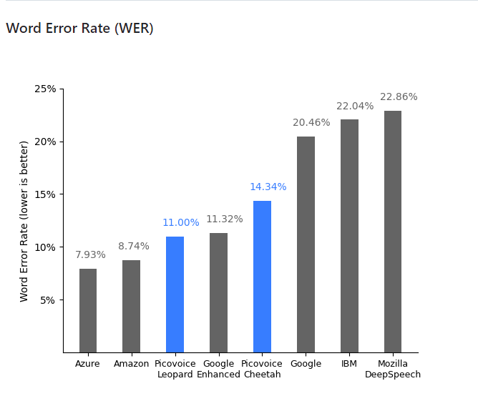
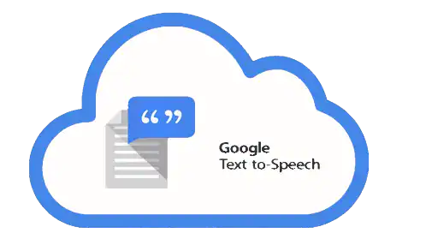
Software Decisions
Speech-to-Text
Text-to-Speech
ELECTRICAL & COMPUTER ENGINEERING
GRAINGER ENGINEERING
Notes:
Brahmteg
https://github.com/Picovoice/speech-to-text-benchmark
Important thing of note: since we allow similar words to also count as Hey Aiden (Hayden, Haydn, etc), it can actually be wrong and still recognize properly. That means that our system should have better than the average 20.46%

Slide 14
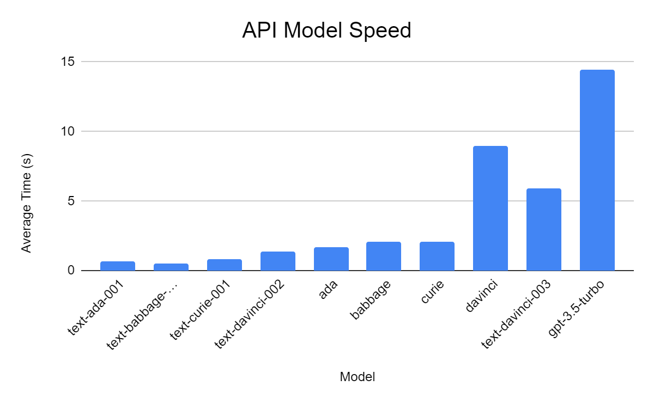
API Speed
OpenAI has models of varying capabilities for different use cases.
For demonstration purposes, gpt-3.5-turbo was chosen
Models are listed in order from least to most powerful
ELECTRICAL & COMPUTER ENGINEERING
GRAINGER ENGINEERING
Notes:
Brahmteg

Slide 15
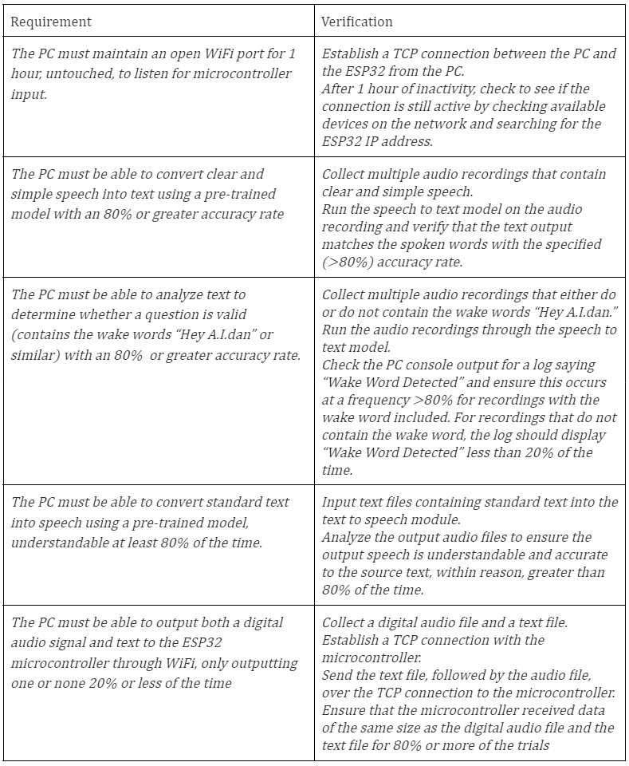
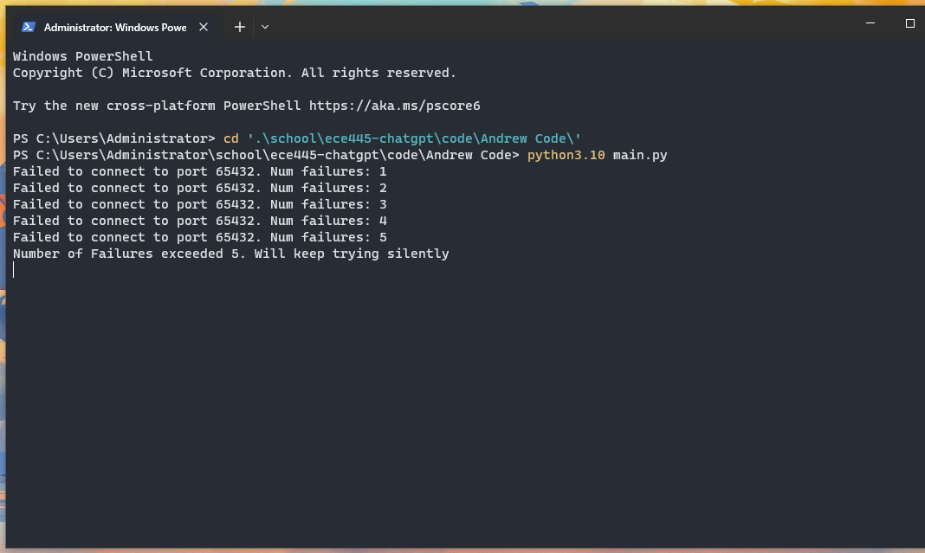
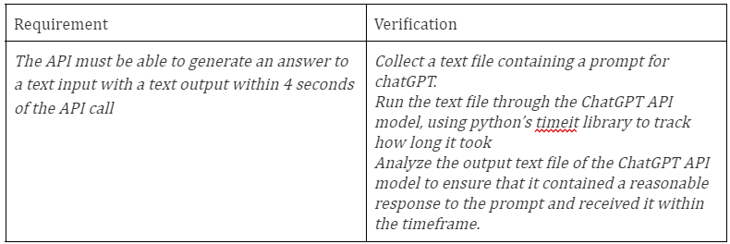
PC Subsystem Requirements and Verification
ELECTRICAL & COMPUTER ENGINEERING
GRAINGER ENGINEERING
Notes:
Brahmteg

Slide 16
Onboard Subsystem Requirements and Verification
ELECTRICAL & COMPUTER ENGINEERING
GRAINGER ENGINEERING
Notes:
Brahmteg

Slide 17
Successes and Challenges
ELECTRICAL & COMPUTER ENGINEERING
GRAINGER ENGINEERING

Slide 18
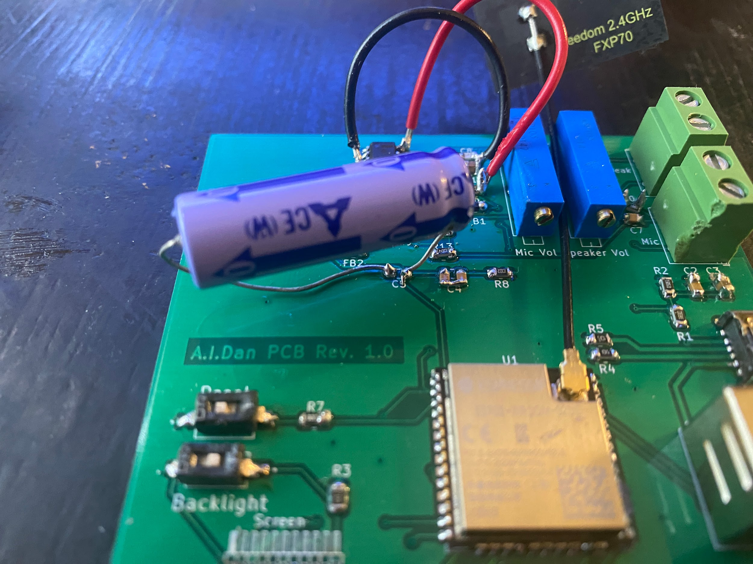
Hardware - Successes and Challenges
PCB
Didn’t end up working
Likely due to a short somewhere on board
Creative soldering required to achieve original goal
Screen
too small for use case - Standard GPT-3 Turbo responses 4096 tokens long
ELECTRICAL & COMPUTER ENGINEERING
GRAINGER ENGINEERING
Notes:
Andrew

Slide 19
Software - Successes and Challenges
Chat Completion API:
chatgpt-3.5-turbo is slower than ideal
User QOL Improvements
omnidirectional audio
window management
ELECTRICAL & COMPUTER ENGINEERING
GRAINGER ENGINEERING
Notes:
Brahmteg

Slide 20
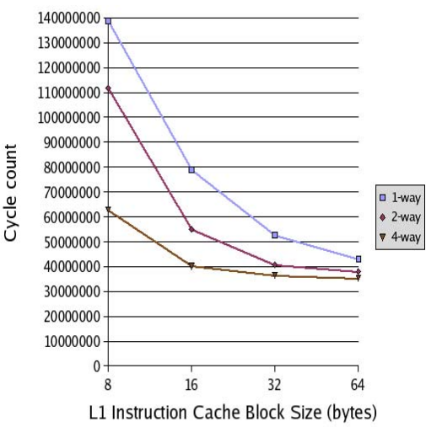
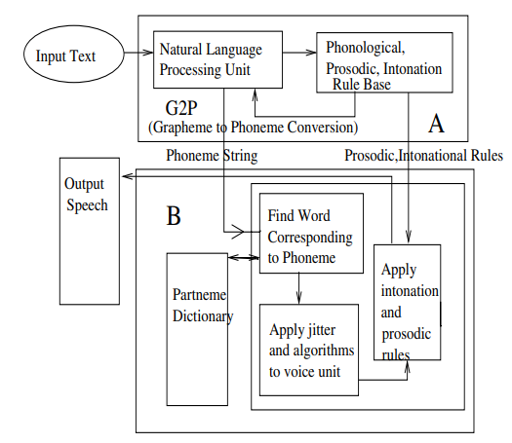
Conclusions
Better software than hardware project
Interesting design concept, maybe not the best for this course
Making a board solely for I/O seems wasteful
much of the design necessitated high level programming
What could we have done differently?
Use a beefier processor, and move what processing we could to the microcontroller (TTS)
IMAGE / GRAPHIC
S. Dey, M. Kedia and A. Basu, "Architectural Optimizations for Text to Speech Synthesis in Embedded Systems," 2007 Asia and South Pacific Design Automation Conference, Yokohama, Japan, 2007, pp. 298-303, doi: 10.1109/ASPDAC.2007.358002.
ELECTRICAL & COMPUTER ENGINEERING
GRAINGER ENGINEERING
Notes:
Andrew
graph basically just shows that you can get tts working on the order of tens of millions of cycles on an arm processor, which is single digit seconds or less (they used 200 mhz arm processors)

Slide 21
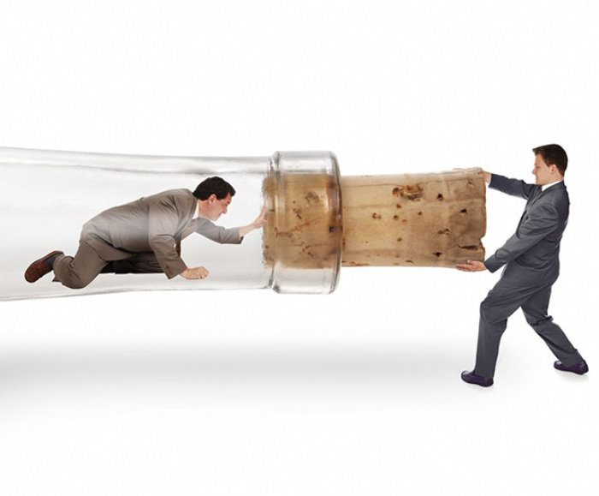
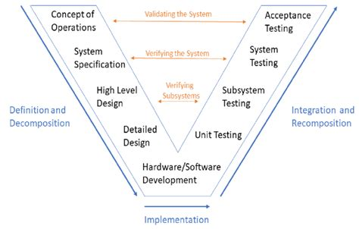
Conclusions
Revision hell/bottlenecks
If there was time for more board revisions, would likely have gone smoother
Redesign of board pushed back much of the timeline
Needed more time for troubleshooting/ embedded programming
What could we have done differently?
Systems engineering processes
prioritize parts of the project that have linear progression over those that can be done in parallel to the rest of the system
ELECTRICAL & COMPUTER ENGINEERING
GRAINGER ENGINEERING
Notes:
Andrew

Slide 22
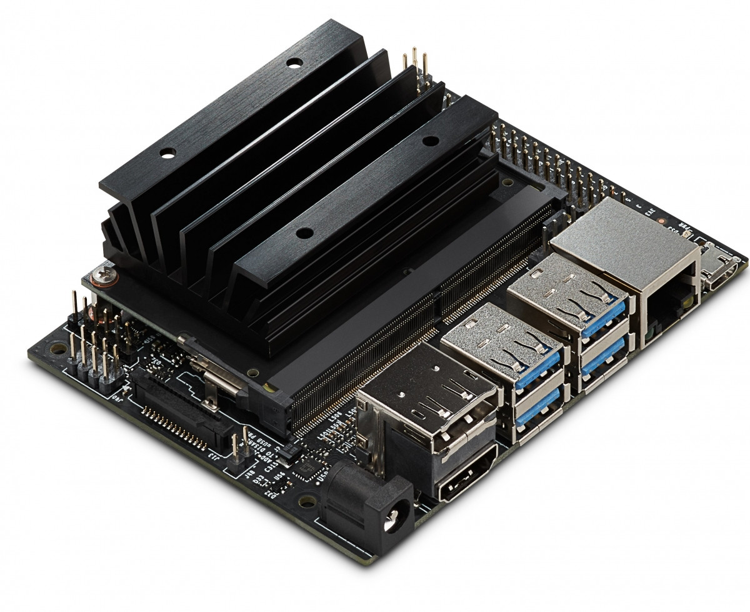
Future work
Downsize
Ideally no external computer whatsoever
Needs a more powerful processor than the esp-32, and preferably the ability to run high-level languages (python, C#, etc.)
Possible better systems:
Jetson nano/orin nano
raspberry pi
IMAGE / GRAPHIC
ELECTRICAL & COMPUTER ENGINEERING
GRAINGER ENGINEERING
Notes:
Andrew

Slide 23
Future work
Better Audio Capture
Important for a more commercial release: whole room listening
Possible improvement vectors:
Post-processing
Higher quality microphone “Room Mic”
In-house speech recognition algorithm
ELECTRICAL & COMPUTER ENGINEERING
GRAINGER ENGINEERING
Notes:
Andrew

Slide 24
Questions?
ELECTRICAL & COMPUTER ENGINEERING
GRAINGER ENGINEERING

