Slide 1
Smart Key/Key Box
Team 72
Jacob Connor, Mehul Kaushik, Yingtong Hu

Slide 2
Introduction
Trackable keys and a key box manages all keys
A better way to deal with missing keys

Slide 3
Objective
Easier to find missing keys through sound and light tracks
Be able to calculate the distance between the missing key and the key box
Be able to deactivate the keys that can’t be tracked within 100-meter radius
Be able to reactivate the keys that are found after deactivated

Slide 4
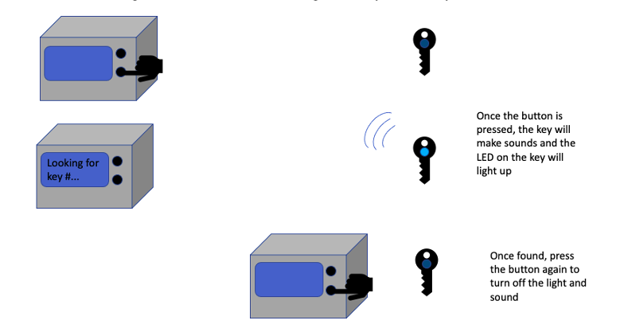
The Key/Key Box System
Visual aid for looking for a key

Slide 5
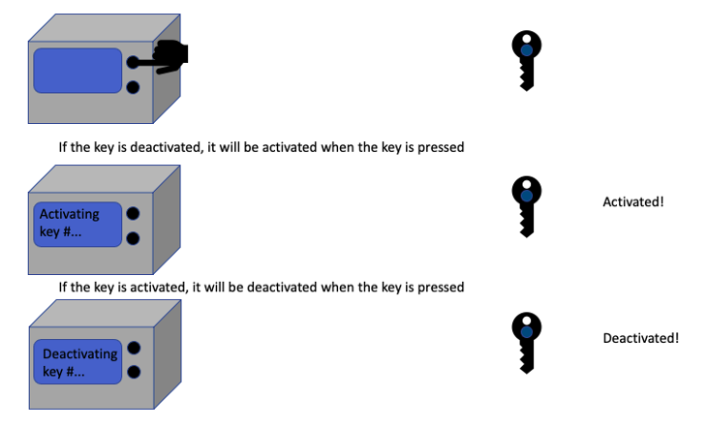
The Key/Key Box System
Visual aid for activation and deactivation

Slide 6
System Overview
Hardware
Power Supply Module
Control Module
Feedback Module
Software
Overall system logic

Slide 7
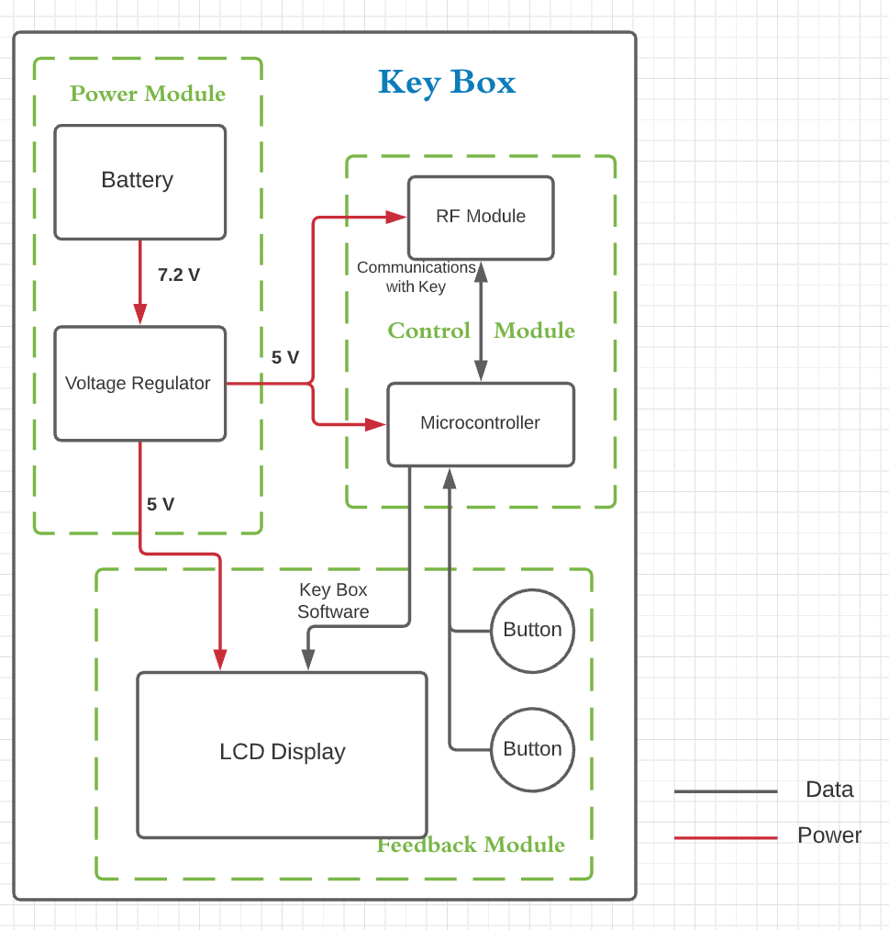
Key Box Block Diagram

Slide 8
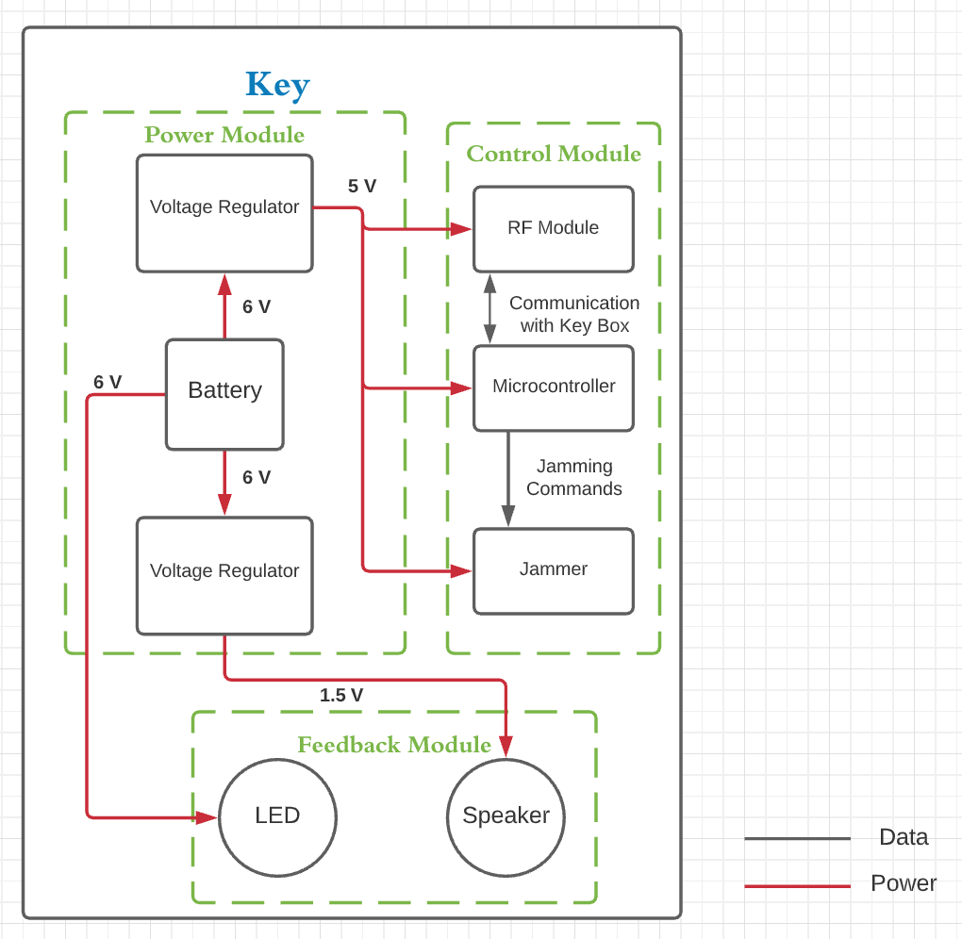
Key Block Diagram

Slide 9
Hardware Overview
Power Supply Module
Provides stable voltage input for other components
Control Module
Communication between key and key box
Jams key signals to the car
Feedback Module
Communication between user and system

Slide 10
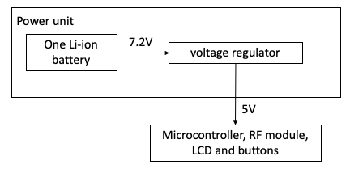
Power Supply Module – Key Box
One Li-ion 7.2V rechargeable battery
One 5V-output voltage regulator

Slide 11
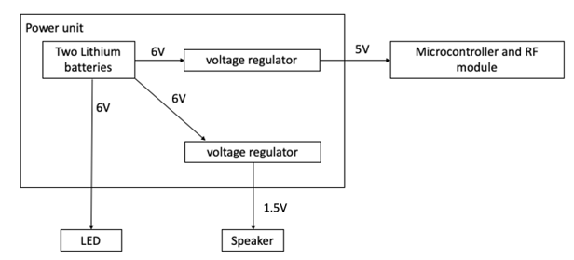
Power Supply Module - Key
Two Lithium 3V non-rechargeable battery
One 5V-output voltage regulator
One 1.5-output voltage regulator

Slide 12
Control Module – Key Box
RF Module
433MHz 2KM
Communicates with key
Distance calculation
Microcontroller
ATMEGA2560-16AU
Software

Slide 13
Control Module – Key
RF Module
433MHz 2KM
Communicate with key box
Distance calculation
Microcontroller
ATMEGA2560-16AU
Software
Jammer
433MHz 2KM
Activate and deactivate the key
Sends out same frequency signals and jams the key signals to the car

Slide 14
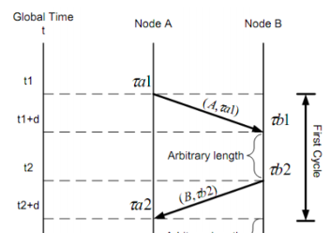
RF Module – Distance Calculation
$Time of Flight = \hat{t_{p}}= {(τ}_{B1}−τ_{A1}+τ_{A2}−τ_{B2})/2$
Distance = TOF * Velocity

Slide 15
Distance Calculation Tests
Round number | Time of Flight (ns)
#1 | 3452938
#2 | 5324958
#3 | 1345093
#4 | 9584938
#5 | 2348593
#6 | 2234894
#7 | 5493094
Time measurements are not consistent
Distance calculation is currently not reliable

Slide 16
Feedback Module
Key Box
LCD or Serial prints?
Two Pushbutton Switches SPST-NO 5V
Looking-for-a-key, activation-deactivation
Key
LED Lighting series White, Cool 5000K 6V
Speaker 1.5V TOP PORT 81dB

Slide 17
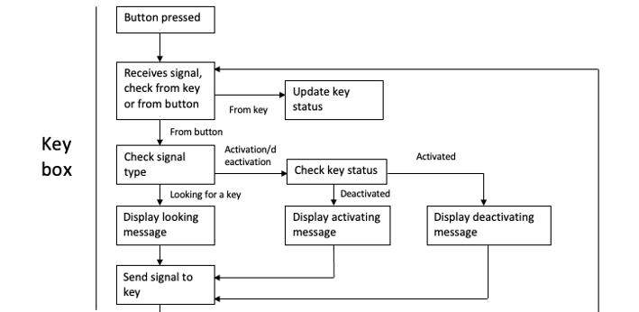
Software– Key box
Receives 2 bits from key
Sending out 3 bits
Three signal types:
Looking for a key(100)
Activating a key (010)
Deactivating a key(001)

Slide 18
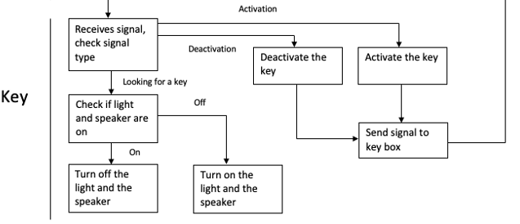
Software– Key
Receives 3 bits from key box
Sending out 2 bits:
Success(10)
Fail(01)
Deactivation:
Sending out signals to jam the signals from key to car

Slide 19
Conclusion and Future work
Power Module tested and provides stable voltage
Control Module tested, overall logic works
Feedback Module tested and outputs correct messages
Need a better RF module to calculate the distance
Need to send out deactivation signals with a different frequency than signal used in communication

Slide 20
!
Thank you!
Questions?

