Slide 1
Elderly Homes Health Tracking System
Team 6
Aishee Mondal, Jeep Kaewla, Sanjana Pingali
4/28/2023

Slide 2
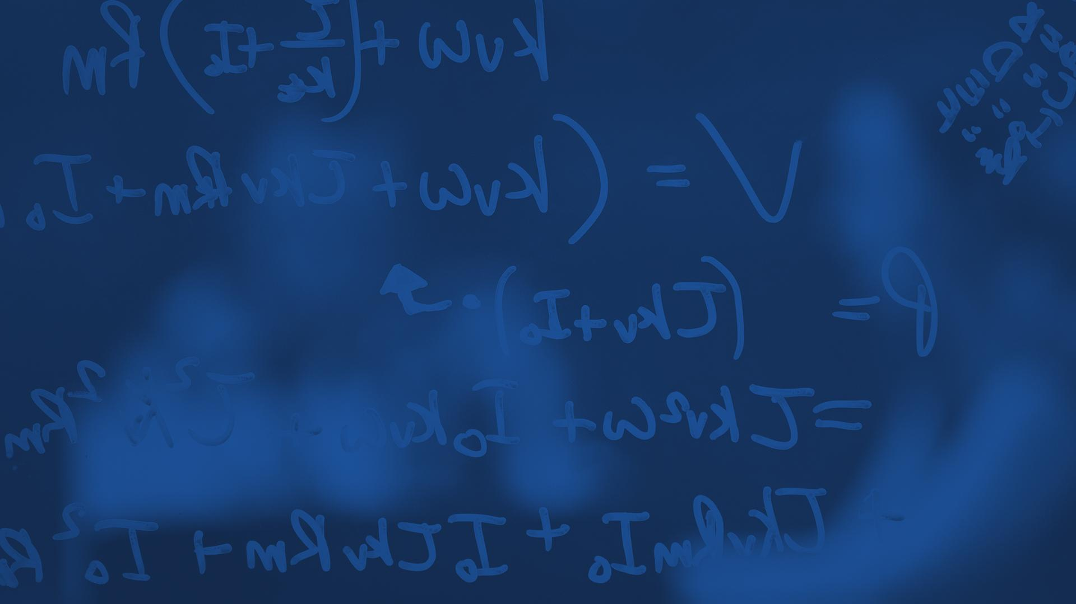
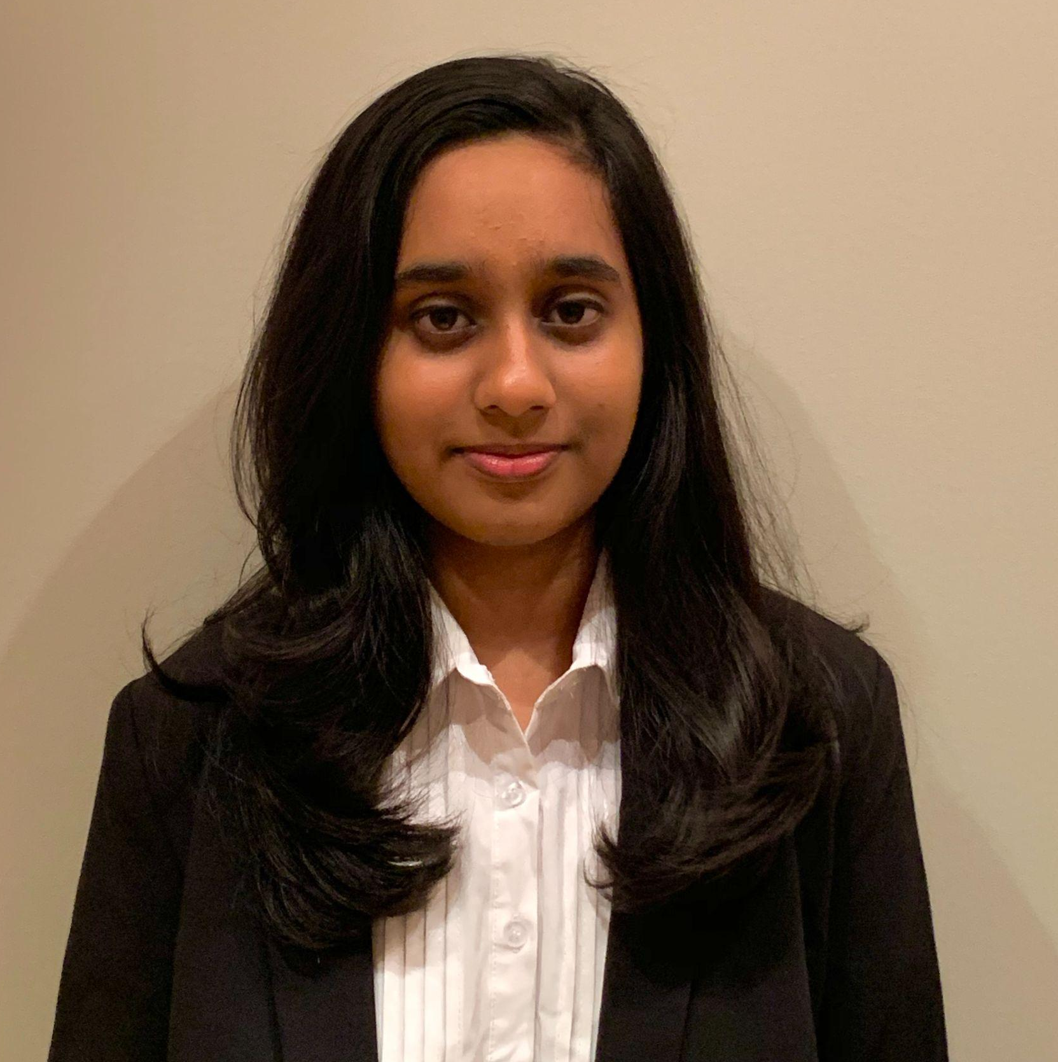
Introduction
Aishee Mondal
Senior in Computer Engineering
Jeep Kaewla
Senior in Computer Engineering
Sanjana Pingali
Senior in Computer Engineering
ELECTRICAL & COMPUTER ENGINEERING
GRAINGER ENGINEERING

Slide 3
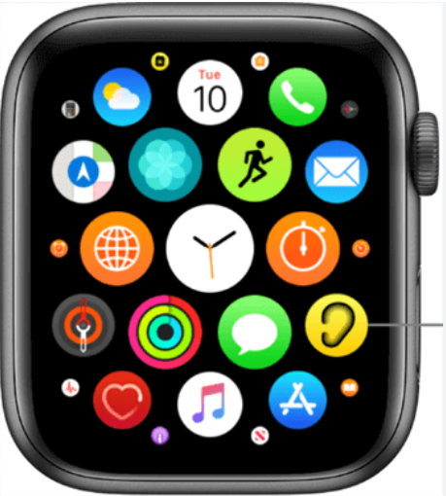
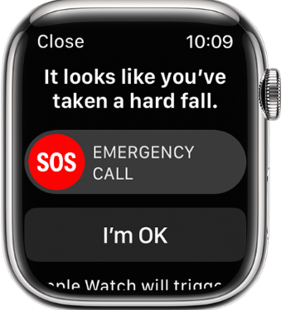
Introduction
Problem
Older people struggle to communicate health issues, lacking intuitive tech.
No cost effective solutions for monitoring in Elderly Homes and Assisted Living Centers.
Lack of centralized aspect in Smart Health monitoring.
Lack of emergency alerts/notifications sent to a central system.
ELECTRICAL & COMPUTER ENGINEERING
GRAINGER ENGINEERING

Slide 4
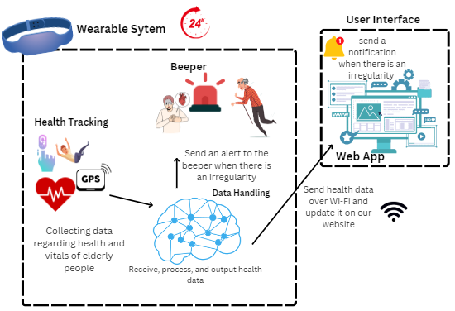
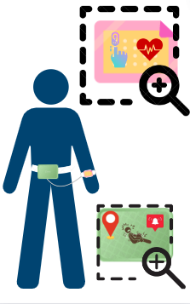
Introduction
Solution
Cost Effective and innovative solution ($56.73 per node)
Centralized, continuous monitoring with the web app.
Fast assistance with alarm and notification on app.
Intuitive to use and easy to wear as a belt and wrist band.
ELECTRICAL & COMPUTER ENGINEERING
GRAINGER ENGINEERING

Slide 5
Objectives
ELECTRICAL & COMPUTER ENGINEERING
GRAINGER ENGINEERING

Slide 6
Objective
High Level Requirement 1
This device can monitor heart rate, blood oxygen level, GPS location, and fall detection of the person and enables the staff to view these results through the web application within 90 seconds ± 30 seconds of measurement.
ELECTRICAL & COMPUTER ENGINEERING
GRAINGER ENGINEERING

Slide 7
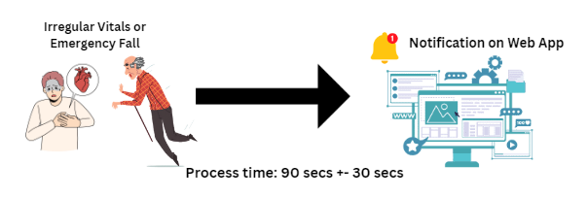
Objective
High Level Requirement 2
A notification is sent to the web application within 90 seconds ± 30 seconds when an irregularity is observed for a specific elderly person. These irregularities include the following: The heart rate is less than 40 BPM or greater than 150 BPM, the blood oxygen level is less than 96%, or a fall is detected, and the person is immobile for more than 30 seconds.
ELECTRICAL & COMPUTER ENGINEERING
GRAINGER ENGINEERING

Slide 8
Objective
High Level Requirement 3
The beeper on the belt emits an alert to attract immediate attention within 30 seconds ± 10 seconds of an irregularity (as defined above in the first high-level requirement) being detected.
ELECTRICAL & COMPUTER ENGINEERING
GRAINGER ENGINEERING

Slide 9
Design
ELECTRICAL & COMPUTER ENGINEERING
GRAINGER ENGINEERING

Slide 10
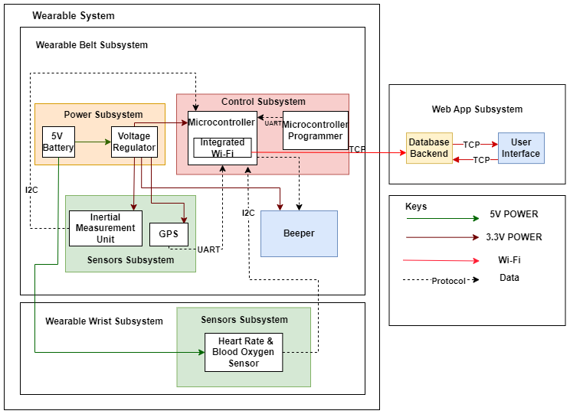
Design
Block Diagram
ELECTRICAL & COMPUTER ENGINEERING
GRAINGER ENGINEERING

Slide 11
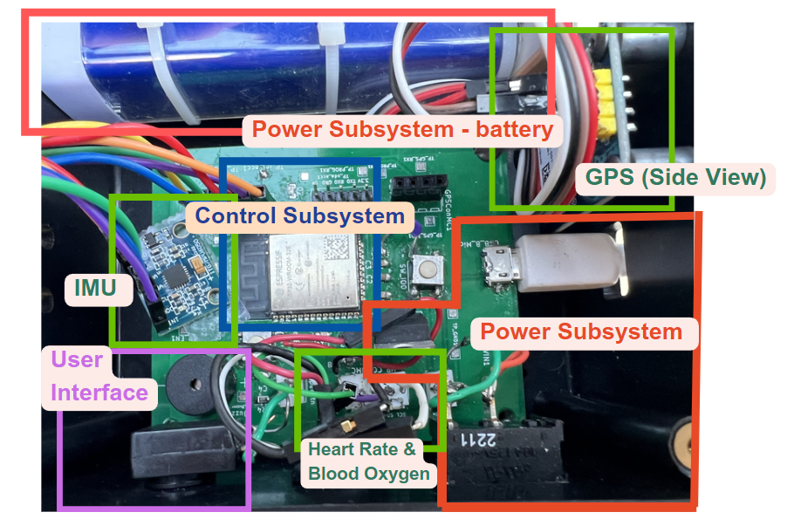
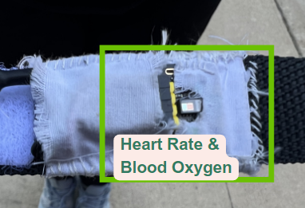
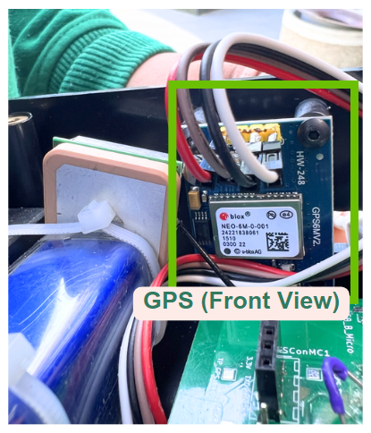
Design
ELECTRICAL & COMPUTER ENGINEERING
GRAINGER ENGINEERING

Slide 12
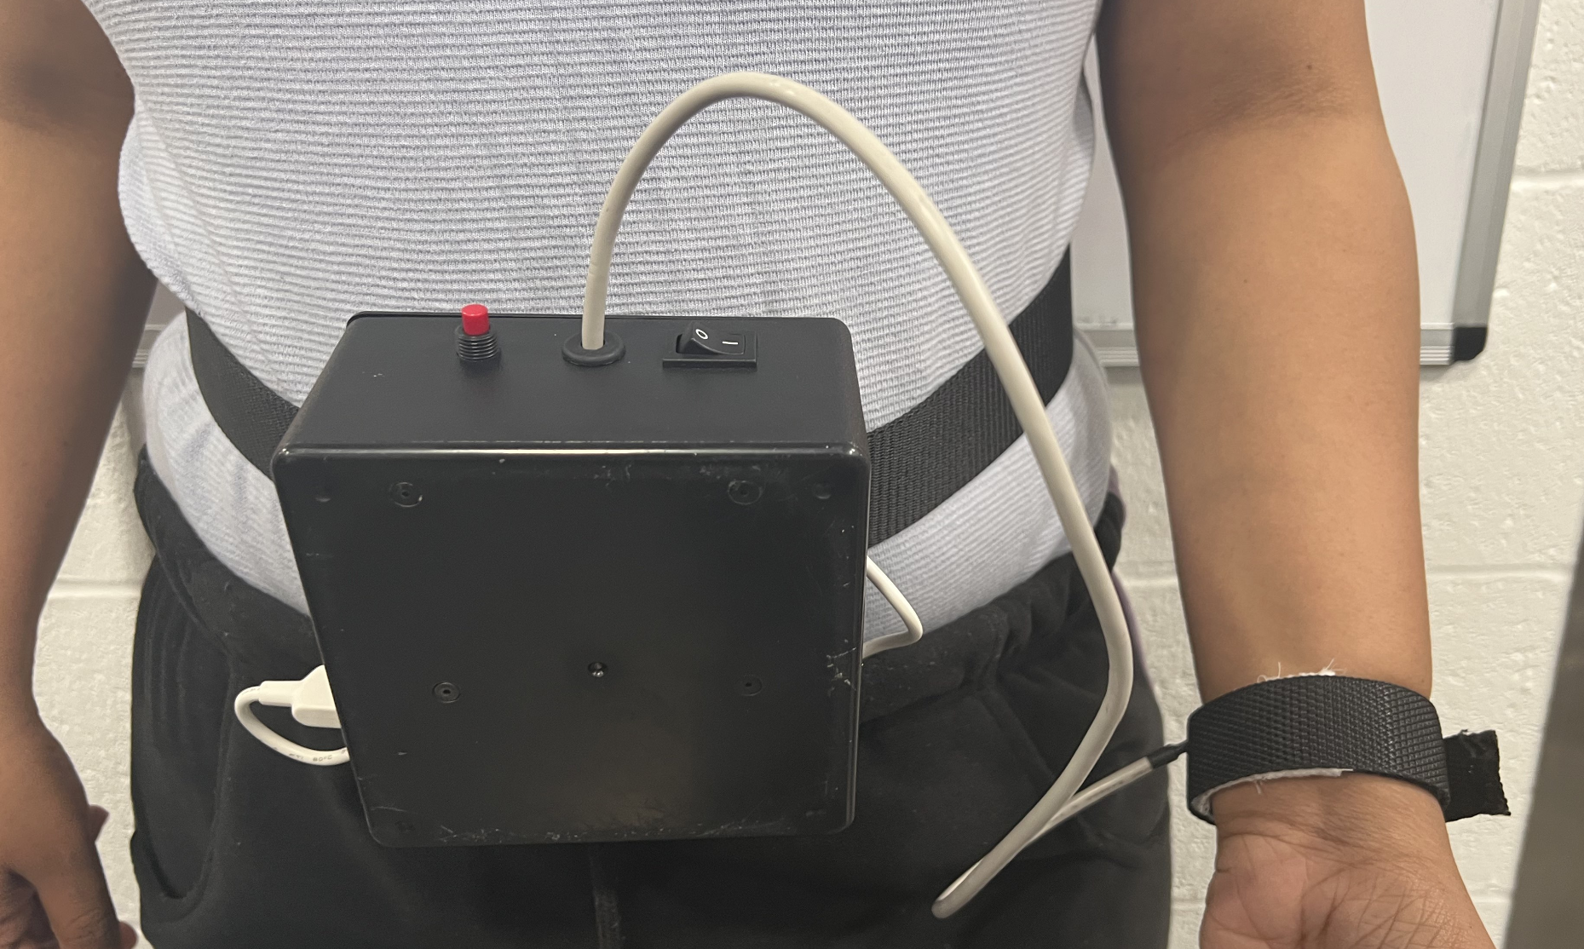
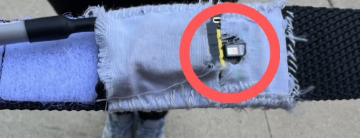
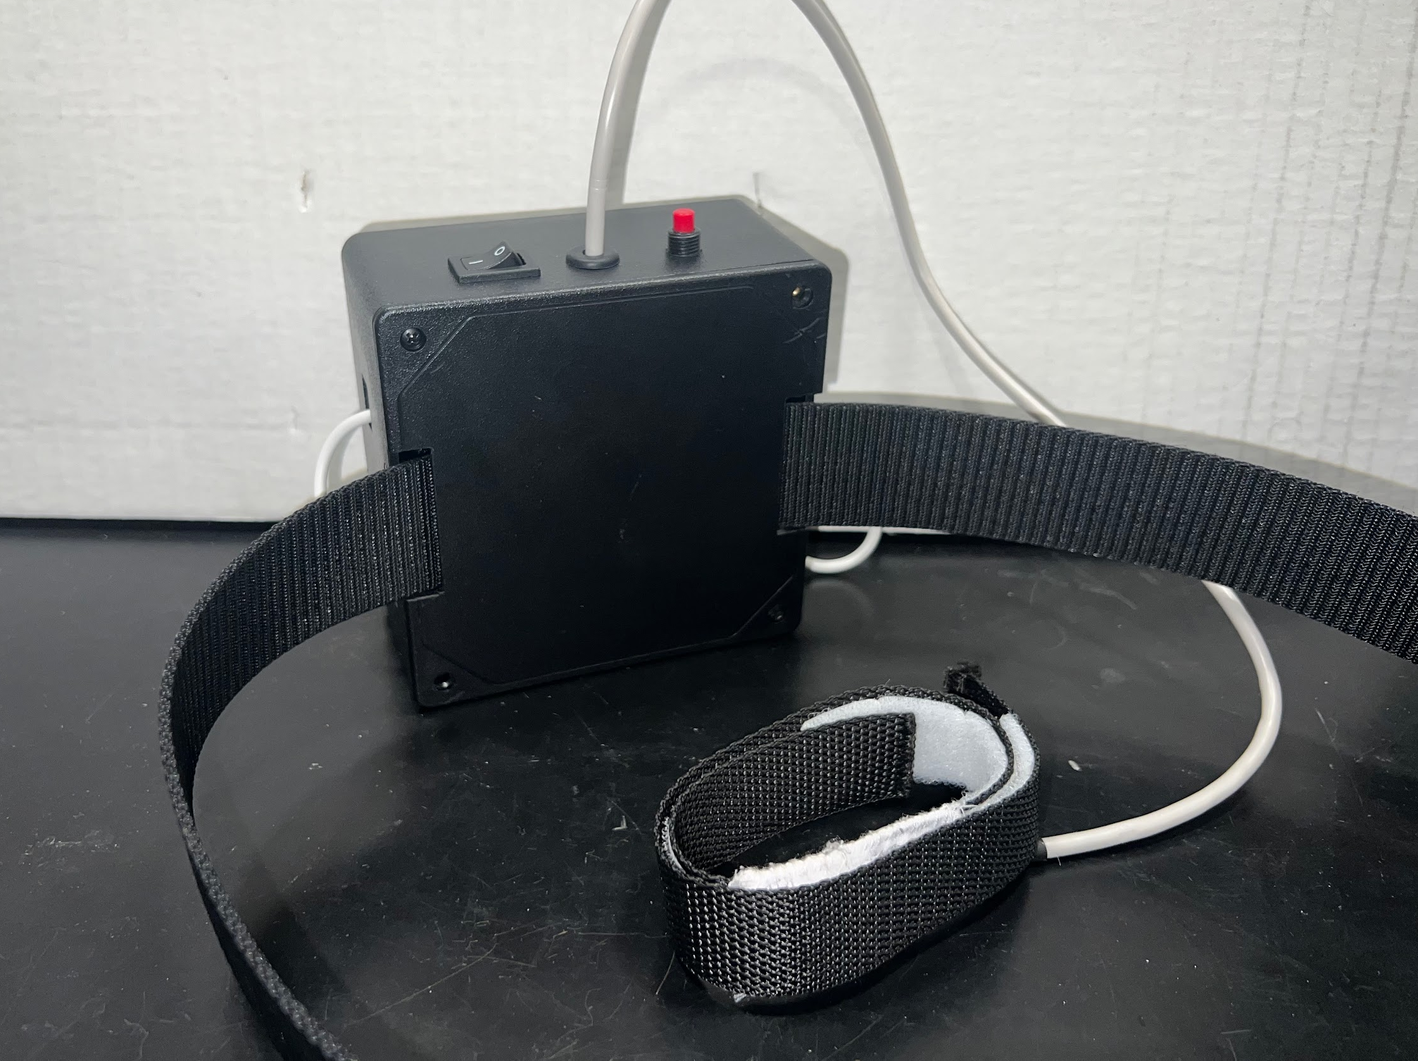
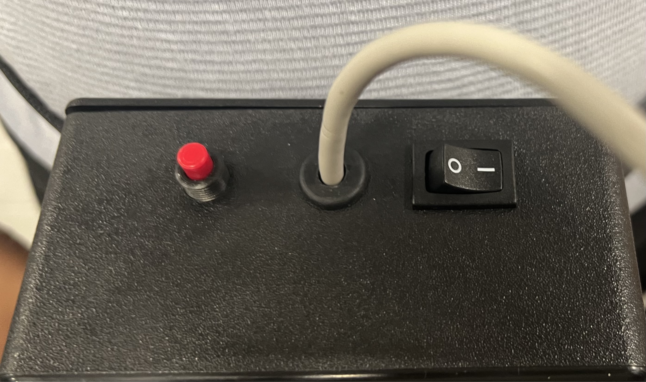
Design
Physical Design
Worn Device
Enclosed Heart Rate Sensor
Back View
Side View
ELECTRICAL & COMPUTER ENGINEERING
GRAINGER ENGINEERING

Slide 13
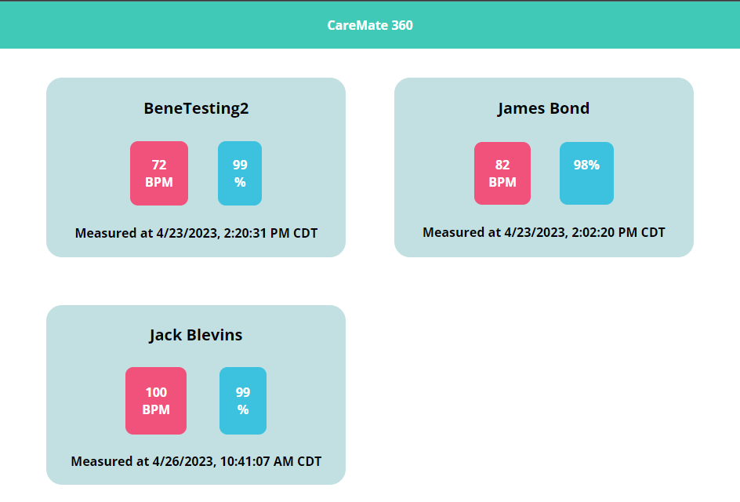
Design
Web Application Interface - Centralized Monitoring
ELECTRICAL & COMPUTER ENGINEERING
GRAINGER ENGINEERING

Slide 14
Design
Web Application Interface
-
Health Trends
ELECTRICAL & COMPUTER ENGINEERING
GRAINGER ENGINEERING

Slide 15
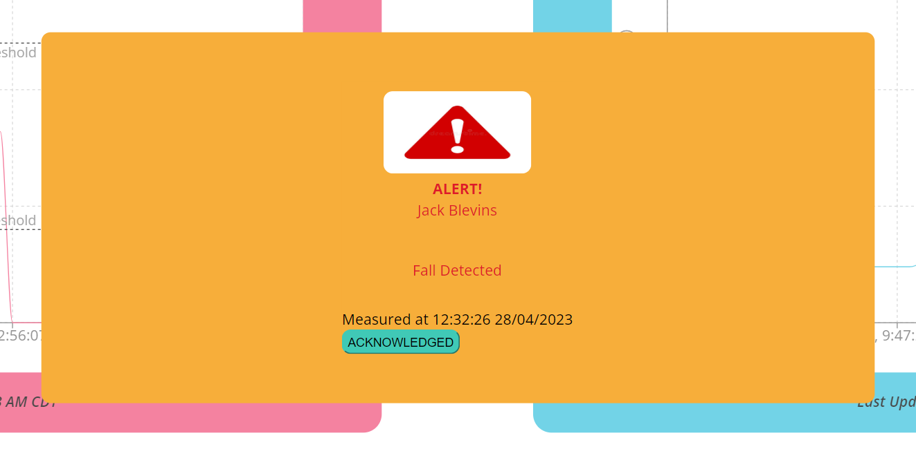
Design
Web Application Interface - Notification System
ELECTRICAL & COMPUTER ENGINEERING
GRAINGER ENGINEERING

Slide 16
Design
Demonstration Video
ELECTRICAL & COMPUTER ENGINEERING
GRAINGER ENGINEERING

Slide 17
Sensors Subsystem
ELECTRICAL & COMPUTER ENGINEERING
GRAINGER ENGINEERING

Slide 18
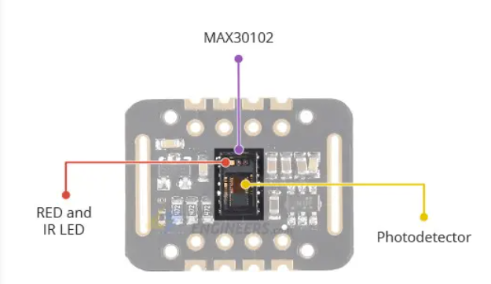
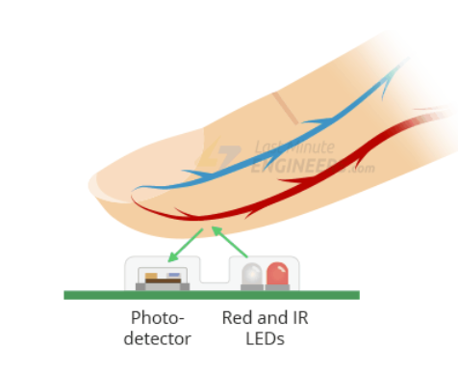
Sensor Subsystem
Heart Rate Monitor and Blood Oxygen
ELECTRICAL & COMPUTER ENGINEERING
GRAINGER ENGINEERING

Slide 19
Sensor Subsystem
Output and Results
The MAX30102 will collect reflected InfraRed and Red LED values.
The photodetector uses this to determine the how oxygenated hemoglobin is and the amount of oxygen absorbed by the blood.
These values are converted into Beats per minute and blood oxygen percentages.
Compared with heart rate and blood oxygen readings from oximeter to measure accuracy.
ELECTRICAL & COMPUTER ENGINEERING
GRAINGER ENGINEERING

Slide 20
Sensor Subsystem
Heart Rate and Blood Oxygen
ELECTRICAL & COMPUTER ENGINEERING
GRAINGER ENGINEERING

Slide 21
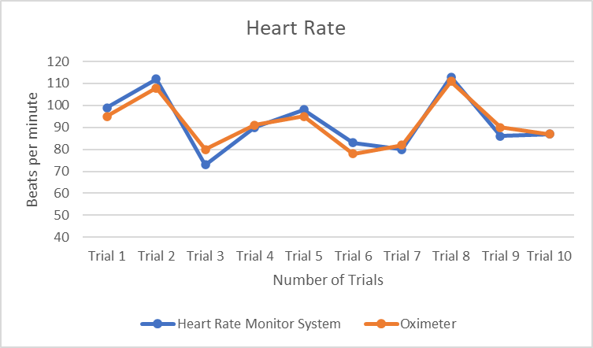
Sensor Subsystem
Requirement and Verification
Requirement | Verification
Provide a heart rate measurement with 90% accuracy compared to an Oximeter | The current heart rate displayed is compared to the oximeter.
Trial | 1 | 2 | 3 | 4 | 5 | 6 | 7 | 8 | 9 | 10
Error(%) | 4.211 | 3.704 | 8.75 | 1.099 | 3.158 | 6.410 | 2.439 | 1.802 | 4.444 | 0
ELECTRICAL & COMPUTER ENGINEERING
GRAINGER ENGINEERING

Slide 22
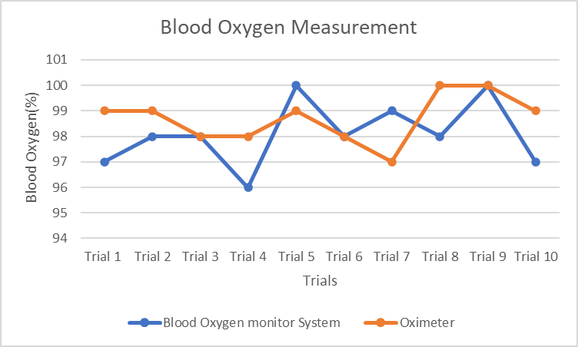
Sensor Subsystem
Requirement and Verification
Requirement | Verification
Provide an accurate ± 2% oxygen level compared to an Oximeter | The current oxygen level displayed is compared to the oximeter.
ELECTRICAL & COMPUTER ENGINEERING
GRAINGER ENGINEERING

Slide 23
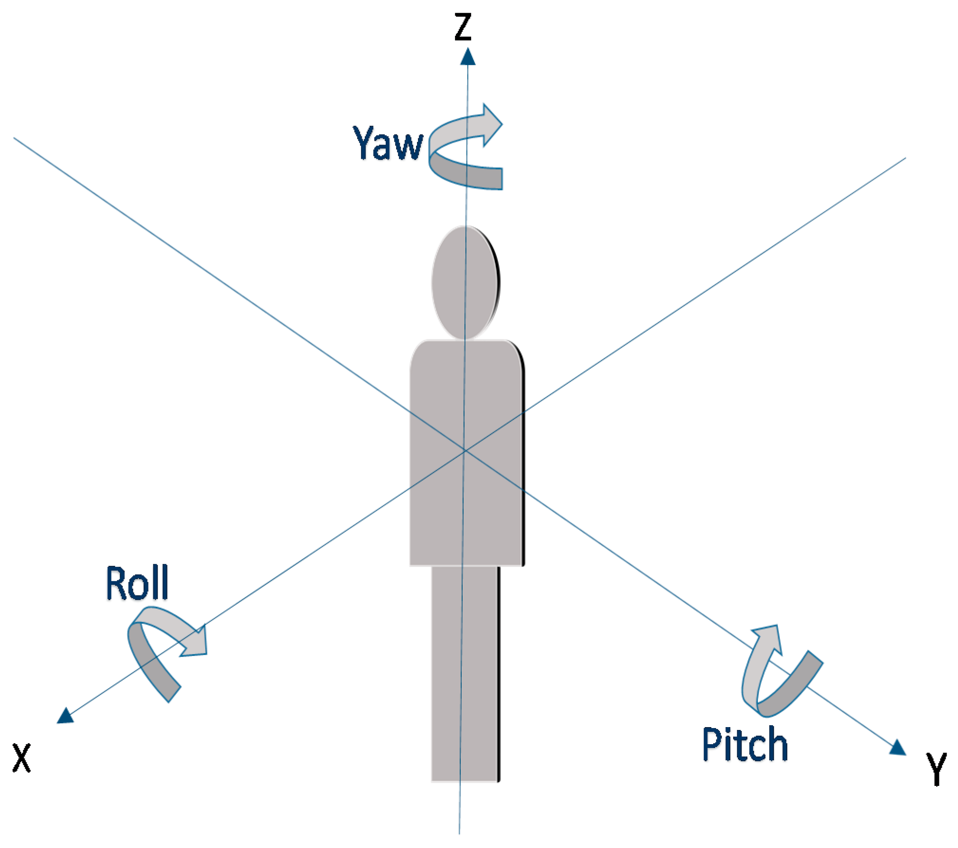
Sensor Subsystem
Inertial Measurement Unit (IMU)
Collect the data we need for our fall detection algorithm
Use I2C protocol
Inputs to the Fall Detection Algorithm
Root mean square acceleration
Roll and Pitch Angles
ELECTRICAL & COMPUTER ENGINEERING
GRAINGER ENGINEERING

Slide 24
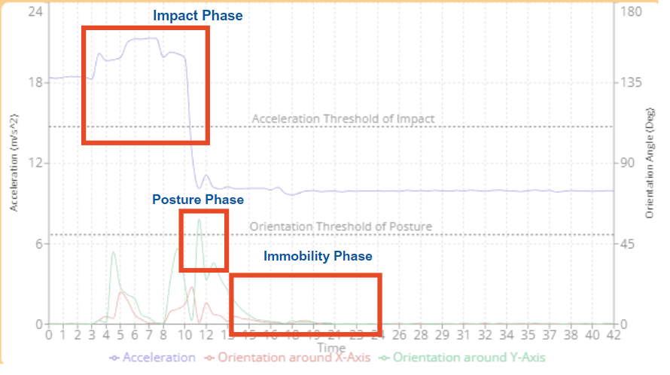
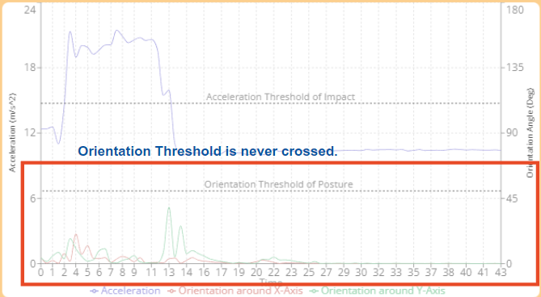
Sensor Subsystem : Inertial Measurement Unit
Falling
Fall Detection Algorithm
For a fall to be detected these conditions must be true:
Detects a sudden change in the root mean square of magnitude greater than 1.5 * Gravity ~14.715 m/s^2 (Impact Phase)
Followed by a sudden change in orientation in pitch or yaw greater than 50 degrees in less than 2 seconds (Posture Phase)
Needed to differentiate a fall from jumping and running
Remains immobile for 30 seconds (Immobility Phase)
Jumping
ELECTRICAL & COMPUTER ENGINEERING
GRAINGER ENGINEERING

Slide 25
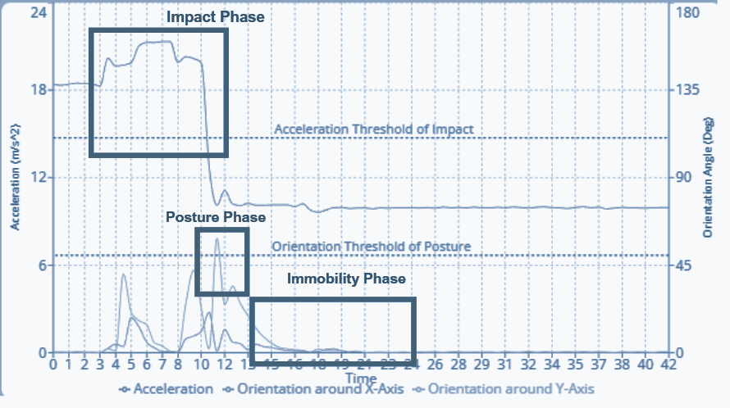
Sensor Subsystem : Inertial Measurement Unit
Fall Detection Algorithm - Falling Graph
ELECTRICAL & COMPUTER ENGINEERING
GRAINGER ENGINEERING

Slide 26
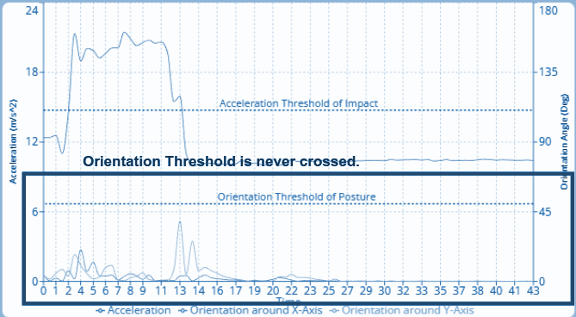
Sensor Subsystem : Inertial Measurement Unit
Fall Detection Algorithm - Jumping Graph
ELECTRICAL & COMPUTER ENGINEERING
GRAINGER ENGINEERING

Slide 27
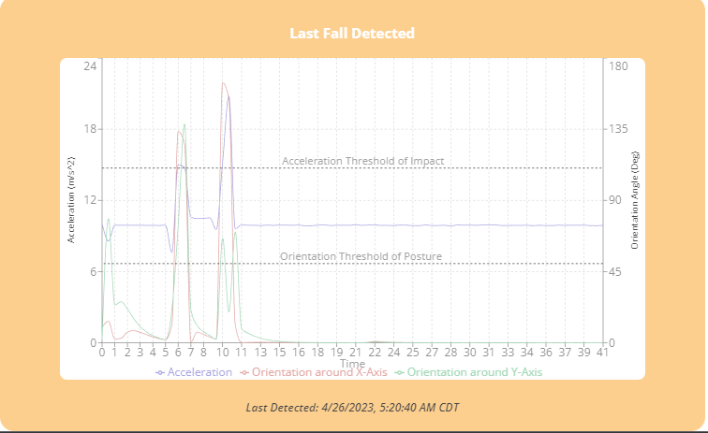
Sensor Subsystem : Inertial Measurement Unit
Output
Stored the last 80 entries before the fall occurred to be displayed on the graph in our web application
ELECTRICAL & COMPUTER ENGINEERING
GRAINGER ENGINEERING

Slide 28
Sensor Subsystem : Inertial Measurement Unit
Requirement and Verification
Results:
10 successes in 12 trials
83.33% accuracy
Requirement | Verification
Detect if a person has fallen with 70% accuracy. | Pretends to fall down on a soft surface (falls forward, right, left, and backward directions 3 times each) and remains immobile for 30 seconds and see if a notification has popped up on the web application. Beeper should also emit a sound.
Key
F: Forward
B: Backward
L: Left
R: Right
 | Trial 1 | Trial 2 | Trial 3 | Trial4 | Trial 5 | Trial 6 | Trial 7 | Trial 8 | Trial9 | Trial 10 | Trial 11 | Trial12
Fall Direction | F | F | F | B | B | B | L | L | L | R | R | R
Fall Detected | Yes | Yes | No | Yes | Yes | Yes | Yes | No | Yes | Yes | Yes | Yes
ELECTRICAL & COMPUTER ENGINEERING
GRAINGER ENGINEERING

Slide 29
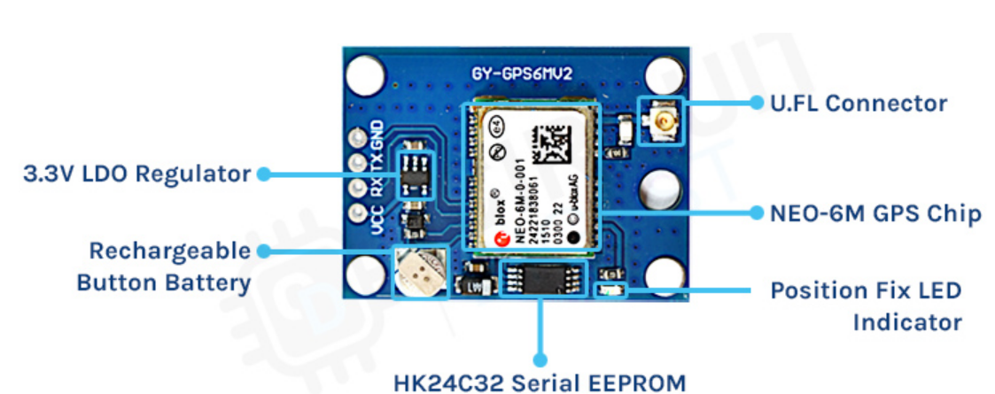
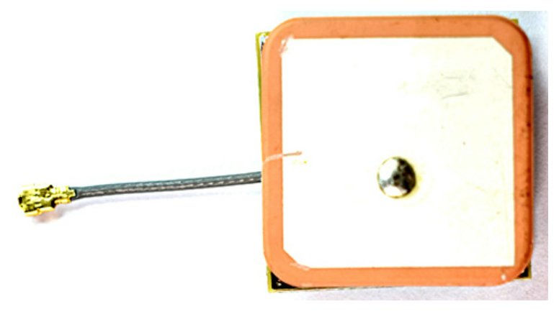
Sensor Subsystem
GPS
NEO-6MV2 GPS chip with high accuracy of 2.5m
Voltage rating of 2.5-3.6V (supplied with 3.3V)
NEO6M chip tracks 22 satellite over 50 channels
Power save mode : 45mA supply current
Ceramic patch antenna connected to GPS (-161dB sensitive antenna)
UART Communication Protocol with the Microcontroller
ELECTRICAL & COMPUTER ENGINEERING
GRAINGER ENGINEERING

Slide 30
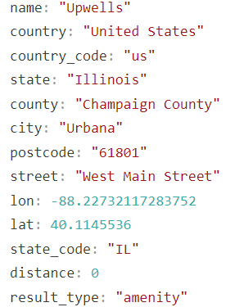
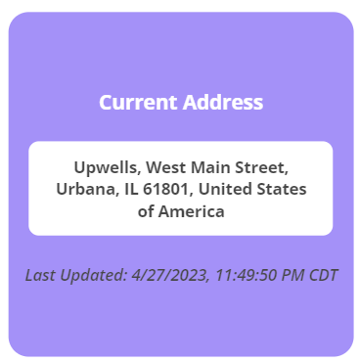
Sensor Subsystem : GPS
GPS
Address displayed on the Web Application
Output from the API on searching with latitude and longitude
ELECTRICAL & COMPUTER ENGINEERING
GRAINGER ENGINEERING

Slide 31
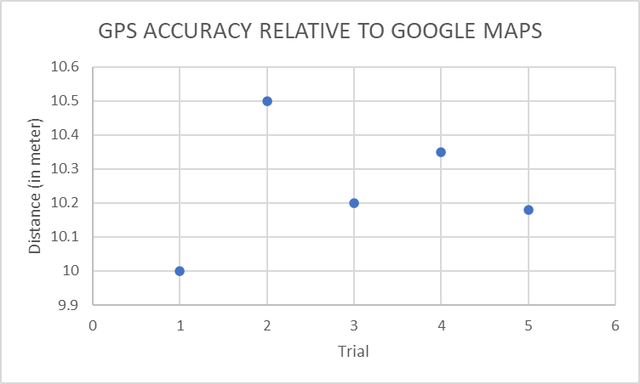
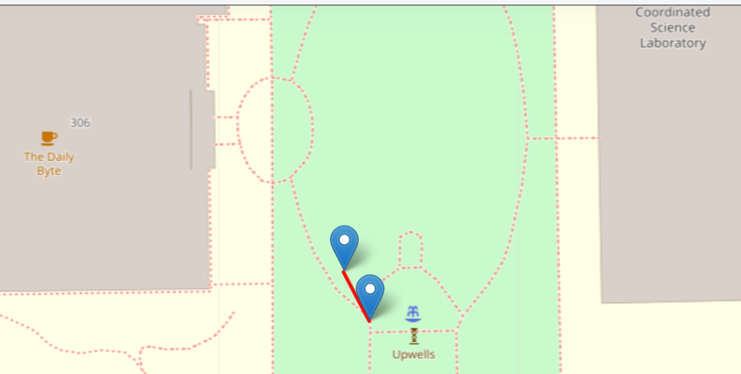
Sensor Subsystem: GPS
Requirement and Verification
Requirement | Verification
Provide the location of where the person is within 20m of the actual location | Collect the latitude and longitude values from the GPS. Check the actual latitude and longitude using Google Maps.Calculate distance between the two.
ELECTRICAL & COMPUTER ENGINEERING
GRAINGER ENGINEERING

Slide 32
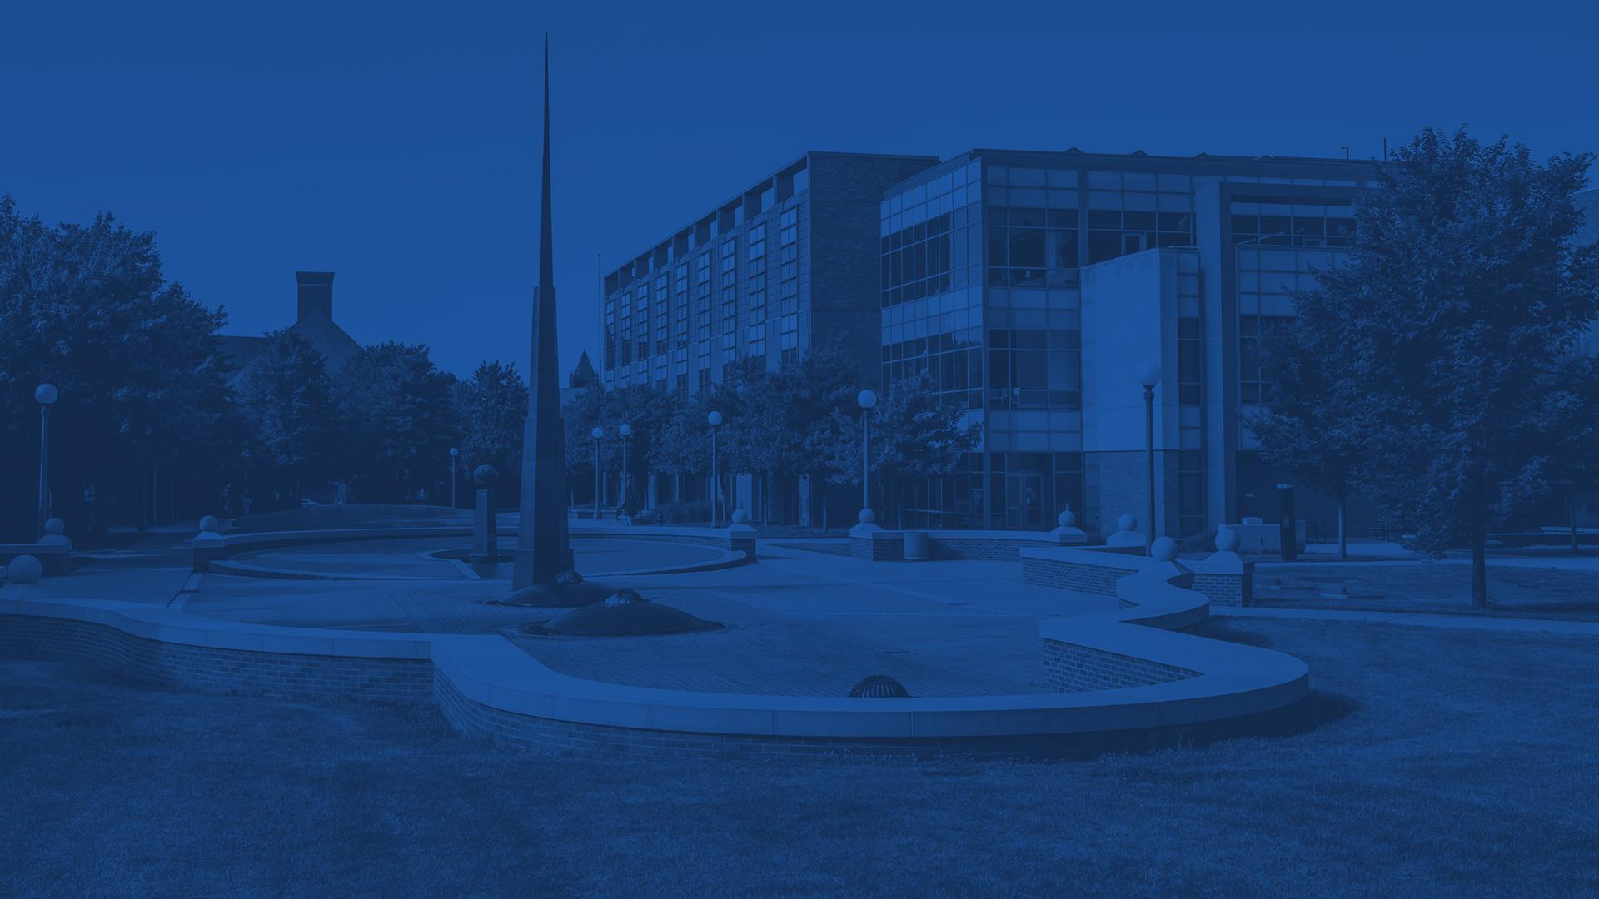
Power Subsystem
ELECTRICAL & COMPUTER ENGINEERING
GRAINGER ENGINEERING

Slide 33
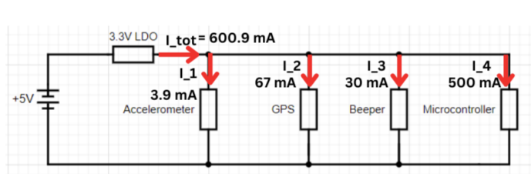
Power Subsystem
Voltage Rating of Components
Inertial Measurement Unit: 3.3V
GPS Module: 3.3V
Beeper: 3.3V
ESP32: 3.3V
Heart Rate and Blood Oxygen Module: 5V (not shown since require 5V - no regulator needed)
Dropout Voltage
Chosen 5V battery to ensure voltage drop to 3.3V is more than minimum drop out of 1.2V and not too high to overheat.
ELECTRICAL & COMPUTER ENGINEERING
GRAINGER ENGINEERING

Slide 34
Power Subsystem
Thermal Resistance
Chosen the LD1117V33 TO220 component
low thermal resistance to reduce the increase in temperature per Watt
ELECTRICAL & COMPUTER ENGINEERING
GRAINGER ENGINEERING

Slide 35
Control Subsystem
ELECTRICAL & COMPUTER ENGINEERING
GRAINGER ENGINEERING

Slide 36
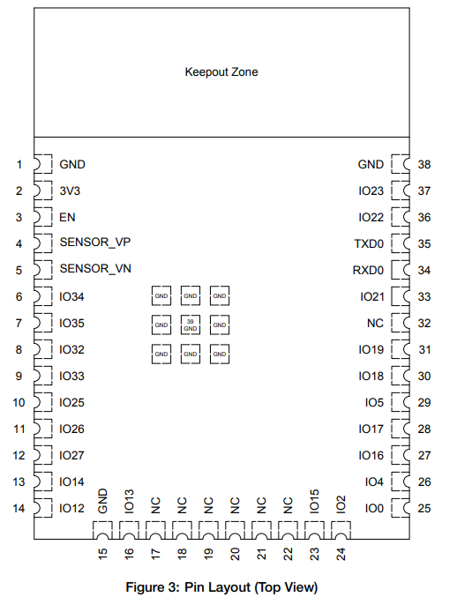
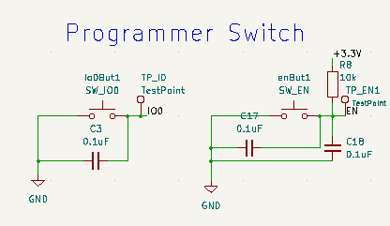
Control Subsystem
Processing and Serialization of Data
ESP32- WROOM-32E microcontroller module
WiFi enabled within Microcontroller
Programming logic
Button connected to IO0 (Boot) active low
Button connected to EN (Enable) active low
ELECTRICAL & COMPUTER ENGINEERING
GRAINGER ENGINEERING

Slide 37
Control Subsystem
Sending Data over WiFi to Database
After data from sensors is collected, serialize data as JSON
Create an HTTP request that is able to POST this data as JSON body to backend
Updates the Database and the Frontend
ELECTRICAL & COMPUTER ENGINEERING
GRAINGER ENGINEERING

Slide 38
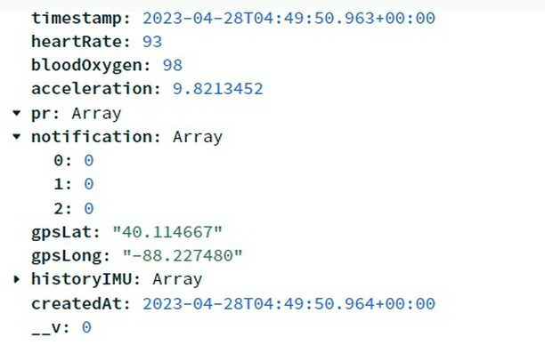
Control Subsystem
Requirement and Verification
Requirement | Verification
Process all sensor data in JSON format to MongoDB database | The MongoDB database should have a new entry that has all the fields with values in the correct format.
Output of newest entry in Mongo Database
ELECTRICAL & COMPUTER ENGINEERING
GRAINGER ENGINEERING

Slide 39
Backend and Database
Subsystem
ELECTRICAL & COMPUTER ENGINEERING
GRAINGER ENGINEERING

Slide 40
Backend and Database Subsystem
Backend
GET Request
Used for obtaining data to be displayed on the frontend web application
Supports WHERE, SORT, LIMIT, SELECT operations
POST Request
Used for posting data from the microcontroller to the web application
ELECTRICAL & COMPUTER ENGINEERING
GRAINGER ENGINEERING

Slide 41
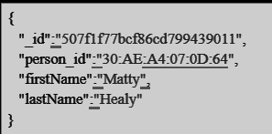
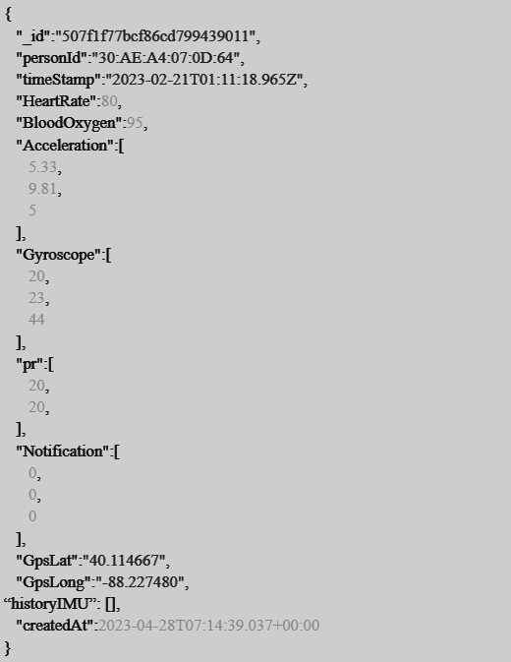
Backend and Database Subsystem
Database
Person Collection
Stores personal information of the elderly
Sensor Collection
Stores measured health data of an elderly at the time shown in timestamp
ELECTRICAL & COMPUTER ENGINEERING
GRAINGER ENGINEERING

Slide 42
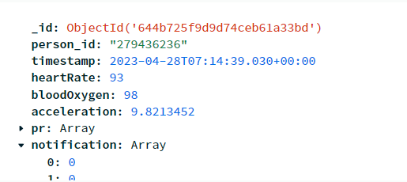
Backend and Database Subsystem
Requirement and Verification
Document stored in MongoDB to be retrieved by _id
Verification
ELECTRICAL & COMPUTER ENGINEERING
GRAINGER ENGINEERING

Slide 43
Backend and Database Subsystem
Requirement and Verification
Sending POST Request
Verification
ELECTRICAL & COMPUTER ENGINEERING
GRAINGER ENGINEERING

Slide 44
User Interface
Subsystem
ELECTRICAL & COMPUTER ENGINEERING
GRAINGER ENGINEERING

Slide 45
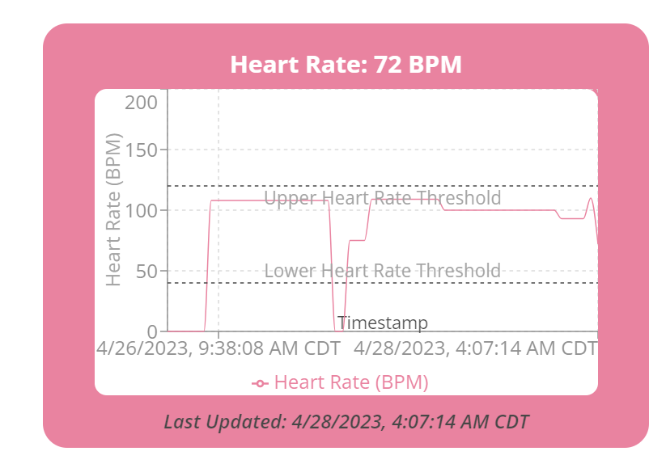
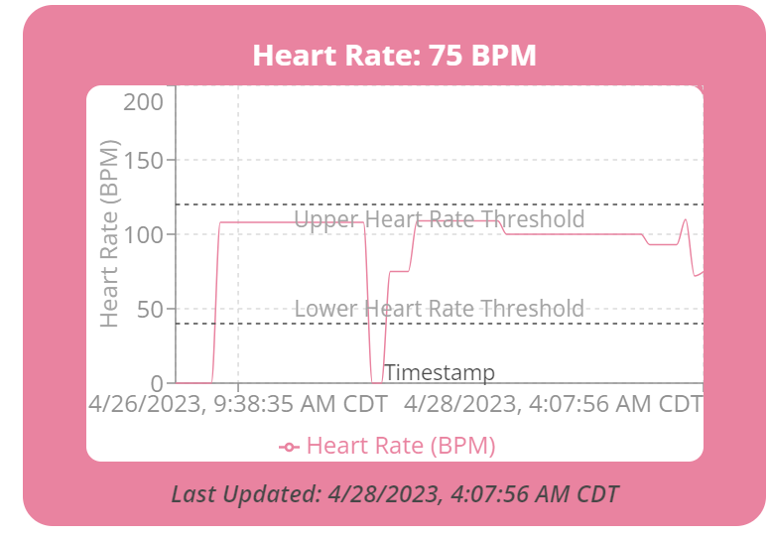
User Interface Subsystem
Web Application Frontend
Requirement and Verification
Requirements | Verification
Display sensor data on the web app within 90 seconds ± 30 seconds after measurements. | The web application shows the sensor data along with the timestamp of measurement.
ELECTRICAL & COMPUTER ENGINEERING
GRAINGER ENGINEERING

Slide 46
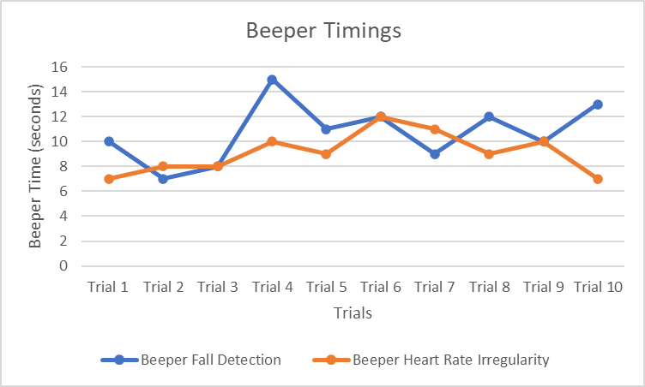
User Interface Subsystem
Beeper
The beeper sounds an alert when an irregularity occurs.
Requirement and Verification
Requirement | Verification
Emits an alarm with a latency of 30 seconds ± 10 seconds in the case of an irregularity as described in the high level requirements. | When an irregularity is been observed, the beeper should emit the alarm within the latency of 30 seconds.
ELECTRICAL & COMPUTER ENGINEERING
GRAINGER ENGINEERING

Slide 47
Successes and Challenges
ELECTRICAL & COMPUTER ENGINEERING
GRAINGER ENGINEERING

Slide 48
Successes
Fast Notification Time
The original high level requirement was to be able to update the web application within 90 seconds ± 30 seconds after measurements.
Able to achieve an average of approximately 32 seconds between update intervals much faster than original expectations.
Trials | Trial 1 | Trial 2 | Trial 3 | Trial 4 | Trial 5 | Trial 6 | Trial 7 | Trial 8 | Trial 9 | Trial 10
Time (seconds) | 31 | 32 | 32 | 33 | 31 | 32 | 32 | 32 | 31 | 32
ELECTRICAL & COMPUTER ENGINEERING
GRAINGER ENGINEERING

Slide 49
Successes
High level requirements work with main PCB
First time designing and making PCB and managed to successfully function as expected
Successfully integrated software with hardware through wireless communication
ELECTRICAL & COMPUTER ENGINEERING
GRAINGER ENGINEERING

Slide 50
Challenges
Integrating Multiple I2C Sensors
Upon integrating sensors, data received only from last initialized I2C device was received.
Engineering Reason
Problem: I2C devices were sharing the same address.
Solution: changing the address pin to be high for the Inertial Measurement Unit (other I2C device) on the PCB trace
ELECTRICAL & COMPUTER ENGINEERING
GRAINGER ENGINEERING

Slide 51
Challenges
Programmer Button Logic
Difficulty understanding how to program ESP32-WROOM-32E in custom PCB.
Could not find a programmer that would put it on boot mode directly.
Engineering Reason
Added boot and reset buttons to the printed circuit board
Setting IO0 (low) and then EN (low) on the microcontroller while the code is uploading simulates this logic to switch on in Boot Mode.
ELECTRICAL & COMPUTER ENGINEERING
GRAINGER ENGINEERING

Slide 52
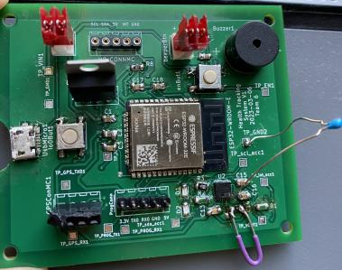
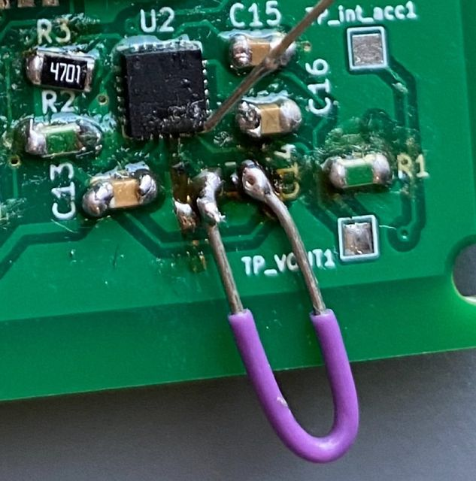
Challenges
Unable to Integrate IMU chip on Main PCB
We integrated our IMU sensor on the PCB
Had a wrong capacitor connected to a pin on IMU
Engineering Reason : resulted in a burnt trace and no possible connection
ELECTRICAL & COMPUTER ENGINEERING
GRAINGER ENGINEERING

Slide 53
Conclusion
ELECTRICAL & COMPUTER ENGINEERING
GRAINGER ENGINEERING

Slide 54
Conclusion
What did you learn ?
Computer Aided Design
Designing project end to end
Printed Circuit Board Design
Soldering, Reflow Considerations
Power Source Considerations
Choosing Voltages and Regulators
Increased knowledge of sensors used and microcontrollers
Possible Redesign Scope
Vary Heart Rate, Blood Oxygen and Fall detection thresholds based on person
ELECTRICAL & COMPUTER ENGINEERING
GRAINGER ENGINEERING

Slide 55
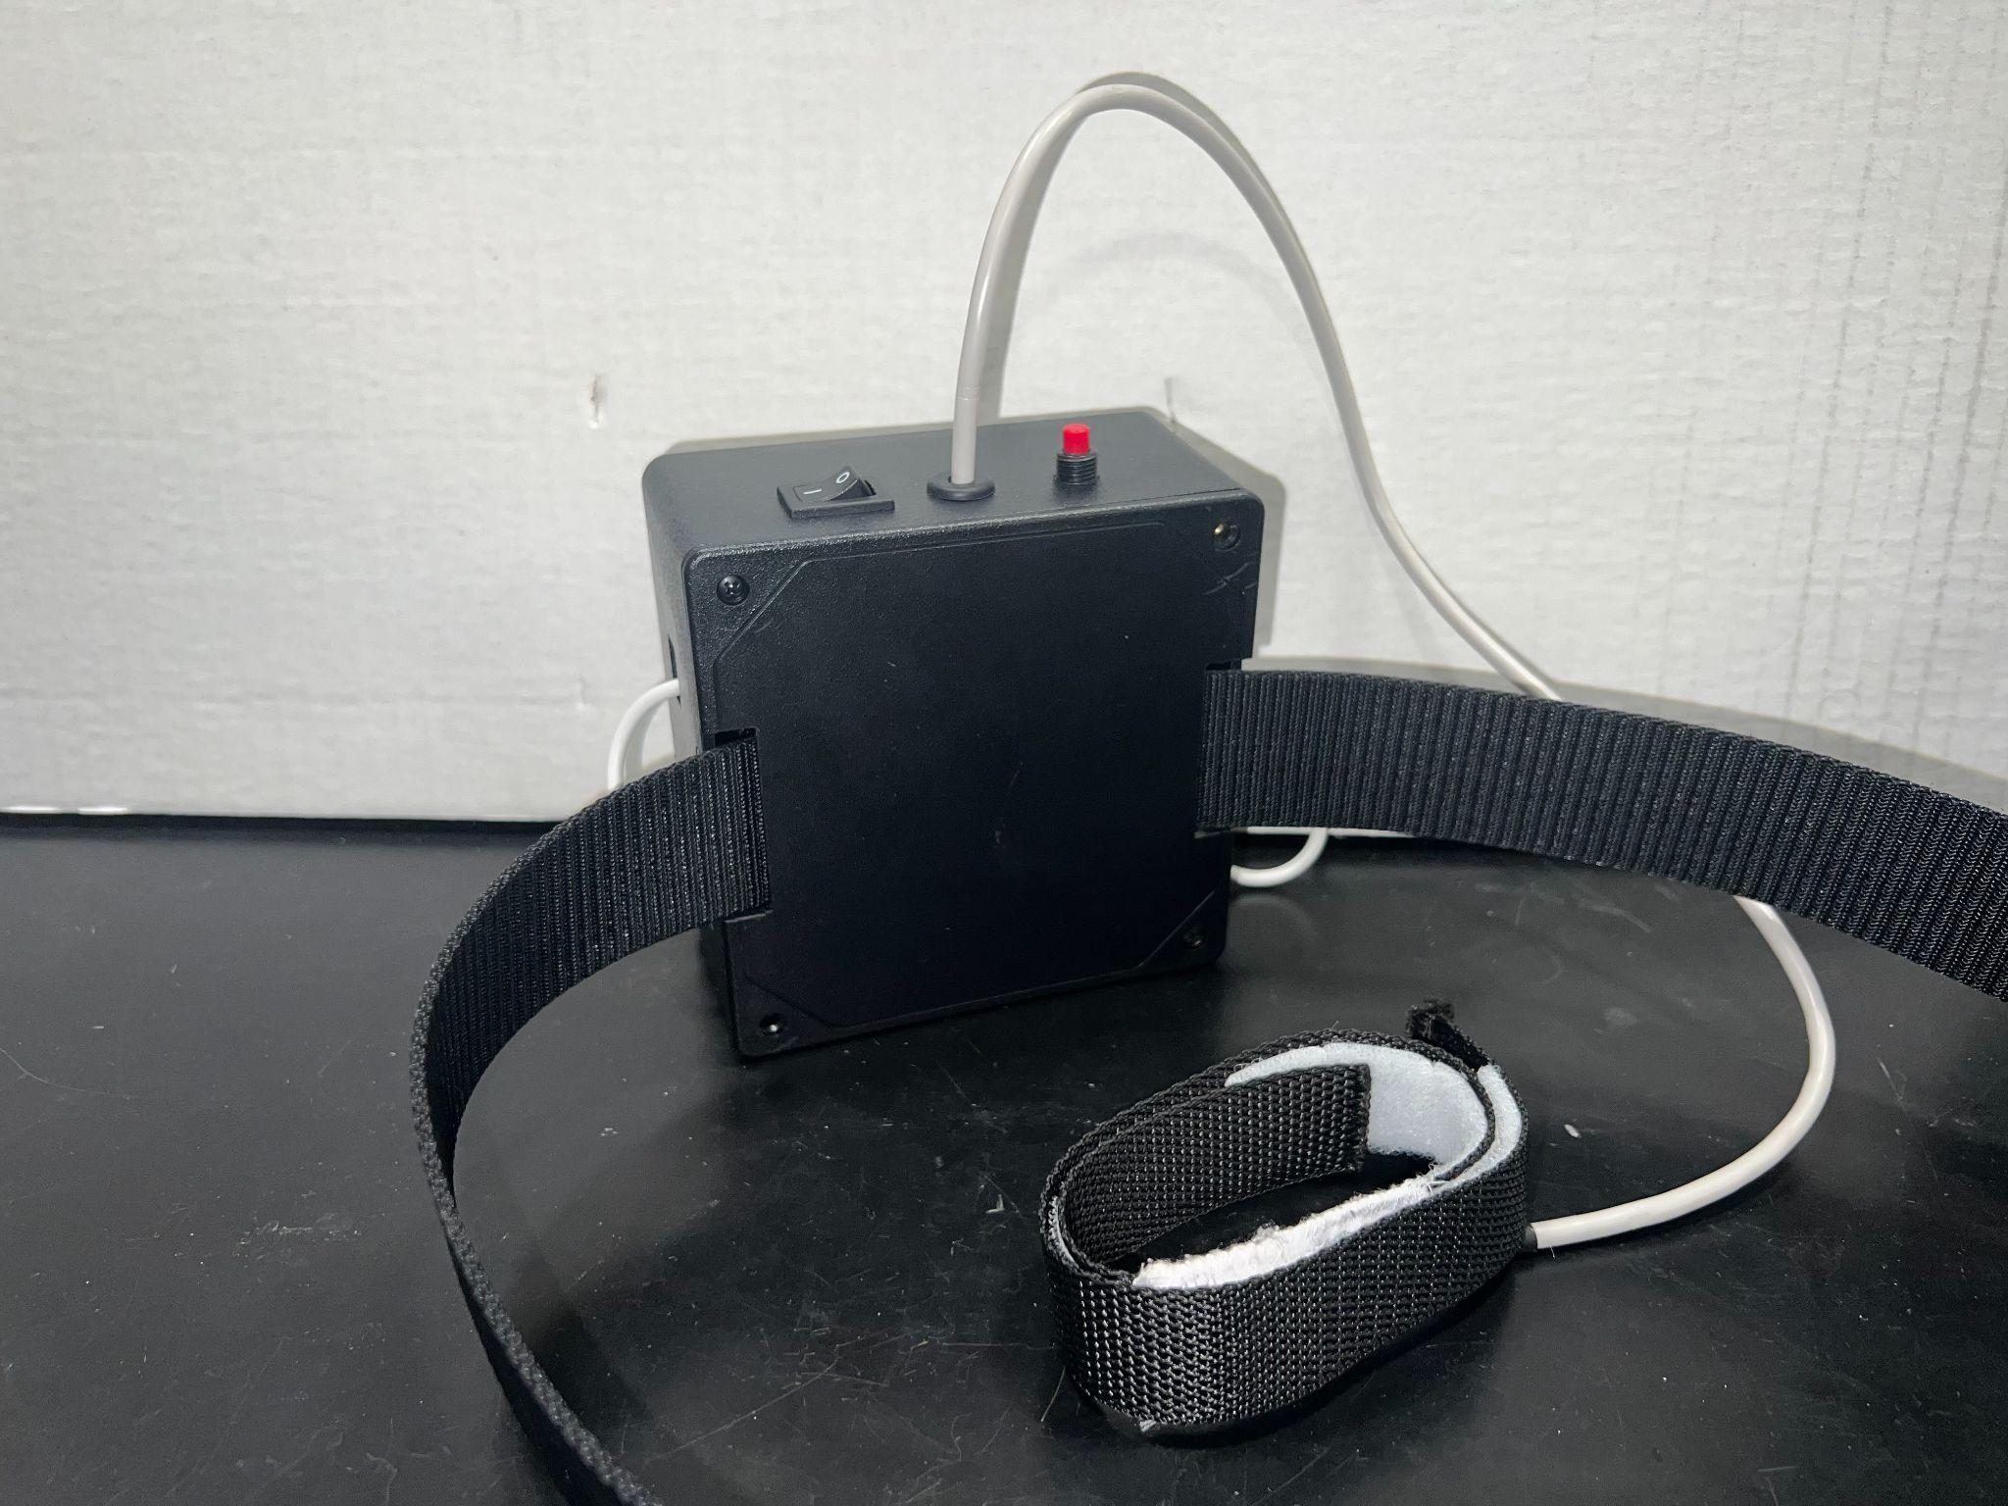
Conclusion
Ethics and Safety
Related to IEEE code 7.8.II.9, we ensure that our device does not harm individuals.
The webbing used in our heart sensor module ensures that no harmful components are in contact with skin.
no wires are dangling and no power connections are in direct contact with skin.
ELECTRICAL & COMPUTER ENGINEERING
GRAINGER ENGINEERING

Slide 56
Conclusion
Further Work
More robust box and connections
More data analysis displayed on the web application
Use Machine Learning models to more accurately predict fall detection, and other underlying health problems.
ELECTRICAL & COMPUTER ENGINEERING
GRAINGER ENGINEERING

Slide 57
Thank You !
Any Questions?
ELECTRICAL & COMPUTER ENGINEERING
GRAINGER ENGINEERING

