Slide 1
The Blitz Board
Team 66: Owen Shin, Nick Bingenheimer, James Tang
April 27th, 2023
Notes:
https://courses.engr.illinois.edu/ece445/guidelines/final-presentation.asp

Slide 2
Objective
ELECTRICAL & COMPUTER ENGINEERING
GRAINGER ENGINEERING

Slide 3
Objective
What problem are we solving?
Developing a way play chess against a computer at a physical interface
How was this going to be solved?
Dual-axis motor system with three motors to move pieces
Electromagnet to grab metallic pieces
Reed Switches for sensing human-player pieces
PCB with microcontroller for control of motors, a chess clock, reading data from reed switches
ELECTRICAL & COMPUTER ENGINEERING
GRAINGER ENGINEERING

Slide 4
Expectation
ELECTRICAL & COMPUTER ENGINEERING
GRAINGER ENGINEERING

Slide 5
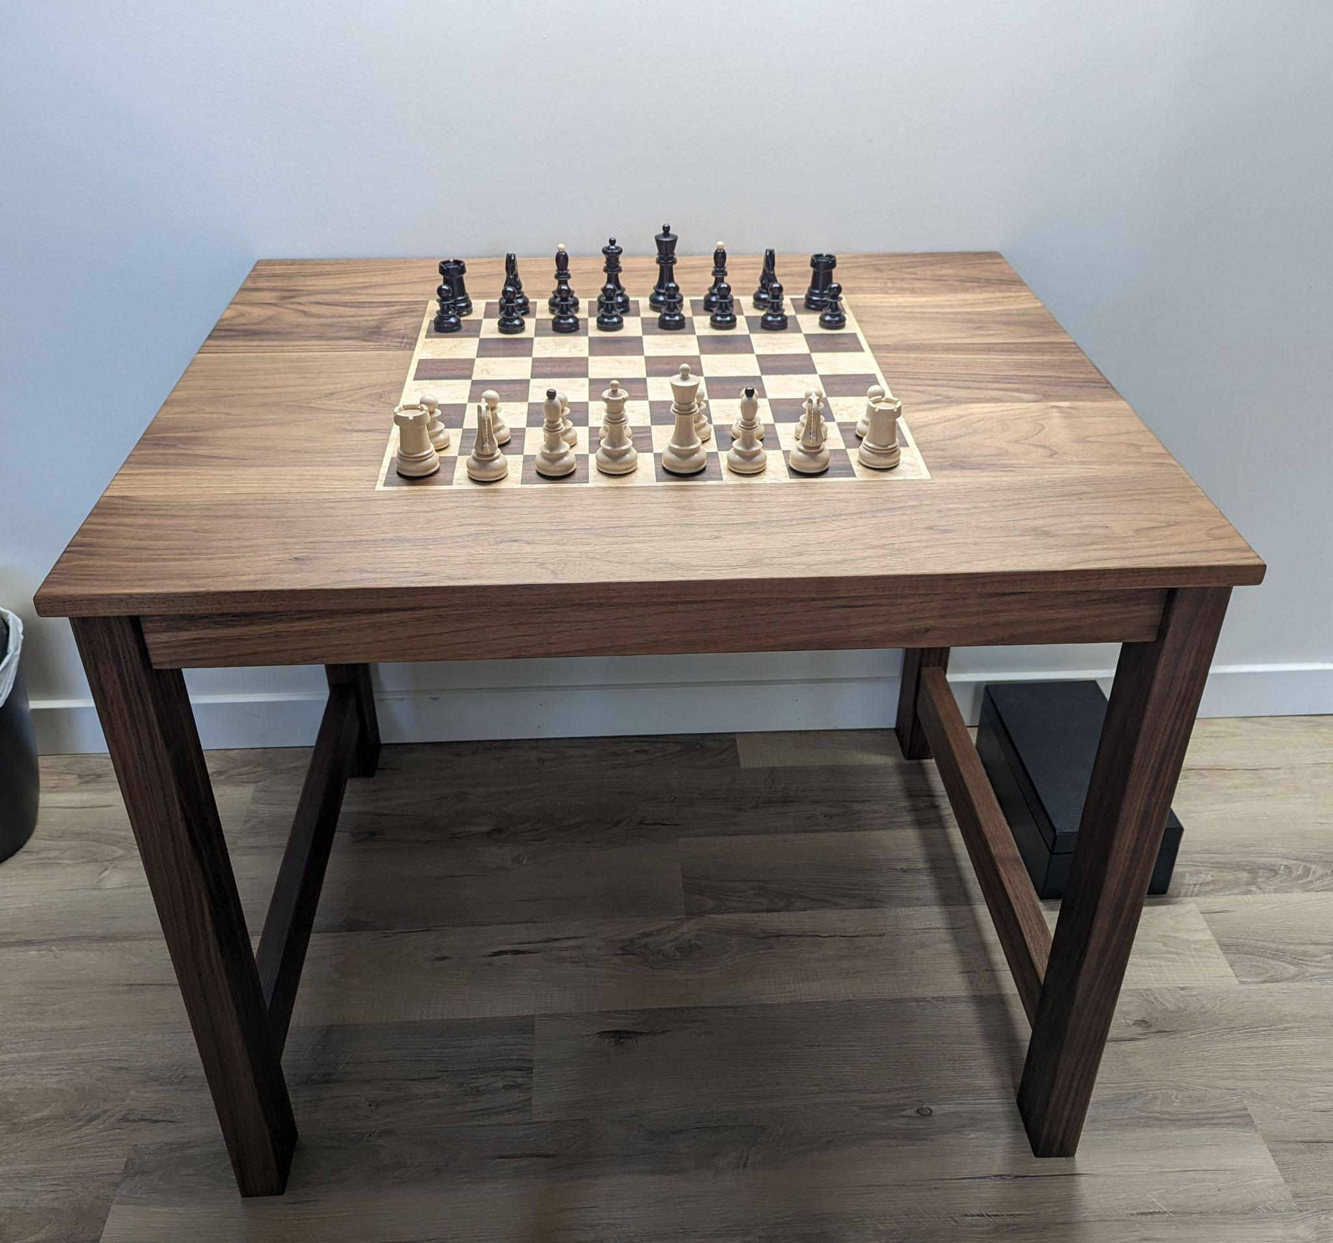
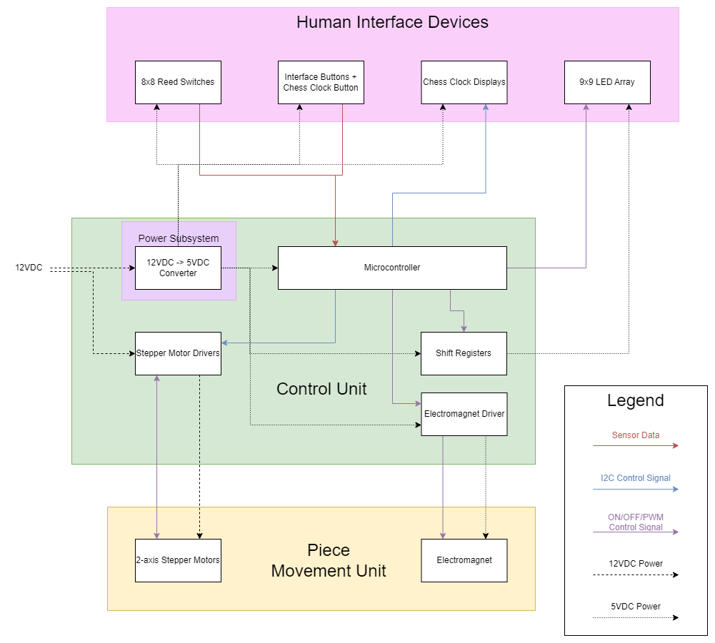
Visual aid of initial expected design
Initial block diagram
ELECTRICAL & COMPUTER ENGINEERING
GRAINGER ENGINEERING
Notes:
We can quickly cover some of the biggest parts of our ambitious project and mostly highlight the block diagram. Be concise, really just point out the many parts and components present in our expected design. Example of our initial “expected” design, had many complexities and details not relevant to high level requirements

Slide 6
Reality
ELECTRICAL & COMPUTER ENGINEERING
GRAINGER ENGINEERING

Slide 7
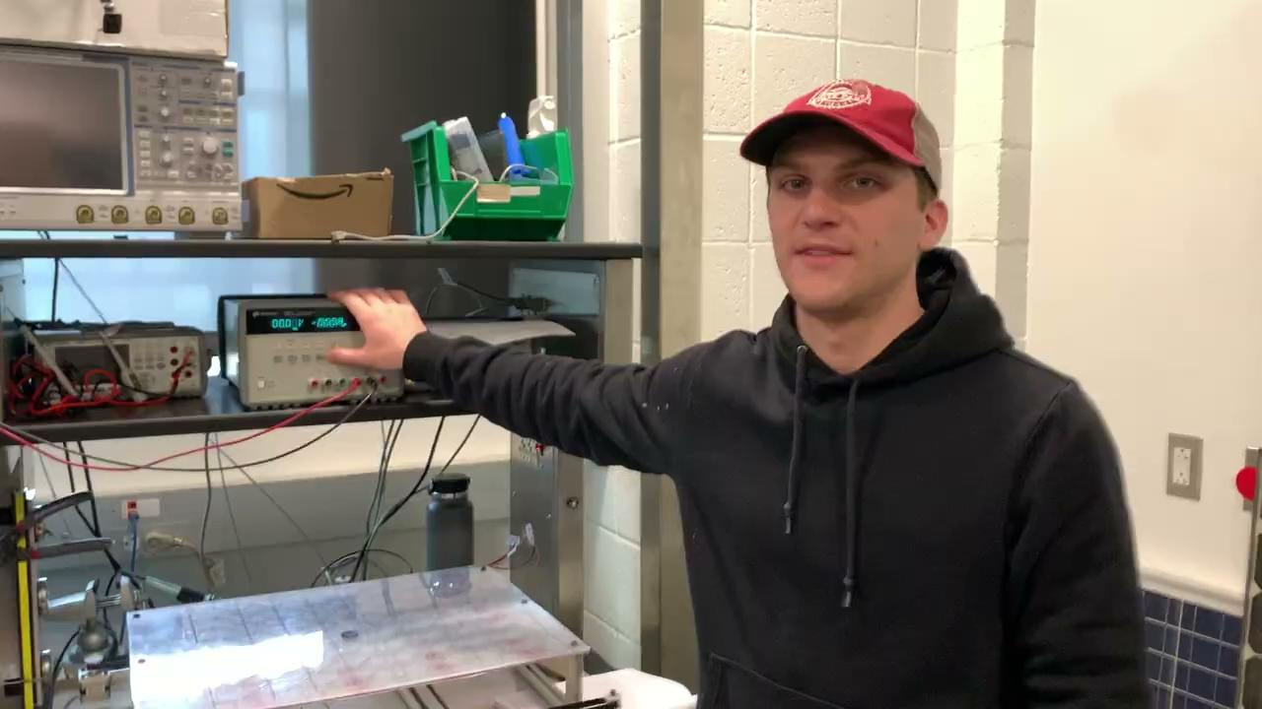

Slide 8
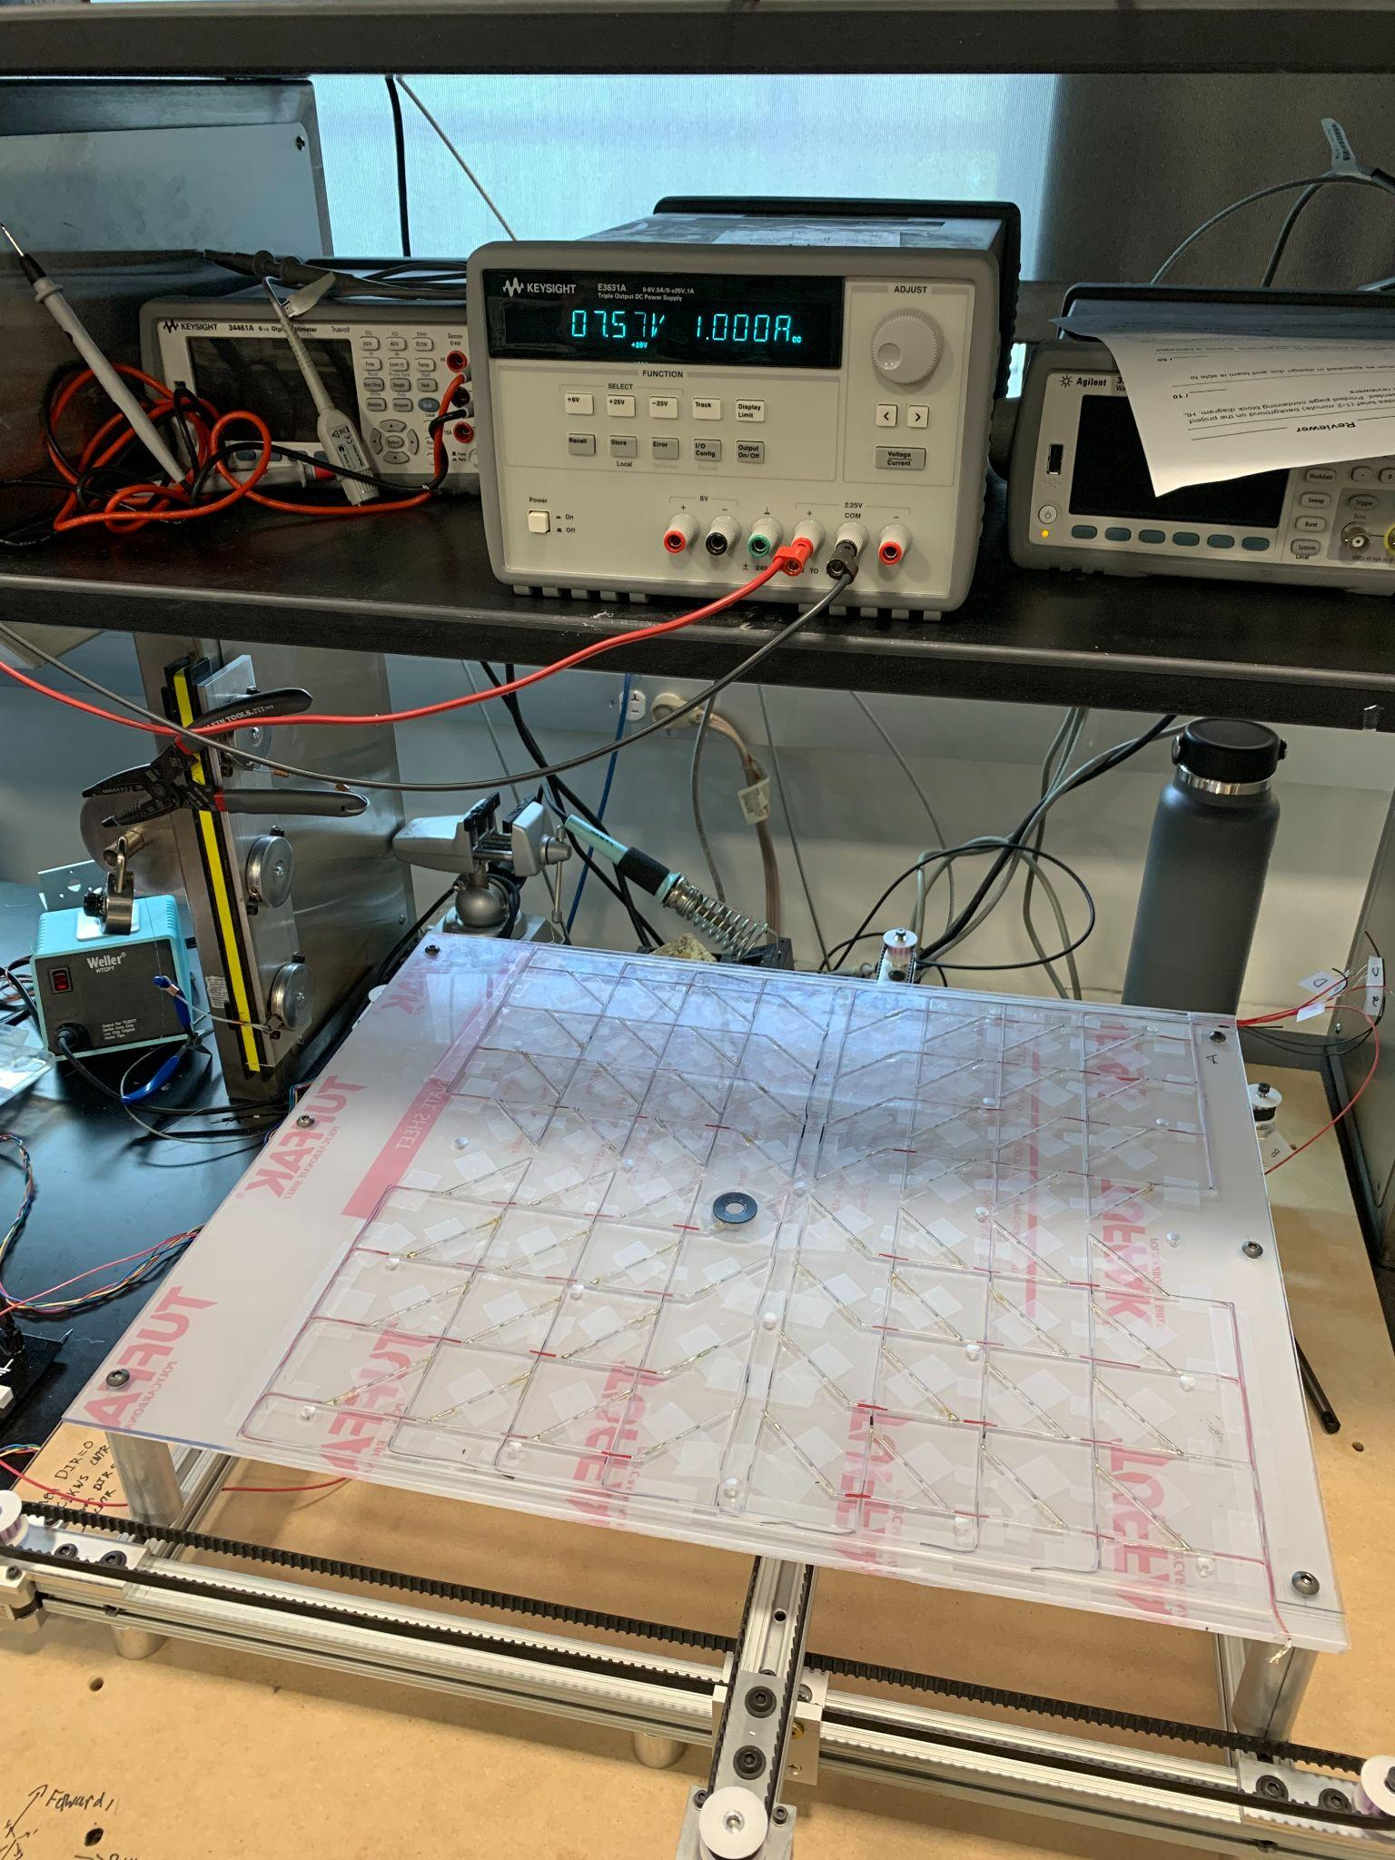
Real System Design
What was actually achieved?
Pieces could be moved by electromagnet precisely
Verified that Piece Movement unit could function with the proper control signals from a microcontroller
PCB was fully built and the microcontroller could interface and be programmed by a computer
IMAGE / GRAPHIC
ELECTRICAL & COMPUTER ENGINEERING
GRAINGER ENGINEERING

Slide 9
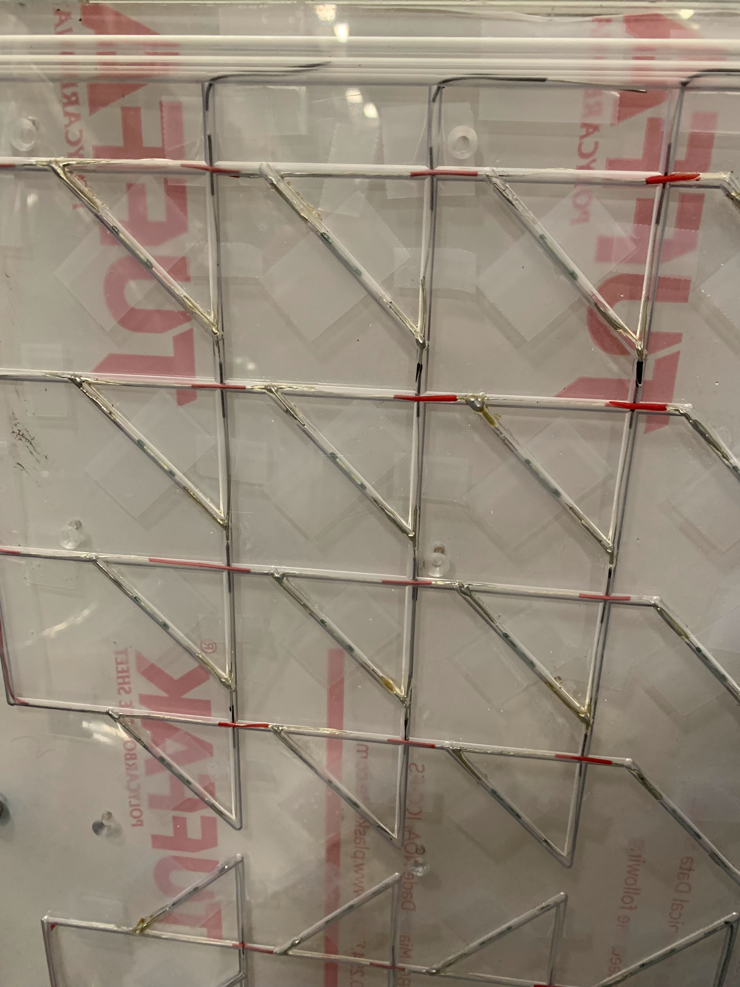
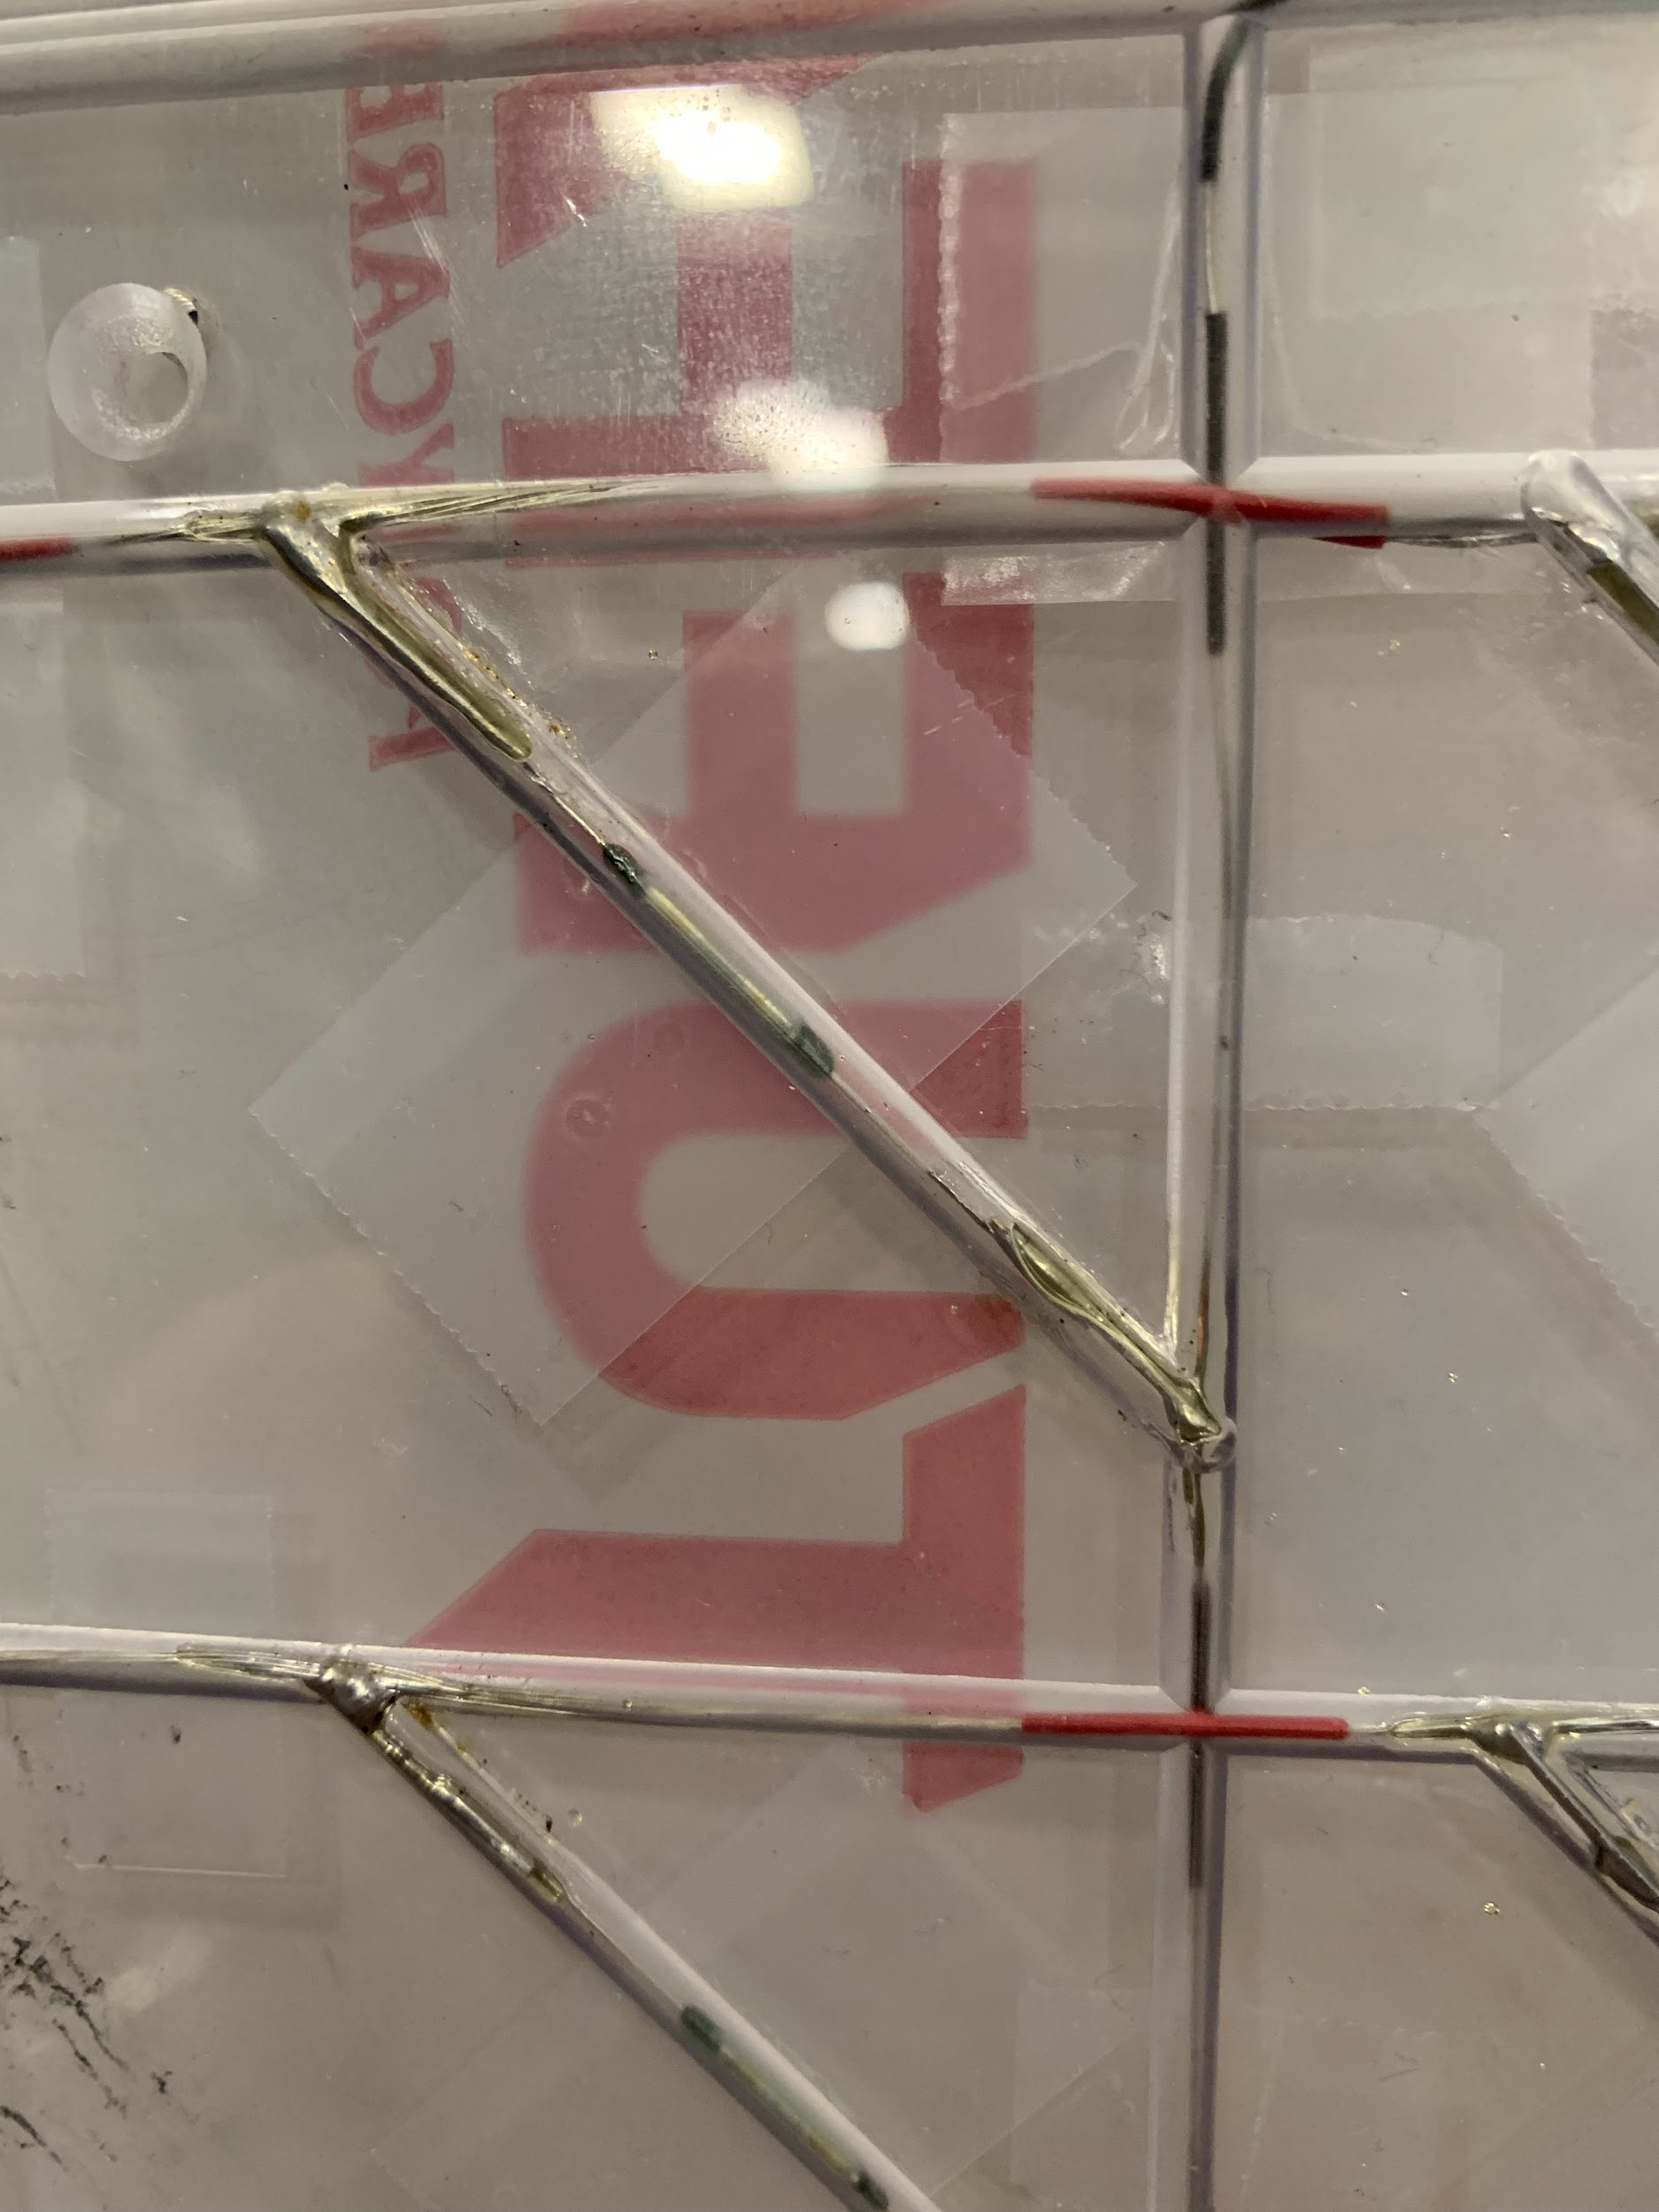
Human Interface Unit
Reed switches
What Changed?
Hall effect sensors were replaced with reed switches to save space
LEDs were removed
Chess clock were first modified than removed
Design Augment Considerations
Physical limitations of boardtop
Simplified the chess clock into a single button and display
MCU was unable to function
ELECTRICAL & COMPUTER ENGINEERING
GRAINGER ENGINEERING
Notes:
Rocking chess clock

Slide 10
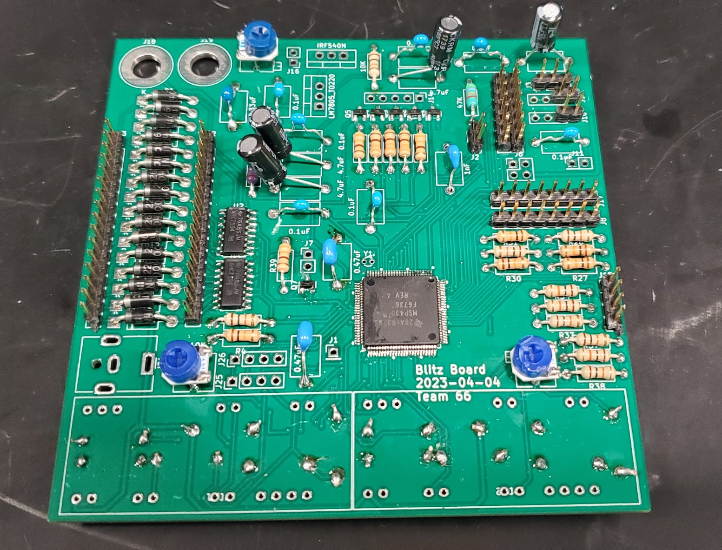
Control Unit and Main PCB
What Changed?
The control unit was functional but not used
The microcontroller could be programmed and debugged via a TI-brand JTAG debugger
All sub-circuits in the board were assembled
Design Augment Considerations
The microcontroller was initially not interfacing with a computer
The intended cable between the board and debugger was not used for budget reasons
ELECTRICAL & COMPUTER ENGINEERING
GRAINGER ENGINEERING

Slide 11
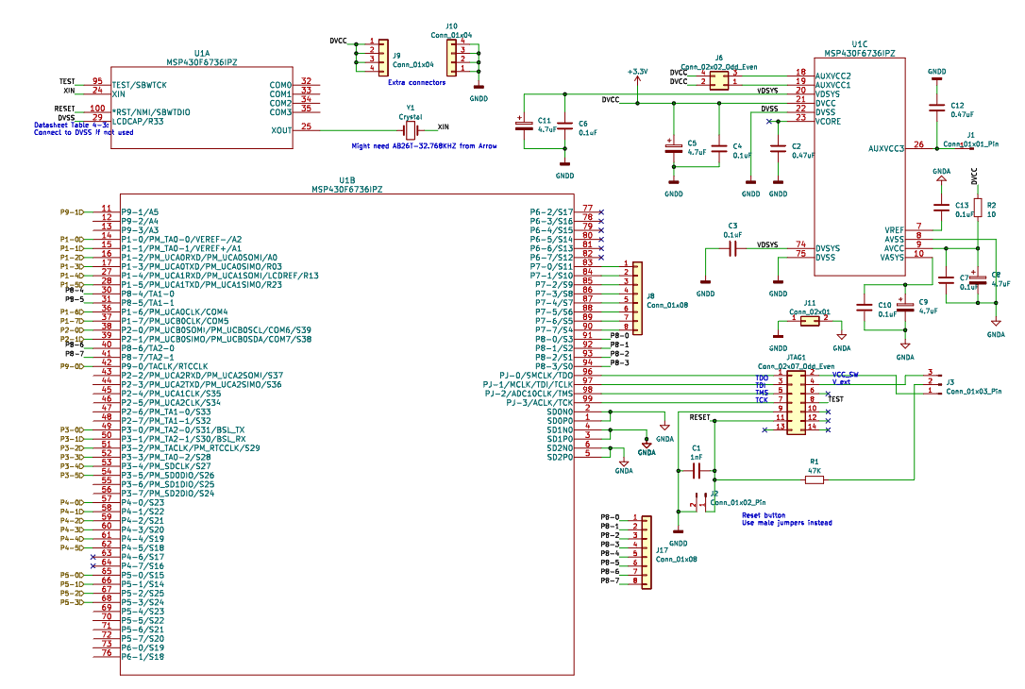
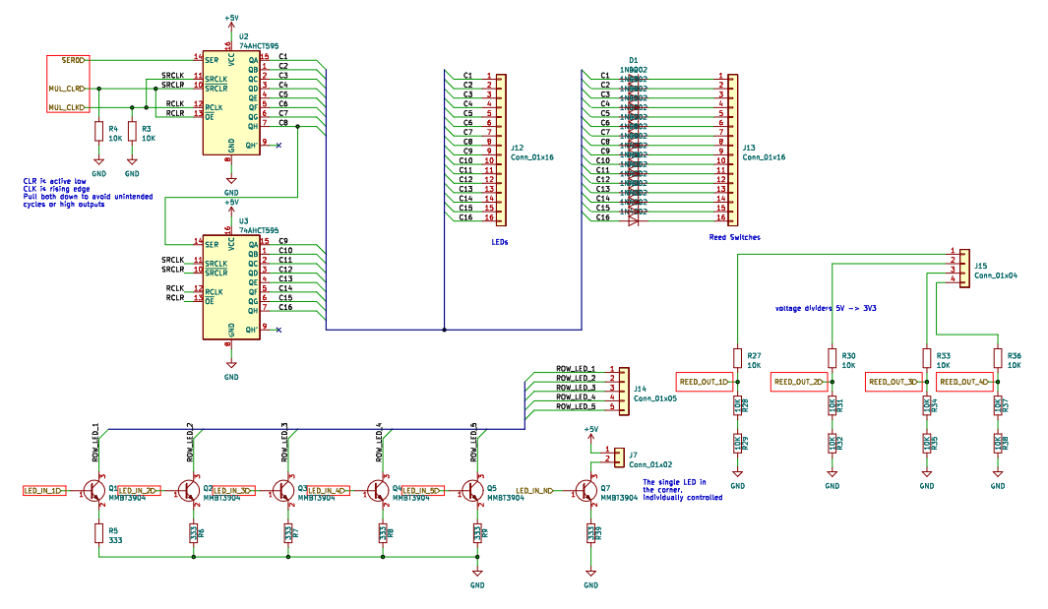
MCU and JTAG Connection
Multiplexing Circuit
Control Circuit Schematic
ELECTRICAL & COMPUTER ENGINEERING
GRAINGER ENGINEERING

Slide 12
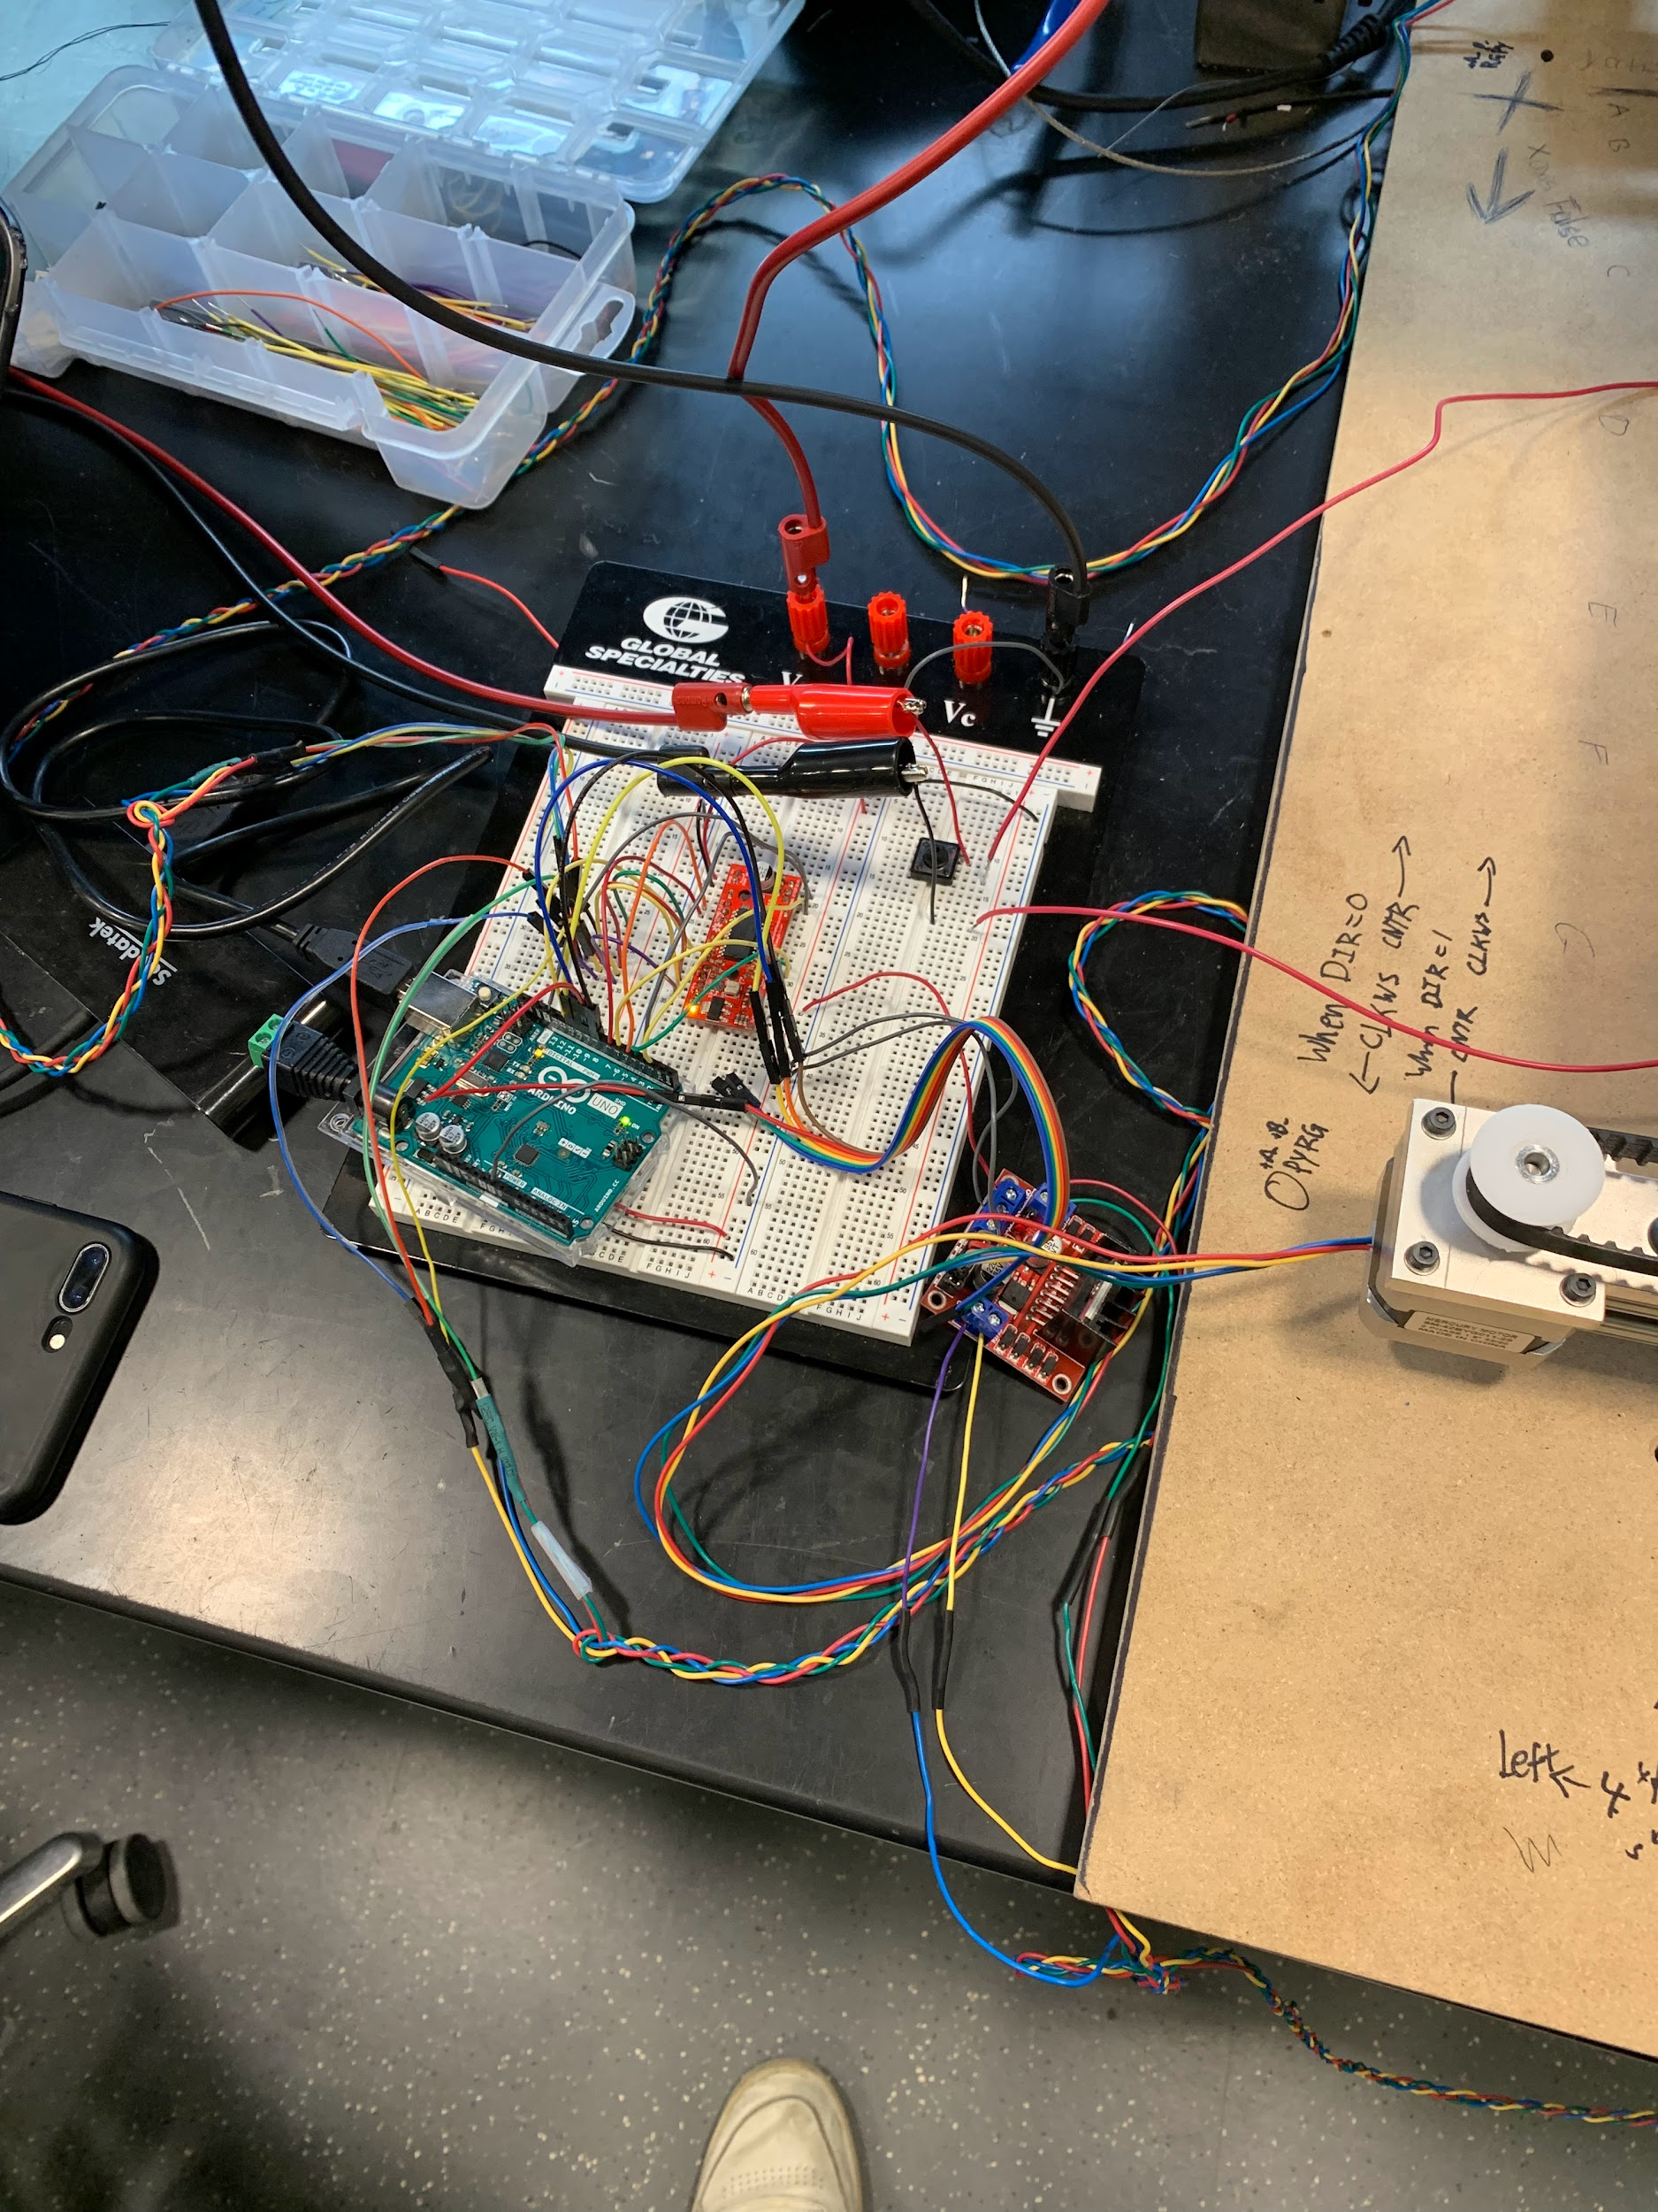
Piece Movement Unit
Motor Power Supply
What Changed?
Added a larger electromagnet (5VDC to 12VDC)
Had to switch to Arduino as MCU
Used different drive circuits in demonstration
Design Augment Considerations
A faulty motor driver
Lack of MCU
Electromagnetic field limitations
Electromagnet Power Supply
Arduino
Motor Drivers
Stepper Motor
ELECTRICAL & COMPUTER ENGINEERING
GRAINGER ENGINEERING

Slide 13
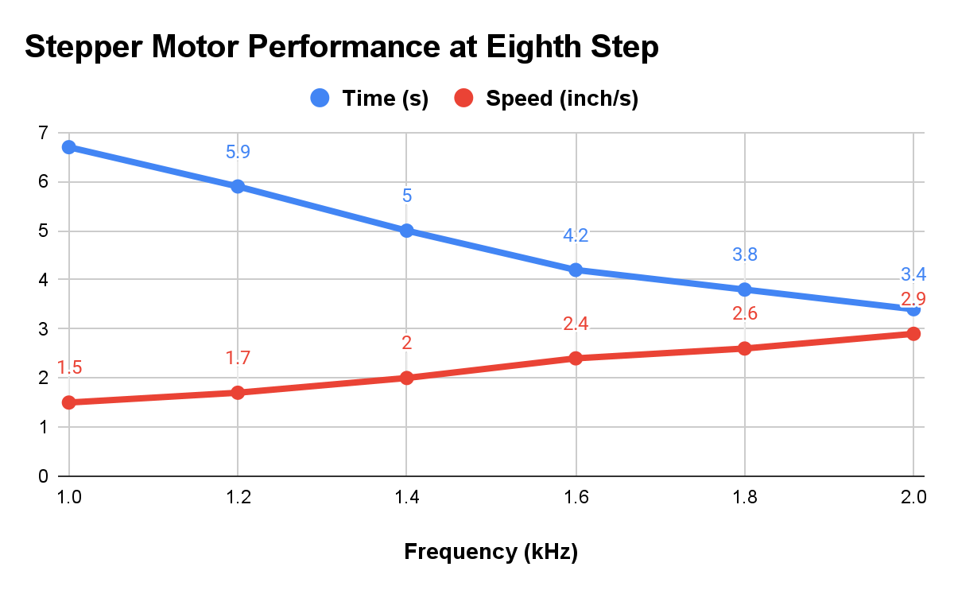
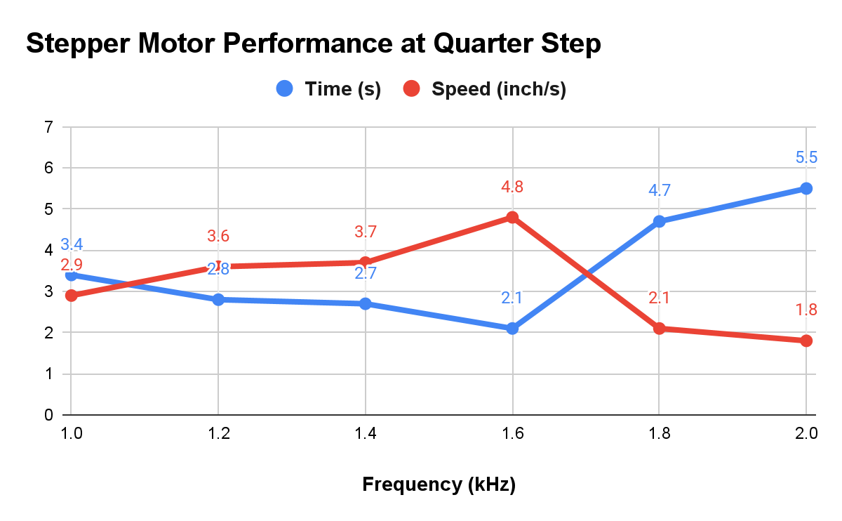
Stepper Motor Data
Choose to operate at 1.4kHz in eighth step
CHART / GRAPH
ELECTRICAL & COMPUTER ENGINEERING
GRAINGER ENGINEERING

Slide 14
Successes and Challenges
ELECTRICAL & COMPUTER ENGINEERING
GRAINGER ENGINEERING

Slide 15
Successes and Challenges
What are the successes?
Complete physical construction of the chess board with modification
Stepper motors can move chess pieces to the designated location precisely
Electromagnetic can turn on to pull chess pieces and turn off when the move is complete
What are the challenges?
Unable to program the microcontroller due to connection issues
Unable to implement chess engine, chess clock, and the multiplexing of reed switches due to MCU
Unable to fit the LEDs on the board top due to physical limitations
ELECTRICAL & COMPUTER ENGINEERING
GRAINGER ENGINEERING

Slide 16
Conclusions
ELECTRICAL & COMPUTER ENGINEERING
GRAINGER ENGINEERING

Slide 17
Conclusions
What did we learn from the project?
How to design a product from scratch
Expect challenges as the project progresses
When the motor is not running, it is likely that there is a wrong connection
Order extra components because you don’t know if you’ll get a bad one
What would you do differently if you redesigned your project?
Make the PCB less complex; interfaces for extra peripherals to connect to the microcontroller don't need to be on the board
Create an end goal which relies less on software and a microcontroller
ELECTRICAL & COMPUTER ENGINEERING
GRAINGER ENGINEERING

Slide 18
Future Recommendations
ELECTRICAL & COMPUTER ENGINEERING
GRAINGER ENGINEERING

Slide 19
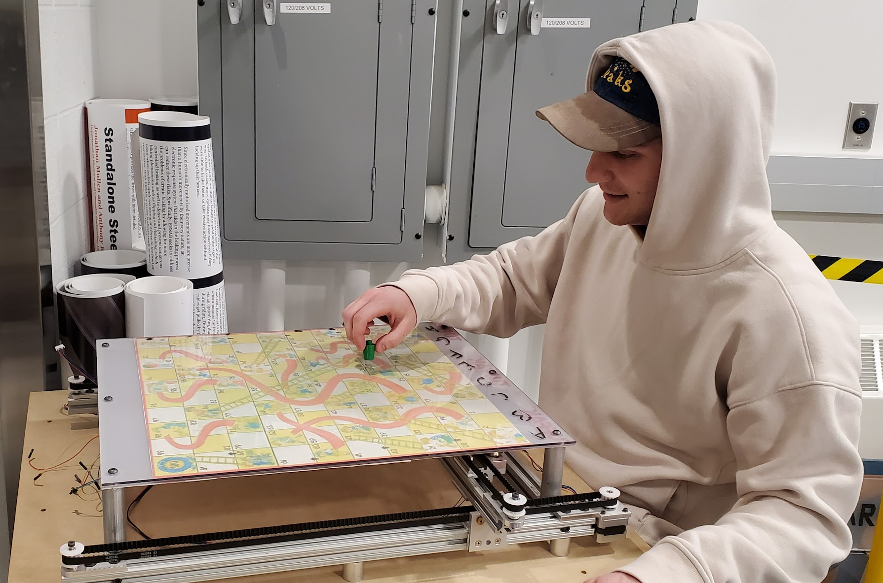
Future Recommendations
Hardware Improvements
Increase the speed and accuracy of the motor
Reduce the size and weight of the chess board
Enclose the chess board
Software Improvements
Automatically set chess pieces in place
Provide different levels of difficulty when playing with the chess engine
Allow players to connect and play with each other
Build an application for better interaction interface
Add voice control
ELECTRICAL & COMPUTER ENGINEERING
GRAINGER ENGINEERING

Slide 20
Questions?
ELECTRICAL & COMPUTER ENGINEERING
GRAINGER ENGINEERING

