Slide 1
Team #72: Window/Blinds Regulator
Electrical & Computer Engineering
Austin Chong, Mahdi Almosa, Marco Oyarzun

Slide 2
Objective
What problem are we solving?
ELECTRICAL & COMPUTER ENGINEERING
GRAINGER ENGINEERING

Slide 3
Objective
What Problem is the Window/Blinds Regulator Solving?
Optimal Sleep
Circadian Rhythm Regulation
Temperature Control
Natural Air/ Ventilation
Energy Efficiency
ELECTRICAL & COMPUTER ENGINEERING
GRAINGER ENGINEERING

Slide 4
Project Overview
ELECTRICAL & COMPUTER ENGINEERING
GRAINGER ENGINEERING

Slide 5
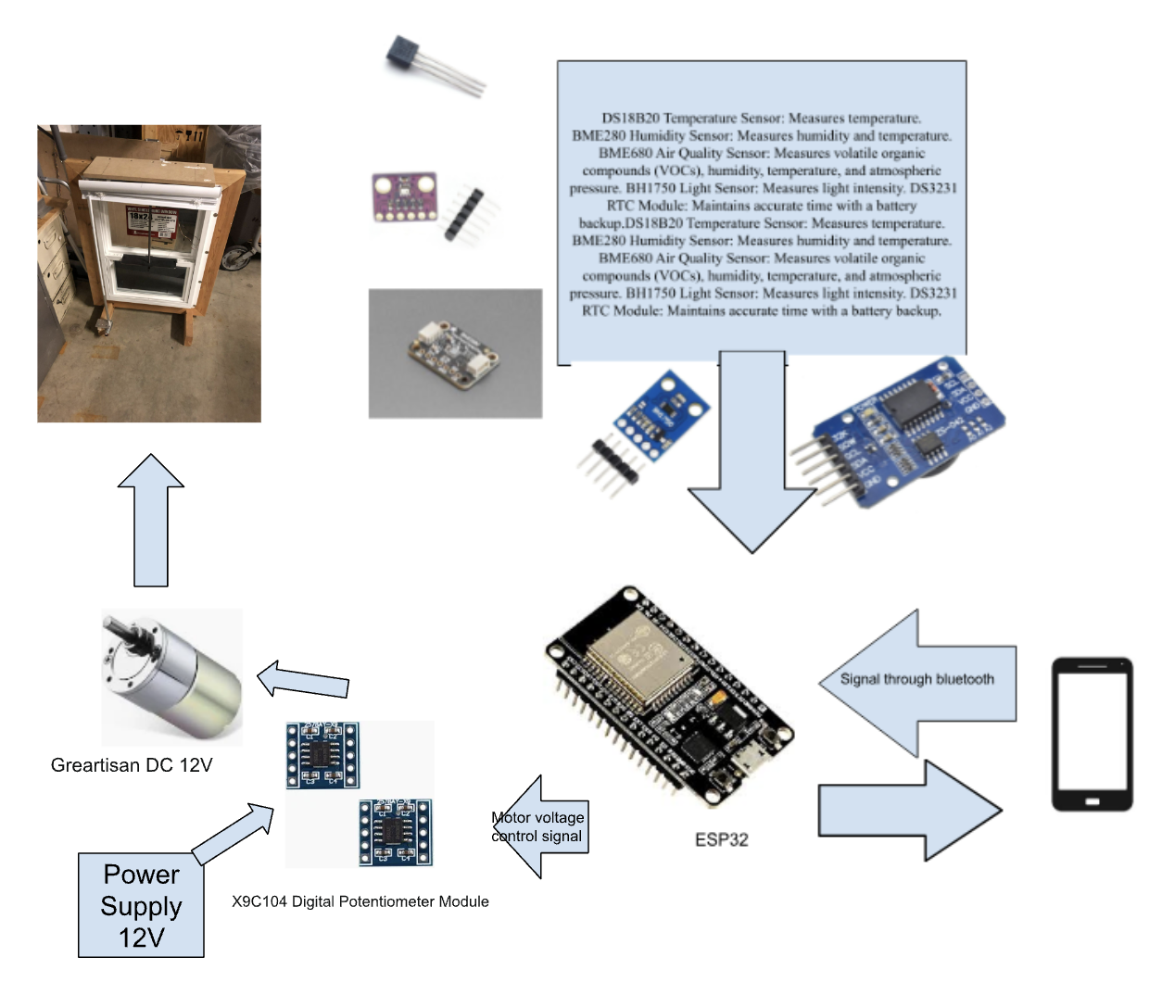
Initial Idea
Original Design
The prototype idea was an automated approach to the window/blind regulation. With the given sensors triggering the system to open/close accordingly.
Automated Regulation
This eliminates the need for outside communication such as your own device. However, there were complications regarding automating the sensors with the motors. Thus, manual device regulation was taken into consideration instead.
ELECTRICAL & COMPUTER ENGINEERING
GRAINGER ENGINEERING

Slide 6
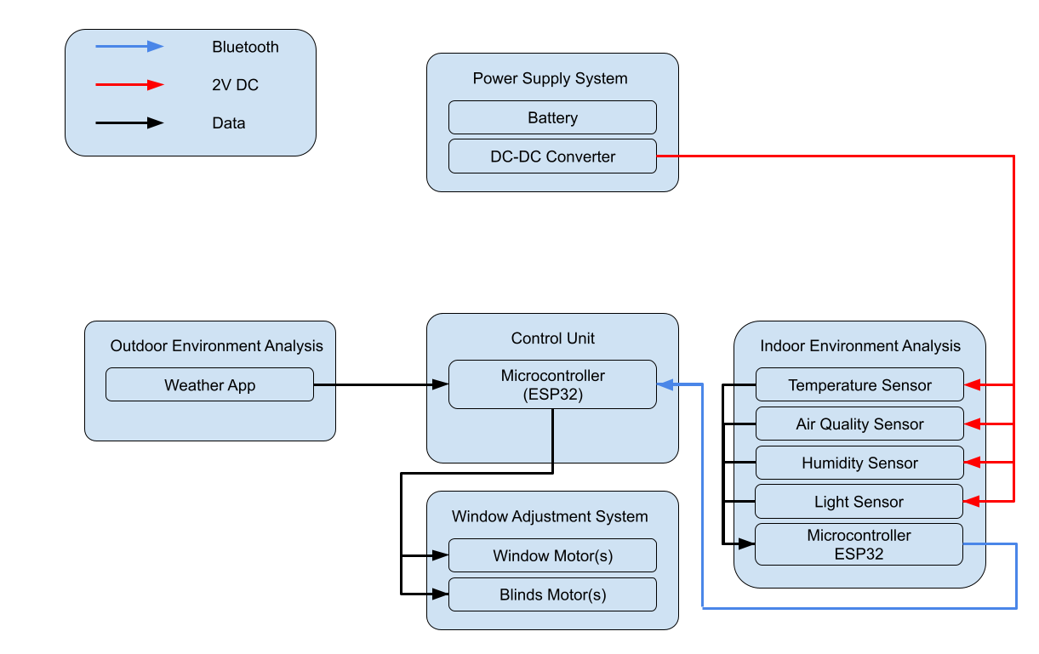
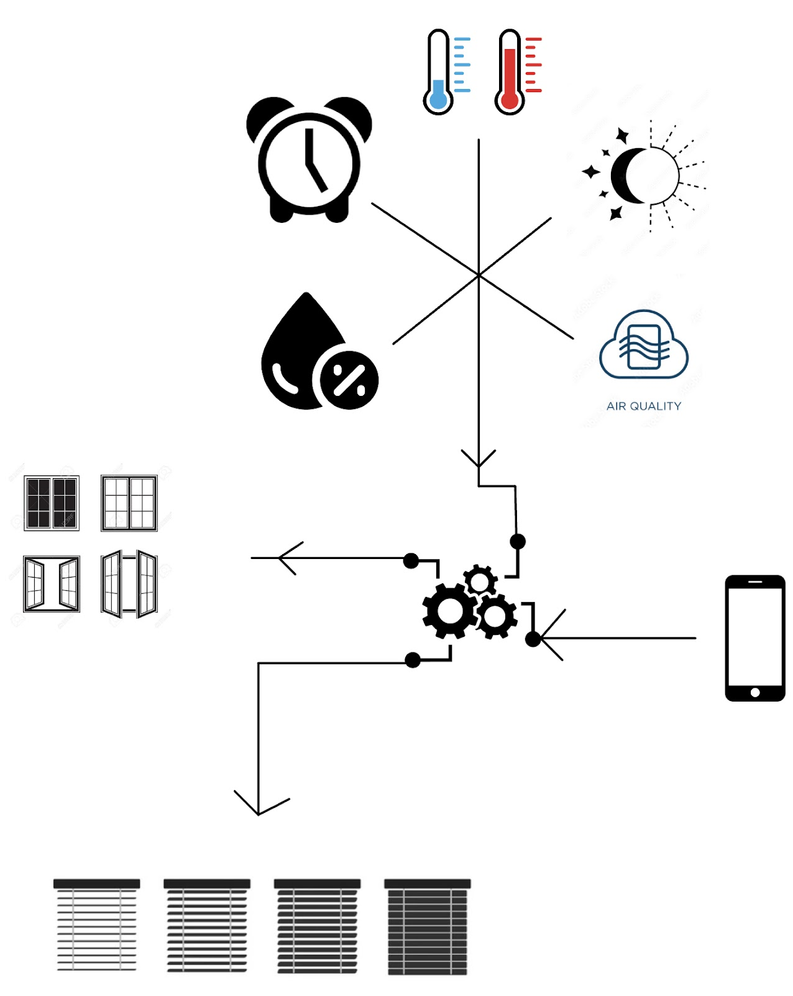
Project Overview
Proposed Solution
Our project involves the development of a comprehensive self-service window and blind regulation system designed to respond to diverse indoor and outdoor environmental conditions.
Self-Service
You will have the ability and flexibility of customizing the settings of the window through their own device. You will be able to see the temperature, humidity, and air quality of current environment; then adjust the windows/blinds accordingly.
Block Diagram
ELECTRICAL & COMPUTER ENGINEERING
GRAINGER ENGINEERING

Slide 7
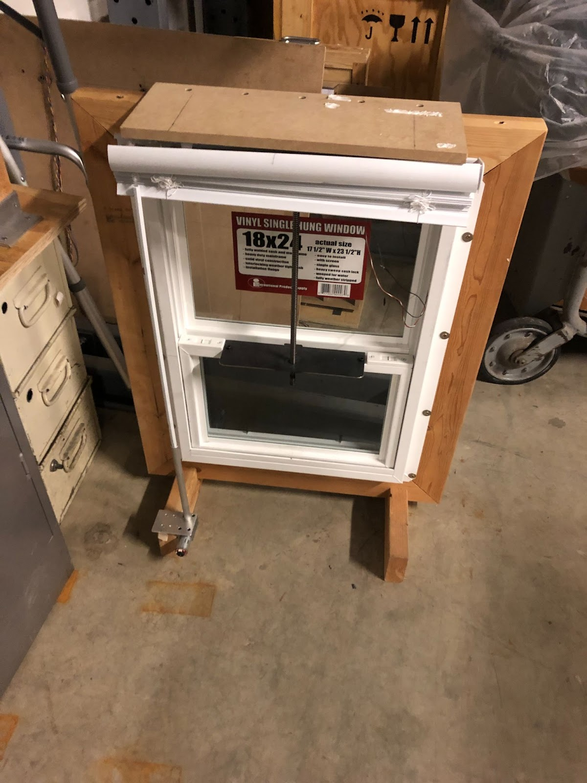
Project Overview
High Level Requirements
Windows/Blinds need to open/close upon request.
The windows/blinds should both move remotely or by device. Also using a PID controller to control the position of the window.
The windows and blinds have sensors that detect the temperature as well as humidity.
ELECTRICAL & COMPUTER ENGINEERING
GRAINGER ENGINEERING

Slide 8
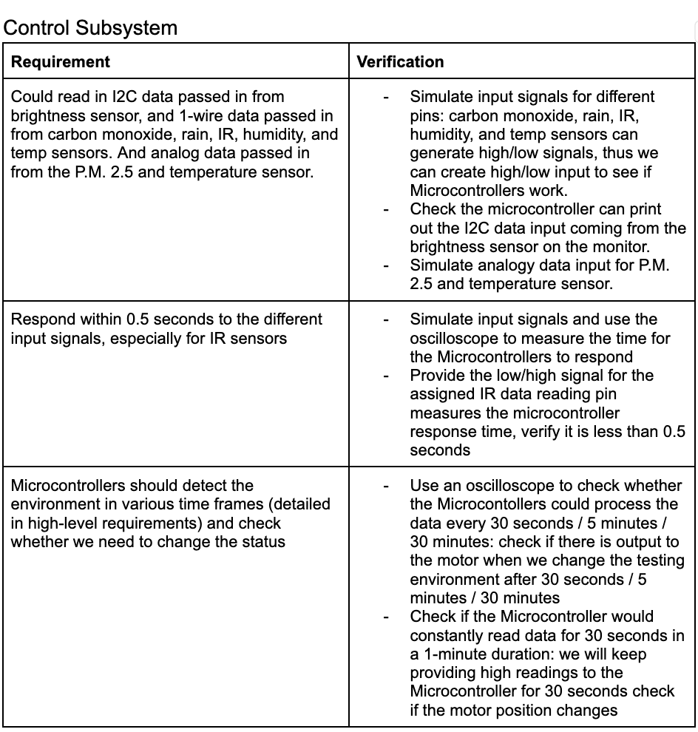
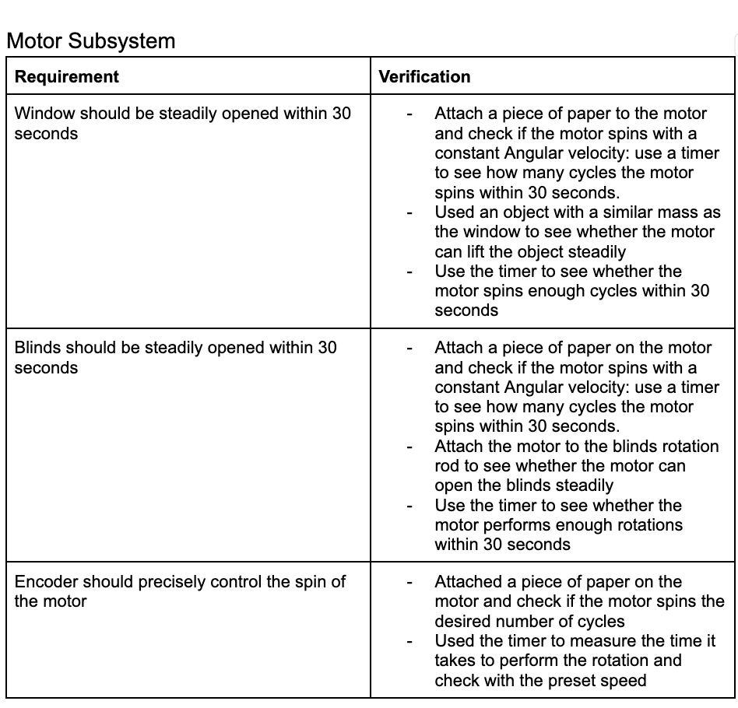
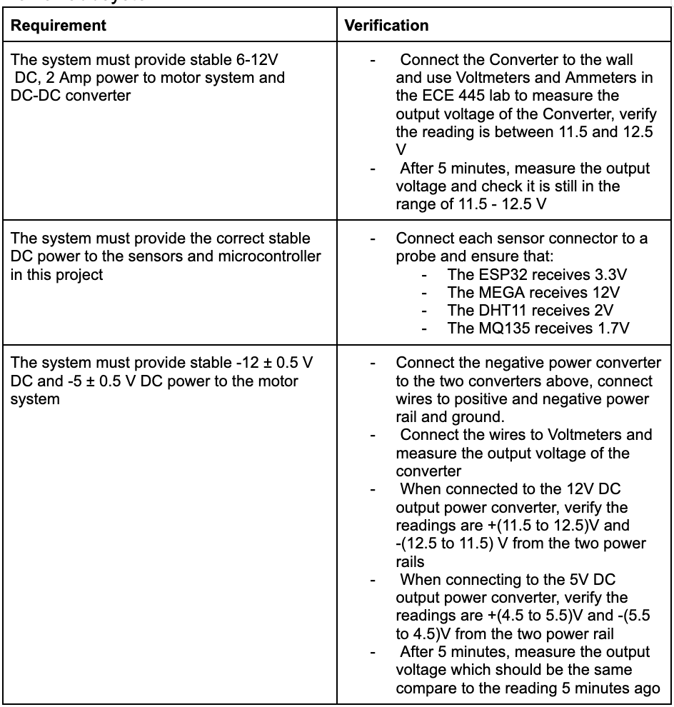
Project Overview
Requirements and Verification
ELECTRICAL & COMPUTER ENGINEERING
GRAINGER ENGINEERING

Slide 9
Parts List
ELECTRICAL & COMPUTER ENGINEERING
GRAINGER ENGINEERING

Slide 10
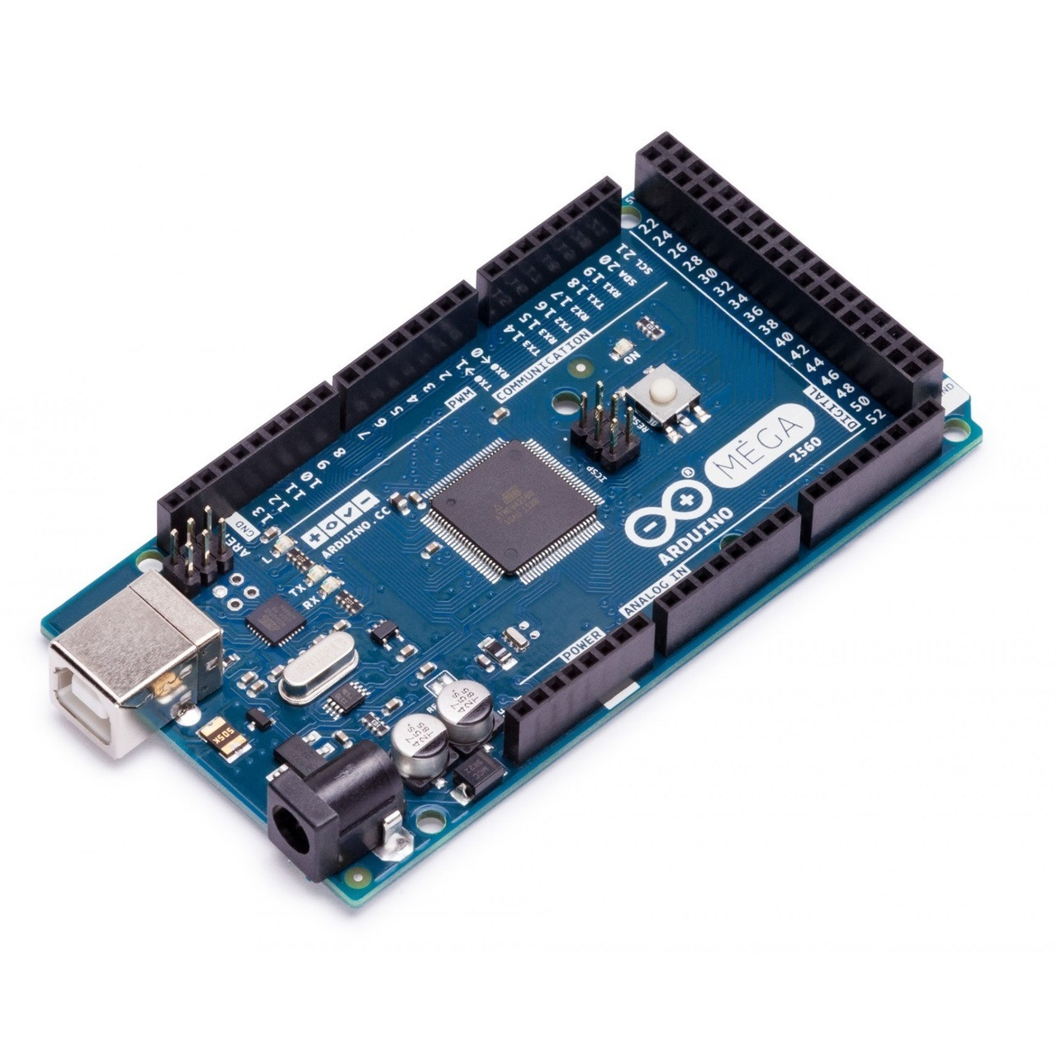
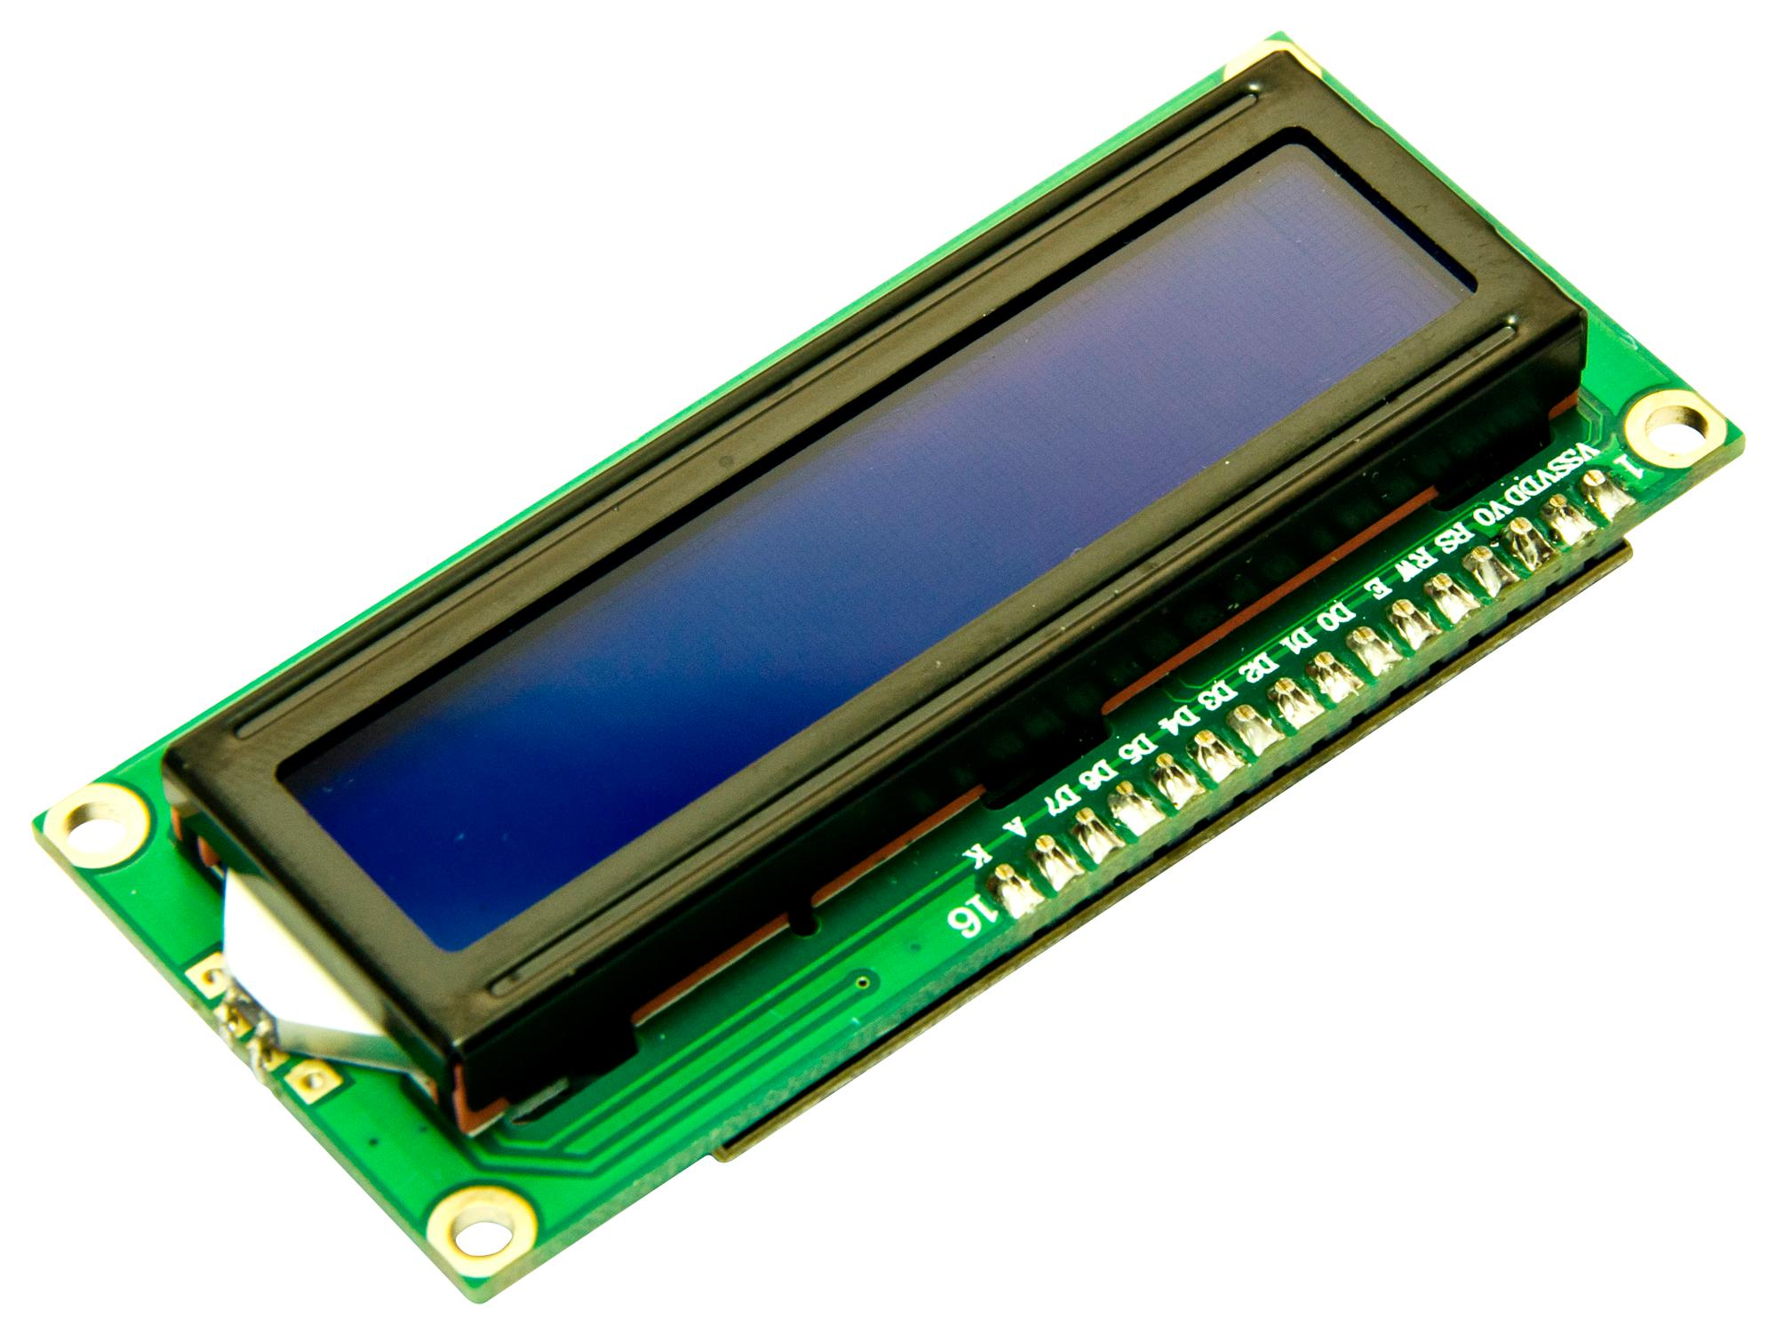
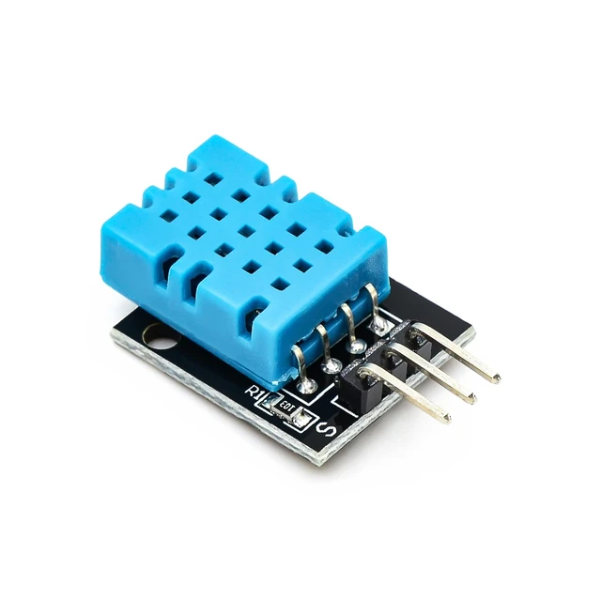
Parts
MEGA 2560
5V
LCD Displays
DHT11
ELECTRICAL & COMPUTER ENGINEERING
GRAINGER ENGINEERING

Slide 11
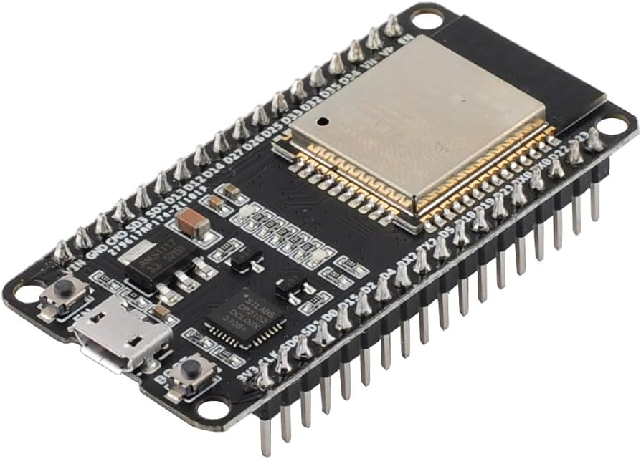
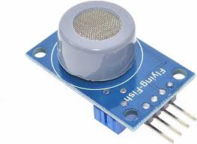
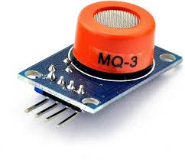
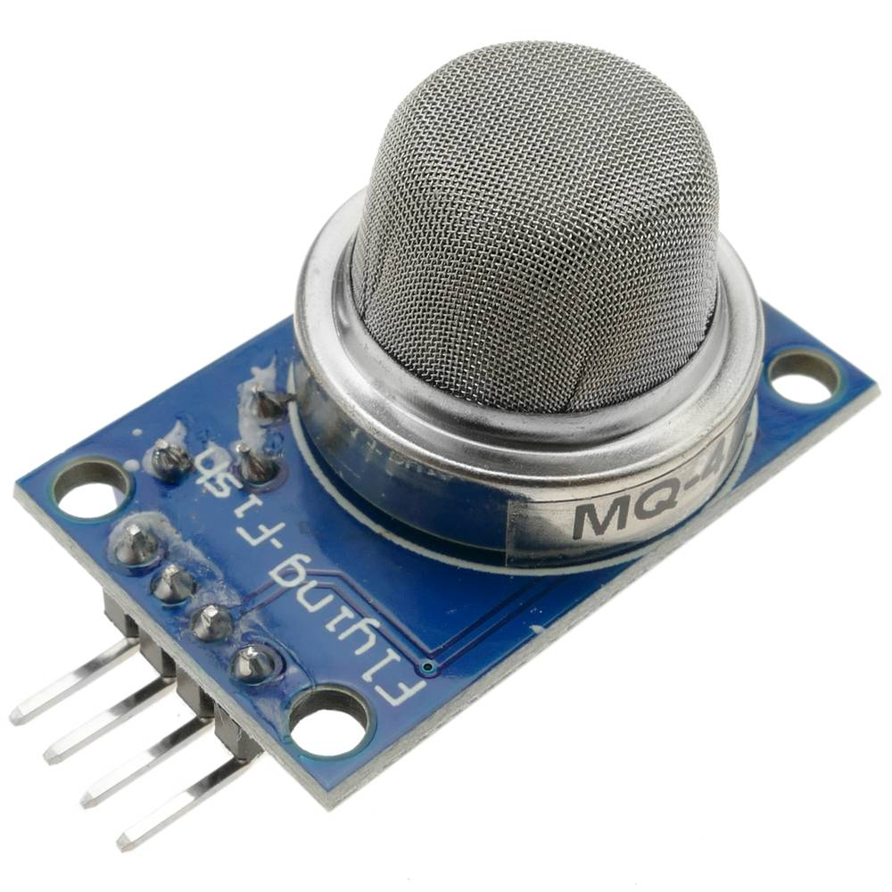
Parts
ESP32
3.3V
MQ3
MQ7
MQ135
ELECTRICAL & COMPUTER ENGINEERING
GRAINGER ENGINEERING

Slide 12
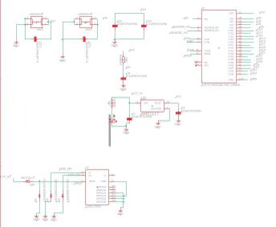
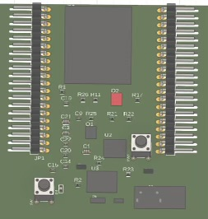
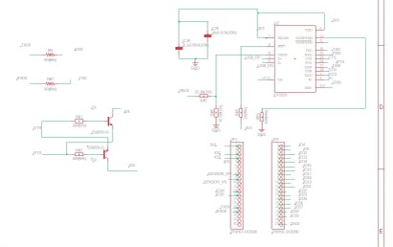
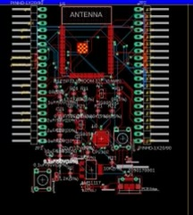
PCB
PCB Design
ESP32 dev kit V1 from scratch
ESP32
ELECTRICAL & COMPUTER ENGINEERING
GRAINGER ENGINEERING

Slide 13
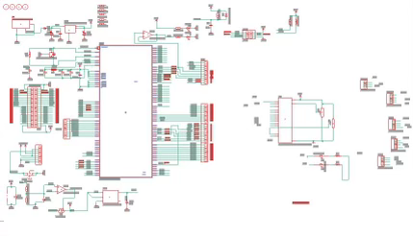
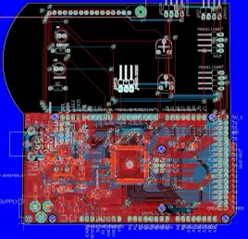
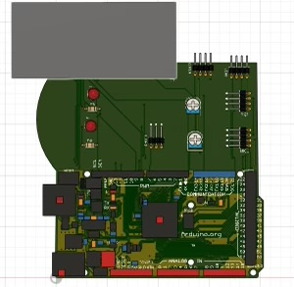
PCB
PCB Design
MEGA2560 extended
Imported main board from Arduino
MEGA2560
ELECTRICAL & COMPUTER ENGINEERING
GRAINGER ENGINEERING

Slide 14
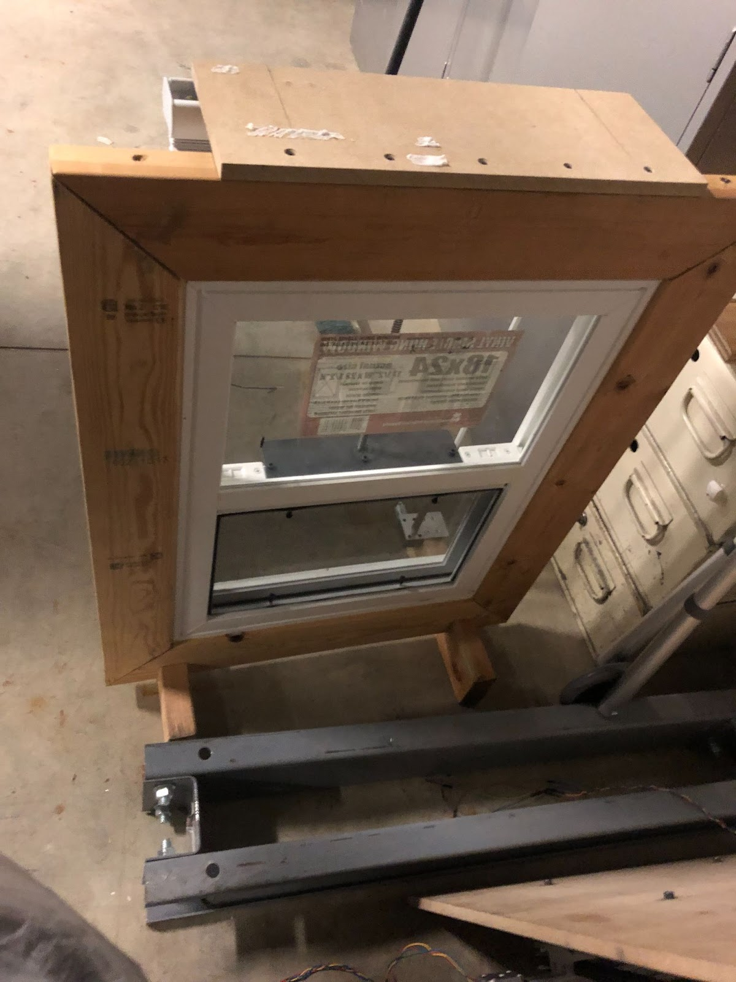
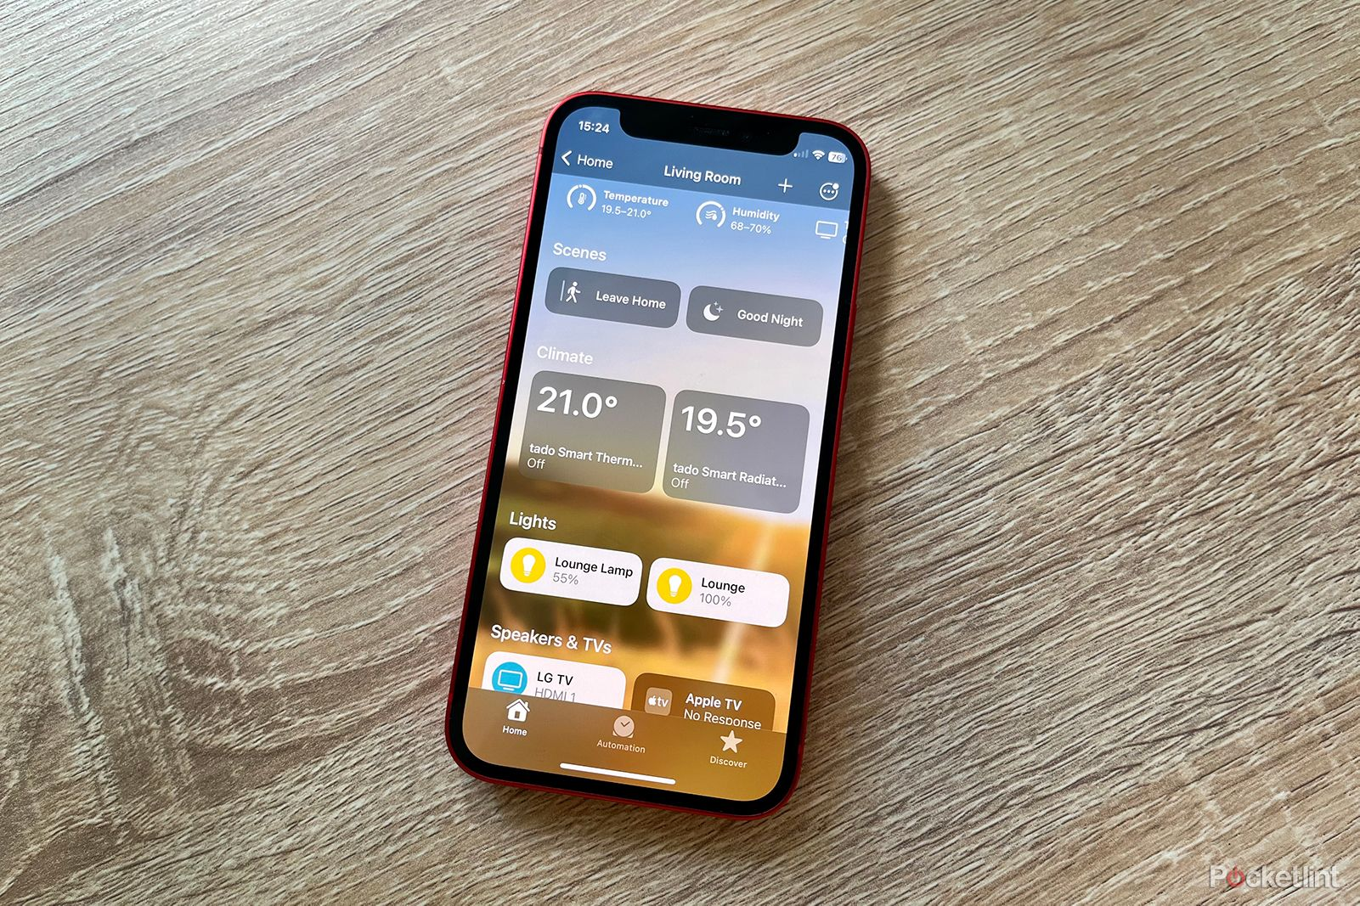
Testing
Testing the Software
Wi-Fi interface so users would be able to connect their devices to the system
Window position PID Controller
Display the status of our sensors on the Home app of apple devices
Open/close the blinds/window given this information
Obstacles
Strength of the motor
Current Supply
GPIOs
I2C Communication Protocol
Tracking the current state of the window/blinds
Calibration
ELECTRICAL & COMPUTER ENGINEERING
GRAINGER ENGINEERING

Slide 15
Conclusion
ELECTRICAL & COMPUTER ENGINEERING
GRAINGER ENGINEERING

Slide 16
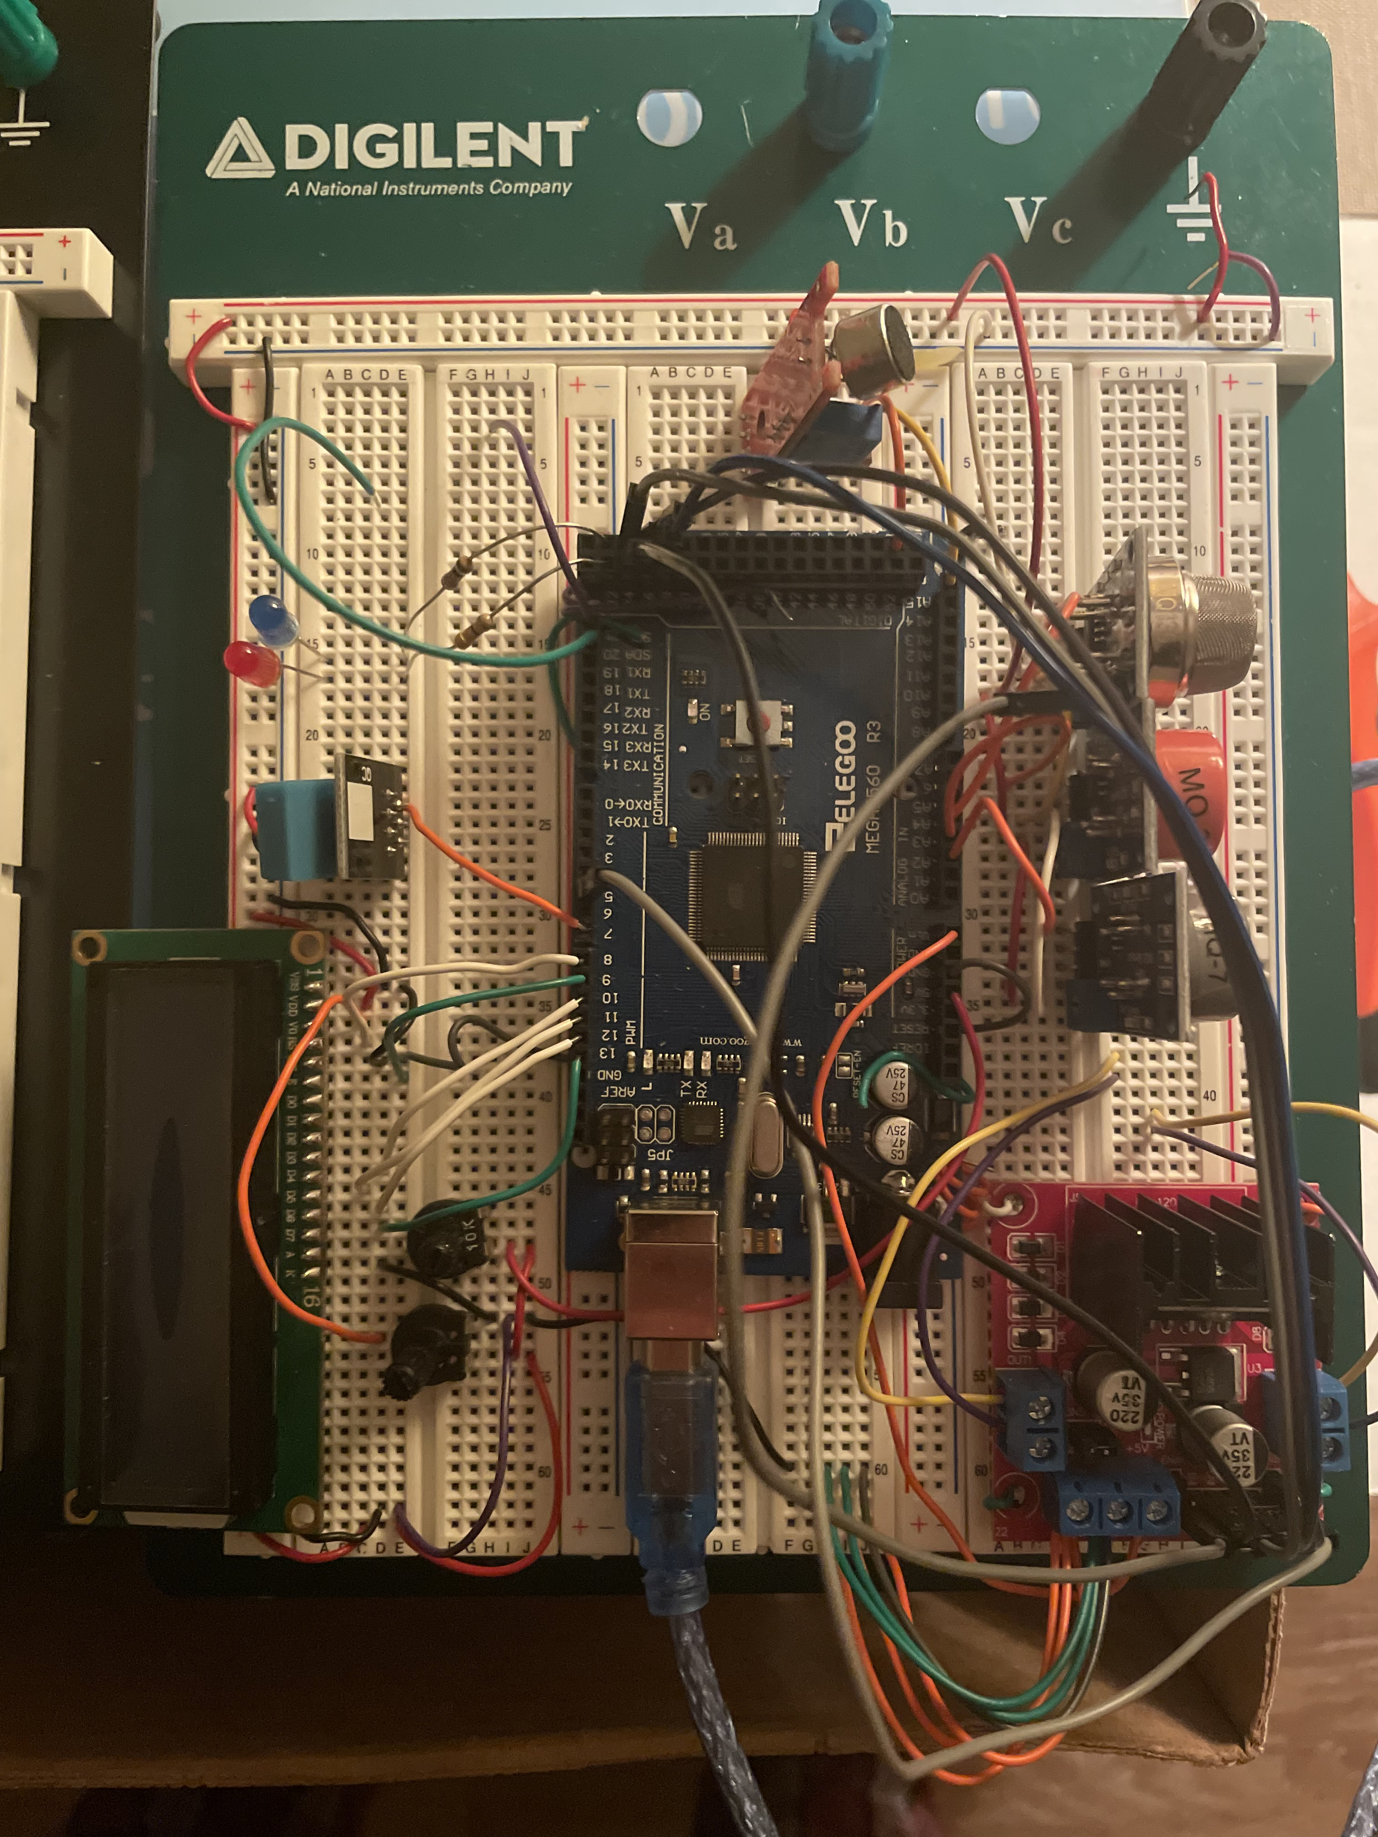
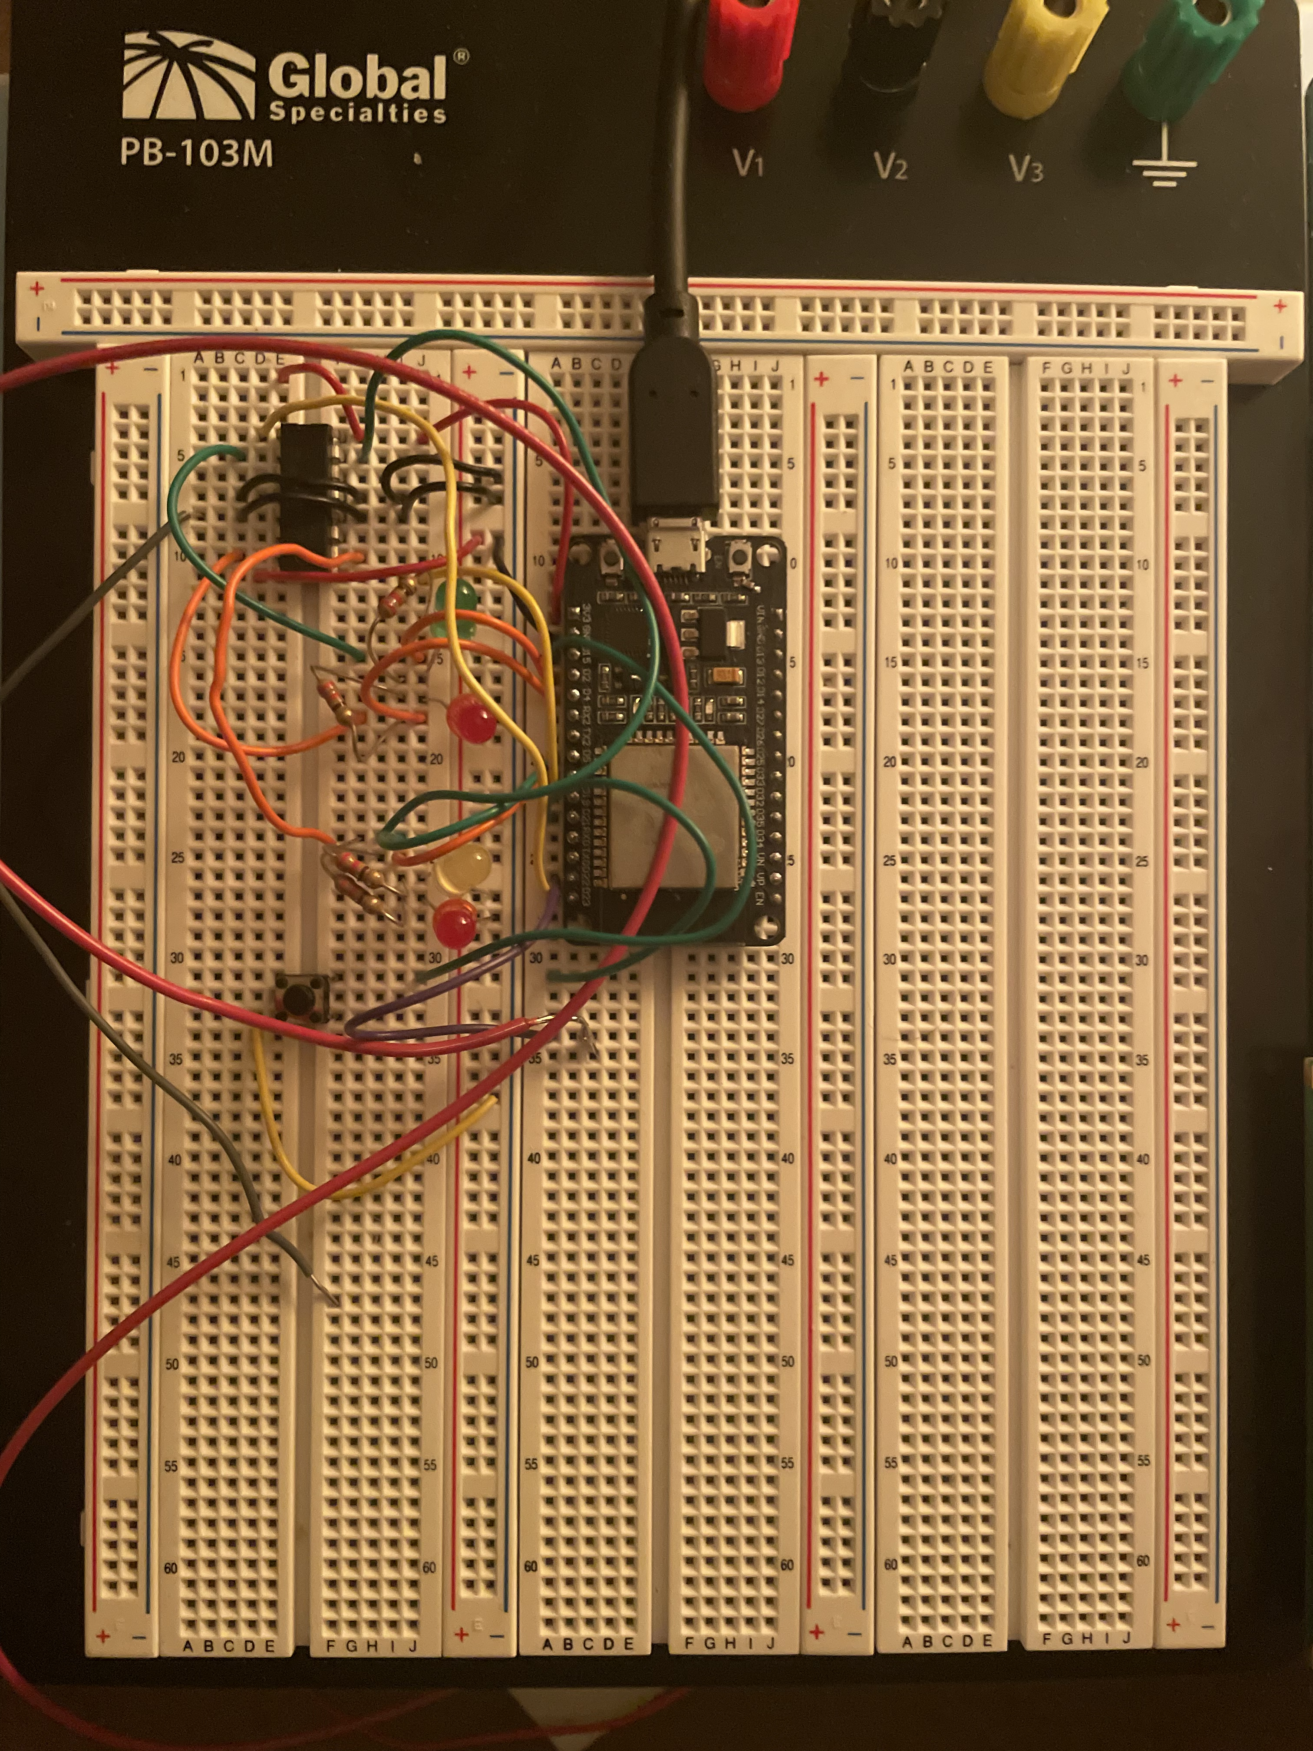
Final Product
Positives
Successful connection to the window
User-friendly app
Opened and closed on command
Negatives
Built on breadboards
Used development kits
No automation
ELECTRICAL & COMPUTER ENGINEERING
GRAINGER ENGINEERING

Slide 17
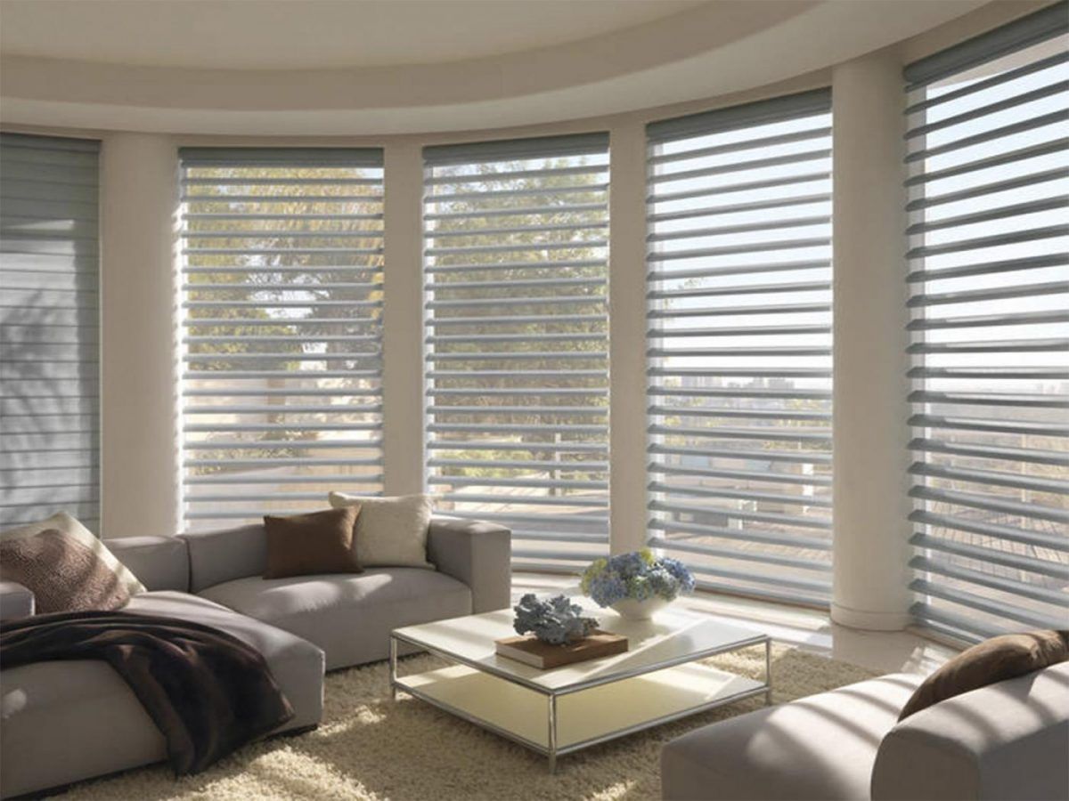
Recommendations for Further Work
Plenty of potential
Finish automation
Add control features (app, remote control)
Develop mechanics
Physical appearance
Put it to use!
ELECTRICAL & COMPUTER ENGINEERING
GRAINGER ENGINEERING

Slide 18
References
"The acceleration due to gravity (g) - Definition, Value, Formula." BYJU'S, n.d., https://byjus.com/physics/value-of-g/#:~:text=The%20acceleration%20due%20to%20gravity,due%20to%20the%20Earth's%20gravity.
"Blind Fabric Material Weight Calculations." Rollertrol, n.d., https://rollertrol.com/blind-fabric-material-weight-calculations.
Flori, Robert E. "F=ma Particle Straight Line 1." Missouri University of Science and Technology, https://web.mst.edu/~reflori/be150/Dyn%20Lecture%20Videos/F=ma%20Particle%20Straight%20Line%201/F=ma%20Particle%20Straight%20Line%201.pdf.
"ECE Admissions | Why ECE | Salary Averages." Department of Electrical and Computer Engineering, University of Illinois Urbana-Champaign, https://ece.illinois.edu/admissions/why-ece/salary-averages.
https://www.istockphoto.com/photos/good-sleep
ELECTRICAL & COMPUTER ENGINEERING
GRAINGER ENGINEERING

Slide 19
Thank You!
Questions?
ELECTRICAL & COMPUTER ENGINEERING
GRAINGER ENGINEERING

