Slide 1
Roomscale 3D LiDAR Solution
Team 7 | Xizheng Fang, Terence Lee, Cheng Xu | ECE 445 Senior Design
| April 23, 2021
Notes:
Start Jamie

Slide 2
Introduction
Light Detection and Ranging (LiDAR)
Used in autonomous driving, surveying, etc.
High cost of entry ($10,000+)
Nothing for hobbyists and individuals
Notes:
Definition of LiDAR system: light detection and ranging system, which is shorted as LiDAR system, can use pulses of light to measure distance.
Lots of industries such as Tesla uses 3D LiDAR scanners in some advanced systems such as automatic driving. However, the prices for these 3D LiDAR are usually unaffordable for hobbyists like us.
That’s why we decide to design a cheap alternative for hobbyists who are interested in 3D LiDAR but are limited by the high cost of entry

Slide 3
Objectives
Scan a medium room in a short timeframe (~60s)
The output should resemble the environment
Data is encoded into industry standard file format (.las)
Notes:
Go over the high level requirements and explain how they relate back to the key problem
Scanning a medium room in a timeframe realistic size with not too long timeframe for hobbyists that is ideal for remaining cheap+accessible
industry-standard binary format

Slide 4
LiDAR system
Notes:
This is the final prototype team came up with
Designed to keep the physical footprint as small and simple as possible, with two ¼ in 20 thread on the bottom for mounting
Can see each of the individual components on the picture to the right

Slide 5
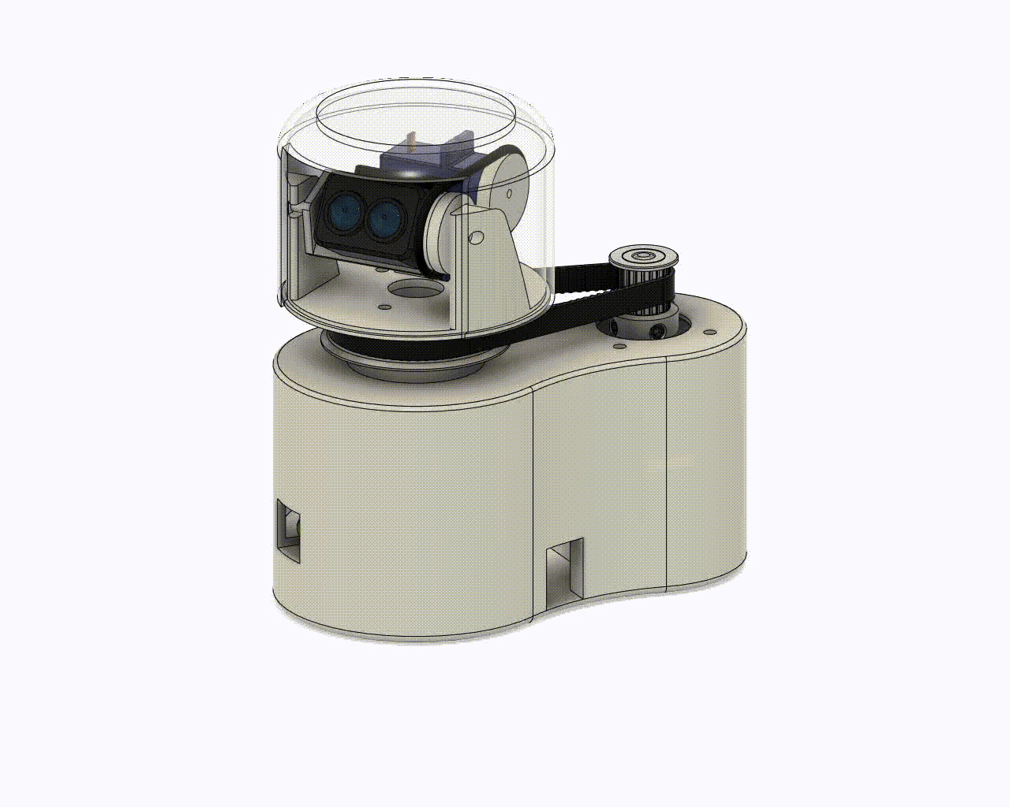
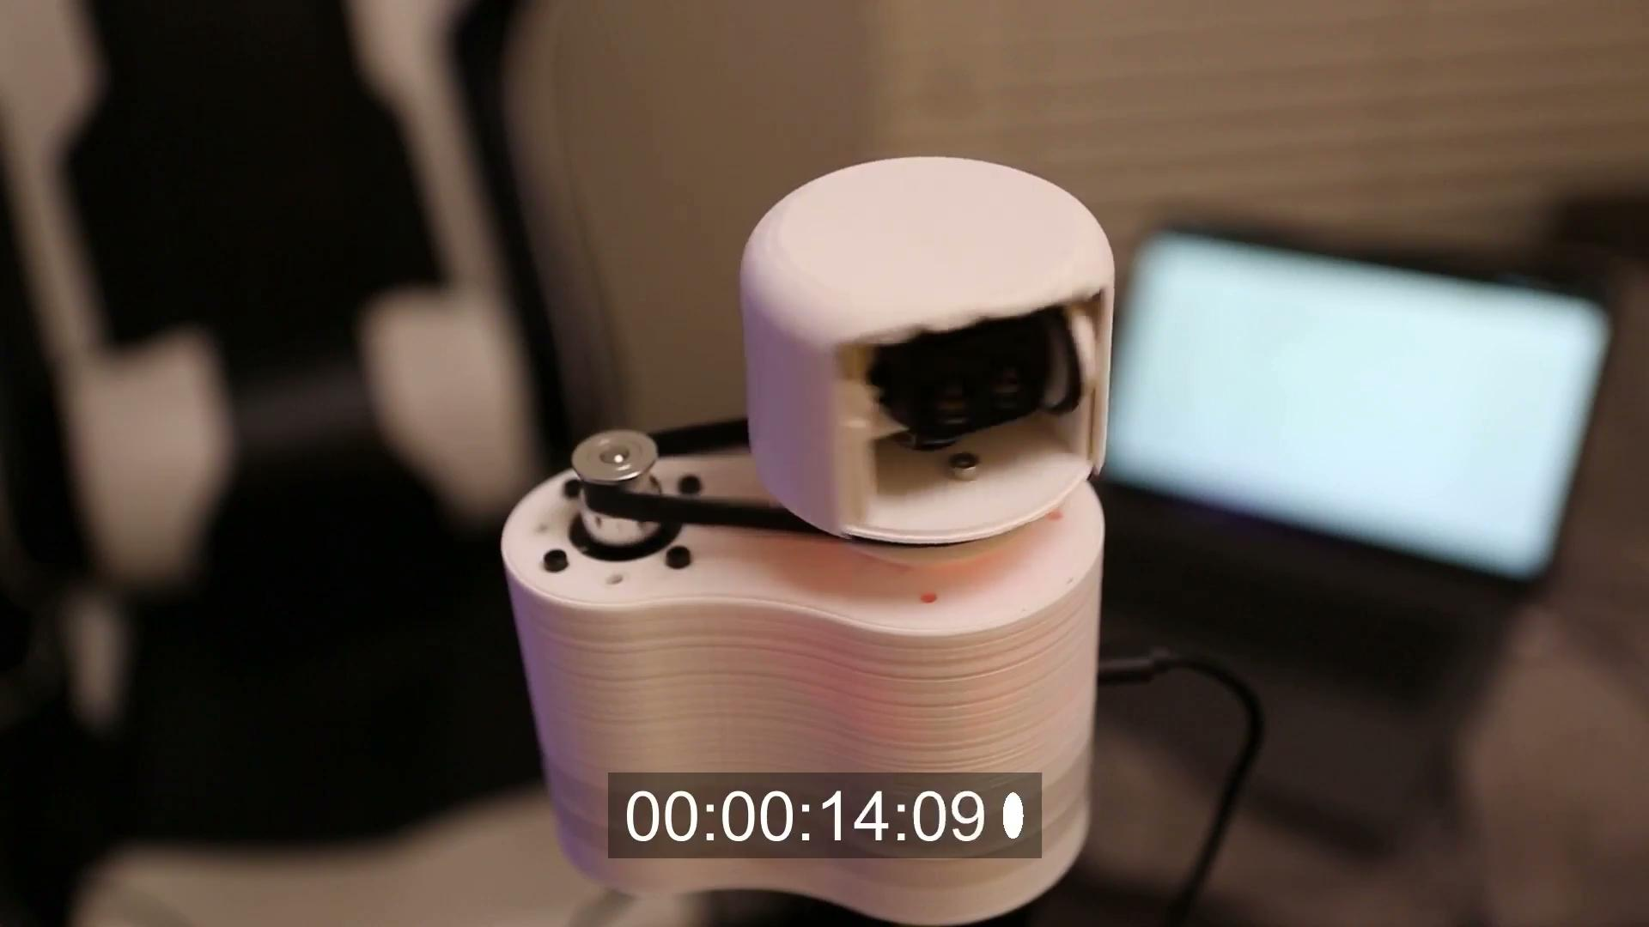
How it works
Notes:
End Jamie Transition to Xizheng
Time-of-flight (TOF) sensor attached to a two motor system
Motors rotate the sensor 360° horizontally at a specific vertical pitch each cycle
Each cycle collects a slice of the environment data representing the specific vertical pitch
Data collected is sent to the computer where it is parsed and used to create a point cloud visualization

Slide 6
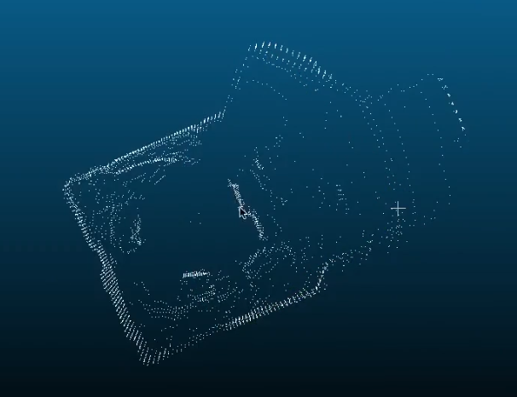
Comparison
Notes:
Start Xizheng
Point out identifiable features in both and correlate them

Slide 7
System Overview
Hardware
Power Supply
Lidar Sensor Unit
RC Servo Unit
Stepper Unit
Software
Control motor rotation with PWM collect sensor data
Spherical to Cartesian conversion
Encoding to las output file

Slide 8
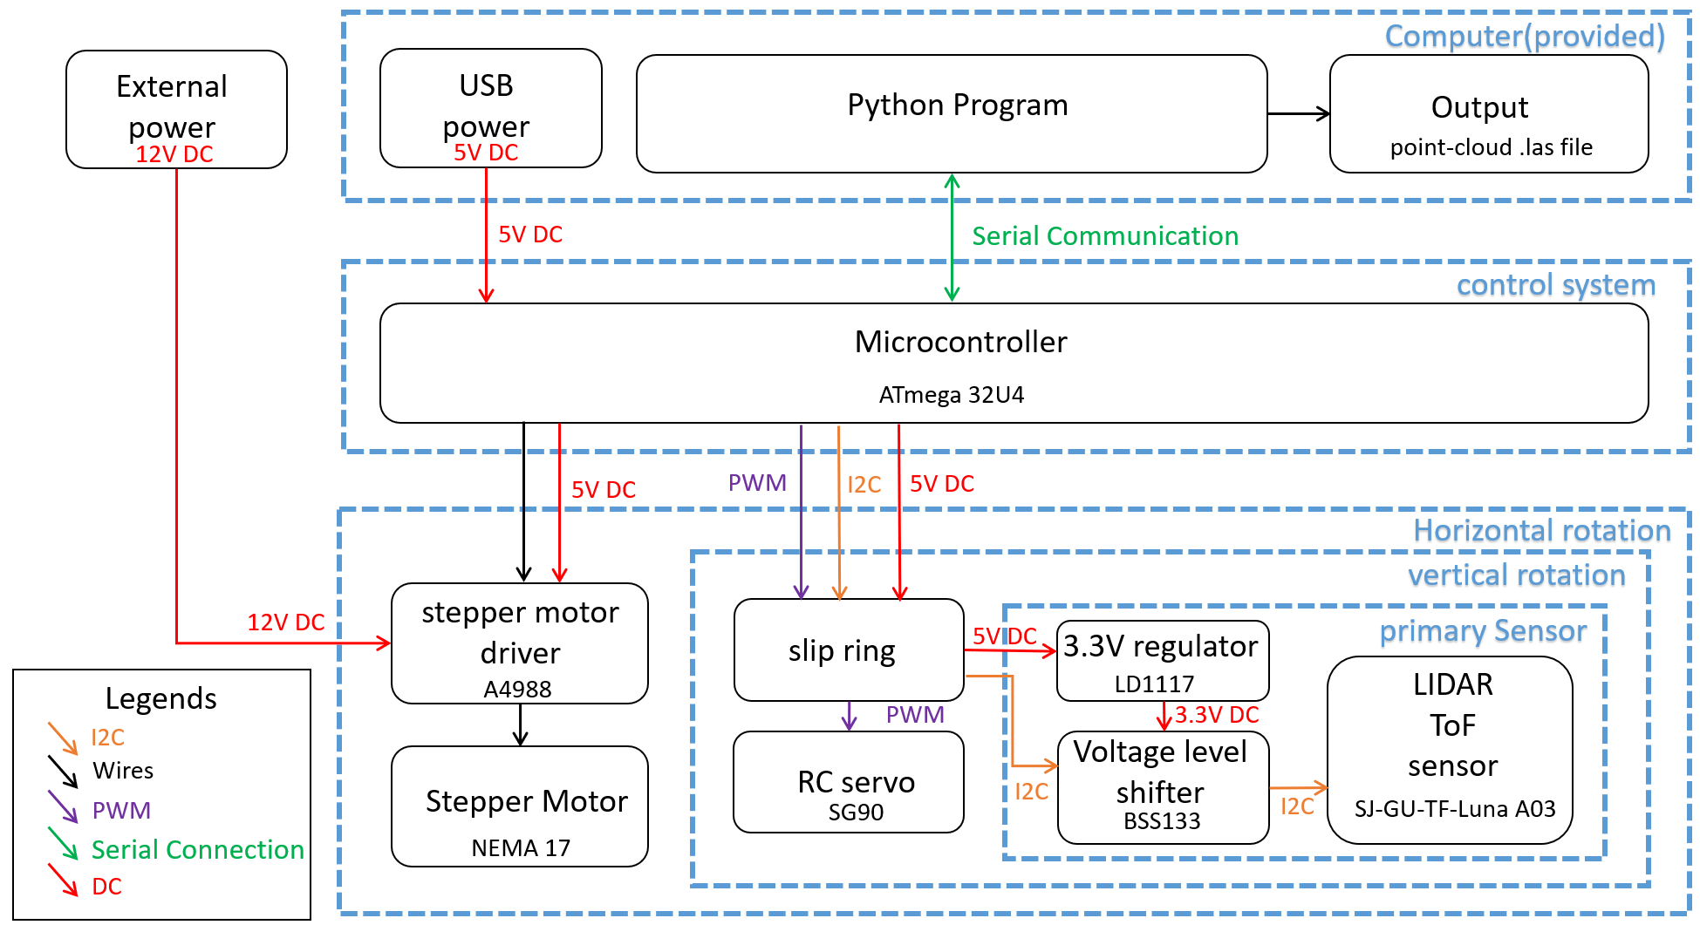
Block Diagram
Notes:
Describe each block in sequence, the block’s name, what are the components in the block, then describe how each block is connected to each other.

Slide 9
Hardware Overview
Power Supply (Not pictured)
12V Barrel Jack converter, USB 5V power
Lidar Sensor Unit
Time-of-Flight (TOF) sensor
RC Servo Unit
Slip Ring connect microcontroller -> TOF sensor
RC Servo manages vertical rotation
Stepper Unit
A4988 Stepper motor driver (Not pictured)
Stepper Motor in charge of horizontal rotation
TOF Sensor
RC Servo
Vertical Rotation Pulley
Horizontal Rotation Pulley
Slip Ring
Stepper Motor
Notes:
End Xizheng Transition to Jamie
We will use the following hardware parts: power supply, which is a 12V Barrel Jack converter that powers the stepper motor driver, and a 5V USB power used to power the microcontroller. The Lidar Sensor Unit, which consists of a Time-of-Flight(ToF) sensor that is in charge of taking distance measurements. The RC Servo Unit, which consists of Slip Ring and the RC Servo. The slip ring will connect the microcontroller and the ToF sensor, and the RC servo is in charge of the vertical rotation. The Stepper Unit, which consists of an A4988 stepper motor driver and a stepper motor. They are in charge of horizontal rotation.

Slide 10
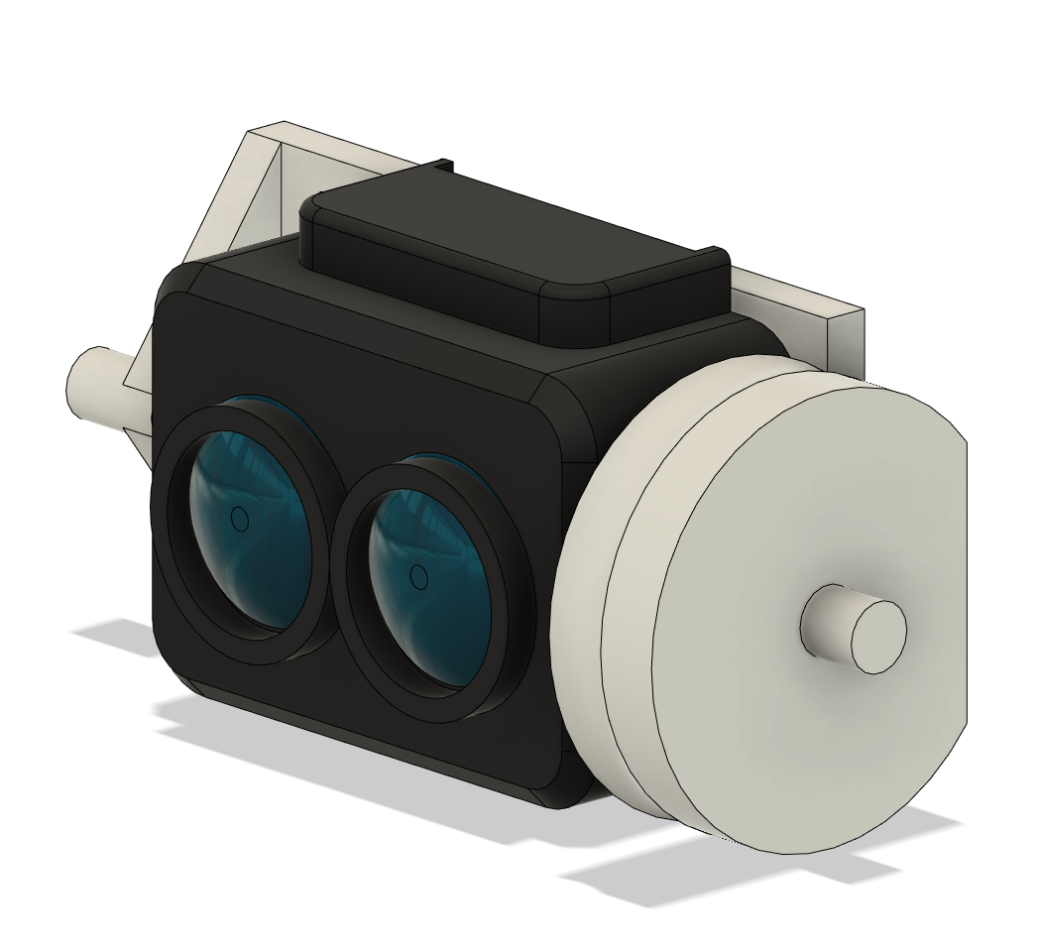
LiDAR Sensor Unit
SJ-GU-TF-Luna A03 LiDAR module
Takes point-to-point (1D) measurements
Communicates via I²C protocol
200 Hz refresh rate
9 meter range
Notes:
Start Jamie
The LiDAR sensor unit is mainly a SJ-GU-TF-Luna A03 LiDAR module.(describe the module in the picture) It will take 1D measurements of the environment and communicate with the microcontroller via I2C protocol. The sensor has a 200 Hz refresh rate and has a maximum scanning range of 20 meters and minimum scanning range of 20 cm. However, in order to keep the resolution of the final output, we decide to use a maximum scanning range of 9m.

Slide 11
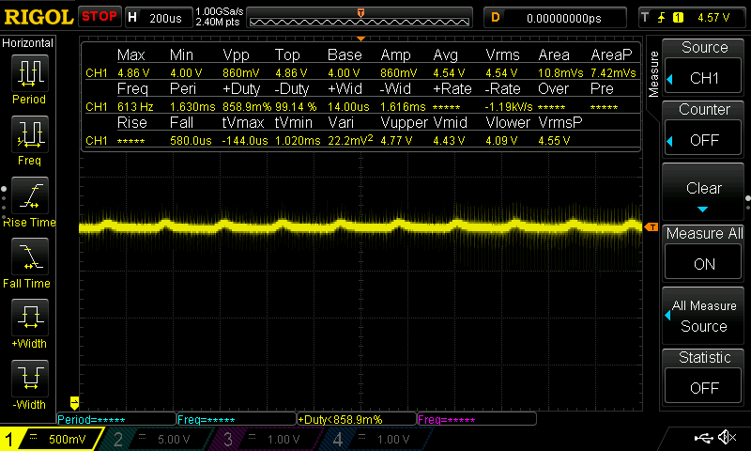
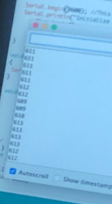
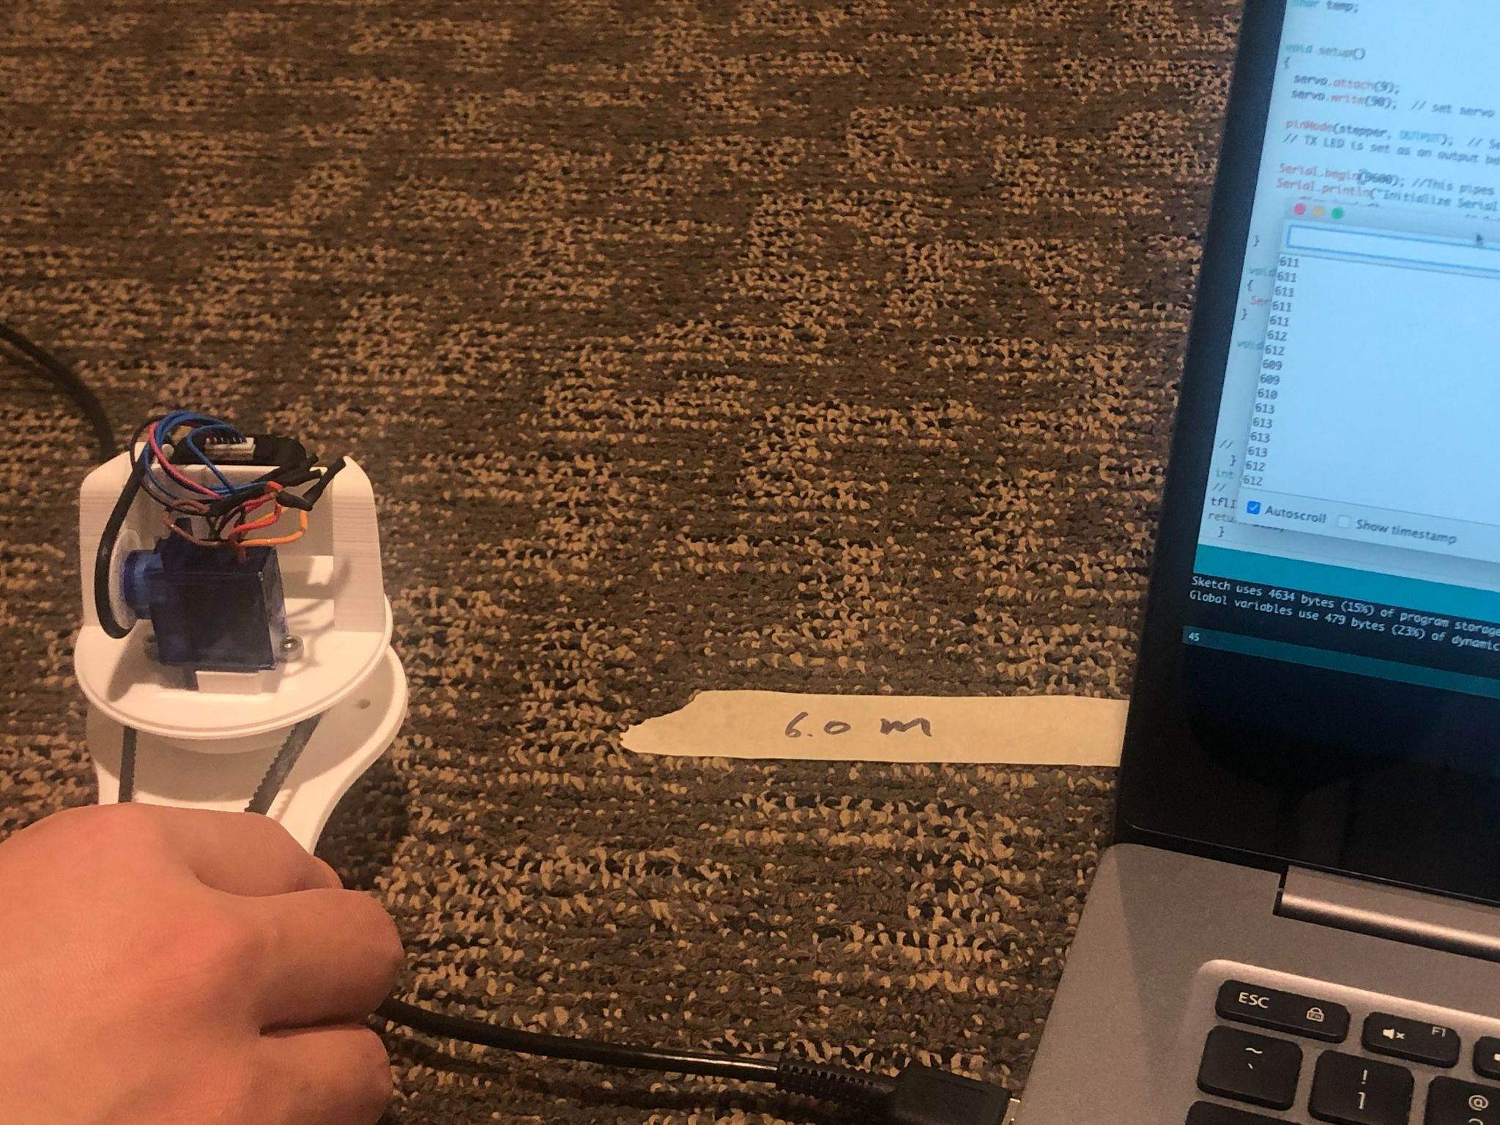
LiDAR Sensor Unit R/V
Power Reading Oscilloscope
stable 3.7 V - 5.2 V input power
Accuracy @ 6 meters
Max Distance Reading (mm)
Notes:
Describe the requirements and related test data

Slide 12
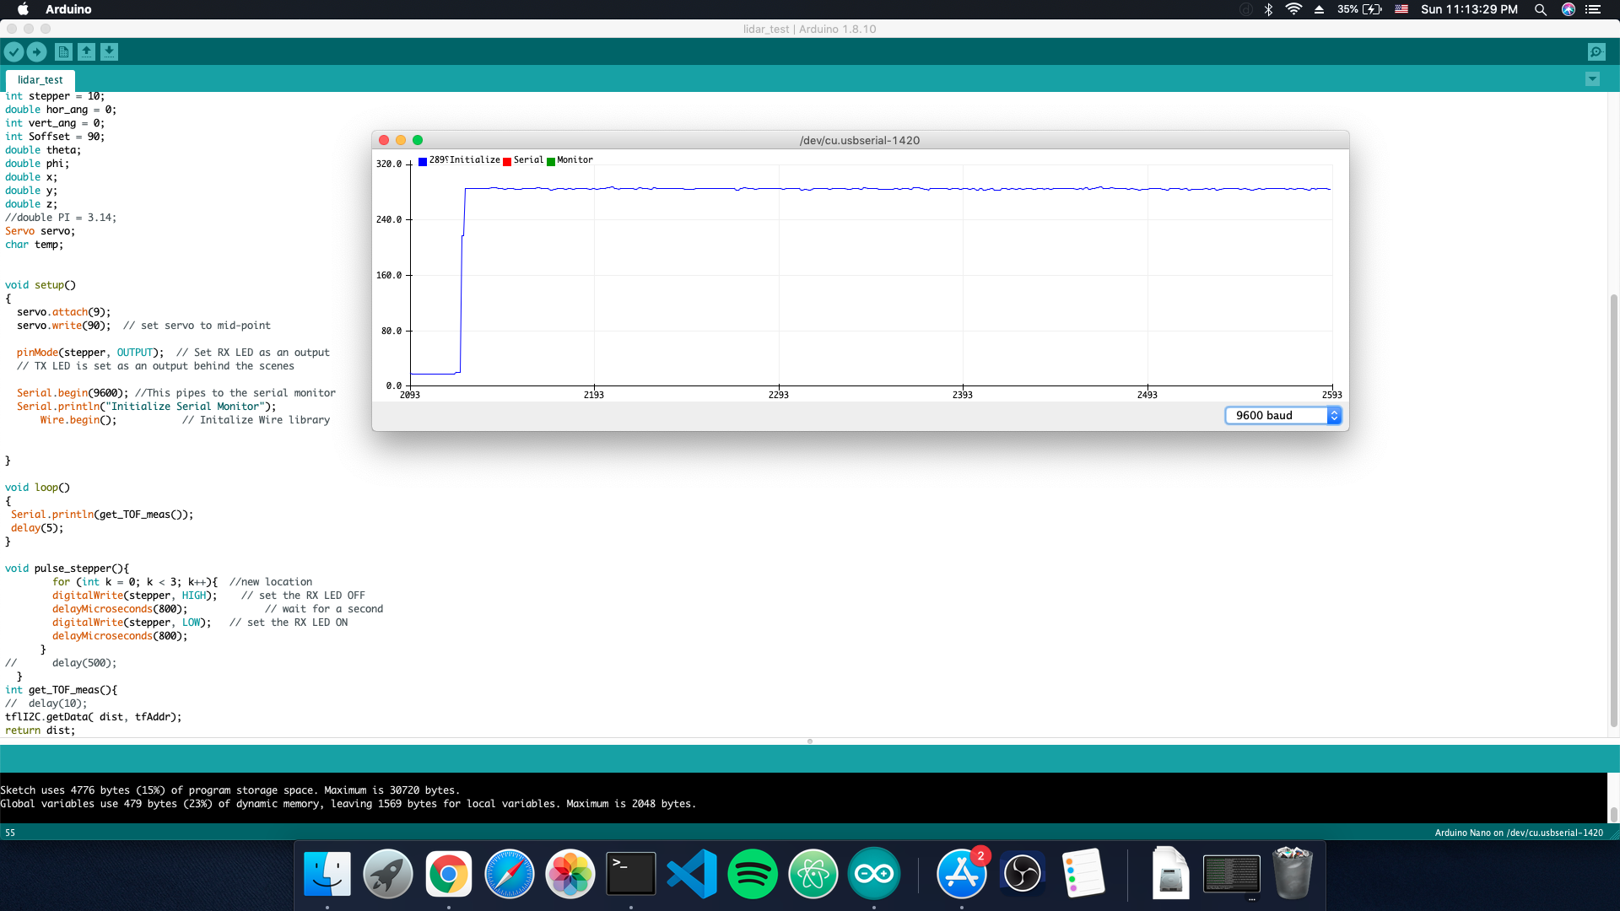
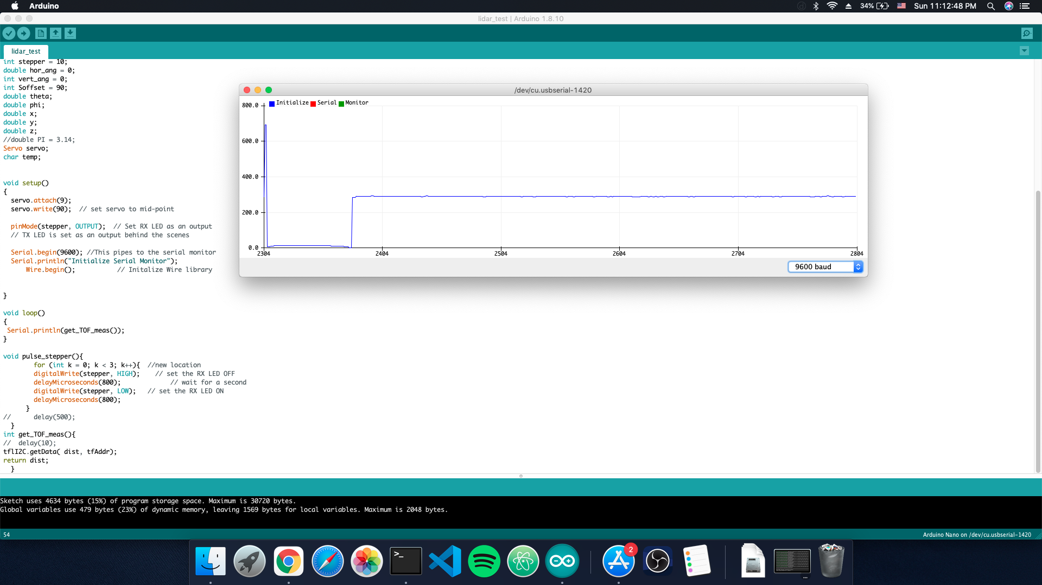
LiDAR Sensor Unit R/V Cont.
Polling frequency of around 200Hz
Correct sensor data

Slide 13
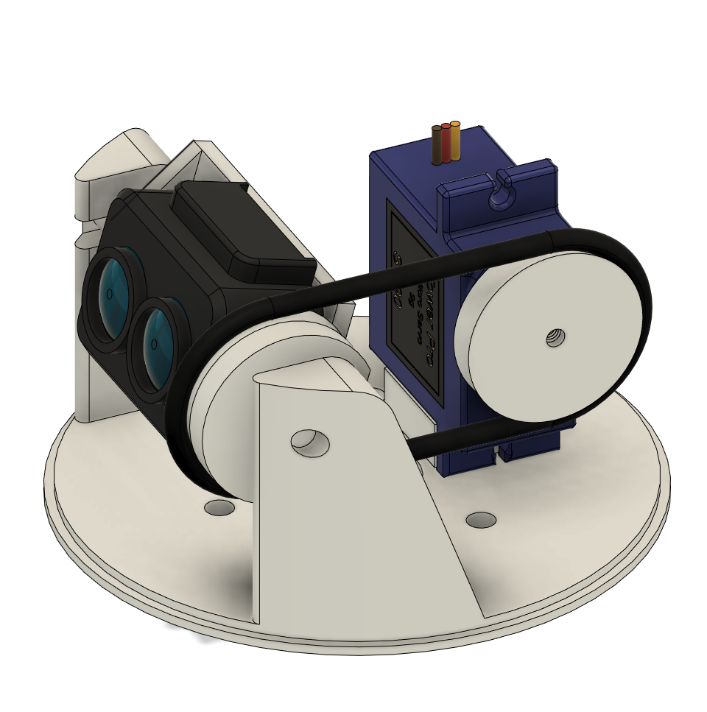
RC Servo Unit
RC Servo
Slip Ring
connects microcontroller with sensor + servo
Prevents the wire from twisting
SG90 9G Micro Servo
Responsible for vertical rotation
20 steps @ 3 degrees each
Notes:
The RC Servo Unit consists of a slip ring and an rc servo. (describe the components in the graph)The slip ring connects the microcontroller with the sensor and the RC servo and it also prevents the wire to get twisted when the sensor rotates during the scan process. For rc servo, we use a SG90 9G micro servo as our rc servo, it is regulated by a PWM signal from the microcontroller to do the vertical rotation. It will take 20 steps in the vertical direction and each step has 3 degrees.

Slide 14
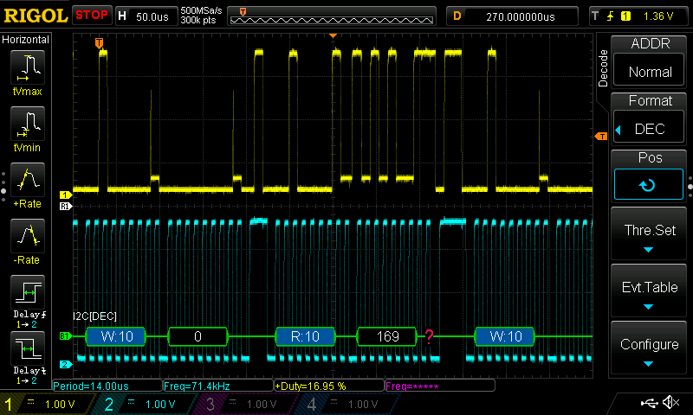
RC Servo Unit R/V
I²C and PWM signals aren’t compromised
ToF sensor can still receive 3.7 - 5.2 V power
Notes:
Describe the requirements for the rc servo unit and the related test data

Slide 15
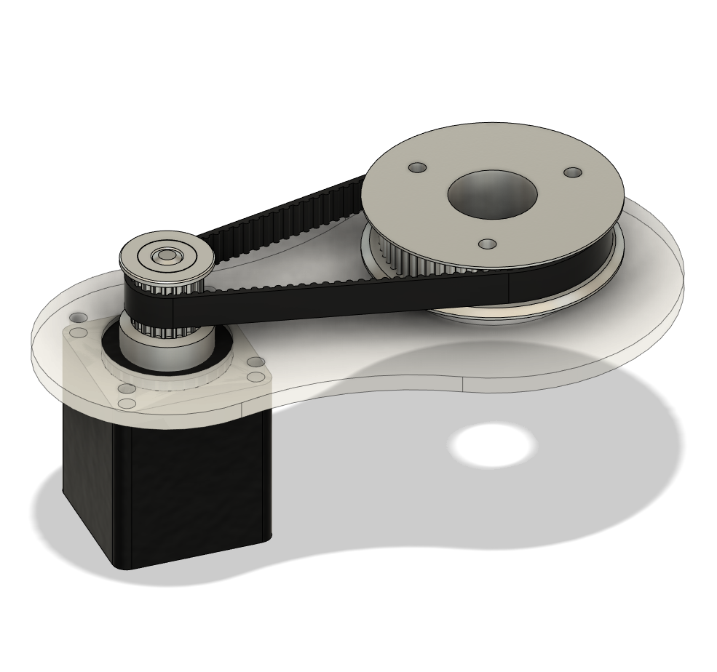
Stepper Unit
Nema 11 stepper motor
Uses 200 steps @ 1.8 degrees
3 : 1 gear reduction
A4988 micro-stepping motor driver
12 V from external DC jack
5 V and signal from microcontroller
Stepper Motor
Notes:
The stepper unit consists of a A4988 micro-stepper motor driver and a Nema 11 stepper motor. (describe the unit components in the graph). The stepper motor driver receives control signals from the microcontroller to control the movement of the stepper motor. Under the stepper driver’s control, the Nema 11 stepper motor will take around 200 steps per horizontal rotation with each step having an angle around 2 degrees. Another thing needs to mention is that since the number of the pulley teeth of the platform that holds the sensor is three times of the number of the pulley teeth of the stepper motor, the motor actually has to take 3 steps per measurement during the rotation.

Slide 16
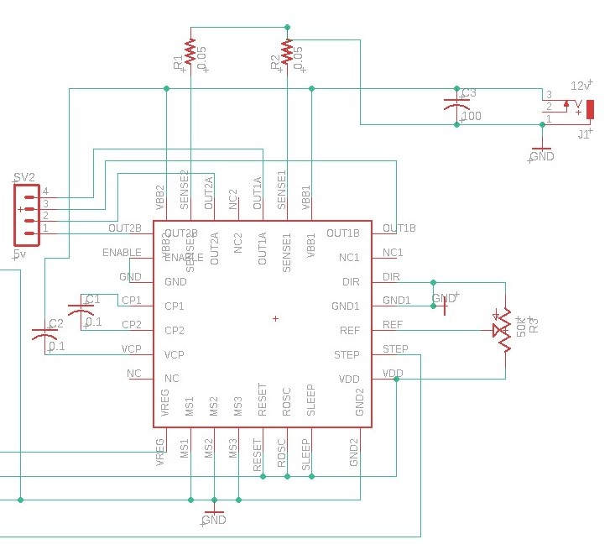
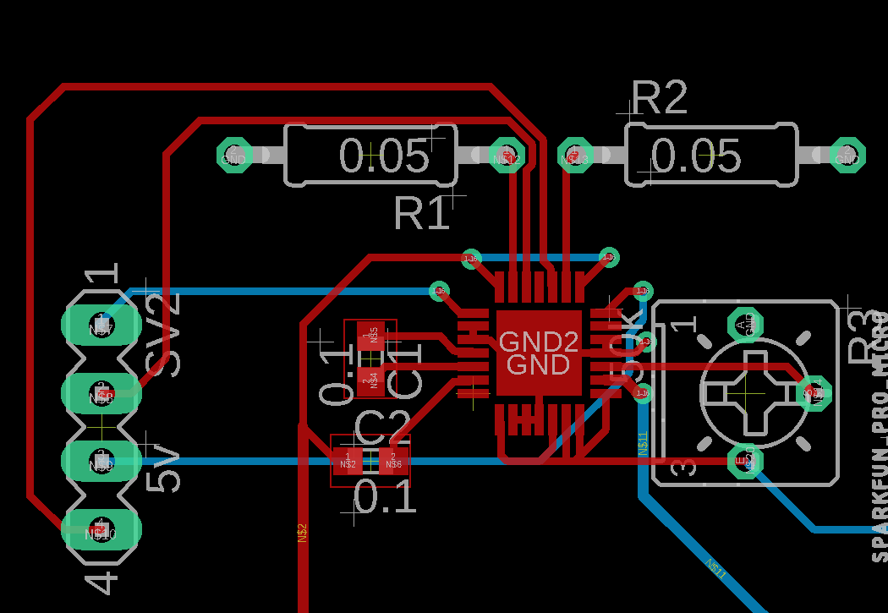
Stepper Unit Cont.
Notes:
Describe the schematic of the A4988 stepper motor driver.

Slide 17
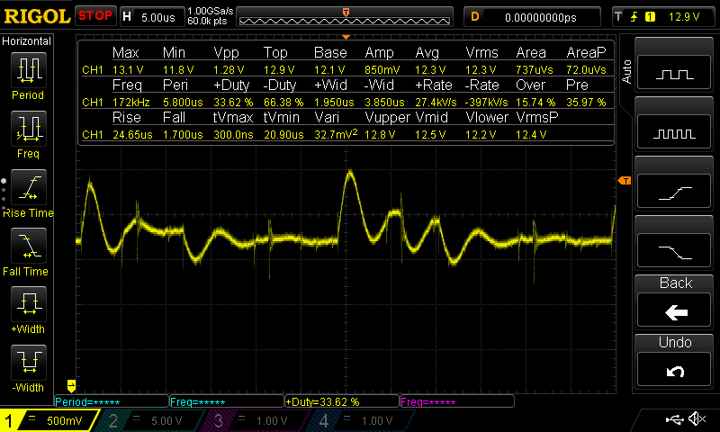
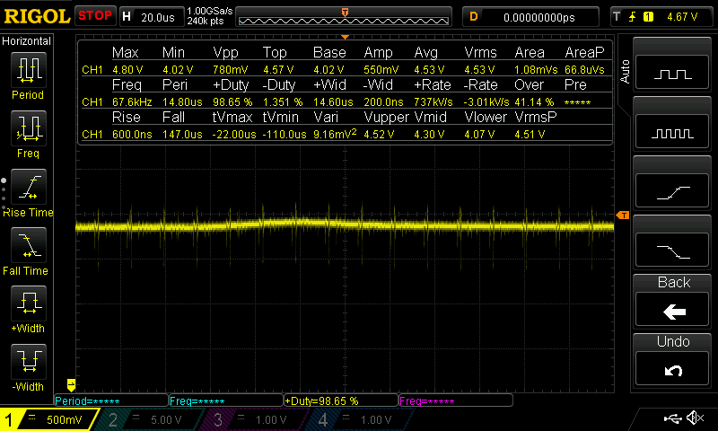
Stepper Unit R/V
Test if the stepper motor receives a 11.5 to 13.5 V input from wall and the driver receives a 3.7 to 5.2 V input from the microcontroller.
Notes:
End Jamie Transition to Xizheng

Slide 18
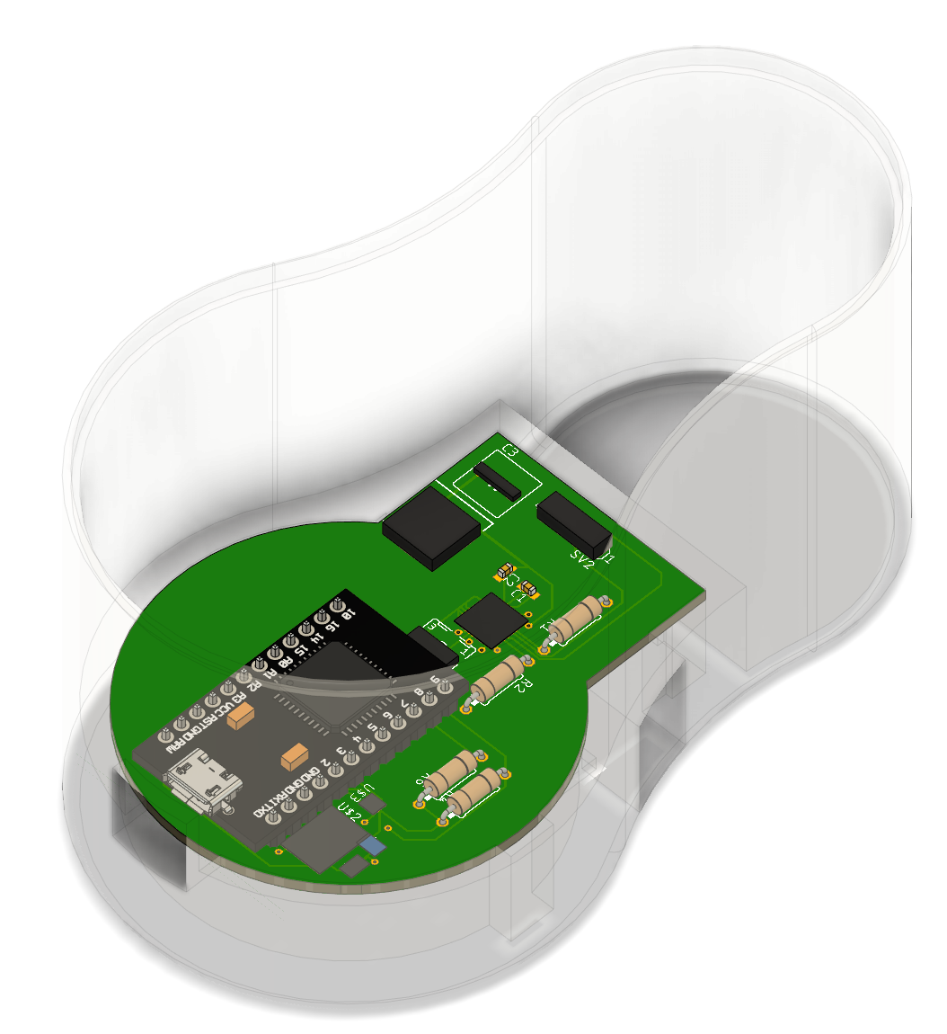
Microcontroller(Hardware)
Atmega32U4 chip
Uses LD1117 voltage regulator + BSS138 bi-directional logic level converter
Communicate with microcontroller via I²C
Uses PWM signal to control the movement of A4988 stepper motor driver
Notes:
Start Xizheng
We use Atmega32U4 chip as our microcontroller,(describe the pro micro chip in the graph), the microcontroller will control the components in horizontal unit, vertical unit and sensor unit. It will communicate with the sensor via I2C protocol, since this signal requires a 3.3 V logic level, we use a LD1117 voltage regulator and a BSS138 bi-directional logic level converter to achieve the normal communication between them. The microcontroller also sends a PWM signal to the rc servo and a STEP signal to the stepper driver so the movements of the servo, the stepper and the sensor are all synchronized.

Slide 19
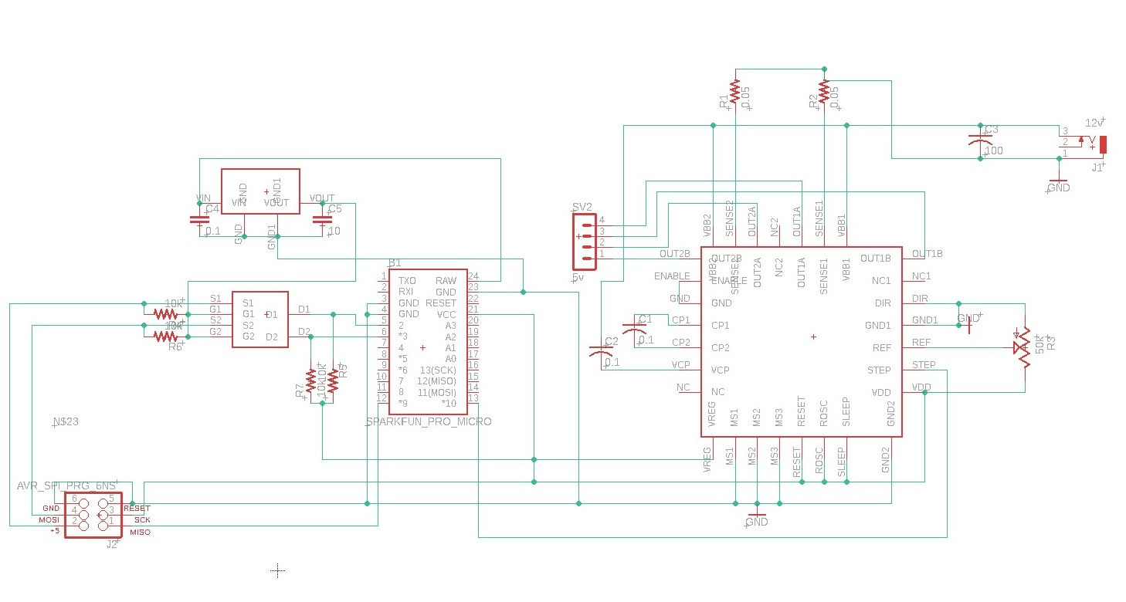
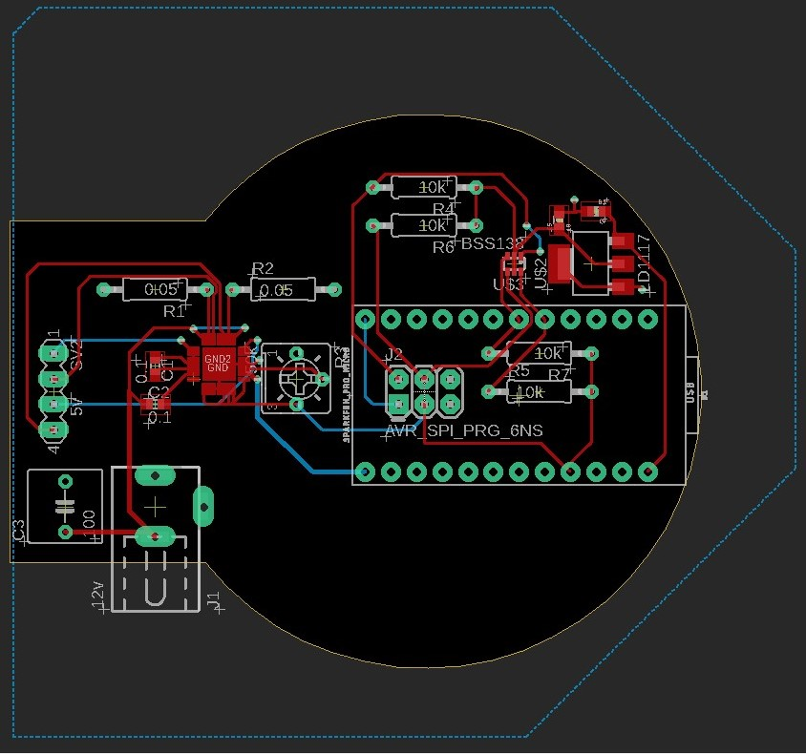
Microcontroller(Schematic)
Notes:
Describe the schematic of the microcontroller

Slide 20
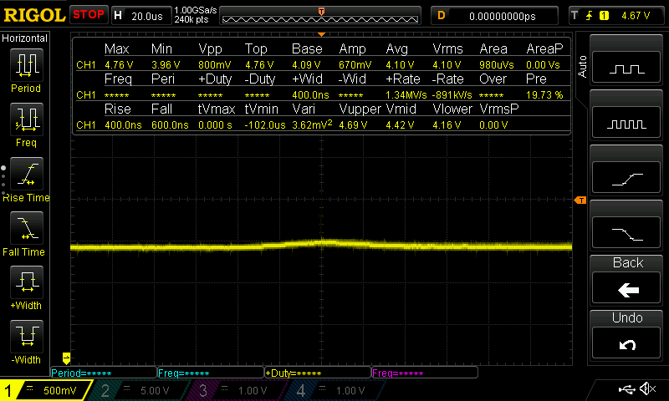
Microcontroller R/V
Test microcontroller operates within 10% of 4.5 V
Notes:
Explain test data

Slide 21
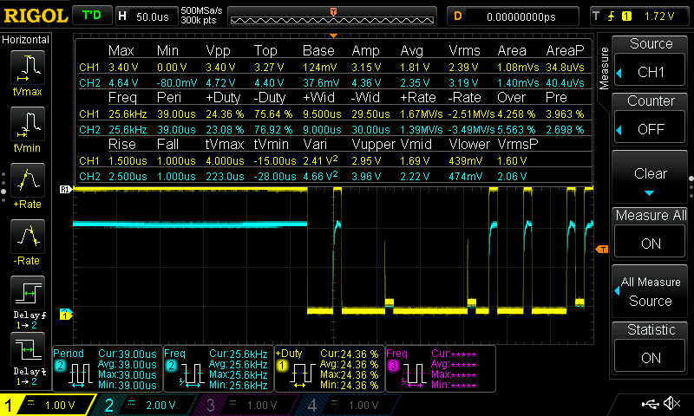
Microcontroller R/V Cont.
Test the BSS138 bi-directional level shifter works properly
Notes:
End Xizheng Transition to Terence

Slide 22
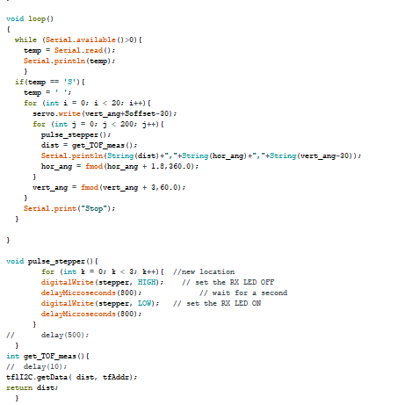
Microcontroller (Software)
Arduino Code
Sends pulses to the servo and stepper to adjust horizontal and vertical angles after each TOF sensor refresh
Collects reading from TOF sensor via I²C and sends it to the computer via serial
Angle tracking + data collection/sending to computer
Motor control function
Notes:
Start Terence
Responsible for controlling vertical/horizontal rotation
Tracks the angle displacement each cycle collects data from tof sensor
Establish serial connection sends data to computer

Slide 23
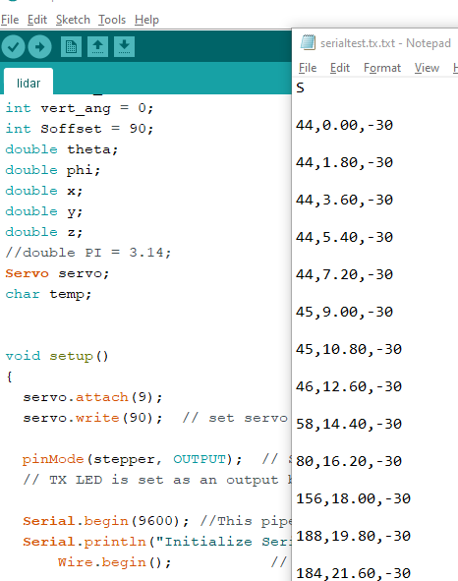
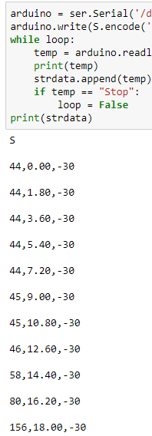
Microcontroller R/V (Software)
Verify reliability of serial data stream between microcontroller and computer
...
Microcontroller (Sent)
Computer (Recieved)

Slide 24
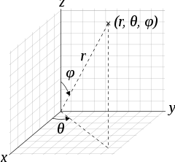
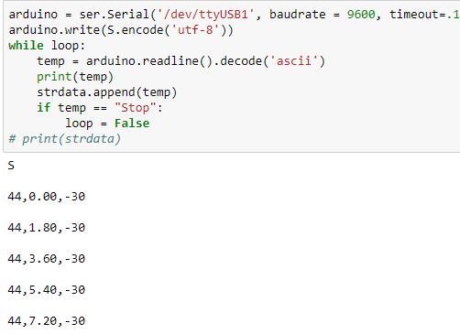
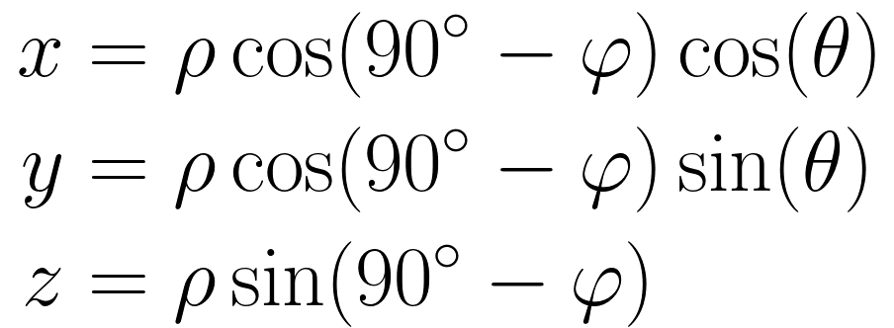
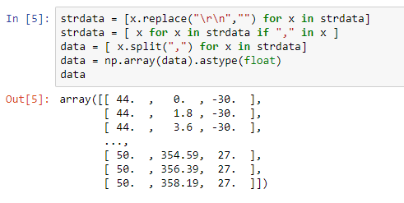
Software
Python script
Collect data sent from microcontroller via serial
3D spherical to cartesian
Data parsed + encoded into industry standard LAS format
Serial Connection + printing data recieved
3D Spherical Coordinates
Restructuring Data for parsing
Spherical -> Cartesian Conversion
Notes:
Use python library to connect to the arduino serial connection
Data collected in spherical coordinate (r, φ, θ) must be converted into x y z first
Numpy and laspy to encode the las file

Slide 25
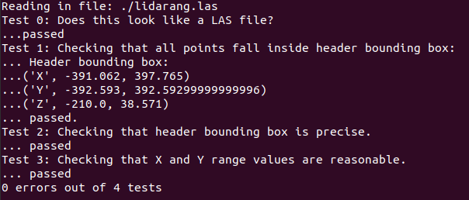
Software Part 2 R/V
Verify the file integrity of the output LAS file (lasvalidate)
Compare output las file to surrounding room
Lasvalidate output
Las output file
Notes:
Built in laspy function lasvalidate runs tests on output point cloud
Checks header box, scaling values, offsets checks everything makes sense

Slide 26
Limiting Factors
Scanning accuracy of the sensor
Improved precision of the TOF sensor
Rotation rate of the stepper motor
Finish the scanning faster
Resolution of Point Cloud File
Smaller angle increments for horizontal/vertical rotation
Notes:
The horizontal movement speed is capped by the servo motor physical limits which results in longer scan times
To fulfill time limit, we had to use relatively large vertical angle increments resulting in lower point cloud resolution

Slide 27
Future Recommendations
Higher refresh rate sensor to improve point cloud resolution
Faster servo/stepper motor reducing scan time
Remove dependency on wall outlet power for portability
System entirely powered via USB (5V/2A)
Implement the las file to be viewable via VR headset
User can explore scanned room and better visualize the scan
Notes:
Based on the limit of our system, if we want to improve it, we should use a sensor with higher refresh rate so we will have a point cloud with higher resolution.
We can also use a faster stepper or servo motor so we can reduce our system scanning time.
Also, since now our system depends heavily on the wall outlet as the power, in order to increase the portability in the future, we can make it entirely depends on the USB power, which is a 5V power.
For the software part, we can alter the python code to give a real time visualization of the cloud point output so we don’t have to throw the output file into the software every time. We can further make the las file viable via VR headset so the user can have a vivid visualization of the environment.

Slide 28
Ethics/Safety
TOF sensor has the potential to cause damage to the human eye
Recommend stepping outside or avoiding eye contact
Alternatively utilizing safety laser goggles
Cheaper cost of entry into LiDAR can have unintended consequences/use cases
Potential to be used in targeting system/AI recognition for malicious purposes

Slide 29
Thanks for Listening
Any questions?

