Slide 1
FastFretTrainer
Electrical & Computer Engineering
Group #24
Eli Hoon, Murtaza Saifuddin, Omeed Jamali
May 5, 2025
Notes:
Introduce team members and project generally

Slide 2
Overview
Beginner guitarists are often intimidated by the fretboard.
FastFretTrainer makes learning easier.
ELECTRICAL & COMPUTER ENGINEERING
GRAINGER ENGINEERING

Slide 3
Agenda
Introduction
Software Design
Fob Design
Base Design
Conclusions
ELECTRICAL & COMPUTER ENGINEERING
GRAINGER ENGINEERING

Slide 4
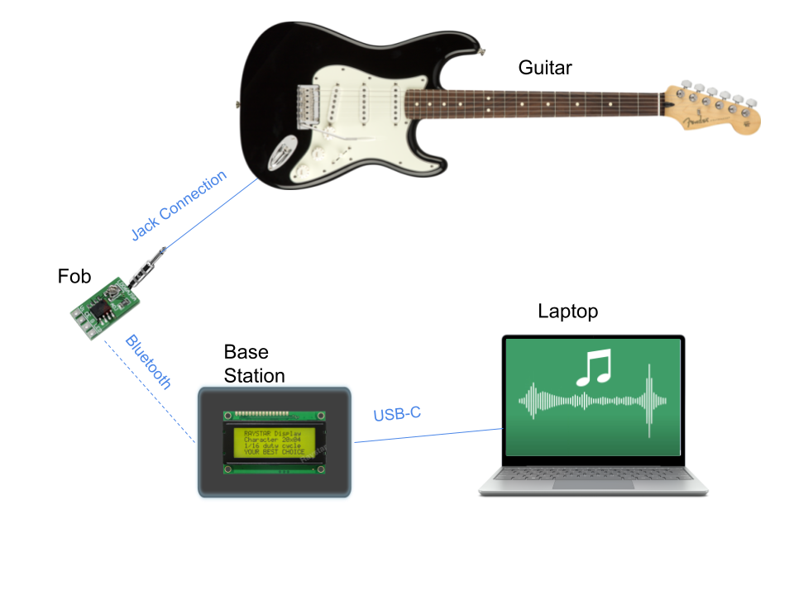
General Design
Design Concept
Practice mode selection
Note requested from user
Guitar signal digitized
Software handles data manipulation
Feedback given to user
High Level Requirements
Wireless data transfer from 1.5 meters away
App can accurately compare played and expected frequencies
LCD display can give feedback (in cents)
MicroUSB
ELECTRICAL & COMPUTER ENGINEERING
GRAINGER ENGINEERING
Notes:
Agenda slide??

Slide 5
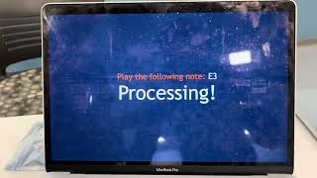
Demo Video
ELECTRICAL & COMPUTER ENGINEERING
GRAINGER ENGINEERING

Slide 6
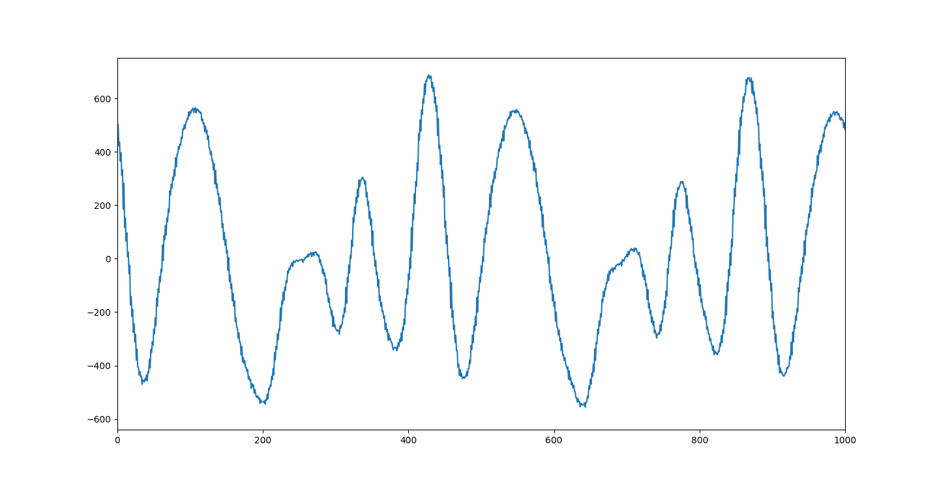
Design Concept
ADC Sampling of Input Guitar Signal
ELECTRICAL & COMPUTER ENGINEERING
GRAINGER ENGINEERING

Slide 7
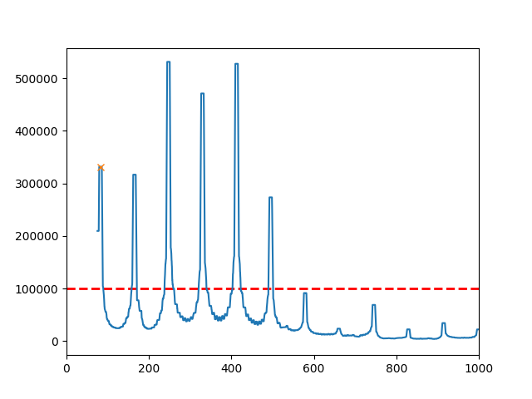
Design Concept
FFT of Guitar Input
ELECTRICAL & COMPUTER ENGINEERING
GRAINGER ENGINEERING
Notes:
Make the X bigger

Slide 8
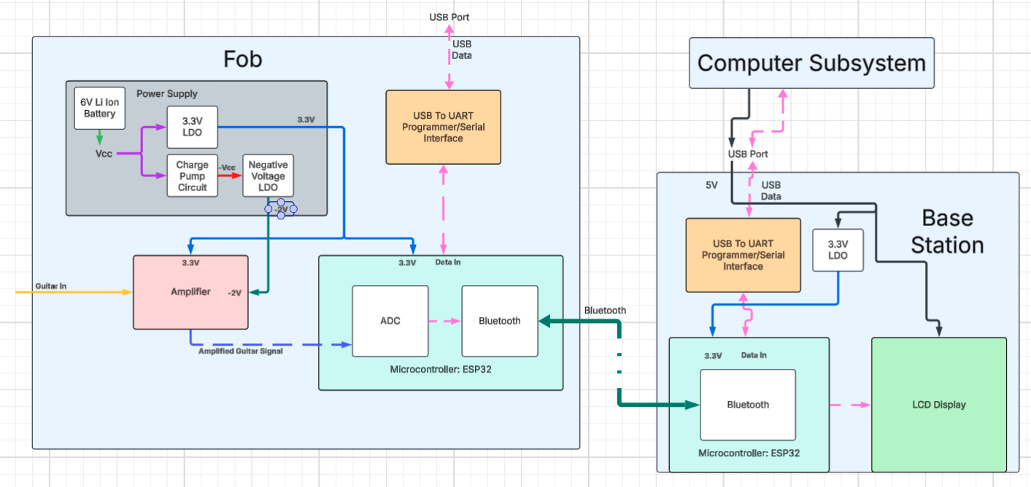
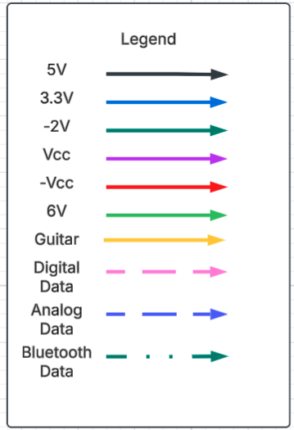
Design Concept
Design Block Diagram
ELECTRICAL & COMPUTER ENGINEERING
GRAINGER ENGINEERING
Notes:
Title change??

Slide 9
Software Design
ELECTRICAL & COMPUTER ENGINEERING
GRAINGER ENGINEERING

Slide 10
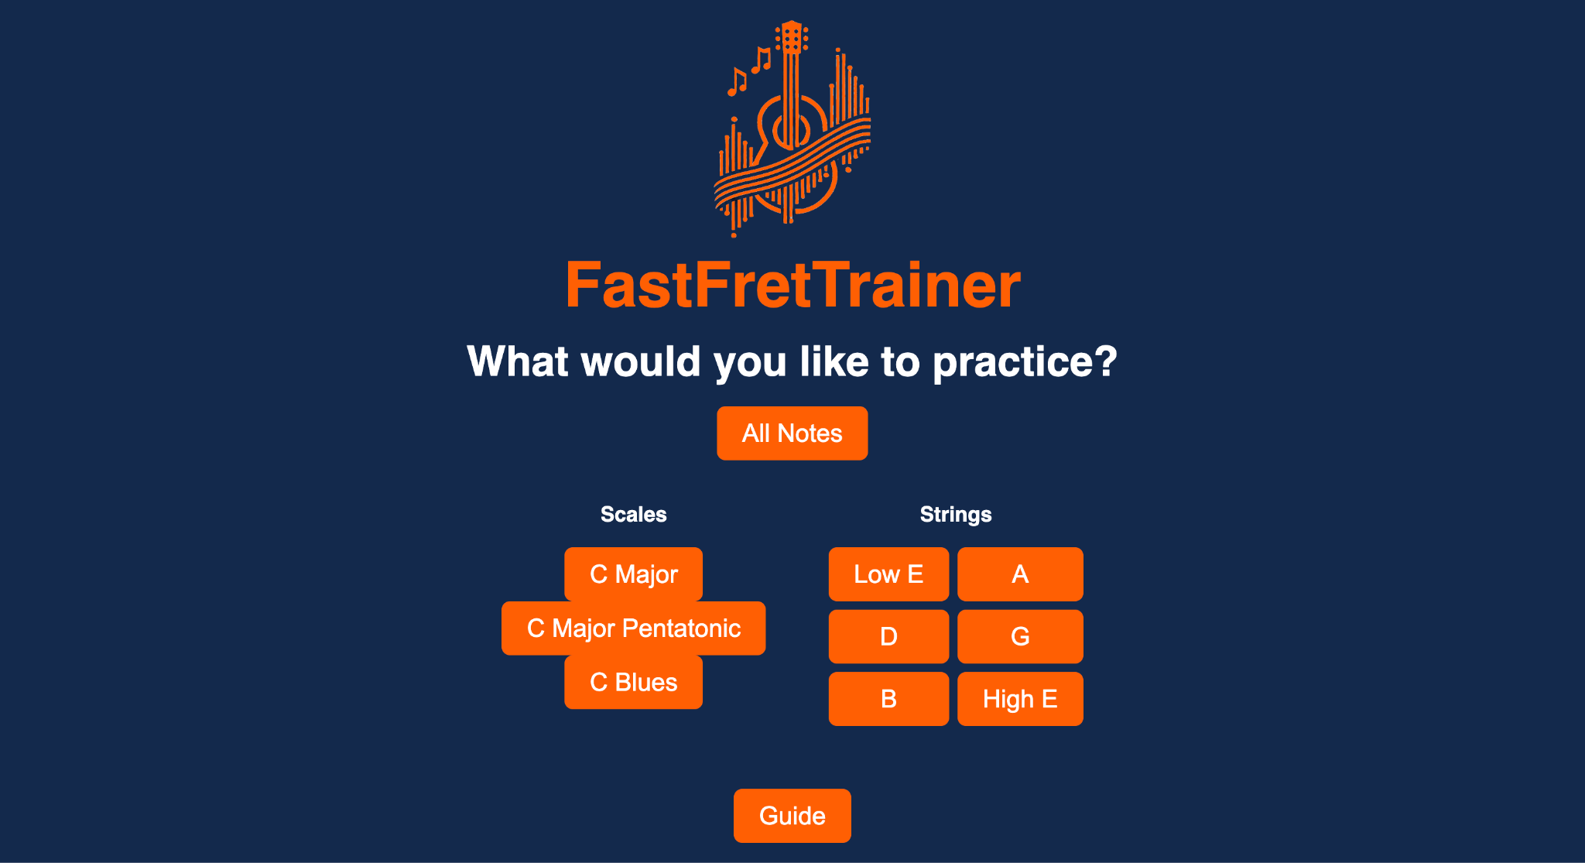
Software Design
Design Concept
Python Data Processing
PySerial for communication
Numpy.fft for frequency analysis
Flask Front-End
Different modes
Visual feedback
Guide
Functional Requirements
Receive expected digital signal
Correctly calculate cents measurement
Send accurate data back to LCD display
ELECTRICAL & COMPUTER ENGINEERING
GRAINGER ENGINEERING

Slide 11
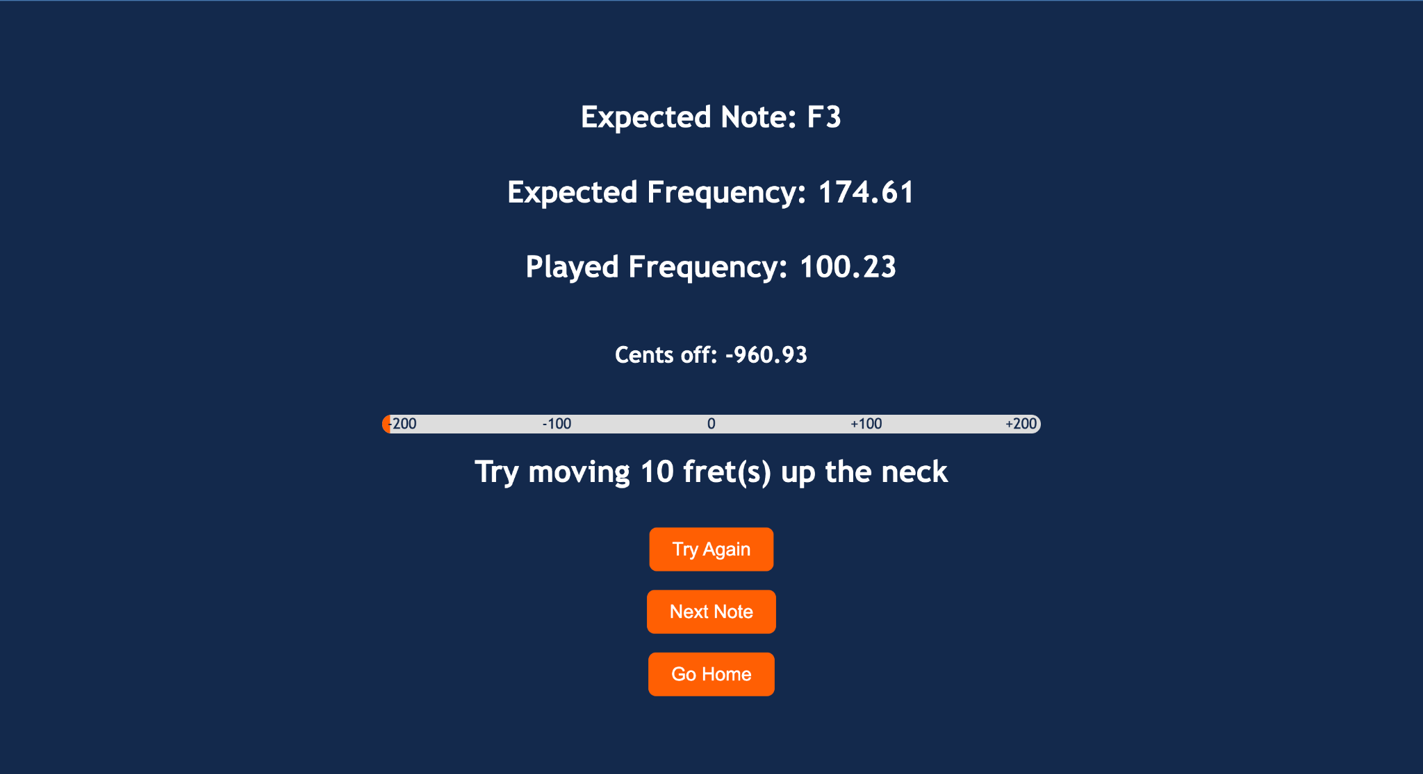
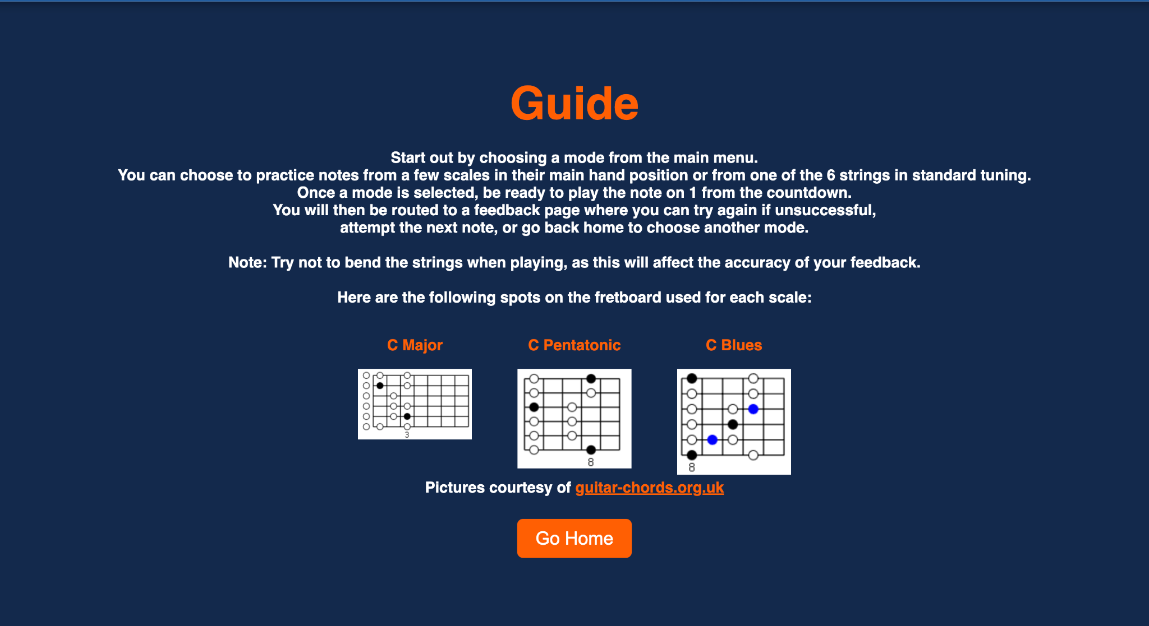
Updated Software Design
Design Changes
Added Guide
Calculate Frets Off
Reason For Change
More intuitive for user
Clarifies specific scale positioning
Provides adjustment feedback beside cents
IMAGE / GRAPHIC
IMAGE / GRAPHIC
ELECTRICAL & COMPUTER ENGINEERING
GRAINGER ENGINEERING

Slide 12
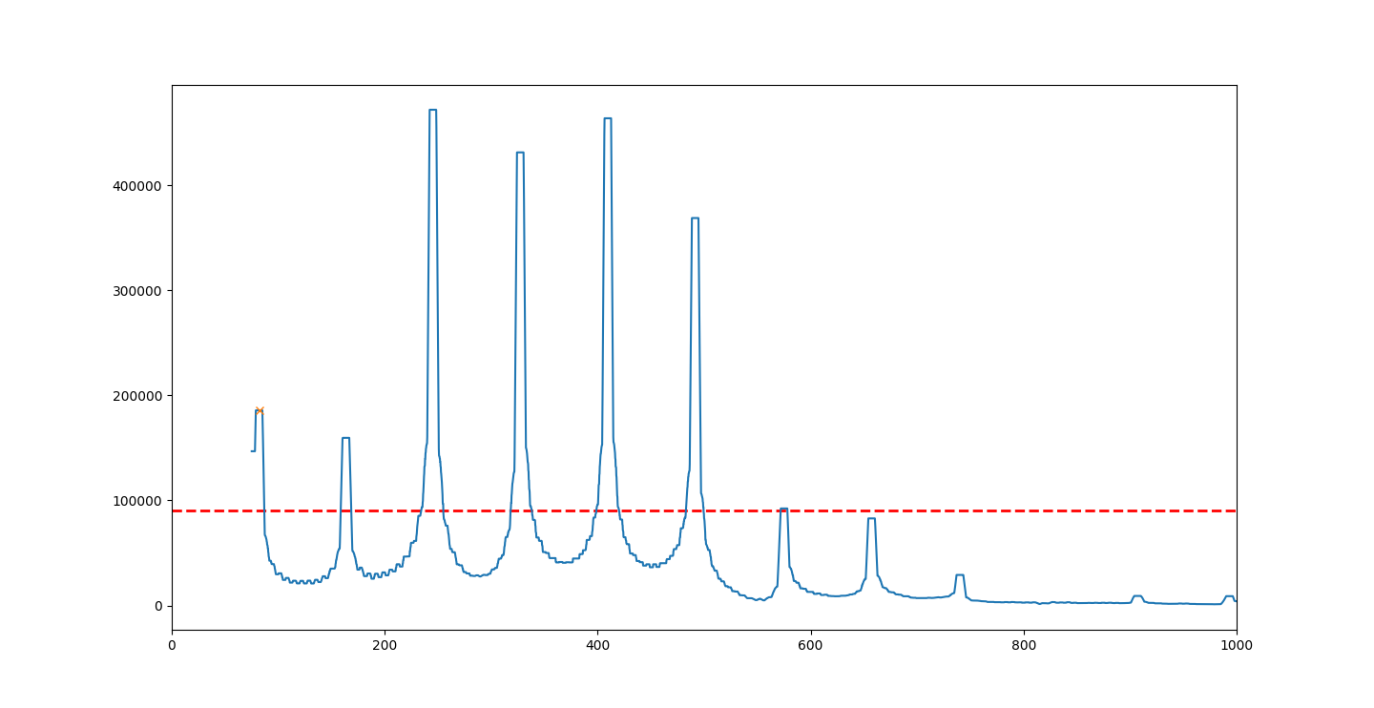
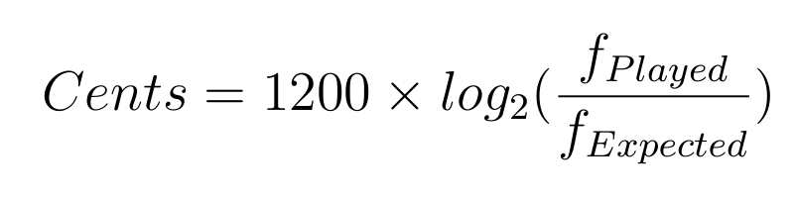
Frequency and Fret Algorithms
Frequency Algorithm
Take FFT of digitized input signal
Analyze bins over 75 hz
Use average + offset to find relative threshold for magnitude
Choose the first peak
Calculate difference using
Fret Algorithm
Search sorted list of frequencies to find closest note
Use matching index of frequency for sorted notes
Calculate difference in indices
ELECTRICAL & COMPUTER ENGINEERING
GRAINGER ENGINEERING

Slide 13
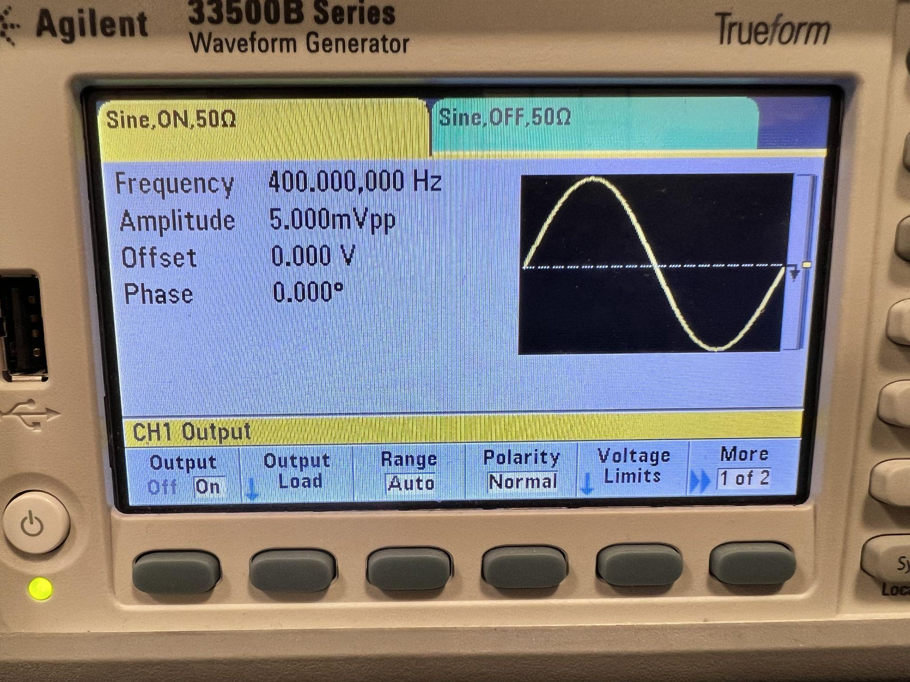
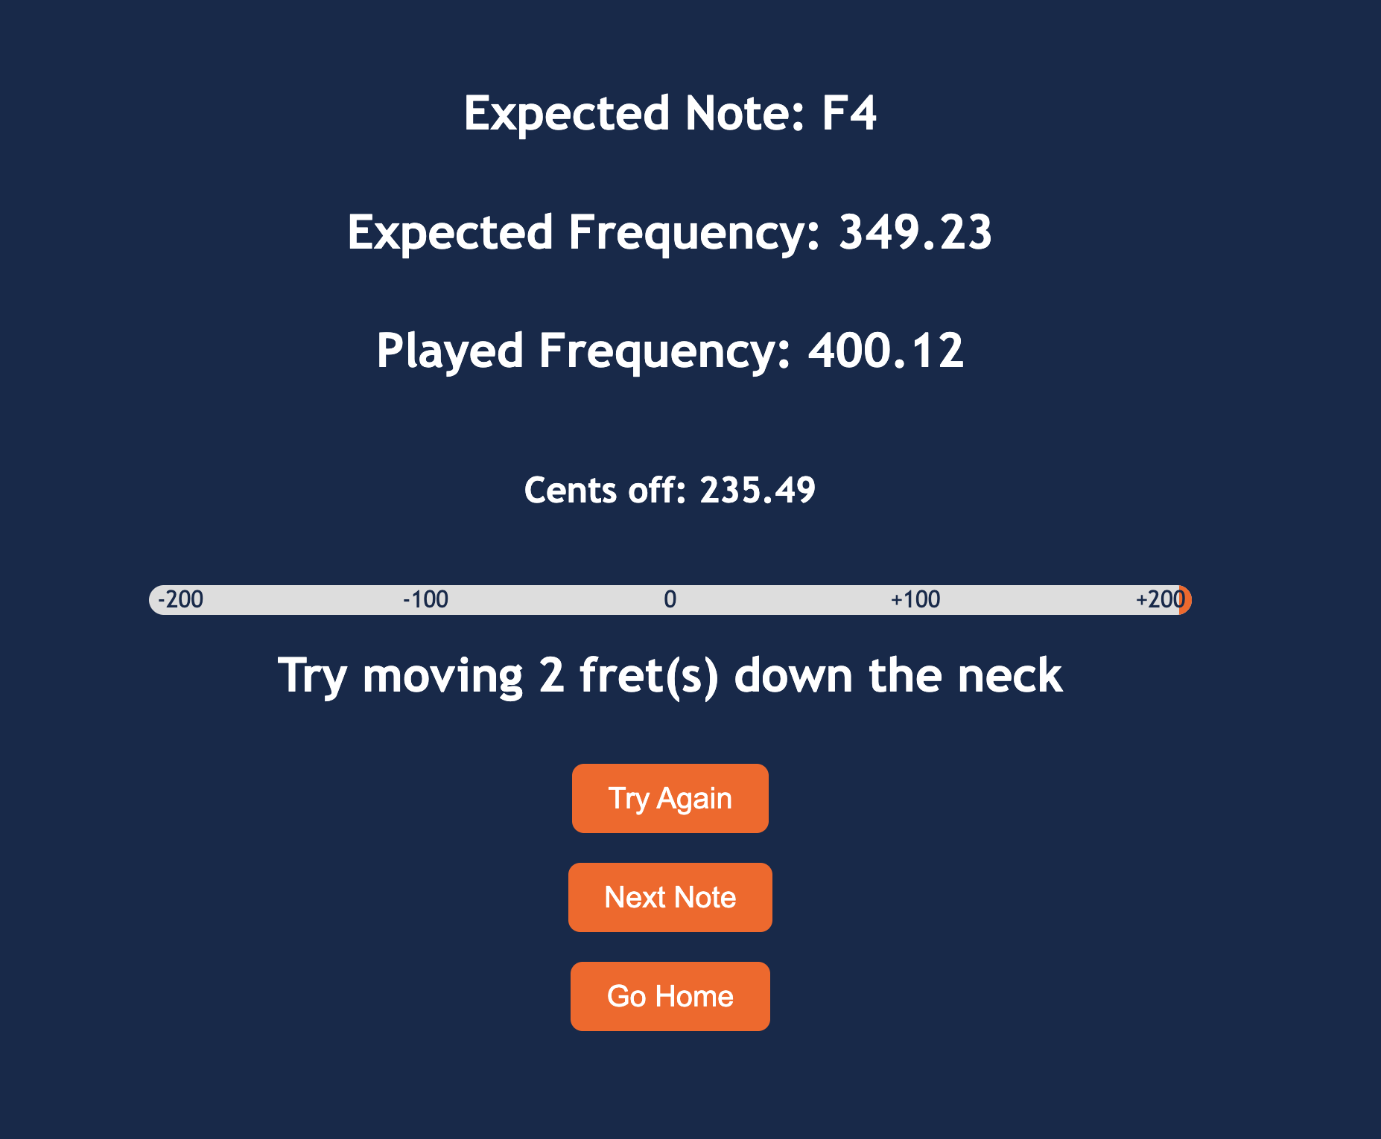
Software R&V
Requirements | Verification
Accurately report the frequency of the note played on the guitar | Use a signal generator and oscilloscope to record the note frequency and compare it to what is reported
Give an accurate measurement of note difference in cents on the scale shown in the UI | Utilize an oscilloscope to measure frequency and manually calculate and compare the cents value
Properly interface with the USB connection to send data packets back to the Base Station | Call write commands via the PC for “Hello world” packets and see if they are displayed on the LCD display
Source Frequency
App Functionality
ELECTRICAL & COMPUTER ENGINEERING
GRAINGER ENGINEERING

Slide 14
Fob Design
ELECTRICAL & COMPUTER ENGINEERING
GRAINGER ENGINEERING

Slide 15
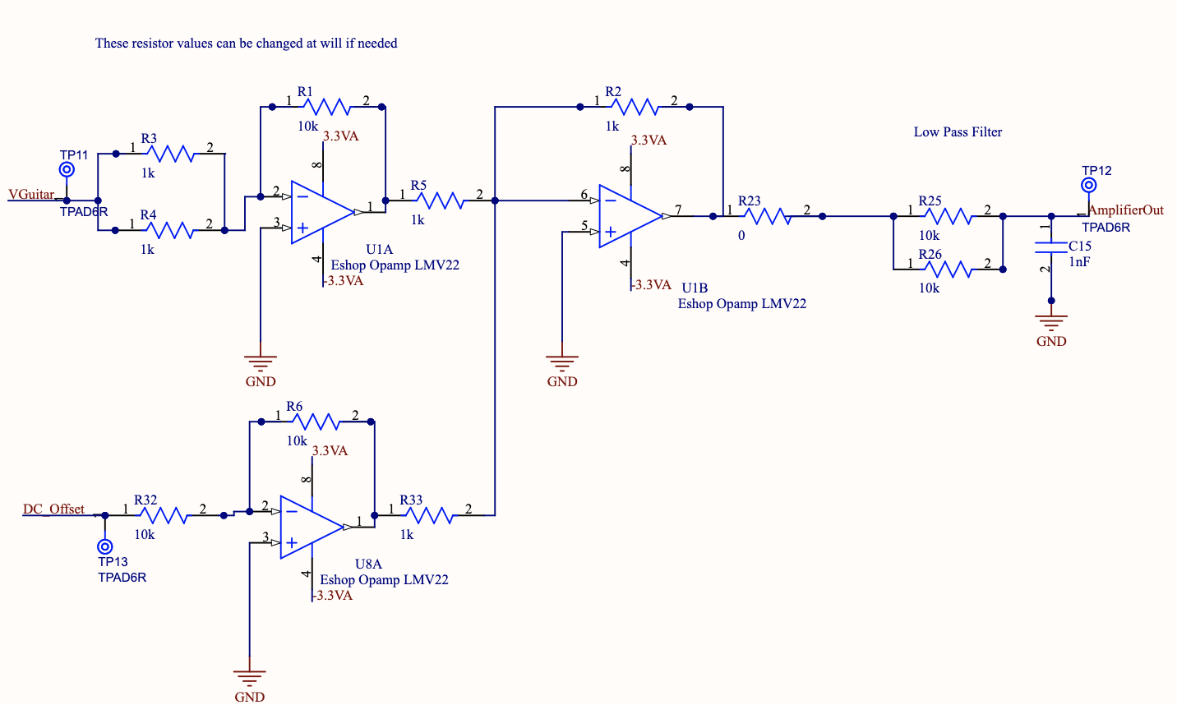
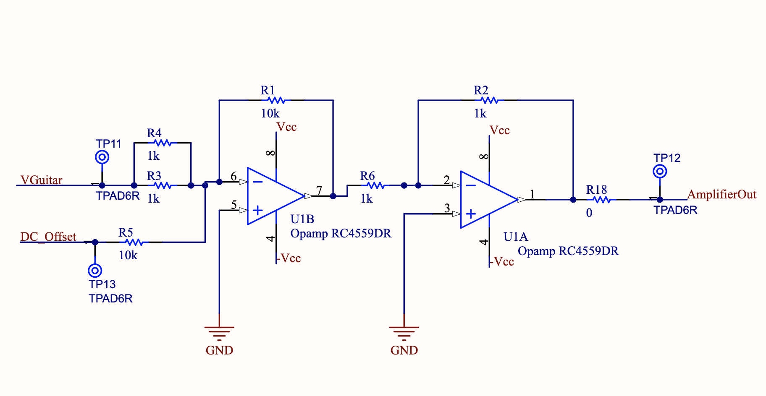
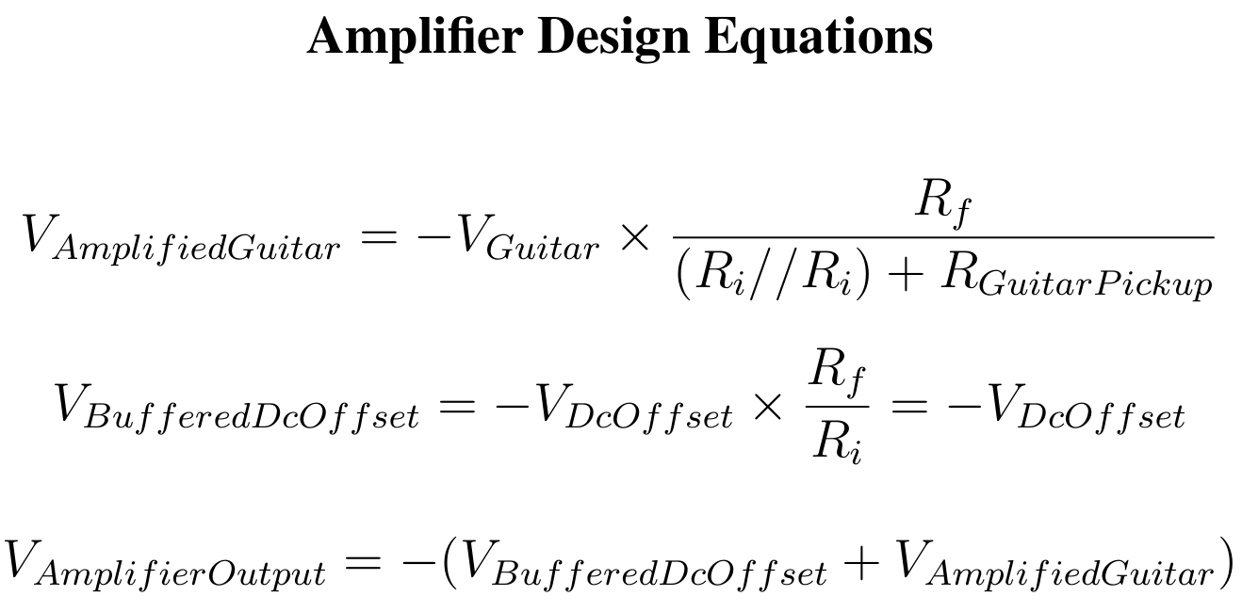
Fob Amplifier Design
Design Concept
First Stage Summing-Inverter
DC Offset
Guitar Signal Amplification
Second Stage Unity Inverter
Functional Requirements
Amplify guitar signal and add DC offset
Ensure output is within ADC range
Biasing rail voltage 3.3V and -2V
IMAGE / GRAPHIC
IMAGE / GRAPHIC
ELECTRICAL & COMPUTER ENGINEERING
GRAINGER ENGINEERING
Notes:
Make the second Image something related to the original amplifier design? Not sure what to put,

Slide 16
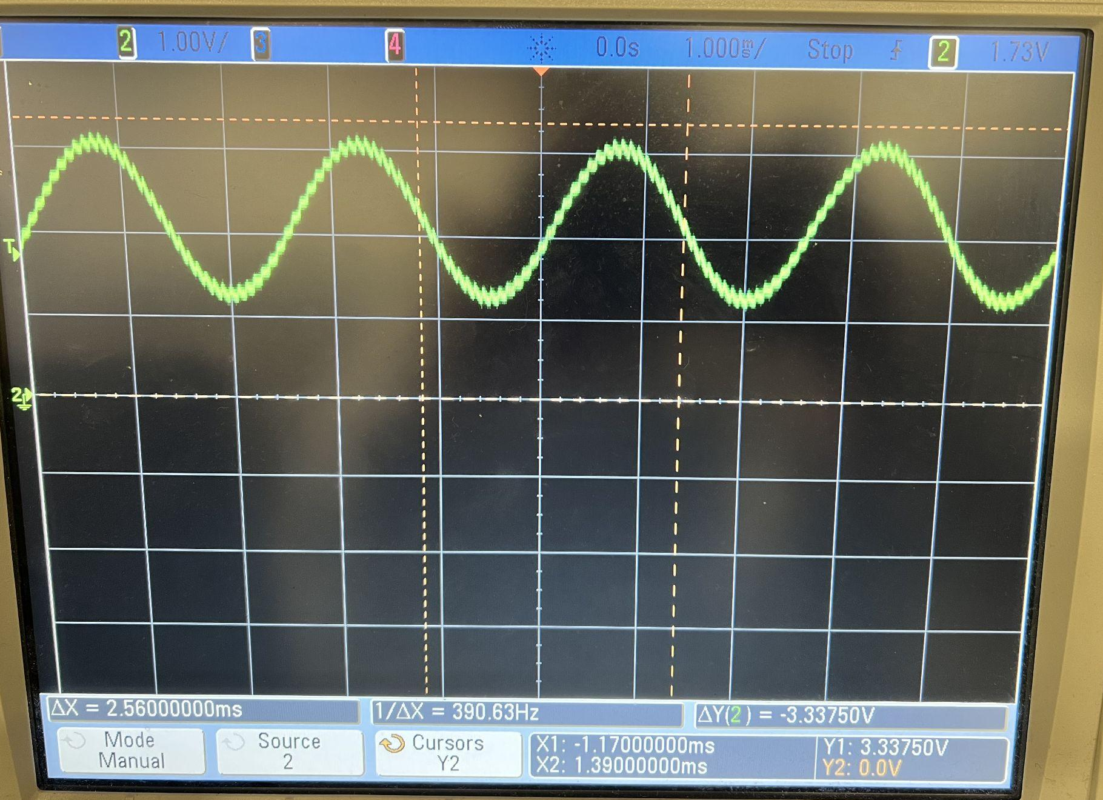
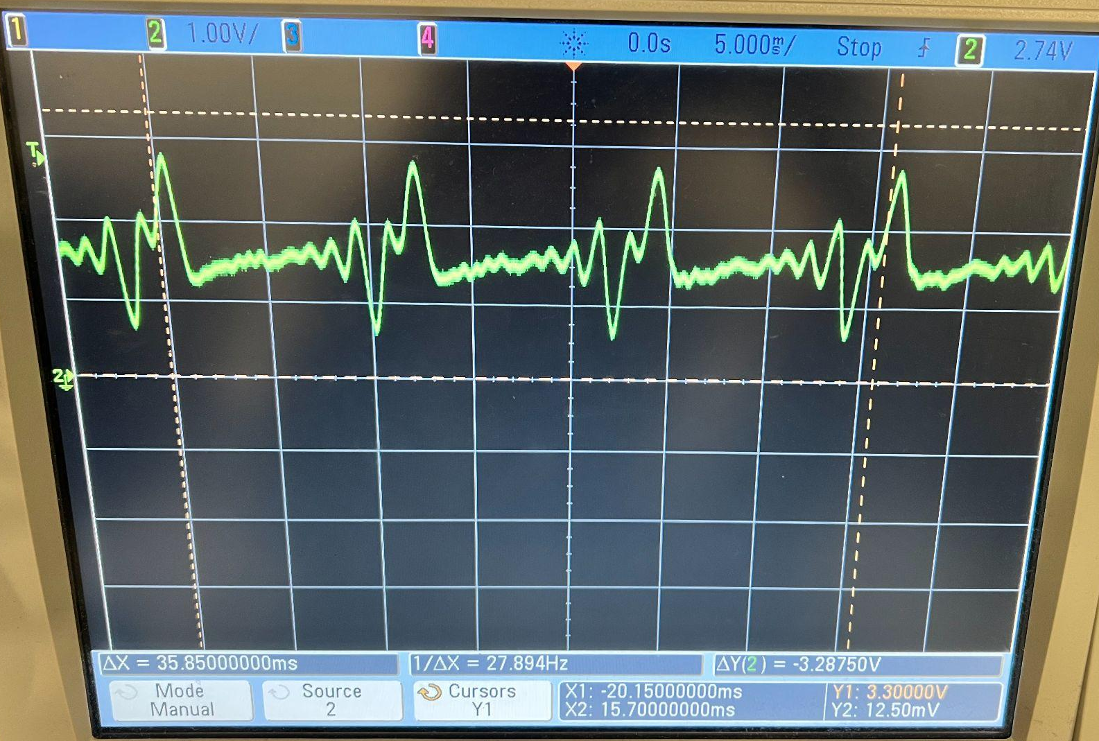
Amplifier Design R&V
Requirements | Verification
Signal input to the ADC must be between 3.3V and 0V | Use a 5mVpp input and ensure the output is within 0V to 3.3V
DC offset must be half of the positive rail voltage. | Use a multimeter to ensure the offset remains within +/-15% of the required 1.65V
5 mVpp Test
Guitar Test
ELECTRICAL & COMPUTER ENGINEERING
GRAINGER ENGINEERING

Slide 17
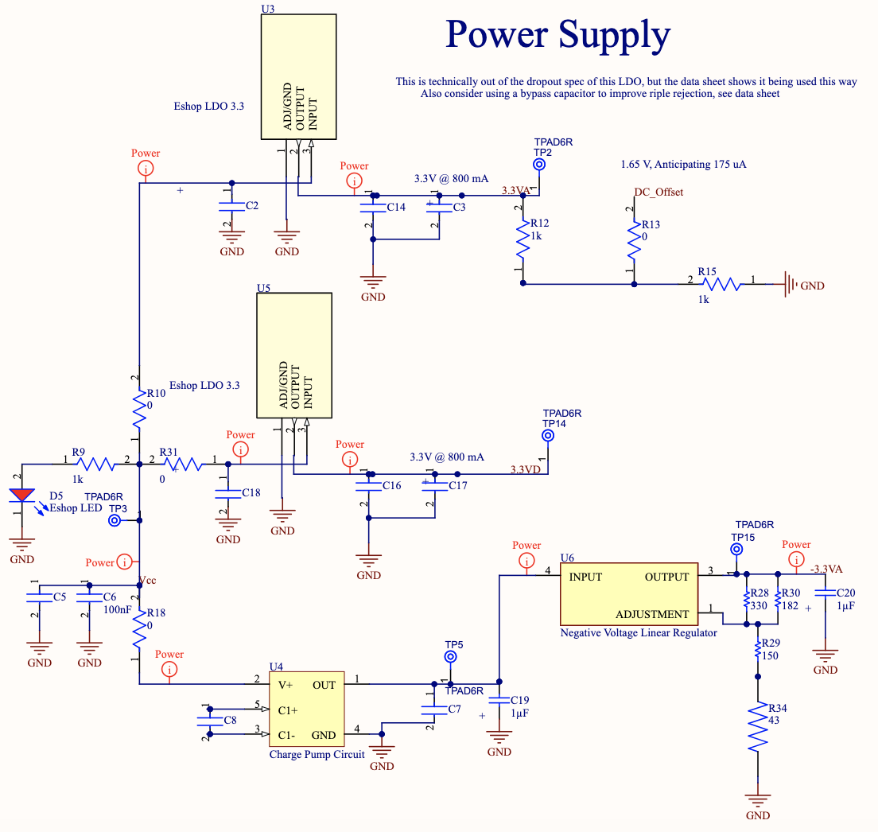
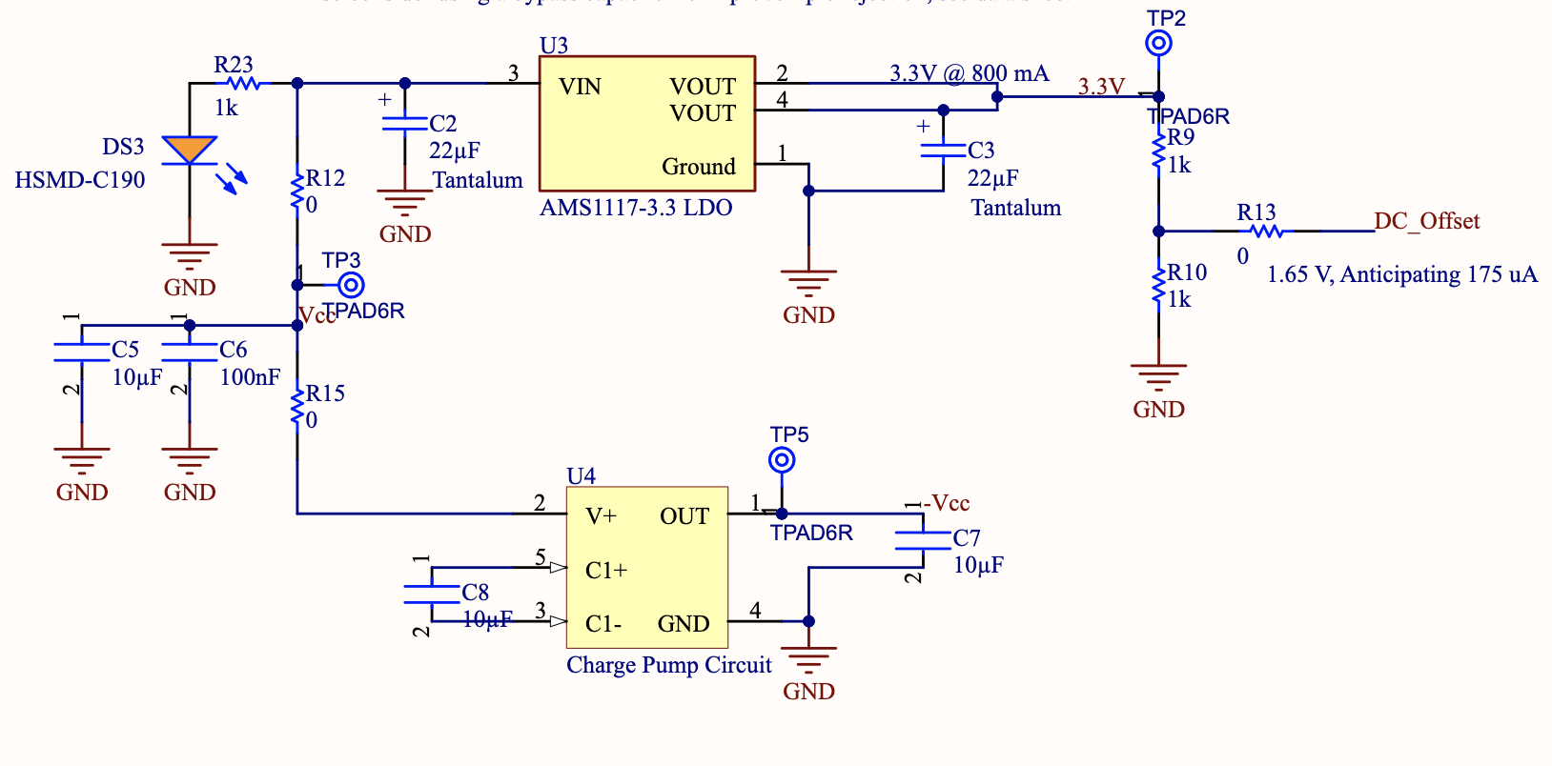
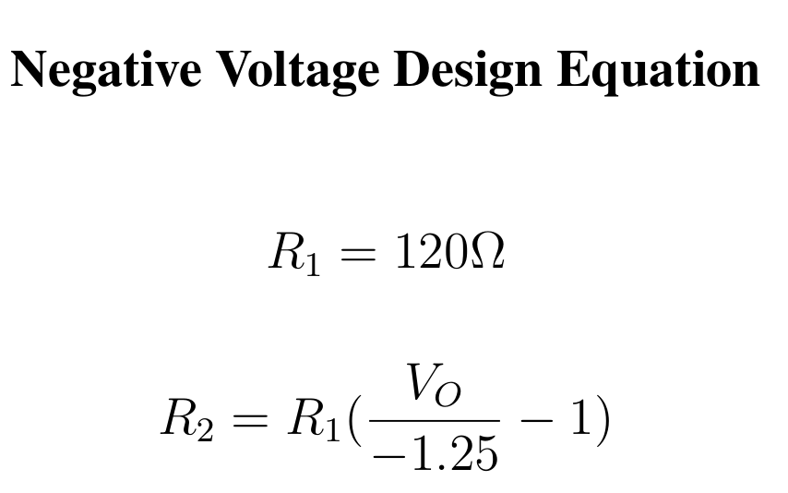
Fob Power Supply Design
Design Concept
Supply Positive and Negative Voltage
Produce DC Offset
Functional Requirements
Step down input Vcc voltage to 3.3V +\- 10%
Ensure DC offset is 1.65V +\- 10%
Negate Vcc to produce -2V +\- 10%
From Datasheet pg 10
ELECTRICAL & COMPUTER ENGINEERING
GRAINGER ENGINEERING
Notes:
Make the second Image something related to the original amplifier design? Not sure what to put,

Slide 18
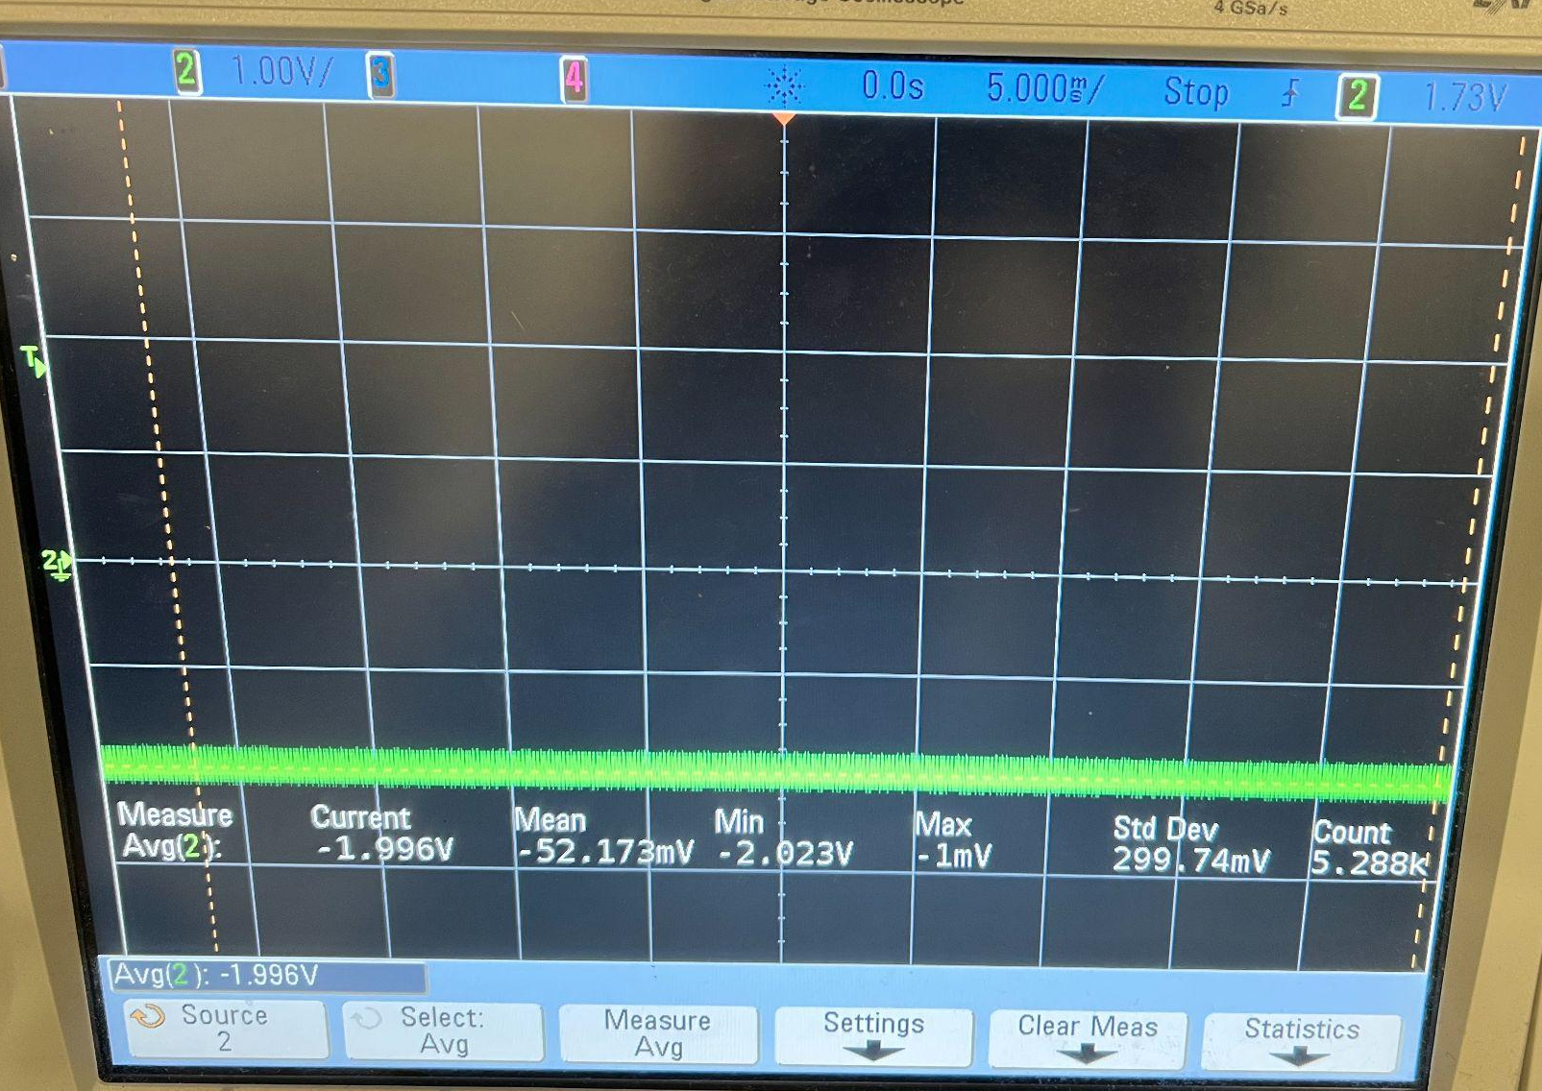
Power Supply Design R&V
Requirements | Verification
Four 1.5V AA batteries in series will be used to power the fob and supply voltage to the ESP32 on the fob. | Measure and ensure the output remains between 5 and 6.4V.
Ensure the power circuit steps down the supply voltage to 3.3V | Use a multimeter to ensure we have 3.3V +/- 10%
The output of the negative voltage LDO must be as close as possible to -2V | Probe the output of the negative voltage LDO to ensure that the value is within 10% of -2V
Negative Voltage Output
Positive Voltage Output
ELECTRICAL & COMPUTER ENGINEERING
GRAINGER ENGINEERING

Slide 19
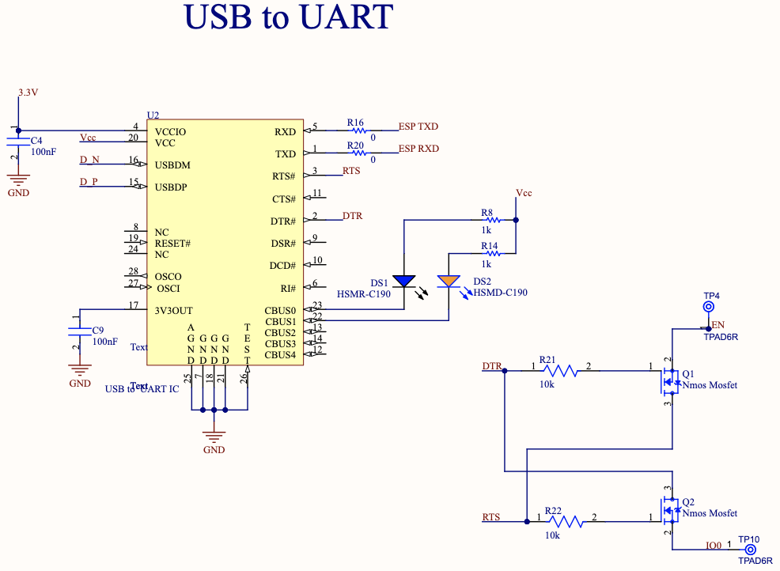
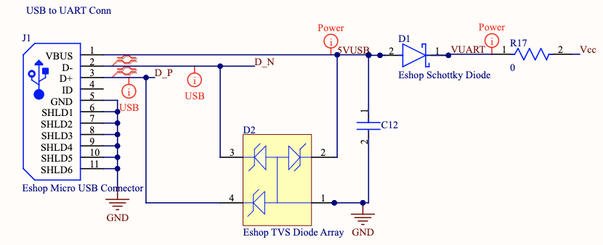
USB/UART Design
Design Concept
Serial Communication
Automatic Programming
TVS and Reverse Voltage Protection
Functional Requirements
Connection between FTDI chip and USB port
UART connection to ESP
5V supply
IMAGE / GRAPHIC
IMAGE / GRAPHIC
ELECTRICAL & COMPUTER ENGINEERING
GRAINGER ENGINEERING
Notes:
Make the second Image something related to the original amplifier design? Not sure what to put,

Slide 20
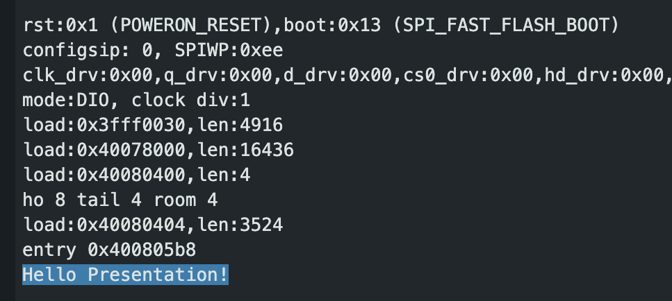
USB/UART R&V
Requirements | Verification
Provide 3.3V-5.25V +/- 0.5% for power. | Use a multimeter to ensure Vcc is 3.3V and no more than 5.25V
The FT232RL must receive UART signals, convert to USB, and transfer to the PC. | Send a “Hello World” message from the ESP32.
When plugged in, the device must be recognized by a COM port. | On the PC side, The Mac should recognize the device as a USB device
The ESP32 TX/RX pins must correctly be configured to the FT232RL TX/RX pins. | Use a multimeter to check continuity between the pins respectively.
Hello World Demonstration
ELECTRICAL & COMPUTER ENGINEERING
GRAINGER ENGINEERING

Slide 21
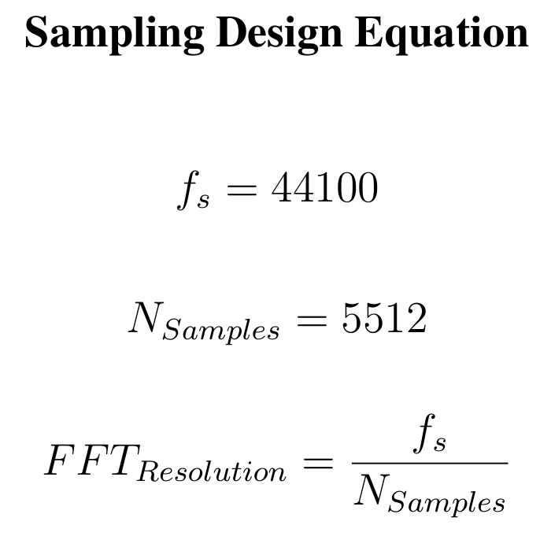
ADC and Wireless Design
Design Concept
Guitar Signal Digitization
Wireless Packet Optimization
Bluetooth Data Transfer
Functional Requirements
ADC Setup and Data Packaging
Bluetooth Initialization
3.3V Supply
ELECTRICAL & COMPUTER ENGINEERING
GRAINGER ENGINEERING
Notes:
Make the second Image something related to the original amplifier design? Not sure what to put,

Slide 22
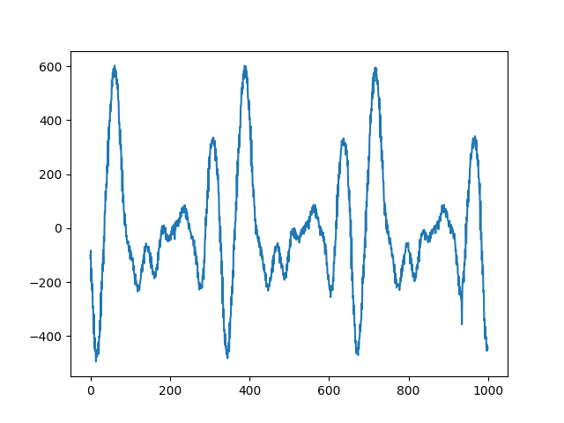
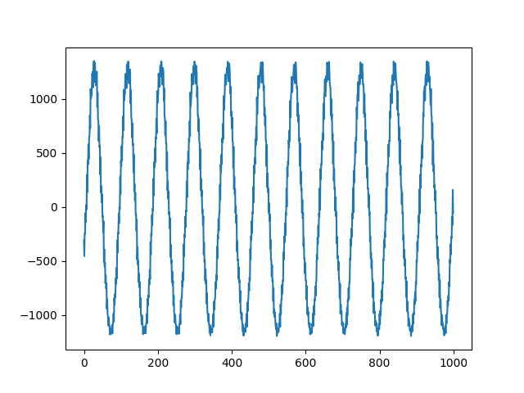
ADC and Wireless R&V
Requirements | Verification
ADC Must be connected correctly to the amplified guitar signal | Verify channel selection and ADC configuration and data acquisition via software plotting
Bluetooth is correctly configured, and data transfer is successful up to distances of 3 meters. | Send “Hello World” packets from the fob to base
Ensure that the Fob and Base can connect reliably | Utilize the SerialBTM example sketch in Arduino IDE to connect devices together
Sampled Guitar Data Sent Over Bluetooth
Sampled 400 Hz Sine Data Sent Over Bluetooth
ELECTRICAL & COMPUTER ENGINEERING
GRAINGER ENGINEERING

Slide 23
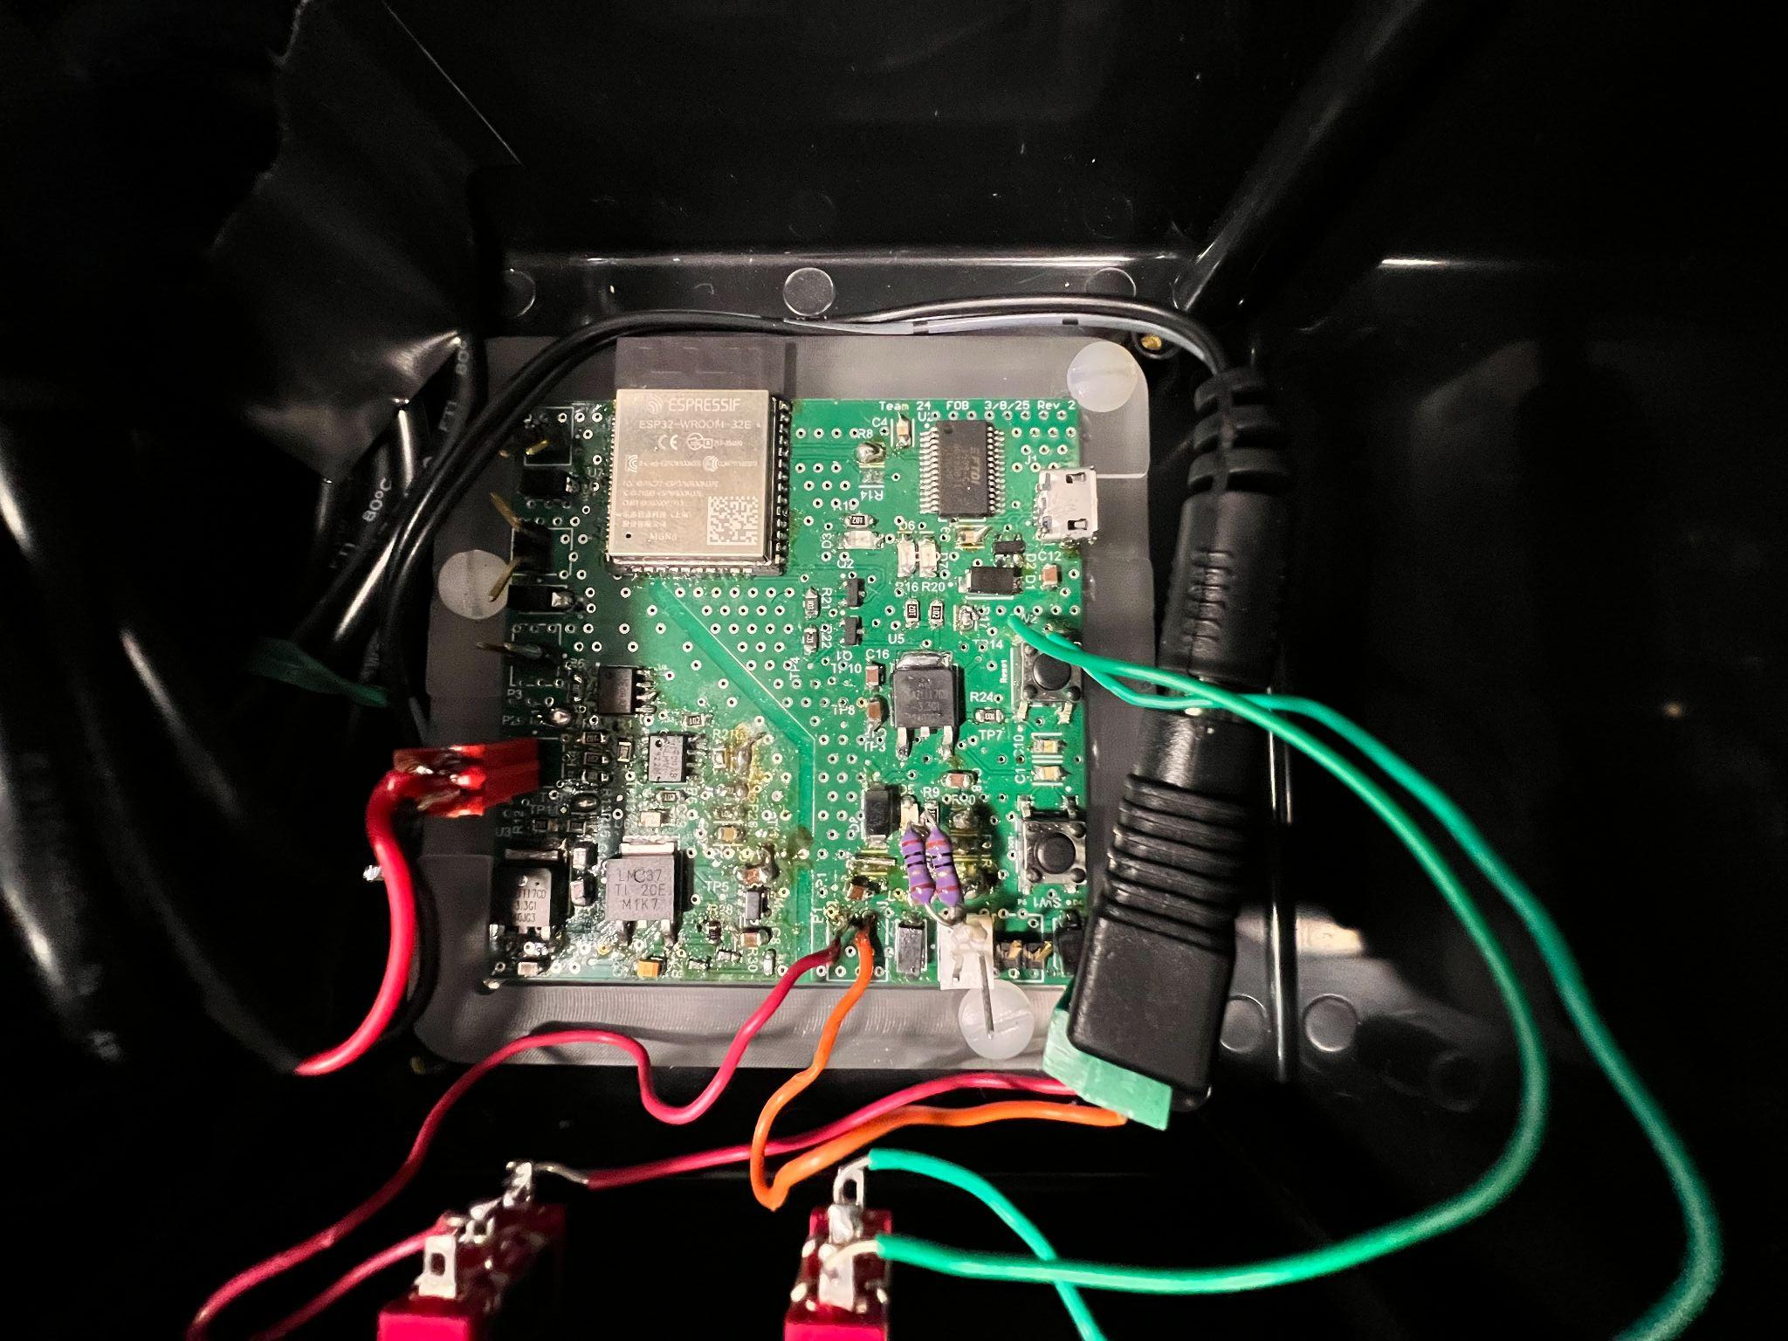
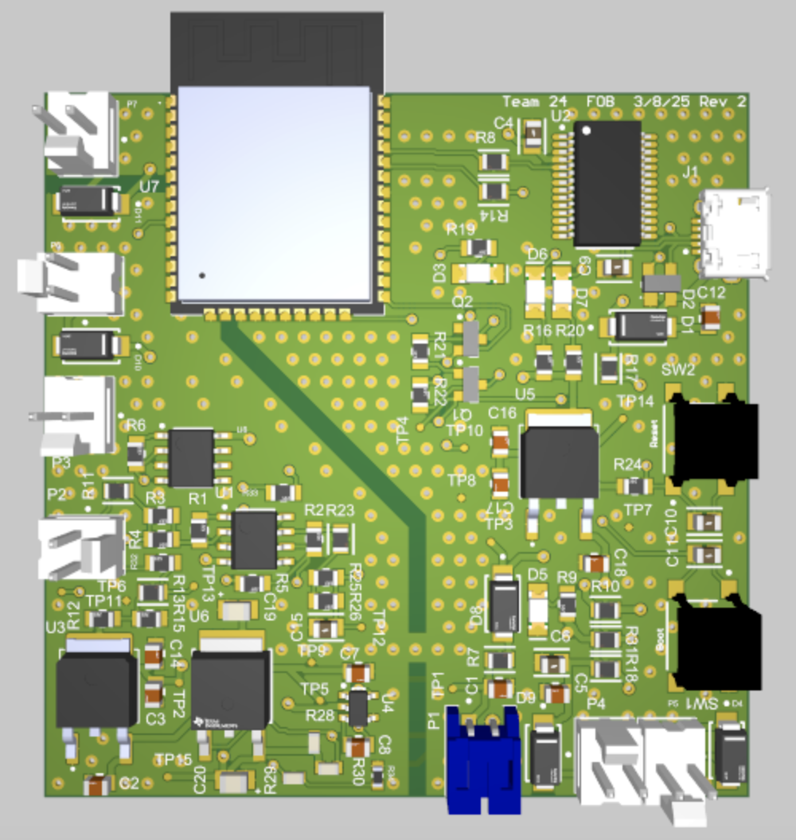
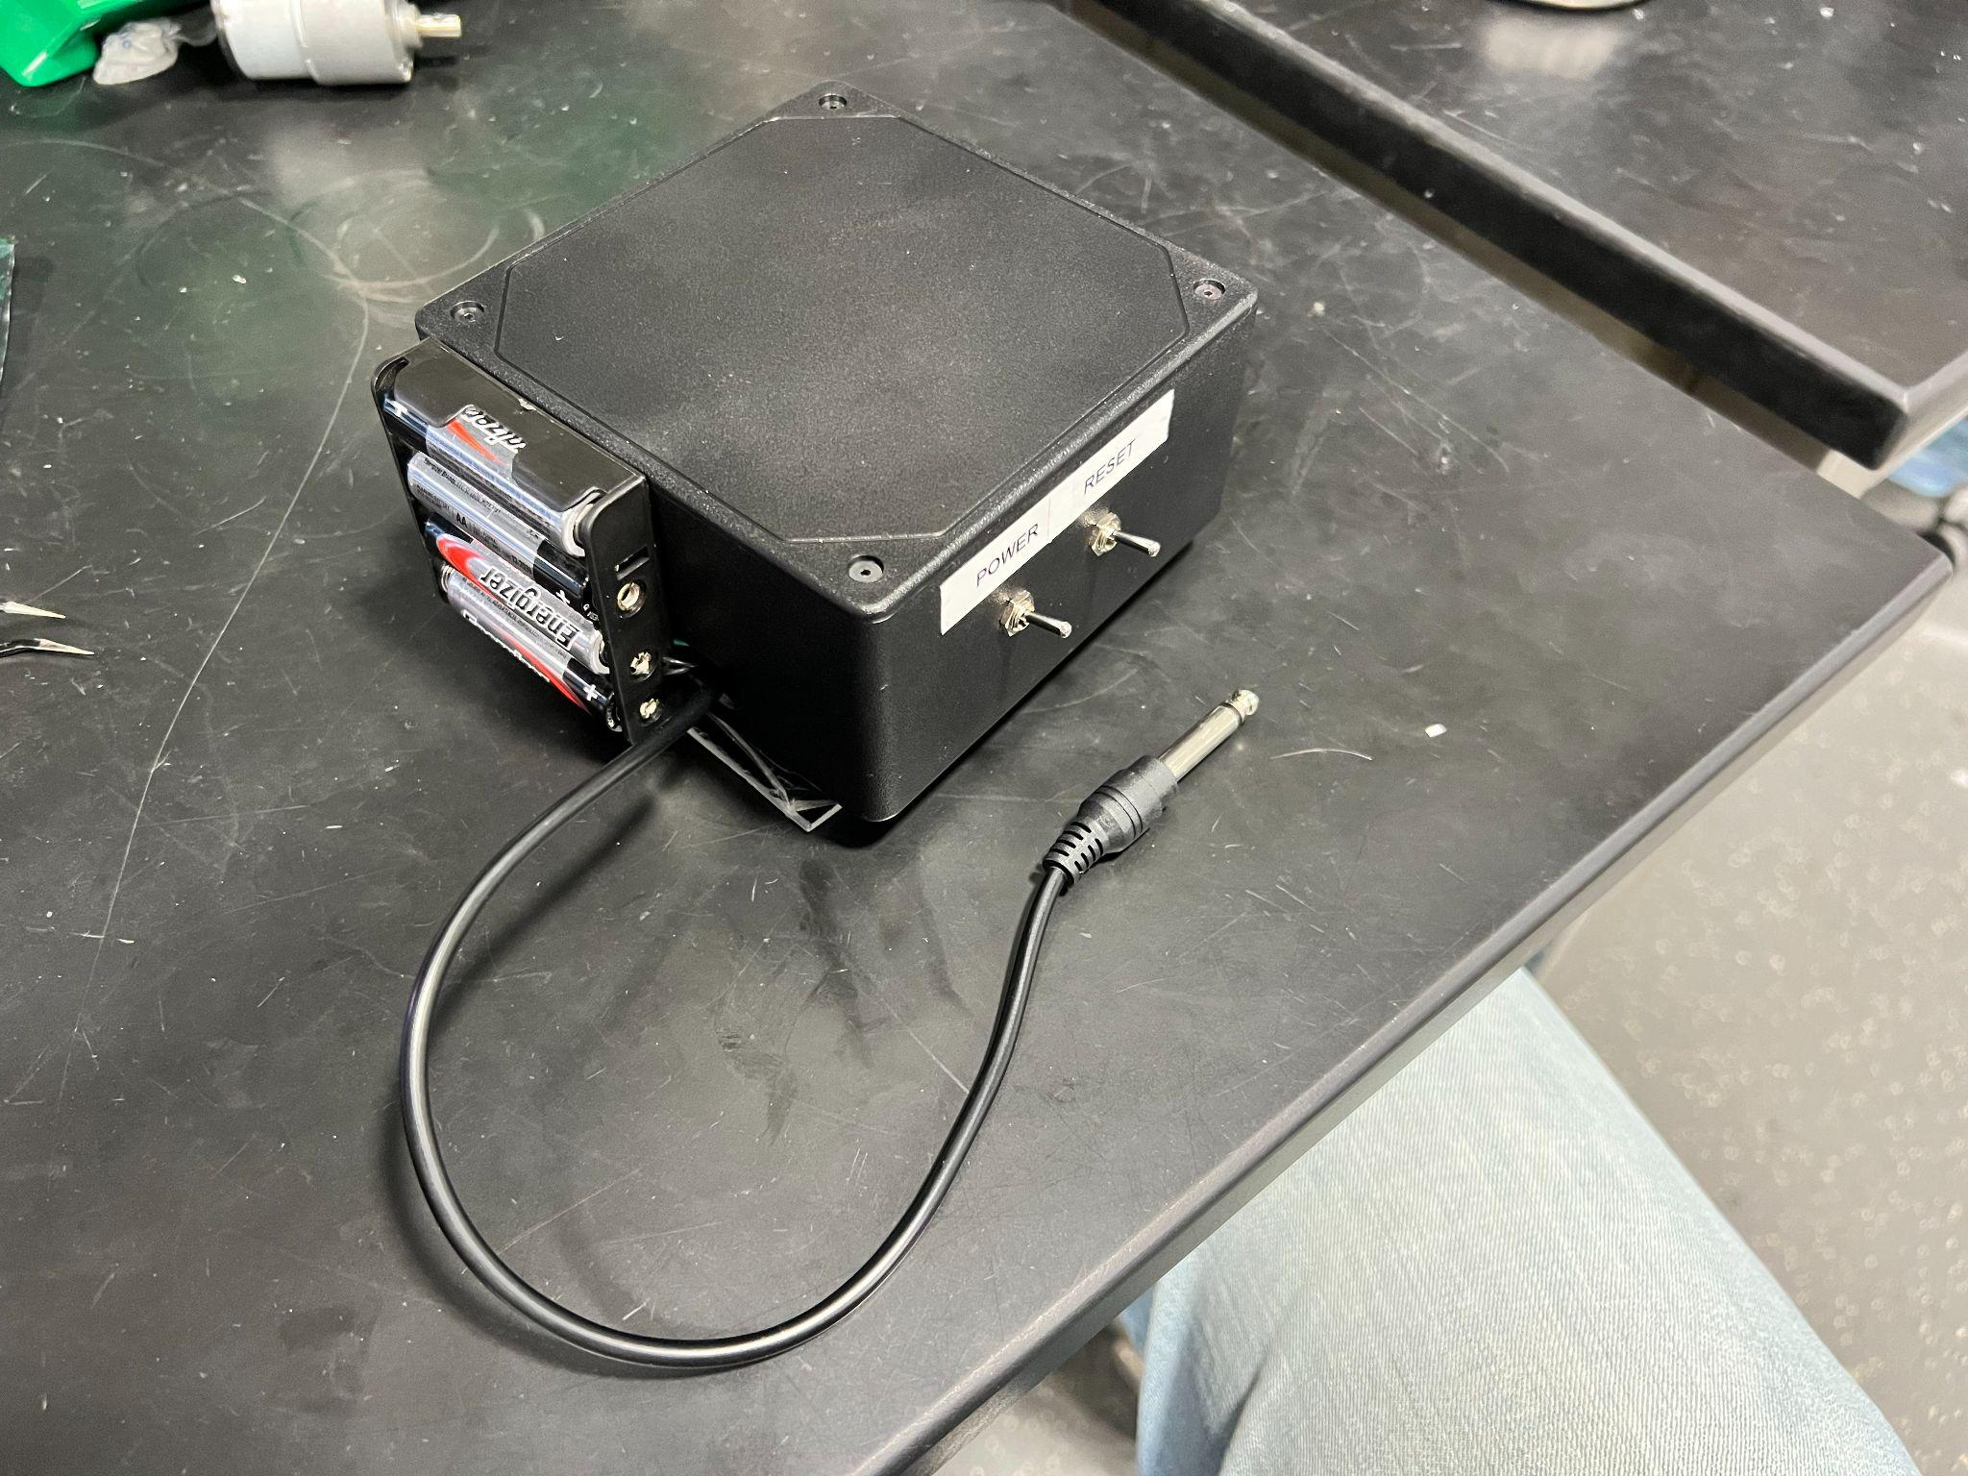
Fob Build
PCB Design
Enclosure Fitment
ELECTRICAL & COMPUTER ENGINEERING
GRAINGER ENGINEERING

Slide 24
Base Station Design
ELECTRICAL & COMPUTER ENGINEERING
GRAINGER ENGINEERING

Slide 25
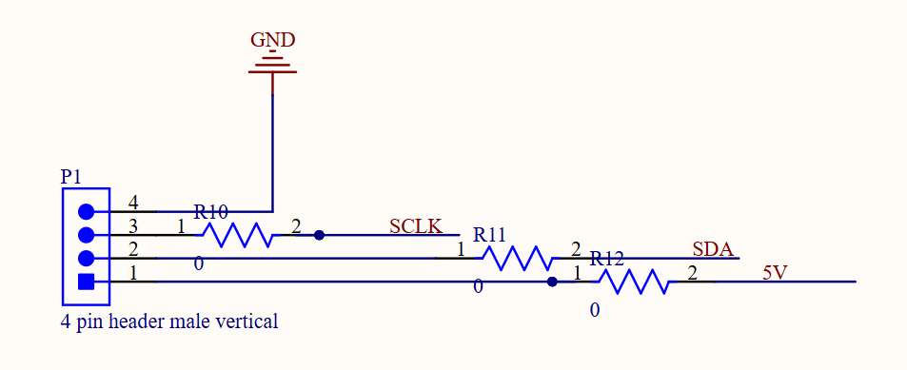
Base Station Design
Design Concept
ESP32 configured with Bluetooth
USB/UART chip to send data to PC
MicroUSB port to program ESP32
Base station powered by PC via MicroUSB cable
4-pin connector for LCD I2C display
Functional Requirements
Receive sampled audio data from fob via Bluetooth
Transmit data to PC by writing to serial terminal
ESP32 will control LCD via I2C
ELECTRICAL & COMPUTER ENGINEERING
GRAINGER ENGINEERING
Notes:
I think we need to add RV for LCD, but otherwise I covered all the other RV, might want to just note that the other RV was covered earlier

Slide 26
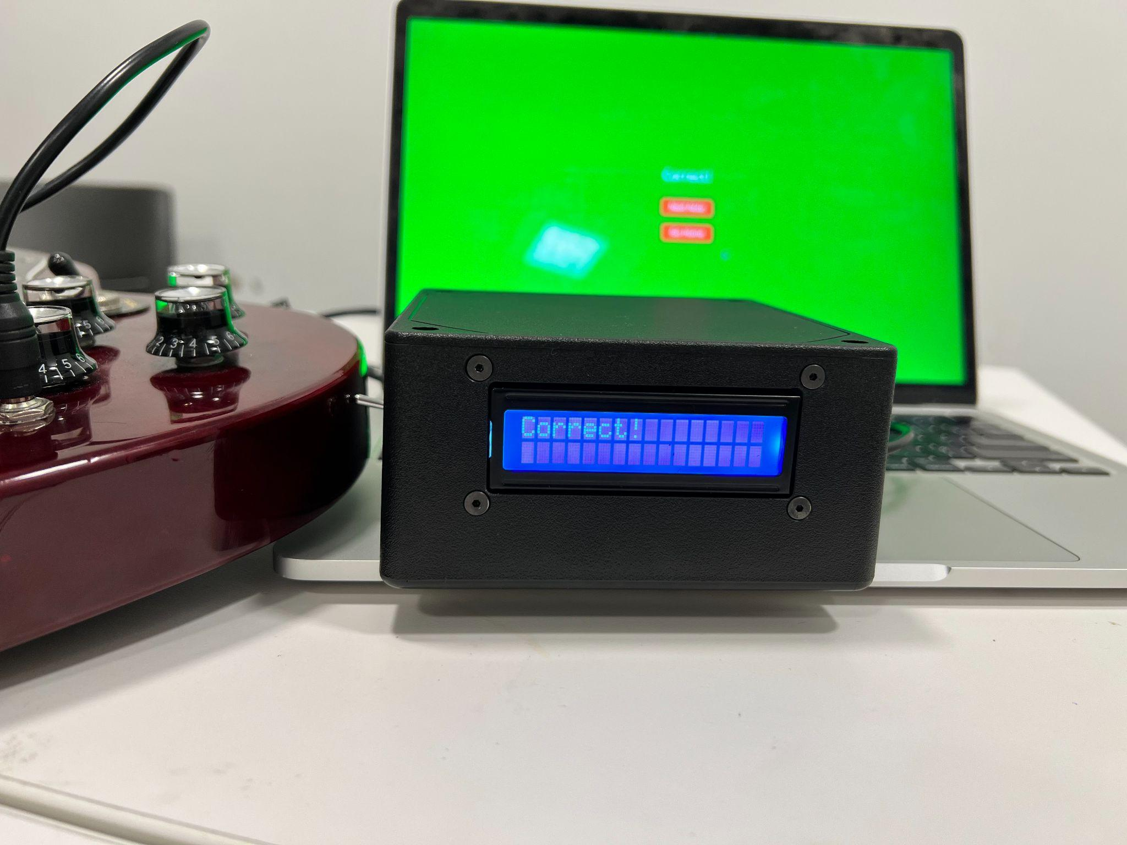
LCD R&V
Requirements | Verification
The I2C LCD1602 requires a 3.15V - 3.45V supply voltage | We can use a multimeter to probe and ensure 3.15V - 3.45V
The SCL and SDA pins must be correctly connected | Probe connections on ESP 32 and LCD display to ensure connection
LCD Displaying Correct Response
ELECTRICAL & COMPUTER ENGINEERING
GRAINGER ENGINEERING

Slide 27
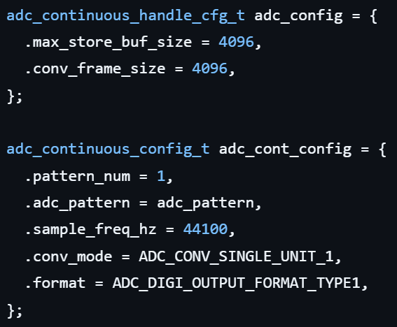
Bluetooth/Firmware Design
Design Concept
Bluetooth and ADC were configured during setup
Utilizing Bluetooth Serial and ADC continuous mode
Handshaking protocol for sampling
PC makes request to base
Base sends request to fob to start sampling
Fob sends data to base once sampled
IMAGE / GRAPHIC
ELECTRICAL & COMPUTER ENGINEERING
GRAINGER ENGINEERING

Slide 28
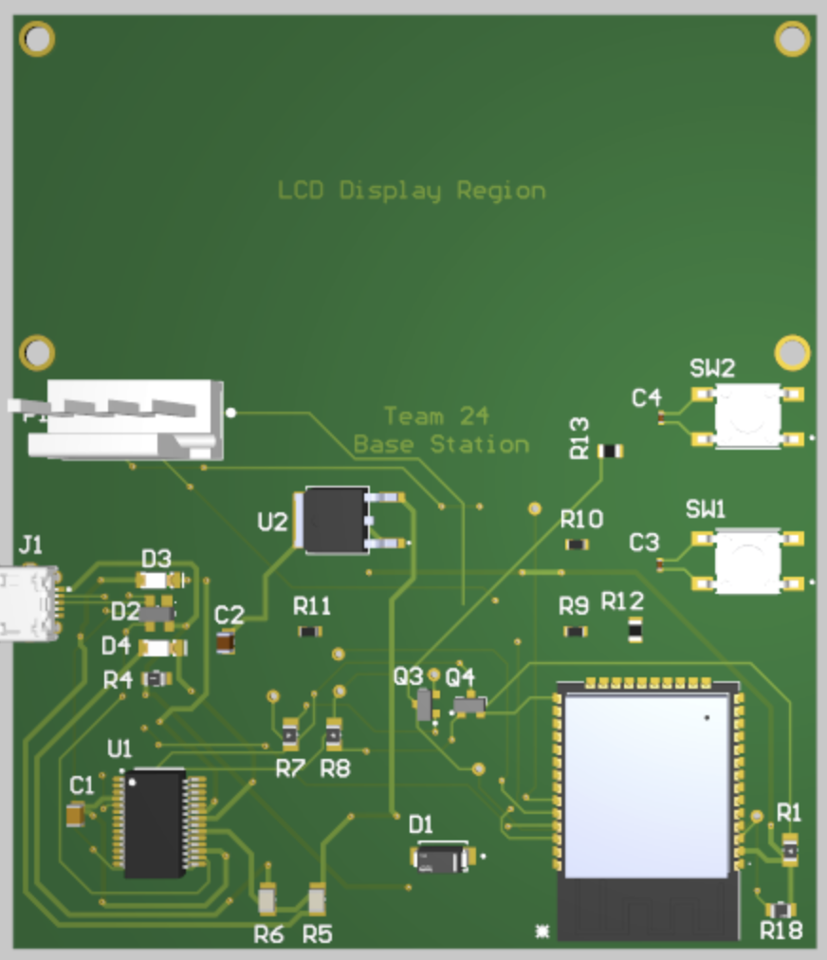
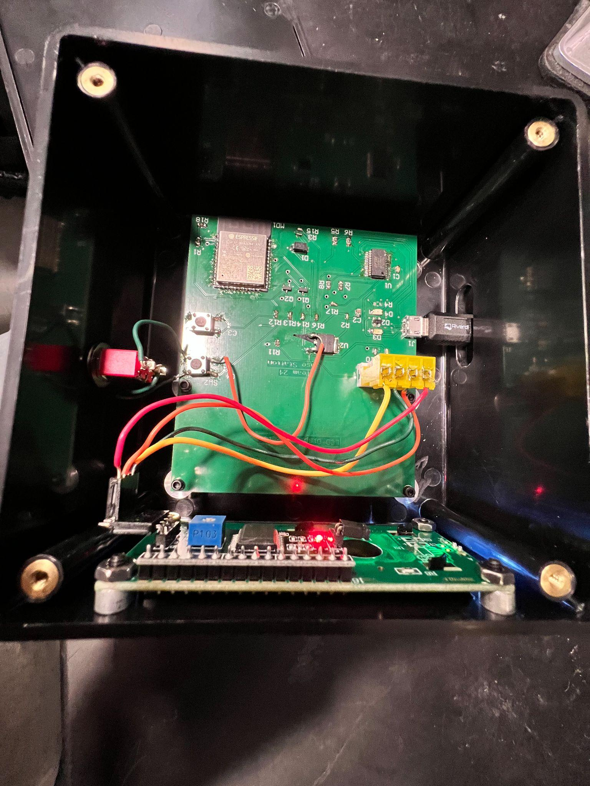
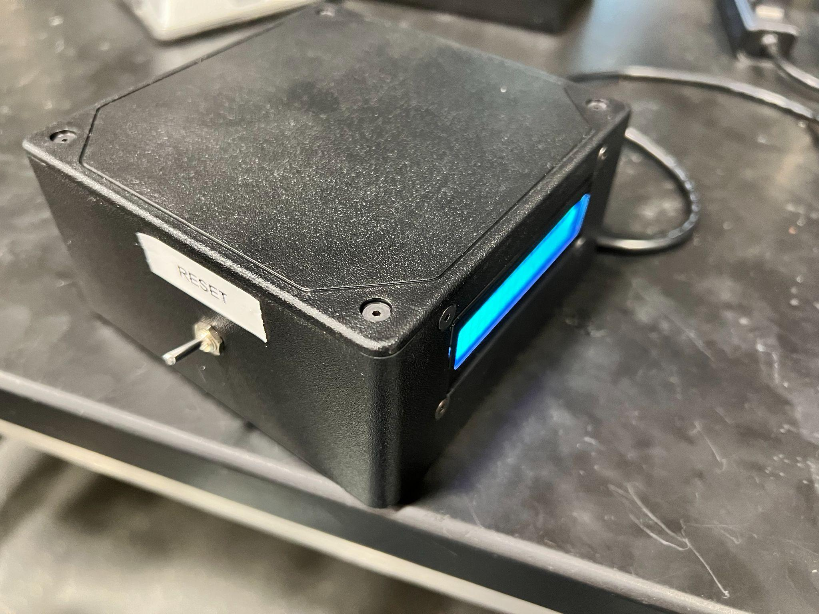
Base Build
PCB Design
Enclosure
ELECTRICAL & COMPUTER ENGINEERING
GRAINGER ENGINEERING

Slide 29
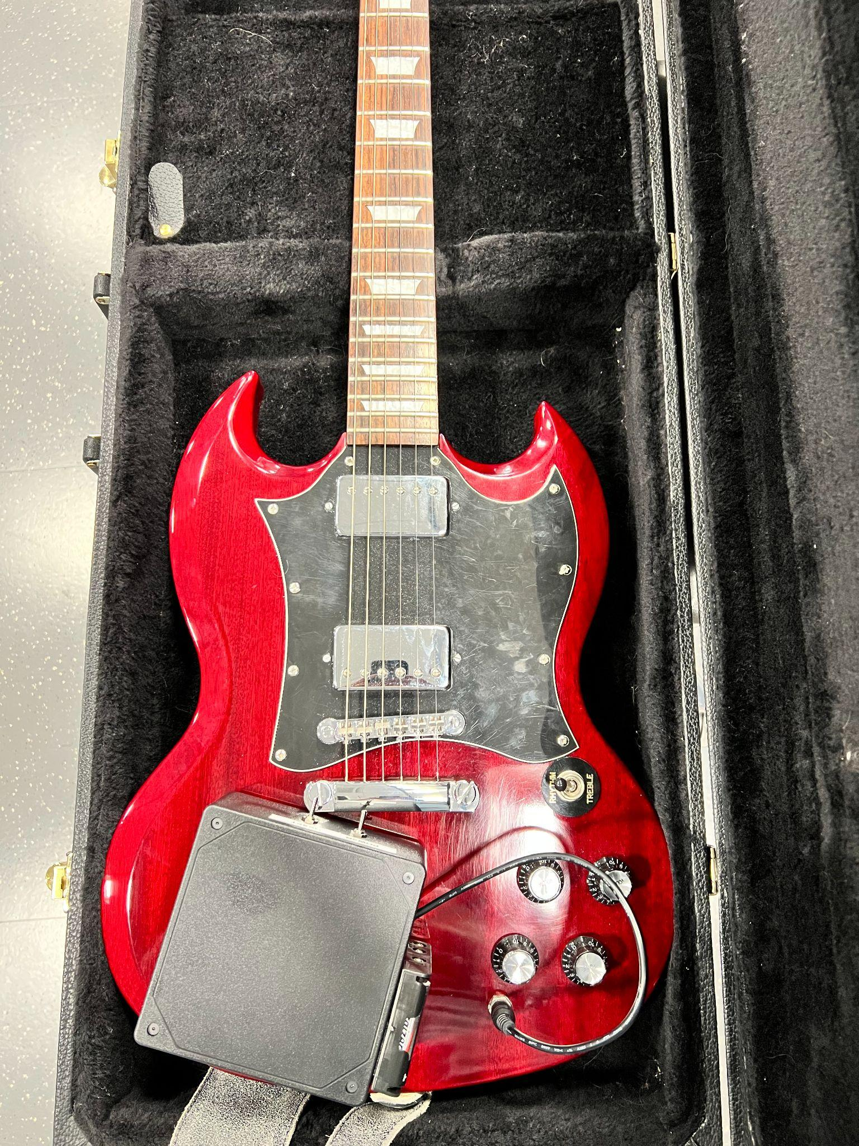
Challenges
Hardware
Amplifier Design - Isolation, Amplification Factor
USB-UART Serial Reset
Clean negative power generation
Firmware
Debugging base station with app integration
Issues with continuous sampling
Software
Isolating fundamental frequency with overtones
Algorithm for feedback on number of frets off
Page routing for handshake process
Integrating all components together was most difficult
ELECTRICAL & COMPUTER ENGINEERING
GRAINGER ENGINEERING

Slide 30
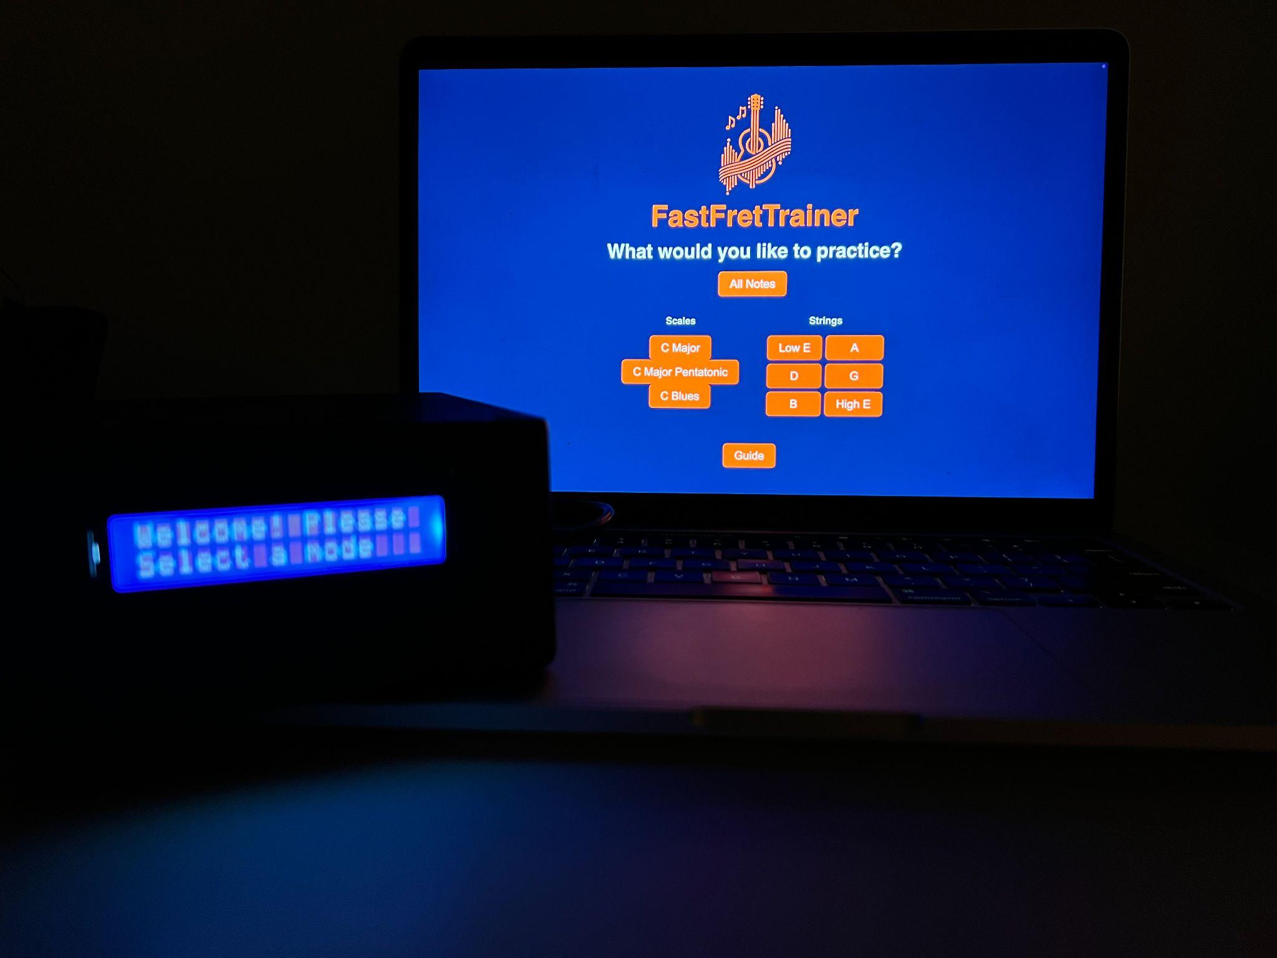
Successes
All high-level requirements were met
Product gives specific feedback on how to adjust
Easy to navigate interface
Samples with reasonably high resolution
Can be a useful tool for players at all skill levels
ELECTRICAL & COMPUTER ENGINEERING
GRAINGER ENGINEERING

Slide 31
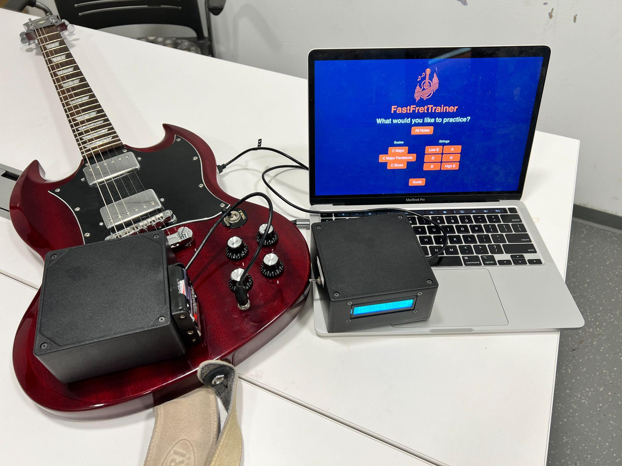
Conclusions from Project
What was Learned
Metrics used in Music and Guitar
Signal Processing for real-world applications
Writing firmware for ESP32
What would Change
Smaller enclosure for fob and base station
Optimized algorithm to reduce processing time
Remove base station all together and send audio data from fob to the app directly via Bluetooth
ELECTRICAL & COMPUTER ENGINEERING
GRAINGER ENGINEERING

Slide 32
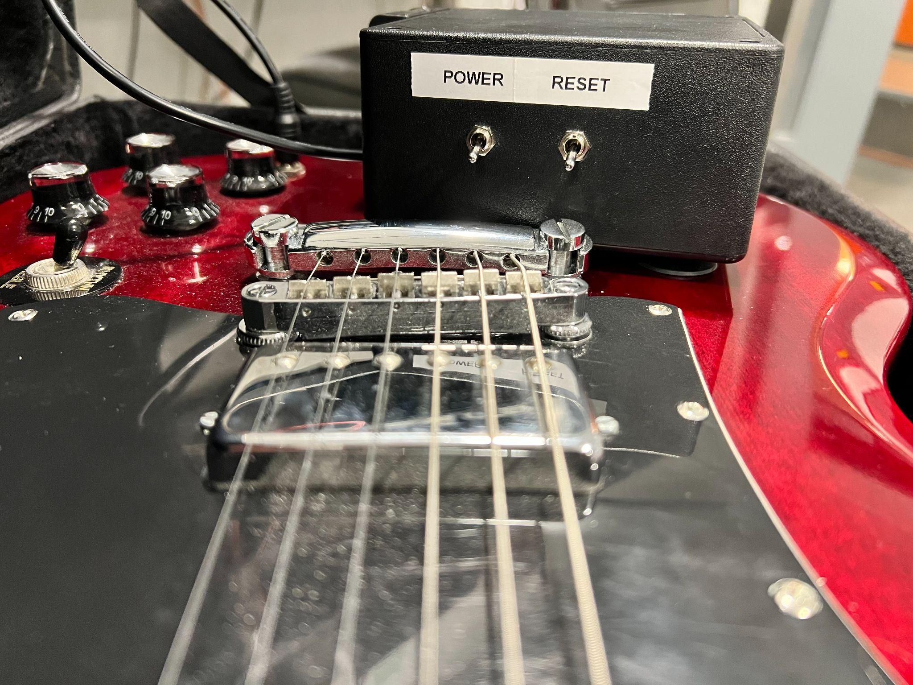
Further Work
Additional Hardware/Firmware features such as:
Continuously sample data to minimize latency
Multithread the data sampling and sending to minimize latency
Additional Software features such as:
Continuous Training Mode
Guitar Chord Training
Additional scales and tunings
ELECTRICAL & COMPUTER ENGINEERING
GRAINGER ENGINEERING

Slide 33
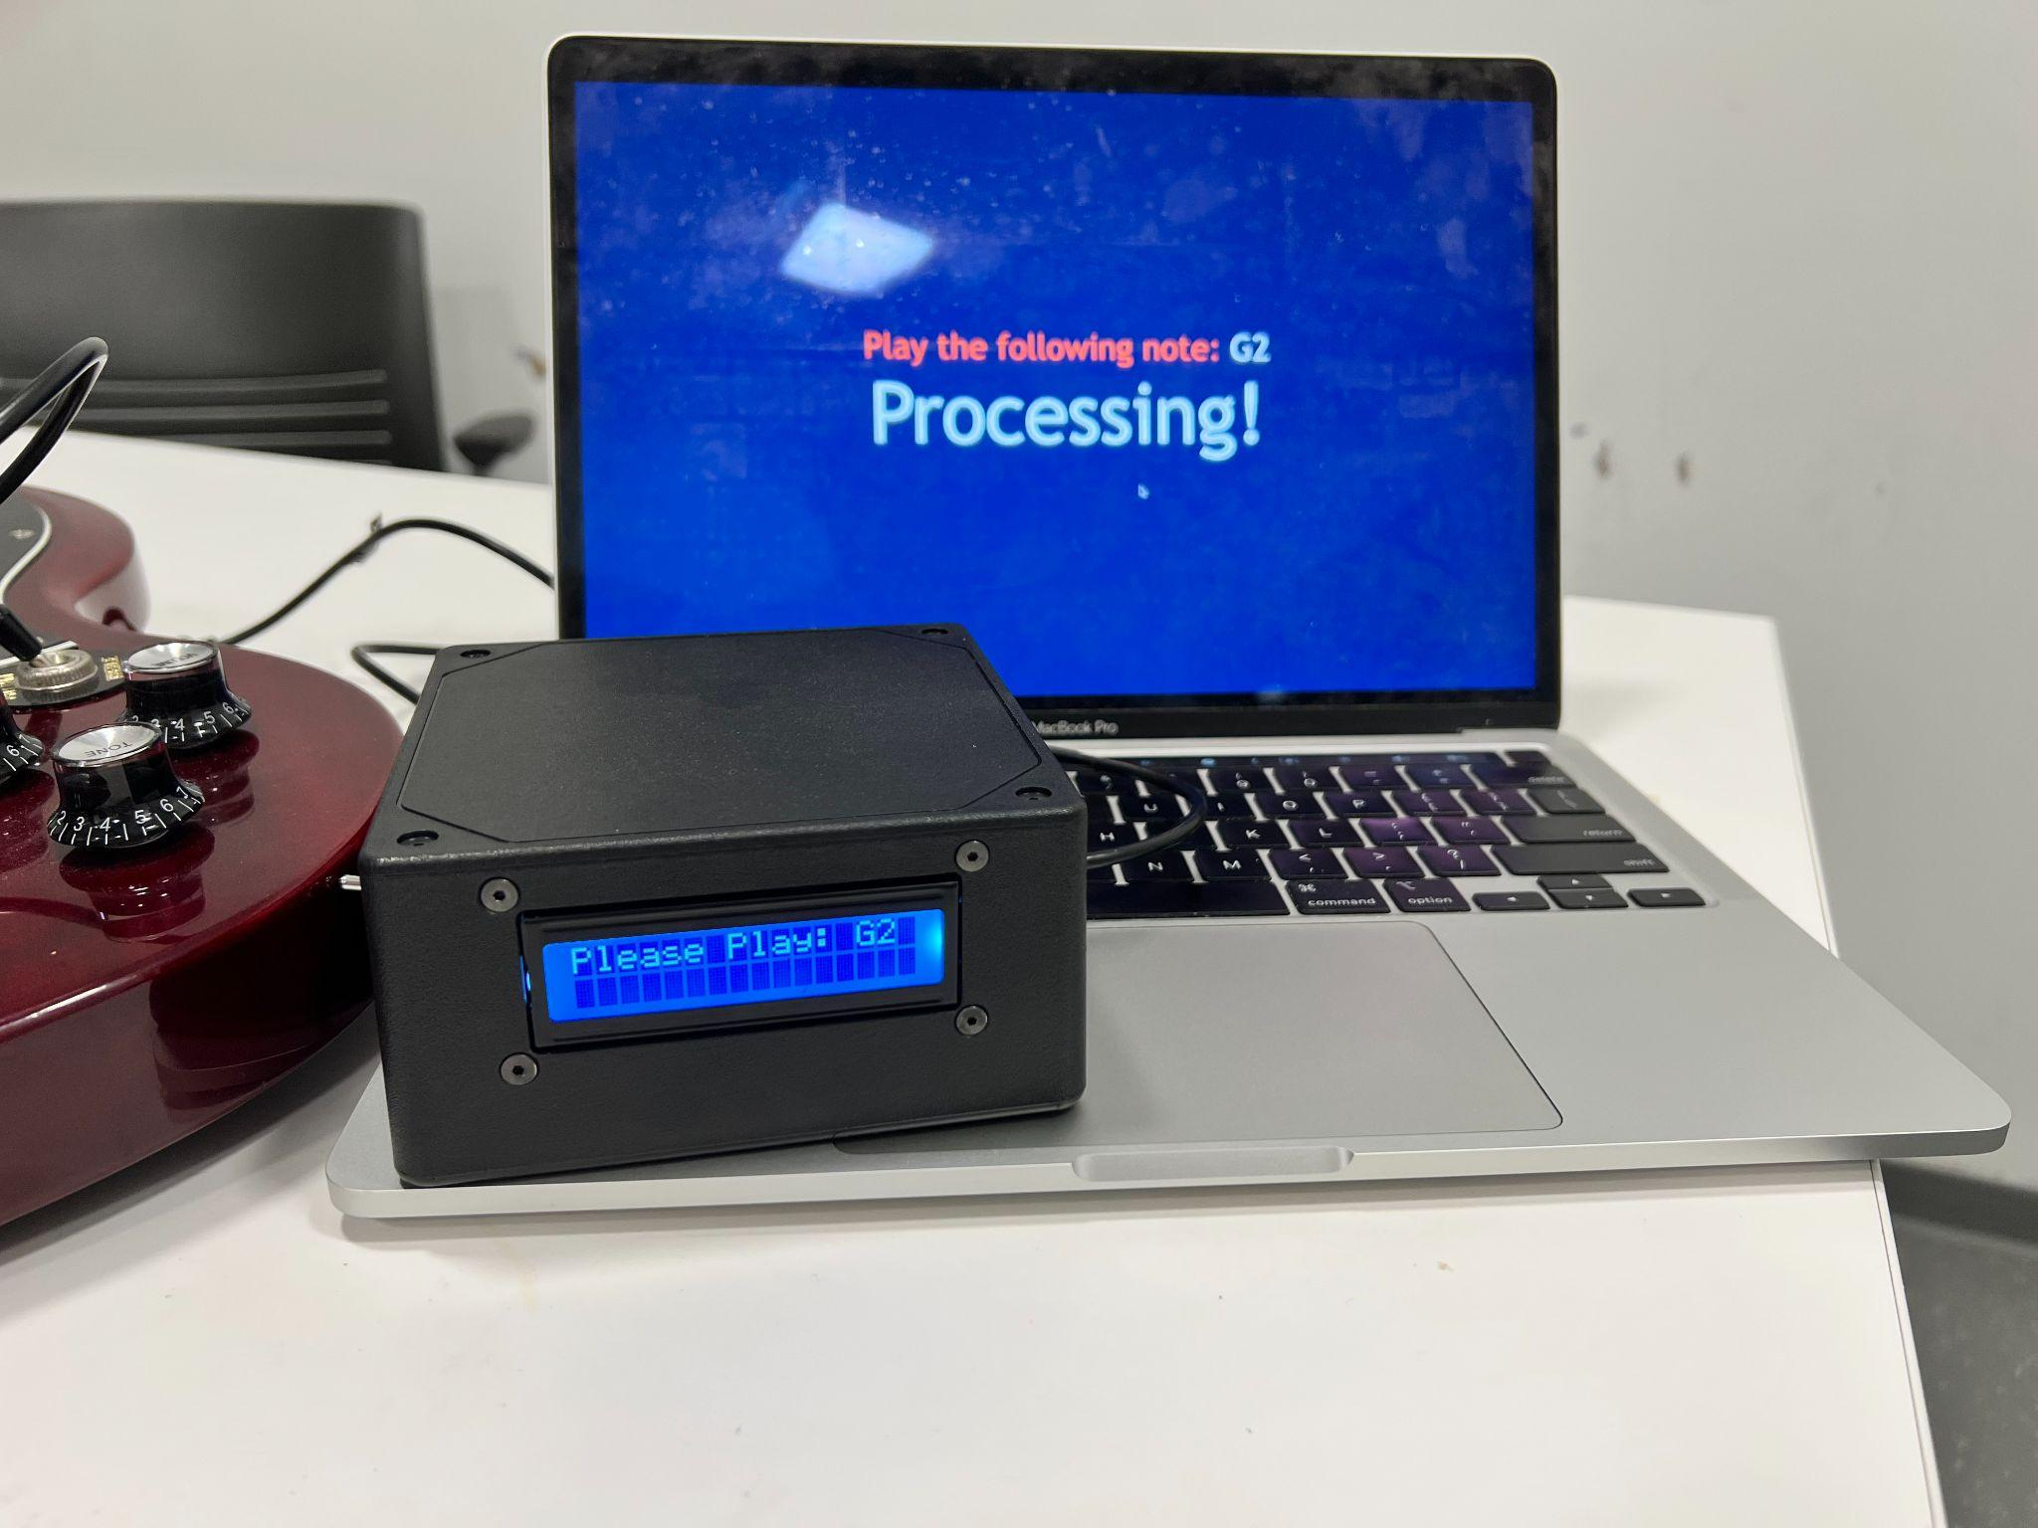
Ethical Concerns
Ethical Concerns
Battery
Misuse
Over Current
Improper Storage
Wireless Communication
Interfering
High Power Transmission
FCC and BQB Certified
IMAGE / GRAPHIC
ELECTRICAL & COMPUTER ENGINEERING
GRAINGER ENGINEERING
Notes:
Not sure that we need this slide, might want to ask eric, or also consider bringing it up during mock presentation

Slide 34
Thank You!
Any Questions?
ELECTRICAL & COMPUTER ENGINEERING
GRAINGER ENGINEERING

