Slide 1
Solar Remote Monitoring of Trough Water Level
Electrical & Computer Engineering
Project # 28
Alina Ampeh, Ajay Venkatraman, Letian Zhang
11/29/2023

Slide 2
Objective
Our Problem
Filling water troughs is a routine and critical chore
600,000 small farms and cattle owners, ~2 million horse owners
Time-consuming task to be performed daily
Consequences if overlooked
Valve solutions are unusable in freezing conditions
Our Solution
A year-round remote water monitoring system solution to automate the burdensome and repetitive task of daily manual water trough inspections.
ELECTRICAL & COMPUTER ENGINEERING
GRAINGER ENGINEERING

Slide 3
Goals
High-Level Requirements
Must allow the monitoring of 3 troughs simultaneously, <200 m away from the central base station
Must relay the trough’s status at least once per hour during light-conditions
Must display HIGH, MED, and LOW with an accuracy of +/- 4”
ELECTRICAL & COMPUTER ENGINEERING
GRAINGER ENGINEERING

Slide 4
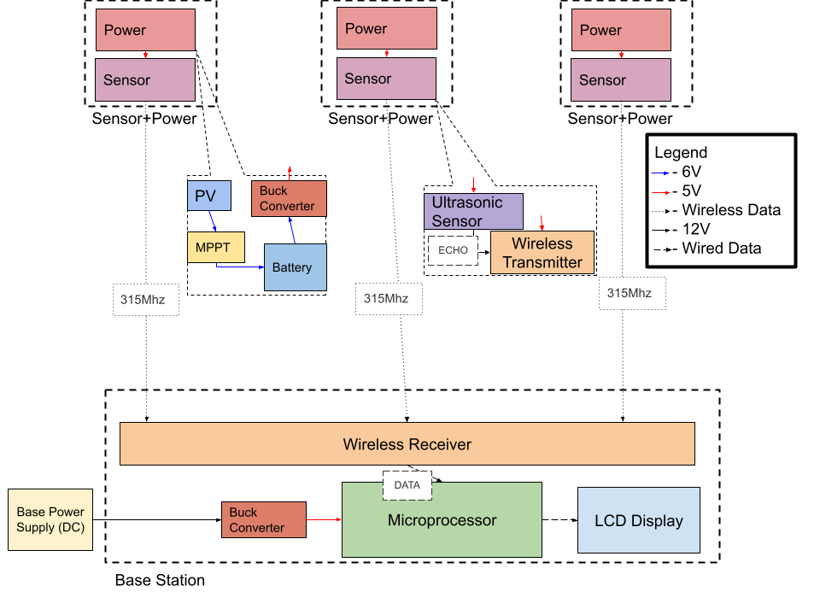
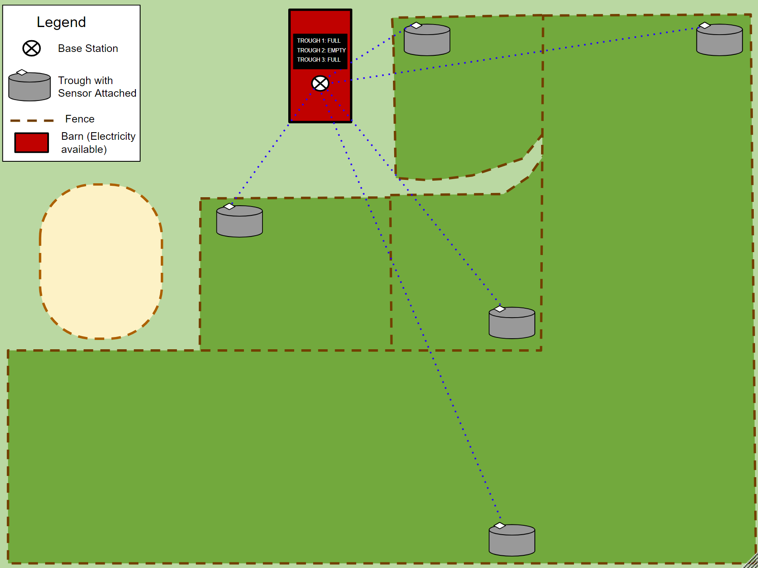
Block Diagram
ELECTRICAL & COMPUTER ENGINEERING
GRAINGER ENGINEERING

Slide 5
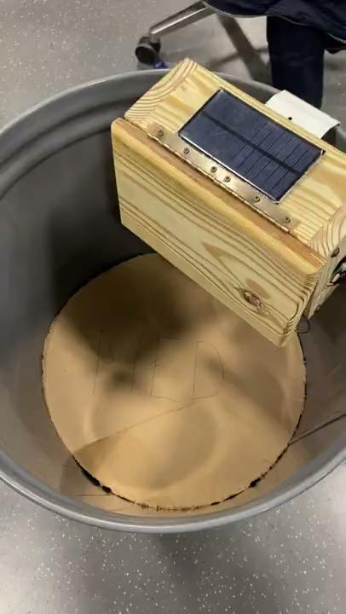
ELECTRICAL & COMPUTER ENGINEERING
GRAINGER ENGINEERING

Slide 6
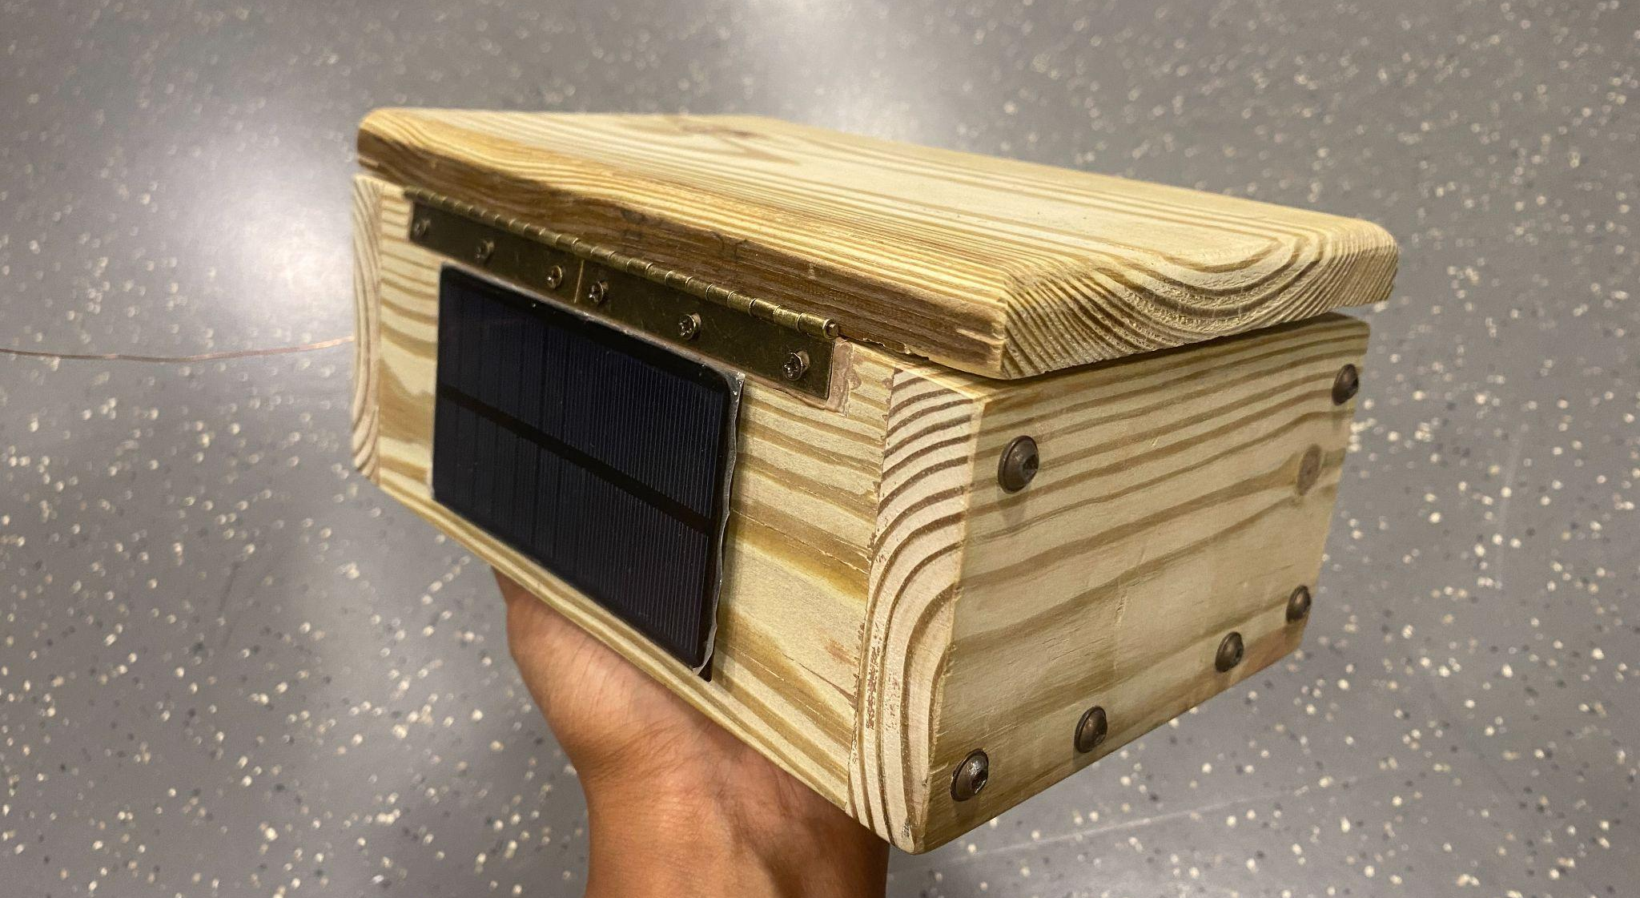
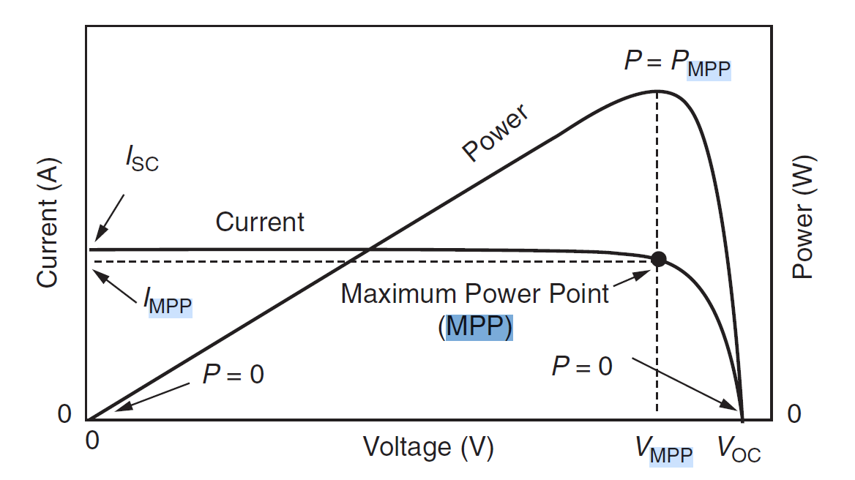
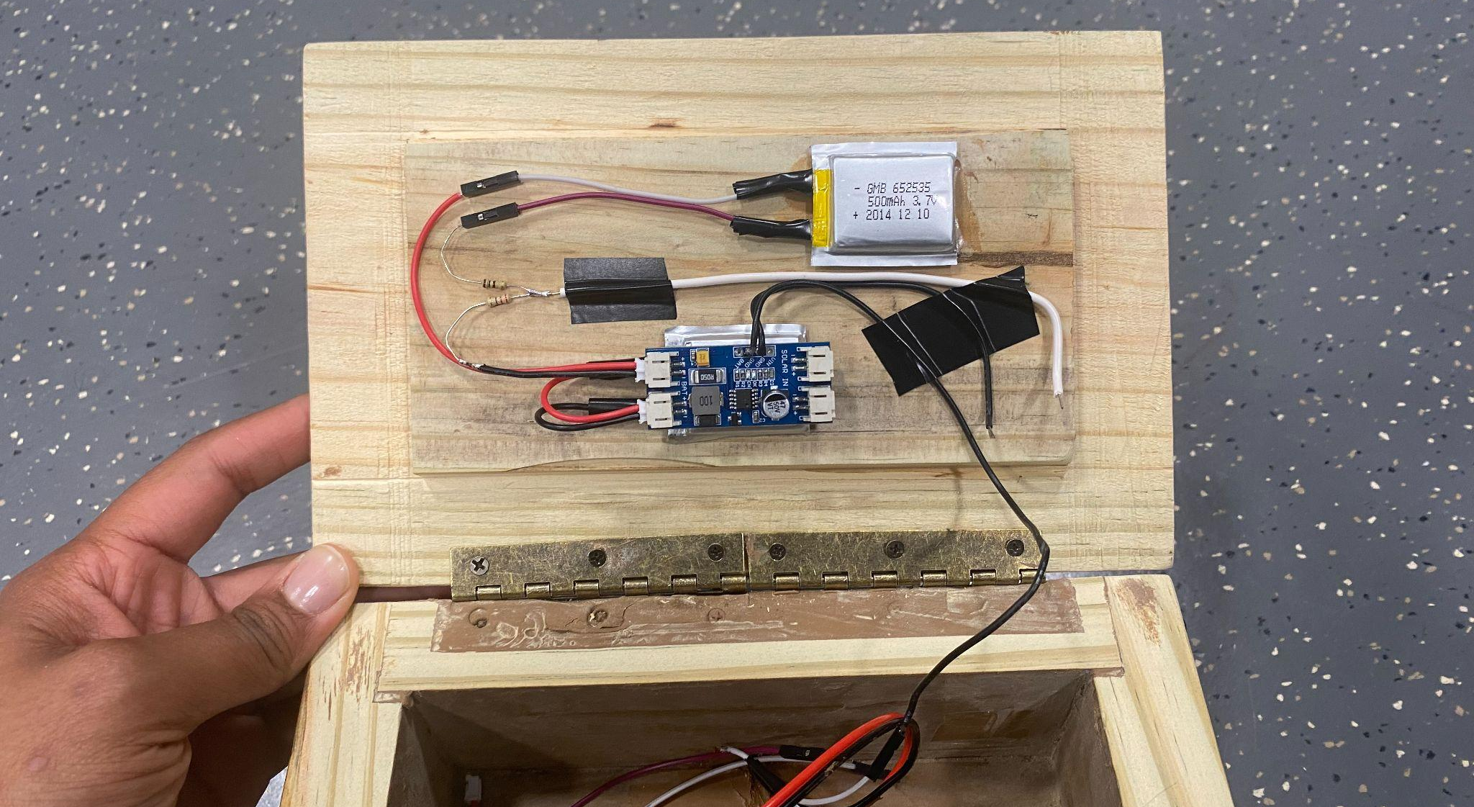
Solar
Requirements:
6V at a minimum from Solar Panel
Step down to 5V for Sensor, Step up to 12V for the Transmitter
5V rechargeable source using 6V Si Panel and Taidascent MPPT, 3.7V Li Ion batteries
Why MPPT? Perturb-and-observe
Future Considerations: tilt angle, boost converters vs linear regulators
IMAGE / GRAPHIC
IMAGE / GRAPHIC
ELECTRICAL & COMPUTER ENGINEERING
GRAINGER ENGINEERING

Slide 7
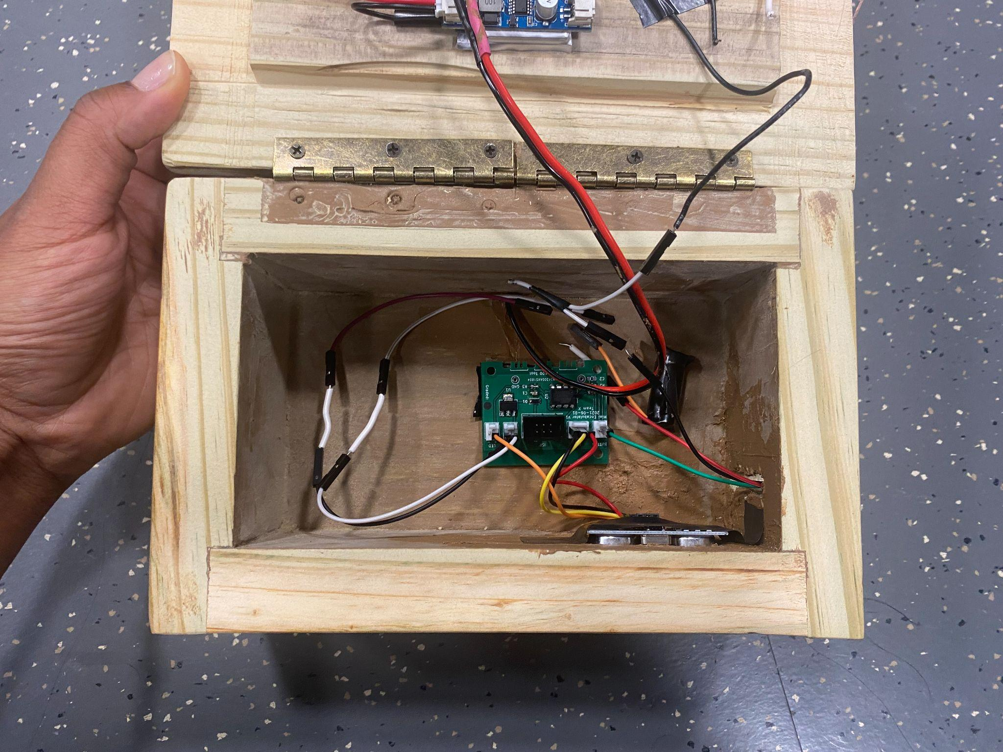
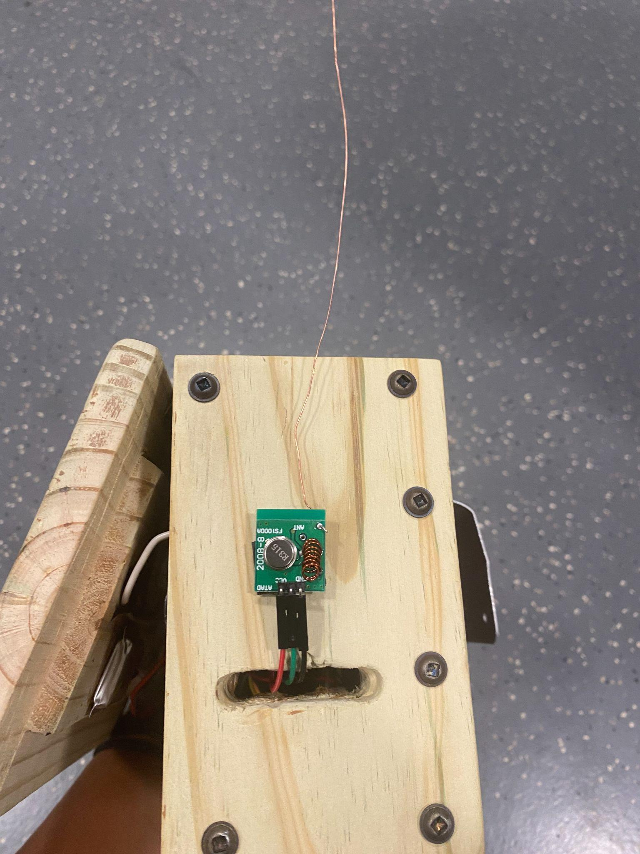
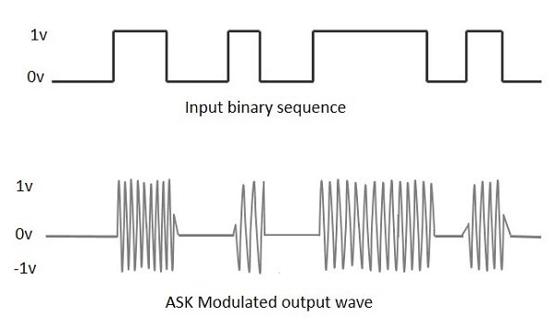
Transmitter/Receiver
Requirement:
Transmit data to the base station on designated time intervals
Components (Re) Used:
315MHz ASK (Amplitude shift keying).
The ATTiny85 from a previous assignment
About ATTiny85:
Upsides:
Area (.365*.310 inch2)
Power consumption
Two Timers
Downsides:
Limited memory
Limited Pins
Over-utilized Timer0
IMAGE / GRAPHIC
IMAGE / GRAPHIC
ELECTRICAL & COMPUTER ENGINEERING
GRAINGER ENGINEERING

Slide 8
Transmitter/Receiver Cont’d
Library Used for TX/RX: VirtualWire → Radiohead
Both have drivers for ASK TX/RX
For Radiohead it’s <RH_ASK.h>
Virtualwire needs less memory
WHY Radiohead finally?
Fits in the memory
Virtualwire occupies Timer0, also used for delay(), millis(), …
Radiohead allows choosing Timer1, not used in our app
And makes measurement accurate
Thanks to https://gitlab.com/thijsvanulden/TinyHead
And https://github.com/connornishijima/TinySnore to fully power down the chip
ELECTRICAL & COMPUTER ENGINEERING
GRAINGER ENGINEERING

Slide 9
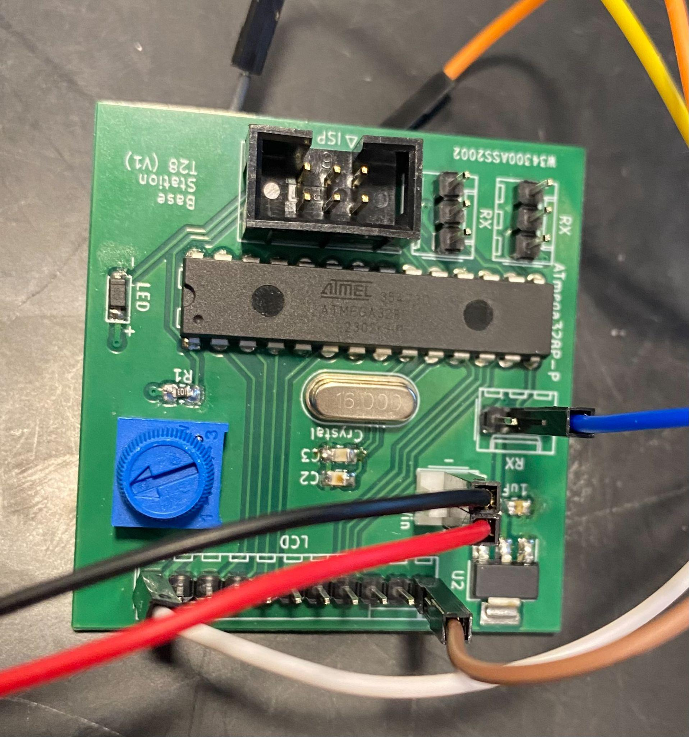
Base Station
Base
ATMega328P
16MHz External Oscillator
Connectors for LCD direct interfacing & Rx
Requirements:
Must update every time the sensor system transmits data
Must have a visible LCD display to relay High Level Requirement conditions
However…
Microcontroller fixed SCL/SDA
LCD Module comes with I2C
TI PCF8574 I2C address: 0x24
2 wires soldered for SCL/SDA
~4V output
SDA
SCL
DATA
LCD-
LCD+
ELECTRICAL & COMPUTER ENGINEERING
GRAINGER ENGINEERING

Slide 10
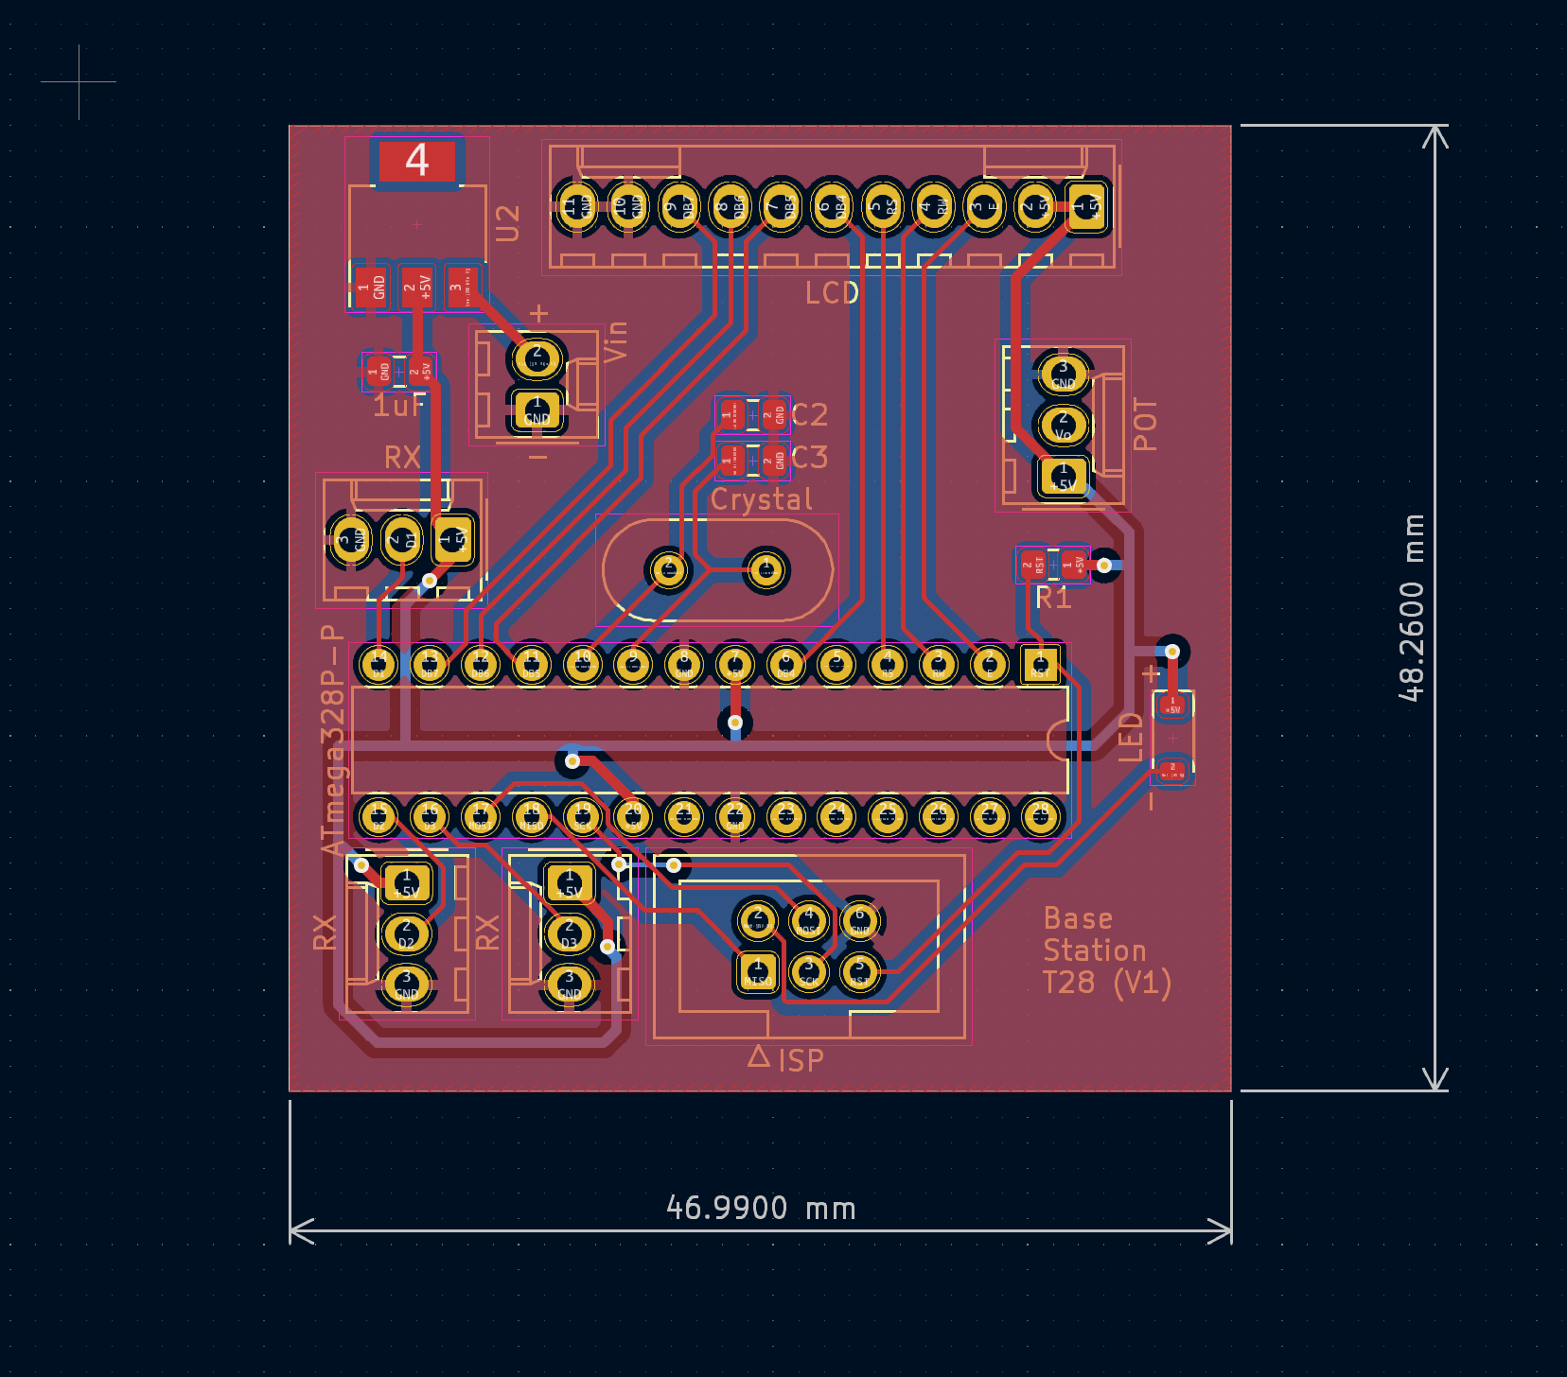
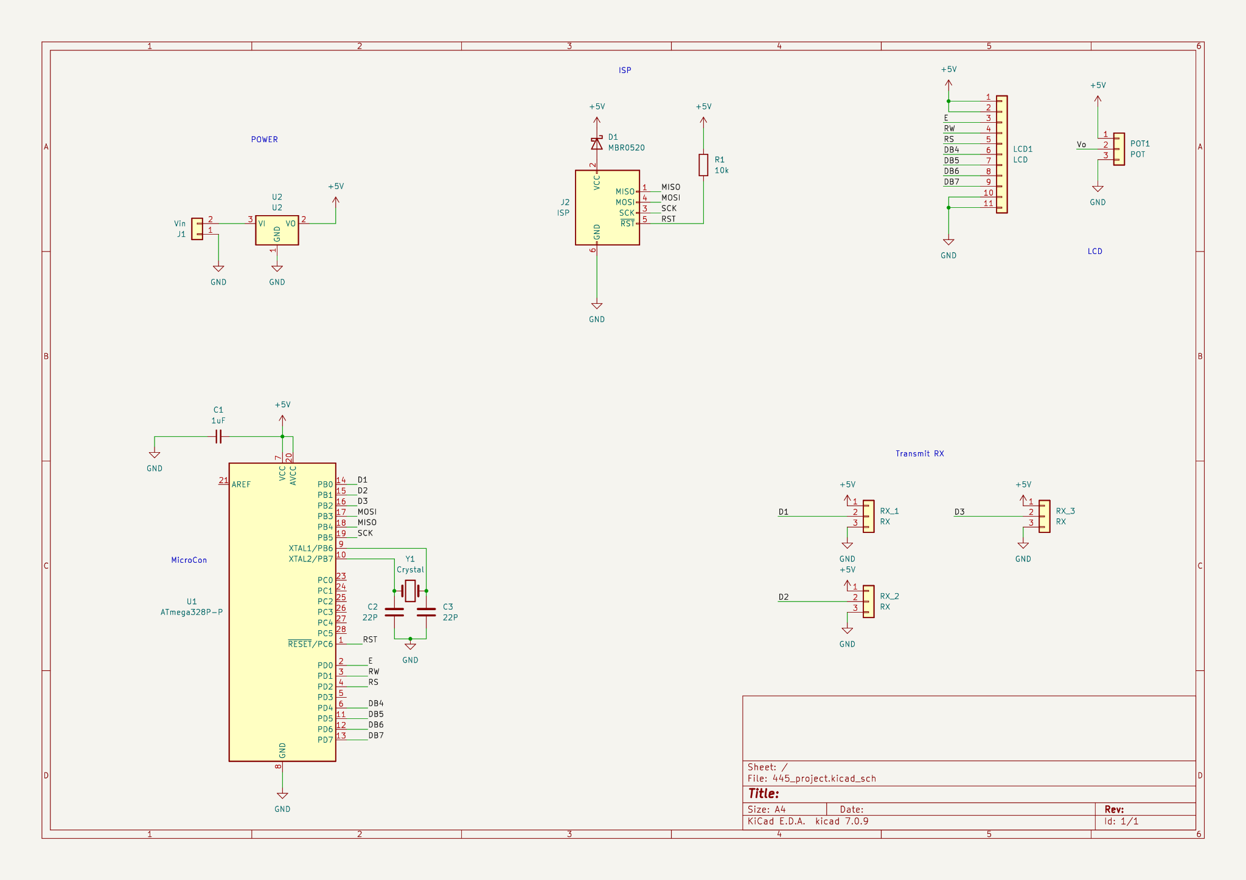
Base Station
ELECTRICAL & COMPUTER ENGINEERING
GRAINGER ENGINEERING

Slide 11
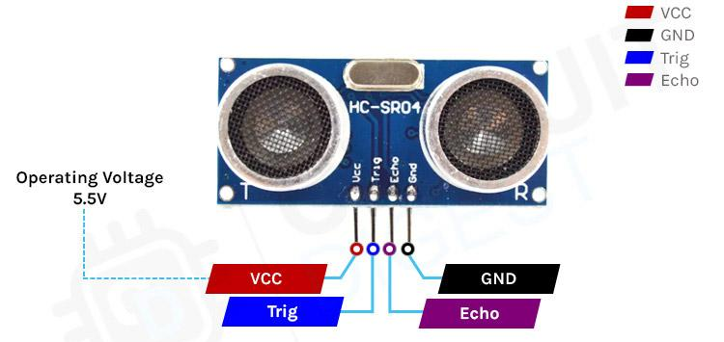
Sensing
Requirement:
Provide measurements with an accuracy within 4 inches
Ultrasonic Sensor (HC-SR04)
Can take between 1.8~5.5V
Powered with 4V in design
Sends 8 sonic bursts through Trigger Pin
Takes a 10us pulse (active high)
Sets the Echo to high for the duration, then low
Measurement done by function pulseIn(), returns passed
Sends interval (Time Delta) to PCB for Encoding
ELECTRICAL & COMPUTER ENGINEERING
GRAINGER ENGINEERING

Slide 12
Encoding/Decoding
Encoding
Most significant base-10 digit given 5-digits for Time Delta
XXXX→T1, XXXX + 10000→T2, XXXX + 20000→T3
Limits:
~171cm→9999us
≤6 sensors as given output is a 16 bit unsigned int
Decoding
If Time Delta is
>20000 → T3, >10000 → T2, else T1
Time delta *.0343 cm / 2
Then compare the distance against 30cm, 60cm (High, Med)
ELECTRICAL & COMPUTER ENGINEERING
GRAINGER ENGINEERING

Slide 13
Success and Challenges
Successes
Met the high level requirements
Displays data from three devices on LCD
Relays data at intervals
Accurate to within 4”
Overcame interference issues at 30s+ interval
Custom PCB w/ microprocessor at base station
Grid independent devices
Challenges
Decoding multiple devices
Interference between devices
Lead times for equipment
Reliable +50 meter transmission
Failures
Rechargeable 12V source for RX/TX range
Tuning AM frequencies outside
ELECTRICAL & COMPUTER ENGINEERING
GRAINGER ENGINEERING

Slide 14
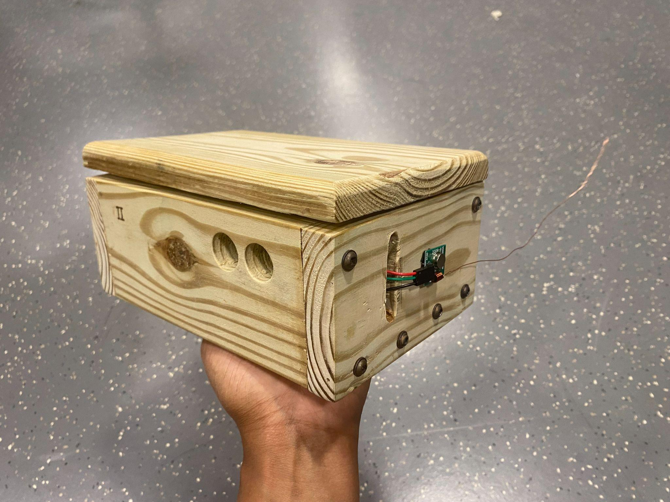
Conclusion
Learned:
Engineering Process from Conception → Design → Finished Product
New (and old) ECE concepts including MPPT, PCB design, ATTiny coding, Testing/Verification Techniques
If we could do it all again:
Plan requirements and verification tables then execute them
Rather than an trial and error approach
Plan around potential lead time issues
Submit orders earlier
Get the LCD before designing PCB
ELECTRICAL & COMPUTER ENGINEERING
GRAINGER ENGINEERING

Slide 15
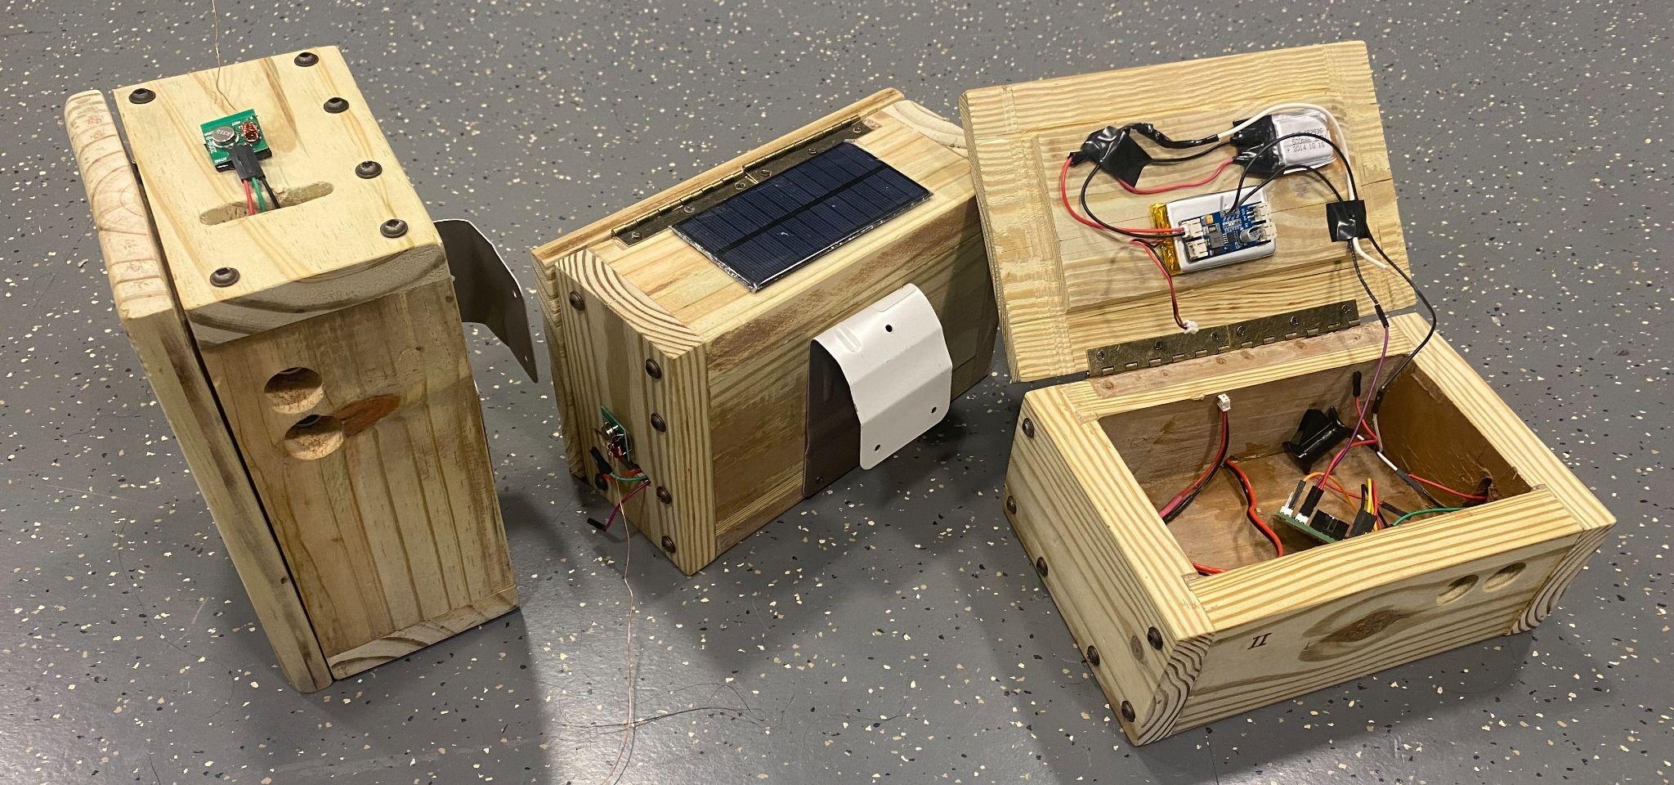
Recommendations
Recommendations:
Research non-line-of-sight transmission (NLOS)
Look into Transceiver (nRF24L01)
Look into Other Microcontrollers (ATTiny1614)
Look into Linear Regulators
ELECTRICAL & COMPUTER ENGINEERING
GRAINGER ENGINEERING

