Slide 1
Automated IC Chip Tester
Team 47
Michael Ruscito, Alison Shikada, Ryan Yoseph
ECE 445 Spring 2021
Notes:
Goal: 20 - 25 seconds
Hello and welcome everyone to Team 47’s Final Presentation for ECE 445. My name is Ryan Yoseph and I will be introducing the project our team has been working on this semester, the Automated IC Chip Tester. Alongside me today are my two partners Alison Shikada (pause for 1 second to wave), and Michael Ruscito (pause 1 second to wave). We are very excited to share our project with you so without further ado, let’s begin.

Slide 2
Introduction
Problem
Students in ECE 385 spend a lot of time unit testing chips used in their circuits
Unit testing IC chips is time consuming and tedious
No current product exists to help facilitate this process for students
Solution
A small, portable device for unit testing IC chips used in ECE 385
Goal: maximize the time students spend in the design process
Notes:
Goal: 15 seconds
A common frustration in ECE 385 is when students find a given IC chip does not work as expected.
Testing each chip manually is tedious and time consuming. Students are encouraged to test individual chips before using them, but this advice is rarely followed.
By adding the time constraint of assignments, complexity of 385 labs, and the potential to ruin chips, neglecting to unit test the IC chips falsely influences students into thinking their IC chips are in mint condition.
Our solution is a small, portable device for unit testing IC chips used in ECE 385. The goal of our project was to streamline the debugging process for students by minimizing the time they spend manually checking each chip thereby maximizing the time they spend in the design process of their labs.

Slide 3
Objectives
Our team designed a device that is:
Battery powered and rechargeable
Inclusive of all IC Chips used in ECE 385
Simple to use with a user interface through a mobile device or computer
Notes:
Goal: 30 seconds
Throughout our own design process, we focused on creating a product that was portable, easy to use, and offered almost instantaneous results.
Specifically, we wanted our users to have a device that made setting up and packing up as fast as possible, which is why we chose a rechargeable single cell lithium polymer battery as our power source.
Moreover, our product delivers a simple, easy-to-use user interface equipped with a drop down menu for selecting the proper test chip.
Finally, our device provides test vectors for all 18 chips provided in the ECE 385 lab kit, ensuring complete functionality.

Slide 4
Project Demo
Notes:
Before moving on, we would like to show you a short video that illustrates a basic overview of our project.

Slide 5
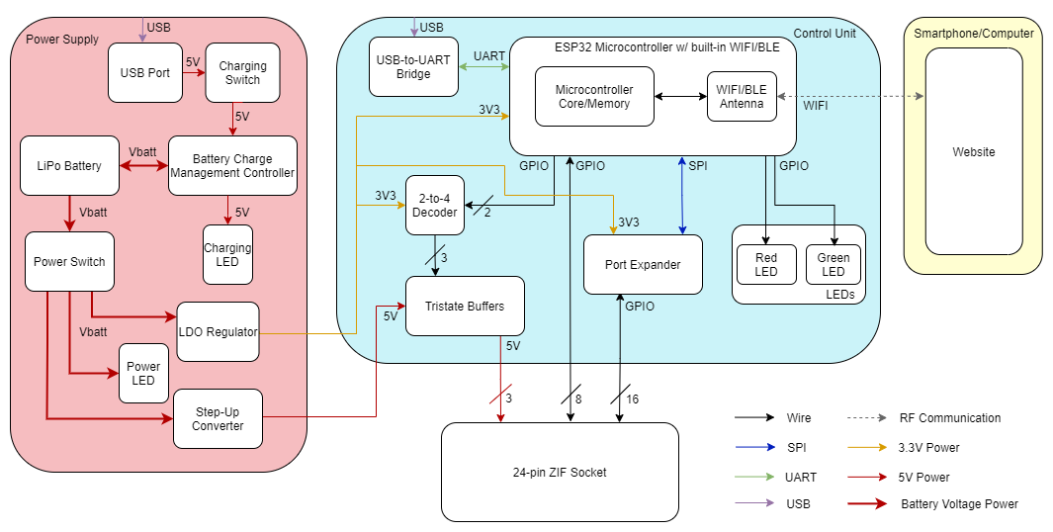
Complete Block Diagram
Notes:
Here is the complete block diagram of our device.
The three main subsystems (from left to right) are the power supply, control unit, and web application.
Moving forward, we will go into detail about each subsystem and the design choices that ultimately resulted in the culmination of our project.

Slide 6
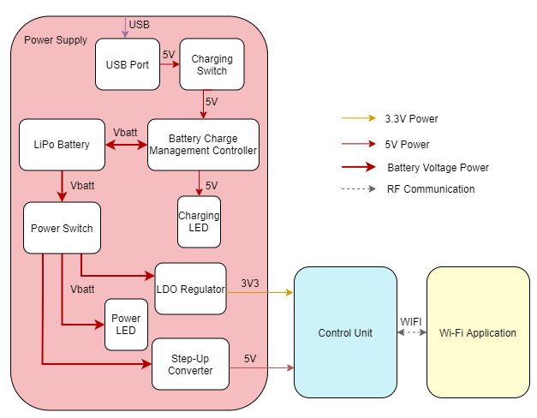
Power Block Diagram
Notes:
First we will start with the power supply subsystem.
Notice that there are two separate power supply rails, 3.3 V and 5 V.
Specifically, the 3.3 V line powers the chips on our printed circuit board while the 5 V line powers the test chip.
In general, the goal of our power supply is to adequately provide constant voltage and constant current to the board and the test chip.

Slide 7
Power Supply – Design Choices for I/Os
Power input: 3.7 V 2 Ah lithium polymer battery
Compact (<20 cm³)
Lightweight (~40 g)
Rechargeable
Charging input: USB 3.0 type B cable
5 V bus
1.5 A maximum output
550 mA ensured by design
Same cable can program FPGA board
Integrated charging & power switches
Orange and red LEDs, respectively, indicate status
Allow the user more flexibility
Notes:
Here are some of the design choices that our team made for the power supply subsystem.

Slide 8
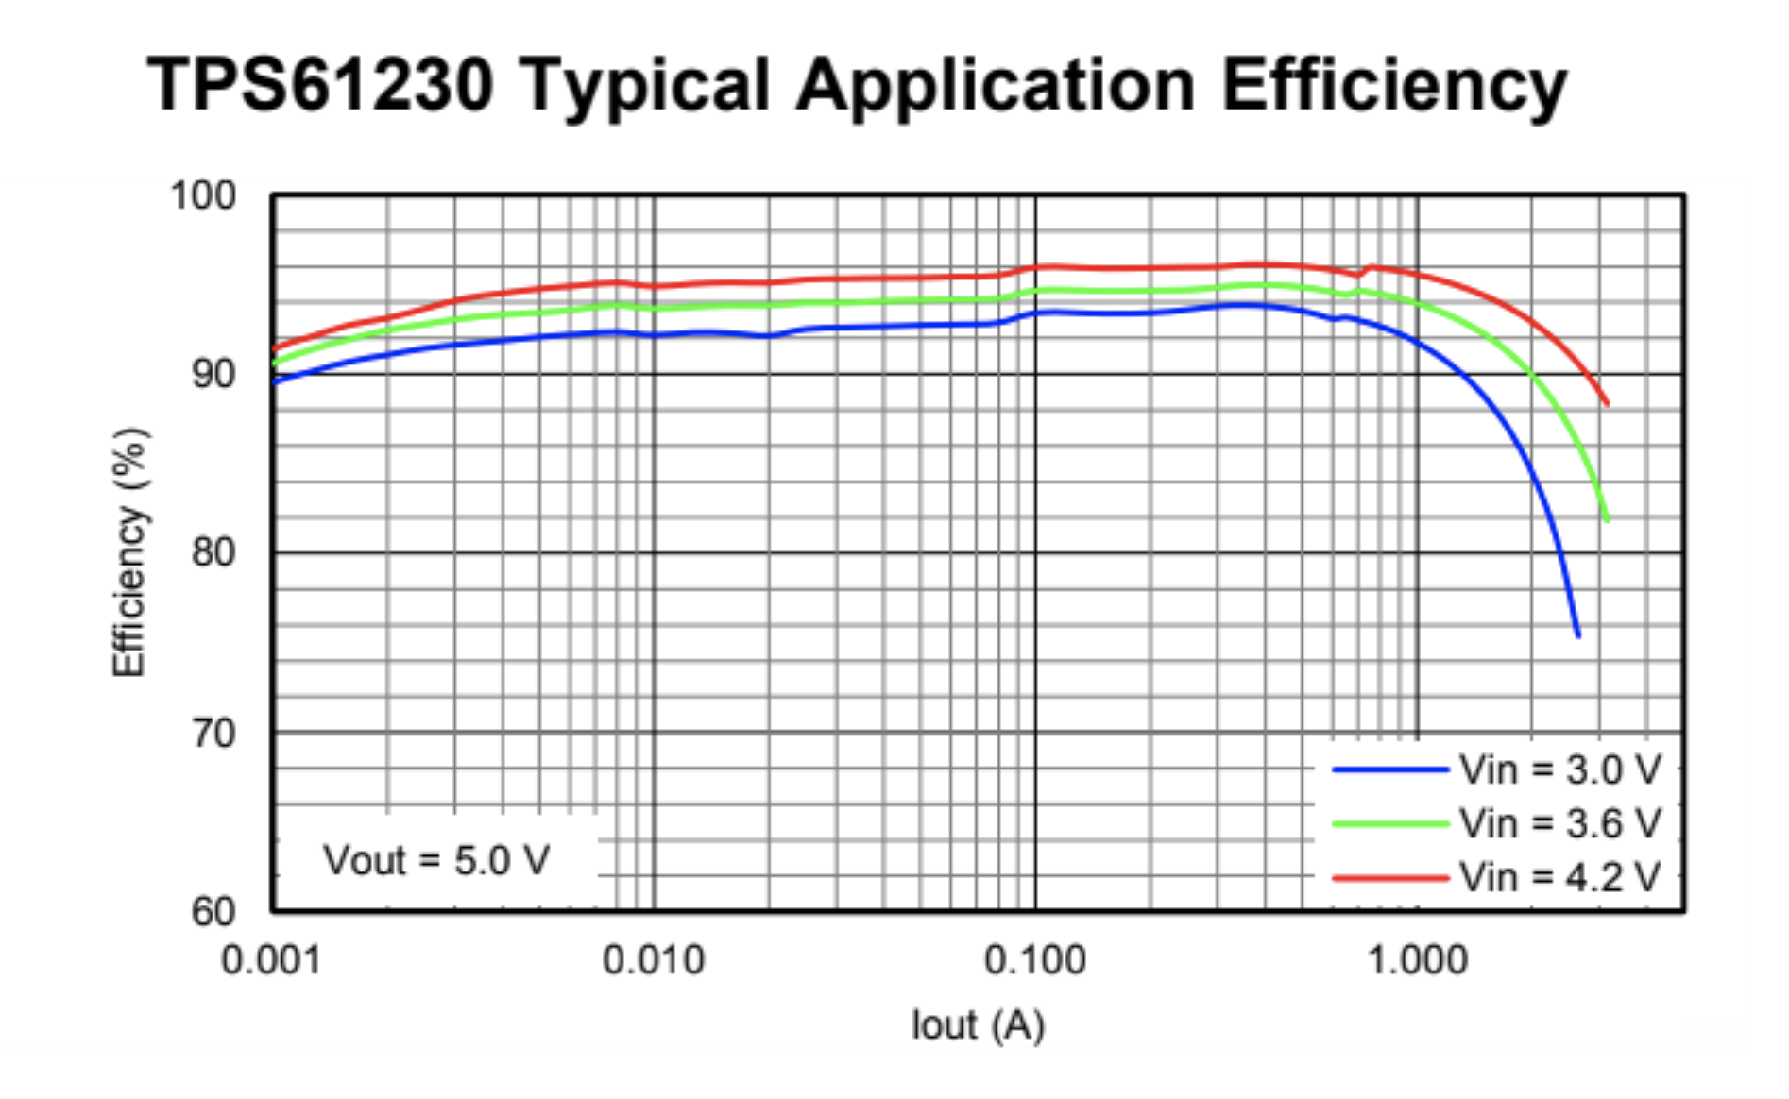
Power Supply – Design Choices For Voltage Regulators
Low Dropout (LDO) Regulator
Drops input voltage to 3.3 V
V_{DO}= 200 mV at 20 ˚C when I_{O}= 750 mA
Great for batteries
90% efficiency when I_{O}= 750 mA
No EMI
DC-DC Step-up Converter
Takes 3.3 V input to 5 V
~94% efficiency when I_{O}= 20 mA
Notes:
Furthermore, ensuring constant voltage/constant current relies heavily on the proper selection of regulators.
For our 3.3 V power supply….
For our 5 V power supply…
Now I am going to hand it off to Michael who will go into detail on the control unit.

Slide 9
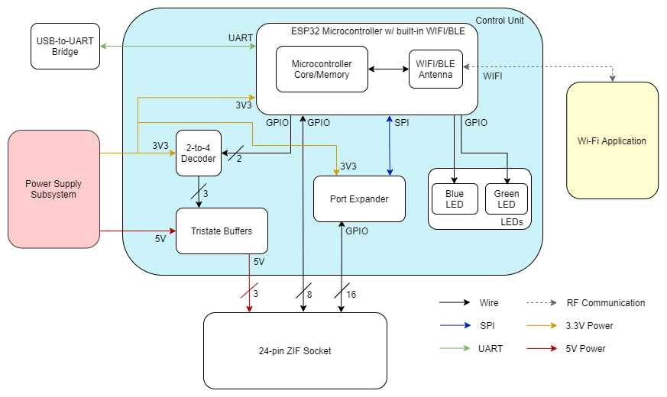
Control Unit Block Diagram

Slide 10
Control Unit Requirements
The port expander must be able to parallelize 16-bit outputs from the SPI communication with the ESP32.
<0.8 V = Low, >2.0 V = High
Logical Low | 0.000 V
Logical High | 3.285 V
The 2-bit signal from the ESP32 must be decoded to the tristate buffers which output 5 V to the selected pin and high impedance to other 2 pins.
Selected Pin | 5.020 V
Other Pins | Floating

Slide 11
ESP32 Requirements
The microcontroller’s firmware must contain a library of test suites for all 18 chips provided in the ECE 385 lab.

Slide 12
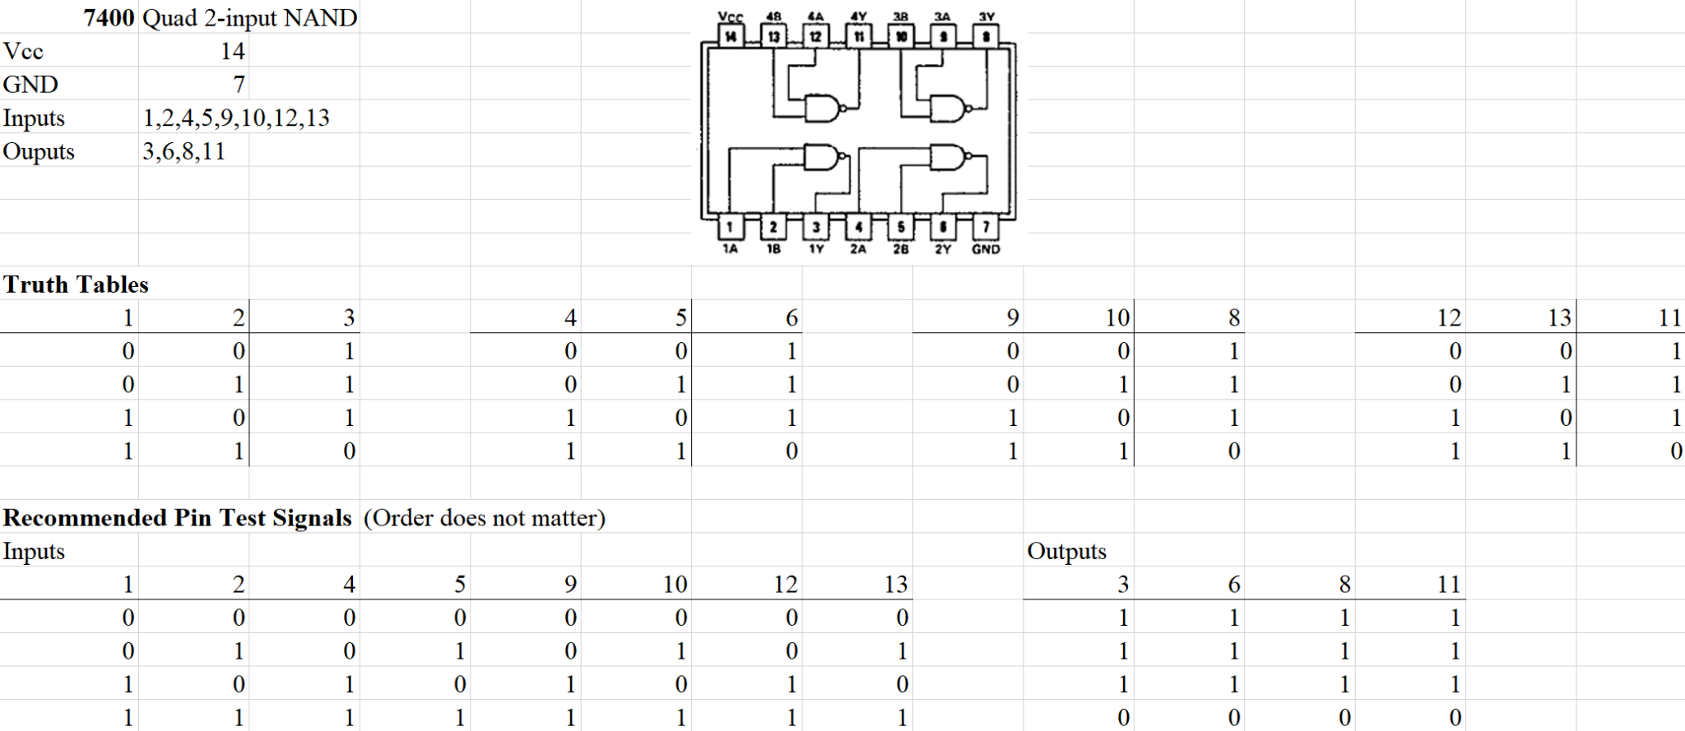
ESP32 Requirements
The microcontroller’s firmware must contain a library of test suites for all 18 chips provided in the ECE 385 lab.

Slide 13
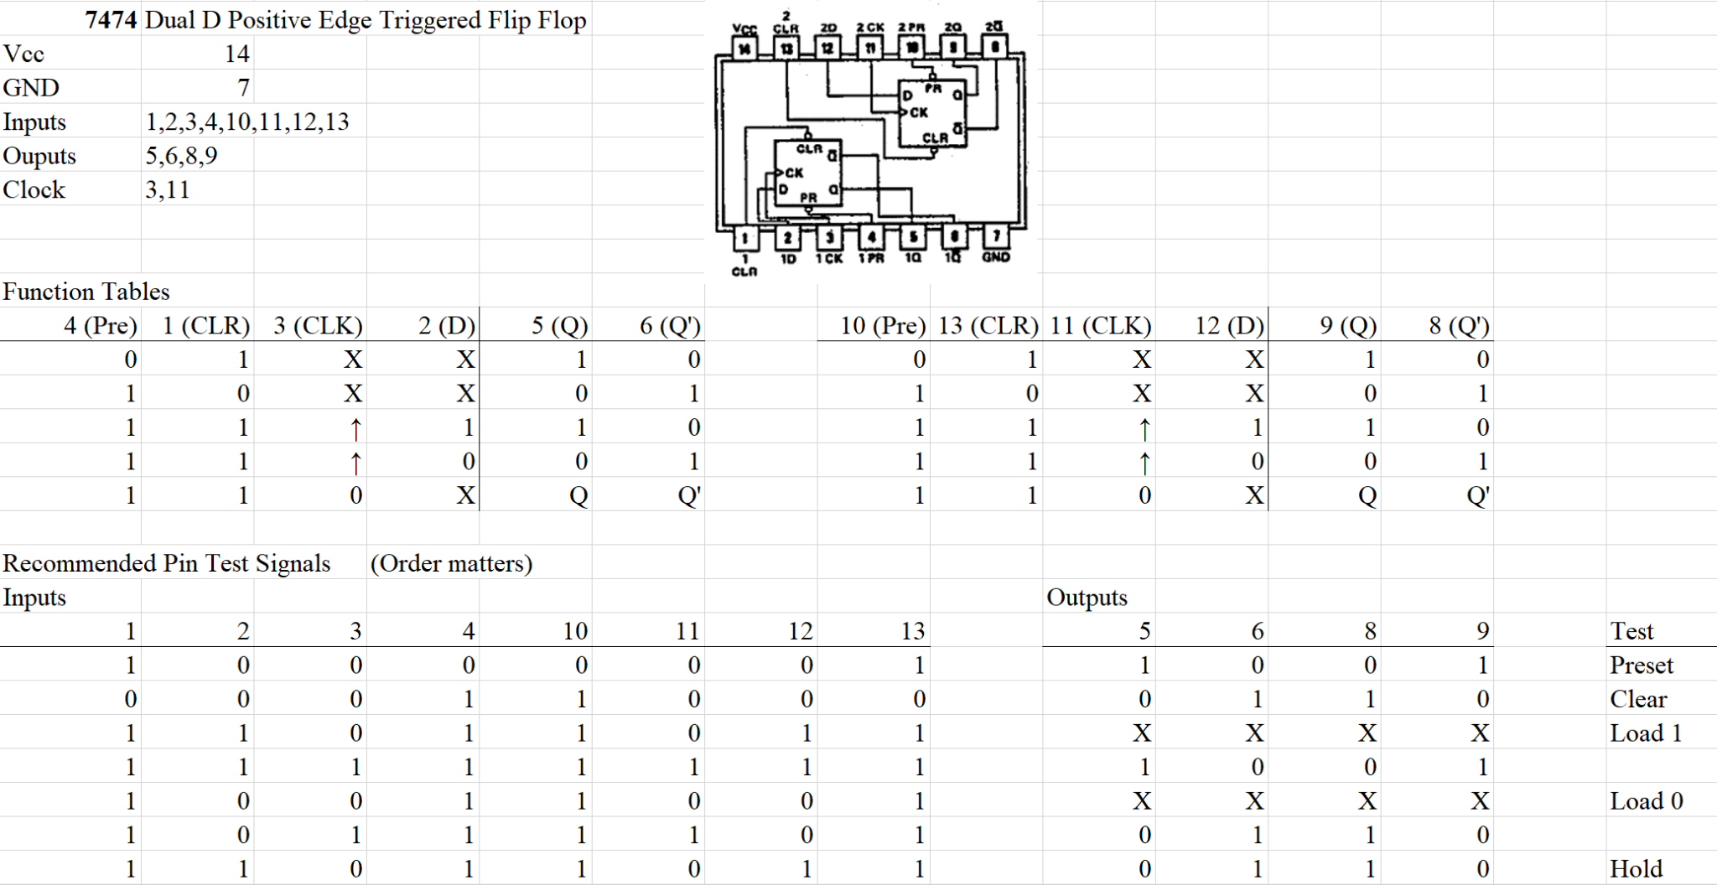
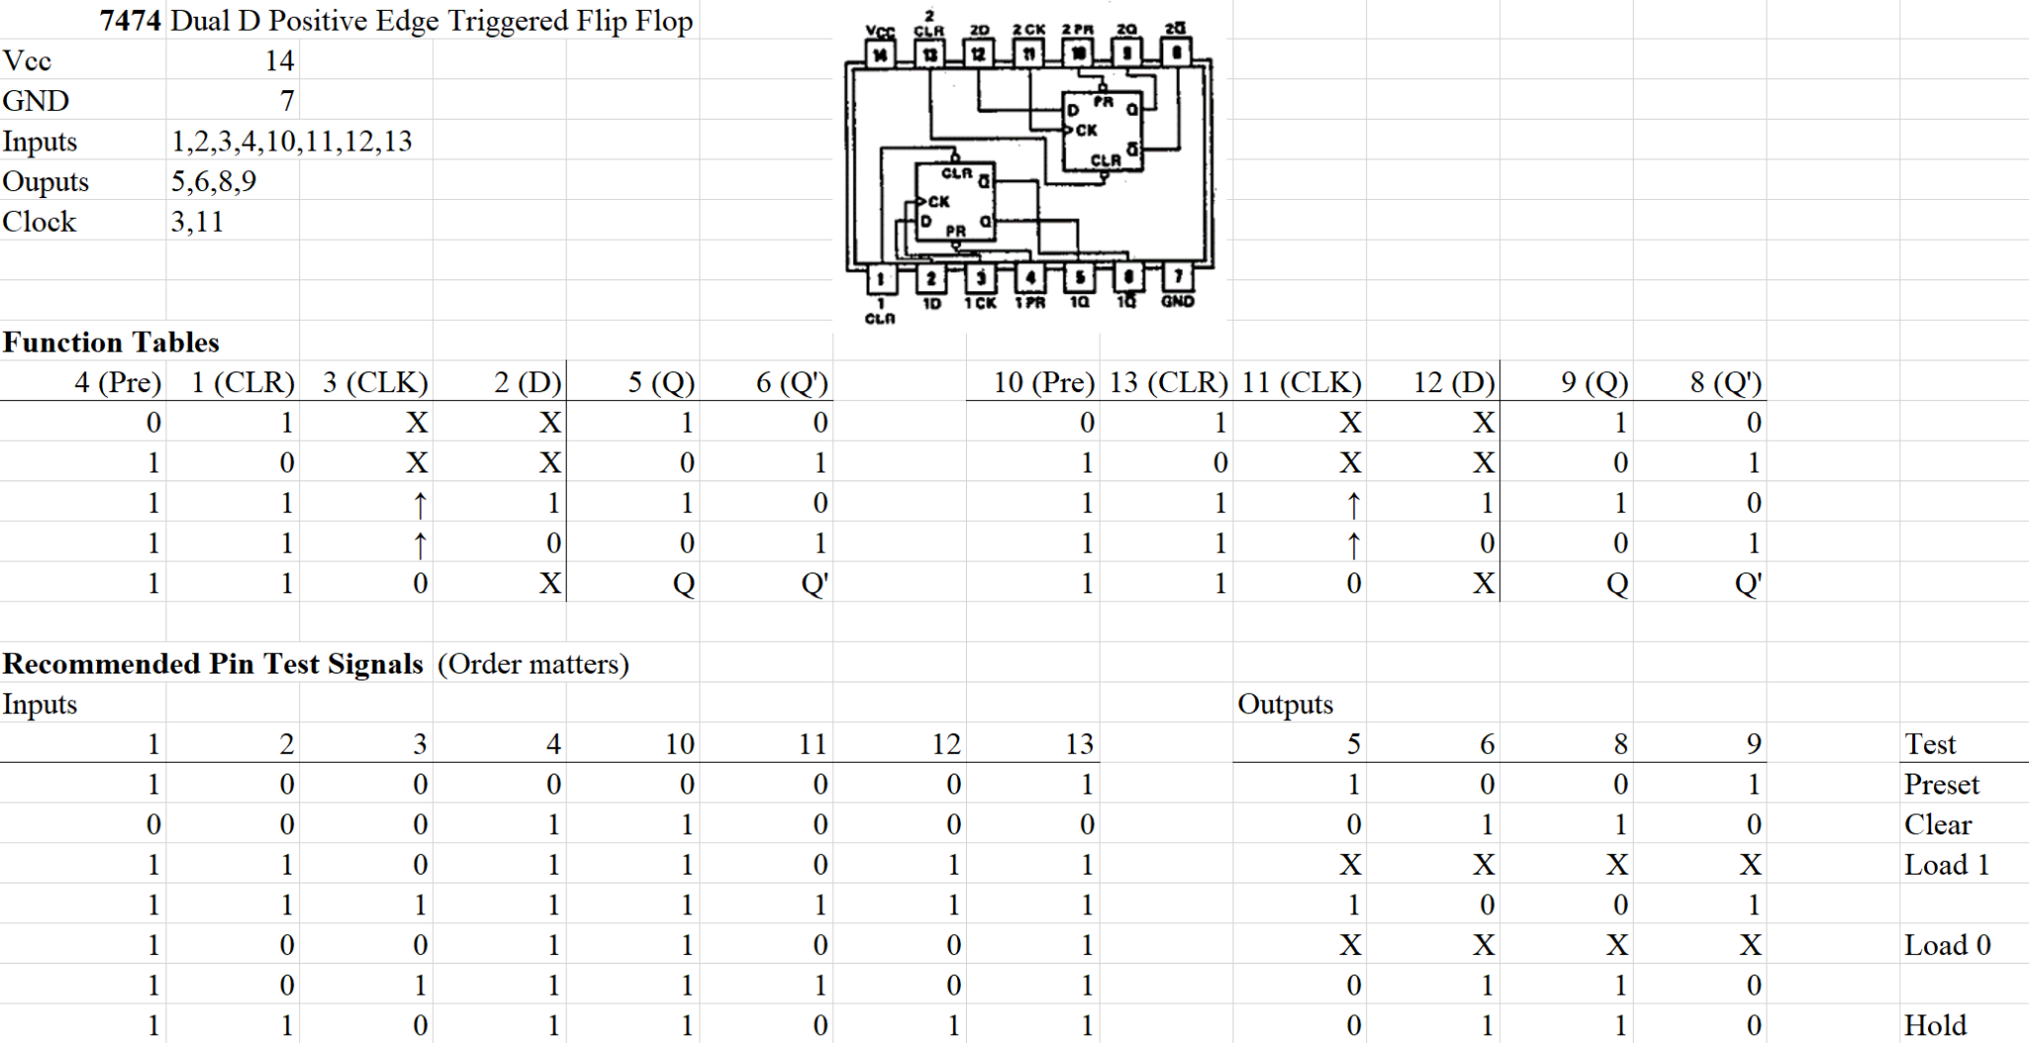
Sequential Logic

Slide 14
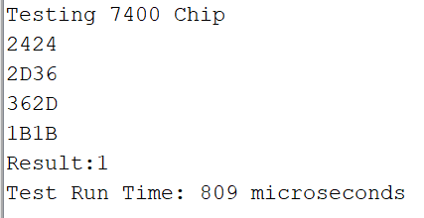
ESP32 Requirements
The ESP32 must be able to read from all 24 of the ZIF socket pins.
0010 0100 0010 0100

Slide 15
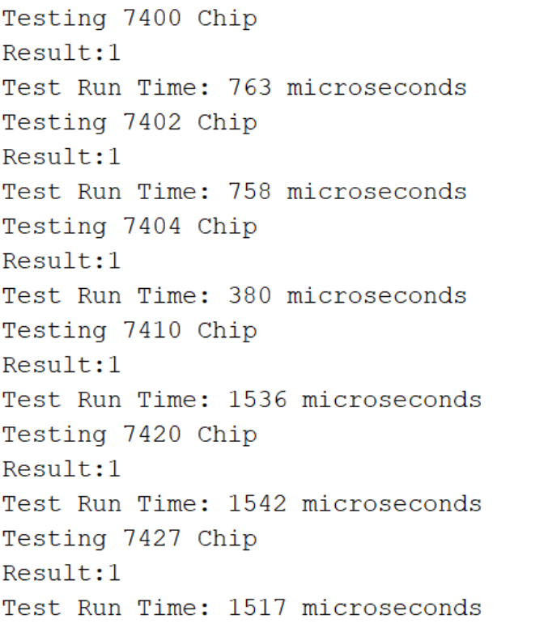
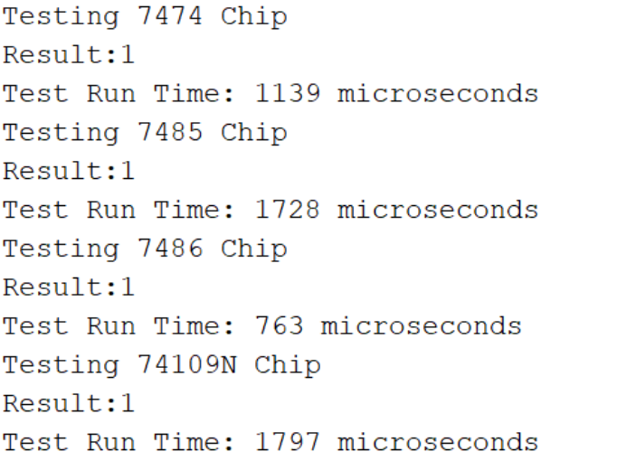
ESP32 Requirements
The device’s internal logic must be able to determine if a chip is working properly in under 2 milliseconds.
Notes:
Put latency constraints in order to provide the user with fast results.

Slide 16
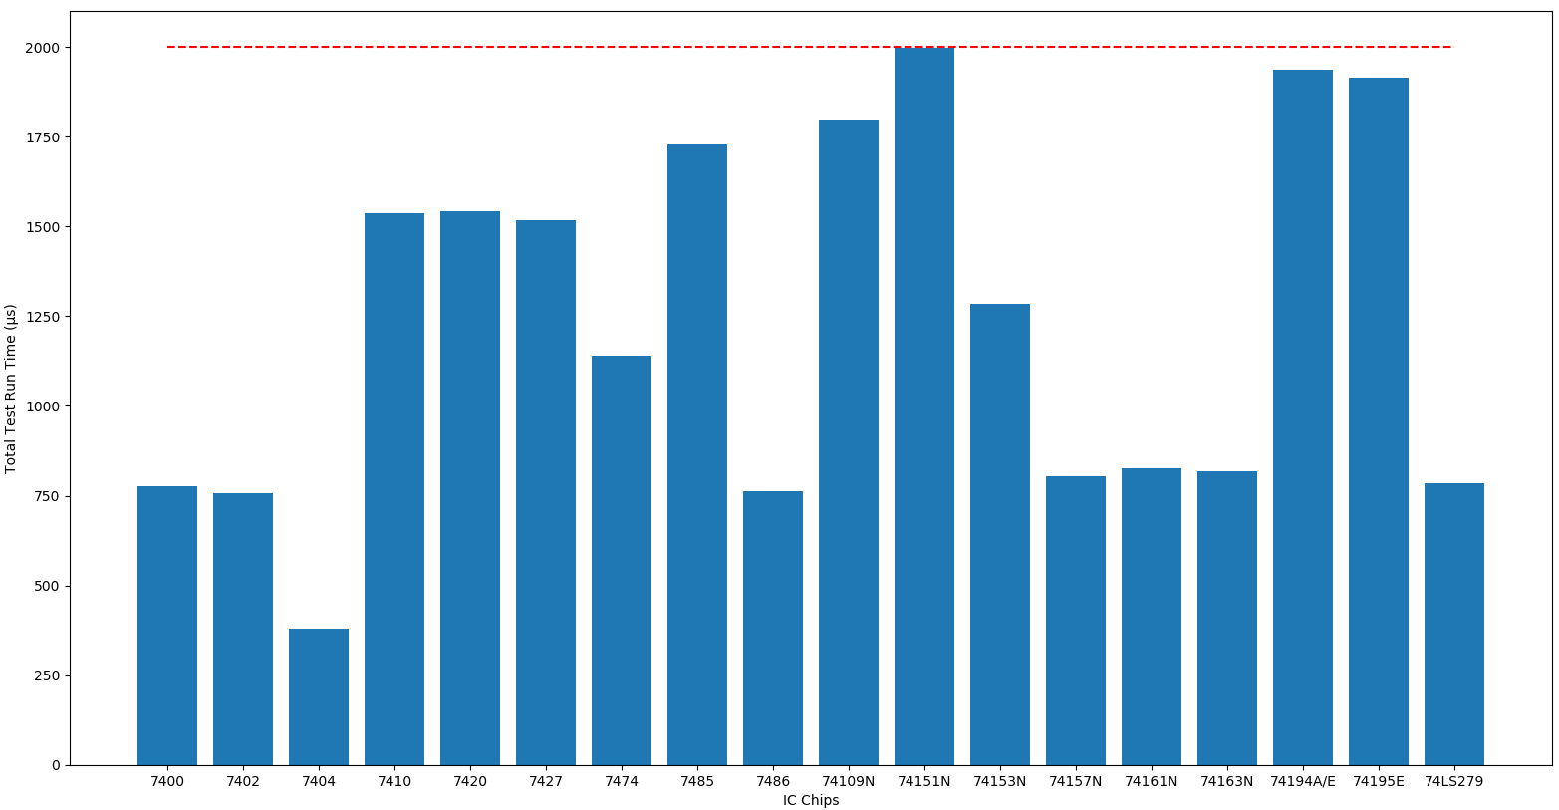
Test Run Times

Slide 17
Web Application - Home Screen
Notes:
How it works
show video

Slide 18
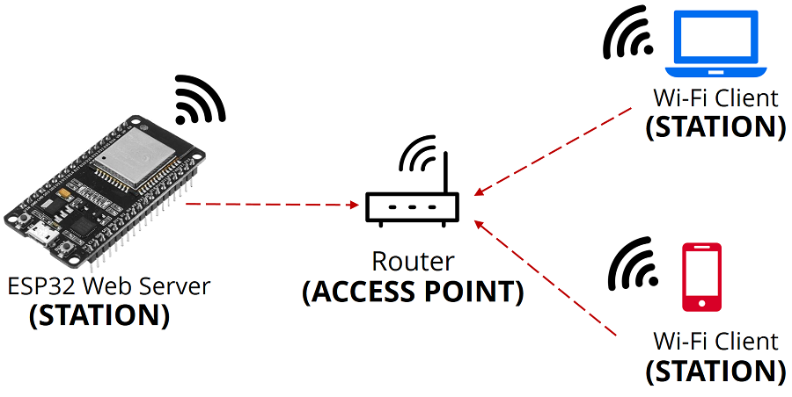
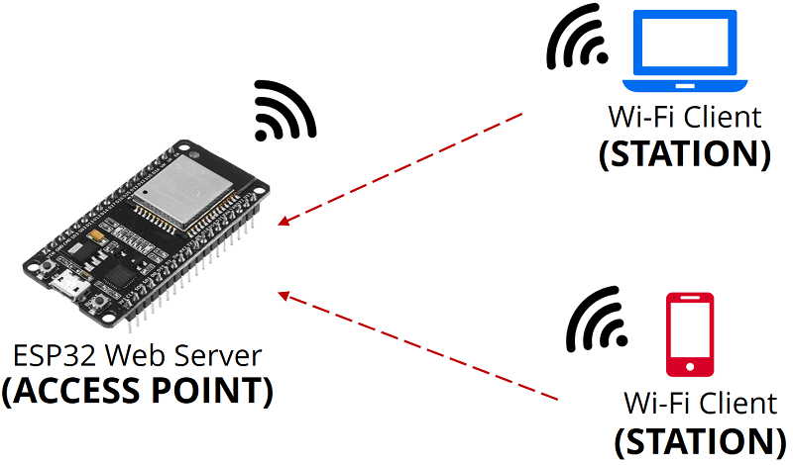
App Design Decisions
WiFi vs BLE application
Soft Access Point (softAP)
React.js vs SPIFFS
aWOT: handling HTTP API requests
Notes:
https://randomnerdtutorials.com/esp32-access-point-ap-web-server/
wifi vs ble
development time, experience and comfortability Arduino app vs Web app; ble communication
soft access point
what is it
turned off for faster development time
added for security (ethics)
app is generated by react.js npm create-react-app rather than using SPI Flat File system because 1) space, 2) development time
aWOT is a web server library from Arduino that can be used with various board architectures. Using aWOT, we can create HTTP API requests. GET, PUT, POST, etc to update state of application

Slide 19
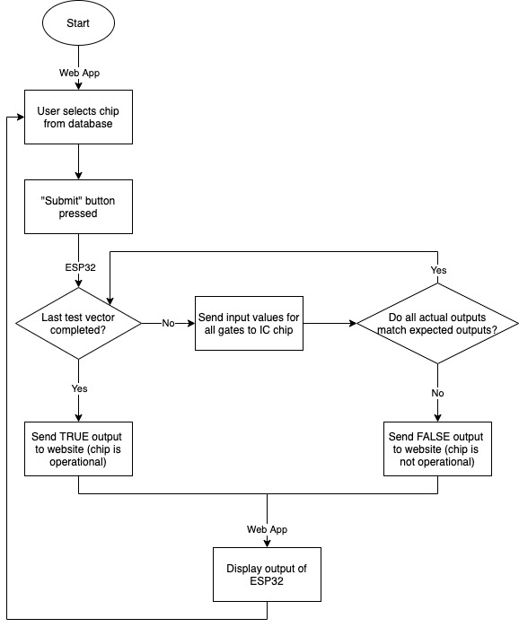
Flowchart
Notes:
mention communication between esp32 and wifi app

Slide 20
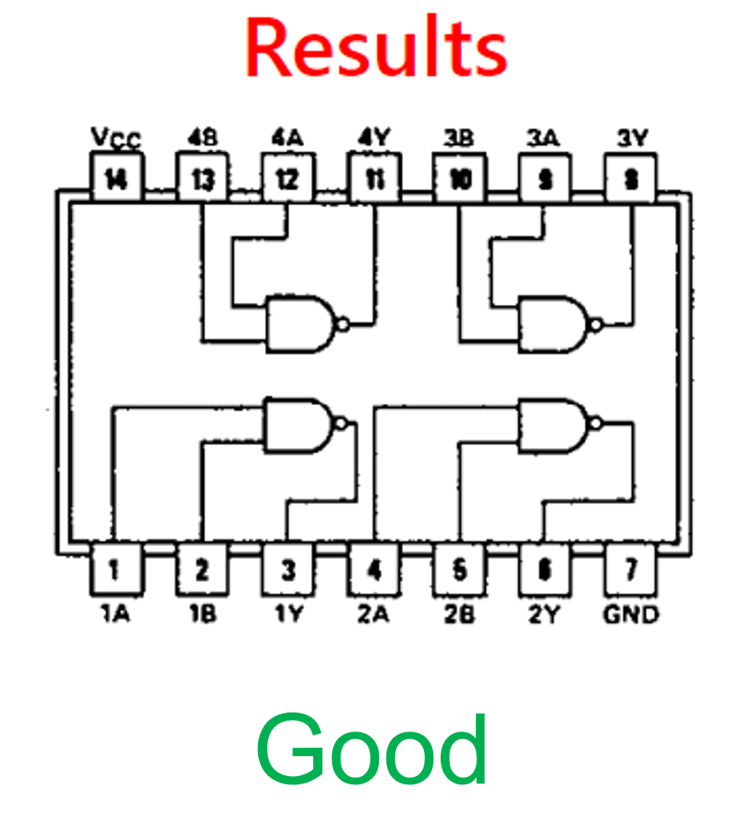
Challenges
Output of website not updating on UI
Possible solution: web socket

Slide 21
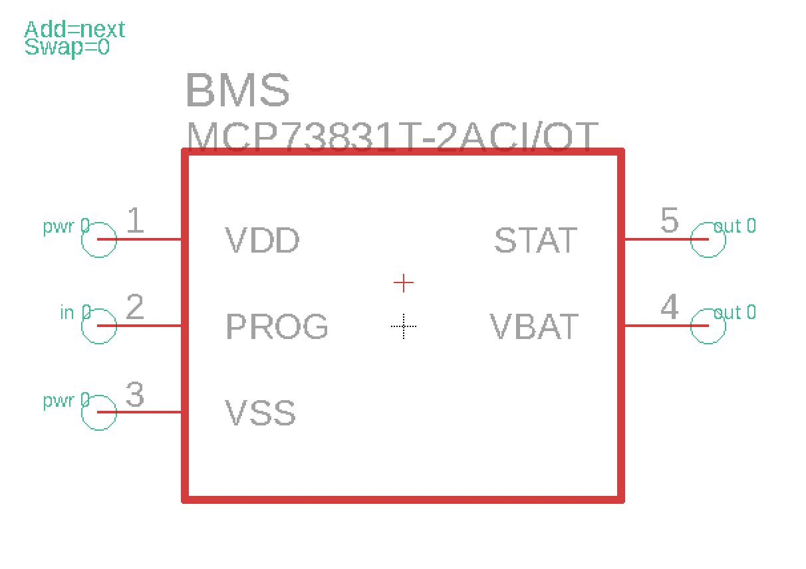
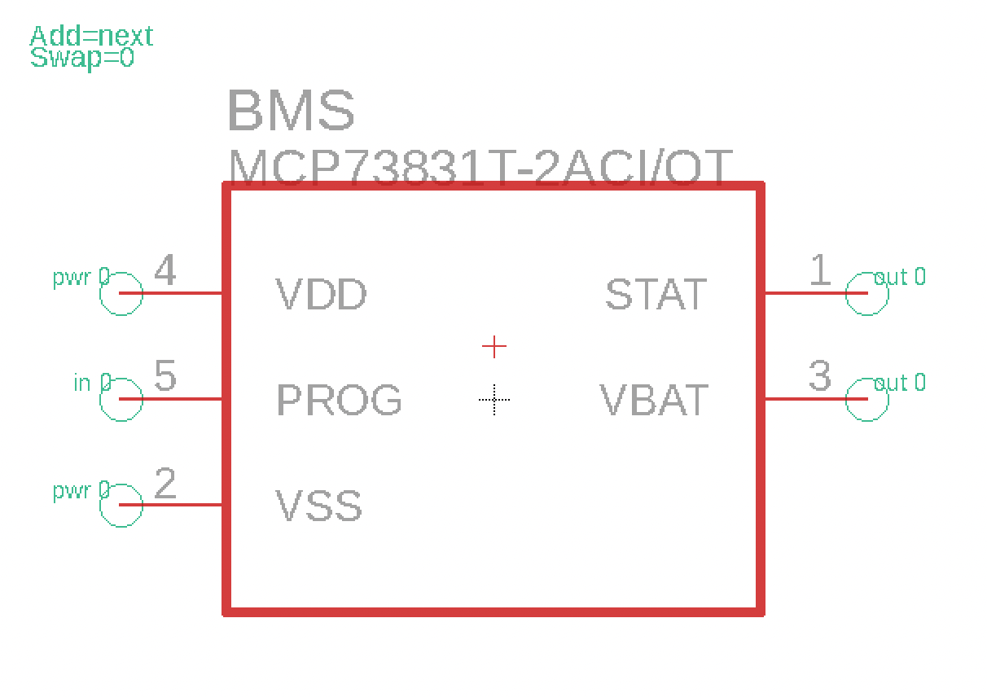
Challenges
Integrated Charging
Solution: improvement on PCB design

Slide 22
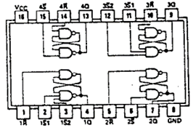
Challenges
S-R latch circuit
Circuitry error or chip error
Potential timing issue with multiple chips
Can be implemented in further work

Slide 23
Conclusions and Further Work
Continuation of this Project
3D printed box for more durable and cleaner UI
Customized user unit tests
Integrating with Shibboleth system
Larger Projects
Larger sized IC chips
Potential for circuit testing
Notes:
Insert photo of physical design from design doc

Slide 24
Questions?

