Slide 1
Autonomous Sailboat
Group 43
Franklin Liu
Megan Shapland
Haoyu Wang
Date: 5/4/21

Slide 2
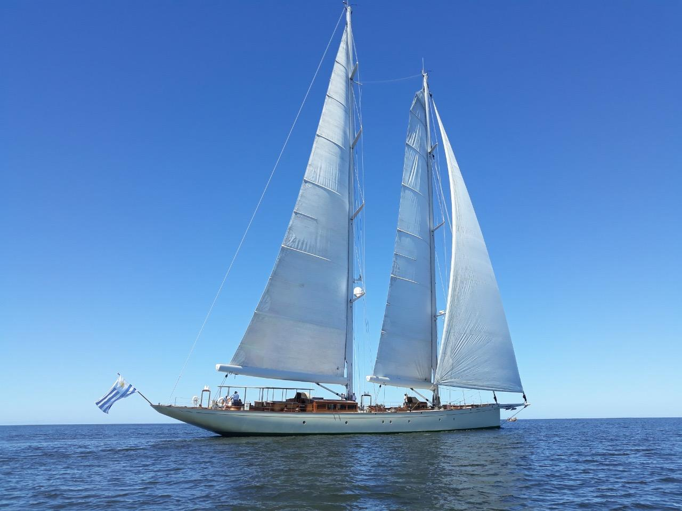
Introduction
There is a large barrier to entry in learning how to operate a sailboat.
Using a sailboat is very complex and people often have to spend many weeks or even months just learning the basics
What if we were to develop an autonomous sailboat that would be able to sail itself?
would not require significant training unlike a normal sailboat
greatly reduced possibility of accidents that are caused by user error

Slide 3
Features
The boat control system must be able to record rudder and sail servo settings as well as sensor and heading data during both modes of operation at one second intervals for up to an hour of operation
The boat must have two modes of operation: autonomous and user remote controll, and the user must be able to switch between these modes while the boat is sailing.
The boat autonomous control system must be able to autonomously sail the boat on a steady course on a heading ranging from 60 to 160 degrees relative to the wind direction by controlling the rudder and sail settings after the user has prepared the boat to sail in that direction

Slide 4
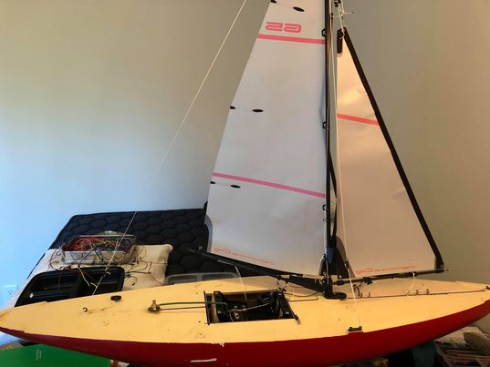
System Overview
Hardware
Arduino Uno
MA3-Anemometer
LSM303DLHC -Compass
Rudder Servo
Sail Servo
FlySky FS-i6 6 channel transmitter
FS-iA6B 6 channel receiver
4AA batteries
Voltage Regulator
Software
Arduino program that interprets data from sensors and user then controls the rudder and sails

Slide 5
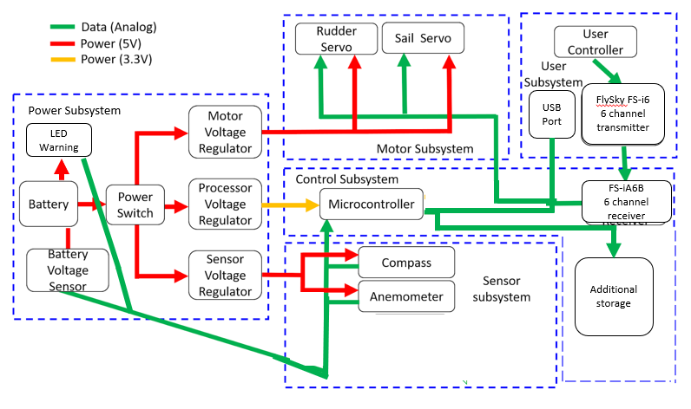
System Overview-Block Diagram

Slide 6
Power Subsystem
Boat power source subsystem is required to power up all other subsystems by providing other subsystems with appropriate voltage inputs.
The battery voltage will need to be regulated to the appropriate power for the subsystems to operate.

Slide 7
4AA Battery
Requirement:
Provides about 6 volts ± 2% of electricity
Capable of providing 10mA for at least 6 hours.
Insulated from water using plastic covering
Verification:
1) Use a multimeter to check whether the voltage of each one of 4 AA batteries is around 1.5V.
2) Use a multimeter to check whether the whole battery pack can supply voltage 6V ± 2% and the current should be around 10mA.
3) After the battery pack works for 6 hours, measure the voltage to check whether the whole battery pack can supply voltage 6V ± 2% with around 10mA.

Slide 8
4AA Battery Testing Results
Multimeter readings match requirements
Power is sufficient

Slide 9
5 and 3.3 Voltage power regulator
Requirement:
Voltage must be regulated to 3.3V for the connection to the control subsystem and 5V for the connection to the other subsystems
0.5mA ± 2% as required for the control subsystem
0.5mA ± 2% as required for the other subsystem
Verification:
1) Use the multimeter to connect the positive and negative side of each of the voltage regulator.
2) The display should output around 3.3V for the connection to the control subsystem and 5V for the connection to the other subsystems
3) Use the multimeter to check whether the current is 0.5mA ± 2% for all subsystems

Slide 10
5 and 3.3 Voltage power regulator Testing Results
multimeter readings match requirements
No chance of overloading circuits
Multimeter Reading of 3.3V Power Supply
Multimeter Reading of 5V Power Supply

Slide 11
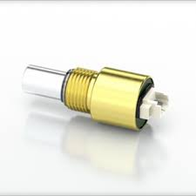
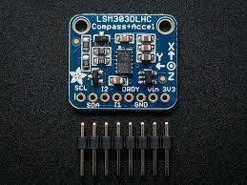
Sensor Subsystem
Responsible for collecting all the data of the boat’s heading and the wind’s direction
Data is then given to the processor for interpretation

Slide 12
LSM303DLHC -Compass
Requirement:
Compass must calculate the boat’s heading relative to true north within 1-3 degrees with no more than 5 seconds latency
Testing
1) Connect the compass device to the microcontroller and computer to view the direction information.
2) Point the compass in four directions (North, South, East, West).
3) Compare the recorded directions outputted by the compass with the actual directions and check if it is within 2 degrees. The compass should also be able to display the direction within 5 seconds.
4) record the signal outputs using a multimeter

Slide 13
Compass Testing Results
I2C signals match expected
Can be converted back from I2C into angle
Graph of SCA Pin during the compass transferring heading data to Arduino controller

Slide 14
MA3 Magnetic Encoder-Anemometer
Requirement:
Anemometer must calculate the wind’s heading relative to true north within 1-3 degrees with no more than 5 seconds latency.
Testing
1) Connect an anemometer device to the microcontroller and computer in order to view the direction information.
2) Move the anemometer from four directions (North, South, East, West).
3) Compare the directions outputted by the anemometer with the direction the fan is pointed at and check if it is within 1-3 degrees. The anemometer should also be able to display the wind direction within 5 seconds.
4) record the signal outputs using a multimeter

Slide 15
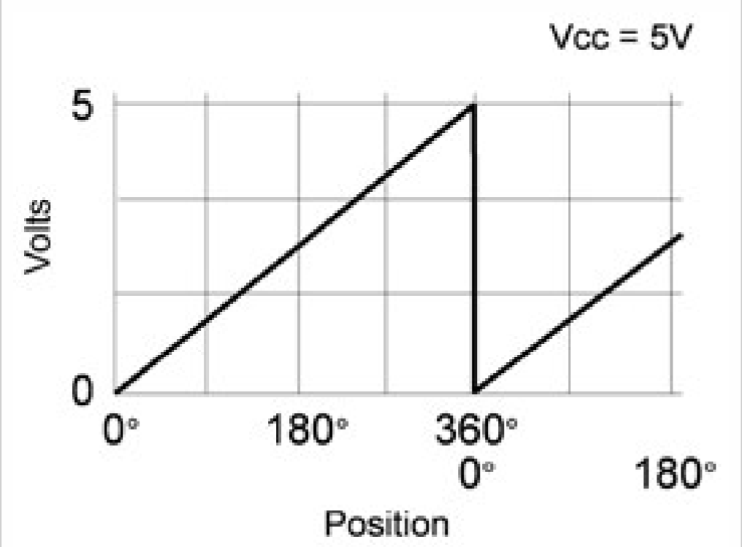
Anemometer Testing Results
Changing the angle of the anemometer changes the voltage
Voltages can be transformed back into equivalent angles
Multimeter Reading of anemometer around zero degrees. (103.5mV)
Multimeter Reading of anemometer around 45 degrees. (0.554 V)
Multimeter Reading of anemometer around 270 degrees. (3.912 V)

Slide 16
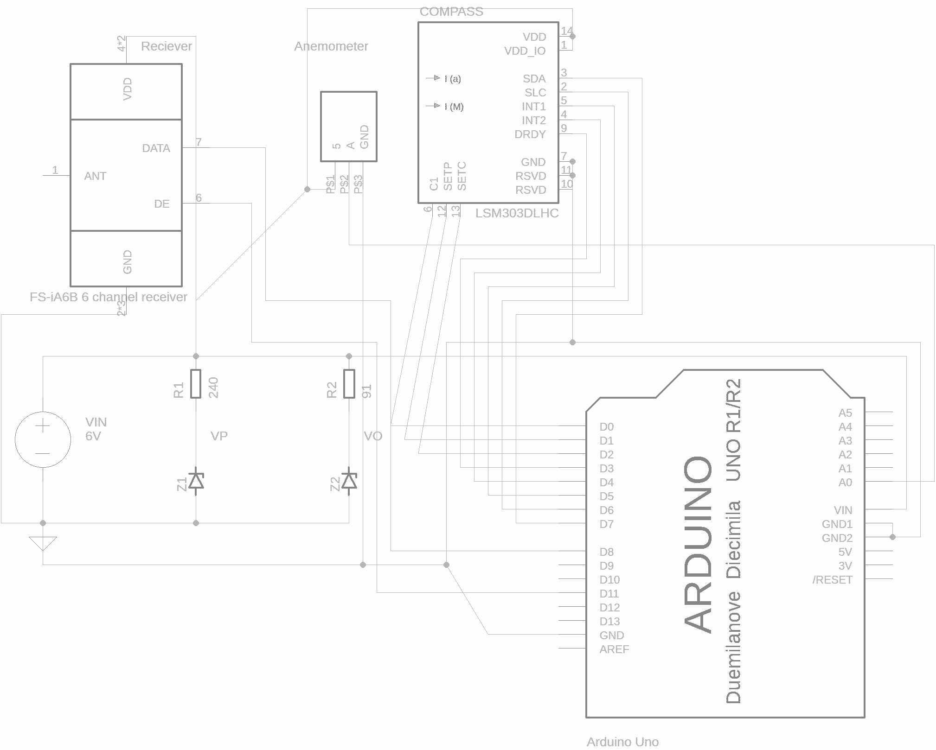
Schematic

Slide 17
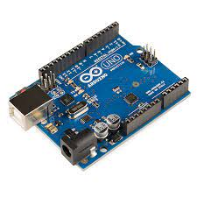
Boat Control Subsystem
Processor accepts data from the Sensor subsystem, and calculates the angles the sails and rudders need to be at to sail to the destination
sends instructions to the Steering Subsystem

Slide 18
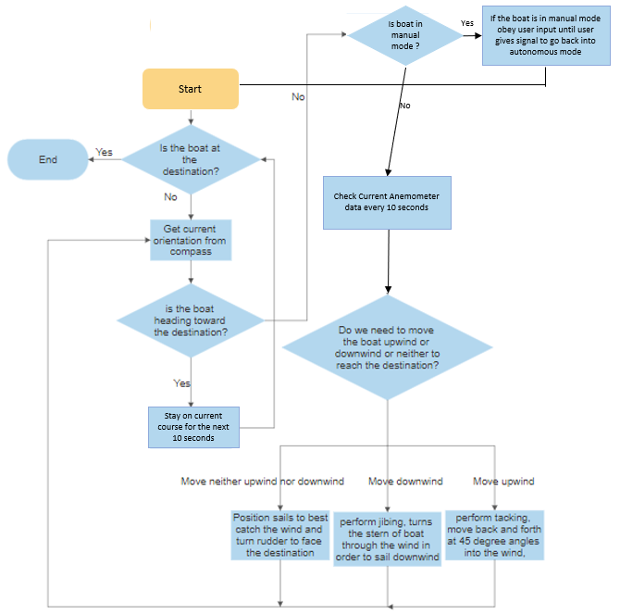
Flow chart

Slide 19
Arduino Uno
Requirement:
Microcontroller should be able to receive data from the compass and anemometer.
Verification:
1) Use a compass to view the boat’s heading.
2) Change the boat’s heading. If the output changes, the microcontroller receives data from the compass.
3) Use a fan to produce wind.
4) Use anemometer to view the wind direction.
5) Move the fan to change wind direction. If the output changes, the microcontroller receives data from the anemometer.

Slide 20
Arduino Uno Testing Results - Data Reception
Arduino successfully interpolate data from compass and annemeter
Read change in wind direction
Read Change in Heading

Slide 21
Arduino Uno
Requirement:
Processor must be able to calculate boat heading and wind direction with relative errors within 1-5% in magnitude with no more than 5 seconds latency.
Verification:
1) Use a compass to view the boat’s heading.
2) Use anemometer to view the wind direction.
3) Compare the recorded boat’s direction and the wind direction outputted by compass and anemometer with the actual heading of the boat and wind direction and check if the relative error is within 1-5% in magnitude. The recorded information should be displayed within 5 seconds.

Slide 22
Arduino Uno Testing Results - Heading Calculation

Slide 23
Arduino Uno
Requirement:
Processor must be able to tell which way to move the boat and what instructions to give the servos based on information from sensors.
Verification:
1) Connect the servos to the microcontroller.
2) Record the correct information collected from the sensors and use them as input.
3) Observe how the sail/rudder servos move in response to signals from the sensors
4) Record signals to servos using multimeter.

Slide 24
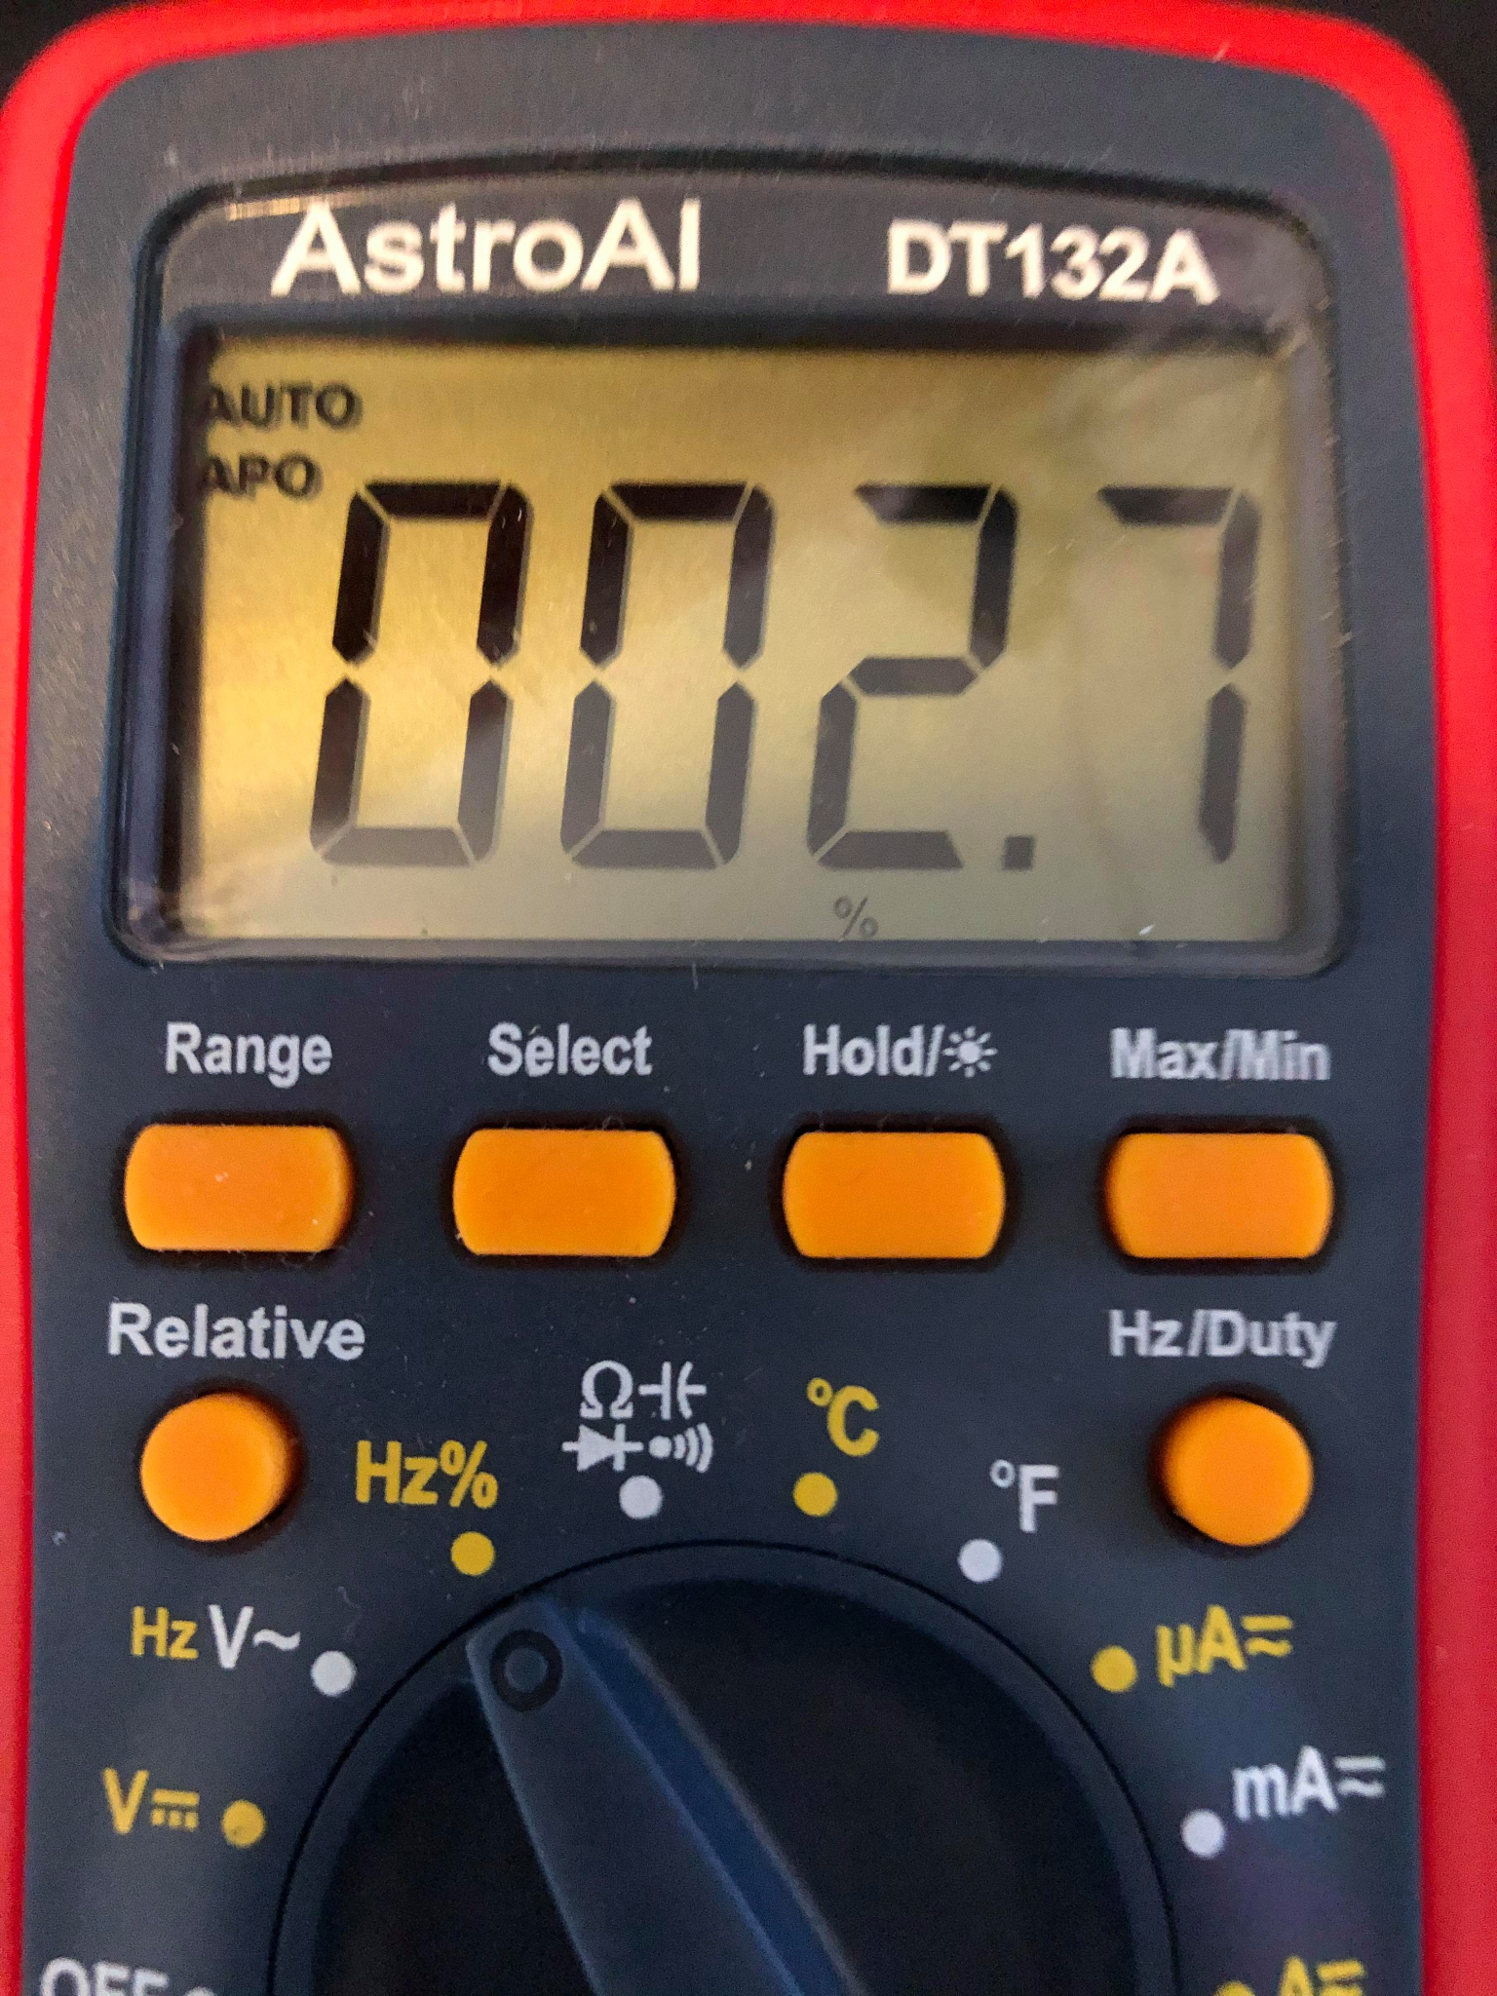
Arduino Uno Testing Results - Servo Transmission
Recordings of multimeter readings from servos
Different PWM signals result in different servo movements
A graph and a multimeter reading of a pwm signal sent to the sail servo.
2.7% Duty Cycle

Slide 25
FS-iA6B 6 channel receiver
Requirement:
Must be able to receive user input commands from the controller and send them to the servos with latency no more than 0.1 seconds \
Verification:
1) Connect receiver to boat motor subsystem
2) input commands into the controller from 100 meters away
3) Observe how the sail/rudder servos move in response to signals from the user input
4) Record signals using multimeter.

Slide 26
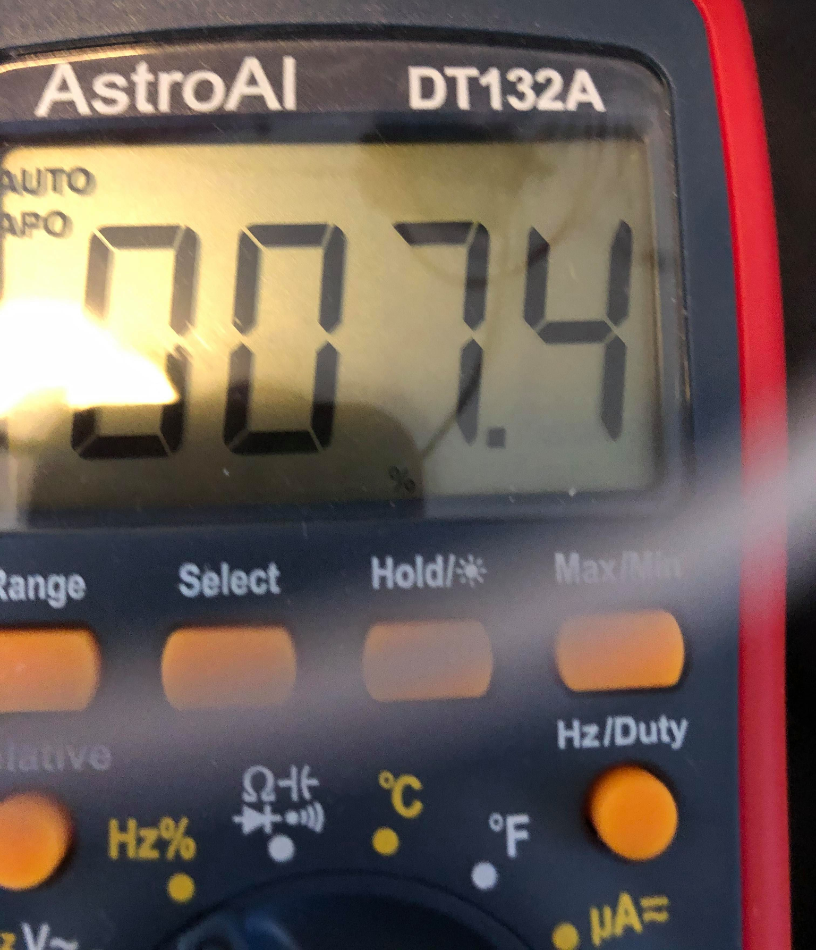
Receiver Testing Results
Multimeter readings match angle from user input
Sail/rudder movement also match
A graph and a multimeter reading of a pwm signal sent by the remote control.
7.4% Duty Cycle

Slide 27
Motor Subsystem
Contains two servos for steering the boat: sail and rudder
receives instructions from the processor subsystem
Rudder Servo
Sail Servo

Slide 28
Motor Subsystem
Requirement:
Servos must be able to turn to angles needed to perform sailing maneuvers within 1-5 degrees.
Verification:
1) Measure the angle of the sails relative to the angle inputted into the controller and see if it is within 1-5 degrees.
2) Repeat step 1 from four directions (North, South, East, West).

Slide 29
Motor Subsystem Testing Results-Movement Angle Accuracy
The angles the servos moved matched out inputs.
90 degrees
45 degrees
135 degrees
90 degrees
160 degrees
135 degrees

Slide 30
User Control Subsystem
Subsystem must be able to transmit commands from the user to the receiver on the boat

Slide 31
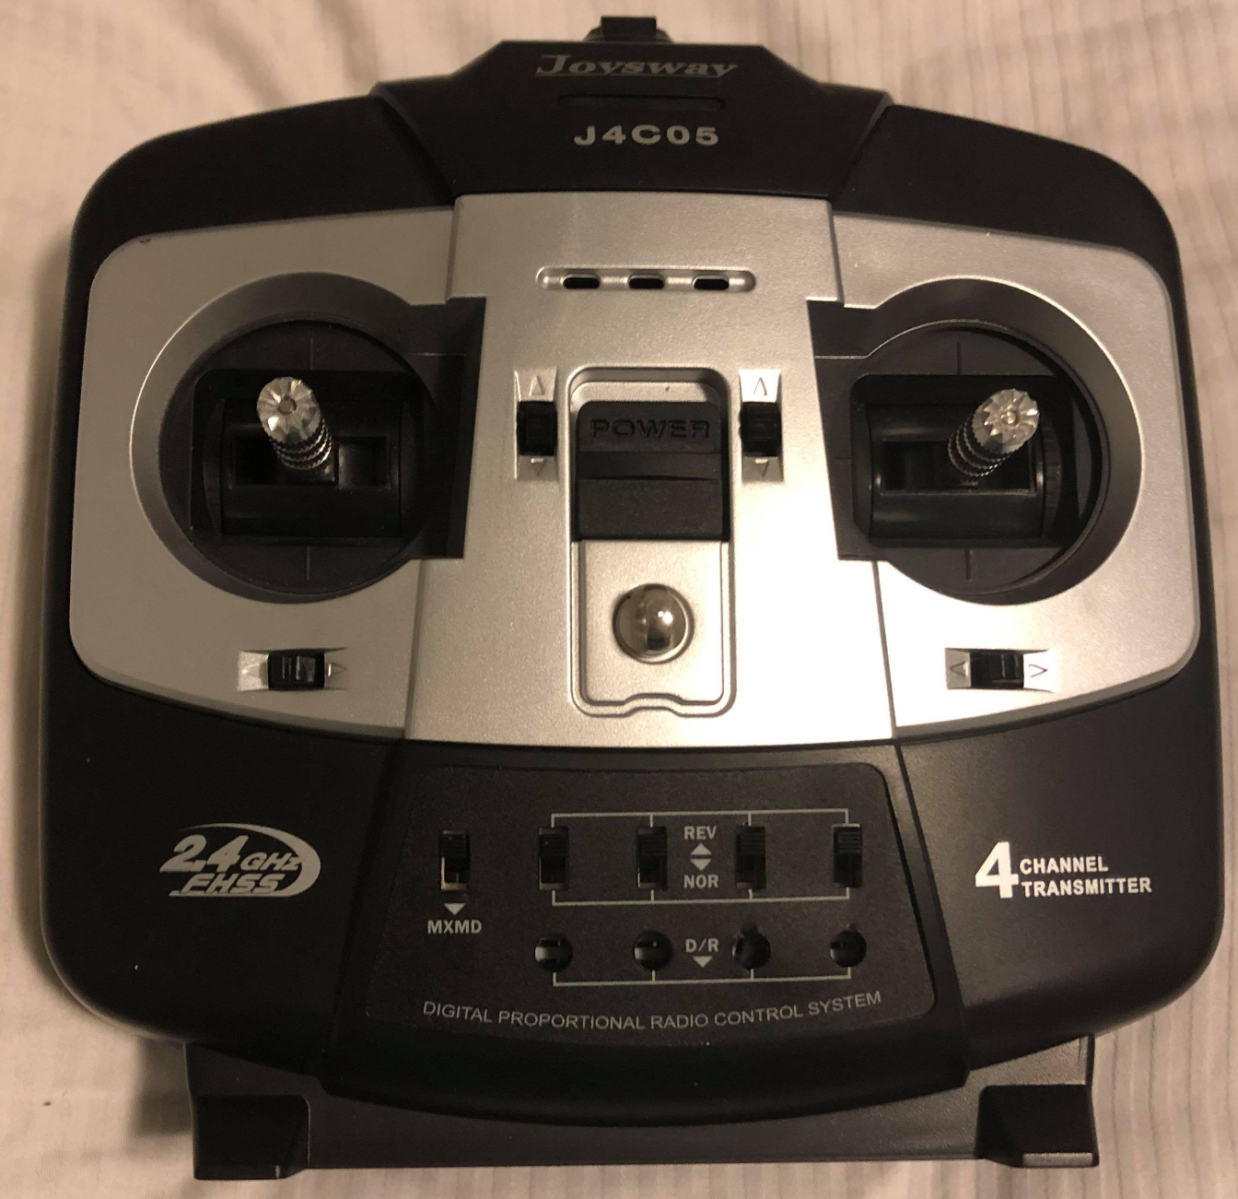
FlySky FS-i6 6 channel transmitter
Requirement:
must be able to transmit user input commands to the boat from 100 meters away
Verification:
1) Switch boat from autonomous to user control
2) Move 100 meters away from the boat
3) input commands into the controller
4) observe how the boat responds to the inputs and see if the match up with the user commands

Slide 32
Transmitter Testing Results
Transmission of user commands to boat succeeded from 100 meters away

Slide 33
Failed Verifcation
One initial problem we had with this project was moving the sail servos
Could move the rudder but not the sail
We could see from multimeter that Arduino was outputting the correct signal
...but the sail servo did not get the signal

Slide 34
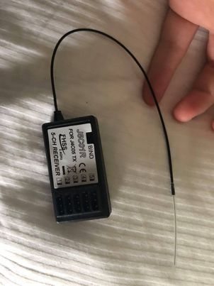
Solution to Failed Verification
The problem was we were routing the signal through the antenna
Signals were mixed because antenna sends out own signal

Slide 35
Future Development
In order to switch between user and autonomous mode we used a relay that had to be flipped by hand. In the future we will want to have the ability to switch between user and autonomous control built into the transmitter
We were unable to test the boat out on water. We would like to do that in the future and take waterproof measures
The current data storage on the Arduino Uno is limited we would like to add more data storage to the Arduino with a separate data storage system
We had a problem with servos over rotating and putting too much stress on the sails. We want to program in hard stops and better calibration to keep this from happening.

