Slide 1
PokerBuddy
Electrical & Computer Engineering
Austin Abraham, Vishal Ramvelu, Lorenzo Dumitrescu
DATE: 05 - 05 - 2025

Slide 2
Introduction
ELECTRICAL & COMPUTER ENGINEERING
GRAINGER ENGINEERING

Slide 3
Team Members
Austin Abraham
Computer Engineer
Vishal Ramvelu
Computer Engineer
Lorenzo Dumitrescu
Computer Engineer
ELECTRICAL & COMPUTER ENGINEERING
GRAINGER ENGINEERING

Slide 4
What is the Objective?
ELECTRICAL & COMPUTER ENGINEERING
GRAINGER ENGINEERING

Slide 5
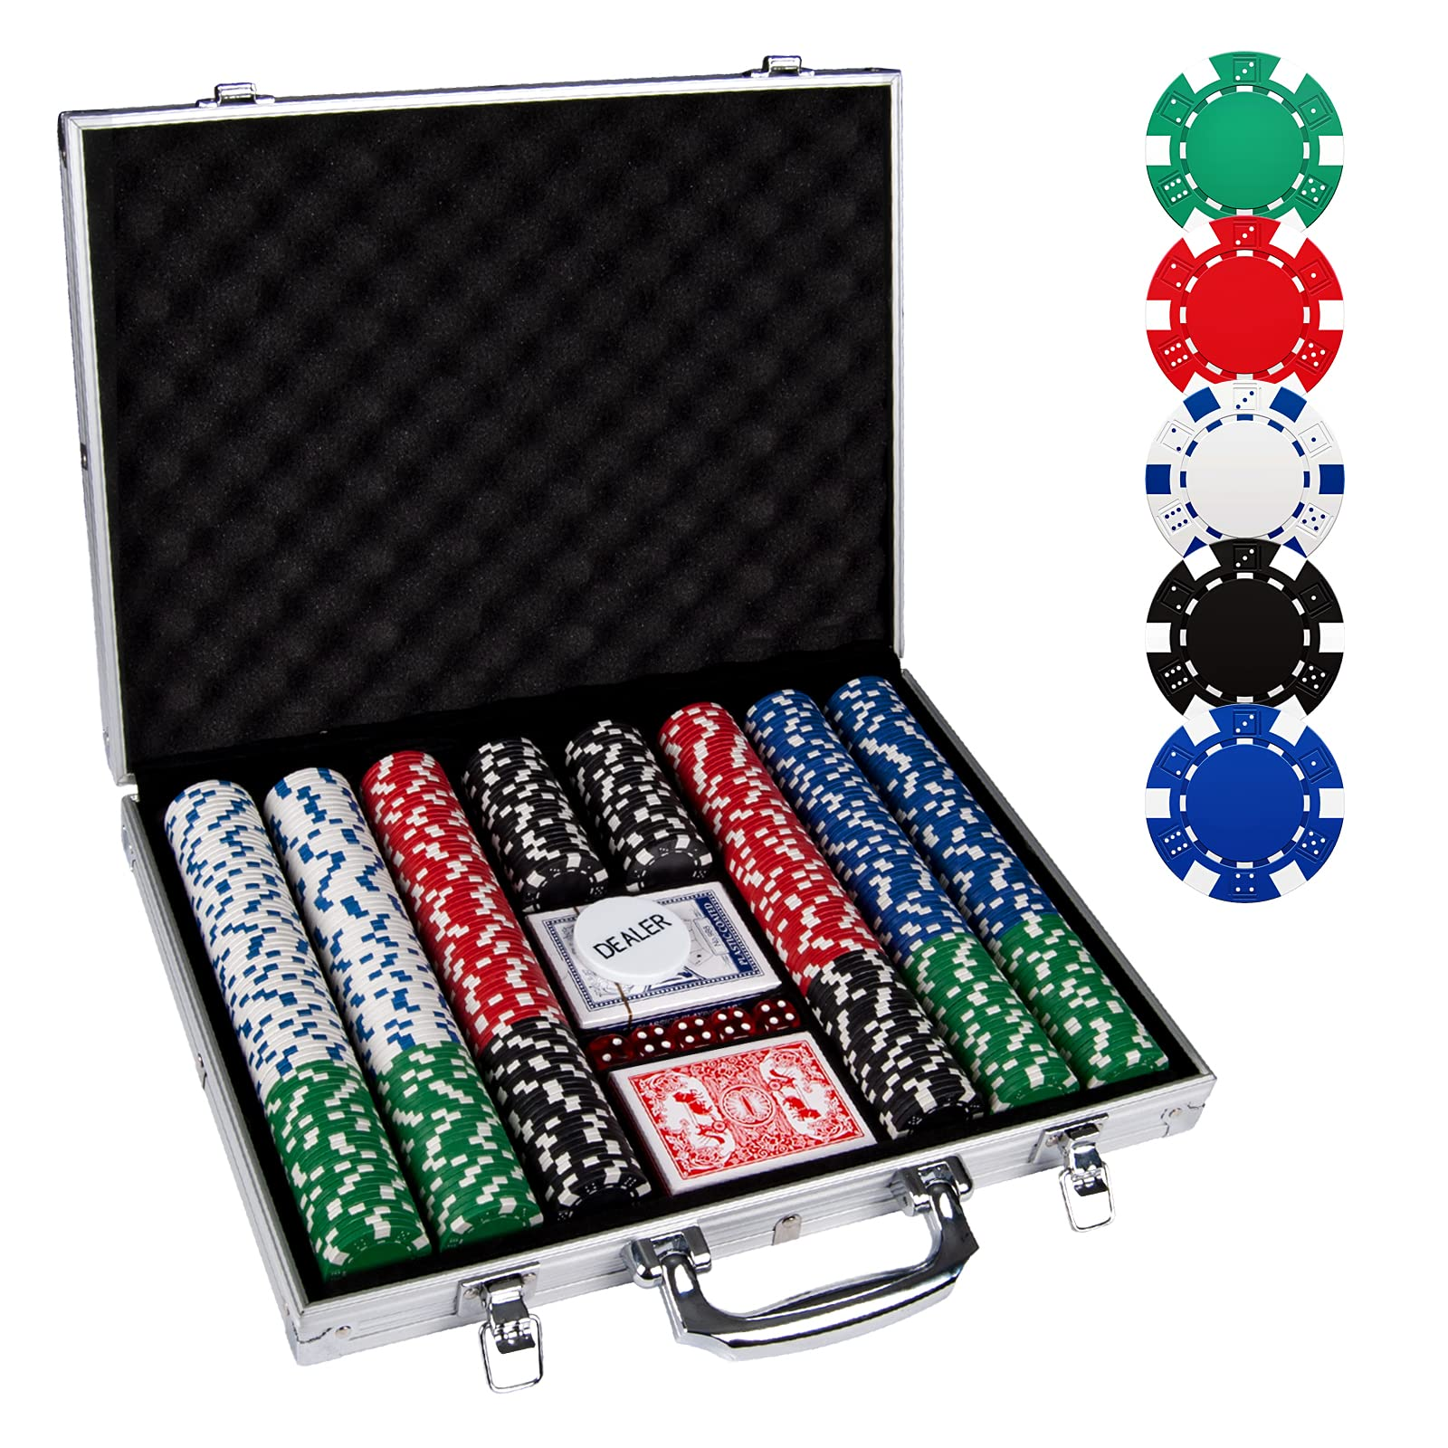
The Problem
Inefficiencies in Traditional Poker Games
Manual chips slow gameplay and cause errors
Hard to track bets, pots, and balances
Turn confusion leads to disputes
Chips can be lost or mismanaged
IMAGE / GRAPHIC
ELECTRICAL & COMPUTER ENGINEERING
GRAINGER ENGINEERING

Slide 6
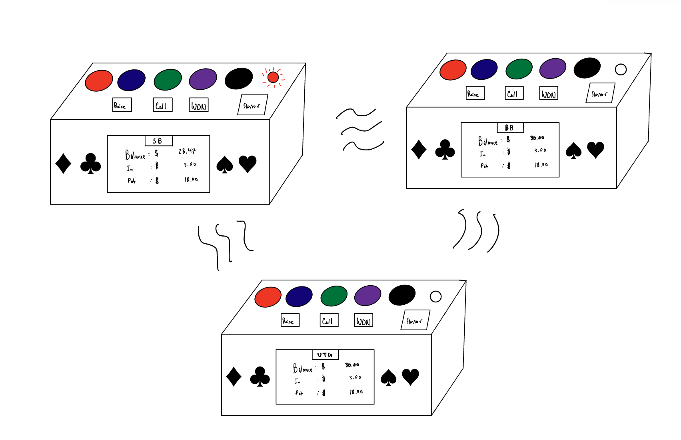
The Solution
A Tactile, Tech-Powered Poker Experience
Tactile chip buttons
Displays for balance, pot, and turn
Local game logic — no central hub needed
Wireless syncing for bets and turns
Battery-powered for portability
IMAGE / GRAPHIC
ELECTRICAL & COMPUTER ENGINEERING
GRAINGER ENGINEERING

Slide 7
High Level Requirements
The system accurately tracks all aspects of the game.
User actions are always recognized and processed correctly.
Devices communicate reliably for smooth gameplay.
ELECTRICAL & COMPUTER ENGINEERING
GRAINGER ENGINEERING

Slide 8
Poker Overview
ELECTRICAL & COMPUTER ENGINEERING
GRAINGER ENGINEERING

Slide 9
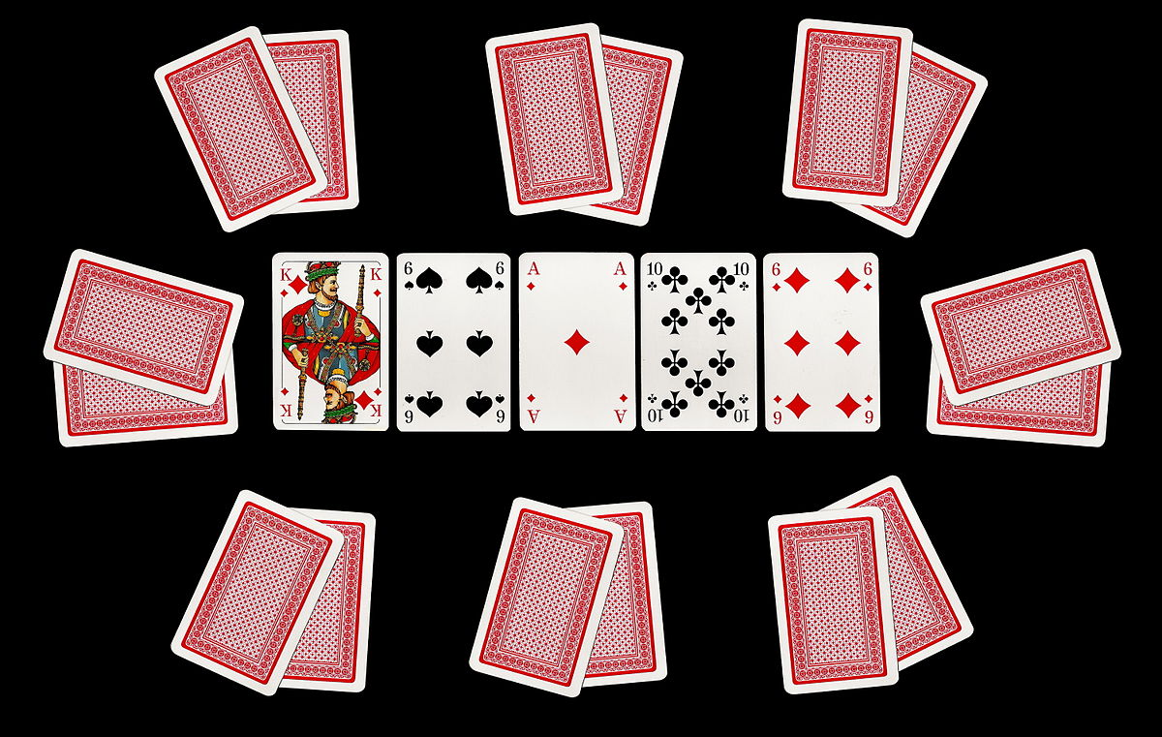
A Quick Look at Poker
The Rules of Poker
Dealt 2 cards with 5 community cards
Make best 5-card hand possible
The game has four betting rounds
On your turn, you can fold, check, call, or raise
Buy-in + chip denominations
IMAGE / GRAPHIC
ELECTRICAL & COMPUTER ENGINEERING
GRAINGER ENGINEERING

Slide 10
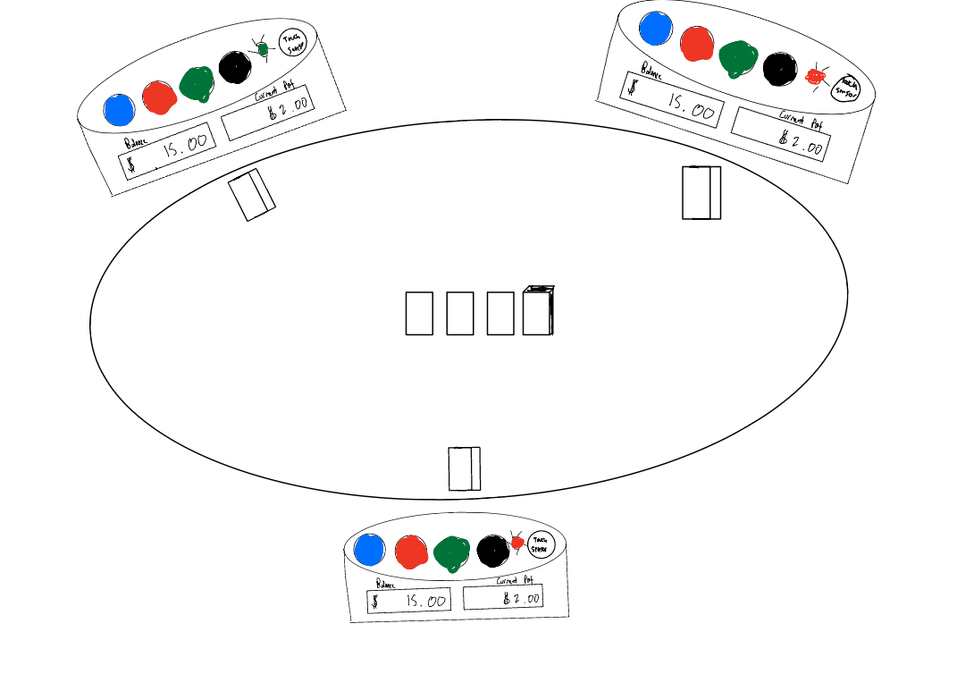
Initial Design
Physical Design Goal
Replicate all actions in logical way
Easy display access for all players
Aesthetic appearance
IMAGE / GRAPHIC
ELECTRICAL & COMPUTER ENGINEERING
GRAINGER ENGINEERING

Slide 11
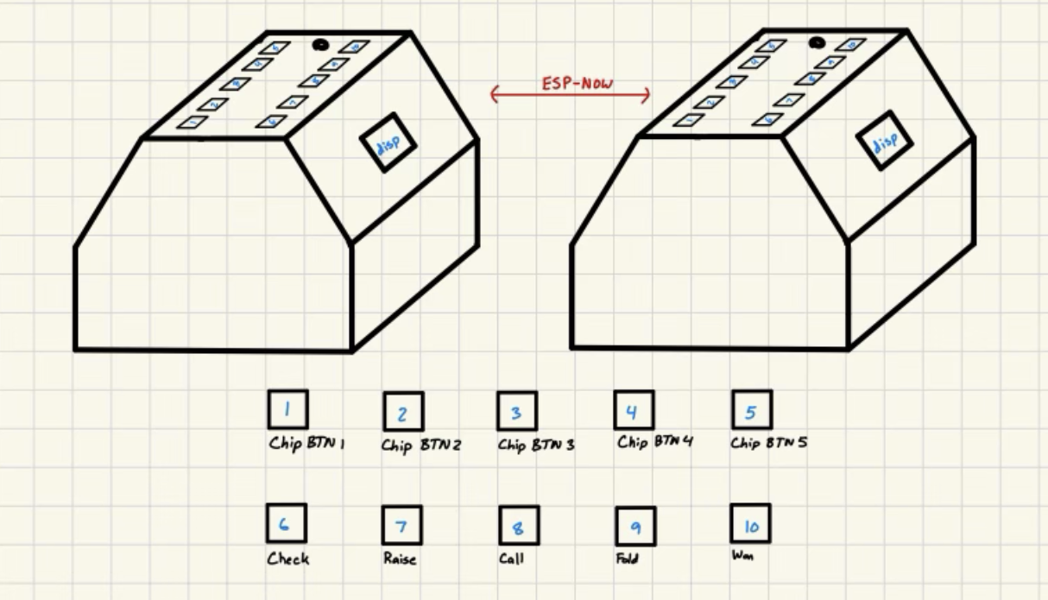
Visual Aid
Final Physical Design
10 buttons with LED light turn indicator
Slanted display on both sides
Removable bottom layer
3D printing process
IMAGE / GRAPHIC
ELECTRICAL & COMPUTER ENGINEERING
GRAINGER ENGINEERING

Slide 12
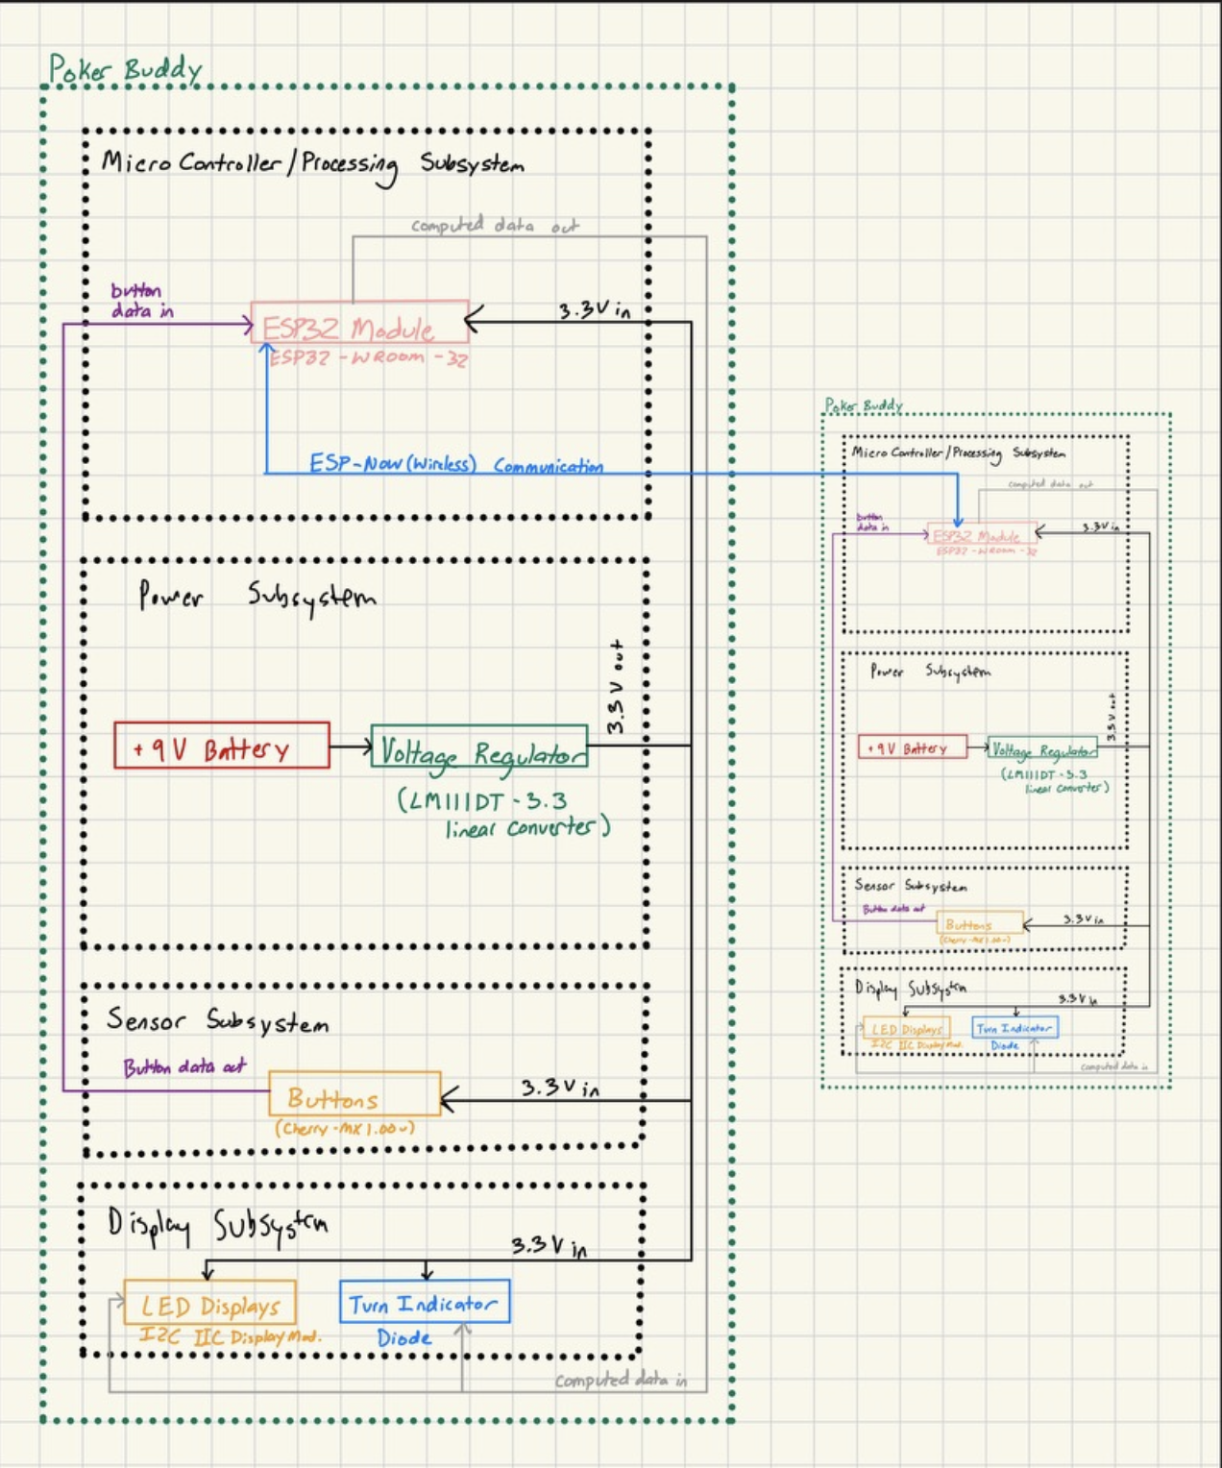
Block Diagram and Subsystems
Block Diagram Set-up
Microcontroller and Processing subsystem
Power Subsystem
Sensor Subsystem
Display Subsystem
ESP-NOW connection between two devices
IMAGE / GRAPHIC
ELECTRICAL & COMPUTER ENGINEERING
GRAINGER ENGINEERING

Slide 13
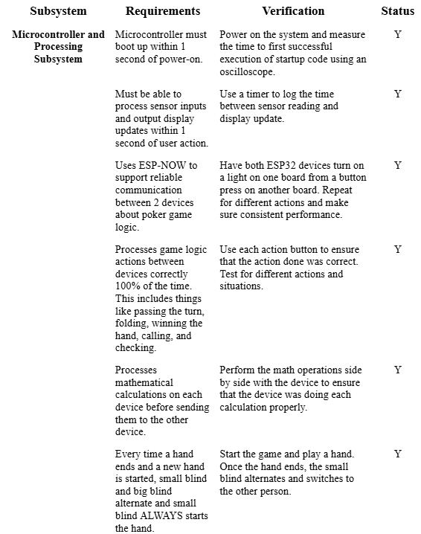
Subsystems
Microcontroller and Processing
ESP32-S3-WROOM-1
Tracks bets, pot size, balances, and turn order
Sensor Input → Displays
Communicates wirelessly
IMAGE / GRAPHIC
ELECTRICAL & COMPUTER ENGINEERING
GRAINGER ENGINEERING

Slide 14
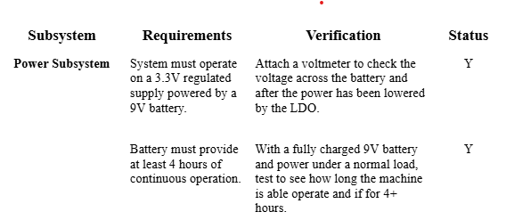
Subsystems
Power
9V battery and LM1117DT-3.3 regulator
Provides stable 3.3V output
Ensures reliable operation
ELECTRICAL & COMPUTER ENGINEERING
GRAINGER ENGINEERING

Slide 15
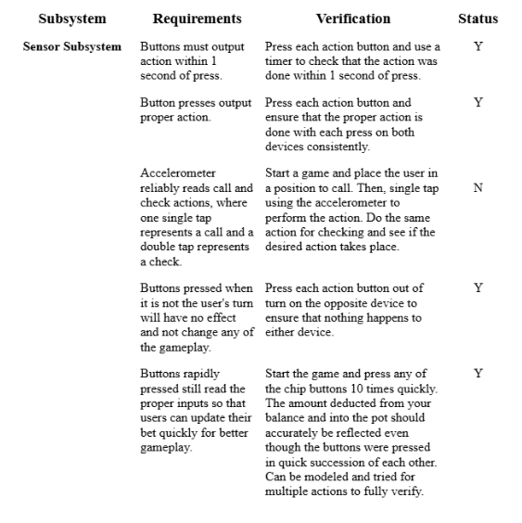
Subsystems
Sensor
Cherry MX buttons
Detects action gestures and betting inputs
Must maintain ≥98% input accuracy for valid game state
ELECTRICAL & COMPUTER ENGINEERING
GRAINGER ENGINEERING

Slide 16
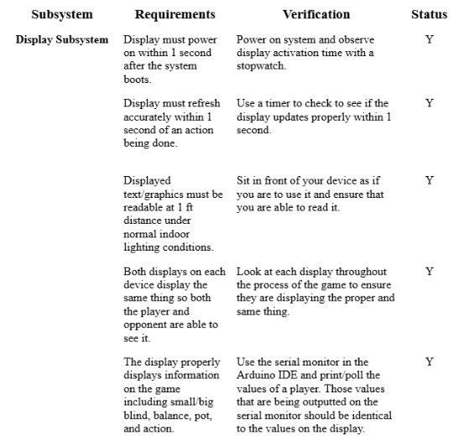
Subsystems
Display
Uses 0.96" OLED (128x64) and turn indicator LED
Displays pot, balances, and turn status in real time
Remains readable in indoor lighting
ELECTRICAL & COMPUTER ENGINEERING
GRAINGER ENGINEERING

Slide 17
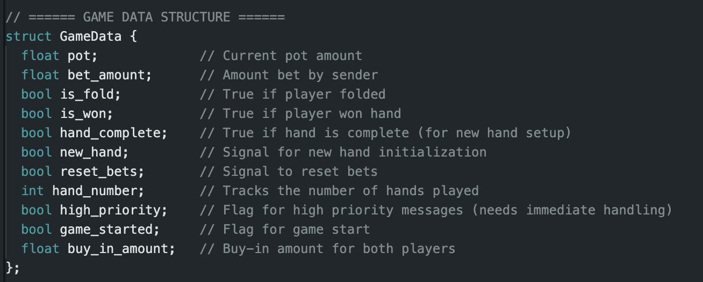
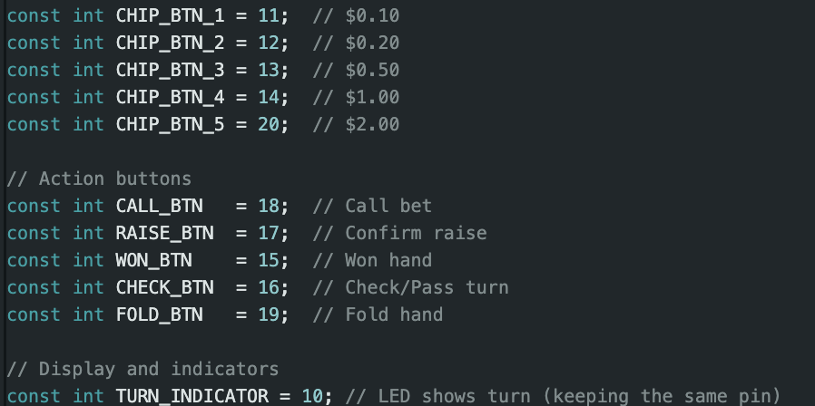
Code
ESP32 Code Process
GameData Struct
Logic Functions
Buttons + Turn indicators
IMAGE / GRAPHIC
ELECTRICAL & COMPUTER ENGINEERING
GRAINGER ENGINEERING

Slide 18
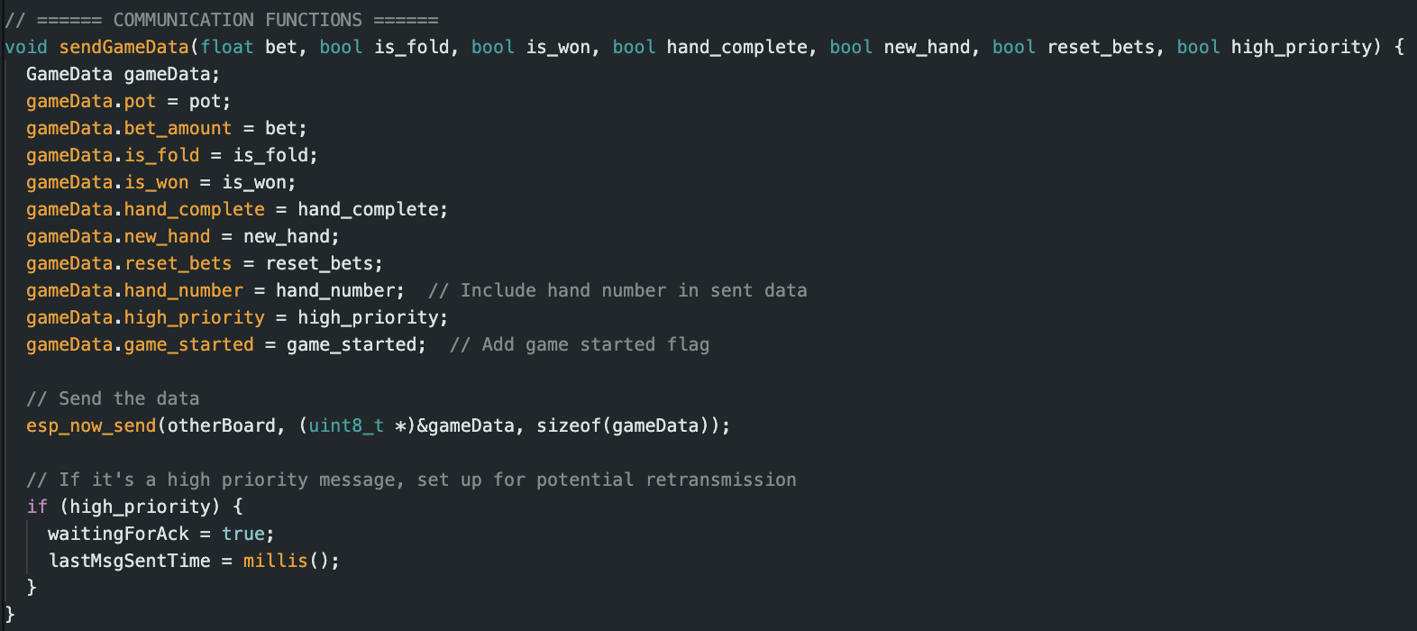
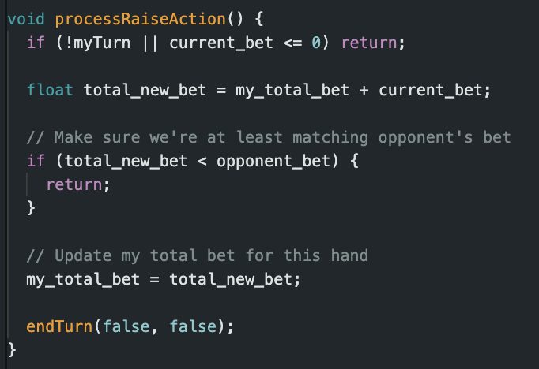
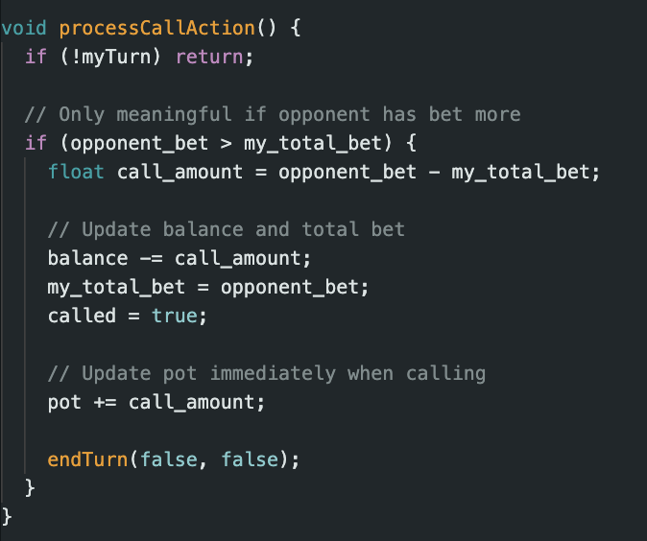
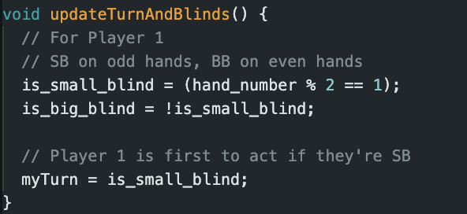
Code
ESP32 Code Process
Sending Information
Processing Actions
Passing Turn
IMAGE / GRAPHIC
ELECTRICAL & COMPUTER ENGINEERING
GRAINGER ENGINEERING

Slide 19
Our Product
ELECTRICAL & COMPUTER ENGINEERING
GRAINGER ENGINEERING

Slide 20
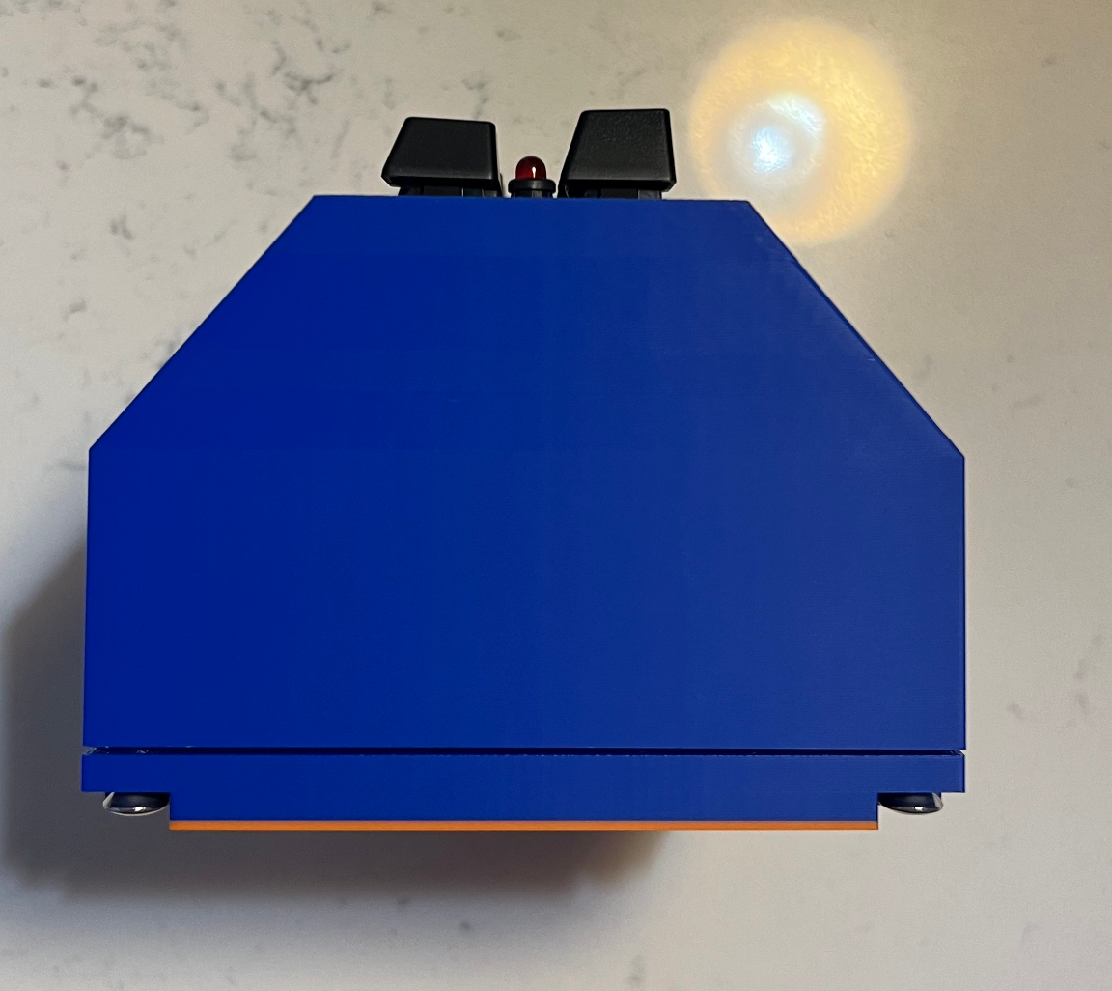
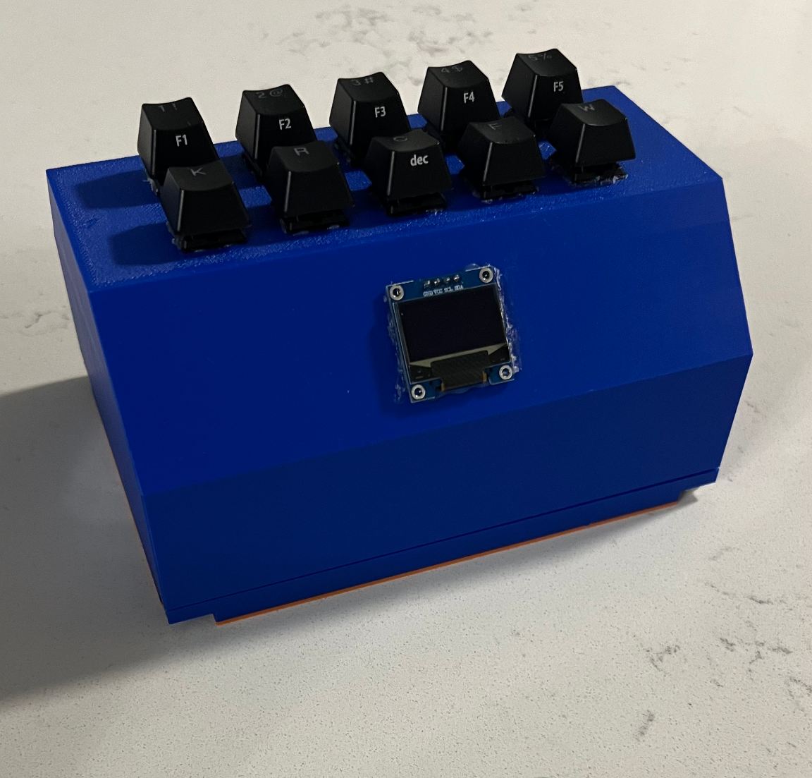
Project Build
ELECTRICAL & COMPUTER ENGINEERING
GRAINGER ENGINEERING

Slide 21
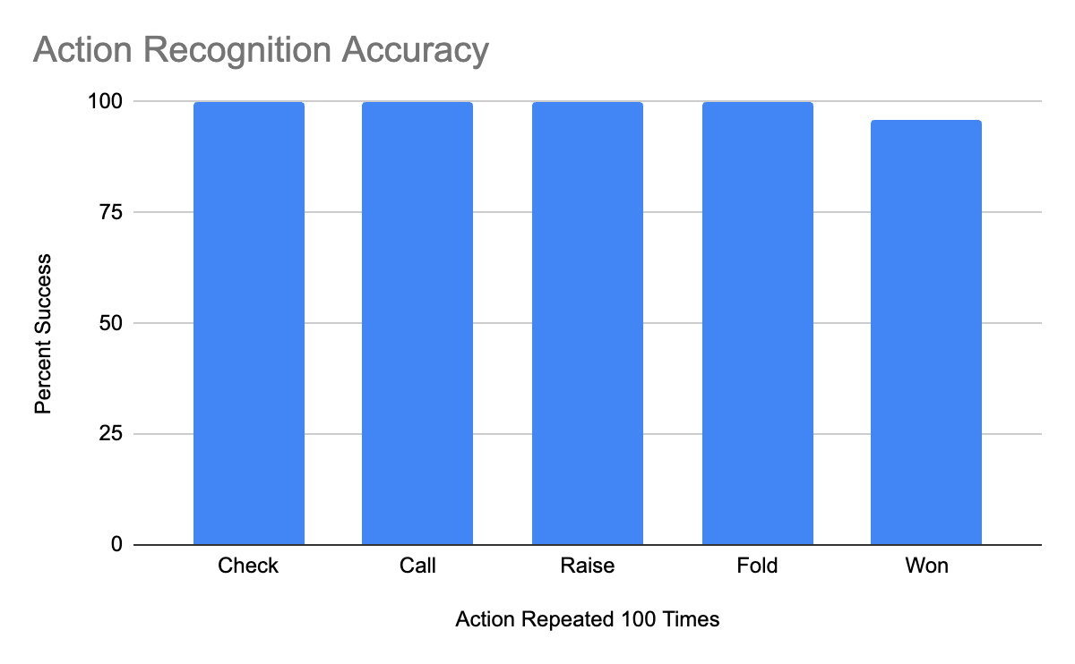
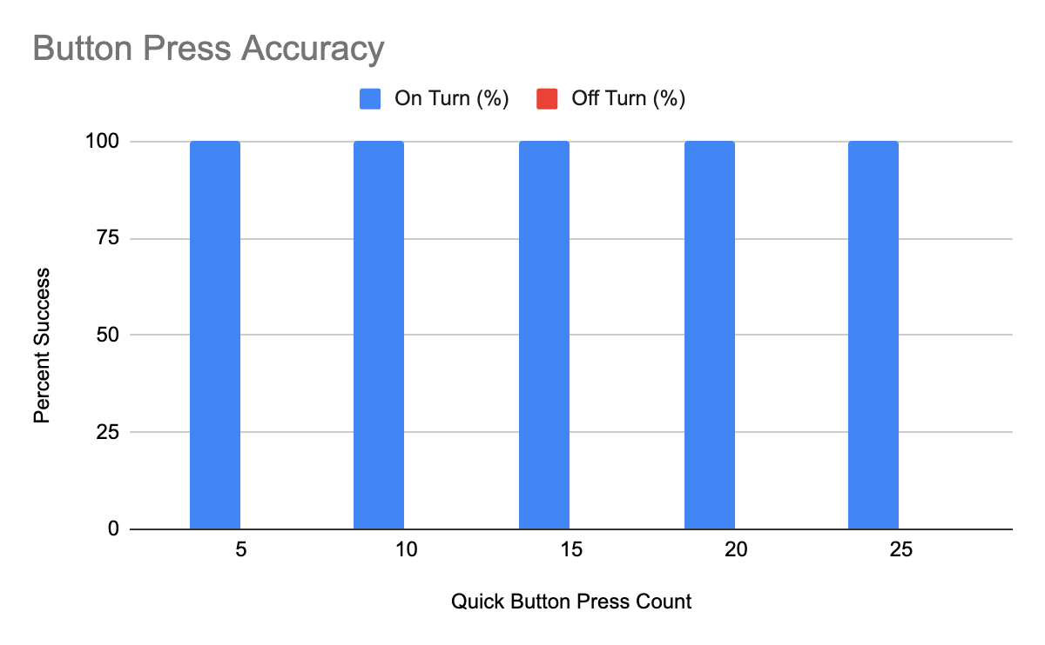
Quantitative Results
Analysis
Action Recognition Process ( > 98%)
Mathematical game logic 100% correct
Button Press Accuracy (100%)
Game state intact for 4hr+ time periods
IMAGE / GRAPHIC
ELECTRICAL & COMPUTER ENGINEERING
GRAINGER ENGINEERING

Slide 22
Reflection
ELECTRICAL & COMPUTER ENGINEERING
GRAINGER ENGINEERING

Slide 23
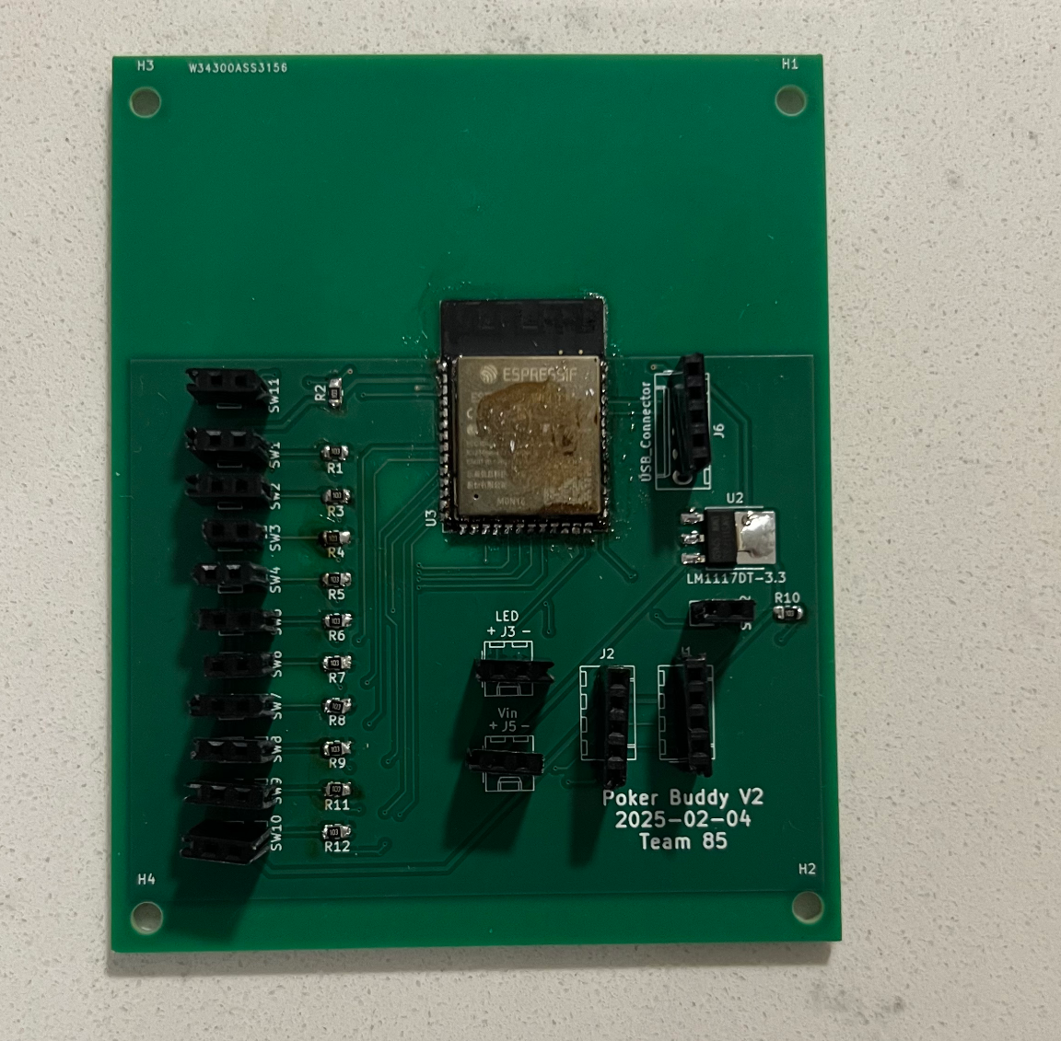
Our Successes and Challenges (and failures)
CAD + PCB + Integration
Final physical design
PCB soldering
Emulating poker logic in code
Integrating different parts into 1 product
IMAGE / GRAPHIC
ELECTRICAL & COMPUTER ENGINEERING
GRAINGER ENGINEERING

Slide 24
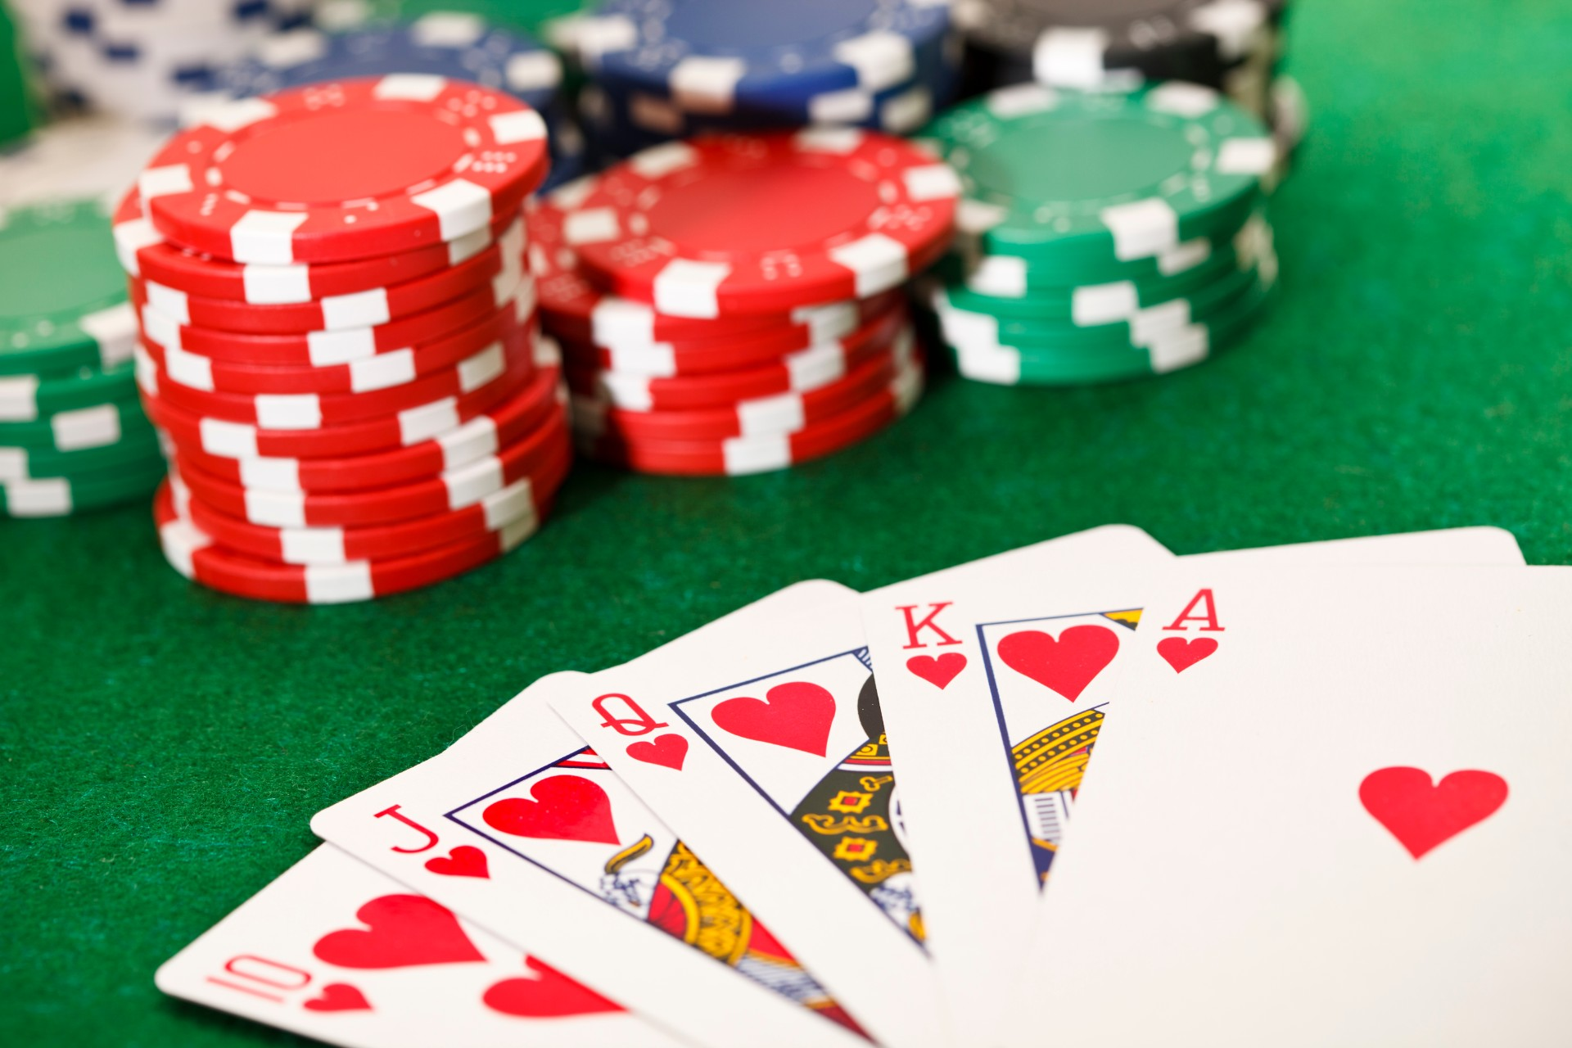
Conclusion
What we learned
PCB construction
Hardware - (soldering, testing components)
Software - (programming ESP32, microcontrollers)
Changes?
Use larger displays
Use an accelerometer
IMAGE / GRAPHIC
ELECTRICAL & COMPUTER ENGINEERING
GRAINGER ENGINEERING

Slide 25
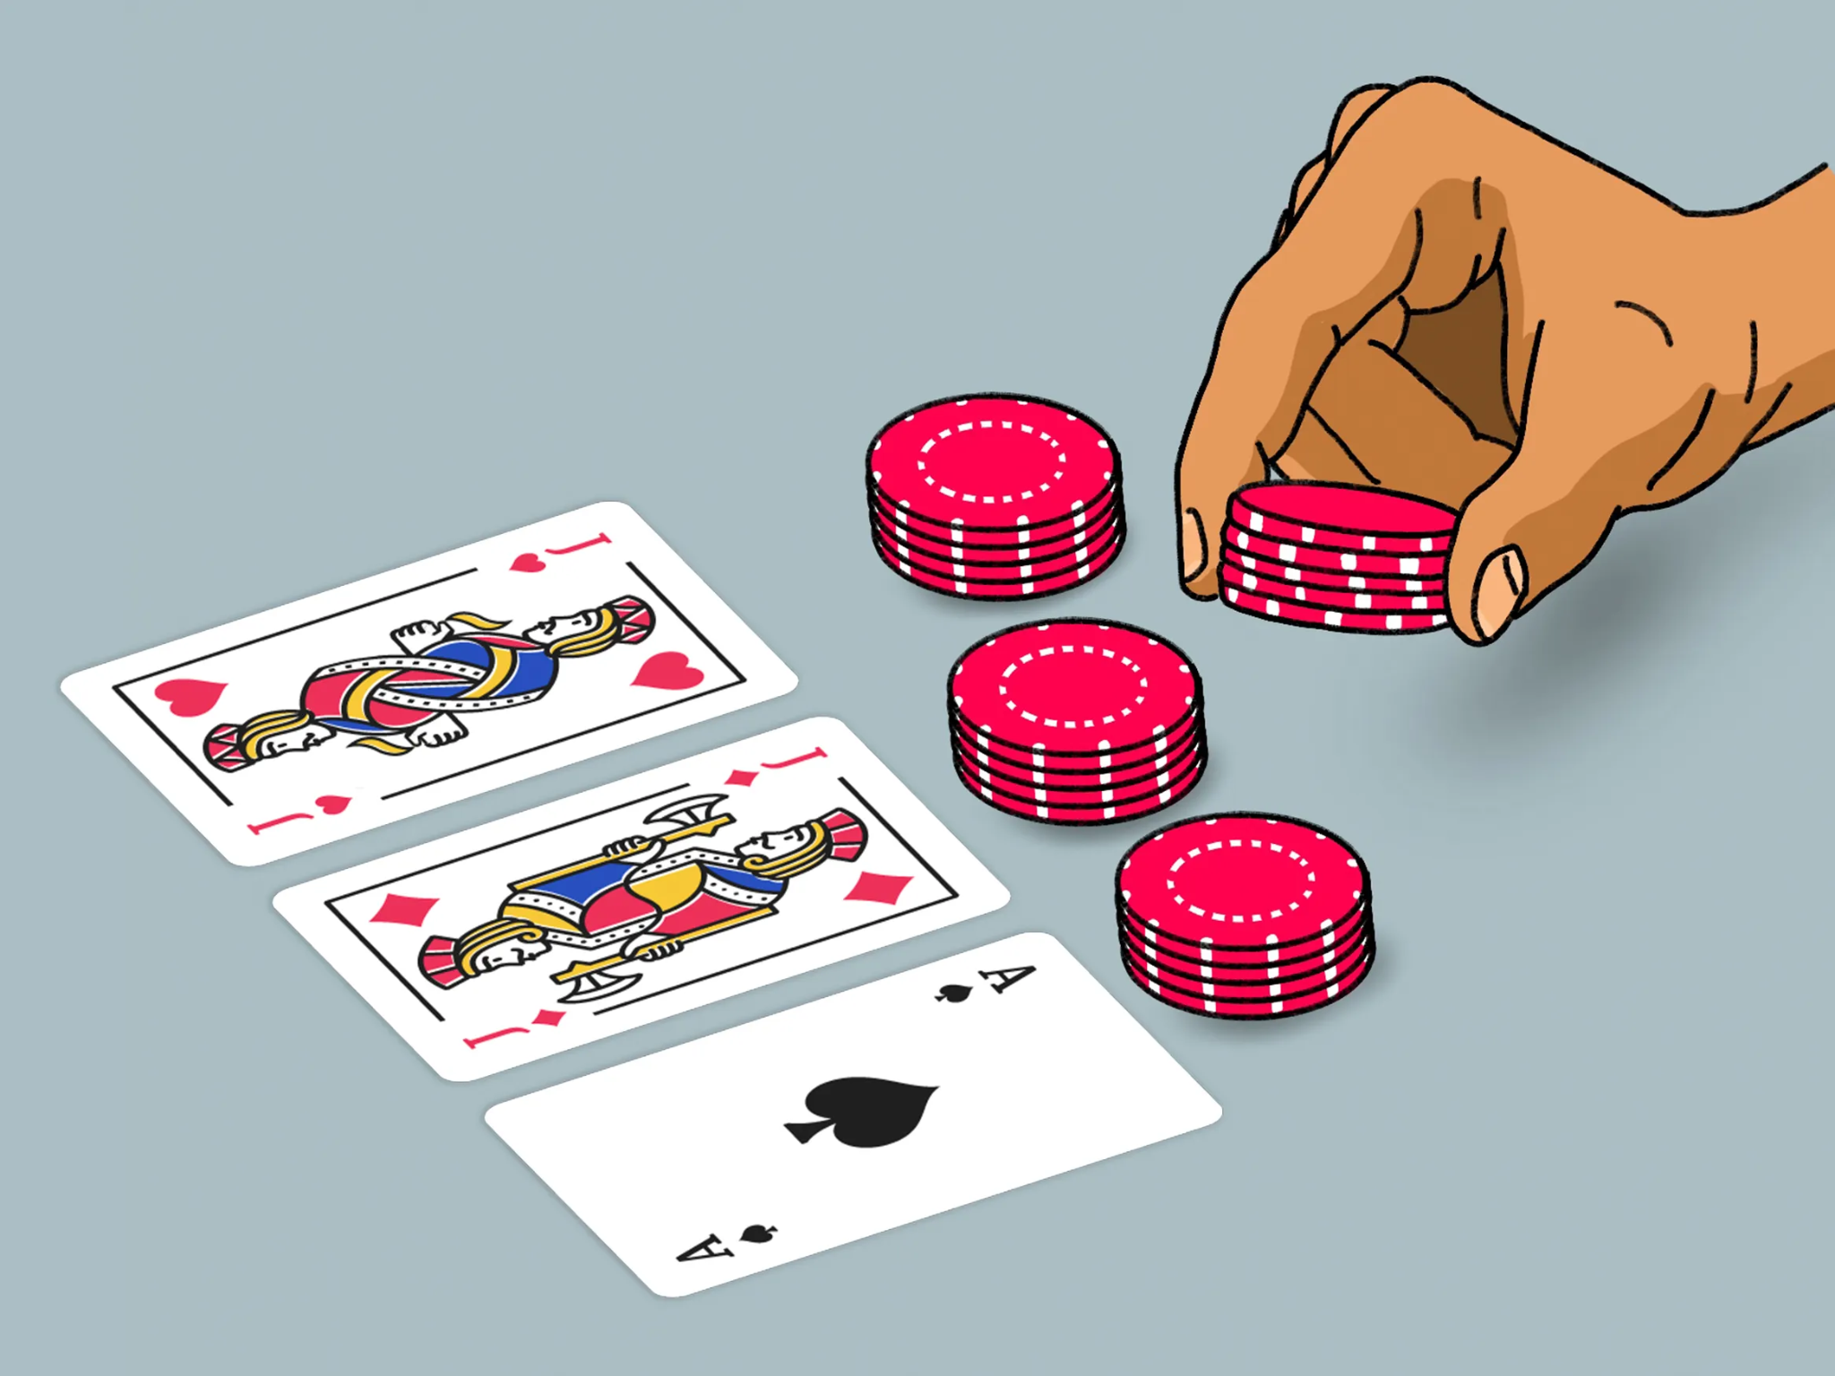
How can we continue our project?
Future plans
Create multiple (3 or more) connected devices
Tailor to more use cases
Additional features (RFID)
IMAGE / GRAPHIC
ELECTRICAL & COMPUTER ENGINEERING
GRAINGER ENGINEERING

Slide 26
Questions?
ELECTRICAL & COMPUTER ENGINEERING
GRAINGER ENGINEERING

