Slide 1
Smart Glasses for the Blind
\ _____\
|__/\__|
Team 38
Ahmed Nahas
Abdul Maaieh
Siraj Khogeer
Professor Jonathan Schuh
TA Sanjana
ELECTRICAL & COMPUTER ENGINEERING
GRAINGER ENGINEERING

Slide 2
We’ve left the blind behind…
… with nothing but
a white cane?

Slide 3
Does it really matter?
36 million
55% expected growth
blind individuals globally
of visual impairment in the next 30 years
$51.4 Billion
in lost economic revenue in the US

Slide 4
Solution
/_____\
|__/\__|

Slide 5
Our Solution
01
02
03
Spatial Awareness
Object Recognition
Standalone, Modular
Allows the user to perceives surroundings through sound
Uses ML models to classify object captured using the camera
Portable, wearable glasses. Modular and scalable software.
/_____\
|__/\__|

Slide 6
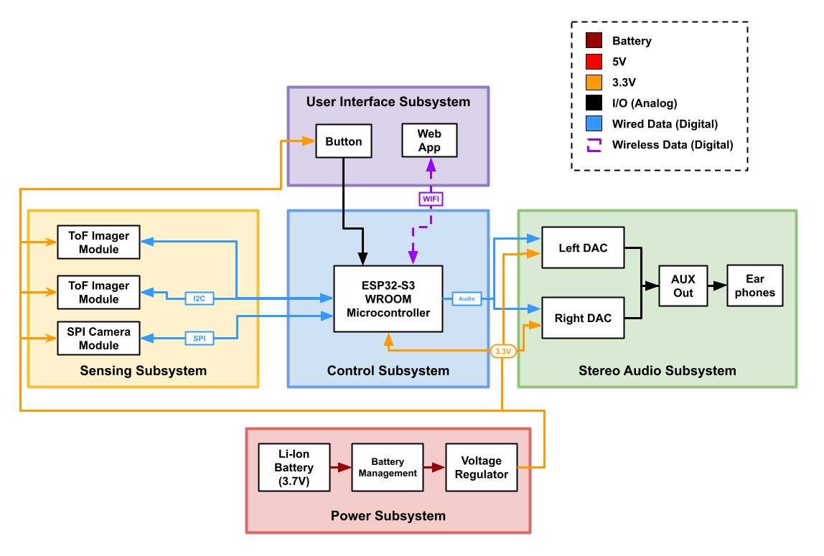
Solution Design
Differentiate between obstacles 0.5 m vs 2 m away
[Spatial Awareness]
Stereo audio output allows differentiating between obstacles 40° to the left and right
[Spatial Awareness]
Correctly identifies objects up to 1 meter ahead and informs the user when prompted
[Object Recognition]
/_____\
|__/\__|

Slide 7
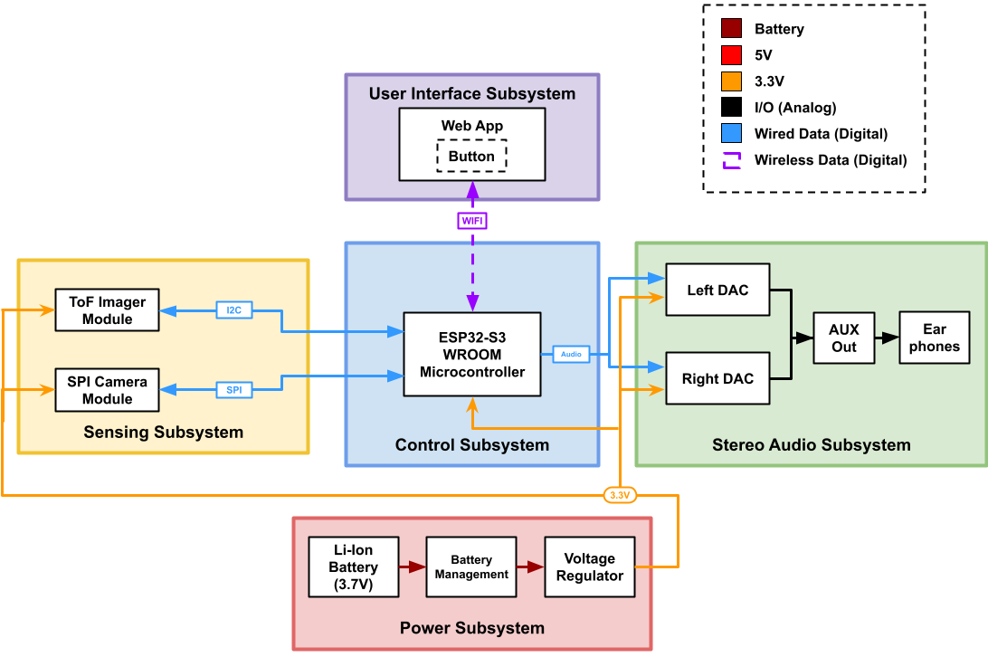
Solution Design
Differentiate between obstacles 0.5 m vs 2 m away
[Spatial Awareness]
Stereo audio output allows differentiating between obstacles 40° to the left and right
[Spatial Awareness]
Correctly identifies objects up to 1 meter ahead and informs the user when prompted
[Object Recognition]
/_____\
|__/\__|

Slide 8
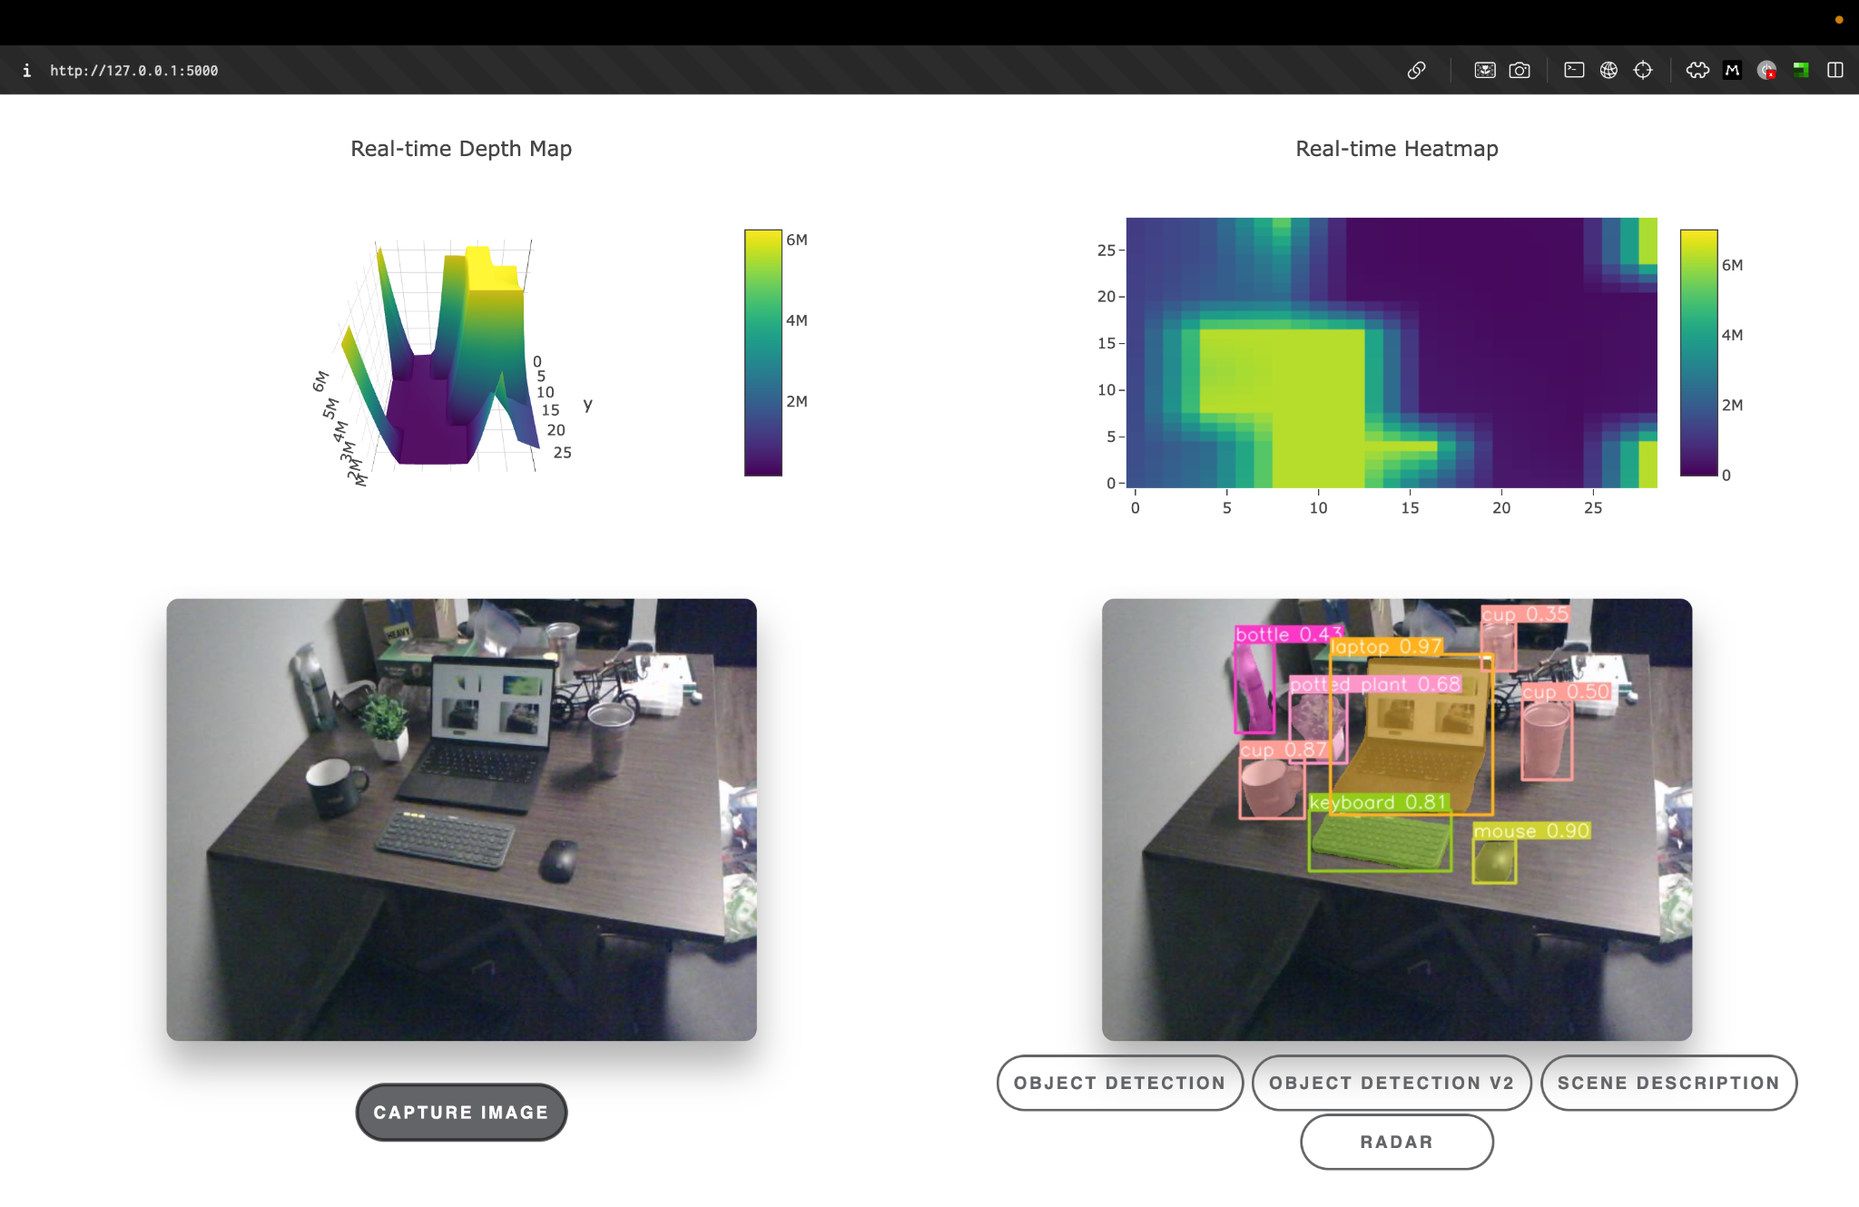
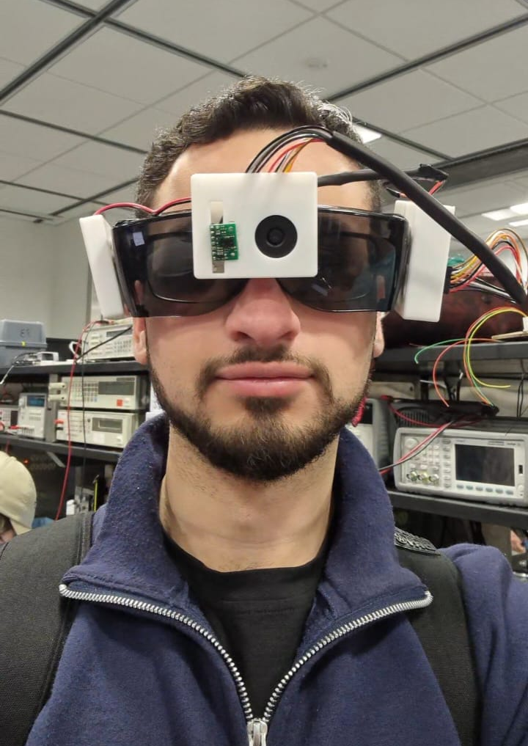
Solution Design
/_____\
|__/\__|

Slide 9
Solution Demo
/_____\
|__/\__|

Slide 10
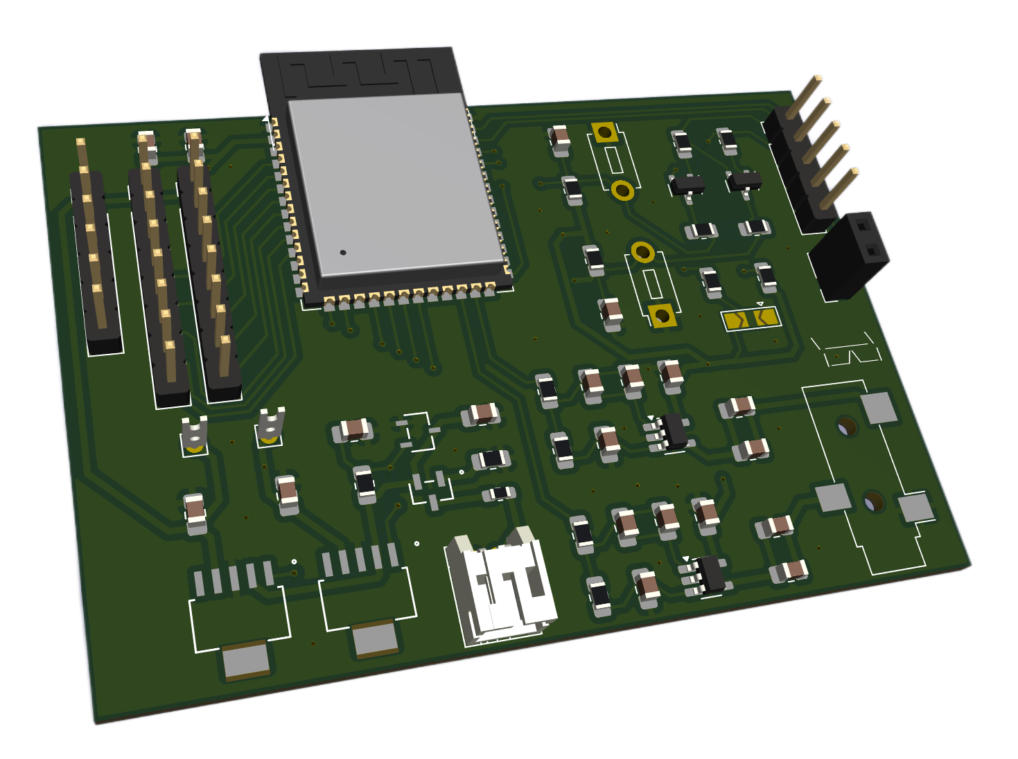
PCB
/_____\
|__/\__|

Slide 11
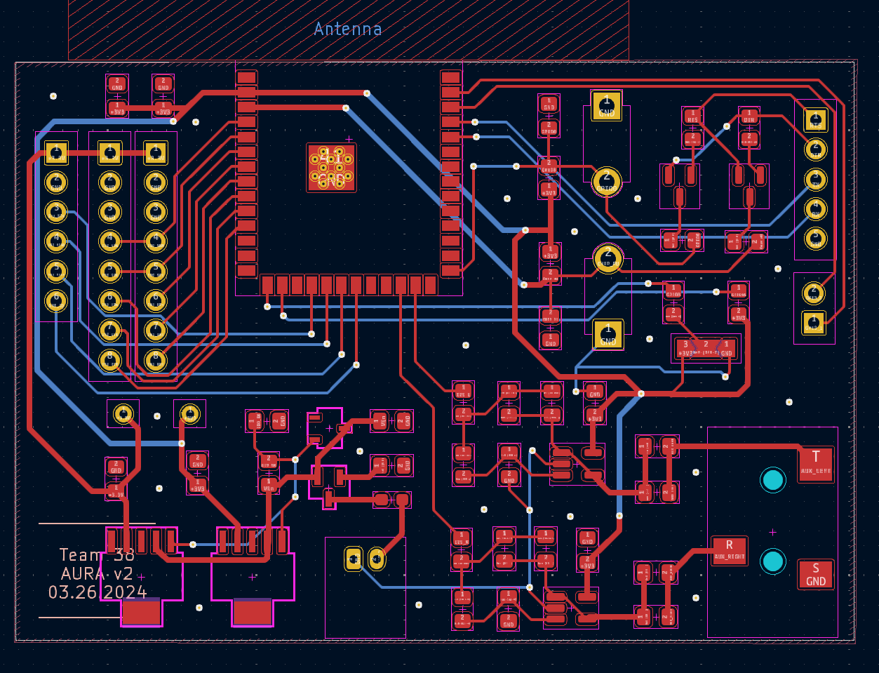
PCB
/_____\
|__/\__|

Slide 12
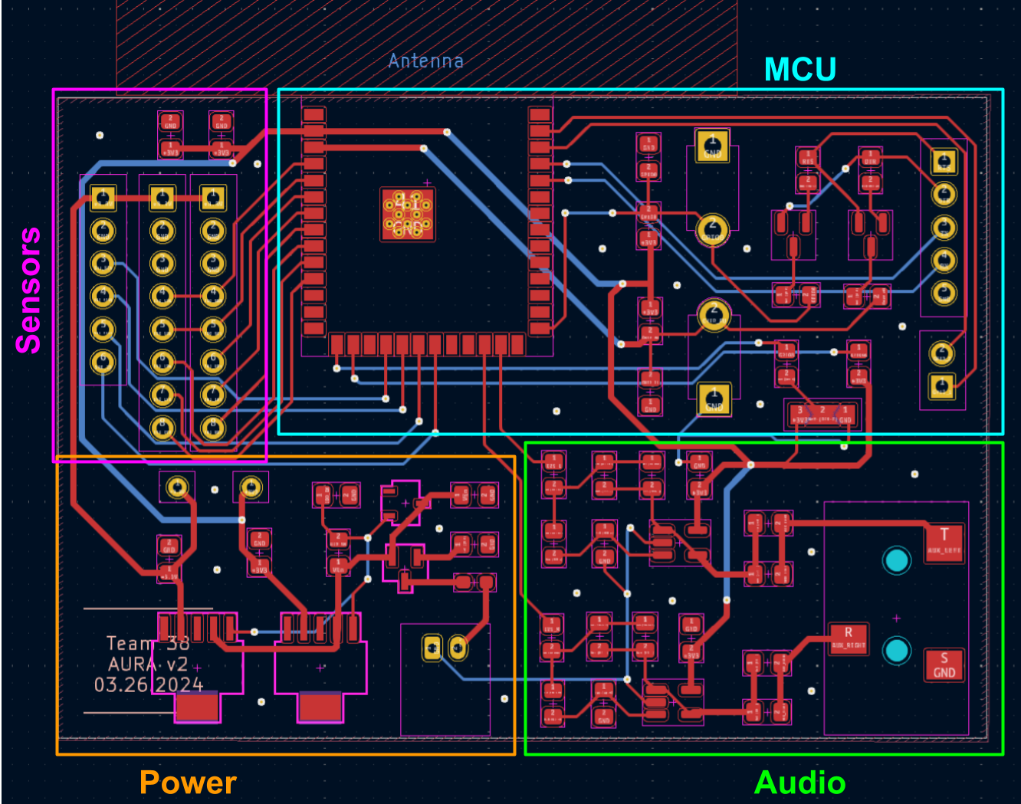
PCB
/_____\
|__/\__|

Slide 13
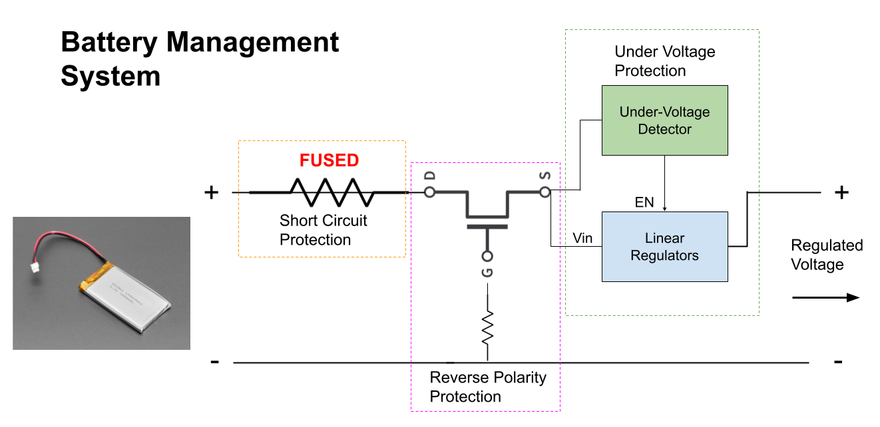
Power Subsystem - Overview
Regulate 4.2V Li-Ion battery to 3.3V to supply rest of subsystems
Ensure circuit and battery protections including:
Short circuit protection
Reverse polarity protection
Undervoltage/Overdischarge protection
Contain Li-Ion battery in enclosure
/_____\
|__/\__|

Slide 14
Power Subsystem - Results
Regulator Data (Vin = 4.1V)
Power is regulated and supplied safely to circuit
Up-to 4 Hours of battery life
R&Vs:
✔ Regulate 4.2V Li-Ion battery to 3.3V +/- 5% at 1A max while ensuring under-voltage protection
✔ Ensure that short circuit of battery is stopped to ensure safety of user
✔ Ensure that reverse polarity connection is stopped to ensure safety of circuit
Regulator | Output Voltage [V]
Sensing Regulator | 3.28
MCU Regulator | 3.29
Other Data
Undervoltage Trip Voltage | 3.53 V
Idle Current | 384 mA
Shorted Current | 1mA
/_____\
|__/\__|

Slide 15
Audio Subsystem - Overview
Convert digital audio from MCU to analog audio to play through AUX
Have 2 distinct stereo channels for spatial awareness
Operate at a safe voltage and volume level, with minimal noise
/_____\
|__/\__|

Slide 16
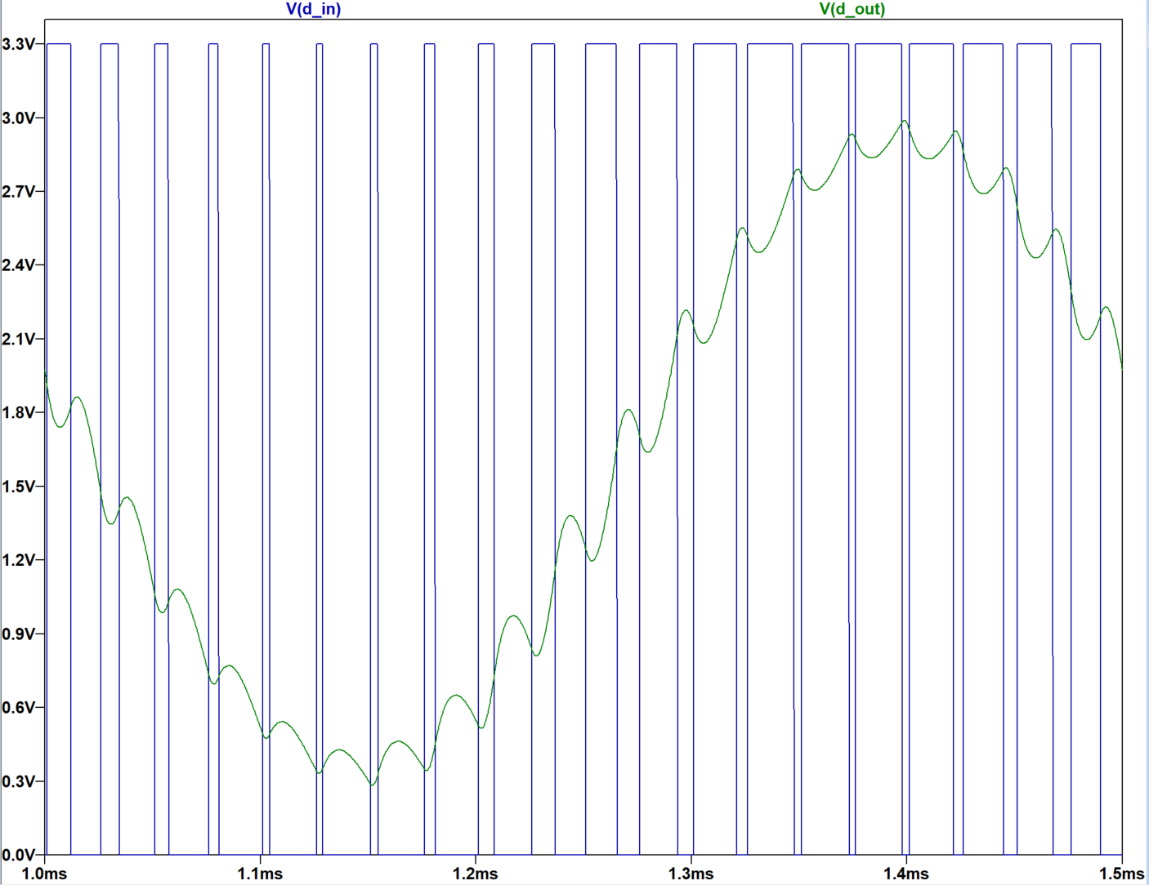
Audio Subsystem - Results
Audio DAC Input vs Output
Successfully plays stereo audio through earphones.
Voltages kept below 0.3Vrms (Consumer Level)
Audio is usable, with unwanted noise at low volumes
R&Vs:
✔ Convert 16-bit audio from ESP32 to analog out
✔ Play audio from AUX port at normal and safe levels
✔ Audio is clear, left and right audio is distinct
/_____\
|__/\__|

Slide 17
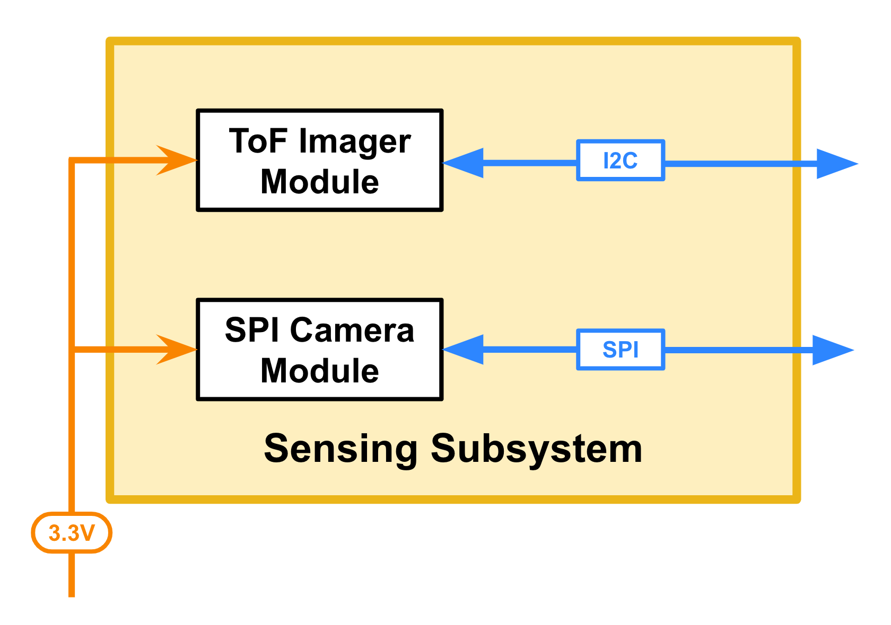
Sensing Subsystem - Overview
[Spatial Awareness]
Collect depth map of obstacles ahead of the user
Operate at 15 Hz to achieve near real-time spatial detection
[Object Recognition]
Collect image of scene in front of user upon request
Deliver the required 640x480 pixel images to control for ML processing
/_____\
|__/\__|

Slide 18
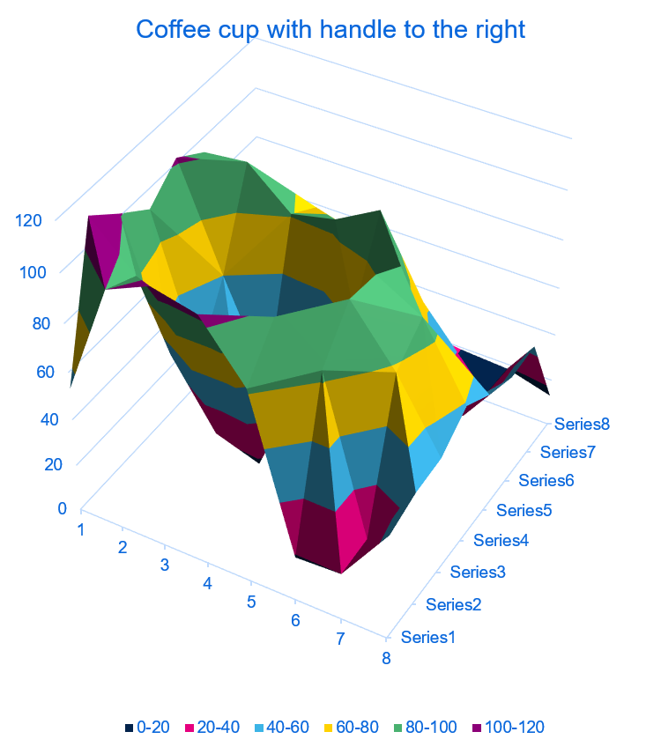
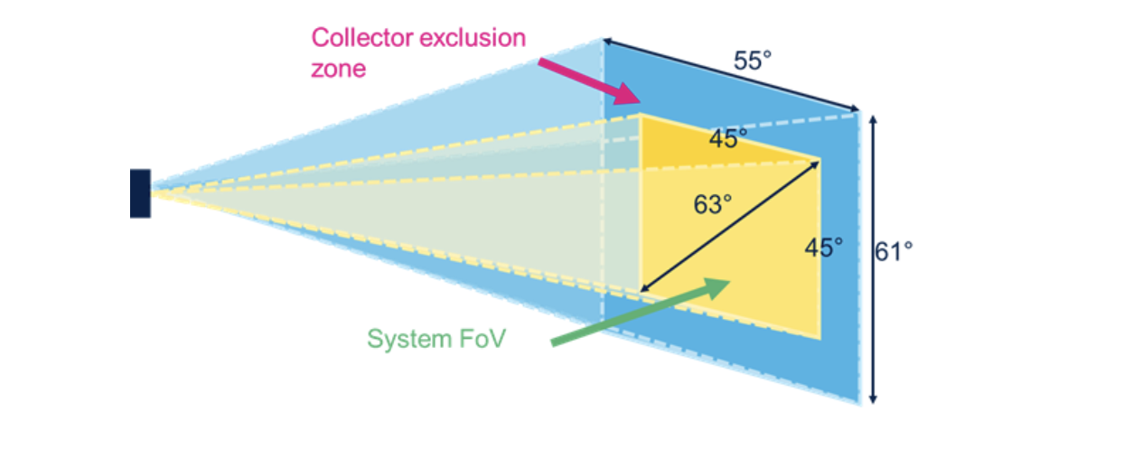
Sensing Subsystem - Results
Imager captures depth data successfully at 15Hz
Range limited to 2.5 meters
Camera captures image and send it to MCU
Changed from 1920x1080 to 640x480
R&Vs:
✔ The Tof sensor successfully maps the surroundings into a 8x8 array and sends it to the ESP32.
✔ SPI camera takes a 640x480 image when the button is pressed, sends the data to the ESP within 2s
/_____\
|__/\__|

Slide 19
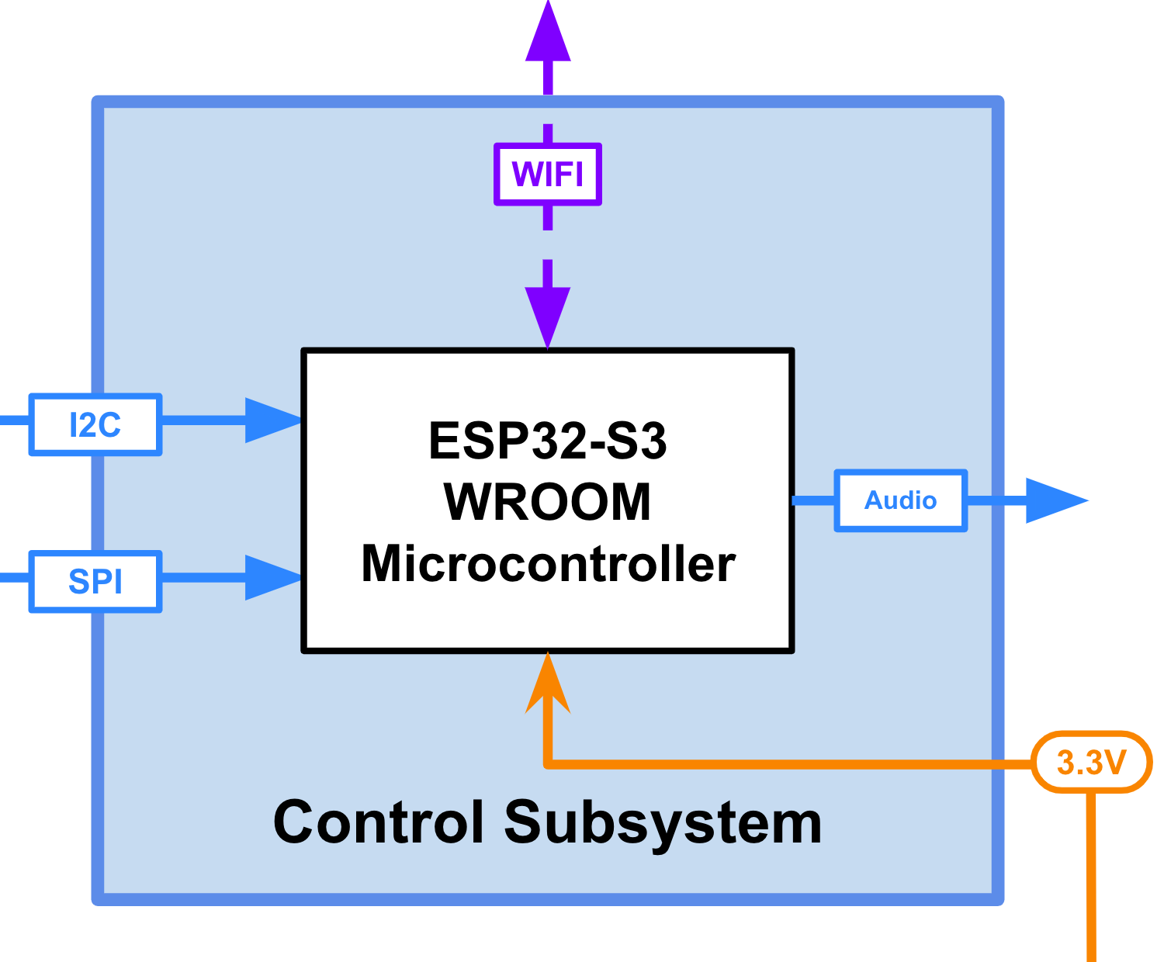
Control Subsystem - Overview
Receives 8x8 array from ToF imager and delivers it to the webapp
Receives 640x480 JPEG image from camera subsystem and delivers it to the webapp
Receives 16 bit stereo audio from webapp and delivers it to the Audio subsystem
/_____\
|__/\__|

Slide 20
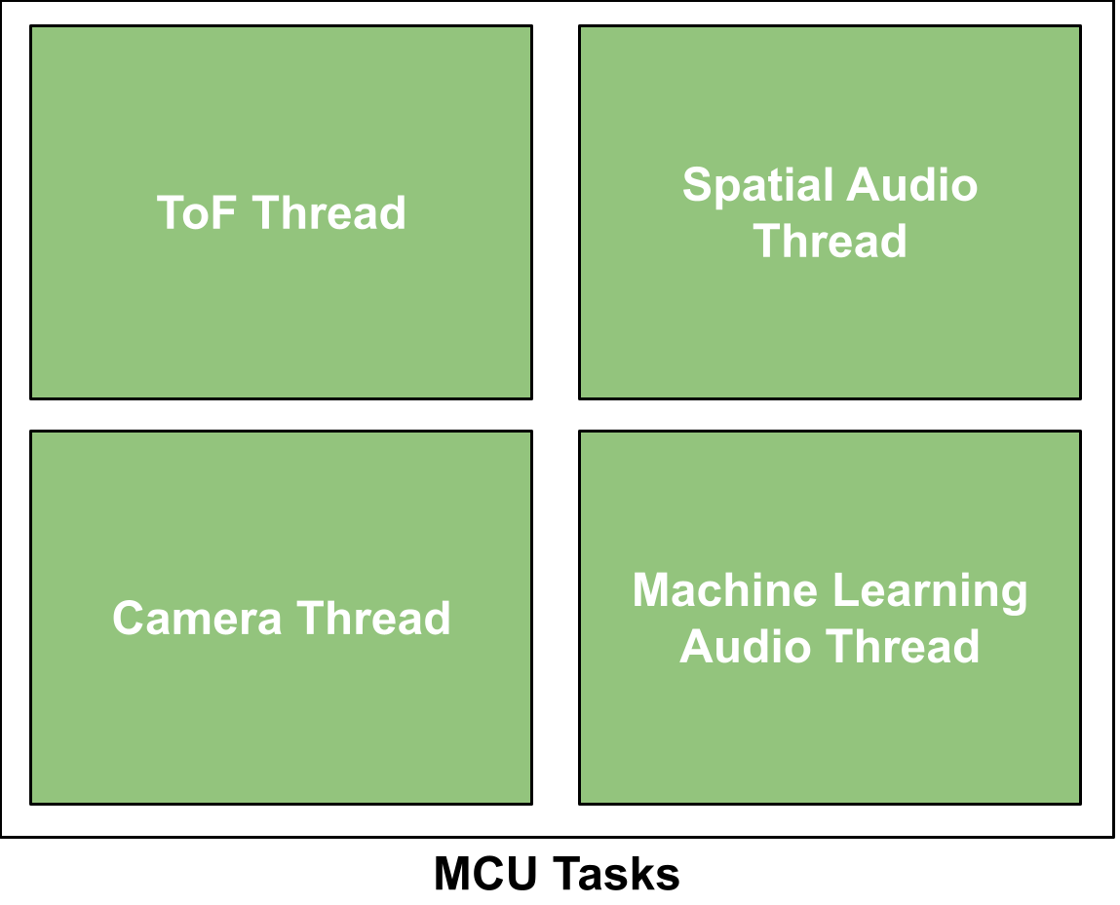
Control Subsystem - Results
MCU handles each subsystem in separate threads for performance and synchronization
R&Vs:
✔ MCU receives data from ToF sensor and sends it to the APP within 1s.
✔ MCU receives capture signal, captures image, and sends it to web-app all within 2 seconds
✔ MCU receives 16-bit stereo audio from web-app, sends data to Audio Subsystem for playing
/_____\
|__/\__|

Slide 21
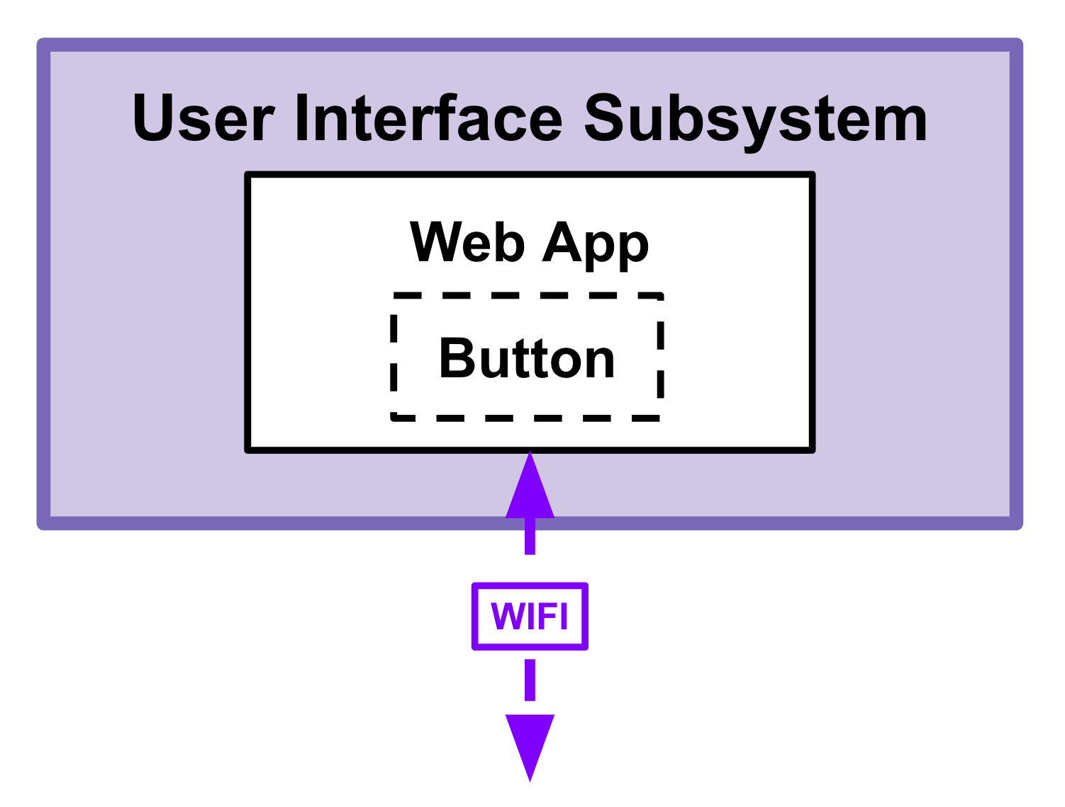
User Interface Subsystem - Overview
[Spatial Awareness]
Translates the live depth map array into ambisonic spatial stereo audio
Sends audio back to MCU with minimal latency to achieve near real-time stereo audio feedback
[Object Recognition]
Once button is pressed prompts the ML algorithm
Communicates identified objects back to the user
/_____\
|__/\__|

Slide 22
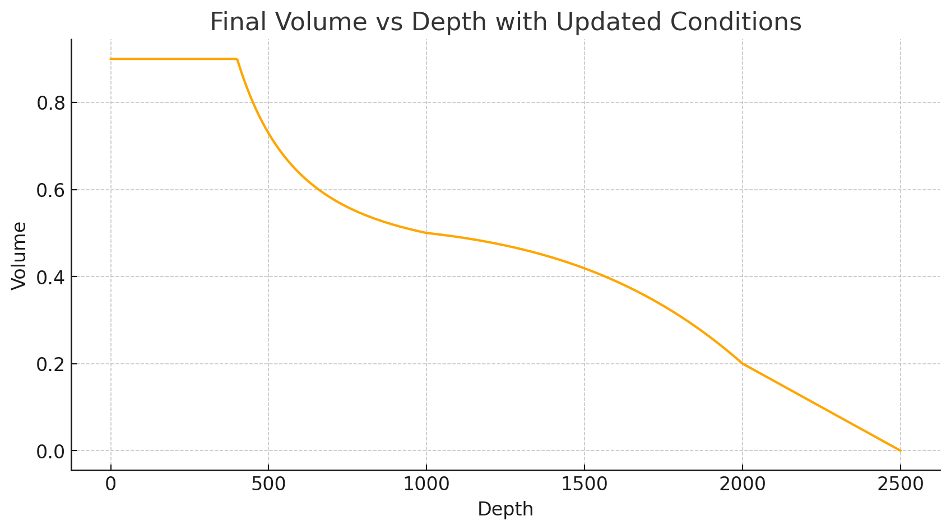
User Interface Subsystem - Results
Successfully constructs spatial audio from depth map, and successfully identifies upto 800 objects
R&Vs:
✔ Connects to MCU through WIFI, receives packets at <2 seconds of latency
✔ Sends back audio data to the MCU to be outputted by the Audio Subsystem with <50ms of latency
✔ Once button is pressed, sends capture signal and prompts the ML algorithm. Communicates identified objects (1m away) back to the user
/_____\
|__/\__|

Slide 23
Successes
Correctly identifies obstacles ahead of the user and alerts them in the correct direction.
Correctly identifies more than 600 objects and relays their direction to the user.
Our PCB works standalone with the battery and sensors reporting directly to it.
Users were able to navigate down the hall with no assistance.
/_____\
|__/\__|

Slide 24
Challenges:
On-board Audio
Changed circuit from binary DAC to active filter and PDM signal
Issues:
Operates at high frequencies > 2MHz
RF interference due to Wifi antenna
Resulted in usable but noisy audio at low volumes
/_____\
|__/\__|

Slide 25
Challenges:
Data Latency & Synchronization
Large amounts of bi-directional data:
Images, Depth, Commands, Audio
Synchronization and latency issues due to limited bandwidth
Minimized effect using multithreading and multiple WiFi sockets
/_____\
|__/\__|

Slide 26
Learning Outcomes?
\ _____\
|__/\__|
ELECTRICAL & COMPUTER ENGINEERING
GRAINGER ENGINEERING

Slide 27
Next Steps ➟
\ _____\
|__/\__|
ELECTRICAL & COMPUTER ENGINEERING
GRAINGER ENGINEERING

Slide 28
Thank you!
\ _____\
|__/\__|
ELECTRICAL & COMPUTER ENGINEERING
GRAINGER ENGINEERING

Slide 29
Challenges: On-Board Audio
Changed design from using a binary DAC, to a active filter and a PDM signal.
Changed due to space and resource constraints
Problems:
Operated at high frequencies > 2MHz, not all ICs supported
Issue with audio noise due RF interference from WiFi antenna
Needed a new PCB design to fix issue, time constraints
Resulted in usable but noisy audio at low volumes

Slide 30
Challenges: Data Latency & Synchronization
Large amounts of bi-directional data:
Camera, ToF Imager, Asynchronous user input
Spatial Audio, Machine Learning Algorithms outputs
Synchronization and latency issues on MCU and Web-App due to limited bandwidth
Minimized effect using multithreading and multiple WiFi sockets

