Slide 1
JargonJolt
Electrical & Computer Engineering
April 29th, 2024

Slide 2
Introduction
ELECTRICAL & COMPUTER ENGINEERING
GRAINGER ENGINEERING

Slide 3
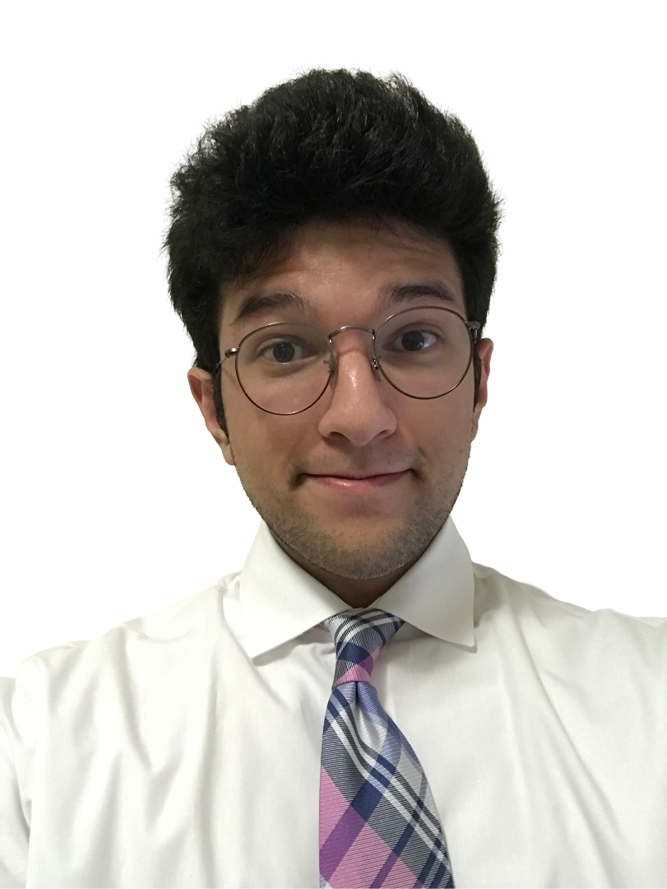
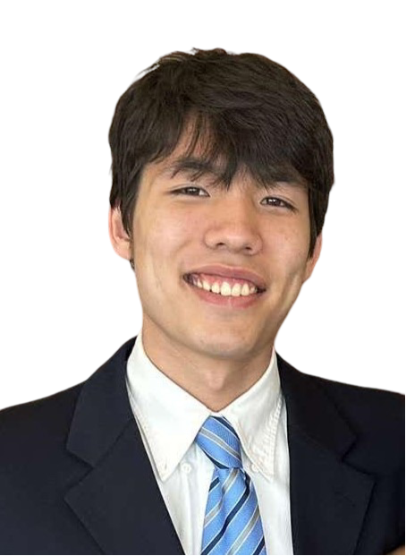
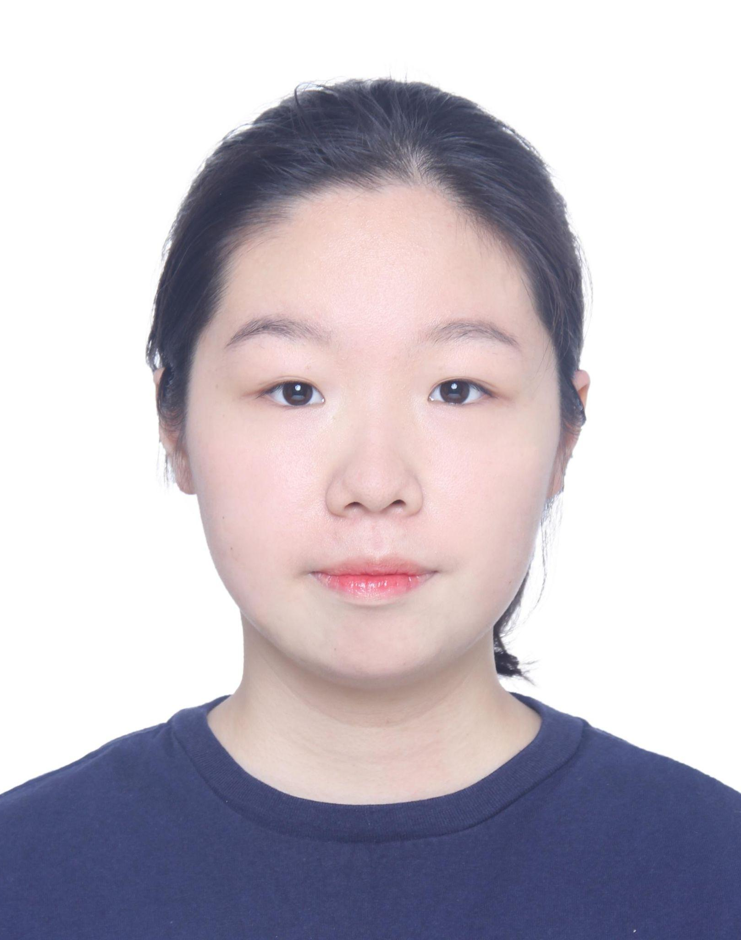
Introduction - About Us
Daniel Chamoun
Luke Hartmann
Nan Kang
Senior, Computer Engineering
Senior, Electrical Engineering
Senior, Computer Engineering
ELECTRICAL & COMPUTER ENGINEERING
GRAINGER ENGINEERING
Notes:
Daniel
Luke
Nancy

Slide 4
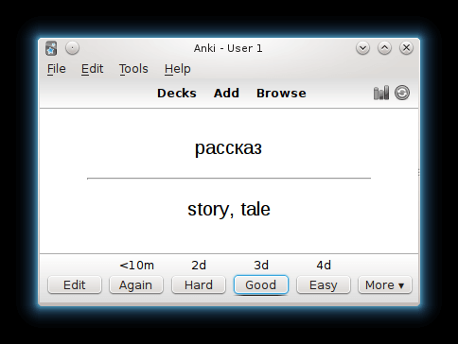
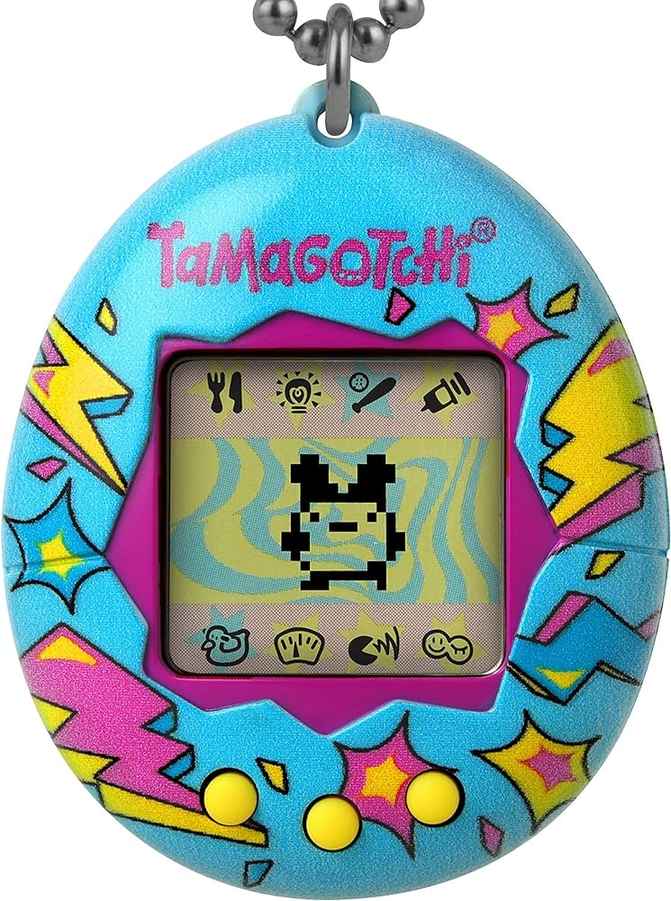
Introduction - Inspirations
Tamagotchi
Anki
Good Studying Habits
Encouraging Learning
Portability
ELECTRICAL & COMPUTER ENGINEERING
GRAINGER ENGINEERING
Notes:
Daniel

Slide 5
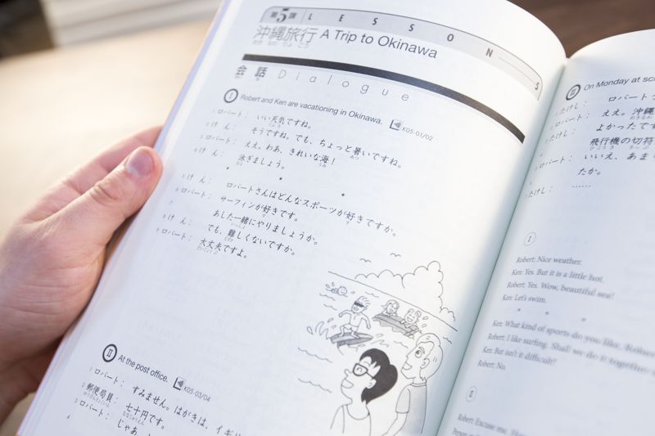
Introductions - Problem
Distractions arise when using a mobile phone
Lack of portable flashcard devices in the market
Language learners often give up due to difficulty
Difficult to practice pronunciations when using textbooks
Language programs are expensive
ELECTRICAL & COMPUTER ENGINEERING
GRAINGER ENGINEERING
Notes:
Daniel

Slide 6
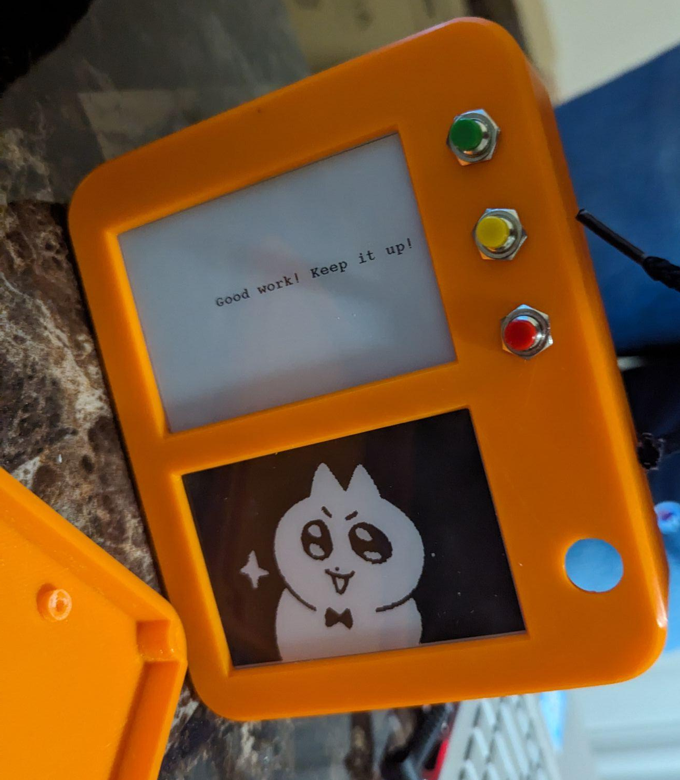
Introductions - Solution
JargonJolt
Daily practice rewards
Responsive digital pet
Fully portable with rechargeable battery
Audio support for pronunciations
Internet support
Cheap manufacturing cost
Fun!
ELECTRICAL & COMPUTER ENGINEERING
GRAINGER ENGINEERING
Notes:
Luke

Slide 7
Design
ELECTRICAL & COMPUTER ENGINEERING
GRAINGER ENGINEERING

Slide 8
Design - High Level Requirements
The device enables users to view flashcards, see answers, select their results, and monitor the status of a digital pet. Flipping and switching between flashcards must be completed within 1 second, and the digital pet should respond to any state changes within 1 second.
The device must have the capacity to store and recall ‘question and answer’ data for up to 500 flashcards, in addition to retaining user interaction history with the flashcard set. Furthermore, it should be capable of downloading flashcard sets from the internet in under 5 minutes.
The device should be portable, with dimensions not exceeding 160mm x 120mm, and designed for long-term use. It must feature a rechargeable battery with a lifespan of at least 2 hours on a single charge.
ELECTRICAL & COMPUTER ENGINEERING
GRAINGER ENGINEERING
Notes:
nan

Slide 9
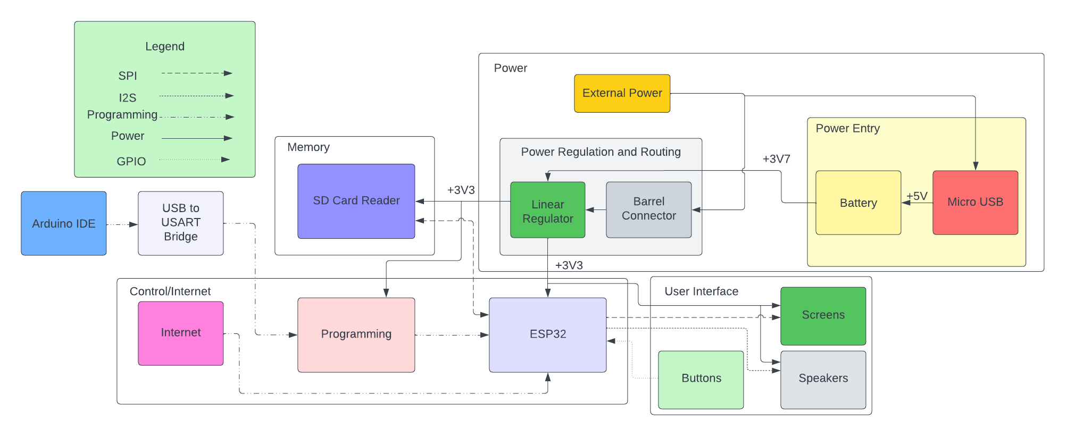
Design - Subsystems
Control/Internet
Link with all other subsystems
Flashcard control process
Power
Supply power to circuit
Offer long life rechargeable battery
Memory
Store and recall flashcard data
Store data regarding user progress
User Interface
Face buttons, screens, and speaker
ELECTRICAL & COMPUTER ENGINEERING
GRAINGER ENGINEERING
Notes:
nan

Slide 10
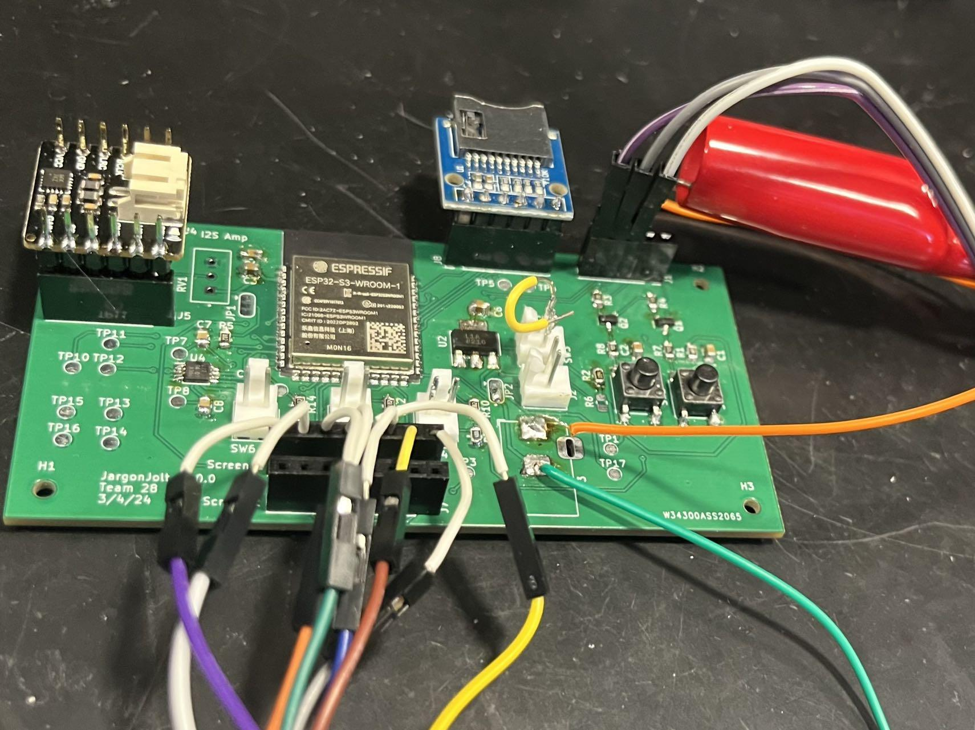
Design - Subsystem Requirements
Communicate with a web server to retrieve flashcard set information.
Read user button inputs.
Facilitate communication between the memory and user interface modules including audio, display, and flashcard data.
While the device is in idle mode, ensure that the screen stays on for at least 2 hours.
ELECTRICAL & COMPUTER ENGINEERING
GRAINGER ENGINEERING
Notes:
Daniel
things to mention here:
3.3 V of power from linear regulator, 5 V from battery: initially wasnt reading 3.3 or even 5, due to barrel jack pins being swapped which was later solved
buttons worked as intended

Slide 11
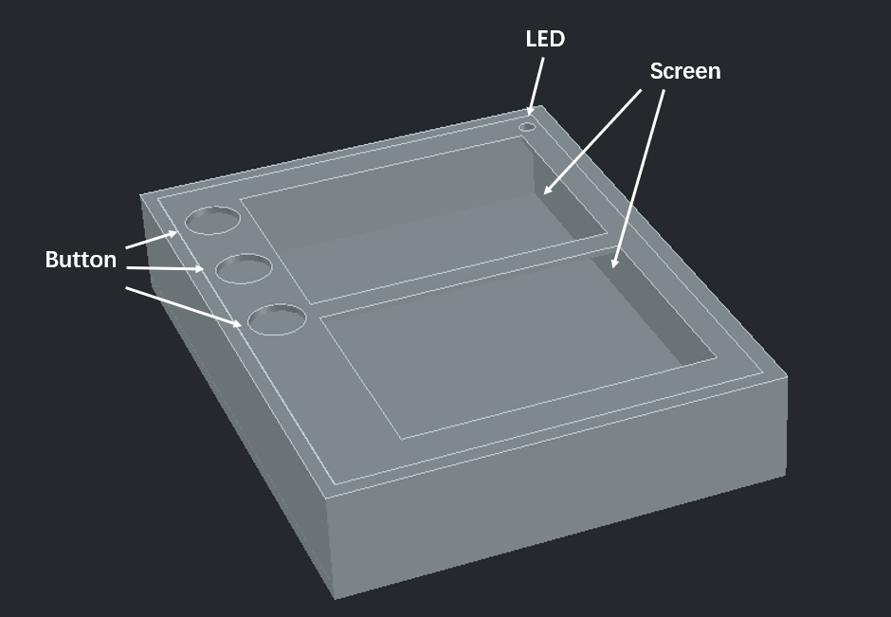
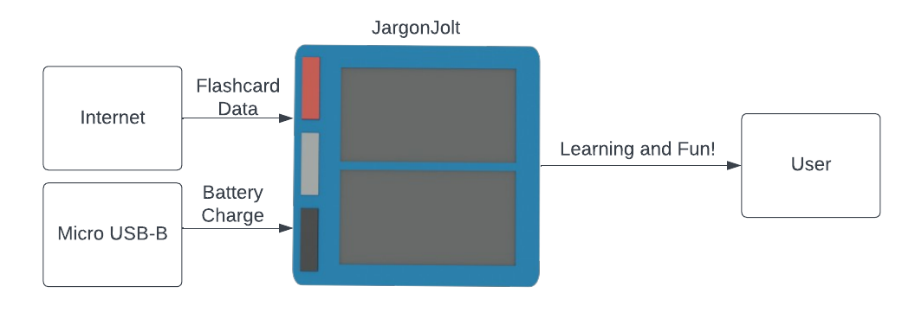
Design - Original Design Changes
Changes:
Switching SRAM to SD card
Physical Design update
Screen Type Color to Black and White
ELECTRICAL & COMPUTER ENGINEERING
GRAINGER ENGINEERING
Notes:
nan

Slide 12
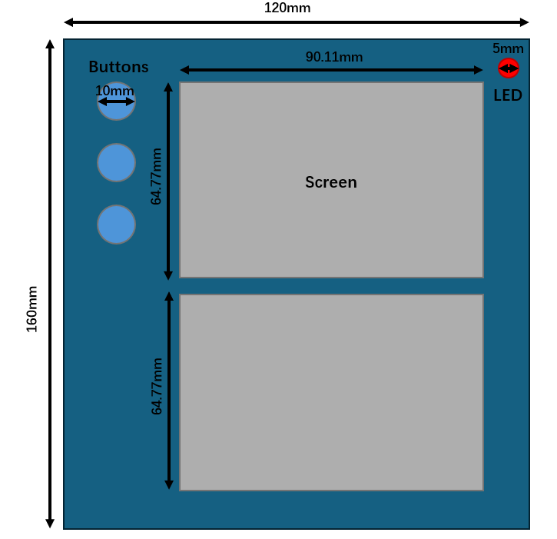
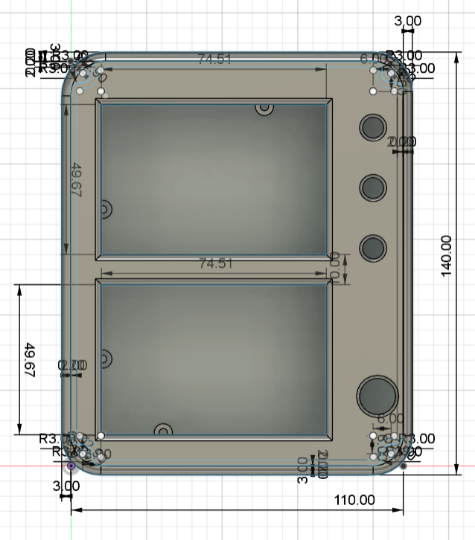
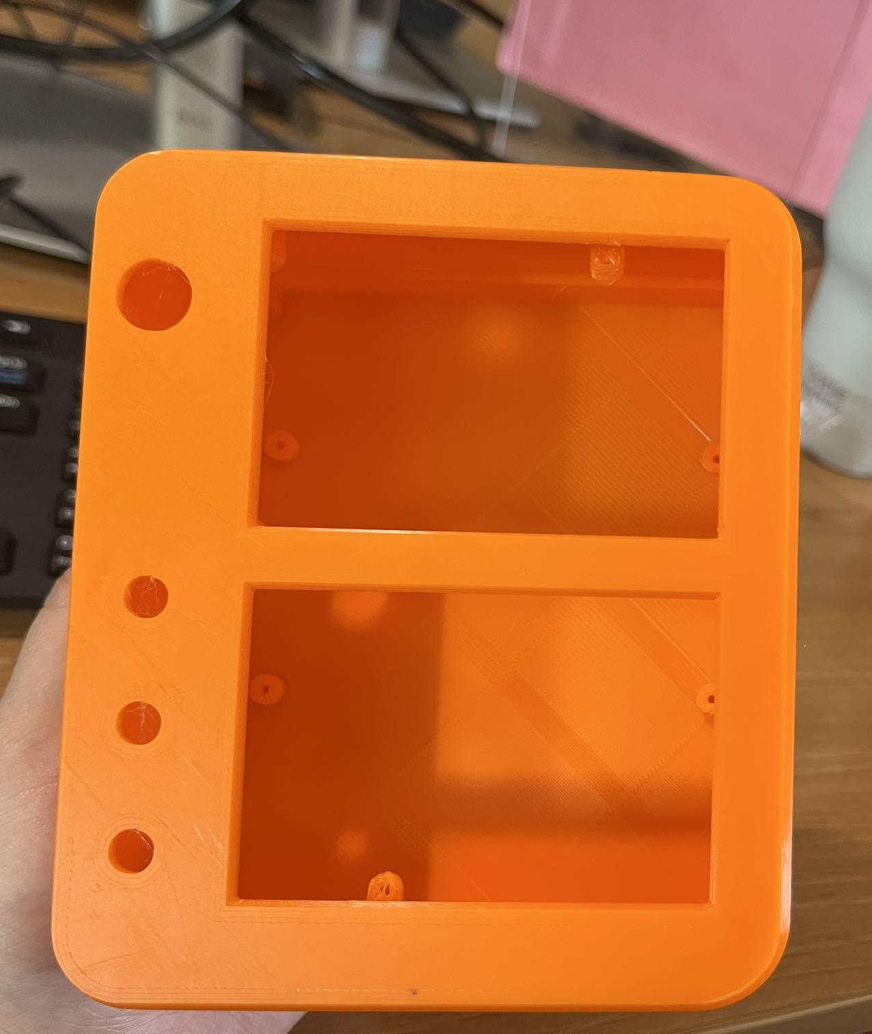
Design - Physical Design
1. Blueprint
2. 3D Design
3. 3D Print
ELECTRICAL & COMPUTER ENGINEERING
GRAINGER ENGINEERING
Notes:
nan
dimension changed due to new screen dim
smooth shape -> safe for children
light material -> more portable

Slide 13
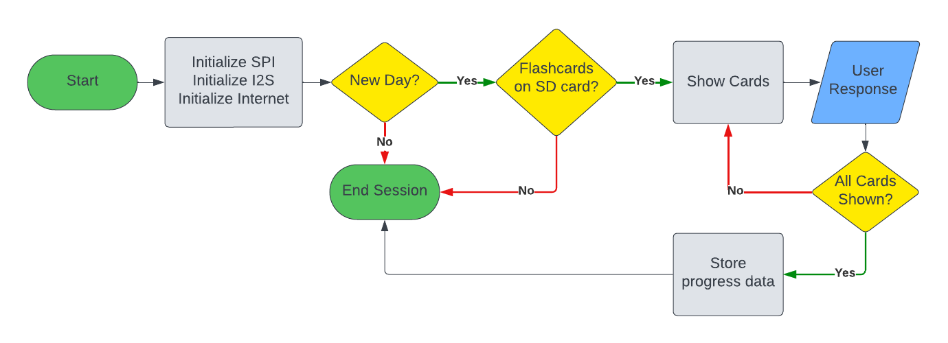
Design - Algorithm
Major Phases:
Initialization of all peripherals and data pre-processing
Show flashcards to the user and respond to inputs
Wrap up by freeing memory and saving user progress
ELECTRICAL & COMPUTER ENGINEERING
GRAINGER ENGINEERING
Notes:
Luke

Slide 14
Results
ELECTRICAL & COMPUTER ENGINEERING
GRAINGER ENGINEERING

Slide 15
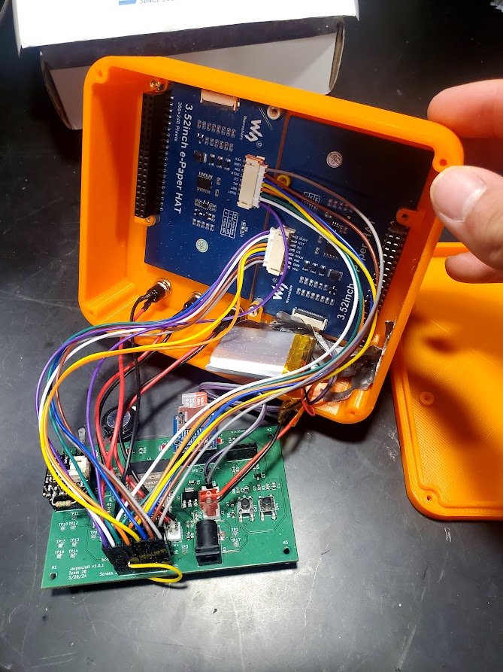
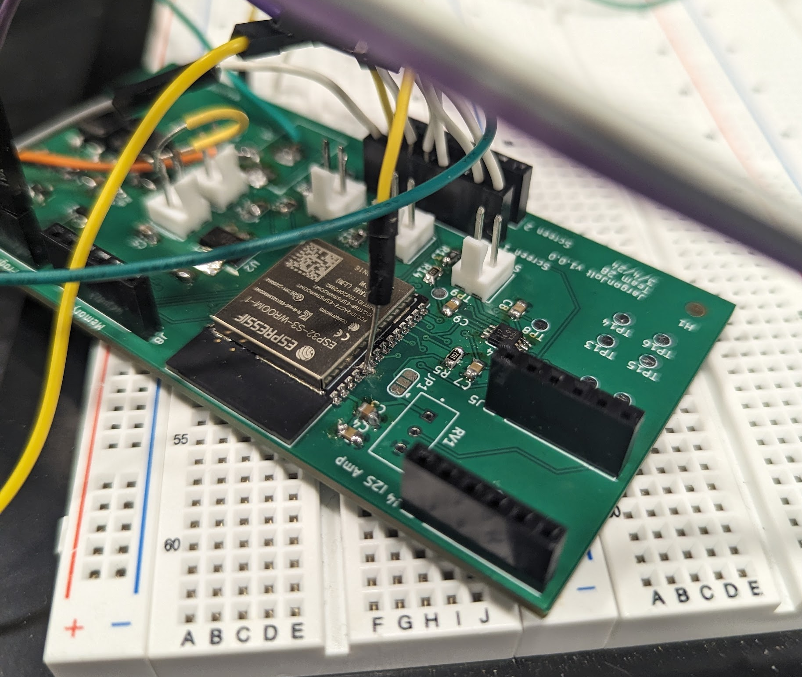
Results - Build
Major Components:
Custom PCB
3D printed outer shell
I2S amplifier and speaker
SPI SD card reader
1000 mAh battery
Low Power digital ink screens
ELECTRICAL & COMPUTER ENGINEERING
GRAINGER ENGINEERING
Notes:
Daniel

Slide 16
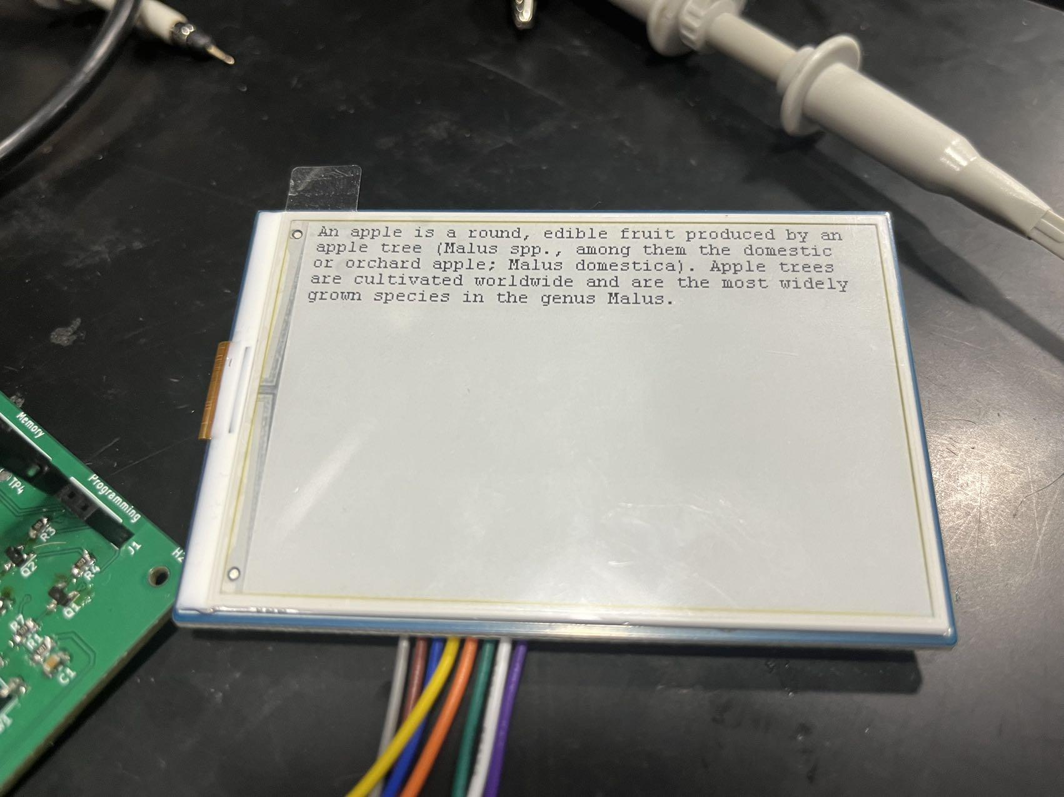
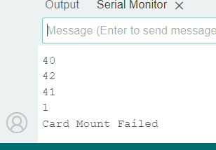
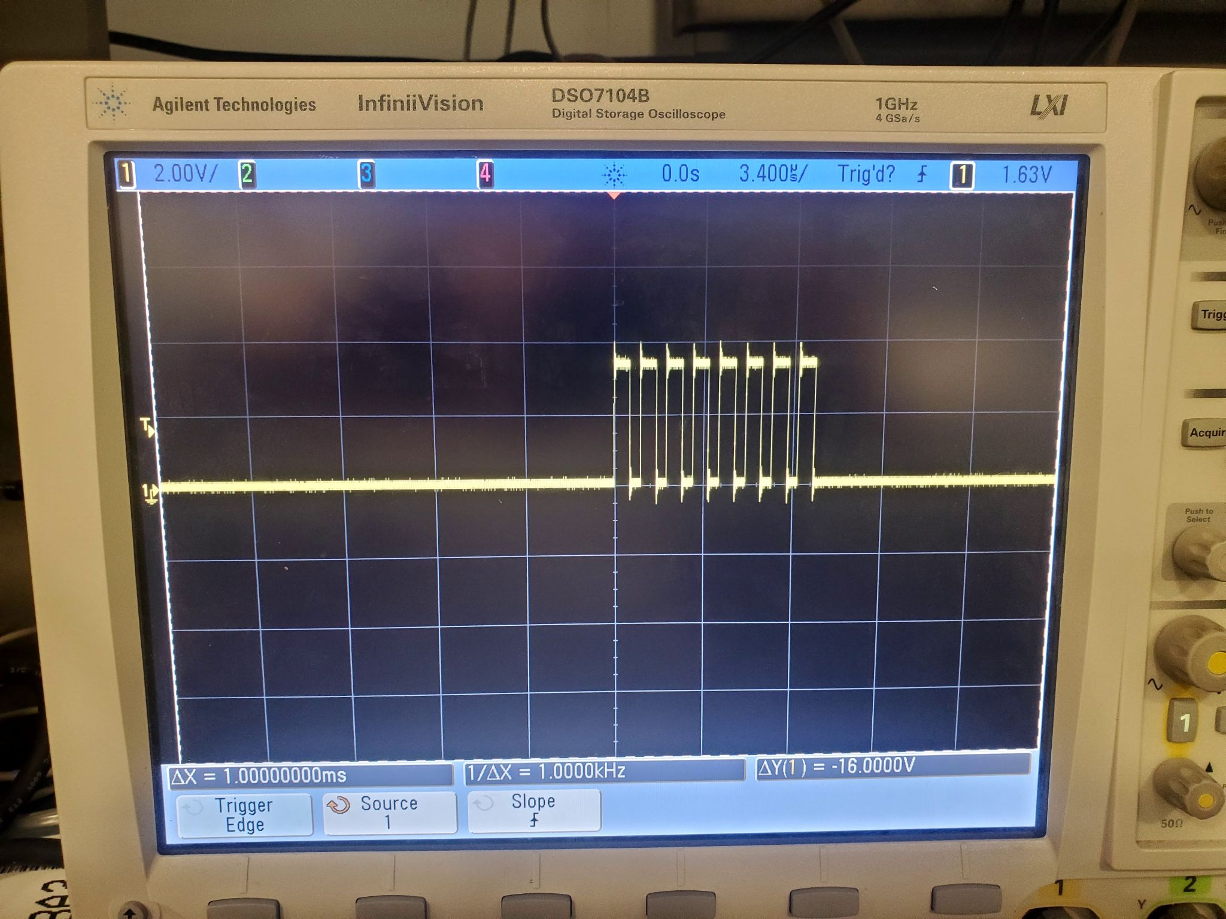
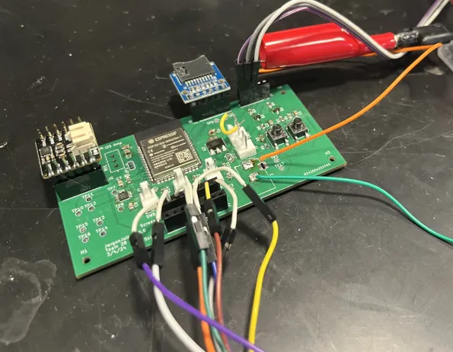
Results - Testing
Testing Strategies:
IO Testing
Multimeter
Oscilloscope
Serial Monitor
External Power
Table top source
Barrel jack
Frequently Tested:
Screens
Audio
Program Behavior
ELECTRICAL & COMPUTER ENGINEERING
GRAINGER ENGINEERING
Notes:
Luke

Slide 17
Results - Final Product
ELECTRICAL & COMPUTER ENGINEERING
GRAINGER ENGINEERING
Notes:
Luke

Slide 18
Discussion
ELECTRICAL & COMPUTER ENGINEERING
GRAINGER ENGINEERING

Slide 19
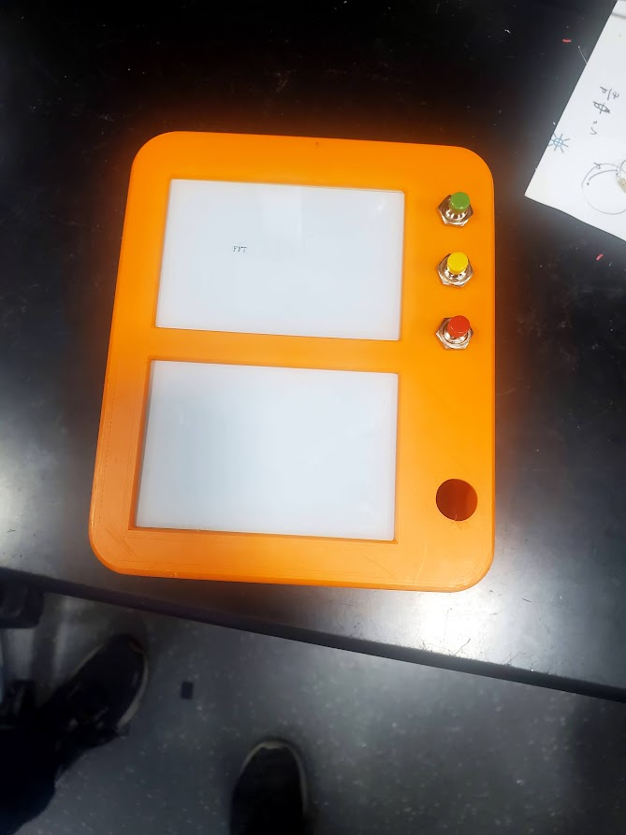
Discussion - Challenges and Successes
Successes:
All parts assembled into the small, portable enclosure
High-level and subsystem requirements met
Long battery life and reliability
Challenges:
Difficulties with configuring libraries
Audio
SD Card
Digital Ink refresh time
Pin mapping on PCB
ELECTRICAL & COMPUTER ENGINEERING
GRAINGER ENGINEERING
Notes:
Daniel

Slide 20
Discussion - Failures
Internet Connectivity
Date and Time
Web Server for flashcard download
Time constraints
Formatting
User Interface
Change hotspot
Select flashcard set
More buttons
ELECTRICAL & COMPUTER ENGINEERING
GRAINGER ENGINEERING
Notes:
Luke
Successfully connected to a hotspot
Did not successfully implement a server for sending flashcards to our sd card remotely
Given more time, this is entirely feasible as we were able to connect to get the time.
File server

Slide 21
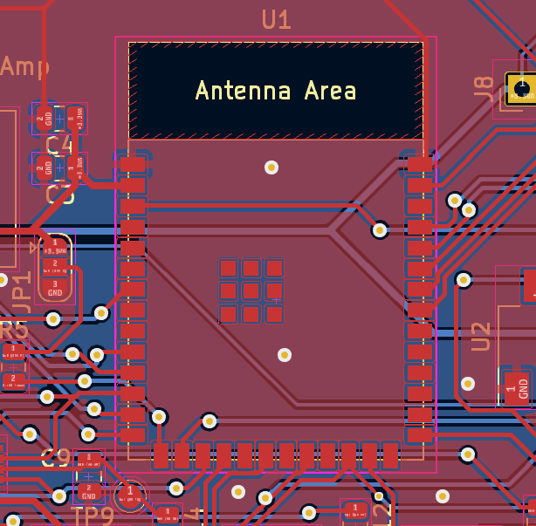
Discussion - Conclusions
Things we Learned
PCB design and fabrication
Familiarity with using an MCU
MCU peripherals
Planning a project
Improvements for next time
More care into prior research
Manage time better
Regular progress review
ELECTRICAL & COMPUTER ENGINEERING
GRAINGER ENGINEERING
Notes:
Luke

Slide 22
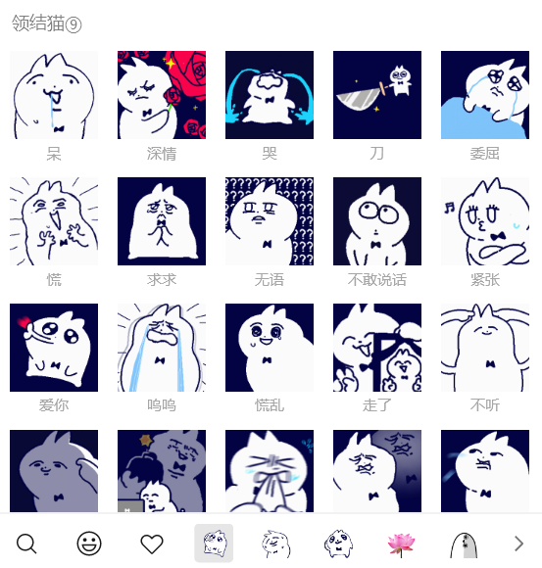
Discussion - Conclusions (cont.)
Ethical Concerns
Copyright infringement
Digital pet
Word libraries
Audio clips
Recommendations For Further Work
Smaller Screen
Foreign Characters
Injection Molding for enclosure
More comprehensive UI
ELECTRICAL & COMPUTER ENGINEERING
GRAINGER ENGINEERING
Notes:
nan
RECOMMENDATIONS
Replace the screen with a smaller dimension one
Adding foreign characters to our font files
Use injection molding machine to make the enclosure
Adopt a setting system for user to adjust flashcards / font size without the use of an external computer
ETHICS
Utilizing memes from WeChat as pet images may pose potential copyright infringement risks.
Downloading word libraries and audio from the internet may breach copyright laws and violate data privacy norms.

