Slide 1
Scanning Bluetooth to FM Transmitter
Team 18
Electrical & Computer Engineering
2 May 2023

Slide 2
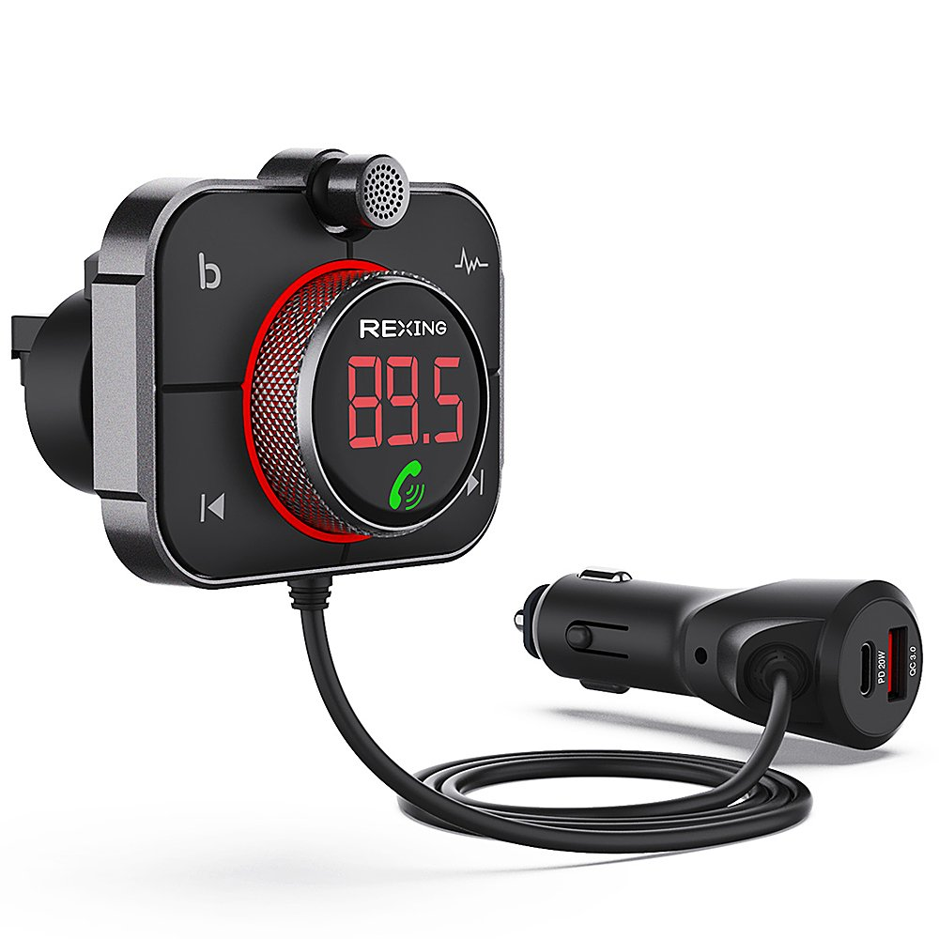
Bluetooth to FM Transmitters
Existing Devices
Current products stream user’s audio from their phone to the car radio via FM
Problem
Devices can only transmit
Require user input to change the frequency
IMAGE / GRAPHIC
Product currently for sale
ELECTRICAL & COMPUTER ENGINEERING
GRAINGER ENGINEERING
Notes:
Madigan

Slide 3
Solution
Add FM Reception Functionality
Device will scan for empty stations
Takes less driver focus off of road
High-Level Requirements
Device will connect and receive audio data via Bluetooth.
Device will transmit audio via FM.
Device will scan FM stations and automatically select one with minimal interference.
Device in enclosure
Device out of enclosure
3
ELECTRICAL & COMPUTER ENGINEERING
GRAINGER ENGINEERING
Notes:
Dan

Slide 4
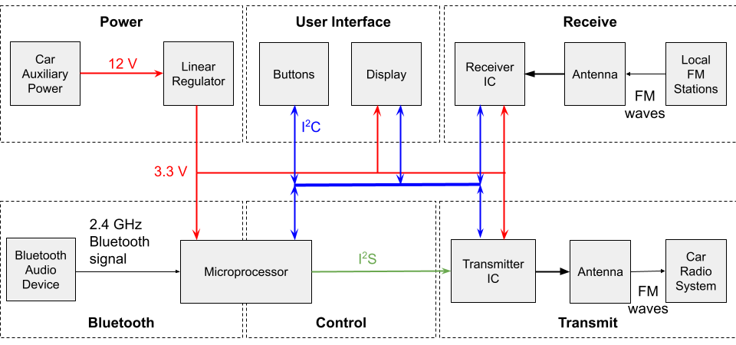
Block Diagram
4
ELECTRICAL & COMPUTER ENGINEERING
GRAINGER ENGINEERING
Notes:
James

Slide 5
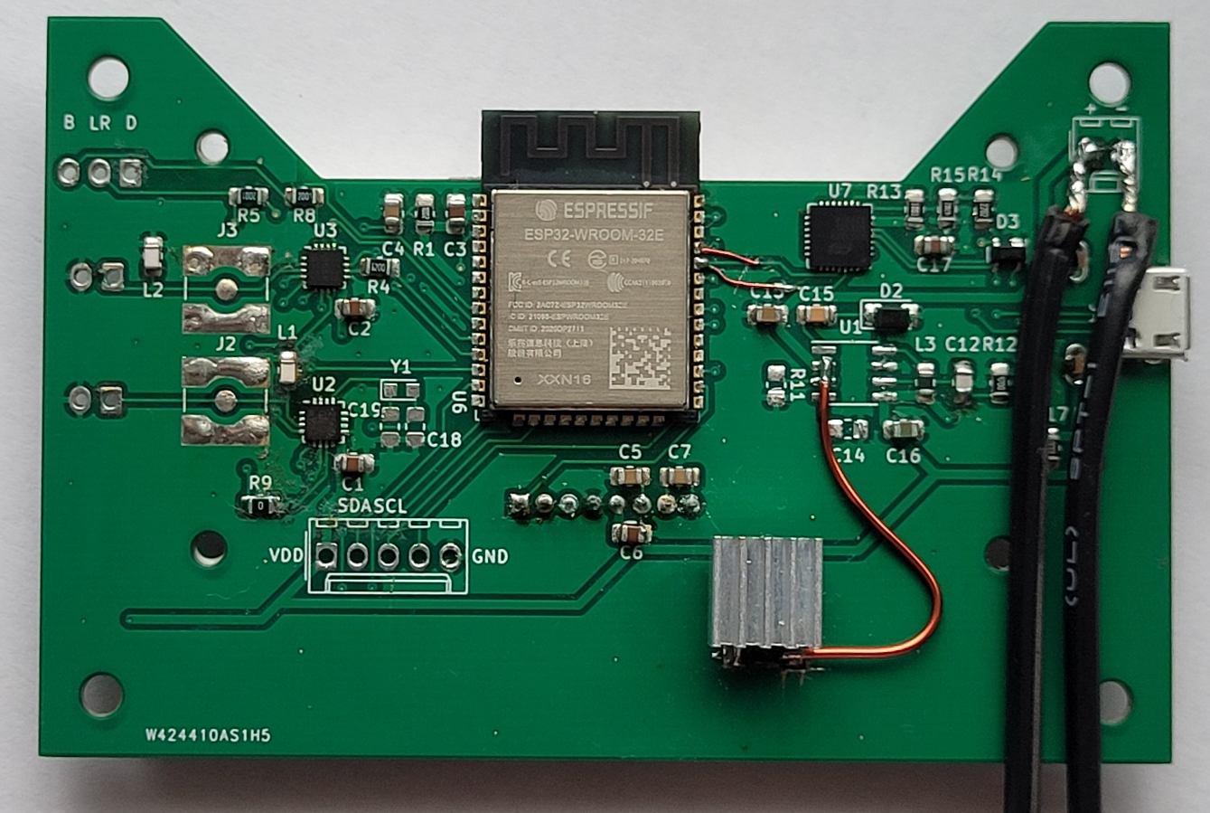
Microcontroller & Bluetooth
ESP32-WROOM-32
Provides built-in Bluetooth, communication protocols, and GPIO
Changed microcontroller to older model for proper Bluetooth support
Bluetooth
Built off of template provided by Espressif Audio Development Framework
Used Bluetooth A2D and AVRC profiles and interrupts for front panel I/O
Back side of PCB
5
ELECTRICAL & COMPUTER ENGINEERING
GRAINGER ENGINEERING
Notes:
James

Slide 6
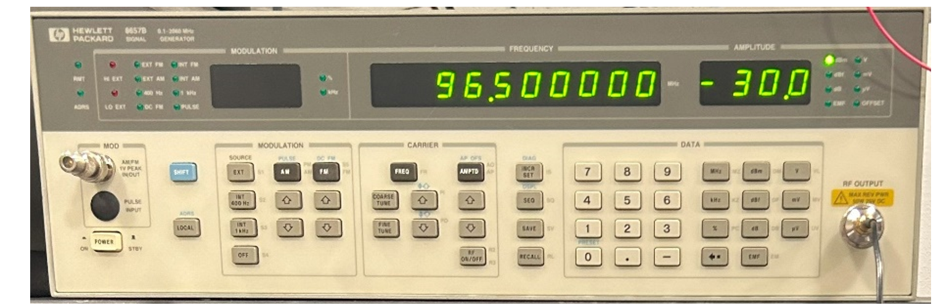
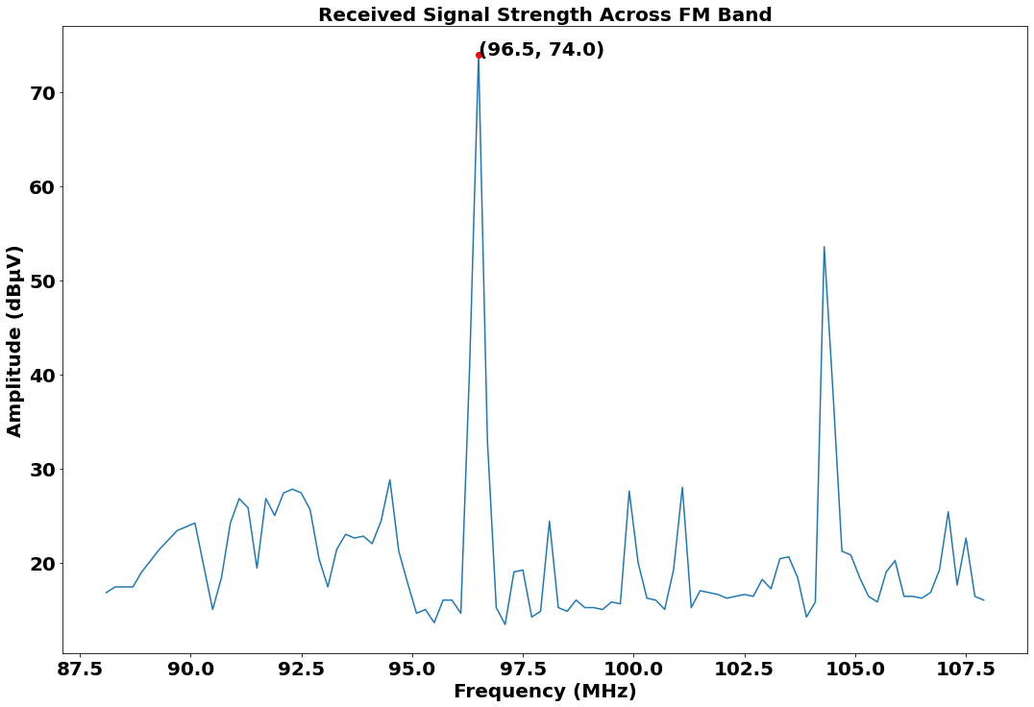
Receiver
Si4706 and Loop Antenna
Receives FM and outputs audio
Loop antenna designed per the manufacturer’s Antenna Design Guidelines
Signal measurement capability (signal strength measurement)
Our design uses signal strength measurement to find vacant channels
Testing
Injected tone using signal generator, took strength measurement
Observed spectrum using spectrum analyzer, compared to data from IC
Added more loops to antenna
Significant coupling between receiver and transmitter
Receiver verification input setup
6
ELECTRICAL & COMPUTER ENGINEERING
GRAINGER ENGINEERING

Slide 7
Receiver
Channel Selection Algorithm
Device continuously scans FM spectrum
Updates rolling average of last 5 measurements
We impose threshold
Sort least to greatest
Finds station with two neighbor stations below threshold on either side
FM Spectrum
Voltage (dBμV)
Frequency (Hz)
7
ELECTRICAL & COMPUTER ENGINEERING
GRAINGER ENGINEERING

Slide 8
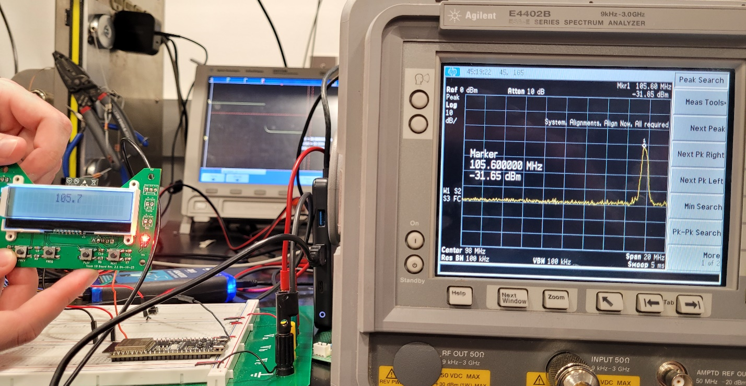
Transmitter
Si4711 and Loop Antenna
Si4711 takes digital audio input and outputs FM signal
Loop antenna designed per the manufacturer’s Antenna Design Guidelines
Testing
Verified transmission by observing output of IC on a spectrum analyzer
Qualitatively confirmed by listening to transmission on a radio
Verified that transmission is not received past 3m
Transmitted signal strength seen on the spectrum analyzer
8
ELECTRICAL & COMPUTER ENGINEERING
GRAINGER ENGINEERING

Slide 9
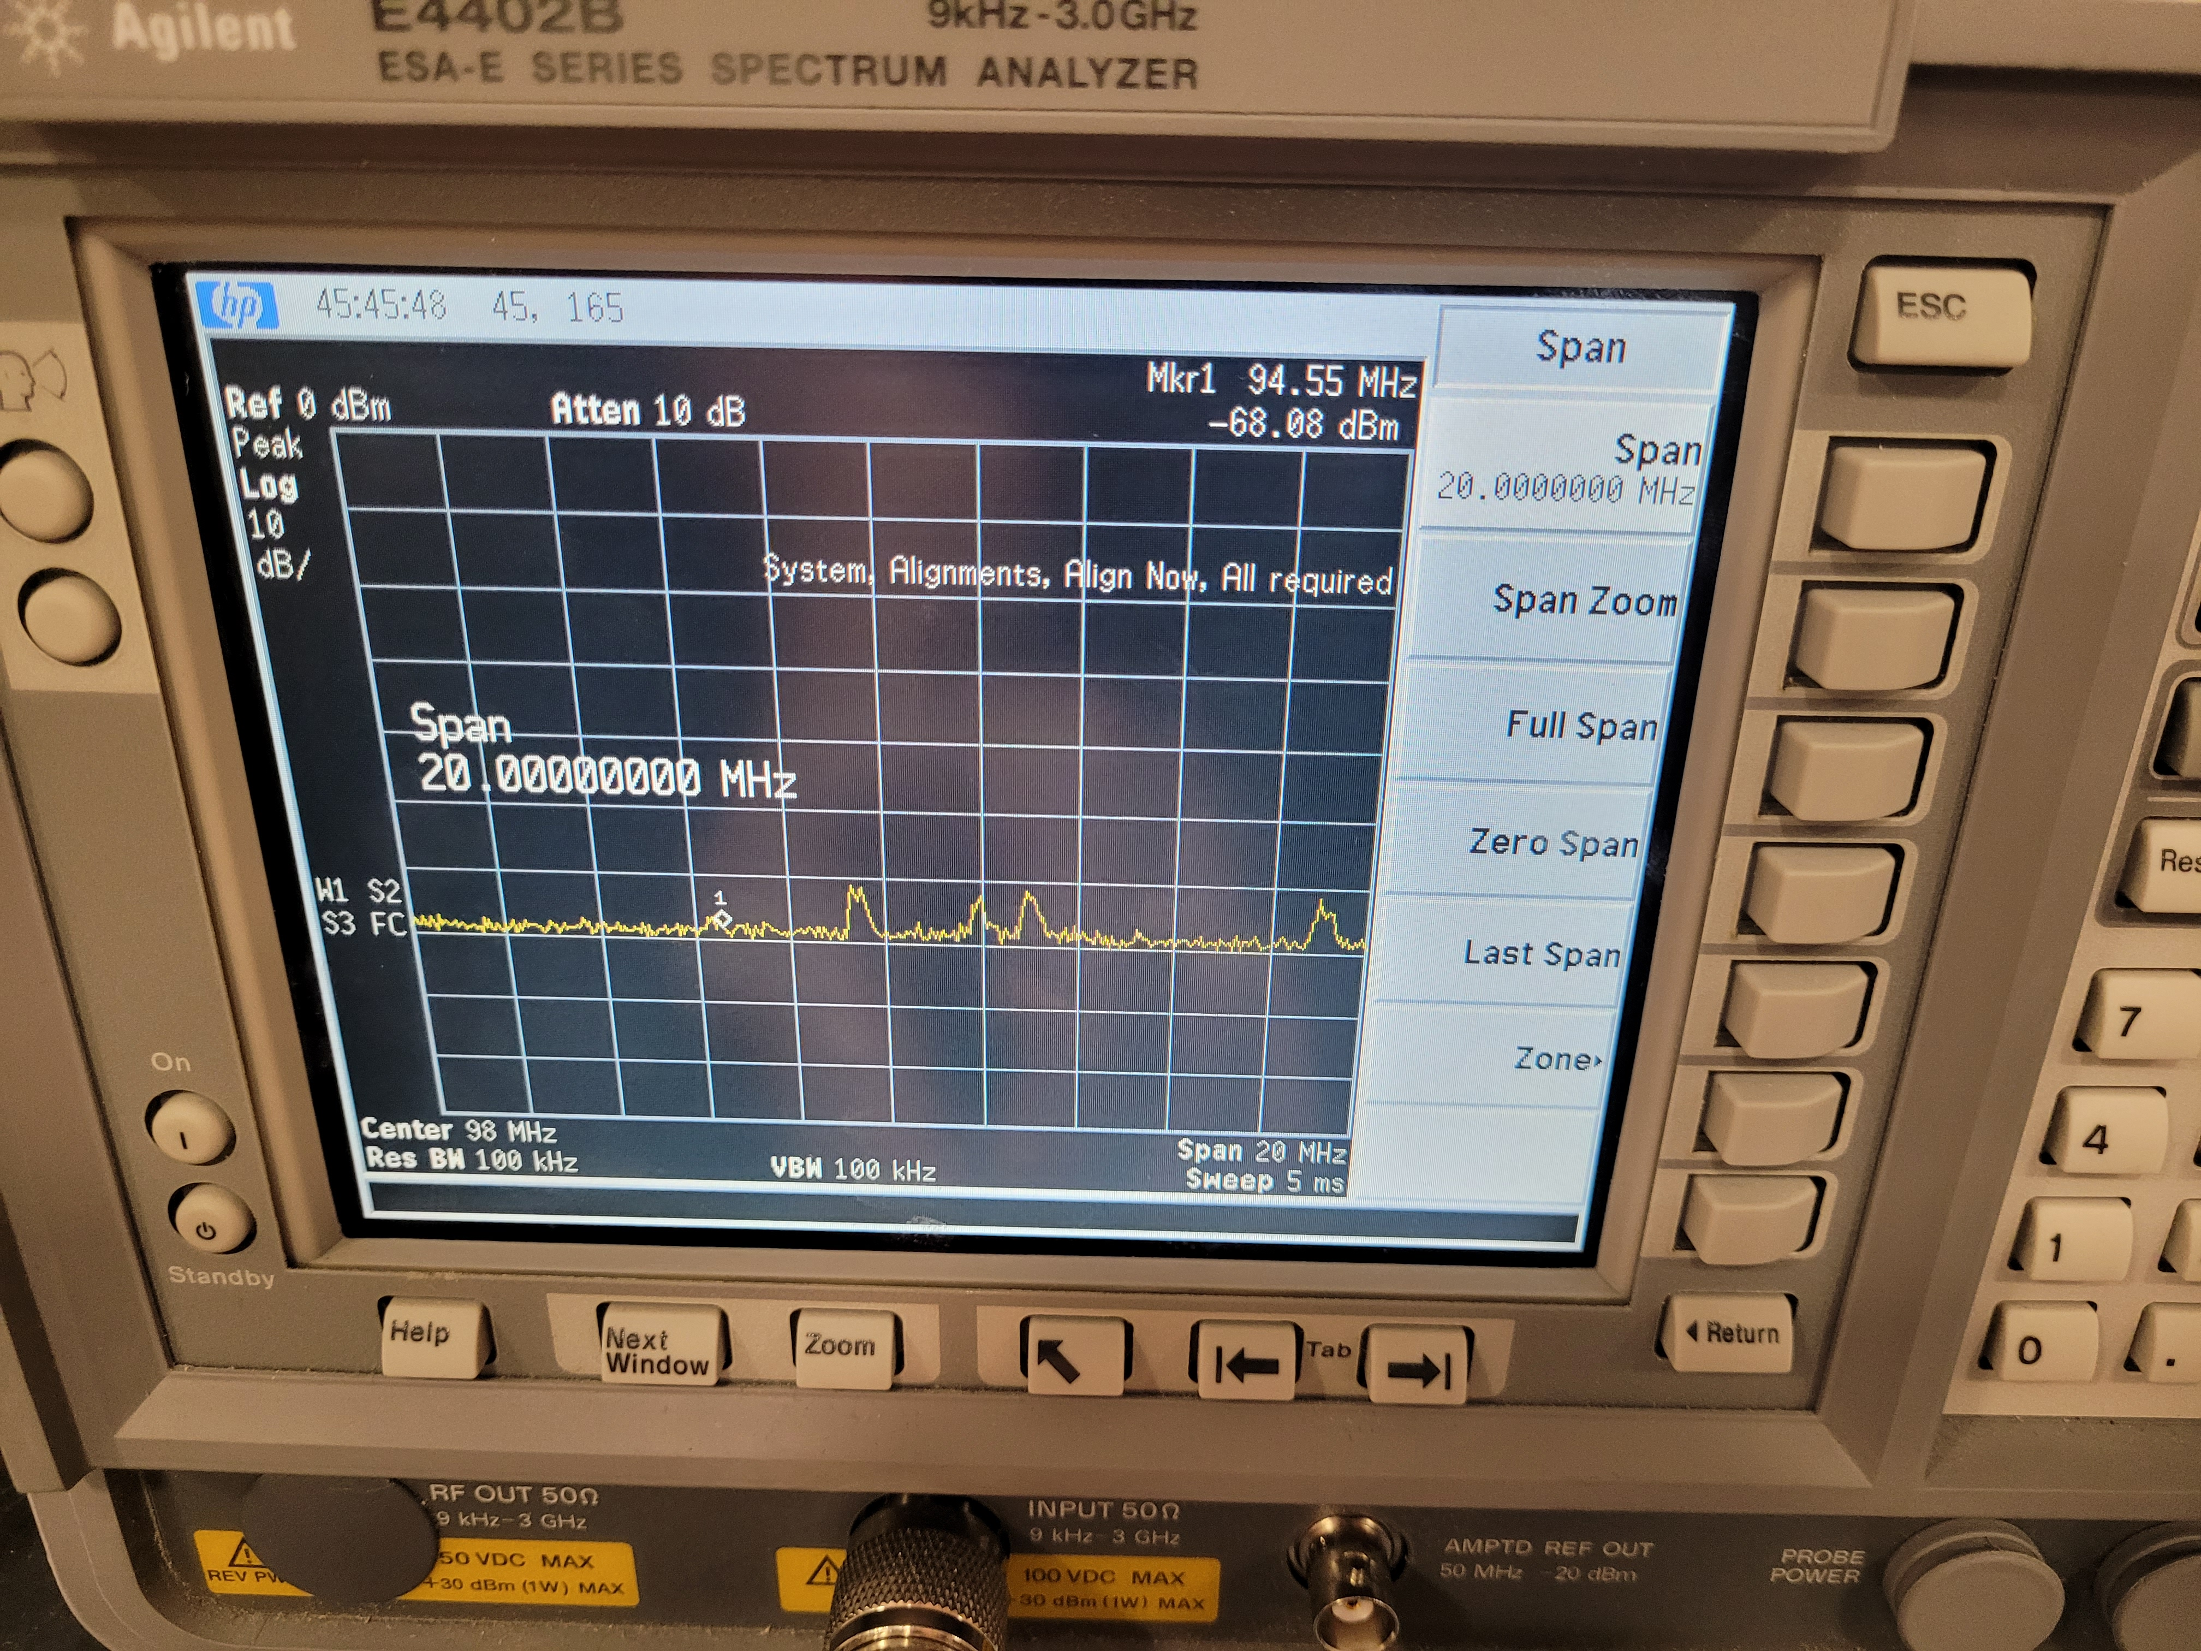
Switching Regulator
TPS5403
Integrated buck converter capable of outputting 1.7A at 3.3V with input voltage between 4.5-28 V
Testing
Initial configuration unable to support the startup power draw
By raising the switching frequency, the issue was solved
Higher switching frequency raised noise floor of receiver
Increased noise floor due to regulator
Noise floor without regulator
9
ELECTRICAL & COMPUTER ENGINEERING
GRAINGER ENGINEERING

Slide 10
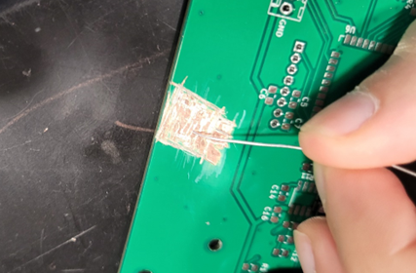
Linear Regulator
NCP1117
Linear regulator capable of outputting 1A at 3.3V with input voltage between 4.5-20V
Traces and pads were manually cut since PCB was not designed for this device
Testing
Placed on electronic load at 600mA
Ran for 58 seconds before dropping the voltage due to overheating
Testing the linear regulator
Cutting the PCB
10
ELECTRICAL & COMPUTER ENGINEERING
GRAINGER ENGINEERING
Notes:
James

Slide 11
Conclusions
Successful Project Despite Challenges
Completed the project based on our initial requirements
Added features not initially planned (e.g., AVRCP and RDS)
Challenges and Learning Opportunities
Avoid placing the transmitter and receiver close to one another to limit coupling
Power supply should be more thoroughly considered and be tested more rigorously
RF circuits have high susceptibility to noise, even at relatively low frequencies
11
ELECTRICAL & COMPUTER ENGINEERING
GRAINGER ENGINEERING

Slide 12
Further Work
Higher Audio Fidelity
Transmit digital audio for HD Radio or similar technologies
Refine Form Factor
Smaller display (e.g., a 7-segment display) and microcontroller
ESP32 could serve as a base for other devices in the vehicle
12
ELECTRICAL & COMPUTER ENGINEERING
GRAINGER ENGINEERING

Slide 13
Thank you to our TA and ECE445 course staff
Questions? Comments? Advice?
13
ELECTRICAL & COMPUTER ENGINEERING
GRAINGER ENGINEERING

