Slide 1
ECE445 Senior Design Final Presentation
Automatic Item Retrieval Bookshelf
Team 1:
Atharv Koshti, Kashyap ramachandrula, vraj patel
1
Notes:
Atharv – introduce project name
Everyone introduce themselves (Kashyap then vraj)

Slide 2
Agenda
o1.
Project Objective
o2.
Design Review
o3.
Project Build & Test Results
o4.
Successes & Challenges
o5.
Conclusions
o6.
Further Recommendations
2
Notes:
Vraj

Slide 3
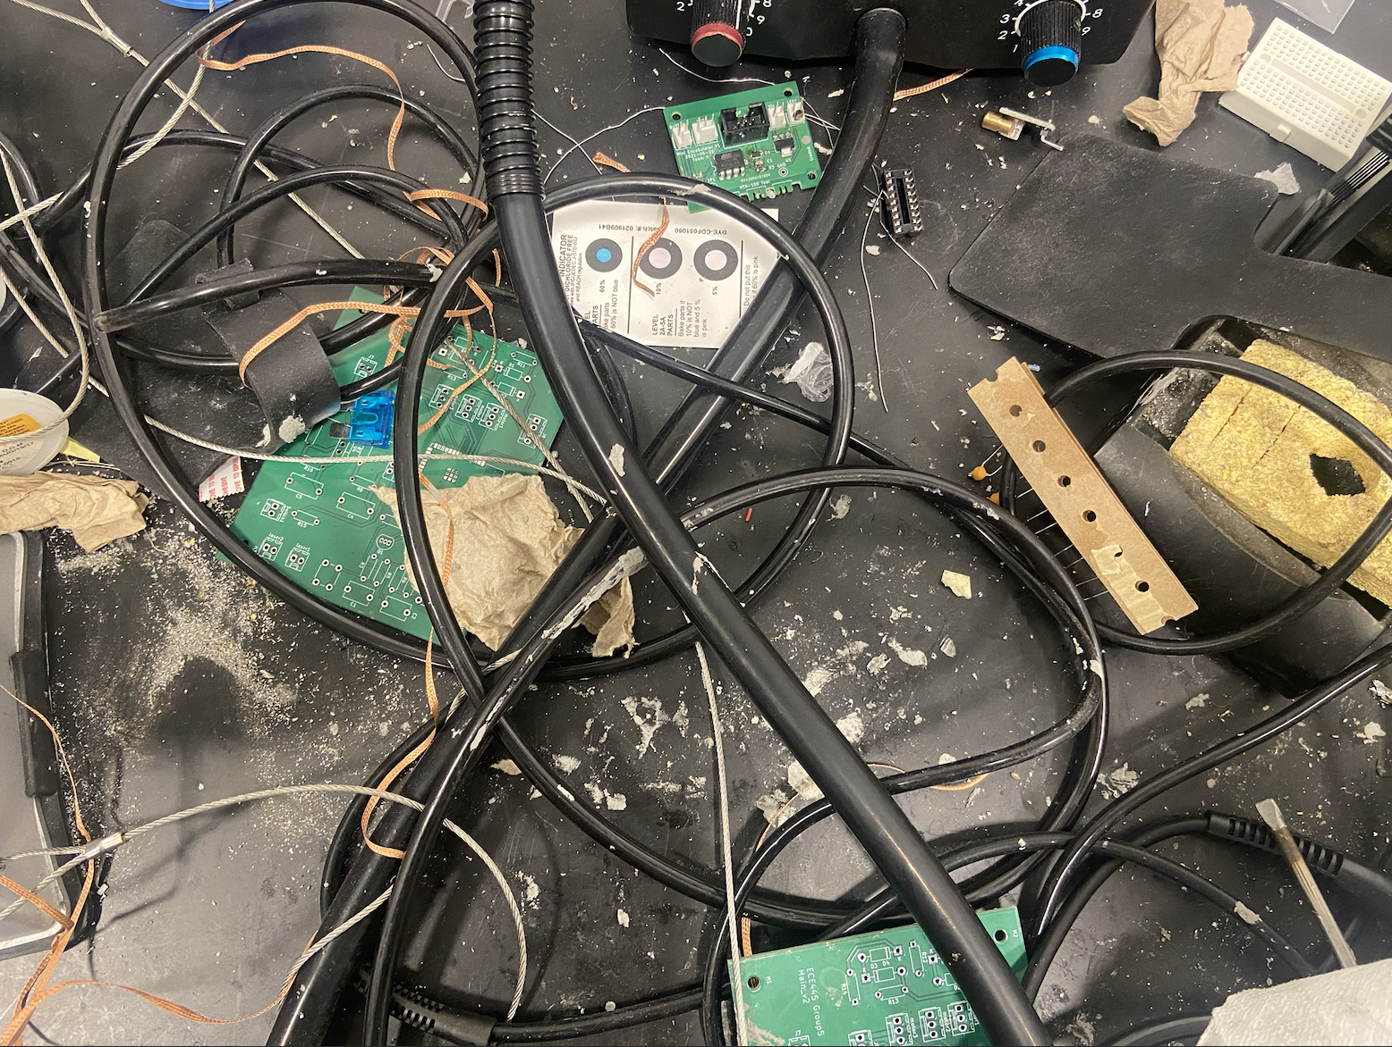
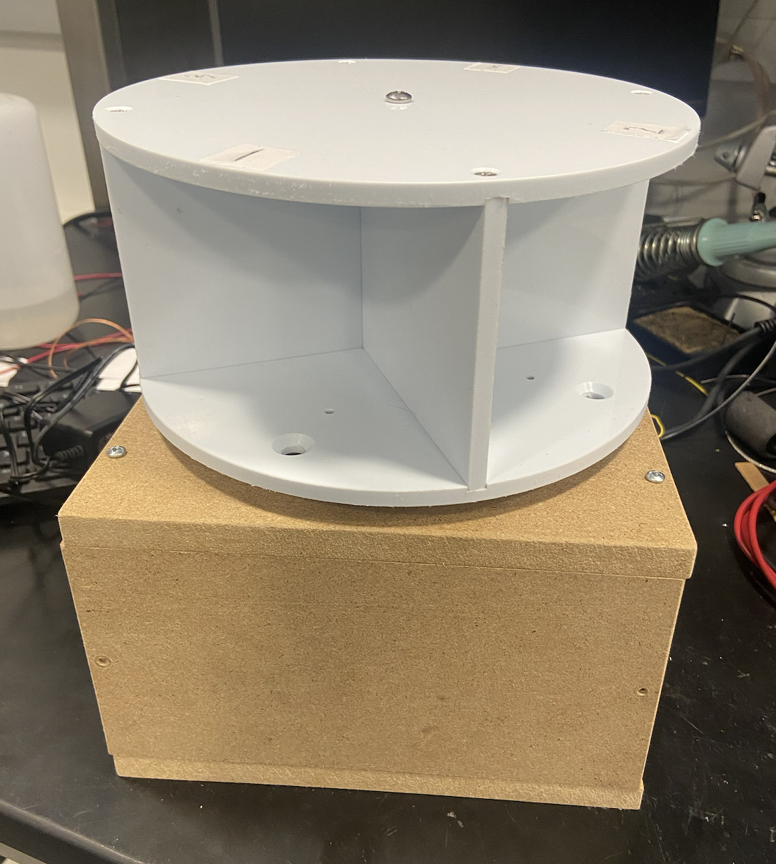
Problem
Solution
When working on projects that consist of small components, like resistors and capacitors, it’s often difficult to keep everything organized and increases the amount of time one spends finding parts rather than focusing on the actual project itself.
Our solution consists of a miniature bookshelf that allows users to place parts in each shelf and access them through an online web applications. Users will be able to insert any components, retrieve components via the bookshelf spinning, and view all components placed on the shelf.
3
Notes:
Atharv

Slide 4
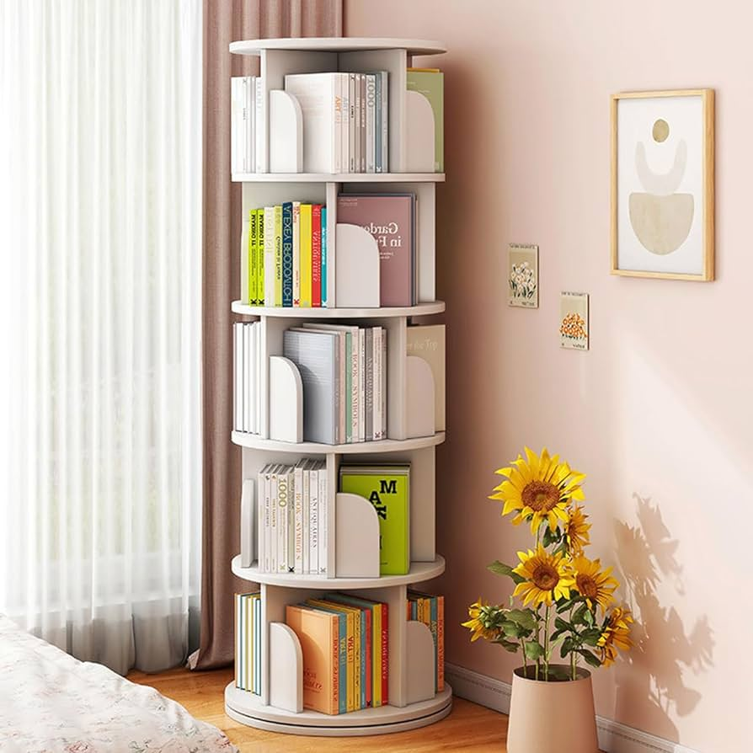
Design Review
Original Design
Changes Made
Functional Requirements
The original design was to create a large bookshelf to store items like books, clothes, etc. It also consisted of a mobile application that would interface with the circuit, LED, motor, and bookshelf.
We updated our design early on to create a much smaller, compact version of our original design. Additionally, we used a web application rather than a mobile application as it was able to connect to the ESP32 using WiFi capability.
Once prompted with the website, the bookshelf will turn to either angle 0, 90, 180, or 270 to face the user with the item that they requested to retrieve
In the website, the user must be able to see 100% of the items they placed on the bookshelf (at least 8 items)
Once the bookshelf has spun to the respective location based on what device the user is looking for, the LED will turn on within 2 seconds to illuminate that shelf.
8in.
10in.
4
Notes:
Kashyap

Slide 5
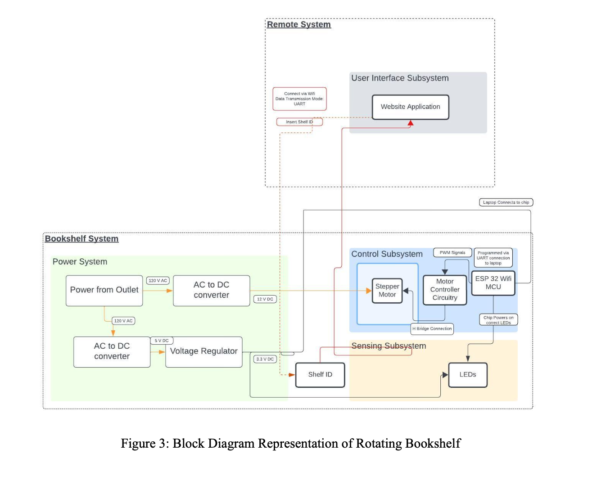
Block Diagram
5
Notes:
Atharv – Power
Vraj – Control
Kashyap - Remote

Slide 6
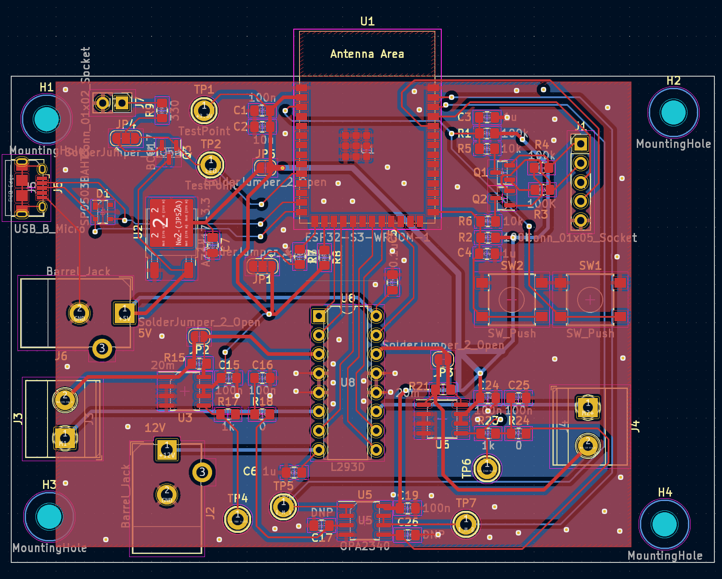
PCB Schematic
6
Notes:
Atharv – Power
Vraj – Control
Kashyap - Remote

Slide 7
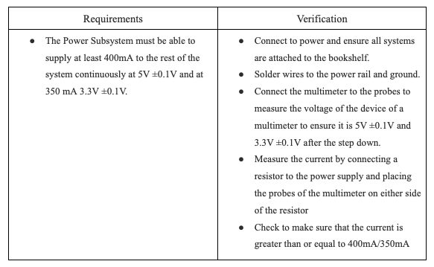
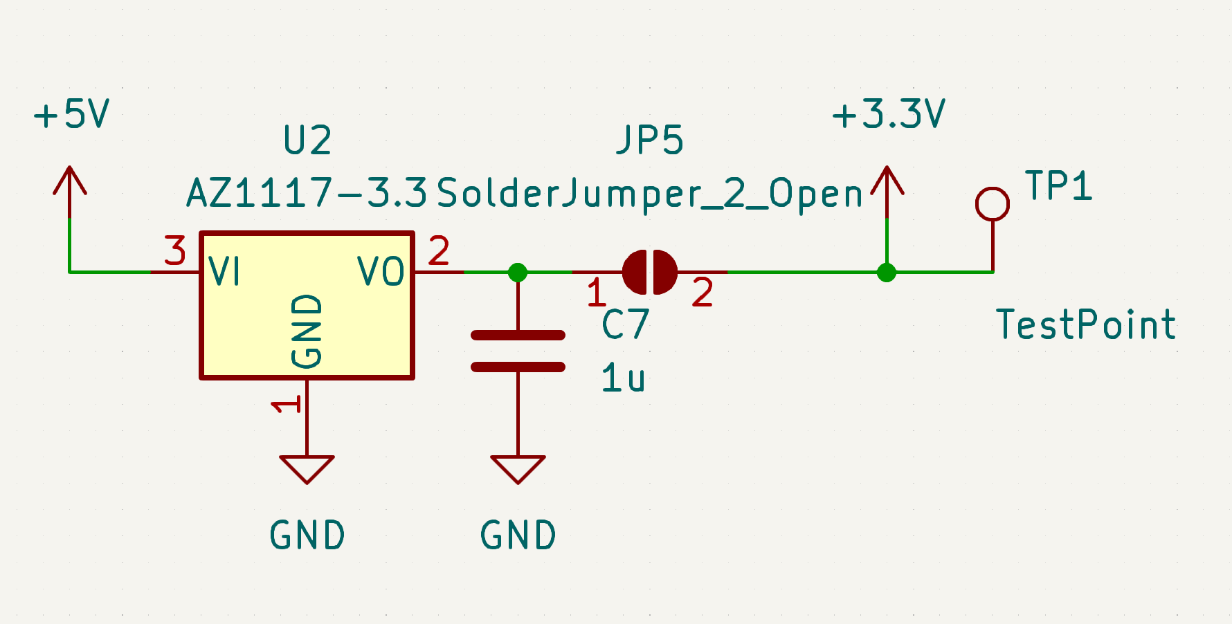
R&V Tables: Power Subsystem
7
Notes:
Vraj

Slide 8
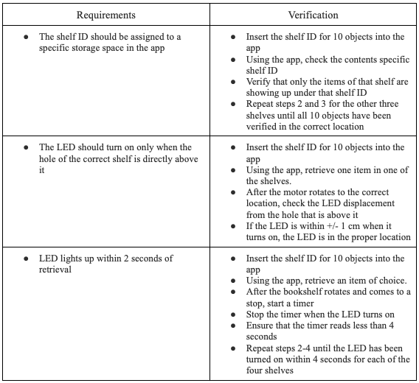
R&V Tables: Sensing Subsystem
8
Notes:
Vraj

Slide 9
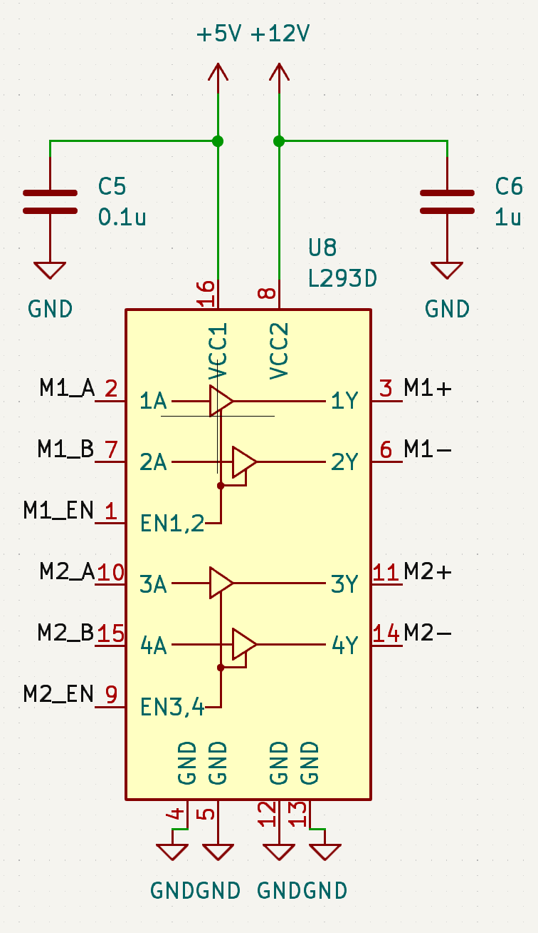
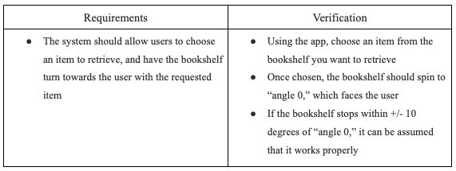
R&V Tables: Control Subsystem(Bookshelf)
9
Notes:
Atharv

Slide 10
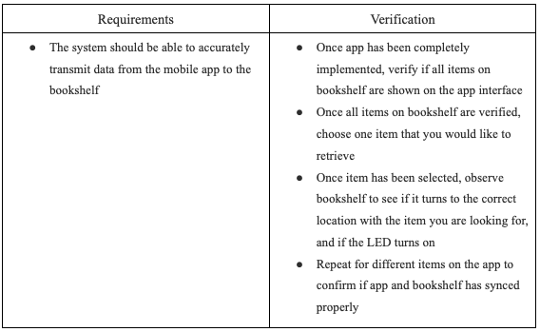
R&V Tables: Control Subsystem(Remote)
10
Notes:
Atharv

Slide 11
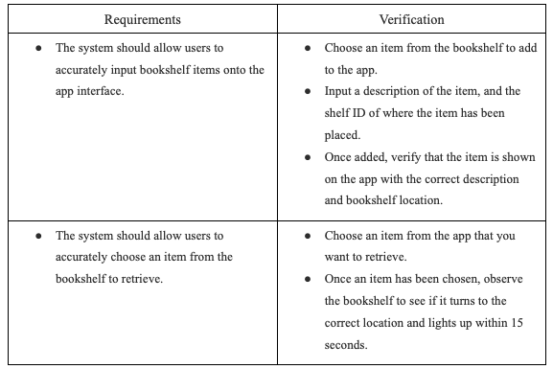
R&V Tables: User Interface Subsystem
11
Notes:
Atharv

Slide 12
Project Update
12
Notes:
All – show the same stuff as the final demo

Slide 13
ESP Programming
13
Notes:
Kashyap

Slide 14
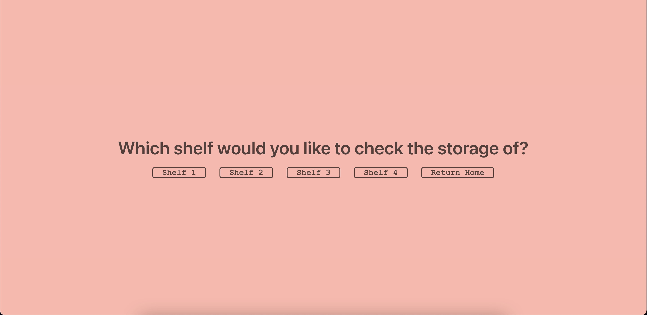
User Interface
14
Notes:
Kashyap

Slide 15
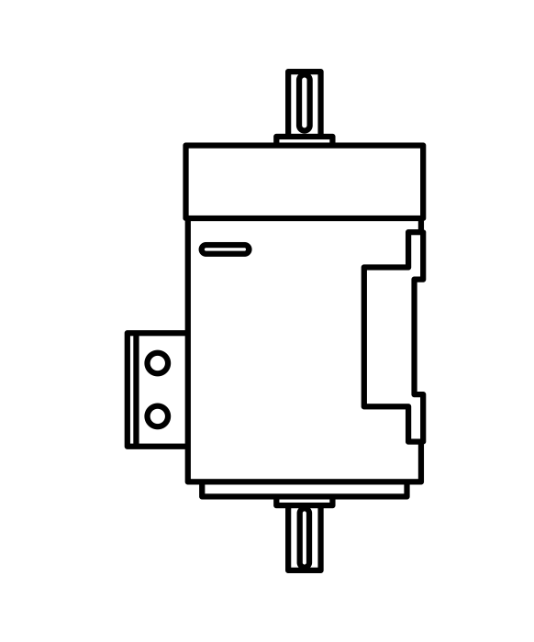
Challenges
PCB Design
ESP32 Function
Motor Issues
Many components on our original design were extremely small and not possible to solder correctly
The ESP32 was inconsistently programming despite multiple soldering attempts, resulting using the breadboard for the final demo
Due to our motor being very old, we faced problems with how smoothly it was rotating
15
Notes:
Kashyap

Slide 16
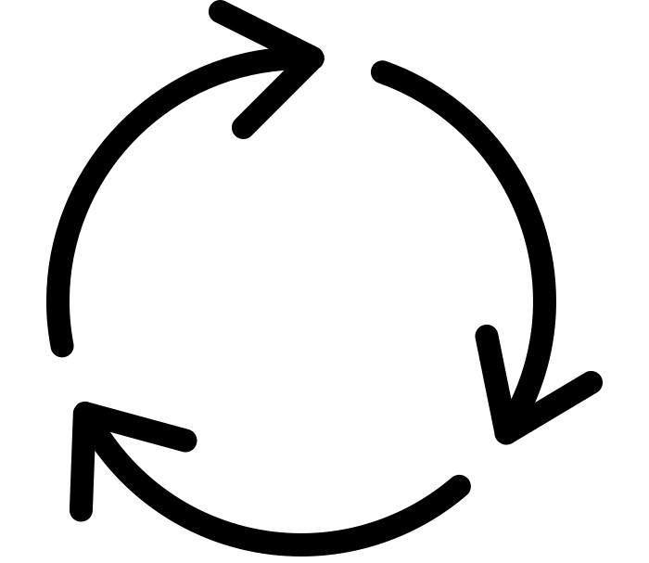
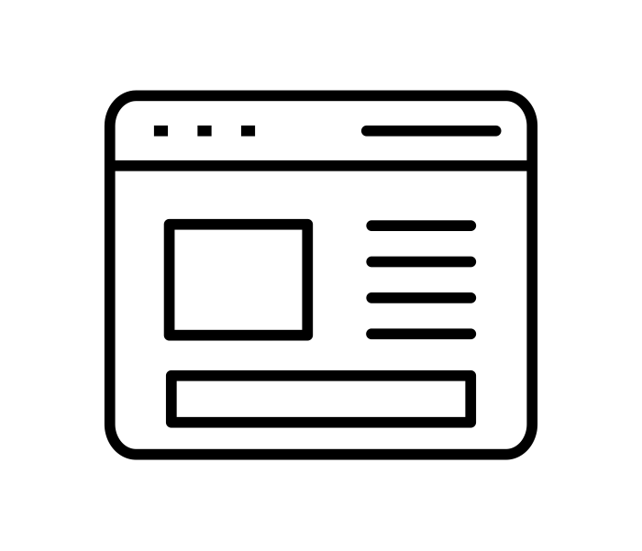
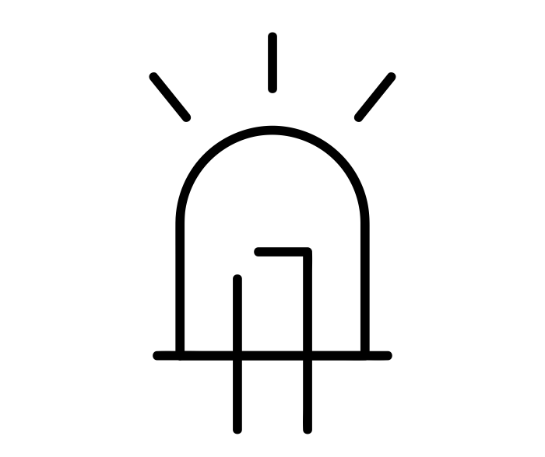
Successes
Bookshelf Rotating
Storage View
LED Illuminating
Once prompted by the user on the website, the bookshelf accurately rotates to the location of the item
Users can accurately view all items on the bookshelf as the website updates in real time
The LED lights up within 2 seconds once the shelf has rotated to the correct location
16
Notes:
Vraj

Slide 17
Conclusions
What we learned…
Project Management
Managing the entire project lifecycle from initial design to testing and iteration taught us how to effectively plan, organize, and execute a project in a specific timeframe
Application of Technical Knowledge
The hands-on experience of building a PCB, designing a web application, and programming Arduino code allowed us to utilize our classroom knowledge in a practical setting
Effective Collaboration
Consistently communicating with each other throughout the project taught us how to best utilize each other’s diverse backgrounds and skills to build a successful project
17
Notes:
Atharv

Slide 18
Further Recommendations
Make the LED face the user or increase its brightness to make it more visible when lit
Add horizontal shelves to separate components within each of the 4 shelves
Create a tab on the website to see items in all shelves at once
18
Notes:
Kashyap

Slide 19
Thank You
Questions?
19
Notes:
Vraj

