Slide 1
Refill Dispensary
Department of Electrical & Computer Engineering
By: Michael Blyakhman, Jackson Wiessing, Lyla Zegelstein
Notes:
Lyla

Slide 2
Who are Jackson, Lyla, Michael?
Notes:
All!

Slide 3
Contents
Introduction
Problem
Solution
Subsystems
UI & Control Unit
Dispensing
Power
PCB
4. Ethics & Safety
5. Improvements
6. Synthesis
Block Diagram
High-Level Requirements
Requirements & Verification
7. Conclusion
Notes:
Lyla

Slide 4
The Problem
Plastic waste is terrible for the environment
It takes 1000s of years for the plastic to decompose
Items often come in large single-use plastic containers.
Users are often forced to purchase a larger quantity than desired
Notes:
Lyla

Slide 5
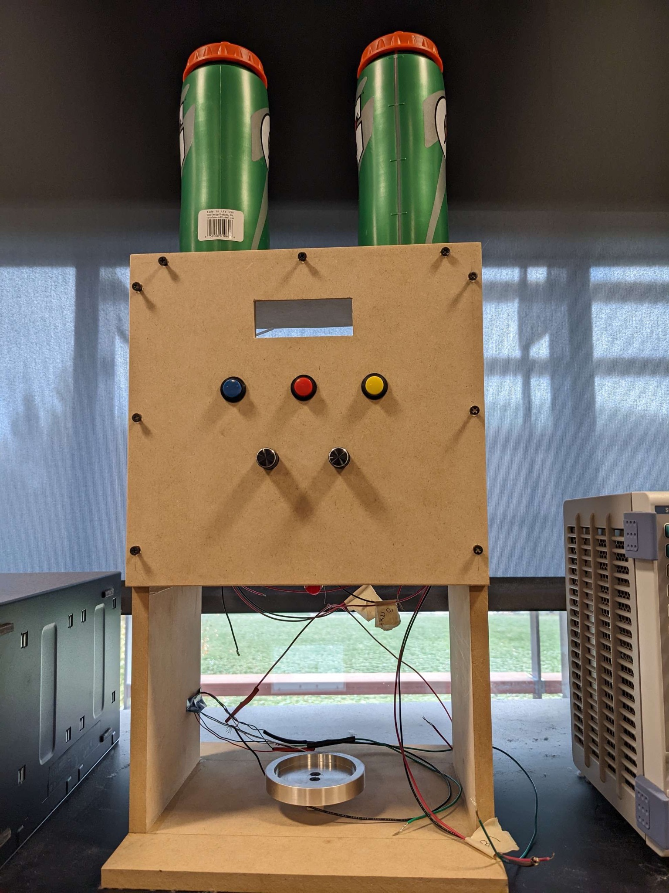
The Solution
A refill machine that allows users to dispense precise quantities of liquid items using their own reusable container
This would reduce the amount of single use plastic items that gets thrown out such as water bottles
Notes:
Lyla
Now, we’re going to build the solution with you

Slide 6
How?

Slide 7
User Interface & Control Unit

Slide 8
Where We Started
Notes:
Lyla
Arduino worked for buttons & potentiometer, but then we later ran into issues when using more involved
Screen issues blah blah blah -> Liquid Crystal Library

Slide 9
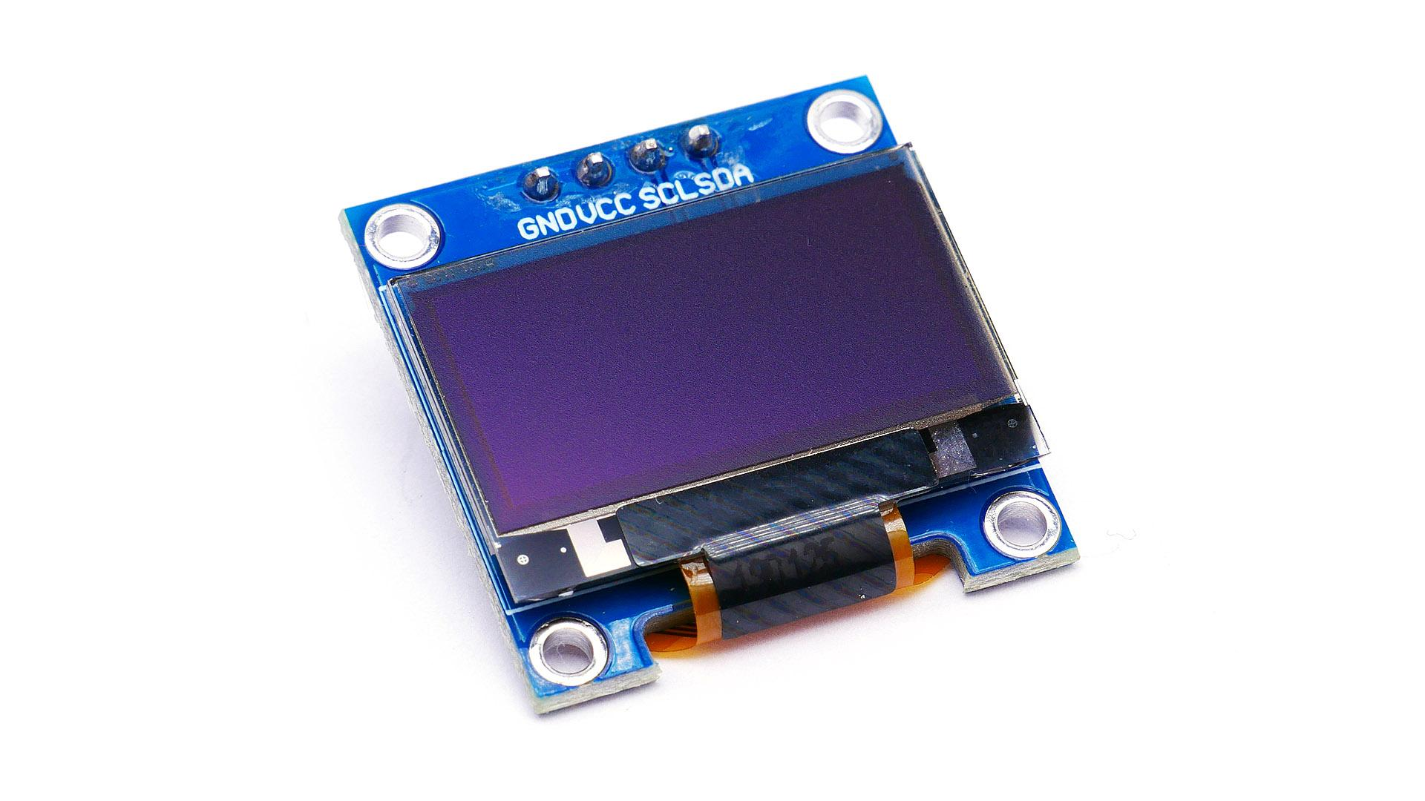
Where We Ended
Notes:
Lyla
Began using micropython etc.
Switched out the screen etc.
Doing section by section and putting things together

Slide 10
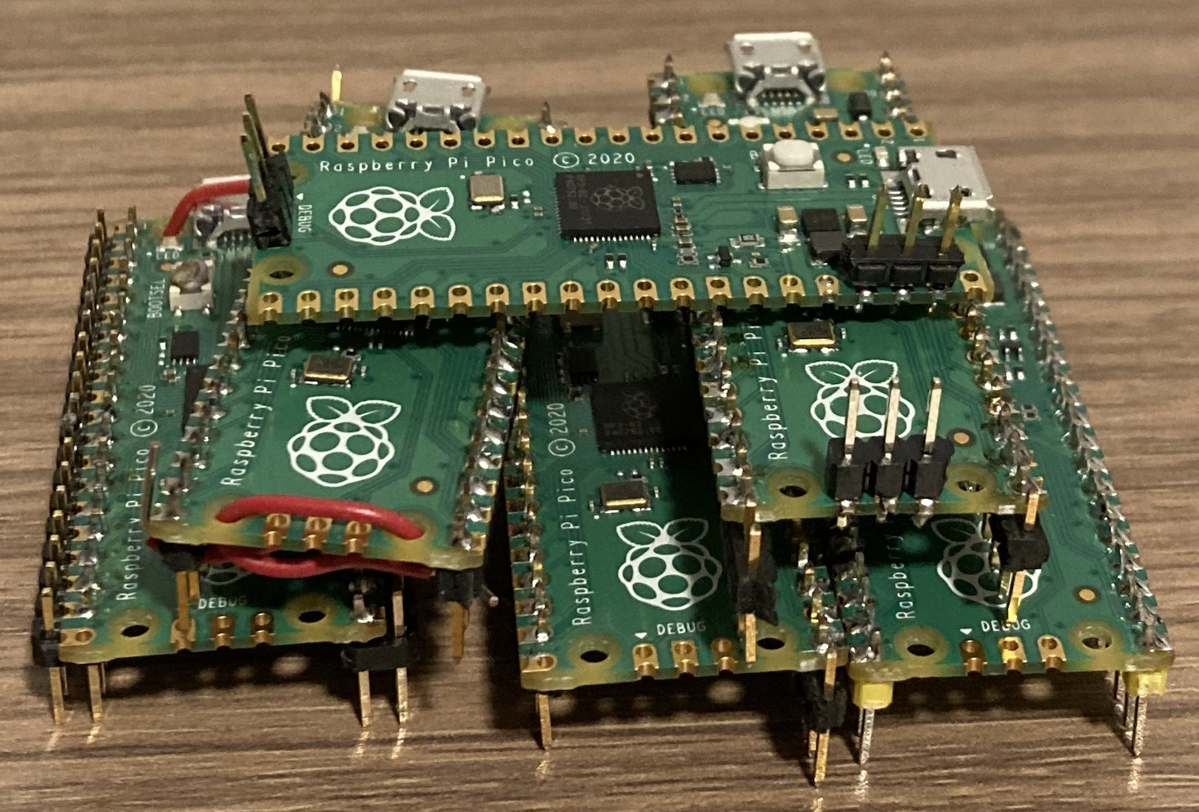
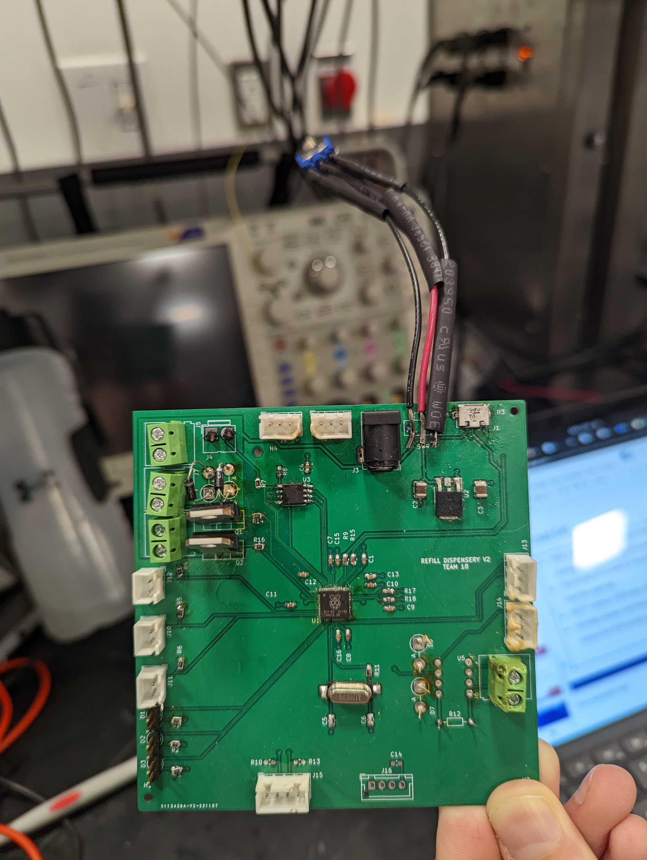
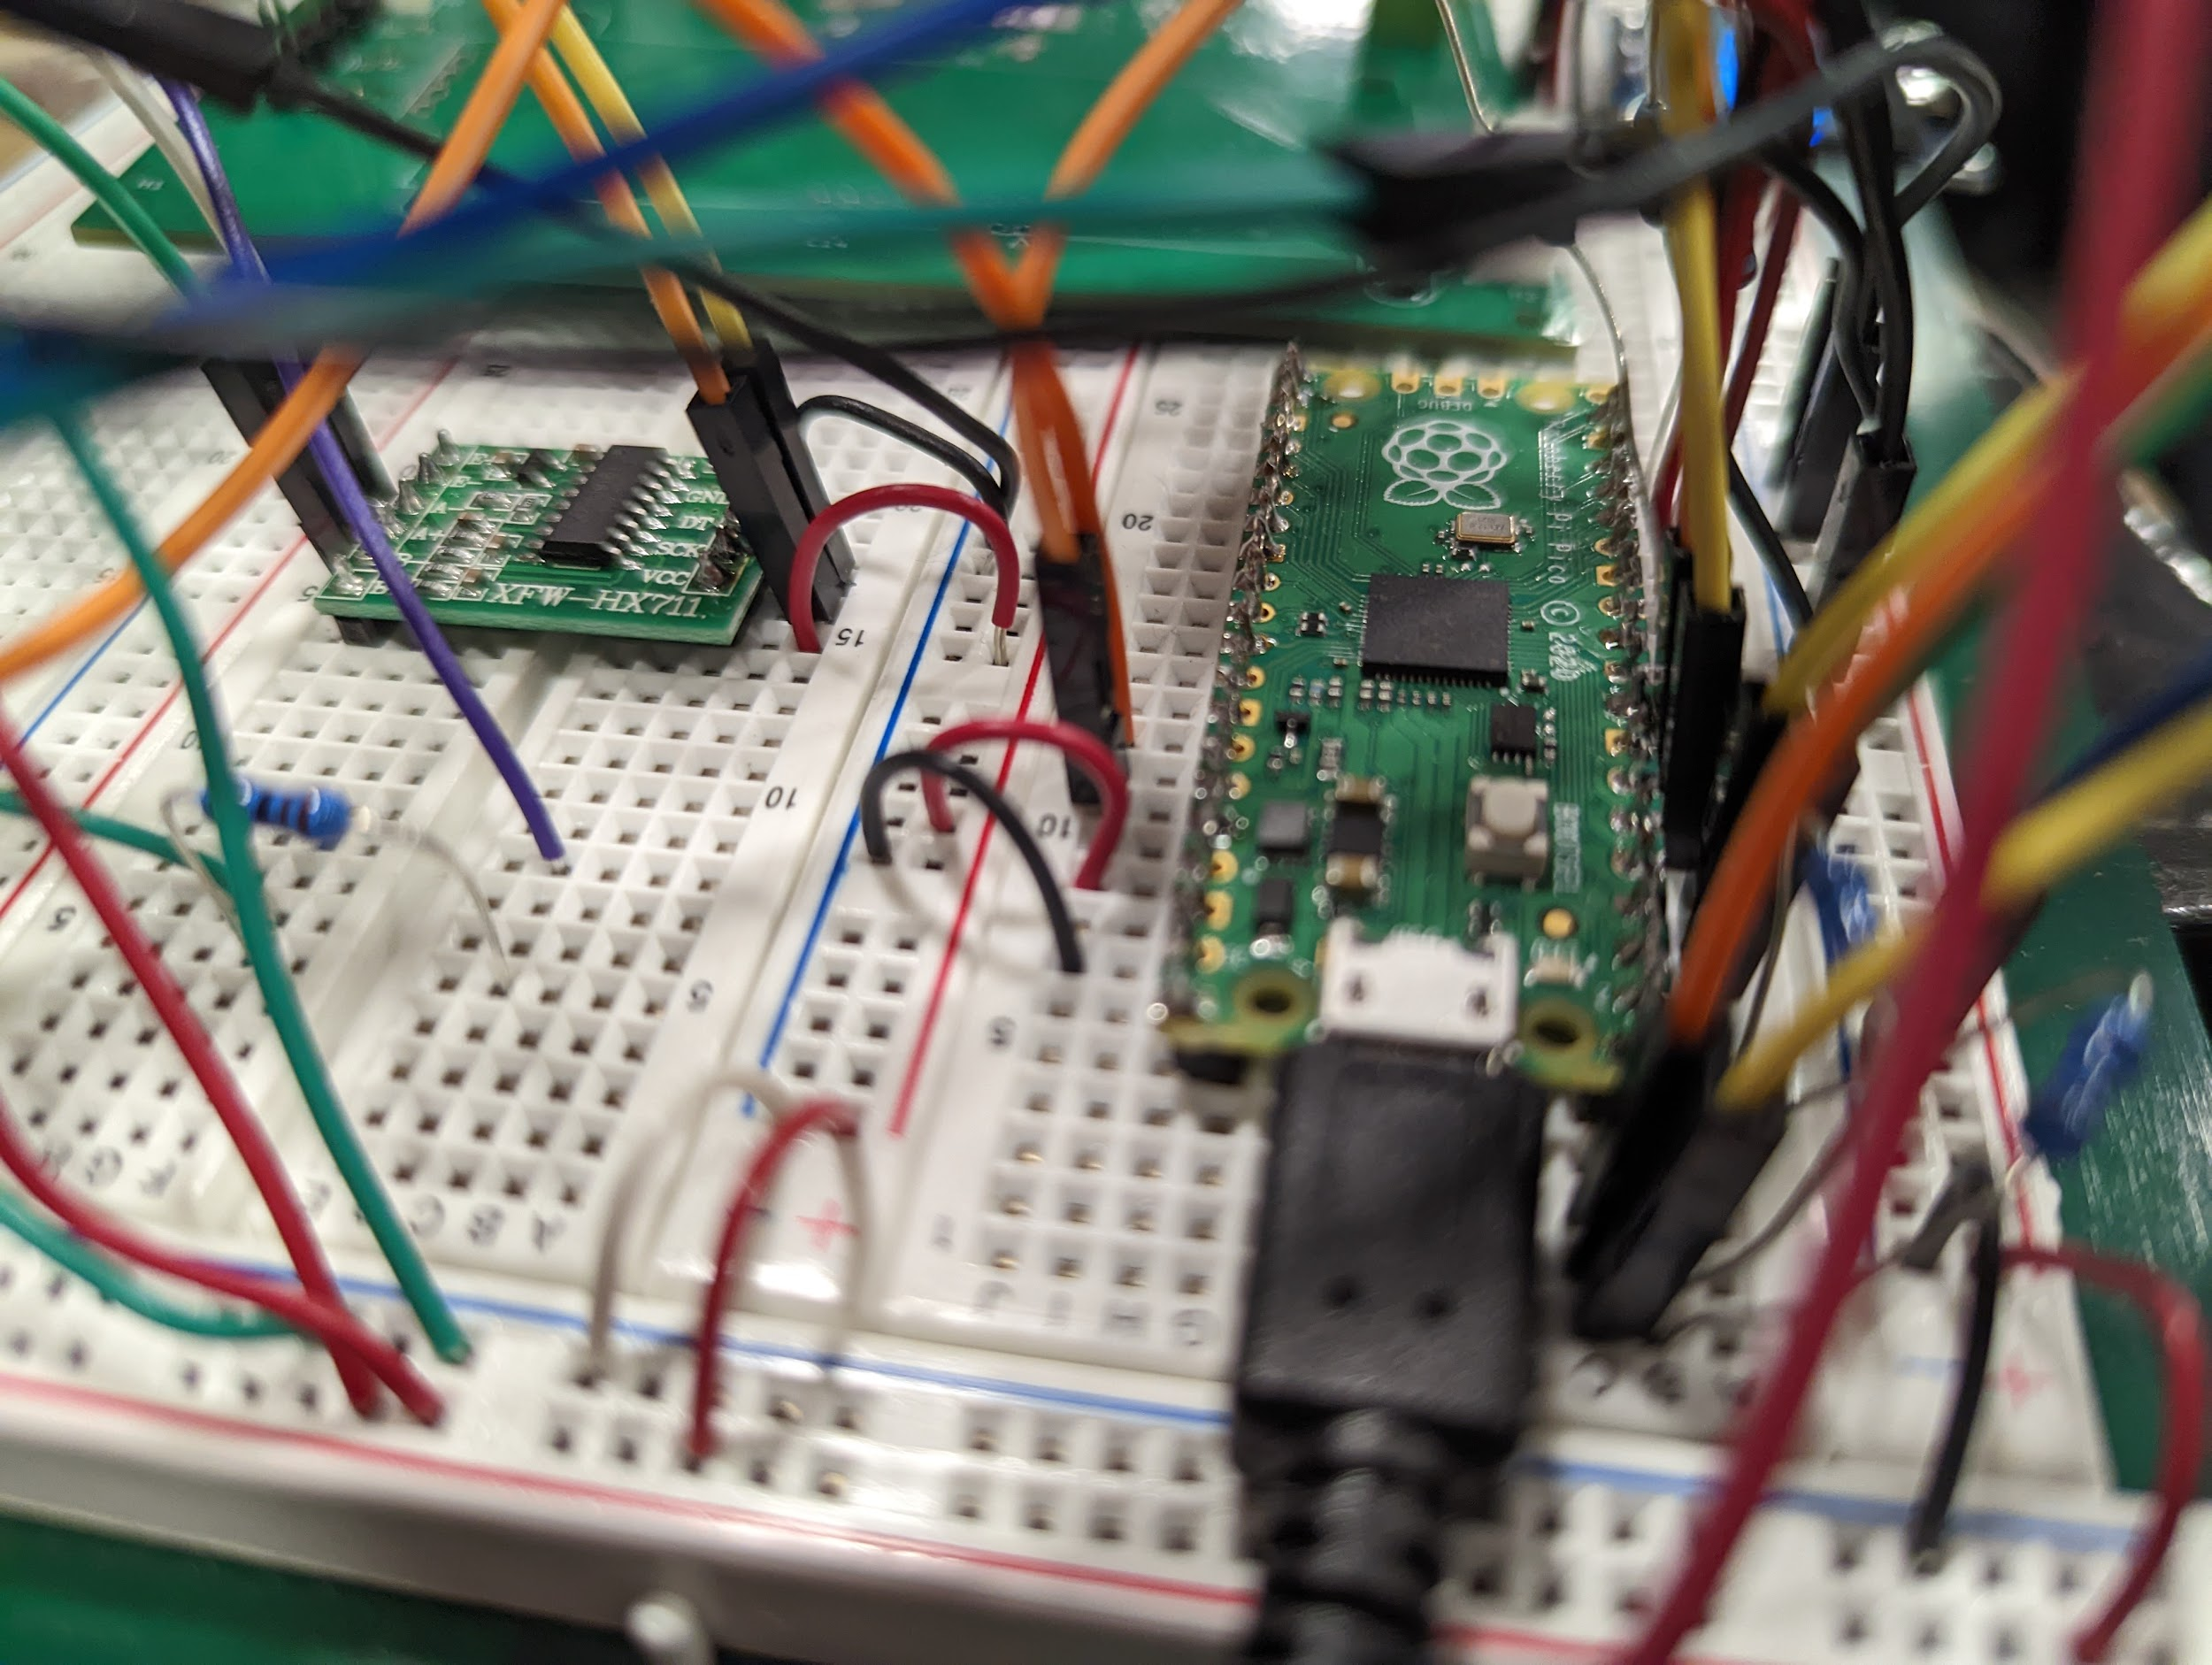
Story Time
Notes:
Lyla & others chime in
The Pico graveyard
The one where the bootsell button got melted (Michael)
That time we tried putting 2 together to try and get debugging software to work (Jackson)
Those couple of times in the beginning that when we didn’t realize that pins meant GPIO pins (Lyla)
It was a great decision to order lots of extras

Slide 11
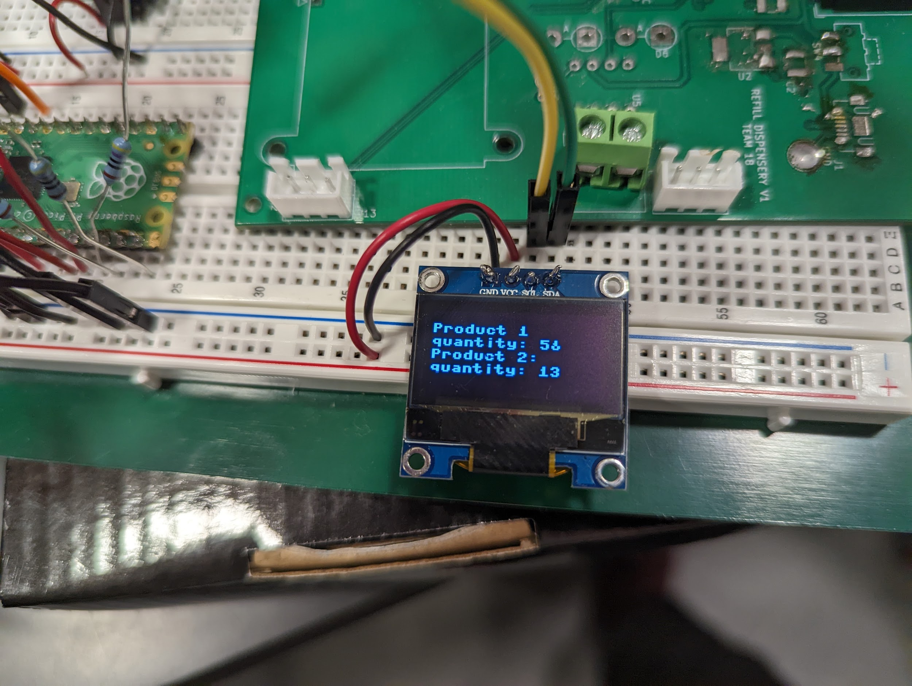
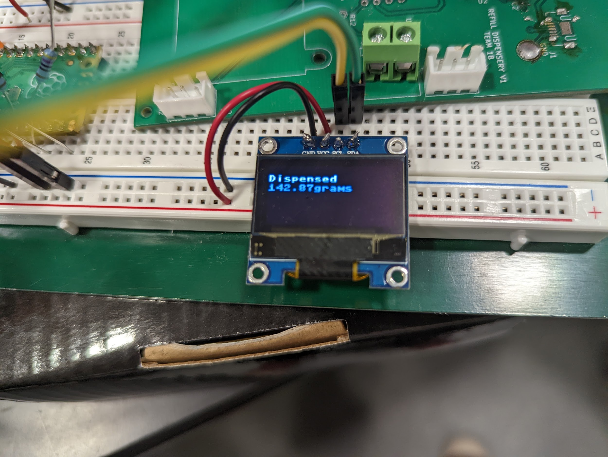
How its going
Notes:
Michael

Slide 12
Dispensing Subsystem

Slide 13
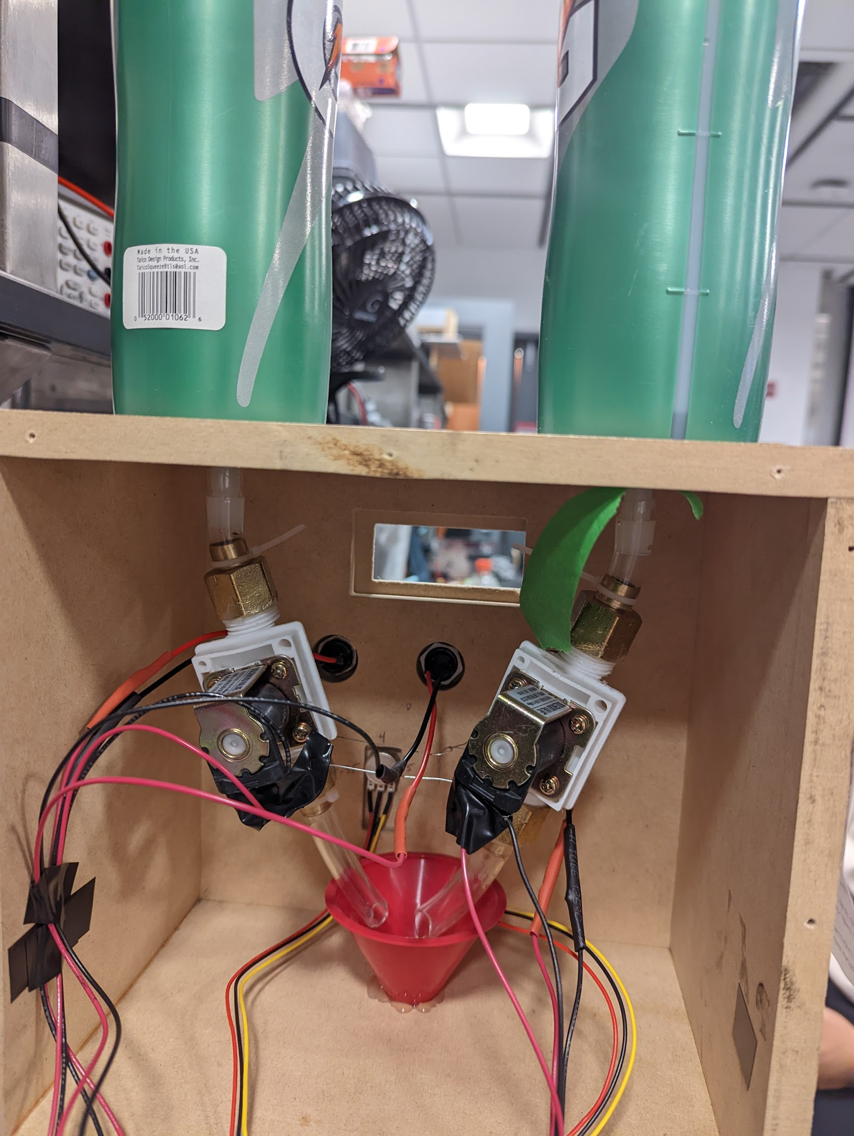
Dispensing System
Notes:
Jackson
The valves with the Pico
Valves were weak, we know they were receiving the full 400mA, but water only came out in a trickle. This could have been caused by an inadequate air release mechanism.

Slide 14
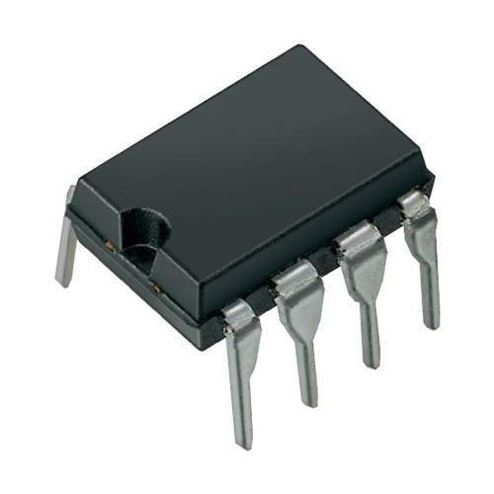
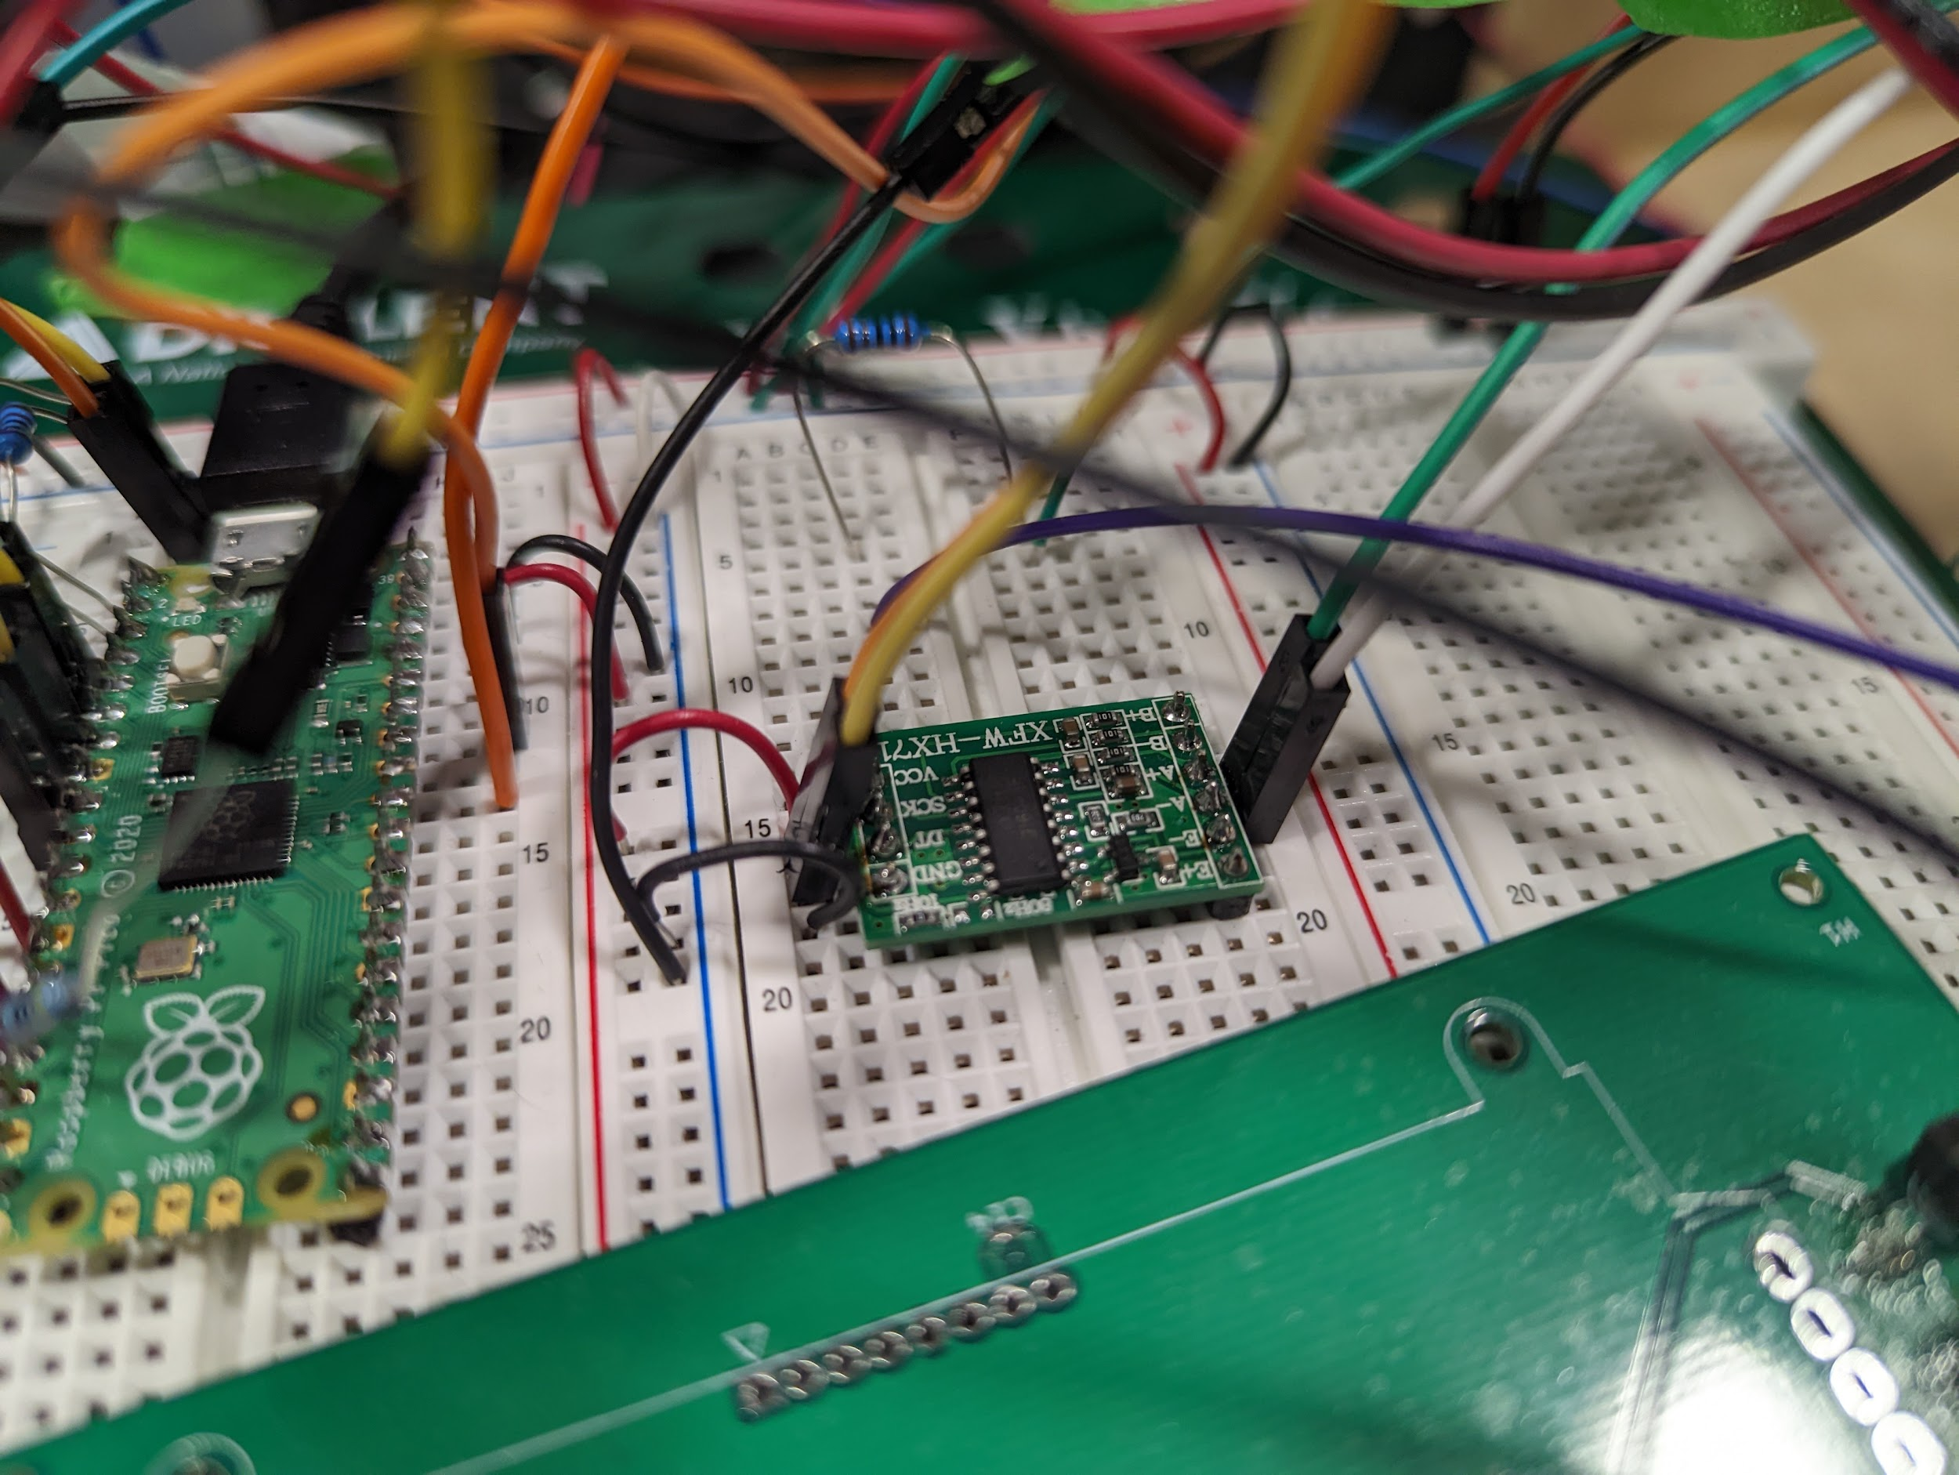
Load Cell
Notes:
Jackson
Switch to HX711 combo ADC and amplifier from AD622
Key part to this project was not running out of ideas
Roll with punches
AD622 amplifier burned out the other components multiple times during testing, despite not having 12V power
This forced us to switch to the Raspberry Pi pico and HX711 amplifier as PCB fried the night before
load cell wires were really small 28-30 awg
HX711 needs 2 GPIO pins, which the final PCB didn’t have
Diodes may have had a turn on voltage that was slightly too high before the PCB burned, preventing the current from being sent to ground

Slide 15
Power & the PCB

Slide 16
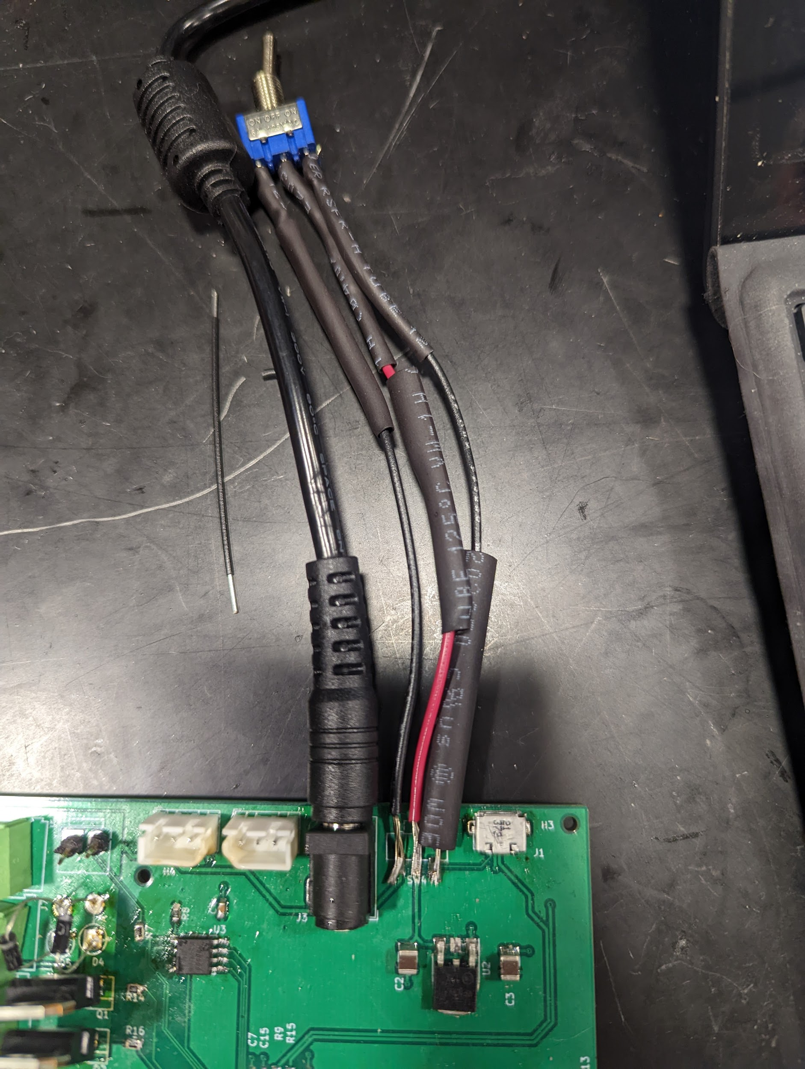
Power
Notes:
Michael
Talk about the components involved and why we chose them
Losing components on the floor & sweeping them up (hahahaha)
Had difficulty getting the board to connect to a computer through USB to flash programs

Slide 17
Voltage Table
Line | Voltage Reading
5V to 3.3V | 3.28974 V
12V to 3.3V | 3.28983 V
12V | 12.0995 V
Notes:
Michael

Slide 18
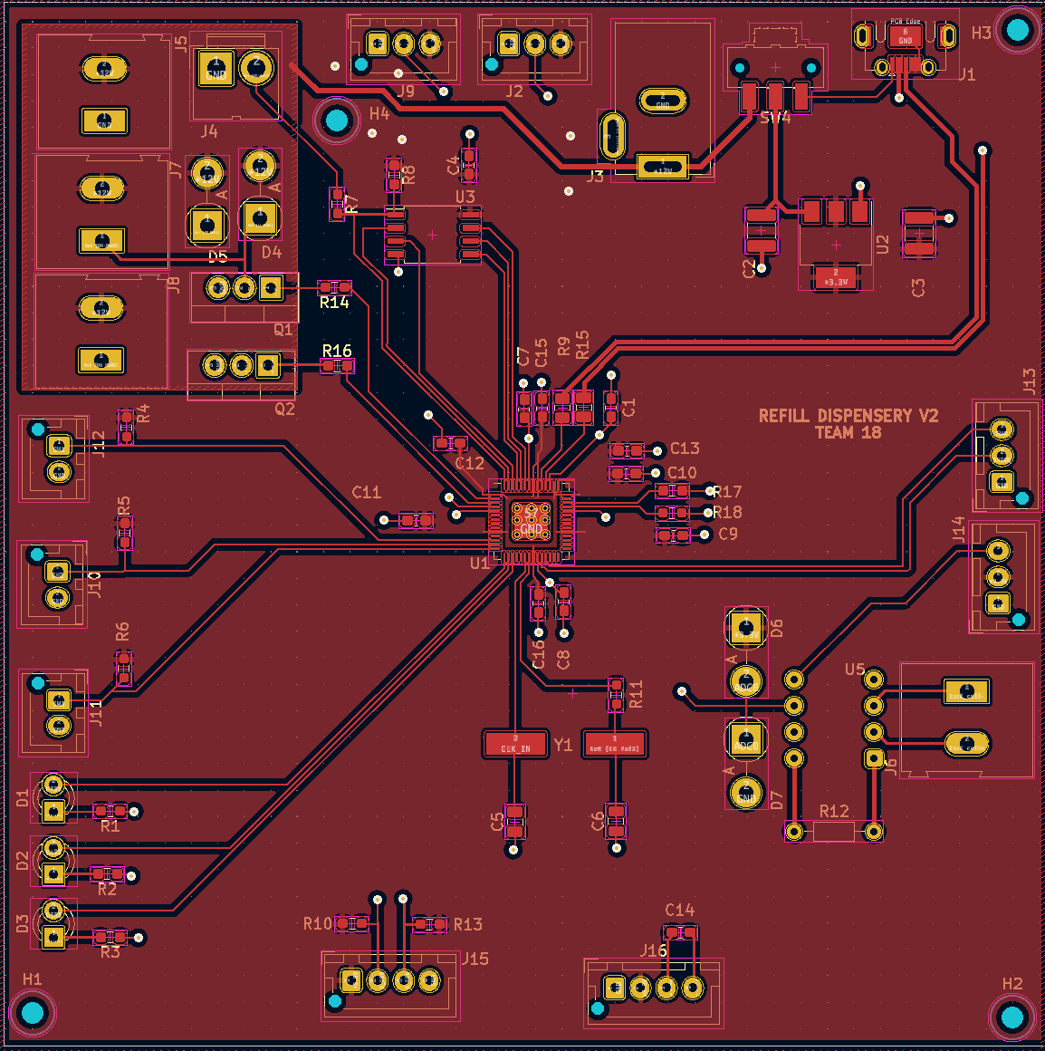
PCB Schematic
Notes:
Jackson
Improvements etc.

Slide 19
Changes to PCB and Other Components
Switched to size 0603 metric SMD components
Moved USB port much closer to the edge so that the cable could be plugged in
Switched from the AD622 amplifier to HX711 as a last resort when the AD622 fried out device.
Notes:
Jackson
HX711 chip

Slide 20
Ethics & Safety

Slide 21
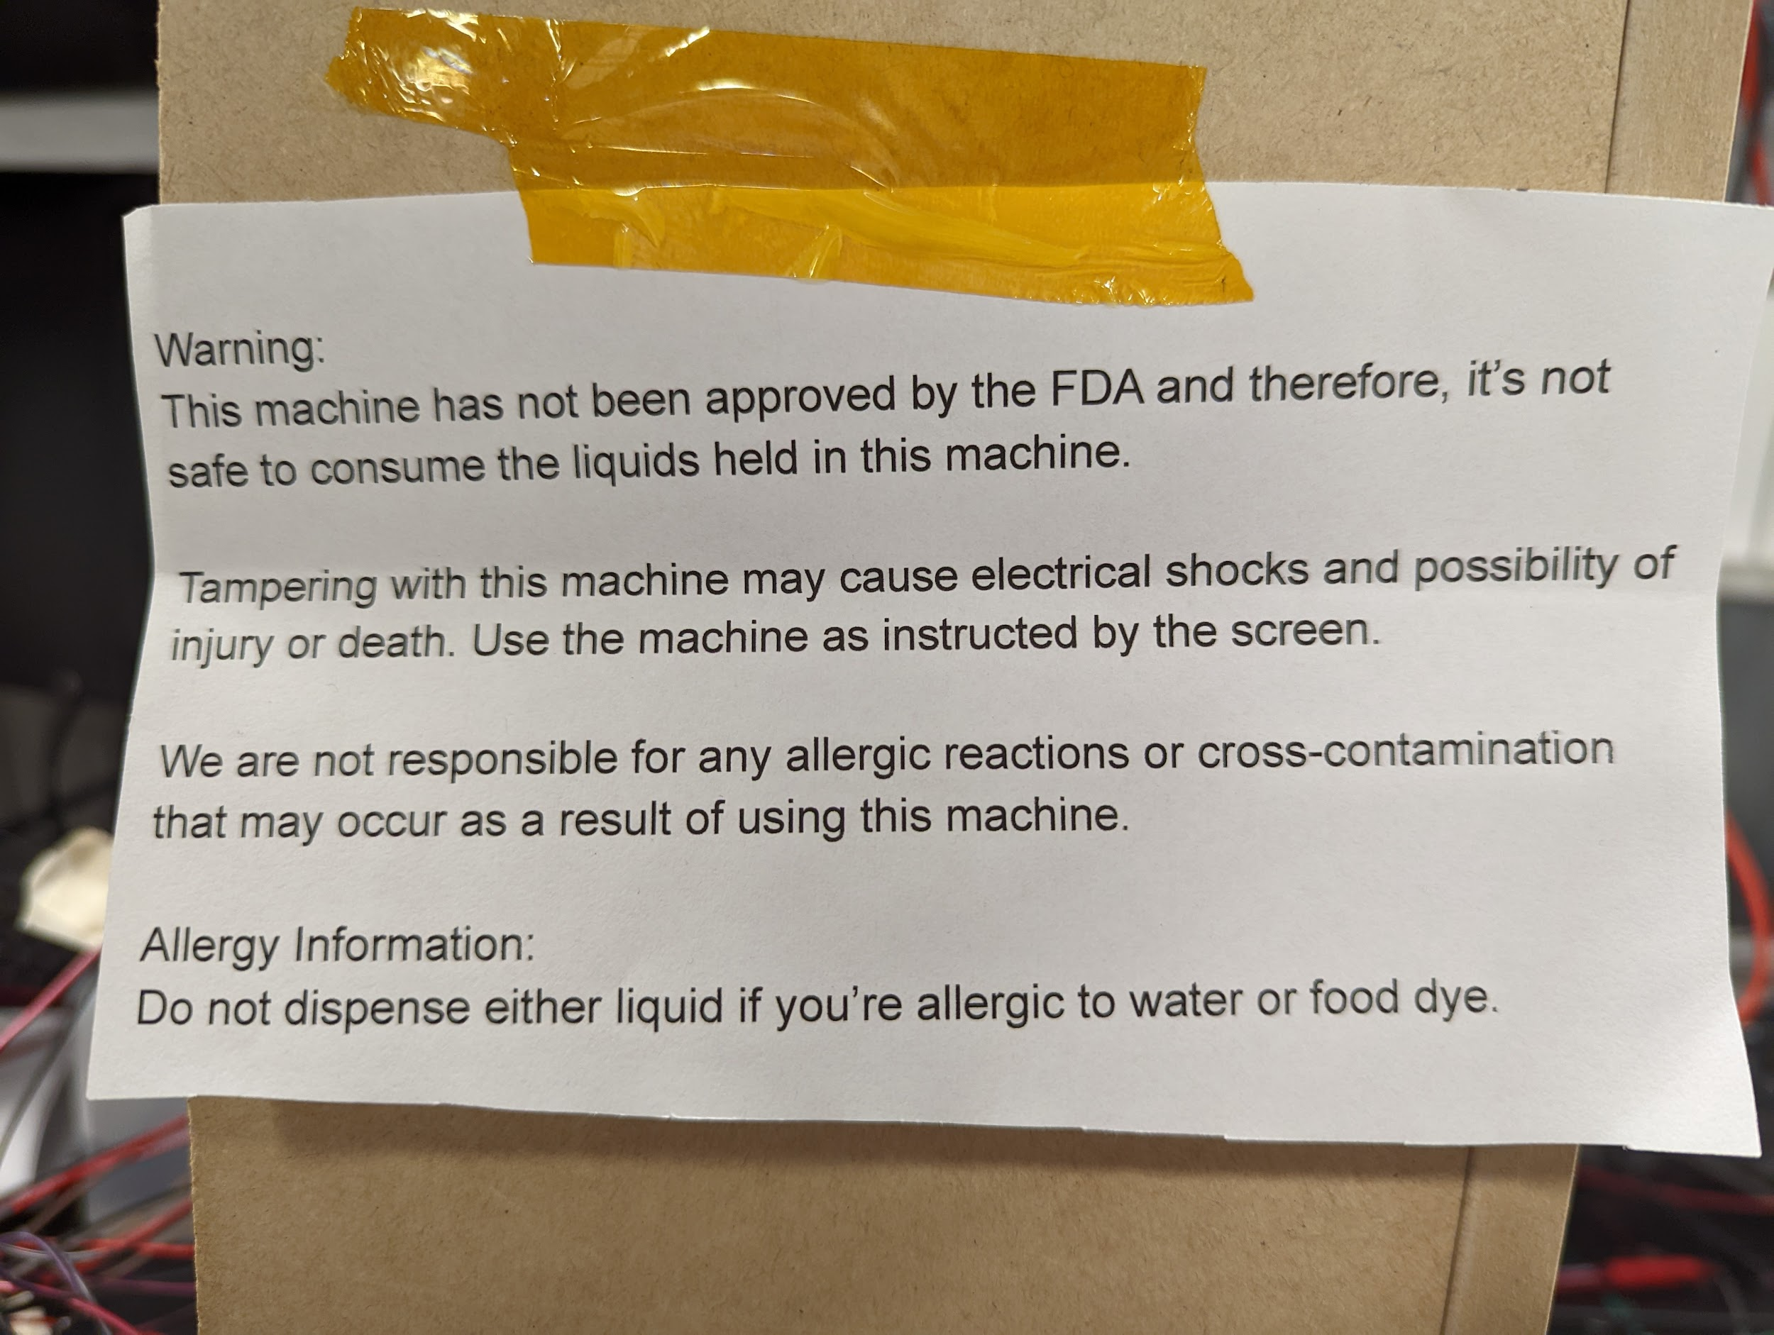
Warning Label
Notes:
Lyla

Slide 22
Improvements

Slide 23
Things We Would Do Differently
Add 2 more GPIO traces on the PCB for the HX711 amplifier
Use more through-hole components to make soldering easier
Allow air to move through the valves to create proper flow
Use a microcontroller with integrated flash to reduce complexity.
Notes:
Michael

Slide 24
Putting It All Together

Slide 25
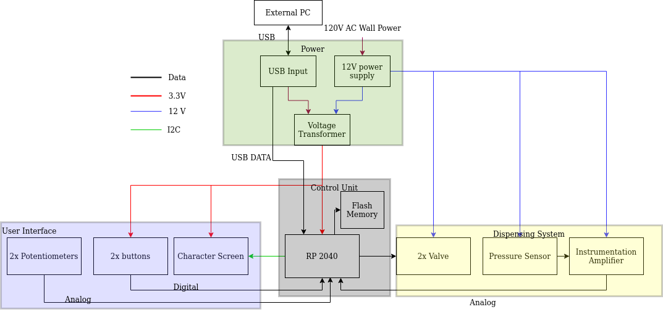
Block Diagram
Notes:
Michael

Slide 26
High-level Requirements
The user is able to choose an item and quantity to get dispensed via buttons and rotary potentiometers. Before placing the order, the user will have some indication of the amount ordered within a tolerance of 10 grams for weights between 0.1 kg and 2kg.
The machine dispenses 2 different types of low-viscosity liquids and is able to perform 2 orders in succession.
The machine can deliver another order properly after 1 of the liquids is switched out or refilled.
Notes:
Michael

Slide 27
RV Results
The screen should use an I2C connection and be capable of displaying the item to be dispensed as well as its quantity with appropriate units. | Yes
Status LEDS should match machine state within 1s of machine state changes | Yes
The machine should dispense the proper item | Yes
The microcontroller ADC should be precise enough to measure 250 unique values from the load cell | Yes
Microcontroller sends proper signals to other subsystems | Yes
Voltage across inductor should always be less than the specified maximum voltage (12V) of the MOSFET | Yes
The load cell should be able to weigh items with a tolerance of 10g for weights up to 5 kg. | Yes
Power supply capable of generating 1A on 12V line at +/- 0.5V | Yes
Notes:
Michael & Jackson

Slide 28
Putting it all together
All subsystems worked together in order to dispense liquid orders
All requirements were met
We were able to overcome the difficulties we faced while building the vending machine
Notes:
Lyla

Slide 29
Thank You!
Notes:
Lyla

