Slide 1
Automatic Light Switch
Team 71
Sangsun Lee, Ruize Sun, Andrew Kim
May.6th, 2025

Slide 2
Introduction
Problem statement
ELECTRICAL & COMPUTER ENGINEERING
GRAINGER ENGINEERING

Slide 3
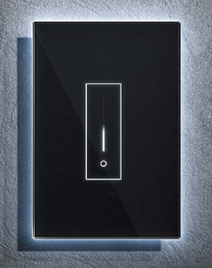
Introduction
Problem Statement
- People who have disabilities or just lazy like me might find it troublesome to get up and turn the light switch on/off
- Idea came from when I was trying to sleep and forgot to turn off my light.
- Renters and homeowners can’t enjoy the luxury of smart light switch, because of challenges such as complex wiring, the need for permanent modifications, or restrictions imposed by landlords.
IMAGE / GRAPHIC
ELECTRICAL & COMPUTER ENGINEERING
GRAINGER ENGINEERING

Slide 4
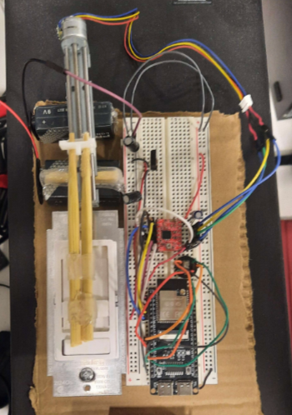
Introduction
Our Solution
- Automatic Light Switch that is designed to be mounted over an existing Dimmable Light Switch.
- Connect through WIFI (Over long distance)
- App and Web-interface application which gives users 5 different levels to adjust the light level
ELECTRICAL & COMPUTER ENGINEERING
GRAINGER ENGINEERING

Slide 5
Block Diagram
High Level Introduction
ELECTRICAL & COMPUTER ENGINEERING
GRAINGER ENGINEERING

Slide 6
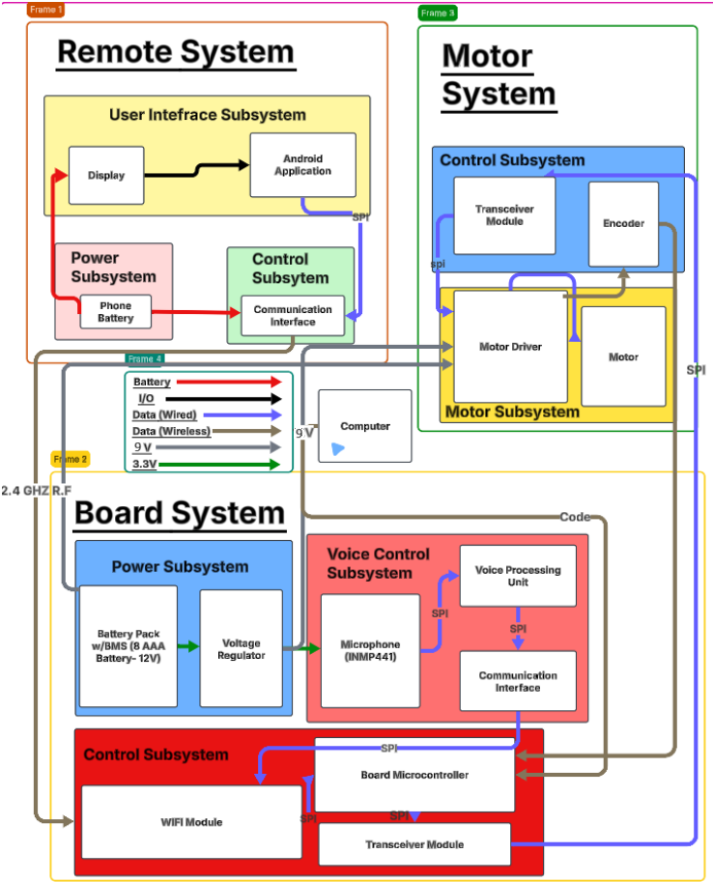
Block Diagram
ELECTRICAL & COMPUTER ENGINEERING
GRAINGER ENGINEERING

Slide 7
Subsystem Overview
Detailed Introduction
ELECTRICAL & COMPUTER ENGINEERING
GRAINGER ENGINEERING

Slide 8
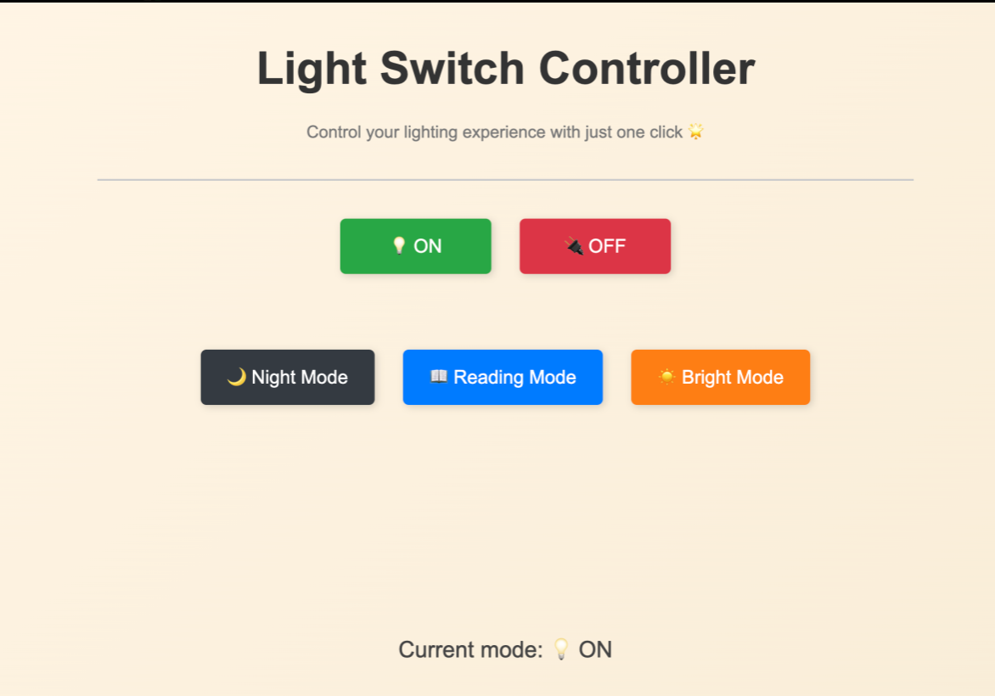
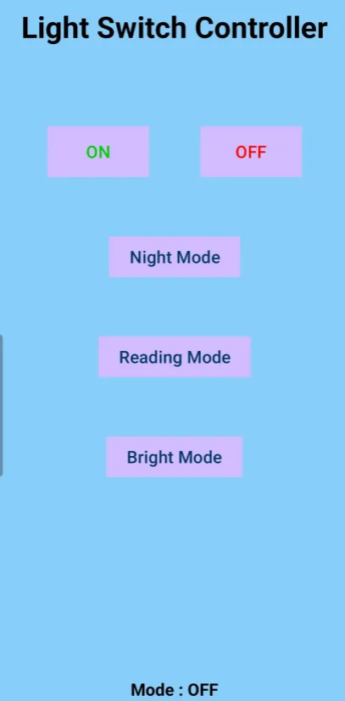
Subsystem Overview
Remote System
- Web client (app/website) communicates with ESP32-S3 Wi-Fi subsystem
- Have 5 different levels, which the user can select
- Shows the current status of the light switch
- When the level is selected, the app/website sends an HTTP post request to the ESP32-S3’s IP Address over a local WIFI Network.
ELECTRICAL & COMPUTER ENGINEERING
GRAINGER ENGINEERING

Slide 9
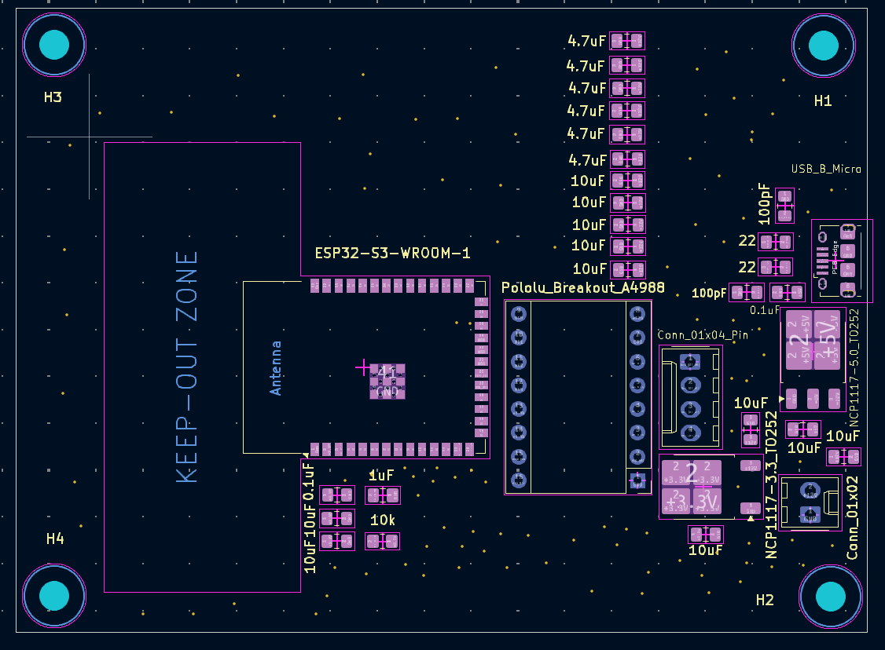
Subsystem Overview
Board System
- Used LDO to convert 9v battery to 5V, which powers the ESP32
- The ESP32 converts the 5v to 3.3v for the motor driver.
- ESP32 processes data sent from the user-interface in the remote system and commands motor driver to adjust the location of the switch handle based on user input.
ELECTRICAL & COMPUTER ENGINEERING
GRAINGER ENGINEERING

Slide 10
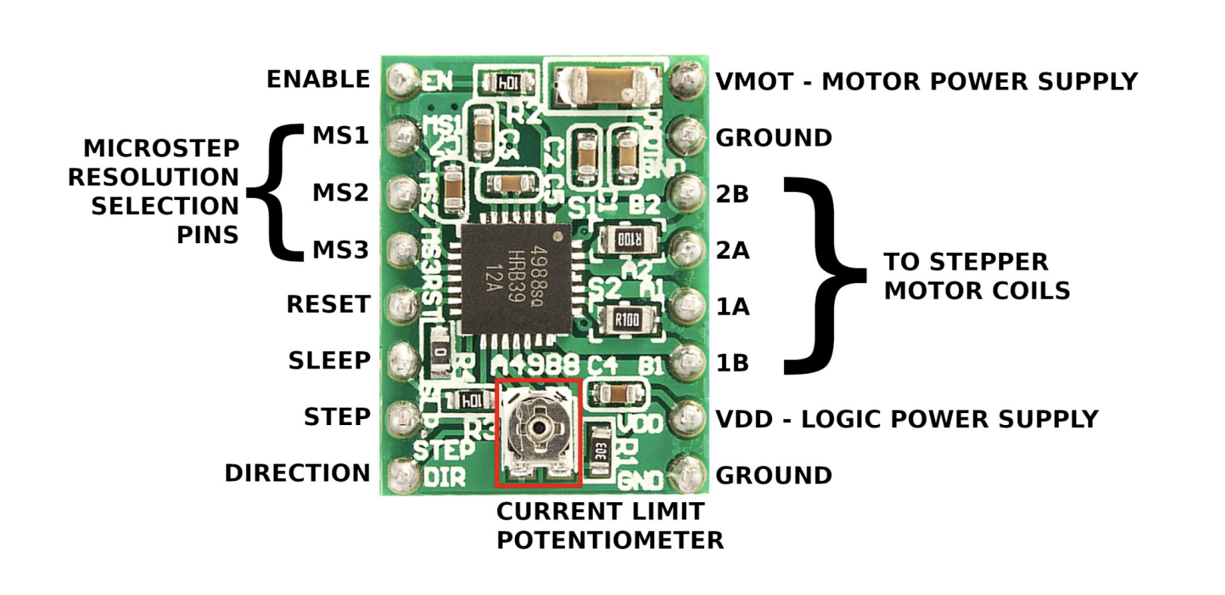
Subsystem Overview
Motor System
Upon receiving a level command, the algorithm inside ESP32 programming will calculate the required number of motor steps and directions, driving the stepper motor through A4988 (Stepper motor driver).
Using the Lead-screw mechanism, we convert rotational motion to linear motion
Pin
MS1 MS2 MS3 | Microstep selection – sets the stepping resolution
STEP | each pulse moves the motor one microstep
DIR | High (clockwise) Low (anti clockwise)
VMOT | Motor power supply (9V)
VDD | Logic power supply (3.3V)
Include image of just the Motor mechanism and motor driver
ELECTRICAL & COMPUTER ENGINEERING
GRAINGER ENGINEERING

Slide 11
Requirements and Verifications
High level requirements and verifications with results
ELECTRICAL & COMPUTER ENGINEERING
GRAINGER ENGINEERING

Slide 12
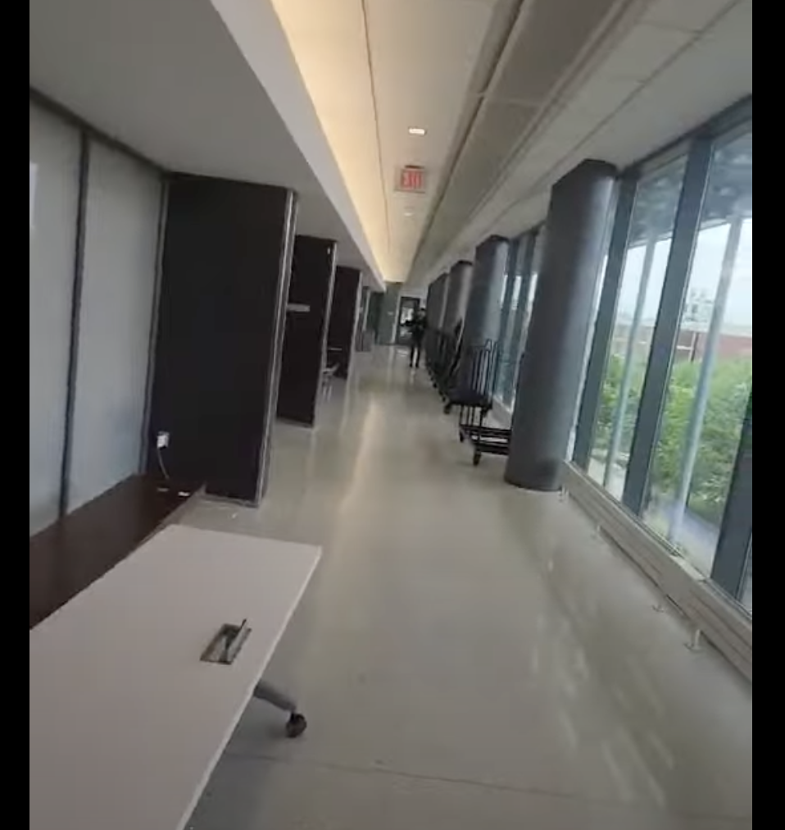
Requirements and Verifications
Remote System
Requirement:
Microcontroller used must be able to receive signals with little latency, ideally under 1 second.
User can send commands to the ESP32-S3 over a distance of 30 meters
Verification:
After connecting application/website to ESP32 through WiFi module, measure the latency between sending signals from application/website and receiving signals at ESP32 by checking motor status.
Person stands 30 meters away from the product
Test Results:
- 0.5 sec
- Shown in Demo video
Put the video of the person standing 30 feet away
ELECTRICAL & COMPUTER ENGINEERING
GRAINGER ENGINEERING

Slide 13
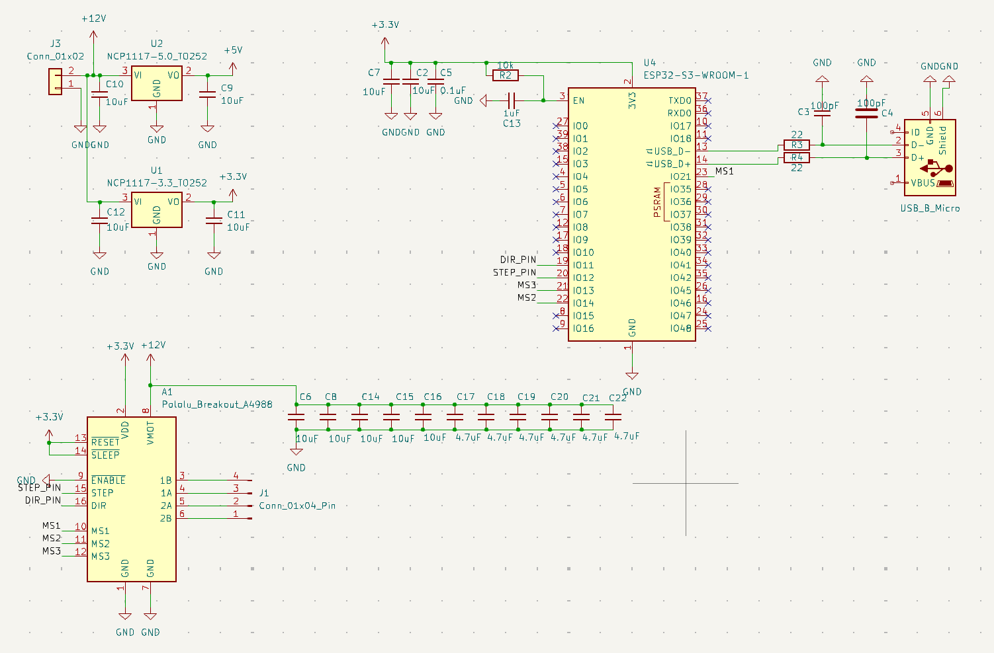
Requirements and Verifications
Board System
Requirement:
- The power output ripple should be lower than 50mV
(5V) / 100mV (9V) to avoid affecting the ESP32 and make it work stable.
- The voltage supply of the ESP32 should be bigger than 4.9v to ensure the ESP32 can start.
Verification:
Use an oscilloscope to measure the power ripple to ensure that the ripple voltage is within the required range.
Use an oscilloscope to measure the pin of the power supply of the ESP32
Test Results:
- Power subsystem supply: Expected = 9V, Actual = 8.97V (Within 0.5V)
- Logic voltage supply: Expected = 3.3V, Actual = 3.28V (Within 0.1V)
ELECTRICAL & COMPUTER ENGINEERING
GRAINGER ENGINEERING

Slide 14
Requirements and Verifications
Motor System
Requirement:
- The motor shall achieve an angular precision of ±1° to ensure accurate switch control
Verification:
- Compare actual motor rotation angle (via
encoder) with the expected angle for multiple test cases
Test Results:
- The difference was only 10 to 20 degree by measuring the distance of how much the switch moved.
Direction | MS1 MS2 MS3 | Expected angle and direction | Actual angle and direction
1 —> 3 | High High Low | 1080 | 1069
3 —> 2 | High High Low | 540 | 548
2 —> 5 | Low Low High | 1620 | 1635
Experimental data
ELECTRICAL & COMPUTER ENGINEERING
GRAINGER ENGINEERING

Slide 15
Video Illustration
https://www.youtube.com/embed/Mt8oAYyj7Cs

Slide 16
Challenges
Challenges met during design process
ELECTRICAL & COMPUTER ENGINEERING
GRAINGER ENGINEERING

Slide 17
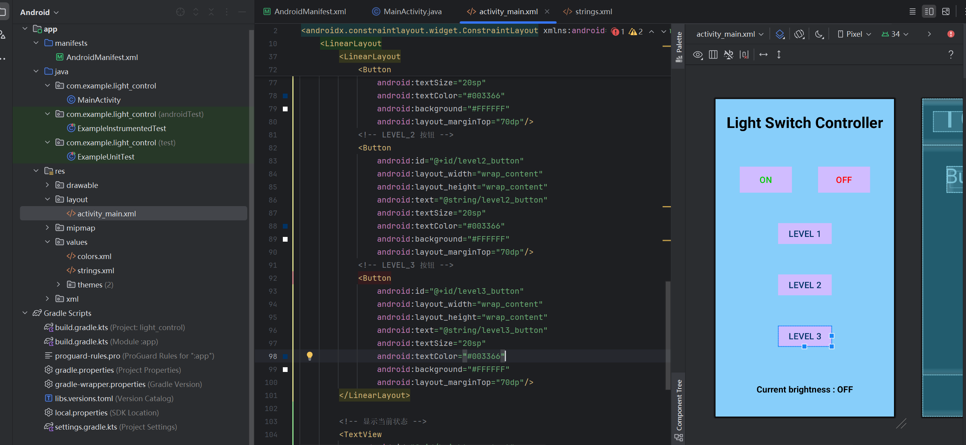
Challenges
PCB Design
The components are small and difficult to solder, which can easily lead to short circuits
Software
We have never studied software development and web design, so we needed to start from the basics, including XML and JAVA, HTML, CSS, JavaScript.
ELECTRICAL & COMPUTER ENGINEERING
GRAINGER ENGINEERING

Slide 18
Conclusion
A Reflection on our project
ELECTRICAL & COMPUTER ENGINEERING
GRAINGER ENGINEERING

Slide 19
Conclusion
- Successful connection between application and website to ESP32 using WiFi
- Programmed instructions for ESP32 using Arduino depending on HTTP server input
- Integrated multiple subsystems: Bi-directional motor control, power regulation, User-interface application (App, Website), WIFI
- Gained hands-on experience with PCB design, embedded programming, and system integration.
ELECTRICAL & COMPUTER ENGINEERING
GRAINGER ENGINEERING

Slide 20
Future Improvements
Improve Mechanical Design
-Using Solidworks, develop a better CAD Model for all light switch
-More accurate object detection and edge recognition
-Enable table mapping and path planning
Successful Voice Control
-Research more about possible microphone modules to use that can be integrated with the ESP32 and voice module successfully
-Develop our own voice module that fits our light switch design
Monitor for Current Status
-Enhance user interaction and flexibility through wireless connectivity and mobile interface
-Develop a mobile app or web interface for users to start, pause, or stop cleaning cycles remotely
ELECTRICAL & COMPUTER ENGINEERING
GRAINGER ENGINEERING

Slide 21
Thank you! Q&A
ELECTRICAL & COMPUTER ENGINEERING
GRAINGER ENGINEERING

