Slide 1
Line Operated Variable Voltage Power Supply
Team 53:
Cesar Mejia, Feroze Butt and Kevin Funkhouser

Slide 2
Agenda
Agenda
Overview
Design
PCB Design
Results
Troubleshooting
ELECTRICAL AND COMPUTER ENGINEERING

Slide 3
Overview
ELECTRICAL AND COMPUTER ENGINEERING

Slide 4
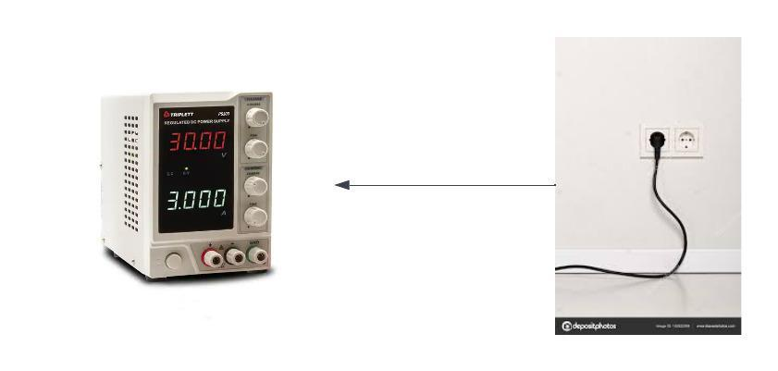
Overview
Problem
Many low-cost bench power supplies have poor accuracy, reliability, and safety features, which can cause issues for precision circuits and user safety.
Even highly rated bench power supplies on the market, such as the Kungber 30V 10A, have significant performance issues according to user reviews.
Poor power factor and harmonic distortion can also be a problem with low-cost power supplies, leading to potential disruptions and damage to circuits and equipment.
ELECTRICAL AND COMPUTER ENGINEERING

Slide 5
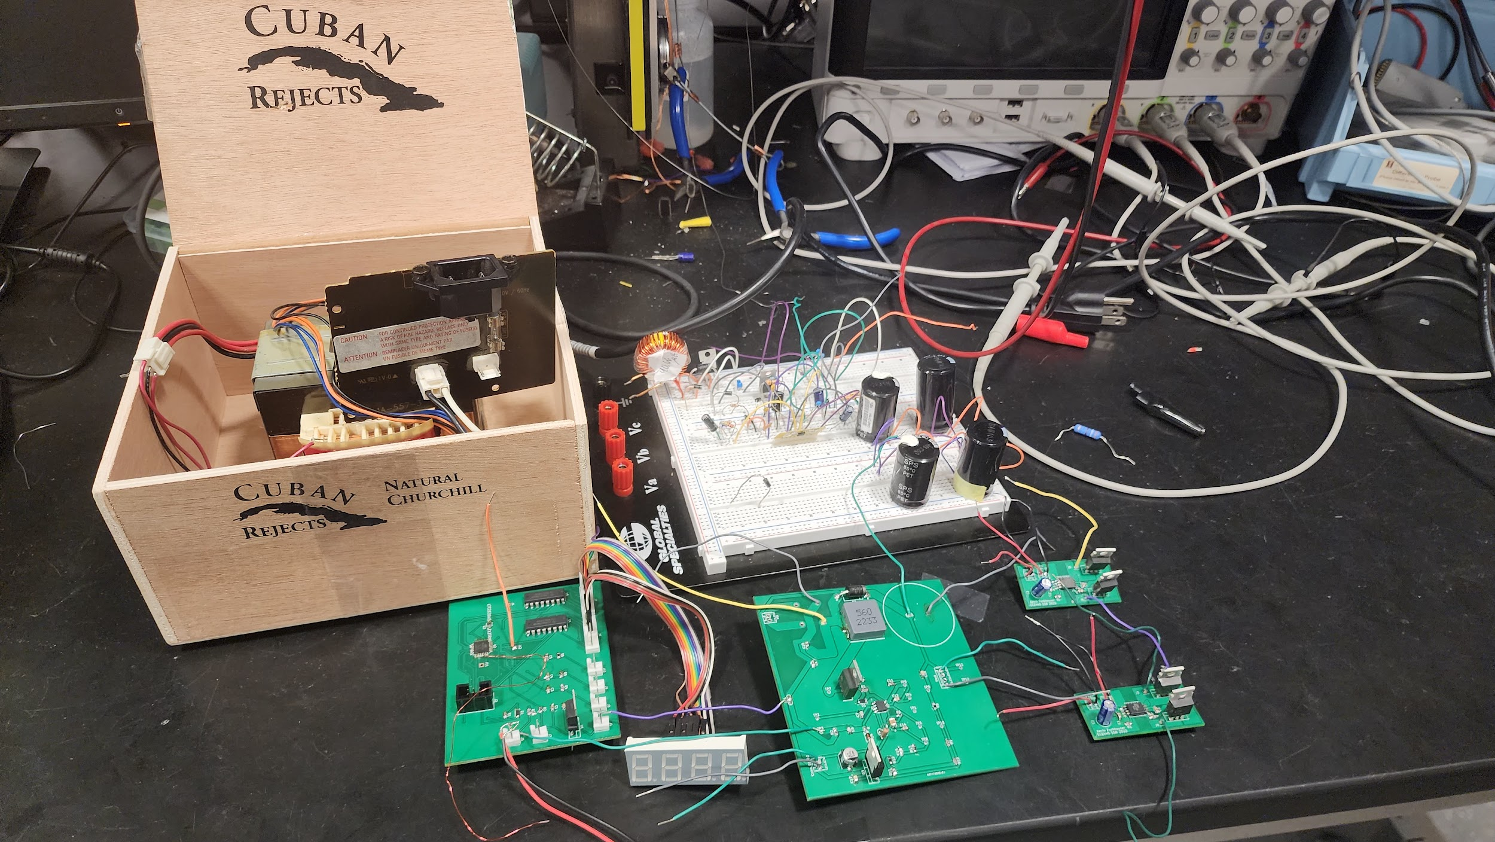
Overview
Solution
A line-operated variable voltage power supply that utilizes switched-mode conversion for high efficiency, isolation, and correction of the power factor and harmonic distortion.
Our goal is to provide a low-cost, accurate, reliable, and safe alternative to existing bench power supplies on the market.
ELECTRICAL AND COMPUTER ENGINEERING

Slide 6
Requirements
High Level Requirements
Power factor greater than 0.9
Meet or exceed IEC 61000-3-2 standards for harmonic current
Deliver 5V to 25V at 50W with 1% accuracy to a static load across the entire voltage range
ELECTRICAL AND COMPUTER ENGINEERING

Slide 7
Design
ELECTRICAL AND COMPUTER ENGINEERING

Slide 8
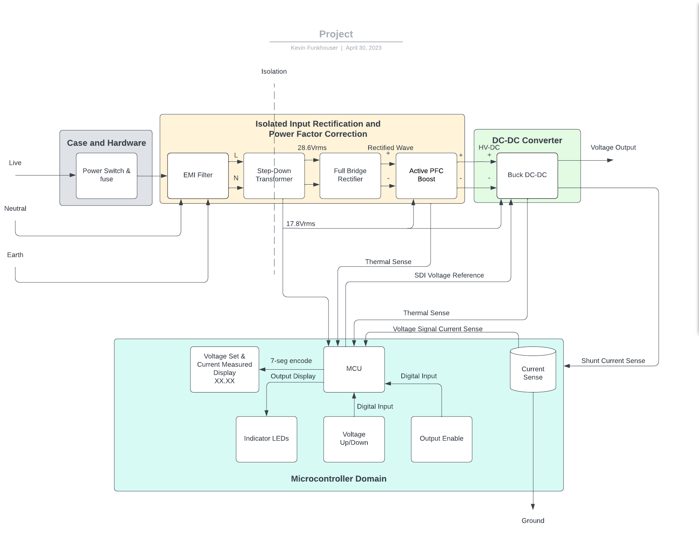
Block Diagram and Requirements
Block Diagram
ELECTRICAL AND COMPUTER ENGINEERING

Slide 9
Block Diagram and Requirements
Requirements and Verifications
Subsystem | Requirements | Verifications
Isolated Input Rectification & PFC | Power Factor >0.9 Meet or exceed IEC 61000-3-2 standards Output: 60-80VDC Galvanic isolation input-output | PF meter or Oscilloscope Current probe and spectrum analyzer Oscilloscope Continuity tester
ELECTRICAL AND COMPUTER ENGINEERING

Slide 10
Block Diagram and Requirements
Requirements and Verifications
DC-DC Converter | Output: 5-25V The converter must be able to respond to the MCU signal to enable and disable its output. | The output voltage and current could be measured with an oscilloscope. The fault can be simulated using a signal generator and the disconnection can be measured with an oscilloscope.
ELECTRICAL AND COMPUTER ENGINEERING

Slide 11
Block Diagram and Requirements
Requirements and Verifications
Case & Hardware | The case must be able to contain all of the circuitry and allow mounting with adequate venting. The case must have displays, buttons, switches, and plugs for user interaction. | This can be verified by inspection. We can verify with a DMM that the case is not electrically live.
ELECTRICAL AND COMPUTER ENGINEERING

Slide 12
Block Diagram and Requirements
Requirements and Verifications
Microcontroller Unit | Output SPI bitstream to DC-DC Converter Respond to thermal overload Display set voltage and current Appropriately send fault signal | SPI bitstream can be verified by the DC-DC converter. Overload signals can be generated, and The display can be observed visually, or by logic analyzer, upon forcing MCU input signals with a signal generator.
ELECTRICAL AND COMPUTER ENGINEERING

Slide 13
PCB Design
ELECTRICAL AND COMPUTER ENGINEERING

Slide 14
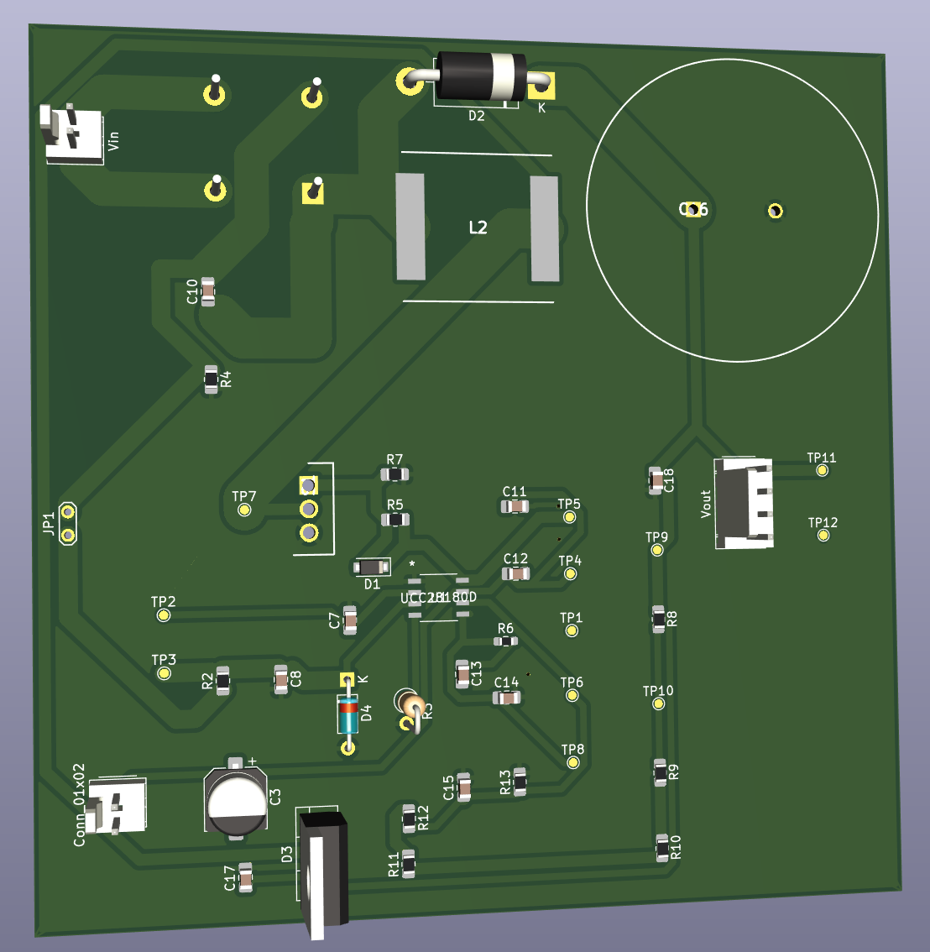
PCB
Boost PFC Controller
Galvanic isolation provided by step-down transformer
Rectification of AC voltage
Boosted output voltage 60V & 100W
ELECTRICAL AND COMPUTER ENGINEERING

Slide 15
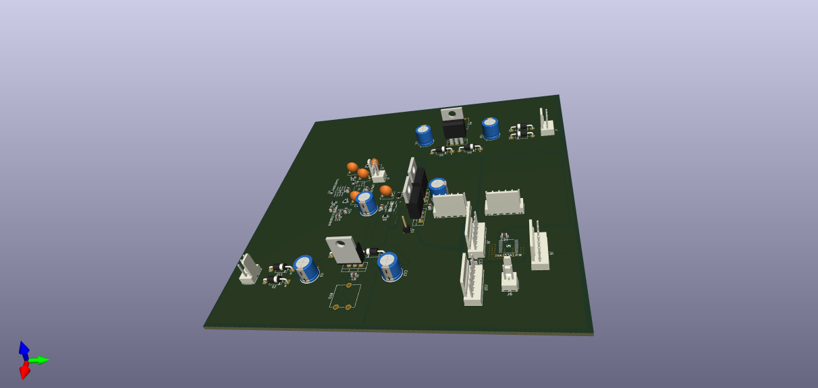
PCB
DC-DC Converter
Converts the HVDC Bus to 5-25V @ 50W
Single Phase Synchronous Buck Converter
Simulations Indicate Capabilities of 10A at 5V <0.2% ripple, 2A at 25V < 0.1% ripple
Auxiliary voltages from transformer secondaries
Current Sense
IMAGE / GRAPHIC
ELECTRICAL AND COMPUTER ENGINEERING

Slide 16
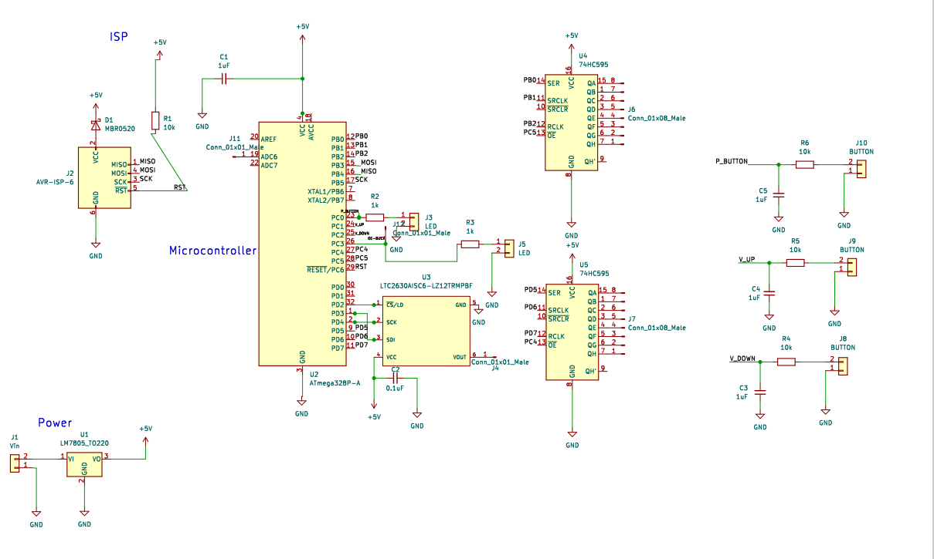
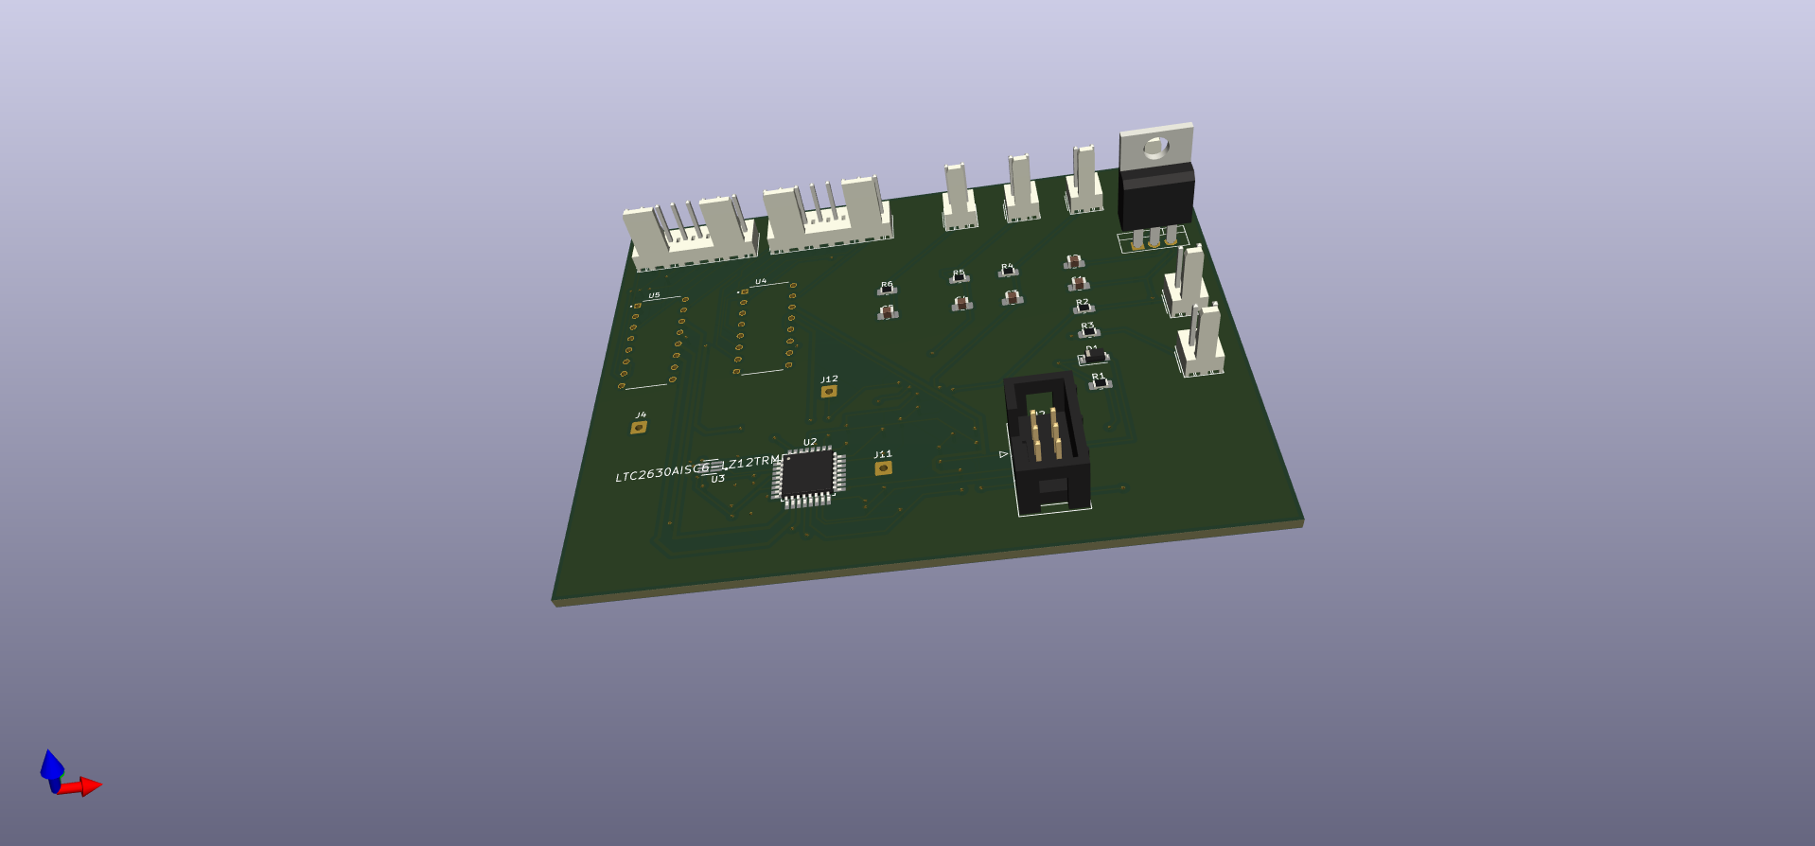
PCB
Microcontroller Unit
Process temperature, current sense, voltage selection
signals
Output a SPI bitstream for the DAC
Display set voltage and measured current
Output enable/disable signal to the DC-DC converter
Output signals to the indicator LED
IMAGE / GRAPHIC
ELECTRICAL AND COMPUTER ENGINEERING

Slide 17
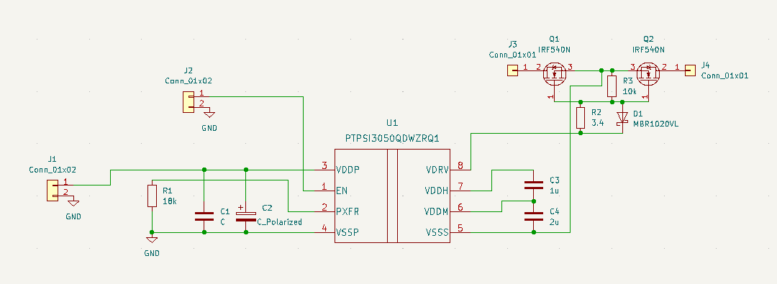
PCB
Solid State Relay
Disconnects the output based upon fault signals
Connects the input to the rectification and PFC system
Successfully designed and tested
ELECTRICAL AND COMPUTER ENGINEERING

Slide 18
Results
ELECTRICAL AND COMPUTER ENGINEERING

Slide 19
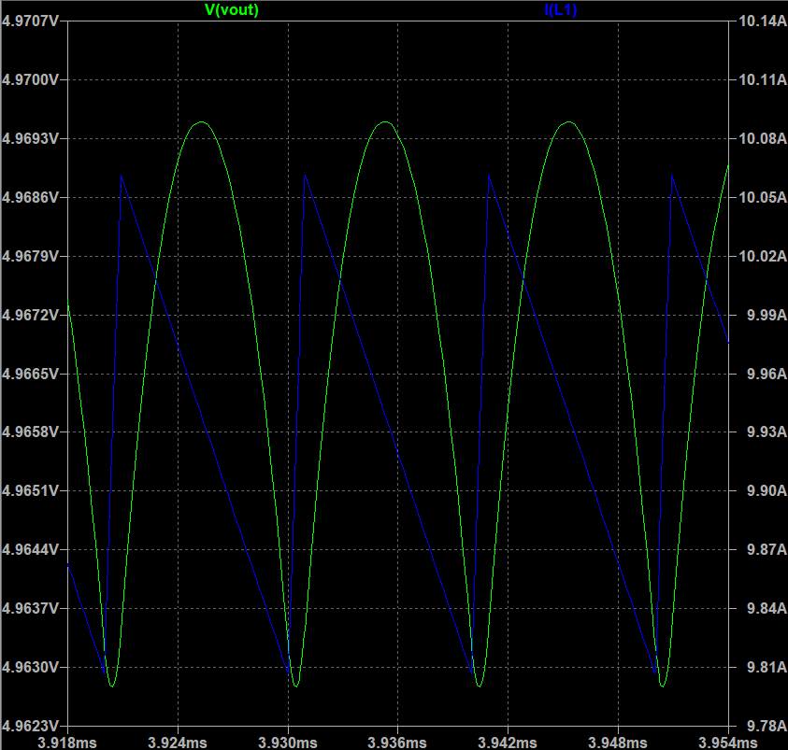
Results
Simulations
< 0.2% voltage ripple at 5V, 10A
< 0.1% voltage ripple at 25V, 2A
< 250nV error amplifier offset
Simulations suggest dominant pole compensation satisfactory
ELECTRICAL AND COMPUTER ENGINEERING

Slide 20
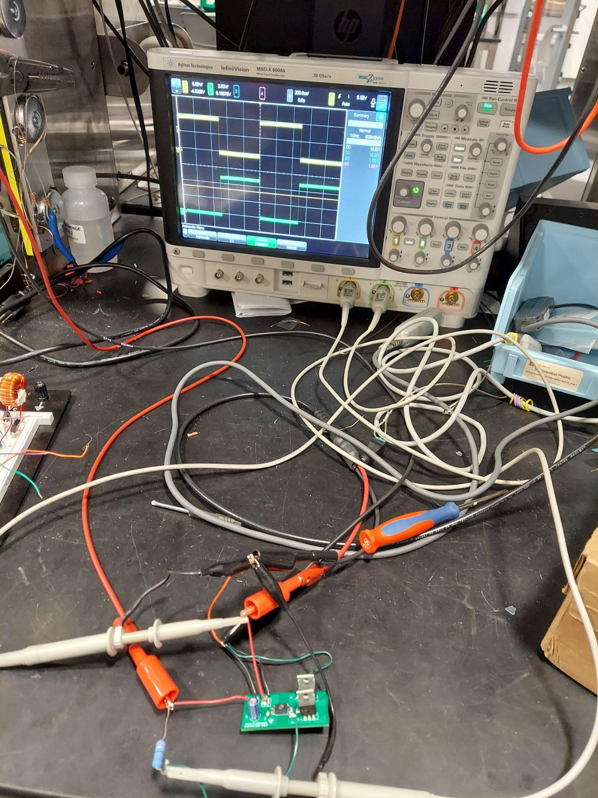
Results
SSR Testing
Fault generation using signal generator
Current limiting resistor between relay and power
Probes at fault signal and resistor relay node
Opposite sign signals indicate current blocking
ELECTRICAL AND COMPUTER ENGINEERING

Slide 21
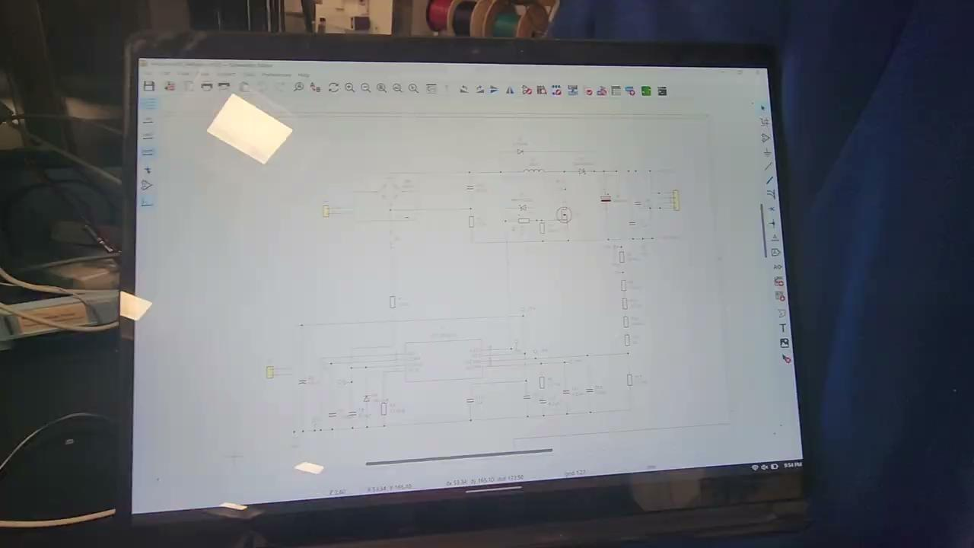
Results
ELECTRICAL AND COMPUTER ENGINEERING

Slide 22
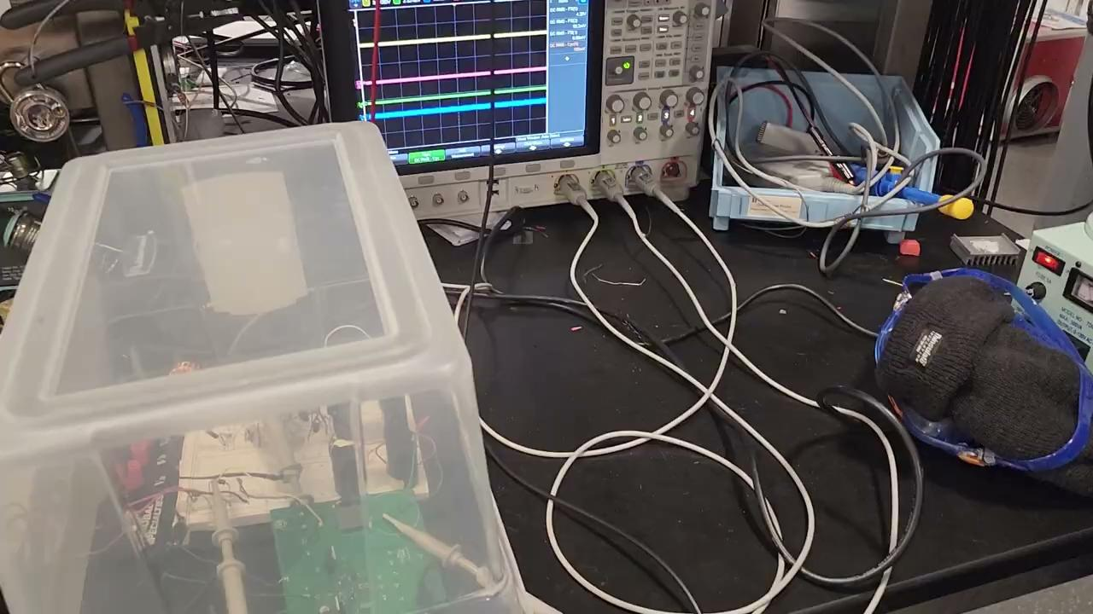
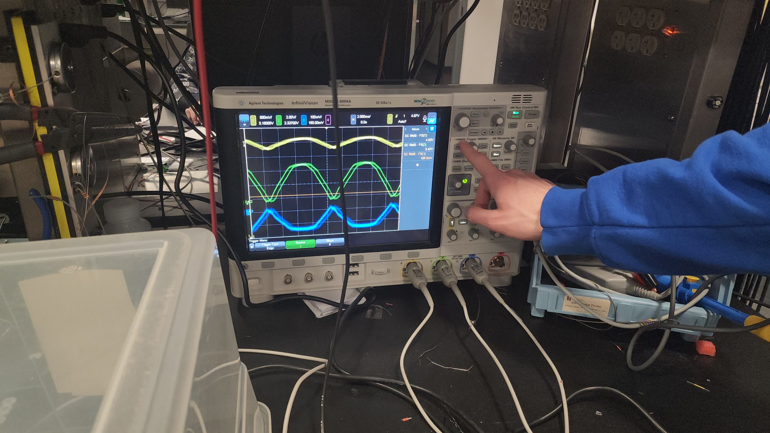
Results
Debugging
ELECTRICAL AND COMPUTER ENGINEERING

Slide 23
Results
What Went Wrong?
Several PCB redesigns - parts were not ordered on time
Testing was delayed and simulations prolonged without these parts
DC-DC Converter PCB was not ordered in a timely manner, and many subsystems were contingent on this board
Capacitors/resistors not appropriately rated
Unstable conditions in Boost PFC Controller made testing difficult
ELECTRICAL AND COMPUTER ENGINEERING

Slide 24
Results
Next Steps?
Redesign Boost PFC Controller with the appropriate component ratings
Redesign PFC PCB with wider current routes allowing heat to dissipate
Order & assemble DC-DC buck converter
ELECTRICAL AND COMPUTER ENGINEERING

Slide 25
Questions?
ELECTRICAL AND COMPUTER ENGINEERING

