Slide 1
Pancake Flippers
Team 54: Jason Kim, David Lin, James Lu
April 29, 2024
Notes:
Introduction: Jason lead
We will be giving a brief overview first, then we will dive deeper into the components

Slide 2
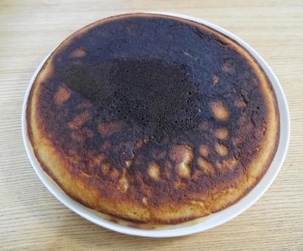
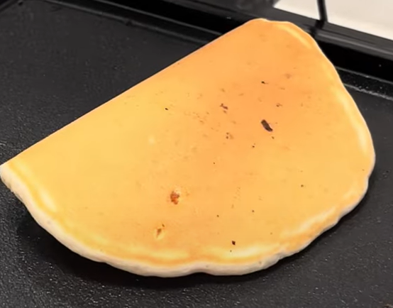
Problem: Flipping pancakes can be a challenge from determining when to flip to flipping the pancake properly.
Solution: A device that automates the task of flipping pancakes
ELECTRICAL & COMPUTER ENGINEERING
GRAINGER ENGINEERING
Notes:
James

Slide 3
Problem: Flipping pancakes can be a challenge from determining when to flip to flipping the pancake properly.
Solution: A device that automates the task of flipping pancakes
ELECTRICAL & COMPUTER ENGINEERING
GRAINGER ENGINEERING
Notes:
James

Slide 4
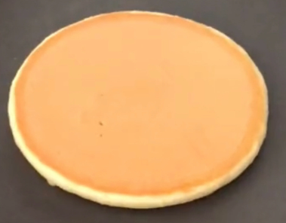
Problem: Flipping pancakes can be a challenge from determining when to flip to flipping the pancake properly.
Solution: A device that automates the task of flipping pancakes
ELECTRICAL & COMPUTER ENGINEERING
GRAINGER ENGINEERING
Notes:
James

Slide 5
Problem: Flipping pancakes can be a challenge from determining when to flip to flipping the pancake properly.
Solution: A device that automates the task of flipping pancakes
ELECTRICAL & COMPUTER ENGINEERING
GRAINGER ENGINEERING
Notes:
James

Slide 6
High Level Requirements
Pancake flip with no/minimal tears.
AI detection for flipping cue.
LCD displays right messages at the right time.
ELECTRICAL & COMPUTER ENGINEERING
GRAINGER ENGINEERING
Notes:
James

Slide 7
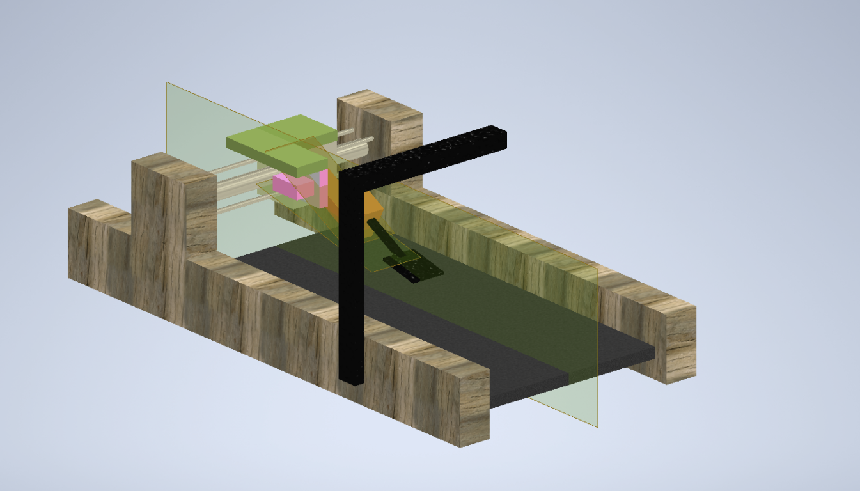
Visual Aid
(Short commentary or relevant information about the contents of the chart/graph.)
ELECTRICAL & COMPUTER ENGINEERING
GRAINGER ENGINEERING
Notes:
David

Slide 8
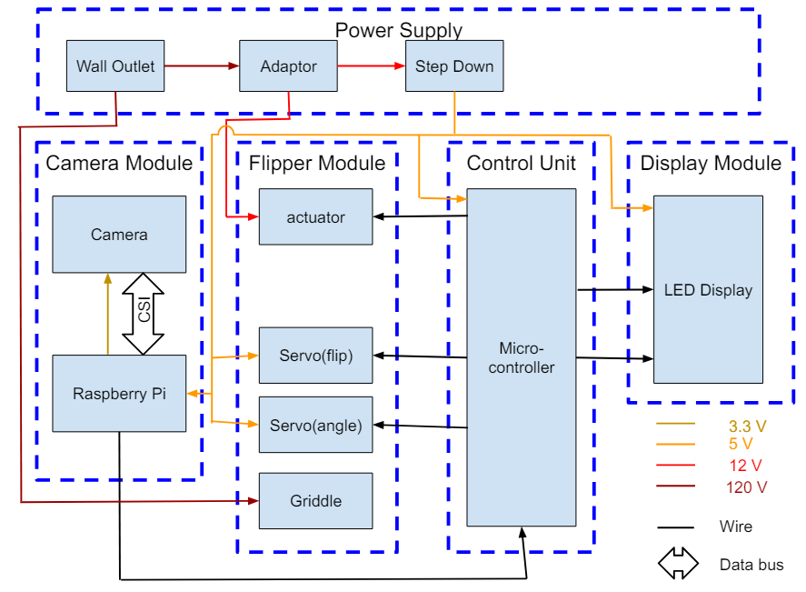
Block Diagram
ELECTRICAL & COMPUTER ENGINEERING
GRAINGER ENGINEERING
Notes:
Jason

Slide 9
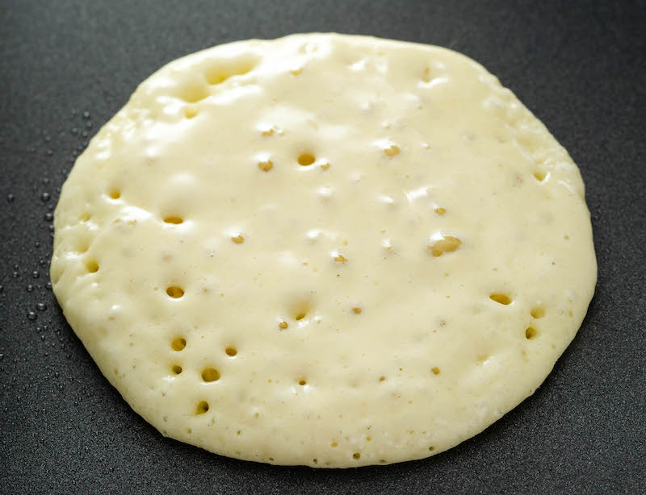
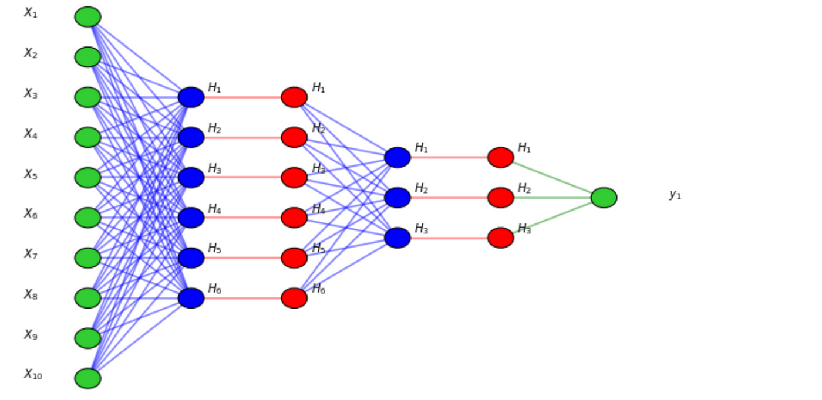
Changes Made
Identifying Bubbles
We could find bubbles with OpenCV, but we were not able to detect them using AI
Bubble count was not a good indicator of doneness
We did not have a dataset for detecting bubbles, we ended up using OpenCV to create the dataset
ELECTRICAL & COMPUTER ENGINEERING
GRAINGER ENGINEERING
Notes:
David

Slide 10
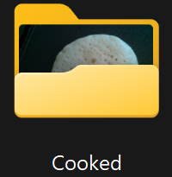
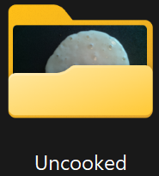
Changes Made
Pivot to Cooked/Uncooked
We instead created two tags, Cooked or Uncooked then trained the model to identify them
Much better indicator of doneness
Much easier to annotate data
Differing lighting conditions would throw off the algorithm
Dataset Augmentation
Train Model
ELECTRICAL & COMPUTER ENGINEERING
GRAINGER ENGINEERING
Notes:
David

Slide 11
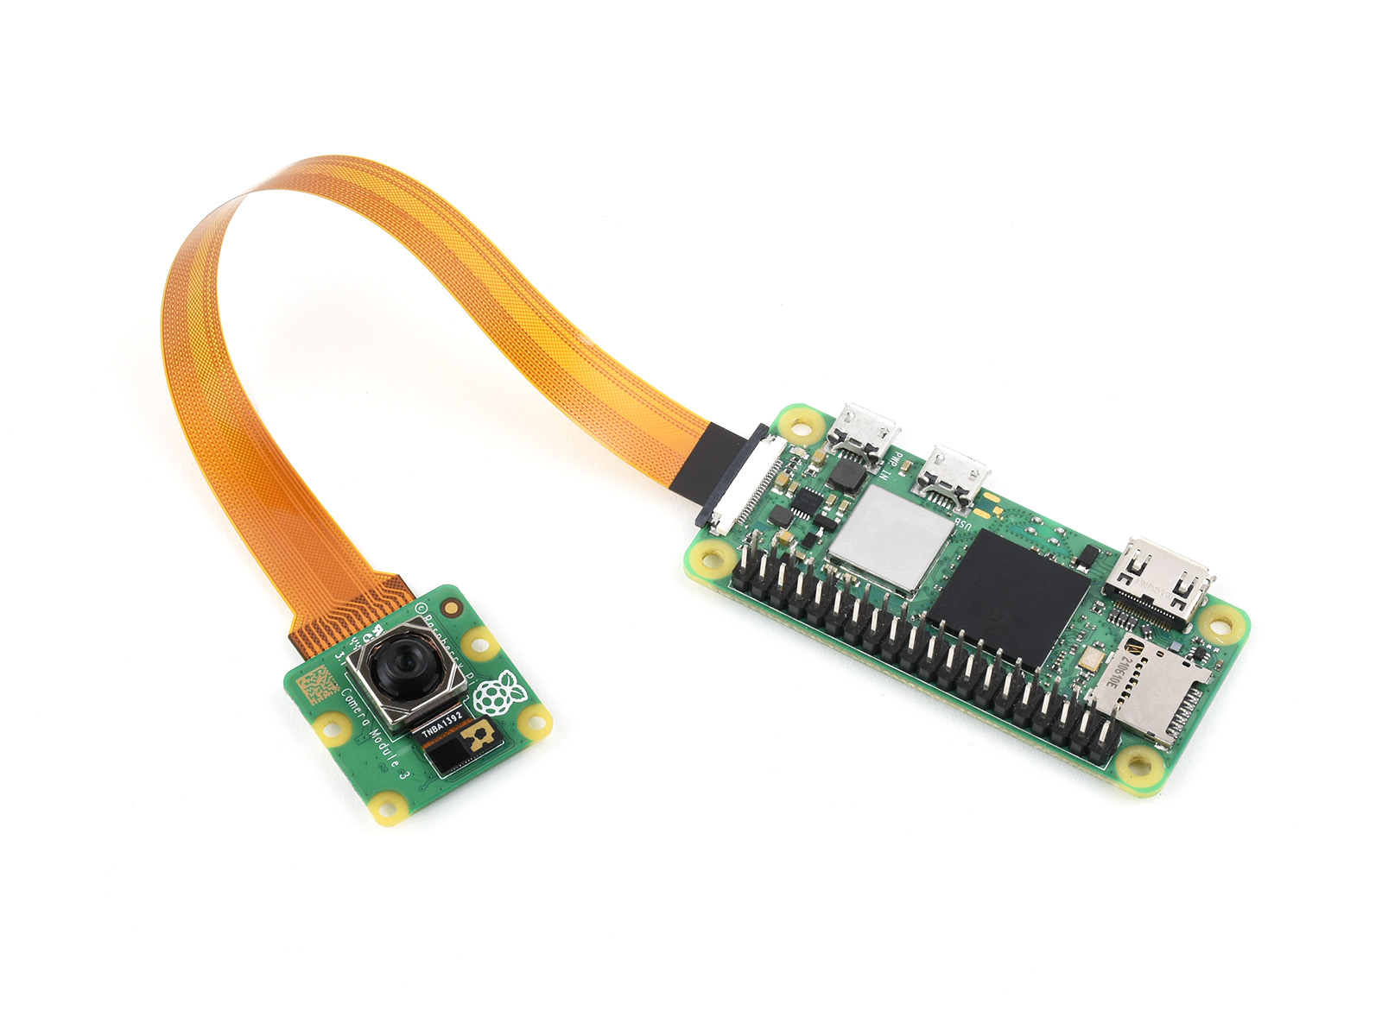
Camera Module
ELECTRICAL & COMPUTER ENGINEERING
GRAINGER ENGINEERING
Notes:
David: The Ai stuff we discussed was programmed on the Raspberry Pi, which took the image data from the camera. That sums up the camera Module

Slide 12
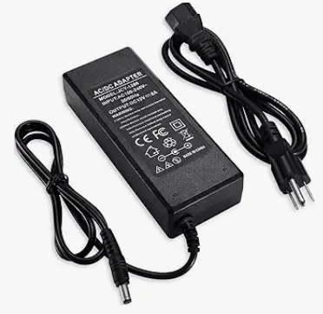
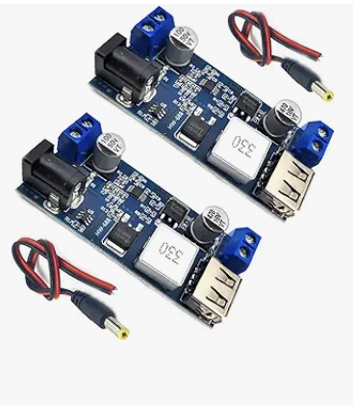
Power Supply Unit
 | Voltage | Current (Max)
Microcontroller | 5V | 500mA
Raspberry Pi Zero 2 W | 5V | 580mA
Pi Camera | 5V | 250mA
Lift Servo | 5V | 1900mA
Flip Servo | 5V | 1800mA
Total |  | 5030mA
Linear Actuator | 12V | 3A
Total |  | 3000mA
96W 12V Power Supply
2x 10W 12V to 5V Power Supply
ELECTRICAL & COMPUTER ENGINEERING
GRAINGER ENGINEERING
Notes:
David

Slide 13
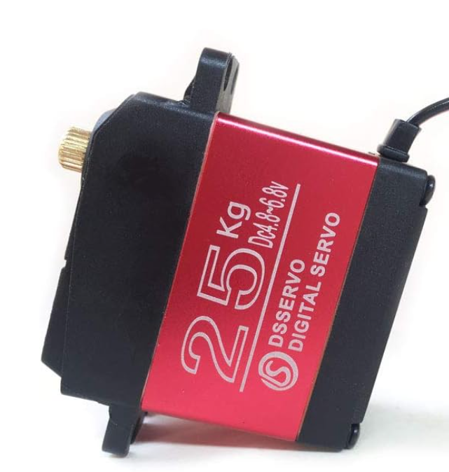
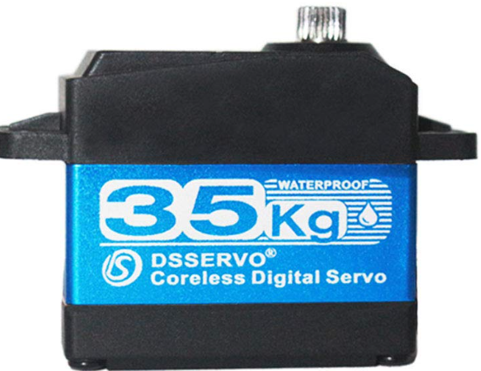
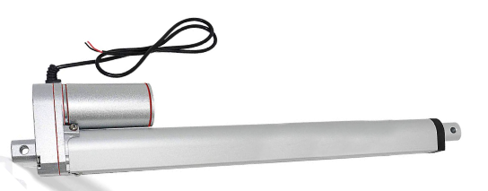
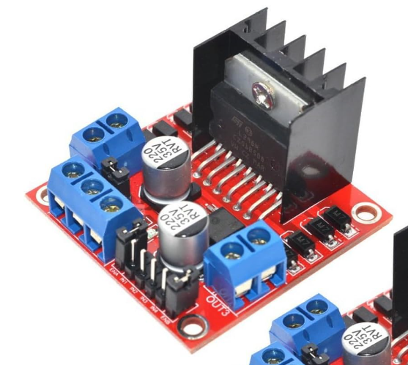
Flipper Unit
180°
90°
8 in
ELECTRICAL & COMPUTER ENGINEERING
GRAINGER ENGINEERING
Notes:
Jason: The requirements were 0.3 Nm and 1.5 nm. The servos receive control signal directly from control unit. The linear actuator is control using an H-bridge. The fixture to hold everything in place we give credit to the Machine shop and David’s CAD which the machine shop worked off of. It’s the visual aid you all saw before

Slide 14
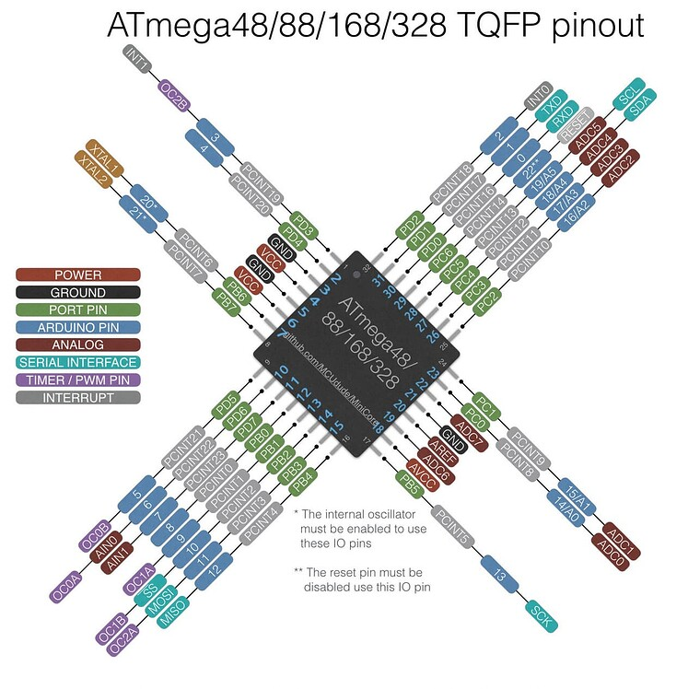
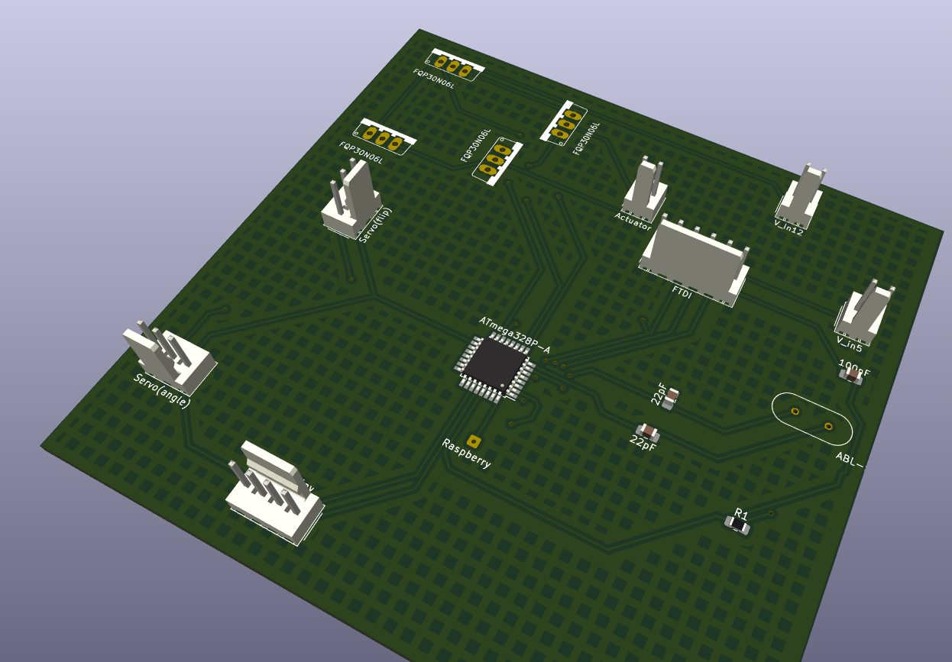
Control Unit
ELECTRICAL & COMPUTER ENGINEERING
GRAINGER ENGINEERING
Notes:
Talk about all connections

Slide 15
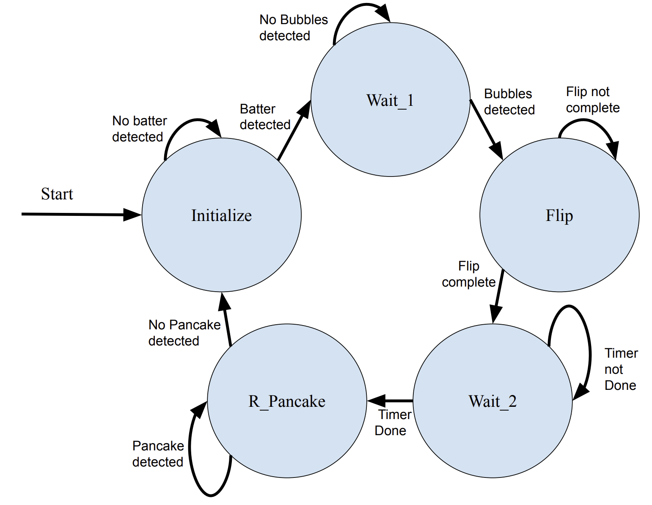
Control Unit - Software
Pancake Not Ready
Pancake Ready
Initialize incomplete, Pour batter Timer not done
Pour batter timer done
Remove Pancake Timer done
Remove Pancake Timer not done
ELECTRICAL & COMPUTER ENGINEERING
GRAINGER ENGINEERING

Slide 16
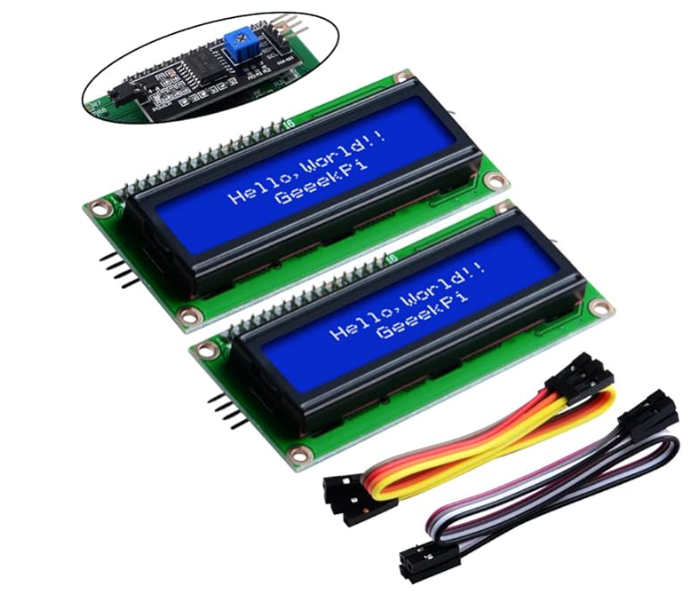
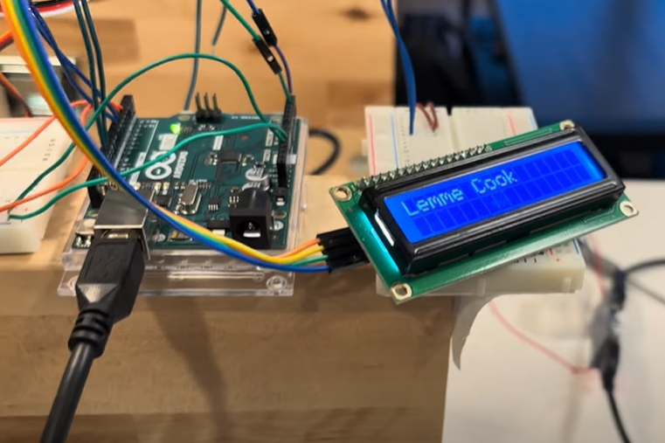
LCD Display
Pour Batter
Cooking
Pancake is ready
ELECTRICAL & COMPUTER ENGINEERING
GRAINGER ENGINEERING

Slide 17
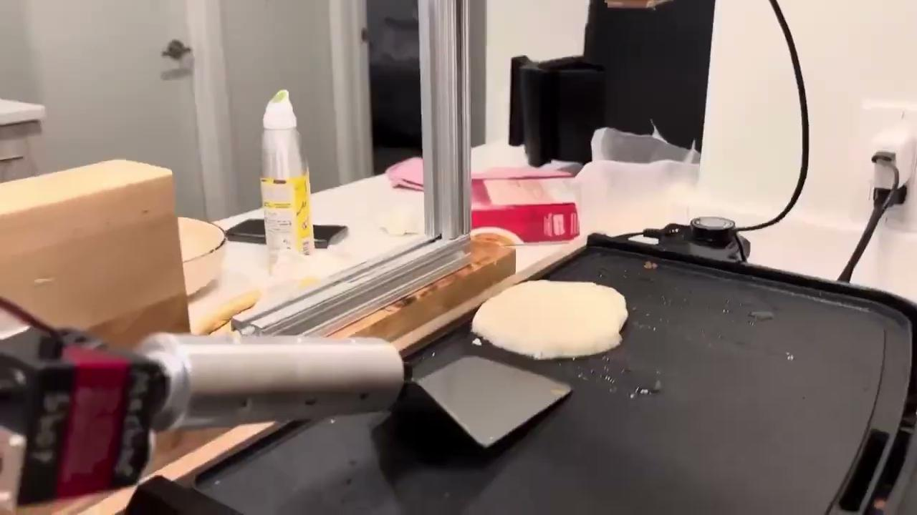
Functional Testing
ELECTRICAL & COMPUTER ENGINEERING
GRAINGER ENGINEERING
Notes:
James this one is u
talk about how it was able to flip the pancake successfully, all the servos and linear actuator and display (basically everything) worked syncronously, etc. also add a 30 sec video of flipping
maybe take images from this and put em here
Pancake Flipper 2024 (youtube.com)

Slide 18
Functional Testing
Requirements | Verification
Raspberry Pi requires a stable 5V power supply and must interface with the camera using the Camera Serial Interface (CSI). The Pi must process the camera feed in real-time and run the binary AI classifier to determine pancake readiness. | Use a multimeter to measure the voltage at the Raspberry Pi's power input while it is running. Verify the physical connection between the Raspberry Pi and the camera module through the CSI port. Test the interface by capturing a series of test images or video to confirm successful communication and data transfer.
Camera needs to capture images at a resolution sufficient for the AI classifier to determine the cooking status accurately. | Determine the minimum resolution required by the AI classifier for accurate cooking status determination. Test the camera by capturing images at this resolution and running them through the classifier to verify accuracy.
Requirements | Verification
Adaptor supplies at least 3A at 12 V +/- 0.2V for the linear actuator and at least 1.5A at 5V +/- 0.1V for the Raspberry Pi and microcontroller. | Use a multimeter to measure the output voltage of the adaptor under a load simulating the linear actuator's consumption and the output voltage of the adaptor under a load simulating the combined consumption of the Raspberry Pi and microcontroller.
The power lines must be capable of handling the current without significant voltage drop over the length of the wire. | Perform a voltage drop test by measuring the voltage at the beginning and end of the power lines under maximum expected load.
ELECTRICAL & COMPUTER ENGINEERING
GRAINGER ENGINEERING
Notes:
James this one is u
talk about how it was able to flip the pancake successfully, all the servos and linear actuator and display (basically everything) worked syncronously, etc. also add a 30 sec video of flipping
maybe take images from this and put em here
Pancake Flipper 2024 (youtube.com)

Slide 19
Functional Testing
Requirements | Verification
Actuator and linear driver must provide precise control of the spatula's position with a positional accuracy of +/- 5 mm and must operate at 12V. | Perform multiple operations to ensure the actuator maintains the specified positional accuracy of +/- 1mm. Verify the operation voltage of the actuator and linear driver is consistently at 12V using a multimeter.
Servos are required to rotate accurately within a 1-degree precision and operate on a 5V power supply. The torque needed for the flip servo is approximately 0.3 Nm, while the angle servo requires about 1.5 Nm. The flip servo must achieve a 180-degree rotation, and the angle servo should reach 90 degrees. | Use a protractor or an angle measurement tool to verify that the servo can achieve rotations with 1-degree precision. Confirm the servos operate at a stable 5V supply voltage using a multimeter. Test each servo by applying a load equivalent to the required torque specification and measure the actual torque output to ensure it meets the 0.3 Nm for the flip servo and 1.5 Nm for the angle servo. Measure the rotation angle using a protractor or digital angle finder to ensure the flip servo reaches a full 180-degree rotation and the angle servo achieves a 90-degree rotation.
Requirements | Verification
Microcontroller requires a 5V power source and must be capable of handling multiple input/output operations | Use a multimeter to confirm the microcontroller is receiving a stable 5V power supply. Conduct a stress test by simultaneously triggering various input and output tasks programmed into the microcontroller and observe if it can manage without errors or resets.
Microcontroller must process Raspberry Pi signals and control the Flipper Module within 100 milliseconds to ensure timely flipping. | Implement a test script on the Raspberry Pi that sends signals to the microcontroller, simulating the commands to flip. Measure the response time from signal reception to the initiation of the Flipper Module's action using a logic analyzer or timing software.
Must include digital I/O for controlling the Flipper Module and a serial or I2C connection to the Display Module. | Physically inspect the microcontroller to confirm the presence of the required digital I/O pins and either a serial or I2C interface for connections.
ELECTRICAL & COMPUTER ENGINEERING
GRAINGER ENGINEERING
Notes:
James this one is u
talk about how it was able to flip the pancake successfully, all the servos and linear actuator and display (basically everything) worked syncronously, etc. also add a 30 sec video of flipping
maybe take images from this and put em here
Pancake Flipper 2024 (youtube.com)

Slide 20
Functional Testing
Requirements | Verification
The LED display must operate on a 5V supply and be able to present information legibly in various lighting conditions. | Use a multimeter to verify that the LED display operates with a 5V power supply. Place the LED display in environments with differing light levels (e.g., bright sunlight, dim light) and confirm that the information displayed remains clear and readable from a reasonable distance.
Must receive data from the microcontroller via I2C or a similar protocol to display the pancake and griddle status. | Send test data from the microcontroller to the display, representing various pancake and griddle statuses. Verify that the display accurately reflects the sent data and correctly represents the status information.
The display should update within 500 milliseconds of receiving new data. | Simulate real operation by continuously sending updated status data from the microcontroller to the LED display. Measure the time interval between sending the data and the display update using a stopwatch or a software tool capable of timing the update latency.
Notes:
James this one is u
talk about how it was able to flip the pancake successfully, all the servos and linear actuator and display (basically everything) worked syncronously, etc. also add a 30 sec video of flipping
maybe take images from this and put em here
Pancake Flipper 2024 (youtube.com)

Slide 21
Successes and Challenges
Successes:
Pancake Flipper / Cooking Design
Pancake Image Classifier
Challenges: 12V Power (H Bridge)
ATMega328p Programming
ELECTRICAL & COMPUTER ENGINEERING
GRAINGER ENGINEERING
Notes:
Jason

Slide 22
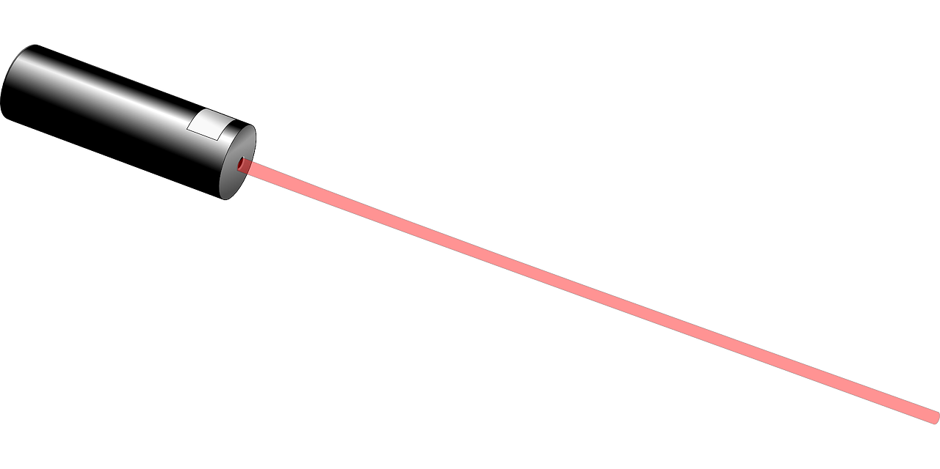
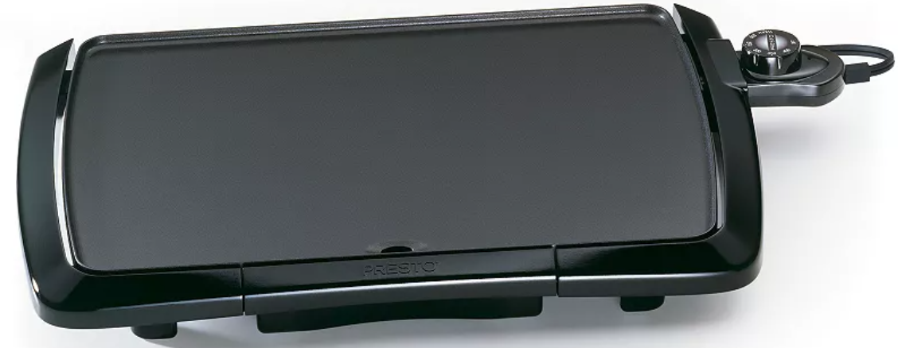
Conclusions for Project
Extremely fun (and tasty) project
Good mix of Mechanical, Software, and Electrical engineering
Lessons Learned:
Power systems are dangerous and difficult!
Takeaways:
Don’t try to use custom solutions
Finish early in case of unexpected delays
Recommendations for Future Work:
Add laser to indicate where to pour/center batter
Optimize power
ELECTRICAL & COMPUTER ENGINEERING
GRAINGER ENGINEERING
Notes:
James

