Slide 1
Smart Availability Indicator for ECEB Study Rooms
Group 27: Ritvik Goradia, Siddarth Iyer
TA: Sanjana Pingali

Slide 2
Introduction
ELECTRICAL & COMPUTER ENGINEERING
GRAINGER ENGINEERING

Slide 3
Introduction
Problem Statement
ECEB has limited number of study rooms that are high in demand
Currently no system in place to conveniently check room availability
Students must go floor-by-floor to find a vacant study room
More often than not, rooms are not available forcing students to find other alternatives
ELECTRICAL & COMPUTER ENGINEERING
GRAINGER ENGINEERING

Slide 4
Introduction
Our Solution
Create a website that reflects real-time availability of study rooms
Automatically control room lighting based on occupancy
Allow the user to adjust the brightness of the light
ELECTRICAL & COMPUTER ENGINEERING
GRAINGER ENGINEERING

Slide 5
Introduction
High-Level Requirements
Lights should turn on within 3 seconds of the user entering the room and turn off when the user leave
User should be able to adjust brightness using dial
Changes in room availability should update on the website within 10 seconds
ELECTRICAL & COMPUTER ENGINEERING
GRAINGER ENGINEERING

Slide 7
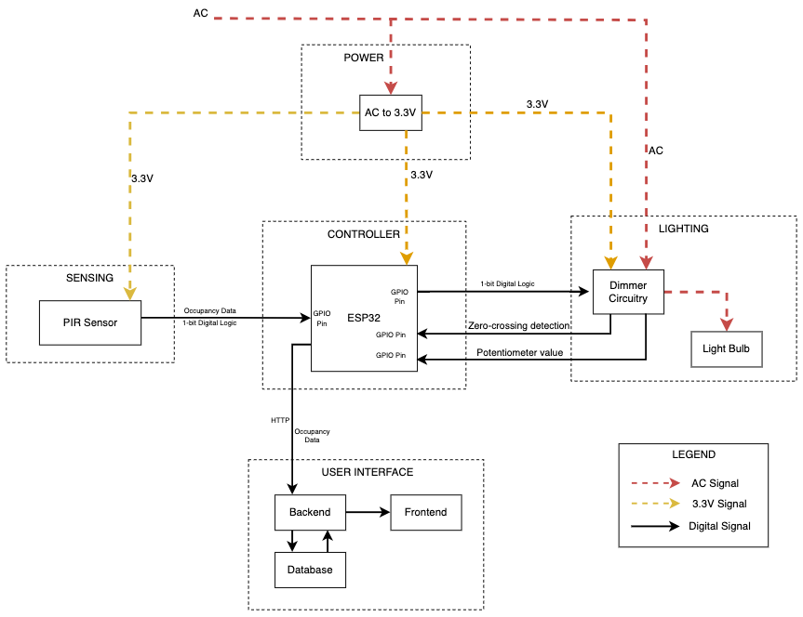
Introduction
ELECTRICAL & COMPUTER ENGINEERING
GRAINGER ENGINEERING

Slide 8
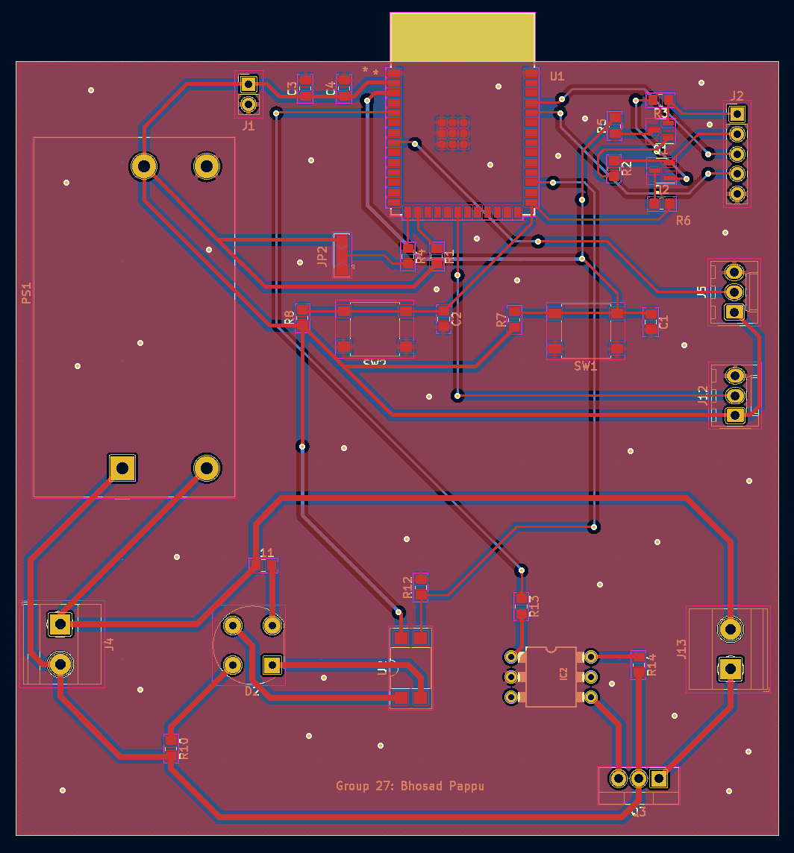
Introduction
CHART / GRAPH
PCB Design
ELECTRICAL & COMPUTER ENGINEERING
GRAINGER ENGINEERING

Slide 9
Sensing Subsystem
ELECTRICAL & COMPUTER ENGINEERING
GRAINGER ENGINEERING

Slide 10
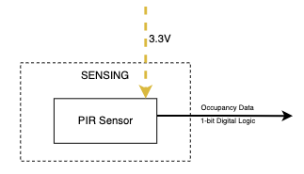
Sensing Subsystem
Overview
Determines room availability using Passive Infrared Sensor
Relays availability information to microcontroller to accordingly turn on/off light and update website
ELECTRICAL & COMPUTER ENGINEERING
GRAINGER ENGINEERING

Slide 11
Sensing Subsystem
Requirements
Sensor outputs logic low when no human is present
Sensor outputs logic high 3.3V pulse when motion is detected
ELECTRICAL & COMPUTER ENGINEERING
GRAINGER ENGINEERING

Slide 12
Sensing Subsystem
Results of Requirement 1
Sensor outputs logic low when no human is present
Test | Low Pulse Observed for 10 s?
1 | Yes
2 | Yes
3 | Yes
4 | Yes
5 | Yes
Test | Low Pulse Observed for 10 s?
6 | Yes
7 | Yes
8 | Yes
9 | Yes
10 | Yes
ELECTRICAL & COMPUTER ENGINEERING
GRAINGER ENGINEERING

Slide 13
Sensing Subsystem
Results of Requirement 2
Sensor outputs logic high 3.3V pulse when motion is detected
Test | High Pulse Observed? | Voltage Observed
1 | Yes | 3.293 V
2 | Yes | 3.293 V
3 | Yes | 3.293 V
4 | Yes | 3.294 V
5 | Yes | 3.293 V
Test | High Pulse Observed? | Voltage Observed
6 | Yes | 3.294 V
7 | Yes | 3.294 V
8 | Yes | 3.293 V
9 | Yes | 3.293 V
10 | Yes | 3.293 V
ELECTRICAL & COMPUTER ENGINEERING
GRAINGER ENGINEERING

Slide 14
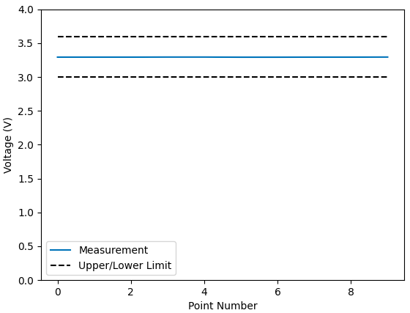
Sensing Subsystem
ELECTRICAL & COMPUTER ENGINEERING
GRAINGER ENGINEERING

Slide 15
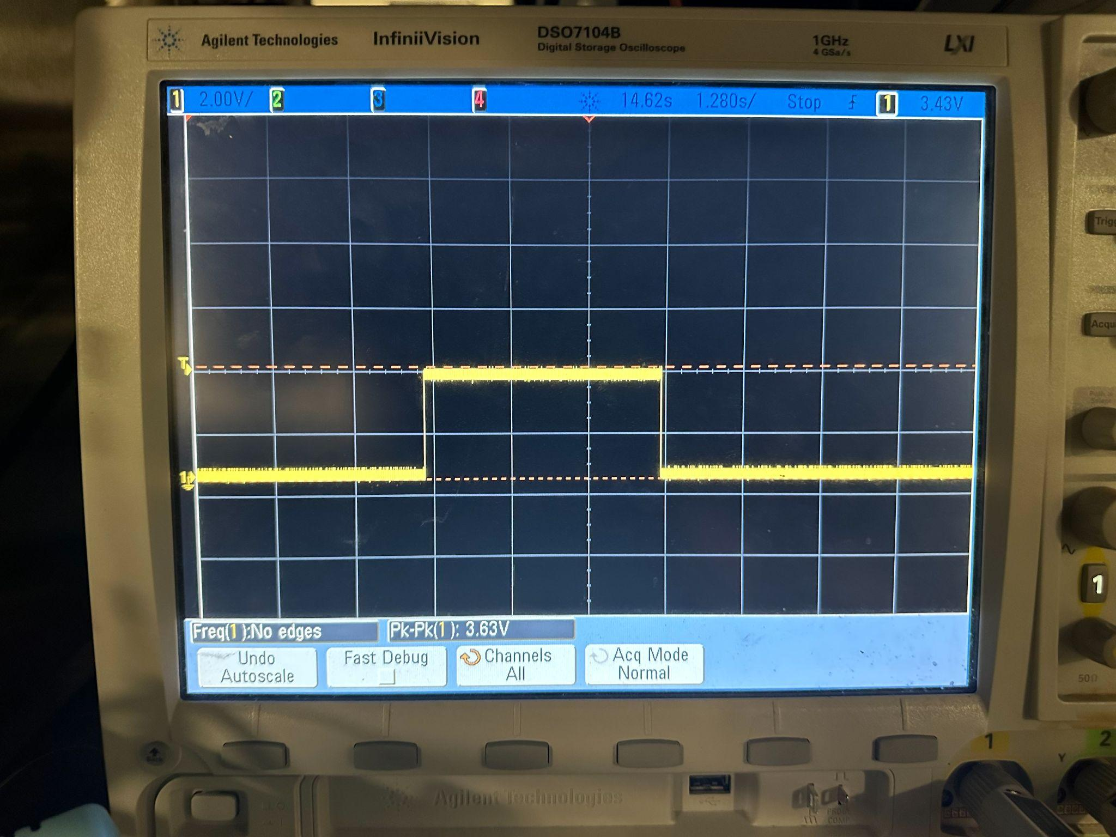
Sensing Subsystem
CHART / GRAPH
Pulse sent by PIR Sensor upon detecting motion
ELECTRICAL & COMPUTER ENGINEERING
GRAINGER ENGINEERING

Slide 16
Lighting Subsystem
ELECTRICAL & COMPUTER ENGINEERING
GRAINGER ENGINEERING

Slide 17
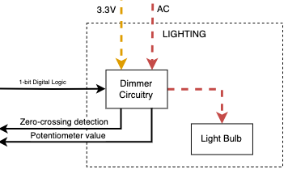
Lighting Subsystem
Overview
Turn light on/off based on availability data received from micro-controller
Allow user to adjust the brightness of the light by tuning a knob
ELECTRICAL & COMPUTER ENGINEERING
GRAINGER ENGINEERING

Slide 18
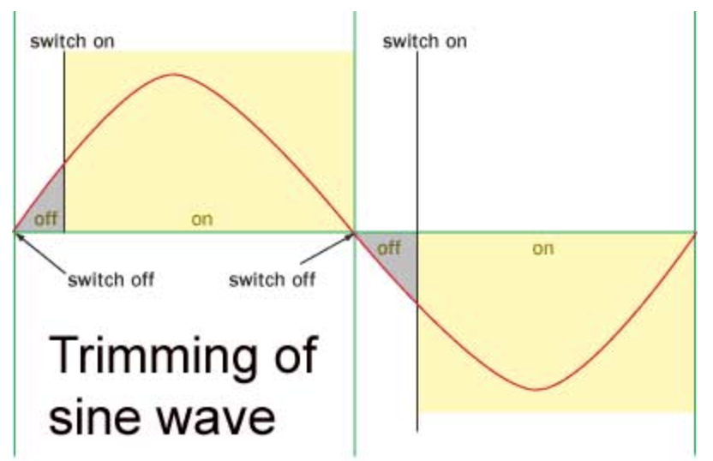
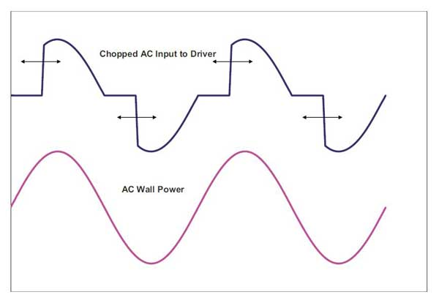
Lighting Subsystem
ELECTRICAL & COMPUTER ENGINEERING
GRAINGER ENGINEERING

Slide 19
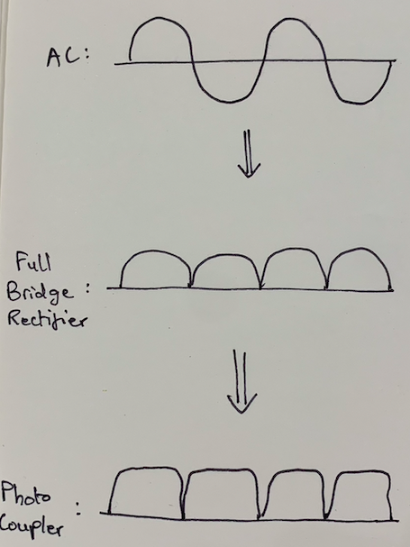
Lighting Subsystem
ELECTRICAL & COMPUTER ENGINEERING
GRAINGER ENGINEERING

Slide 20
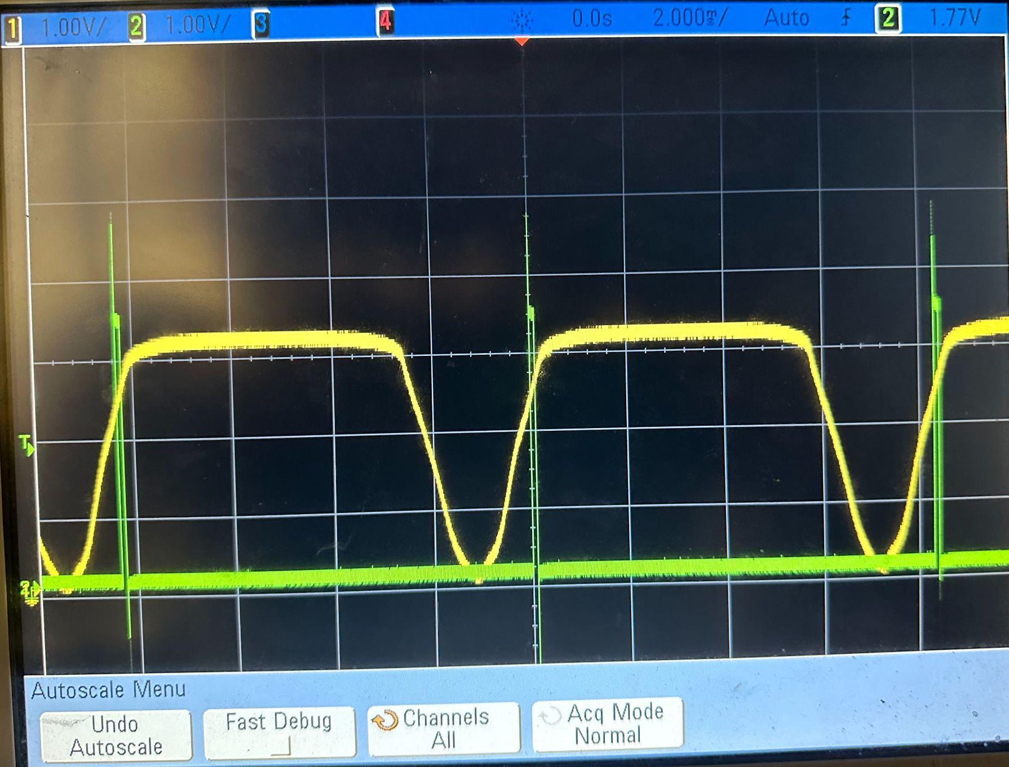
Lighting Subsystem
CHART / GRAPH
Pulse sent by microcontroller to lighting submodule
ELECTRICAL & COMPUTER ENGINEERING
GRAINGER ENGINEERING

Slide 21
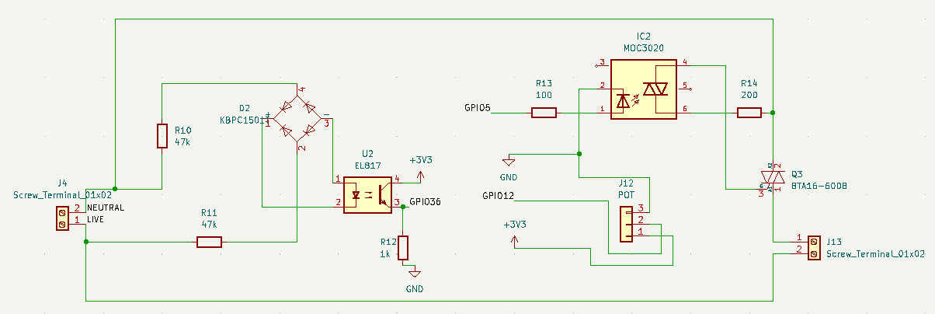
Lighting Subsystem
Schematic
ELECTRICAL & COMPUTER ENGINEERING
GRAINGER ENGINEERING

Slide 22
Lighting Subsystem
Requirements
Light remains off when no pulse is received from the microcontroller
While the microcontroller is sending pulses, tuning the potentiometer alters the brightness of the bulb from low to high
ELECTRICAL & COMPUTER ENGINEERING
GRAINGER ENGINEERING

Slide 23
Micro-controller Subsystem
ELECTRICAL & COMPUTER ENGINEERING
GRAINGER ENGINEERING

Slide 24
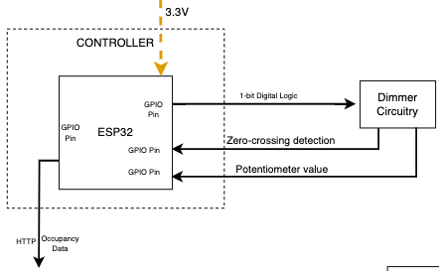
Micro-controller Subsystem
Overview
Receive availability data from PIR Sensor
Update database via HTTP
Send pulses to Lighting Submodule to activate the light
ELECTRICAL & COMPUTER ENGINEERING
GRAINGER ENGINEERING

Slide 25
Micro-controller Subsystem
Requirements
Outputs 3.3 V digital pulse at constant rate to lighting submodule upon detecting motion
Outputs 0 V digital signal to lighting submodule when room is unoccupied
ELECTRICAL & COMPUTER ENGINEERING
GRAINGER ENGINEERING

Slide 26
Micro-controller Subsystem
Results of Requirement 1
Outputs 3.3 V digital pulse at constant rate to lighting submodule upon detecting motion
Test | Pulse sent at Constant rate? | Pulse is sent for at least 15 seconds?
1 | Yes | Yes
2 | Yes | Yes
3 | Yes | Yes
4 | Yes | Yes
5 | Yes | Yes
Test | Pulse sent at Constant rate? | Pulse is sent for at least 15 seconds?
6 | Yes | Yes
7 | Yes | Yes
8 | Yes | Yes
9 | Yes | Yes
10 | Yes | Yes
ELECTRICAL & COMPUTER ENGINEERING
GRAINGER ENGINEERING

Slide 27
Micro-controller Subsystem
Results of Requirement 2
Outputs 0 V digital signal to lighting submodule when room is unoccupied
Test | Stops sending pulse once room is unoccupied?
1 | Yes
2 | Yes
3 | Yes
4 | Yes
5 | Yes
Test | Stops sending pulse once room is unoccupied?
6 | Yes
7 | Yes
8 | Yes
9 | Yes
10 | Yes
ELECTRICAL & COMPUTER ENGINEERING
GRAINGER ENGINEERING

Slide 28
Micro-controller Subsystem
CHART / GRAPH
Pulse sent by microcontroller to lighting submodule
(Bright)
ELECTRICAL & COMPUTER ENGINEERING
GRAINGER ENGINEERING

Slide 29
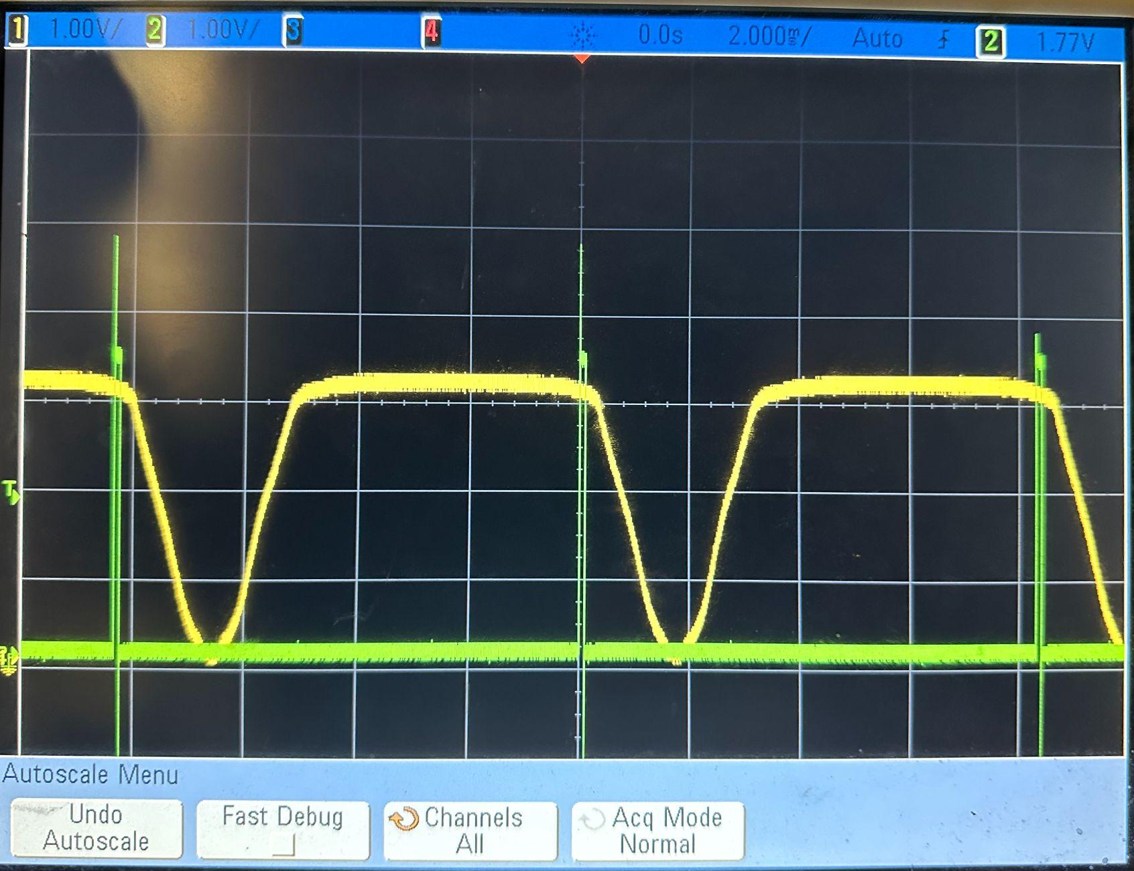
Micro-controller Subsystem
CHART / GRAPH
Pulse sent by microcontroller to lighting submodule
(Dim)
ELECTRICAL & COMPUTER ENGINEERING
GRAINGER ENGINEERING

Slide 30
User Interface Subsystem
ELECTRICAL & COMPUTER ENGINEERING
GRAINGER ENGINEERING

Slide 31
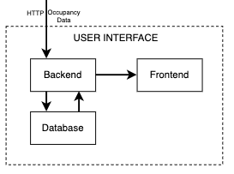
User Interface Subsystem
Overview
Receive availability data from the microcontroller via HTTP
Store data in database
Update website based on received data
ELECTRICAL & COMPUTER ENGINEERING
GRAINGER ENGINEERING

Slide 32
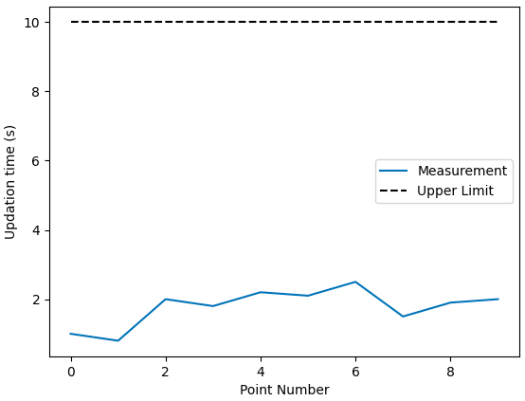
User Interface Subsystem
Requirements
Website should update occupancy information within 10 seconds
ELECTRICAL & COMPUTER ENGINEERING
GRAINGER ENGINEERING

Slide 33
Power Module
ELECTRICAL & COMPUTER ENGINEERING
GRAINGER ENGINEERING

Slide 34
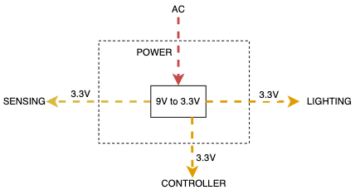
Power Module
Overview
Provide 3.3 V power to various sub-systems
ELECTRICAL & COMPUTER ENGINEERING
GRAINGER ENGINEERING

Slide 35
Power Module
Tolerance Analysis (Linear Regulator)
Required Output: 3.3 V
Battery Headroom: 9V - 3.3V = 5.7 V
Dropout Voltage: 0.4V
Power Dissipation: I_{out} * (V_{in} – V_{out}) = 0.6 * (9 - 3.3) = 3.42 W
ELECTRICAL & COMPUTER ENGINEERING
GRAINGER ENGINEERING

Slide 36
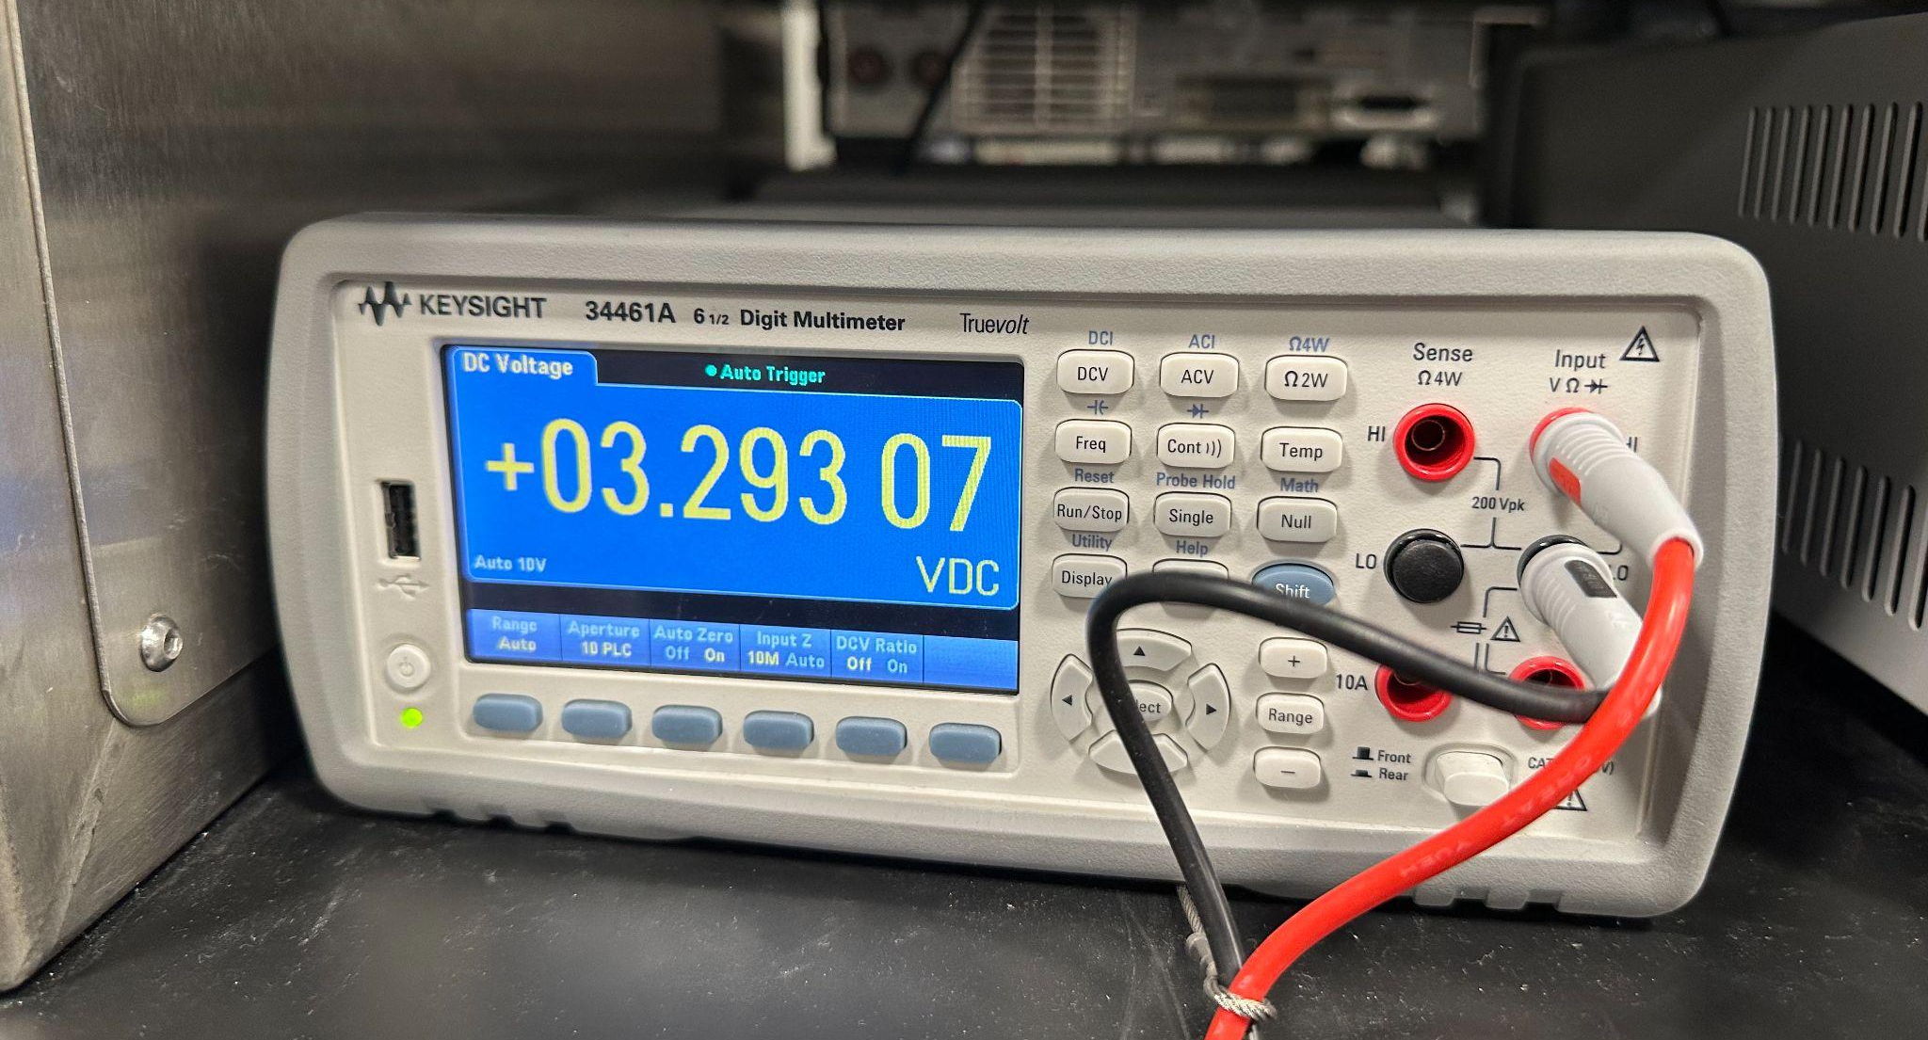
Power Module
CHART / GRAPH
Output Voltage from Linear Regulator
ELECTRICAL & COMPUTER ENGINEERING
GRAINGER ENGINEERING

Slide 37
Challenges and Successes
ELECTRICAL & COMPUTER ENGINEERING
GRAINGER ENGINEERING

Slide 38
Challenges and Successes
Challenges
Unable to flash Microcontroller
AC-DC Converter did not get delivered
Successes
All high-level requirements were satisfied
All subsystem requirements were satisfied
ELECTRICAL & COMPUTER ENGINEERING
GRAINGER ENGINEERING

Slide 39
Conclusion
ELECTRICAL & COMPUTER ENGINEERING
GRAINGER ENGINEERING

Slide 40
Conclusion
Next Steps
Add security to the website
Optimize PCB to take up less area
Design professional, compact packaging
ELECTRICAL & COMPUTER ENGINEERING
GRAINGER ENGINEERING

Slide 41
Questions?
ELECTRICAL & COMPUTER ENGINEERING
GRAINGER ENGINEERING

