Slide 1
Affordable Portable MIDI Synthesizer
Electrical & Computer Engineering
Sujay Murali
Richard Engel
David Gutzwiller
4/28/2023

Slide 2
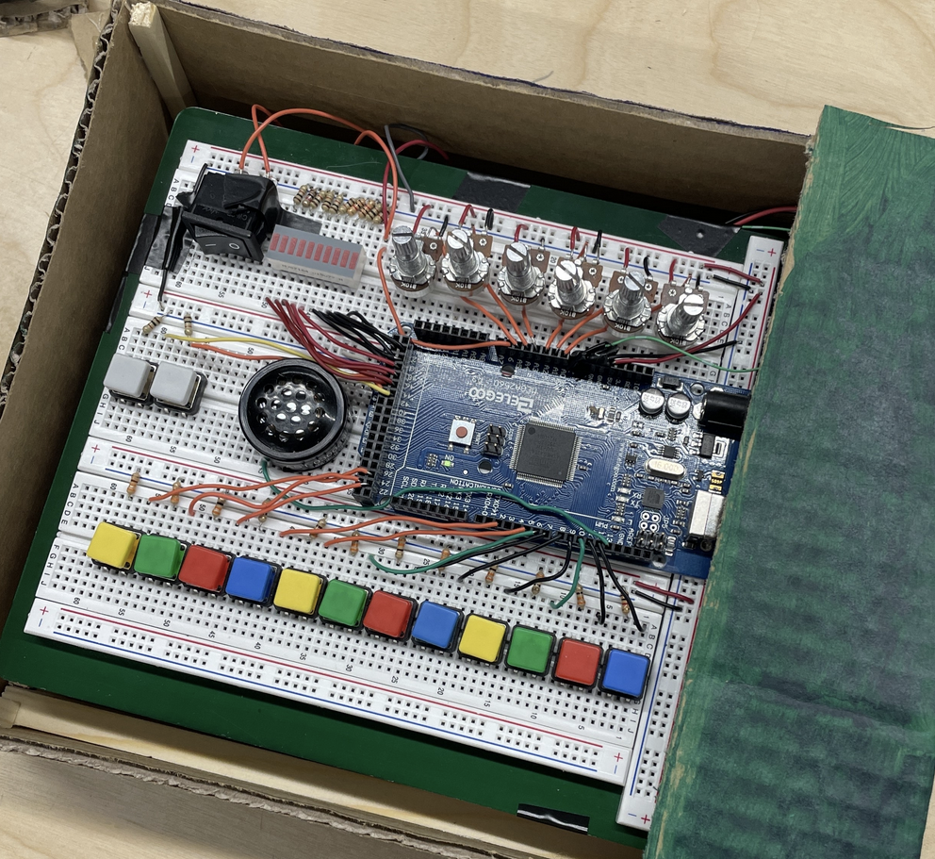
Why we made it…
ELECTRICAL & COMPUTER ENGINEERING
GRAINGER ENGINEERING
Notes:
D

Slide 3
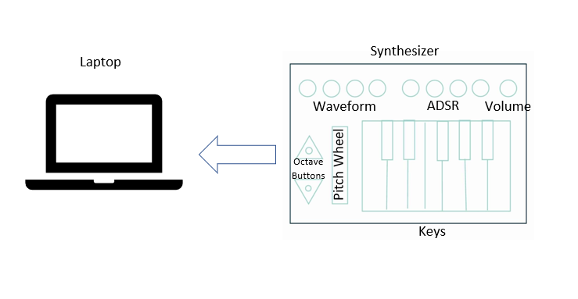
High Level Requirements
Input Functionality
Output Functionality
Power Functionality
ELECTRICAL & COMPUTER ENGINEERING
GRAINGER ENGINEERING
Notes:
D

Slide 4
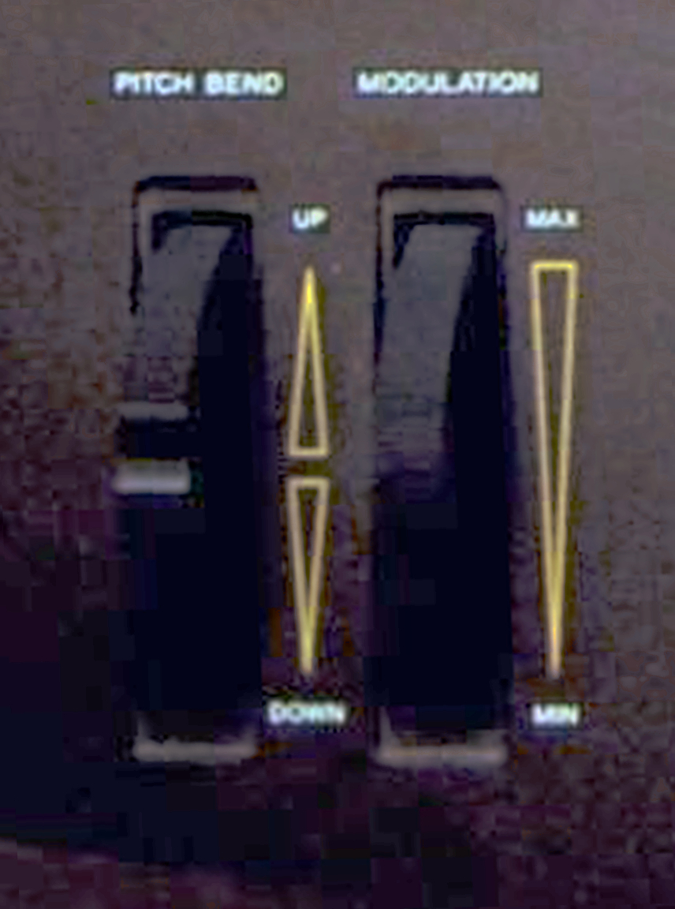
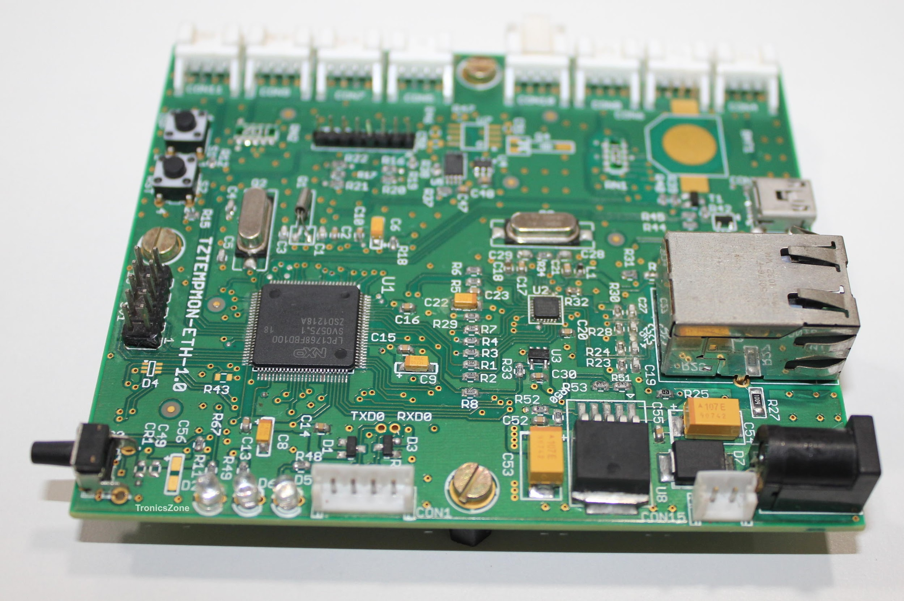
What Changed?
ELECTRICAL & COMPUTER ENGINEERING
GRAINGER ENGINEERING
Notes:
D

Slide 5
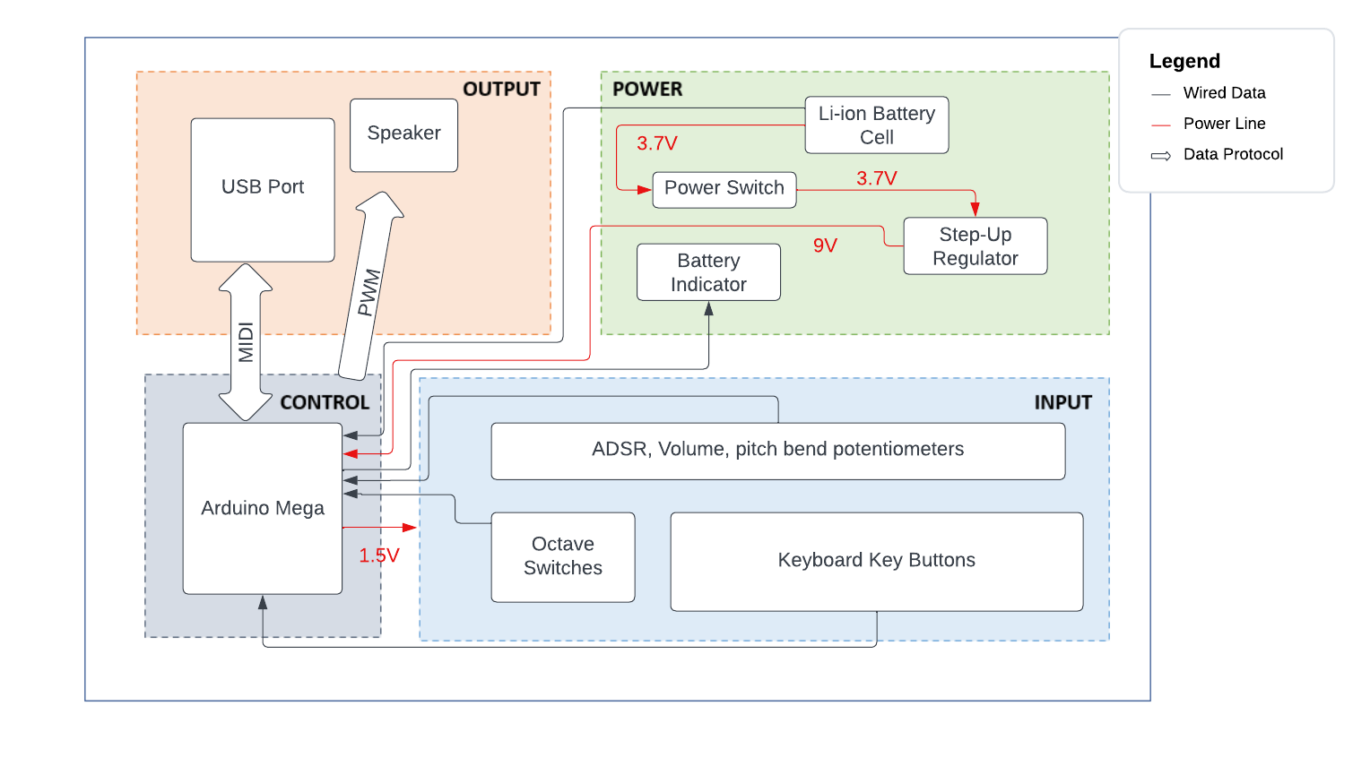
ELECTRICAL & COMPUTER ENGINEERING
GRAINGER ENGINEERING
Notes:
D

Slide 6
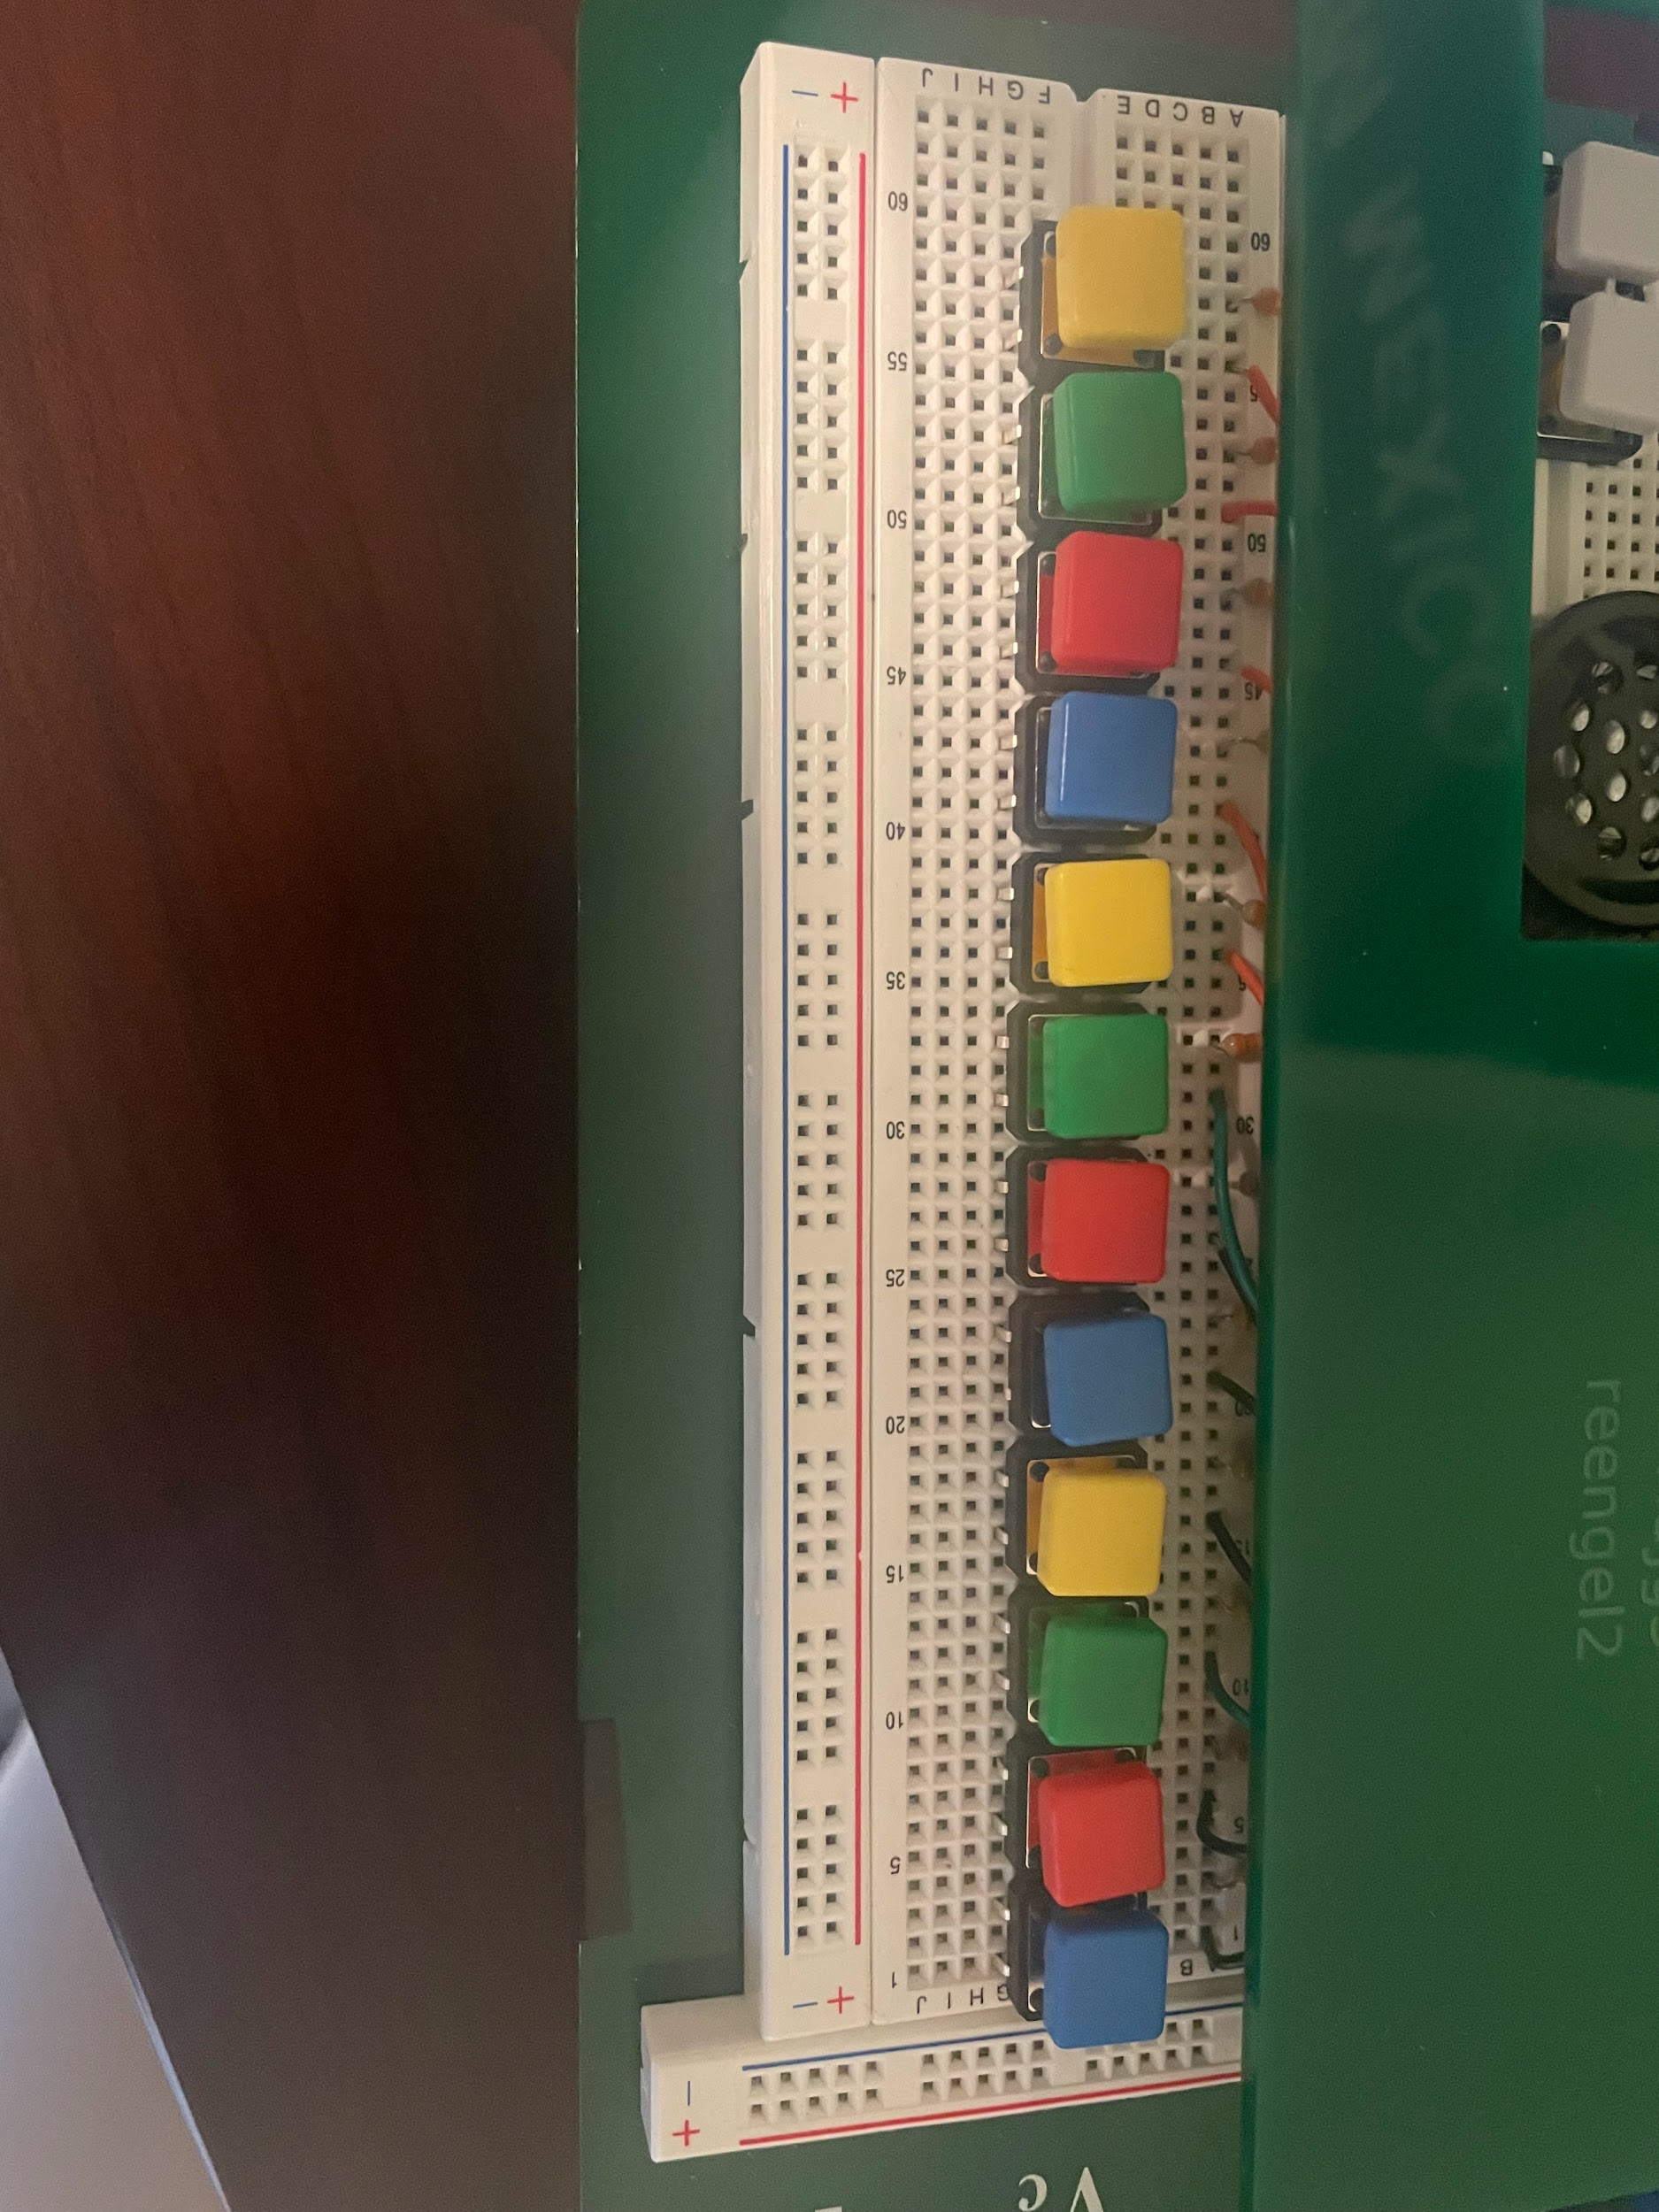
Buttons and Knobs
(Input Subsystem)
ELECTRICAL & COMPUTER ENGINEERING
GRAINGER ENGINEERING
Notes:
S

Slide 7
Inputs
Requirements | Verifications
Each piano key should send a distinct signal (13 total signals) to the Microcontroller Subsystem | Check using the Arduino that each signal is received and distinct
Octave changers and pitch bend wheel should change both the synthesized audio and the MIDI output by one octave or one whole tone either up or down respectively. | Verify functionality on the synthesized notes through examination of the speaker audio and voltmeter reading Verify proper MIDI functionality through examination of the MIDI messages output from the microcontroller
ELECTRICAL & COMPUTER ENGINEERING
GRAINGER ENGINEERING
Notes:
S

Slide 8
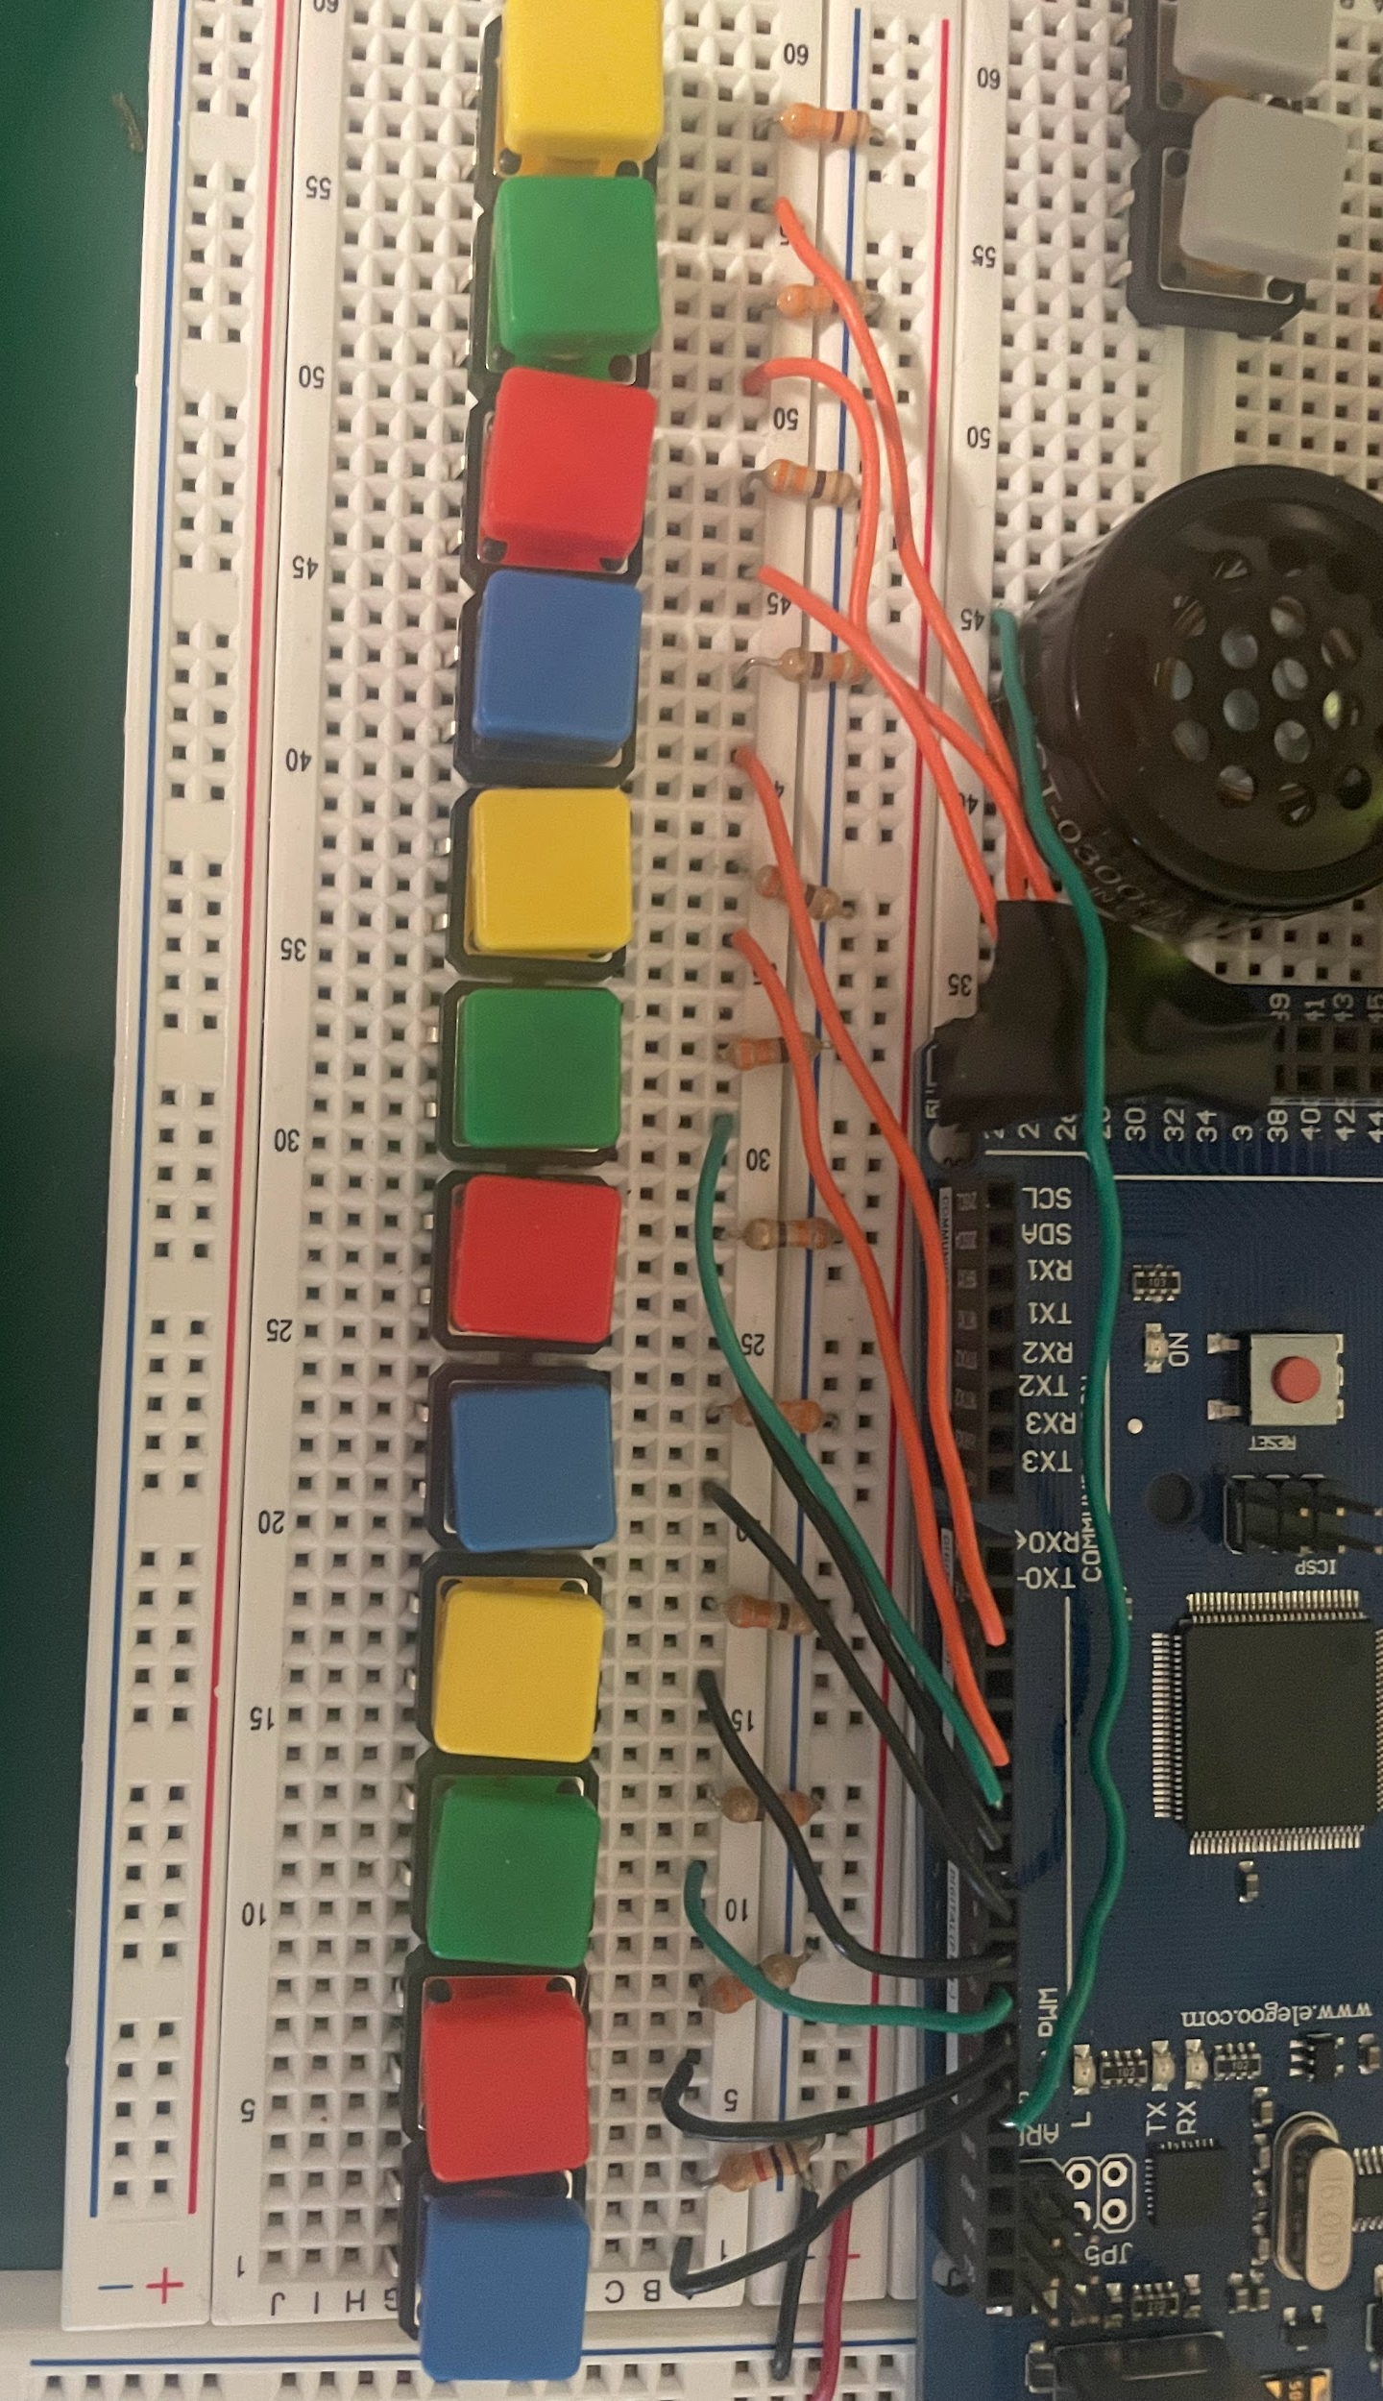
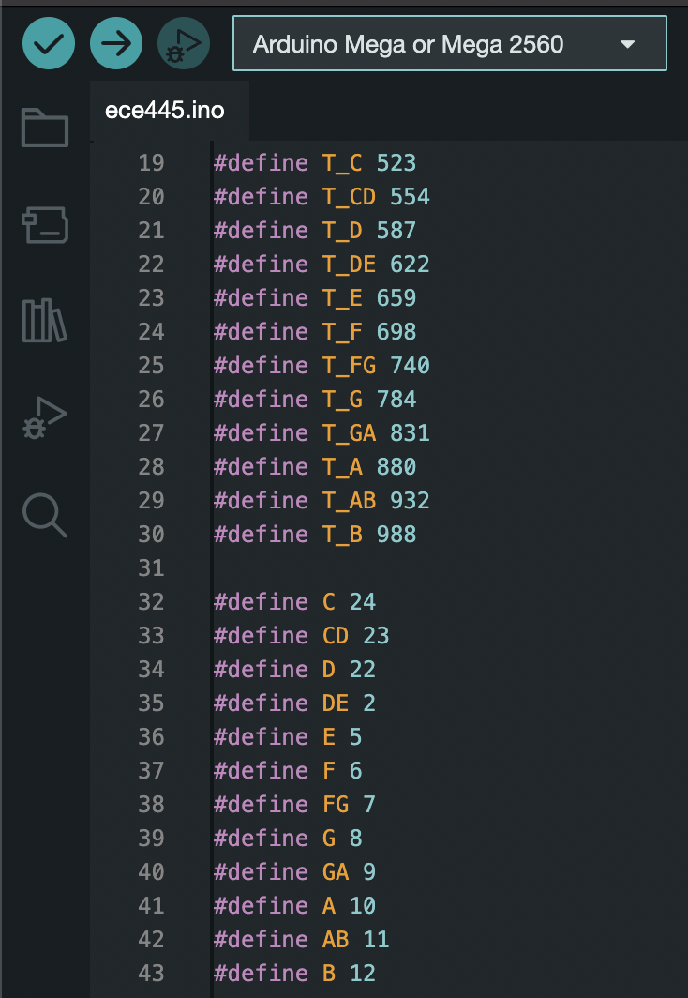
Notes
ELECTRICAL & COMPUTER ENGINEERING
GRAINGER ENGINEERING
Notes:
S

Slide 9
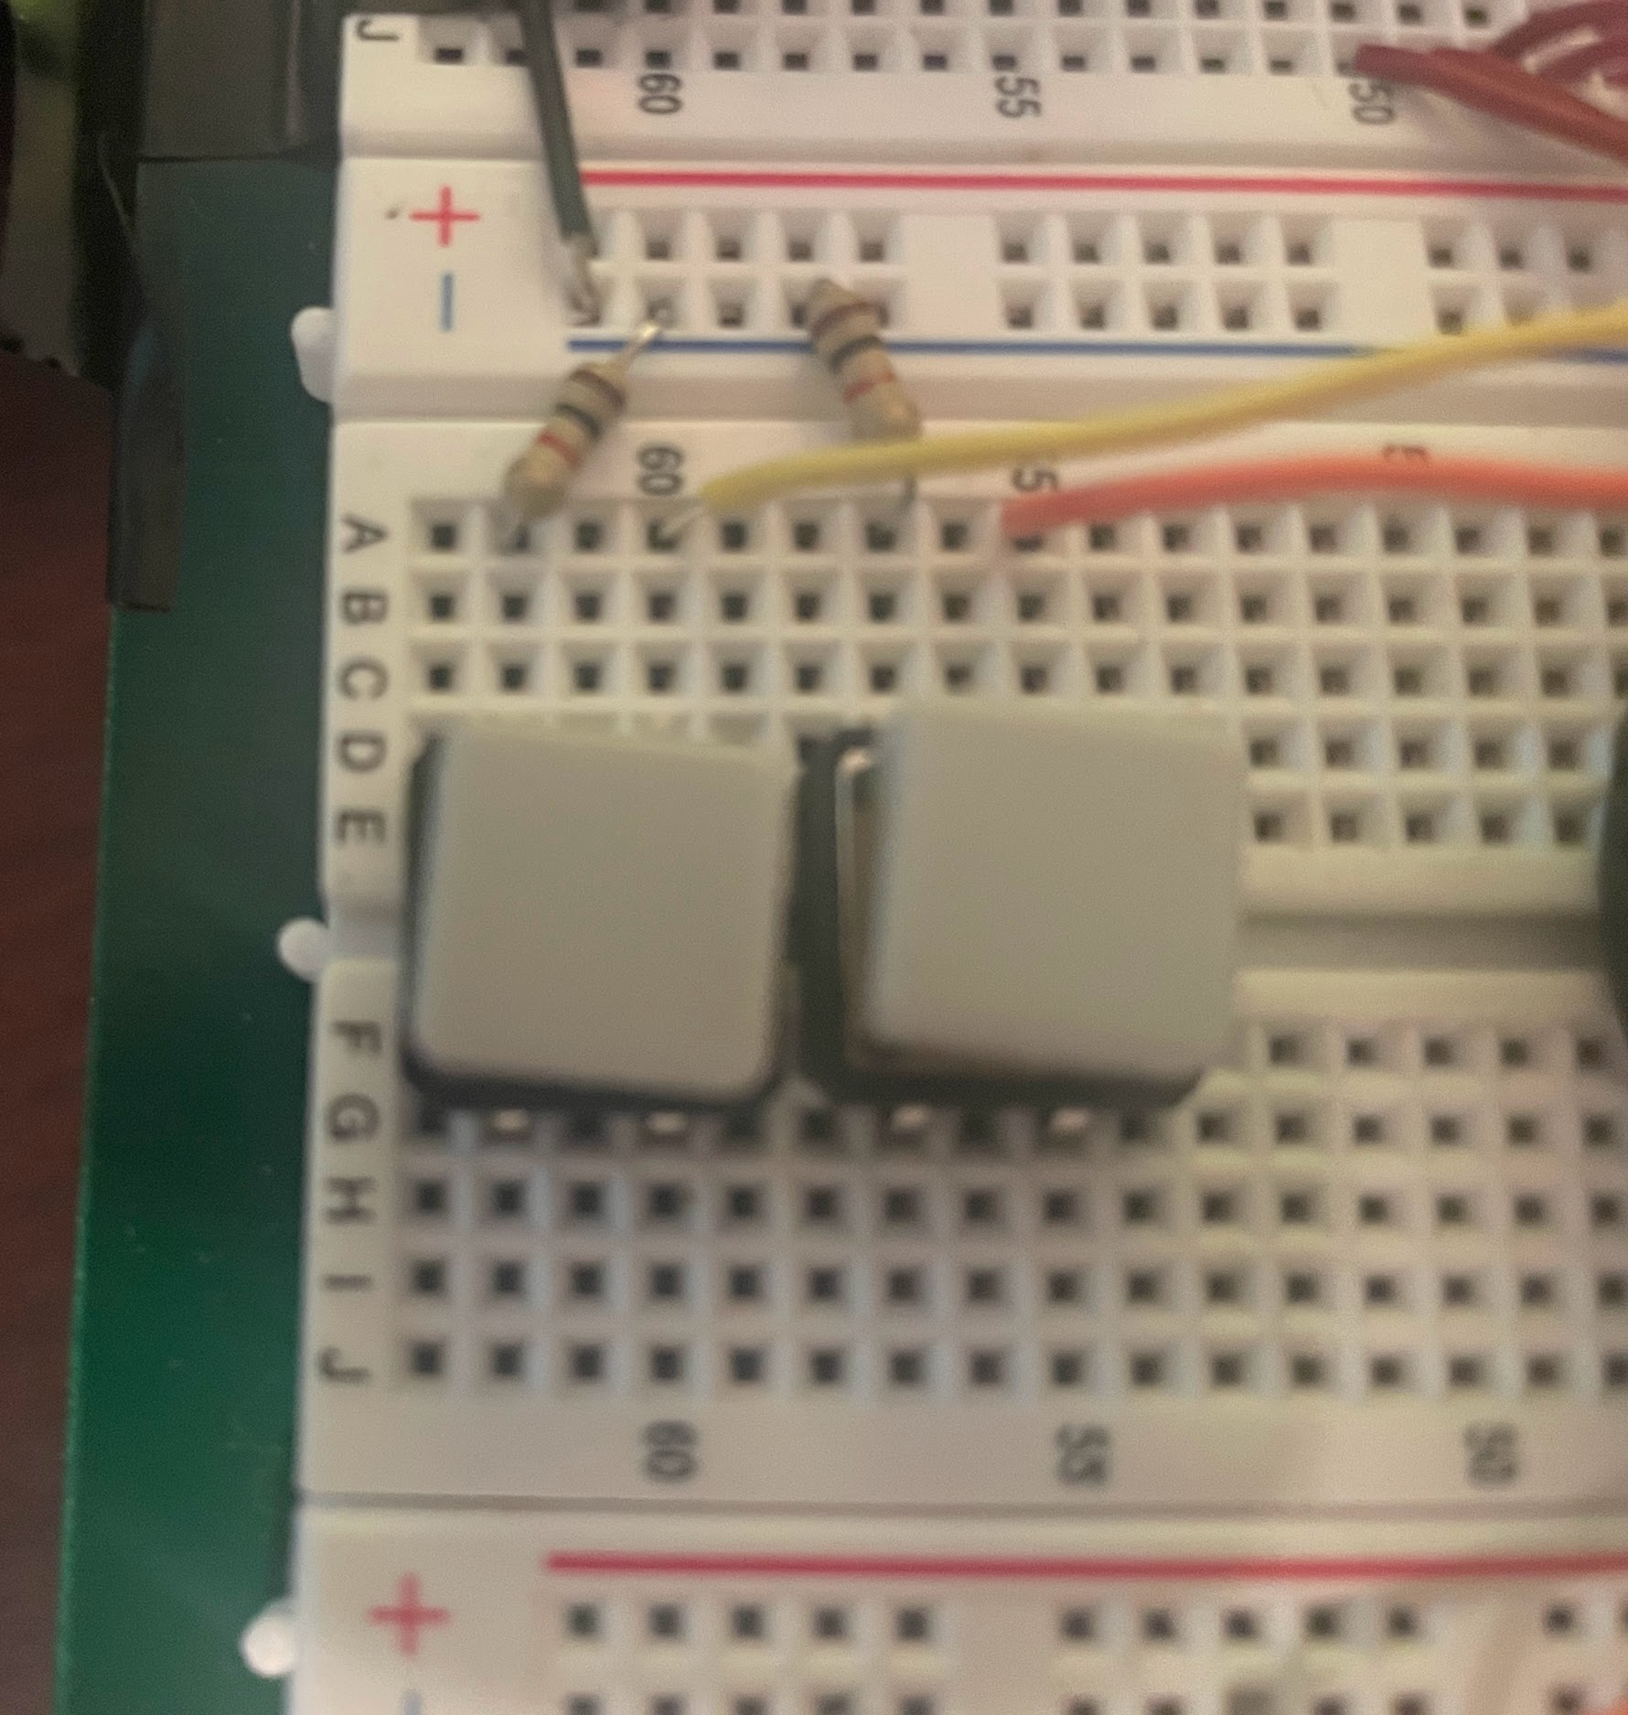
Octaves
ELECTRICAL & COMPUTER ENGINEERING
GRAINGER ENGINEERING
Notes:
S

Slide 10
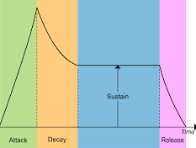
What is ADSR?
ELECTRICAL & COMPUTER ENGINEERING
GRAINGER ENGINEERING
Notes:
S

Slide 11
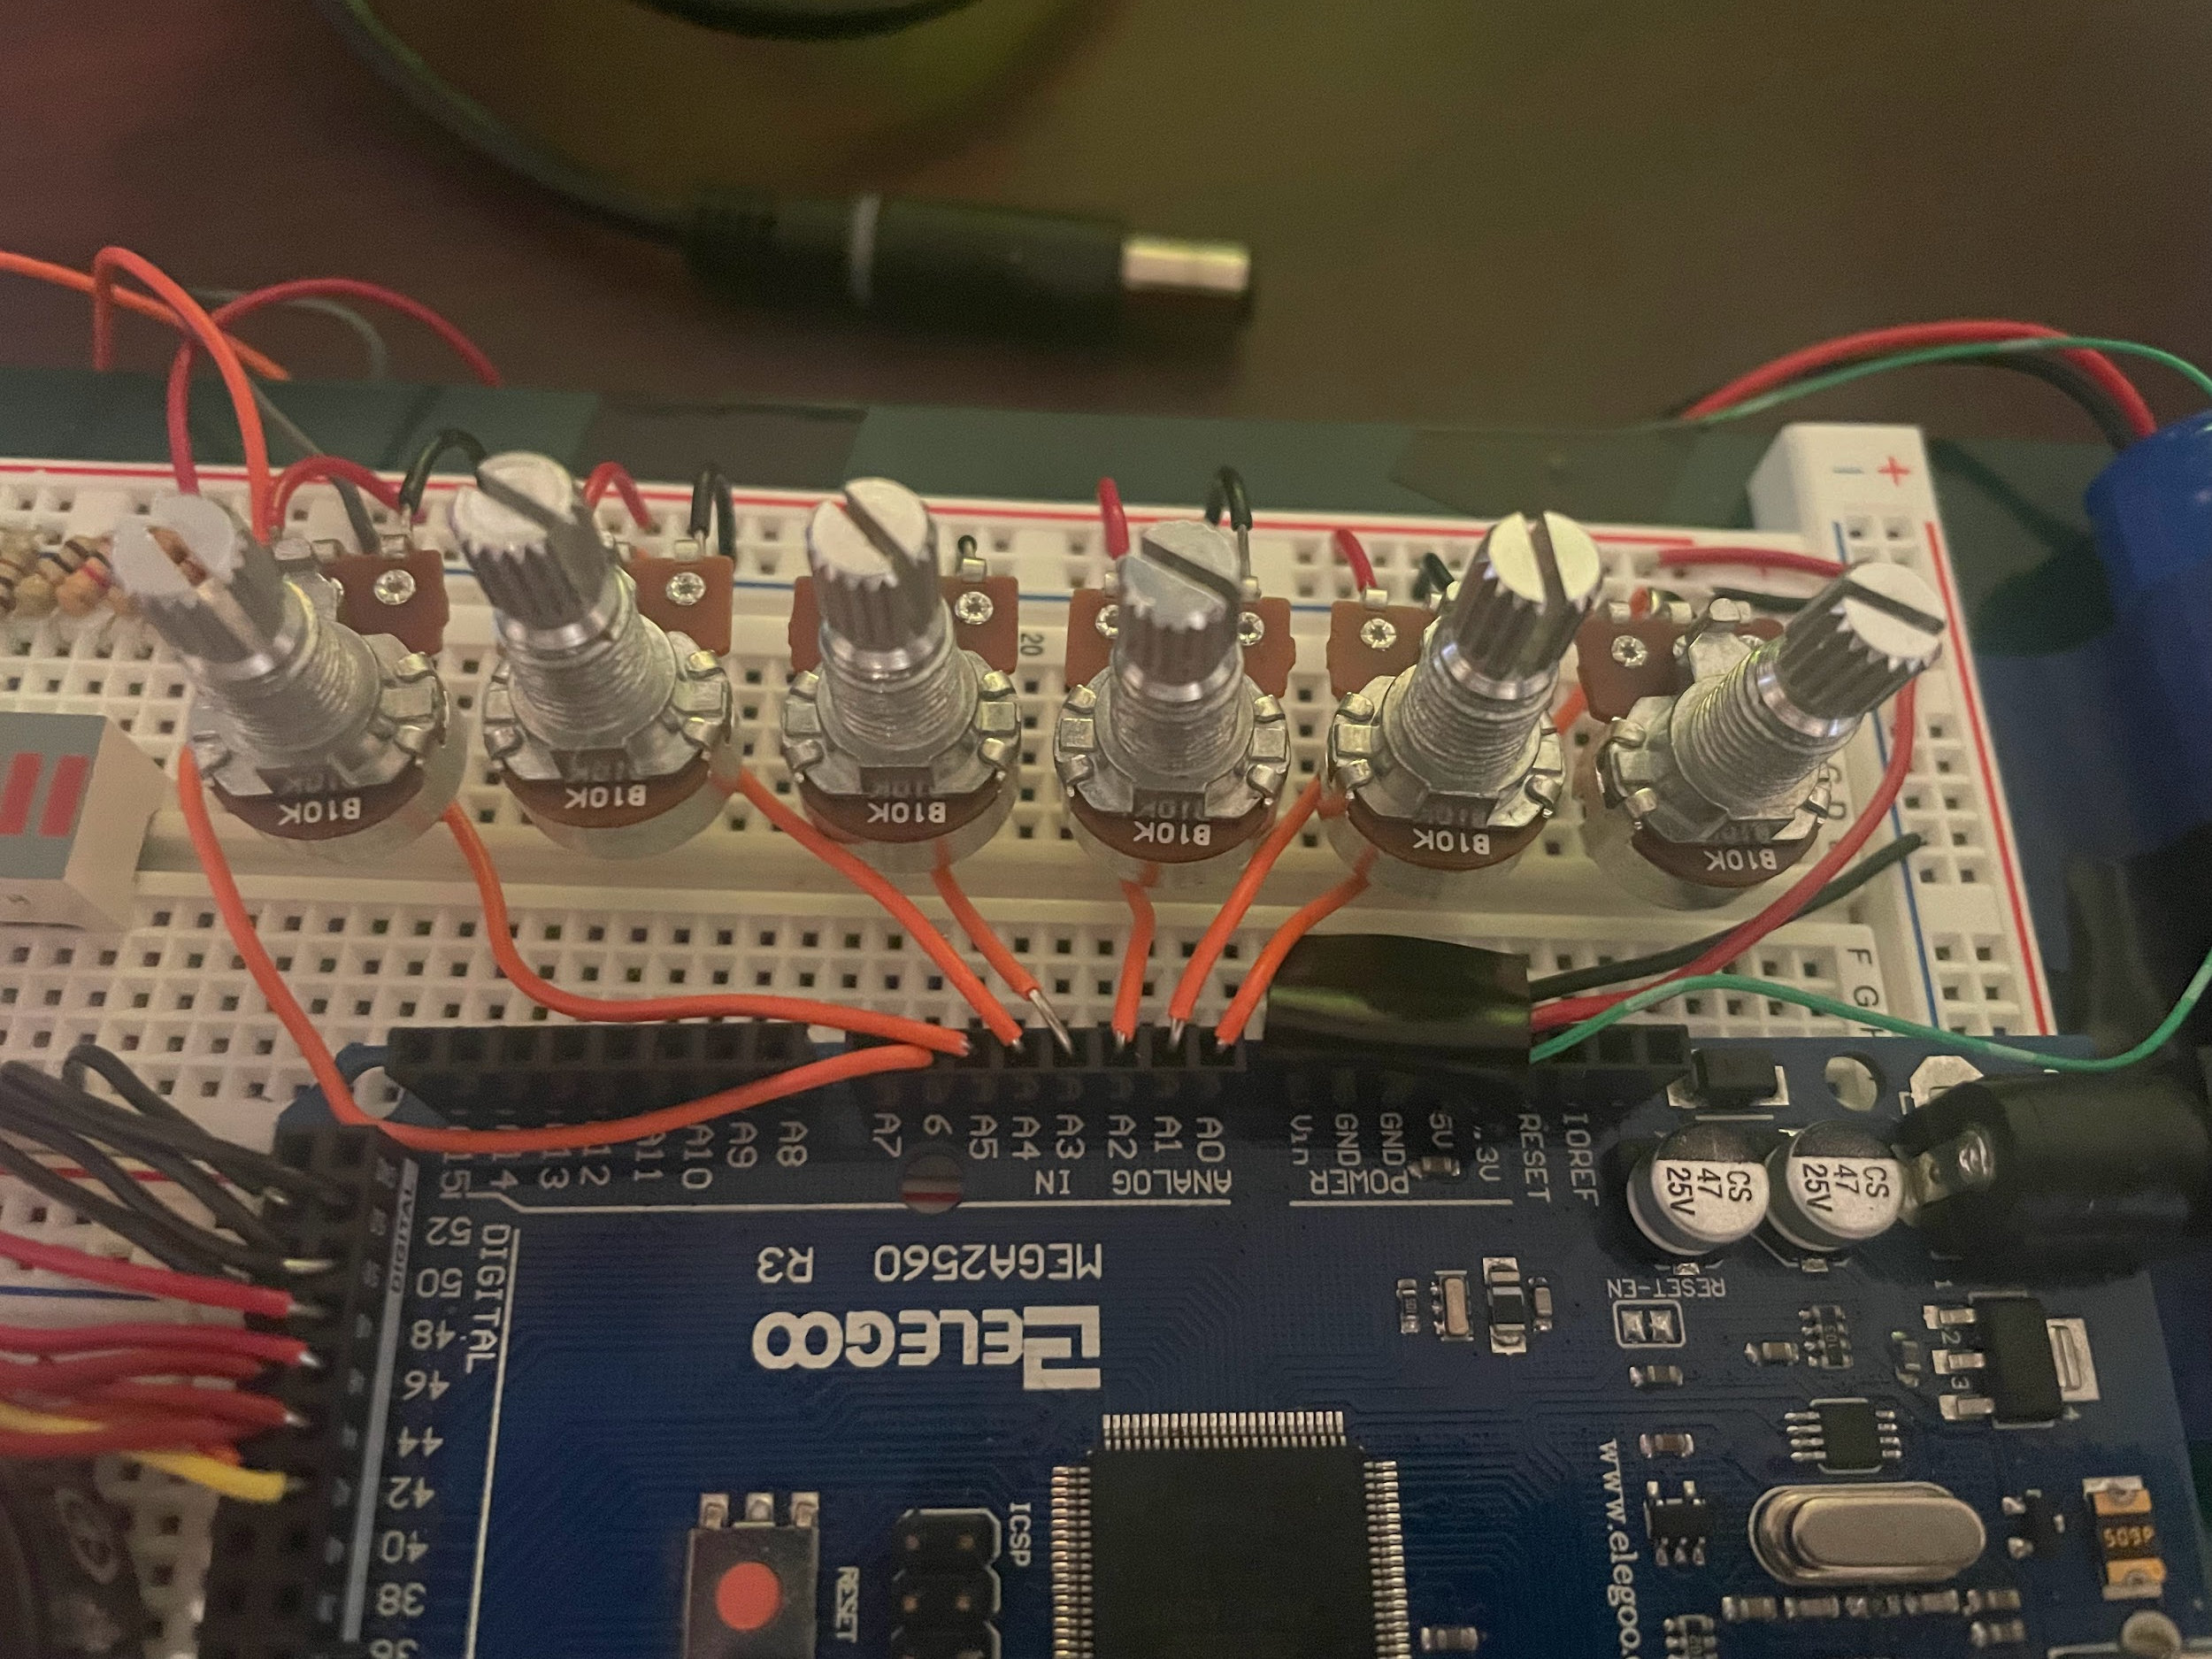
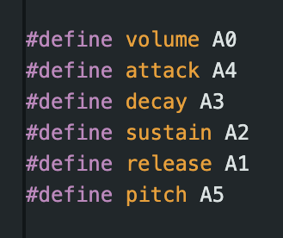
Potentiometers
ELECTRICAL & COMPUTER ENGINEERING
GRAINGER ENGINEERING
Notes:
S

Slide 12
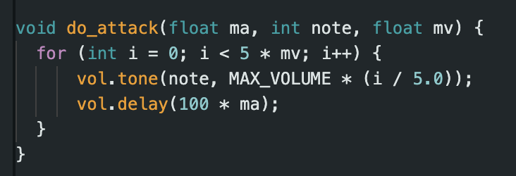
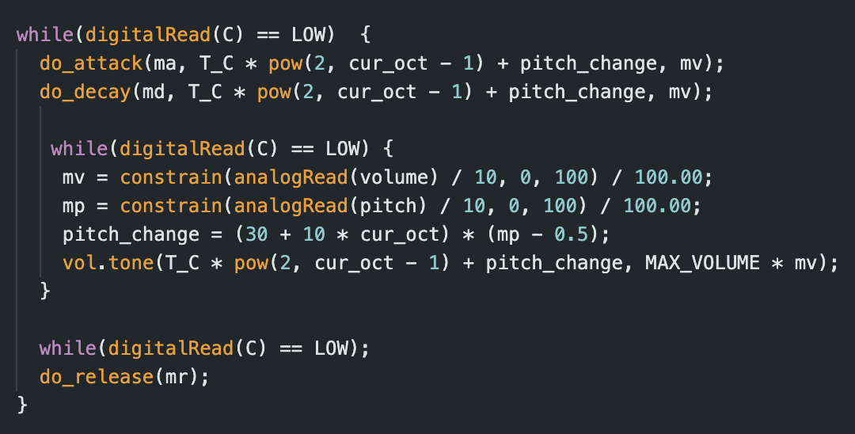
ELECTRICAL & COMPUTER ENGINEERING
GRAINGER ENGINEERING
Notes:
S

Slide 13
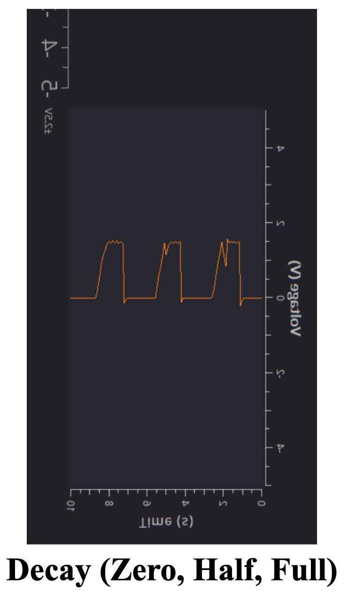
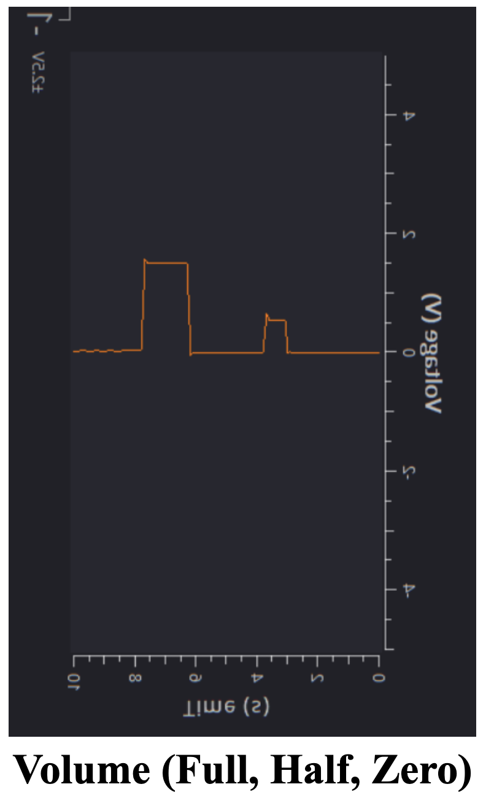
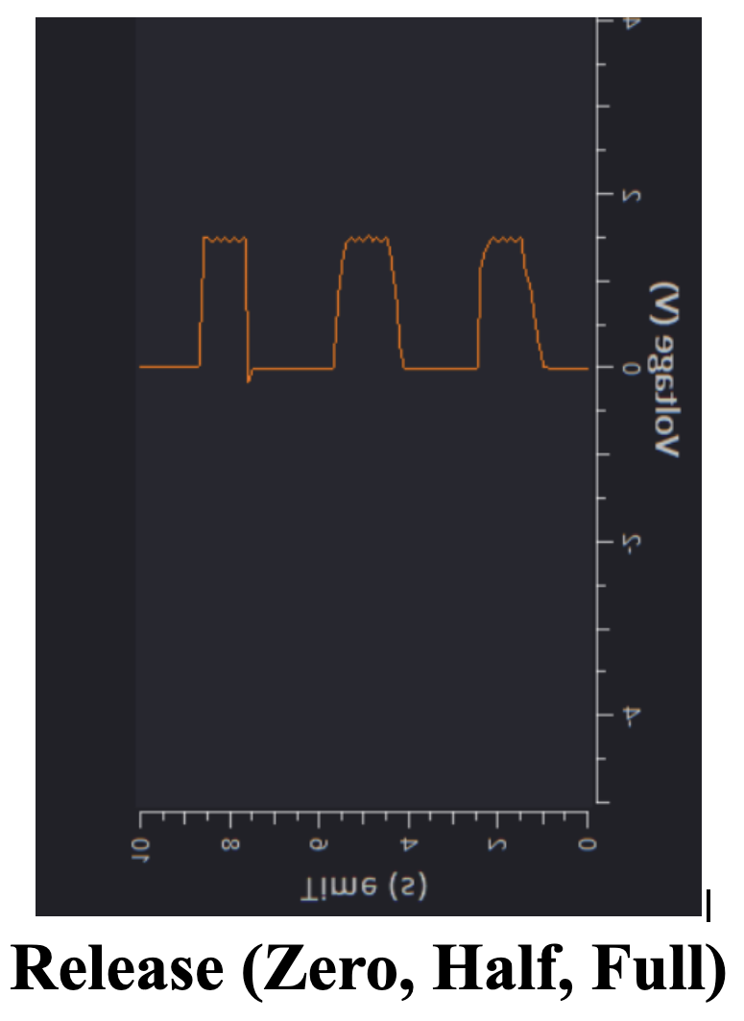
Results
ELECTRICAL & COMPUTER ENGINEERING
GRAINGER ENGINEERING
Notes:
S

Slide 14
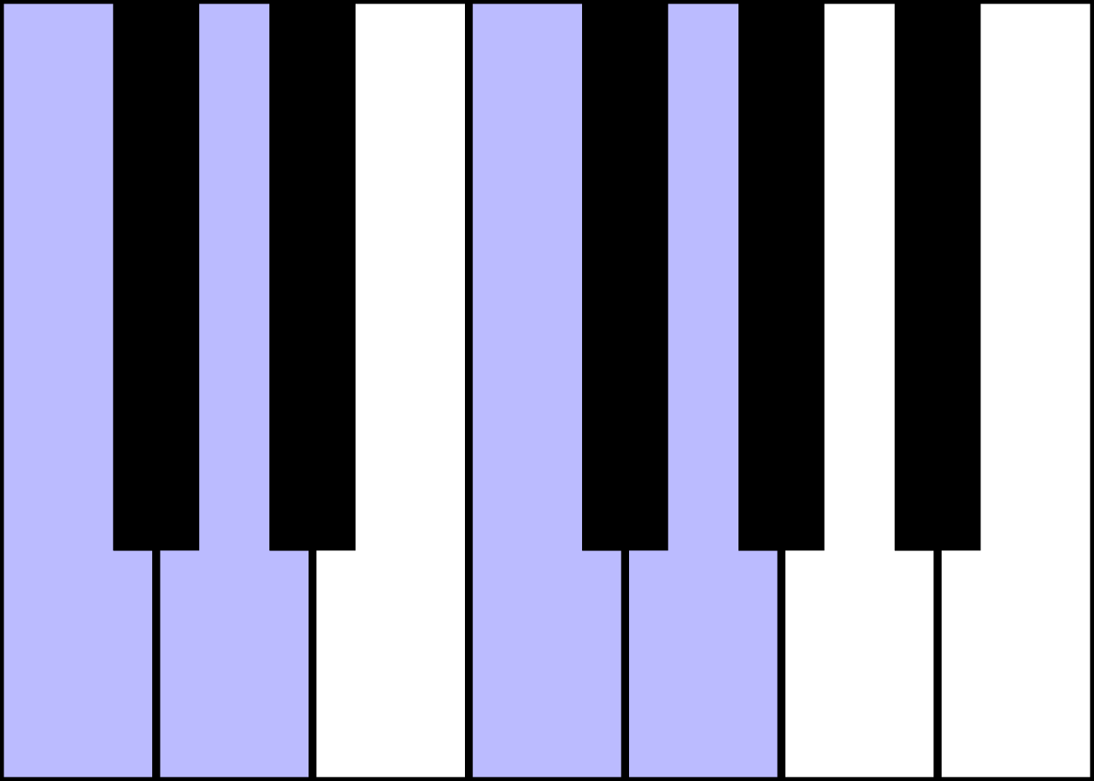
Challenges
Correct soldering
Noticeable Changes for Delay and Sustain
Multi-Tones/Chords
ELECTRICAL & COMPUTER ENGINEERING
GRAINGER ENGINEERING
Notes:
S

Slide 15
Speaker
(Output Subsystem)
ELECTRICAL & COMPUTER ENGINEERING
GRAINGER ENGINEERING
Notes:
R

Slide 16
Sound
Requirements | Verifications
Speaker can produce sounds between 150Hz and 1900 Hz | In a largely volume-free room, point speaker towards microphone on piano tuner. Use this to measure frequency response of speaker at lowest and highest setting.
Speaker can produce sounds up to at least 60 dB at full volume. | Computer software like TrueRTA or REW can test volume readings of our speaker very accurately, so we will do the same microphone testing with our driver to check the volume
ELECTRICAL & COMPUTER ENGINEERING
GRAINGER ENGINEERING
Notes:
R

Slide 17
Verification
Note Frequency (Hz)
ELECTRICAL & COMPUTER ENGINEERING
GRAINGER ENGINEERING
Notes:
R

Slide 18
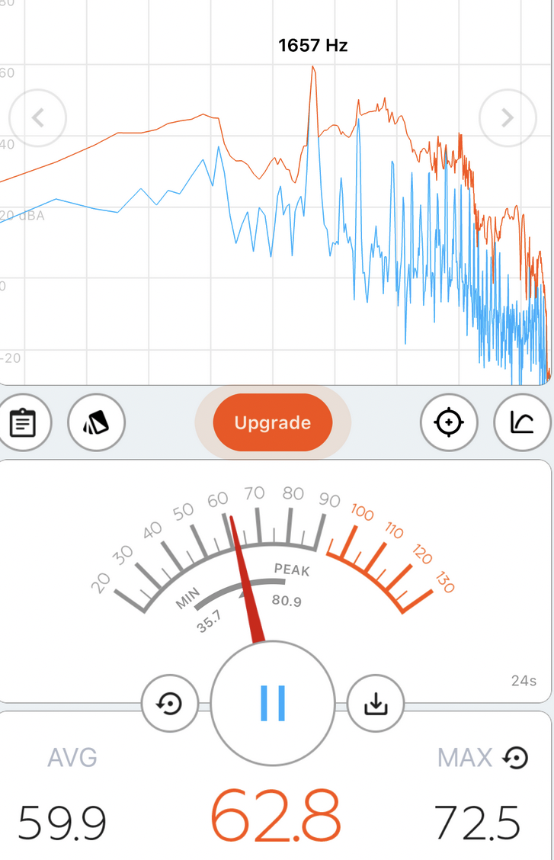
ELECTRICAL & COMPUTER ENGINEERING
GRAINGER ENGINEERING
Notes:
R

Slide 19
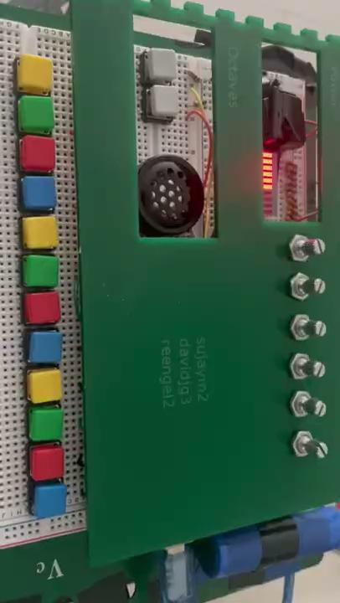
ELECTRICAL & COMPUTER ENGINEERING
GRAINGER ENGINEERING
Notes:
R

Slide 20
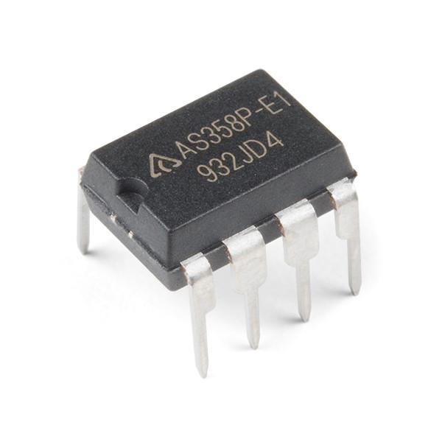
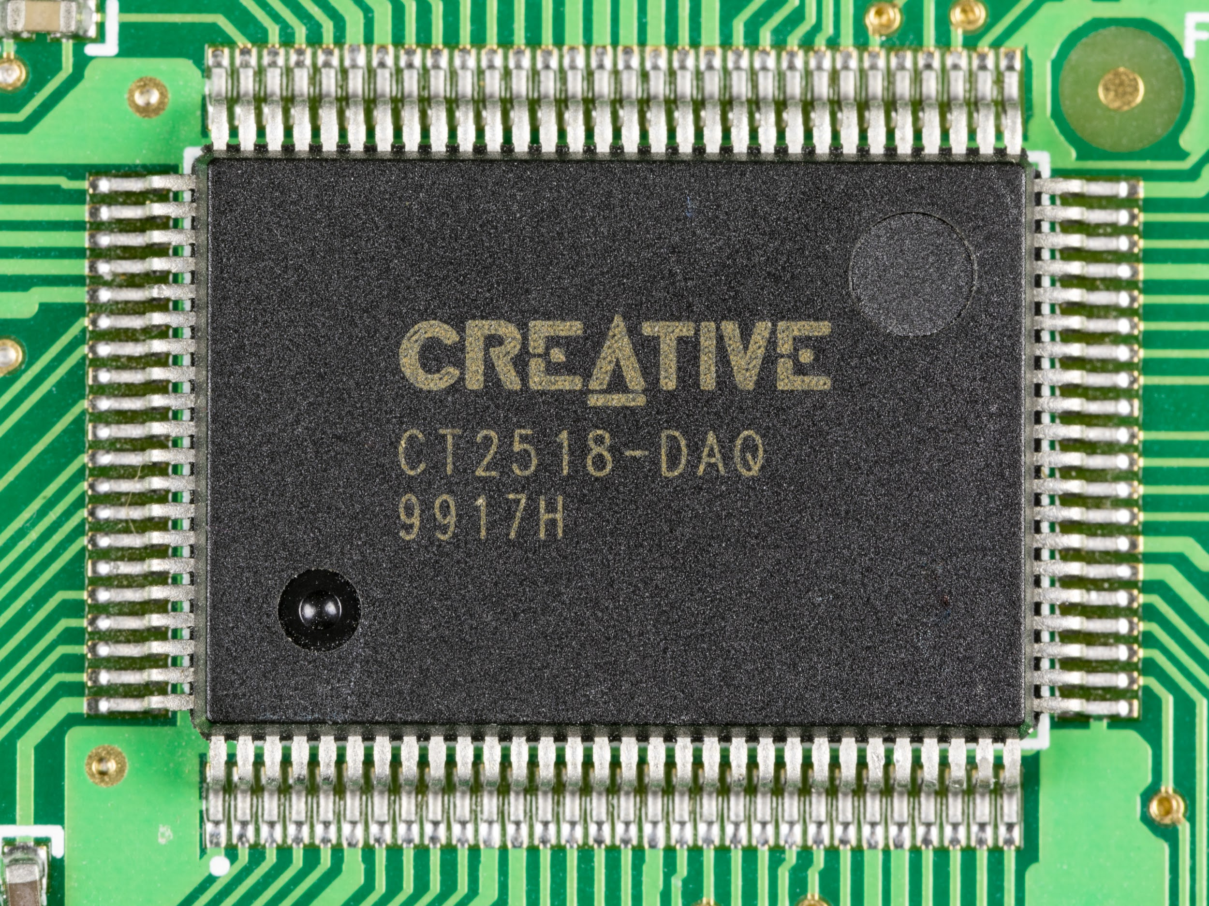
Still a little quiet
ELECTRICAL & COMPUTER ENGINEERING
GRAINGER ENGINEERING
Notes:
R

Slide 21
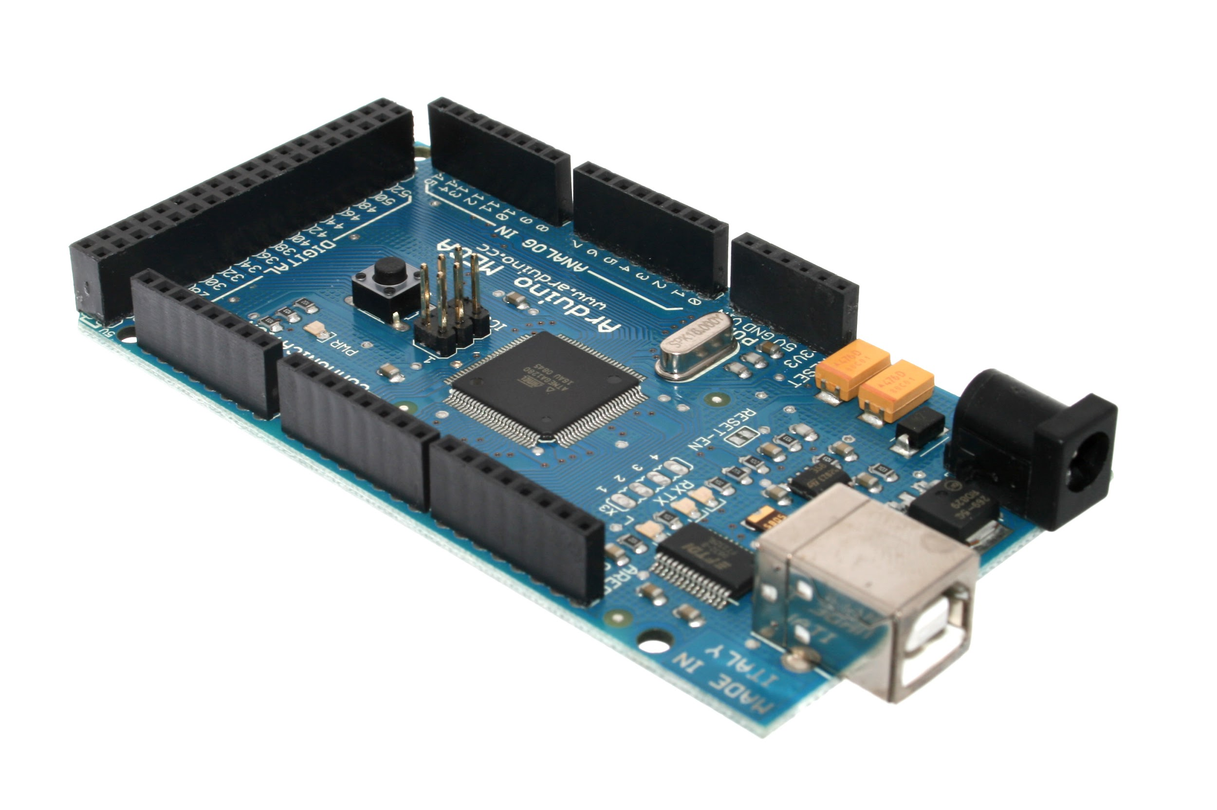
Arduino (Microcontroller Subsystem)
ELECTRICAL & COMPUTER ENGINEERING
GRAINGER ENGINEERING
Notes:
D

Slide 22
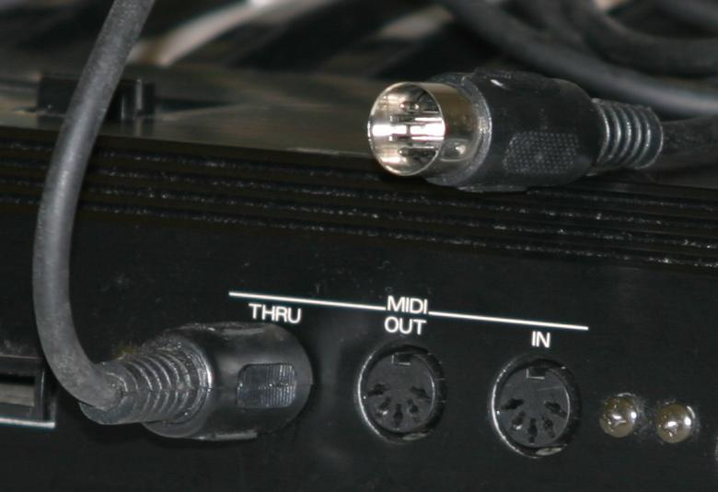
What is MIDI?
Musical Instrument Digital Interface
Protocol for Digital Audio Workstation (DAWs)
Allows DAWs to understand musical notes
Command, Note, Volume
ELECTRICAL & COMPUTER ENGINEERING
GRAINGER ENGINEERING
Notes:
D

Slide 23
Outputs
Requirements | Verifications
The microcontroller successfully performs digital audio synthesis and outputs the data in SPI form | Sensor data is processed and converted to SPI by using an oscilloscope with a high-impedance multimeter.
The microcontroller successfully generates MIDI messages based on the input | Connect the microcontroller to a Windows computer via USB. Using Ableton, see if MIDI messages are being translated through the microcontroller onto the computer
ELECTRICAL & COMPUTER ENGINEERING
GRAINGER ENGINEERING
Notes:
D

Slide 24
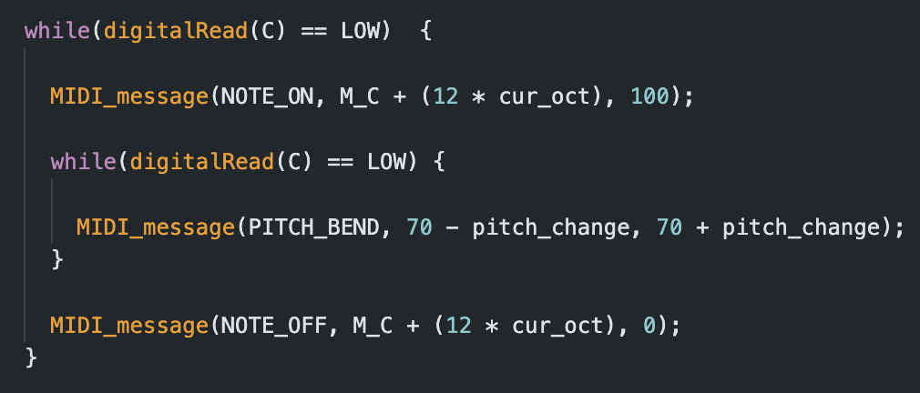
ELECTRICAL & COMPUTER ENGINEERING
GRAINGER ENGINEERING
Notes:
S

Slide 25
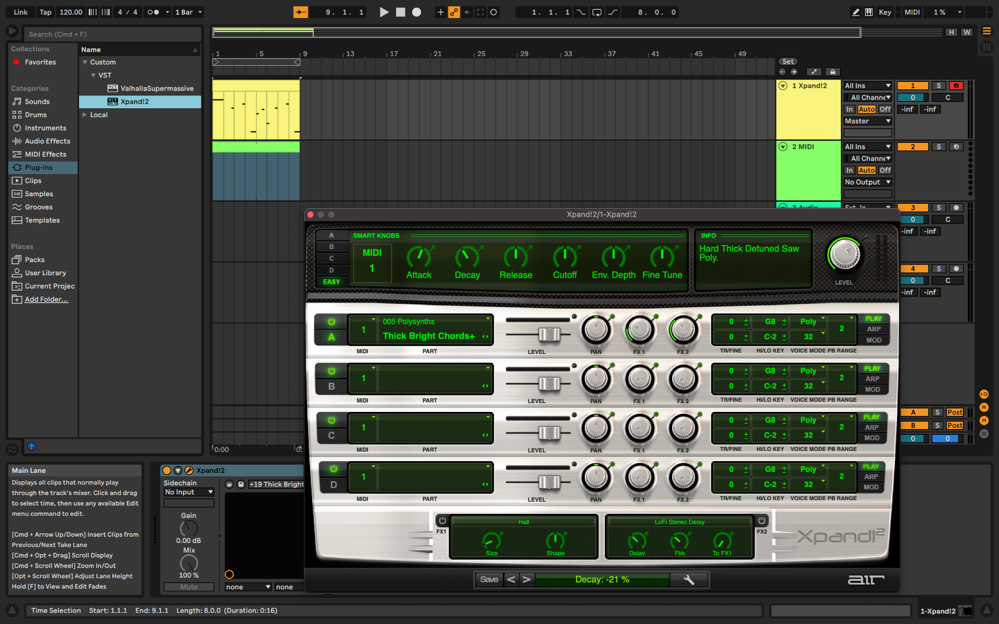
ELECTRICAL & COMPUTER ENGINEERING
GRAINGER ENGINEERING
Notes:
S

Slide 26
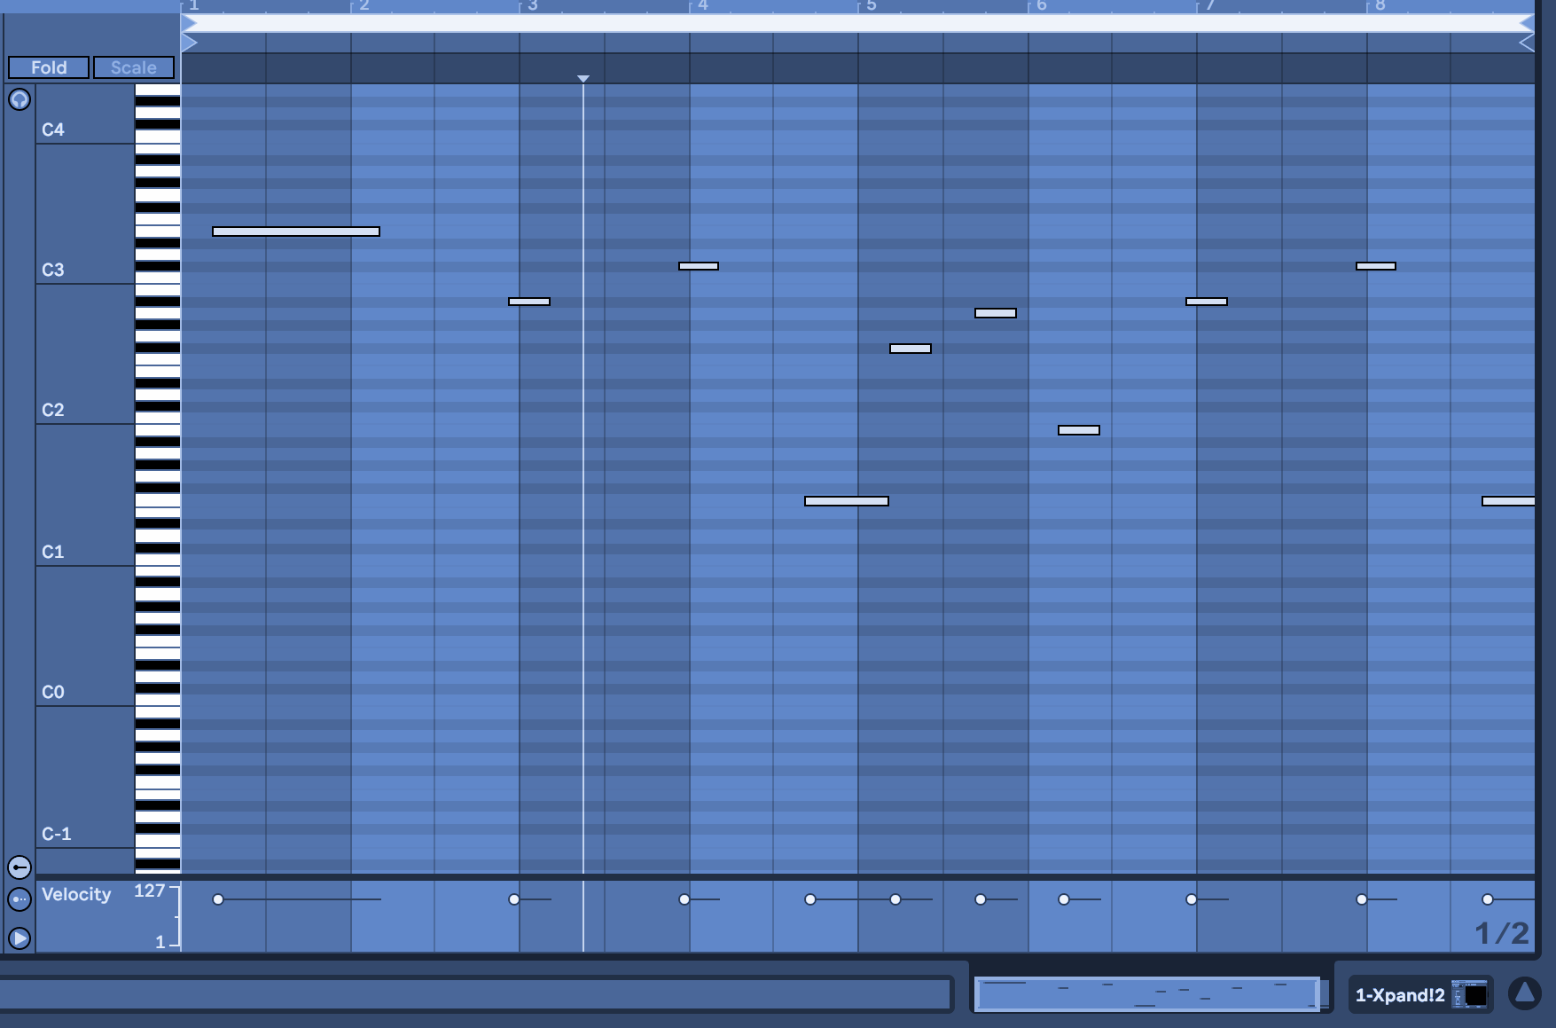
Takeaways…
MIDI Loops!
Incorporating more functionality (octaves, ADSR)
Still no chords…
Clean up code, use MIDI pin to reduce latency, add loop recordings
ELECTRICAL & COMPUTER ENGINEERING
GRAINGER ENGINEERING
Notes:
S

Slide 27
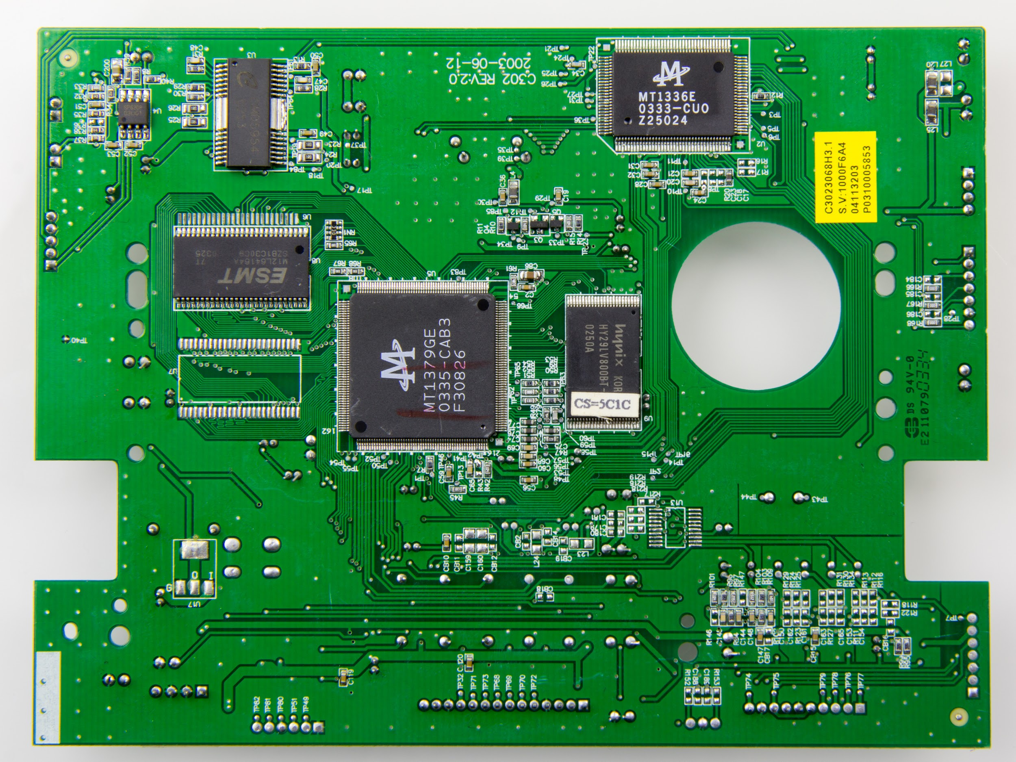
Turning it on and off
(Power Subsystem)
ELECTRICAL & COMPUTER ENGINEERING
GRAINGER ENGINEERING
Notes:
R

Slide 28
Power
Requirements | Verifications
The power system successfully supplies 7V-12V of power to the microcontroller | Ensure that when the battery is not powered on that the Vin to the microcontroller is 0 Volts Ensure that when the battery is turned on the microcontroller Vin is greater than or equal to 7 Volts
The battery life can last at least 3 hours from a full charge | Measure a 9 Volts or greater as input to the microcontroller at any moment within 3 hours of turning the battery on
LED bar graph can display battery life in 10% increments | Monitor the LED bar graph as the battery drains
ELECTRICAL & COMPUTER ENGINEERING
GRAINGER ENGINEERING
Notes:
R

Slide 29
PCB Components
Battery Connector
Step-Up Voltage Regulator
Rocker Switch
ELECTRICAL & COMPUTER ENGINEERING
GRAINGER ENGINEERING
Notes:
R

Slide 30
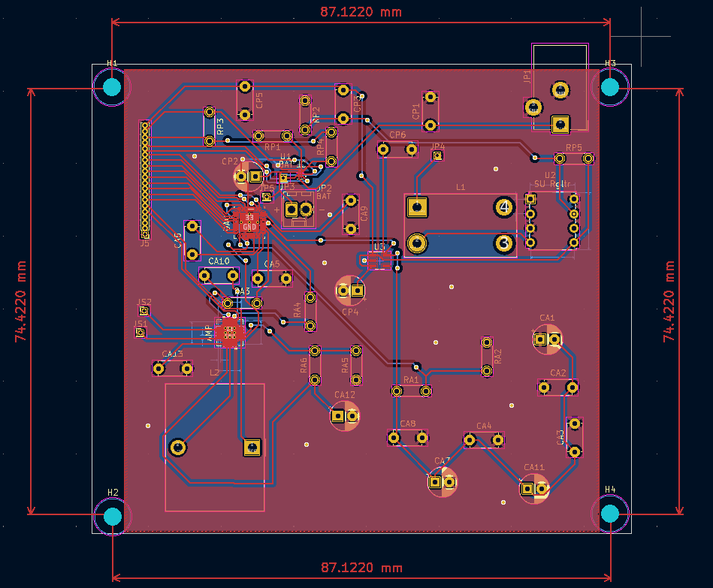
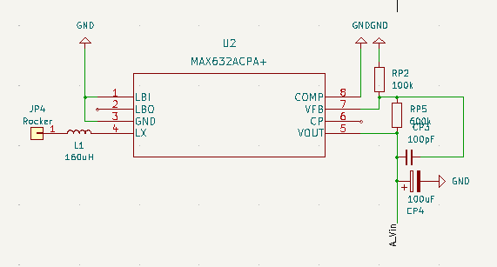
Design
ELECTRICAL & COMPUTER ENGINEERING
GRAINGER ENGINEERING
Notes:
R

Slide 31
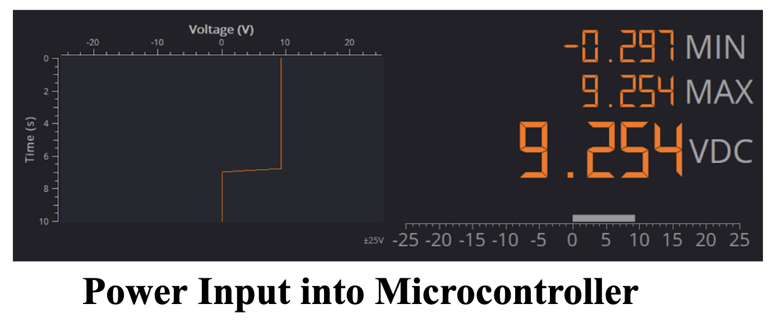
ELECTRICAL & COMPUTER ENGINEERING
GRAINGER ENGINEERING
Notes:
R

Slide 32
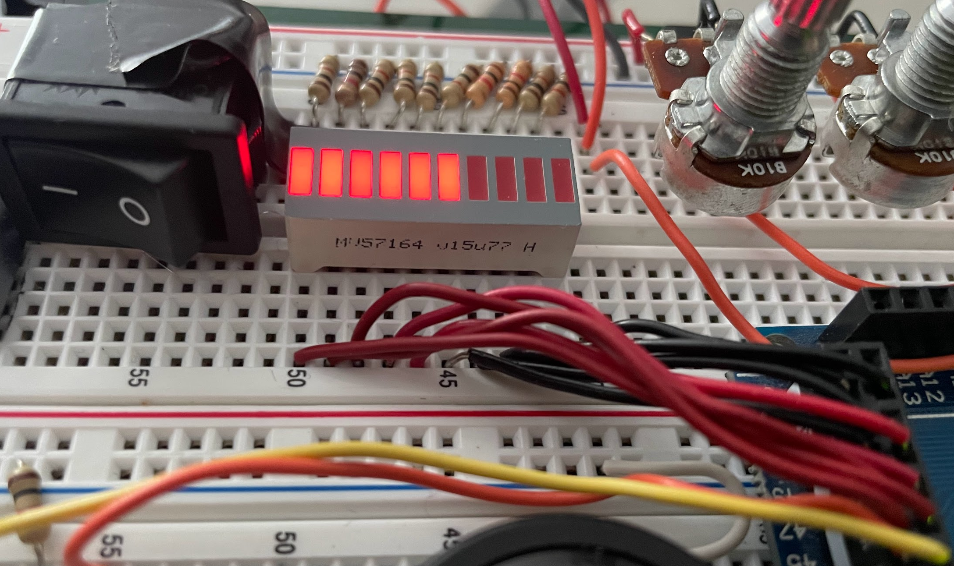
LED Battery Graph
ELECTRICAL & COMPUTER ENGINEERING
GRAINGER ENGINEERING
Notes:
R

Slide 33
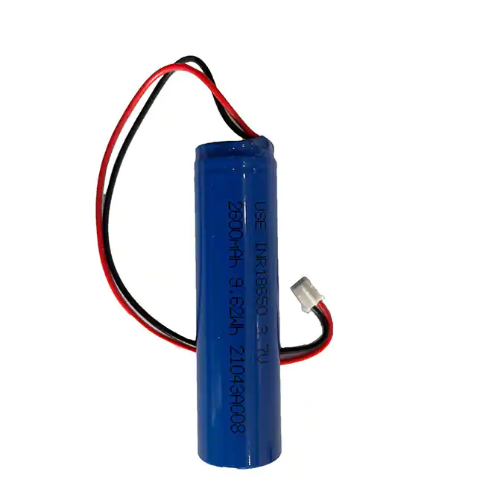
Power Draw
\
Only significant power draw from battery is Arduino Mega
25 output ports
Each port has a maximum current draw of 20ma, resulting in maximum total current of 500ma
With a battery capacity of 2600 mAh, this should result in a minimum battery life of ~5 hours.
ELECTRICAL & COMPUTER ENGINEERING
GRAINGER ENGINEERING
Notes:
R

Slide 34
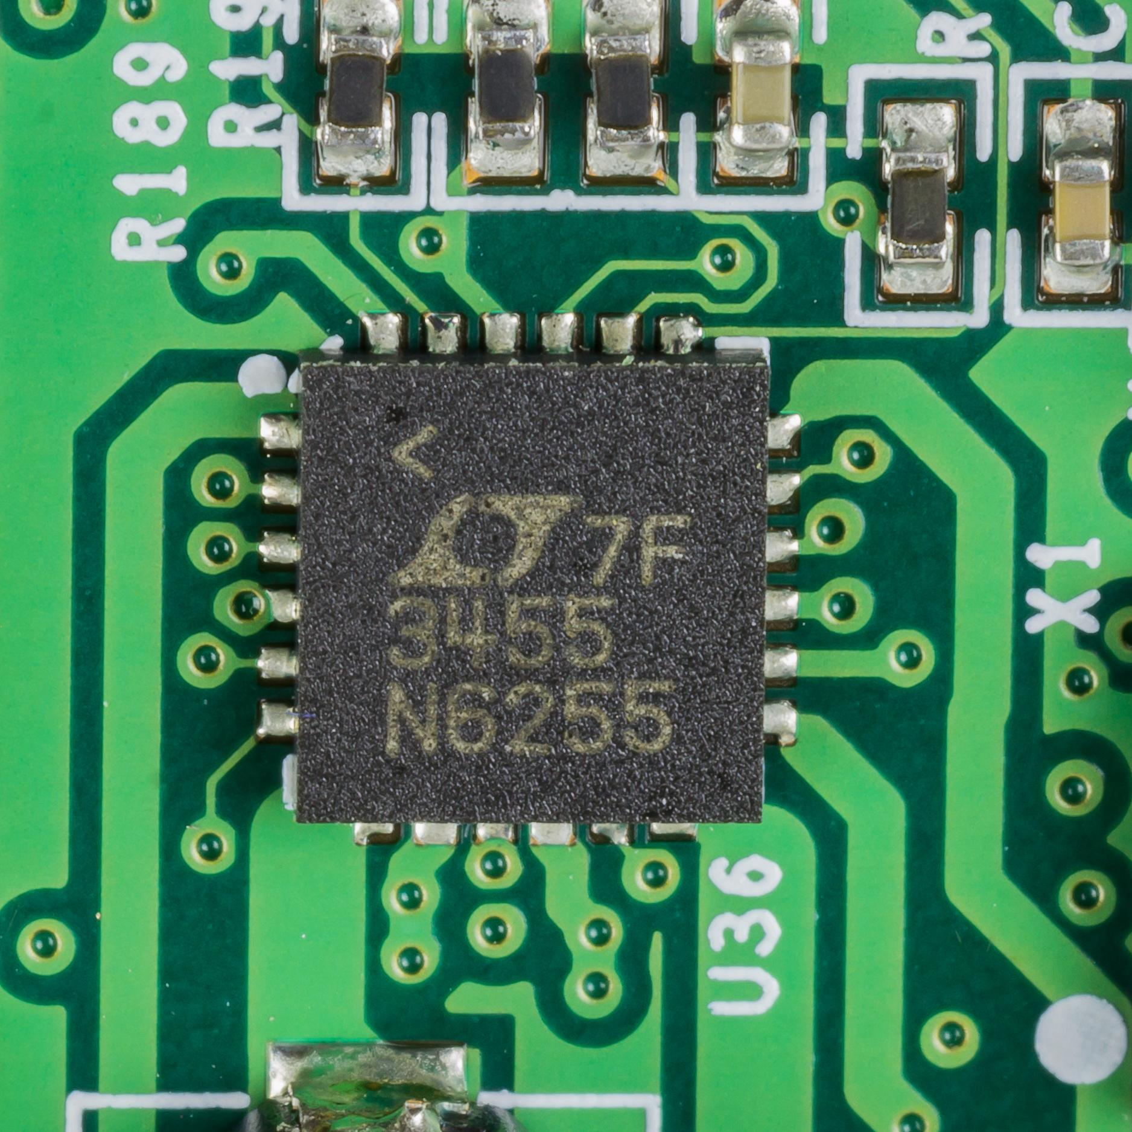
Takeaways…
Performance remained
consistent
Linear Charger and
rechargeability
Better battery for more
parts
ELECTRICAL & COMPUTER ENGINEERING
GRAINGER ENGINEERING
Notes:
R

Slide 35
In conclusion:
More parts; DAC, MIDI Pin, Charger
Incorporate more into PCB
$91.15 in parts!
Fulfilled high level requirements
ELECTRICAL & COMPUTER ENGINEERING
GRAINGER ENGINEERING
Notes:
D

Slide 36
Thank You!
ELECTRICAL & COMPUTER ENGINEERING
GRAINGER ENGINEERING

