Slide 1
CS/ECE 438: Communication Networks
Fall 2019
3. Transport Layer

Slide 2
Chapter 3: Transport Layer
application
transport
network
link
physical

Slide 3
Chapter 3: Transport Layer
our goals:
understand principles behind transport layer services:
  multiplexing, demultiplexing
  reliable data transfer
  flow control
  congestion control
learn about Internet transport layer protocols:
  UDP: connectionless transport
  TCP: connection-oriented reliable transport
  TCP congestion control

Slide 4
Chapter 3: Outline
  Transport Layer Services
  Multiplexing and Demultiplexing
  Connectionless Transport: UDP
  Principles of Reliable Data Transfer
  Connection-Oriented Transport: TCP
  Principles of Congestion Control
  TCP Congestion Control

Slide 5

















Transport services and protocols
provide logical communication between app processes running on different hosts
transport protocols run in end systems
  send side: breaks app messages into segments, passes to network layer
  rcv side: reassembles segments into messages, passes to app layer
more than one transport protocol available to apps
  Internet: TCP and UDP
application
transport
network
data link
physical
logical end-end transport
application
transport
network
data link
physical

Slide 6
Transport vs. Network Layer
household analogy:
network layer: logical communication between hosts
transport layer: logical communication between processes
  relies on, enhances, network layer services
12 kids in Ann’s house sending letters to 12 kids in Bill’s house:
hosts = houses
processes = kids
app messages = letters in envelopes
transport protocol = Ann and Bill who demux to in-house siblings
network-layer protocol = postal service

Slide 7
Internet transport-layer protocols
reliable, in-order delivery: (TCP)
  congestion control
  flow control
  connection setup
unreliable, unordered delivery: (UDP)
  no-frills extension of “best-effort” IP
services not available:
  delay guarantees
  bandwidth guarantees
application
transport
network
data link
physical
network
data link
physical
network
data link
physical
network
data link
physical
logical end-end transport
network
data link
physical
network
data link
physical
network
data link
physical
network
data link
physical
application
transport
network
data link
physical

Slide 8
Chapter 3: Outline
  Transport Layer Services
  Multiplexing and Demultiplexing
  Connectionless Transport: UDP
  Principles of Reliable Data Transfer
  Connection-Oriented Transport: TCP
  Principles of Congestion Control
  TCP Congestion Control

Slide 9

Multiplexing/Demultiplexing
multiplexing at sender:
demultiplexing at receiver:
use header info to deliver
received segments to correct
socket
handle data from multiple
sockets, add transport header (later used for demultiplexing)
application
application
P1
P2
application
socket
P3
transport
P4
process
transport
network
transport
network
link
network
link
physical
link
physical
physical

Slide 10
How Demultiplexing works
host receives IP datagrams
  each datagram has source IP address, destination IP address
  each datagram carries one transport-layer segment
  each segment has source, destination port number
host uses IP addresses & port numbers to direct segment to appropriate socket
32 bits
source port #
dest port #
other header fields
application
data
(payload)
TCP/UDP segment format

Slide 11
Connectionless Demultiplexing
recall: To send into UDP socket, must specify
  destination IP address
  destination port #
recall: created socket has host-local port #:
DatagramSocket mySocket1
= new DatagramSocket(12534);
when host receives UDP segment:
  checks destination port # in segment
  directs UDP segment to socket with that port #
IP datagrams with same dest. port #, but different source IP addresses and/or source port numbers will be directed to same socket at dest

Slide 12
Connectionless Demux: example
socket.bind(‘’, 6428)
socket.bind(‘’, 9157)
socket.bind(‘’, 5775)
application
application
P1
application
P3
P4
transport
transport
network
transport
network
link
network
link
physical
link
physical
physical
socket.sendto((…, 6428))
source port: 6428
dest port: 9157
source port: ?
dest port: ?
source port: 9157
dest port: 6428
source port: ?
dest port: ?

Slide 13
Connection-Oriented Demux
TCP socket identified by 4-tuple:
  source IP address
  source port number
  dest IP address
  dest port number
demux: receiver uses all four values to direct segment to appropriate socket
server host may support many simultaneous TCP sockets:
  each socket identified by its own 4-tuple
web servers have different sockets for each connecting client
  non-persistent HTTP will have different socket for each request

Slide 14
Connection-oriented demux: example
application
application
P4
P5
P6
application
P3
P2
P3
transport
transport
network
transport
network
link
network
link
physical
link
physical
server: IP address B
physical
host: IP address A
source IP,port: B,80
dest IP,port: A,9157
host: IP address C
source IP,port: C,5775
dest IP,port: B,80
source IP,port: A,9157
dest IP, port: B,80
source IP,port: C,9157
dest IP,port: B,80
three segments, all destined to IP address: B,
dest port: 80 are demultiplexed to different sockets

Slide 15
Connection-oriented demux: example
threaded server
application
application
application
P4
P3
P3
P2
transport
transport
network
transport
network
link
network
link
physical
link
physical
server: IP address B
physical
host: IP address A
source IP,port: B,80
dest IP,port: A,9157
host: IP address C
source IP,port: C,5775
dest IP,port: B,80
source IP,port: A,9157
dest IP, port: B,80
source IP,port: C,9157
dest IP,port: B,80

Slide 16
Chapter 3: Outline
  Transport Layer Services
  Multiplexing and Demultiplexing
  Connectionless Transport: UDP
  Principles of Reliable Data Transfer
  Connection-Oriented Transport: TCP
  Principles of Congestion Control
  TCP Congestion Control

Slide 17
UDP: User Datagram Protocol [RFC 768]
“no frills,” “bare bones” Internet transport protocol
“best effort” service, UDP segments may be:
  lost
  delivered out-of-order to app
connectionless:
  no handshaking between UDP sender, receiver
  each UDP segment handled independently of others
why is there a UDP?
no connection establishment (which can add delay)
simple: no connection state at sender, receiver
small header size
no congestion control: UDP can blast away as fast as desired
UDP use:
  streaming multimedia apps (loss tolerant, rate sensitive)
  DNS
  SNMP
reliable transfer over UDP:
  add reliability at application layer

Slide 18
UDP: segment header
length, in bytes of UDP segment, including header
32 bits
source port #
dest port #
length
checksum
application
data
(payload)
UDP segment format

Slide 19
UDP checksum
Goal: detect “errors” (e.g., flipped bits) in transmitted segment
sender:
treat segment contents, including header fields, as sequence of 16-bit integers
checksum: addition (one’s complement sum) of segment contents
sender puts checksum value into UDP checksum field
receiver:
compute checksum of received segment
check if computed checksum equals checksum field value:
  NO - error detected
  YES - no error detected. But maybe errors nonetheless? More later ….

Slide 20
Internet checksum: example
example: add two 16-bit integers
1 1 1 1 0 0 1 1 0 0 1 1 0 0 1 1 0
1 1 1 0 1 0 1 0 1 0 1 0 1 0 1 0 1
1 1 0 1 1 1 0 1 1 1 0 1 1 1 0 1 1
1 1 0 1 1 1 0 1 1 1 0 1 1 1 1 0 0
1 0 1 0 0 0 1 0 0 0 1 0 0 0 0 1 1
wraparound
sum
checksum
Note: when adding numbers, a carryout from the most significant bit needs to be added to the result
Notes:
Kurose and Ross forgot to say anything about wrapping the carry and adding it to low order bit

Slide 21
Chapter 3: Outline
  Transport Layer Services
  Multiplexing and Demultiplexing
  Connectionless Transport: UDP
  Principles of Reliable Data Transfer
  Connection-Oriented Transport: TCP
  Principles of Congestion Control
  TCP Congestion Control

Slide 22
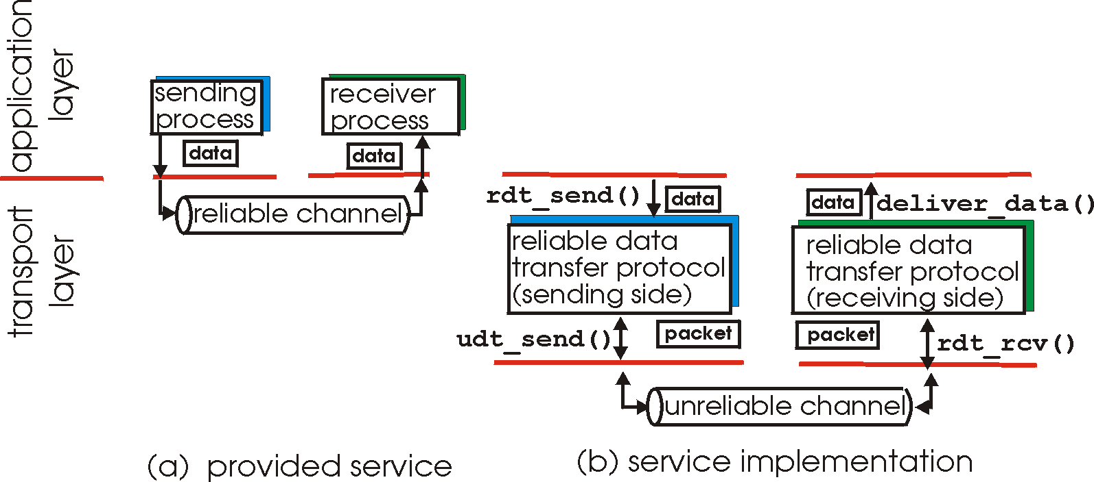
Principles of reliable data transfer
important in application, transport, link layers
  top-10 list of important networking topics!
characteristics of unreliable channel will determine complexity of reliable data transfer protocol (rdt)

Slide 23
Principles of reliable data transfer
important in application, transport, link layers
  top-10 list of important networking topics!
characteristics of unreliable channel will determine complexity of reliable data transfer protocol (rdt)

Slide 24
Principles of reliable data transfer
important in application, transport, link layers
  top-10 list of important networking topics!
characteristics of unreliable channel will determine complexity of reliable data transfer protocol (rdt)

Slide 25
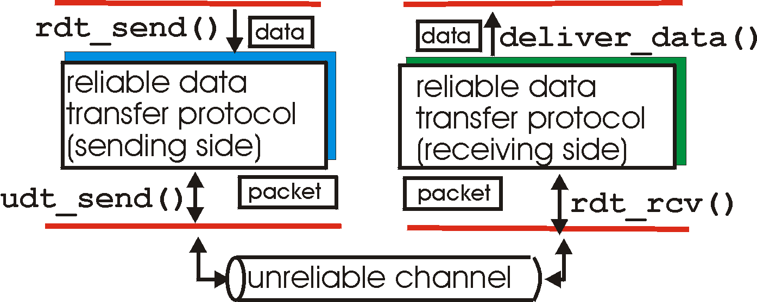
Reliable data transfer: getting started
rdt_send(): called from above, (e.g., by app.). Passed data to
deliver to receiver upper layer
deliver_data(): called by rdt to deliver data to upper
send
side
receive
side
udt_send(): called by rdt,
to transfer packet over
unreliable channel to receiver
rdt_rcv(): called when packet arrives on rcv-side of channel

Slide 26
Reliable data transfer: getting started
We’ll:
incrementally develop sender, receiver sides of reliable data transfer protocol (rdt)
consider only unidirectional data transfer
  but control info will flow on both directions!
use finite state machines (FSM) to specify sender, receiver
event causing state transition
actions taken on state transition
state: when in this “state” next state uniquely determined by next event
state
1
state
2
event
actions

Slide 27
rdt1.0: Reliable transfer over a reliable channel
underlying channel perfectly reliable
  no bit errors
  no loss of packets
separate FSMs for sender, receiver:
  sender sends data into underlying channel
  receiver reads data from underlying channel
Wait for call from above
rdt_send(data)
Wait for call from below
rdt_rcv(packet)
extract (packet,data)
deliver_data(data)
packet = make_pkt(data)
udt_send(packet)
sender
receiver

Slide 28
rdt2.0: Channel with bit errors
underlying channel may flip bits in packet
  checksum to detect bit errors
the question: how to recover from errors:
  acknowledgements (ACKs): receiver explicitly tells sender that pkt received OK
  negative acknowledgements (NAKs): receiver explicitly tells sender that pkt had errors
  sender retransmits pkt on receipt of NAK
new mechanisms in rdt2.0 (beyond rdt1.0):
  error detection
  receiver feedback: control msgs (ACK,NAK) rcvr->sender
How do humans recover from “errors”
during conversation?

Slide 29
rdt2.0: Channel with bit errors
underlying channel may flip bits in packet
  checksum to detect bit errors
the question: how to recover from errors:
  acknowledgements (ACKs): receiver explicitly tells sender that pkt received OK
  negative acknowledgements (NAKs): receiver explicitly tells sender that pkt had errors
  sender retransmits pkt on receipt of NAK
new mechanisms in rdt2.0 (beyond rdt1.0):
  error detection: checksum
  feedback: control msgs (ACK,NAK) from receiver to sender

Slide 30
rdt2.0: FSM specification
rdt_send(data)
sndpkt = make_pkt(data, checksum)
udt_send(sndpkt)
receiver
rdt_rcv(rcvpkt) &&
isNAK(rcvpkt)
Wait for call from above
Wait for ACK or NAK
rdt_rcv(rcvpkt) &&
corrupt(rcvpkt)
udt_send(sndpkt)
udt_send(NAK)
rdt_rcv(rcvpkt) && isACK(rcvpkt)
Λ
Wait for call from below
sender
rdt_rcv(rcvpkt) &&
notcorrupt(rcvpkt)
extract(rcvpkt,data)
deliver_data(data)
udt_send(ACK)

Slide 31
rdt2.0: Operation with no errors
rdt_send(data)
snkpkt = make_pkt(data, checksum)
udt_send(sndpkt)
rdt_rcv(rcvpkt) &&
isNAK(rcvpkt)
Wait for call from above
Wait for ACK or NAK
rdt_rcv(rcvpkt) &&
corrupt(rcvpkt)
udt_send(sndpkt)
udt_send(NAK)
rdt_rcv(rcvpkt) && isACK(rcvpkt)
Wait for call from below
Λ
rdt_rcv(rcvpkt) &&
notcorrupt(rcvpkt)
extract(rcvpkt,data)
deliver_data(data)
udt_send(ACK)

Slide 32
rdt2.0: Error scenario
rdt_send(data)
snkpkt = make_pkt(data, checksum)
udt_send(sndpkt)
rdt_rcv(rcvpkt) &&
isNAK(rcvpkt)
Wait for call from above
Wait for ACK or NAK
rdt_rcv(rcvpkt) &&
corrupt(rcvpkt)
udt_send(sndpkt)
udt_send(NAK)
rdt_rcv(rcvpkt) && isACK(rcvpkt)
Wait for call from below
Λ
rdt_rcv(rcvpkt) &&
notcorrupt(rcvpkt)
extract(rcvpkt,data)
deliver_data(data)
udt_send(ACK)
Notes:
What if ACK is corrupted?
Can we resend the packet?

Slide 33
rdt2.0 has a fatal flaw!
what happens if ACK/NAK corrupted?
sender doesn’t know what happened at receiver!
Can’t just retransmit: possible duplicate
handling duplicates:
sender retransmits current pkt if ACK/NAK corrupted
sender adds sequence number to each pkt
receiver discards (doesn’t deliver up) duplicate pkt
stop and wait
sender sends one packet,
then waits for receiver
response

Slide 34
rdt2.1: Sender, handles garbled ACK/NAKs
rdt_send(data)
sndpkt = make_pkt(0, data, checksum)
udt_send(sndpkt)
rdt_rcv(rcvpkt) &&
( corrupt(rcvpkt) ||
isNAK(rcvpkt) )
Wait for call 0 from above
Wait for ACK or NAK 0
udt_send(sndpkt)
rdt_rcv(rcvpkt)
&& notcorrupt(rcvpkt)
&& isACK(rcvpkt)
rdt_rcv(rcvpkt)
&& notcorrupt(rcvpkt)
&& isACK(rcvpkt)
Λ
Λ
Wait for ACK or NAK 1
Wait for
call 1 from above
rdt_rcv(rcvpkt) &&
( corrupt(rcvpkt) ||
isNAK(rcvpkt) )
rdt_send(data)
udt_send(sndpkt)
sndpkt = make_pkt(1, data, checksum)
udt_send(sndpkt)

Slide 35
rdt2.1: Receiver, handles garbled ACK/NAKs
rdt_rcv(rcvpkt) && notcorrupt(rcvpkt)
&& has_seq0(rcvpkt)
extract(rcvpkt,data)
deliver_data(data)
sndpkt = make_pkt(ACK, chksum)
udt_send(sndpkt)
rdt_rcv(rcvpkt) && (corrupt(rcvpkt)
rdt_rcv(rcvpkt) && (corrupt(rcvpkt)
sndpkt = make_pkt(NAK, chksum)
udt_send(sndpkt)
sndpkt = make_pkt(NAK, chksum)
udt_send(sndpkt)
Wait for
0 from below
Wait for
1 from below
rdt_rcv(rcvpkt) &&
not corrupt(rcvpkt) &&
has_seq1(rcvpkt)
rdt_rcv(rcvpkt) &&
not corrupt(rcvpkt) &&
has_seq0(rcvpkt)
sndpkt = make_pkt(ACK, chksum)
udt_send(sndpkt)
sndpkt = make_pkt(ACK, chksum)
udt_send(sndpkt)
rdt_rcv(rcvpkt) && notcorrupt(rcvpkt)
&& has_seq1(rcvpkt)
extract(rcvpkt,data)
deliver_data(data)
sndpkt = make_pkt(ACK, chksum)
udt_send(sndpkt)

Slide 36
rdt2.1: Discussion
sender:
seq # added to pkt
two seq. #’s (0,1) will suffice. Why?
must check if received ACK/NAK corrupted
twice as many states
  state must “remember” whether “expected” pkt should have seq # of 0 or 1
receiver:
must check if received packet is duplicate
  state indicates whether 0 or 1 is expected pkt seq #
note: receiver can not know if its last ACK/NAK received OK at sender

Slide 37
rdt2.1 Summary
Handles bit corruptions that are detected by checksum
Uses a 1-bit sequence number to detect retransmission at receiver
Correct sequence:
S: 0, packet0
R: ACK
S: 1, packet1
Packet corrupt
S: 0, packet0
R: NAK
S: 0, packet0
R: ACK
S: 1, packet1
ACK corrupt
S: 0, packet0
R: ACK
S: 0, packet0
R: ACK
S: 1, packet1

Slide 38
Eliminating NAK
Suppose current seq # is 1
ACK means:
  I received packet 1 correctly
  Seq # of last correct packet is 1
NAK means:
  I did not receive packet 1 correctly
  Seq # of last correct packet is 0

Slide 39
rdt2.2: A NAK-free protocol
same functionality as rdt2.1, using ACKs only
instead of NAK, receiver sends ACK for last pkt received OK
  receiver must explicitly include seq # of pkt being ACKed
duplicate ACK at sender results in same action as NAK: retransmit current pkt

Slide 40
rdt2.2: sender, receiver fragments
rdt_send(data)
sndpkt = make_pkt(0, data, checksum)
udt_send(sndpkt)
rdt_rcv(rcvpkt) &&
( corrupt(rcvpkt) ||
isACK(rcvpkt,1) )
Wait for call 0 from above
Wait for ACK
0
udt_send(sndpkt)
sender FSM
fragment
rdt_rcv(rcvpkt)
&& notcorrupt(rcvpkt)
&& isACK(rcvpkt,0)
rdt_rcv(rcvpkt) &&
(corrupt(rcvpkt) ||
has_seq1(rcvpkt))
Λ
Wait for
0 from below
receiver FSM
fragment
sndpkt = make_pkt(ACK1, chksum)
udt_send(sndpkt)
rdt_rcv(rcvpkt) && notcorrupt(rcvpkt)
&& has_seq0(rcvpkt)
extract(rcvpkt,data)
deliver_data(data)
sndpkt = make_pkt(ACK0, chksum)
udt_send(sndpkt)

Slide 41
rdt3.0: Channels with errors and loss
new assumption: underlying channel can also lose packets (data, ACKs)
  checksum, seq. #, ACKs, retransmissions will be of help … but not enough
approach: sender waits “reasonable” amount of time for ACK
retransmits if no ACK received in this time
requires countdown timer
if pkt (or ACK) just delayed (not lost):
  retransmission will be duplicate, but seq. #’s already handles this
  receiver must specify seq # of pkt being ACKed

Slide 42
rdt 3.0 sender
rdt_send(data)
rdt_rcv(rcvpkt) &&
( corrupt(rcvpkt) ||
isACK(rcvpkt,1) )
sndpkt = make_pkt(0, data, checksum)
udt_send(sndpkt)
start_timer
rdt_rcv(rcvpkt)
Λ
Λ
Wait for
call 0 from above
Wait for ACK0
timeout
udt_send(sndpkt)
start_timer
rdt_rcv(rcvpkt)
&& notcorrupt(rcvpkt)
&& isACK(rcvpkt,1)
rdt_rcv(rcvpkt)
&& notcorrupt(rcvpkt)
&& isACK(rcvpkt,0)
stop_timer
stop_timer
Wait for ACK1
Wait for
call 1 from above
timeout
udt_send(sndpkt)
start_timer
rdt_rcv(rcvpkt)
rdt_send(data)
Λ
rdt_rcv(rcvpkt) &&
( corrupt(rcvpkt) ||
isACK(rcvpkt,0) )
sndpkt = make_pkt(1, data, checksum)
udt_send(sndpkt)
start_timer
Λ

Slide 43

rdt3.0 in action
sender
receiver
sender
receiver
send pkt0
pkt0
send pkt0
pkt0
rcv pkt0
rcv pkt0
ack0
send ack0
ack0
send ack0
rcv ack0
rcv ack0
send pkt1
pkt1
send pkt1
pkt1
rcv pkt1
X
ack1
send ack1
loss
rcv ack1
send pkt0
pkt0
rcv pkt0
timeout
resend pkt1
ack0
send ack0
pkt1
rcv pkt1
ack1
send ack1
rcv ack1
send pkt0
pkt0
(a) no loss
rcv pkt0
ack0
send ack0
(b) packet loss

Slide 44
rdt3.0 in action
sender
receiver
sender
receiver
send pkt0
pkt0
send pkt0
pkt0
rcv pkt0
rcv pkt0
ack0
send ack0
send ack0
rcv ack0
ack0
send pkt1
pkt1
rcv ack0
rcv pkt1
send pkt1
pkt1
send ack1
rcv pkt1
ack1
send ack1
ack1
X
loss
timeout
resend pkt1
pkt1
rcv pkt1
timeout
resend pkt1
rcv ack1
pkt1
rcv pkt1
pkt0
(detect duplicate)
send pkt0
send ack1
ack1
(detect duplicate)
ack1
rcv pkt0
rcv ack1
send ack1
rcv ack1
ack0
send ack0
pkt0
send pkt0
pkt0
send pkt0
rcv pkt0
rcv pkt0
ack0
(detect duplicate)
ack0
send ack0
send ack0
(c) ACK loss
(d) premature timeout/ delayed ACK

Slide 45
Performance of rdt3.0
rdt3.0 is correct, but performance stinks
e.g.: 1 Gbps link, 15 ms prop. delay, 8000 bit packet:
L
8000 bits
D_{trans} =
=
=
8 microsecs
R
10⁹ bits/sec
  U _{sender}: utilization – fraction of time sender busy sending
  if RTT=30 msec, 1KB pkt every 30 msec: 33kB/sec throughput over 1 Gbps link
network protocol limits use of physical resources!

Slide 46
Performance of rdt3.0
rdt3.0 is correct, but performance stinks
e.g.: 1 Gbps link, 15 ms prop. delay, 8000 bit packet:
L
8000 bits
D_{trans} =
=
=
8 microsecs
R
10⁹ bits/sec
  U _{sender}: utilization – fraction of time sender busy sending
  if RTT=30 msec, 1KB pkt every 30 msec: 33kB/sec throughput over 1 Gbps link
network protocol limits use of physical resources!

Slide 47
rdt3.0: stop-and-wait operation
sender
receiver
first packet bit transmitted, t = 0
last packet bit transmitted, t = L / R
first packet bit arrives
RTT
last packet bit arrives, send ACK
ACK arrives, send next
packet, t = RTT + L / R

Slide 48
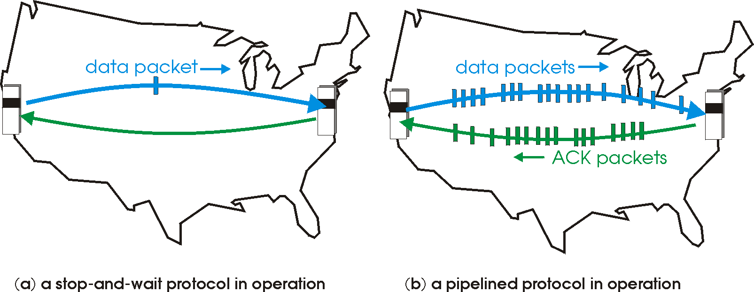
Pipelined protocols
pipelining: sender allows multiple, “in-flight”, yet-to-be-acknowledged pkts
  range of sequence numbers must be increased
  buffering at sender and/or receiver

Slide 49
Pipelining: increased utilization
sender
receiver
first packet bit transmitted, t = 0
last bit transmitted, t = L / R
first packet bit arrives
RTT
last packet bit arrives, send ACK
last bit of 2nd packet arrives, send ACK
last bit of 3rd packet arrives, send ACK
ACK arrives, send next
packet, t = RTT + L / R

Slide 50
Pipelining: increased utilization
sender
receiver
first packet bit transmitted, t = 0
last bit transmitted, t = L / R
first packet bit arrives
RTT
last packet bit arrives, send ACK
last bit of 2nd packet arrives, send ACK
last bit of 3rd packet arrives, send ACK
ACK arrives, send next
packet, t = RTT + L / R
3-packet pipelining increases
utilization by a factor of 3!

Slide 51
Pipelined protocols: overview
Go-back-N:
sender can have up to N unacked packets in pipeline
receiver only sends cumulative ack
  Doesn’t ack packet if there’s a gap
sender has timer for oldest unacked packet
  when timer expires, retransmit all unacked packets
Selective Repeat:
sender can have up to N unacked packets in pipeline
rcvr sends individual ack for each packet
sender maintains timer for each unacked packet
  when timer expires, retransmit only that unacked packet

Slide 52
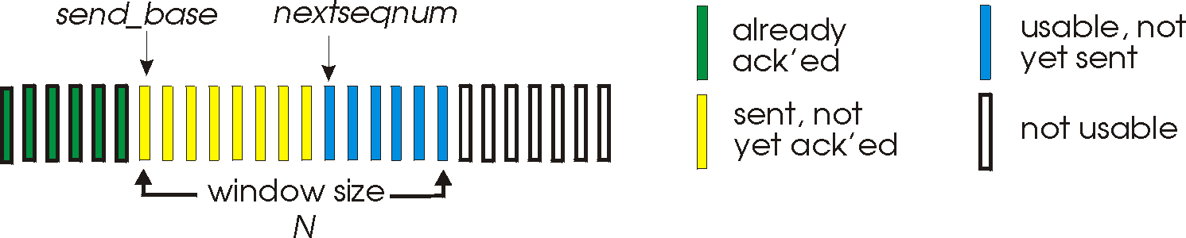
Go-Back-N: sender
k-bit seq # in pkt header
“window” of up to N, consecutive unack’ed pkts allowed
ACK(n): ACKs all pkts up to, including seq # n – “cumulative ACK”
  may receive duplicate ACKs (see receiver)
timer for oldest in-flight pkt
timeout(n): retransmit packet n and all higher seq # pkts in window

Slide 53
GBN: sender extended FSM
rdt_send(data)
if (nextseqnum < base+N) {
sndpkt[nextseqnum] = make_pkt(nextseqnum,data,chksum)
udt_send(sndpkt[nextseqnum])
if (base == nextseqnum)
start_timer
nextseqnum++
}
else
refuse_data(data)
Λ
base=1
nextseqnum=1
timeout
Wait
start_timer
udt_send(sndpkt[base])
udt_send(sndpkt[base+1])
…
udt_send(sndpkt[nextseqnum-1])
rdt_rcv(rcvpkt)
&& corrupt(rcvpkt)
rdt_rcv(rcvpkt) &&
notcorrupt(rcvpkt)
base = getacknum(rcvpkt)+1
If (base == nextseqnum)
stop_timer
else
start_timer

Slide 54
GBN: receiver extended FSM
default
udt_send(sndpkt)
rdt_rcv(rcvpkt)
&& notcurrupt(rcvpkt)
&& hasseqnum(rcvpkt,expectedseqnum)
Λ
Wait
extract(rcvpkt,data)
deliver_data(data)
sndpkt = make_pkt(expectedseqnum,ACK,chksum)
udt_send(sndpkt)
expectedseqnum++
expectedseqnum=1
sndpkt =
make_pkt(expectedseqnum,ACK,chksum)
ACK-only: always send ACK for correctly-received pkt with highest in-order seq #
  may generate duplicate ACKs
  need only remember expectedseqnum
out-of-order pkt:
  discard (don’t buffer): no receiver buffering!
  re-ACK pkt with highest in-order seq #

Slide 55
GBN in action
sender window (N=4)
sender
receiver
0 1 2 3 4 5 6 7 8
send pkt0
send pkt1
send pkt2
send pkt3
(wait)
0 1 2 3 4 5 6 7 8
receive pkt0, send ack0
receive pkt1, send ack1
receive pkt3, discard,
(re)send ack1
0 1 2 3 4 5 6 7 8
X
0 1 2 3 4 5 6 7 8
loss
0 1 2 3 4 5 6 7 8
rcv ack0, send pkt4
rcv ack1, send pkt5
0 1 2 3 4 5 6 7 8
receive pkt4, discard,
(re)send ack1
ignore duplicate ACK
receive pkt5, discard,
(re)send ack1
pkt 2 timeout
0 1 2 3 4 5 6 7 8
send pkt2
send pkt3
send pkt4
send pkt5
0 1 2 3 4 5 6 7 8
0 1 2 3 4 5 6 7 8
rcv pkt2, deliver, send ack2
rcv pkt3, deliver, send ack3
rcv pkt4, deliver, send ack4
rcv pkt5, deliver, send ack5
0 1 2 3 4 5 6 7 8

Slide 56
Selective Repeat
receiver individually acknowledges all correctly received pkts
  buffers pkts, as needed, for eventual in-order delivery to upper layer
sender only resends pkts for which ACK not received
  sender timer for each unACKed pkt
sender window
  N consecutive seq #’s
  limits seq #s of sent, unACKed pkts

Slide 57
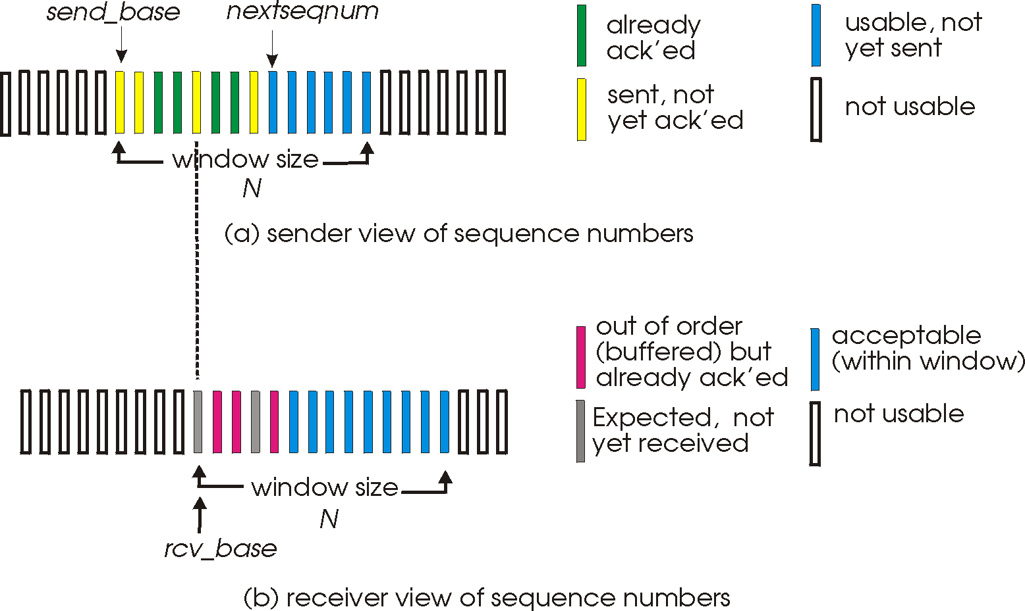
Selective repeat: sender, receiver windows

Slide 58
Selective repeat
sender
receiver
data from above:
if next available seq # in window, send pkt
timeout(n):
resend pkt n, restart timer
ACK(n) in [sendbase,sendbase+N]:
mark pkt n as received
if n smallest unACKed pkt, advance window base to next unACKed seq #
pkt n in [rcvbase, rcvbase+N-1]
send ACK(n)
out-of-order: buffer
in-order: deliver (also deliver buffered, in-order pkts), advance window to next not-yet-received pkt
pkt n in [rcvbase-N,rcvbase-1]
ACK(n)
otherwise:
ignore

Slide 59
Selective repeat in action
sender window (N=4)
sender
receiver
0 1 2 3 4 5 6 7 8
send pkt0
send pkt1
send pkt2
send pkt3
(wait)
0 1 2 3 4 5 6 7 8
0 1 2 3 4 5 6 7 8
receive pkt0, send ack0
receive pkt1, send ack1
receive pkt3, buffer,
send ack3
X
0 1 2 3 4 5 6 7 8
loss
0 1 2 3 4 5 6 7 8
rcv ack0, send pkt4
rcv ack1, send pkt5
0 1 2 3 4 5 6 7 8
receive pkt4, buffer,
send ack4
record ack3 arrived
receive pkt5, buffer,
send ack5
pkt 2 timeout
0 1 2 3 4 5 6 7 8
send pkt2
0 1 2 3 4 5 6 7 8
record ack4 arrived
0 1 2 3 4 5 6 7 8
rcv pkt2; deliver pkt2,
pkt3, pkt4, pkt5; send ack2
record ack5 arrived
0 1 2 3 4 5 6 7 8
Q: what happens when ack2 arrives?

Slide 60

Selective repeat: dilemma
sender window
(after receipt)
receiver window
(after receipt)
0 1 2 3 0 1 2
pkt0
0 1 2 3 0 1 2
pkt1
0 1 2 3 0 1 2
example:
seq #’s: 0, 1, 2, 3
window size=3
0 1 2 3 0 1 2
pkt2
0 1 2 3 0 1 2
0 1 2 3 0 1 2
0 1 2 3 0 1 2
pkt3
X
0 1 2 3 0 1 2
pkt0
will accept packet
with seq number 0
(a) no problem
receiver sees no difference in two scenarios!
duplicate data accepted as new in (b)
Q: what relationship between seq # size and window size to avoid problem in (b)?
receiver can’t see sender side.
receiver behavior identical in both cases!
something’s (very) wrong!
0 1 2 3 0 1 2
pkt0
0 1 2 3 0 1 2
pkt1
0 1 2 3 0 1 2
0 1 2 3 0 1 2
pkt2
0 1 2 3 0 1 2
X
0 1 2 3 0 1 2
X
timeout
retransmit pkt0
X
0 1 2 3 0 1 2
pkt0
will accept packet
with seq number 0
(b) oops!

Slide 61
Chapter 3: Outline
  Transport Layer Services
  Multiplexing and Demultiplexing
  Connectionless Transport: UDP
  Principles of Reliable Data Transfer
  Connection-Oriented Transport: TCP
  Principles of Congestion Control
  TCP Congestion Control
  Structure
  Reliable Data Transfer
  Flow Control
  Connection Management

Slide 62
TCP: Overview RFCs: 793,1122,1323, 2018, 2581
point-to-point:
  one sender, one receiver
reliable, in-order byte steam:
  no “message boundaries”
pipelined:
  TCP congestion and flow control set window size
full duplex data:
  bi-directional data flow in same connection
  MSS: maximum segment size
connection-oriented:
  handshaking (exchange of control msgs) inits sender, receiver state before data exchange
flow controlled:
  sender will not overwhelm receiver

Slide 63
TCP segment structure
32 bits
URG: urgent data
(generally not used)
counting
by bytes
of data
(not segments!)
source port #
dest port #
sequence number
ACK: ACK #
valid
acknowledgement number
head
len
not
used
U
receive window
A
PSH: push data now
(generally not used)
P
R
S
F
# bytes
rcvr willing
to accept
checksum
Urg data pointer
RST, SYN, FIN:
connection estab
(setup, teardown
commands)
options (variable length)
application
data
(variable length)
Internet
checksum
(as in UDP)

Slide 64
TCP seq. numbers, ACKs
outgoing segment from sender
sequence numbers:
  byte stream “number” of first byte in segment’s data
acknowledgements:
  seq # of next byte expected from other side
  cumulative ACK
Q: how receiver handles out-of-order segments
  A: TCP spec doesn’t say, - up to implementer
source port #
dest port #
sequence number
acknowledgement number
rwnd
checksum
urg pointer
window size
N
  sender sequence number space
sent
ACKed
sent, not-yet ACKed
(“in-flight”)
usable
but not
yet sent
not
usable
incoming segment to sender
source port #
dest port #
sequence number
acknowledgement number
A
rwnd
checksum
urg pointer

Slide 65
TCP seq. numbers, ACKs
Host A
Host B
User
types
‘C’
Seq=42, ACK=79, data = ‘C’
host ACKs
receipt of
‘C’, echoes
back ‘C’
Seq=79, ACK=43, data = ‘C’
host ACKs
receipt
of echoed
‘C’
Seq=43, ACK=80
simple telnet scenario

Slide 66
TCP round trip time, timeout
Q: how to set TCP timeout value?
longer than RTT
  but RTT varies
too short: premature timeout, unnecessary retransmissions
too long: slow reaction to segment loss
Q: how to estimate RTT?
SampleRTT: measured time from segment transmission until ACK receipt
  ignore retransmissions
SampleRTT will vary, want estimated RTT “smoother”
  average several recent measurements, not just current SampleRTT

Slide 67
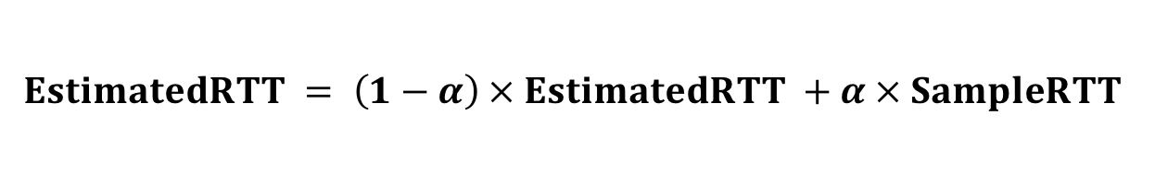
TCP round trip time, timeout
$$EstimatedRTT = \left(1−α\right) × EstimatedRTT +α × SampleRTT$$
exponential weighted moving average
influence of past sample decreases exponentially fast
typical value: α = 0.125
RTT: gaia.cs.umass.edu to fantasia.eurecom.fr
RTT (milliseconds)
sampleRTT
EstimatedRTT
time (seconds)

Slide 68

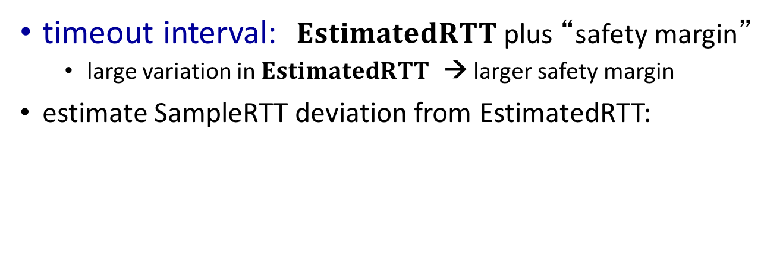

TCP round trip time, timeout
timeout interval: $EstimatedRTT$ plus “safety margin”
  large variation in $EstimatedRTT$ → larger safety margin
estimate SampleRTT deviation from EstimatedRTT:
$$DevRTT = \left(1−β\right)×DevRTT +β×\left|SampleRTT−EstimatedRTT\right|$$
(typically, β = 0.25)
$$TimeoutInterval = EstimatedRTT +4×DevRTT$$
estimated RTT
“safety margin”
* Check out the online interactive exercises for more examples: http://gaia.cs.umass.edu/kurose_ross/interactive/

Slide 69
Chapter 3: Outline
  Transport Layer Services
  Multiplexing and Demultiplexing
  Connectionless Transport: UDP
  Principles of Reliable Data Transfer
  Connection-Oriented Transport: TCP
  Principles of Congestion Control
  TCP Congestion Control
  Structure
  Reliable Data Transfer
  Flow Control
  Connection Management

Slide 70
TCP reliable data transfer
TCP creates rdt service on top of IP’s unreliable service
  pipelined segments
  cumulative acks
  single retransmission timer
retransmissions triggered by:
  timeout events
  duplicate acks
Let’s initially consider simplified TCP sender:
  ignore duplicate acks
  ignore flow control, congestion control

Slide 71
TCP sender events:
data rcvd from app:
create segment with seq #
seq # is byte-stream number of first data byte in segment
start timer if not already running
  think of timer as for oldest unacked segment
  expiration interval: TimeOutInterval
timeout:
retransmit segment that caused timeout
restart timer
ack rcvd:
if ack acknowledges previously unacked segments
  update what is known to be ACKed
  start timer if there are still unacked segments

Slide 72
TCP sender (simplified)
data received from application above
create segment, seq. #: NextSeqNum
pass segment to IP (i.e., “send”)
NextSeqNum = NextSeqNum + length(data)
if (timer currently not running)
start timer
Λ
NextSeqNum = InitialSeqNum
SendBase = InitialSeqNum
wait
for
event
timeout
retransmit not-yet-acked segment with smallest seq. #
start timer
ACK received, with ACK field value y
if (y > SendBase) {
SendBase = y
/* SendBase–1: last cumulatively ACKed byte */
if (there are currently not-yet-acked segments)
start timer
else stop timer
}

Slide 73
TCP: retransmission scenarios
Host A
Host B
Host A
Host B
SendBase=92
Seq=92, 8 bytes of data
Seq=92, 8 bytes of data
timeout
timeout
Seq=100, 20 bytes of data
ACK=100
X
ACK=100
ACK=120
Seq=92, 8 bytes of data
Seq=92, 8
bytes of data
SendBase=100
SendBase=120
ACK=100
ACK=120
SendBase=120
lost ACK scenario
premature timeout

Slide 74
TCP: retransmission scenarios
Host A
Host B
Seq=92, 8 bytes of data
Seq=100, 20 bytes of data
timeout
ACK=100
X
ACK=120
Seq=120, 15 bytes of data
cumulative ACK

Slide 75
TCP Sliding Window Protocol – Sender Side
LastByteAcked <= LastByteSent
LastByteSent <= LastByteWritten
Buffer bytes between LastByteAcked and LastByteWritten
Maximum buffer size
Advertised window
Data available, but outside window
First unacknowledged byte
Last byte sent

Slide 76
TCP Sliding Window Protocol – Receiver Side
LastByteRead < NextByteExpected
NextByteExpected <= LastByteRcvd + 1
Buffer bytes between NextByteRead and LastByteRcvd
Maximum buffer size
Advertised window
Buffered, out-of-order data
Next byte expected (ACK value)
Next byte to be read by application

Slide 77
TCP ACK generation - 1
Maximum buffer size
Available buffer size
Next byte expected (ACK value)
Next byte to be read by application
Arrival of in-order segment with expected seq #. All data up to expected seq # already ACKed
  Delayed ACK. Wait up to 500ms for next segment.

Slide 78
TCP ACK generation - 2
Maximum buffer size
Available buffer size
Next byte expected (ACK value)
Next byte to be read by application
Arrival of in-order segment with expected seq #. One other segment has ACK pending
  Immediately send single cumulative ACK, ACKing both in-order segments

Slide 79
TCP ACK generation - 3
Maximum buffer size
Available buffer size
Next byte expected (ACK value)
Next byte to be read by application
Arrival of out-of-order segment higher-than-expect seq. # Gap detected
  Immediately send duplicate ACK, indicating seq. # of next expected byte

Slide 80
TCP ACK generation - 4
Maximum buffer size
Available buffer size
Next byte expected (ACK value)
Next byte to be read by application
Arrival of segment that partially or completely fills gap
  Immediate send ACK, provided that segment starts at lower end of gap

Slide 81
TCP ACK generation [RFC 1122, RFC 2581]
event at receiver
arrival of in-order segment with
expected seq #. All data up to
expected seq # already ACKed
arrival of in-order segment with
expected seq #. One other
segment has ACK pending
arrival of out-of-order segment
higher-than-expect seq. # .
Gap detected
arrival of segment that
partially or completely fills gap
TCP receiver action
delayed ACK. Wait up to 500ms
for next segment. If no next segment,
send ACK
immediately send single cumulative
ACK, ACKing both in-order segments
immediately send duplicate ACK,
indicating seq. # of next expected byte
immediate send ACK, provided that
segment starts at lower end of gap

Slide 82
TCP fast retransmit
time-out period often relatively long:
  long delay before resending lost packet
detect lost segments via duplicate ACKs.
  sender often sends many segments back-to-back
  if segment is lost, there will likely be many duplicate ACKs.
TCP fast retransmit
if sender receives 3 ACKs for same data
(“triple duplicate ACKs”), resend unacked segment with smallest seq #
  likely that unacked segment lost, so don’t wait for timeout

Slide 83
TCP fast retransmit
Host A
Host B
Seq=92, 8 bytes of data
Seq=100, 20 bytes of data
X
ACK=100
timeout
ACK=100
ACK=100
ACK=100
Seq=100, 20 bytes of data
fast retransmit after sender
receipt of triple duplicate ACK

Slide 84
Chapter 3: Outline
  Transport Layer Services
  Multiplexing and Demultiplexing
  Connectionless Transport: UDP
  Principles of Reliable Data Transfer
  Connection-Oriented Transport: TCP
  Principles of Congestion Control
  TCP Congestion Control
  Structure
  Reliable Data Transfer
  Flow Control
  Connection Management

Slide 85
TCP flow control
application
process
application may
remove data from
TCP socket buffers ….
application
TCP socket
receiver buffers
OS
… slower than TCP
receiver is delivering
(sender is sending)
TCP
code
flow control
IP
code
receiver controls sender, so sender won’t overflow receiver’s buffer by transmitting too much, too fast
from sender
receiver protocol stack

Slide 86
TCP flow control
receiver “advertises” free buffer space by including rwnd value in TCP header of receiver-to-sender segments
  RcvBuffer size set via socket options (typical default is 4096 bytes)
  many operating systems autoadjust RcvBuffer
sender limits amount of unacked (“in-flight”) data to receiver’s rwnd value
guarantees receive buffer will not overflow
to application process
RcvBuffer
buffered data
rwnd
free buffer space
TCP segment payloads
receiver-side buffering

Slide 87
Chapter 3: Outline
  Transport Layer Services
  Multiplexing and Demultiplexing
  Connectionless Transport: UDP
  Principles of Reliable Data Transfer
  Connection-Oriented Transport: TCP
  Principles of Congestion Control
  TCP Congestion Control
  Structure
  Reliable Data Transfer
  Flow Control
  Connection Management

Slide 88
Connection Management
before exchanging data, sender/receiver “handshake”:
agree to establish connection (each knowing the other willing to establish connection)
agree on connection parameters
application
application
connection state: ESTAB
connection variables:
  seq # client-to-server
  server-to-client
  rcvBuffer size
  at server,client
connection state: ESTAB
connection Variables:
  seq # client-to-server
  server-to-client
  rcvBuffer size
  at server,client
network
network
Socket clientSocket =
newSocket("hostname","port number");
Socket connectionSocket = welcomeSocket.accept();

Slide 89
TCP 3-way handshake
client state
server state
LISTEN
LISTEN
choose init seq num, x
send TCP SYN msg
SYNSENT
SYNbit=1, Seq=x
choose init seq num, y
send TCP SYNACK
msg, acking SYN
SYN RCVD
SYNbit=1, Seq=y
ACKbit=1; ACKnum=x+1
received SYNACK(x)
indicates server is live;
send ACK for SYNACK;
this segment may contain
client-to-server data
ESTAB
ACKbit=1, ACKnum=y+1
received ACK(y)
indicates client is live
ESTAB

Slide 90
TCP: closing a connection
client state
server state
ESTAB
ESTAB
clientSocket.close()
FIN_WAIT_1
can no longer
send but can
receive data
FINbit=1, seq=x
CLOSE_WAIT
ACKbit=1; ACKnum=x+1
can still
send data
FIN_WAIT_2
wait for server
close
LAST_ACK
FINbit=1, seq=y
TIMED_WAIT
can no longer
send data
ACKbit=1; ACKnum=y+1
timed wait
for 2*max
segment lifetime
CLOSED
CLOSED

Slide 91
TCP 3-way handshake: FSM
TCP Client Lifecycle
TCP Server Lifecycle
Socket clientSocket =
newSocket("hostname","port number");
Timeout (30sec)
Socket connectionSocket = welcomeSocket.accept();
Closed
Closed
Λ
SYN(seq=x)
Λ
ACK(ACKnum=y’+1)
Λ
Time
Wait
SYN
Sent
Last
ACK
Listen
SYNACK(seq=y,
ACKnum=x+1)
SYN(x)
SYNACK(seq=y,
ACKnum=x+1)
create new socket
FIN(y’)
ACK(ACKnum=y+1)
Finish sending data
ACK(ACKnum=y’+1)
FIN(seq=y’)
FIN
Wait 2
ESTAB
Close
Wait
SYN
rcvd
ACK(ACKnum=x’+1)
FIN
Wait 1
FIN(x’)
ESTAB
ACK(ACKnum=y+1)
clientSocket.close()
ACK(ACKnum=x’+1)
Λ
FIN(seq=x’)
Λ

Slide 92
Chapter 3: Outline
  Transport Layer Services
  Multiplexing and Demultiplexing
  Connectionless Transport: UDP
  Principles of Reliable Data Transfer
  Connection-Oriented Transport: TCP
  Principles of Congestion Control
  TCP Congestion Control
  Structure
  Reliable Data Transfer
  Flow Control
  Connection Management

Slide 93
Principles of congestion control
congestion:
informally: “too many sources sending too much data too fast for network to handle”
different from flow control!
manifestations:
  lost packets (buffer overflow at routers)
  long delays (queueing in router buffers)
a top-10 problem!

Slide 94
Causes/costs of congestion: scenario 1
original data: λ_{in}
throughput: λ_{out}
two senders, two receivers
one router, infinite buffers
output link capacity: R
no retransmission
Host A
unlimited shared output link buffers
Host B
R/2
λ_{out}
delay
λ_{in}
R/2
λ_{in}
R/2
maximum per-connection throughput: R/2
large delays as arrival rate, λ_{in}, approaches capacity

Slide 95
Causes/costs of congestion: scenario 2
one router, finite buffers
sender retransmission of timed-out packet
  application-layer input = application-layer output: λ_{in} = λ_{out}
  transport-layer input includes retransmissions : λ_{in} λ_{in}
‘
λ_{in} : original data
λ'_{in}: original data, plus retransmitted data
λ_{out}
Host A
finite shared output link buffers
Host B

Slide 96

Causes/costs of congestion: scenario 2
Realistic: duplicates
packets can be lost, dropped at router due to full buffers
λ_{in} : original data
copy
λ'_{in}: original data, plus retransmitted data
λ_{out}
A
no buffer space!
Host B

Slide 97


Causes/costs of congestion: scenario 2
Realistic: duplicates
packets can be lost, dropped at router due to full buffers
sender times out prematurely, sending two copies, both of which are delivered
R/2
λ_{out}
when sending at R/2, some packets are retransmissions including duplicated that are delivered!
λ_{in}
R/2
λ_{in}
copy
λ'_{in}
λ_{out}
timeout
A
free buffer space!
Host B

Slide 98
Causes/costs of congestion: scenario 2
Realistic: duplicates
packets can be lost, dropped at router due to full buffers
sender times out prematurely, sending two copies, both of which are delivered
R/2
when sending at R/2, some packets are retransmissions including duplicated that are delivered!
λ_{out}
λ_{in}
R/2
“costs” of congestion:
more work (retrans) for given “goodput”
unneeded retransmissions: link carries multiple copies of pkt
  decreasing goodput

Slide 99
Causes/costs of congestion: scenario 3
Q: what happens as λ_{in} and λ_{in}’ increase ?
four senders
multihop paths
timeout/retransmit
A: as red λ_{in}’ increases, all arriving blue pkts at upper queue are dropped, blue throughput → 0
Host A
λ_{in} : original data
λ_{out}
Host B
λ'_{in}: original data, plus retransmitted data
finite shared output link buffers
Host D
Host C

Slide 100
Causes/costs of congestion: scenario 3
R/2
λ_{out}
λ_{in}’
R/2
another “cost” of congestion:
when packet dropped, any upstream transmission capacity used for that packet was wasted!

Slide 101
Chapter 3: Outline
  Transport Layer Services
  Multiplexing and Demultiplexing
  Connectionless Transport: UDP
  Principles of Reliable Data Transfer
  Connection-Oriented Transport: TCP
  Principles of Congestion Control
  TCP Congestion Control
  Structure
  Reliable Data Transfer
  Flow Control
  Connection Management

Slide 102
TCP Congestion Control: CWND
sender sequence number space
TCP sending rate:
roughly: send cwnd bytes, wait RTT for ACKS, then send more bytes
cwnd
last byte
ACKed
last byte sent
sent, not-yet ACKed
(“in-flight”)
rate
cwnd
sender limits transmission:
cwnd is dynamic, function of perceived network congestion
~
bytes/sec
~
RTT
LastByteSent-LastByteAcked
cwnd
<

Slide 103
TCP Slow Start
Host A
Host B
When connection begins, increase rate exponentially until first loss event:
  initially cwnd = 1 MSS
  double cwnd every RTT
  done by incrementing cwnd for every ACK received up to some threshold
summary: initial rate is slow but ramps up exponentially fast
one segment
RTT
two segments
four segments
time

Slide 104
TCP Congestion Avoidance:
AIMD: Additive Increase Multiplicative Decrease
approach: sender increases transmission rate (window size), probing for usable bandwidth, until loss occurs
  additive increase: increase cwnd by 1 MSS every RTT until loss detected
  multiplicative decrease: cut cwnd in half after loss
additively increase window size …
…. until loss occurs (then cut window in half)
AIMD saw tooth
behavior: probing
for bandwidth
cwnd: TCP sender
congestion window size
time

Slide 105
TCP: detecting, reacting to loss
Loss indicated by timeout:
  cwnd set to 1 MSS;
  window then grows exponentially (as in slow start) to threshold, then grows linearly (as in additive increase)
Loss indicated by 3 duplicate ACKs:
  TCP Tahoe:
    always sets cwnd to 1 (timeout or 3 duplicate acks)
  TCP Reno: (Fast Recovery)
    dup ACKs indicate network capable of delivering some segments
    cwnd is cut in half window then grows linearly (as in additive increase)

Slide 106
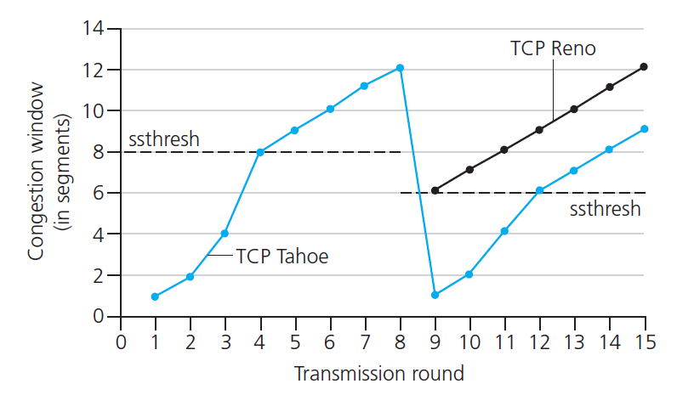
TCP: switching from slow start to CA
Q: when should the exponential increase switch to linear?
A: when cwnd gets to 1/2 of its value before timeout.
Implementation:
Variable ssthresh,
on loss event, ssthresh is set to 1/2 of cwnd just before loss event
* Check out the online interactive exercises for more examples: http://gaia.cs.umass.edu/kurose_ross/interactive/

Slide 107
Summary: TCP Congestion Control
New
ACK!
New
ACK!
.
duplicate ACK
new ACK
dupACKcount++
new ACK
cwnd = cwnd + MSS (MSS/cwnd)
dupACKcount = 0
transmit new segment(s), as allowed
cwnd = cwnd+MSS
dupACKcount = 0
transmit new segment(s), as allowed
Λ
cwnd = 1 MSS
ssthresh = 64 KB
dupACKcount = 0
cwnd > ssthresh
slow
start
Λ
congestion
avoidance
timeout
ssthresh = cwnd/2
cwnd = 1 MSS
dupACKcount = 0
retransmit missing segment
duplicate ACK
timeout
dupACKcount++
ssthresh = cwnd/2
cwnd = 1 MSS
dupACKcount = 0
retransmit missing segment
timeout
New
ACK!
ssthresh = cwnd/2
cwnd = 1
dupACKcount = 0
retransmit missing segment
New ACK
dupACKcount == 3
cwnd = ssthresh
dupACKcount = 0
dupACKcount == 3
ssthresh= cwnd/2
cwnd = ssthresh + 3
retransmit missing segment
ssthresh= cwnd/2
cwnd = ssthresh + 3
retransmit missing segment
fast
recovery
duplicate ACK
cwnd = cwnd + MSS
transmit new segment(s), as allowed

Slide 108
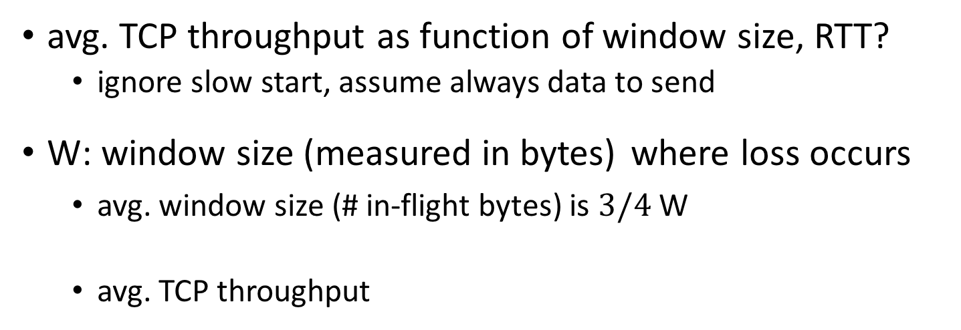

TCP throughput
avg. TCP throughput as function of window size, RTT?
  ignore slow start, assume always data to send
W: window size (measured in bytes) where loss occurs
  avg. window size (# in-flight bytes) is $3/4$ W
  avg. TCP throughput
$$=\frac{3/4 W}{RTT}$$
W
W/2

Slide 109
TCP Futures: TCP over “long, fat pipes”
Example: 1500 byte segments, 100ms RTT, want 10 Gbps throughput
requires W = 83,333 in-flight segments
throughput in terms of segment loss probability, L [Mathis 1997]:
  ➜ to achieve 10 Gbps throughput, need a loss rate of L = 2·10⁻¹⁰ – a very small loss rate!
1.22
.
MSS
TCP throughput =
RTT
L

Slide 110
TCP Fairness
fairness goal: if K TCP sessions share same bottleneck link of bandwidth R, each should have average rate of R/K
TCP connection 1
bottleneck
router
capacity R
TCP connection 2

Slide 111
Why is TCP fair?
two competing sessions:
additive increase gives slope of 1, as throughout increases
multiplicative decrease decreases throughput proportionally
R
equal bandwidth share
loss: decrease window by factor of 2
congestion avoidance: additive increase
Connection 2 throughput
loss: decrease window by factor of 2
congestion avoidance: additive increase
Connection 1 throughput
R

Slide 112
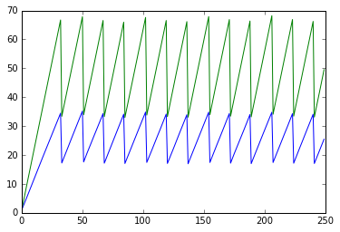
RTT-fairness
Two TCP connections share the same link
  A has RTT of 100ms
  B has RTT of 50ms
Will they share bandwidth equally?
Additive increase is clocked by RTT
B will increase its window faster
When rate(A)+rate(B) reaches capacity, both halve their window

Slide 113
Explicit Congestion Notification (ECN)
network-assisted congestion control:
two bits in IP header (ToS field) marked by network router to indicate congestion
congestion indication carried to receiving host
receiver (seeing congestion indication in IP datagram) ) sets ECE bit on receiver-to-sender ACK segment to notify sender of congestion
source
TCP ACK segment
destination
application
transport
network
link
physical
ECE=1
application
transport
network
link
physical
ECN=00
ECN=11
IP datagram

Slide 114
Chapter 3: summary
principles behind transport layer services:
  multiplexing, demultiplexing
  reliable data transfer
  flow control
  congestion control
instantiation, implementation in the Internet
  UDP
  TCP
next:
leaving the network “edge” (application, transport layers)
into the network “core”
two network layer components:
  data plane
  control plane

