Slide 1
CS/ECE 438: Communication Networks
Fall 2017
6. Wireless & Mobile Networks

Slide 2
Chapter 6 : Wireless and Mobile Networks
Background:
# wireless (mobile) phone subscribers now exceeds # wired phone subscribers (5-to-1)!
# wireless Internet-connected devices equals # wireline Internet-connected devices
  laptops, Internet-enabled phones promise anytime untethered Internet access
two important (but different) challenges
  wireless: communication over wireless link
  mobility: handling the mobile user who changes point of attachment to network

Slide 3
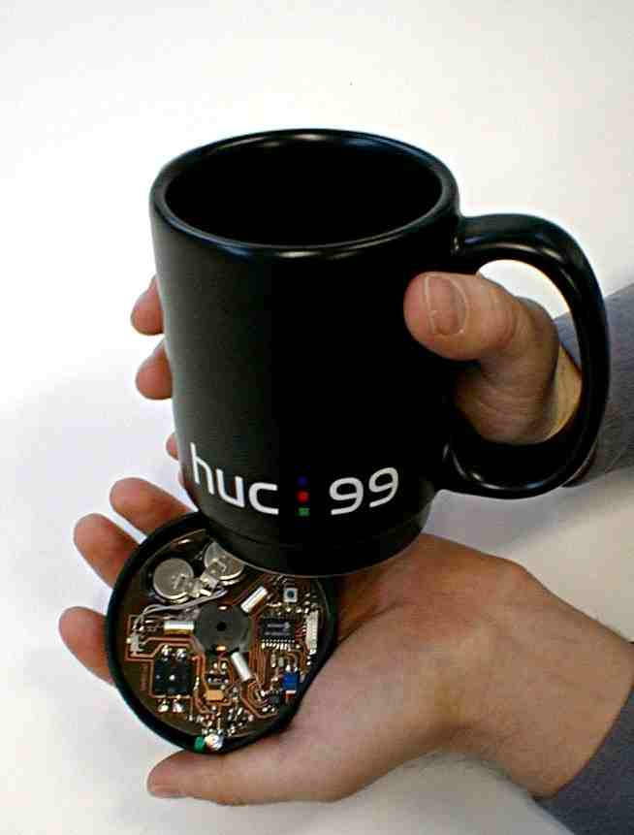

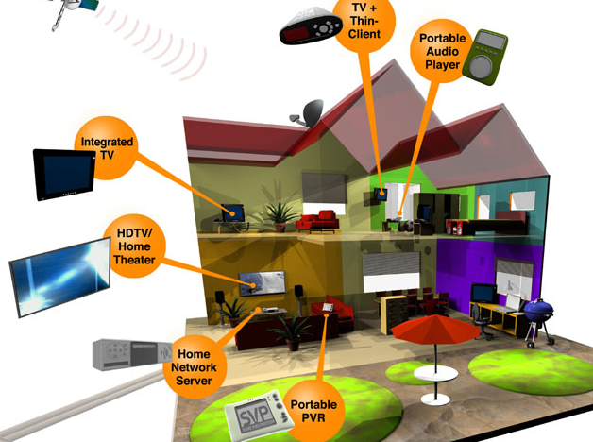
Wireless Biomedical Implants
Wireless Wearables
Wireless Networks Increasingly Prevalent
Wireless Homes
Cellular Networks
Wireless Sensors
UAVs
Wireless Data Centers
Wireless VR
Wireless Vehicles

Slide 4
Increasing Demand for Wireless Connectivity

Slide 5
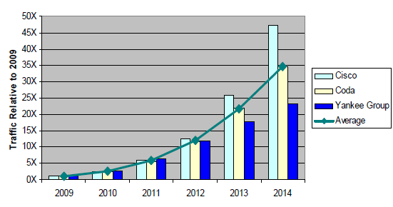
Increasing Demand for Wireless Connectivity

Slide 6
Many Motivations for Wireless
Unrestricted mobility / deployability
  Unplugged from power outlet
Significantly lower cost
  No cable layout, service provision
  Low maintenance
Ease
  Direct communication with minimum infrastructure

Slide 7
No Free Lunch
Numerous challenges
  Channel fluctuation
  Lower bandwidth
  Limited Battery power
  Disconnection due to mobility
  Security
  …

Slide 8
Question Is …
Can’t we use the rich “wireline” knowledge ?
  In solving the wireless challenges

Slide 9
The Answer
Wireless channel: A dispersive medium
The PHY and MAC layer completely dissimilar
The whole game changes

Slide 10
Chapter 6: Outline
  Introduction
  Wireless Links
  Wireless MAC
  WiFi: 802.11 Wireless LANs
  Cellular Networks: 3G, LTE
  Mobility

Slide 11



















Elements of a wireless network
network
infrastructure

Slide 12



Elements of a wireless network
wireless hosts
laptop, smartphone
run applications
may be stationary (non-mobile) or mobile
  wireless does not always mean mobility
network
infrastructure

Slide 13

Elements of a wireless network
base station
typically connected to wired network
relay - responsible for sending packets between wired network and wireless host(s) in its “area”
  e.g., cell towers, 802.11 access points
network
infrastructure

Slide 14
Elements of a wireless network
wireless link
typically used to connect mobile(s) to base station
also used as backbone link
multiple access protocol coordinates link access
various data rates, transmission distance
network
infrastructure

Slide 15
Characteristics of selected wireless links
1300
802.11 ac
450
802.11n
54
802.11a,g
802.11a,g point-to-point
5-11
802.11b
4G: LTWE WIMAX
4
3G: UMTS/WCDMA-HSPDA, CDMA2000-1xEVDO
Data rate (Mbps)
1
802.15
.384
2.5G: UMTS/WCDMA, CDMA2000
.056
2G: IS-95, CDMA, GSM
Indoor
10-30m
Outdoor
50-200m
Mid-range
outdoor
200m – 4 Km
Long-range
outdoor
5Km – 20 Km

Slide 16
Elements of a wireless network
infrastructure mode
base station connects mobiles into wired network
handoff: mobile changes base station providing connection into wired network
network
infrastructure

Slide 17
Elements of a wireless network
ad hoc mode
no base stations
nodes can only transmit to other nodes within link coverage
nodes organize themselves into a network: route among themselves

Slide 18
Wireless network taxonomy
single hop
multiple hops
host connects to
base station (WiFi,
WiMAX, cellular)
which connects to
larger Internet
host may have to
relay through several
wireless nodes to
connect to larger
Internet: mesh net
infrastructure
(e.g., APs)
no base station, no
connection to larger
Internet. May have to
relay to reach other
a given wireless node
MANET, VANET
no
infrastructure
no base station, no
connection to larger
Internet (Bluetooth,
ad hoc nets)

Slide 19
Chapter 6: Outline
  Introduction
  Wireless Links
  Wireless MAC
  WiFi: 802.11 Wireless LANs
  Cellular Networks: 3G, LTE
  Mobility

Slide 20

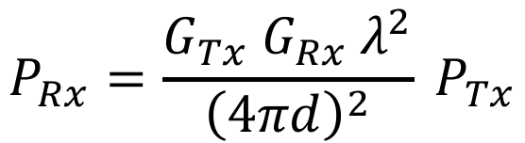
Wireless Link Characteristics
important differences from wired link ….
  decreased signal strength: radio signal attenuates as it propagates through matter (path loss)
$$P_{Rx}=\frac{G_{Tx} G_{Rx}{ λ}^{2}}{{\left(4πd\right)}^{2}} P_{Tx}$$
$$Path Loss (dB)=10\log_{10}{P_{Tx}/P_{Rx}}$$

Slide 21




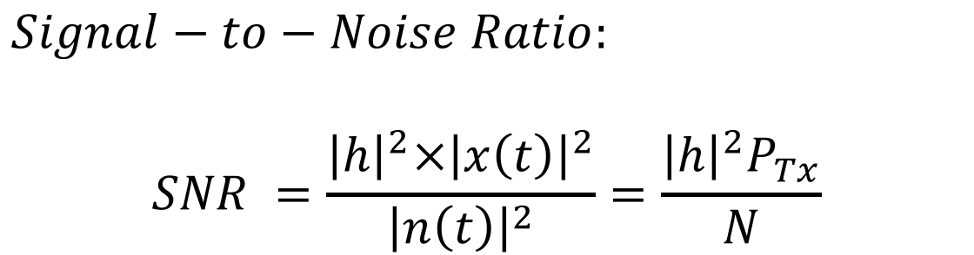

Wireless Link Characteristics
important differences from wired link ….
  decreased signal strength: radio signal attenuates as it propagates through matter (path loss)
$$∝\frac{λ}{d} e^{j2πd/λ}$$
$$h$$
$$x(t)$$
$$y\left(t\right)=h x(t)$$
$$+ n(t)$$
$Signal−to−Noise Ratio:$
$$SNR =\frac{{{\left|h\right|}^{2}×\left|x\left(t\right)\right|}^{2}}{{\left|n\left(t\right)\right|}^{2}}=\frac{{\left|h\right|}^{2}P_{Tx}}{N}$$

Slide 22




Wireless Link Characteristics
SNR: signal-to-noise ratio
  High SNR – easier to extract signal from noise (a “good thing”)
  Low SNR – hard to extract signal from noise ( a “bad thing”)
$$+$$
$$=$$
Bits:
0
1
0
0
$$+$$
$$=$$
Bits:
0
1
0
0
HIGH SNR ➔ Low Bit Error Rate
LOW SNR ➔ High Bit Error Rate

Slide 23
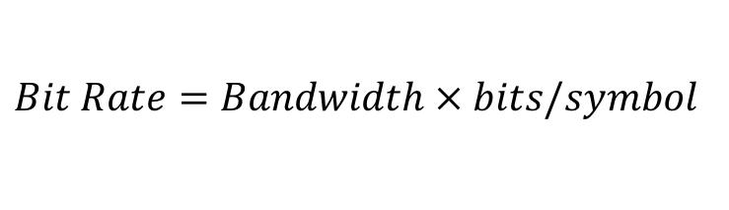
Wireless Link Characteristics
SNR: signal-to-noise ratio
  High SNR ➔ Lower Bit Error ➔ Use higher order modulation i.e. pack more bits per symbol
BPSK: 1 bit per symbol
16 QAM: 4 bits per symbol
$$Bit Rate=Bandwidth × bits/symbol$$

Slide 24
Wireless Link Characteristics
SNR: signal-to-noise ratio
  High SNR ➔ Lower Bit Error ➔ Use higher order modulation i.e. pack more bits per symbol
  Some types of modulations:
    BPSK: Binary Phase Shift Keying

Slide 25
Wireless Link Characteristics
SNR: signal-to-noise ratio
  High SNR ➔ Lower Bit Error ➔ Use higher order modulation i.e. pack more bits per symbol
  Some types of modulations:
    BPSK: Binary Phase Shift Keying
    QPSK: Phase Shift Keying

Slide 26
Wireless Link Characteristics
SNR: signal-to-noise ratio
  High SNR ➔ Lower Bit Error ➔ Use higher order modulation i.e. pack more bits per symbol
  Some types of modulations:
    BPSK: Binary Phase Shift Keying
    QPSK: Quadrature Phase Shift Keying
    QAM: Quadrature Amplitude Modulation

Slide 27
Wireless Link Characteristics
SNR: signal-to-noise ratio
  High SNR ➔ Lower Bit Error ➔ Use higher order modulation i.e. pack more bits per symbol
  Some types of modulations:
    BPSK: Binary Phase Shift Keying
    QPSK: Quadrature Phase Shift Keying
    QAM: Quadrature Amplitude Modulation

Slide 28
Wireless Link Characteristics
SNR: signal-to-noise ratio
  High SNR ➔ Lower Bit Error ➔ Use higher order modulation i.e. pack more bits per symbol
  Some types of modulations:
    BPSK: Binary Phase Shift Keying
    QPSK: Quadrature Phase Shift Keying
    QAM: Quadrature Amplitude Modulation
    FSK: Frequency Shift Keying

Slide 29
Wireless Link Characteristics
SNR: signal-to-noise ratio
  High SNR ➔ Lower Bit Error ➔ Use higher order modulation i.e. pack more bits per symbol
  Some types of modulations:
    BPSK: Binary Phase Shift Keying
    QPSK: Quadrature Phase Shift Keying
    QAM: Quadrature Amplitude Modulation
    FSK: Frequency Shift Keying
    PAM: Pulse Amplitude Modulation
    On-OFF Keying

Slide 30
Wireless Link Characteristics
SNR versus BER tradeoffs
  given physical layer modulation:
  Higher SNR → Low BER
  given SNR: choose physical layer that meets BER requirement, giving highest throughput
    SNR may change with mobility: dynamically adapt physical layer (modulation technique, coding)→ rate adaptation
10⁻¹
10⁻²
10⁻³
BER
10⁻⁴
10⁻⁵
10⁻⁶
10⁻⁷
10
20
30
40
SNR(dB)
QAM256 (8 Mbps)
QAM16 (4 Mbps)
BPSK (1 Mbps)

Slide 31
Wireless Link Characteristics
Given SNR, what is maximum rate that we can achieve?
  Shannon Capacity Theorem:
$$Capacity=Bandwidth×\log_{2}\left(1+SNR\right)$$

Slide 32
Wireless Link Characteristics
important differences from wired link ….
  interference from other sources: standardized wireless network frequencies (e.g., 2.4 GHz) shared by other devices (e.g., phone); devices (motors) interfere as well
X
Multiple Wired Links → No Interference
Multiple Wireless Links → Interference

Slide 33
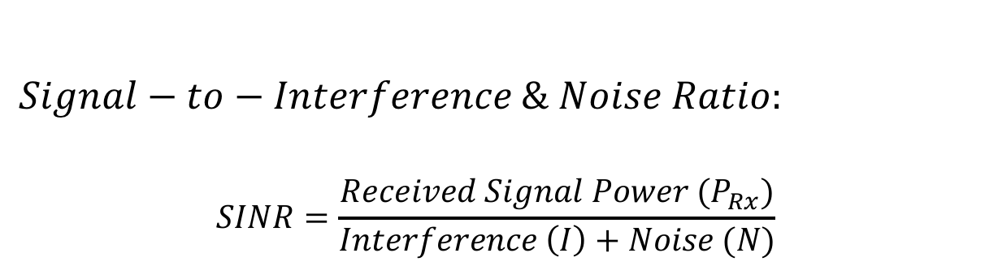
Wireless Link Characteristics
important differences from wired link ….
  interference from other sources: standardized wireless network frequencies (e.g., 2.4 GHz) shared by other devices (e.g., phone); devices (motors) interfere as well
$$Signal−to−Interference \& Noise Ratio:$$
$$SINR=\frac{Received Signal Power (P_{Rx})}{Interference \left(I\right)+Noise (N)}$$
MAC Protocols necessary to avoid interference!

Slide 34
Wireless Link Characteristics
important differences from wired link ….
  multipath propagation: radio signal reflects off objects ground, arriving at destination at slightly different times
$$y\left(t\right)=h_{1} x\left(t−τ_{1}\right)+h_{2} x\left(t−τ_{2}\right)+h_{3} x\left(t−τ_{3}\right)$$

Slide 35
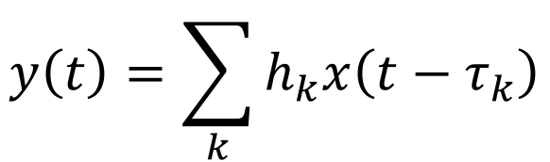

Wireless Link Characteristics
important differences from wired link ….
  multipath propagation: radio signal reflects off objects ground, arriving at destination at slightly different times
$$y\left(t\right)=\sum_{k}{h_{k}x\left(t−τ_{k}\right)}$$
$$=h\left(t\right)∗x\left(t\right)$$

Slide 36
Wireless Link Characteristics
important differences from wired link ….
  multipath propagation: radio signal reflects off objects ground, arriving at destination at slightly different times
    Inter-Symbol-Interference:
    Paths can sum up destructively or constructively
    ➔ Channel Fading

Slide 37
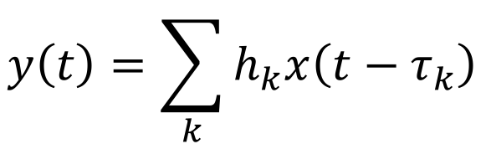


Wireless Link Characteristics
important differences from wired link ….
  multipath propagation: radio signal reflects off objects ground, arriving at destination at slightly different times
$$y\left(t\right)=\sum_{k}{h_{k}x\left(t−τ_{k}\right)}$$
$$=h\left(t\right)∗x\left(t\right)$$
$$⟺H\left(f\right)X\left(f\right)$$

Slide 38

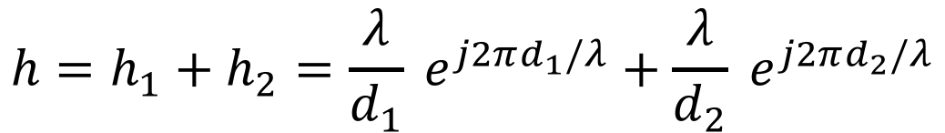
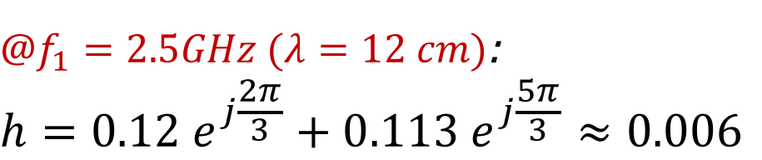
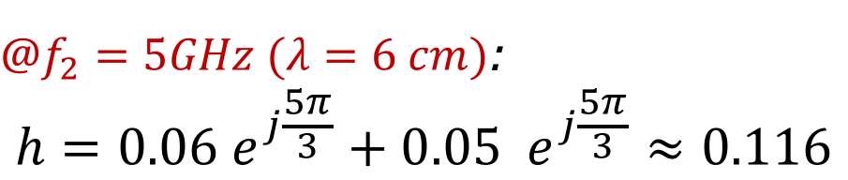
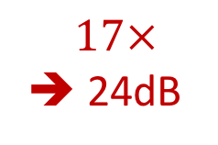
Wireless Link Characteristics
  Frequency Selective Fading:
  Example 2 paths with distance $d_{1}=1m, d_{2}=1.06m$:
$$h=h_{1}+h_{2}=\frac{λ}{d_{1}} e^{j2πd_{1}/λ}+\frac{λ}{d_{2}} e^{j2πd_{2}/λ}$$
$@f_{1}=2.5GHz (λ=12 cm)$:
$$h=0.12 e^{j\frac{2π}{3}}+0.113 e^{j\frac{5π}{3}}≈0.006$$
$$17×$$
➔ 24dB
$@f_{2}=5GHz (λ=6 cm)$:
$$h=0.06 e^{j\frac{5π}{3}}+0.05 e^{j\frac{5π}{3}}≈0.116$$

Slide 39
Wireless Link Characteristics
important differences from wired link ….
  multipath propagation: radio signal reflects off objects ground, arriving at destination at slightly different times
  Solution:
  OFDM: Orthogonal Frequency Division Multiplexing
  Idea: transmit symbols in frequency not time.

Slide 40
Orthogonal Frequency Division Multiplexing

Slide 41



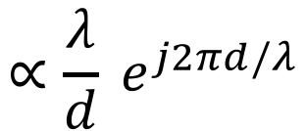

Channel Estimation and Correction
$$∝\frac{λ}{d} e^{j2πd/λ}$$
$$h$$
$$x(t)$$
$$y\left(t\right)=h x(t)$$
$$+ n(t)$$
How to estimate and correct for channel?
Send Preamble Bits

Slide 42






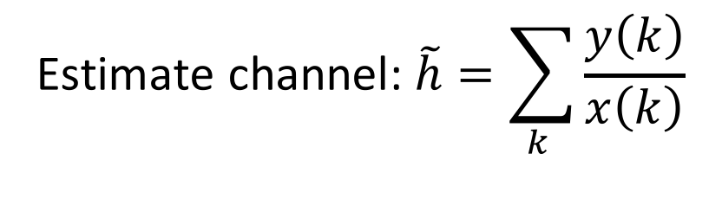
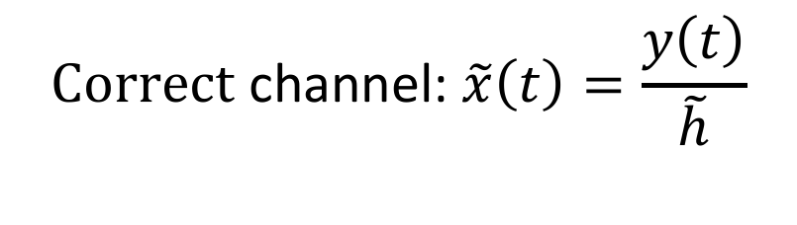
Channel Estimation and Correction
$$∝\frac{λ}{d} e^{j2πd/λ}$$
$$h$$
$$x(t)$$
$$y\left(t\right)=h x(t)$$
$$+ n(t)$$
Preamble Bits: Known bits
$$x\left(0\right)=1$$
$$y\left(0\right)=h+n\left(0\right)$$
$$x\left(1\right)=1$$
$$y\left(1\right)=h+n\left(1\right)$$
$$x\left(2\right)=−1$$
$$y\left(2\right)=−h+n\left(2\right)$$
$$\text{Estimate} \text{channel}\text{:} \tilde{h}=\sum_{k }{\frac{y\left(k\right)}{x\left(k\right)}}$$
$$\text{C}\text{orrect} \text{channel}\text{:} \tilde{x}\left(t\right)=\frac{y\left(t\right)}{\tilde{h}}$$

Slide 43



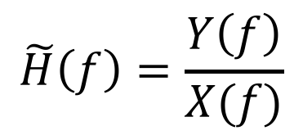
Channel Estimation and Correction
$$∝\frac{λ}{d} e^{j2πd/λ}$$
$$h$$
$$x(t)$$
$$y\left(t\right)=h \left(t\right)∗ x(t)$$
$$+ n(t)$$
What about multi-tap channel?
OFDM: Send bits in frequency domain
$$h \left(t\right)∗ x(t)⟺H\left(f\right)X(f)$$
Channel estimation and correction can be done in frequency domain.
$$\tilde{H}\left(f\right)=\frac{Y\left(f\right)}{X(f)}$$

Slide 44
Spread Spectrum
Problem of radio transmission: frequency dependent fading can wipe out narrow band signals for duration of the interference
Solution: spread the narrow band signal into a broad band signal using a special code
interference
spread signal
power
signal
power
spread
interference
detection at
receiver
f
f

Slide 45
DSSS (Direct Sequence Spread Spectrum)
XOR the signal with pseudonoise (PN) sequence (chipping sequence)
Advantages
  reduces frequency selective
  fading
  Robust to interference
  Multi-user
Used in 3G & 802.11b
T_{b}
user data
0
1
XOR
T_{c}
chipping
sequence
0
1
1
0
1
0
1
0
1
1
0
1
0
1
=
resulting
signal
0
1
1
0
1
0
1
1
0
0
1
0
1
0

Slide 46
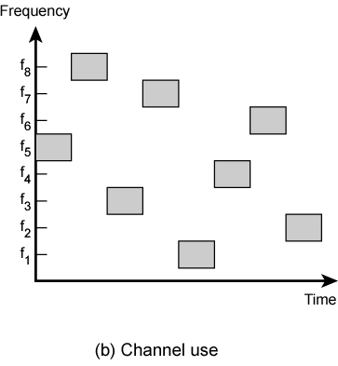
FHSS (Frequency Hopping Spread Spectrum)
Discrete changes of carrier frequency
  sequence of frequency changes determined via PN sequence
Advantages
  frequency selective fading and interference limited to short period
  uses only small portion of spectrum at any time
  Secure
Used in bluetooth & military applicaitons

Slide 47
Wireless Link Characteristics
important differences from wired link ….
  decreased signal strength: radio signal attenuates as it propagates through matter (path loss)
  interference from other sources: standardized wireless network frequencies (e.g., 2.4 GHz) shared by other devices (e.g., phone); devices (motors) interfere as well
  multipath propagation: radio signal reflects off objects ground, arriving ad destination at slightly different times
…. make communication across (even a point to point) wireless link much more “difficult”

Slide 48

Wireless network characteristics
Multiple wireless senders and receivers create additional problems (beyond multiple access):
A
B
C
C
A’s signal
strength
C’s signal
strength
B
A
Hidden terminal problem
B, A hear each other
B, C hear each other
A, C can not hear each other means A, C unaware of their interference at B
space
Signal attenuation:
B, A hear each other
B, C hear each other
A, C can not hear each other interfering at B

Slide 49
Wireless network characteristics
Advantage of signal attenuation: Spatial Reuse
A
B
D
C
A’s signal
strength
C’s signal
strength
space

Slide 50
Wireless network characteristics
Problem: A wants to transmit a packet to C
A
d
B
d
C
Option 1: A increases its power such that its packet reaches C
A
B
C
Option 2: A sends that packet to B which intern send it to C
A
B
C

Slide 51
Wireless network characteristics
Problem: A wants to transmit a packet to C
A
d
B
d
C
Option 1: A increases its power such that its packet reaches C
To double transmission range, we need: 4x more overall power!
A
B
C
To transmit over two hops, we need: 2x more overall power!
Option 2: A sends that packet to B which intern send it to C
A
B
C

Slide 52
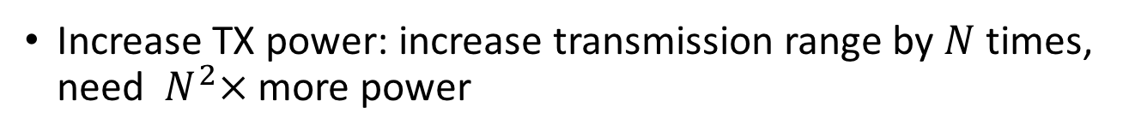
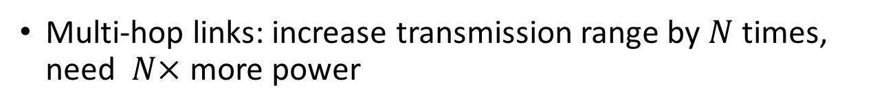
Wireless network characteristics
Multi-hop wireless networks:
A
d
B
d
C
Increase TX power: increase transmission range by $N$ times, need $N^{2}×$ more power
Multi-hop links: increase transmission range by $N$ times, need $N×$ more power
Ad hoc multi-hop wireless networks!

Slide 53
Chapter 6: Outline
  Introduction
  Wireless Links
  Wireless MAC
  WiFi: 802.11 Wireless LANs
  Cellular Networks: 3G, LTE
  Mobility

Slide 54
The Channel Access Problem
Multiple nodes share a channel
Pairwise communication desired
  Simultaneous communication not possible
MAC Protocols
  Suggests a scheme to schedule communication
    Maximize number of communications
    Ensure fairness among all transmitters
A
B
C

Slide 55
The Trivial Solution
A
B
C
Transmit and pray
  Plenty of collisions → poor throughput at high load

Slide 56
The Simple Fix
Don’t
transmit
A
B
C
Transmit and pray
  Plenty of collisions → poor throughput at high load
Listen before you talk
  Carrier sense multiple access (CSMA)
  Defer transmission when signal on channel
Can collisions still occur?

Slide 57
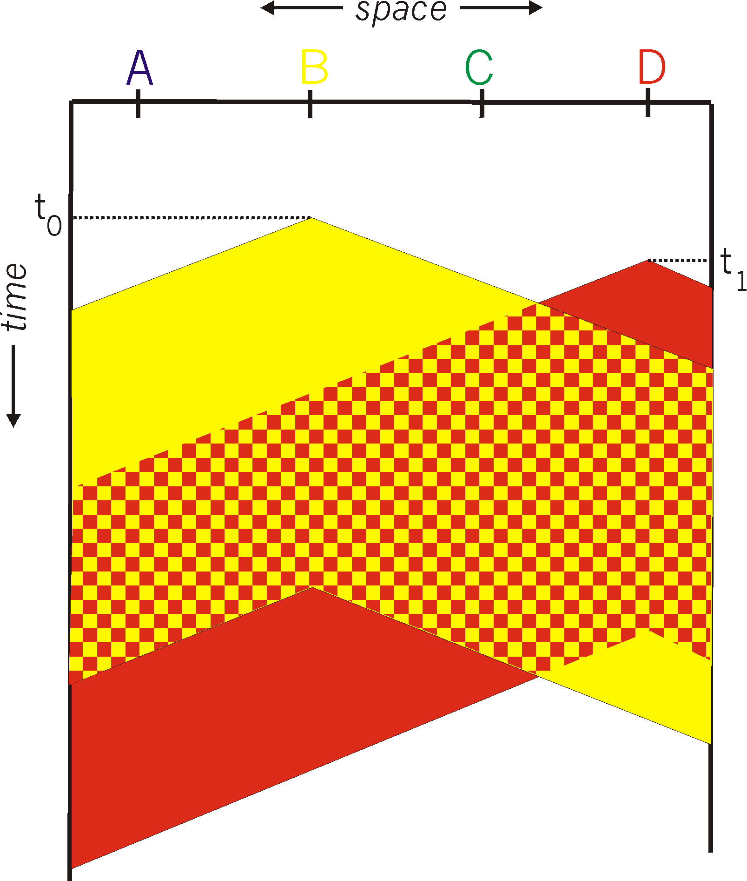
CSMA collisions
spatial layout of nodes
Collisions can still occur:
Propagation delay non-zero between transmitters
When collision:
Entire packet transmission
time wasted
note:
Role of distance & propagation delay in determining collision probability

Slide 58
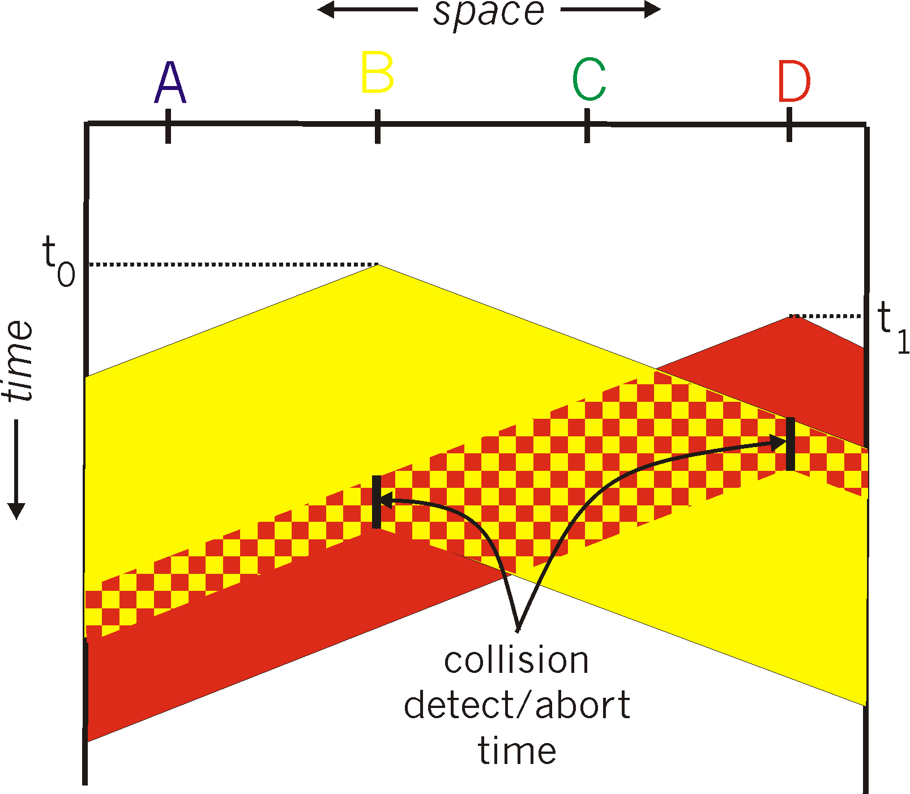
CSMA/CD (Collision Detection)
Keep listening to channel
  While transmitting
If (Transmitted_Signal != Sensed_Signal)
  → Sender knows it’s a Collision
  → ABORT

Slide 59
2 Observations on CSMA/CD
Transmitter can send/listen concurrently
  If (Sensed - received = null)? Then success
The signal is identical at Tx and Rx
  Non-dispersive
The transmitter can DETECT if and
when collision occurs

Slide 60
Unfortunately …
Both observations do not hold for wireless
Leading to …

Slide 61
Wireless Medium Access Control
C
D
A
B
Signal
power
SINR threshold
Distance

Slide 62
Wireless Media Disperse Energy
A cannot send and listen in parallel
C
D
A
B
Signal
power
Signal not same at different locations
SINR threshold
Distance

Slide 63
Collision Detection Difficult
Signal reception based on SINR
  Transmitter can only hear itself
  Cannot determine signal quality at receiver

Slide 64
Red signal >> Blue signal
Red < Blue = collision
C
D
X
A
B
Signal
power
SINR threshold
Distance

Slide 65
Important: C has not heard A, but can interfere at receiver B
C is the hidden terminal to A
C
D
X
A
B
Signal
power
SINR threshold
Distance

Slide 66
Important: X has heard A, but should not defer transmission to Y
Y
X is the exposed terminal to A
C
D
X
A
B
Signal
power
SINR threshold
Distance

Slide 67
Hidden and Exposed Terminal Problems
Critical to wireless networks even today

Slide 68
IEEE 802.11
RTS = Request
To Send
CTS = Clear
To Send
M
Y
S
RTS
D
CTS
K

Slide 69
IEEE 802.11
silenced
M
Y
S
silenced
Data
D
ACK
X
silenced
K
silenced

Slide 70
But is that enough?

Slide 71
RTS/CTS
Does it solve hidden terminals ?
  Assuming carrier sensing zone = communication zone
E
RTS
F
CTS
A
B
C
D
E does not receive CTS successfully → Can later initiate transmission to D.
Hidden terminal problem remains.

Slide 72
Hidden Terminal Problem
How about increasing carrier sense range ??
  E will defer on sensing carrier → no collision !!!
E
RTS
F
CTS
A
B
C
D
Data

Slide 73
Hidden Terminal Problem
But what if barriers/obstructions ??
  E doesn’t hear C → Carrier sensing does not help
E
RTS
F
CTS
A
B
C
D
Data

Slide 74
Exposed Terminal
B should be able to transmit to A
  RTS prevents this
E
RTS
CTS
A
B
C
D

Slide 75
Exposed Terminal
B should be able to transmit to A
  Carrier sensing makes the situation worse
E
RTS
CTS
A
B
C
D

Slide 76
Multiplexing
Multiplexing in 4 dimensions
  space (s_{i})
  time (t)
  frequency (f)
  code (c)
k₁
k₂
k₃
k₄
k₅
k₆
c
t
c
s₁
t
s₂
f
f
c
t
s₃
f

Slide 77
Frequency multiplex
Separation of spectrum into smaller frequency bands
Channel gets band of the spectrum for the whole time
Advantages:
  no dynamic coordination needed
  works also for analog signals
Disadvantages:
  waste of bandwidth
  if traffic distributed unevenly
  inflexible
  guard spaces
k₃
k₄
k₅
k₆
c
f
t

Slide 78
Time multiplex
Channel gets the whole spectrum for a certain amount of time
Advantages:
  only one carrier in the
  medium at any time
  throughput high even
  for many users
Disadvantages:
  precise
  synchronization
  necessary
k₁
k₂
k₃
k₄
k₅
k₆
c
f
t

Slide 79
Time and frequency multiplex
A channel gets a certain frequency band for a certain amount of time (e.g. GSM)
Advantages:
  better protection against tapping
  protection against frequency
  selective interference
  higher data rates compared to
  code multiplex
Precise coordination
required
k₁
k₂
k₃
k₄
k₅
k₆
c
f
t

Slide 80
Code multiplex
k₁
k₂
k₃
k₄
k₅
k₆
Each channel has unique code
All channels use same spectrum at same time
Advantages:
  bandwidth efficient
  no coordination and synchronization
  good protection against interference
Disadvantages:
  lower user data rates
  more complex signal regeneration
Implemented using spread spectrum technology
c
f
t

Slide 81
Code Division Multiple Access (CDMA)
unique “code” assigned to each user; i.e., code set partitioning
  all users share same frequency, but each user has own “chipping” sequence (i.e., code) to encode data
  allows multiple users to “coexist” and transmit simultaneously with minimal interference (if codes are “orthogonal”)
encoded signal = (original data) X (chipping sequence)
decoding: inner-product of encoded signal and chipping sequence
Example codes: Gold Codes, Walsh Codes

Slide 82
CDMA encode/decode
channel output Z_{i,m}
Z_{i,m}= d_{i}.c_{m}
data
bits
d₀ = 1
1
1
1
1
1
d₁ = -1
1
1
1
-
-
-
-
1
-
-
-
1
-
1
1
1
1
1
sender
1
1
slot 1
channel
output
slot 0
channel
output
1
1
1
1
1
code
1
1
-
-
-
1
-
1
1
1
-
-
-
1
-
1
1
1
slot 1
slot 0
M
D_{i} = Σ Z_{i,m}.c_{m}
m=1
M
received
input
1
1
1
1
1
1
1
1
d₀ = 1
-
-
-
-
1
-
-
-
1
-
1
1
1
1
1
1
d₁ = -1
1
slot 1
channel
output
slot 0
channel
output
1
1
1
1
1
code
1
1
-
-
-
1
-
1
1
1
-
-
-
1
-
1
1
1
receiver
slot 1
slot 0

Slide 83
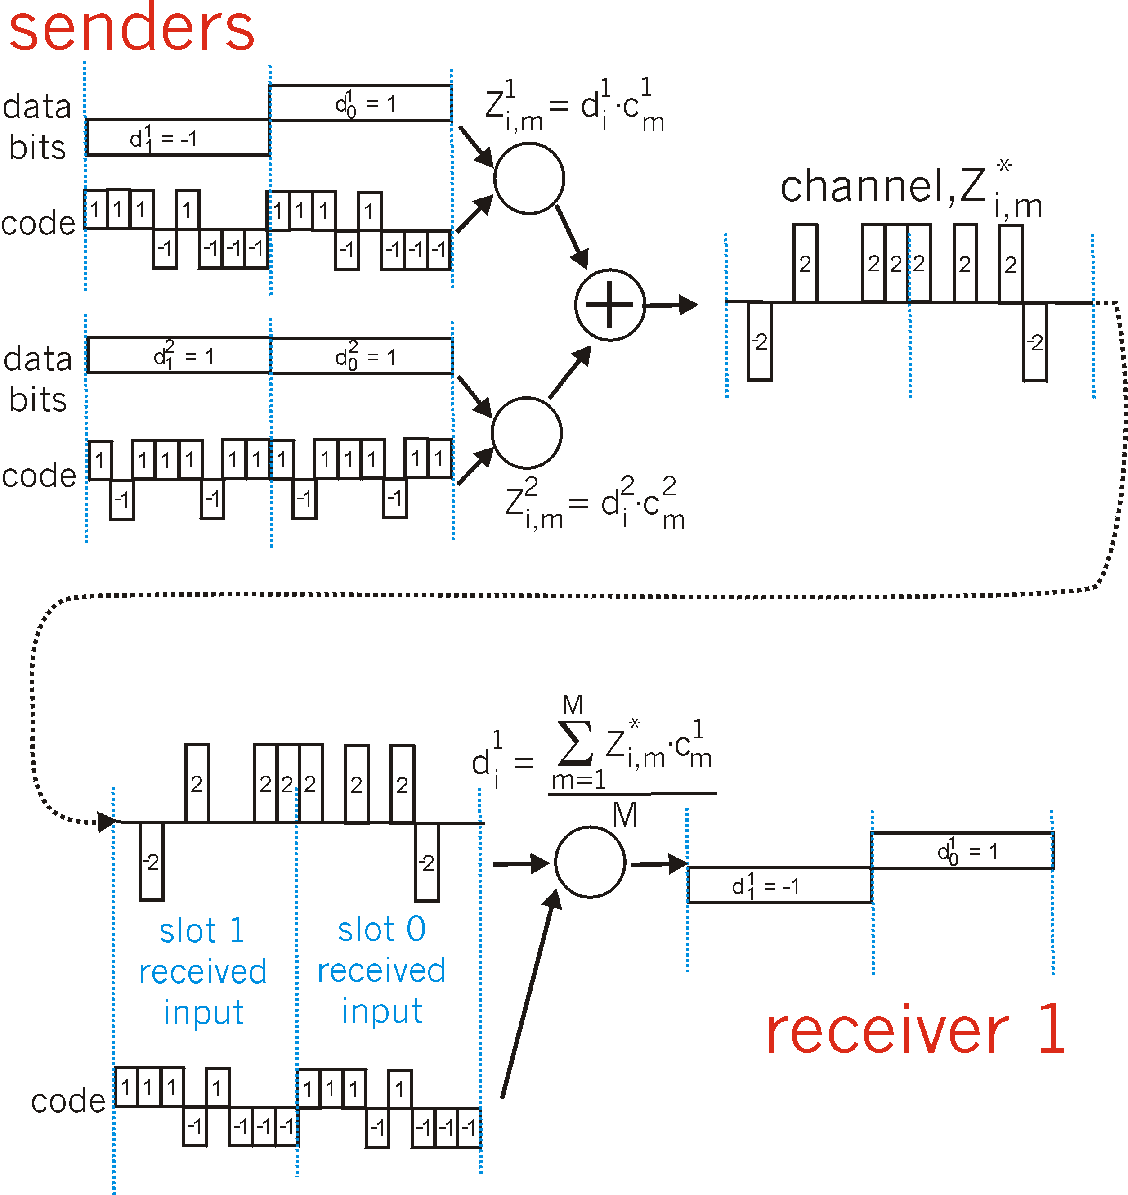
CDMA: two-sender interference
channel sums together transmissions by sender 1 and 2
Sender 1
Sender 2
using same code as sender 1, receiver recovers sender 1’s original data from summed channel data!

Slide 84
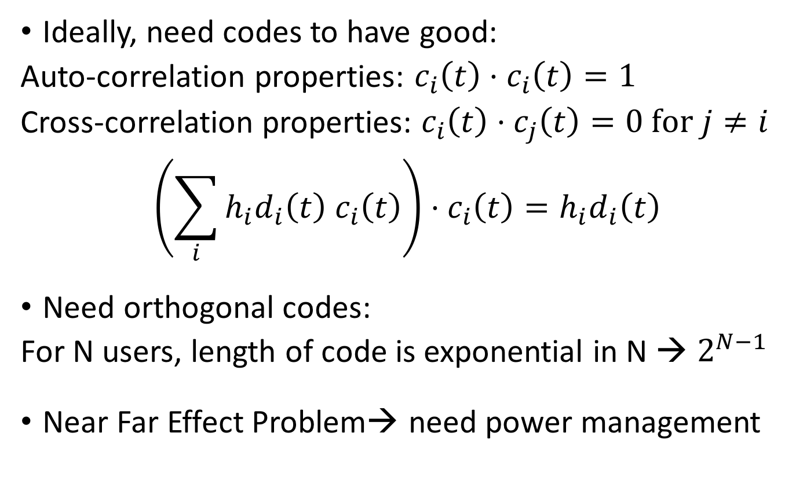
Code Division Multiple Access (CDMA)
Ideally, need codes to have good:
Auto-correlation properties: $c_{i}\left(t\right)⋅c_{i}\left(t\right)=1$
Cross-correlation properties: $c_{i}\left(t\right)⋅c_{j}\left(t\right)=0 for j≠i$
$$\left(\sum_{i}{h_{i}{d_{i}\left(t\right) c}_{i}\left(t\right)}\right)⋅c_{i}\left(t\right)=h_{i}d_{i}\left(t\right)$$
Need orthogonal codes:
For N users, length of code is exponential in N → $2^{N−1}$
Near Far Effect Problem→ need power management

Slide 85
Chapter 6: Outline
  Introduction
  Wireless Links
  Wireless MAC
  WiFi: 802.11 Wireless LANs
  Cellular Networks: 3G, LTE
  Mobility

Slide 86
IEEE 802.11 Wireless LAN
802.11b
2.4-5 GHz unlicensed spectrum
up to 11 Mbps
direct sequence spread spectrum (DSSS) in physical layer
  all hosts use same chipping code
802.11a
  5-6 GHz range
  up to 54 Mbps
802.11g
  2.4-5 GHz range
  up to 54 Mbps
802.11n: multiple antenna
  2.4-5 GHz range
  up to 200 Mbps
802.11ac: multiple antenna
  2.4-5 GHz range
  Up to 1.69 Gbps
802.11ad/ay: Millimeter wave
  2.4, 5, 60 GHz range
  Up to 7 Gbps

Slide 87




802.11 LAN architecture
wireless host communicates with base station
  base station = access point (AP)
Basic Service Set (BSS) (aka “cell”) in infrastructure mode contains:
  wireless hosts
  access point (AP): base station
  ad hoc mode: hosts only
Internet
hub, switch
or router
BSS 1
BSS 2

Slide 88
802.11: Channels, association
802.11b: 2.4GHz-2.485GHz spectrum divided into 11 channels at different frequencies
  AP admin chooses frequency for AP
  interference possible: channel can be same as that chosen by neighboring AP!
host: must associate with an AP
  scans channels, listening for beacon frames containing AP’s name (SSID) and MAC address
  selects AP to associate with
  may perform authentication
  will typically run DHCP to get IP address in AP’s subnet

Slide 89
802.11: passive/active scanning
BBS 1
BBS 2
BBS 1
BBS 2
1
AP 2
AP 1
1
1
AP 2
AP 1
2
2
2
3
3
4
H1
H1
passive scanning:
beacon frames sent from APs
association Request frame sent: H1 to selected AP
association Response frame sent from selected AP to H1
active scanning:
Probe Request frame broadcast from H1
Probe Response frames sent from APs
Association Request frame sent: H1 to selected AP
Association Response frame sent from selected AP to H1

Slide 90



IEEE 802.11: multiple access
avoid collisions: 2⁺ nodes transmitting at same time
802.11: CSMA - sense before transmitting
  don’t collide with ongoing transmission by other node
802.11: no collision detection!
  difficult to receive (sense collisions) when transmitting due to weak received signals (fading)
  can’t sense all collisions in any case: hidden terminal, fading
  goal: avoid collisions: CSMA/C(ollision)A(voidance)
A
B
C
C
B
A’s signal
strength
C’s signal
strength
A
space

Slide 91
IEEE 802.11 MAC Protocol: CSMA/CA
802.11 sender
1 if sense channel idle for DIFS then
  transmit entire frame (no CD)
2 if sense channel busy then
  start random backoff time
  timer counts down while channel idle
  transmit when timer expires
  if no ACK, increase random backoff interval, repeat 2
802.11 receiver
- if frame received OK
return ACK after SIFS (ACK needed due to hidden terminal problem)
sender
receiver
DIFS
data
SIFS
ACK

Slide 92
Avoiding collisions (more)
idea: allow sender to “reserve” channel rather than random access of data frames: avoid collisions of long data frames
sender first transmits small request-to-send (RTS) packets to BS using CSMA
  RTSs may still collide with each other (but they’re short)
BS broadcasts clear-to-send CTS in response to RTS
CTS heard by all nodes
  sender transmits data frame
  other stations defer transmissions
avoid data frame collisions completely
using small reservation packets!

Slide 93

Collision Avoidance: RTS-CTS exchange
A
B
AP
RTS(B)
RTS(A)
reservation collision
RTS(A)
CTS(A)
CTS(A)
DATA (A)
defer
time
ACK(A)
ACK(A)

Slide 94
802.11 frame: addressing
2
2
6
6
6
2
6
0 - 2312
4
frame
control
duration
address
1
address
2
address
3
seq
control
address
4
payload
CRC
Address 4: used only in ad hoc mode
Address 1: MAC address
of wireless host or AP
to receive this frame
Address 3: MAC address
of router interface to which AP is attached
Address 2: MAC address
of wireless host or AP
transmitting this frame

Slide 95
802.11 frame: addressing
Internet
H1
R1
router
R1 MAC addr H1 MAC addr
dest. address
source address
802.3 frame
AP MAC addr H1 MAC addr R1 MAC addr
address 1
address 2
address 3
802.11 frame

Slide 96
802.11 frame: more
frame seq #
(for RDT)
duration of reserved
transmission time (RTS/CTS)
2
2
6
6
6
2
6
0 - 2312
4
frame
control
duration
address
1
address
2
address
3
seq
control
address
4
payload
CRC
2
2
4
1
1
1
1
1
1
1
1
Protocol
version
Type
Subtype
To
AP
From
AP
More
frag
Retry
Power
mgt
More
data
WEP
Rsvd
frame type
(RTS, CTS, ACK, data)

Slide 97

802.11: mobility within same subnet
H1 remains in same IP subnet: IP address can remain same
switch: which AP is associated with H1?
  self-learning (Ch. 5): switch will see frame from H1 and “remember” which switch port can be used to reach H1
BBS 1
H1
BBS 2

Slide 98
802.11: advanced capabilities
Rate adaptation
base station, mobile dynamically change transmission rate (physical layer modulation technique) as mobile moves, SNR varies
10⁻¹
10⁻²
10⁻³
BER
10⁻⁴
10⁻⁵
10⁻⁶
10⁻⁷
10
20
30
40
SNR(dB)
1. SNR decreases, BER increase as node moves away from base station
QAM256 (8 Mbps)
QAM16 (4 Mbps)
2. When BER becomes too high, switch to lower transmission rate but with lower BER
BPSK (1 Mbps)
operating point

Slide 99
Chapter 6: Outline
  Introduction
  Wireless Links
  Wireless MAC
  WiFi: 802.11 Wireless LANs
  Cellular Networks: 3G, LTE
  Mobility

Slide 100

Components of cellular network architecture
MSC
connects cells to wired tel. net.
manages call setup (more later!)
handles mobility (more later!)
cell
covers geographical region
base station (BS) analogous to 802.11 AP
mobile users attach to network through BS
air-interface: physical and link layer protocol between mobile and BS
Mobile
Switching
Center
Public telephone
network
Mobile
Switching
Center
wired network

Slide 101
Cellular networks: the first hop
Two techniques for sharing mobile-to-BS radio spectrum
combined FDMA/TDMA: divide spectrum in frequency channels, divide each channel into time slots
CDMA: code division multiple access
time slots
frequency
bands

Slide 102
2G (voice) network architecture
Base station system (BSS)
MSC
BTS
BSC
G
Public
telephone
network
Gateway
MSC
Legend
Base transceiver station (BTS)
Base station controller (BSC)
Mobile Switching Center (MSC)
Mobile subscribers

Slide 103
3G (voice+data) network architecture
MSC
G
Public
telephone
network
radio
network
controller
Gateway
MSC
G
Public
Internet
SGSN
Key insight: new cellular data
network operates in parallel
(except at edge) with existing
cellular voice network
voice network unchanged in core
data network operates in parallel
GGSN
Serving GPRS Support Node (SGSN)
Gateway GPRS Support Node (GGSN)

Slide 104
3G (voice+data) network architecture
MSC
G
Public
telephone
network
radio
network
controller
Gateway
MSC
G
Public
Internet
SGSN
GGSN
radio interface
(WCDMA, HSPA)
radio access network
Universal Terrestrial Radio
Access Network (UTRAN)
core network
General Packet Radio Service
(GPRS) Core Network
public
Internet

Slide 105
3G versus 4G LTE network architecture
MSC
G
Public
telephone
network
3G
radio
network
controller
Gateway
MSC
G
Public
Internet
SGSN
GGSN
4G-LTE
HSS
MME
G
G
Public
Internet
S-GW
P-GW
radio access network
Universal Terrestrial Radio
Access Network (UTRAN)
Evolved Packet Core
(EPC)

Slide 106
4G: differences from 3G
all IP core: IP packets tunneled (through core IP network) from base station to gateway
no separation between voice and data – all traffic carried over IP core to gateway
Mobility
Management
Entity (MME)
Home Subscriber
Server(HSS)
(like HLR+VLR)
Serving
Gateway
(S-GW)
Packet data
network
Gateway
(P-GW)
UE
(user element)
eNodeB
(base station)
HSS
MME
control
G
G
Public
Internet
data
S-GW
P-GW
radio access network
Universal Terrestrial Radio
Access Network (UTRAN)
Evolved Packet Core
(EPC)

Slide 107
Chapter 6: Outline
  Introduction
  Wireless Links
  Wireless MAC
  WiFi: 802.11 Wireless LANs
  Cellular Networks: 3G, LTE
  Mobility

Slide 108
What is mobility?
spectrum of mobility, from the network perspective:
no mobility
high mobility
mobile wireless user,
using same access
point
mobile user, connecting/ disconnecting from network using DHCP.
mobile user, passing through multiple access point while maintaining ongoing connections (like cell phone)

Slide 109



Mobility: vocabulary
home network: permanent “home” of mobile
(e.g., 128.119.40/24)
home agent: entity that will perform mobility functions on behalf of mobile, when mobile is remote
wide area network
permanent address: address in home network, can always be used to reach mobile
e.g., 128.119.40.186

Slide 110
Mobility: more vocabulary
permanent address: remains constant (e.g., 128.119.40.186)
visited network: network in which mobile currently resides (e.g., 79.129.13/24)
care-of-address: address in visited network.
(e.g., 79,129.13.2)
wide area network
foreign agent: entity in visited network that performs mobility functions on behalf of mobile.
correspondent: wants to communicate with mobile

Slide 111
Mobility: approaches
let routing handle it: routers advertise permanent address of mobile-nodes-in-residence via usual routing table exchange.
  routing tables indicate where each mobile located
  no changes to end-systems
let end-systems handle it:
  indirect routing: communication from correspondent to mobile goes through home agent, then forwarded to remote
  direct routing: correspondent gets foreign address of mobile, sends directly to mobile

Slide 112
Mobility: approaches
let routing handle it: routers advertise permanent address of mobile-nodes-in-residence via usual routing table exchange.
  routing tables indicate where each mobile located
  no changes to end-systems
let end-systems handle it:
  indirect routing: communication from correspondent to mobile goes through home agent, then forwarded to remote
  direct routing: correspondent gets foreign address of mobile, sends directly to mobile
not
scalable
to millions of
mobiles

Slide 113
Mobility: registration
visited network
home network
1
2
wide area network
mobile contacts foreign agent on entering visited network
foreign agent contacts home agent home: “this mobile is resident in my network”
end result:
foreign agent knows about mobile
home agent knows location of mobile

Slide 114

Mobility via indirect routing
foreign agent receives packets, forwards to mobile
home agent intercepts packets, forwards to foreign agent
visited
network
home
network
3
wide area network
2
1
correspondent addresses packets using home address of mobile
4
mobile replies directly to correspondent

Slide 115



Indirect Routing: comments
mobile uses two addresses:
  permanent address: used by correspondent (hence mobile location is transparent to correspondent)
  care-of-address: used by home agent to forward datagrams to mobile
foreign agent functions may be done by mobile itself
triangle routing: correspondent-home-network-mobile
  inefficient when
  correspondent, mobile
  are in same network

Slide 116


Mobility via direct routing
foreign agent receives packets, forwards to mobile
correspondent forwards to foreign agent
visited
network
home
network
3
1
2
4
correspondent requests, receives foreign address of mobile
mobile replies directly to correspondent

Slide 117
Components of cellular network architecture
recall:
correspondent
wired public telephone
network
MSC
MSC
MSC
MSC
MSC
different cellular networks,
operated by different providers

Slide 118
GSM: indirect routing to mobile
HLR
home
network
2
correspondent
home
Mobile
Switching
Center
home MSC consults HLR,
gets roaming number of
mobile in visited network
1
call routed
to home network
3
Public switched
telephone
network
VLR
Mobile
Switching
Center
4
home MSC sets up 2nd leg of call
to MSC in visited network
mobile
user
MSC in visited network completes
call through base station to mobile
visited
network

Slide 119
GSM: handoff with common MSC
handoff goal: route call via new base station (without interruption)
reasons for handoff:
  stronger signal to/from new BSS (continuing connectivity, less battery drain)
  load balance: free up channel in current BSS
  GSM doesn't mandate why to perform handoff (policy), only how (mechanism)
handoff initiated by old BSS
VLR
Mobile
Switching
Center
old
routing
new
routing
old BSS
new BSS

Slide 120
GSM: handoff with common MSC
1. old BSS informs MSC of impending handoff, provides list of 1⁺ new BSSs
2. MSC sets up path (allocates resources) to new BSS
3. new BSS allocates radio channel for use by mobile
4. new BSS signals MSC, old BSS: ready
5. old BSS tells mobile: perform handoff to new BSS
6. mobile, new BSS signal to activate new channel
7. mobile signals via new BSS to MSC: handoff complete. MSC reroutes call
8 MSC-old-BSS resources released
VLR
Mobile
Switching
Center
4
2
1
8
7
3
old BSS
5
6
new BSS

Slide 121
Chapter 6: Outline
  Introduction
  Wireless Links
  Wireless MAC
  WiFi: 802.11 Wireless LANs
  Cellular Networks: 3G, LTE
  Mobility

Slide 122
Wireless, mobility: impact on higher layer protocols
logically, impact should be minimal …
  best effort service model remains unchanged
  TCP and UDP can (and do) run over wireless, mobile
… but performance-wise:
  packet loss/delay due to bit-errors (discarded packets, delays for link-layer retransmissions), and handoff
  TCP interprets loss as congestion, will decrease congestion window un-necessarily
  delay impairments for real-time traffic
  limited bandwidth of wireless links

