Slide 1
Distributed Systems CS425/ECE428
Instructor: Radhika Mittal
Acknowledgements for some of materials: Indy Gupta and Nikita Borisov

Slide 2
Logistics
MP1 has been released.
Due on March 4th, 11:59pm.
HW1 is due next week Monday.
You should be able to solve all questions by now (except 7c).
You should be able to solve 7c after the end of today’s class.
Academic Integrity:
Violation: copying from peers, from previous years’, from the web, etc.

Slide 3
Today’s agenda
Wrap up Multicast
Chapter 15.4
Tree-based multicast and Gossip
Mutual Exclusion
Chapter 15.2

Slide 4
Recap: Multicast
Useful communication mode in distributed systems:
Writing an object across replica servers.
Group messaging.
…..
Basic multicast (B-multicast): unicast send to each process in the group.
Does not guarantee consistent message delivery if sender fails.
Reliable multicast (R-mulicast):
Defined by three properties: integrity, validity, agreement.
If some correct process multicasts a message m, then all other correct processes deliver m (exactly once).
When a process receives a message ‘m’ for the first time, it re-multicasts it again to other processes in the group.

Slide 5
Recap: Ordered Multicast
FIFO ordering: If a correct process issues multicast(g,m) and then multicast(g,m’), then every correct process that delivers m’ will have already delivered m.
Causal ordering: If multicast(g,m) → multicast(g,m’) then any correct process that delivers m’ will have already delivered m.
Note that → counts multicast messages delivered to the application, rather than all network messages.
Total ordering: If a correct process delivers message m before m’, then any other correct process that delivers m’ will have already delivered m.

Slide 6
Ordered Multicast
FIFO ordering: If a correct process issues multicast(g,m) and then multicast(g,m’), then every correct process that delivers m’ will have already delivered m.
Causal ordering: If multicast(g,m) → multicast(g,m’) then any correct process that delivers m’ will have already delivered m.
Note that → counts multicast messages delivered to the application, rather than all network messages.
Total ordering: If a correct process delivers message m before m’ then any other correct process that delivers m’ will have already delivered m.

Slide 7
Implementing total order multicast
Basic idea:
Same sequence number counter across different processes.
Instead of different sequence number counter for each process.
Two types of approach
Using a centralized sequencer
A decentralized mechanism (ISIS)

Slide 8
Implementing total order multicast
Basic idea:
Same sequence number counter across different processes.
Instead of different sequence number counter for each process.
Two types of approach
Using a centralized sequencer
A decentralized mechanism (ISIS)

Slide 9
ISIS algorithm for total ordering
P
2
1 Message
3
2
P
2
2 Proposed Seq
4
1
3 Agreed Seq
1
2
P
1
3
P
3

Slide 10
ISIS algorithm for total ordering
Sender multicasts message to everyone.
Receiving processes:
reply with proposed priority (sequence no.)
larger than all observed agreed priorities
larger than any previously proposed (by self) priority
store message in priority queue
ordered by priority (proposed or agreed)
mark message as undeliverable
Sender chooses agreed priority, re-multicasts message id with agreed priority
maximum of all proposed priorities
Upon receiving agreed (final) priority for a message ‘m’
Update m’s priority to final, and accordingly reorder messages in queue.
mark the message m as deliverable.
deliver any deliverable messages at front of priority queue.
P
2
1 Message
3
2
P
2
2 Proposed Seq
4
1
3 Agreed Seq
1
2
P
1
3
P
3

Slide 11
Example: ISIS algorithm
A
A:1
P1
A:2
C:2
B:3
C
P2
B:1
A:2
C:3
P3
B:1
A:2
C:3
B

Slide 12
How do we break ties?
Problem: priority queue requires unique priorities.
Solution: add process # to suggested priority.
priority.(id of the process that proposed the priority)
i.e., 3.2 == process 2 proposed priority 3
Compare on priority first, use process # to break ties.
2.1 > 1.3
3.2 > 3.1

Slide 13
Example: ISIS algorithm
A
✔
✔
✔
A:1.1
C:3.3
P1
A:2.3
C:2.1
B:3.1
C
✔
✔
✔
P2
B:1.2
B:3.1
A:2.2
A:2.3
C:3.2
C:3.3
✔
✔
✔
B:1.3
P3
B:3.1
A:2.3
C:3.3
B
[see .pptx file for animations]

Slide 14
Proof of total order with ISIS
Consider two messages, m₁ and m₂, and two processes, p and p’.
Suppose that p delivers m₁ before m₂.
When p delivers m₁, it is at the head of the queue. m₂ is either:
Already in p’s queue, and deliverable, so
finalpriority(m₁) < finalpriority(m₂)
Already in p’s queue, and not deliverable, so
finalpriority(m₁) < proposedpriority(m₂) <= finalpriority(m₂)
Not yet in p’s queue:
same as above, since proposed priority > priority of any delivered message
Suppose p’ delivers m₂ before m₁, by the same argument:
finalpriority(m₂) < finalpriority(m₁)
Contradiction!

Slide 15
Ordered Multicast
FIFO ordering
If a correct process issues multicast(g,m) and then multicast(g,m’), then every correct process that delivers m’ will have already delivered m.
Causal ordering
If multicast(g,m) → multicast(g,m’) then any correct process that delivers m’ will have already delivered m.
Note that → counts multicast messages delivered to the application, rather than all network messages.
Total ordering
If a correct process delivers message m before m’, then any other correct process that delivers m’ will have already delivered m.

Slide 16
More efficient multicast mechanisms
Our focus so far has been on the application-level semantics of multicast.
What are some of the more efficient underlying mechanisms for a B-multicast?

Slide 17
B-Multicast
Sender

Slide 18
B-Multicast using unicast sends
Sender
TCP/UDP packets

Slide 19
B-Multicast using unicast sends
Sender
Closer look at physical network paths.

Slide 20
B-Multicast using unicast sends
Sender
Redundant packets!

Slide 21
B-Multicast using unicast sends
Similar redundancy when individual nodes also act as routers (e.g. wireless sensor networks).
Sender
How do we reduce the overhead?

Slide 22
Tree-based multicast
Instead of sending a unicast to all nodes,
construct a minimum spanning tree and unicast along that.
Sender
TCP/UDP packets

Slide 23
Tree-based multicast
A process does not directly send messages to all other processes in the group.
It sends a message to only a subset of processes.
Sender
TCP/UDP packets

Slide 24
Tree-based multicast
A process does not directly send messages to all other processes in the group.
It sends a message to only a subset of processes.
Closer look at the physical network.
Sender

Slide 25
Tree-based multicast
Sender
Also possible to construct a tree that includes network routers. IP multicast!

Slide 26
Tree-based multicast
Sender
What happens if a node fails?
Overhead of tree construction and repair.
TCP/UDP packets

Slide 27
Third approach: Gossip
Transmit to b random targets.

Slide 28
Third approach: Gossip
Transmit to b random targets.
Other nodes do the same when they receive a message.

Slide 29
Third approach: Gossip
Transmit to b random targets.
Other nodes do the same when they receive a message.

Slide 30
Third approach: Gossip
No “tree-construction” overhead.
More efficient than unicasting to all receivers.
Also known as “epidemic multicast”.
Probabilistic in nature – no hard guarantees. Good enough for many applications.
Notes:
B value (called the reproduction number) for coronavirus: 2.6. For flu it is 1.3

Slide 31
Third approach: Gossip
Used in many real-world systems:
Facebook’s distributed datastore uses it to determine group membership and failures.
Bitcoin uses it to exchange transaction information between nodes.
Notes:
B value (called the reproduction number) for coronavirus: 2.6. For flu it is 1.3

Slide 32
Multicast Summary
Multicast is an important communication mode in distributed systems.
Applications may have different requirements:
Basic
Reliable
Ordered: FIFO, Causal, Total
Combinations of the above.
Underlying mechanisms to spread the information:
Unicast to all receivers.
Tree-based multicast, and gossip: sender unicasts messages to only a subset of other processes, and they spread the message further.
Gossip is more scalable and more robust to process failures.

Slide 33
Today’s agenda
Wrap up Multicast
Chapter 15.4
Tree-based multicast and Gossip
Mutual Exclusion
Chapter 15.2
Goal: reason about ways in which different processes in a distributed system can safely manipulate shared resources.

Slide 34
Why Mutual Exclusion?
Bank’s Servers in the Cloud: Two of your customers make simultaneous deposits of $10,000 into your bank account, each from a separate ATM.
Both ATMs read initial amount of $1000 concurrently from the bank’s cloud server
Both ATMs add $10,000 to this amount (locally at the ATM)
Both write the final amount to the server
What’s wrong?

Slide 35
Why Mutual Exclusion?
Bank’s Servers in the Cloud: Two of your customers make simultaneous deposits of $10,000 into your bank account, each from a separate ATM.
Both ATMs read initial amount of $1000 concurrently from the bank’s cloud server
Both ATMs add $10,000 to this amount (locally at the ATM)
Both write the final amount to the server
You lost $10,000!
The ATMs need mutually exclusive access to your account entry at the server
or, mutually exclusive access to executing the code that modifies the account entry.

Slide 36
More uses of mutual exclusion
Distributed file systems
Locking of files and directories
Accessing objects in a safe and consistent way
Ensure at most one server has access to object at any point of time
In industry
Chubby is Google’s locking service

Slide 37
Problem Statement for mutual exclusion
Critical Section Problem:
Piece of code (at all processes) for which we need to ensure there is at most one process executing it at any point of time.
Each process can call three functions
enter() to enter the critical section (CS)
AccessResource() to run the critical section code
exit() to exit the critical section

Slide 38
Our bank example
ATM1:
enter();
// AccessResource()
obtain bank amount;
add in deposit;
update bank amount;
// AccessResource() end
exit();
ATM2:
enter();
// AccessResource()
obtain bank amount;
add in deposit;
update bank amount;
// AccessResource() end
exit();

Slide 39
Mutual exclusion for a single OS
If all processes are running in one OS on a machine (or VM):
Semaphores
Mutexes
Condition variables
Monitors
…

Slide 40
Processes Sharing an OS: Semaphores
Semaphore == an integer that can only be accessed via two special functions
Semaphore S=1; // Max number of allowed accessors.
wait(S) (or P(S) or down(S)):
while(1) { // each execution of the while loop is atomic
if (S > 0) {
S--;
break;
}
}
signal(S) (or V(S) or up(s)):
S++; // atomic
enter()
Atomic operations are supported via hardware instructions such as compare-and-swap, test-and-set, etc.
exit()

Slide 41
Our bank example
ATM1:
enter();
// AccessResource()
obtain bank amount;
add in deposit;
update bank amount;
// AccessResource() end
exit();
ATM2:
enter();
// AccessResource()
obtain bank amount;
add in deposit;
update bank amount;
// AccessResource() end
exit();

Slide 42
Our bank example
Semaphore S=1; // shared
ATM1:
wait(S); //enter
// AccessResource()
obtain bank amount;
add in deposit;
update bank amount;
// AccessResource() end
signal(S); // exit
ATM2:
wait(S); //enter
// AccessResource()
obtain bank amount;
add in deposit;
update bank amount;
// AccessResource() end
signal(S); // exit

Slide 43
Mutual exclusion in distributed systems
Processes communicating by passing messages.
Cannot share variables like semaphores!
How do we support mutual exclusion in a distributed system?

Slide 44
Mutual exclusion in distributed systems
Our focus today: Classical algorithms for mutual exclusion in distributed systems.
Central server algorithm
Ring-based algorithm
Ricart-Agrawala Algorithm
Maekawa Algorithm

Slide 45
Mutual Exclusion Requirements
Need to guarantee 3 properties:
Safety (essential):
At most one process executes in CS (Critical Section) at any time.
Liveness (essential):
Every request for a CS is granted eventually.
Ordering (desirable):
Requests are granted in the order they were made.

Slide 46
System Model
Each pair of processes is connected by reliable channels (such as TCP).
Messages sent on a channel are eventually delivered to recipient, and in FIFO (First In First Out) order.
Processes do not fail.
Fault-tolerant variants exist in literature.

Slide 47
Mutual exclusion in distributed systems
Our focus today: Classical algorithms for mutual exclusion in distributed systems.
Central server algorithm
Ring-based algorithm
Ricart-Agrawala Algorithm
Maekawa Algorithm

Slide 48
Central Server Algorithm
Elect a central server (or leader)
Leader keeps
A queue of waiting requests from processes who wish to access the CS
A special token which allows its holder to access CS
Actions of any process in group:
enter()
Send a request to leader
Wait for token from leader
exit()
Send back token to leader

Slide 49
Central Server Algorithm
Leader Actions:
On receiving a request from process Pi
if (leader has token)
Send token to Pi
else
Add Pi to queue
On receiving a token from process Pi
if (queue is not empty)
Dequeue head of queue (say Pj), send that process the token
else
Retain token

Slide 50
Analysis of Central Algorithm
Safety – at most one process in CS
Exactly one token
Liveness – every request for CS granted eventually
With N processes in system, queue has at most N processes
If each process exits CS eventually and no failures, liveness guaranteed
Ordering:
FIFO ordering guaranteed in order of requests received at leader
Not in the order in which requests were sent or the order in which processes enter CS!

Slide 51
Analysis of Central Algorithm
Safety – at most one process in CS
Exactly one token
Liveness – every request for CS granted eventually
With N processes in system, queue has at most N processes
If each process exits CS eventually and no failures, liveness guaranteed
Ordering:
FIFO ordering guaranteed in order of requests received at leader
Not in the order in which requests were sent or the order in which processes call “enter”!

Slide 52
Analyzing Performance
Three metrics:
Bandwidth: the total number of messages sent in each enter and exit operation.
Client delay: the delay incurred by a process at each enter and exit operation (when no other process is in CS, or waiting)
We will focus on the client delay for the enter operation.
Synchronization delay: the time interval between one process exiting the critical section and the next process entering it (when there is only one process waiting). Measures of the throughput of the system.

Slide 53
Analysis of Central Algorithm
Bandwidth: the total number of messages sent in each enter and exit operation.
2 messages for enter
1 message for exit
Client delay: the delay incurred by a process at each enter and exit operation (when no other process is in CS, or waiting)
2 message latencies or 1 round-trip (request + grant) on enter.
Synchronization delay: the time interval between one process exiting the critical section and the next process entering it (when there is only one process waiting)
2 message latencies (release + grant)

Slide 54
Limitations of Central Algorithm
The leader is the performance bottleneck and single point of failure.

Slide 55
Mutual exclusion in distributed systems
Our focus today: Classical algorithms for mutual exclusion in distributed systems.
Central server algorithm
Ring-based algorithm
Ricart-Agrawala Algorithm
Maekawa Algorithm

Slide 56
Ring-based Mutual Exclusion
Currently holds token,
can access CS
N12
N3
N6
N32
N80
N5
Token:

Slide 57
Ring-based Mutual Exclusion
Cannot access CS anymore
N12
N3
Here’s the token!
N6
N32
N80
N5
Token:

Slide 58
Ring-based Mutual Exclusion
N12
N3
N6
Currently holds token,
can access CS
N32
N80
N5
Token:

Slide 59
Ring-based Mutual Exclusion
N Processes organized in a virtual ring
Each process can send message to its successor in ring
Exactly 1 token
enter()
Wait until you get token
exit() // already have token
Pass on token to ring successor
If receive token, and not currently in enter(), just pass on token to ring successor

Slide 60
Analysis of Ring-based algorithm
Safety
Exactly one token
Liveness
Token eventually loops around ring and reaches requesting process (no failures)
Ordering
Token not always obtained in order of enter events.

Slide 61
Analysis of Ring-based algorithm
Safety
Exactly one token
Liveness
Token eventually loops around ring and reaches requesting process (no failures)
Ordering
Token not always obtained in order of enter events.

Slide 62
Analysis of Ring-based algorithm
Bandwidth
Per enter, 1 message at requesting process but up to N messages throughout system.
1 message sent per exit.
Constantly consumes bandwidth even when no process requires entry to the critical section (except when a process is executing critical section).

Slide 63
Analysis of Ring-based algorithm
Client delay:
Best case: just received token
Worst case: just sent token to neighbor
0 to N message transmissions after entering enter()
Synchronization delay between one process’ exit() from the CS and the next process’ enter():
Best case: process in enter() is successor of process in exit()
Worst case: process in enter() is predecessor of process in exit()
Between 1 and (N-1) message transmissions.
Can we improve upon this O(n) client and synchronization delays?

Slide 64
Mutual exclusion in distributed systems
Our focus today: Classical algorithms for mutual exclusion in distributed systems.
Central server algorithm
Ring-based algorithm
Ricart-Agrawala Algorithm (next class)
Maekawa Algorithm

Slide 65
MP1: Event Ordering
https://courses.grainger.illinois.edu/ece428/sp2024/mps/mp1.html
Lead TA: Siddharth Lal
Task:
Collect transaction events on distributed nodes.
Multicast transactions to all nodes while maintaining total order.
Ensure transaction validity.
Handle failure of arbitrary nodes.
Objective:
Build a decentralized multicast protocol to ensure total ordering and handle node failures.
Notes:
Why Byzantine?

Slide 66
MP1 Architecture Setup
node ID
config_file
node ID
config_file
node ID
config_file
Example input arguments for first node:
./mp1_node node1 config.txt
config.txt looks like this:
Notes:
Why Byzantine?

Slide 67
MP1 Architecture Setup
node ID
config_file
node ID
config_file
node ID
config_file
Notes:
Why Byzantine?

Slide 68
MP1 Architecture
Notes:
Why Byzantine?

Slide 69
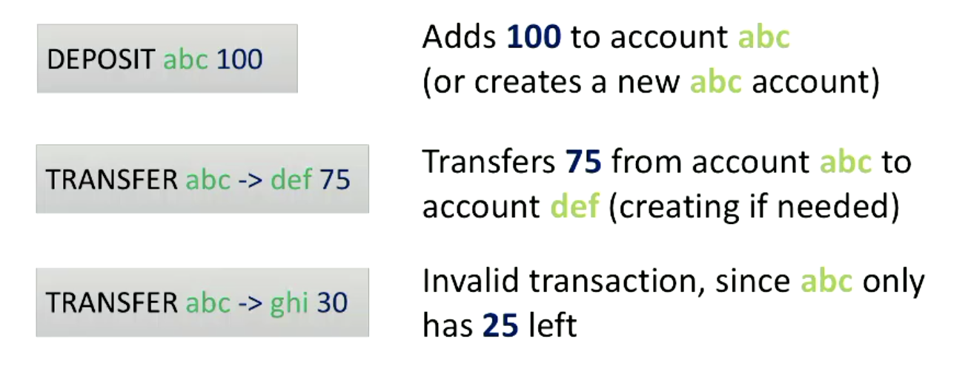
Transaction Validity
Notes:
Why Byzantine?

Slide 70
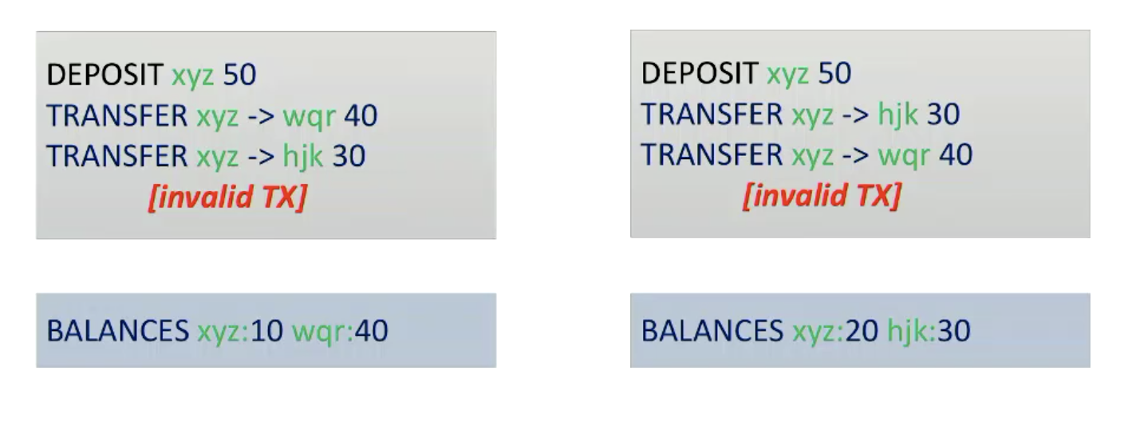
Transaction Validity: ordering matters
Notes:
Why Byzantine?

Slide 71
Graph
Compute the “processing time” for each transaction:
Time difference between when it was generated (read) at a node, and when it was processed by the last (alive) node.
Plot the CDF (cumulative distribution function) of the transaction processing time for each evaluation scenario.
Notes:
Why Byzantine?

Slide 72
MP1: Logistics
Due on March 4th.
Late policy: Can use part of your 168hours of grace period accounted per student over the entire semester.
You are allowed to reuse code from MP0.
Note: MP1 requires all nodes to connect to each other, as opposed to each node connecting to a central logger.
Read the specification carefully. Start early!!
Notes:
Why Byzantine?

