Slide 1
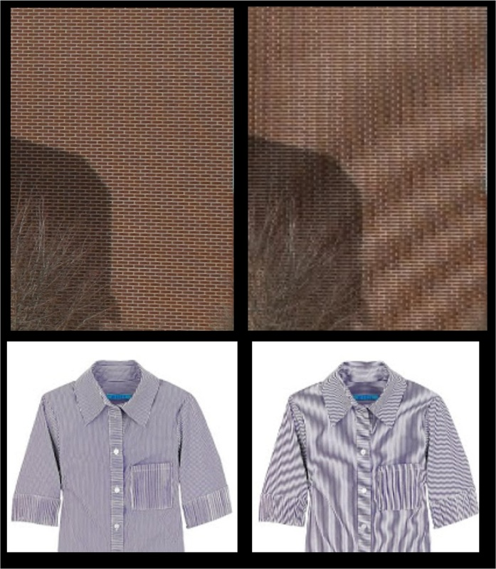
Spatial Aliasing
due to improperly focused camera

Slide 2
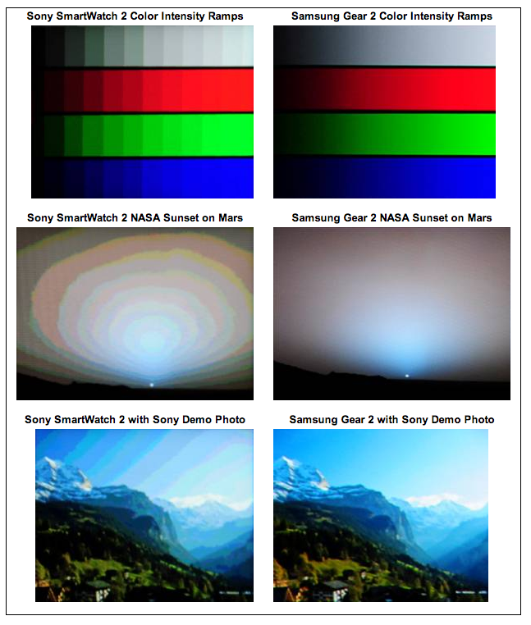
Contouring Artifacts

Slide 3
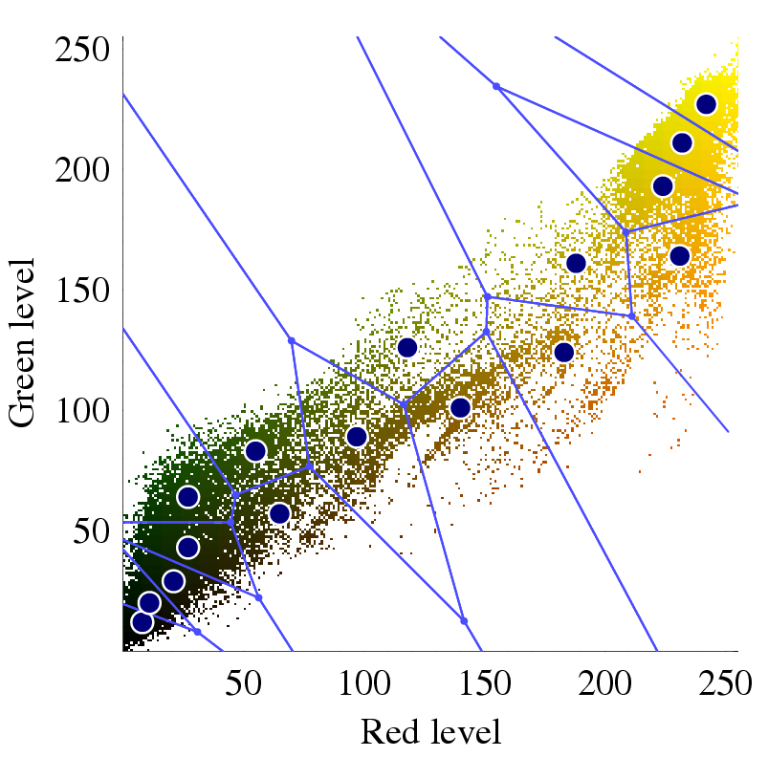
Palette Quantization (16 colors)

Slide 4
Bayer Mosaic

Slide 5
LED and other light sources

Slide 6
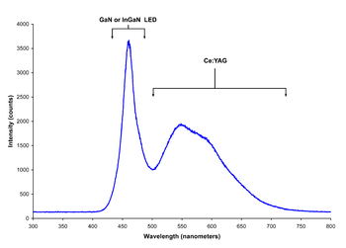
LED light spectra
Red, Green, Blue LEDs “White” Blue LED

Slide 7
LED vs OLED

Slide 8
LED vs OLED

Slide 9
Liquid Crystal Display (LCD)
Off On

Slide 10
Visual persistence

Slide 11
Halftone dots (newspaper printing)

Slide 12
1910 postcard

Slide 13
Subtractive Colors

Slide 14
Color Halftoning

Slide 15
Screening vs Error diffusion

Slide 16
Floyd-Steinberg error diffusion

Slide 17
Film formats
Cinemascope: 1.85 : 1 aspect ratio (with anamorphic lens)

Slide 18
35mm Film

Slide 19
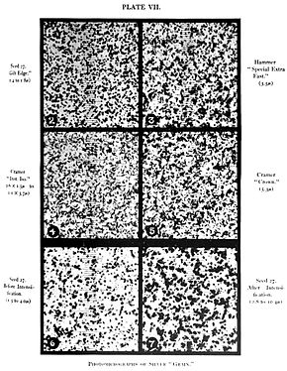
Film grain

Slide 20
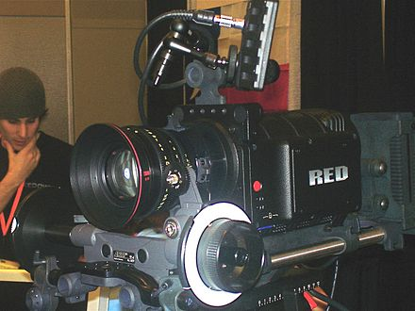
Digital cinema camera
2048x1080 (2K format) or 4096x2160 (4K format)

Slide 21
Digital cinema formats

Slide 22
Digital cinema projector

Slide 23
TV Standards worldwide

Slide 24
Interlacing artifacts

Slide 25
Digital TV formats
spec | Horizontal pixels |  | Vertical pixels | Aspect ratio | Monitor interface | Format name | Frames per sec | Fields per sec | Transmitted interlaced
ATSC | 1920 |  | 1080 | 16:9 | 1080i | 1080 60i | 30 | 60 | yes
 |  |  |  |  |  | 1080 30p | 30 | 30 | no
 |  |  |  |  |  | 1080 24p | 24 | 24 | no
 | 1280 |  | 720 | 16:9 | 720p | 720 60p | 60 | 60 | no
 |  |  |  |  |  | 720 30p | 30 | 30 | no
 |  |  |  |  |  | 720 24p | 24 | 24 | no
 | 704 |  | 480 | 16:9 | 480p | 480 60p | 60 | 60 | no
 |  |  |  |  | 480i | 480 60i | 30 | 60 | yes
 |  |  |  |  |  | 480 30p | 30 | 30 | no
 |  |  |  |  |  | 480 24p | 24 | 24 | no
 | 704 |  | 480 | 4:3 | 480p | 480 60p | 60 | 60 | no
 |  |  |  |  | 480i | 480 60i | 30 | 60 | yes
 |  |  |  |  |  | 480 30p | 30 | 30 | no
 |  |  |  |  |  | 480 24p | 24 | 24 | no
 | 640 |  | 480 | 4:3 | 480p | 480 60p | 60 | 60 | no
 |  |  |  |  | 480i | 480 60i | 30 | 60 | yes
 |  |  |  |  |  | 480 30p | 30 | 30 | no
 |  |  |  |  |  | 480 24p | 24 | 24 | no
NTSC | ≈640 | 483 |  | 4:3 | Note 1 | NTSC | 30 | 60 | yes

