Slide 1
Human Visual System

Slide 2
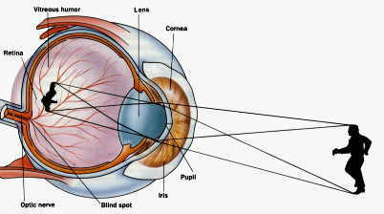
The Human Eye

Slide 3
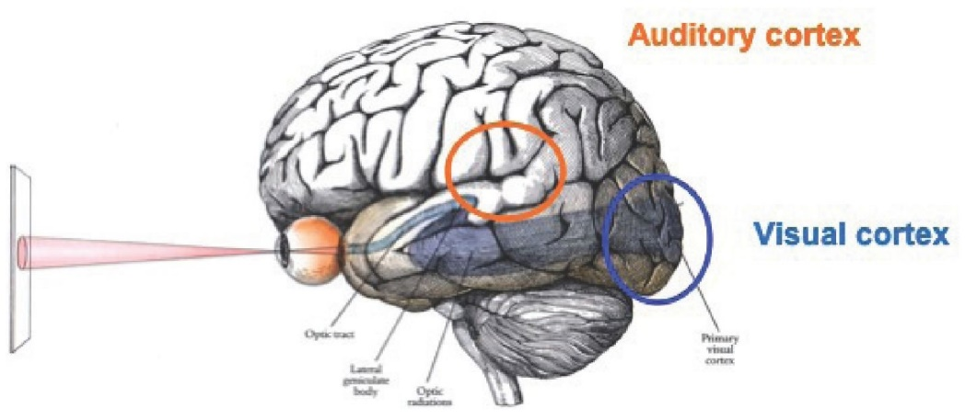
Visual Cortex

Slide 4
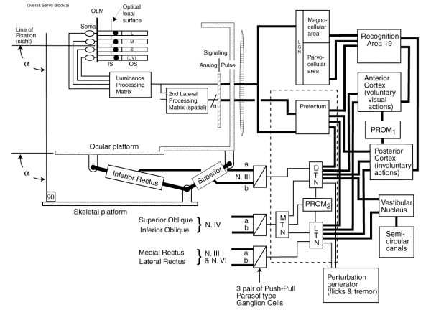
Servo Diagram of Human Visual System

Slide 5

Visual Illusion: is this an old or young lady?

Slide 6
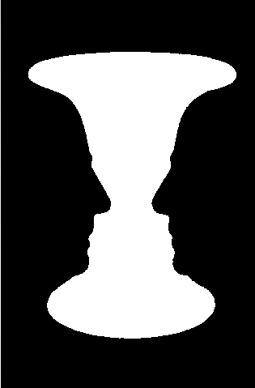
Is this a vase or two persons facing each other?

Slide 7
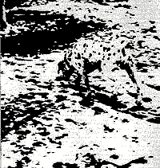
Do you see a Dalmatian dog?

Slide 8
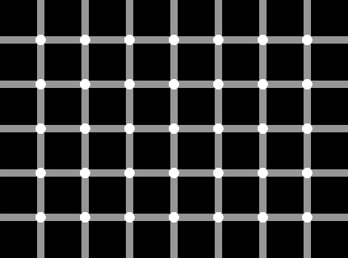
Do you see black dots?

Slide 9
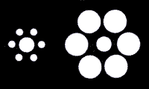
Which of the two center disks is larger?

Slide 10
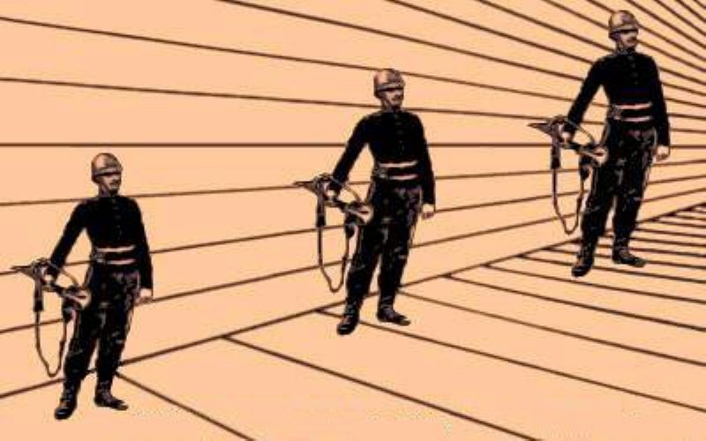
Which of the three soldiers is bigger?

Slide 11
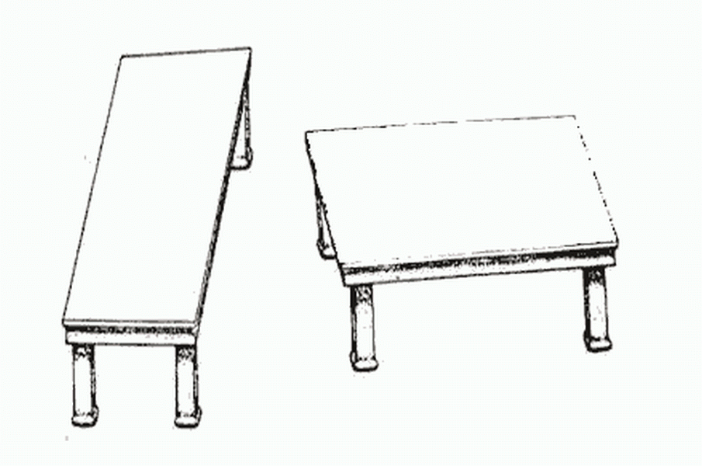
How different are these tabletops?

Slide 12
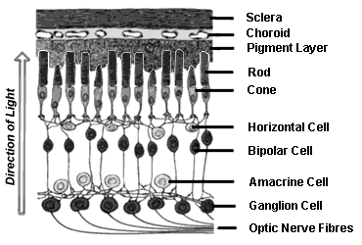
Schematic diagram of retina

Slide 13
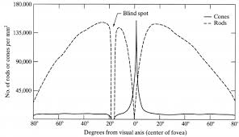
Density of rods and cones in the retina

Slide 14
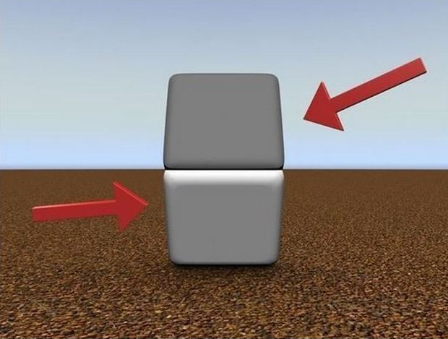
Brightness vs Luminance

Slide 15
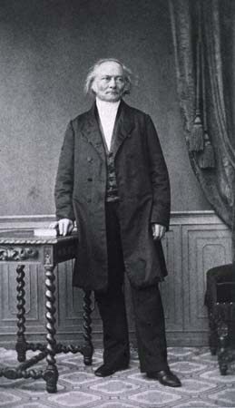
Weber’s Law

Slide 16
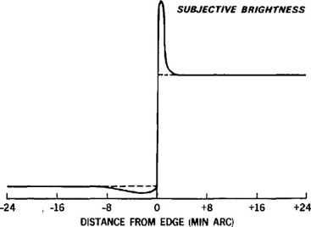
Masking in presence of an edge

Slide 17
Masking

Slide 18
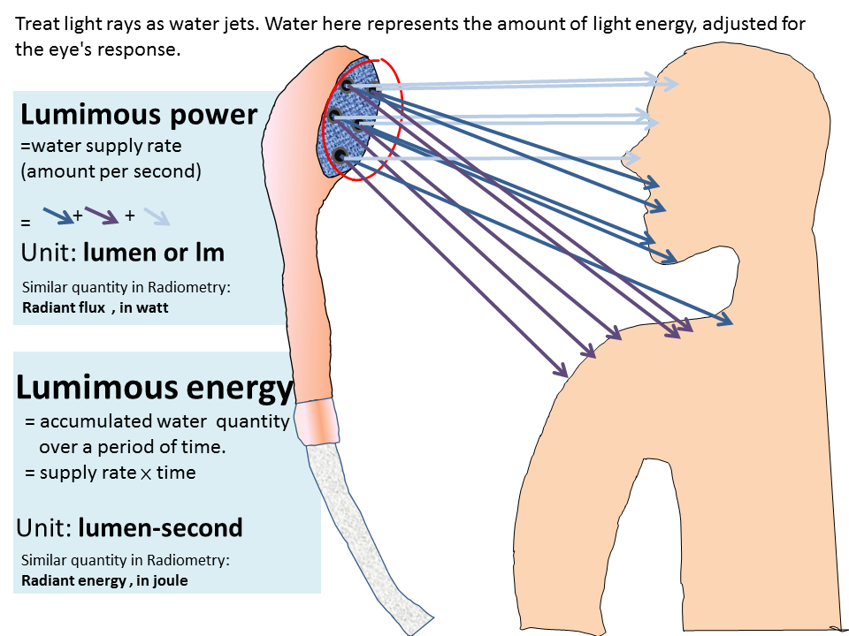
Luminous power
By Yonoodle,Kung-Shuo Heish - Own work, CC BY-SA 4.0, https://commons.wikimedia.org/w/index.php?curid=45321142

Slide 19
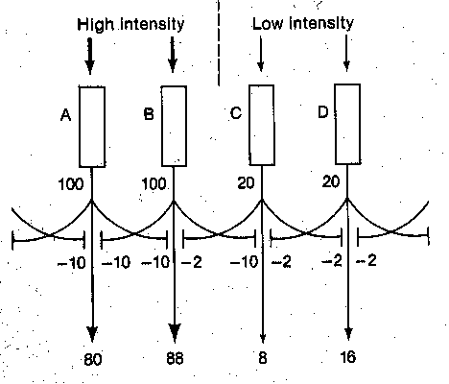
Lateral Inhibition
Light reduces response of neighboring receptors

Slide 20
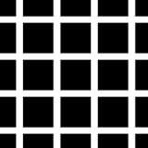
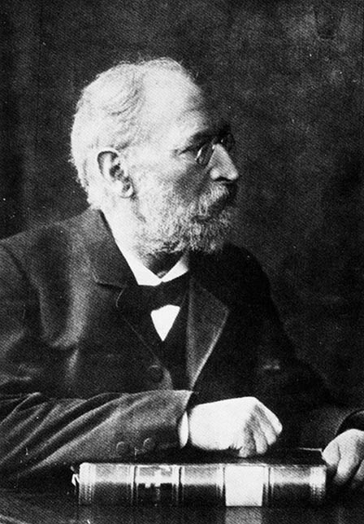
Hermann Grid

Slide 21
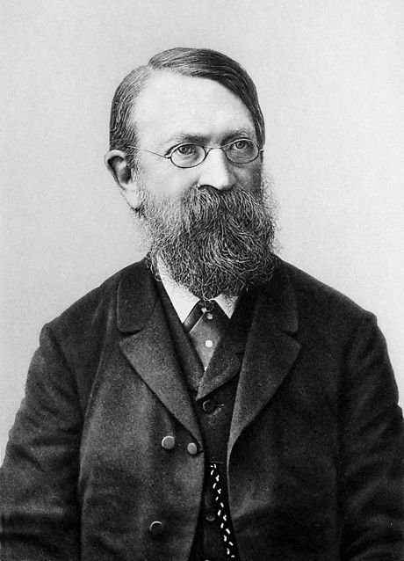

Mach band effect

Slide 22
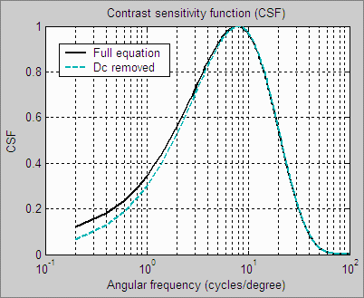
Modulation Transfer Function of HVS

Slide 23
Measurement of MTF

Slide 24
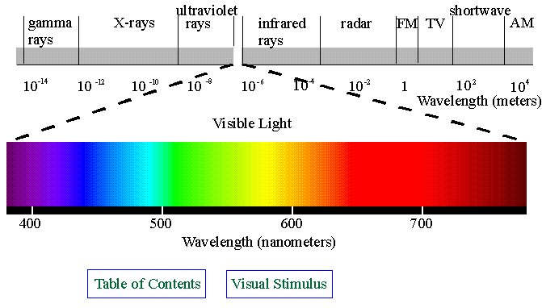
EM Spectrum

Slide 25
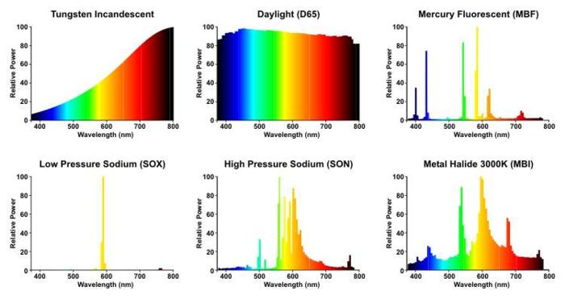
Light spectra

Slide 26
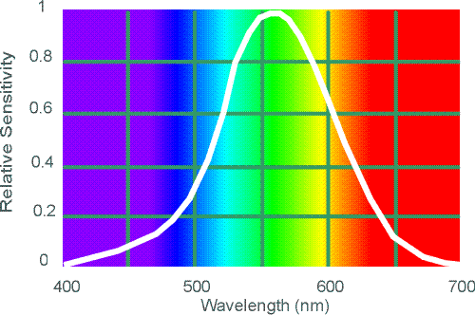
Spectral Sensitivity of HVS

Slide 27
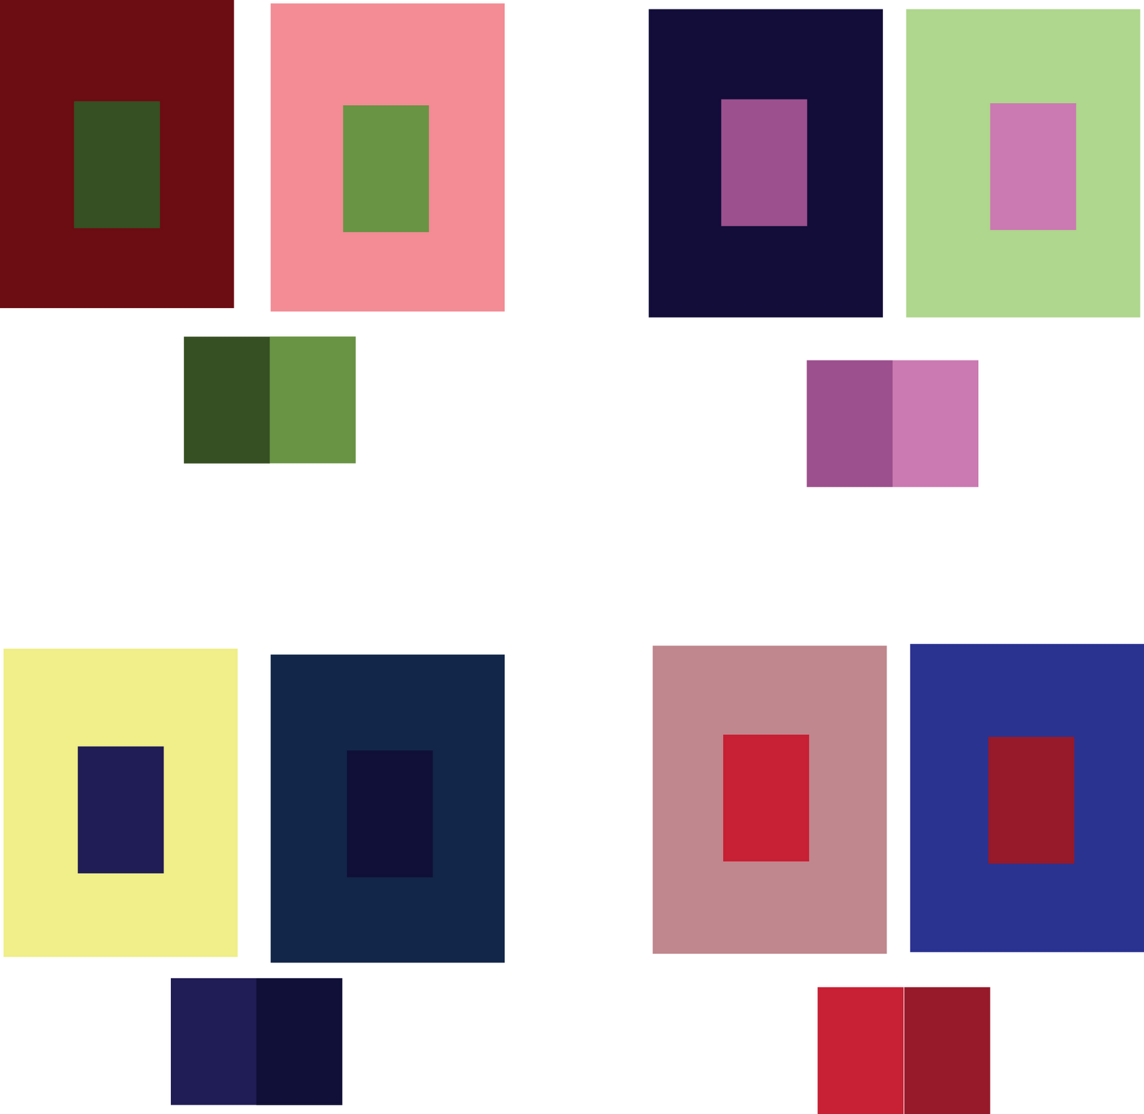
Simultaneous color contrast
For each pair of images, the center blocks appear to have the same color, but in reality they do not. The same blocks are repeated below each pair.

Slide 28
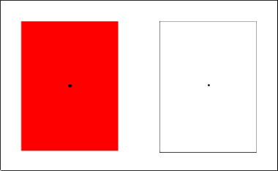
Desensitization of cones
Focus on the small black dot in the center of the red square for about 30 seconds. Then shift your focus to the small black dot in the center of the white square. What do you see?

Slide 29
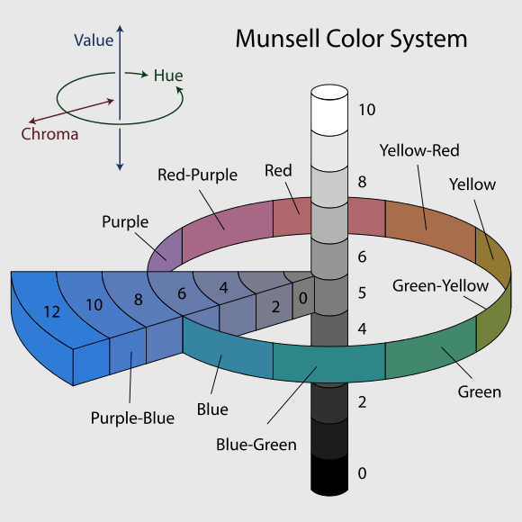
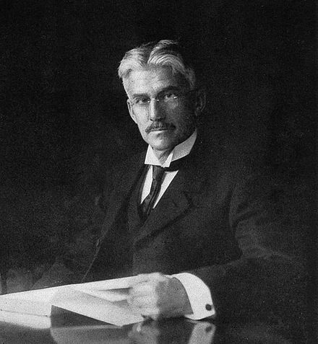
Munsell color system
The 3 attributes of color: Brightness, hue, and saturation

Slide 30
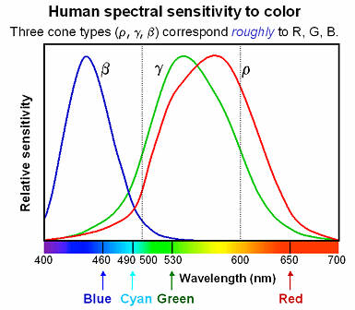
Typical Cone Absorption Spectra

Slide 31
Cone responses

Slide 32
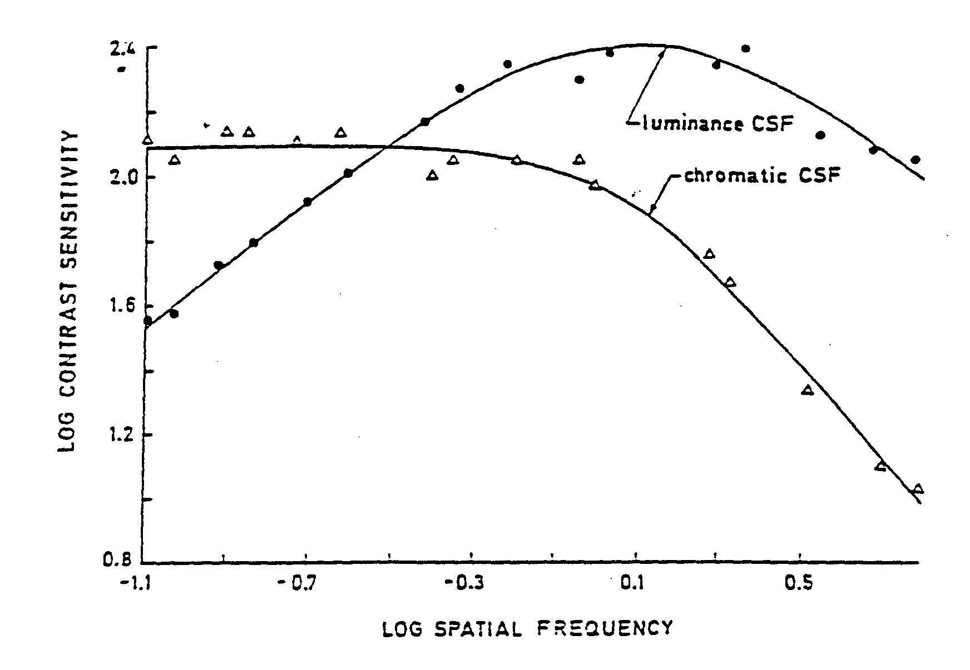
Chromatic spatial frequency response of HVS

Slide 33
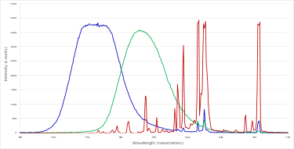
Primary Colors

Slide 34
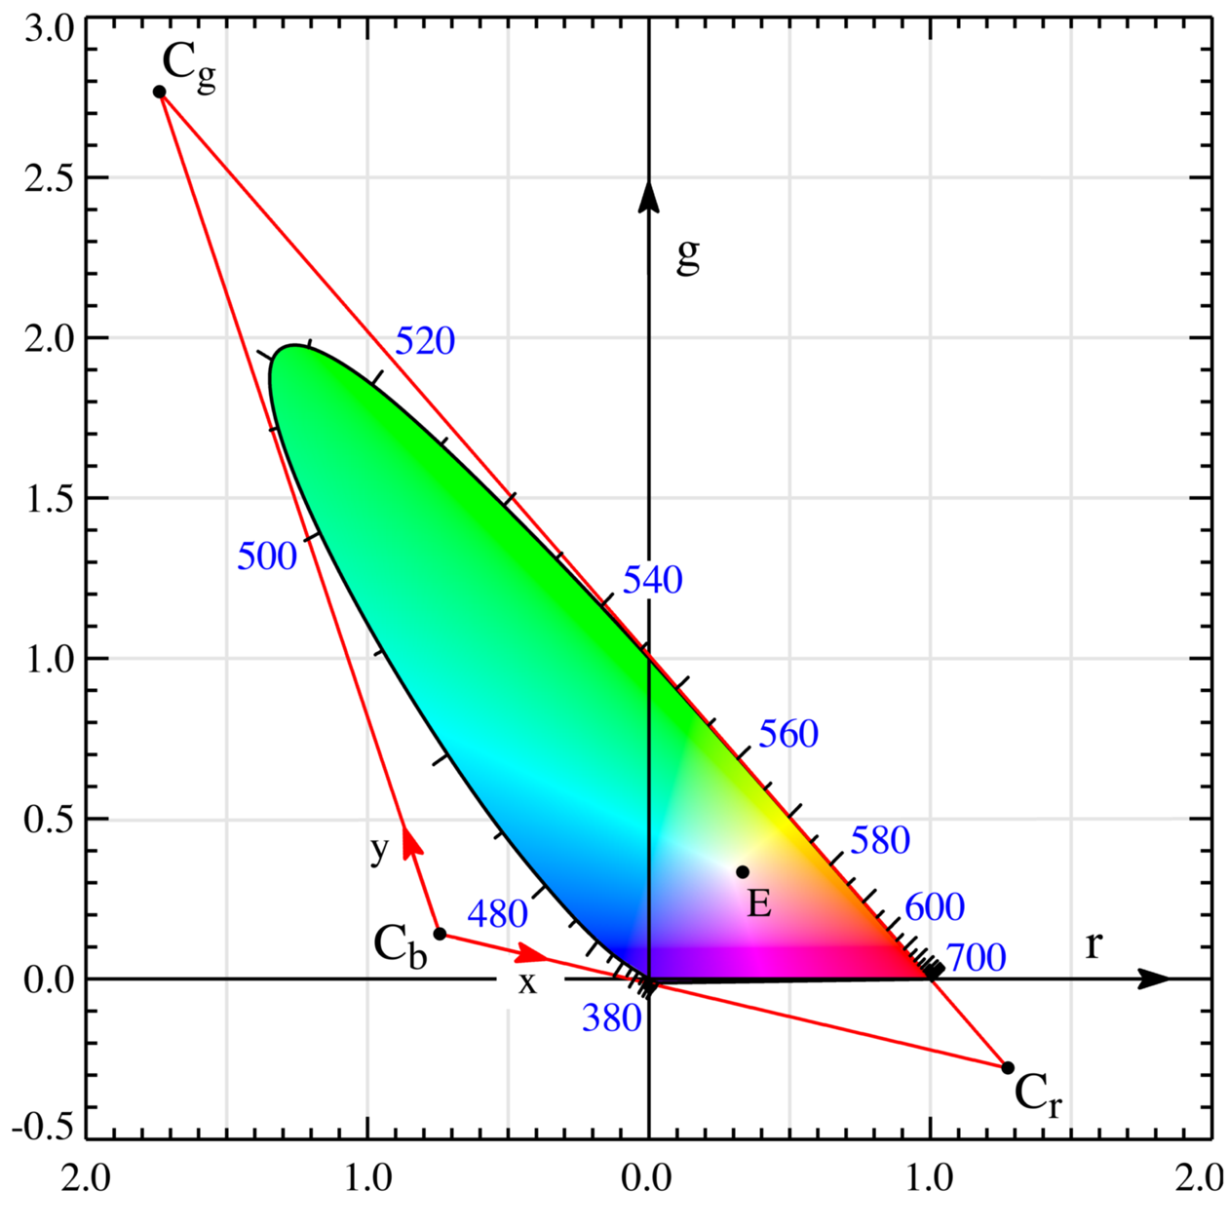
Color gamut (RGB primaries)
CIE: R=700nm G=546.1nm B=435.8nm

Slide 35
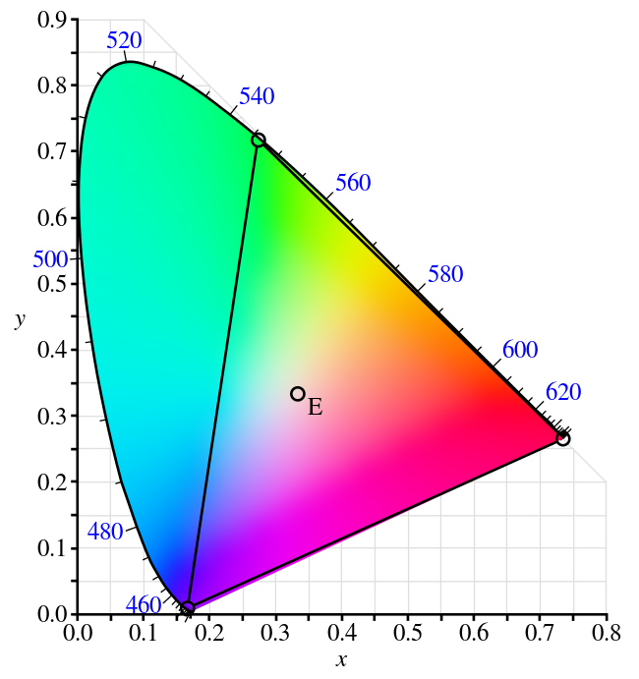
Color gamut (XYZ color space)

Slide 36
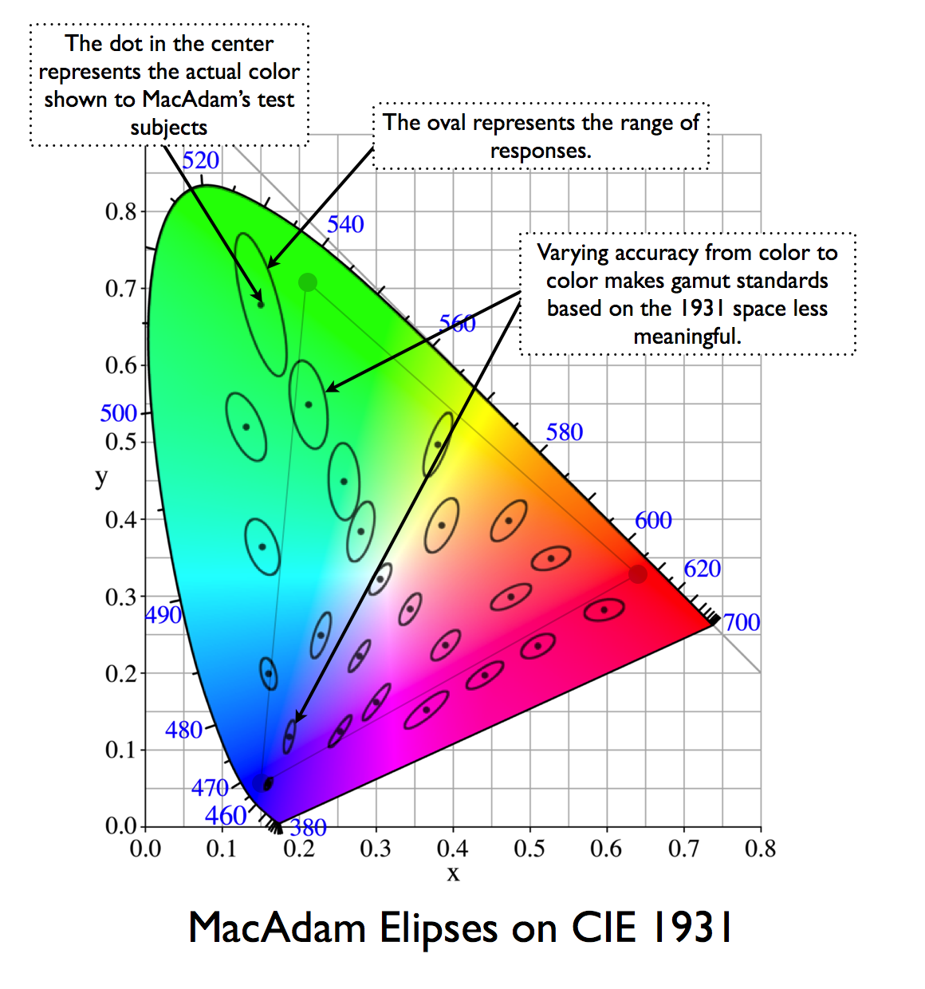
MacAdam Ellipses
Just noticeable differences

Slide 37
Flicker Visibility Curves

Slide 38
Spatio-Temporal MTF

Slide 39
Sections of spatio-temporal MTF

