Slide 1
ECE 417 Lecture 20: MP5 Walkthrough
10/31/2019

Slide 2
Outline
Background things that are done for you
Observations: mel-frequency cepstral coefficients (MFCC)
Token to type alignment
Gaussian surprisal: set_surprisal
Scaled Forward-Backward Algorithm: set_alphahat, set_betahat
E-step: set_gamma, set_xi
M-step: set_mu, set_var, set_tpm

Slide 3
Done for you: Mel Frequency Cepstral Coefficients (MFCC)
What you need to know:
MFCC is a low-dimensional vector (13 dimensions) that keeps most of the speech-relevant information from the MSTFT (magnitude short-time Fourier transform, 257 dimensions).
What you don’t need to know, but here’s the information in case you’re interested: How it’s done.
Compute the MSTFT, $X[t,k] = \left|X_{t}\left(e^{j\frac{2πk}{N}}\right)\right|$
Modify the frequency scale (human perception of pitch).
Take the logarithm (human perception of loudness).
Take the DCT (approximately decorrelates the features).

Slide 4
What frequency scale do people hear?

Slide 5
Inner ear

Slide 6
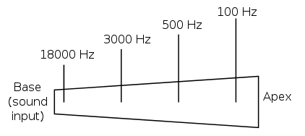
Basilar membrane of the cochlea = a bank of mechanical bandpass filters

Slide 7
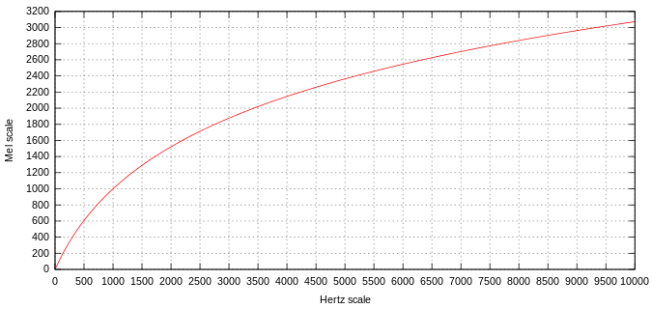
Mel-scale
The experiment:
Play tones A, B, C
Let the user adjust tone D until pitch(D)-pitch(C) sounds the same as pitch(B)-pitch(A)
Analysis: create a frequency scale m(f) such that m(D)-m(C) = m(B)-m(A)
Result: $m\left(f\right)=2595\log_{10}\left(1+\frac{f}{700}\right)$

Slide 8
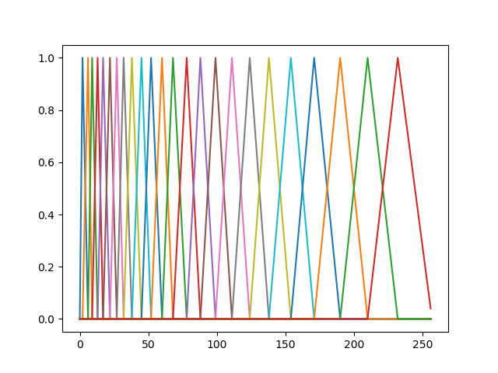
Mel-scale filterbanks
Define filters such that each filter has a width equal to about 200 mels
As a function of Hertz: narrow filters at low frequency, wider at high frequency

Slide 9
Mel-frequency filterbank features
Suppose X is a matrix representing the MSTFT, $X[t,k] = |X_{t}(e^{j\frac{2πk}{N}})|$. We can compute the filterbank features as $F=XH$, where H is the matrix of bandpass filters shown here:
$$×$$
$$=$$
MSTFT, $X$
(an NFRAMESx257 matrix)
Triangle filters, $H$
(a 257x24 matrix)
Filterbank features, $F=XH$
(an NFRAMESx24 matrix)

Slide 10
How can we decorrelate the features? Answer: DCT!

Slide 11
Remember, the 2D DCT looked like this…
$$\cos\left(\frac{πk_{1}\left(n_{1}+\frac{1}{2}\right)}{N_{1}}\right)\cos\left(\frac{πk_{2}\left(n_{2}+\frac{1}{2}\right)}{N_{2}}\right)$$
With a 36th order DCT (up to k1=5,k2=5), we can get a bit more detail about the image.

Slide 12
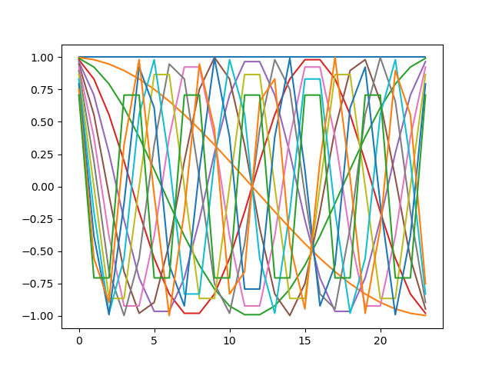
The 1D DCT looks like this:
Suppose F is a matrix representing the mel-scale filterbank features, $F=XH$. We can compute the mel-frequency cepstral coefficients (MFCC) as $M=\ln\left(F\right)T$, where T is the DCT matrix:
$$×$$
$$=$$
Log Filterbank features, $lnF$
(an NFRAMESx24 matrix)
DCT matrix, $T$
(a 24x13 matrix)
MFCC, $M=ln\left(F\right)T$
(an NFRAMESx13 matrix)

Slide 13
DCT works like PCA!! That’s why we use it.
Filterbank features (left): neighboring frequency bands are highly correlated.
MFCC (right): different cepstral coefficients are nearly uncorrelated.
$$×$$
$$=$$
Log Filterbank features, $lnF$
(an NFRAMESx24 matrix)
DCT matrix, $T$
(a 24x13 matrix)
MFCC, $M=ln\left(F\right)T$
(an NFRAMESx13 matrix)

Slide 14
Outline
Background things that are done for you
Observations: mel-frequency cepstral coefficients = f(MSTFT)
Token to type alignment
Gaussian surprisal, a.k.a. information: set_surprisal
Scaled Forward-Backward Algorithm: set_alphahat, set_betahat
E-step: set_gamma, set_xi
M-step: set_mu, set_var, set_tpm

Slide 15
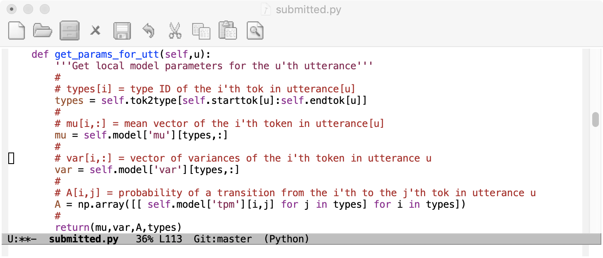
Token-to-type alignment
This defines the types (distinct phones that are present in the training data)
We talked about it a great deal in Tuesday’s lecture.
Here’s the code that does it:
self.model[‘phones’] = ' aelmnoruøǁɘɤɨɯɵɹɺɾʉʘʙ’
self.tok2type = [ str.find(self.model['phones'],x) for x in self.toks ]
This creates an array
tok2type:tok$→$type
This code cuts out the tok2type array for a particular utterance, u, and then computes:
mu: matrix of mean vectors
var: matrix of variance vectors
A: transition probabilities among the tokens of the utterance

Slide 16
Outline
Background things that are done for you
Observations: mel-frequency cepstral coefficients = f(MSTFT)
Token to type alignment
Gaussian surprisal, a.k.a. information: set_surprisal
Scaled Forward-Backward Algorithm: set_alphahat, set_betahat
E-step: set_gamma, set_xi
M-step: set_mu, set_var, set_tpm

Slide 17
Independent events: Diagonal covariance Gaussian
Suppose that $\vec{o}=\left[o_{1}\text{,…, }o_{D}\right]$ is a D-dimensional observation vector, and the observation dimensions are uncorrelated (e.g., MFCC). Then we can write the Gaussian pdf as
$$b_{j}\left(\vec{o}\right)=\frac{1}{\sqrt{\left|2πΣ_{j}\right|}}e^{−\frac{1}{2}{\left(\vec{o}−{\vec{μ}}_{j}\right)}^{T}Σ_{j}^{−1}\left(\vec{o}−{\vec{μ}}_{j}\right)}=\prod_{d=1}^{D}{\frac{1}{\sqrt{2πσ_{jd}^{2}}}e^{−\frac{1}{2}\frac{{\left(o_{d}−μ_{jd}\right)}^{2}}{σ_{jd}^{2}}}}$$
One scalar operation for each of the D dimensions: Complexity = $O\{D\}$
Complexity of inverting a DxD matrix: $O\{D^{3}\}$

Slide 18
Claude Shannon, “A Mathematical Theory of Communication,” 1948
1. An event is informative if it is unexpected. The information content of an event, e, must be some (as yet unknown) monotonically decreasing function, f(), of its probability:
$$i(e)=f(p(e))$$
2. The information provided by two independent events, $e_{1}$ and $e_{2}$, is the sum of the information provided by each:
$$i(e_{1},e_{2})=i(e_{1})+i(e_{2})$$
There is only one function, f(), that satisfies both of these criteria:
$$i\left(e\right)=−\log{p(e)}$$
$$i\left(e_{1},e_{2}\right)=−\log{p\left(e_{1}\right)p\left(e_{2}\right)}=−\log{p\left(e_{1}\right)}−\log{p\left(e_{2}\right)}=i(e_{1})+i(e_{2})$$

Slide 19
Surprisal
The “information” provided by observation $\vec{o}$ is $i\left(\vec{o}\right)=−\log{p(\vec{o})}$.
But the word “information” has been used for so many purposes that we hesitate to stick with it. There is a more technical-sounding word that is used only for this purpose: “surprisal.”
$i\left(\vec{o}\right)=−\log{p(\vec{o})}$ is the “surprisal” of observation $\vec{o}$, because it measures the degree to which we are surprised to observe $\vec{o}$.
If $\vec{o}$ is very likely ($p(\vec{o})≈1$) then we are not surprised ($i(\vec{o})≈0$).
If $\vec{o}$ is very unlikely ($p(\vec{o})≈0$), then we are very surprised ($i(\vec{o})≈∞$).

Slide 20
Gaussian is computationally efficient, but numerically AWFUL!!
10d observation vector
Gaussian probability
Surprisal
Probability densities:
Unreasonable numbers,
very hard to work
with in floating point!
Surprisal: reasonable
numbers, easy to work
with in floating point
Observations: reasonable
numbers, easy to work
with in floating point
WARNING: Don’t calculate surprisal using the method on this slide!!!
Use the method on the next slide!!!

Slide 21
How to calculate surprisal without calculating probability first
$$i_{j}\left(\vec{o}\right)=−\ln{b_{j}\left(\vec{o}\right)}=−\ln{\prod_{d=1}^{D}{\frac{1}{\sqrt{2πσ_{jd}^{2}}}e^{−\frac{1}{2}\frac{{\left(o_{d}−μ_{jd}\right)}^{2}}{σ_{jd}^{2}}}}}$$
$$=\frac{1}{2}\sum_{d=1}^{D}{\left(\frac{{\left(o_{d}−μ_{jd}\right)}^{2}}{σ_{jd}^{2}}+\ln{2πσ_{jd}^{2}}\right)}$$

Slide 22
MP5 walkthrough: what surprisal looks like (after 1 epoch of training)
Dark blue: small surprise
Silence model during silences: zero surprise
Vowel model during vowels: zero surprise
Bright green: large surprise
Vowel model during silences: high surprise
Silence model during vowels: high surprise

Slide 23
Outline
Background things that are done for you
Observations: mel-frequency cepstral coefficients = f(MSTFT)
Token to type alignment
Gaussian surprisal, a.k.a. information: set_surprisal
Scaled Forward-Backward Algorithm: set_alphahat, set_betahat
E-step: set_gamma, set_xi
M-step: set_mu, set_var, set_tpm

Slide 24
Forward-Backward Algorithm
$$α_{t}\left(j\right)=\sum_{i=1}^{N}{α_{t−1}\left(i\right)a_{ij}b_{j}\left({\vec{o}}_{t}\right)}=\sum_{i=1}^{N}{α_{t−1}\left(i\right)a_{ij}e^{−i_{j}\left({\vec{o}}_{t}\right)}}$$
Oh NO! The very small number came back again!

Slide 25
Solution: Scaled Forward-Backward
The key idea: define a scaled alpha probability, alphahat (${\hat{α}}_{t}\left(j\right)$), such that
$$\sum_{j=1}^{N}{{\hat{α}}_{t}\left(j\right)}=1$$
We can compute alphahat simply as
$${\hat{α}}_{t}\left(j\right)=\frac{\sum_{i=1}^{N}{{\hat{α}}_{t−1}\left(i\right)a_{ij}e^{−i_{j}\left({\vec{o}}_{t}\right)}}}{\sum_{j=1}^{N}{\sum_{i=1}^{N}{{\hat{α}}_{t−1}\left(i\right)a_{ij}e^{−i_{j}\left({\vec{o}}_{t}\right)}}}}$$

Slide 26
Solution: Scaled Forward-Backward
Similarlym define a scaled betahat (${\hat{β}}_{t}\left(i\right)$), such that
$$\sum_{i=1}^{N}{{\hat{β}}_{t}\left(i\right)}=1$$
We can compute betahat simply as
$${\hat{β}}_{t}\left(i\right)=\frac{\sum_{j=1}^{N}{a_{ij}e^{−i_{j}\left({\vec{o}}_{t+1}\right)}{\hat{β}}_{t+1}\left(j\right)}}{\sum_{i=1}^{N}{\sum_{j=1}^{N}{a_{ij}e^{−i_{j}\left({\vec{o}}_{t+1}\right)}{\hat{β}}_{t+1}\left(j\right)}}}$$

Slide 27
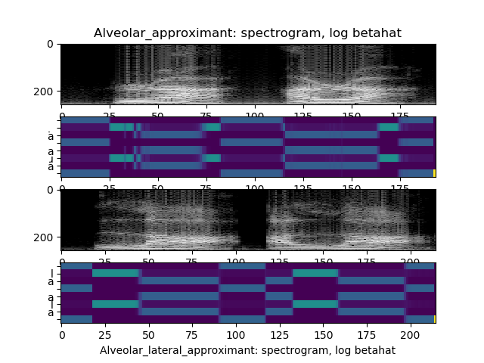
MP5 Walkthrough: What alphahat and betahat look like

Slide 28
Why does scaling work?
Notice that the denominator is independent of $i$ or $j$. So the difference between $α_{t}\left(j\right)$ and ${\hat{α}}_{t}\left(j\right)$ is a scaling factor (let’s call it $g_{t}$) that doesn’t depend on $j$:
$${\hat{α}}_{t}\left(j\right)=\frac{1}{g_{t}}\sum_{i=1}^{N}{{\hat{α}}_{t−1}\left(i\right)a_{ij}e^{−i_{j}\left({\vec{o}}_{t}\right)}}=…=\frac{α_{t}\left(j\right)}{\prod_{τ=1}^{t}{g_{τ}}}$$
Likewise, the difference between $β_{t}\left(i\right)$ and ${\hat{β}}_{t}\left(i\right)$ is some other scaling factor (let’s call it $h_{t}$) that doesn’t depend on $i$:
$${\hat{β}}_{t}\left(i\right)=\frac{1}{h_{t}}\sum_{j=1}^{N}{a_{ij}e^{−i_{j}\left({\vec{o}}_{t+1}\right)}{\hat{β}}_{t+1}\left(j\right)}=…=\frac{β_{t}\left(i\right)}{\prod_{τ=t+1}^{T}{h_{τ}}}$$

Slide 29
Why does scaling work?
So we can calculate gamma as:
$$γ_{t}\left(j\right)=\frac{α_{t}\left(j\right)β_{t}\left(j\right)}{\sum_{k=1}^{N}{α_{t}\left(k\right)β_{t}\left(k\right)}}=\frac{α_{t}\left(j\right)β_{t}\left(j\right)/\prod_{τ=1}^{t}{g_{τ}\prod_{τ=t+1}^{T}{h_{τ}}}}{\sum_{k=1}^{N}{α_{t}\left(k\right)β_{t}\left(k\right)}/\prod_{τ=1}^{t}{g_{τ}\prod_{τ=t+1}^{T}{h_{τ}}}}$$
$$=\frac{{\hat{α}}_{t}\left(j\right){\hat{β}}_{t}\left(j\right)}{\sum_{k=1}^{N}{{\hat{α}}_{t}\left(k\right){\hat{β}}_{t}\left(k\right)}}$$
In other words, the scaling (of the scaled forward-backward algorithm) has no effect at all on the calculation of gamma and xi!!

Slide 30
Outline
Background things that are done for you
Observations: mel-frequency cepstral coefficients = f(MSTFT)
Token to type alignment
Gaussian surprisal, a.k.a. information: set_surprisal
Scaled Forward-Backward Algorithm: set_alphahat, set_betahat
E-step: set_gamma, set_xi
M-step: set_mu, set_var, set_tpm

Slide 31
E-Step: set_gamma, set_xi
In other words, the scaling (of the scaled forward-backward algorithm) has no effect at all on the calculation of gamma and xi!!
$$γ_{t}\left(j\right)=\frac{{\hat{α}}_{t}\left(j\right){\hat{β}}_{t}\left(j\right)}{\sum_{k=1}^{N}{{\hat{α}}_{t}\left(k\right){\hat{β}}_{t}\left(k\right)}}$$
$$ξ_{t}\left(i,j\right)=\frac{{\hat{α}}_{t}\left(i\right)a_{ij}e^{−i_{j}\left({\vec{o}}_{t+1}\right)}{\hat{β}}_{t+1}\left(j\right)}{\sum_{k=1}^{N}{\sum_{l=1}^{N}{{\hat{α}}_{t}\left(k\right)a_{kl}e^{−i_{l}\left({\vec{o}}_{t+1}\right)}{\hat{β}}_{t+1}\left(l\right)}}}$$

Slide 32
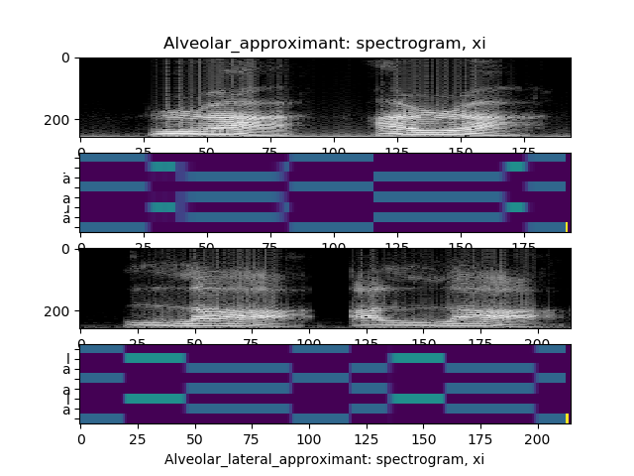
MP5 Walkthrough: What gamma and xi look like

Slide 33
Outline
Background things that are done for you
Observations: mel-frequency cepstral coefficients = f(MSTFT)
Token to type alignment
Gaussian surprisal, a.k.a. information: set_surprisal
Scaled Forward-Backward Algorithm: set_alphahat, set_betahat
E-step: set_gamma, set_xi
M-step: set_mu, set_var, set_tpm

Slide 34
M-Step: set_mu, set_var, set_tpm
Define the following index variables:
$u=$Utterance ID
$t=$Frame number
$i,j=$Token indices
$m,n=$Type indices
And, for convenience,
${\vec{σ}}_{m}^{2}=$Variance vector for the m’th type
$TPM(m,n)=$Transition probability from type m to type n
$${\vec{μ}}_{m}=\frac{\sum_{u=1}^{U}{\sum_{t=1}^{T}{\sum_{j:type\left(j\right)=m}{γ_{t}\left(j\right){\vec{o}}_{t}}}}}{\sum_{u=1}^{U}{\sum_{t=1}^{T}{\sum_{j:type\left(j\right)=m}{γ_{t}\left(j\right)}}}}$$
$${\vec{σ}}_{m}^{2}=\frac{\sum_{u=1}^{U}{\sum_{t=1}^{T}{\sum_{j:type\left(j\right)=m}{γ_{t}\left(j\right){\left({\vec{o}}_{t}−{\vec{μ}}_{m}\right)}^{2}}}}}{\sum_{u=1}^{U}{\sum_{t=1}^{T}{\sum_{j:type\left(j\right)=m}{γ_{t}\left(j\right)}}}}$$
$$TPM(m,n)=\frac{\sum_{u=1}^{U}{\sum_{t=1}^{T}{\sum_{i,j:type\left(i,j\right)=(m,n)}{ξ_{t}\left(i,j\right)}}}}{\sum_{u=1}^{U}{\sum_{t=1}^{T}{\sum_{i,j:type\left(i\right)=(m)}{ξ_{t}\left(i,j\right)}}}}$$

Slide 35
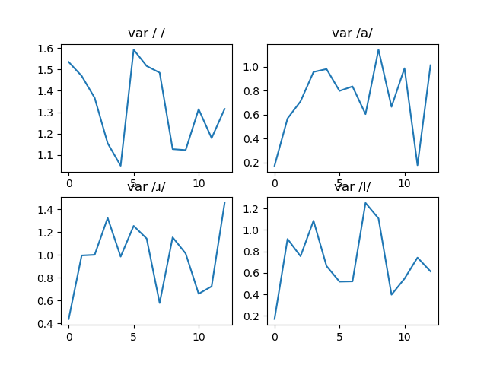
MP5 Walkthrough: What mu and var look like

Slide 36
MP5 Walkthrough: What TPM looks like

Slide 37
Conclusions
Step 0, set_surprisal: use the formula on slide 22 to compute $i_{j}\left(\vec{o}\right)$ directly, without computing $b_{j}\left(\vec{o}\right)$
Steps 1 and 2, set_alphahat and set_betahat: use the formulas on slides 26 and 27, this allows you to immediately normalize alphahat and betahat so that they each sum to 1.
Steps 3 and 4, set_gamma and set_xi: use the formulas on slide 32, you get $γ_{t}\left(j\right)$ and $ξ_{t}\left(i,j\right)$ directly from ${\hat{α}}_{t}\left(i\right)$ and ${\hat{β}}_{t+1}\left(j\right)$, despite the scaling!
Steps 5-7, set_mu, set_var, and set_tpm: use the formulas on slide 35, the only trick is that you have to be careful about token-to-type mapping.

Slide 38
… and the final speech recognition result: How well did it work? About 90% accurate! (testing on the training data, though!)

