Slide 1
Image filtering and image features
September 26, 2019

Slide 2
Outline: Image filtering and image features
Images as signals
Color spaces and color features
2D convolution
Matched filters
Gradient filters
Separable convolution
Accuracy spectrum of a 1-feature classifier

Slide 3
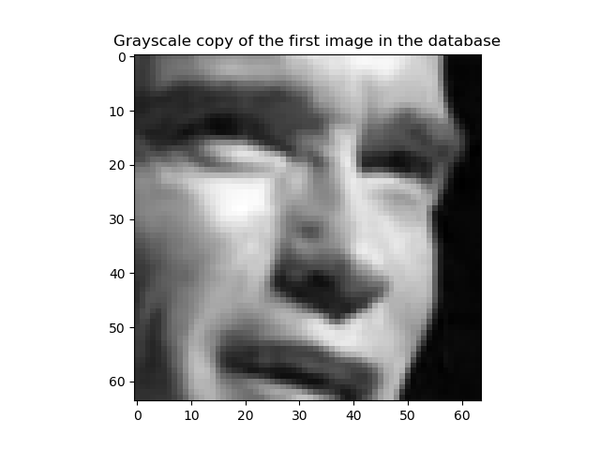
Images as signals
x[n₁,n₂,c] = intensity in row n1, column n2, color plane c.
Most image formats (e.g., JPG, PNG, GIF, PPM) distribute images with three color planes: Red, Green, and Blue (RGB)
In this example (Arnold Schwarzenegger’s face), the grayscale image was created as
$$\overline{x} \left[n_{1},n_{2}\right]=\frac{1}{3}\sum_{c∈\{R,G,B\}}{x\left[n_{1},n_{2},c\right]}$$
n₁
n₂

Slide 4
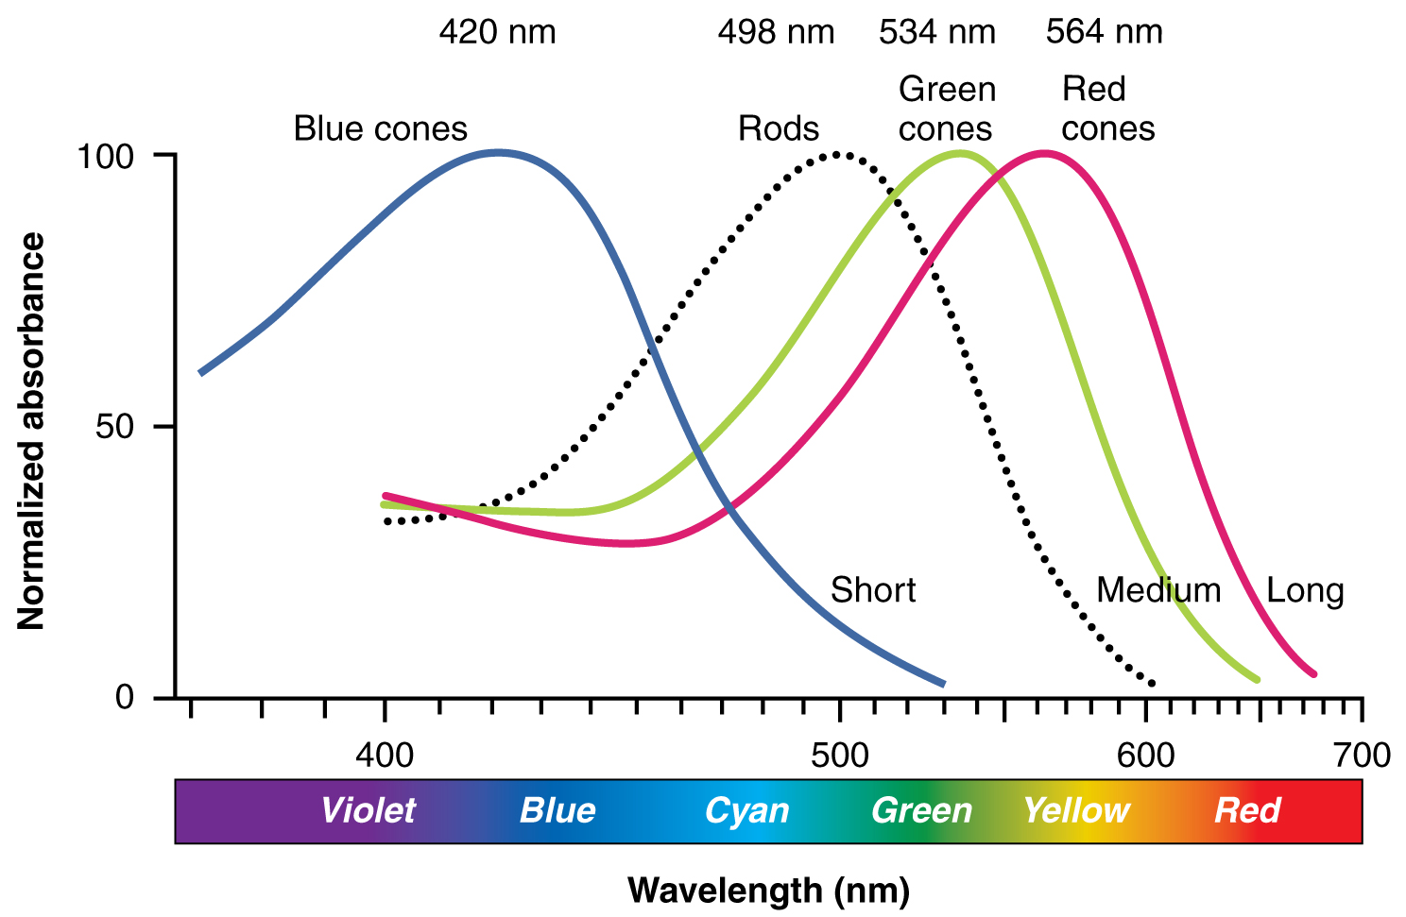
Color spaces: RGB
Every natural object reflects a continuous spectrum of colors.
However, the human eye only has three color sensors:
Red cones are sensitive to lower frequencies
Green cones are sensitive to intermediate frequencies
Blue cones are sensitive to higher frequencies
By activating LED or other display hardware at just three discrete colors (R, G, and B), it is possible to fool the human eye into thinking that it sees a continuum of colors.
Therefore, most image file formats only code three discrete colors (RGB).
Illustration from Anatomy & Physiology, Connexions Web site. http://cnx.org/content/col11496/1.6/, Jun 19, 2013.

Slide 5
Color features: Luminance
The “grayscale” image is often computed as the average of R, G, and B intensities, i.e., $\overline{x} \left[n_{1},n_{2}\right]=\frac{1}{3}\sum_{c∈\{R,G,B\}}{x\left[n_{1},n_{2},c\right]}$.
The human eye, on the other hand, is more sensitive to green light than to either red or blue.
The intensity of light, as viewed by the human eye, is well approximated by the standard ITU-R BT.601:
$$x\left[n_{1},n_{2},Y\right]=0.299x\left[n_{1},n_{2},R\right]+0.587x\left[n_{1},n_{2},G\right]+0.114x\left[n_{1},n_{2},B\right]$$
This signal ($x\left[n_{1},n_{2},Y\right]$) is called the luminance of light at pixel $\left[n_{1},n_{2}\right]$.

Slide 6
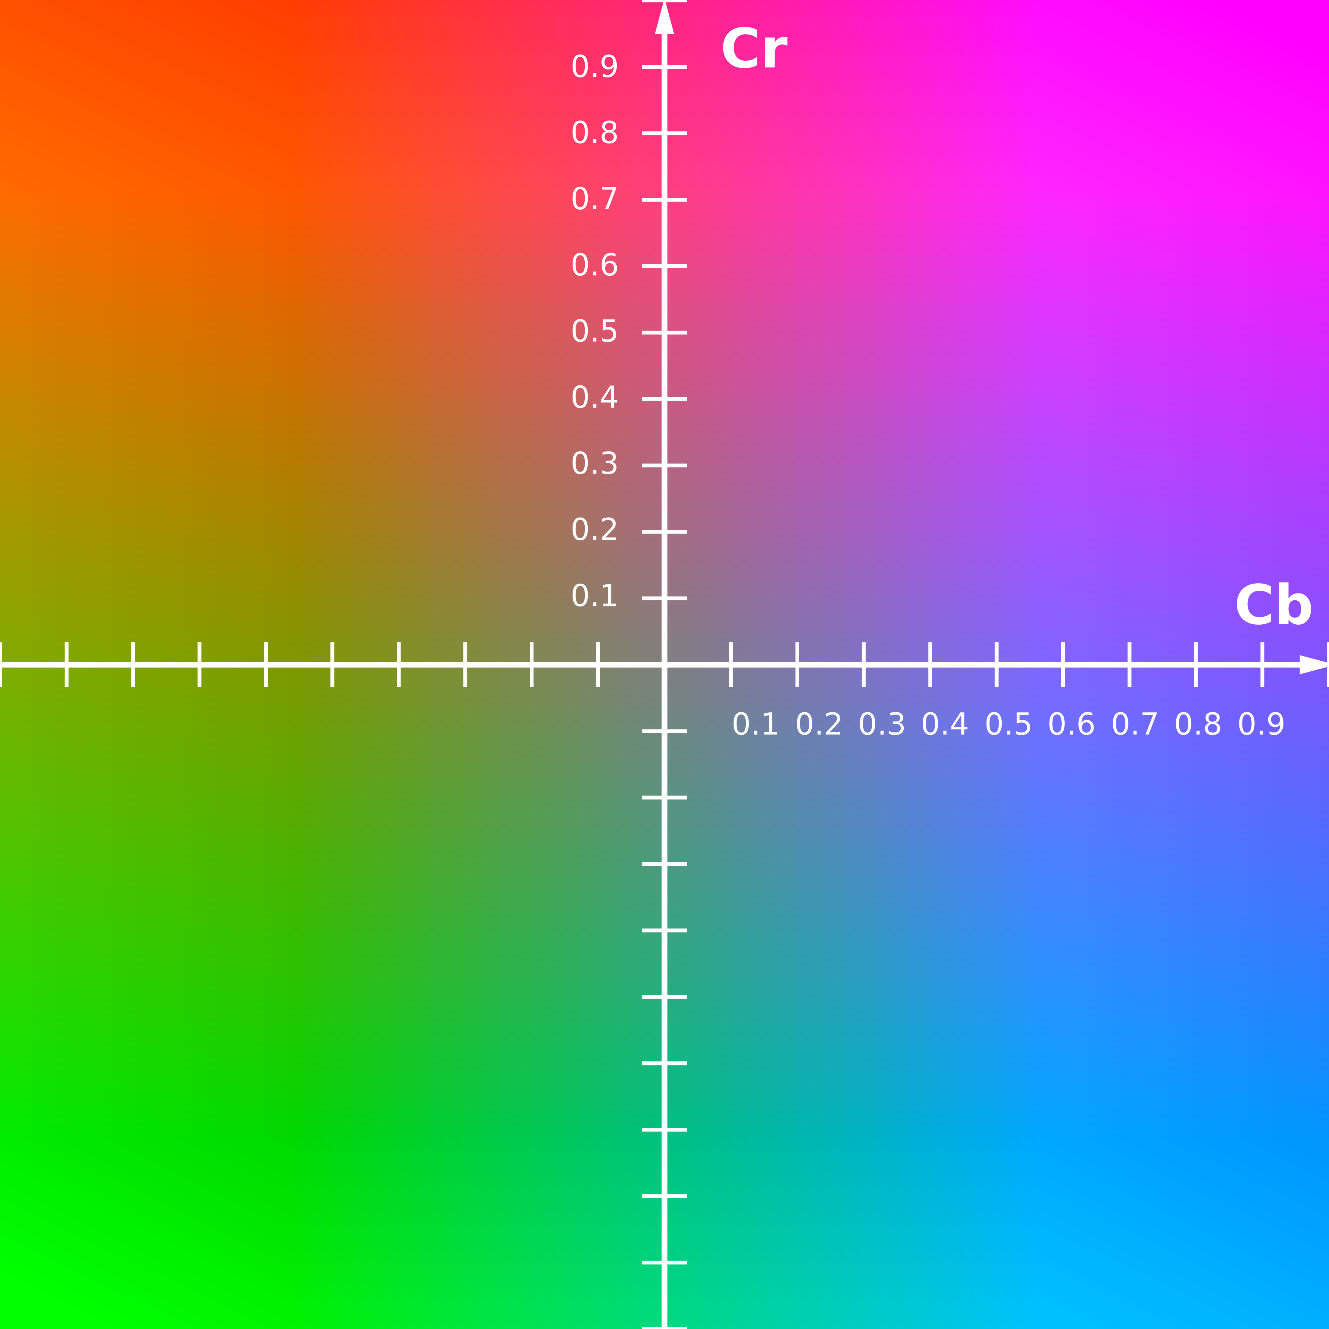
Color features: Chrominance
Chrominance = color-shift of the image.
We measure $P_{R}$=red-shift, and $P_{B}$=blue-shift, relative to luminance (luminance is sort of green-based, remember?)
We want $P_{R}\left[n_{1},n_{2}\right]$ and $P_{B}\left[n_{1},n_{2}\right]$ to describe only the color-shift of the pixel, not its average luminance.
We do that using
$$\left[\begin{matrix}Y \\ P_{B} \\ P_{R}\end{matrix}\right]=\left[\begin{matrix}{\vec{v}}_{Y} \\ {\vec{v}}_{B} \\ {\vec{v}}_{R}\end{matrix}\right]\left[\begin{matrix}R \\ G \\ B\end{matrix}\right]$$
Where $sum({\vec{v}}_{R})=sum({\vec{v}}_{B})=0$.
Cr and Cb, at Y=0.5
Simon A. Eugster, own work.

Slide 7
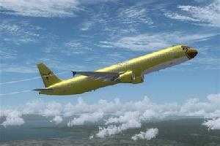
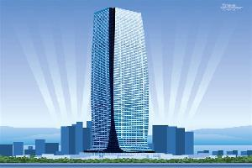
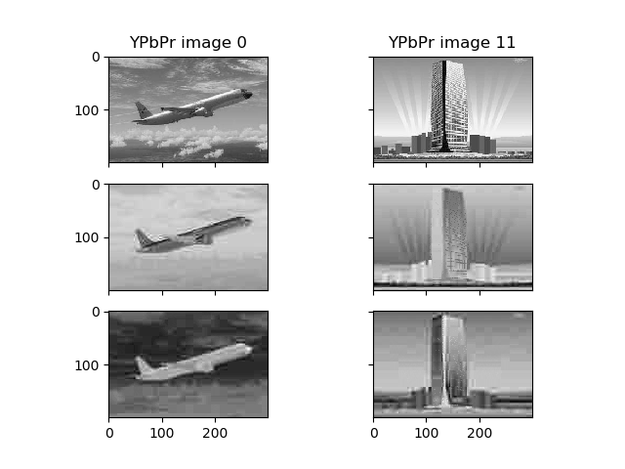
Color features: Chrominance
$$\left[\begin{matrix}Y \\ P_{B} \\ P_{R}\end{matrix}\right]=\left[\begin{matrix}0.299 & 0.587 & 0.114 \\ −0.168736 & −0.331264 & 0.5 \\ 0.5 & −0.418688 & −0.081312\end{matrix}\right]\left[\begin{matrix}R \\ G \\ B\end{matrix}\right]$$
gives $sum({\vec{v}}_{R})=sum({\vec{v}}_{B})=0$.

Slide 8
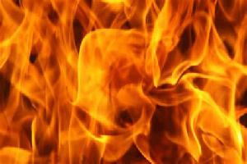
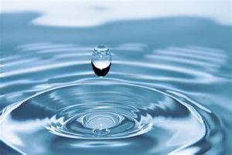
Color features: Chrominance
Some images are obviously red! (e.g., fire, or wood)
Some images are obviously blue! (e.g., water, or sky)
Average(Pb)-Average(Pr) should be a good feature for distinguishing between, for example, ”fire” versus “water”

Slide 9
Color features: norms
The average Pb value is ${\overline{P}}_{B}=\frac{1}{N_{1}N_{2}}\sum_{n_{1}=0}^{N_{1}−1}{\sum_{n_{2}=0}^{N_{2}−1}{P_{B}\left[n_{1},n_{2}\right]}}$.
The problem with this feature is that it gives too much weight to small values of $P_{B}\left[n_{1},n_{2}\right]$, i.e., some pixels might not be all that bluish – as a result, some “water” images have low average-pooled Pb.
The max Pb value is ${\hat{P}}_{B}=\max_{n_{1}}{\max_{n_{2}}{P_{B}\left[n_{1},n_{2}\right]}}$.
The problem with this feature is that it gives too much weight to LARGE values of $P_{B}\left[n_{1},n_{2}\right]$, i.e., in the “fire” image, there might be one or two pixels that are blue, even though all of the others are red --- as a result, some “fire” images might have an unreasonably high max-pooled Pb.
The Frobenius norm is $\left\|P_{B}\right\|={\left(\sum_{n_{1}=0}^{N_{1}−1}{\sum_{n_{2}=0}^{N_{2}−1}{P_{B}^{2}\left[n_{1},n_{2}\right]}}\right)}^{1/2}$
The Frobenius norm emphasizes large values, but it doesn’t just depend on the LARGEST value – it tends to resemble an average of the largest values.
In MP3, Frobenius norm seems to be work better than max-pooling or average-pooling. For other image processing problems, you might want to use average-pooling or max-pooling instead.

Slide 10
Outline: Image filtering and image features
Images as signals
Color spaces and color features
2D convolution
Matched filters
Gradient filters
Separable convolution
Accuracy spectrum of a 1-feature classifier

Slide 11
2D convolution
The 2D convolution is just like a 1D convolution, but in two dimensions.
$$x\left[n_{1},n_{2},c\right]∗∗h\left[n_{1},n_{2},c\right]=\sum_{m_{1}=0}^{N_{1}−1}{\sum_{m_{2}=0}^{N_{2}−1}{x\left[m_{1},m_{2},c\right]h\left[n_{1}−m_{1},n_{2}−m_{2},c\right]}}$$
Note that we don’t convolve over the color plane – just over the rows and columns.

Slide 12
Full, Valid, and Same-size convolution outputs
$$y\left[n_{1},n_{2},c\right]=\sum_{m_{1}=0}^{N_{1}−1}{\sum_{m_{2}=0}^{N_{2}−1}{x\left[m_{1},m_{2},c\right]h\left[n_{1}−m_{1},n_{2}−m_{2},c\right]}}$$
Suppose that x is an N₁xN₂ image, while h is a filter of size M₁xM₂. Then there are three possible ways to define the size of the output:
“Full” output: Both $x\left[m_{1},m_{2}\right]$ and $h\left[m_{1},m_{2}\right]$ are zero-padded prior to convolution, and then $y\left[n_{1},n_{2}\right]$ is defined wherever the result is nonzero. This gives $y\left[n_{1},n_{2}\right]$ the size of (N₁+M₁-1)x(N₂+M₂-1).
“Same” output: The output, $y\left[n_{1},n_{2}\right]$, has the size N₁xN₂. This means that there is some zero-padding.
“Valid” output: The summation is only performed for values of (n1,n2,m1,m2) at which both x and h are well-defined. This gives $y\left[n_{1},n_{2},c\right]$ the size of (N₁-M₁+1)x(N₂-M₂+1).

Slide 13
Example: differencing
Suppose we want to calculate the difference between each pixel, and its second neighbor:
$$y\left[n_{1},n_{2}\right]=x\left[n_{1},n_{2}\right]−x\left[n_{1},n_{2}−2\right]$$
We can do that as
$$y=\sum_{m_{1}=0}^{N_{1}−1}{\sum_{m_{2}=0}^{N_{2}−1}{x\left[m_{1},m_{2}\right]h\left[n_{1}−m_{1},n_{2}−m_{2}\right]}}$$
where
$$h\left[n_{1},n_{2}\right]=\left\{\begin{matrix}1 & n_{1}=0,n_{2}=0 \\ −1 & n_{1}=0,n_{2}=2 \\ 0 & else\end{matrix}\right.$$
…we often will write this as h=[1,0,-1].

Slide 14
Example: averaging
Suppose we want to calculate the average between each pixel, and its two neighbors:
$$y\left[n_{1},n_{2}\right]=x\left[n_{1},n_{2}\right]+2x\left[n_{1},n_{2}−1\right]+x\left[n_{1},n_{2}−2\right]$$
We can do that as
$$y=\sum_{m_{1}=0}^{N_{1}−1}{\sum_{m_{2}=0}^{N_{2}−1}{x\left[m_{1},m_{2}\right]h\left[n_{1}−m_{1},n_{2}−m_{2}\right]}}$$
where
$$h\left[n_{1},n_{2}\right]=\left\{\begin{matrix}1 & n_{1}=0,n_{2}∈\{0,2\} \\ 2 & n_{1}=0,n_{2}=1 \\ 0 & else\end{matrix}\right.$$
…we often will write this as h=[1,2,1].

Slide 15
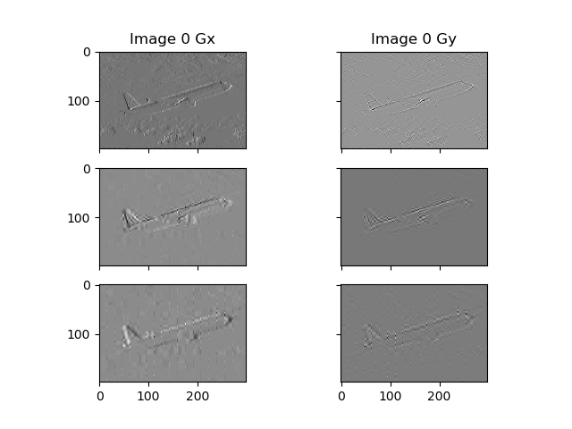
The two ways we’ll use convolution in mp3
Matched filtering: The filter is designed to pick out a particular type of object (e.g., a bicycle, or a Volkswagon beetle). The output of the filter has a large value when the object is found, and a small random value otherwise.
Gradient: Two filters are designed, one to estimate the horizontal image gradient $G_{x}\left[n_{1},n_{2},c\right]=\frac{δ}{δn_{2}}x\left[n_{1},n_{2},c\right]$, and one to estimate the vertical image gradient $G_{y}\left[n_{1},n_{2},c\right]=\frac{δ}{δn_{1}}x\left[n_{1},n_{2},c\right]$

Slide 16
Outline: Image filtering and image features
Images as signals
Color spaces and color features
2D convolution
Matched filters
Gradient filters
Separable convolution
Accuracy spectrum of a 1-feature classifier

Slide 17
Matched filter is the solution to the “signal detection” problem.
Suppose we have a noisy signal, x[n]. We have two hypotheses:
H0: x[n] is just noise, i.e., x[n]=v[n], where v[n] is a zero-mean, unit-variance Gaussian white noise signal.
H1: x[n]=s[n]+v[n], where v[n] is the same random noise signal, but s[n] is a deterministic (non-random) signal that we know in advance.
We want to create a hypothesis test as follows:
Compute y[n]=h[n]*x[n]
If y[0] > threshold, then conclude that H1 is true (signal present). If y[0] < threshold, then conclude that H0 is true (signal absent).
Can we design h[n] in order to maximize the probability that this classifier will give the right answer?

Slide 18
The “signal detection” problem
$$y\left[n\right]=x\left[n\right]∗h\left[n\right]=s\left[n\right]∗h\left[n\right]+v\left[n\right]∗h[n]$$
Call it w[n]: $w\left[n\right]=v\left[n\right]∗h\left[n\right]=\sum{v\left[m\right]}h[n−m]$ is a Gaussian random variable with zero average.
The weighted sum of Gaussians is also a Gaussian
$E\left[w\left[m\right]\right]=0$because $E\left[v\left[m\right]\right]=0$
The variance is $σ_{w}^{2}=\sum{{σ_{v}^{2}h}^{2} [n−m]}=\sum{h^{2} [n−m]}$
(because we assumed that $σ_{v}^{2}=1$).
Suppose we constrain h[n] as $\sum{h^{2} [n−m]}=1$. Then we have $σ_{w}^{2}=1$.
So under H0 (signal absent), y[n] is a zero-mean, unit-variance Gaussian random signal.

Slide 19
The “signal detection” problem
$$y\left[n\right]=x\left[n\right]∗h\left[n\right]=s\left[n\right]∗h\left[n\right]+w\left[n\right]$$
So w[0] is a zero-mean, unit-variance Gaussian random variable.
We have two hypotheses:
H0: $y\left[0\right]=w\left[0\right]$
H1: $y\left[0\right]=w\left[0\right]+\sum{s\left[m\right]h[0−m]}$
Goal: we know s[m]. We want to design h[m] so that $\sum{s\left[m\right]h[−m]}$ is as large as possible, subject to the constraint that $\sum{h^{2} [n−m]}=1$.

Slide 20
The solution: matched filters
Goal: we know s[m]. We want to design h[m] so that $\sum{s\left[m\right]h[−m]}$ is as large as possible, subject to the constraint that $\sum{h^{2} [n−m]}=1$.
The solution: $h\left[m\right]∝s[−m]$.
(Specifically, $h\left[m\right]=s[−m]/\sqrt{\sum{s^{2} [m]}}$)
Under H0 (signal absent), y[0] is a zero-mean unit-variance Gaussian (ZMUVG):
$$y\left[0\right]=w\left[0\right]$$
Then under H1 (signal present), y[0] is a ZMUVG + 1:
$$y\left[0\right]=w\left[0\right]+\sum{s\left[m\right]h[−m]}=w\left[0\right]+\frac{\sum{s^{2} [m]}}{\sqrt{\sum{s^{2} [m]}}}=w\left[0\right]+\sqrt{\sum{s^{2} [m]}}$$

Slide 21
The solution: matched filters
The solution: $h\left[m\right]=s[−m]/\sqrt{\sum{s^{2} [m]}}$.
Compute y[n]=h[n]*x[n]
If y[0] > 0.5 $\sqrt{\sum{s^{2} [m]}}$, then conclude that H1 is true (signal present).
If y[0] < 0.5 $\sqrt{\sum{s^{2} [m]}}$, then conclude that H0 is true (signal absent).

Slide 22
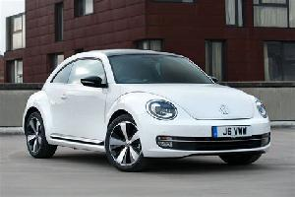
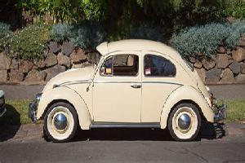
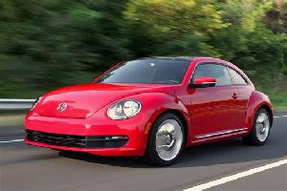
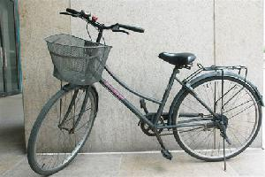
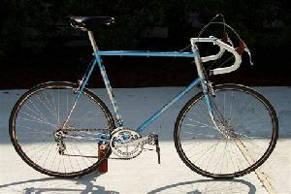
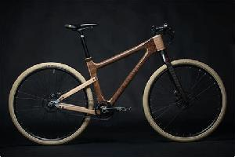
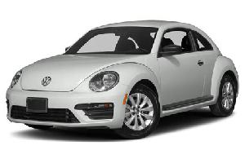
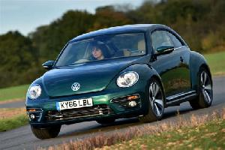
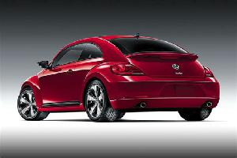
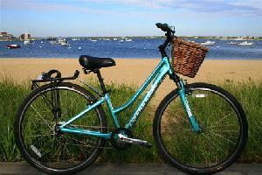
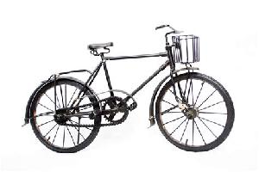
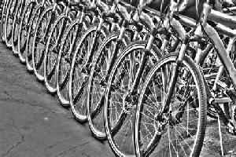
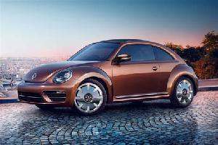
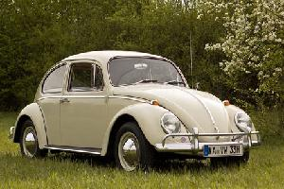
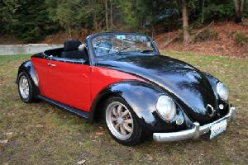
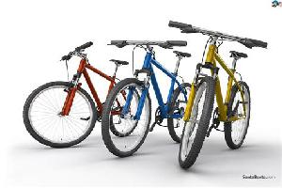
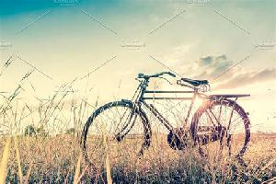
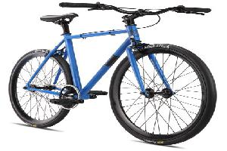
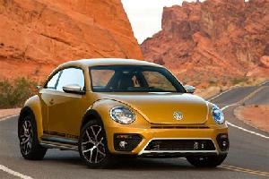
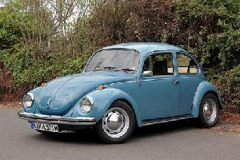
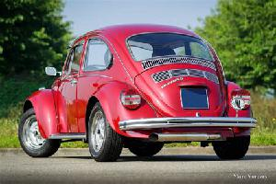
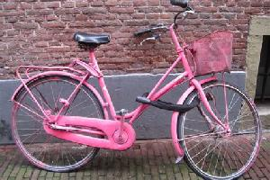
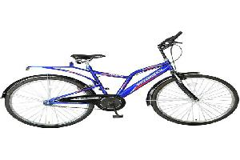
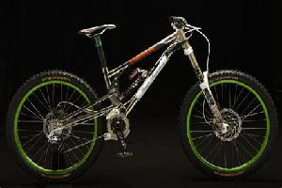
Example: beetles versus bicycles

Slide 23
Designing a matched filter by averaging all of the input data
Given: 12 example images of beetles, $x_{d}\left[n_{1},n_{2},c\right]$, for $0≤d≤11$.
Goal: design a matched filter $h\left[n_{1},n_{2},c\right]$ that will maximize
$$y_{d}\left[0,0,c\right]=\sum_{m_{1}}{\sum_{m_{2}}{x_{d}\left[m_{1},m_{2},c\right]}h\left[{−m}_{1},−m_{2},c\right]}$$
…on average for $0≤d≤11$, subject to $\sum_{m_{1}}{\sum_{m_{2}}{h^{2}\left[m_{1},m_{2},c\right]}}=1$. Solution:
$$h\left[m_{1},m_{2},c\right]∝\frac{1}{12}\sum_{d}{x_{d}\left[−m_{1},−m_{2},c\right]}$$

Slide 24
Designing a matched filter by averaging all of the input data
Solution:
$$h\left[m_{1},m_{2},c\right]∝\frac{1}{12}\sum_{d}{x_{d}\left[−m_{1},−m_{2},c\right]}$$
Flip each image left-to-right ($−m_{2}$)
Flip each image top-to-bottom ($−m_{1}$)
Take the average, across all of the training images
To make the output of this filtering more interesting: throw away the first two rows, last two rows, first two columns, and last two columns of each input image, the result will be that $h\left[m_{1},m_{2},c\right]$ has a size M₁=N₁-4, M₂=N₂-4, so the “valid” output will be 5x5.

Slide 25
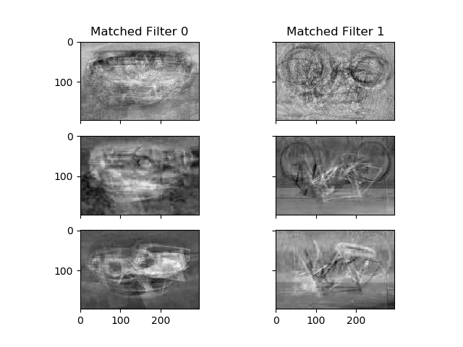
Matched filters for beetles and bicycles
Flip each image left-to-right ($−m_{2}$)
Flip each image top-to-bottom ($−m_{1}$)
Take the average, across all of the training images.
Shown here: three color planes, Y, Pb, and Pr.

Slide 26
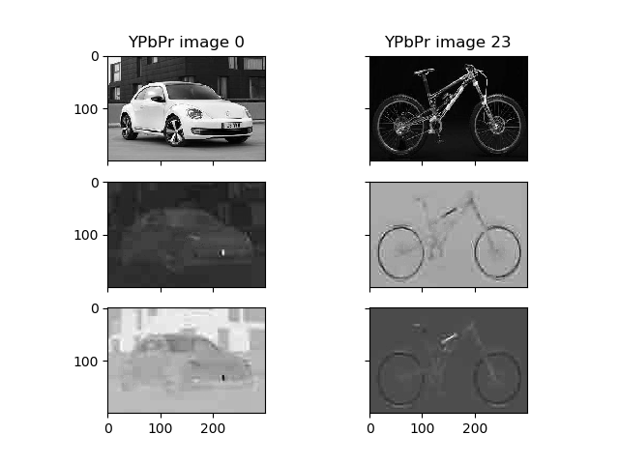
Match = input image, convolved with matched filter
$$y_{d}\left[n_{1},n_{2},c\right]=x_{d}\left[n_{1},n_{2},c\right]∗∗h\left[n_{1},n_{2},c\right]$$
$$=$$
$$∗∗$$

Slide 27
A note about ”valid” output pixels:
$$y_{d}\left[n_{1},n_{2},c\right]=\sum_{m_{1}}{\sum_{m_{2}}{x_{d}\left[m_{1},m_{2},c\right]}h\left[n_{1}{−m}_{1},n_{2}−m_{2},c\right]}$$
Valid output pixels are the values of $y_{d}\left[n_{1},n_{2},c\right]$ whose summations include only valid pixels of $x_{d}\left[m_{1},m_{2},c\right]$ and $h\left[n_{1}{−m}_{1},n_{2}−m_{2},c\right]$. The result has size (N₁-M₁+1)x(N₂-M₂+1)=5x5.
$$=$$
$$∗∗$$

Slide 28
Match outputs
$$y_{d}\left[n_{1},n_{2},c\right]=\sum_{m_{1}}{\sum_{m_{2}}{x_{d}\left[m_{1},m_{2},c\right]}h\left[n_{1}{−m}_{1},n_{2}−m_{2},c\right]}$$
The best match should occur at n1=0, n2=0, which is sort of the pixel in the middle of the output. However, that middle pixel is rarely the best match. Instead, the best match often occurs a few pixels to the right, left, up, or down, implying that this particular image is shifted relative to the mean-image.
$$=$$
$$∗∗$$

Slide 29
Outline: Image filtering and image features
Images as signals
Color spaces and color features
2D convolution
Matched filters
Gradient filters
Separable convolution
Accuracy spectrum of a 1-feature classifier

Slide 30
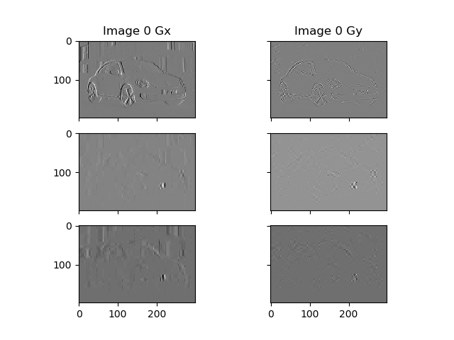
Computing the gradient of image pixels
The gradient of an image turns each image plane, c, into a pair of image planes:
$$∇x\left[n_{1},n_{2},c\right]=\left[\frac{δ}{δn_{1}}x\left[n_{1},n_{2},c\right],\frac{δ}{δn_{2}}x\left[n_{1},n_{2},c\right]\right]$$
We usually divide the gradient into two sub-images, the horizontal gradient Gx, and the vertical gradient Gy:
$$G_{x}\left[n_{1},n_{2},c\right]=\frac{δ}{δn_{2}}x\left[n_{1},n_{2},c\right]$$
$$G_{y}\left[n_{1},n_{2},c\right]=\frac{δ}{δn_{1}}x\left[n_{1},n_{2},c\right]$$

Slide 31
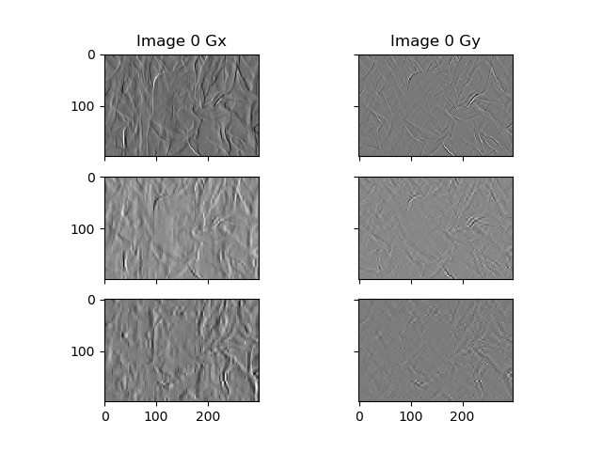
Computing the gradient of image pixels
Of course we can’t really calculate the derivative of a discrete image. So we approximate it using filters
$$G_{x}\left[n_{1},n_{2},c\right]=x\left[n_{1},n_{2},c\right]∗∗h_{x}\left[n_{1},n_{2}\right]≈\frac{δ}{δn_{2}}x\left[n_{1},n_{2},c\right]$$
$$G_{y}\left[n_{1},n_{2},c\right]=x\left[n_{1},n_{2},c\right]∗∗h_{y}\left[n_{1},n_{2}\right]≈\frac{δ}{δn_{1}}x\left[n_{1},n_{2},c\right]$$

Slide 32
The Sobel mask
The Sobel mask is a particularly simple approximation to the gradient – it takes the difference in one direction, then averages in the other direction:
$$h_{x}\left[n_{1},n_{2}\right]=\left[\begin{matrix}1 & 0 & −1 \\ 2 & 0 & −2 \\ 1 & 0 & −1\end{matrix}\right]$$
$$h_{y}\left[n_{1},n_{2}\right]=\left[\begin{matrix}1 & 2 & 1 \\ 0 & 0 & 0 \\ −1 & −2 & −1\end{matrix}\right]$$

Slide 33
Splitting the Sobel mask into separable filters
The Sobel mask is very popular, in part, because each of the 2D filters can be separated into a row-filter, followed by a column-filter:
$$h_{x}\left[n_{1},n_{2}\right]=\left[\begin{matrix}1 & 0 & −1 \\ 2 & 0 & −2 \\ 1 & 0 & −1\end{matrix}\right]=\left[\begin{matrix}1 \\ 2 \\ 1\end{matrix}\right]\left[\begin{matrix}1 & 0 & −1\end{matrix}\right]$$
$$h_{y}\left[n_{1},n_{2}\right]=\left[\begin{matrix}1 & 2 & 1 \\ 0 & 0 & 0 \\ −1 & −2 & −1\end{matrix}\right]=\left[\begin{matrix}1 \\ 0 \\ −1\end{matrix}\right]\left[\begin{matrix}1 & 2 & 1\end{matrix}\right]$$

Slide 34
Outline: Image filtering and image features
Images as signals
Color spaces and color features
2D convolution
Matched filters
Gradient filters
Separable convolution
Accuracy spectrum of a 1-feature classifier

Slide 35
Separable filters
A “separable filter” is one that can be written as the product of a row-filter, times a column-filter:
$$h\left[n_{1},n_{2}\right]=h_{1}\left[n_{1}\right]h_{2}\left[n_{2}\right]$$
If the filter can be separated, then the convolution can also be separated:
$$\sum_{m_{1}}{\sum_{m_{2}}{x_{d}\left[m_{1},m_{2}\right]}h\left[n_{1}{−m}_{1},n_{2}−m_{2}\right]}=\sum_{m_{2}}{\left(\sum_{m_{1}}{x_{d}\left[m_{1},m_{2}\right]}h_{1}\left[n_{1}{−m}_{1}\right]\right)h_{2}\left[n_{2}−m_{2}\right]}$$

Slide 36
Separable filters
This operation requires a double-summation, which has a computational complexity equal to (# rows)X(# columns):
$$y\left[n_{1},n_{2}\right]=\sum_{m_{1}}{\sum_{m_{2}}{x_{d}\left[m_{1},m_{2}\right]}h\left[n_{1}{−m}_{1},n_{2}−m_{2}\right]}$$
This operation requires a single summation, which has a computational complexity equal to (# rows):
$$v\left[n_{1},m_{2}\right]=\sum_{m_{1}}{x_{d}\left[m_{1},m_{2}\right]}h_{1}\left[n_{1}{−m}_{1}\right]$$

Slide 37
Separable filters
This operation requires a double-summation, which has a computational complexity equal to (# rows)X(# columns):
$$y\left[n_{1},n_{2}\right]=\sum_{m_{1}}{\sum_{m_{2}}{x_{d}\left[m_{1},m_{2}\right]}h\left[n_{1}{−m}_{1},n_{2}−m_{2}\right]}$$
This operation requires a single summation, which has a computational complexity equal to (# rows):
$$v\left[n_{1},m_{2}\right]=\sum_{m_{1}}{x_{d}\left[m_{1},m_{2}\right]}h_{1}\left[n_{1}{−m}_{1}\right]$$
This operation requires a single summation, which has a computational complexity equal to (# columns):
$$y\left[n_{1},n_{2}\right]=\sum_{m_{2}}{v\left[n_{1},m_{2}\right]}h_{2}\left[n_{2}{−m}_{2}\right]$$

Slide 38
Separable filters
This operation requires a double-summation, which has a computational complexity equal to (# rows)X(# columns):
$$y\left[n_{1},n_{2}\right]=\sum_{m_{1}}{\sum_{m_{2}}{x_{d}\left[m_{1},m_{2}\right]}h\left[n_{1}{−m}_{1},n_{2}−m_{2}\right]}$$
This operation requires two single summations, with a computational complexity equal to (# rows) + (# columns):
$$y\left[n_{1},n_{2}\right]=\sum_{m_{2}}{\left(\sum_{m_{1}}{x_{d}\left[m_{1},m_{2}\right]}h_{1}\left[n_{1}{−m}_{1}\right]\right)h_{2}\left[n_{2}−m_{2}\right]}$$
Usually, a computational complexity of (# rows) + (# columns) is much, much less than (# rows)X(# columns)!!!

Slide 39
Outline: Image filtering and image features
Images as signals
Color spaces and color features
2D convolution
Matched filters
Gradient filters
Separable convolution
Accuracy spectrum of a 1-feature classifier

Slide 40
What is a “1-feature classifier”?
Example: airplanes (blue) vs. skyscrapers (green)
Test some feature, f[k]. Say that the test image is “class 1” if and only if f[k] >= threshold.
Threshold for the color feature
Threshold for the matched-filtering feature
Threshold for the gradient feature

Slide 41
What are the possible thresholds?
Example: airplanes (blue) vs. skyscrapers (green)
Notice that the only thresholds that are worth testing are the values of feature[k] that are actually measured values, for at least one datum!
Varying the threshold from one datum to the next makes no change, at all, in the accuracy, so it’s not useful to test those thresholds.

Slide 42
Accuracy spectrum
Example: airplanes vs. skyscrapers
The “accuracy spectrum” for a particular feature is the list of all possible accuracies that could be achieved by any one-feature classifier.
Test, as possible threshold, every value of feature[k] observed for any training image.
List the resulting classifier accuracies.
For each feature, find the best threshold.

Slide 43
Negative polarity
Example: airplanes vs. skyscrapers
What happens if some accuracies are below 50%?
That just means that you should use, instead, a “negative polarity” classifier:
Call an image “class 0” if feature[k]>=threshold.
The accuracy of the “negative polarity” classifier is 1 minus the accuracy of the “positive polarity” classifier. So you want max(accuracy,1-accuracy), maximum over all possible thresholds.

Slide 44
A few final thoughts
Fire vs. Water: you should find that color is the best classifier
Airplanes vs. Skyscrapers: gradient feature gets 92% accuracy! Skyscrapers have a lot of vertical edges (Gx is large), while airplanes have a lot of horizontal edges (Gy is large).
Beetles vs. Bicycles: the matched filter does well in this case, because beetles and bicycles have pretty matchable shapes.

