Slide 1
ECE 417, Lecture 6:
Discrete Cosine Transform
Mark Hasegawa-Johnson
9/6/2019

Slide 2
Outline
DCT
KNN
How to draw the contour plots of a multivariate Gaussian pdf

Slide 3
Discrete Cosine Transform
Last time: PCA
Why it’s useful: PCs are uncorrelated with one another, so you can keep just the top-N (for N<<D), and still get a pretty good nearest-neighbor classifier.
Why it’s difficult: PCA can only be calculated when you’ve already collected the whole dataset.
Question: can we estimate what the PCA will be in advance, before we have the whole dataset? For example, what are the PC axes for the set of “all natural images”?

Slide 4
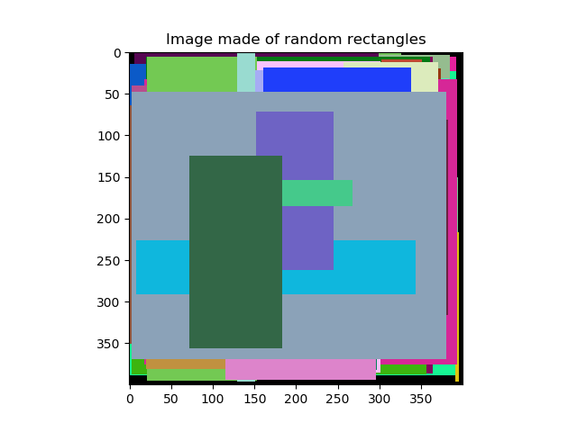
A model of natural images
Choose an object of a random color,
Make it a random size,
Position it at a random location in the image,
Repeat.

Slide 5
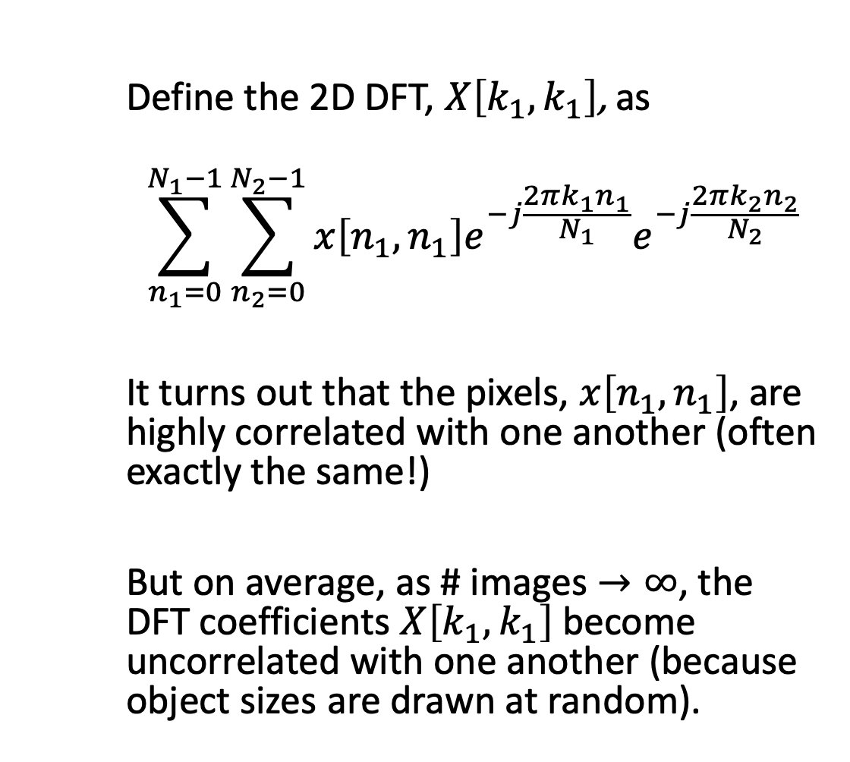
Result: PCA = DFT!
Define the 2D DFT, $X\left[k_{1},k_{1}\right]$, as
$$\sum_{n_{1}=0}^{N_{1}−1}{\sum_{n_{2}=0}^{N_{2}−1}{x\left[n_{1},n_{1}\right]e^{−j\frac{2πk_{1}n_{1}}{N_{1}}}e^{−j\frac{2πk_{2}n_{2}}{N_{2}}}}}$$
It turns out that the pixels, $x\left[n_{1},n_{1}\right]$, are highly correlated with one another (often exactly the same!)
But on average, as # images $→∞$, the DFT coefficients $X\left[k_{1},k_{1}\right]$become uncorrelated with one another (because object sizes are drawn at random).

Slide 6
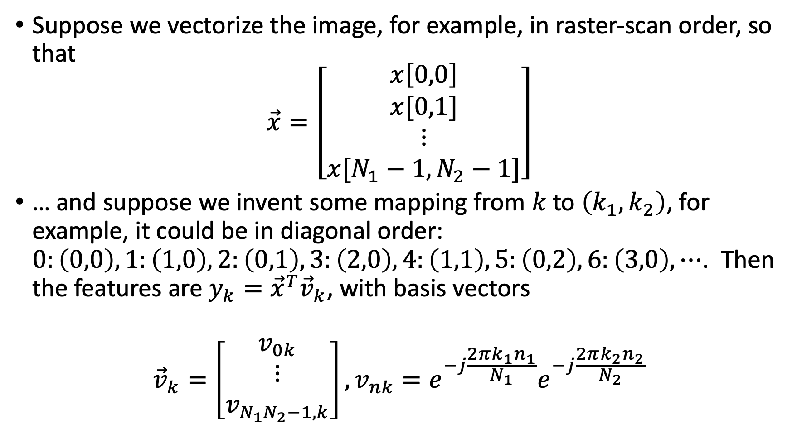
2D DFT as a vector transform
Suppose we vectorize the image, for example, in raster-scan order, so that
$$\vec{x}=\left[\begin{matrix}\begin{aligned}x\left[0,0\right] \\ x[0,1]\end{aligned} \\ ⋮ \\ x[N_{1}−1,N_{2}−1]\end{matrix}\right]$$
… and suppose we invent some mapping from $k$ to $\left(k_{1},k_{2}\right)$, for example, it could be in diagonal order: $0:\left(0,0\right),1:\left(1,0\right),2:\left(0,1\right),3:\left(2,0\right),4:\left(1,1\right),5:\left(0,2\right),6:\left(3,0\right),⋯$. Then the features are $y_{k}={\vec{x}}^{T}{\vec{v}}_{k}$, with basis vectors
$${\vec{v}}_{k}=\left[\begin{matrix}v_{0k} \\ ⋮ \\ v_{N_{1}N_{2}−1,k}\end{matrix}\right],v_{nk}=e^{−j\frac{2πk_{1}n_{1}}{N_{1}}}e^{−j\frac{2πk_{2}n_{2}}{N_{2}}}$$

Slide 7
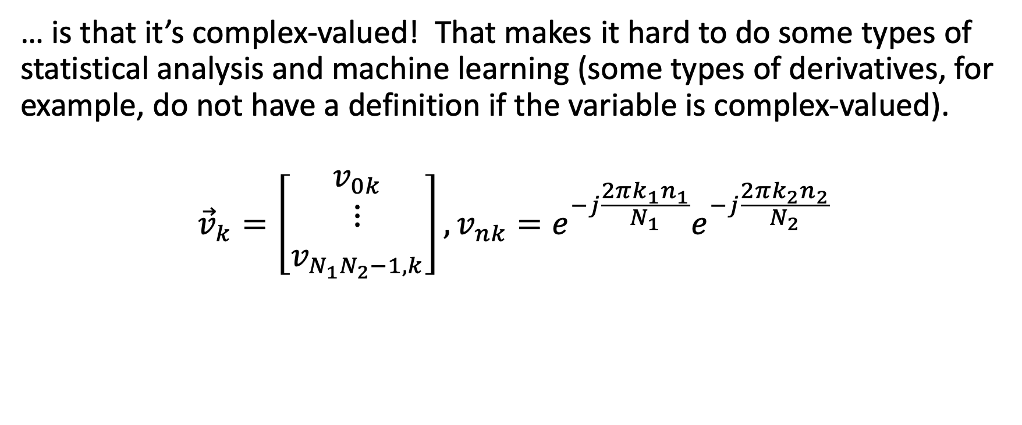
The problem with DFT…
… is that it’s complex-valued! That makes it hard to do some types of statistical analysis and machine learning (some types of derivatives, for example, do not have a definition if the variable is complex-valued).
$${\vec{v}}_{k}=\left[\begin{matrix}v_{0k} \\ ⋮ \\ v_{N_{1}N_{2}−1,k}\end{matrix}\right],v_{nk}=e^{−j\frac{2πk_{1}n_{1}}{N_{1}}}e^{−j\frac{2πk_{2}n_{2}}{N_{2}}}$$

Slide 8
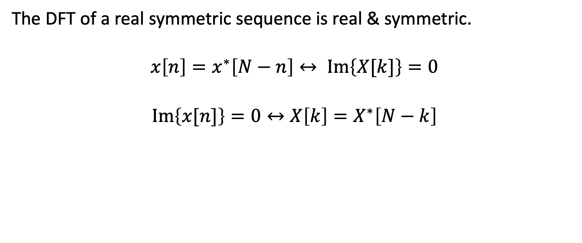
How to make the DFT real
The DFT of a real symmetric sequence is real & symmetric.
$$x\left[n\right]=x^{∗}\left[N−n\right]↔ Im\left\{X[k]\right\}=0$$
$$Im\left\{x[n]\right\}=0↔X\left[k\right]=X^{∗}\left[N−k\right]$$

Slide 9
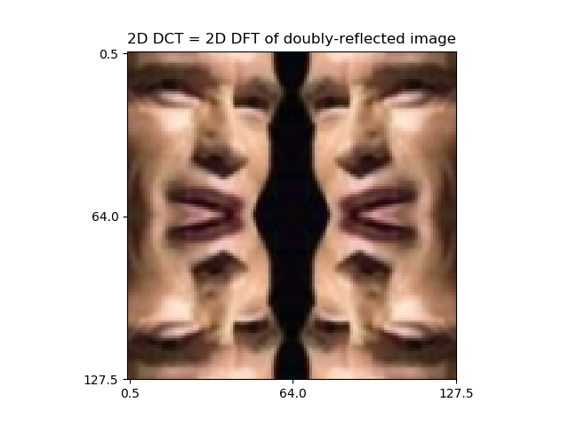
How to make the DFT real
Most natural images are real-valued.
Let’s also make it symmetric: pretend that the observed image is just ¼ of a larger, mirrored image.

Slide 10
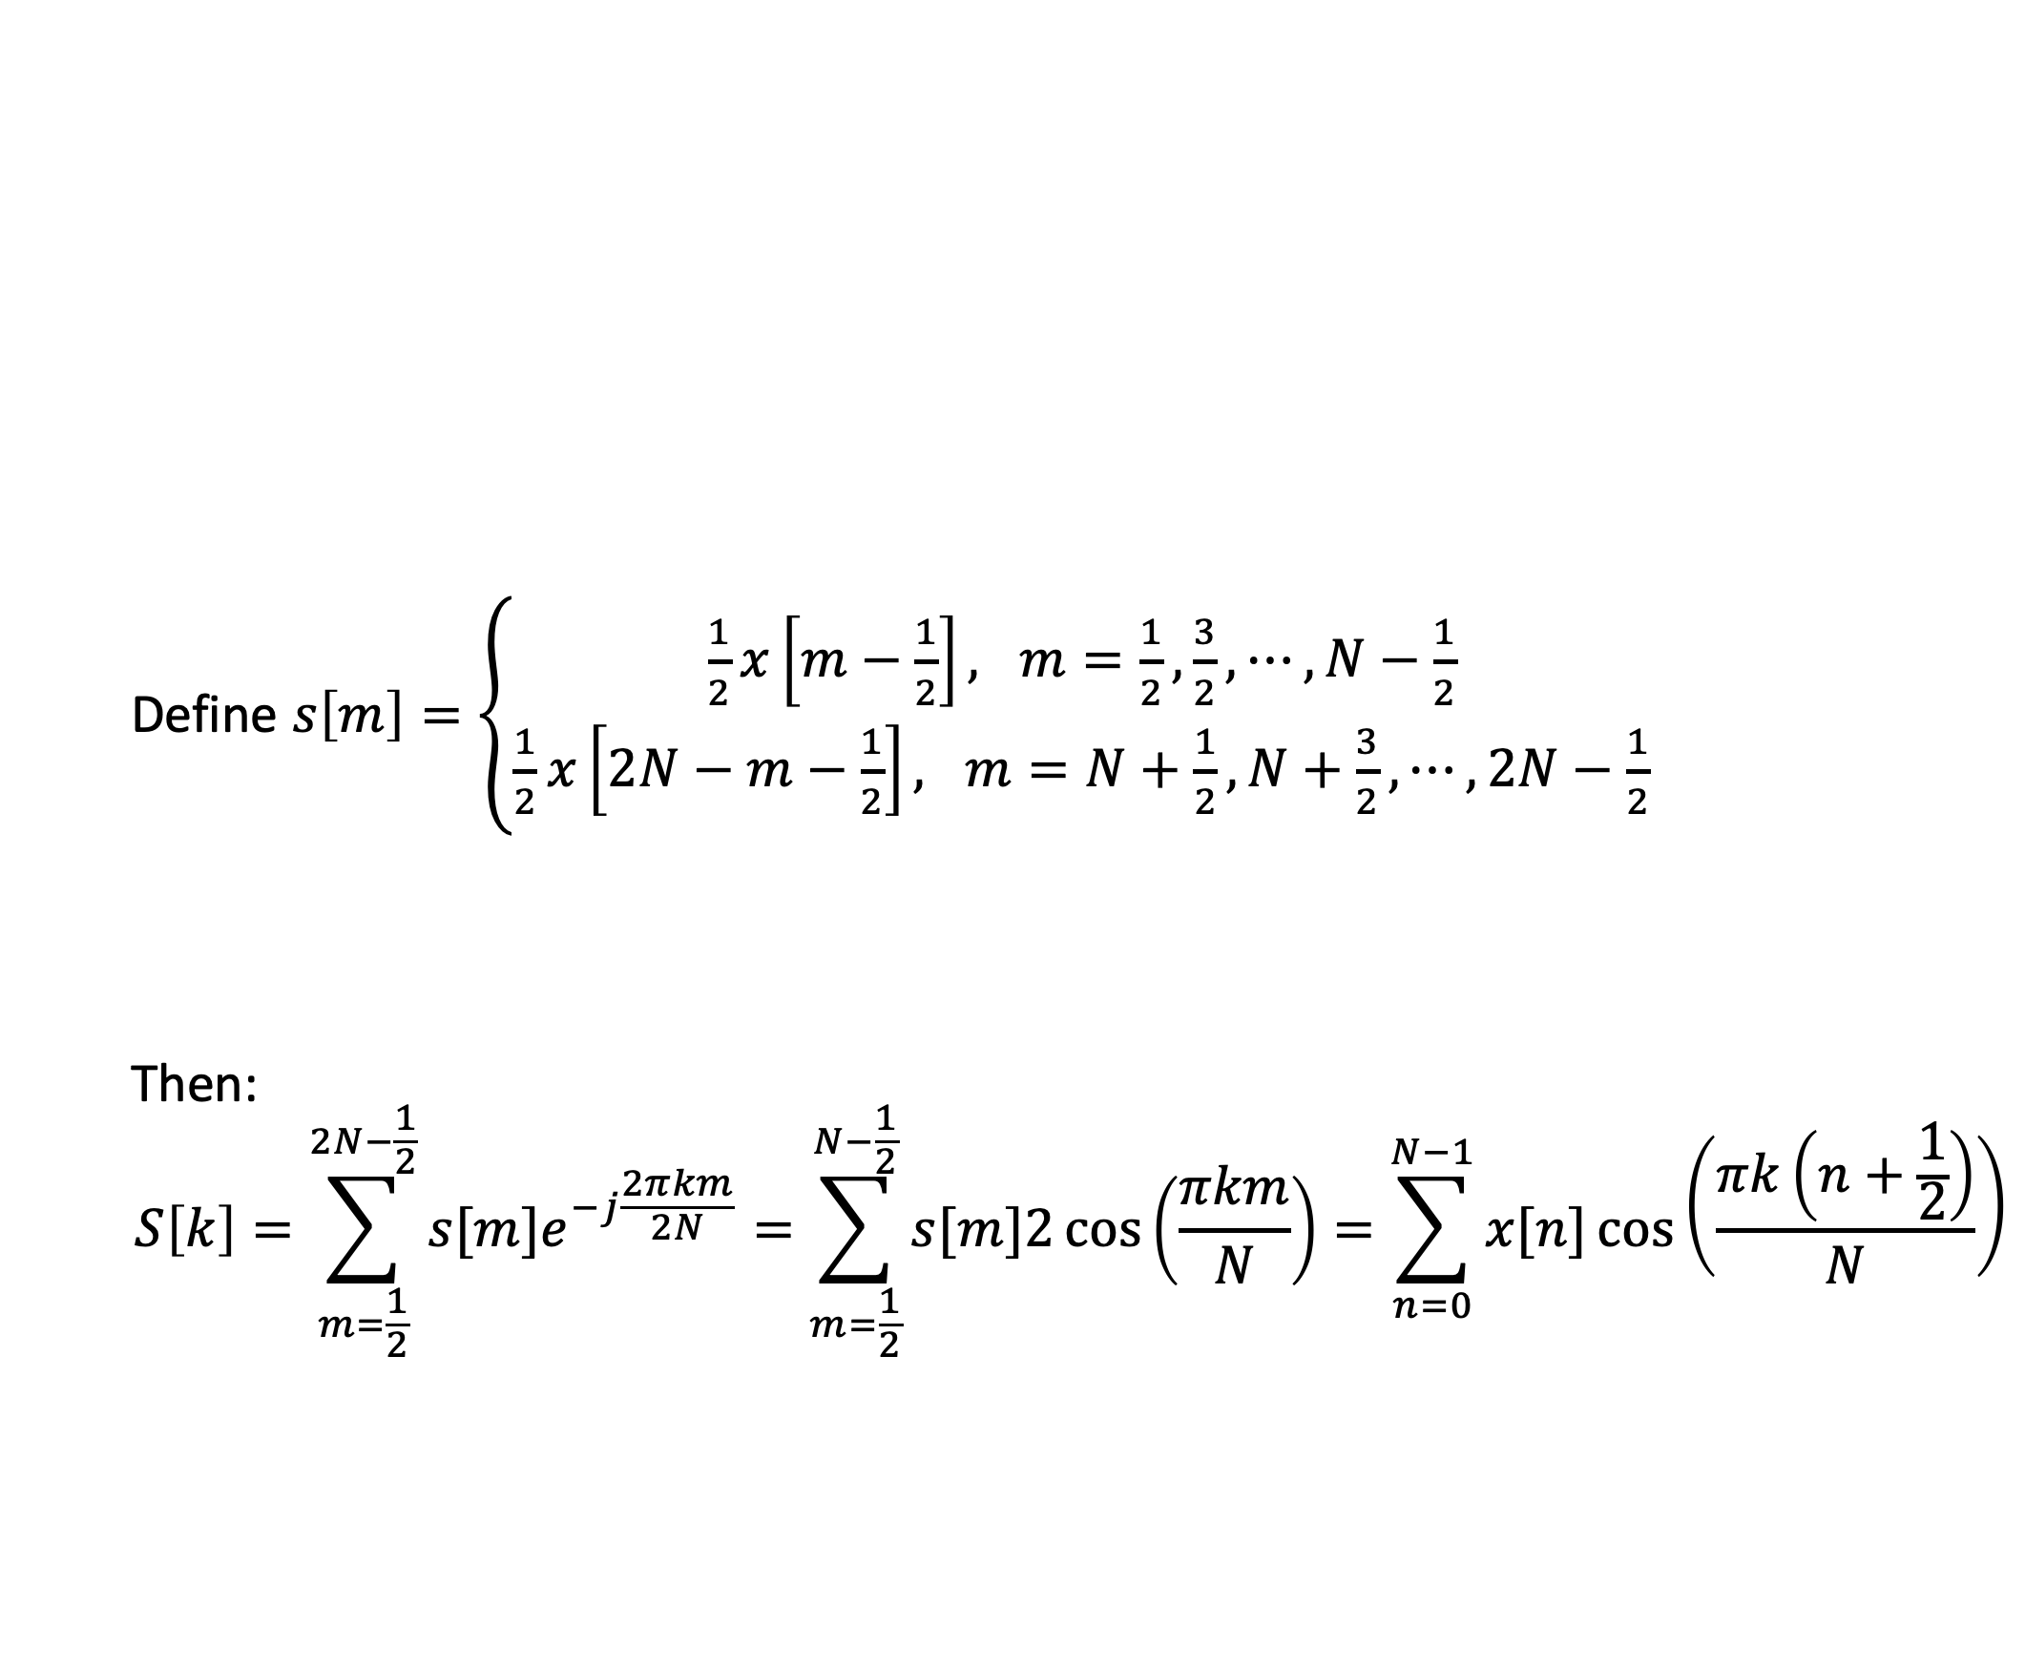
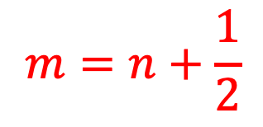
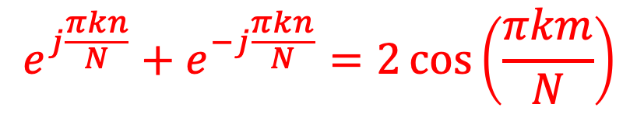
Discrete Cosine Transform
Define $s\left[m\right]=\left\{\begin{matrix}\frac{1}{2}x\left[m−\frac{1}{2}\right], m=\frac{1}{2},\frac{3}{2},⋯,N−\frac{1}{2} \\ \frac{1}{2}x\left[2N−m−\frac{1}{2}\right], m=N+\frac{1}{2},N+\frac{3}{2},⋯,2N−\frac{1}{2}\end{matrix}\right.$
Then:
$$S\left[k\right]=\sum_{m=\frac{1}{2}}^{2N−\frac{1}{2}}{s[m]e^{−j\frac{2πkm}{2N}}}=\sum_{m=\frac{1}{2}}^{N−\frac{1}{2}}{s[m]2\cos\left(\frac{πkm}{N}\right)}=\sum_{n=0}^{N−1}{x[n]\cos\left(\frac{πk\left(n+\frac{1}{2}\right)}{N}\right)}$$
$$e^{j\frac{πkn}{N}}+e^{−j\frac{πkn}{N}}=2\cos\left(\frac{πkm}{N}\right)$$
$$m=n+\frac{1}{2}$$

Slide 11
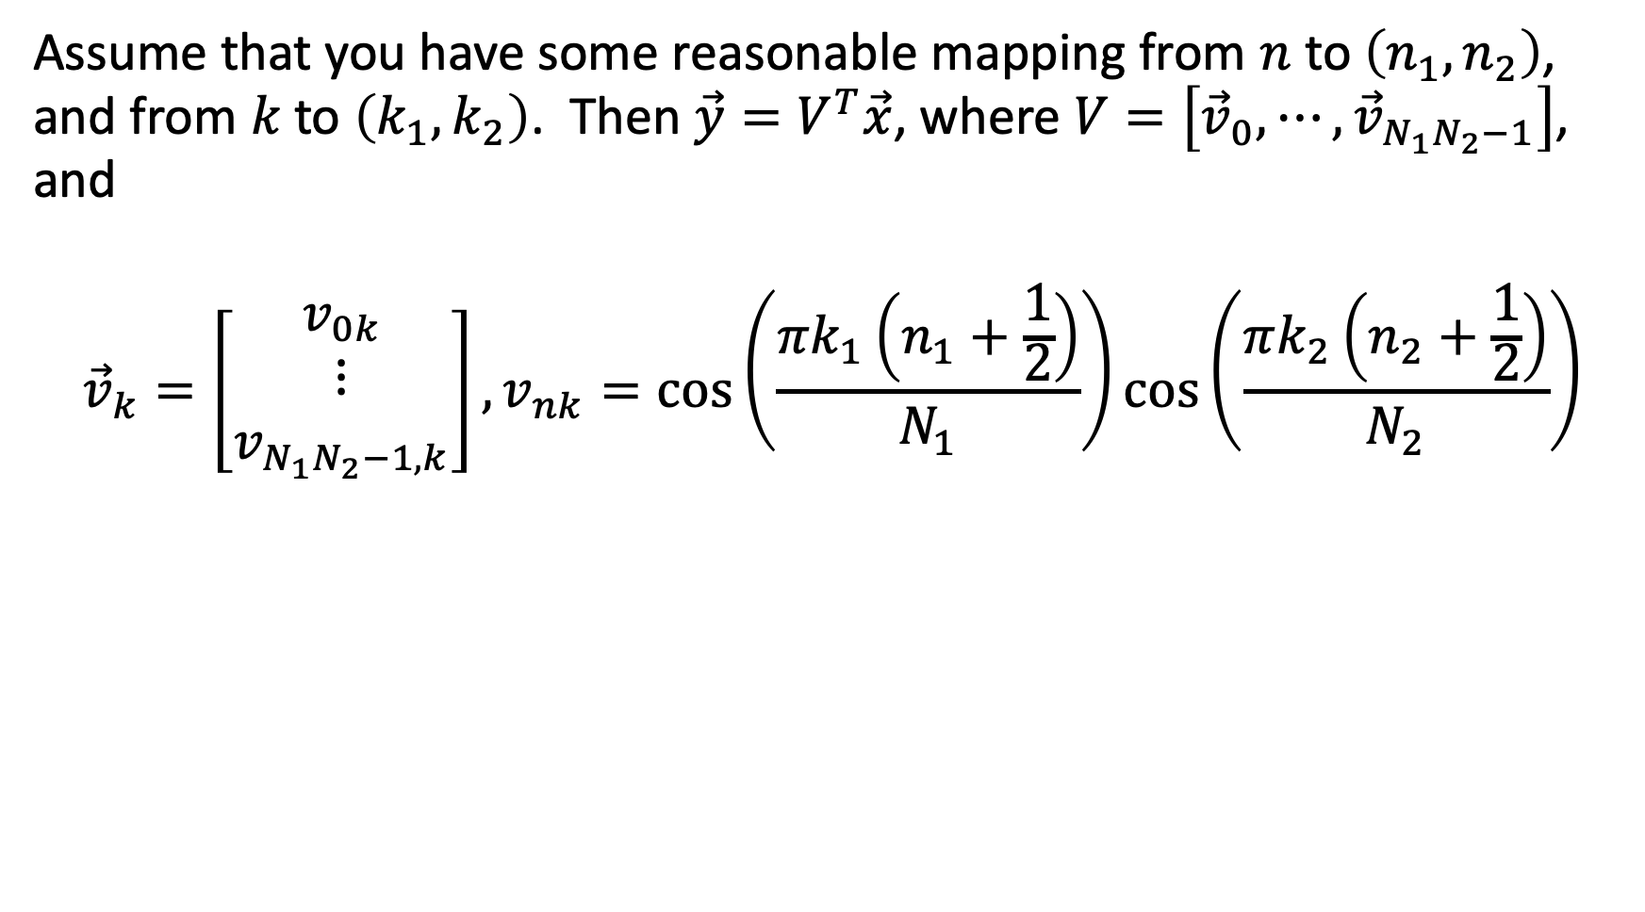
2D DCT as a vector transform
Assume that you have some reasonable mapping from $n$ to $\left(n_{1},n_{2}\right)$, and from $k$ to $\left(k_{1},k_{2}\right)$. Then $\vec{y}=V^{T}\vec{x}$, where $V=\left[{\vec{v}}_{0},⋯,{\vec{v}}_{N_{1}N_{2}−1}\right]$, and
$${\vec{v}}_{k}=\left[\begin{matrix}v_{0k} \\ ⋮ \\ v_{N_{1}N_{2}−1,k}\end{matrix}\right],v_{nk}=\cos\left(\frac{πk_{1}\left(n_{1}+\frac{1}{2}\right)}{N_{1}}\right)\cos\left(\frac{πk_{2}\left(n_{2}+\frac{1}{2}\right)}{N_{2}}\right)$$

Slide 12
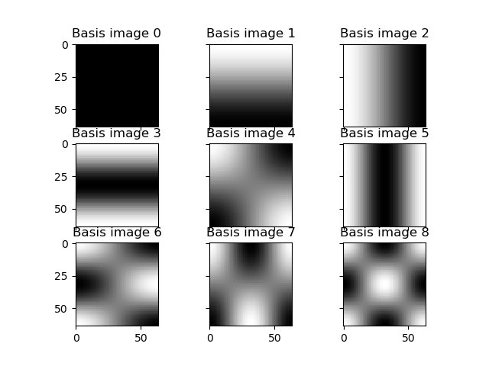
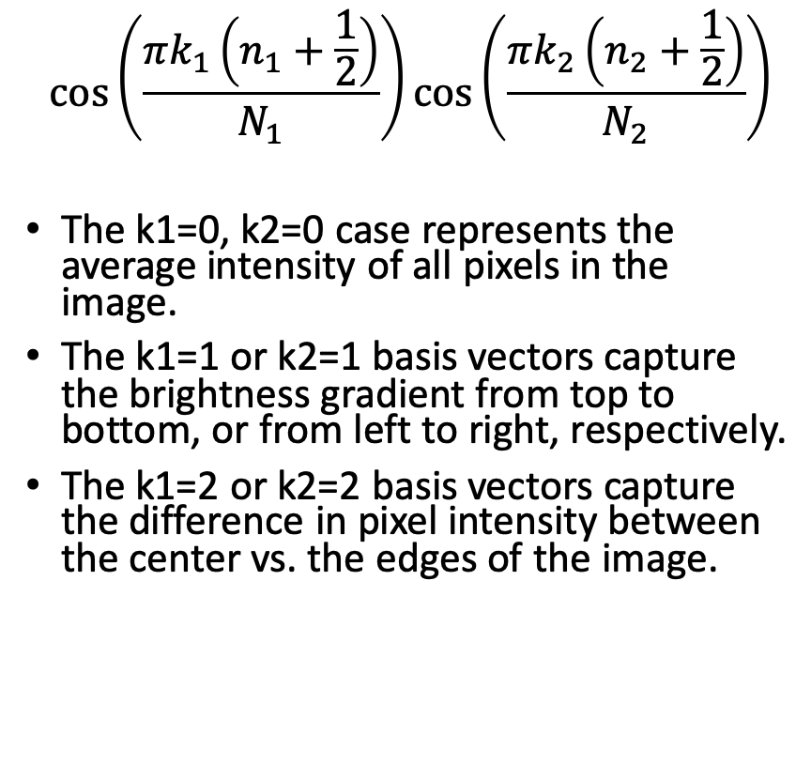
Basis Images: 9th-order 2D DCT
$$\cos\left(\frac{πk_{1}\left(n_{1}+\frac{1}{2}\right)}{N_{1}}\right)\cos\left(\frac{πk_{2}\left(n_{2}+\frac{1}{2}\right)}{N_{2}}\right)$$
The k1=0, k2=0 case represents the average intensity of all pixels in the image.
The k1=1 or k2=1 basis vectors capture the brightness gradient from top to bottom, or from left to right, respectively.
The k1=2 or k2=2 basis vectors capture the difference in pixel intensity between the center vs. the edges of the image.

Slide 13
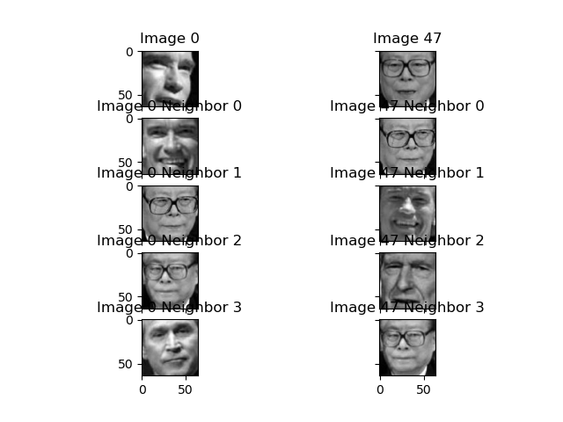
Nearest neighbors: 9th-order 2D DCT
This image shows the four nearest neighbors of “Image 0” (Arnold Schwarzenegger) and “Image 47” (Jiang Zemin), calculated using a 9th-order 2D DCT.
Neighbors of “Image 0” are dark on the right-hand-side, and in the lower-left corner.
Neighbors of “Image 47” are darker on the bottom than the top.
Neither of these features captures person identity very well…

Slide 14
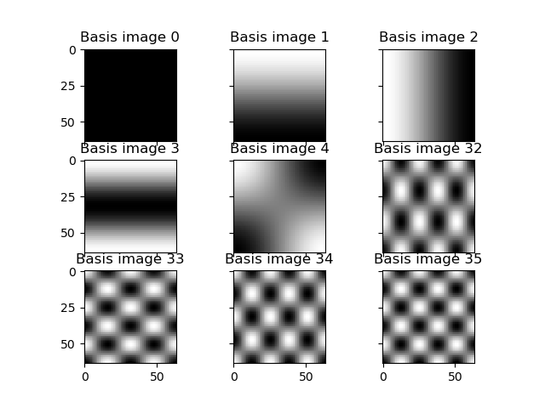

Basis Images: 36th-order 2D DCT
$$\cos\left(\frac{πk_{1}\left(n_{1}+\frac{1}{2}\right)}{N_{1}}\right)\cos\left(\frac{πk_{2}\left(n_{2}+\frac{1}{2}\right)}{N_{2}}\right)$$
With a 36th order DCT (up to k1=5,k2=5), we can get a bit more detail about the image.

Slide 15
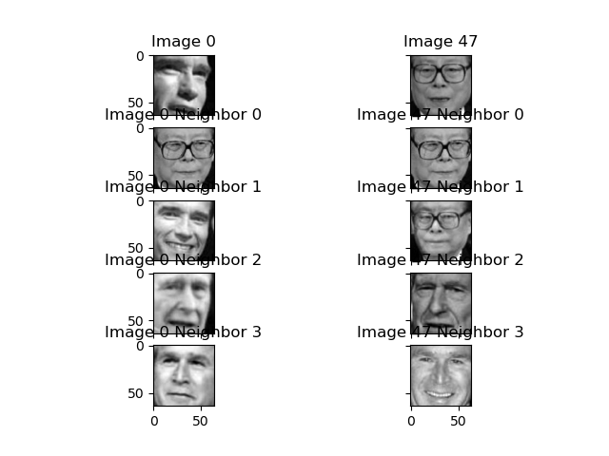
Nearest neighbors: 36th-order 2D DCT
The 36 order DCT is, at least, capturing the face orientation: most of the images considered “similar” are at least looking in the same way.
Jiang Zemin seems to be correctly identified (2 of the 4 neighbors are the same person), but Arnold Schwarzenegger isn’t (each of the 4 “similar” images shows a different person!)

Slide 16
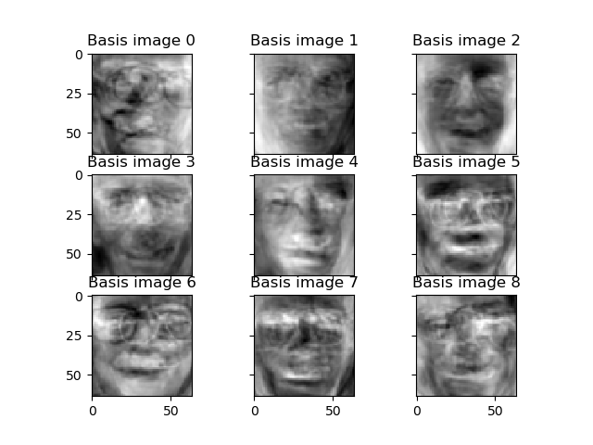
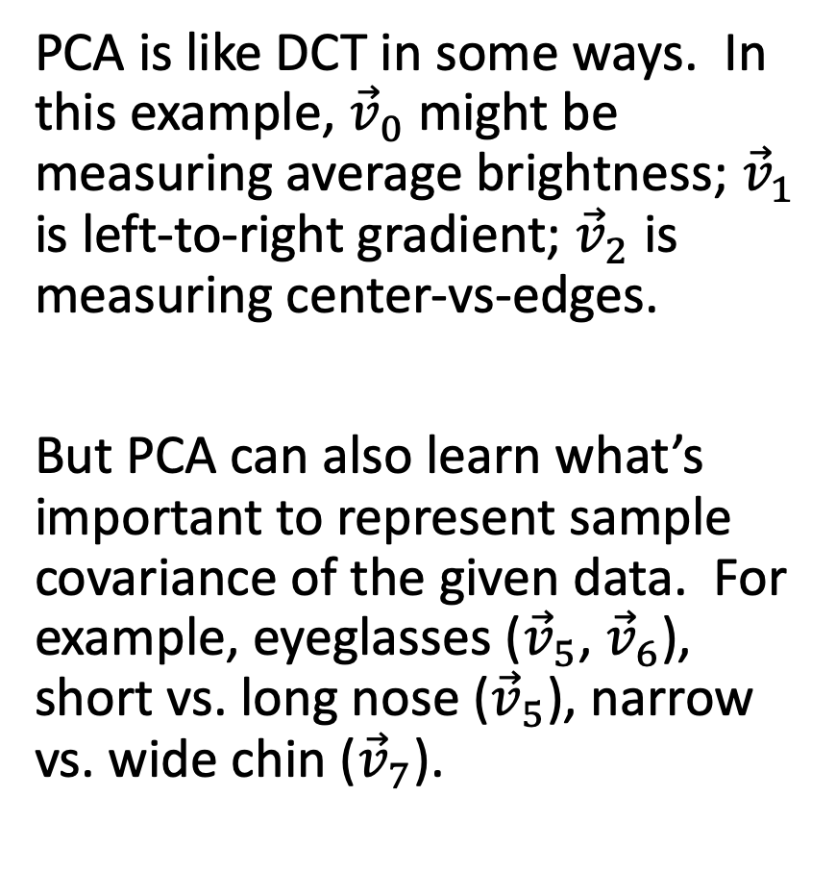
PCA vs. DCT
PCA is like DCT in some ways. In this example, ${\vec{v}}_{0}$ might be measuring average brightness; ${\vec{v}}_{1}$ is left-to-right gradient; ${\vec{v}}_{2}$ is measuring center-vs-edges.
But PCA can also learn what’s important to represent sample covariance of the given data. For example, eyeglasses (${\vec{v}}_{5}$, ${\vec{v}}_{6}$), short vs. long nose (${\vec{v}}_{5}$), narrow vs. wide chin (${\vec{v}}_{7}$).

Slide 17
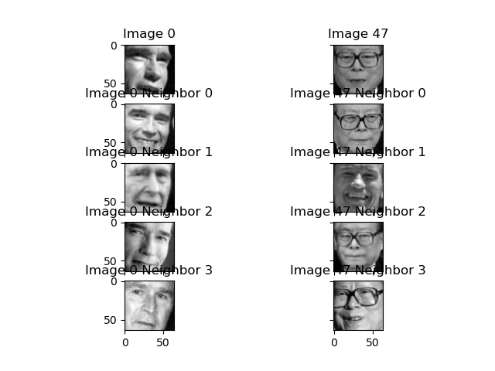
Nearest neighbors: 9th-order PCA
For these two test images, 9th-order PCA has managed to identify both people.
Two of the four neighbors of ”Image 0” are Arnold Schwarzenegger.
Three of the four neighbors of “Image 47” are Jiang Zemin.

Slide 18
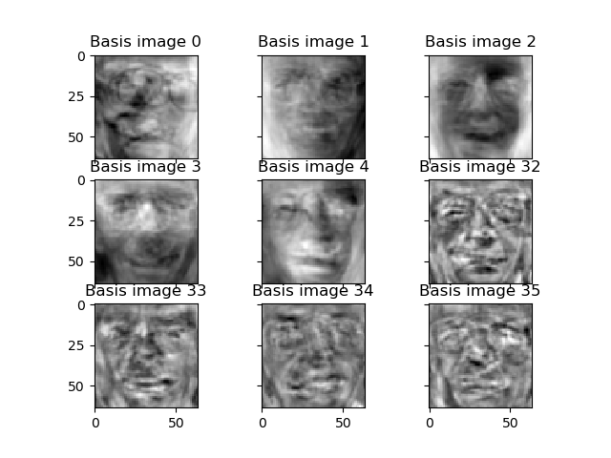
High-order PCA might be just noise!
It is not always true that PCA outperforms DCT. Especially for higher-dimension feature vectors, PCA might just learn random variation in the training dataset, which might not be useful for identifying person identity.
…vs…

Slide 19
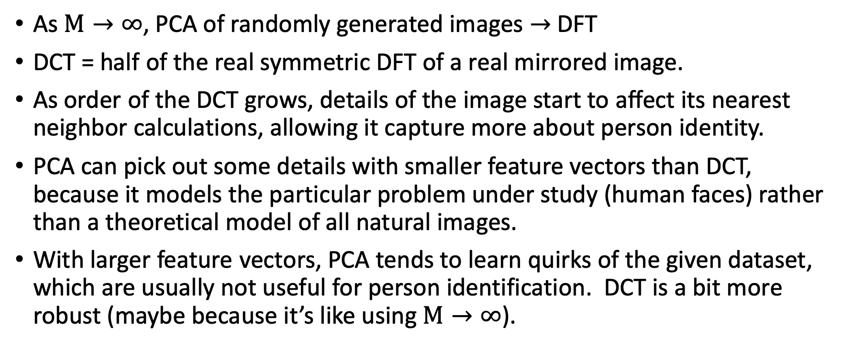
Summary
As $M→∞$, PCA of randomly generated images $→$ DFT
DCT = half of the real symmetric DFT of a real mirrored image.
As order of the DCT grows, details of the image start to affect its nearest neighbor calculations, allowing it capture more about person identity.
PCA can pick out some details with smaller feature vectors than DCT, because it models the particular problem under study (human faces) rather than a theoretical model of all natural images.
With larger feature vectors, PCA tends to learn quirks of the given dataset, which are usually not useful for person identification. DCT is a bit more robust (maybe because it’s like using $M→∞$).

Slide 20
Outline
DCT
KNN
How to draw the contour plots of a multivariate Gaussian pdf

Slide 21
K-Nearest Neighbors (KNN) Classifier
To classify each test token, find the K training tokens that are closest.
Look up the reference labels (known true person IDs) of those K neighbors. Let them vote. If there is a winner, then use that person ID as the hypothesis for the test token.
  If there is no winner, then fall back to 1NN.

Slide 22
Confusion Matrix
Hypothesis
 | 0 | 1 | 2 | 3
0 | # times that person 0 was classified correctly (sometimes abbreviated C(0|0)) | # times that person 0 was classified as person 1 (sometimes abbreviated C(1|0)) | … | …
1 | … | … | …
2
3
Reference

Slide 23
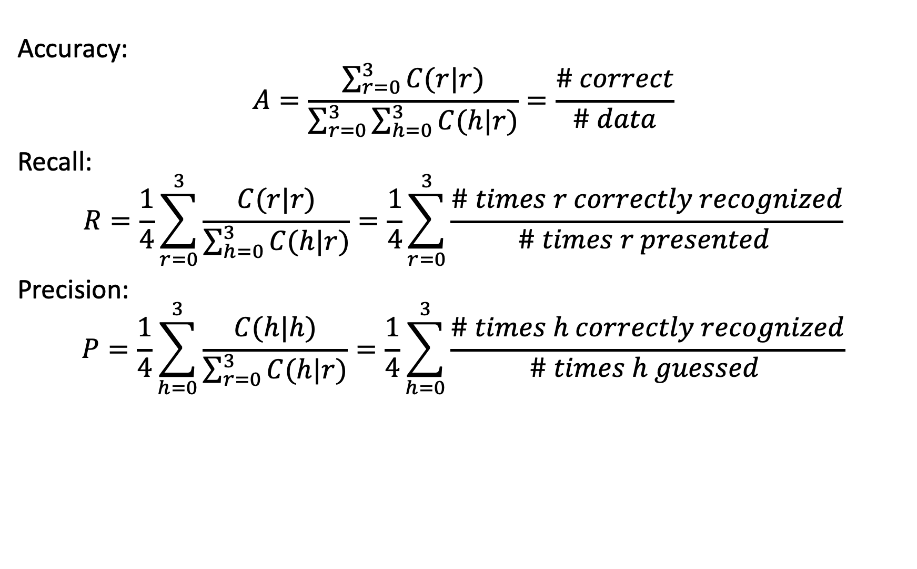
Accuracy, Recall, and Precision
Accuracy:
$$A=\frac{\sum_{r=0}^{3}{C(r|r)}}{\sum_{r=0}^{3}{\sum_{h=0}^{3}{C(h|r)}}}=\frac{\# correct}{\# data}$$
Recall:
$$R=\frac{1}{4}\sum_{r=0}^{3}{\frac{C(r|r)}{\sum_{h=0}^{3}{C(h|r)}}}=\frac{1}{4}\sum_{r=0}^{3}{\frac{\# times r correctly recognized}{\# times r presented }}$$
Precision:
$$P=\frac{1}{4}\sum_{h=0}^{3}{\frac{C(h|h)}{\sum_{r=0}^{3}{C(h|r)}}}=\frac{1}{4}\sum_{h=0}^{3}{\frac{\# times h correctly recognized}{\# times h guessed }}$$

Slide 24
Outline
DCT
KNN
How to draw the contour plots of a multivariate Gaussian pdf

Slide 25
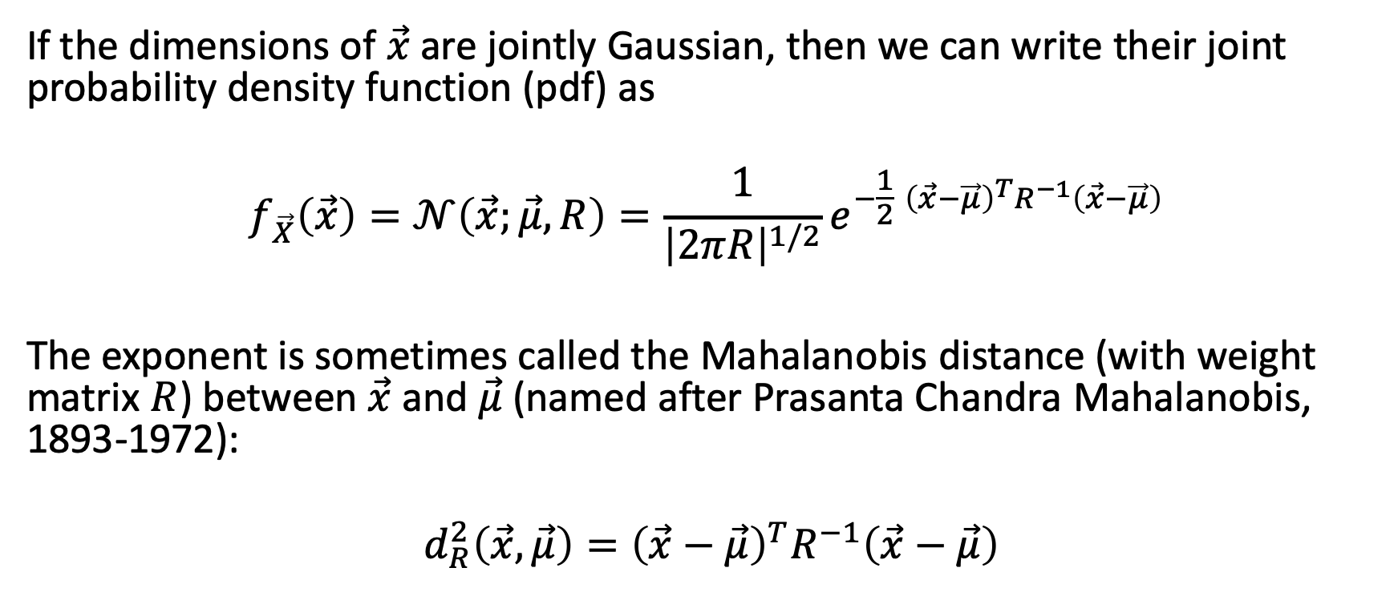
The Multivariate Gaussian probability density function
If the dimensions of $\vec{x}$are jointly Gaussian, then we can write their joint probability density function (pdf) as
$$f_{\vec{X}}\left(\vec{x}\right)=𝒩\left(\vec{x};\vec{μ},R\right)=\frac{1}{{\left|2πR\right|}^{1/2}}e^{−\frac{1}{2}{ \left(\vec{x}−\vec{μ}\right)}^{T}R^{−1}\left(\vec{x}−\vec{μ}\right)}$$
The exponent is sometimes called the Mahalanobis distance (with weight matrix $R$) between $\vec{x}$ and $\vec{μ}$ (named after Prasanta Chandra Mahalanobis, 1893-1972):
$${ d_{R}^{2}\left(\vec{x},\vec{μ}\right)=\left(\vec{x}−\vec{μ}\right)}^{T}R^{−1}\left(\vec{x}−\vec{μ}\right)$$

Slide 26
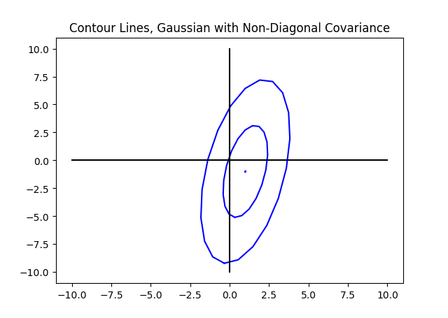
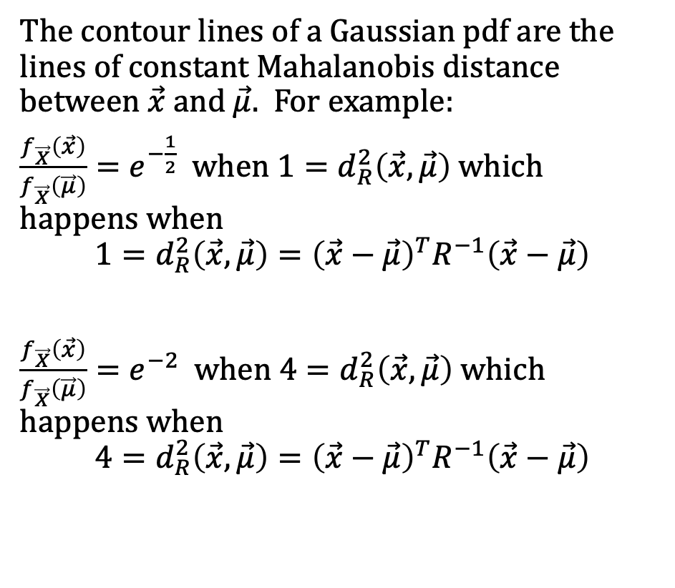
Contour lines of a Gaussian pdf
The contour lines of a Gaussian pdf are the lines of constant Mahalanobis distance between $\vec{x}$ and $\vec{μ}$. For example:
$\frac{f_{\vec{X}}\left(\vec{x}\right)}{f_{\vec{X}}\left(\vec{μ}\right)}=e^{−\frac{1}{2}}$ when $1=d_{R}^{2}\left(\vec{x},\vec{μ}\right)$ which happens when
$${1=d_{R}^{2}\left(\vec{x},\vec{μ}\right)=\left(\vec{x}−\vec{μ}\right)}^{T}R^{−1}\left(\vec{x}−\vec{μ}\right)$$
$\frac{f_{\vec{X}}\left(\vec{x}\right)}{f_{\vec{X}}\left(\vec{μ}\right)}=e^{−2}$ when $4=d_{R}^{2}\left(\vec{x},\vec{μ}\right)$ which happens when
$${4=d_{R}^{2}\left(\vec{x},\vec{μ}\right)=\left(\vec{x}−\vec{μ}\right)}^{T}R^{−1}\left(\vec{x}−\vec{μ}\right)$$

Slide 27
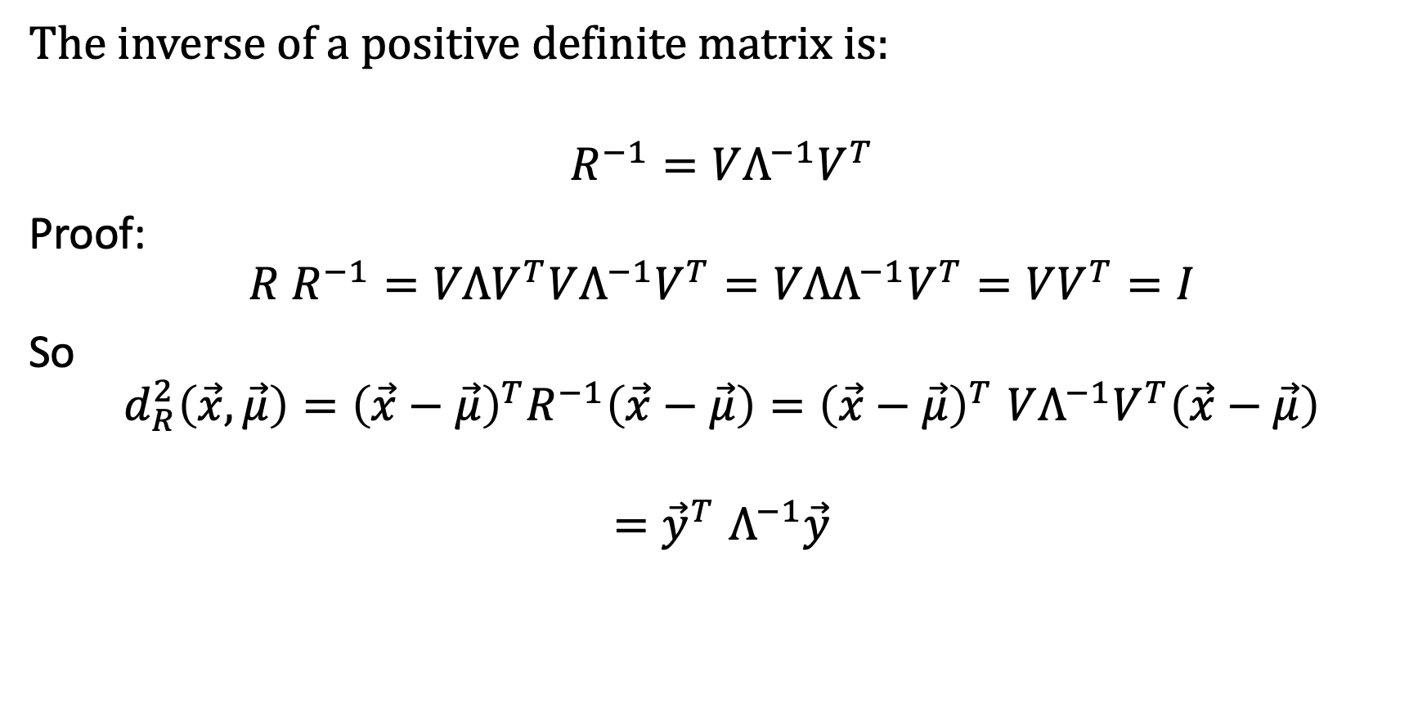
Inverse of a positive definite matrix
The inverse of a positive definite matrix is:
$$R^{−1}=VΛ^{−1}V^{T}$$
Proof:
$$R R^{−1}=VΛV^{T}VΛ^{−1}V^{T}=VΛΛ^{−1}V^{T}=VV^{T}=I$$
So
$${d_{R}^{2}\left(\vec{x},\vec{μ}\right)=\left(\vec{x}−\vec{μ}\right)}^{T}R^{−1}\left(\vec{x}−\vec{μ}\right){=\left(\vec{x}−\vec{μ}\right)}^{T}VΛ^{−1}V^{T}\left(\vec{x}−\vec{μ}\right)$$
$${=\vec{y}}^{T}Λ^{−1}\vec{y}$$

Slide 28
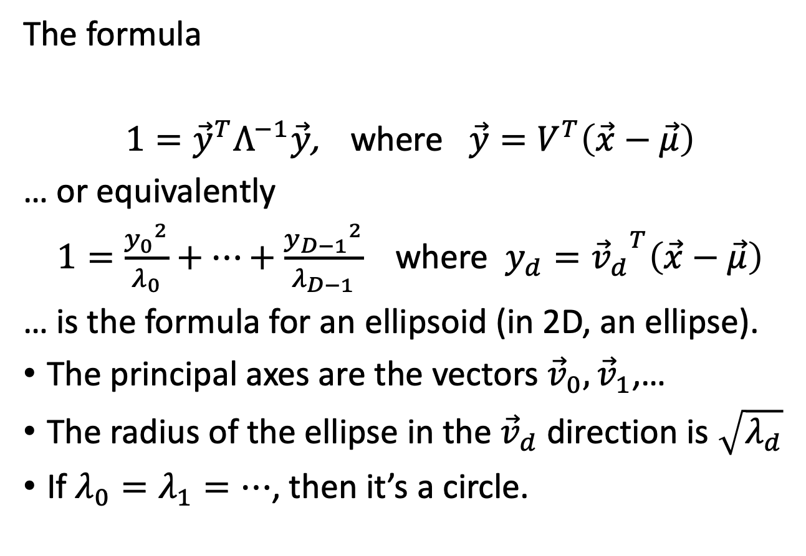
Facts about ellipses
The formula
$1={\vec{y}}^{T}Λ^{−1}\vec{y}$, where $\vec{y}=V^{T}\left(\vec{x}−\vec{μ}\right)$
… or equivalently
$1=\frac{{y_{0}}^{2}}{λ_{0}}+…+\frac{{y_{D−1}}^{2}}{λ_{D−1}}$ where $y_{d}={{\vec{v}}_{d}}^{T}\left(\vec{x}−\vec{μ}\right)$
… is the formula for an ellipsoid (in 2D, an ellipse).
The principal axes are the vectors ${\vec{v}}_{0},{\vec{v}}_{1}$,…
The radius of the ellipse in the ${\vec{v}}_{d}$direction is $\sqrt{λ_{d}}$
If $λ_{0}=λ_{1}=…$, then it’s a circle.

Slide 29
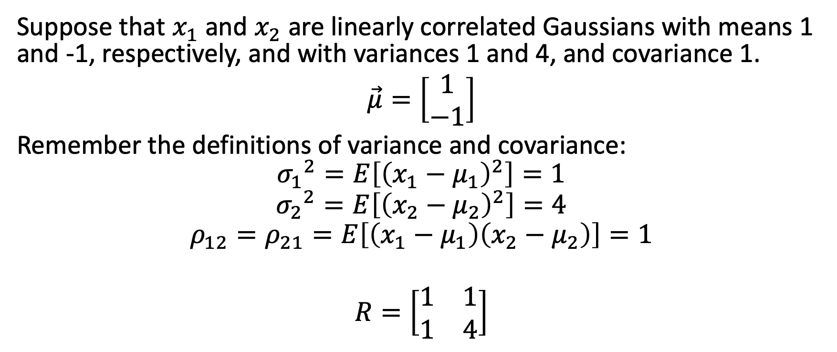
Example
Suppose that $x_{1}$ and $x_{2}$ are linearly correlated Gaussians with means 1 and -1, respectively, and with variances 1 and 4, and covariance 1.
$\vec{μ}=\left[\begin{matrix}1 \\ −1\end{matrix}\right]$
Remember the definitions of variance and covariance:
$${σ_{1}}^{2}=E\left[{\left(x_{1}−μ_{1}\right)}^{2}\right]=1$$
$${σ_{2}}^{2}=E\left[{\left(x_{2}−μ_{2}\right)}^{2}\right]=4$$
$$ρ_{12}=ρ_{21}=E\left[\left(x_{1}−μ_{1}\right)\left(x_{2}−μ_{2}\right)\right]=1$$
$$R=\left[\begin{matrix}1 & 1 \\ 1 & 4\end{matrix}\right]$$

Slide 30
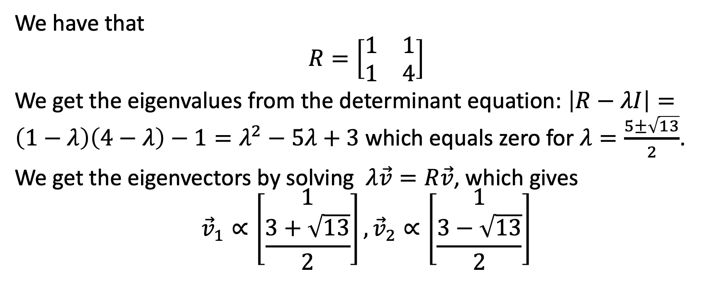
Example
We have that
$$R=\left[\begin{matrix}1 & 1 \\ 1 & 4\end{matrix}\right]$$
We get the eigenvalues from the determinant equation: $\left|R−λI\right|=\left(1−λ\right)\left(4−λ\right)−1=λ^{2}−5λ+3$ which equals zero for $λ=\frac{5±\sqrt{13}}{2}$.
We get the eigenvectors by solving $λ\vec{v}=R\vec{v}$, which gives
$${\vec{v}}_{1}∝\left[\begin{matrix}1 \\ \frac{3+\sqrt{13}}{2}\end{matrix}\right],{\vec{v}}_{2}∝\left[\begin{matrix}1 \\ \frac{3−\sqrt{13}}{2}\end{matrix}\right]$$

Slide 31
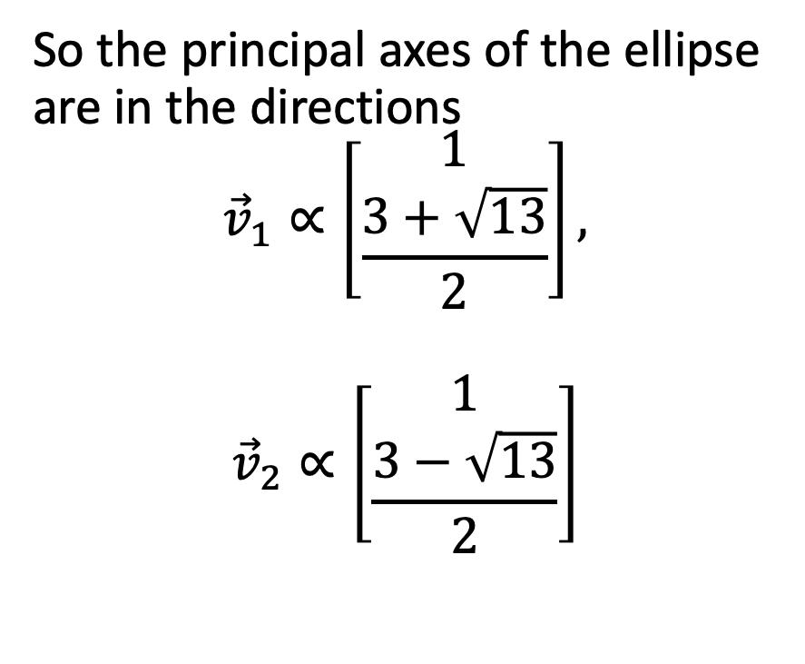
Example
So the principal axes of the ellipse are in the directions
$${\vec{v}}_{1}∝\left[\begin{matrix}1 \\ \frac{3+\sqrt{13}}{2}\end{matrix}\right],$$
$${\vec{v}}_{2}∝\left[\begin{matrix}1 \\ \frac{3−\sqrt{13}}{2}\end{matrix}\right]$$

Slide 32
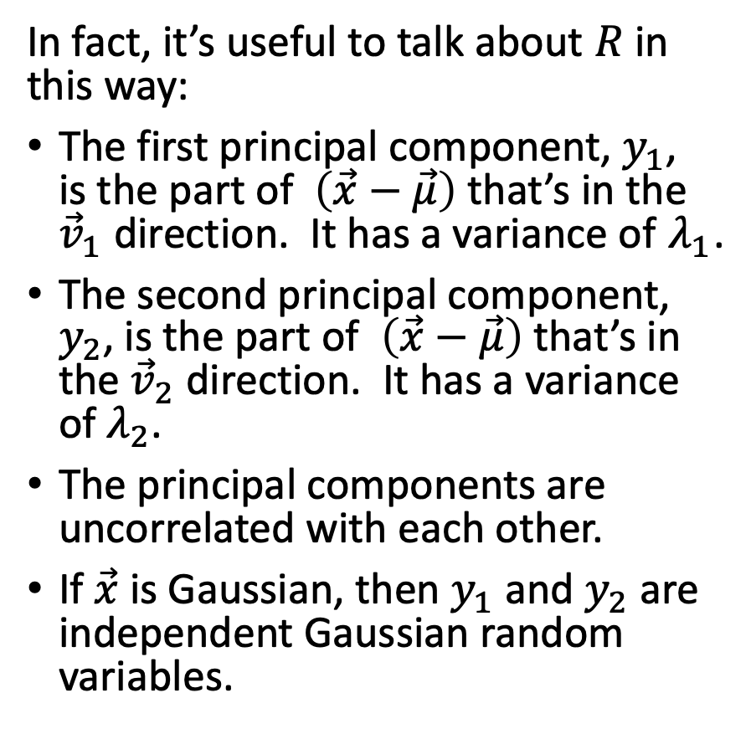
Summary
In fact, it’s useful to talk about $R$ in this way:
The first principal component, $y_{1}$, is the part of $\left(\vec{x}−\vec{μ}\right)$ that’s in the ${\vec{v}}_{1}$ direction. It has a variance of $λ_{1}$.
The second principal component, $y_{2}$, is the part of $\left(\vec{x}−\vec{μ}\right)$ that’s in the ${\vec{v}}_{2}$ direction. It has a variance of $λ_{2}$.
The principal components are uncorrelated with each other.
If $\vec{x}$ is Gaussian, then $y_{1}$ and $y_{2}$ are independent Gaussian random variables.

