Slide 1
ECE 417 Lecture 5:
Principal Component Analysis (PCA)
Mark Hasegawa-Johnson
9/6/2019

Slide 2
Content
Linear transforms
Eigenvectors
Eigenvalues
Symmetric matrices
Gaussian random vectors
Principal component axes = eigenvectors of the covariance
Gram matrix
Singular value decomposition

Slide 3

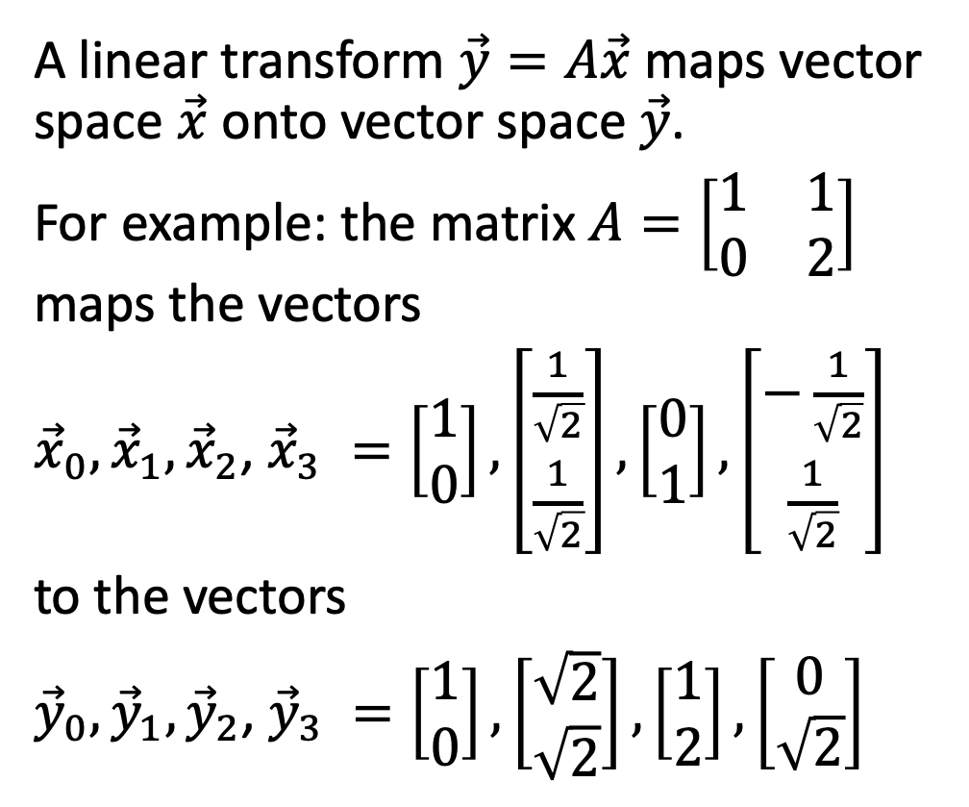



Linear Transforms
$$x_{1}$$
A linear transform $\vec{y}=A\vec{x}$ maps vector space $\vec{x}$ onto vector space $\vec{y}$.
For example: the matrix $A=\left[\begin{matrix}1 & 1 \\ 0 & 2\end{matrix}\right]$ maps the vectors
${\vec{x}}_{0},{\vec{x}}_{1},{\vec{x}}_{2}$, ${\vec{x}}_{3} =\left[\begin{matrix}1 \\ 0\end{matrix}\right],\left[\begin{matrix}\frac{1}{\sqrt{2}} \\ \frac{1}{\sqrt{2}}\end{matrix}\right],\left[\begin{matrix}0 \\ 1\end{matrix}\right],\left[\begin{matrix}−\frac{1}{\sqrt{2}} \\ \frac{1}{\sqrt{2}}\end{matrix}\right]$
to the vectors
${\vec{y}}_{0},{\vec{y}}_{1},{\vec{y}}_{2}$, ${\vec{y}}_{3} =\left[\begin{matrix}1 \\ 0\end{matrix}\right],\left[\begin{matrix}\sqrt{2} \\ \sqrt{2}\end{matrix}\right],\left[\begin{matrix}1 \\ 2\end{matrix}\right],\left[\begin{matrix}0 \\ \sqrt{2}\end{matrix}\right]$
$$x_{0}$$
A
$$y_{1}$$
$$y_{0}$$

Slide 4
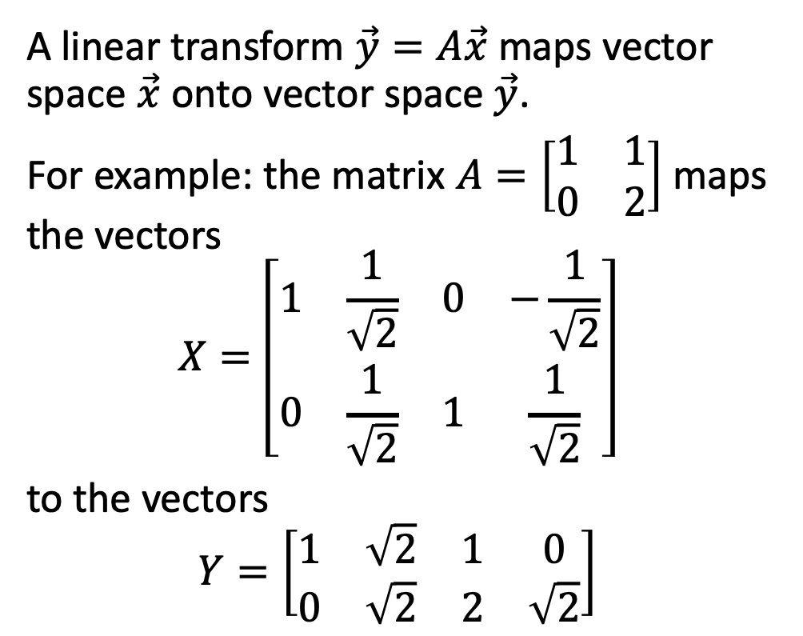

Linear Transforms
$$x_{1}$$
A linear transform $\vec{y}=A\vec{x}$ maps vector space $\vec{x}$ onto vector space $\vec{y}$.
For example: the matrix $A=\left[\begin{matrix}1 & 1 \\ 0 & 2\end{matrix}\right]$ maps the vectors
$$X=\left[\begin{matrix}1 & \frac{1}{\sqrt{2}} & 0 & −\frac{1}{\sqrt{2}} \\ 0 & \frac{1}{\sqrt{2}} & 1 & \frac{1}{\sqrt{2}}\end{matrix}\right]$$
to the vectors
$$Y=\left[\begin{matrix}1 & \sqrt{2} & 1 & 0 \\ 0 & \sqrt{2} & 2 & \sqrt{2}\end{matrix}\right]$$
$$x_{0}$$
A
$$y_{1}$$
$$y_{0}$$

Slide 5
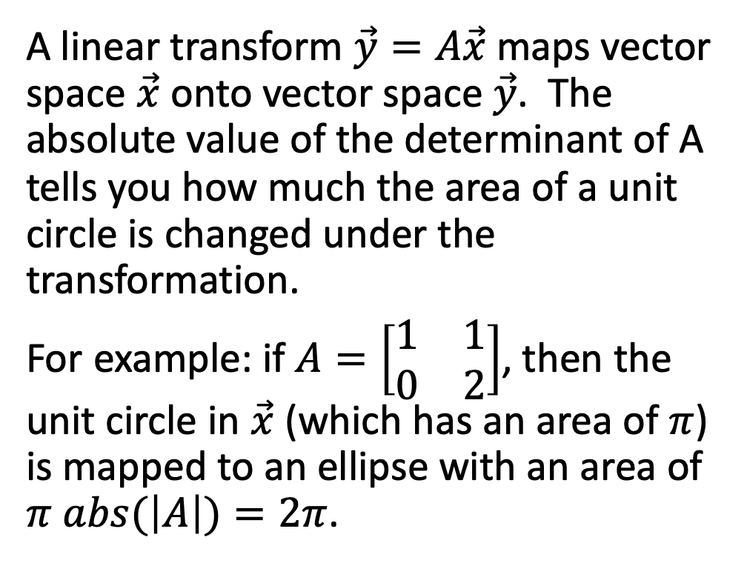

Linear Transforms
$$x_{1}$$
A linear transform $\vec{y}=A\vec{x}$ maps vector space $\vec{x}$ onto vector space $\vec{y}$. The absolute value of the determinant of A tells you how much the area of a unit circle is changed under the transformation.
For example: if $A=\left[\begin{matrix}1 & 1 \\ 0 & 2\end{matrix}\right]$, then the unit circle in $\vec{x}$ (which has an area of $π$) is mapped to an ellipse with an area of $π abs(\left|A\right|)=2π$.
$$x_{0}$$
A
$$y_{1}$$
$$y_{0}$$

Slide 6
Content
Linear transforms
Eigenvectors
Eigenvalues
Symmetric matrices
Gaussian random vectors
Principal component axes = eigenvectors of the covariance
Gram matrix
Singular value decomposition

Slide 7
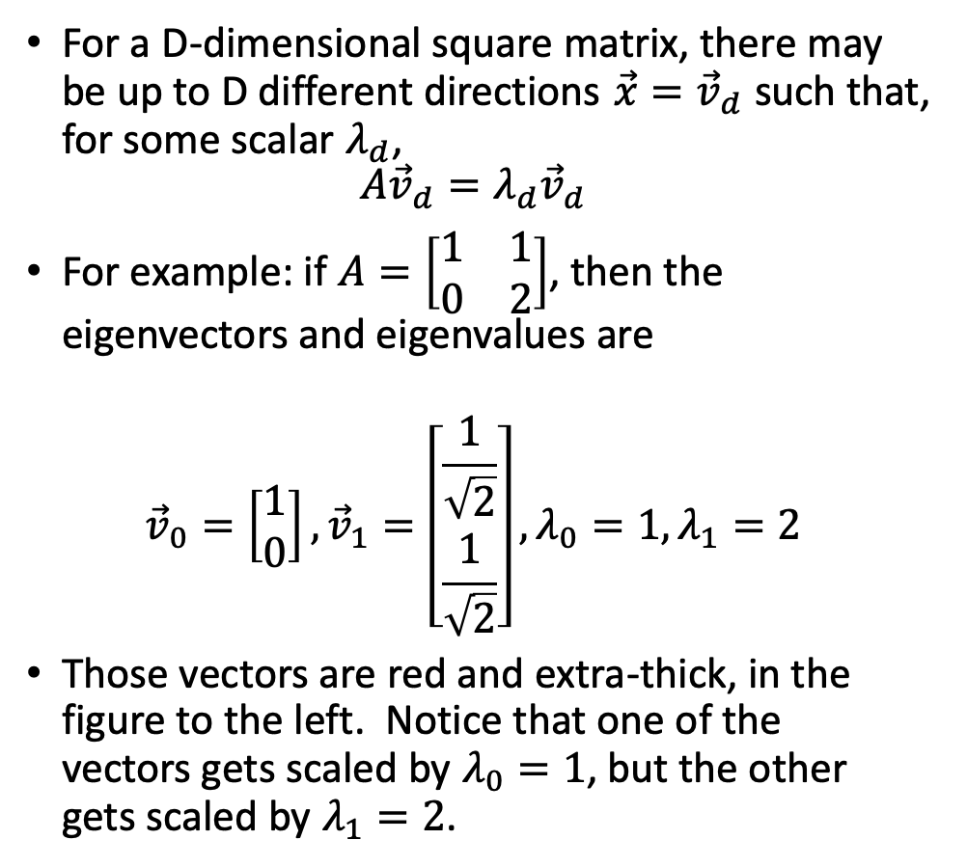
Eigenvectors
$$x_{1}$$
For a D-dimensional square matrix, there may be up to D different directions $\vec{x}={\vec{v}}_{d}$ such that, for some scalar $λ_{d}$,
$$A{\vec{v}}_{d}=λ_{d}{\vec{v}}_{d}$$
For example: if $A=\left[\begin{matrix}1 & 1 \\ 0 & 2\end{matrix}\right]$, then the eigenvectors and eigenvalues are
$${\vec{v}}_{0}=\left[\begin{matrix}1 \\ 0\end{matrix}\right],{\vec{v}}_{1}=\left[\begin{matrix}\frac{1}{\sqrt{2}} \\ \frac{1}{\sqrt{2}}\end{matrix}\right],λ_{0}=1, λ_{1}=2$$
Those vectors are red and extra-thick, in the figure to the left. Notice that one of the vectors gets scaled by $λ_{0}=1$, but the other gets scaled by $λ_{1}=2$.
$$x_{0}$$
A
$$y_{1}$$
$$y_{0}$$

Slide 8
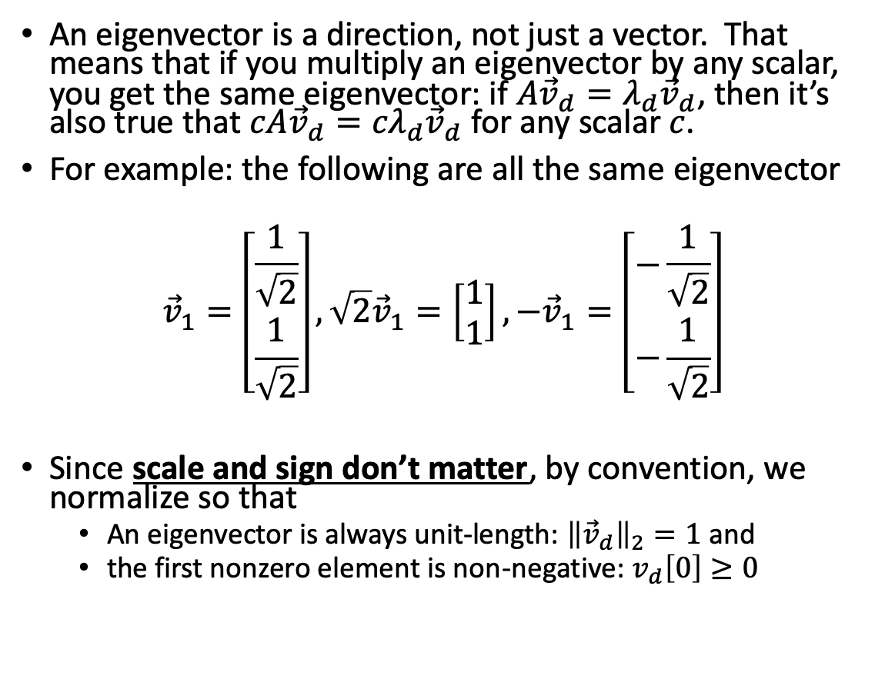
Eigenvectors
$$x_{1}$$
An eigenvector is a direction, not just a vector. That means that if you multiply an eigenvector by any scalar, you get the same eigenvector: if $A{\vec{v}}_{d}=λ_{d}{\vec{v}}_{d}$, then it’s also true that $cA{\vec{v}}_{d}={cλ}_{d}{\vec{v}}_{d}$ for any scalar $c$.
For example: the following are all the same eigenvector
$${\vec{v}}_{1}=\left[\begin{matrix}\frac{1}{\sqrt{2}} \\ \frac{1}{\sqrt{2}}\end{matrix}\right],\sqrt{2}{\vec{v}}_{1}=\left[\begin{matrix}1 \\ 1\end{matrix}\right],−{\vec{v}}_{1}=\left[\begin{matrix}−\frac{1}{\sqrt{2}} \\ −\frac{1}{\sqrt{2}}\end{matrix}\right]$$
Since scale and sign don’t matter, by convention, we normalize so that
  An eigenvector is always unit-length: ${\left\|{\vec{v}}_{d}\right\|}_{2}=1$ and
  the first nonzero element is non-negative: $v_{d}\left[0\right]≥0$
$$x_{0}$$
A
$$y_{1}$$
$$y_{0}$$

Slide 9
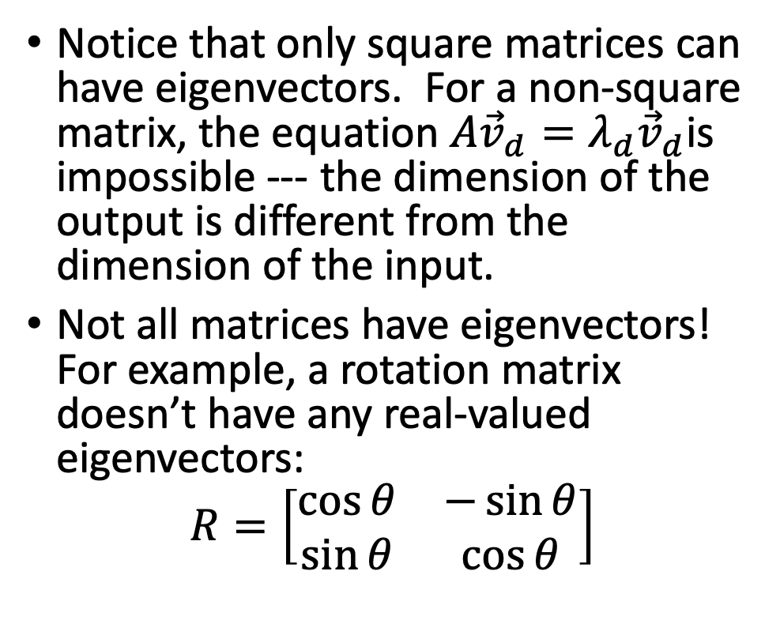
Eigenvectors
$$x_{1}$$
Notice that only square matrices can have eigenvectors. For a non-square matrix, the equation $A{\vec{v}}_{d}=λ_{d}{\vec{v}}_{d}$is impossible --- the dimension of the output is different from the dimension of the input.
Not all matrices have eigenvectors! For example, a rotation matrix doesn’t have any real-valued eigenvectors:
$$R=\left[\begin{matrix}\cos{θ} & −\sin{θ} \\ \sin{θ} & \cos{θ}\end{matrix}\right]$$
$$x_{0}$$
R
$$y_{1}$$
$$y_{0}$$

Slide 10
Content
Linear transforms
Eigenvectors
Eigenvalues
Symmetric matrices
Gaussian random vectors
Principal component axes = eigenvectors of the covariance
Gram matrix
Singular value decomposition

Slide 11
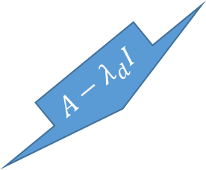
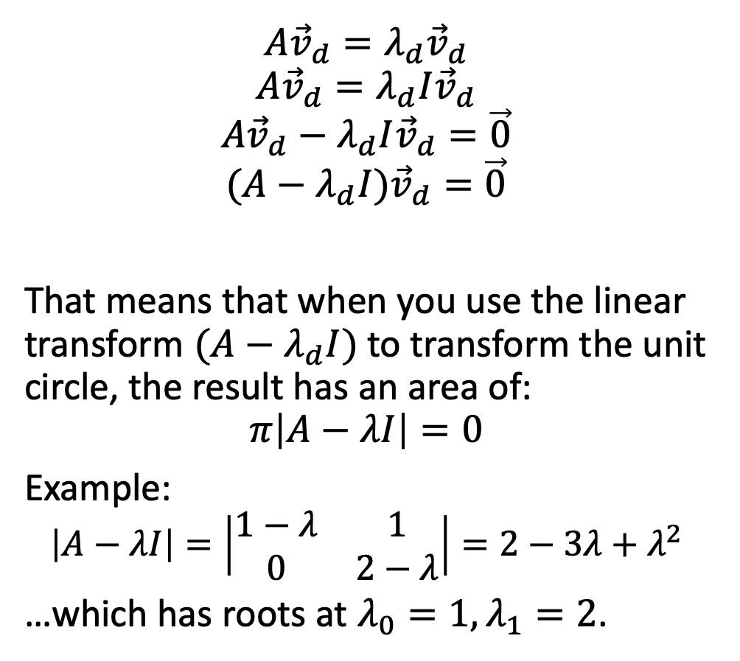
Eigenvalues
$$x_{1}$$
$$A{\vec{v}}_{d}=λ_{d}{\vec{v}}_{d}$$
$$A{\vec{v}}_{d}=λ_{d}I{\vec{v}}_{d}$$
$$A{\vec{v}}_{d}−λ_{d}I{\vec{v}}_{d}=\vec{0}$$
$$(A−λ_{d}I){\vec{v}}_{d}=\vec{0}$$
That means that when you use the linear transform $(A−λ_{d}I)$ to transform the unit circle, the result has an area of:
$$π\left|A−λI\right|=0$$
Example:
$$\left|A−λI\right|=\left|\begin{matrix}1−λ & 1 \\ 0 & 2−λ\end{matrix}\right|=2−3λ+λ^{2}$$
…which has roots at $λ_{0}=1, λ_{1}=2$.
$$x_{0}$$
$$A−λ_{d}I$$
$$y_{1}$$
$$y_{0}$$

Slide 12
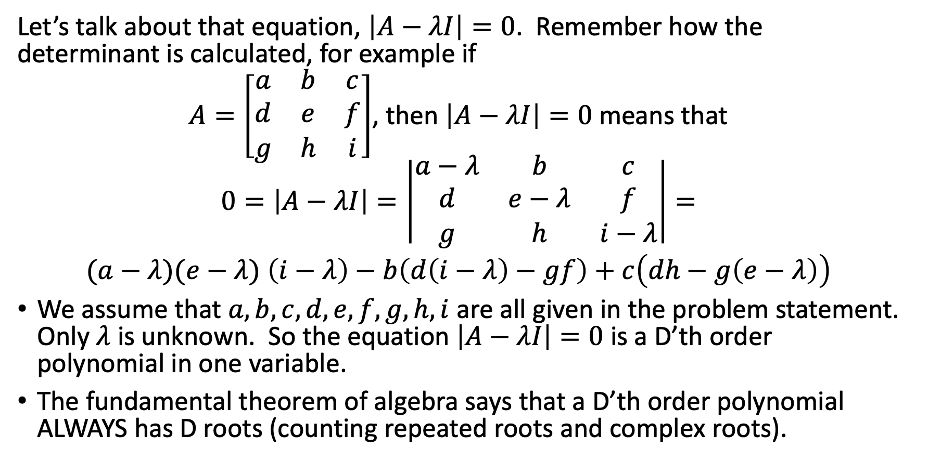
Eigenvalues
Let’s talk about that equation, $\left|A−λI\right|=0$. Remember how the determinant is calculated, for example if
$A=\left[\begin{matrix}a & b & c \\ d & e & f \\ g & h & i\end{matrix}\right]$, then $\left|A−λI\right|=0$ means that
$$0=\left|A−λI\right|=\left|\begin{matrix}a−λ & b & c \\ d & e−λ & f \\ g & h & i−λ\end{matrix}\right|=$$
$(a−λ)(e−λ)$ $\left(i−λ\right)−b\left(d\left(i−λ\right)−gf\right)+c\left(dh−g\left(e−λ\right)\right)$
We assume that $a, b, c, d, e, f, g, h, i$ are all given in the problem statement. Only $λ$ is unknown. So the equation $\left|A−λI\right|=0$ is a D’th order polynomial in one variable.
The fundamental theorem of algebra says that a D’th order polynomial ALWAYS has D roots (counting repeated roots and complex roots).

Slide 13
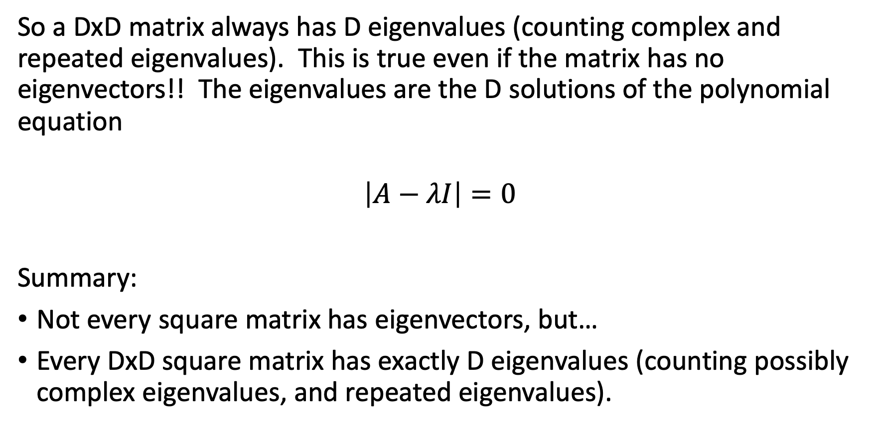
Eigenvalues
So a DxD matrix always has D eigenvalues (counting complex and repeated eigenvalues). This is true even if the matrix has no eigenvectors!! The eigenvalues are the D solutions of the polynomial equation
$$\left|A−λI\right|=0$$
Summary:
Not every square matrix has eigenvectors, but…
Every DxD square matrix has exactly D eigenvalues (counting possibly complex eigenvalues, and repeated eigenvalues).

Slide 14
Content
Linear transforms
Eigenvectors
Eigenvalues
Symmetric matrices
Gaussian random vectors
Principal component axes = eigenvectors of the covariance
Gram matrix
Singular value decomposition

Slide 15
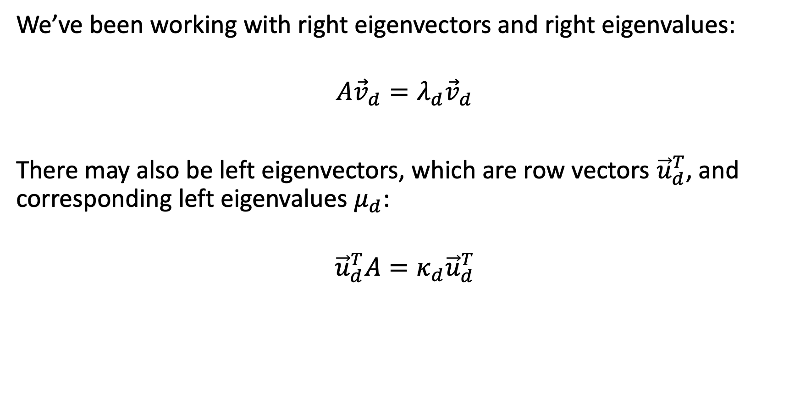
Left and right eigenvectors
We’ve been working with right eigenvectors and right eigenvalues:
$$A{\vec{v}}_{d}=λ_{d}{\vec{v}}_{d}$$
There may also be left eigenvectors, which are row vectors ${\vec{u}}_{d}^{T}$, and corresponding left eigenvalues $μ_{d}$:
$${\vec{u}}_{d}^{T}A=κ_{d}{\vec{u}}_{d}^{T}$$

Slide 16
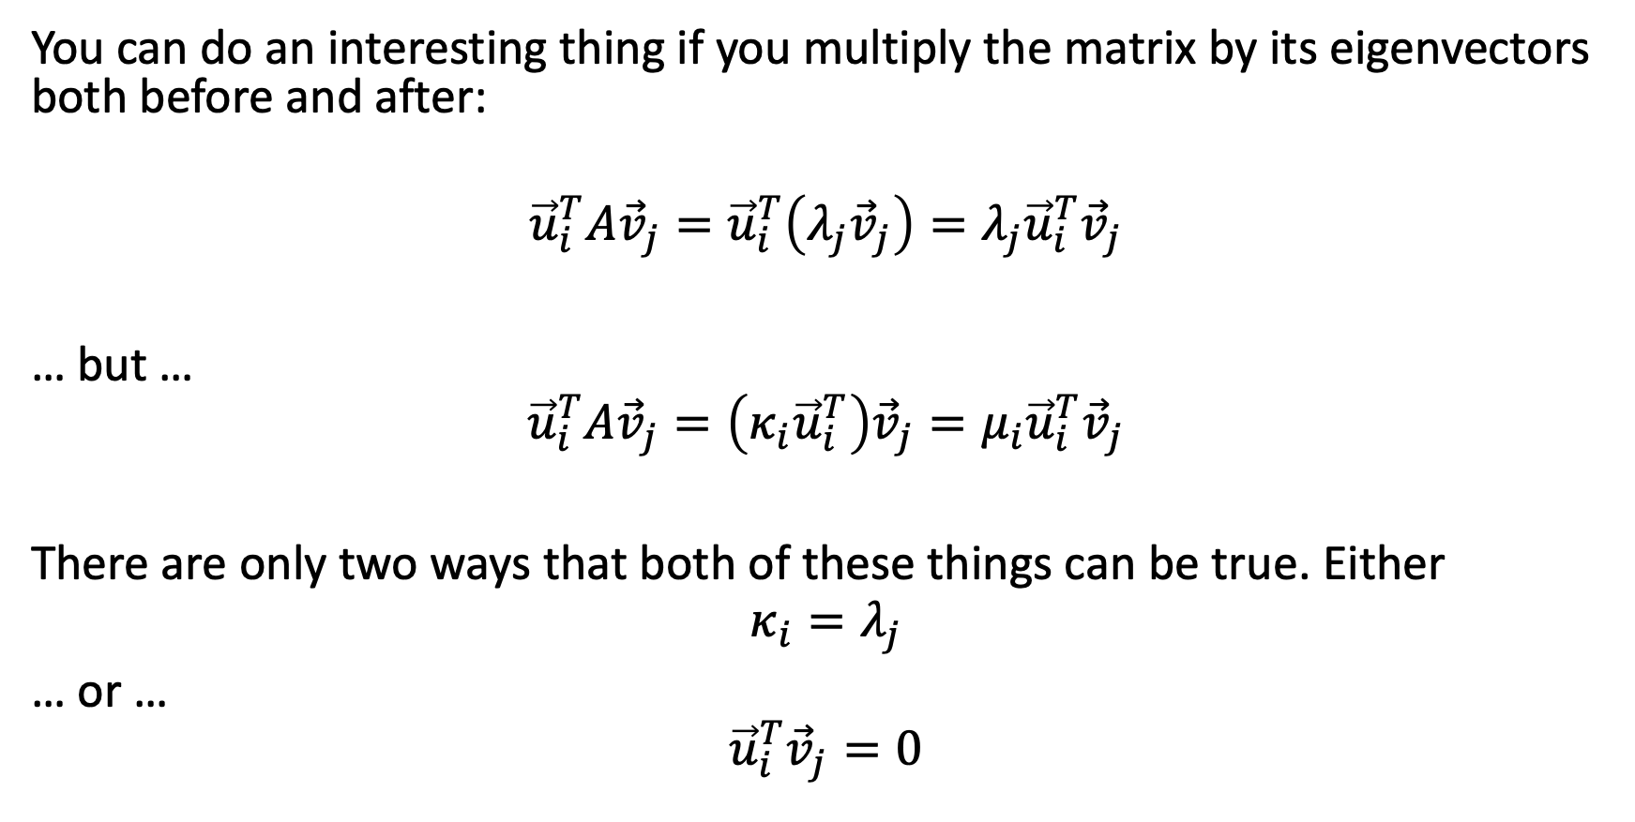
Eigenvectors on both sides of the matrix
You can do an interesting thing if you multiply the matrix by its eigenvectors both before and after:
$${\vec{u}}_{i}^{T}A{\vec{v}}_{j}={\vec{u}}_{i}^{T}\left(λ_{j}{\vec{v}}_{j}\right)=λ_{j}{\vec{u}}_{i}^{T}{\vec{v}}_{j}$$
… but …
$${\vec{u}}_{i}^{T}A{\vec{v}}_{j}=\left(κ_{i}{\vec{u}}_{i}^{T}\right){\vec{v}}_{j}=μ_{i}{\vec{u}}_{i}^{T}{\vec{v}}_{j}$$
There are only two ways that both of these things can be true. Either
$$κ_{i}=λ_{j}$$
… or …
$${\vec{u}}_{i}^{T}{\vec{v}}_{j}=0$$

Slide 17
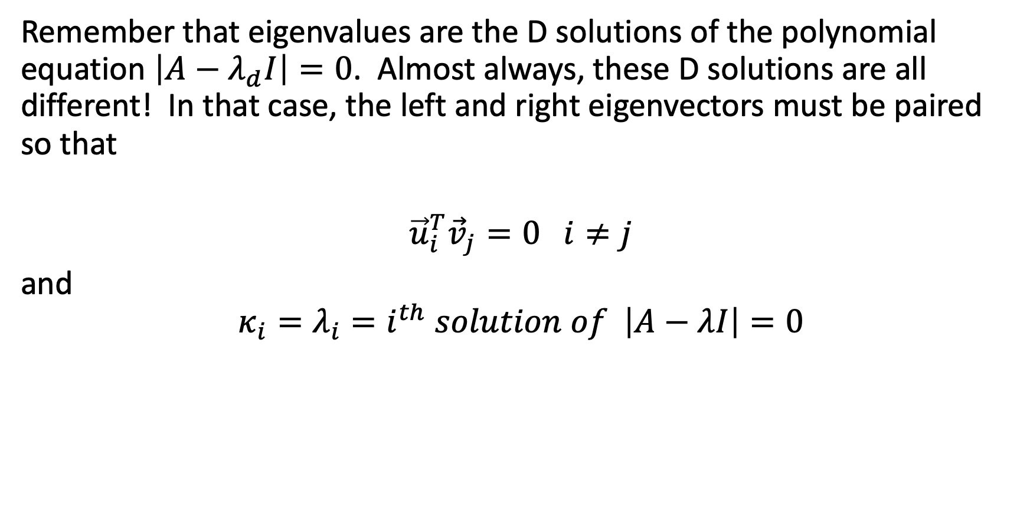
Left and right eigenvectors must be paired!!
Remember that eigenvalues are the D solutions of the polynomial equation $\left|A−λ_{d}I\right|=0$. Almost always, these D solutions are all different! In that case, the left and right eigenvectors must be paired so that
$${\vec{u}}_{i}^{T}{\vec{v}}_{j}=0 i≠j$$
and
$$κ_{i}=λ_{i}=i^{th} solution of \left|A−λI\right|=0$$

Slide 18
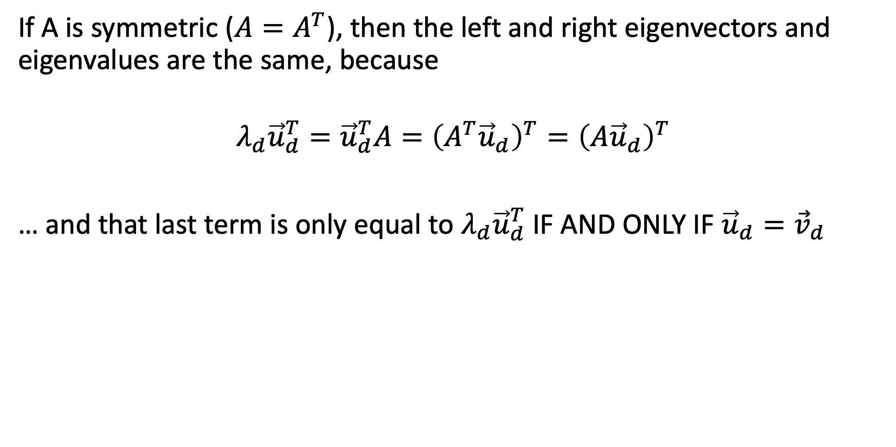
Symmetric matrices: left == right
If A is symmetric ($A=A^{T}$), then the left and right eigenvectors and eigenvalues are the same, because
$${{λ_{d}{\vec{u}}_{d}^{T}={\vec{u}}_{d}^{T}A=\left(A^{T}{\vec{u}}_{d}\right)}^{T}=\left(A{\vec{u}}_{d}\right)}^{T}$$
… and that last term is only equal to $λ_{d}{\vec{u}}_{d}^{T}$ IF AND ONLY IF ${\vec{u}}_{d}={\vec{v}}_{d}$

Slide 19
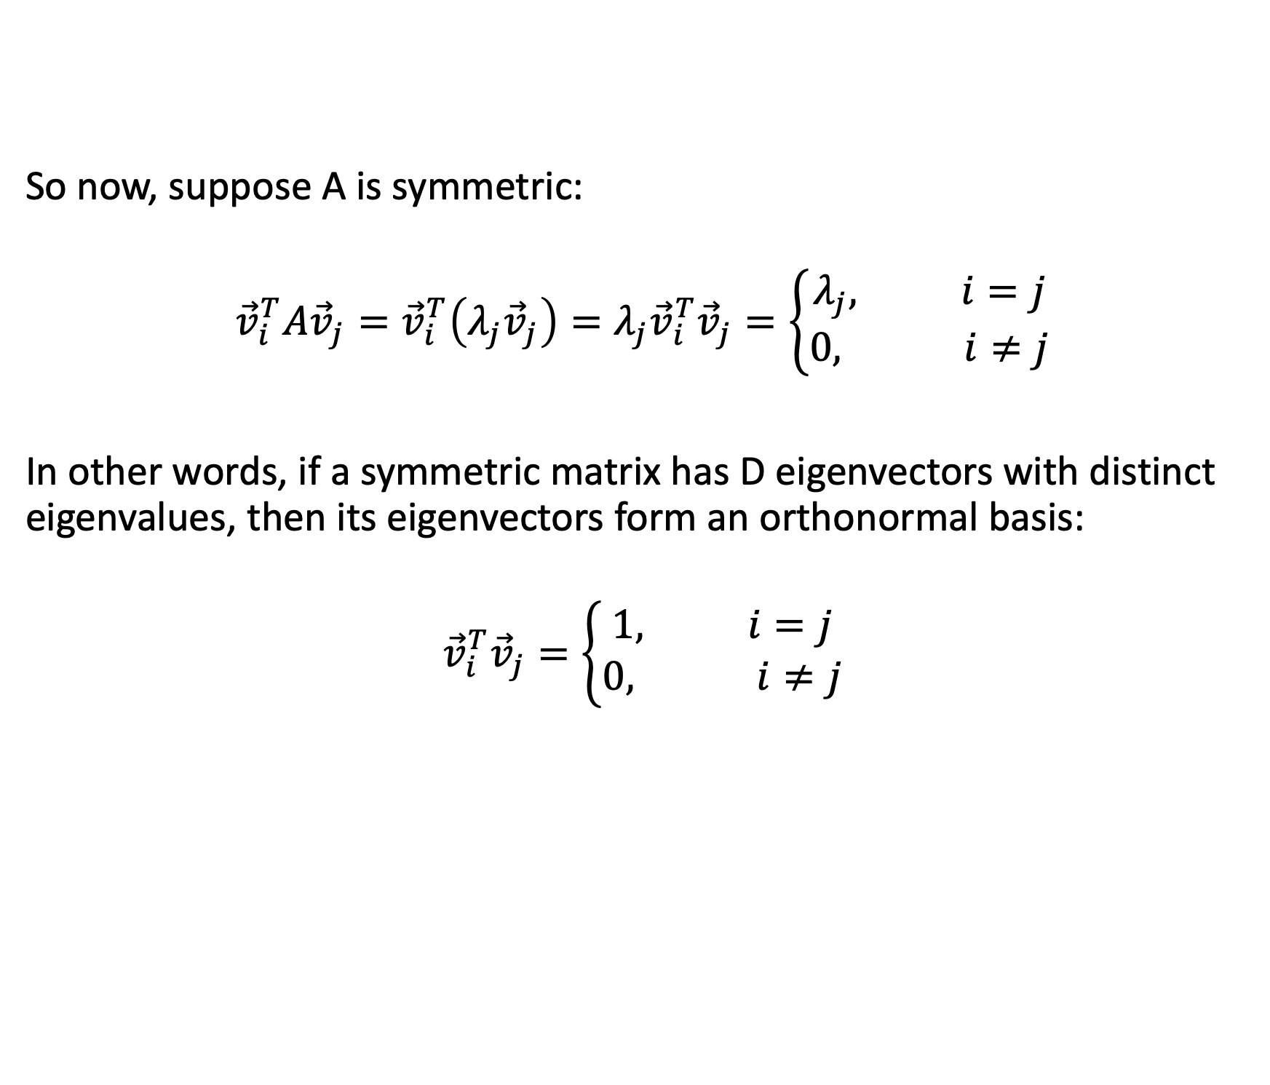
Symmetric matrices have orthonormal eigenvectors
So now, suppose A is symmetric:
$${\vec{v}}_{i}^{T}A{\vec{v}}_{j}={\vec{v}}_{i}^{T}\left(λ_{j}{\vec{v}}_{j}\right)=λ_{j}{\vec{v}}_{i}^{T}{\vec{v}}_{j}=\left\{\begin{aligned}λ_{j}, i=j \\ 0, i≠j\end{aligned}\right.$$
In other words, if a symmetric matrix has D eigenvectors with distinct eigenvalues, then its eigenvectors form an orthonormal basis:
$${\vec{v}}_{i}^{T}{\vec{v}}_{j}=\left\{\begin{aligned}1, i=j \\ 0, i≠j\end{aligned}\right.$$

Slide 20
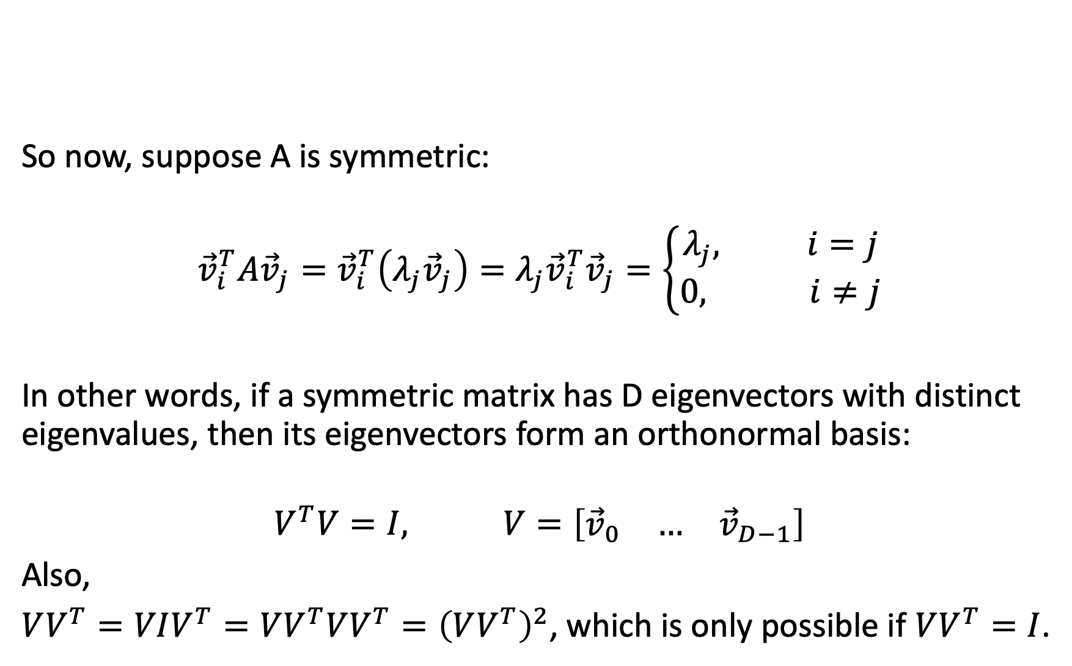
Symmetric matrices have orthonormal eigenvectors
So now, suppose A is symmetric:
$${\vec{v}}_{i}^{T}A{\vec{v}}_{j}={\vec{v}}_{i}^{T}\left(λ_{j}{\vec{v}}_{j}\right)=λ_{j}{\vec{v}}_{i}^{T}{\vec{v}}_{j}=\left\{\begin{aligned}λ_{j}, i=j \\ 0, i≠j\end{aligned}\right.$$
In other words, if a symmetric matrix has D eigenvectors with distinct eigenvalues, then its eigenvectors form an orthonormal basis:
$$V^{T}V=I, V=\left[\begin{matrix}{\vec{v}}_{0} & … & {\vec{v}}_{D−1}\end{matrix}\right]$$
Also,
$VV^{T}=VIV^{T}=VV^{T}VV^{T}={\left(VV^{T}\right)}^{2}$, which is only possible if $VV^{T}=I$.

Slide 21
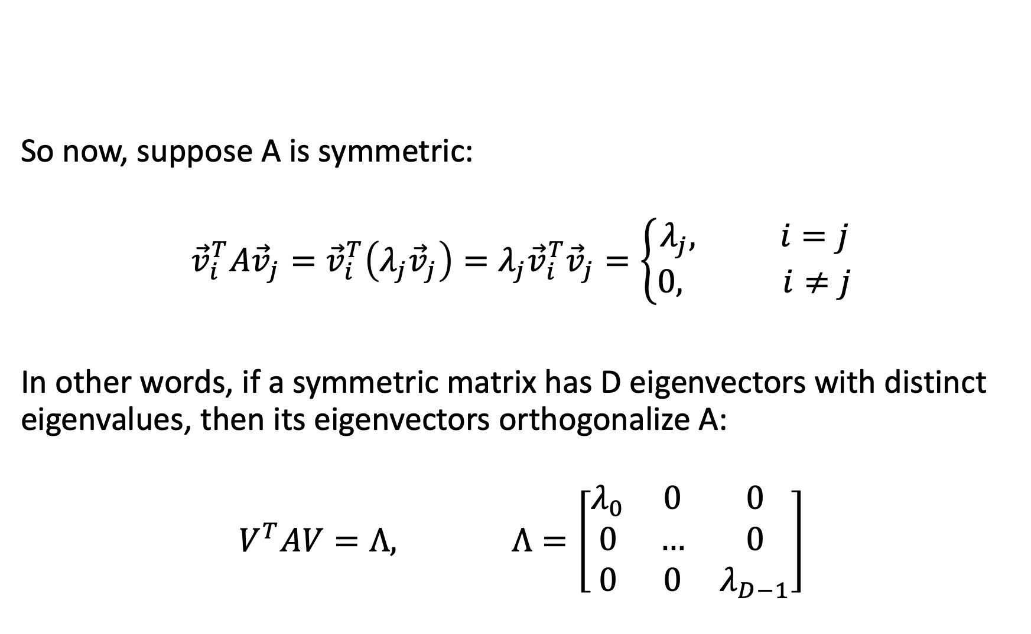
Eigenvectors orthogonalize a symmetric matrix:
So now, suppose A is symmetric:
$${\vec{v}}_{i}^{T}A{\vec{v}}_{j}={\vec{v}}_{i}^{T}\left(λ_{j}{\vec{v}}_{j}\right)=λ_{j}{\vec{v}}_{i}^{T}{\vec{v}}_{j}=\left\{\begin{aligned}λ_{j}, i=j \\ 0, i≠j\end{aligned}\right.$$
In other words, if a symmetric matrix has D eigenvectors with distinct eigenvalues, then its eigenvectors orthogonalize A:
$$V^{T}AV=Λ, Λ=\left[\begin{matrix}λ_{0} & 0 & 0 \\ 0 & … & 0 \\ 0 & 0 & λ_{D−1}\end{matrix}\right]$$

Slide 22
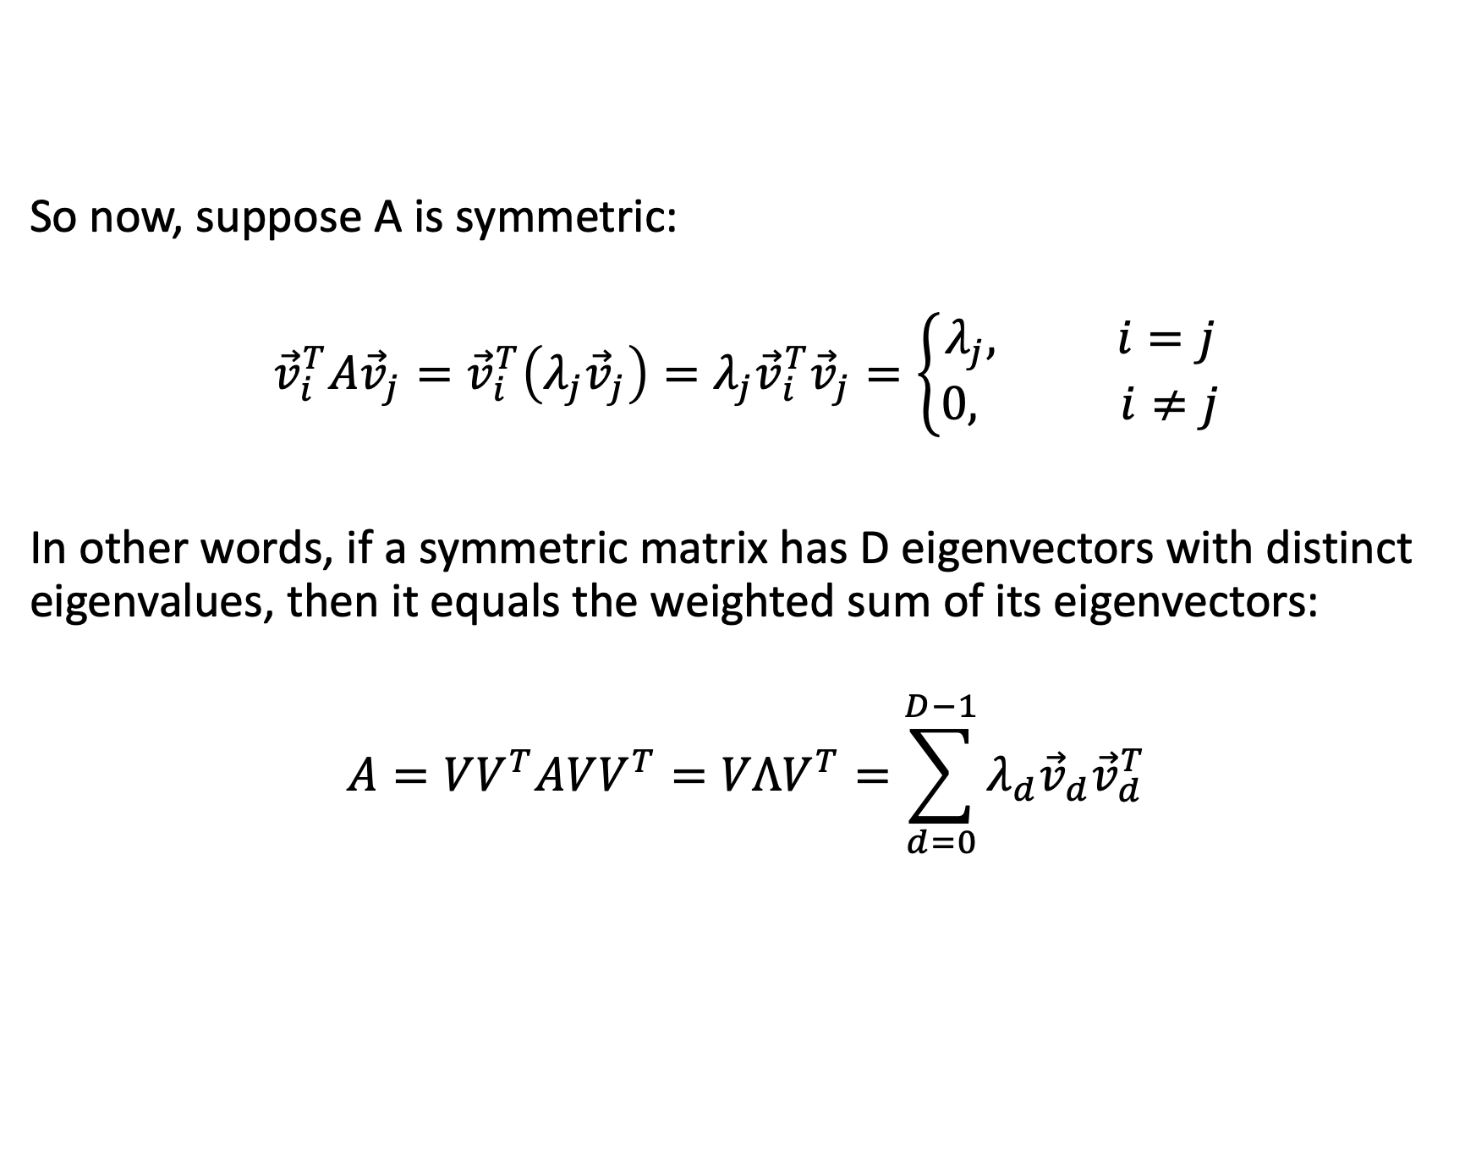
A symmetric matrix is the weighted sum of its eigenvectors:
So now, suppose A is symmetric:
$${\vec{v}}_{i}^{T}A{\vec{v}}_{j}={\vec{v}}_{i}^{T}\left(λ_{j}{\vec{v}}_{j}\right)=λ_{j}{\vec{v}}_{i}^{T}{\vec{v}}_{j}=\left\{\begin{aligned}λ_{j}, i=j \\ 0, i≠j\end{aligned}\right.$$
In other words, if a symmetric matrix has D eigenvectors with distinct eigenvalues, then it equals the weighted sum of its eigenvectors:
$$A=VV^{T}AVV^{T}=VΛV^{T}=\sum_{d=0}^{D−1}{λ_{d}{\vec{v}}_{d}{\vec{v}}_{d}^{T}}$$

Slide 23

Summary: properties of symmetric matrices
If A is symmetric with D eigenvectors, and D distinct eigenvalues, then
$$A=VΛV^{T}$$
$$Λ=V^{T}AV$$
$$VV^{T}=V^{T}V=I$$

Slide 24
Content
Linear transforms
Eigenvectors
Eigenvalues
Symmetric matrices
Gaussian random vectors
Principal component axes = eigenvectors of the covariance
Gram matrix
Singular value decomposition

Slide 25
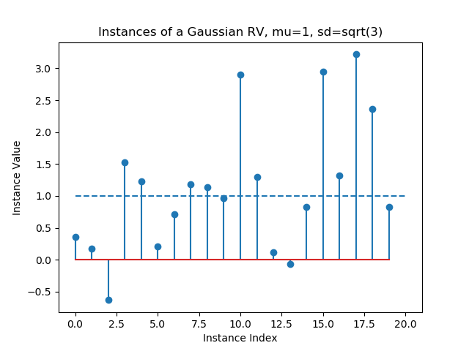

Scalar Gaussian Random Variables
$$μ=E\left[x\right]$$
$$σ^{2}=E\left[{\left(x−μ\right)}^{2}\right]$$

Slide 26
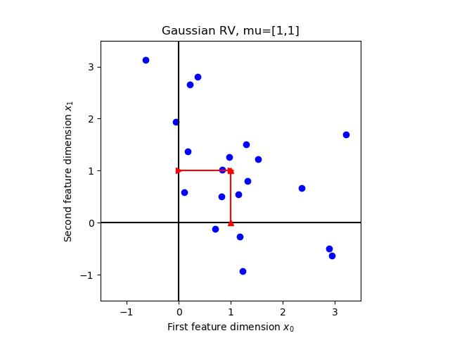

Gaussian Random Vector
$$\vec{x}=\left[\begin{matrix}x_{0} \\ ⋮ \\ x_{D−1}\end{matrix}\right],\vec{μ}=\left[\begin{matrix}μ_{0} \\ ⋮ \\ μ_{D−1}\end{matrix}\right]$$
$$\vec{μ}=E\left[\vec{x}\right]$$

Slide 27
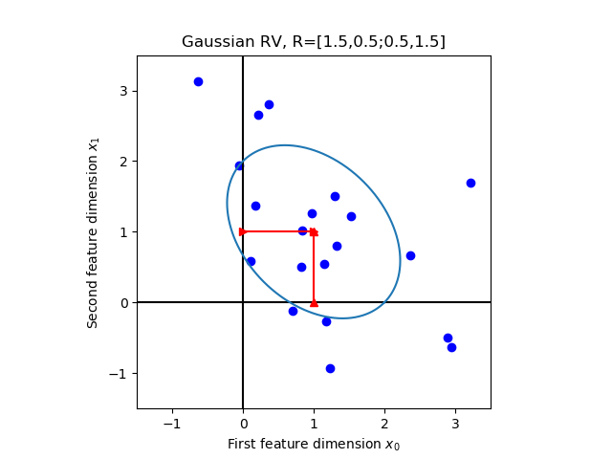
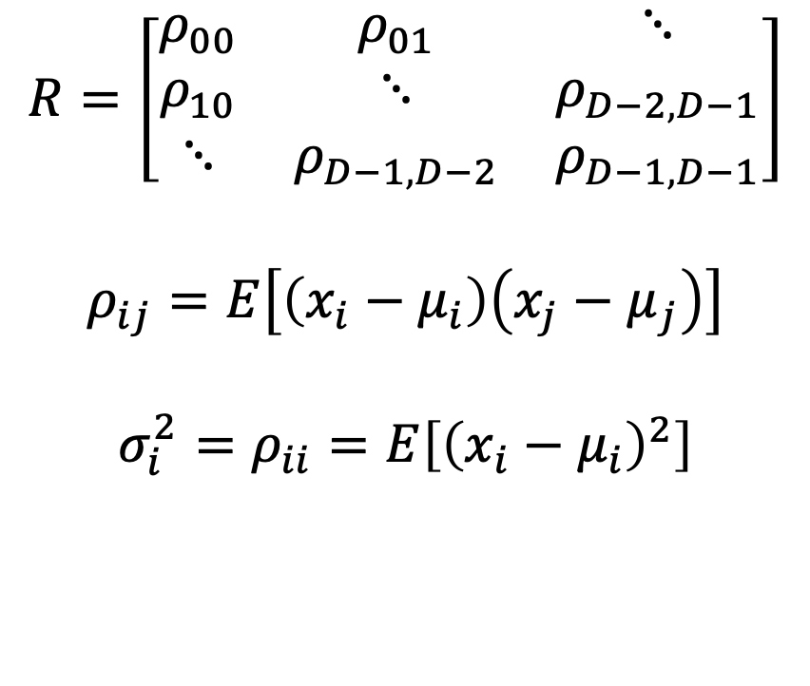
Gaussian Random Vector
$$R=\left[\begin{matrix}ρ_{00} & ρ_{01} & ⋱ \\ ρ_{10} & ⋱ & ρ_{D−2,D−1} \\ ⋱ & ρ_{D−1,D−2} & ρ_{D−1,D−1}\end{matrix}\right]$$
$$ρ_{ij}=E\left[\left(x_{i}−μ_{i}\right)\left(x_{j}−μ_{j}\right)\right]$$
$$σ_{i}^{2}=ρ_{ii}=E\left[{\left(x_{i}−μ_{i}\right)}^{2}\right]$$

Slide 28
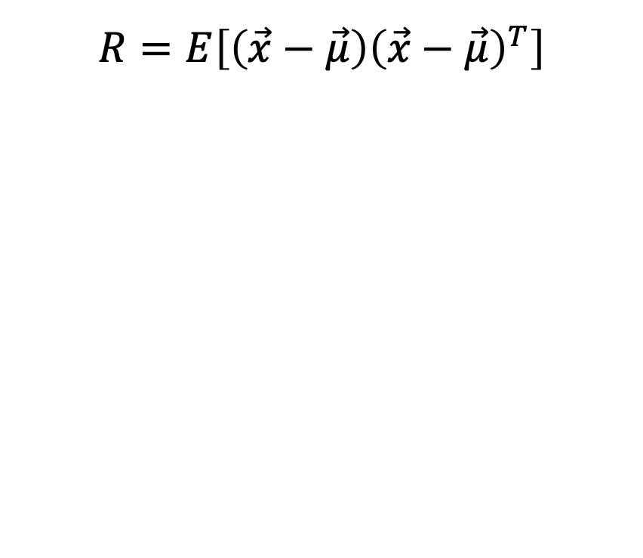
Gaussian Random Vector
$$R=E\left[\left(\vec{x}−\vec{μ}\right){\left(\vec{x}−\vec{μ}\right)}^{T}\right]$$

Slide 29
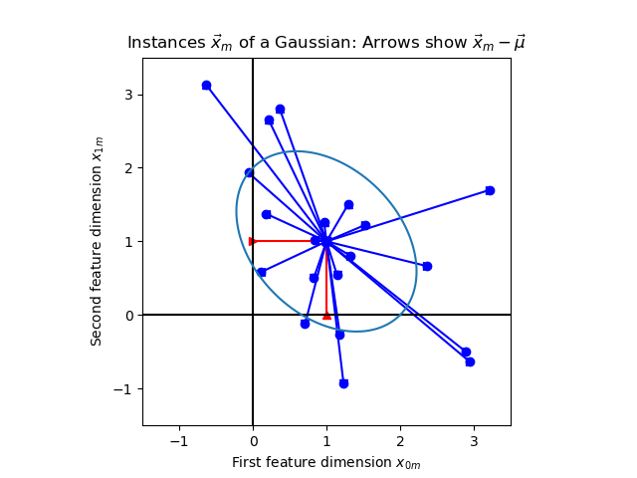
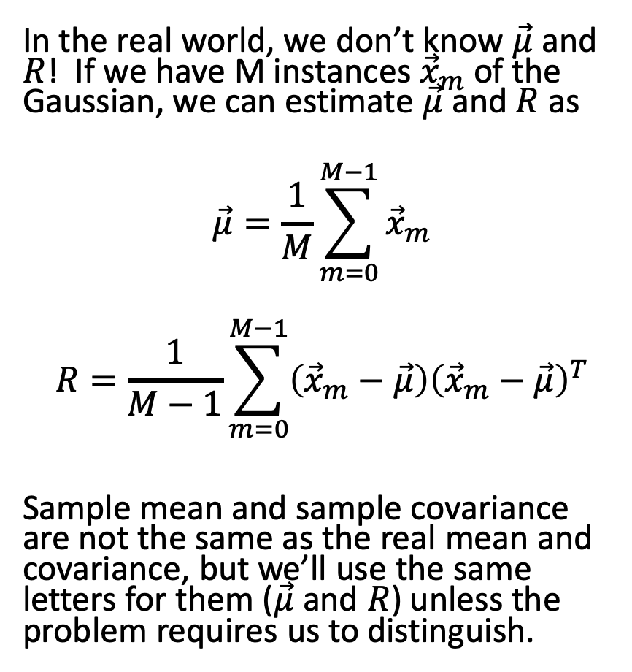
Sample Mean, Sample Covariance
In the real world, we don’t know $\vec{μ}$ and $R$! If we have M instances ${\vec{x}}_{m}$of the Gaussian, we can estimate $\vec{μ}$ and $R$ as
$$\vec{μ}=\frac{1}{M}\sum_{m=0}^{M−1}{{\vec{x}}_{m}}$$
$$R=\frac{1}{M−1}\sum_{m=0}^{M−1}{\left({\vec{x}}_{m}−\vec{μ}\right){\left({\vec{x}}_{m}−\vec{μ}\right)}^{T}}$$
Sample mean and sample covariance are not the same as the real mean and covariance, but we’ll use the same letters for them ($\vec{μ}$ and $R$) unless the problem requires us to distinguish.

Slide 30
Content
Linear transforms
Eigenvectors
Eigenvalues
Symmetric matrices
Gaussian random vectors
Principal component axes = eigenvectors of the covariance
Gram matrix
Singular value decomposition

Slide 31
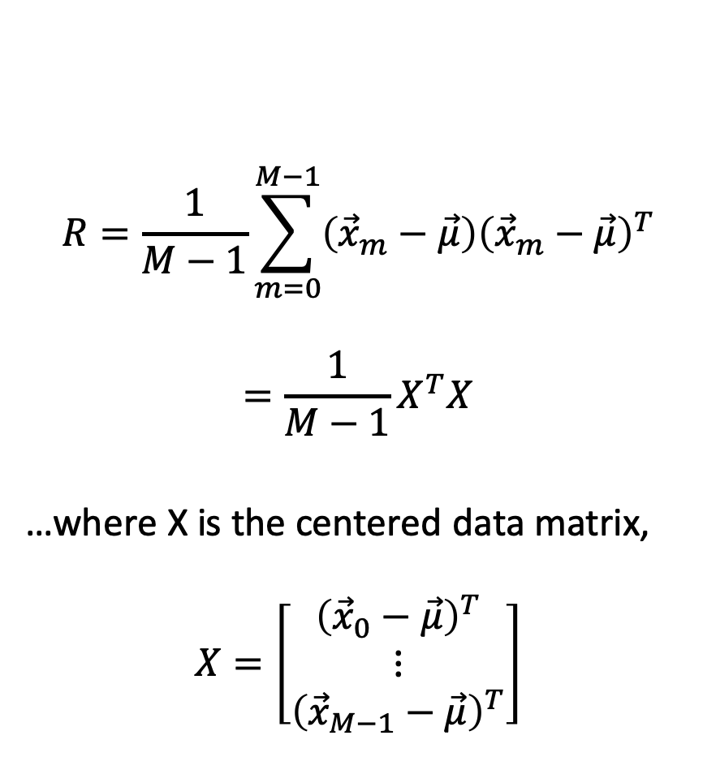
Sample Covariance
$$R=\frac{1}{M−1}\sum_{m=0}^{M−1}{\left({\vec{x}}_{m}−\vec{μ}\right){\left({\vec{x}}_{m}−\vec{μ}\right)}^{T}}$$
$$=\frac{1}{M−1}X^{T}X$$
…where X is the centered data matrix,
$$X=\left[\begin{matrix}{\left({\vec{x}}_{0}−\vec{μ}\right)}^{T} \\ ⋮ \\ {\left({\vec{x}}_{M−1}−\vec{μ}\right)}^{T}\end{matrix}\right]$$

Slide 32
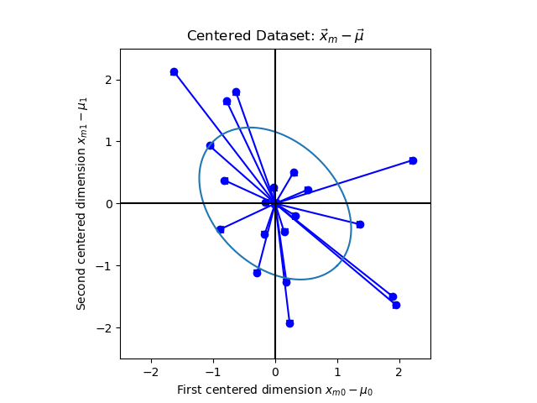

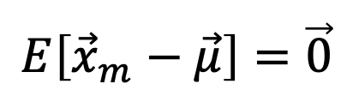
Centered Data Matrix
$$X=\left[\begin{matrix}{\left({\vec{x}}_{0}−\vec{μ}\right)}^{T} \\ ⋮ \\ {\left({\vec{x}}_{M−1}−\vec{μ}\right)}^{T}\end{matrix}\right]$$
$$E\left[{\vec{x}}_{m}−\vec{μ}\right]=\vec{0}$$

Slide 33
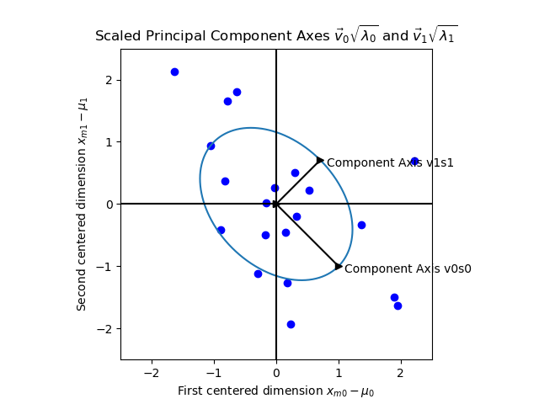
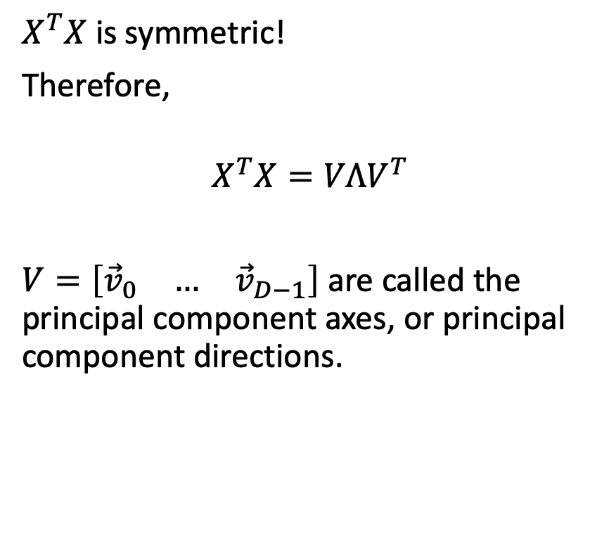
Principal Component Axes
$X^{T}X$ is symmetric!
Therefore,
$$X^{T}X=VΛV^{T}$$
$V=\left[\begin{matrix}{\vec{v}}_{0} & … & {\vec{v}}_{D−1}\end{matrix}\right]$ are called the principal component axes, or principal component directions.

Slide 34
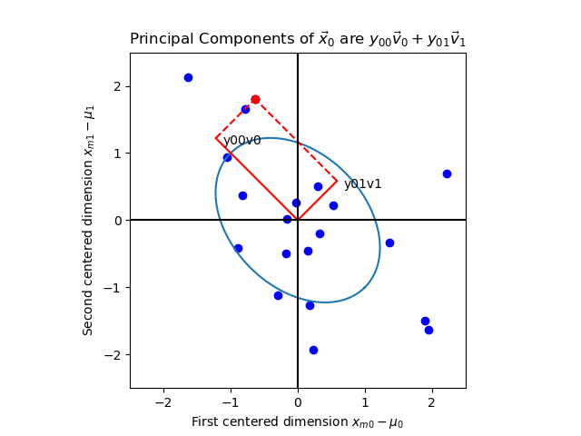
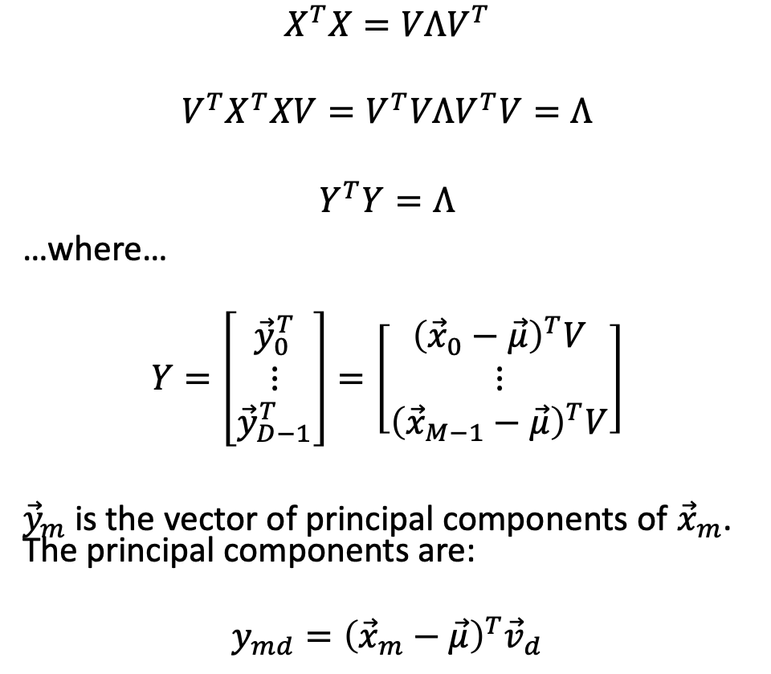
Principal Components
$$X^{T}X=VΛV^{T}$$
$${V^{T}X}^{T}XV=V^{T}VΛV^{T}V=Λ$$
$$Y^{T}Y=Λ$$
…where…
$$Y=\left[\begin{matrix}{\vec{y}}_{0}^{T} \\ ⋮ \\ {\vec{y}}_{D−1}^{T}\end{matrix}\right]=\left[\begin{matrix}{\left({\vec{x}}_{0}−\vec{μ}\right)}^{T}V \\ ⋮ \\ {\left({\vec{x}}_{M−1}−\vec{μ}\right)}^{T}V\end{matrix}\right]$$
${\vec{y}}_{m}$ is the vector of principal components of ${\vec{x}}_{m}$. The principal components are:
$$y_{md}={\left({\vec{x}}_{m}−\vec{μ}\right)}^{T}{\vec{v}}_{d}$$

Slide 35
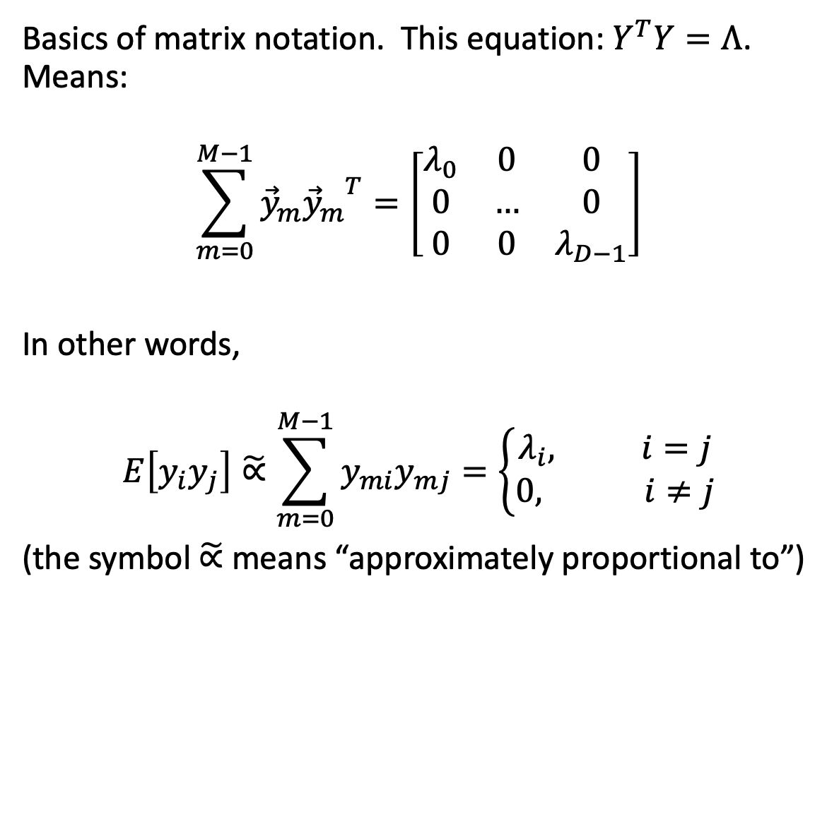
Principal Components are Uncorrelated
Basics of matrix notation. This equation: $Y^{T}Y=Λ$. Means:
$$\sum_{m=0}^{M−1}{{\vec{y}}_{m}{{\vec{y}}_{m}}^{T}}=\left[\begin{matrix}λ_{0} & 0 & 0 \\ 0 & … & 0 \\ 0 & 0 & λ_{D−1}\end{matrix}\right]$$
In other words,
$$E\left[y_{i}y_{j}\right]\tilde{∝}\sum_{m=0}^{M−1}{y_{mi}y_{mj}}=\left\{\begin{aligned}λ_{i}, i=j \\ 0, i≠j\end{aligned}\right.$$
(the symbol $\tilde{∝}$ means “approximately proportional to”)

Slide 36


Eigenvalue $∝$ Variance of the Principal Component
More precisely, the sample covariance of principal components $y_{i}$ and $y_{j}$ is 0, unless $i=j$, in which case
$$\frac{1}{M−1}\sum_{m=0}^{M−1}{y_{mi}^{2}}=\frac{λ_{i}}{M−1}$$

Slide 37
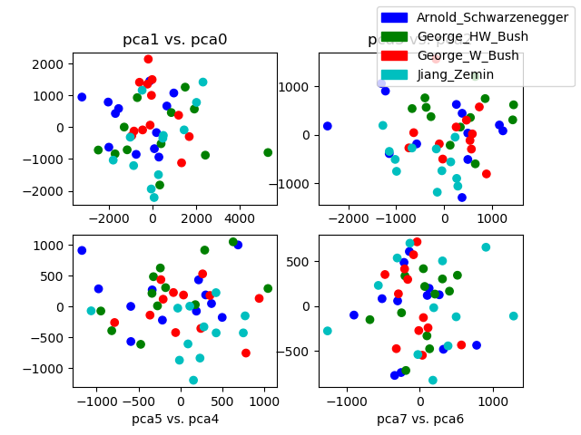

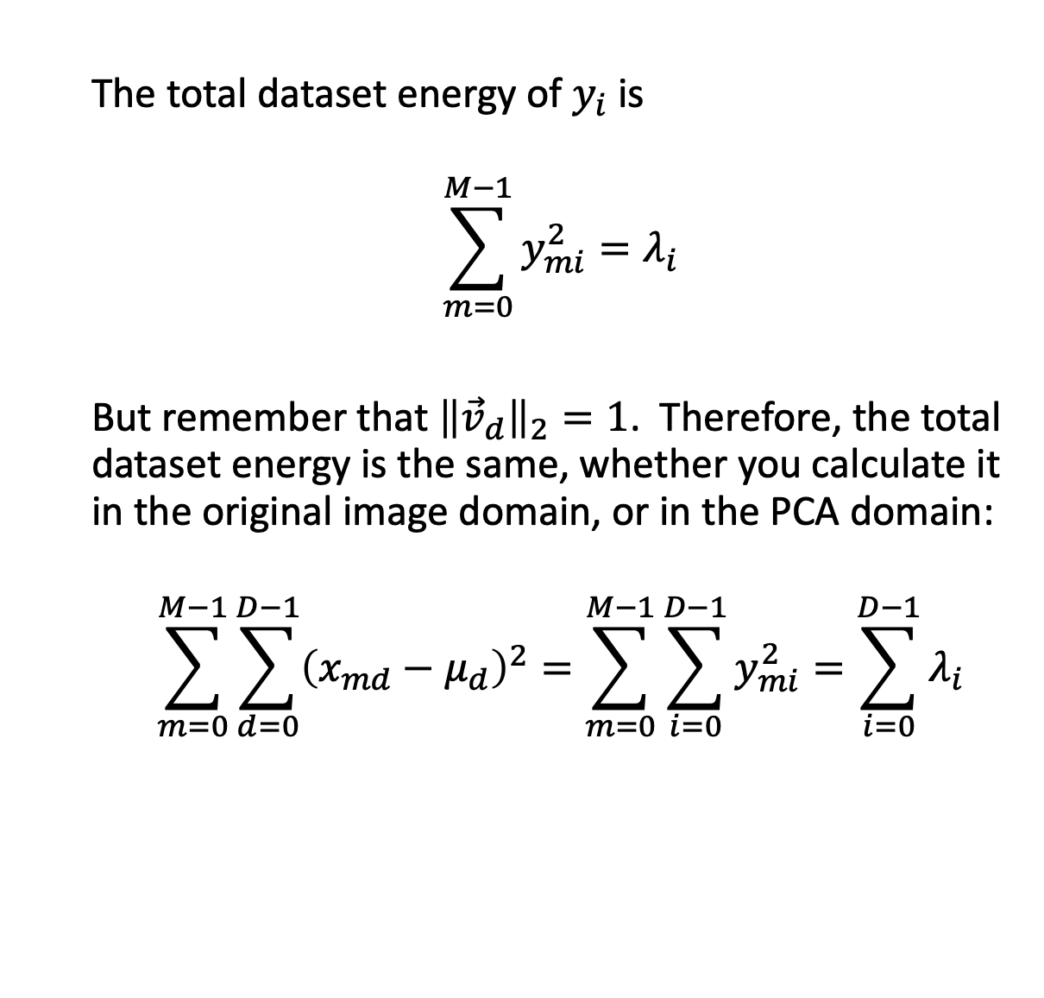
Eigenvalue $=$ Energy of the Principal Component
The total dataset energy of $y_{i}$ is
$$\sum_{m=0}^{M−1}{y_{mi}^{2}}=λ_{i}$$
But remember that ${\left\|{\vec{v}}_{d}\right\|}_{2}=1$. Therefore, the total dataset energy is the same, whether you calculate it in the original image domain, or in the PCA domain:
$$\sum_{m=0}^{M−1}{\sum_{d=0}^{D−1}{{\left(x_{md}−μ_{d}\right)}^{2}}}=\sum_{m=0}^{M−1}{\sum_{i=0}^{D−1}{y_{mi}^{2}}}=\sum_{i=0}^{D−1}{λ_{i}}$$

Slide 38
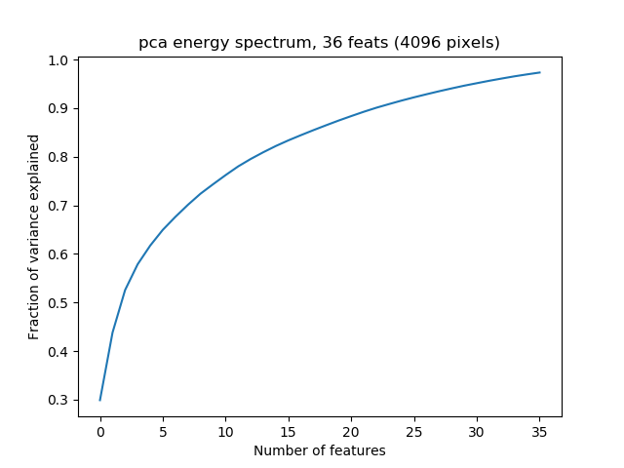
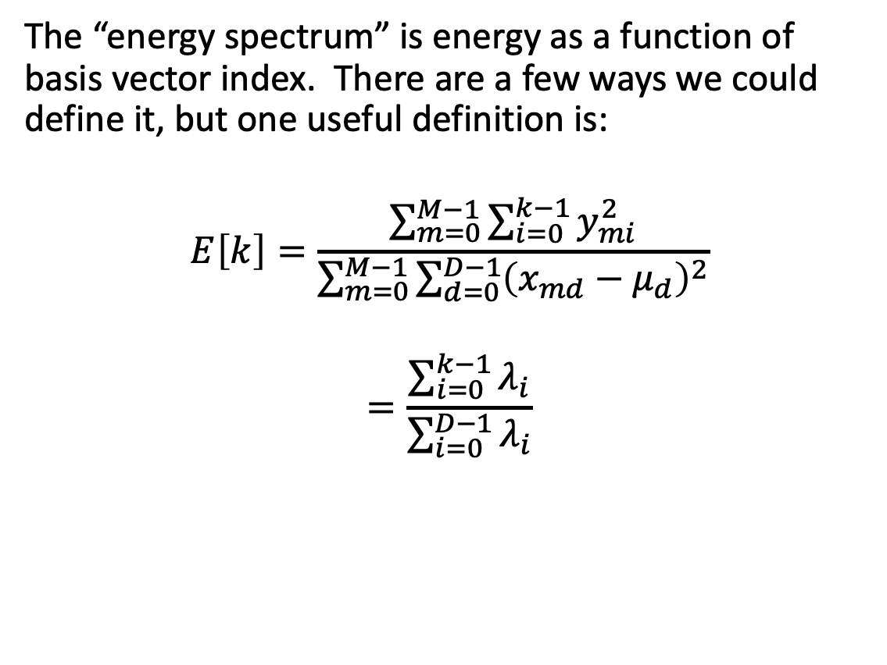
Energy Spectrum = Fraction of Energy Explained
The “energy spectrum” is energy as a function of basis vector index. There are a few ways we could define it, but one useful definition is:
$$E\left[k\right]=\frac{\sum_{m=0}^{M−1}{\sum_{i=0}^{k−1}{y_{mi}^{2}}}}{\sum_{m=0}^{M−1}{\sum_{d=0}^{D−1}{{\left(x_{md}−μ_{d}\right)}^{2}}}}$$
$$=\frac{\sum_{i=0}^{k−1}{λ_{i}}}{\sum_{i=0}^{D−1}{λ_{i}}}$$

Slide 39
Content
Linear transforms
Eigenvectors
Eigenvalues
Symmetric matrices
Gaussian random vectors
Principal component axes = eigenvectors of the covariance
Gram matrix
Singular value decomposition

Slide 40
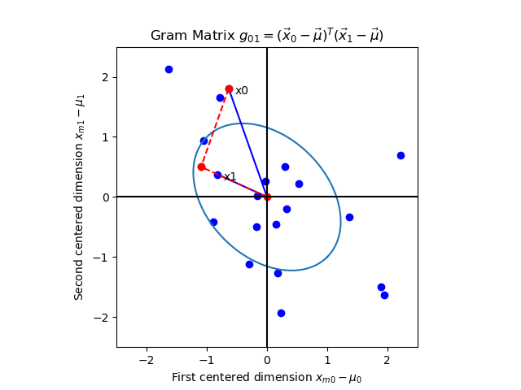
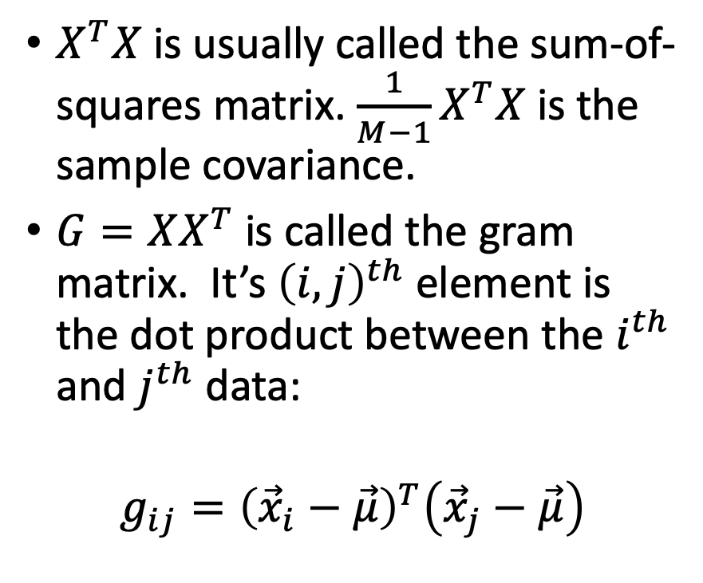
Gram Matrix
$X^{T}X$ is usually called the sum-of-squares matrix. $\frac{1}{M−1}X^{T}X$ is the sample covariance.
$G=XX^{T}$ is called the gram matrix. It’s ${\left(i,j\right)}^{th}$ element is the dot product between the $i^{th}$ and $j^{th}$ data:
$$g_{ij}={\left({\vec{x}}_{i}−\vec{μ}\right)}^{T}\left({\vec{x}}_{j}−\vec{μ}\right)$$

Slide 41
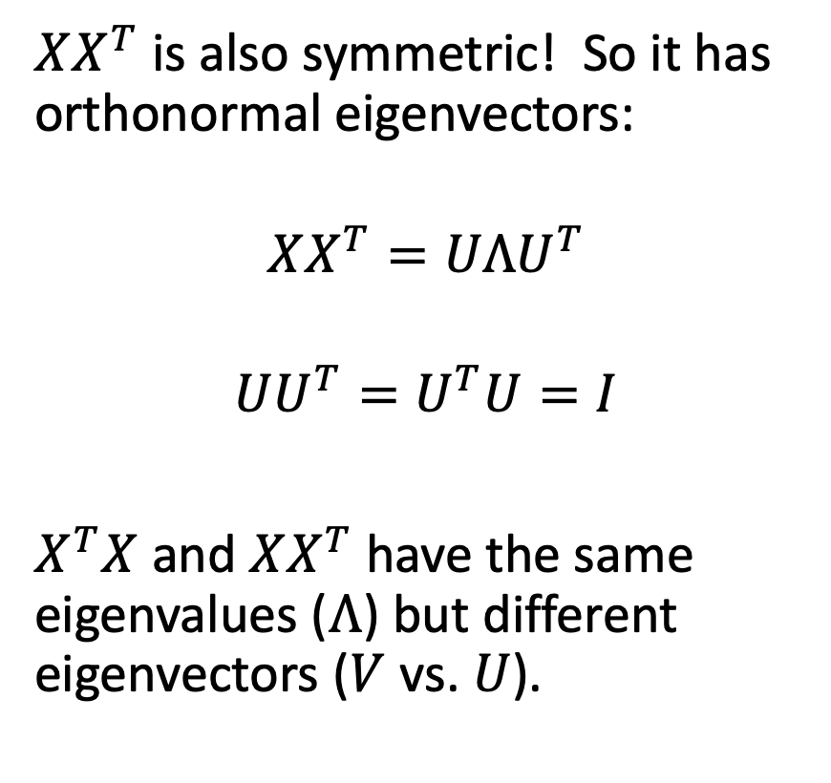
Eigenvectors of the Gram Matrix
$XX^{T}$ is also symmetric! So it has orthonormal eigenvectors:
$$XX^{T}=UΛU^{T}$$
$$UU^{T}=U^{T}U=I$$
$X^{T}X$ and $XX^{T}$ have the same eigenvalues ($Λ$) but different eigenvectors ($V$ vs. $U$).

Slide 42
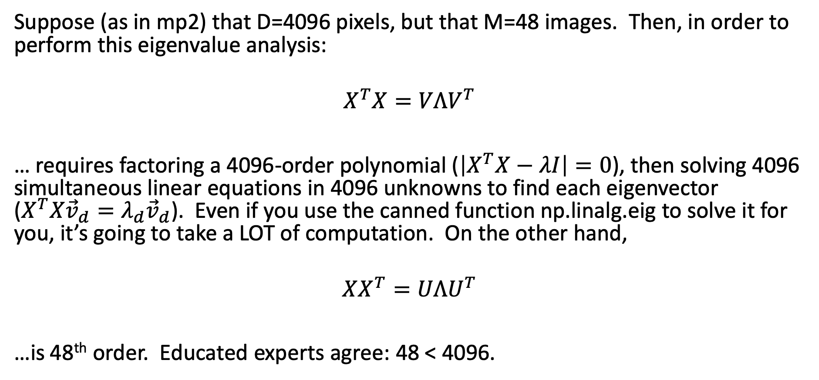
Why the Gram matrix is useful…
Suppose (as in mp2) that D=4096 pixels, but that M=48 images. Then, in order to perform this eigenvalue analysis:
$$X^{T}X=VΛV^{T}$$
… requires factoring a 4096-order polynomial ($\left|X^{T}X−λI\right|=0$), then solving 4096 simultaneous linear equations in 4096 unknowns to find each eigenvector ($X^{T}X{\vec{v}}_{d}=λ_{d}{\vec{v}}_{d}$). Even if you use the canned function np.linalg.eig to solve it for you, it’s going to take a LOT of computation. On the other hand,
$$XX^{T}=UΛU^{T}$$
…is 48th order. Educated experts agree: 48 < 4096.

Slide 43
Content
Linear transforms
Eigenvectors
Eigenvalues
Symmetric matrices
Gaussian random vectors
Principal component axes = eigenvectors of the covariance
Gram matrix
Singular value decomposition

Slide 44
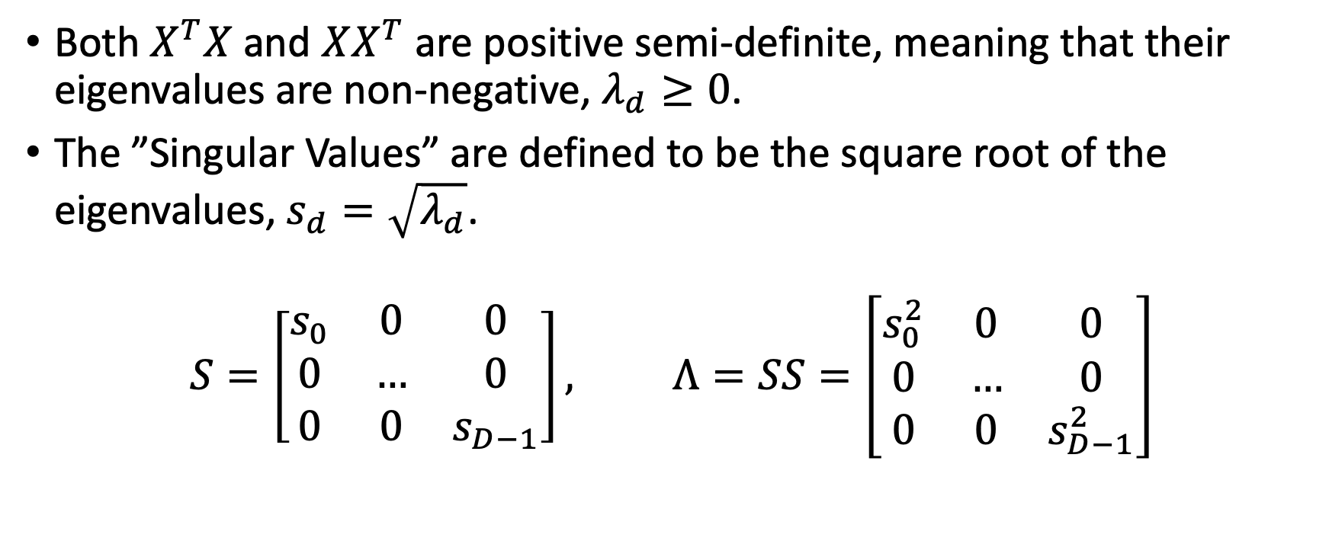
Singular Values
Both $X^{T}X$ and $XX^{T}$ are positive semi-definite, meaning that their eigenvalues are non-negative, $λ_{d}≥0$.
The ”Singular Values” are defined to be the square root of the eigenvalues, $s_{d}=\sqrt{λ_{d}}$.
$$S=\left[\begin{matrix}s_{0} & 0 & 0 \\ 0 & … & 0 \\ 0 & 0 & s_{D−1}\end{matrix}\right], Λ=SS=\left[\begin{matrix}s_{0}^{2} & 0 & 0 \\ 0 & … & 0 \\ 0 & 0 & s_{D−1}^{2}\end{matrix}\right]$$

Slide 45

Singular Value Decomposition
$$\left(M−1\right)R=X^{T}X=VΛV^{T}=VSSV^{T}$$
$$G=XX^{T}=UΛU^{T}=USSU^{T}$$

Slide 46

Singular Value Decomposition
$$X^{T}X=VSSV^{T}=VSISV^{T}=VSU^{T}USV^{T}$$
$$XX^{T}=USSU^{T}=USISU^{T}=USV^{T}VSU^{T}$$

Slide 47
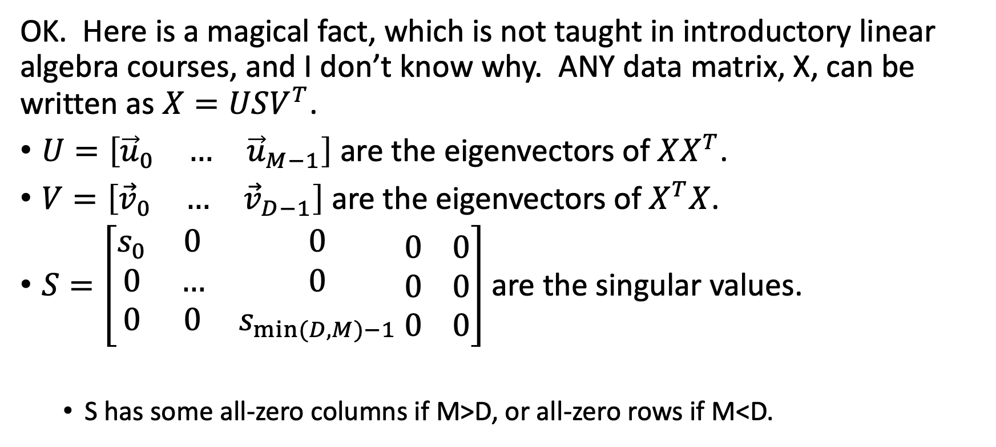
Singular Value Decomposition
OK. Here is a magical fact, which is not taught in introductory linear algebra courses, and I don’t know why. ANY data matrix, X, can be written as $X=USV^{T}$.
$U=\left[\begin{matrix}{\vec{u}}_{0} & … & {\vec{u}}_{M−1}\end{matrix}\right]$ are the eigenvectors of $XX^{T}$.
$V=\left[\begin{matrix}{\vec{v}}_{0} & … & {\vec{v}}_{D−1}\end{matrix}\right]$ are the eigenvectors of $X^{T}X$.
$S=\left[\begin{matrix}s_{0} & 0 & 0 \\ 0 & … & 0 \\ 0 & 0 & s_{min⁡(D,M)−1}\end{matrix} \begin{matrix}0 \\ 0 \\ 0\end{matrix} \begin{matrix}0 \\ 0 \\ 0\end{matrix}\right]$ are the singular values.
  S has some all-zero columns if M>D, or all-zero rows if M<D.

Slide 48

What np.linalg.svd does
First, decide whether you want to find the eigenvectors of $XX^{T}$ or of $X^{T}X$: just check to see which one is larger. If you discover that 4096>48, then compute $XX^{T}=UΛU^{T}$, and $S=\sqrt{Λ}$. Then you find $V$ as follows:
$$X^{T}=VSU^{T}$$
$$X^{T}U=VS$$
$$X^{T}US^{−1}=V$$

Slide 49

Methods that solve mp2
Direct eigenvector analysis of $X^{T}X=VΛV^{T}$ gives the right answer, but takes a very long time. When I tried this, it timed-out the autograder.
Applying np.linalg.svd to $X$ gives the right answer, very fast.
This also works, and is actually just as fast as np.linalg.svd (I tested it): you can apply np.linalg.eig to the gram matrix $G=XX^{T}$, then compute $V^{T}=S^{−1}U^{T}X$.

