Slide 1
A review of Facial Animation
ECE 417 guest lecture
Nov. 29, 2018
Kevin Gu

Slide 2
Content
Rule-based animation synthesis
Data-driven animation synthesis
  Appearance based approach
  Control Point based approach
Related papers
Dataset & Toolset

Slide 3
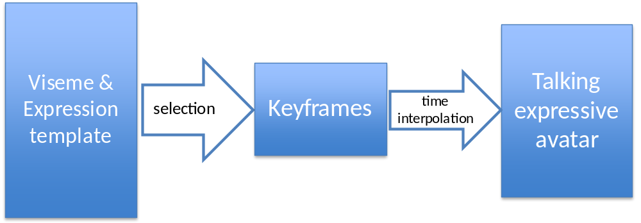
Rule-based animation synthesis
Goal: given text input, generate facial animation
Rule-based: for each viseme, find the corresponding facial gesture,
then concatenate to generate animation.

Slide 4
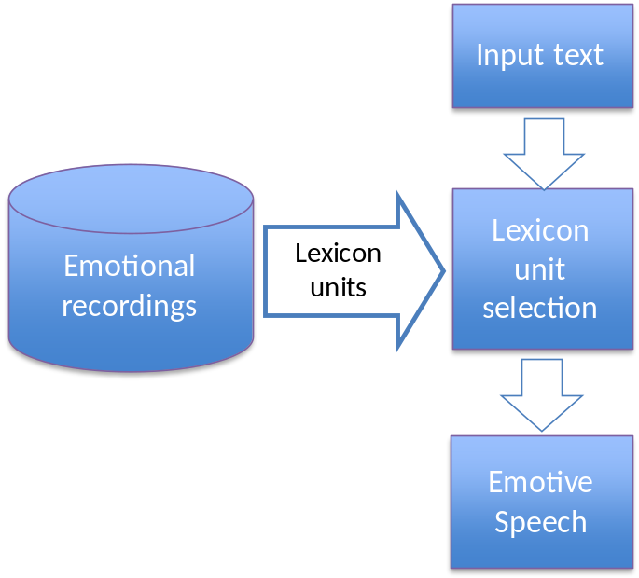
Rule-based animation synthesis
Video synthesis
  Facial expression controlled by
  templates
  Select appropriate template
  based on emotion and viseme
Audio synthesis
  Real person speech recording.
  Record different emotions
  Unit Selection method

Slide 5
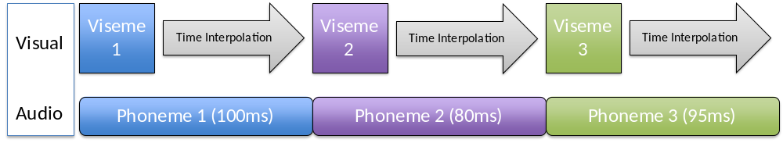
Rule-based animation synthesis
Audio-Video sync
  Sync by keyframes
  Animation generated by
  time interpolation

Slide 6
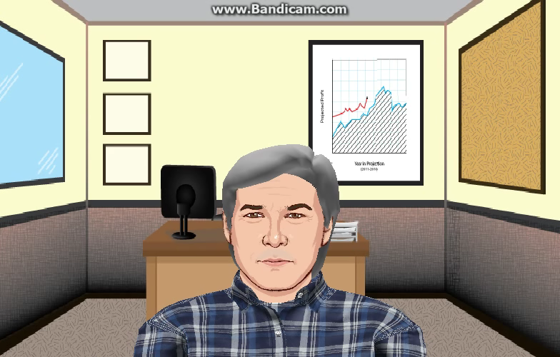
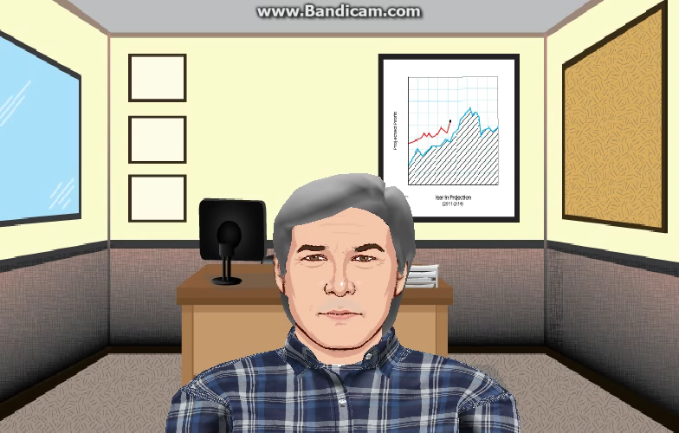
Rule-based animation synthesis
Demos
Low risk High risk

Slide 7
Rule-based animation synthesis
Advantages
  No training required.
  Generalize to different person.
  Less computation
Disadvantages
  Coarticulation effect not considered
  Conceptually isolated speech sound is influenced by, and becomes more like, a preceding or following speech sound.
Solution
  Diphone, Triphone
  Data-driven

Slide 8
Data-driven animation synthesis
Advantages
  No hand-crafted templates/features
  Learn the pattern from large among of data
  Able to model higher level dependencies between visemes
  Easier to implement
Disadvantages
  Data hungry
  Computationally heavy
  Generalization to different person

Slide 9
Data-driven animation synthesis
“Dynamic Units of Visual Speech”
  Templates corresponds to animation sequences (instead of a single viseme)
  Concatenate animation sequences.
  AAM (Activate-Appearance-Model) parameterization.
Taylor, S. L., Mahler, M., Theobald, B. J., & Matthews, I. (2012, July). Dynamic units of visual speech. In Proceedings of the ACM SIGGRAPH/Eurographics Symposium on Computer Animation (pp. 275-284). Eurographics Association.

Slide 10
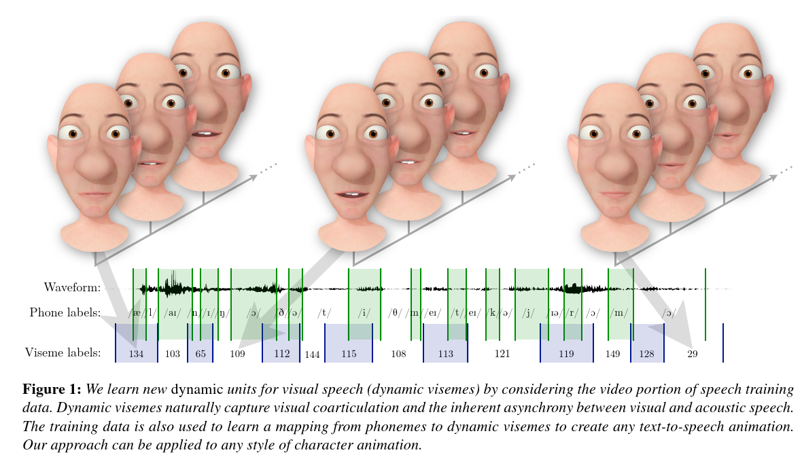
Data-driven animation synthesis
“Dynamic Units of Visual Speech”
Taylor, S. L., Mahler, M., Theobald, B. J., & Matthews, I. (2012, July). Dynamic units of visual speech. In Proceedings of the ACM SIGGRAPH/Eurographics Symposium on Computer Animation (pp. 275-284). Eurographics Association.

Slide 11
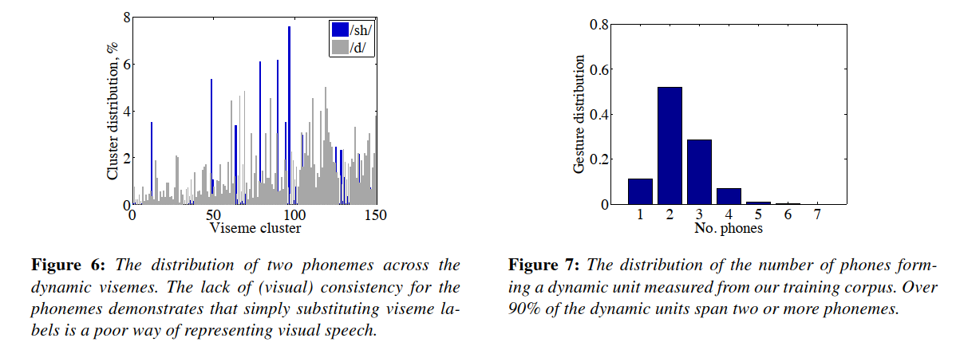
Data-driven animation synthesis
Dynamic Units of Visual Speech
Taylor, S. L., Mahler, M., Theobald, B. J., & Matthews, I. (2012, July). Dynamic units of visual speech. In Proceedings of the ACM SIGGRAPH/Eurographics Symposium on Computer Animation (pp. 275-284). Eurographics Association.
Train AAM Model
Segment animation seq based on
salient points along the trajectory
Cluster segmented seq.
Notes:
Taylor, S. L., Mahler, M., Theobald, B. J., & Matthews, I. (2012, July). Dynamic units of visual speech. In Proceedings of the ACM SIGGRAPH/Eurographics Symposium on Computer Animation (pp. 275-284). Eurographics Association.

Slide 12
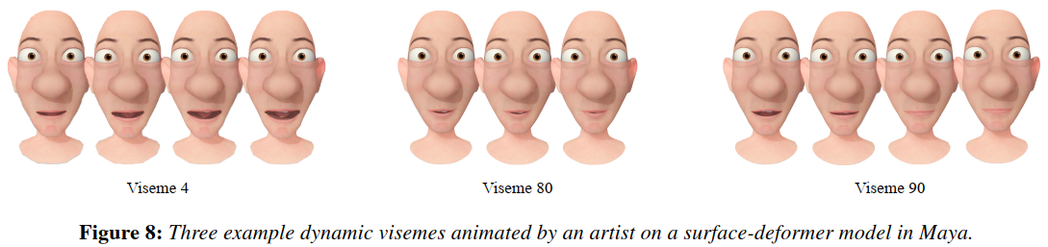
Data-driven animation synthesis
Dynamic Units of Visual Speech
Animation synthesis
Taylor, S. L., Mahler, M., Theobald, B. J., & Matthews, I. (2012, July). Dynamic units of visual speech. In Proceedings of the ACM SIGGRAPH/Eurographics Symposium on Computer Animation (pp. 275-284). Eurographics Association.
Input phoneme seq
Exhaustive search for all possible dynamic visemes
Find the best matching one
Concatenate to get animation
Notes:
Taylor, S. L., Mahler, M., Theobald, B. J., & Matthews, I. (2012, July). Dynamic units of visual speech. In Proceedings of the ACM SIGGRAPH/Eurographics Symposium on Computer Animation (pp. 275-284). Eurographics Association.

Slide 13
Data-driven animation synthesis – Neural Network
Use NN to map input (text/audio) to facial animation features (landmark locations/AAM parameters)
Appearance-based
Generate 2D image sequence.
(or AAM parameter sequence)
Control-Point-based
Generate facial landmark location sequence, then morph a morphable model to generate final animation.

Slide 14
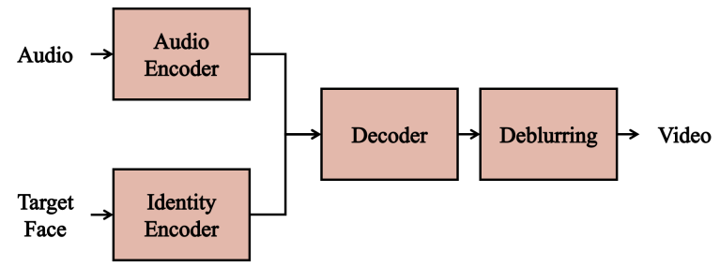
Data-driven animation synthesis – Neural Network
Appearance-Based Approach
“You said that?”
J. S. Chung, A. Jamaludin, A. Zisserman, You said that?, British Machine Vision Conference, 2017
A deblurring Convolution network for post-processing (trained separately).
Input_audio:
MFCC for 0.35 sec window
Input_visual:
Still identity image
Output:
a single frame representing the current 0.35 sec input audio.

Slide 15
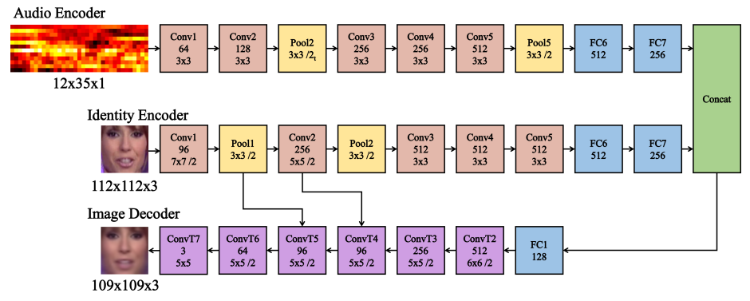
Data-driven animation synthesis – Neural Network
Appearance-Based Approach
“You said that?”
J. S. Chung, A. Jamaludin, A. Zisserman, You said that?, British Machine Vision Conference, 2017

Slide 16
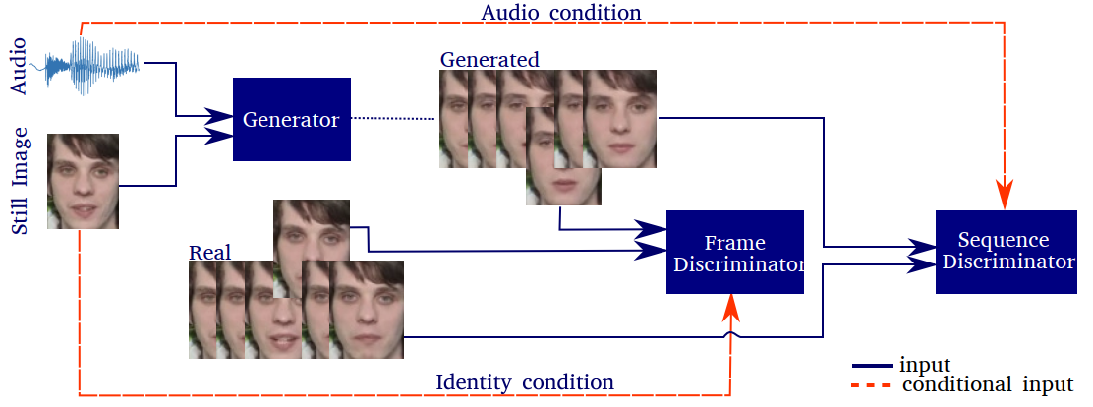
Data-driven animation synthesis – Neural Network
Appearance-Based Approach
“End-to-End Speech-Driven Facial Animation with Temporal GANs”
Vougioukas, K., Petridis, S., & Pantic, M. (2018). End-to-End Speech-Driven Facial Animation with Temporal GANs. arXiv preprint arXiv:1805.09313.

Slide 17
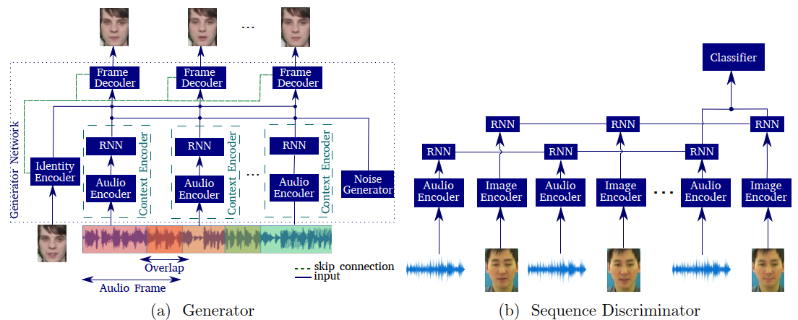
Data-driven animation synthesis – Neural Network
Appearance-Based Approach
“End-to-End Speech-Driven Facial Animation with Temporal GANs”
Vougioukas, K., Petridis, S., & Pantic, M. (2018). End-to-End Speech-Driven Facial Animation with Temporal GANs. arXiv preprint arXiv:1805.09313.

Slide 18
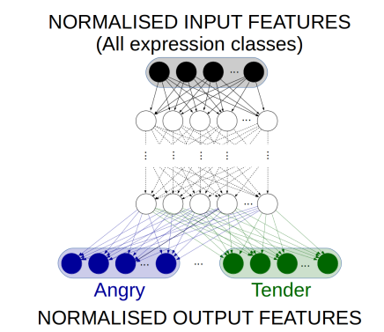
Data-driven animation synthesis – Neural Network
Appearance-Based Approach
“Expressive visual text to speech and expression adaptation using deep neural networks”
Parker, J., Maia, R., Stylianou, Y., & Cipolla, R. (2017, March). Expressive visual text to speech and expression adaptation using deep neural networks. In Acoustics, Speech and Signal Processing (ICASSP), 2017 IEEE International Conference on (pp. 4920-4924). IEEE.
Input:
503-dim numeric and binary features analyzed from input text sentence
Output:
audio features and video features
(17 AAM parameters and their first derivatives).
Notes:
6 layers, each with 1024 hidden units
6 output layers, one for each emotion
Random initialization, SGD
MSE loss
L2-norm regularization, penalty of 0.001
Minibatch 256

Slide 19
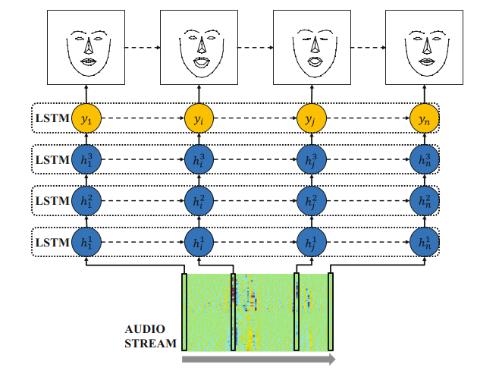
Data-driven animation synthesis – Neural Network
Control-Point Based Approach
“Generating Talking Face Landmarks from Speech”
Eskimez, S. E., Maddox, R. K., Xu, C., & Duan, Z. (2018, July). Generating Talking Face Landmarks from Speech. In International Conference on Latent Variable Analysis and Signal Separation (pp. 372-381). Springer, Cham.
Output:
landmark location of mean face
Input:
Audio features
Notes:
6 layers, each with 1024 hidden units
6 output layers, one for each emotion
Random initialization, SGD
MSE loss
L2-norm regularization, penalty of 0.001
Minibatch 256

Slide 20
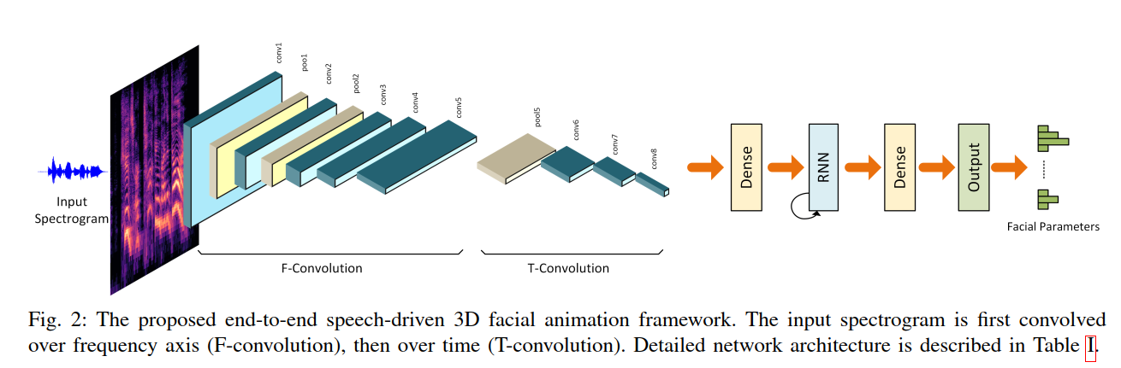
Data-driven animation synthesis – Neural Network
Control-Point Based Approach
“End-to-end Learning for 3D Facial Animation from Raw Waveforms of Speech”
Pham, H. X., Wang, Y., & Pavlovic, V. (2017). End-to-end Learning for 3D Facial Animation from Raw Waveforms of Speech. arXiv preprint arXiv:1710.00920.
Input:
2D array of frequency-time audio feature (for a single video frame)
Output:
head rotation angle and blendshape parameters
Notes:
6 layers, each with 1024 hidden units
6 output layers, one for each emotion
Random initialization, SGD
MSE loss
L2-norm regularization, penalty of 0.001
Minibatch 256

Slide 21
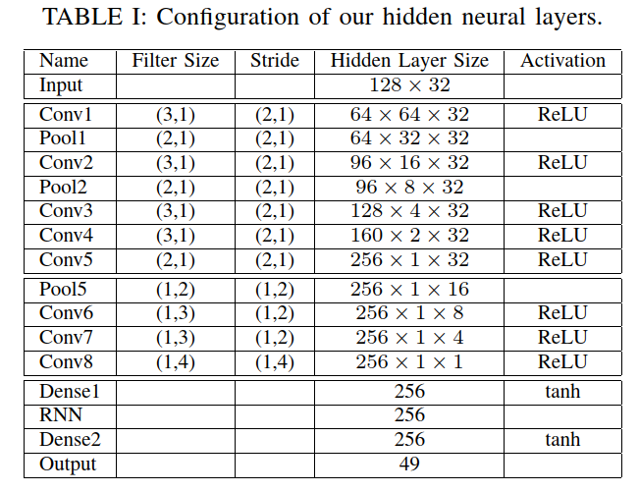
Data-driven animation synthesis – Neural Network
Control-Point Based Approach
“End-to-end Learning for 3D Facial Animation from Raw Waveforms of Speech”
Pham, H. X., Wang, Y., & Pavlovic, V. (2017). End-to-end Learning for 3D Facial Animation from Raw Waveforms of Speech. arXiv preprint arXiv:1710.00920.
F-convolution
T-convolution
Notes:
6 layers, each with 1024 hidden units
6 output layers, one for each emotion
Random initialization, SGD
MSE loss
L2-norm regularization, penalty of 0.001
Minibatch 256

Slide 22
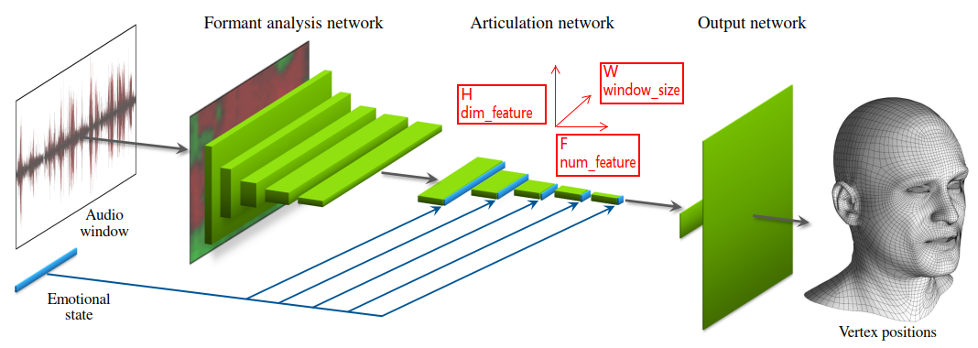
Data-driven animation synthesis – Neural Network
Control-Point Based Approach
“Audio-driven facial animation by joint end-to-end learning of pose and emotion”
Karras, T., Aila, T., Laine, S., Herva, A., & Lehtinen, J. (2017). Audio-driven facial animation by joint end-to-end learning of pose and emotion. ACM Transactions on Graphics (TOG), 36(4), 94.
Notes:
6 layers, each with 1024 hidden units
6 output layers, one for each emotion
Random initialization, SGD
MSE loss
L2-norm regularization, penalty of 0.001
Minibatch 256

Slide 23
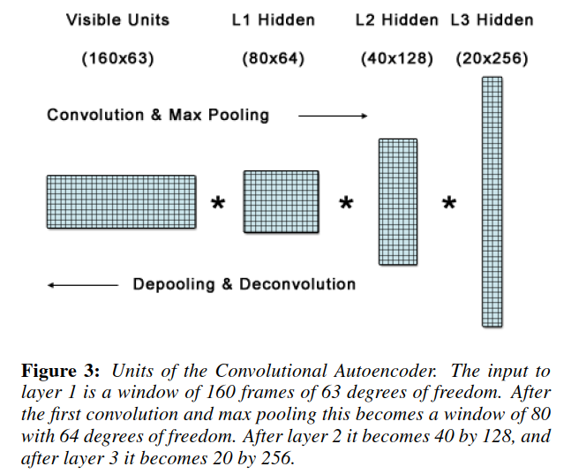
Data-driven animation synthesis – Neural Network
Related papers
“Learning Motion Manifolds with Convolutional Autoencoders”
Use autoencoder to project noisy
motion data onto a manifold, which
represents possible human motion data
Similar to dynamic viseme, except that
this paper learns a motion manifold
instead of a discrete set of dynamic
visemes
Holden, D., Saito, J., Komura, T., & Joyce, T. (2015, November). Learning motion manifolds with convolutional autoencoders. In SIGGRAPH Asia 2015 Technical Briefs (p. 18). ACM.
Notes:
6 layers, each with 1024 hidden units
6 output layers, one for each emotion
Random initialization, SGD
MSE loss
L2-norm regularization, penalty of 0.001
Minibatch 256

Slide 24
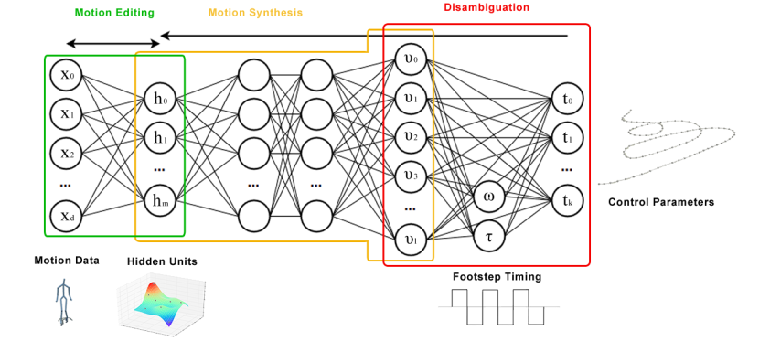
Data-driven animation synthesis – Neural Network
Related papers
“A Deep Learning Framework for Character Motion Synthesis and Editing”
Holden, D., Saito, J., & Komura, T. (2016). A deep learning framework for character motion synthesis and editing. ACM Transactions on Graphics (TOG), 35(4), 138.
Notes:
6 layers, each with 1024 hidden units
6 output layers, one for each emotion
Random initialization, SGD
MSE loss
L2-norm regularization, penalty of 0.001
Minibatch 256

Slide 25
Dataset & Toolset
DataSet
  BIWI: http://www.vision.ee.ethz.ch/datasets/b3dac2.en.html
  SAVEE: http://kahlan.eps.surrey.ac.uk/savee/Introduction.html
  GRID: http://spandh.dcs.shef.ac.uk/gridcorpus/
  RAVDESS: https://smartlaboratory.org/ravdess/
  IEMOCAP: https://sail.usc.edu/iemocap/
  TCD-TIMIT: https://sigmedia.tcd.ie/TCDTIMIT/node/1
ToolSet
  OpenFace: https://github.com/TadasBaltrusaitis/OpenFace
  Dlib (extract facial landmark locations)
  PyTorch, TensorFlow, etc.
Notes:
6 layers, each with 1024 hidden units
6 output layers, one for each emotion
Random initialization, SGD
MSE loss
L2-norm regularization, penalty of 0.001
Minibatch 256

