Slide 1
ECE 417, Lecture 11:
MFCC
Mark Hasegawa-Johnson
10/2/2018

Slide 2
Content
What spectrum do people hear? The basilar membrane
Frequency scales for hearing: mel scale
Mel-filter spectral coefficients (also called “filterbank features”)
Speech Production: Consonants and Vowels
Parseval’s Theorem: Cepstral Distance = Spectral Distance

Slide 3
What spectrum do people hear? Basilar membrane

Slide 4
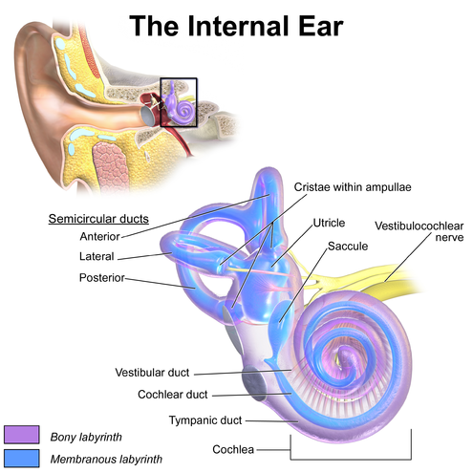
Inner ear

Slide 5
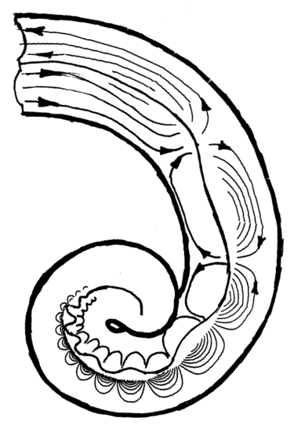
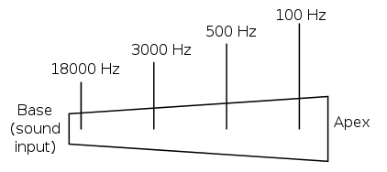
Basilar membrane of the cochlea = a bank of mechanical bandpass filters

Slide 6
Frequency scales for hearing: mel scale

Slide 7
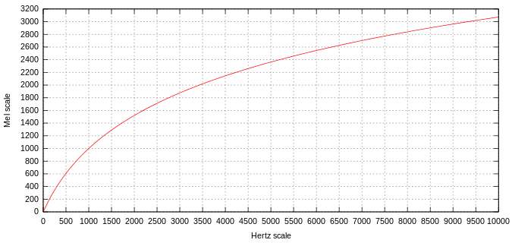
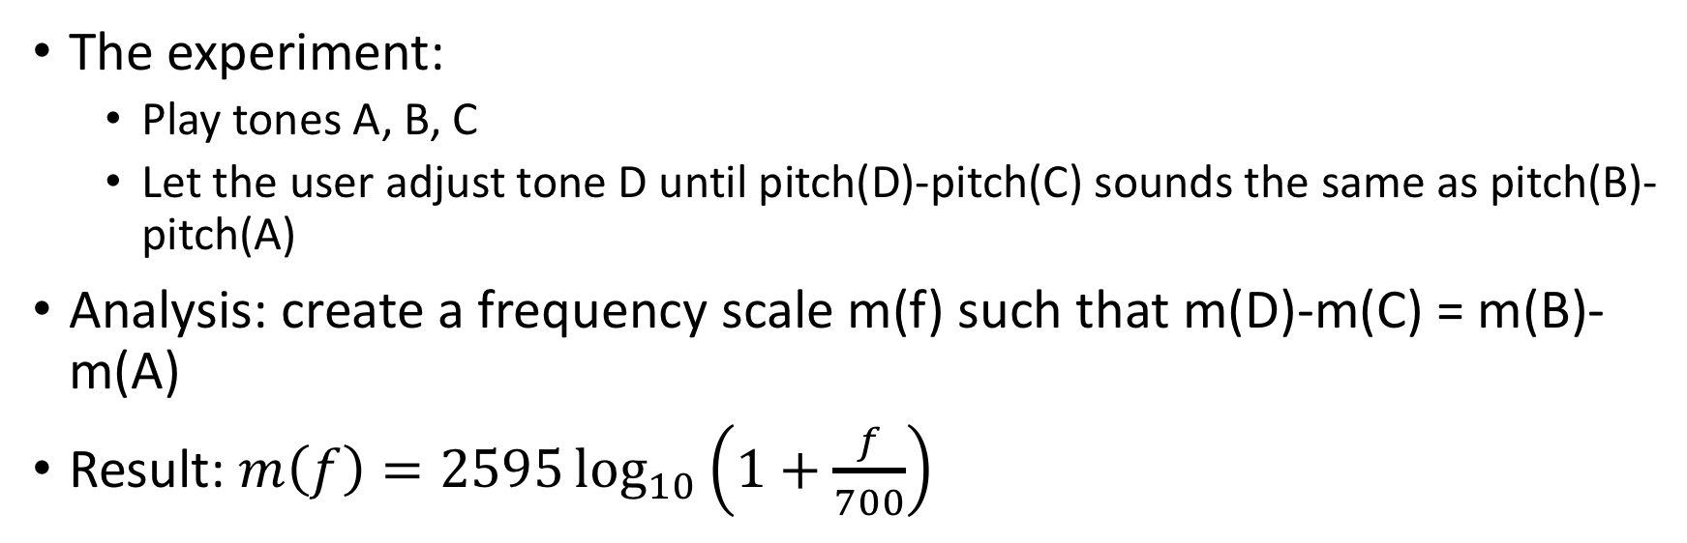
Mel-scale
The experiment:
  Play tones A, B, C
  Let the user adjust tone D until pitch(D)-pitch(C) sounds the same as pitch(B)-pitch(A)
Analysis: create a frequency scale m(f) such that m(D)-m(C) = m(B)-m(A)
Result: $m\left(f\right)=2595\log_{10}\left(1+\frac{f}{700}\right)$

Slide 8
Mel Frequency Spectral Coefficients (Filterbank Coefficients)

Slide 9
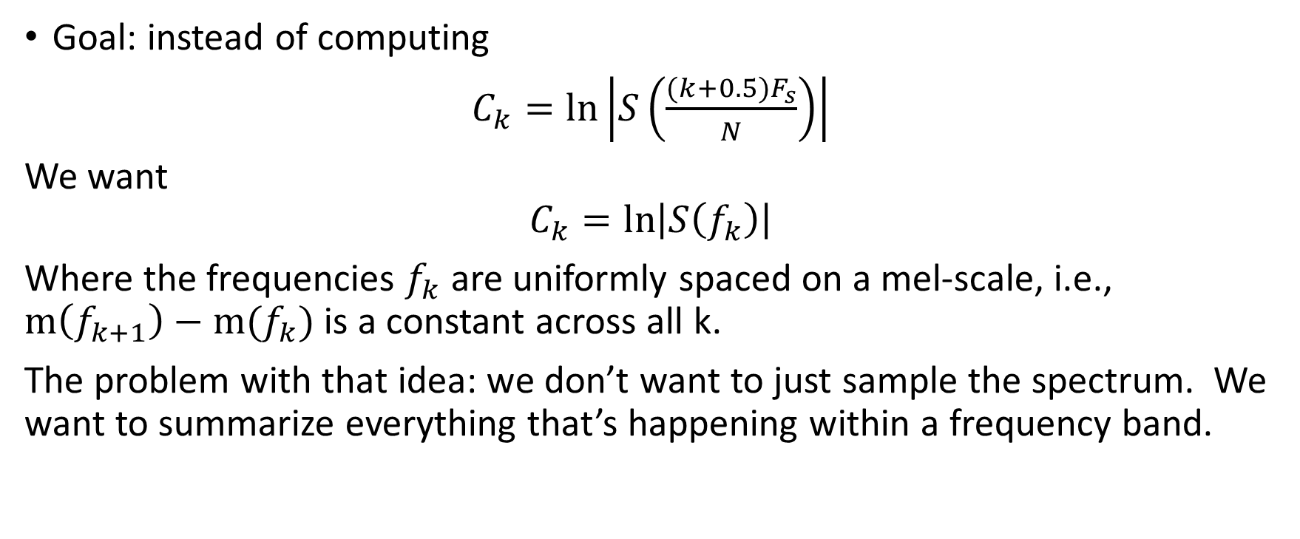
Mel filterbank coefficients: convert the spectrum from Hertz-frequency to mel-frequency
Goal: instead of computing
$C_{k}=ln\left|S\left(\frac{(k+0.5)F_{s}}{N}\right)\right|$
We want
$$C_{k}=ln\left|S\left(f_{k}\right)\right|$$
Where the frequencies $f_{k}$ are uniformly spaced on a mel-scale, i.e., $m\left(f_{k+1}\right)−m(f_{k})$ is a constant across all k.
The problem with that idea: we don’t want to just sample the spectrum. We want to summarize everything that’s happening within a frequency band.

Slide 10
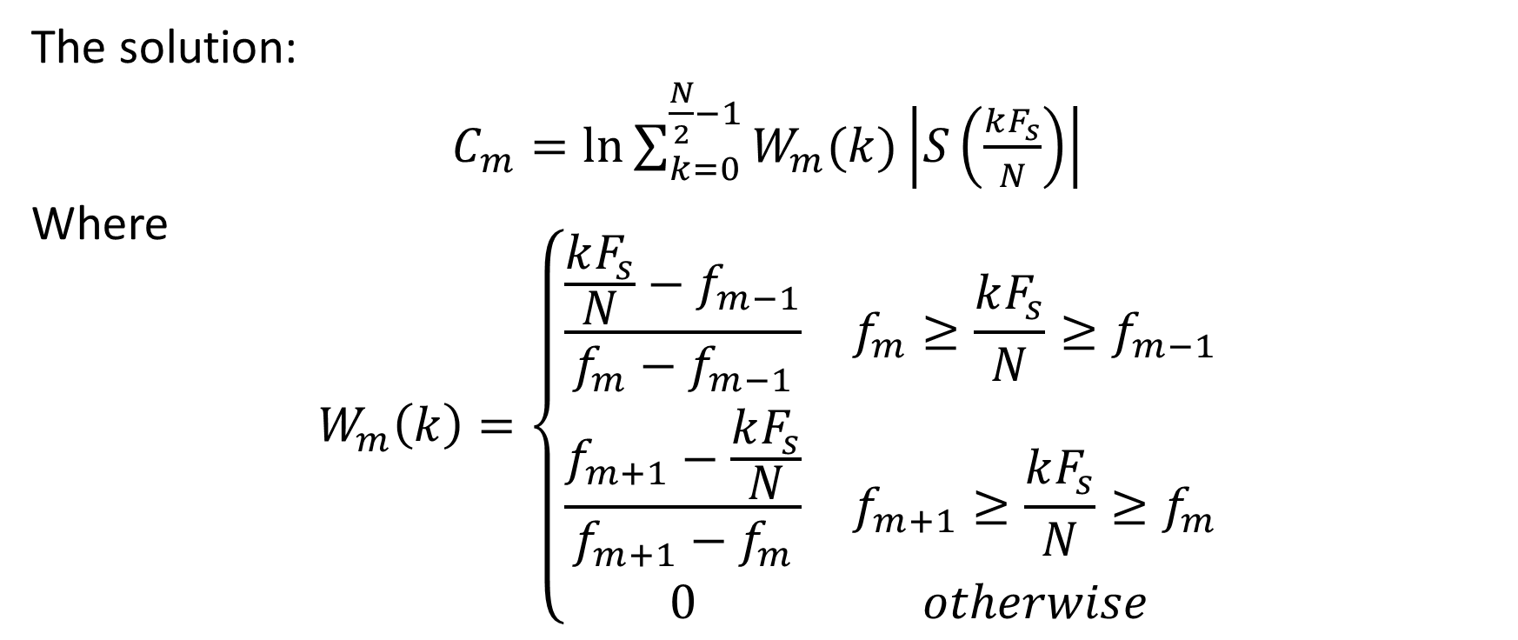
Mel filterbank coefficients: convert the spectrum from Hertz-frequency to mel-frequency
The solution:
$C_{m}=ln{\sum_{k=0}^{\frac{N}{2}−1}{W_{m}(k)\left|S\left(\frac{kF_{s}}{N}\right)\right|}}$
Where
$$W_{m}\left(k\right)=\left\{\begin{matrix}\frac{\frac{kF_{s}}{N}−f_{m−1}}{f_{m}−f_{m−1}} & f_{m}≥\frac{kF_{s}}{N}≥f_{m−1} \\ \frac{f_{m+1}−\frac{kF_{s}}{N}}{f_{m+1}−f_{m}} & f_{m+1}≥\frac{kF_{s}}{N}≥f_{m} \\ 0 & otherwise\end{matrix}\right.$$

Slide 11
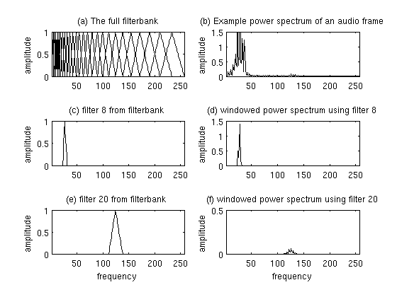
Mel filterbank coefficients: convert the spectrum from Hertz-frequency to mel-frequency

Slide 12
Speech Production

Slide 13
The Source-Filter Model of Speech Production
(Chiba & Kajiyama, 1940)
Sources: there are only three, all of them have wideband spectrum
  Voicing: vibration of the vocal folds, same type of aerodynamic mechanism as a flag flapping in the wind.
  Frication or Aspiration: turbulence created when air passes through a narrow aperture
  Burst: the “pop” that occurs when high air pressure is suddenly released
Filter:
  Vocal tract = the air cavity between glottis and lips
  Just like a flute or a shower stall, it has resonances
  The excitation has energy at all frequencies; excitation at the resonant frequencies is enhanced

Slide 14
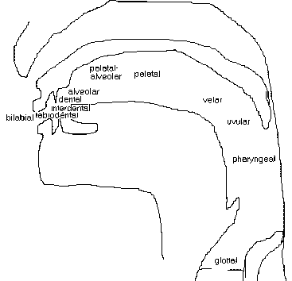
Different sounds: Consonants
Scharenborg, 2017
Place of articulation
  Where is the constriction/blocking of the air stream?
Manner of articulation
  Stops: /p, t, k, b, d, g/
  Fricatives: /f, s, S, v, z, Z/
  Affricates: /tS, dZ/
  Approximants/Liquids: /l, r, w, j/
  Nasals: /m, n, ng/
Voicing
Notes:
The type of consonant or sound that is produced depends on three factors: the place of articulation, the manner of articulation and whether the vocal cords vibrate
Manner of articulation: is it a full blockage or a constriction and how much of a constriction is there?
Plosion
Bit of noise
Combination
Air through the nasal cavity
Fairly open

Slide 15
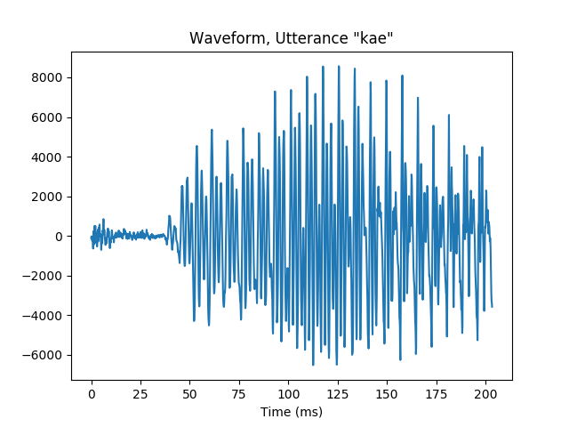
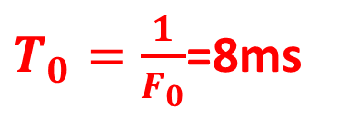
Speech signal: Time domain
$T_{0}=\frac{1}{F_{0}}$=8ms
/k/ burst
/k/ aspiration
voicing

Slide 16
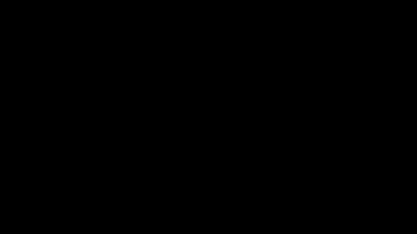
Speech sound production
Scharenborg, 2017
https://www.youtube.com/watch?v=DcNMCB-Gsn8
Recorded in 1962, Ken Stevens
Source: YouTube
Notes:
We all know what speech sounds like, and now we know how they are produced, but what does it look like when we produce speech?

Slide 17
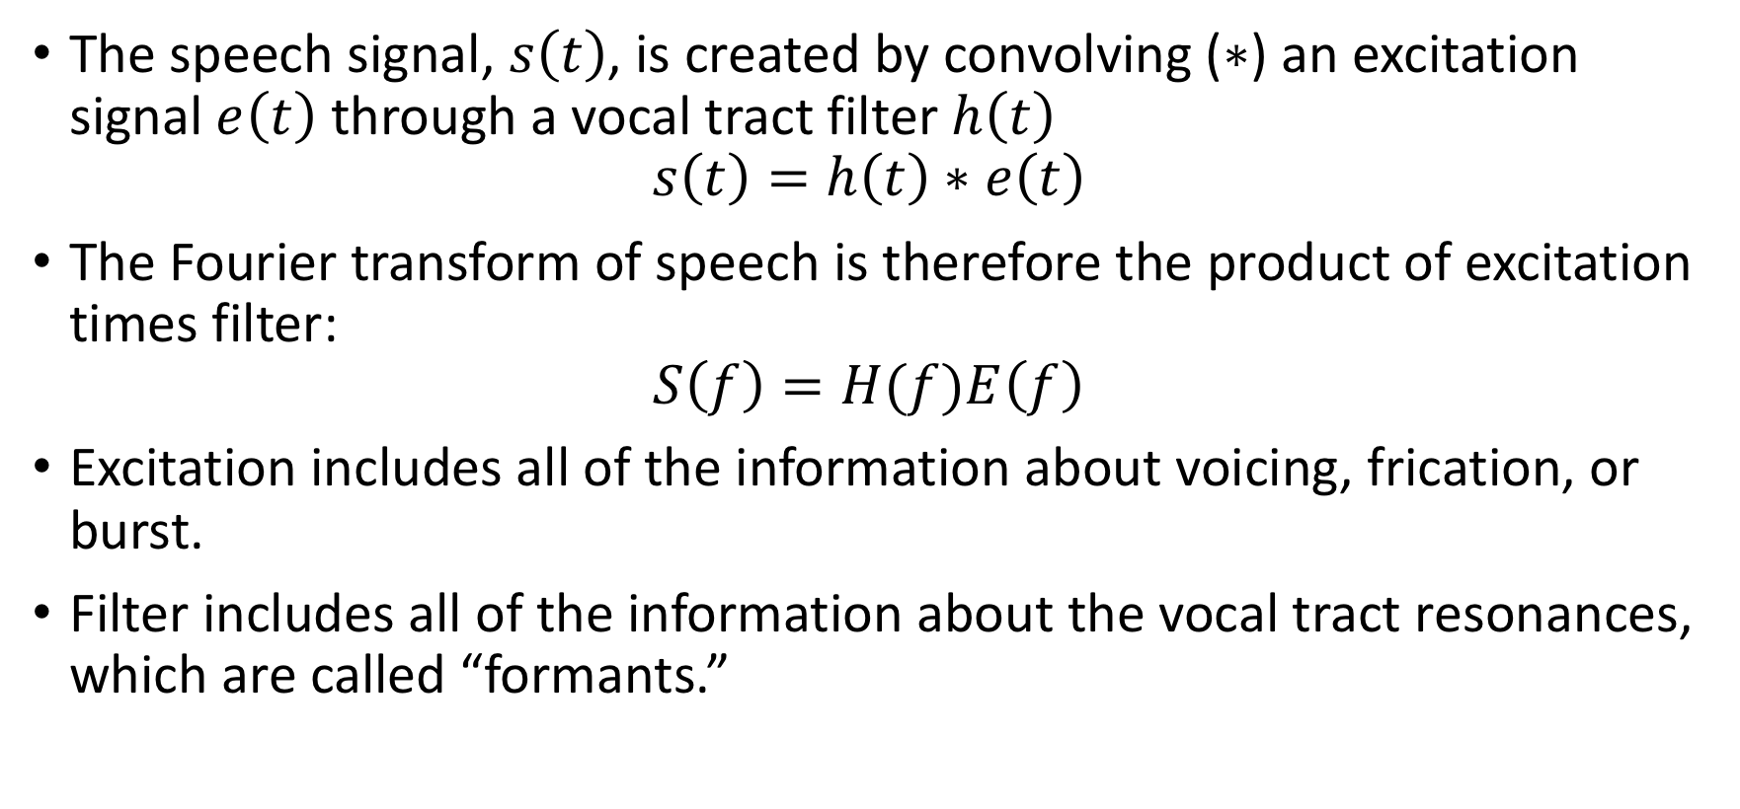
The Source-Filter Model
The speech signal, $s\left(t\right)$, is created by convolving ($∗$) an excitation signal $e\left(t\right)$ through a vocal tract filter $h\left(t\right)$
$$s\left(t\right)=h\left(t\right)∗e\left(t\right)$$
The Fourier transform of speech is therefore the product of excitation times filter:
$$S\left(f\right)=H(f)E\left(f\right)$$
Excitation includes all of the information about voicing, frication, or burst.
Filter includes all of the information about the vocal tract resonances, which are called “formants.”

Slide 18
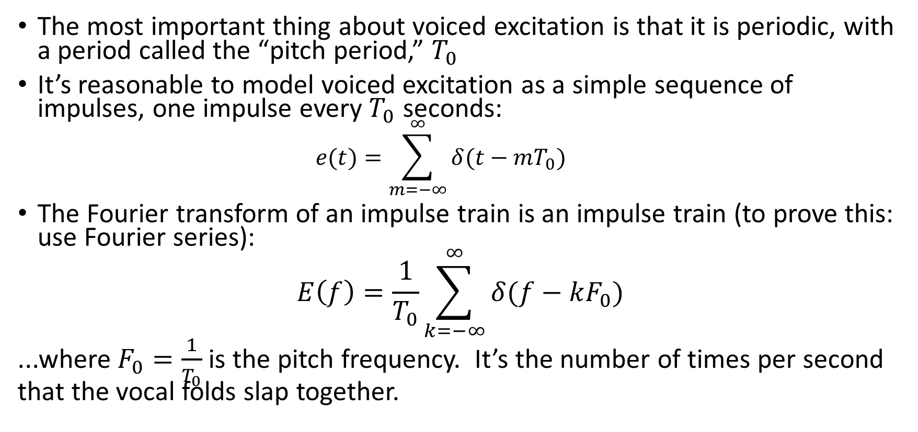
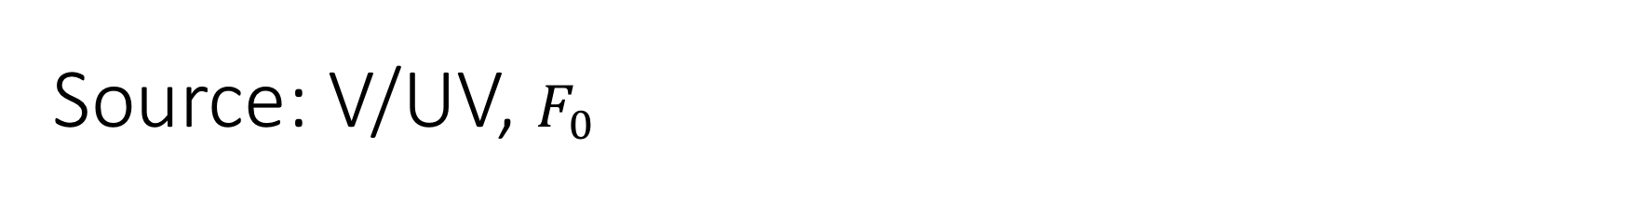
Source: V/UV, $F_{0}$
The most important thing about voiced excitation is that it is periodic, with a period called the “pitch period,” $T_{0}$
It’s reasonable to model voiced excitation as a simple sequence of impulses, one impulse every $T_{0}$ seconds:
  $$e(t)=\sum_{m=−∞}^{∞}{δ(t−mT_{0})}$$
The Fourier transform of an impulse train is an impulse train (to prove this: use Fourier series):
$$E\left(f\right)=\frac{1}{T_{0}}\sum_{k=−∞}^{∞}{δ(f−kF_{0})}$$
...where $F_{0}=\frac{1}{T_{0}}$ is the pitch frequency. It’s the number of times per second that the vocal folds slap together.

Slide 19
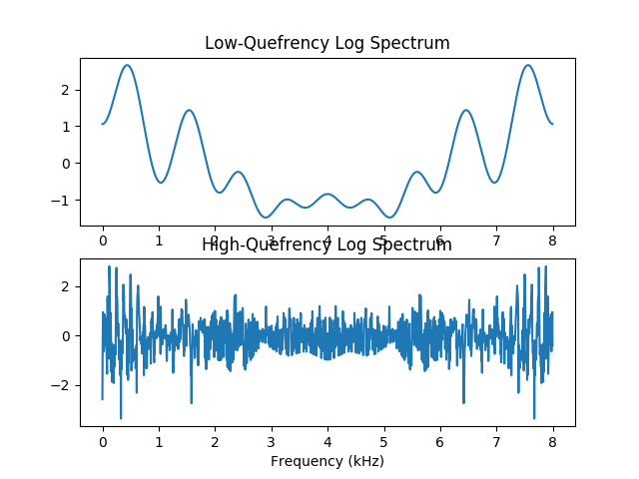
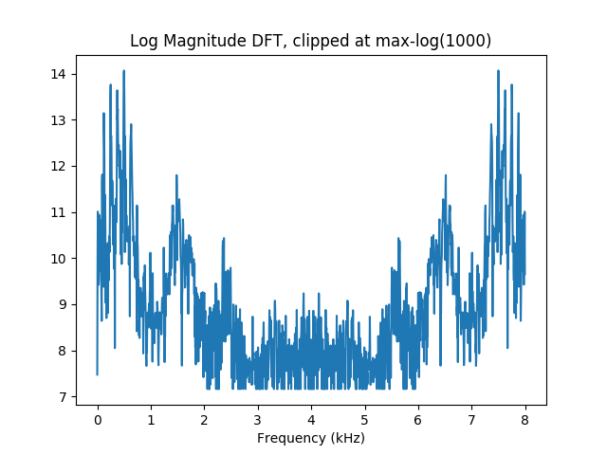
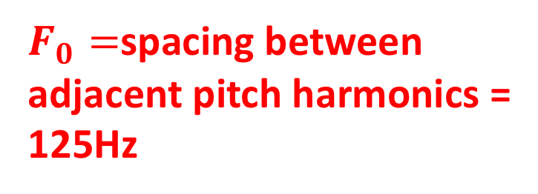
The Source-Filter Model
Transfer Function log|H(f)|
Speech Spectrum log|S(f)|=log|H(f)|+log|E(f)|
$F_{0}=$spacing between
adjacent pitch harmonics =
125Hz
Voice Source Spectrum log|E(f)|

Slide 20
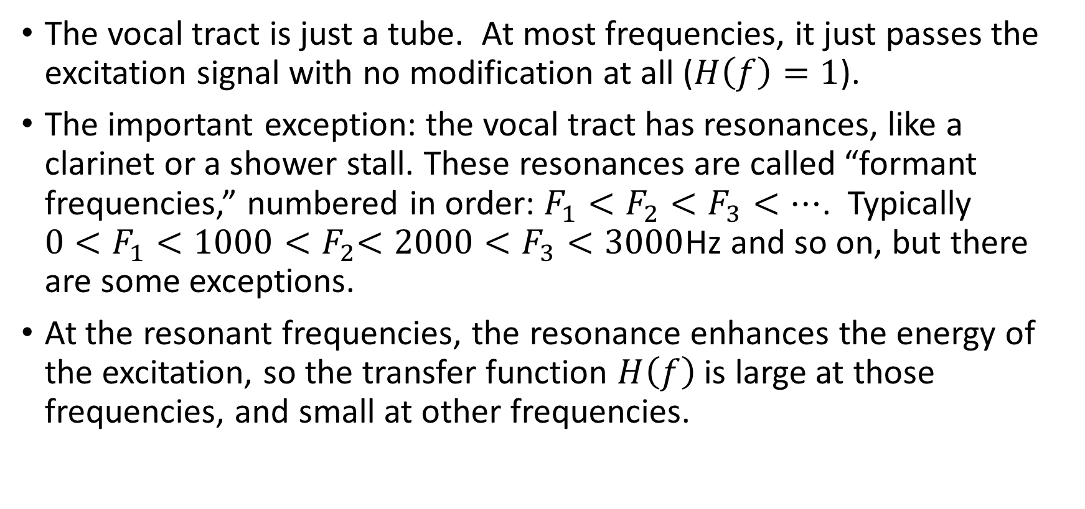

Filter: $F_{1}, F_{2},F_{3},…$
The vocal tract is just a tube. At most frequencies, it just passes the excitation signal with no modification at all ($H\left(f\right)=1$).
The important exception: the vocal tract has resonances, like a clarinet or a shower stall. These resonances are called “formant frequencies,” numbered in order: $F_{1}<F_{2}<F_{3}<…$. Typically ${0<F}_{1}<1000{<F}_{2}<2000<F_{3}<3000$Hz and so on, but there are some exceptions.
At the resonant frequencies, the resonance enhances the energy of the excitation, so the transfer function $H\left(f\right)$ is large at those frequencies, and small at other frequencies.

Slide 21



The Source-Filter Model
$$F_{1}$$
Transfer Function log|H(f)|
$F_{2}$
Speech Spectrum log|S(f)|=log|H(f)|+log|E(f)|
$$F_{3}$$
Voice Source Spectrum log|E(f)|

Slide 22
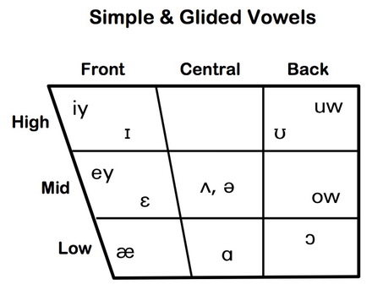
Different sounds: Vowels
Scharenborg, 2017
Tongue height:
  Low: e.g., /a/
  Mid: e.g., /e/
  High: e.g., /i/
Tongue advancement:
  Front : e.g., /i/
  Central : e.g., /ə/
  Back : e.g., /u/
Lip rounding:
  Unrounded: e.g., /ɪ, ɛ, e, ǝ/
  Rounded: e.g., /u, o, ɔ/
Tense/lax:
  Tense: e.g., /i, e, u, o, ɔ, ɑ/
  Lax: e.g., /ɪ, ɛ, æ, ə/
300
heed
who’d
hid
hood
hayed
huggable
F1
head
hoed
had
hawed
900
hod
2000
F2
800
Notes:
In producing vowels the tongue and lips are important for shaping the vocal tract
Tense vowels are typically produced with a narrower mouth than lax vowels, less centralization, and longer duration

Slide 23

Time domain signal: Hard to tell what he was saying
$$s\left(t\right)=h\left(t\right)∗e(t)$$

Slide 24
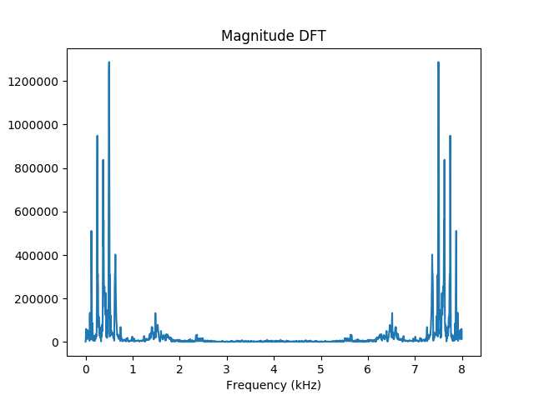
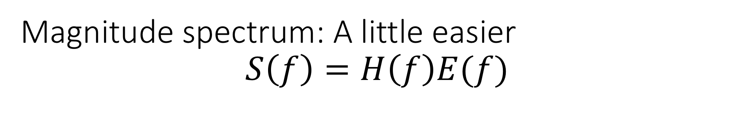


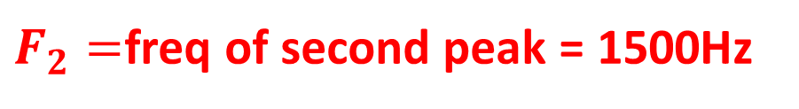
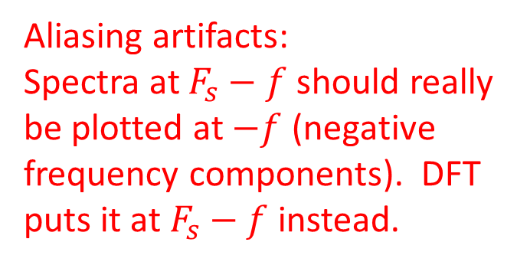
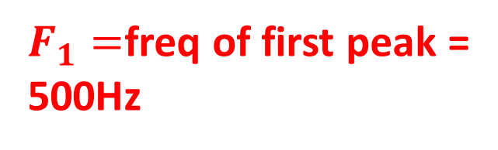
Magnitude spectrum: A little easier
$$S\left(f\right)=H\left(f\right)E(f)$$
$F_{1}=$freq of first peak =
500Hz
Aliasing artifacts:
Spectra at $F_{s}−f$ should really
be plotted at $−f$ (negative
frequency components). DFT
puts it at $F_{s}−f$ instead.
$F_{0}=$spacing between
adjacent pitch harmonics =
125Hz
$F_{2}=$freq of second peak = 1500Hz
$$F_{3}$$

Slide 25
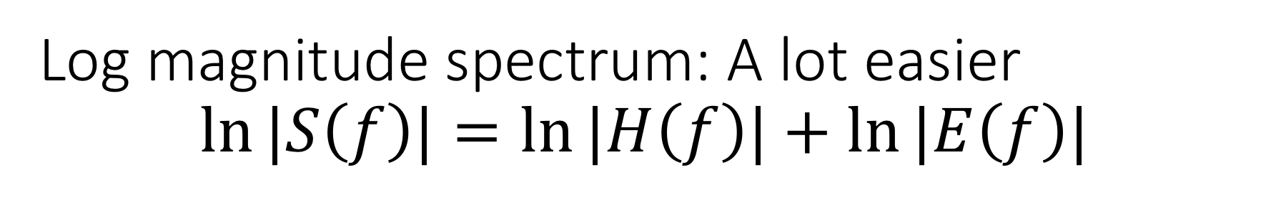
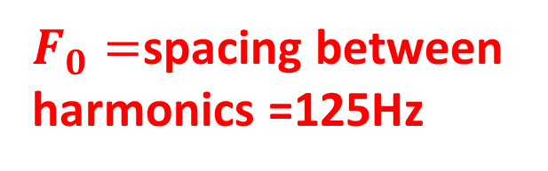
Log magnitude spectrum: A lot easier
$$\ln{|S\left(f\right)|}=\ln{|H\left(f\right)|}+\ln{|E\left(f\right)|}$$
$F_{1}=$freq of first peak =
500Hz
Aliasing artifacts:
Spectra at $F_{s}−f$ should really
be plotted at $−f$ (negative
frequency components). DFT
puts it at $F_{s}−f$ instead.
$F_{0}=$spacing between
harmonics =125Hz
$F_{2}=$freq of second peak = 1500Hz
$$F_{3}$$

Slide 26
Different sounds: Vowels
Scharenborg, 2017
Tongue height:
  Low: e.g., /a/
  Mid: e.g., /e/
  High: e.g., /i/
Tongue advancement:
  Front : e.g., /i/
  Central : e.g., /ə/
  Back : e.g., /u/
Lip rounding:
  Unrounded: e.g., /ɪ, ɛ, e, ǝ/
  Rounded: e.g., /u, o, ɔ/
Tense/lax:
  Tense: e.g., /i, e, u, o, ɔ, ɑ/
  Lax: e.g., /ɪ, ɛ, æ, ə/
300
heed
who’d
hid
hood
hayed
huggable
F1
head
hoed
had
hawed
900
hod
2000
F2
800
Notes:
In producing vowels the tongue and lips are important for shaping the vocal tract
Tense vowels are typically produced with a narrower mouth than lax vowels, less centralization, and longer duration

Slide 27
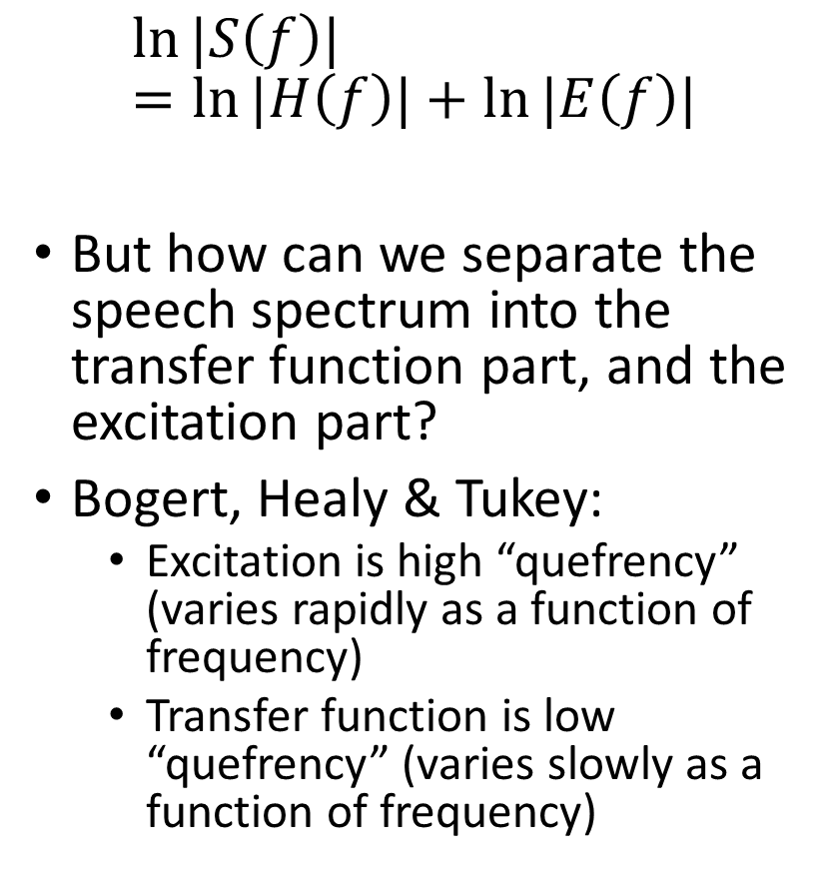
Log spectrum = log filter + log excitation
$$\ln{|S\left(f\right)|}=\ln{|H\left(f\right)|}+\ln{|E\left(f\right)|}$$
But how can we separate the speech spectrum into the transfer function part, and the excitation part?
Bogert, Healy & Tukey:
  Excitation is high “quefrency” (varies rapidly as a function of frequency)
  Transfer function is low “quefrency” (varies slowly as a function of frequency)

Slide 28
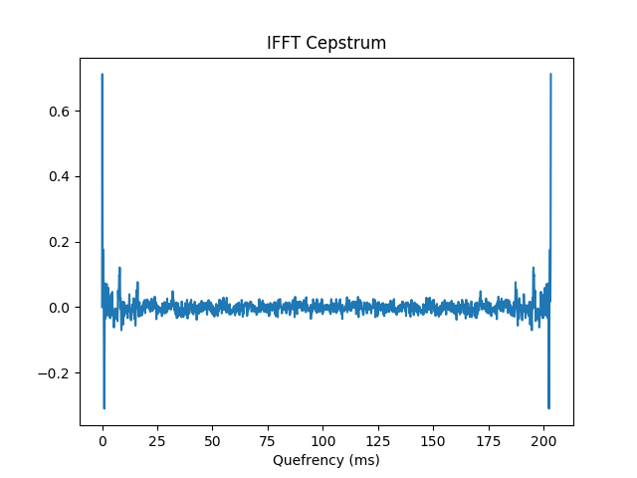
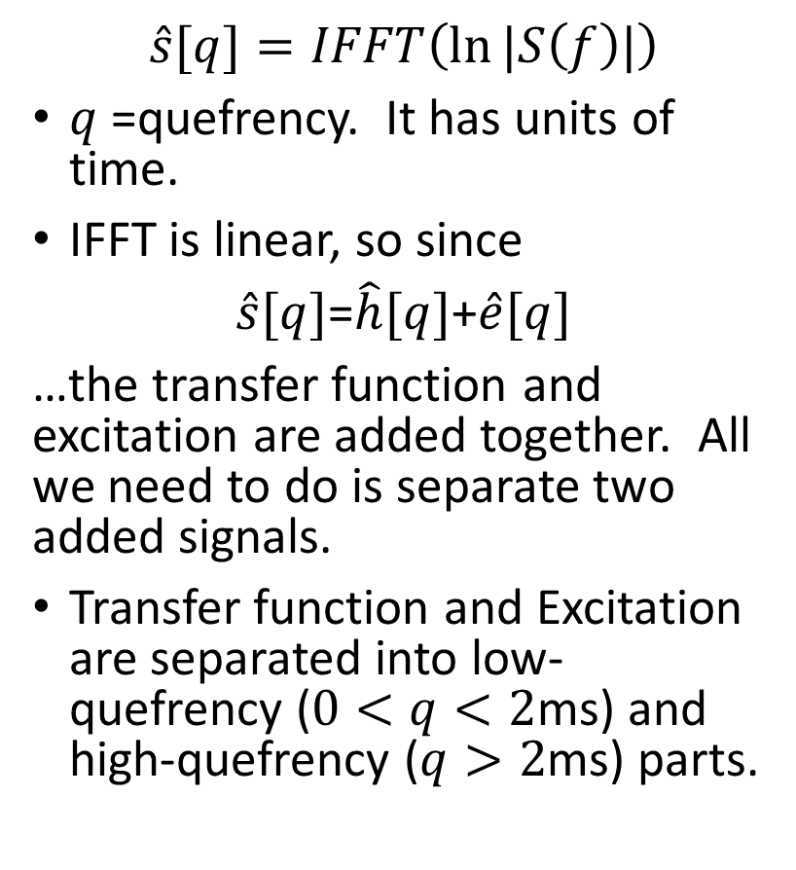
Cepstrum = inverse FFT of the log spectrum
(Bogert, Healy & Tukey, 1962)
$$\hat{s}[q]=IFFT\left(\ln{|S\left(f\right)|}\right)$$
$q$=quefrency. It has units of time.
IFFT is linear, so since
$\hat{s}[q]$=$\hat{h}[q]$+$\hat{e}[q]$
…the transfer function and excitation are added together. All we need to do is separate two added signals.
Transfer function and Excitation are separated into low-quefrency ($0<q<2$ms) and high-quefrency ($q>2$ms) parts.

Slide 29
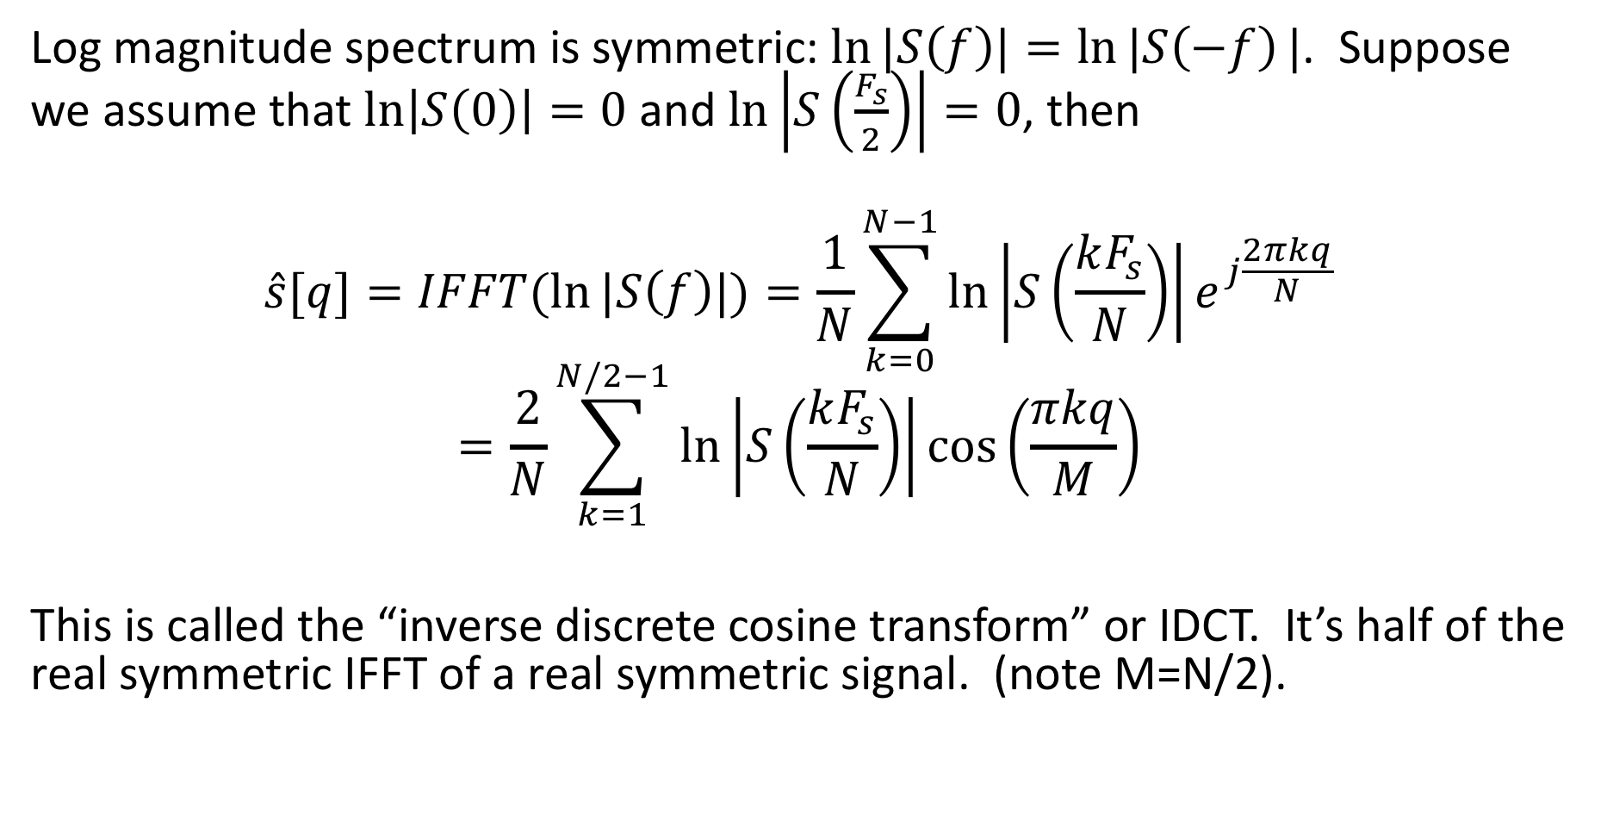
Inverse Discrete Cosine Transform
Log magnitude spectrum is symmetric: $\ln{|S\left(f\right)|}=\ln{|S\left(−f\right)}|$. Suppose we assume that $\ln\left|S\left(0\right)\right|=0$ and $\ln\left|S\left(\frac{F_{s}}{2}\right)\right|=0$, then
$$\hat{s}[q]=IFFT(\ln{|S\left(f\right)|)=\frac{1}{N}\sum_{k=0}^{N−1}{\ln\left|S\left(\frac{kF_{s}}{N}\right)\right|e^{j\frac{2πkq}{N}}}}$$
$$=\frac{2}{N}\sum_{k=1}^{N/2−1}{\ln\left|S\left(\frac{kF_{s}}{N}\right)\right|\cos\left(\frac{πkq}{M}\right)}$$
This is called the “inverse discrete cosine transform” or IDCT. It’s half of the real symmetric IFFT of a real symmetric signal. (note M=N/2).

Slide 30
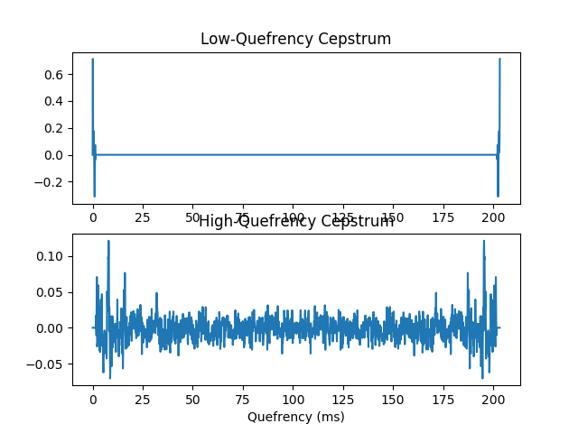
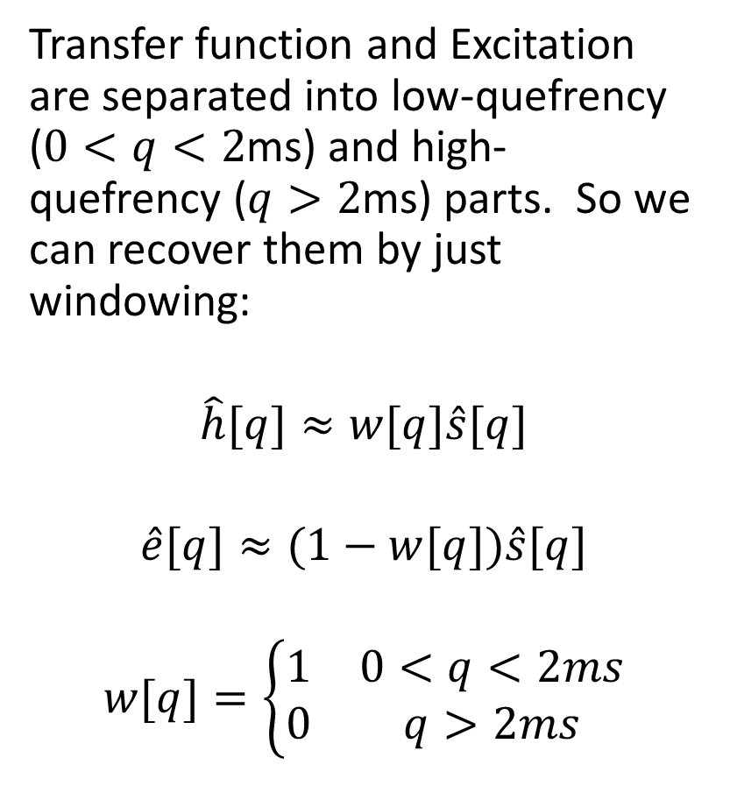
Liftering = filter(spectrum) = window(cepstrum)
(Bogert, Healy & Tukey, 1962)
Transfer function and Excitation are separated into low-quefrency ($0<q<2$ms) and high-quefrency ($q>2$ms) parts. So we can recover them by just windowing:
$$\hat{h}[q]≈w[q]\hat{s}[q]$$
$$\hat{e}[q]≈(1−w[q])\hat{s}[q]$$
$$w[q]=\left\{\begin{matrix}1 & 0<q<2ms \\ 0 & q>2ms\end{matrix}\right.$$

Slide 31
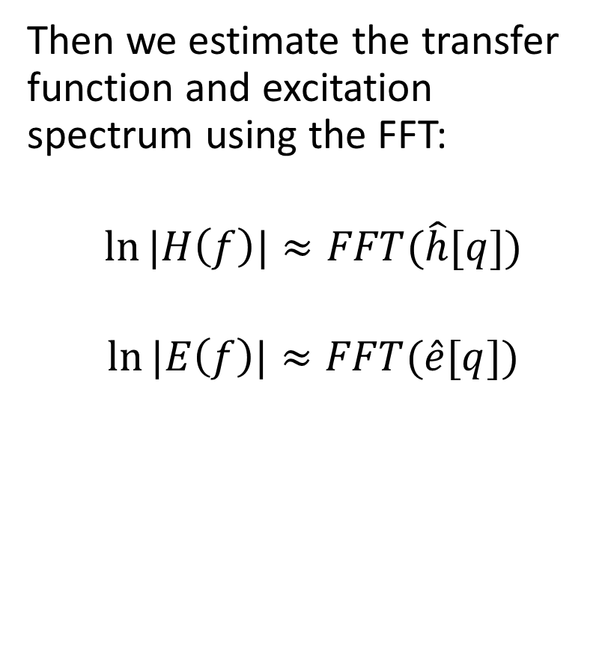
Liftering = filter(spectrum) = window(cepstrum)
(Bogert, Healy & Tukey, 1962)
Then we estimate the transfer function and excitation spectrum using the FFT:
$$\ln{|H\left(f\right)|}≈FFT(\hat{h}[q])$$
$$\ln{|E\left(f\right)|}≈FFT(\hat{e}[q])$$

Slide 32
Parseval’s Theorem
L2 norm of a signal equals the L2 norm of its Fourier transform.

Slide 33
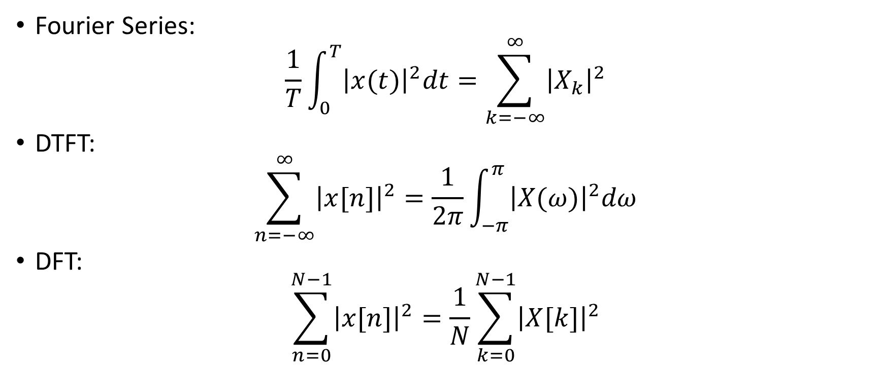
Parseval’s Theorem: Examples
Fourier Series:
$$\frac{1}{T}\int_{0}^{T}{{\left|x(t)\right|}^{2}dt}=\sum_{k=−∞}^{∞}{{\left|X_{k}\right|}^{2}}$$
DTFT:
$$\sum_{n=−∞}^{∞}{{\left|x[n]\right|}^{2}}=\frac{1}{2π}\int_{−π}^{π}{{\left|X(ω)\right|}^{2}dω}$$
DFT:
$$\sum_{n=0}^{N−1}{{\left|x[n]\right|}^{2}}=\frac{1}{N}\sum_{k=0}^{N−1}{{\left|X[k]\right|}^{2}}$$

Slide 34
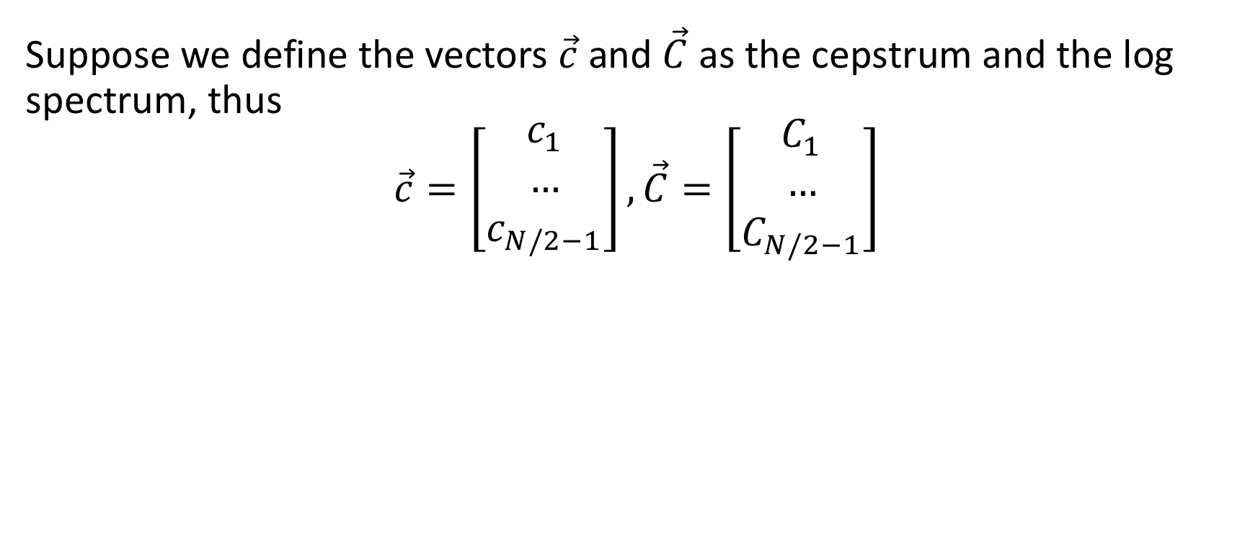
Parseval’s Theorem: Vector Formulation
Suppose we define the vectors $\vec{c}$ and $\vec{C}$ as the cepstrum and the log spectrum, thus
$$\vec{c}=\left[\begin{matrix}c_{1} \\ … \\ c_{N/2−1}\end{matrix}\right],\vec{C}=\left[\begin{matrix}C_{1} \\ … \\ C_{N/2−1}\end{matrix}\right]$$

Slide 35
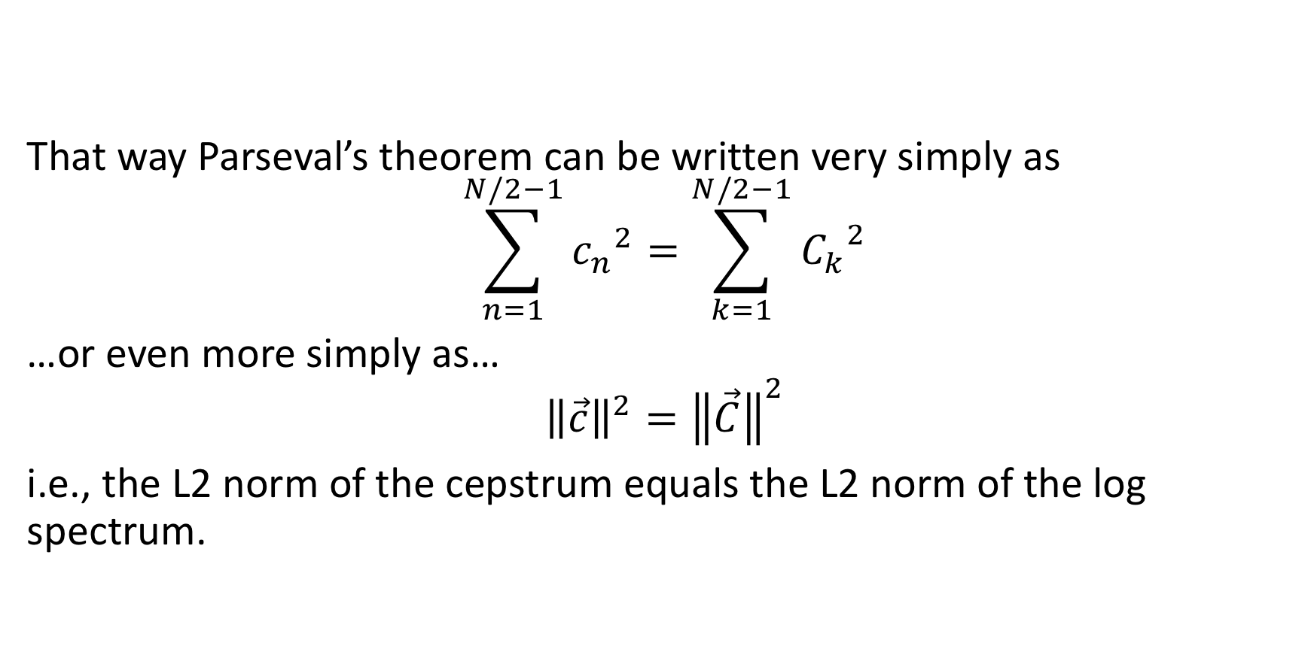
Parseval’s Theorem: Vector Formulation
That way Parseval’s theorem can be written very simply as
$$\sum_{n=1}^{N/2−1}{{c_{n}}^{2}=\sum_{k=1}^{N/2−1}{{C_{k}}^{2}}}$$
…or even more simply as…
$${\left\|\vec{c}\right\|}^{2}={\left\|\vec{C}\right\|}^{2}$$
i.e., the L2 norm of the cepstrum equals the L2 norm of the log spectrum.

Slide 36
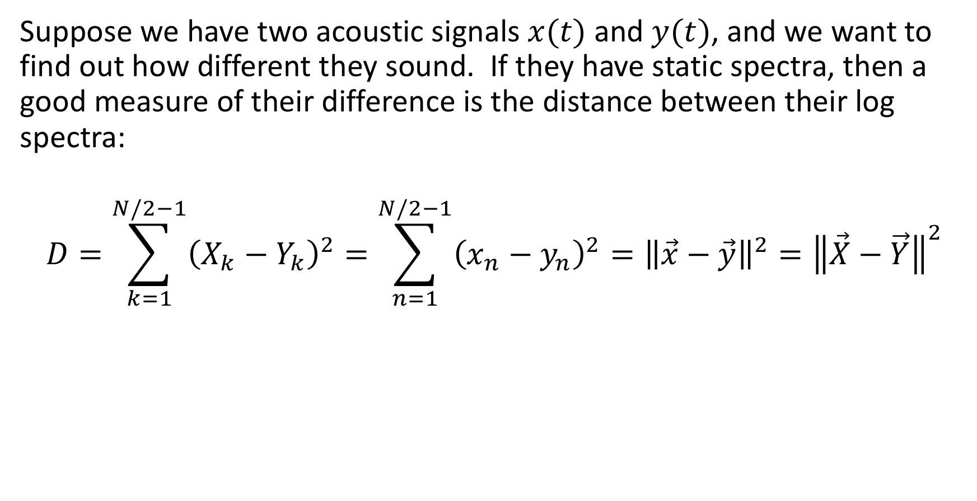
What it means for Gaussian classifiers
Suppose we have two acoustic signals $x(t)$ and $y(t)$, and we want to find out how different they sound. If they have static spectra, then a good measure of their difference is the distance between their log spectra:
$$D=\sum_{k=1}^{N/2−1}{{\left(X_{k}−Y_{k}\right)}^{2}=\sum_{n=1}^{N/2−1}{{\left(x_{n}−y_{n}\right)}^{2}}}={\left\|\vec{x}−\vec{y}\right\|}^{2}={\left\|\vec{X}−\vec{Y}\right\|}^{2}$$

Slide 37
Low-pass liftering smooths the spectrum

Slide 38
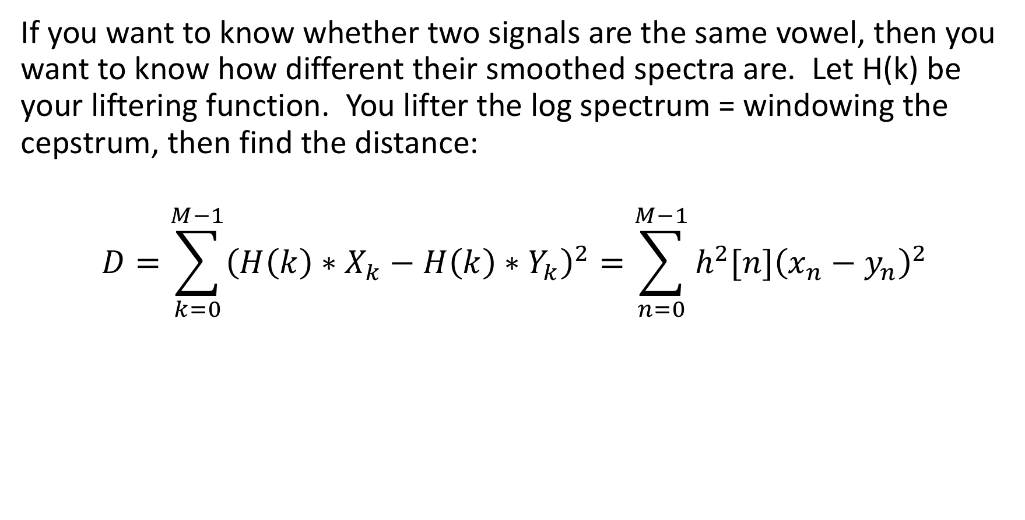
Low-pass liftered L2 norm
If you want to know whether two signals are the same vowel, then you want to know how different their smoothed spectra are. Let H(k) be your liftering function. You lifter the log spectrum = windowing the cepstrum, then find the distance:
$$D=\sum_{k=0}^{M−1}{{\left(H\left(k\right)∗X_{k}−H\left(k\right)∗Y_{k}\right)}^{2}=\sum_{n=0}^{M−1}{{h^{2}[n]\left(x_{n}−y_{n}\right)}^{2}}}$$

Slide 39
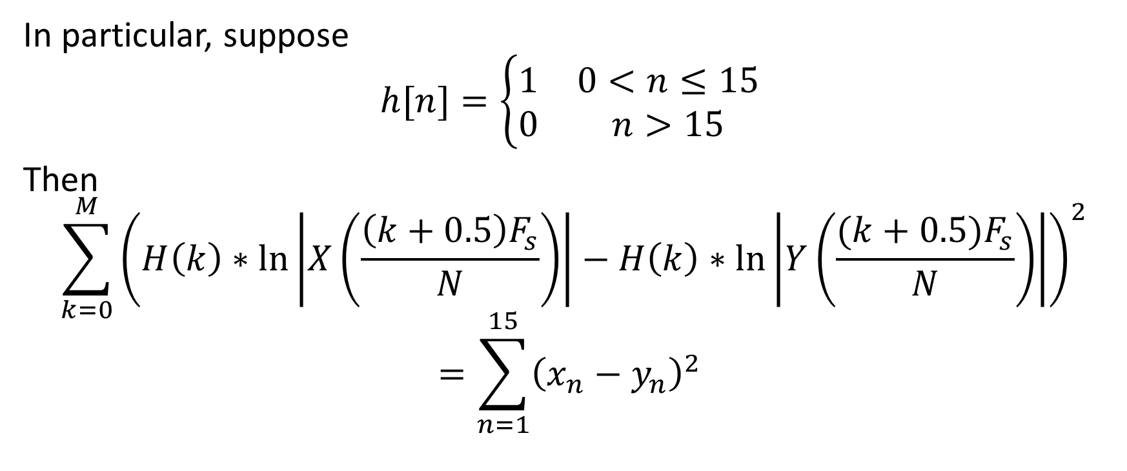
Low-pass liftered L2 norm
In particular, suppose
$$h[n]=\left\{\begin{matrix}1 & 0<n≤15 \\ 0 & n>15\end{matrix}\right.$$
Then
$$\sum_{k=0}^{M}{{\left(H\left(k\right)∗\ln\left|X\left(\frac{\left(k+0.5\right)F_{s}}{N}\right)\right|−H\left(k\right)∗\ln\left|Y\left(\frac{(k+0.5)F_{s}}{N}\right)\right|\right)}^{2}}$$
$$=\sum_{n=1}^{15}{{\left(x_{n}−y_{n}\right)}^{2}}$$

Slide 40
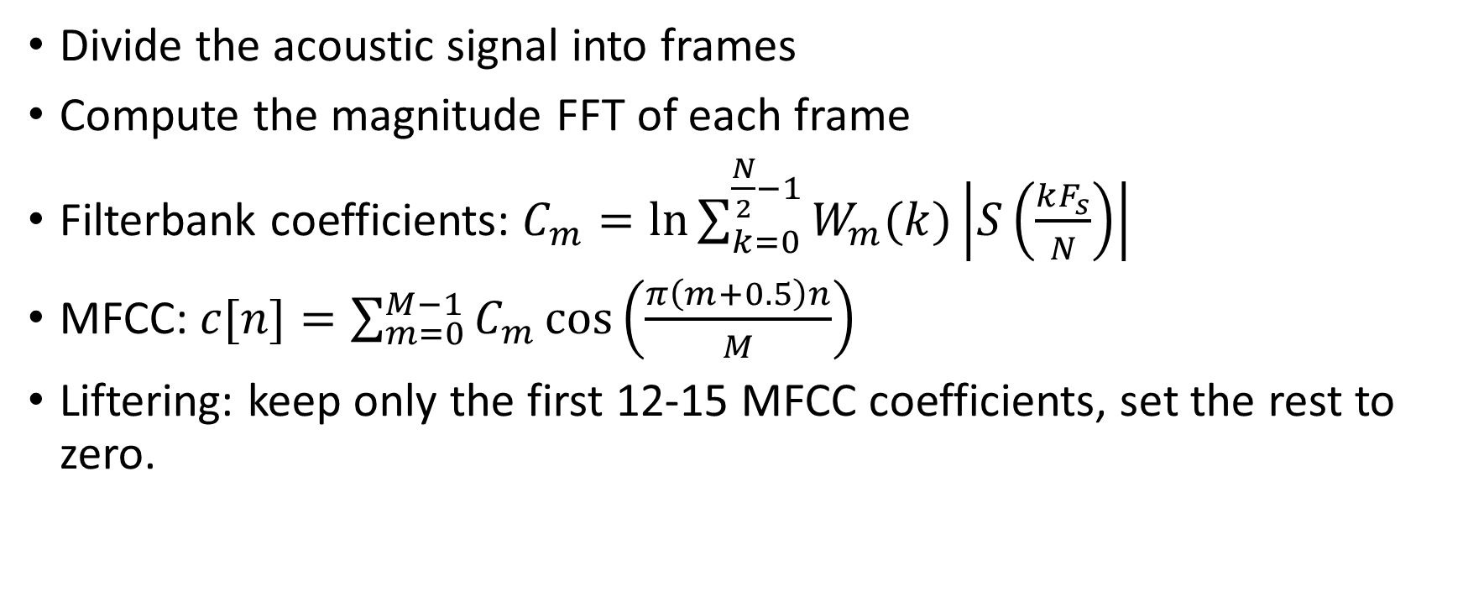
MFCC: mel-frequency cepstral coefficients
Divide the acoustic signal into frames
Compute the magnitude FFT of each frame
Filterbank coefficients: $C_{m}=ln{\sum_{k=0}^{\frac{N}{2}−1}{W_{m}(k)\left|S\left(\frac{kF_{s}}{N}\right)\right|}}$
MFCC: $c[n]=\sum_{m=0}^{M−1}{C_{m}\cos\left(\frac{π\left(m+0.5\right)n}{M}\right)}$
Liftering: keep only the first 12-15 MFCC coefficients, set the rest to zero.

