Slide 1
ECE 417 Lecture 23:
3D Face Modeling
Slides by Vuong Le, Spring 2013
Modified by Mark Hasegawa-Johnson, Fall 2018

Slide 2
Contents
3D Facial Geometry Modeling
3D Facial Geometry Acquisition
3D Facial Deformation Modeling
Applications

Slide 3
3D Facial Geometry Modeling
Polygonal Mesh
3D Morphable Model
Implicit Surface

Slide 4
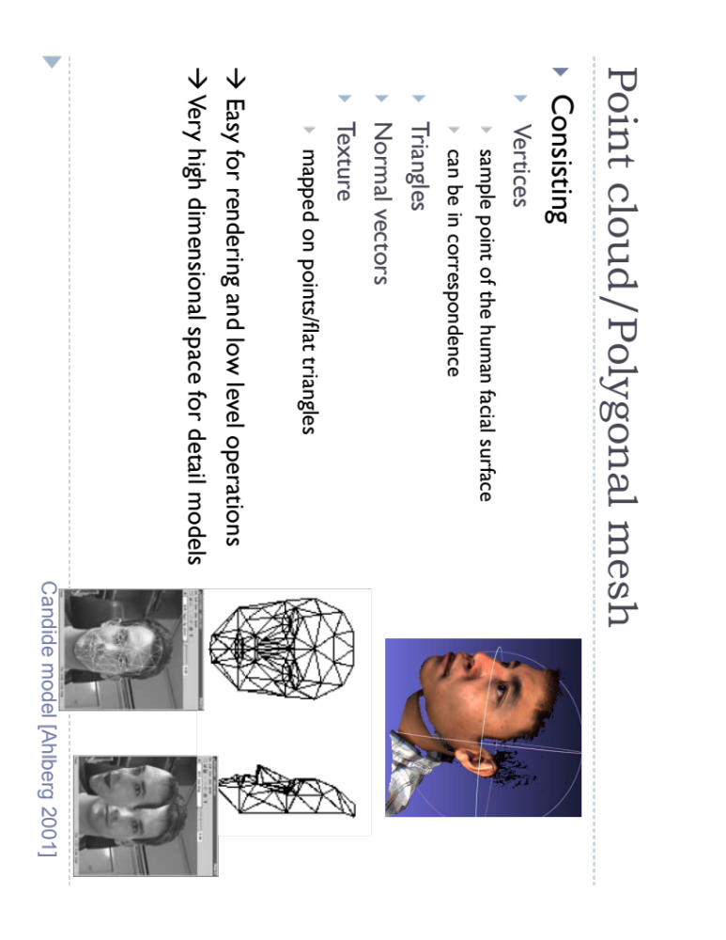

Slide 5
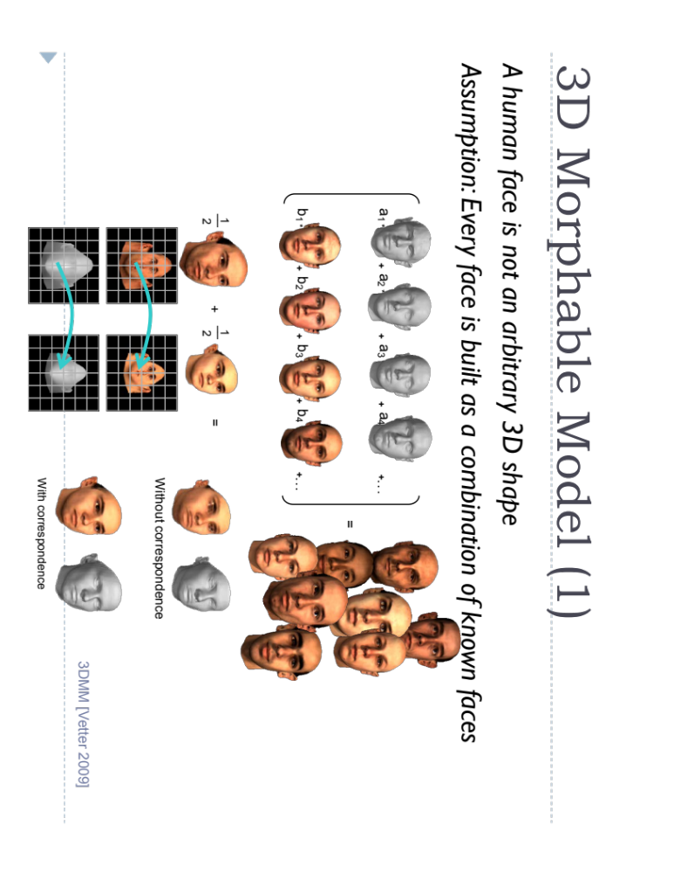

Slide 6
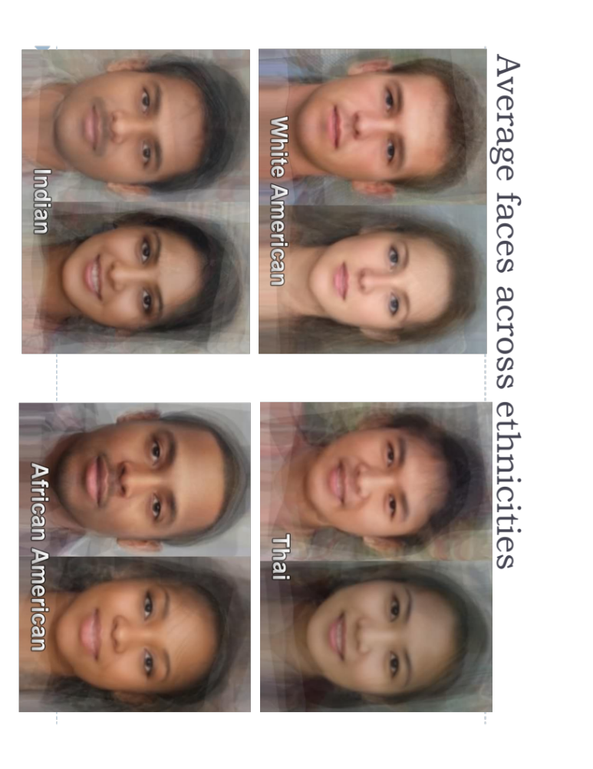

Slide 7
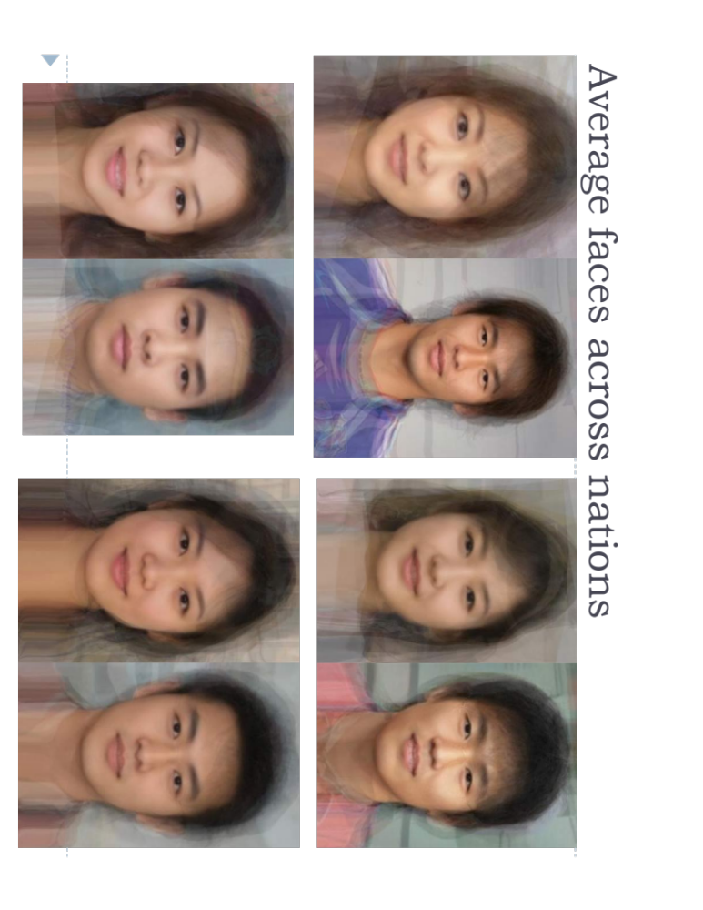

Slide 8
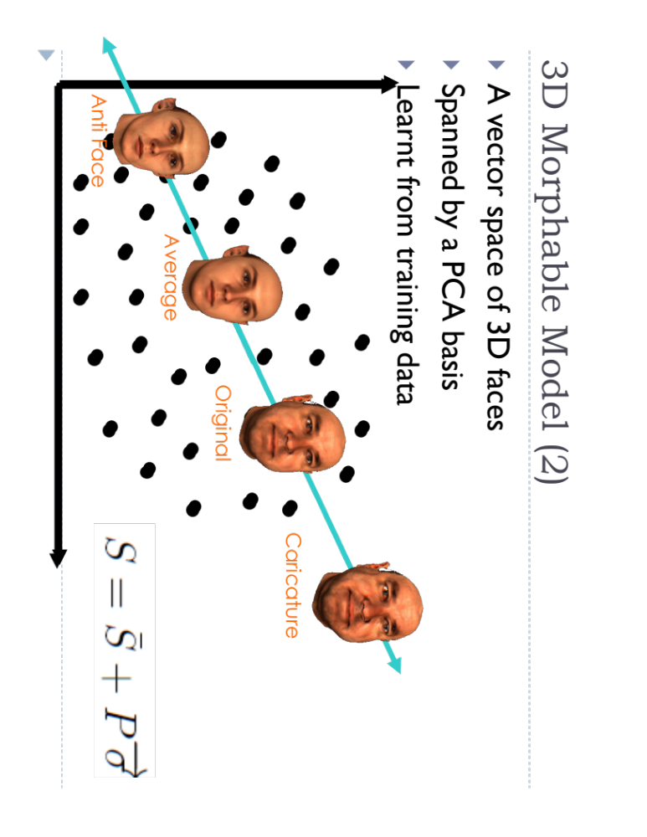

Slide 9
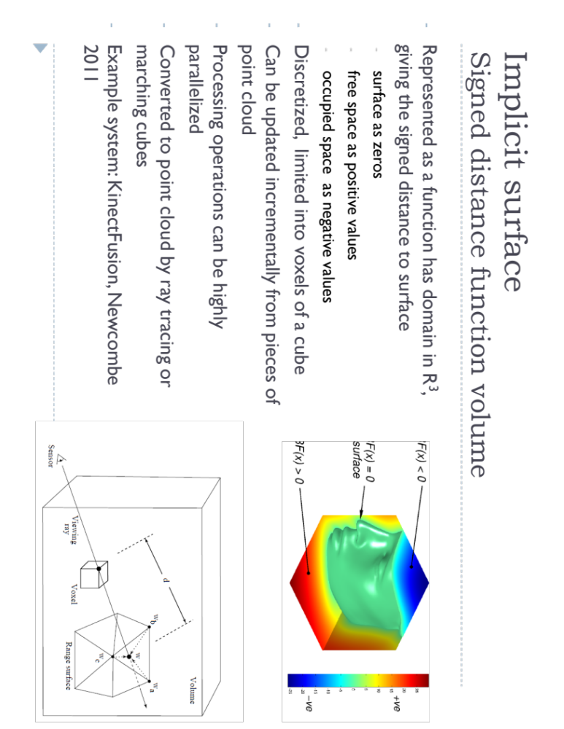

Slide 10
3D Facial Geometry Acquisition
Artist’s Design (skipped)
Active Acquisition
Passive Acquisition
Reconstruction from 2D Images

Slide 11
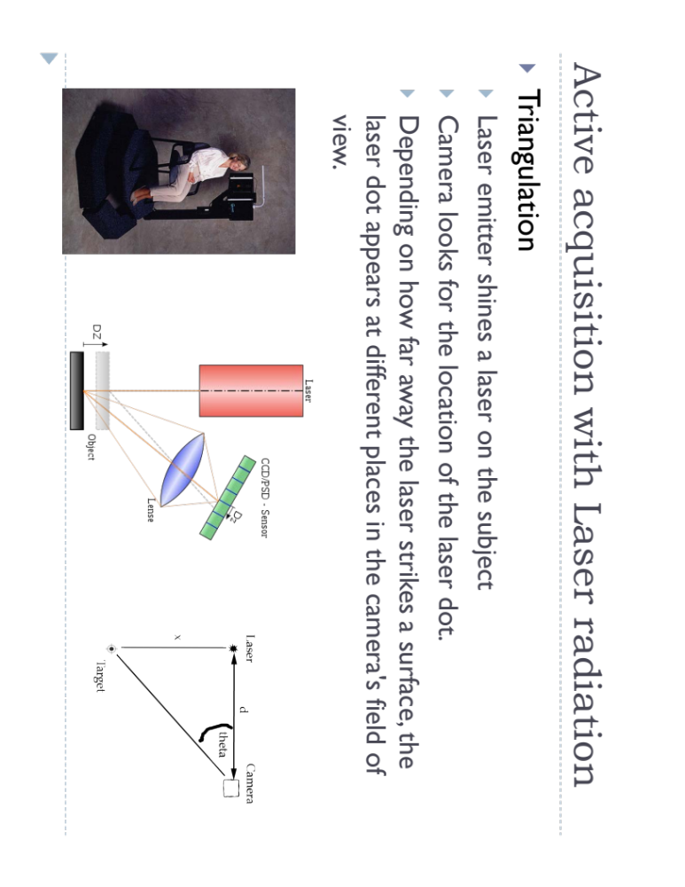

Slide 12
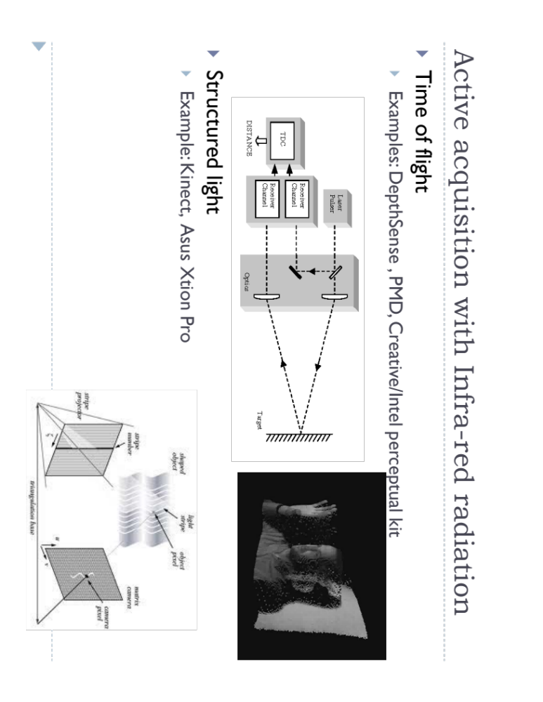

Slide 13
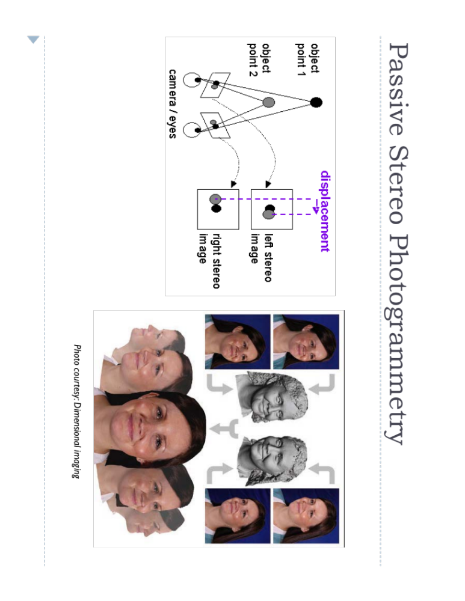

Slide 14
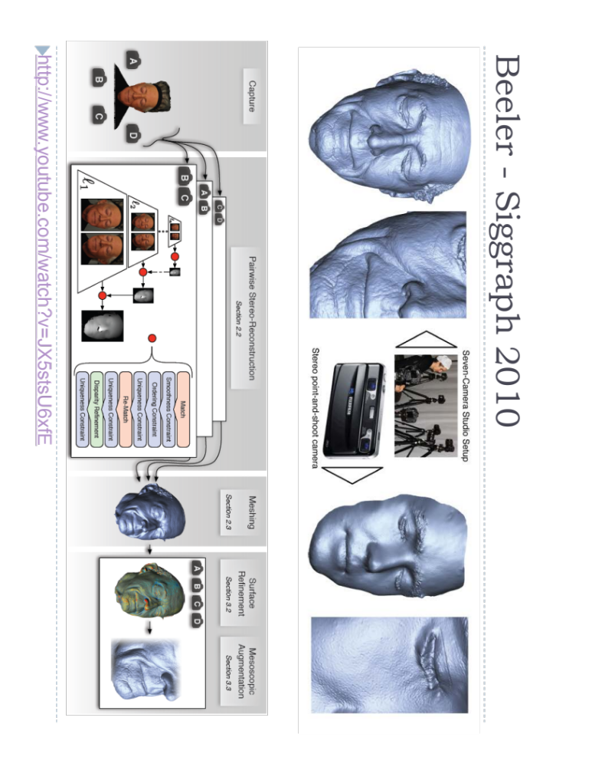

Slide 15
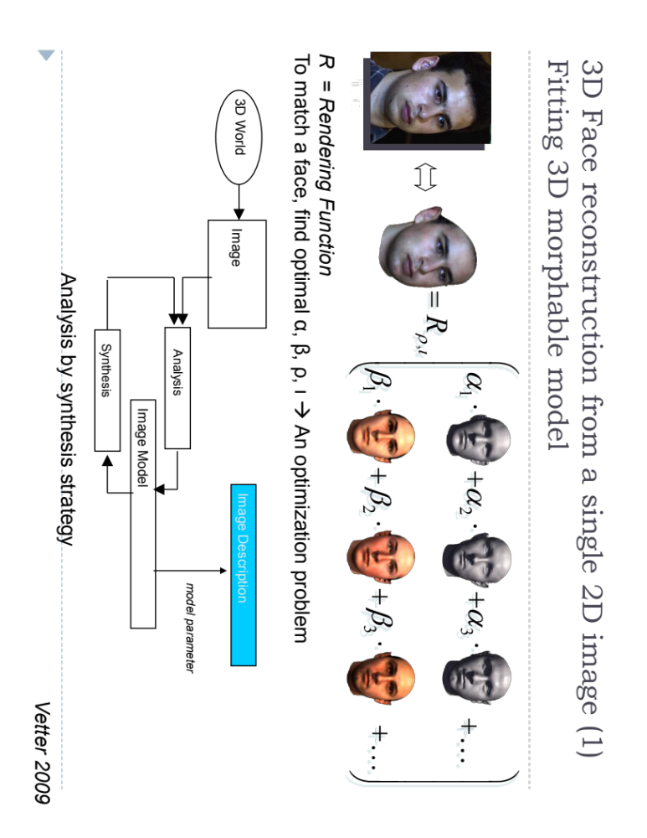

Slide 16
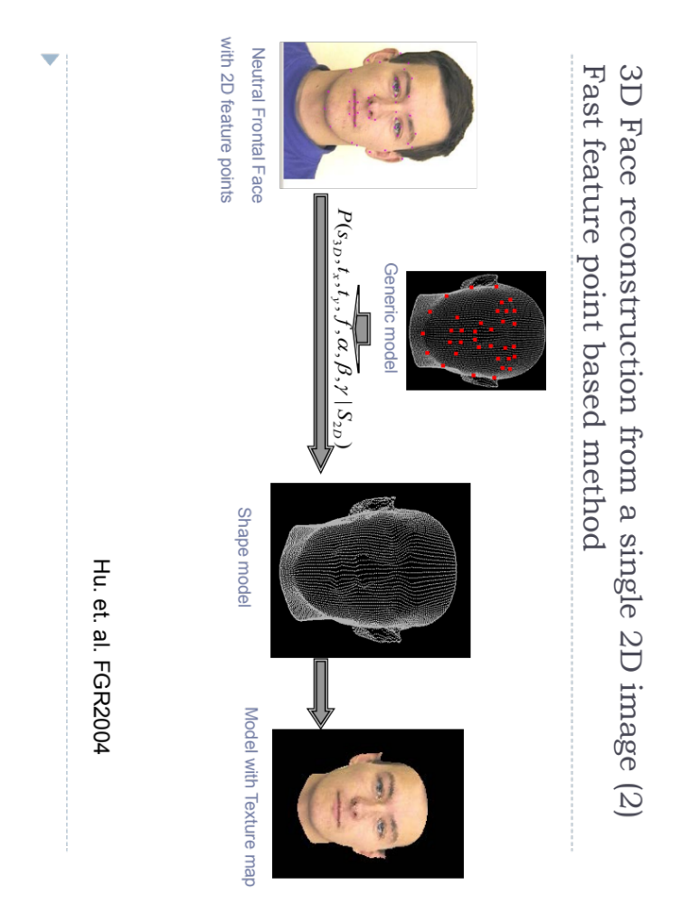

Slide 17
3D Facial Deformation Modeling
Free-form
Bio-kinetics inspired
Facial Action Coding System (Ekman & Friesen, 1978)
Data-driven methods

Slide 18
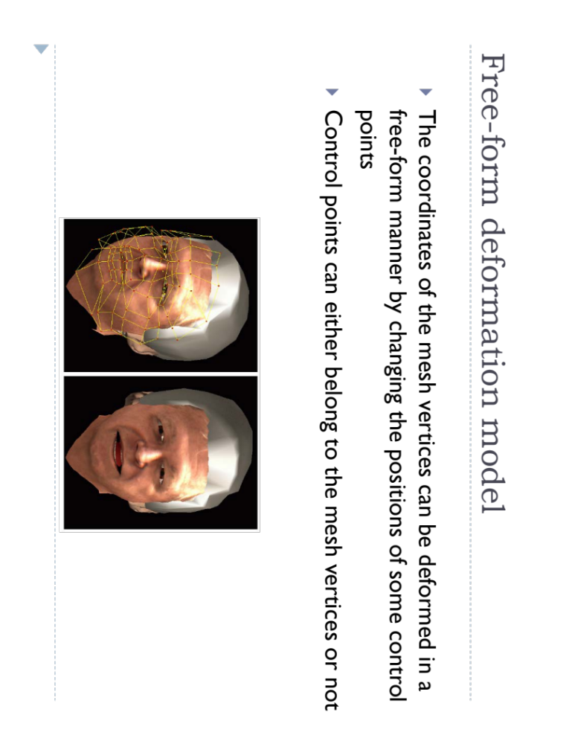

Slide 19
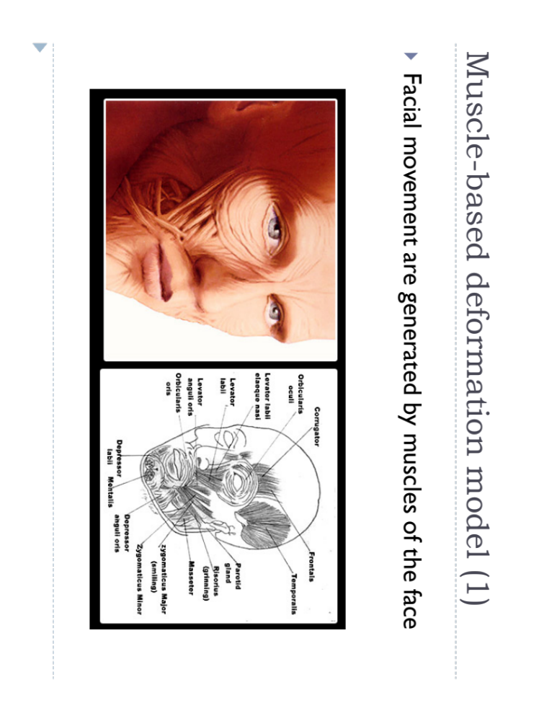

Slide 20
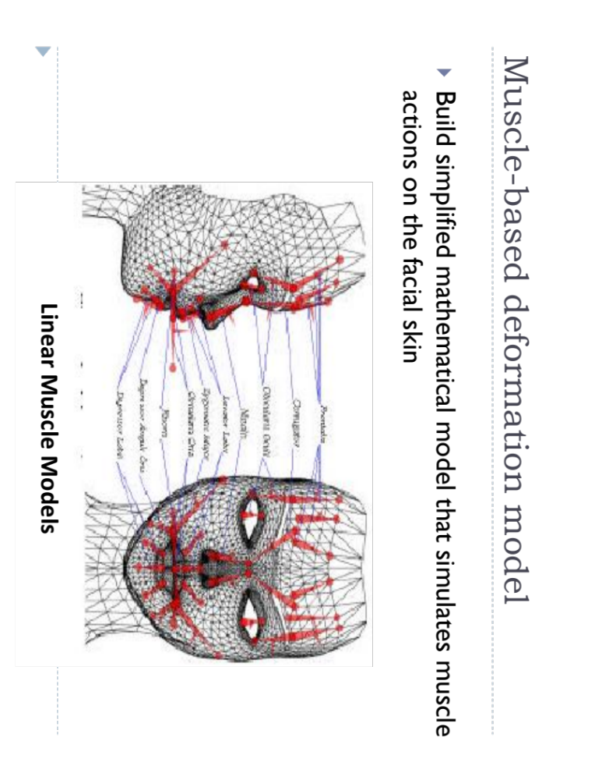

Slide 21
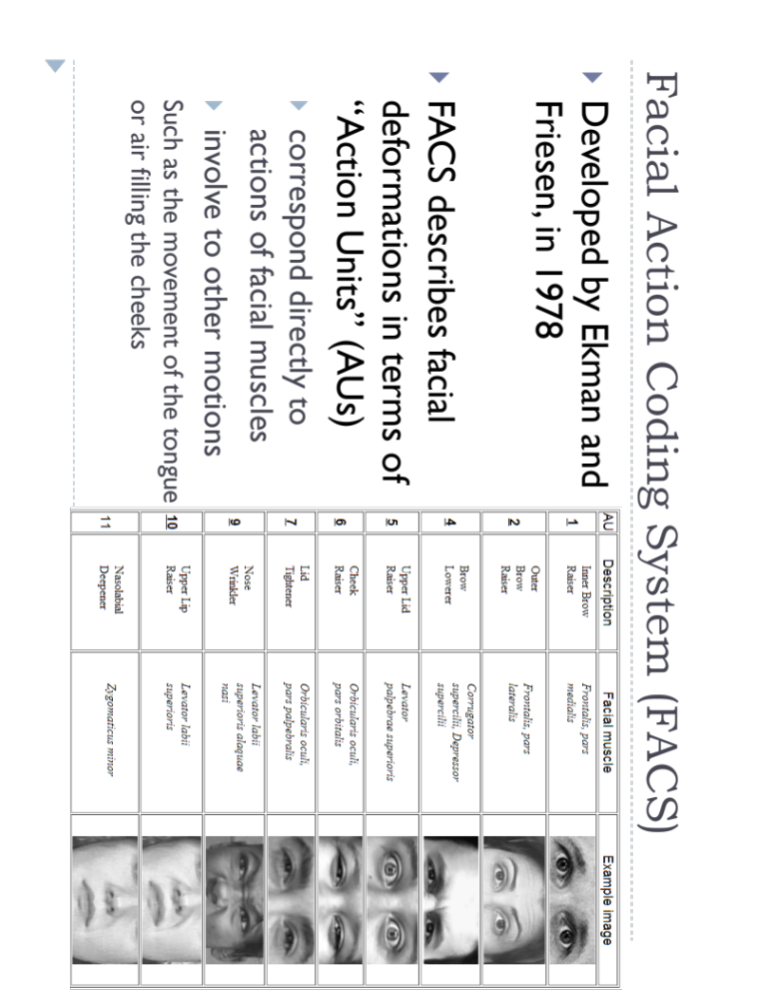

Slide 22
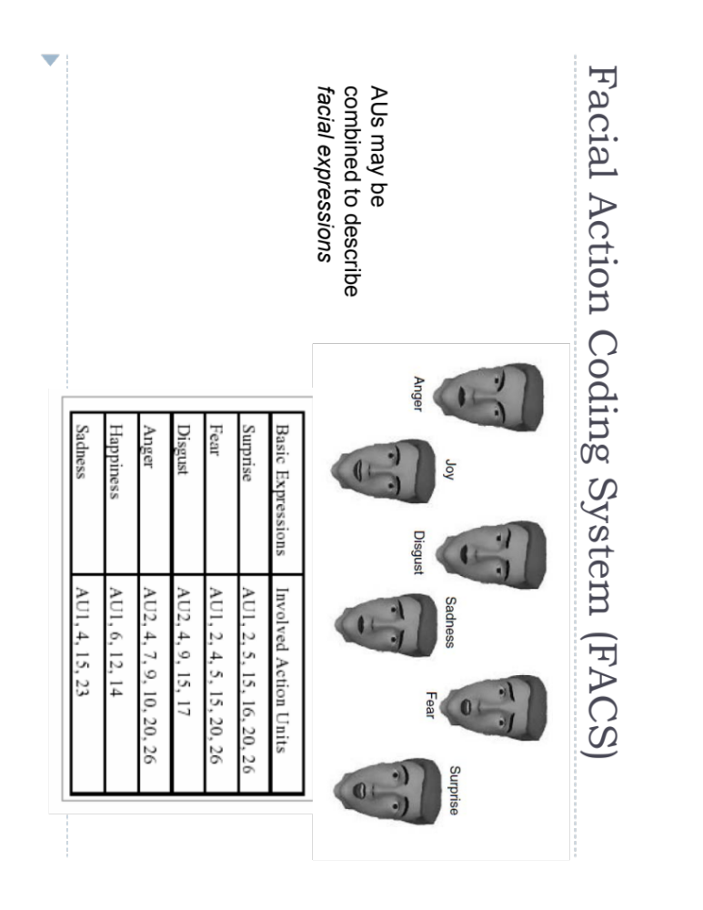

Slide 23
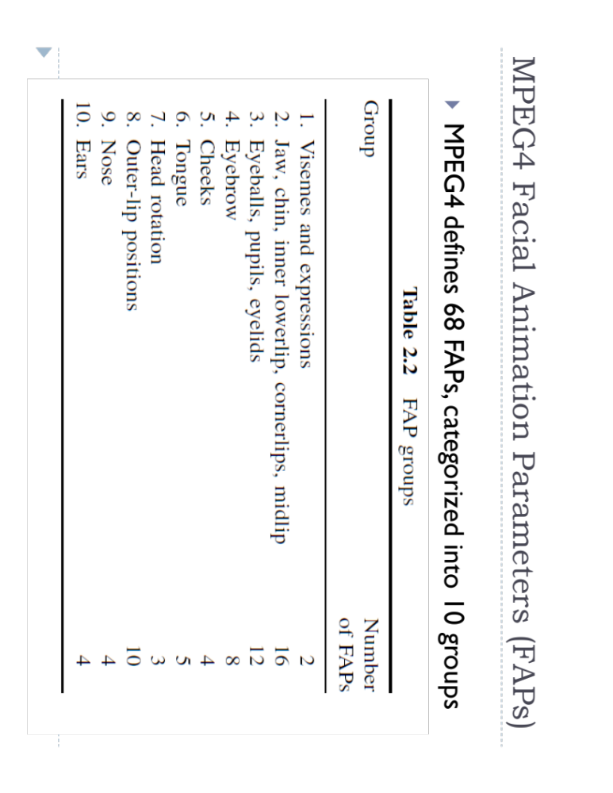

Slide 24
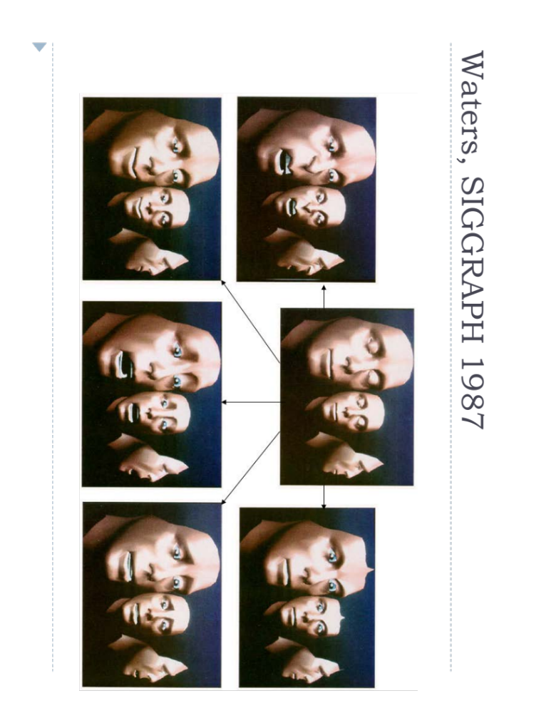

Slide 25
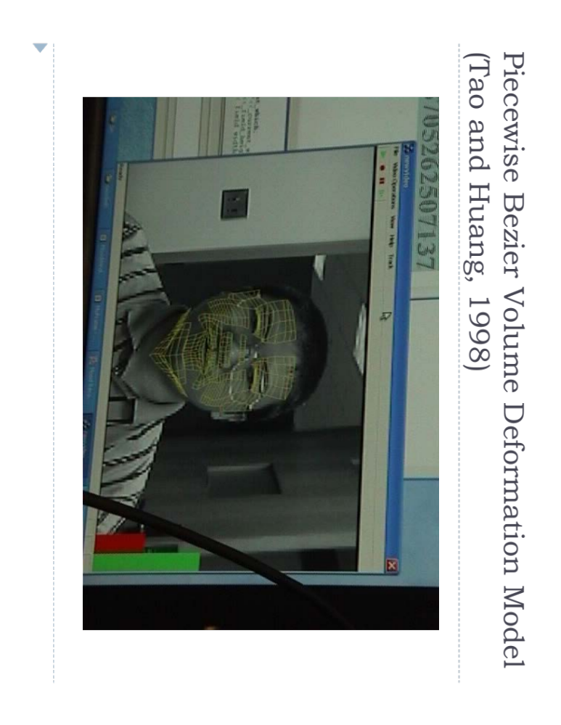

Slide 26
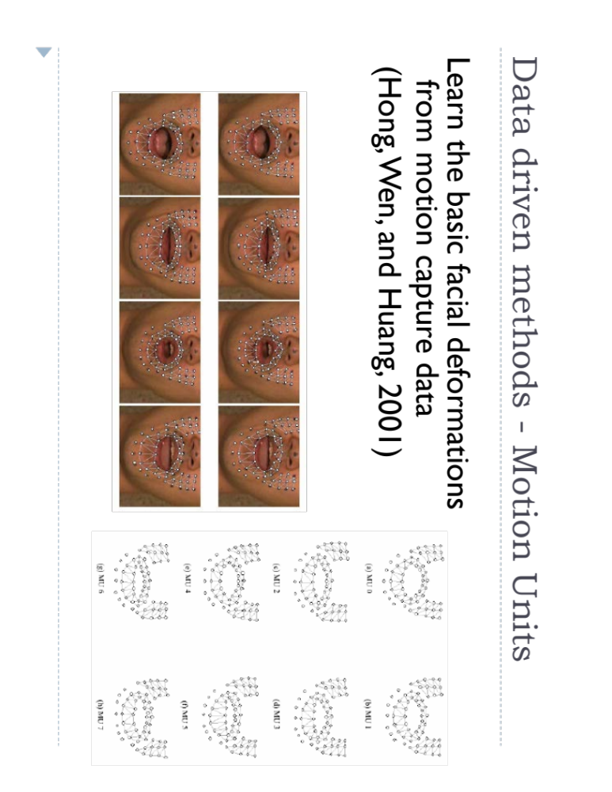

Slide 27
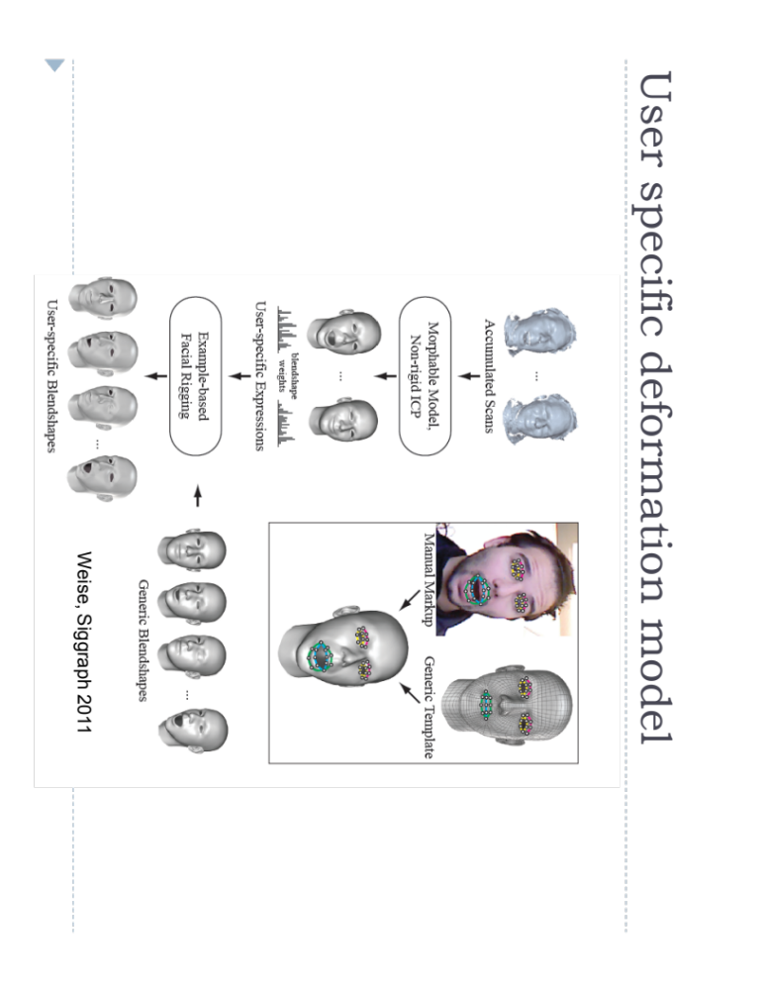

Slide 28
Applications
Face recognition
Face tracking
Emotion recognition
Audiovisual speech recognition
Talking avatar

Slide 29
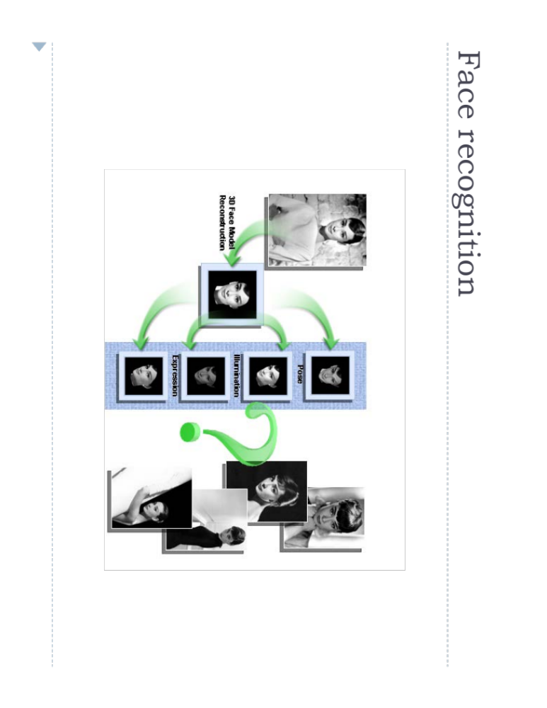

Slide 30
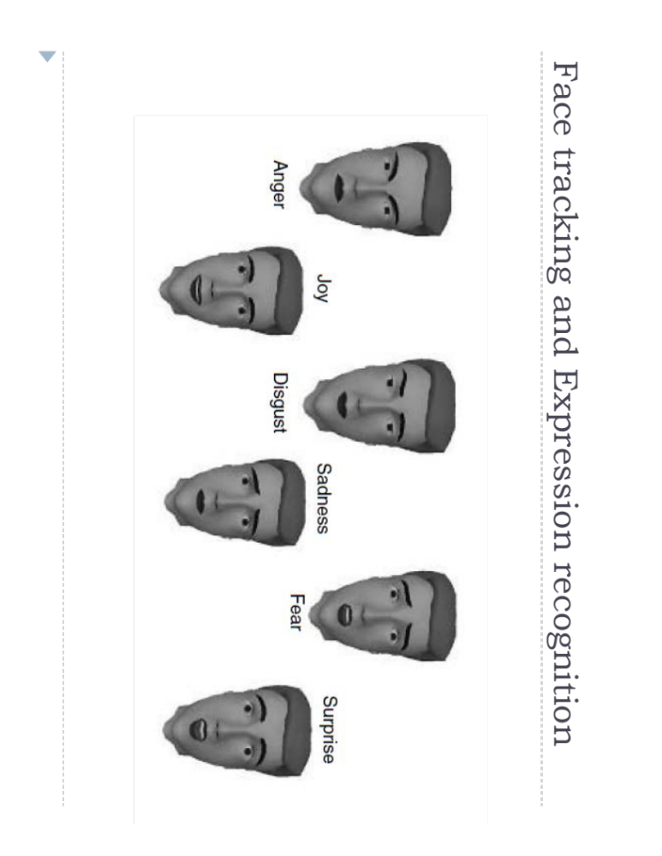

Slide 31
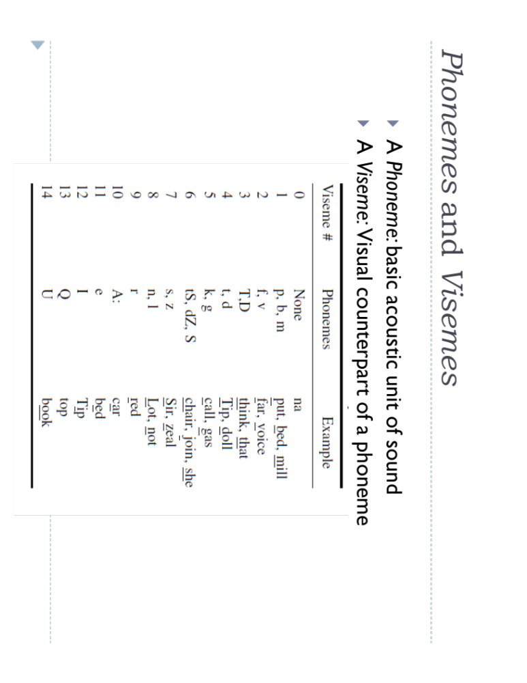
Audio-
Visual
Speech
Recognition
(Sari,
Interspeech
2018)

Slide 32
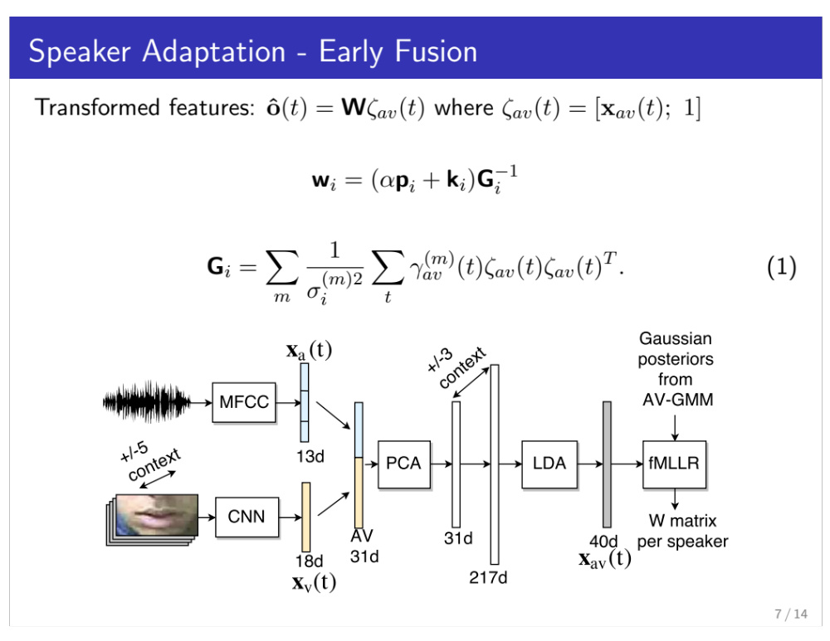
Audio-
Visual
Speech
Recognition
(Sari,
Interspeech
2018)

Slide 33
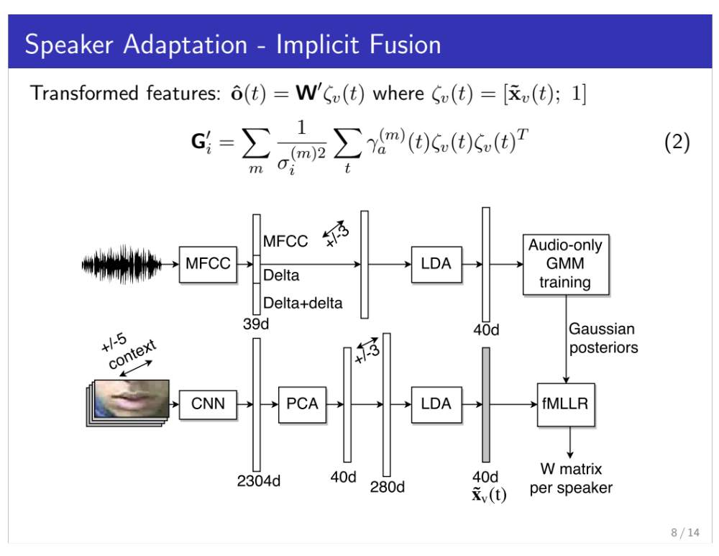
Audio-
Visual
Speech
Recognition
(Sari,
Interspeech
2018)

Slide 34
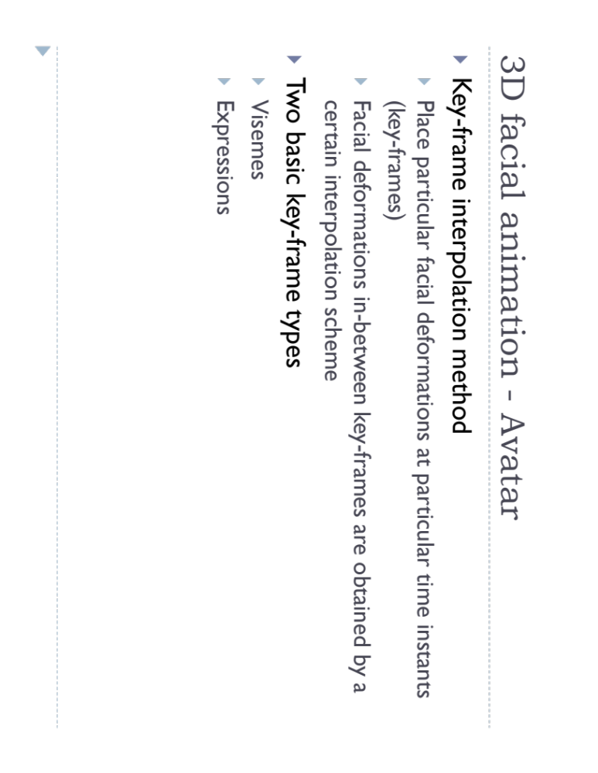

Slide 35
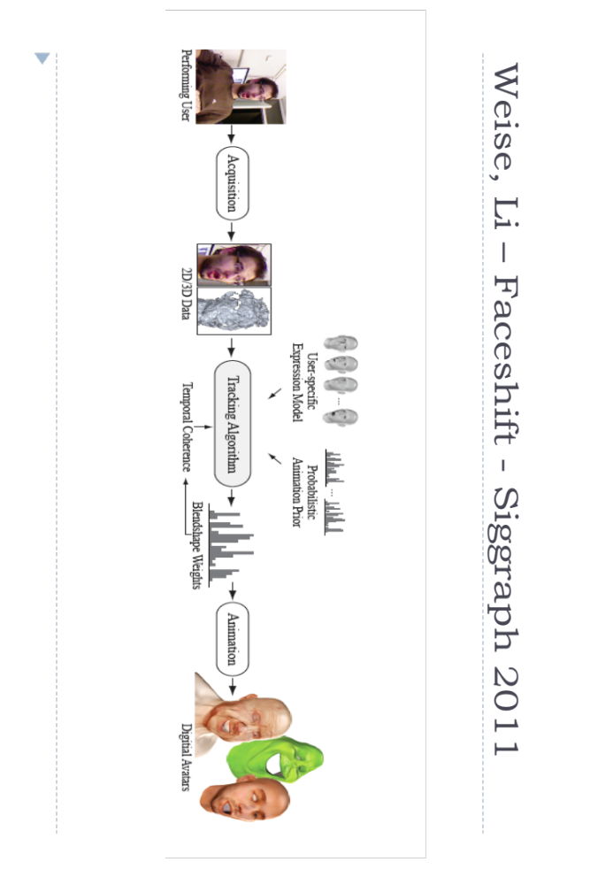

Slide 36
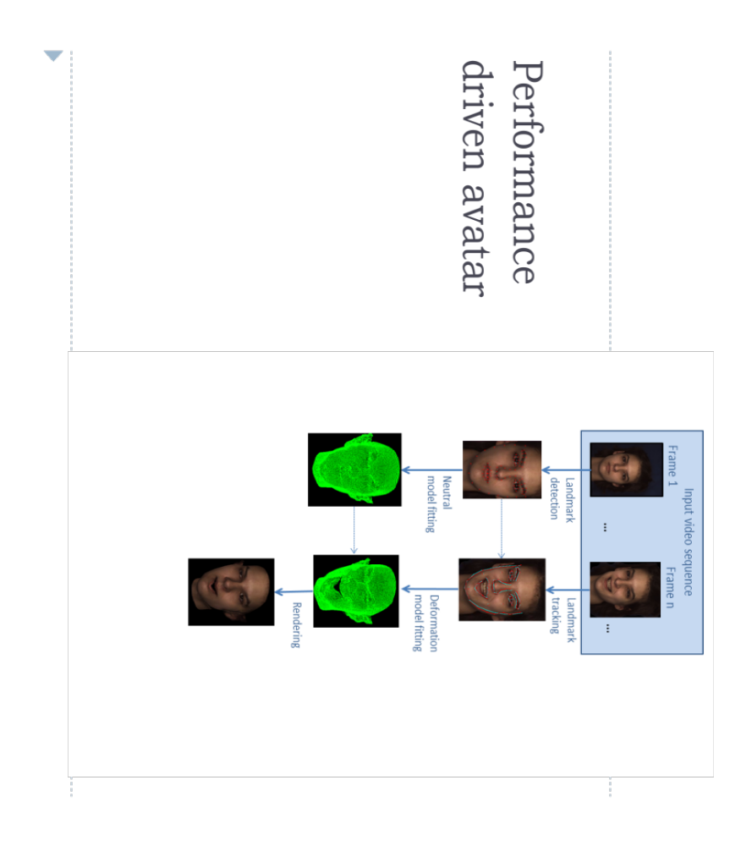

Slide 37
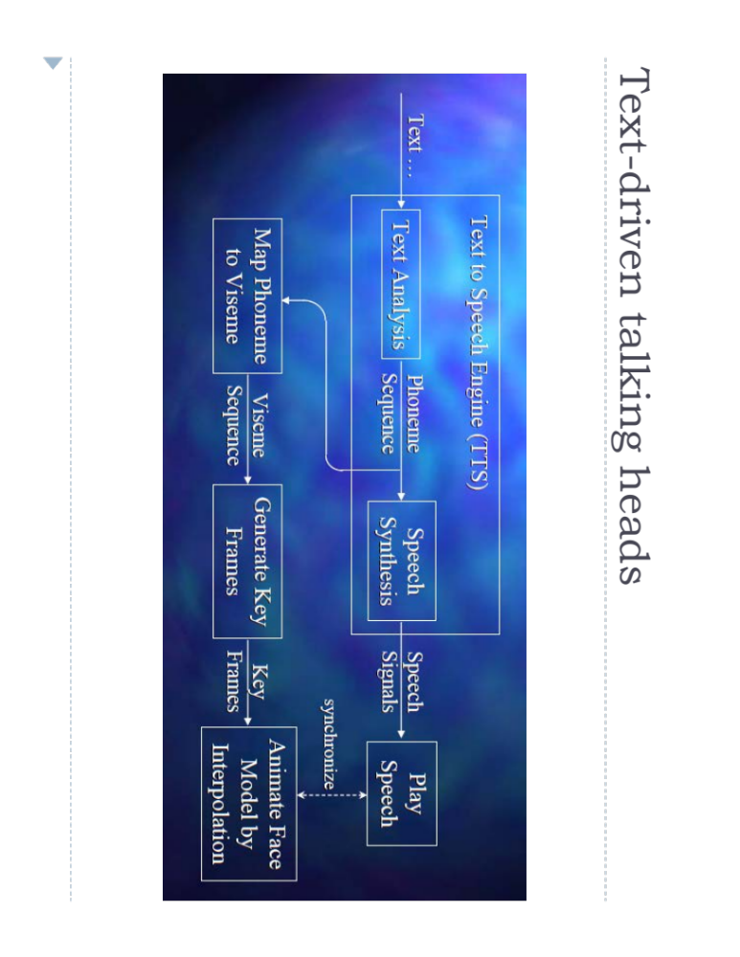

Slide 38
