Slide 1
MP4 Walkthrough
Video Animation
ECE 417 – Multimedia Signal Processing
Fall 2018

Slide 2
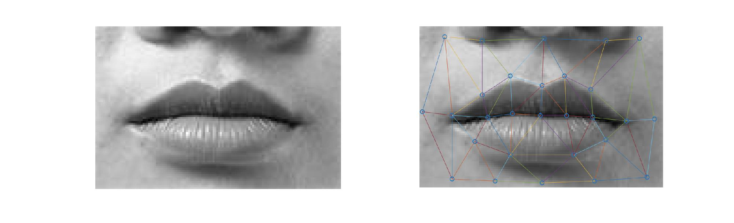
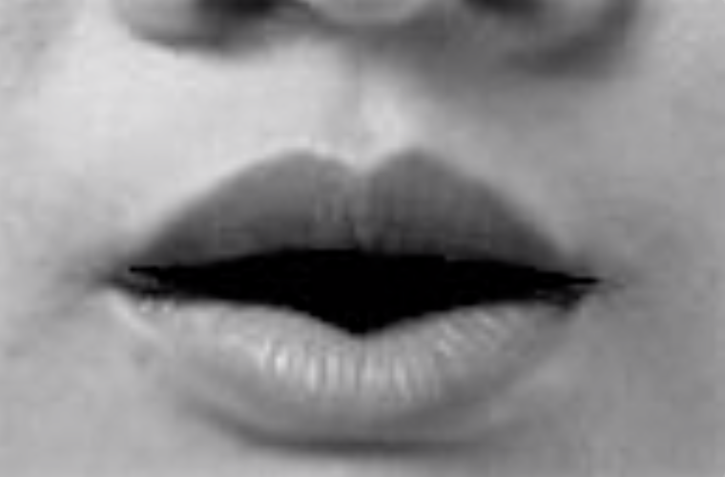
Goal
Generate video frames by warping a static image

Slide 3
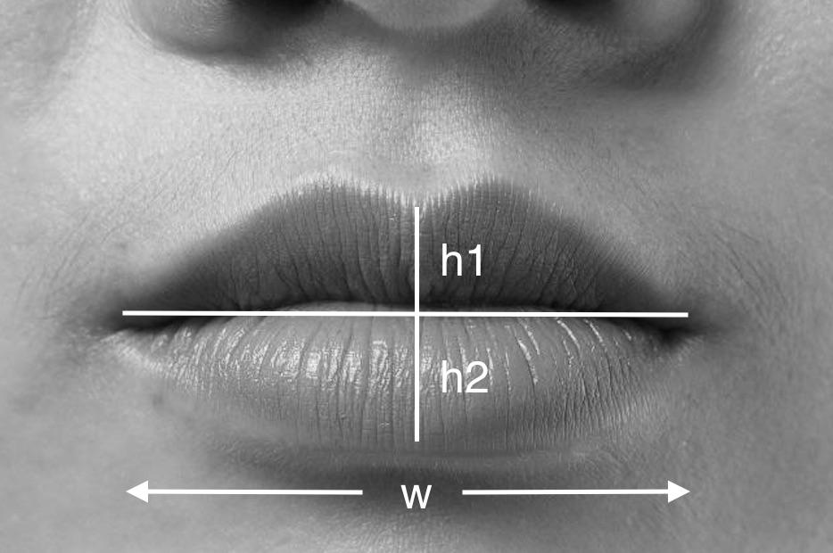

Overview
test.wav
Audio to visual mapping
$∆$W, $∆$h1, $∆$h2
Image Warping
Find new mesh,
Generate deformed
mouth images

Slide 4
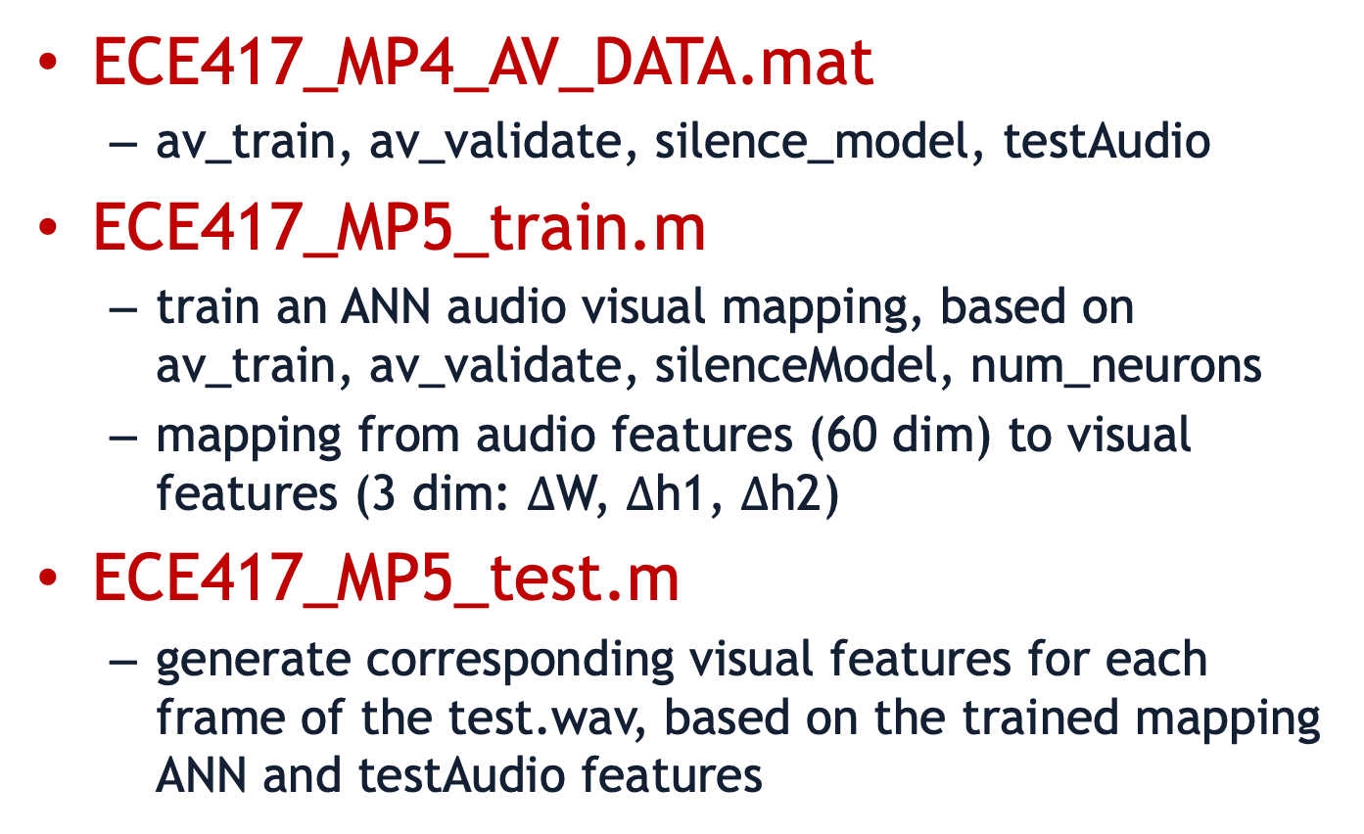
Audio to Visual Mapping
ECE417_MP4_AV_DATA.mat
  av_train, av_validate, silence_model, testAudio
ECE417_MP5_train.m
  train an ANN audio visual mapping, based on av_train, av_validate, silenceModel, num_neurons
  mapping from audio features (60 dim) to visual features (3 dim: $∆$W, $∆$h1, $∆$h2)
ECE417_MP5_test.m
  generate corresponding visual features for each frame of the test.wav, based on the trained mapping ANN and testAudio features

Slide 5
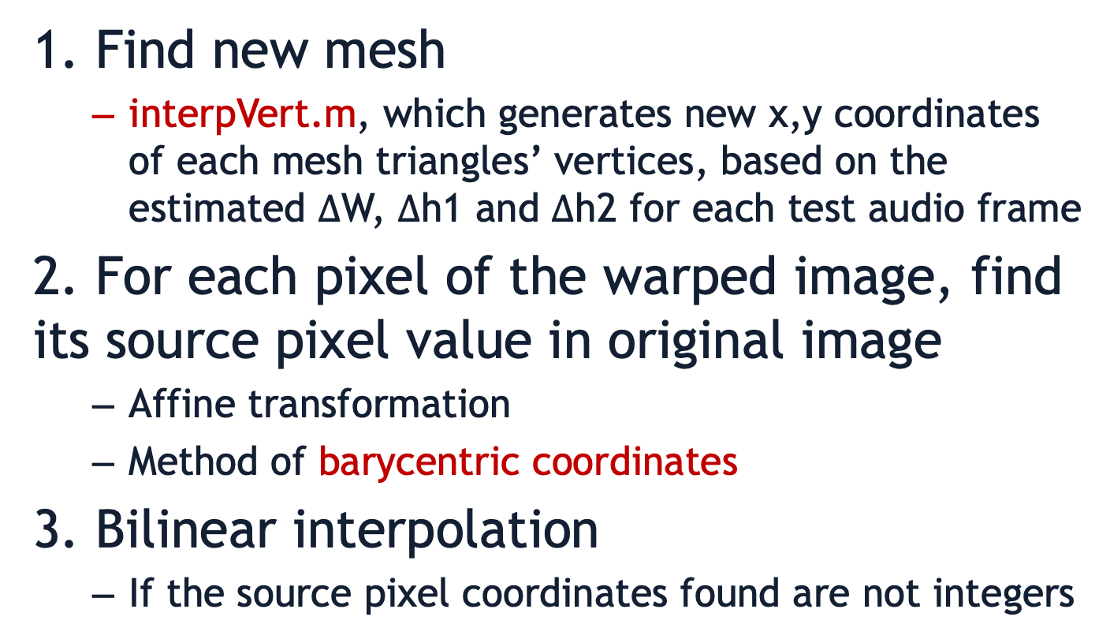
Image warping
1. Find new mesh
  interpVert.m, which generates new x,y coordinates of each mesh triangles’ vertices, based on the estimated $∆$W, $∆$h1 and $∆$h2 for each test audio frame
2. For each pixel of the warped image, find its source pixel value in original image
  Affine transformation
  Method of barycentric coordinates
3. Bilinear interpolation
  If the source pixel coordinates found are not integers

Slide 6
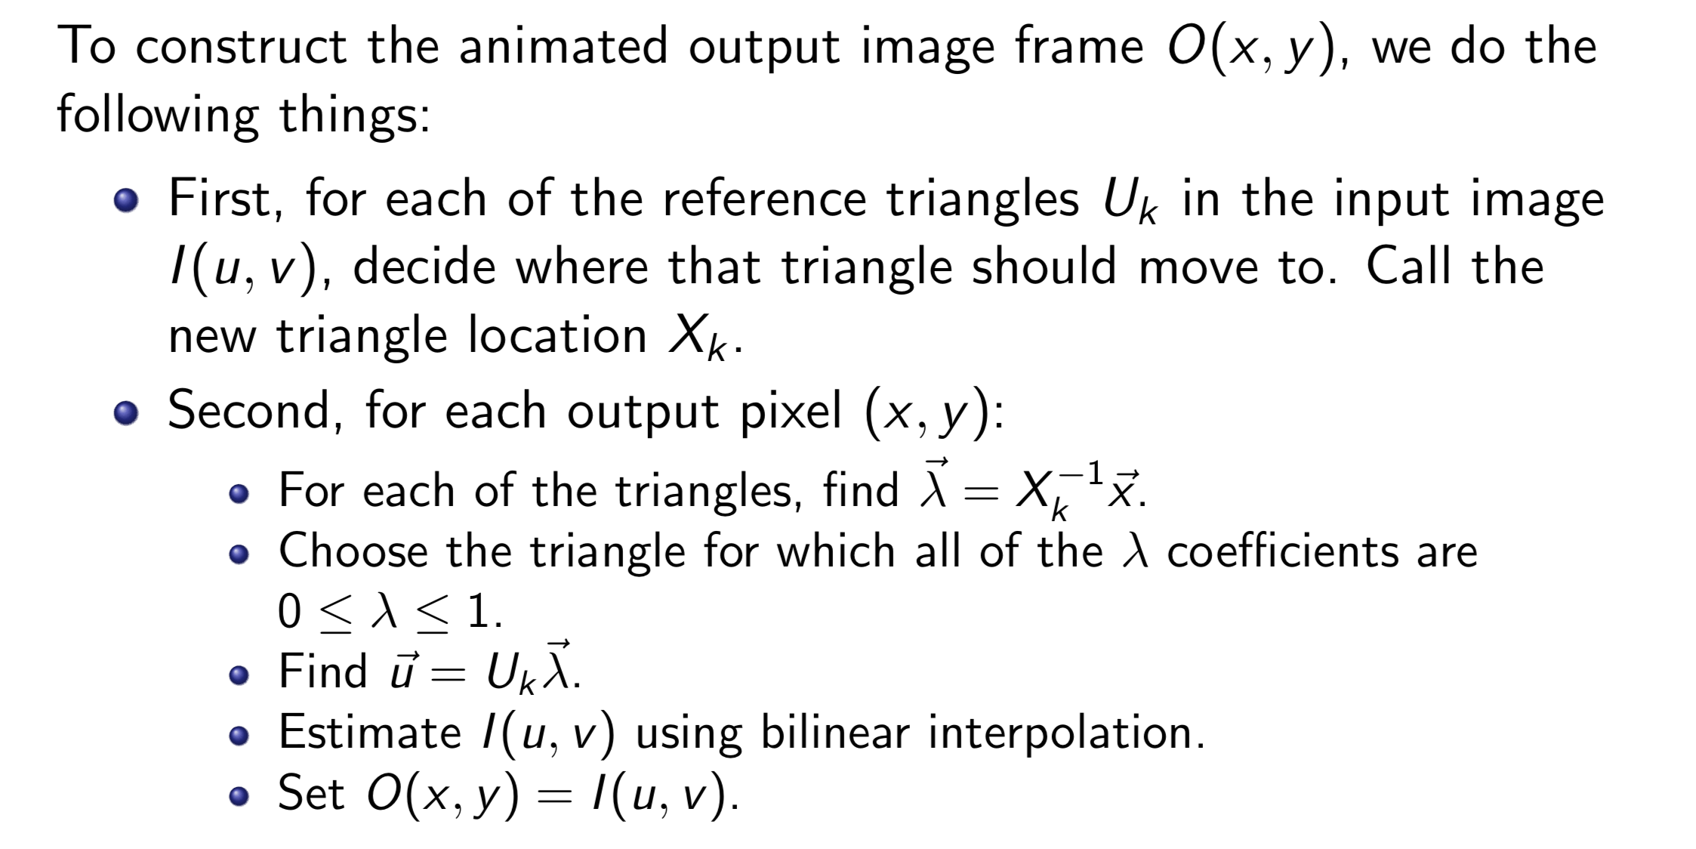
Barycentric Coordinates
Find new
mesh
Barycentric
coordinates

Slide 7
Bilinear Interpolation
u
int(u), int(v)
int(u)+1, int(v)
e
Pixel value at (u,v) =
(1-f)(1-e)I[int(u),int(v)]
+f(1-e)I[int(u)+1,int(v)]
+e(1-f)I[int(u),int(v)+1]
+efI[int(u)+1,int(v)+1]
f
(u,v)
v
int(u), int(v)+1
int(u)+1, int(v)+1

Slide 8
Produce animation movie
Generate mouth images for each frame of test audio (described in the past slides)
Create a video that connects the generated mouth frames
  Save images in JPEG and use the provided DxBMP.exe to convert image sequence to video
  Use matlab’s VideoWriter object to directly write frames into video
Create an animation movie, by combining video with test.wav
  Windows Movie Maker, or VirtualDub, or imovie, or any other movie program of your choice

Slide 9
Extra Credits [20%]
Choose up to two of them, for earning up to 10% extra credit each
  Replace interpVert.m with a function that computes the lip positions in some other way. Try to come up with a function that makes more realistic mouth shapes than interpVert.m.
  Implement the forward neural network in python, and show that you can use the same network weights to generate the same outputs from your python code.
  Animate a new face image: either your own face, or any face that you download from the internet.
  The open mouth is unrealistic, in part because there is no tongue or teeth. Find a somewhat realistic way to show the tongue and teeth in your animated image.
  The neural net sometimes fails to correctly guess lip positions because sometimes the audio signal doesnt contain enough information. Can you think of some auxiliary signal you could give, that would tell the lips when to open? Can you find a way to incorporate that into your animation?

Slide 10
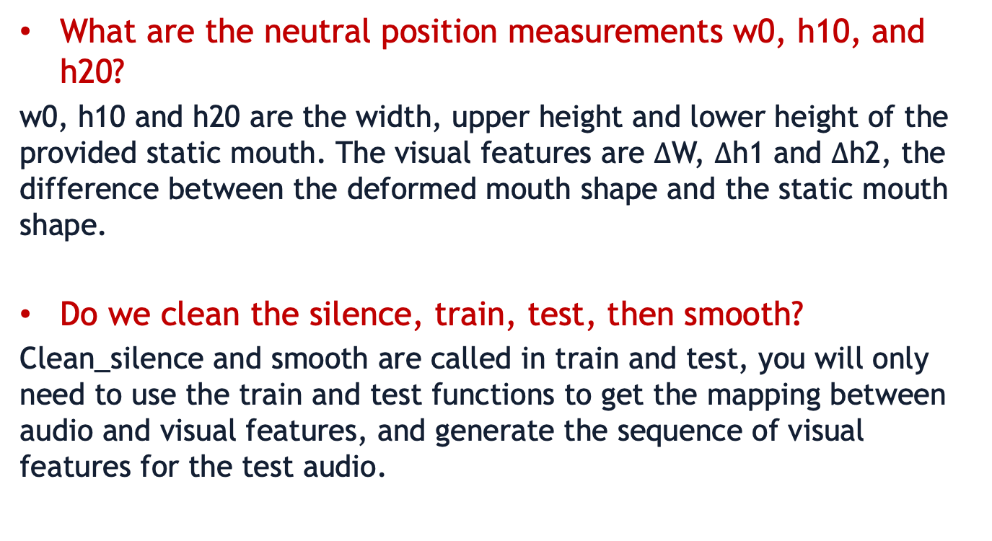
FAQ
What are the neutral position measurements w0, h10, and h20?
w0, h10 and h20 are the width, upper height and lower height of the provided static mouth. The visual features are $∆$W, $∆$h1 and $∆$h2, the difference between the deformed mouth shape and the static mouth shape.
Do we clean the silence, train, test, then smooth?
Clean_silence and smooth are called in train and test, you will only need to use the train and test functions to get the mapping between audio and visual features, and generate the sequence of visual features for the test audio.

Slide 11
FAQ
How are we supposed to check whether a pixel is in the holes inside lips or not?
If the pixel is not in any triangle mesh, leave it black(pixel value of 0). These black pixels should cover all the pixels outside the mesh or in the holes inside the lips.
How should we get the data about widths and heights of neutral lips?
You don't necessarily need to know the specific widths and heights of the neutral lips. The ANN outputs the change of widths and heights between deformed mouth and static mouth. So for the interpVert.m, you can set any reference value for neutral_w, neutral_h1, neutral_h2. w, h1, h2 should then be the reference neutral values plus the change you got from ANN.

Slide 12
Turn In
Movie file you generated
Report
  Describe how you do this MP
  Discussion about your results or any problems you met
  [Optional] document which extra credit you choose, how you did the task and show your results as well as the analysis in the end
  File names must be <Lastname>_<Firstname>_report.pdf
Code
  Readme file
  File names must be <Lastname>_<Firstname>_code.zip
Submission
  Submit your movie, report (PDF) and codes (zip) to Compass
  Teams will submit a single report but make sure that all names are included in the report

