Slide 1
ECE 417, Lecture 9: Exam 1 Review
Mark Hasegawa-Johnson
9/25/2017

Slide 2
Exam Details
In class, Thursday 9/28
No calculators. Solutions can be numerical equations (e.g., cos(0.74))
One page of hand-written notes, front & back
The exam will be composed of 4 long-answer problems

Slide 3
Outline: Course material until now
Distance; Minkowski; Mahalanobis
Gaussians: 1-D, Multi-dimensional
Eigenvectors and PCA (SVD and Gram matrices are not on the exam)
Classifiers: KNN (especially 1-NN) and Bayesian

Slide 4
Distance

Slide 5
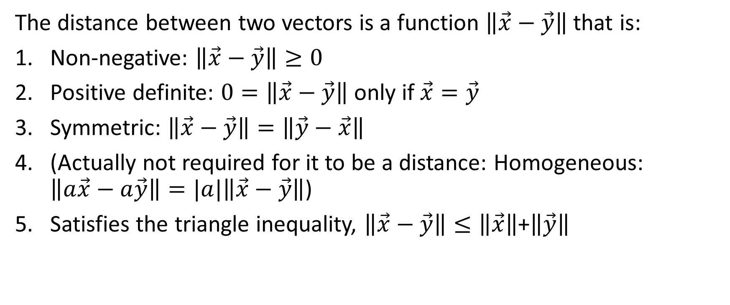
Distance
The distance between two vectors is a function $\left\|\vec{x}−\vec{y}\right\|$ that is:
Non-negative: $\left\|\vec{x}−\vec{y}\right\|≥0$
Positive definite: $0=\left\|\vec{x}−\vec{y}\right\|$ only if $\vec{x}=\vec{y}$
Symmetric: $\left\|\vec{x}−\vec{y}\right\|=\left\|\vec{y}−\vec{x}\right\|$
(Actually not required for it to be a distance: Homogeneous: $\left\|a\vec{x}−a\vec{y}\right\|=|a|\left\|\vec{x}−\vec{y}\right\|$)
Satisfies the triangle inequality, $\left\|\vec{x}−\vec{y}\right\|≤\left\|\vec{x}\right\|$+$\left\|\vec{y}\right\|$

Slide 6
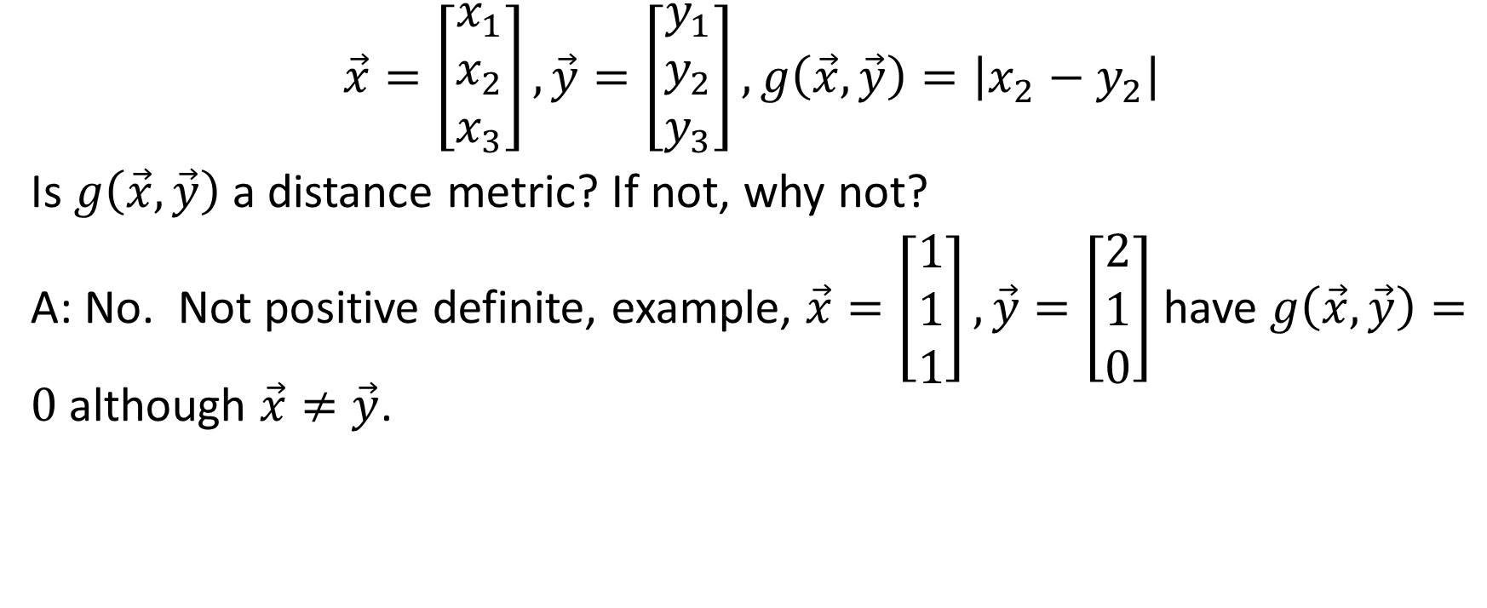
Example Problem
$$\vec{x}=\left[\begin{matrix}x_{1} \\ x_{2} \\ x_{3}\end{matrix}\right],\vec{y}=\left[\begin{matrix}y_{1} \\ y_{2} \\ y_{3}\end{matrix}\right],g\left(\vec{x},\vec{y}\right)=\left|x_{2}−y_{2}\right|$$
Is $g\left(\vec{x},\vec{y}\right)$ a distance metric? If not, why not?
A: No. Not positive definite, example, $\vec{x}=\left[\begin{matrix}1 \\ 1 \\ 1\end{matrix}\right],\vec{y}=\left[\begin{matrix}2 \\ 1 \\ 0\end{matrix}\right]$ have $g\left(\vec{x},\vec{y}\right)=0$ although $\vec{x}≠\vec{y}$.

Slide 7

Minkowski Norm
$${\left\|\vec{x}−\vec{y}\right\|}_{p}=\sqrt[p]{{|x_{1}−y_{1}|}^{p}+…+{|x_{D}−y_{D}|}^{p}}$$

Slide 8

Example
Suppose $\vec{x}=\left[\begin{matrix}x_{1} \\ x_{2} \\ x_{3}\end{matrix}\right]$ and ${{x_{1}=x}_{2}=x}_{3}$ and ${\left\|\vec{x}\right\|}_{p}=2.$ Find $x_{1}$ as a function of $p$.
Answer: $x_{1}=2/3^{1/p}$.

Slide 9
(|x1|^p + |x2|^p+ |x3|^p)^(1/p) = 2
|x1|^p + |x2|^p+ |x3|^p = 2^p
|x1|^p + |x1|^p + |x1|^p = 2^p
|x1|^p = 2^p / 3
x1 = 2 / (3)^(1/p) = 2 3^(-1/p)
Or if p is even,
x1 = - 2 3^(-1/p)

Slide 10
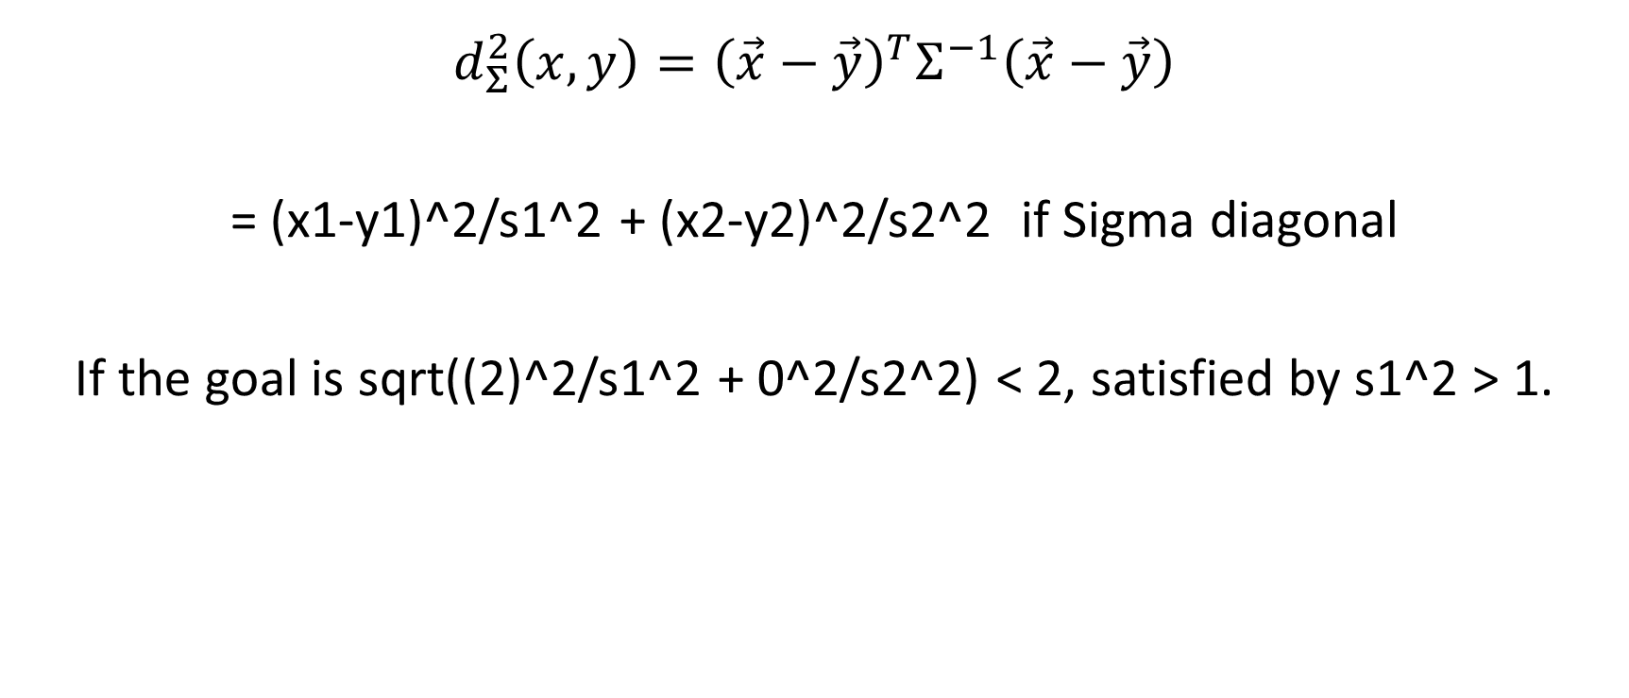
Mahalanobis Distance
$${d_{Σ}^{2}\left(x,y\right)=\left(\vec{x}−\vec{y}\right)}^{T}Σ^{−1}\left(\vec{x}−\vec{y}\right)$$
= (x1-y1)^2/s1^2 + (x2-y2)^2/s2^2 if Sigma diagonal
If the goal is sqrt((2)^2/s1^2 + 0^2/s2^2) < 2, satisfied by s1^2 > 1.

Slide 11
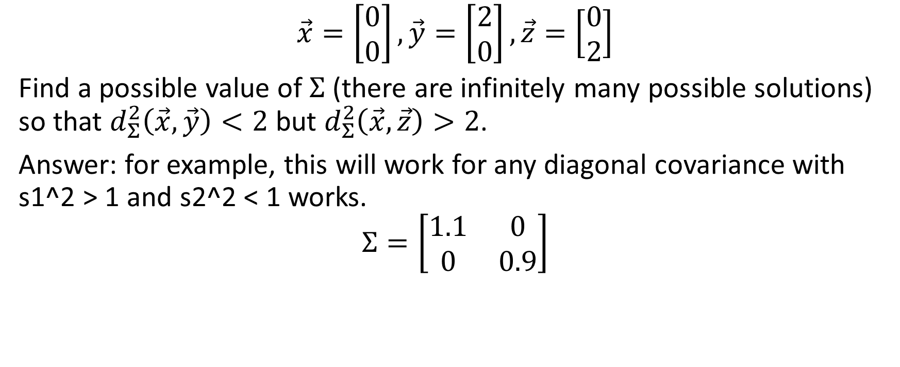
Example
$$\vec{x}=\left[\begin{matrix}0 \\ 0\end{matrix}\right],\vec{y}=\left[\begin{matrix}2 \\ 0\end{matrix}\right],\vec{z}=\left[\begin{matrix}0 \\ 2\end{matrix}\right]$$
Find a possible value of $Σ$ (there are infinitely many possible solutions) so that $d_{Σ}^{2}\left(\vec{x},\vec{y}\right)<2$ but $d_{Σ}^{2}\left(\vec{x},\vec{z}\right)>2$.
Answer: for example, this will work for any diagonal covariance with s1^2 > 1 and s2^2 < 1 works.
$$Σ=\left[\begin{matrix}1.1 & 0 \\ 0 & 0.9\end{matrix}\right]$$

Slide 12
Gaussians

Slide 13
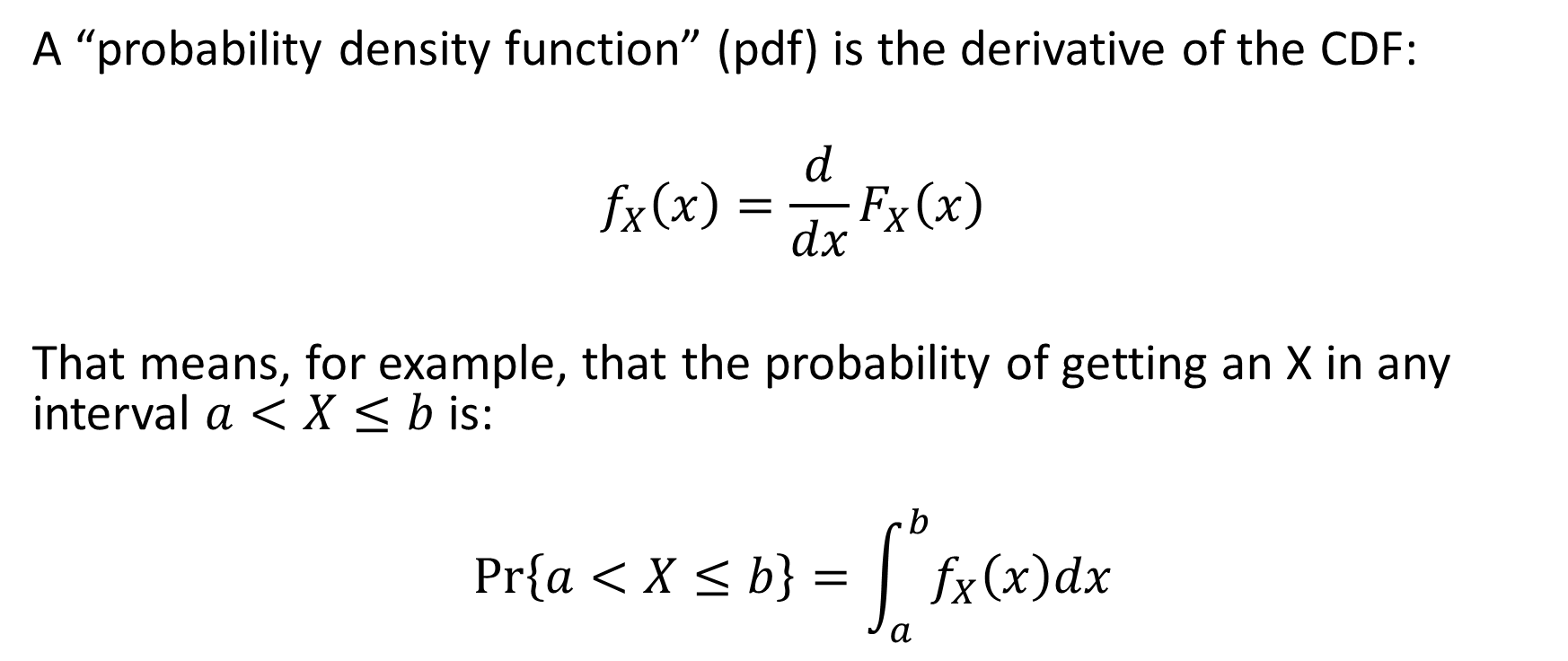
Probability Density Function (pdf)
A “probability density function” (pdf) is the derivative of the CDF:
$$f_{X}\left(x\right)=\frac{d}{dx}F_{X}\left(x\right)$$
That means, for example, that the probability of getting an X in any interval $a<X≤b$ is:
$$\operatorname{Pr}\left\{a<X≤b\right\}=\int_{a}^{b}{f_{X}\left(x\right)dx}$$

Slide 14
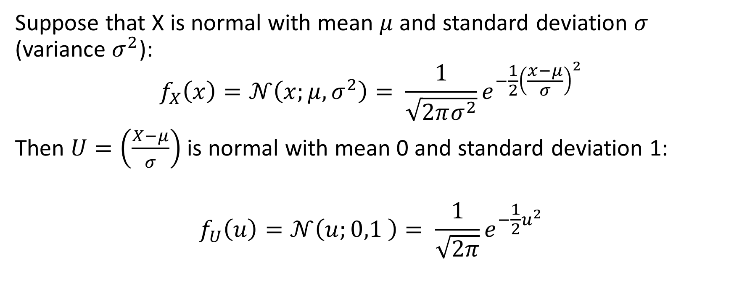
Unit Normal pdf
Suppose that X is normal with mean $μ$ and standard deviation $σ$ (variance $σ^{2}$):
$$f_{X}\left(x\right)=𝒩\left(x;μ,σ^{2}\right)= \frac{1}{\sqrt{2πσ^{2}}}e^{−\frac{1}{2}{\left(\frac{x−μ}{σ}\right)}^{2}}$$
Then $U=\left(\frac{X−μ}{σ}\right)$ is normal with mean 0 and standard deviation 1:
$$f_{U}\left(u\right)=𝒩\left(u;0,1 \right)= \frac{1}{\sqrt{2π}}e^{−\frac{1}{2}u^{2}}$$

Slide 15
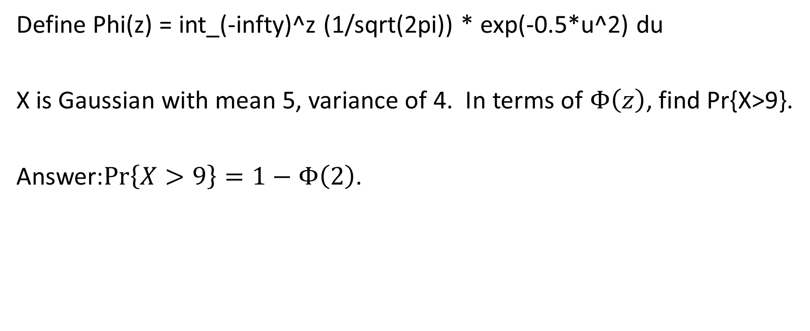
Example
Define Phi(z) = int_(-infty)^z (1/sqrt(2pi)) * exp(-0.5*u^2) du
X is Gaussian with mean 5, variance of 4. In terms of $Φ\left(z\right)$, find Pr{X>9}.
Answer:$\operatorname{Pr}\left\{X>9\right\}=1−Φ\left(2\right)$.

Slide 16

Multivariate Gaussian
$$f_{\vec{X}}\left(\vec{x}\right)=𝒩\left(\vec{x};\vec{μ},Σ\right)=\frac{1}{{{(2π)}^{D/2}\left|Σ\right|}^{1/2}}e^{−\frac{1}{2}{ \left(\vec{x}−\vec{μ}\right)}^{T}Σ^{−1}\left(\vec{x}−\vec{μ}\right)}$$

Slide 17
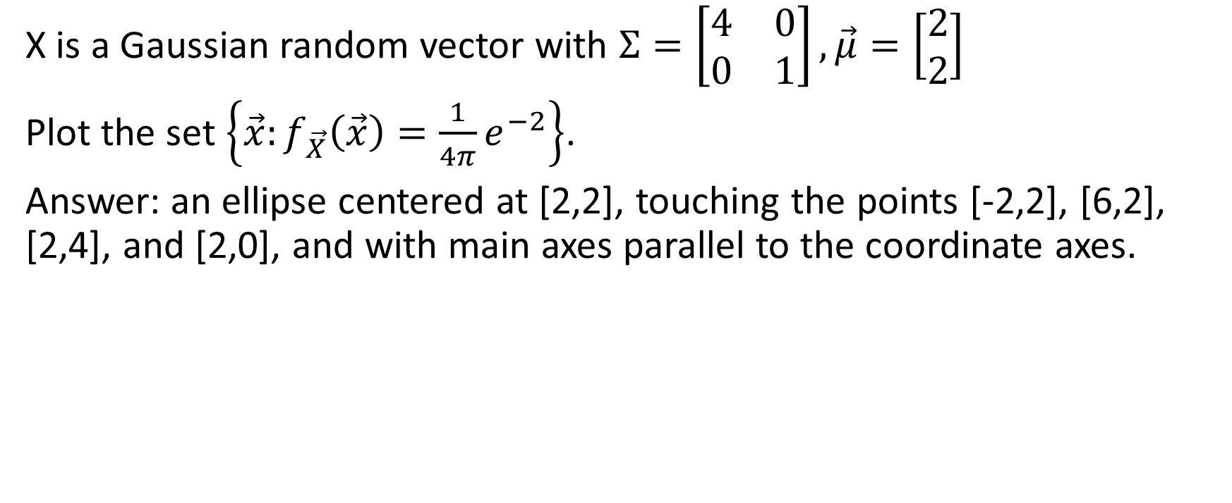
Example
X is a Gaussian random vector with $Σ=\left[\begin{matrix}4 & 0 \\ 0 & 1\end{matrix}\right],\vec{μ}=\left[\begin{matrix}2 \\ 2\end{matrix}\right]$
Plot the set $\left\{\vec{x}:f_{\vec{X}}\left(\vec{x}\right)=\frac{1}{4π}e^{−2}\right\}$.
Answer: an ellipse centered at [2,2], touching the points [-2,2], [6,2], [2,4], and [2,0], and with main axes parallel to the coordinate axes.

Slide 18
Eigenvectors & PCA

Slide 19

Symmetric positive definite matrices
$$Σ=UΛU^{T}$$
$$Σ^{−1}=UΛ^{−1}U^{T}$$
$$U^{T}ΣU=Λ$$
$$U^{T}U=I$$

Slide 20
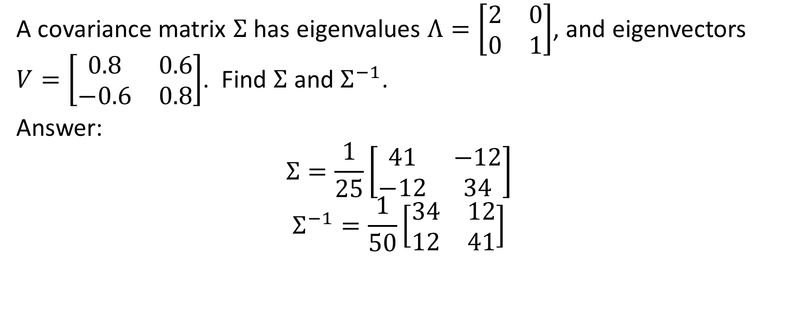
Example
A covariance matrix $Σ$ has eigenvalues $Λ=\left[\begin{matrix}2 & 0 \\ 0 & 1\end{matrix}\right]$, and eigenvectors $V=\left[\begin{matrix}0.8 & 0.6 \\ −0.6 & 0.8\end{matrix}\right]$. Find $Σ$ and $Σ^{−1}$.
Answer:
$$Σ=\frac{1}{25}\left[\begin{matrix}41 & −12 \\ −12 & 34\end{matrix}\right]$$
$$Σ^{−1}=\frac{1}{50}\left[\begin{matrix}34 & 12 \\ 12 & 41\end{matrix}\right]$$

Slide 21

Principal Components
$${d_{Σ}^{2}\left(\vec{x},\vec{μ}\right)=\left(\vec{x}−\vec{μ}\right)}^{T}Σ^{−1}\left(\vec{x}−\vec{μ}\right){=\vec{y}}^{T}Λ^{−1}\vec{y}$$
$$\vec{y}=U^{T}\left(\vec{x}−\vec{μ}\right)=\left[\begin{matrix}{{\vec{u}}_{1}}^{T}\left(\vec{x}−\vec{μ}\right) \\ … \\ {{\vec{u}}_{D}}^{T}\left(\vec{x}−\vec{μ}\right)\end{matrix}\right]$$

Slide 22
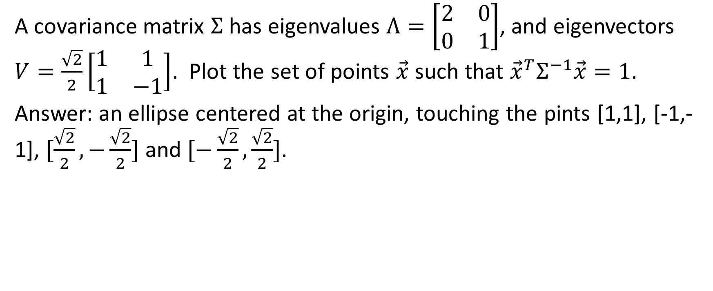
Example
A covariance matrix $Σ$ has eigenvalues $Λ=\left[\begin{matrix}2 & 0 \\ 0 & 1\end{matrix}\right]$, and eigenvectors $V=\frac{\sqrt{2}}{2}\left[\begin{matrix}1 & 1 \\ 1 & −1\end{matrix}\right]$. Plot the set of points $\vec{x}$ such that ${\vec{x}}^{T}Σ^{−1}\vec{x}=1$.
Answer: an ellipse centered at the origin, touching the pints [1,1], [-1,-1], $[\frac{\sqrt{2}}{2},−\frac{\sqrt{2}}{2}]$ and $[−\frac{\sqrt{2}}{2},\frac{\sqrt{2}}{2}]$.

Slide 23
Classifiers

Slide 24
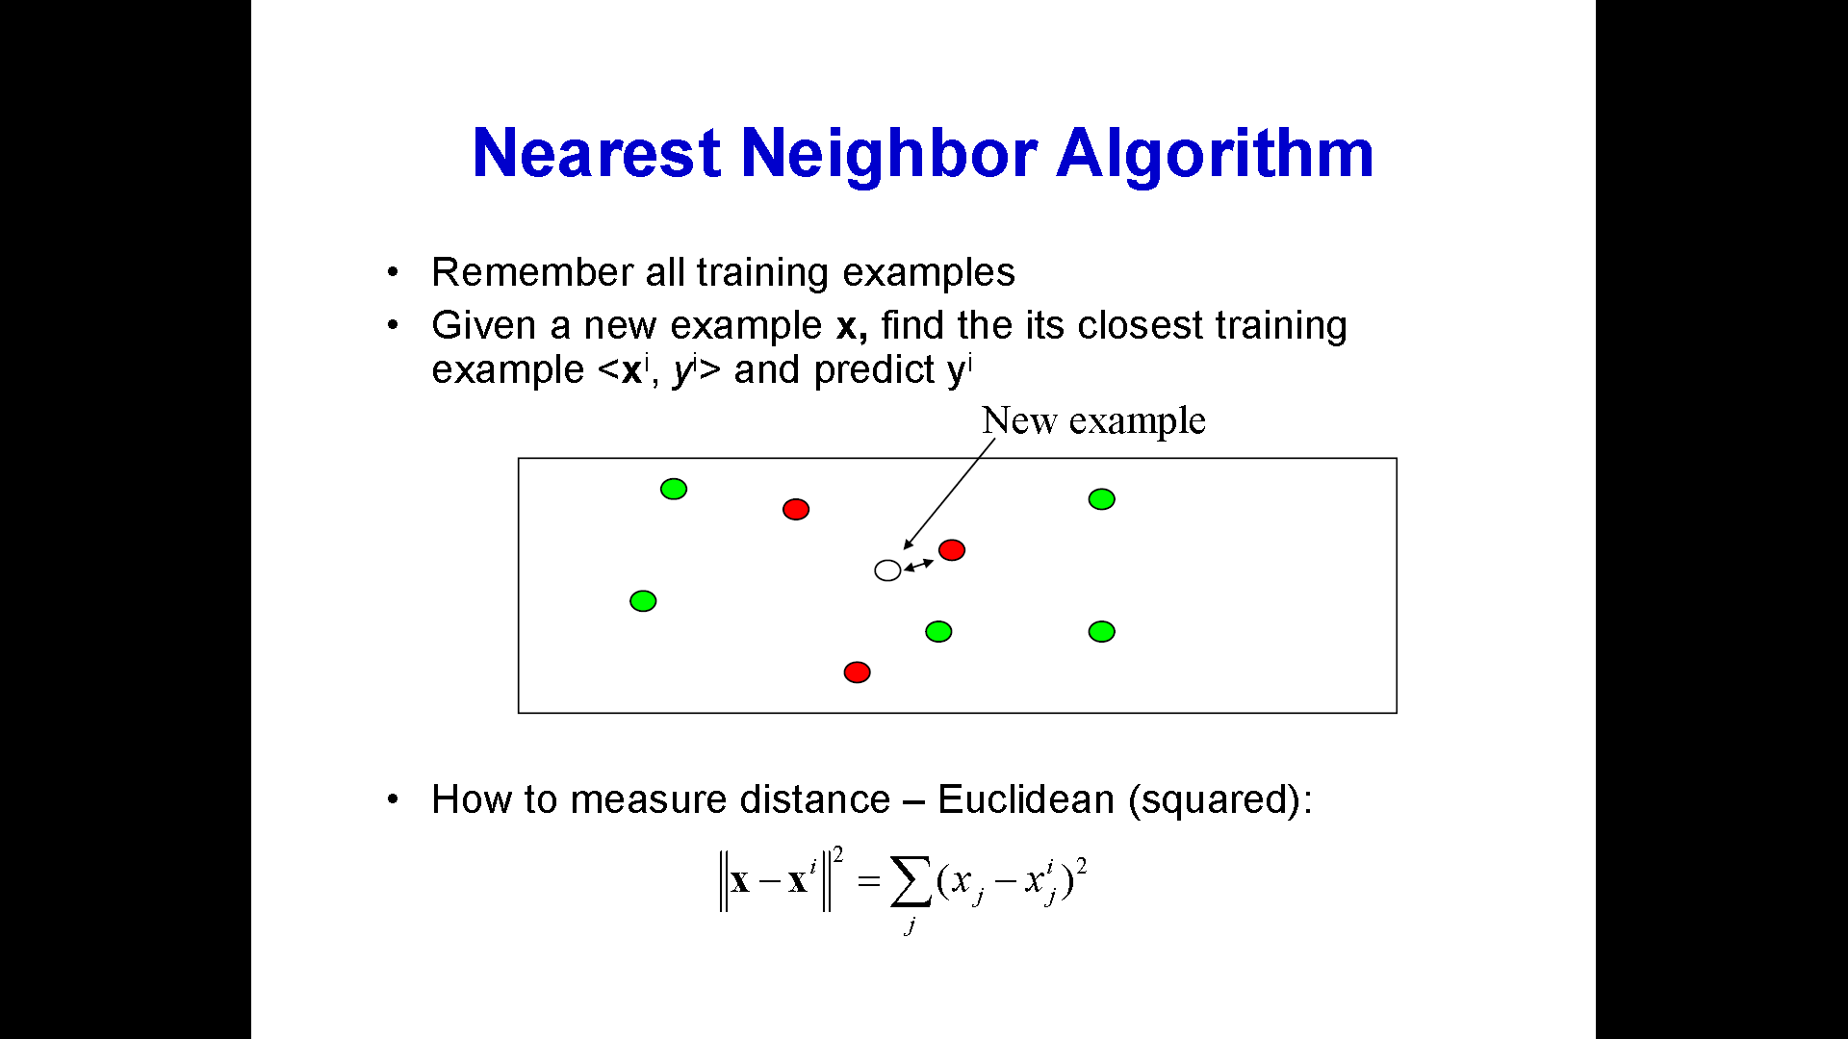

Slide 25
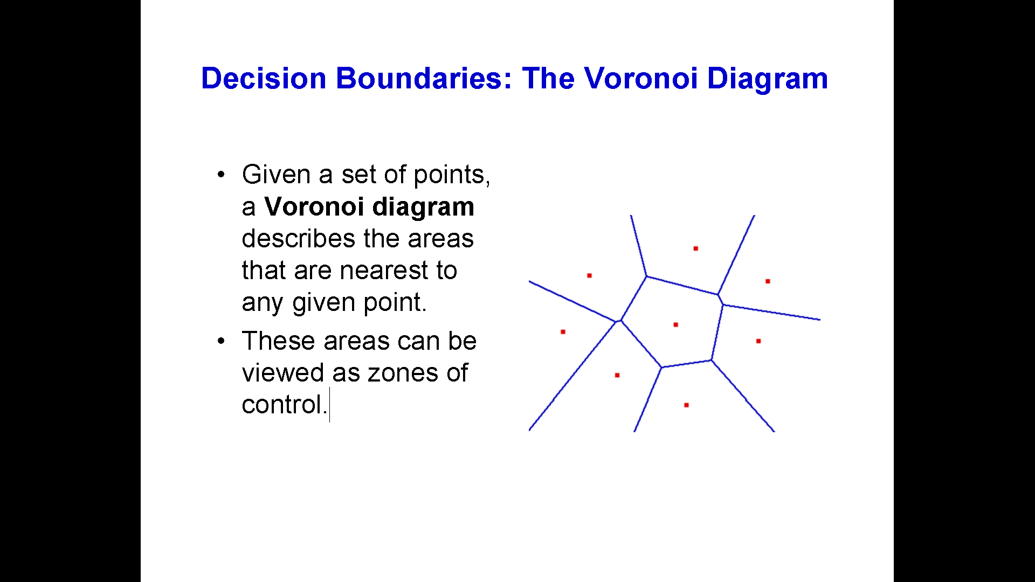

Slide 26
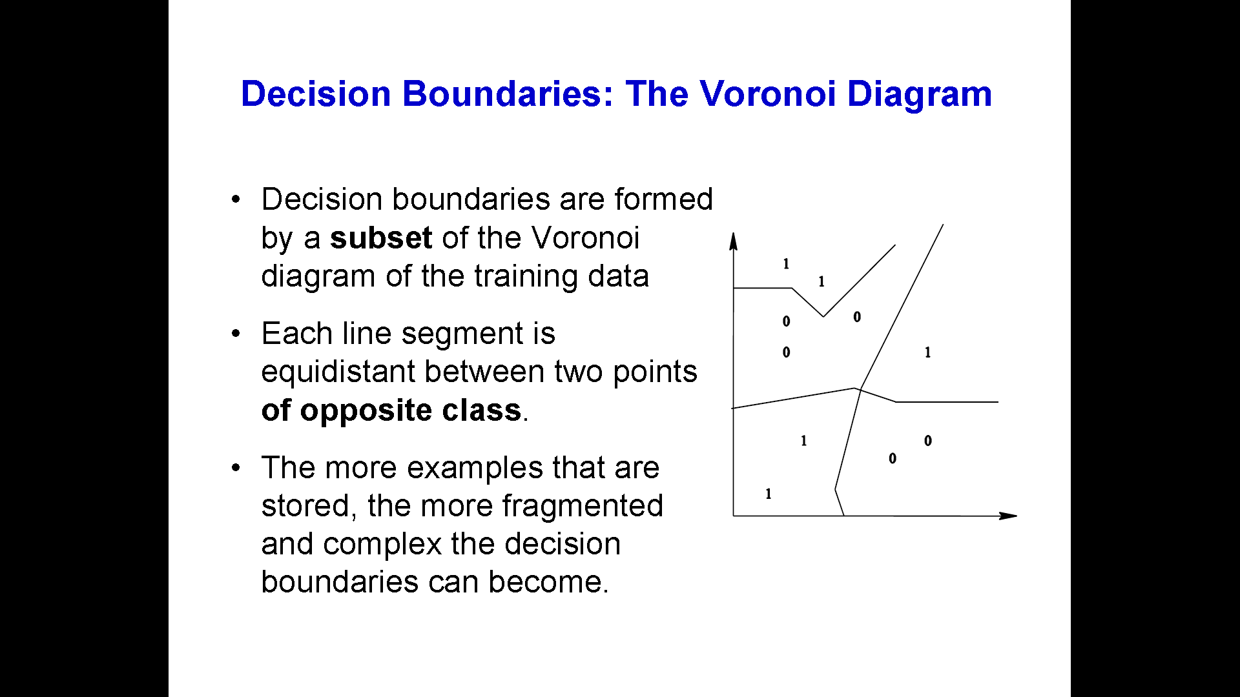

Slide 27
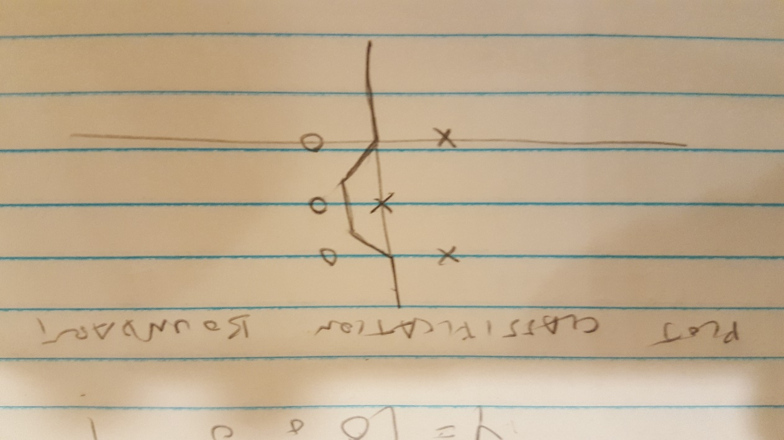
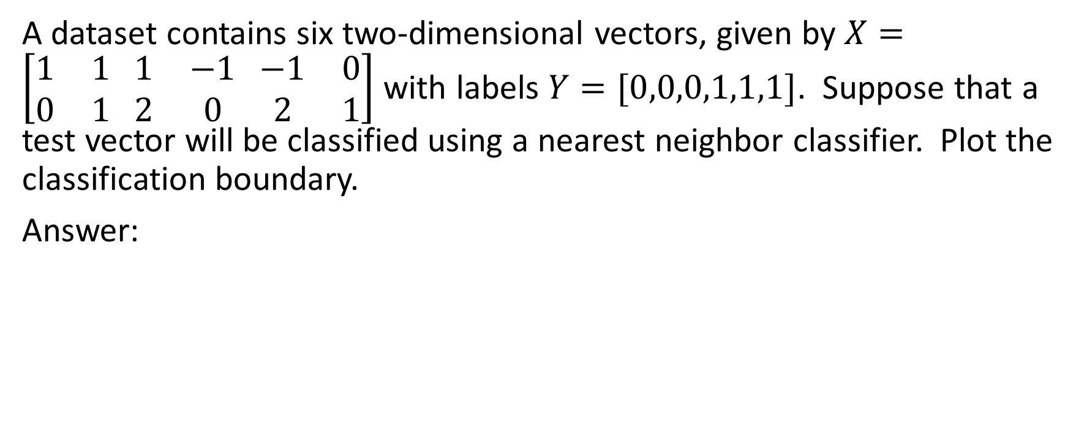
Example
A dataset contains six two-dimensional vectors, given by $X=\left[\begin{matrix}1 & 1 \\ 0 & 1\end{matrix} \begin{matrix}1 & −1 \\ 2 & 0\end{matrix} \begin{matrix}−1 & 0 \\ 2 & 1\end{matrix}\right]$ with labels $Y=[0,0,0,1,1,1]$. Suppose that a test vector will be classified using a nearest neighbor classifier. Plot the classification boundary.
Answer:

Slide 28
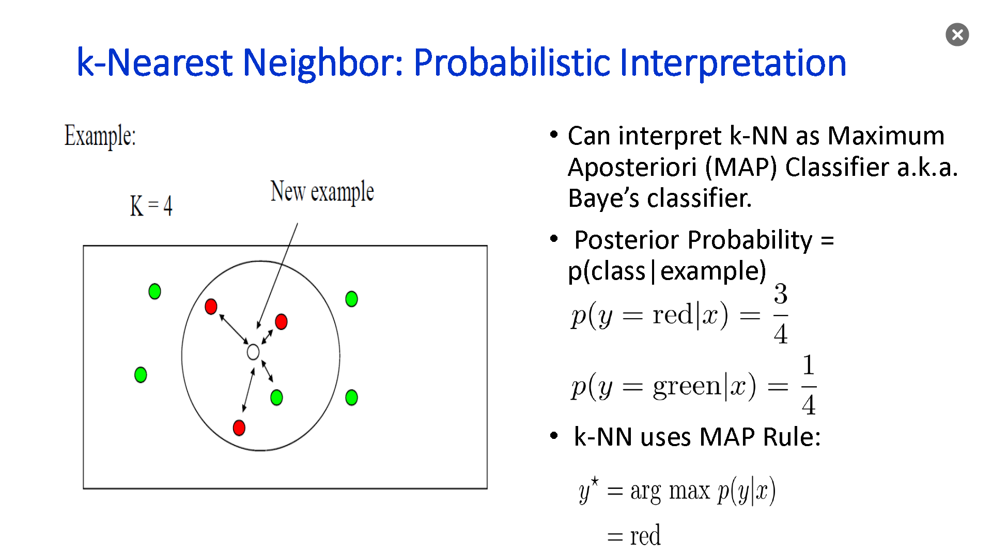

Slide 29
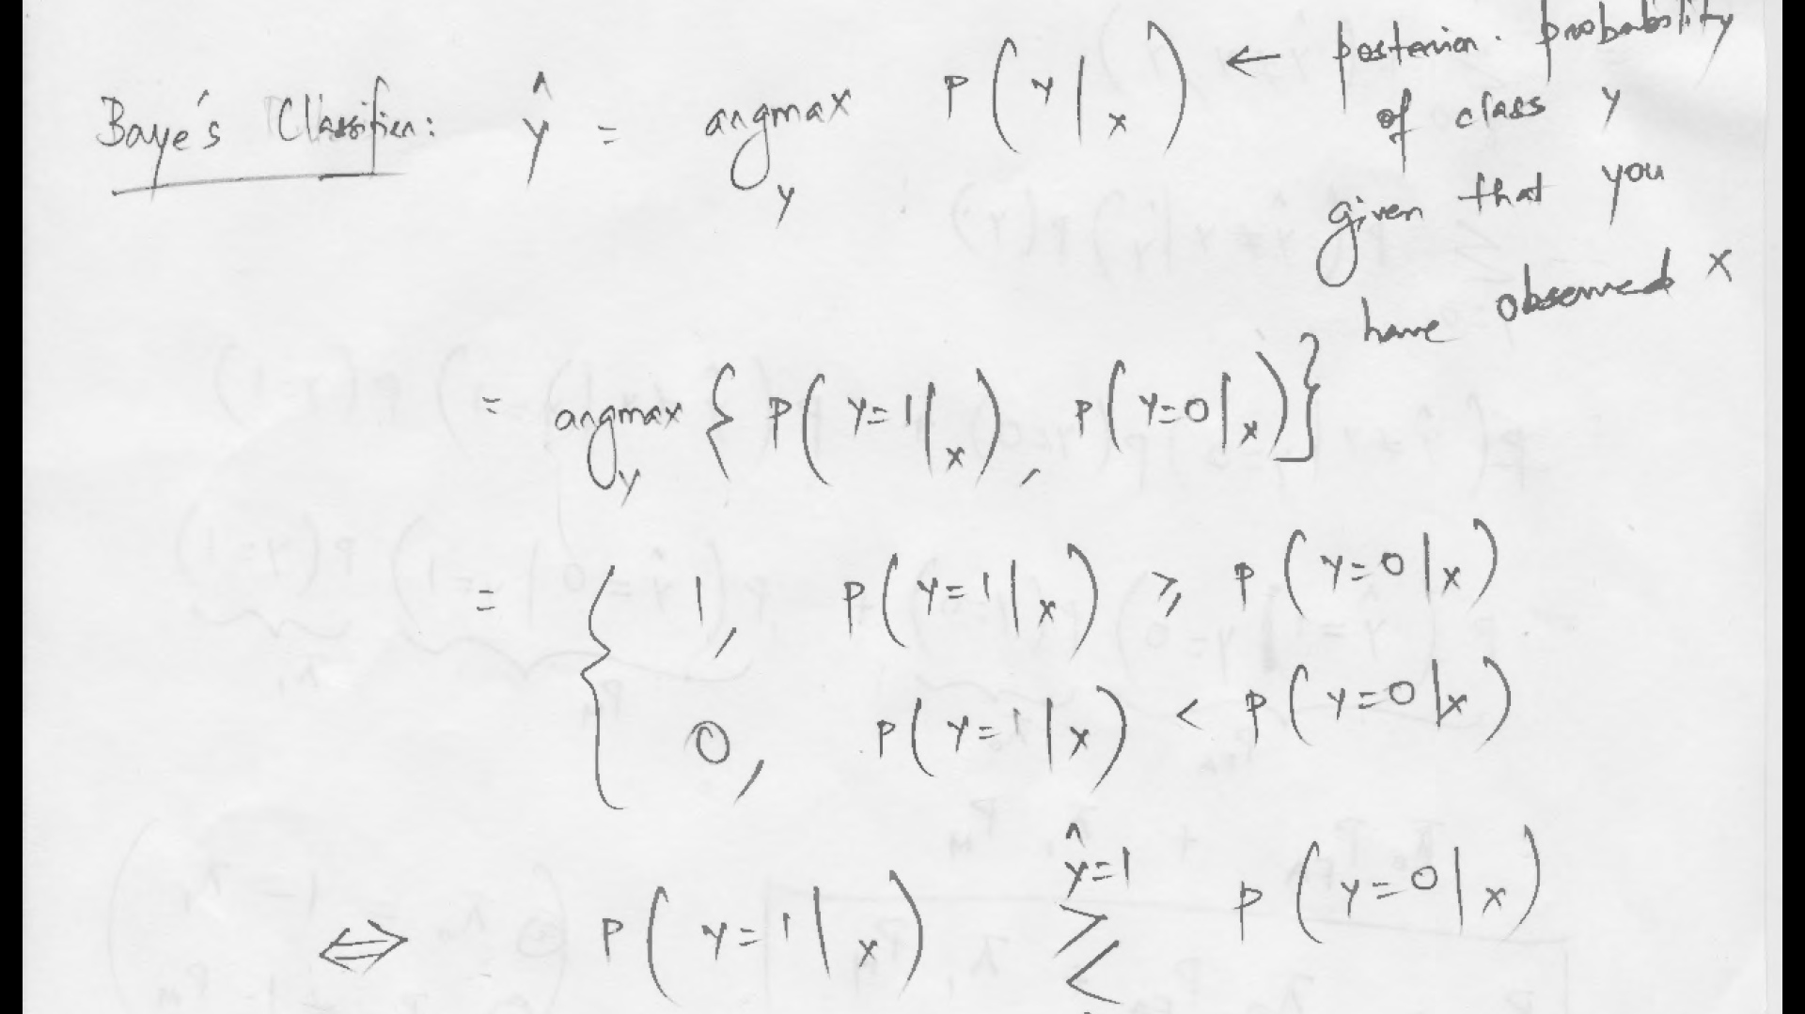

Slide 30
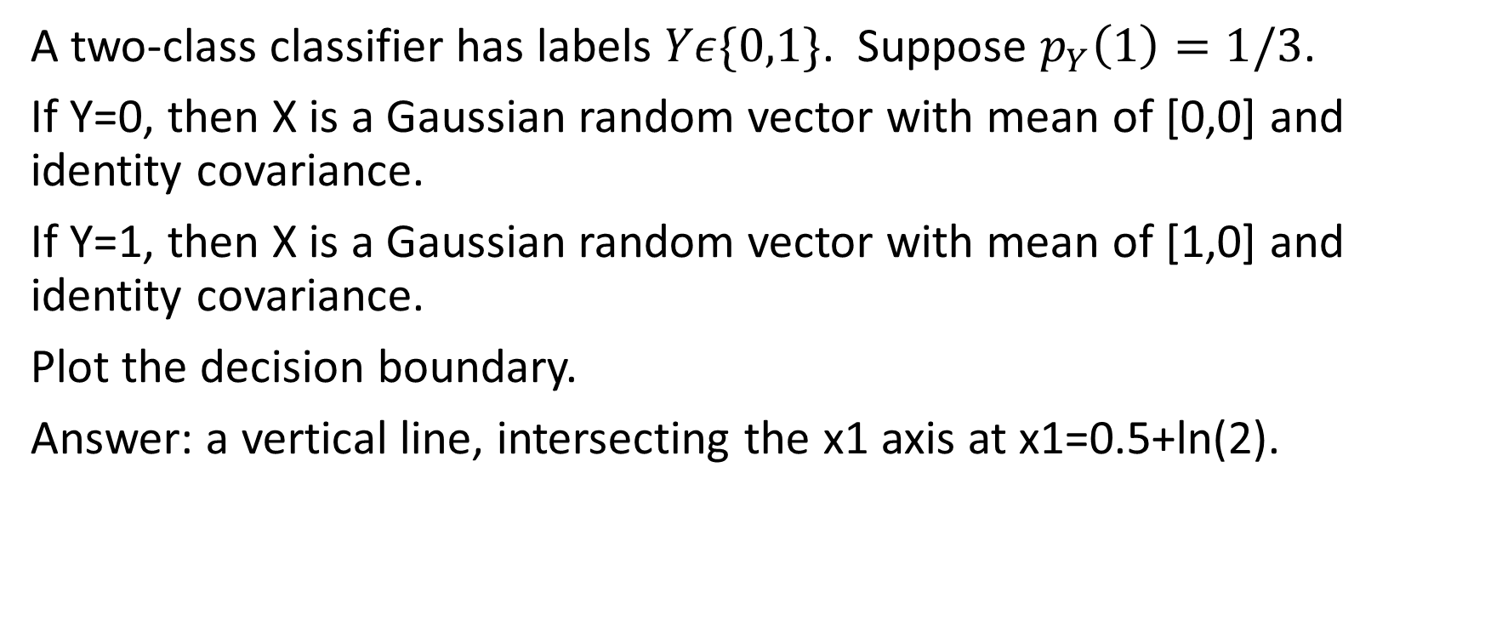
Example
A two-class classifier has labels $Yε\{0,1\}$. Suppose $p_{Y}\left(1\right)=1/3$.
If Y=0, then X is a Gaussian random vector with mean of [0,0] and identity covariance.
If Y=1, then X is a Gaussian random vector with mean of [1,0] and identity covariance.
Plot the decision boundary.
Answer: a vertical line, intersecting the x1 axis at x1=0.5+ln(2).

