Slide 1
ECE 417 Lecture 8:
Speech Production
Mark Hasegawa-Johnson, 9/2017

Slide 2
Speech
(Slide: Scharenborg, 2017)
Specific to humans
Allows us to convey information very fast
Central role in many other language-related processes
One of the most complex skills humans perform:
  https://www.youtube.com/watch?v=DcNMCB-Gsn8
  https://www.youtube.com/watch?v=KtN-FCOeWjI

Slide 3
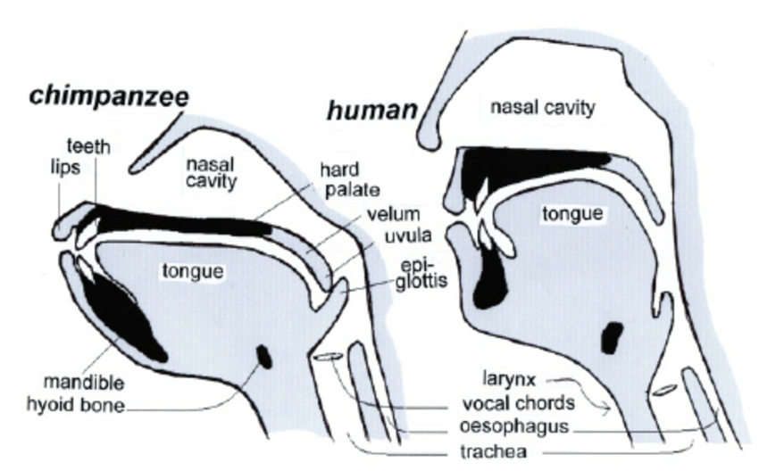
Evolution of the vocal tract
(Slide: Scharenborg, 2017)
Lowering of the tongue into the pharynx → lowering of the larynx
Lengthening of the neck
At the cost of an increase in the risk of choking on food
Neanderthals were not capable of human speech
Modern human vocal tract: since 50,000 years
Notes:
How did humans learn to produce sounds?

Slide 4
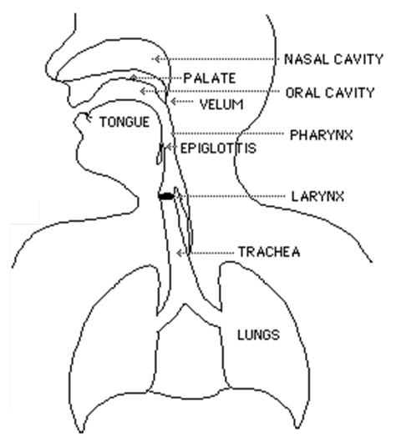
The anatomy and physiology of speech
(Slide: Scharenborg, 2017)
Vocal tract
Area between vocal cords and lips
Pharynx + nasal cavity
+ oral cavity
and lungs

Slide 5
3 steps to produce sounds
(Slide: Scharenborg, 2017)
step 3: articulation =
distortion of air
time-varying formant-frequency
pattern
= speech
step 2: phonation
step 1: initiation
Filter
Source
Notes:
Step 1: air from the lungs is pushed past the vocal cords
If they start to vibrate it is called phonation
Step 3: the air, whether vibrating or not, travels through the oral and nasal cavity. Here the air is distorted/changed depending on the shape of the lips, teeth, tongue.

Slide 6
The Source-Filter Model of Speech Production
(Chiba & Kajiyama, 1940)
Sources: there are only three, all of them have wideband spectrum
  Voicing: vibration of the vocal folds, same type of aerodynamic mechanism as a flag flapping in the wind.
  Frication or Aspiration: turbulence created when air passes through a narrow aperture
  Burst: the “pop” that occurs when high air pressure is suddenly released
Filter:
  Vocal tract = the air cavity between glottis and lips
  Just like a flute or a shower stall, it has resonances
  The excitation has energy at all frequencies; excitation at the resonant frequencies is enhanced

Slide 7
3 steps to produce sounds
step 3: articulation =
distortion of air
time-varying formant-frequency
pattern
= speech
step 2: phonation
step 1: initiation
Filter
Source
Notes:
Step 1: air from the lungs is pushed past the vocal cords
If they start to vibrate it is called phonation
Step 3: the air, whether vibrating or not, travels through the oral and nasal cavity. Here the air is distorted/changed depending on the shape of the lips, teeth, tongue.

Slide 8
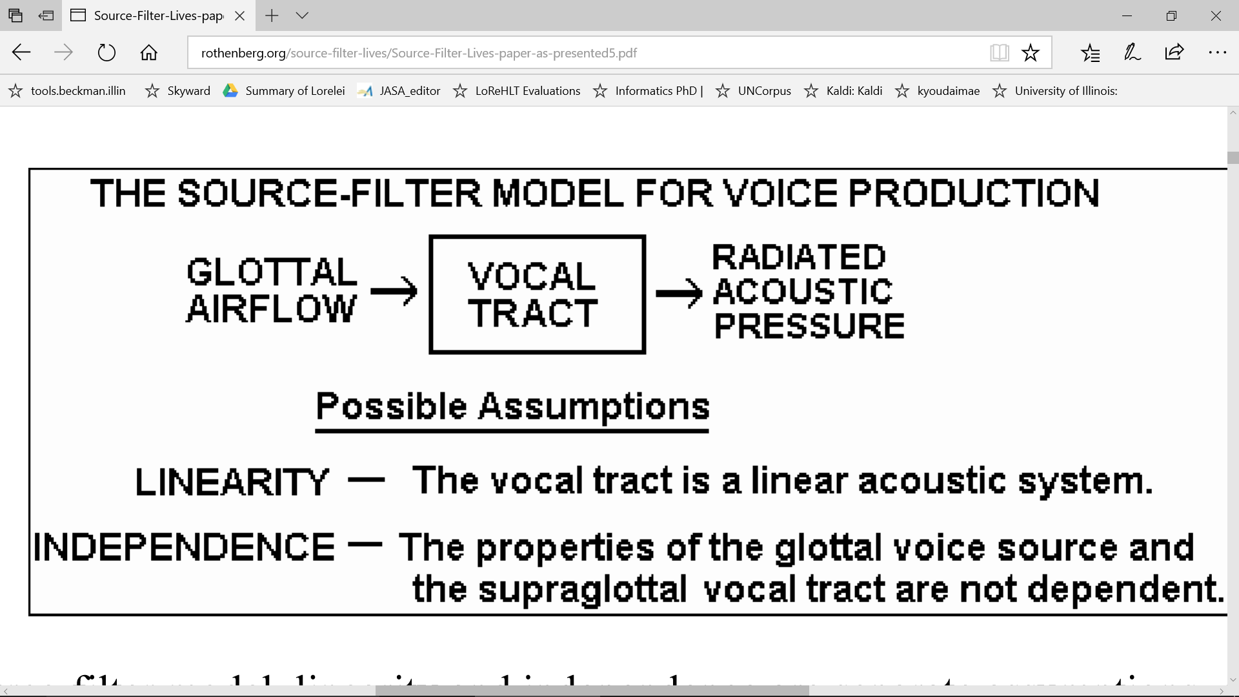
The Source-Filter Model of Speech Production
A picture from Martin Rothenberg’s website
Notes:
Step 1: air from the lungs is pushed past the vocal cords
If they start to vibrate it is called phonation
Step 3: the air, whether vibrating or not, travels through the oral and nasal cavity. Here the air is distorted/changed depending on the shape of the lips, teeth, tongue.

Slide 9
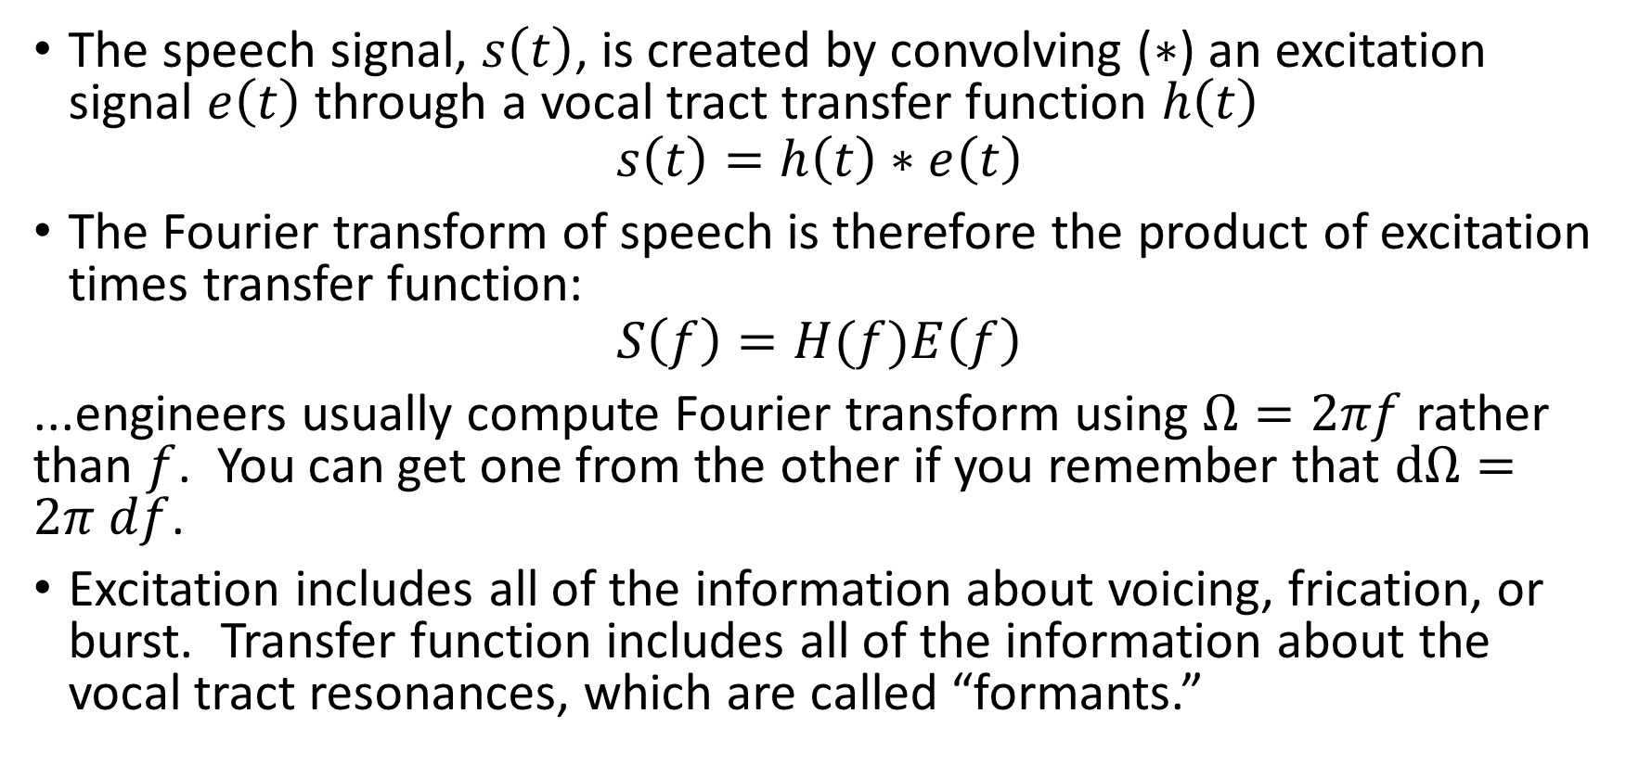
The Source-Filter Model
The speech signal, $s\left(t\right)$, is created by convolving ($∗$) an excitation signal $e\left(t\right)$ through a vocal tract transfer function $h\left(t\right)$
$$s\left(t\right)=h\left(t\right)∗e\left(t\right)$$
The Fourier transform of speech is therefore the product of excitation times transfer function:
$$S\left(f\right)=H(f)E\left(f\right)$$
...engineers usually compute Fourier transform using $Ω=2πf$ rather than $f$. You can get one from the other if you remember that $dΩ=2π df$.
Excitation includes all of the information about voicing, frication, or burst. Transfer function includes all of the information about the vocal tract resonances, which are called “formants.”

Slide 10
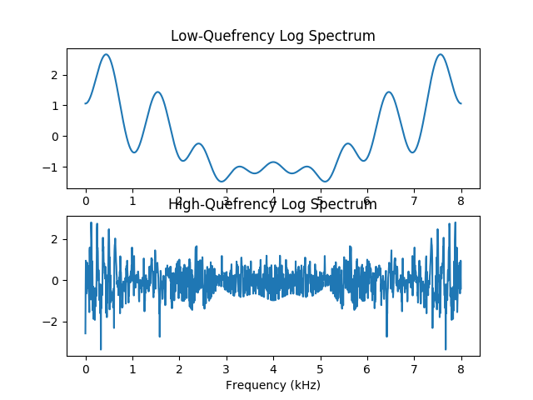
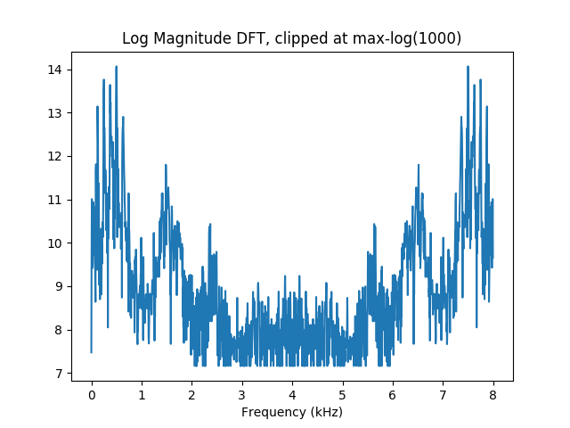
The Source-Filter Model
Transfer Function log|H(f)|
Speech Spectrum log|S(f)|=log|H(f)|+log|E(f)|
Voice Source Spectrum log|E(f)|

Slide 11
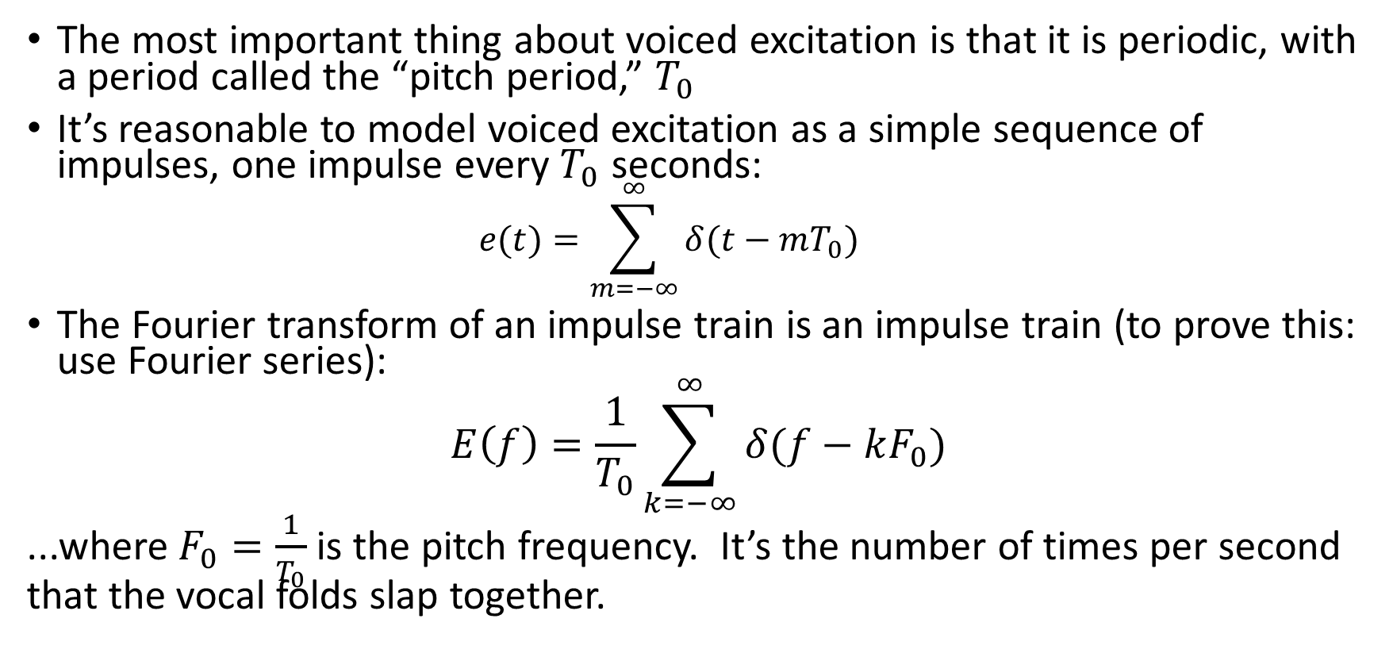
Source-Filter Model: Voice Source
The most important thing about voiced excitation is that it is periodic, with a period called the “pitch period,” $T_{0}$
It’s reasonable to model voiced excitation as a simple sequence of impulses, one impulse every $T_{0}$ seconds:
  $$e(t)=\sum_{m=−∞}^{∞}{δ(t−mT_{0})}$$
The Fourier transform of an impulse train is an impulse train (to prove this: use Fourier series):
$$E\left(f\right)=\frac{1}{T_{0}}\sum_{k=−∞}^{∞}{δ(f−kF_{0})}$$
...where $F_{0}=\frac{1}{T_{0}}$ is the pitch frequency. It’s the number of times per second that the vocal folds slap together.

Slide 12
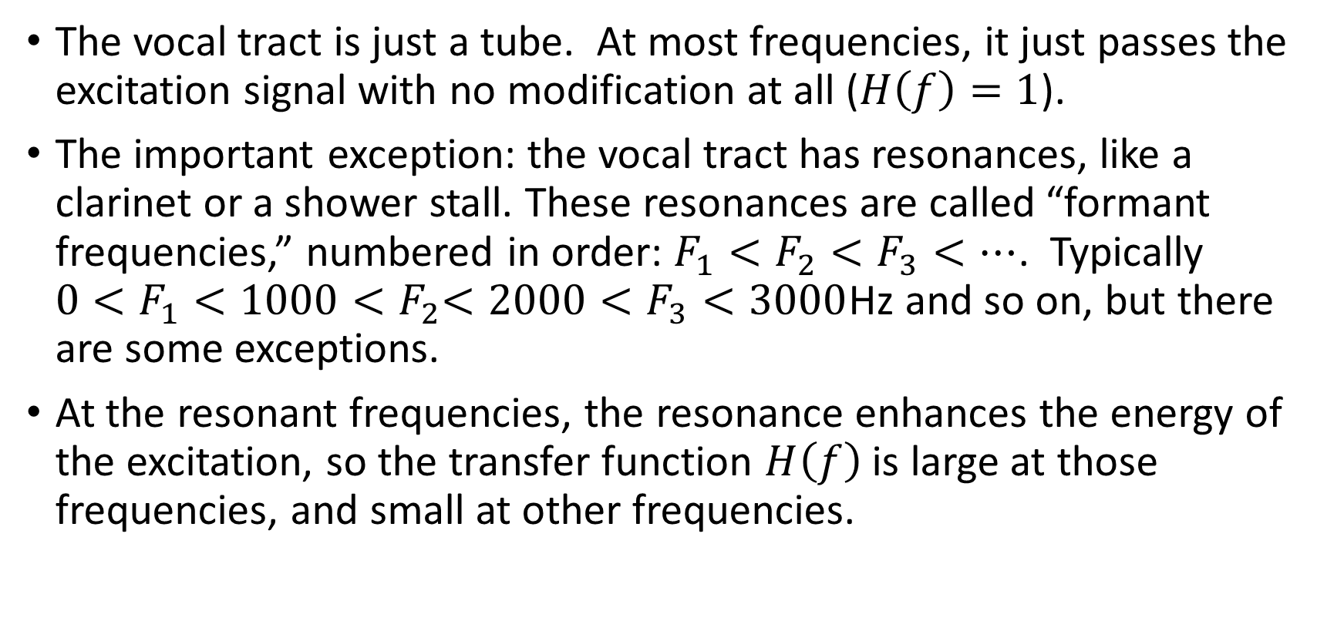
Source-Filter Model: Filter
The vocal tract is just a tube. At most frequencies, it just passes the excitation signal with no modification at all ($H\left(f\right)=1$).
The important exception: the vocal tract has resonances, like a clarinet or a shower stall. These resonances are called “formant frequencies,” numbered in order: $F_{1}<F_{2}<F_{3}<…$. Typically ${0<F}_{1}<1000{<F}_{2}<2000<F_{3}<3000$Hz and so on, but there are some exceptions.
At the resonant frequencies, the resonance enhances the energy of the excitation, so the transfer function $H\left(f\right)$ is large at those frequencies, and small at other frequencies.

Slide 13
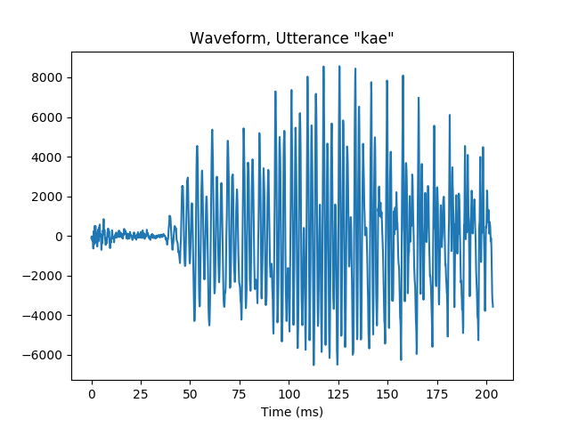


Speech signal: Time domain
$T_{0}=\frac{1}{F_{0}}$=8ms
$T_{1}=\frac{1}{F_{1}}$=2ms
/k/ burst
/k/ aspiration
voicing

Slide 14
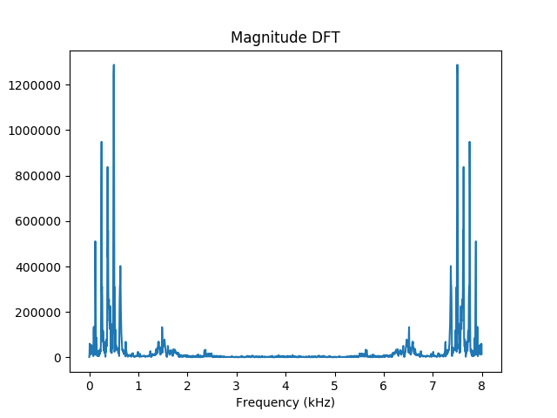
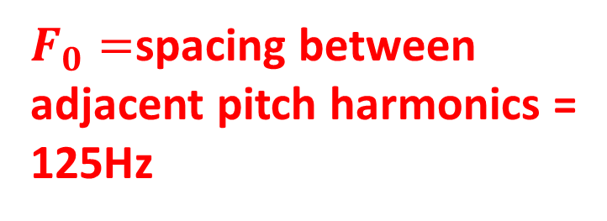

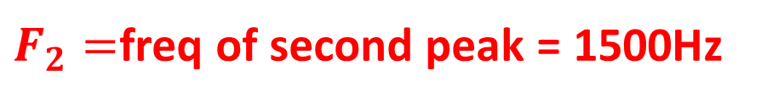
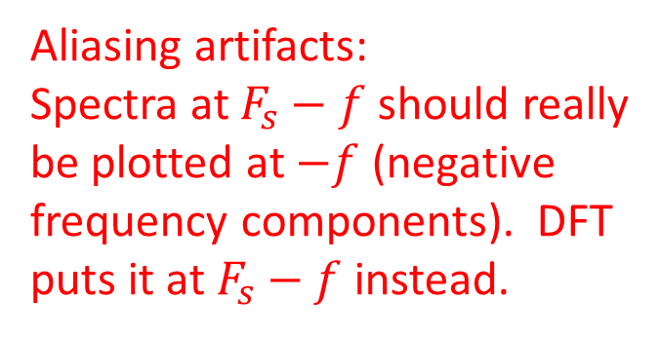
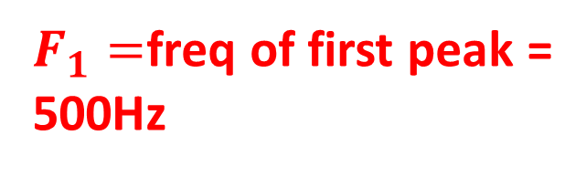
Speech signal: Magnitude Fourier Transform
$F_{1}=$freq of first peak =
500Hz
Aliasing artifacts:
Spectra at $F_{s}−f$ should really
be plotted at $−f$ (negative
frequency components). DFT
puts it at $F_{s}−f$ instead.
$F_{0}=$spacing between
adjacent pitch harmonics =
125Hz
$F_{2}=$freq of second peak = 1500Hz
$$F_{3}$$

Slide 15
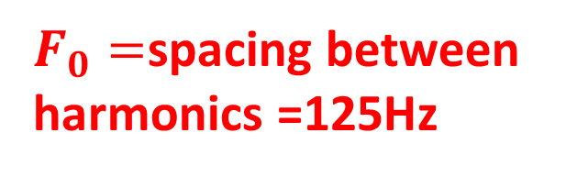
Speech signal: Log Magnitude Transform
$F_{1}=$freq of first peak =
500Hz
Aliasing artifacts:
Spectra at $F_{s}−f$ should really
be plotted at $−f$ (negative
frequency components). DFT
puts it at $F_{s}−f$ instead.
$F_{0}=$spacing between
harmonics =125Hz
$F_{2}=$freq of second peak = 1500Hz
$$F_{3}$$

Slide 16
Part 2: Linguistic units
Scharenborg, 2017
Speech signal
Linguistic units are:
Phone(me)s
Words
Notes:
In the context of this project:
Linguistics units are sounds, sound sequences, partial words, words, multi-word sequences

Slide 17
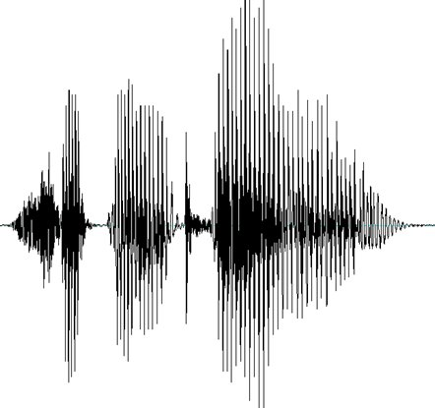
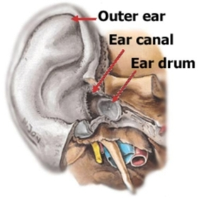
Linguistic units
Scharenborg, 2017
Speech = sound
Sound = differences in air pressure
Air pressure waves perceived as different phone(me)s, phone(me) sequences, and (partial or multi) words
Via eardrum, cochlea, and auditory nerve to brain
speech signal
Notes:
In the context of this project:
Linguistics units are sounds, sound sequences, partial words, words, multi-word sequences

Slide 18
Some terminology
Scharenborg, 2017
Phoneme: the smallest contrastive linguistic unit that distinguishes meaning, e.g., tip vs. dip
Allophone: a variation of a phoneme, eg., p^{h}ot vs. spot
Phone: a distinct speech sound
Word: the smallest distinct unit that can be uttered in isolation which has meaning

Slide 19
Speech sounds
Scharenborg, 2017
Vowels: unblocked air stream
Consonants: constricted or blocked air stream
Notes:
Speech sounds can be divided into two types

Slide 20
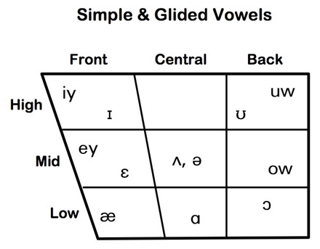
Different sounds: Vowels
Scharenborg, 2017
Tongue height:
  Low: e.g., /a/
  Mid: e.g., /e/
  High: e.g., /i/
Tongue advancement:
  Front : e.g., /i/
  Central : e.g., /ə/
  Back : e.g., /u/
Lip rounding:
  Unrounded: e.g., /ɪ, ɛ, e, ǝ/
  Rounded: e.g., /u, o, ɔ/
Tense/lax:
  Tense: e.g., /i, e, u, o, ɔ, ɑ/
  Lax: e.g., /ɪ, ɛ, æ, ə/
heed
who’d
hid
hood
hayed
head
hoed
had
hawed
hod
Notes:
In producing vowels the tongue and lips are important for shaping the vocal tract
Tense vowels are typically produced with a narrower mouth than lax vowels, less centralization, and longer duration

Slide 21
Different sounds: Vowels
Scharenborg, 2017
Tongue height:
  Low: e.g., /a/
  Mid: e.g., /e/
  High: e.g., /i/
Tongue advancement:
  Front : e.g., /i/
  Central : e.g., /ə/
  Back : e.g., /u/
Lip rounding:
  Unrounded: e.g., /ɪ, ɛ, e, ǝ/
  Rounded: e.g., /u, o, ɔ/
Tense/lax:
  Tense: e.g., /i, e, u, o, ɔ, ɑ/
  Lax: e.g., /ɪ, ɛ, æ, ə/
300
heed
who’d
hid
hood
hayed
F1
head
hoed
had
hawed
900
hod
2000
F2
800
Notes:
In producing vowels the tongue and lips are important for shaping the vocal tract
Tense vowels are typically produced with a narrower mouth than lax vowels, less centralization, and longer duration

Slide 22
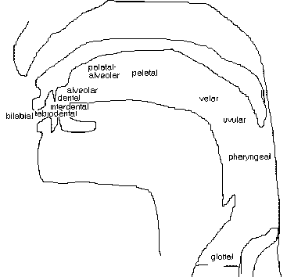
Different sounds: Consonants
Scharenborg, 2017
Place of articulation
  Where is the constriction/blocking of the air stream?
Manner of articulation
  Stops: /p, t, k, b, d, g/
  Fricatives: /f, s, S, v, z, Z/
  Affricates: /tS, dZ/
  Approximants/Liquids: /l, r, w, j/
  Nasals: /m, n, ng/
Voicing
Notes:
The type of consonant or sound that is produced depends on three factors: the place of articulation, the manner of articulation and whether the vocal cords vibrate
Manner of articulation: is it a full blockage or a constriction and how much of a constriction is there?
Plosion
Bit of noise
Combination
Air through the nasal cavity
Fairly open

Slide 23

Speech sound production
Scharenborg, 2017
https://www.youtube.com/watch?v=DcNMCB-Gsn8
Recorded in 1962, Ken Stevens
Source: YouTube
Notes:
We all know what speech sounds like, and now we know how they are produced, but what does it look like when we produce speech?

Slide 24
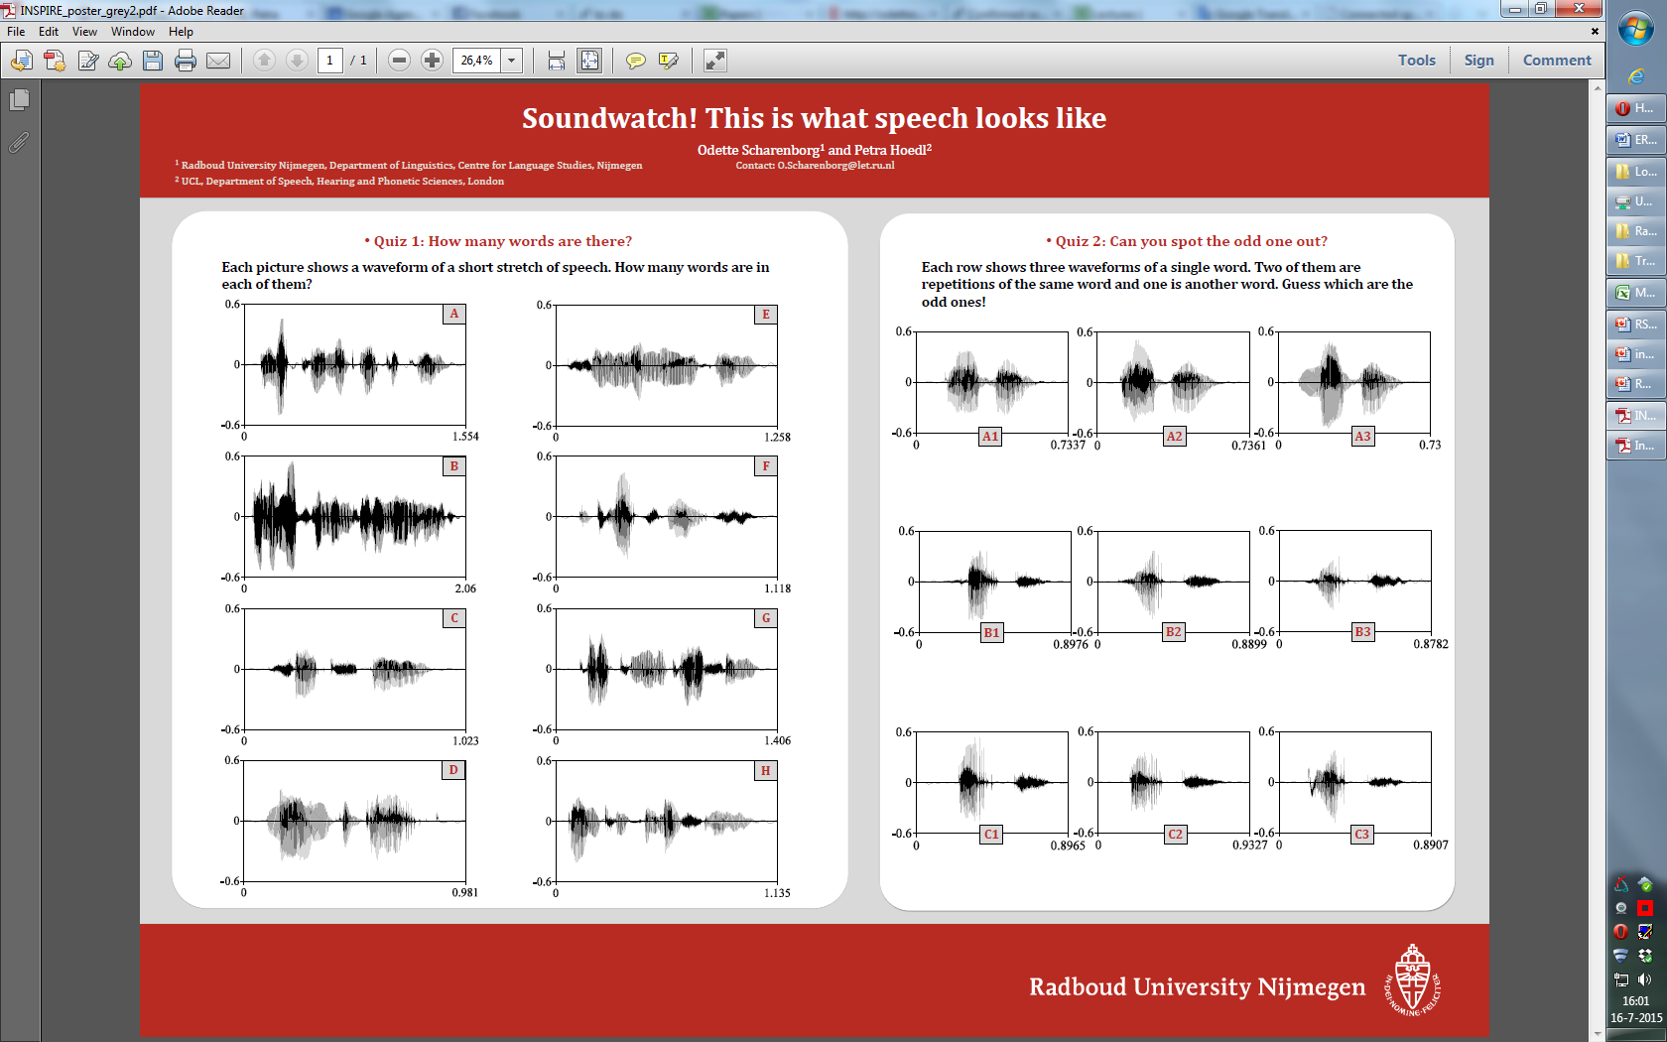
Quiz 1: How many words are there?
Scharenborg, 2017
Each picture shows a waveform of a short stretch of speech:
C
D
A: Electromagnetically (1)
B: Emma loves her mum’s yellow marmelade (6)
C: See you in the evening (5)
D: Attachment (1)
Notes:
Finding the ‘linguistic units’ in speech

Slide 25
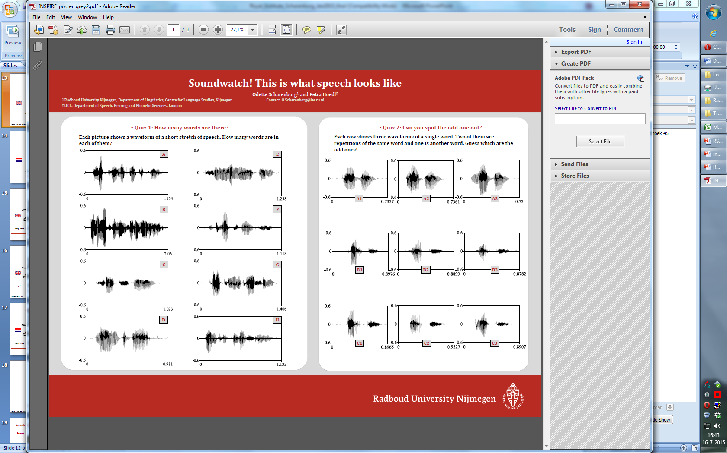
Electromagnetically
Scharenborg, 2017
Why is it so hard to determine the number of words?
/i l ɛ kt romæ g nɛ t ɪ k ǝ l i/
silence ≠ word boundary

Slide 26
Quiz 2: Can you spot the odd one out?
Scharenborg, 2017
Below are three waveforms each containing a single word:
Every time you produce a word it sounds differently
A3 (brother, brother, mother)
Notes:
Every

Slide 27
Enormous variability
Scharenborg, 2017
Speaker differences, e.g., gender, vocal tract length, age
Speaker idiosyncracies , e.g., lisp, creaky voice
Accent: dialects, non-nativeness
Coarticulation: production of a speech sound becomes more like that of a preceding/following speech sound
Speaking style → reductions

Slide 28

Time domain signal: Hard to tell what he was saying
$$s\left(t\right)=h\left(t\right)∗e(t)$$

Slide 29
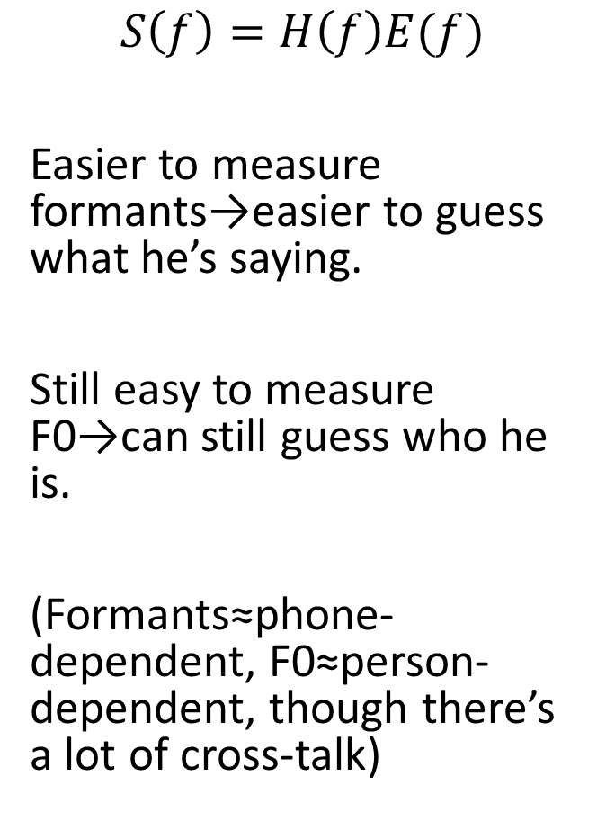
Magnitude spectrum: A little easier
$$S\left(f\right)=H\left(f\right)E(f)$$
Easier to measure formants→easier to guess what he’s saying.
Still easy to measure F0→can still guess who he is.
(Formants≈phone-dependent, F0≈person-dependent, though there’s a lot of cross-talk)

Slide 30
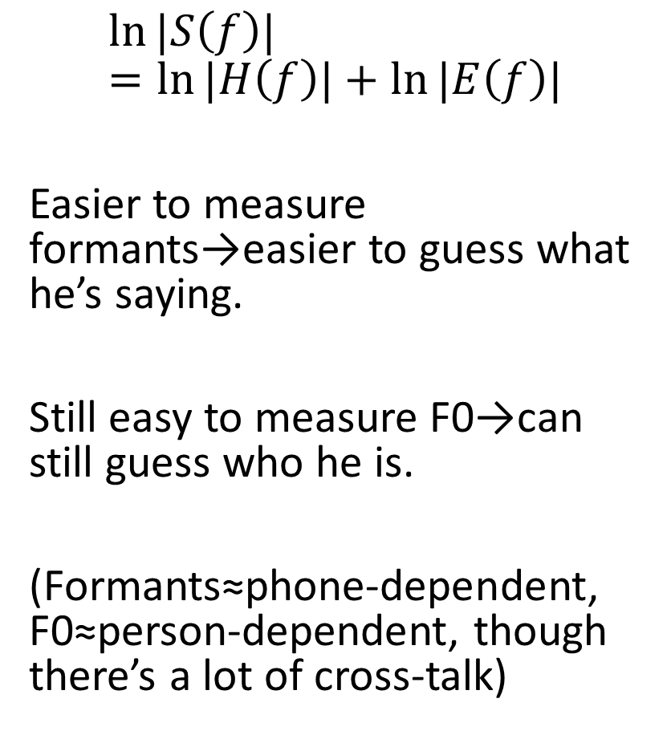
Log magnitude spectrum: A lot easier
$$\ln{|S\left(f\right)|}=\ln{|H\left(f\right)|}+\ln{|E\left(f\right)|}$$
Easier to measure formants→easier to guess what he’s saying.
Still easy to measure F0→can still guess who he is.
(Formants≈phone-dependent, F0≈person-dependent, though there’s a lot of cross-talk)

Slide 31
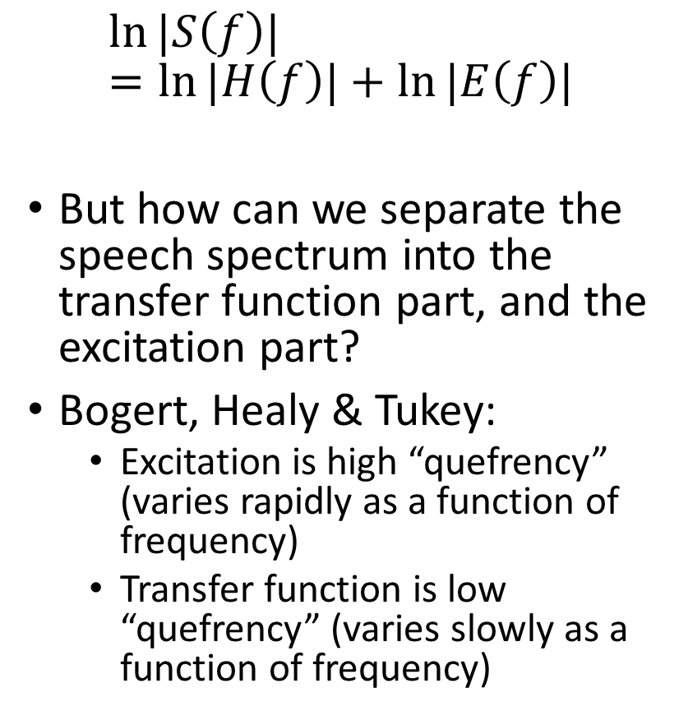
Log spectrum = log filter + log excitation
$$\ln{|S\left(f\right)|}=\ln{|H\left(f\right)|}+\ln{|E\left(f\right)|}$$
But how can we separate the speech spectrum into the transfer function part, and the excitation part?
Bogert, Healy & Tukey:
  Excitation is high “quefrency” (varies rapidly as a function of frequency)
  Transfer function is low “quefrency” (varies slowly as a function of frequency)

Slide 32
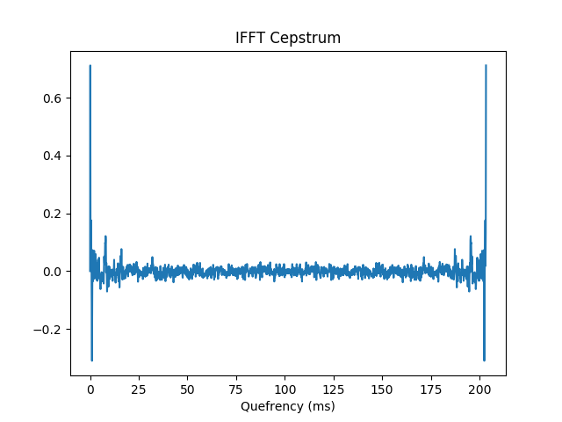
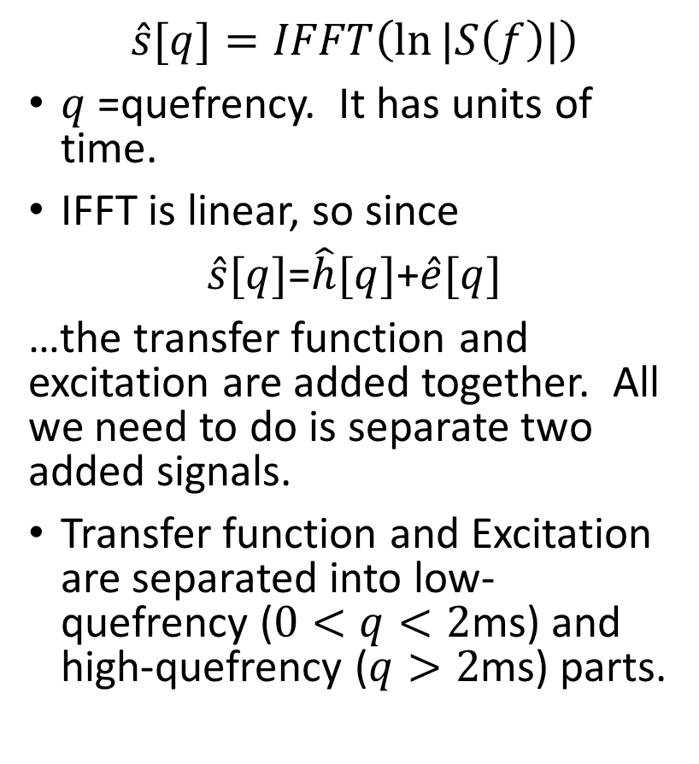
Cepstrum = inverse FFT of the log spectrum
(Bogert, Healy & Tukey, 1962)
$$\hat{s}[q]=IFFT\left(\ln{|S\left(f\right)|}\right)$$
$q$=quefrency. It has units of time.
IFFT is linear, so since
$\hat{s}[q]$=$\hat{h}[q]$+$\hat{e}[q]$
…the transfer function and excitation are added together. All we need to do is separate two added signals.
Transfer function and Excitation are separated into low-quefrency ($0<q<2$ms) and high-quefrency ($q>2$ms) parts.

Slide 33
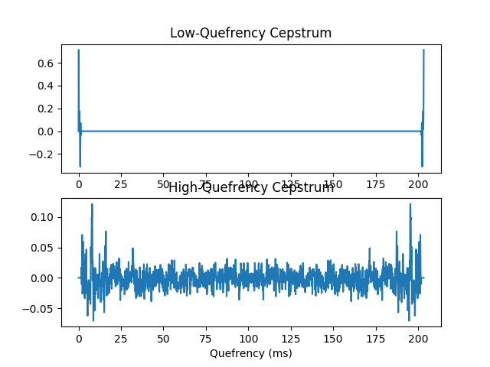
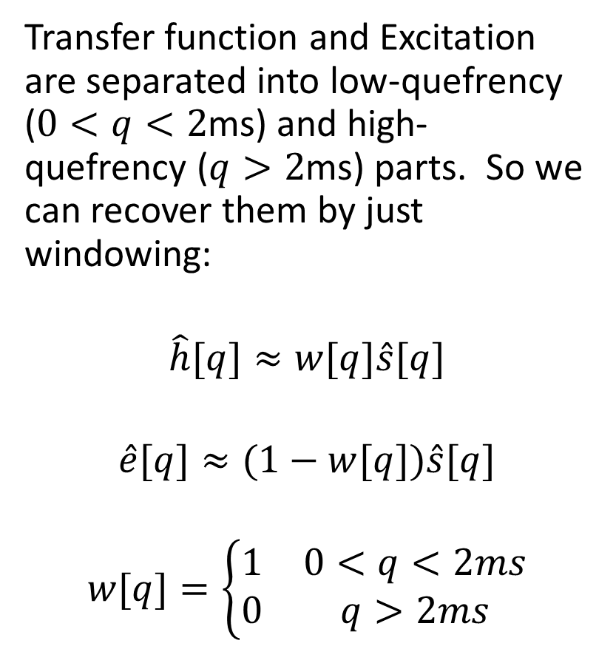
Liftering = filter(spectrum) = window(cepstrum)
(Bogert, Healy & Tukey, 1962)
Transfer function and Excitation are separated into low-quefrency ($0<q<2$ms) and high-quefrency ($q>2$ms) parts. So we can recover them by just windowing:
$$\hat{h}[q]≈w[q]\hat{s}[q]$$
$$\hat{e}[q]≈(1−w[q])\hat{s}[q]$$
$$w[q]=\left\{\begin{matrix}1 & 0<q<2ms \\ 0 & q>2ms\end{matrix}\right.$$

Slide 34
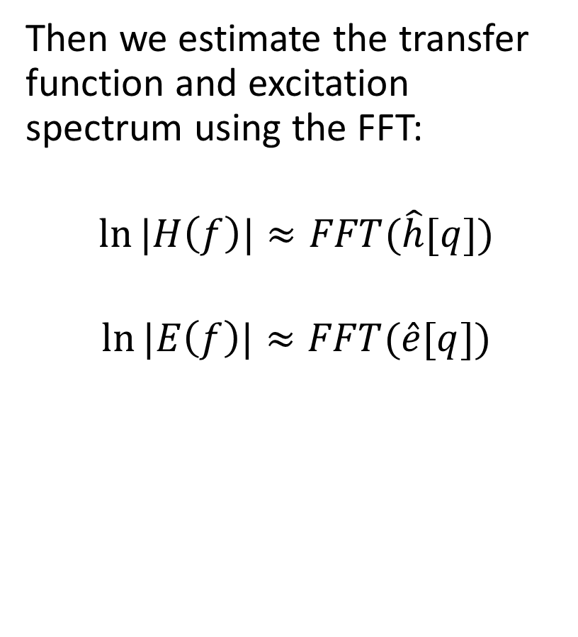
Liftering = filter(spectrum) = window(cepstrum)
(Bogert, Healy & Tukey, 1962)
Then we estimate the transfer function and excitation spectrum using the FFT:
$$\ln{|H\left(f\right)|}≈FFT(\hat{h}[q])$$
$$\ln{|E\left(f\right)|}≈FFT(\hat{e}[q])$$

Slide 35
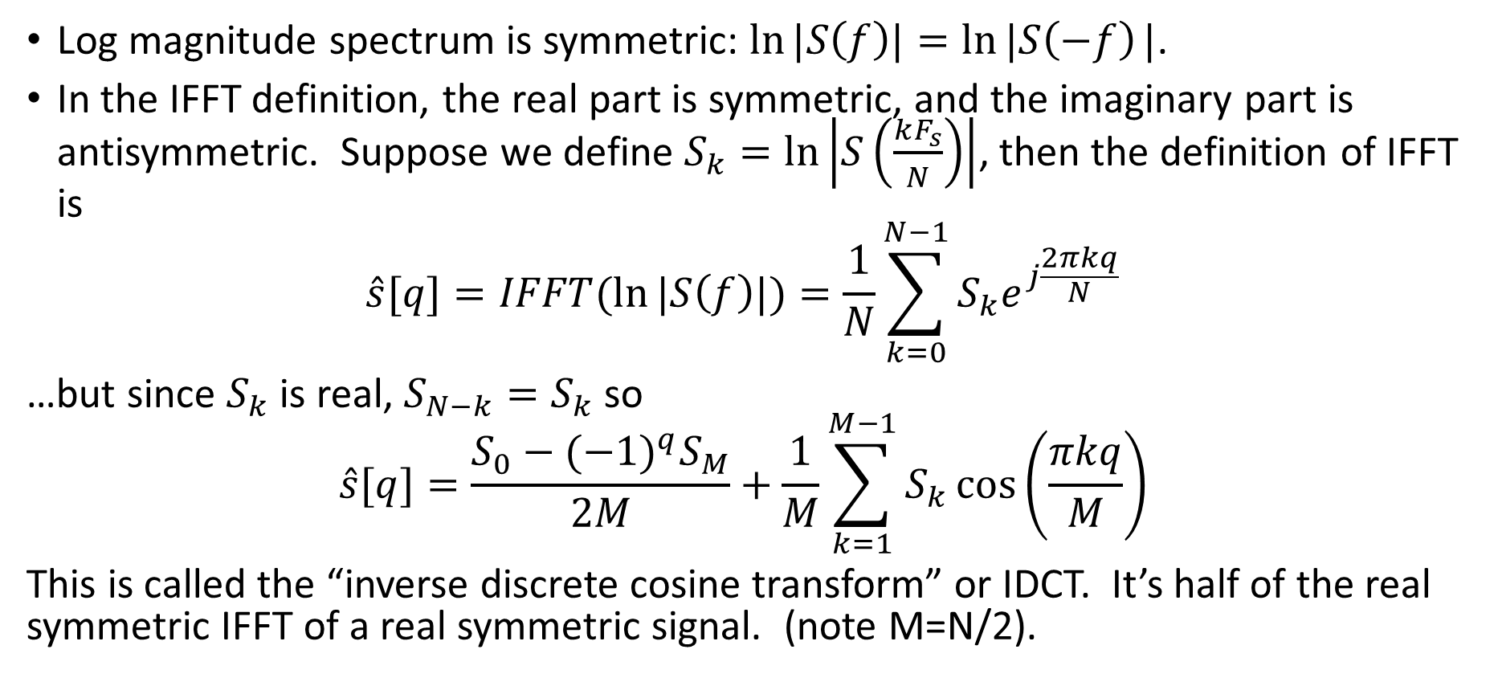
Inverse Discrete Cosine Transform
Log magnitude spectrum is symmetric: $\ln{|S\left(f\right)|}=\ln{|S\left(−f\right)}|$.
In the IFFT definition, the real part is symmetric, and the imaginary part is antisymmetric. Suppose we define $S_{k}=ln\left|S\left(\frac{kF_{s}}{N}\right)\right|$, then the definition of IFFT is
$$\hat{s}[q]=IFFT(\ln{|S\left(f\right)|)=\frac{1}{N}\sum_{k=0}^{N−1}{S_{k}e^{j\frac{2πkq}{N}}}}$$
…but since $S_{k}$ is real, $S_{N−k}=S_{k}$ so
$$\hat{s}[q]=\frac{S_{0}−{(−1)}^{q}S_{M}}{2M}+\frac{1}{M}\sum_{k=1}^{M−1}{S_{k}\cos\left(\frac{πkq}{M}\right)}$$
This is called the “inverse discrete cosine transform” or IDCT. It’s half of the real symmetric IFFT of a real symmetric signal. (note M=N/2).

Slide 36
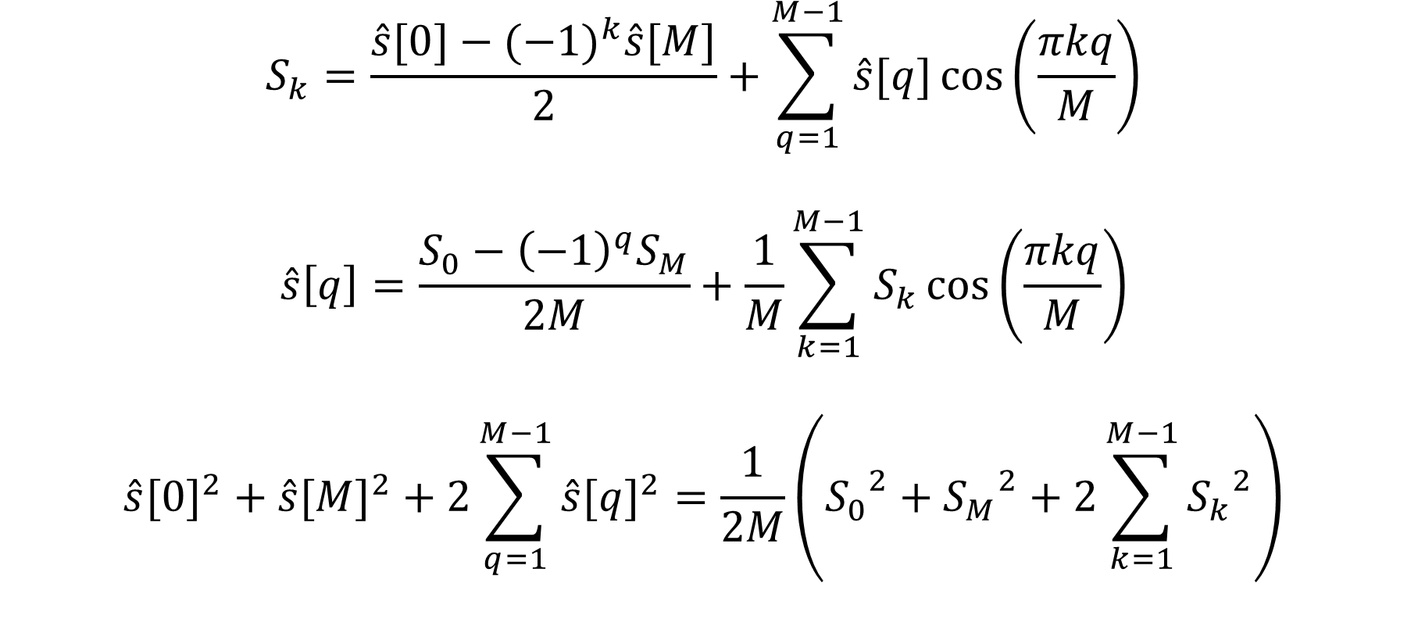
Type I DCT, IDCT, and Parseval’s Theorem
$$S_{k}=\frac{\hat{s}[0]−{(−1)}^{k}\hat{s}[M]}{2}+\sum_{q=1}^{M−1}{\hat{s}[q]\cos\left(\frac{πkq}{M}\right)}$$
$$\hat{s}\left[q\right]=\frac{S_{0}−{\left(−1\right)}^{q}S_{M}}{2M}+\frac{1}{M}\sum_{k=1}^{M−1}{S_{k}\cos\left(\frac{πkq}{M}\right)}$$
$${\hat{s}[0]}^{2}+{\hat{s}[M]}^{2}+2\sum_{q=1}^{M−1}{{\hat{s}[q]}^{2}}=\frac{1}{2M}\left({S_{0}}^{2}+{S_{M}}^{2}+2\sum_{k=1}^{M−1}{{S_{k}}^{2}}\right)$$

Slide 37
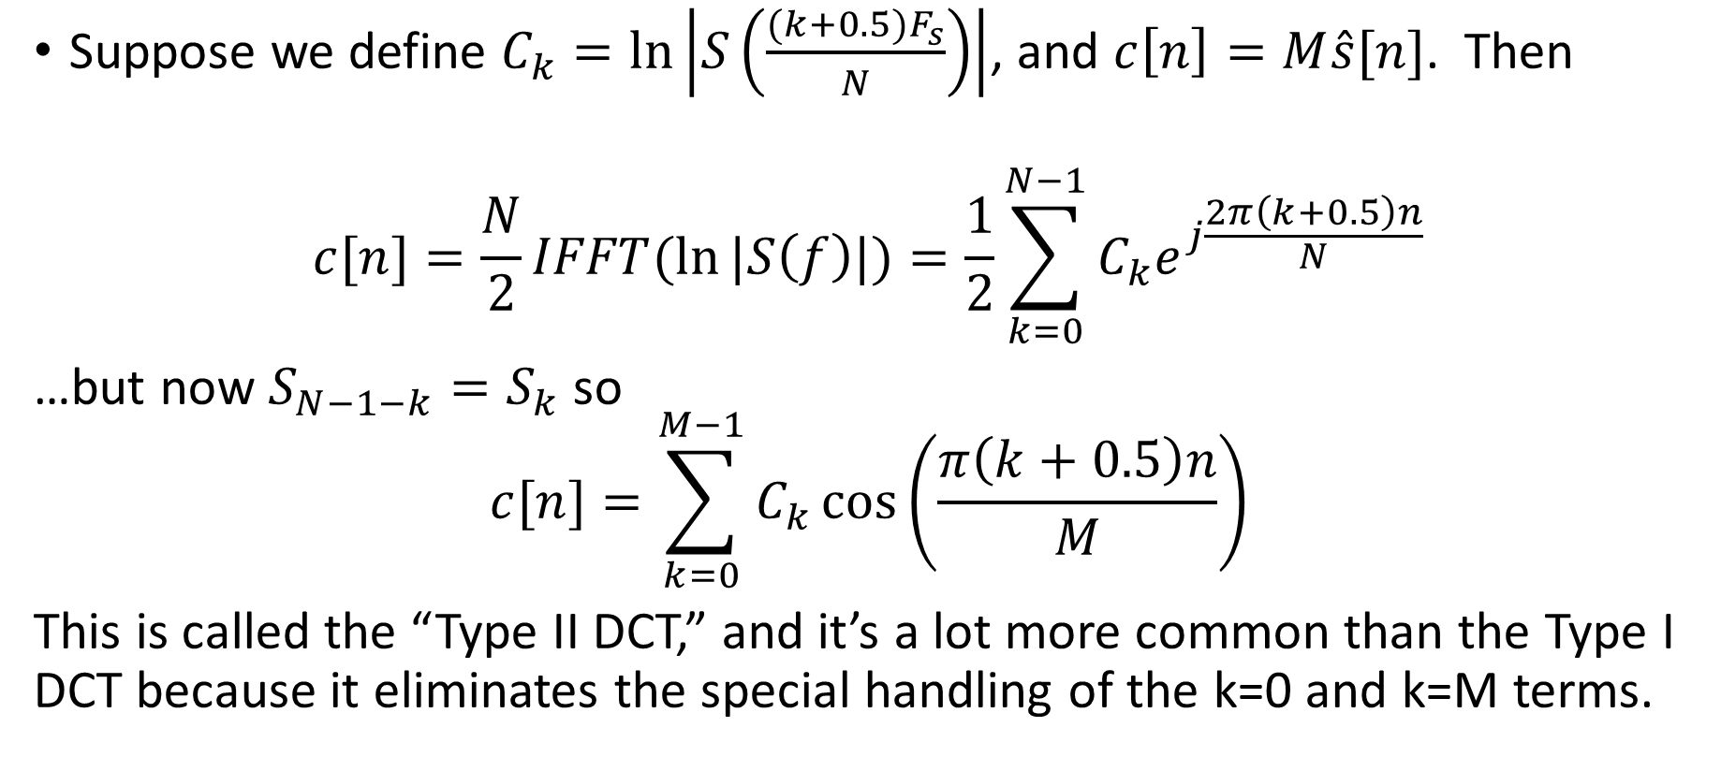
Type II Discrete Cosine Transform
Suppose we define $C_{k}=ln\left|S\left(\frac{(k+0.5)F_{s}}{N}\right)\right|$, and $c\left[n\right]=M\hat{s}[n]$. Then
$$c[n]=\frac{N}{2}IFFT(\ln{|S\left(f\right)|)=\frac{1}{2}\sum_{k=0}^{N−1}{C_{k}e^{j\frac{2π\left(k+0.5\right)n}{N}}}}$$
…but now $S_{N−1−k}=S_{k}$ so
$$c[n]=\sum_{k=0}^{M−1}{C_{k}\cos\left(\frac{π\left(k+0.5\right)n}{M}\right)}$$
This is called the “Type II DCT,” and it’s a lot more common than the Type I DCT because it eliminates the special handling of the k=0 and k=M terms.

Slide 38

Type II DCT, IDCT, and Parseval’s Theorem
$$c[n]=\sum_{k=0}^{M−1}{C_{k}\cos\left(\frac{π\left(k+0.5\right)n}{M}\right)}$$
$$C_{k}=\frac{1}{M}\sum_{k=1}^{M−1}{c[n]\cos\left(\frac{π\left(k+0.5\right)n}{M}\right)}$$
$$\frac{1}{M}\left({c[0]}^{2}+2\sum_{n=1}^{M−1}{{c[n]}^{2}}\right)=\sum_{k=0}^{M−1}{{C_{k}}^{2}}$$

Slide 39
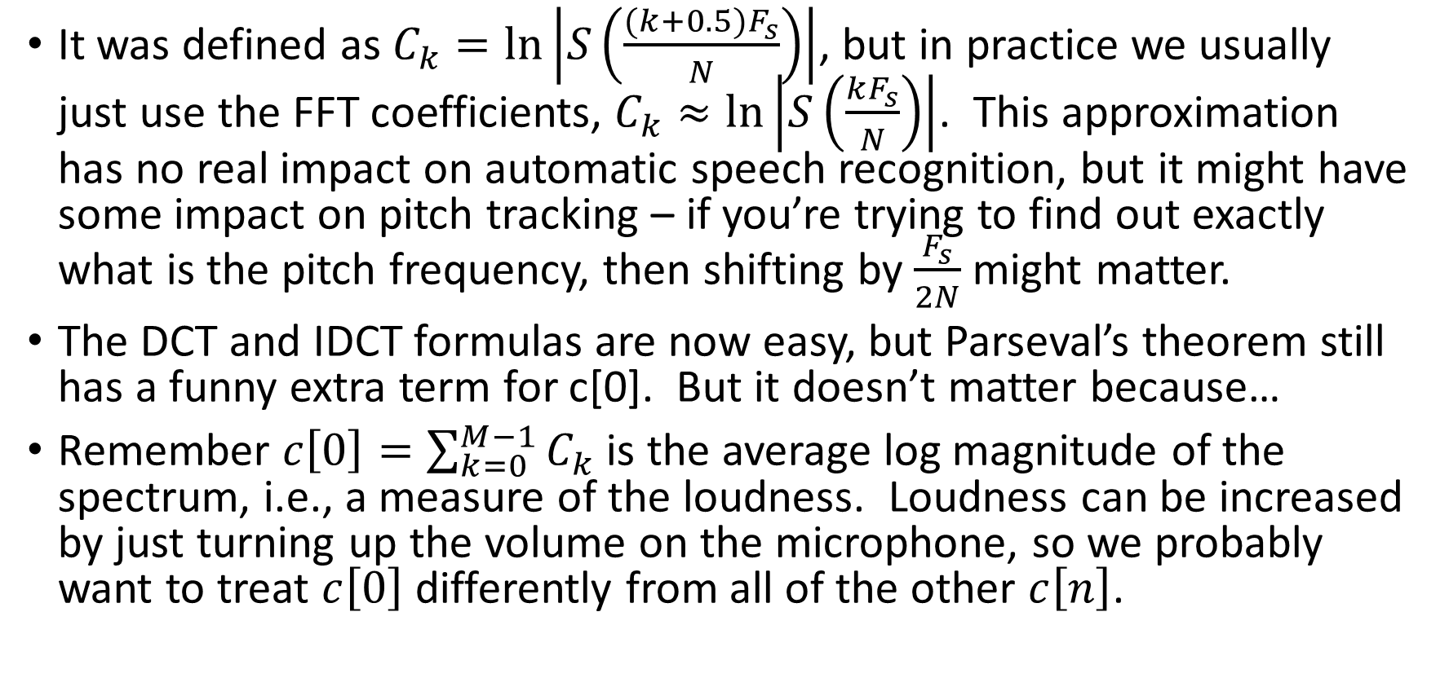
Details about type II DCT
It was defined as $C_{k}=ln\left|S\left(\frac{(k+0.5)F_{s}}{N}\right)\right|$, but in practice we usually just use the FFT coefficients, $C_{k}≈ln\left|S\left(\frac{kF_{s}}{N}\right)\right|$. This approximation has no real impact on automatic speech recognition, but it might have some impact on pitch tracking – if you’re trying to find out exactly what is the pitch frequency, then shifting by $\frac{F_{s}}{2N}$ might matter.
The DCT and IDCT formulas are now easy, but Parseval’s theorem still has a funny extra term for c[0]. But it doesn’t matter because…
Remember $c\left[0\right]=\sum_{k=0}^{M−1}{C_{k}}$ is the average log magnitude of the spectrum, i.e., a measure of the loudness. Loudness can be increased by just turning up the volume on the microphone, so we probably want to treat $c\left[0\right]$ differently from all of the other $c\left[n\right]$.

Slide 40
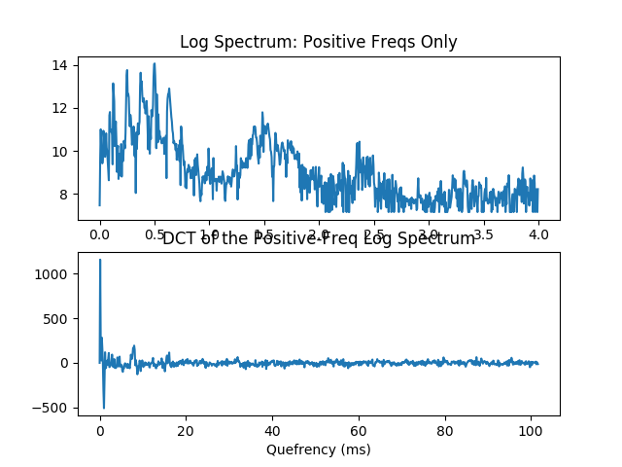
Discrete Cosine Transform = Half of the real symmetric IFFT of a real symmetric signal

Slide 41
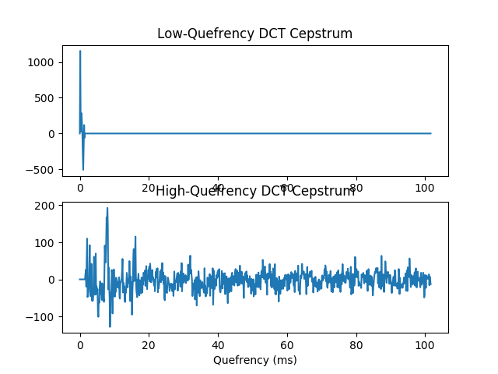
Lifter = window the IFFT (left) or DCT (right) cepstrum

Slide 42
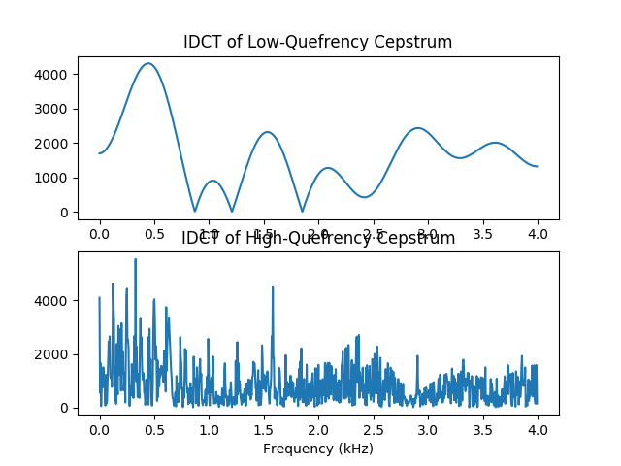
Both kinds of liftering give the same transfer function and excitation estimates

Slide 43
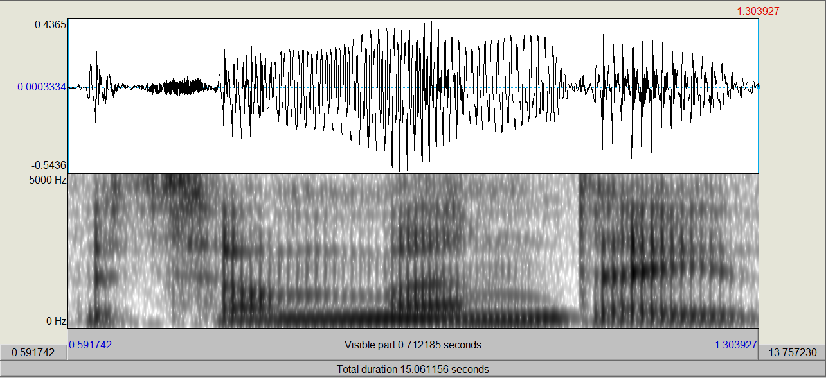

Spectrogram: ln(energy(frequency,time))
Scharenborg, 2017
bu t o nM o n d a y
Spectrum lets you measure formants, so it gives some information about vowels.
Timing is important to know about consonants.
Spectrogram = time on the horizontal axis, frequency on vertical axis.
Notes:
Explain about amplitude (energy) and frequency ranges, voiced sounds, formants and formant transitions, differences in spectral shape
Each sound has its own spectral pattern depending on the shape of the vocal tract
Differences in formant transitions between the o after t and the o after M
Plosion of the d
Difference in formant tracks between o and a
Diphtong ay

Slide 44
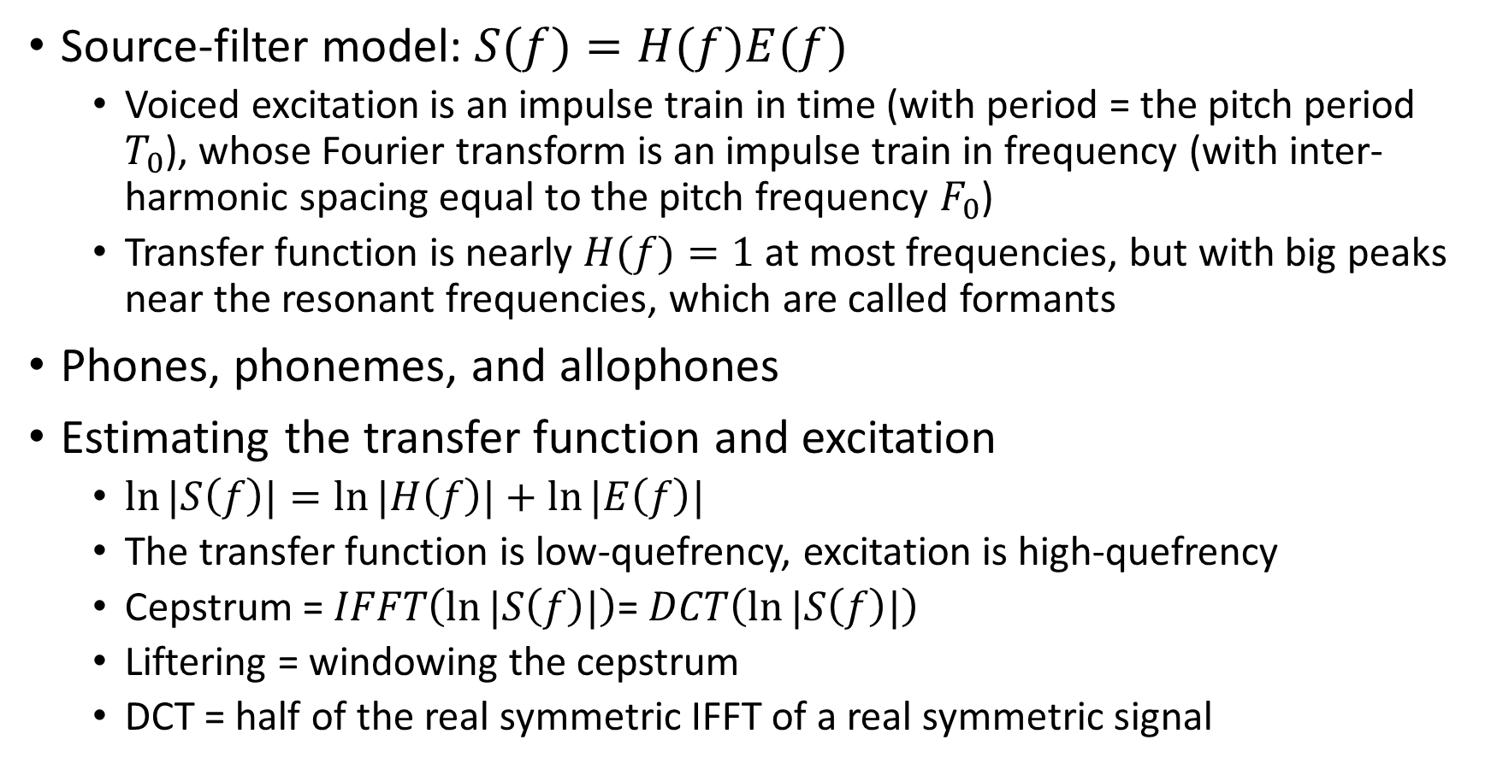
Summary
Source-filter model: $S(f)=H(f)E(f)$
  Voiced excitation is an impulse train in time (with period = the pitch period $T_{0}$), whose Fourier transform is an impulse train in frequency (with inter-harmonic spacing equal to the pitch frequency $F_{0}$)
  Transfer function is nearly $H(f)=1$ at most frequencies, but with big peaks near the resonant frequencies, which are called formants
Phones, phonemes, and allophones
Estimating the transfer function and excitation
  $\ln{|S\left(f\right)|}=\ln{|H\left(f\right)|}+\ln{|E\left(f\right)|}$
  The transfer function is low-quefrency, excitation is high-quefrency
  Cepstrum = $IFFT\left(\ln{|S\left(f\right)|}\right)$= $DCT\left(\ln{|S\left(f\right)|}\right)$
  Liftering = windowing the cepstrum
  DCT = half of the real symmetric IFFT of a real symmetric signal

