Slide 1
ECE 417 Lecture 3:
1-D Gaussians
Mark Hasegawa-Johnson
9/5/2017

Slide 2
Contents
Probability and Probability Density
Gaussian pdf
Central Limit Theorem
Brownian Motion
White Noise
Vector with independent Gaussian elements

Slide 3

Cumulative Distribution Function (CDF)
A “cumulative distribution function” (CDF) specifies the probability that random variable X takes a value less than $θ$:
$$F_{X}\left(x\right)=Pr\left\{X≤x\right\}$$

Slide 4
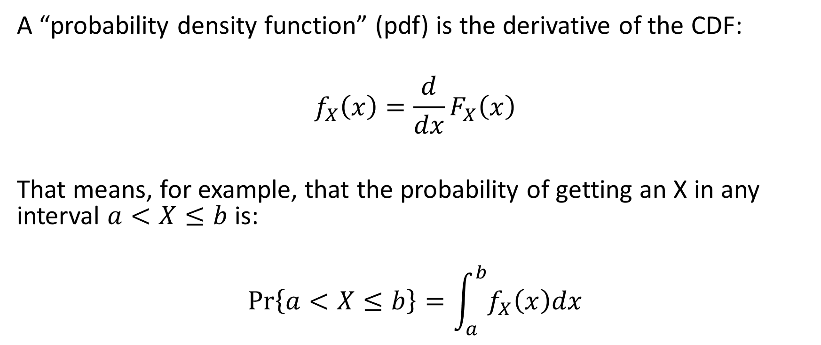
Probability Density Function (pdf)
A “probability density function” (pdf) is the derivative of the CDF:
$$f_{X}\left(x\right)=\frac{d}{dx}F_{X}\left(x\right)$$
That means, for example, that the probability of getting an X in any interval $a<X≤b$ is:
$$\operatorname{Pr}\left\{a<X≤b\right\}=\int_{a}^{b}{f_{X}\left(x\right)dx}$$

Slide 5
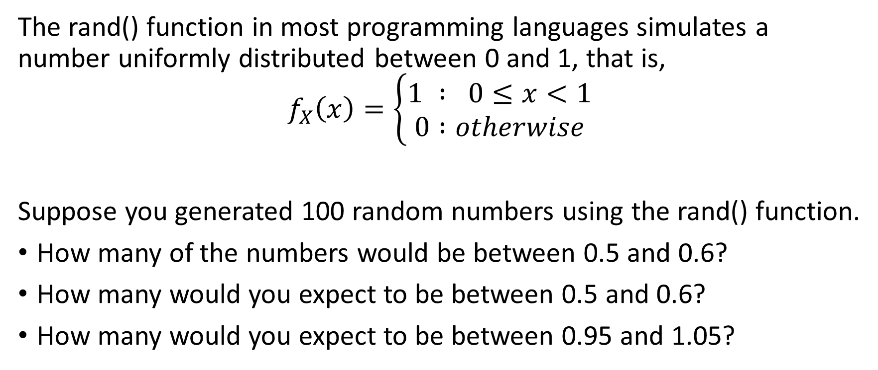
Example: Uniform pdf
The rand() function in most programming languages simulates a number uniformly distributed between 0 and 1, that is,
$$f_{X}\left(x\right)=\left\{\begin{aligned}1 : 0≤x<1 \\ 0 :otherwise\end{aligned}\right.$$
Suppose you generated 100 random numbers using the rand() function.
How many of the numbers would be between 0.5 and 0.6?
How many would you expect to be between 0.5 and 0.6?
How many would you expect to be between 0.95 and 1.05?

Slide 6
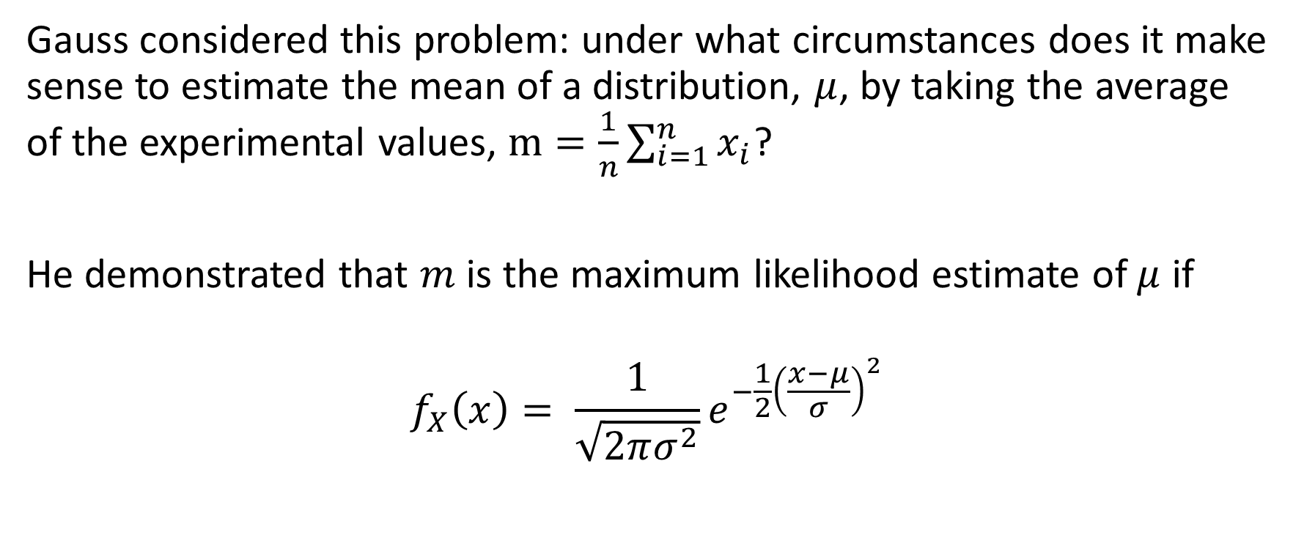
Gaussian (Normal) pdf
Gauss considered this problem: under what circumstances does it make sense to estimate the mean of a distribution, $μ$, by taking the average of the experimental values, $m=\frac{1}{n}\sum_{i=1}^{n}{x_{i}}$?
He demonstrated that $m$ is the maximum likelihood estimate of $μ$ if
$$f_{X}\left(x\right)= \frac{1}{\sqrt{2πσ^{2}}}e^{−\frac{1}{2}{\left(\frac{x−μ}{σ}\right)}^{2}}$$

Slide 7
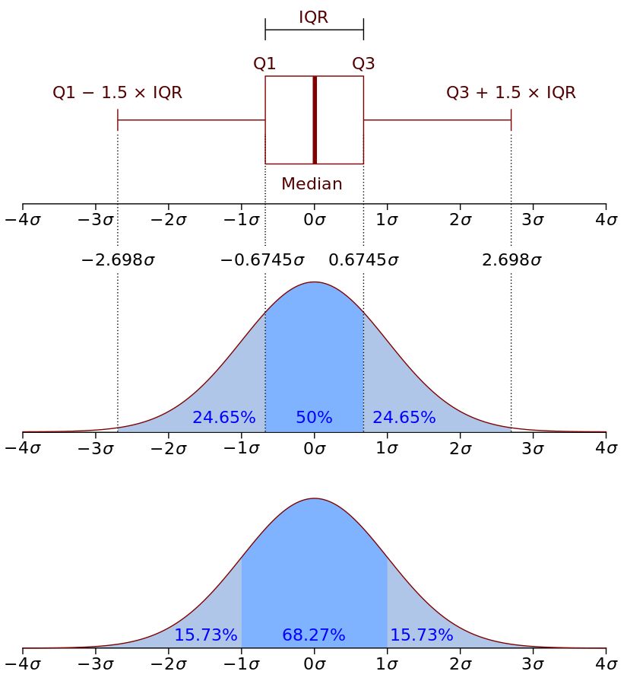
Gaussian pdf
Attribution: jhguch, https://commons.wikimedia.org/wiki/File:Boxplot_vs_PDF.svg

Slide 8
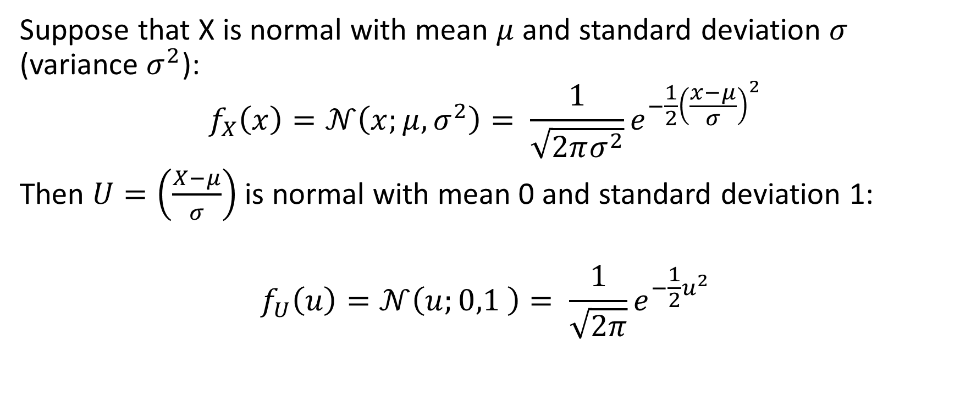
Unit Normal pdf
Suppose that X is normal with mean $μ$ and standard deviation $σ$ (variance $σ^{2}$):
$$f_{X}\left(x\right)=𝒩\left(x;μ,σ^{2}\right)= \frac{1}{\sqrt{2πσ^{2}}}e^{−\frac{1}{2}{\left(\frac{x−μ}{σ}\right)}^{2}}$$
Then $U=\left(\frac{X−μ}{σ}\right)$ is normal with mean 0 and standard deviation 1:
$$f_{U}\left(u\right)=𝒩\left(u;0,1 \right)= \frac{1}{\sqrt{2π}}e^{−\frac{1}{2}u^{2}}$$

Slide 9
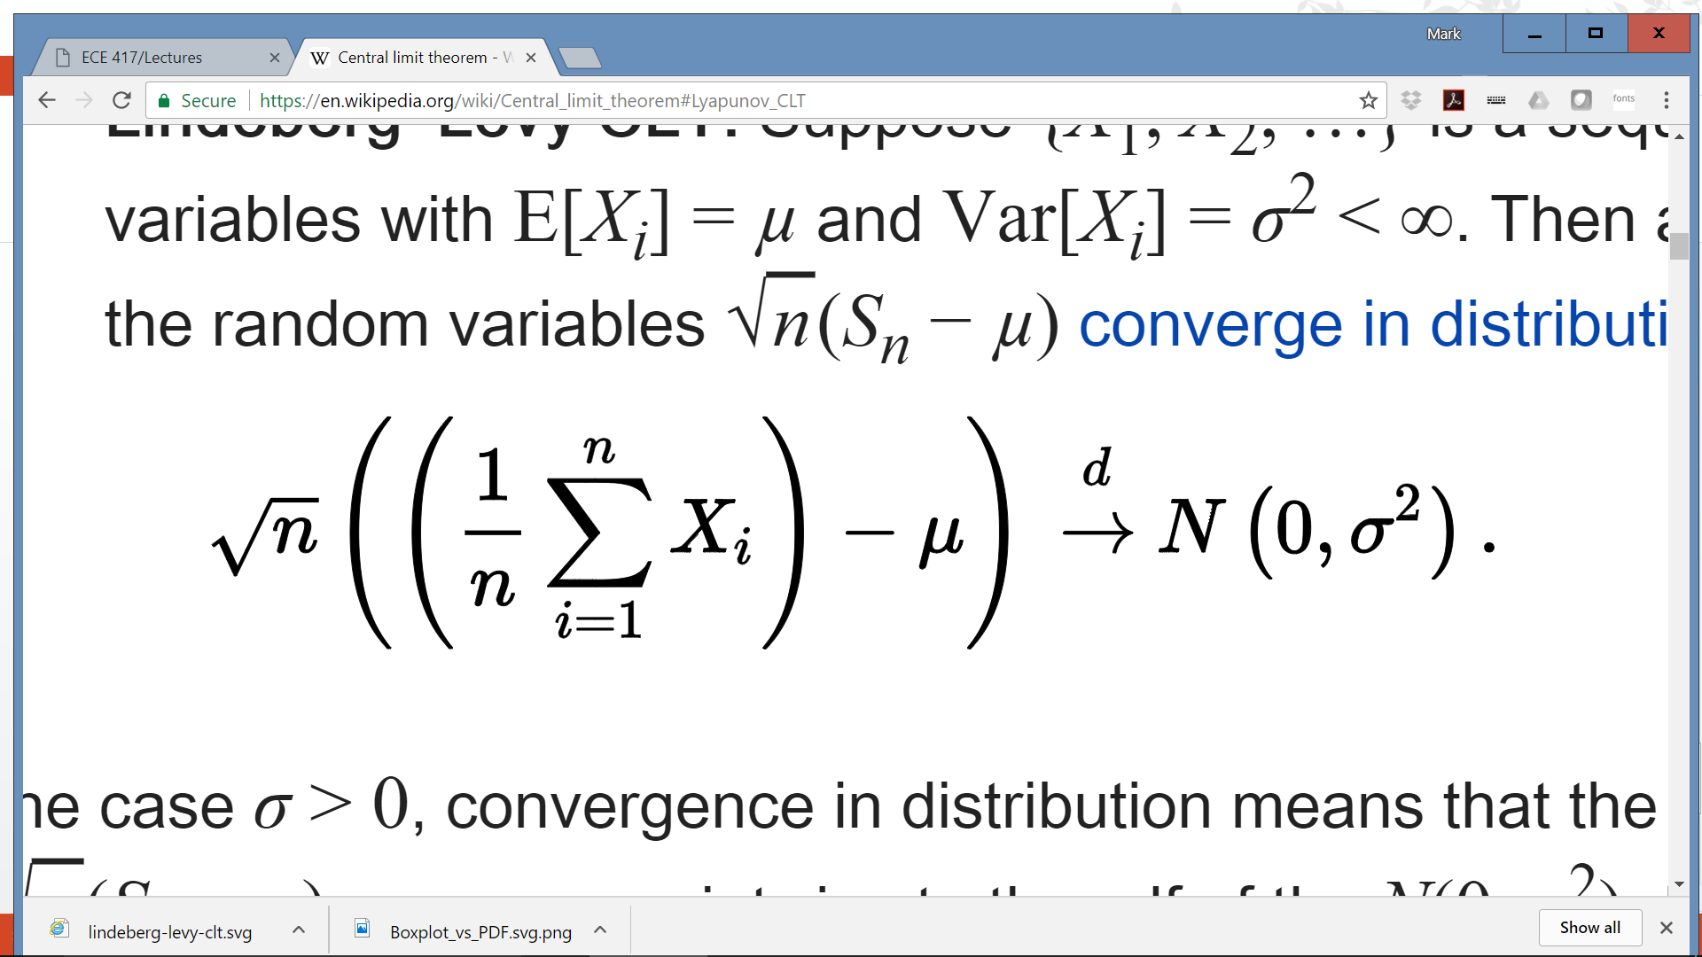

Central Limit Theorem
The Gaussian pdf is important because of the Central Limit Theorem. Suppose $X_{i}$ are i.i.d. (independent and identically distributed), each having mean $μ$ and variance $σ^{2}$. Then

Slide 10
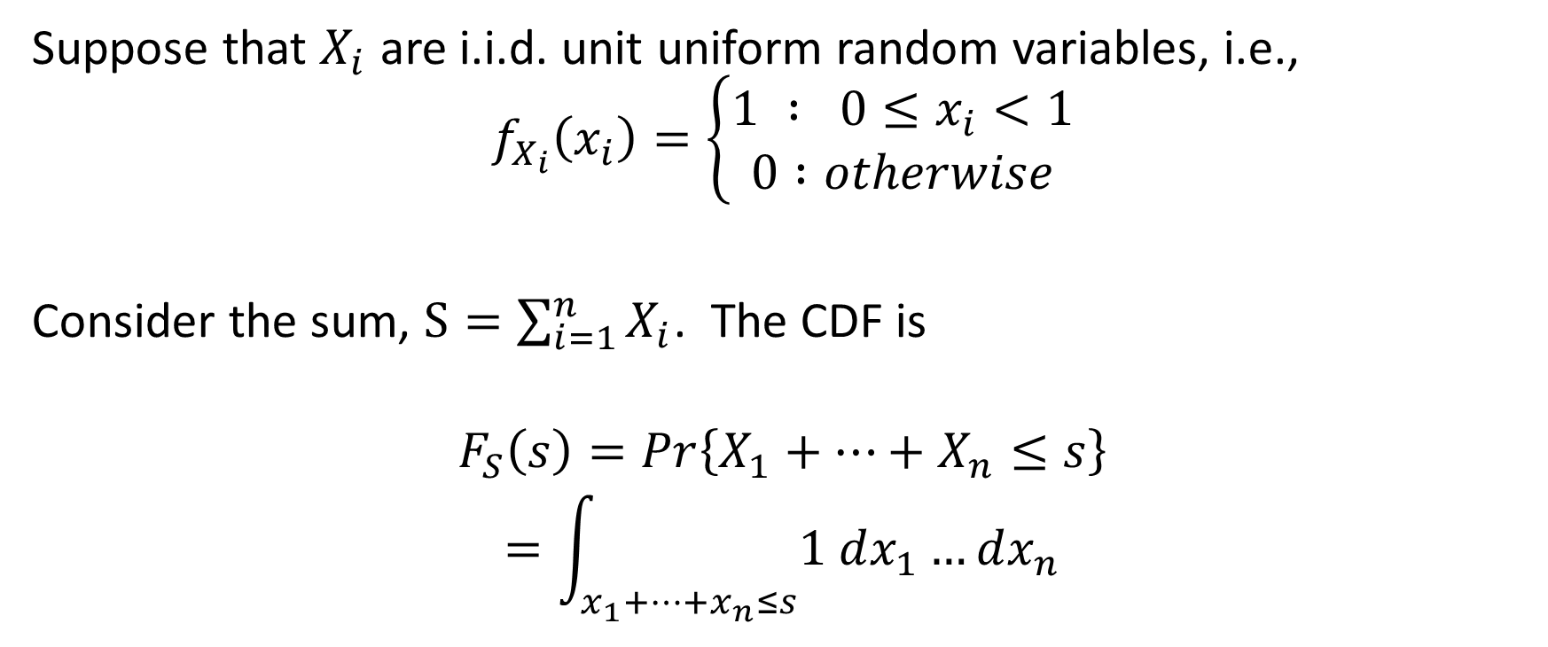
Example: the sum of uniform random variables
Suppose that $X_{i}$ are i.i.d. unit uniform random variables, i.e.,
$$f_{X_{i}}\left(x_{i}\right)=\left\{\begin{aligned}1 : 0≤x_{i}<1 \\ 0 :otherwise\end{aligned}\right.$$
Consider the sum, $S=\sum_{i=1}^{n}{X_{i}}$. The CDF is
$$F_{S}\left(s\right)=Pr\left\{X_{1}+…+X_{n}≤s\right\}$$
$$=\int_{x_{1}+…+x_{n}≤s}{1 dx_{1}…dx_{n}}$$

Slide 11
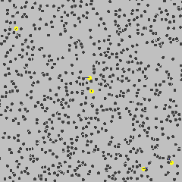
Brownian motion
The Central Limit Theorem matters because Einstein showed that the movement of molecules, in a liquid or gas, is the sum of n i.i.d. molecular collisions.
In other words, the position after t seconds is Gaussian, with mean 0, and with a variance of Dt, where D is some constant.
Attribution: lookang, https://commons.wikimedia.org/wiki/File:Brownianmotion5particles150frame.gif

Slide 12
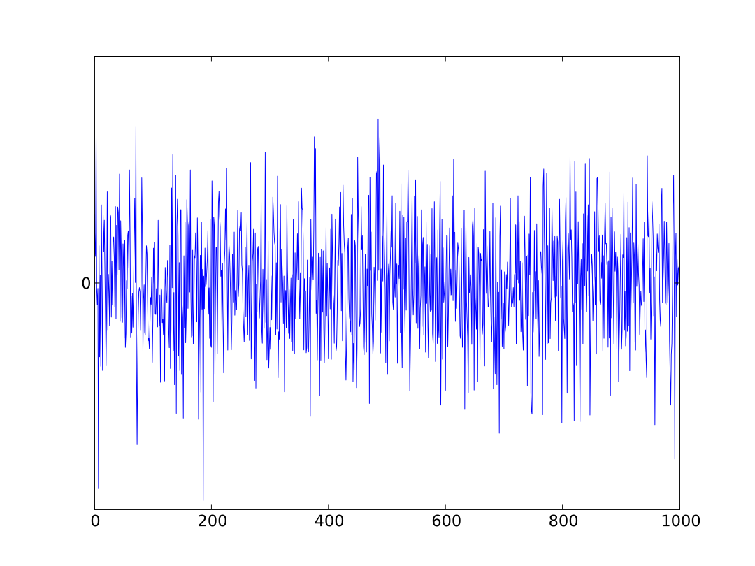
Gaussian Noise
Sound = air pressure fluctuations caused by velocity of air molecules
Velocity of warm air molecules without any external sound source = Gaussian
Therefore:
Sound produced by warm air molecules without any external sound source = Gaussian noise
Electrical signals: same.
Attribution Morn, https://commons.wikimedia.org/wiki/File:White_noise.svg

Slide 13
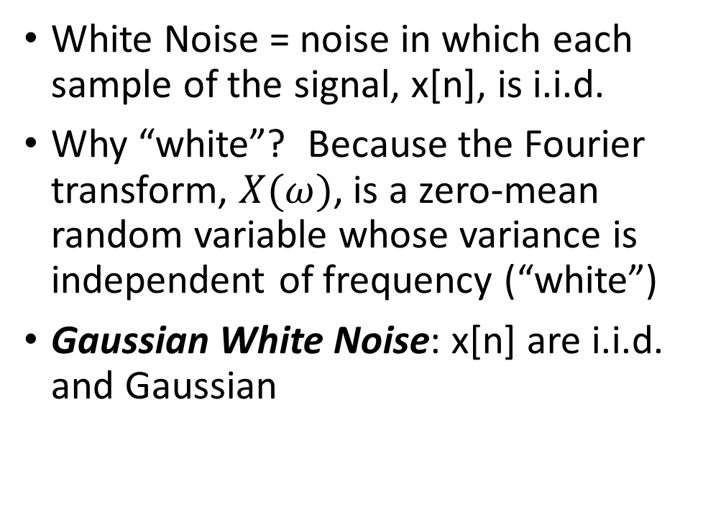
White Noise
White Noise = noise in which each sample of the signal, x[n], is i.i.d.
Why “white”? Because the Fourier transform, $X(ω)$, is a zero-mean random variable whose variance is independent of frequency (“white”)
Gaussian White Noise: x[n] are i.i.d. and Gaussian
Attribution Morn, https://commons.wikimedia.org/wiki/File:White_noise.svg

Slide 14
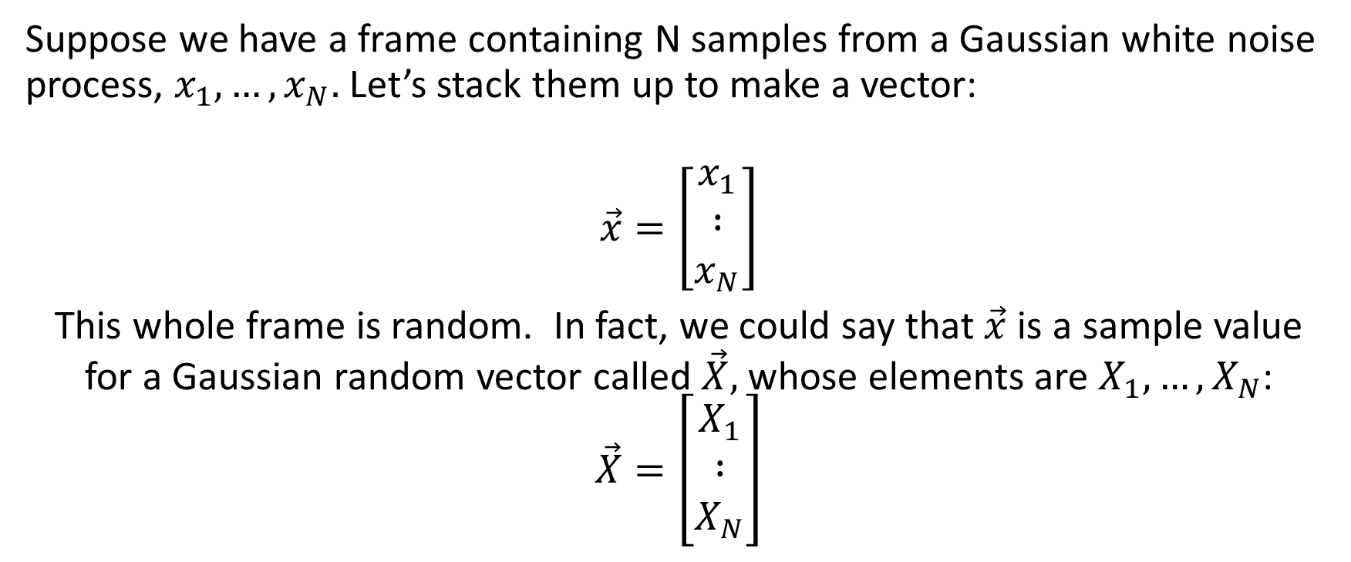
Vector of Independent Gaussian Variables
Suppose we have a frame containing N samples from a Gaussian white noise process, $x_{1},…,x_{N}.$Let’s stack them up to make a vector:
$$\vec{x}=\left[\begin{matrix}x_{1} \\ ∶ \\ x_{N}\end{matrix}\right]$$
This whole frame is random. In fact, we could say that $\vec{x}$ is a sample value for a Gaussian random vector called $\vec{X},$ whose elements are $X_{1},…,X_{N}$:
$$\vec{X}=\left[\begin{matrix}X_{1} \\ ∶ \\ X_{N}\end{matrix}\right]$$

Slide 15
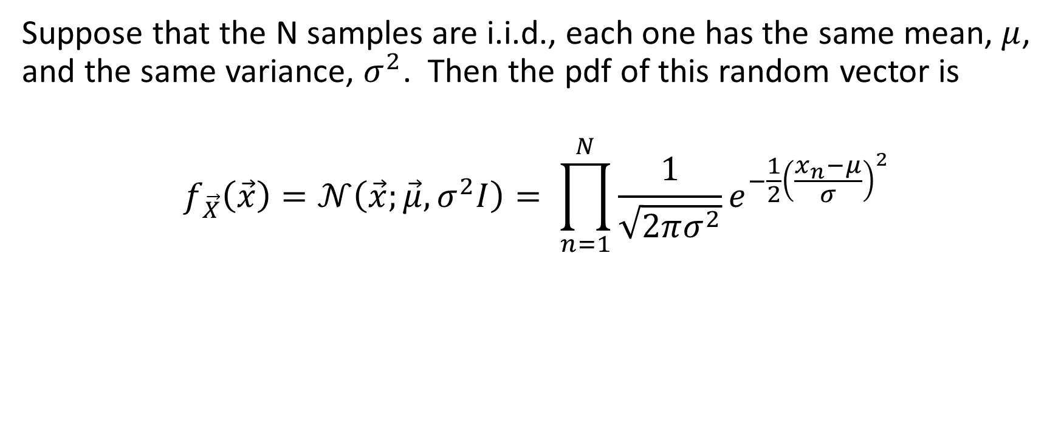
Vector of Independent Gaussian Variables
Suppose that the N samples are i.i.d., each one has the same mean, $μ$, and the same variance, $σ^{2}$. Then the pdf of this random vector is
$$f_{\vec{X}}\left(\vec{x}\right)=𝒩\left(\vec{x};\vec{μ},σ^{2}I\right)= \prod_{n=1}^{N}{\frac{1}{\sqrt{2πσ^{2}}}e^{−\frac{1}{2}{\left(\frac{x_{n}−μ}{σ}\right)}^{2}}}$$

Slide 16
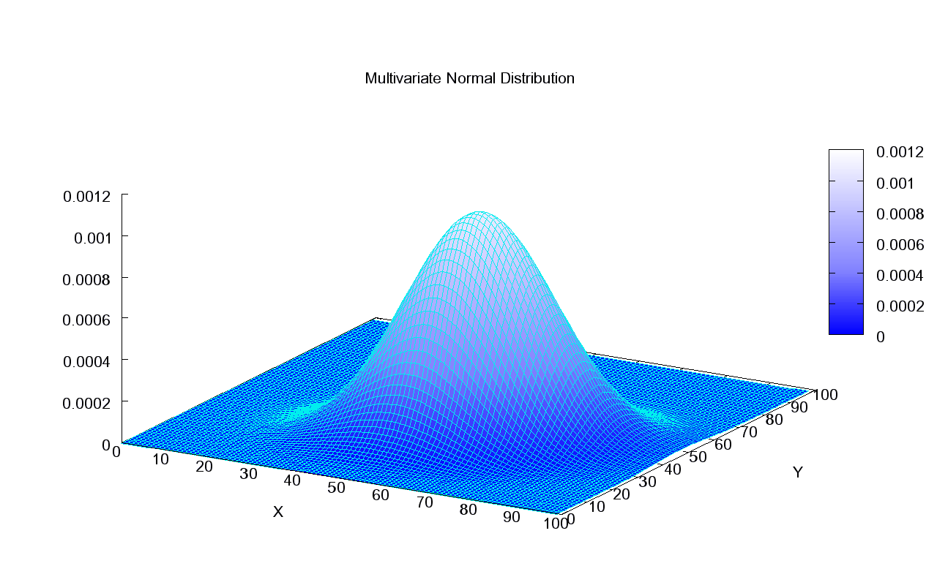
Vector of Independent Gaussian Variables
For example, here’s an example from Wikipedia with mean of 50 and standard deviation of about 12.
Attribution: Piotrg, https://commons.wikimedia.org/wiki/File:Multivariate_Gaussian.png

Slide 17
Summary
CDF = probability that X is less than or equal to x
pdf = derivative of the CDF
Gaussian: pdf is proportional to exp(-x^2)
CLT: if you average N random variables of any kind, the pdf of the average converges to a Gaussian
Brownian motion, e.g., of air molecules in warm air, is the average of many random impacts = Gaussian movement
White noise = i.i.d. random samples. Gaussian white noise: samples are Gaussian and i.i.d.
Gaussian vector with independent elements: pdf of the vector = product of the pdfs of the elements

