Slide 1
ECE 417, Lecture 10:
Speech Perception
Mark Hasegawa-Johnson
10/3/2017

Slide 2
Content
Parseval’s Theorem: Cepstral Distance = Spectral Distance
What spectrum do people hear? The basilar membrane
Frequency scales for hearing: mel, ERB
Filterbank coefficients and MFCC

Slide 3
Parseval’s Theorem
L2 norm of a signal equals the L2 norm of its Fourier transform.

Slide 4

Parseval’s Theorem: Examples
Fourier Series:
$$\frac{1}{T}\int_{0}^{T}{{\left|x(t)\right|}^{2}dt}=\sum_{k=−∞}^{∞}{{\left|X_{k}\right|}^{2}}$$
DTFT:
$$\sum_{n=−∞}^{∞}{{\left|x[n]\right|}^{2}}=\frac{1}{2π}\int_{−π}^{π}{{\left|X(ω)\right|}^{2}dω}$$
DFT:
$$\sum_{n=0}^{N−1}{{\left|x[n]\right|}^{2}}=\frac{1}{N}\sum_{k=0}^{N−1}{{\left|X[k]\right|}^{2}}$$

Slide 5

Parseval’s Theorem: DCT
$$\frac{1}{M}\left({c[0]}^{2}+2\sum_{n=1}^{M−1}{{c[n]}^{2}}\right)=\sum_{k=0}^{M−1}{{C_{k}}^{2}}$$
Where you remember that
$$C_{k}=ln\left|S\left(\frac{(k+0.5)F_{s}}{N}\right)\right|$$

Slide 6
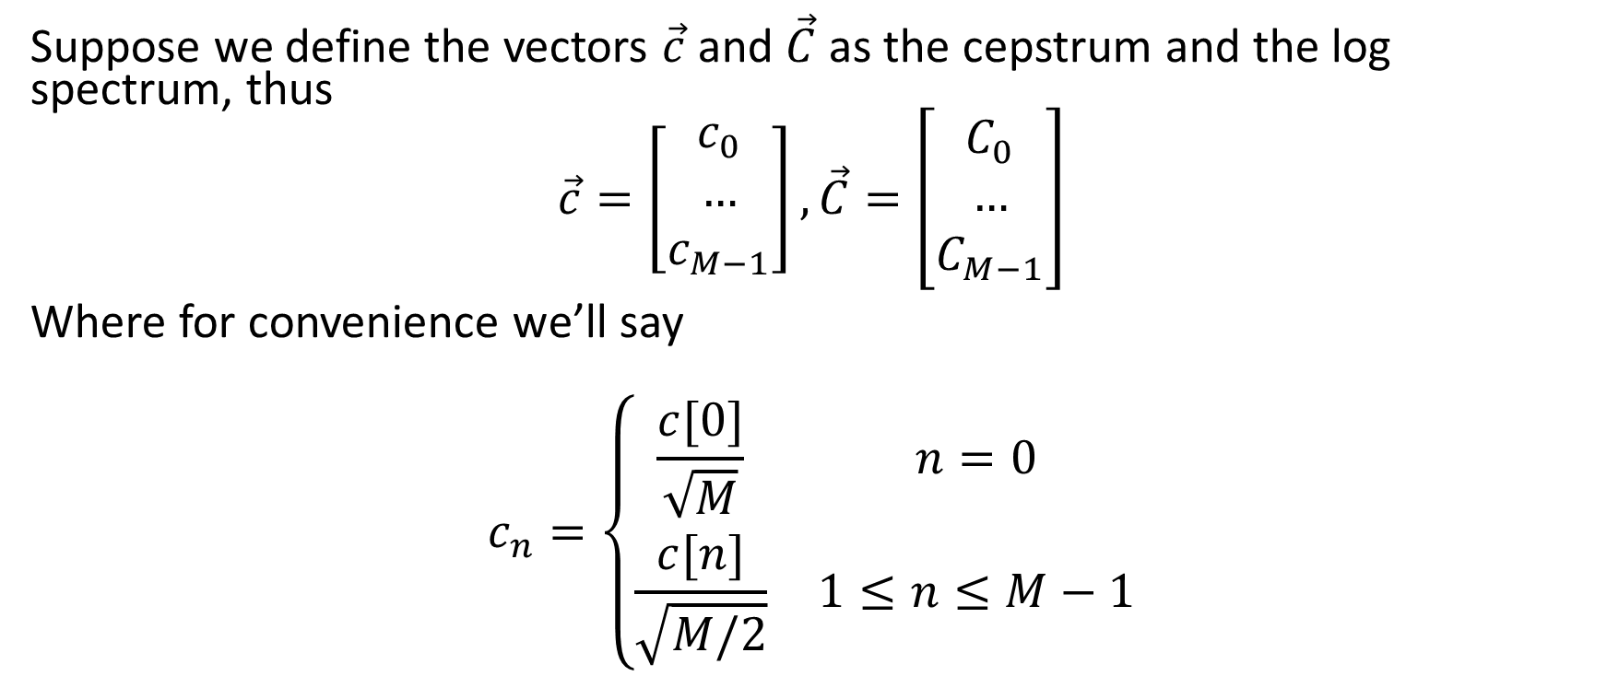
Parseval’s Theorem: Vector Formulation
Suppose we define the vectors $\vec{c}$ and $\vec{C}$ as the cepstrum and the log spectrum, thus
$$\vec{c}=\left[\begin{matrix}c_{0} \\ … \\ c_{M−1}\end{matrix}\right],\vec{C}=\left[\begin{matrix}C_{0} \\ … \\ C_{M−1}\end{matrix}\right]$$
Where for convenience we’ll say
$$c_{n}=\left\{\begin{matrix}\frac{c[0]}{\sqrt{M}} & n=0 \\ \frac{c[n]}{\sqrt{M/2}} & 1≤n≤M−1\end{matrix}\right.$$

Slide 7
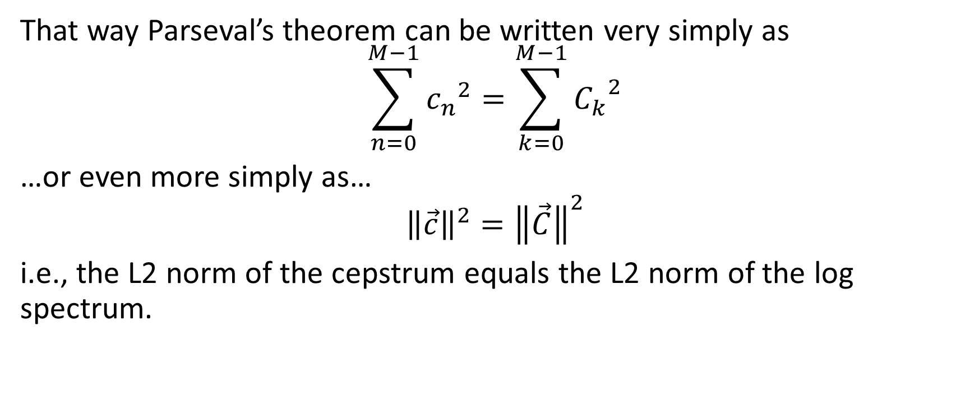
Parseval’s Theorem: Vector Formulation
That way Parseval’s theorem can be written very simply as
$$\sum_{n=0}^{M−1}{{c_{n}}^{2}=\sum_{k=0}^{M−1}{{C_{k}}^{2}}}$$
…or even more simply as…
$${\left\|\vec{c}\right\|}^{2}={\left\|\vec{C}\right\|}^{2}$$
i.e., the L2 norm of the cepstrum equals the L2 norm of the log spectrum.

Slide 8
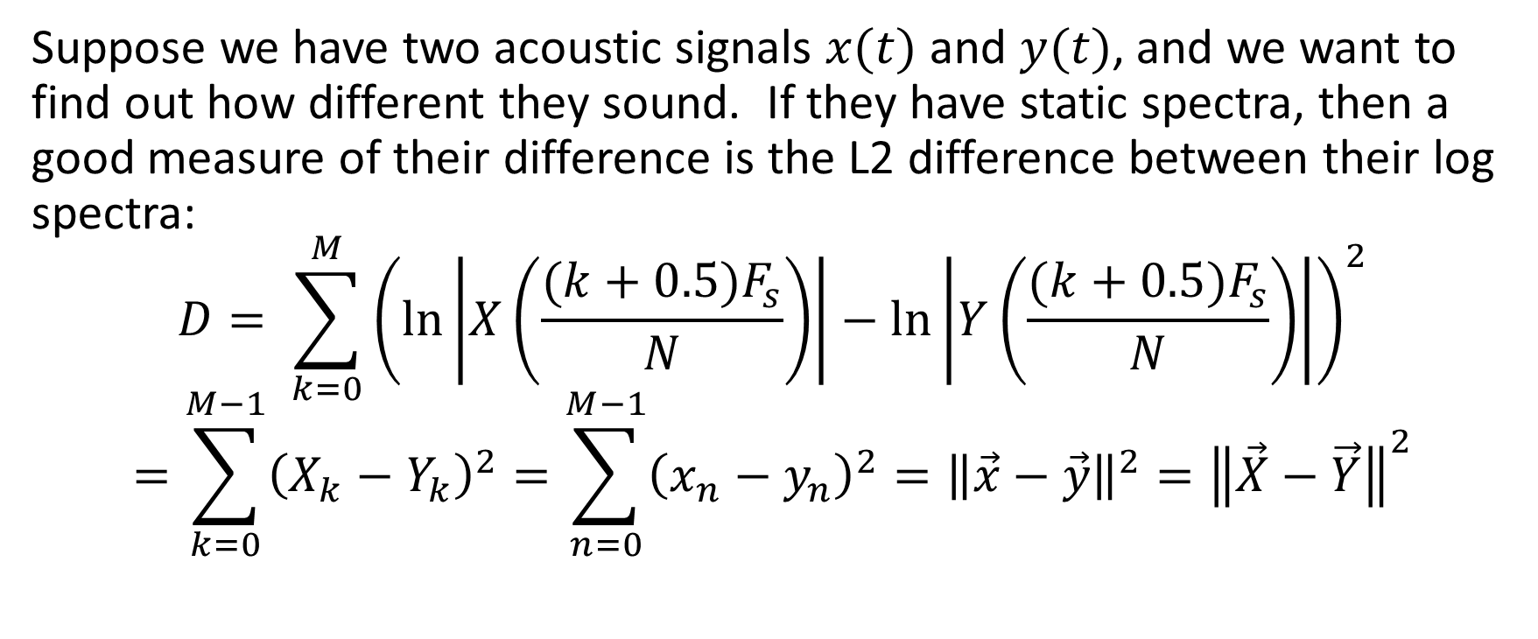
What it means for KNN
Suppose we have two acoustic signals $x(t)$ and $y(t)$, and we want to find out how different they sound. If they have static spectra, then a good measure of their difference is the L2 difference between their log spectra:
$$D= \sum_{k=0}^{M}{{\left(\ln\left|X\left(\frac{(k+0.5)F_{s}}{N}\right)\right|−\ln\left|Y\left(\frac{(k+0.5)F_{s}}{N}\right)\right|\right)}^{2}}$$
$$=\sum_{k=0}^{M−1}{{\left(X_{k}−Y_{k}\right)}^{2}=\sum_{n=0}^{M−1}{{\left(x_{n}−y_{n}\right)}^{2}}}={\left\|\vec{x}−\vec{y}\right\|}^{2}={\left\|\vec{X}−\vec{Y}\right\|}^{2}$$

Slide 9
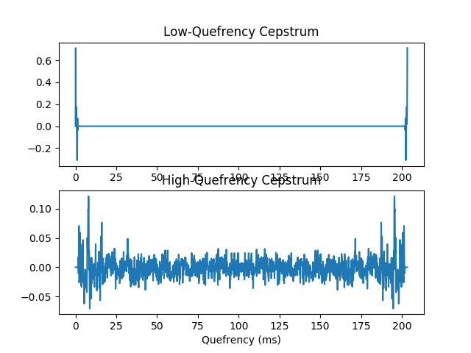
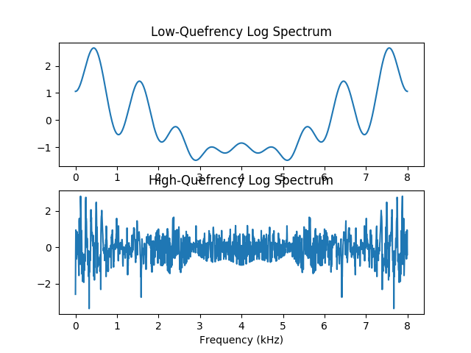
Low-pass liftering smooths the spectrum

Slide 10
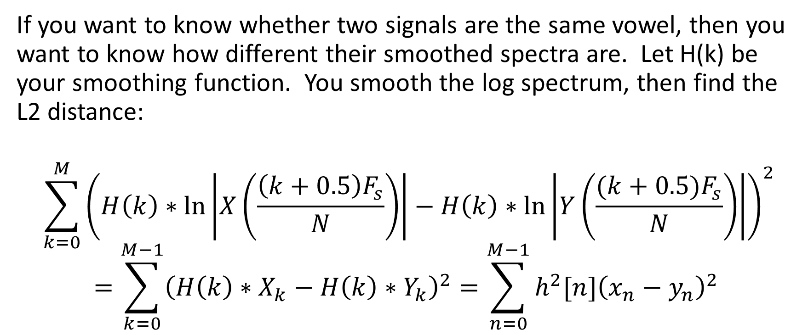
Low-pass liftered L2 norm
If you want to know whether two signals are the same vowel, then you want to know how different their smoothed spectra are. Let H(k) be your smoothing function. You smooth the log spectrum, then find the L2 distance:
$$\sum_{k=0}^{M}{{\left(H\left(k\right)∗\ln\left|X\left(\frac{\left(k+0.5\right)F_{s}}{N}\right)\right|−H\left(k\right)∗\ln\left|Y\left(\frac{(k+0.5)F_{s}}{N}\right)\right|\right)}^{2}}$$
$$=\sum_{k=0}^{M−1}{{\left(H\left(k\right)∗X_{k}−H\left(k\right)∗Y_{k}\right)}^{2}=\sum_{n=0}^{M−1}{{h^{2}[n]\left(x_{n}−y_{n}\right)}^{2}}}$$

Slide 11
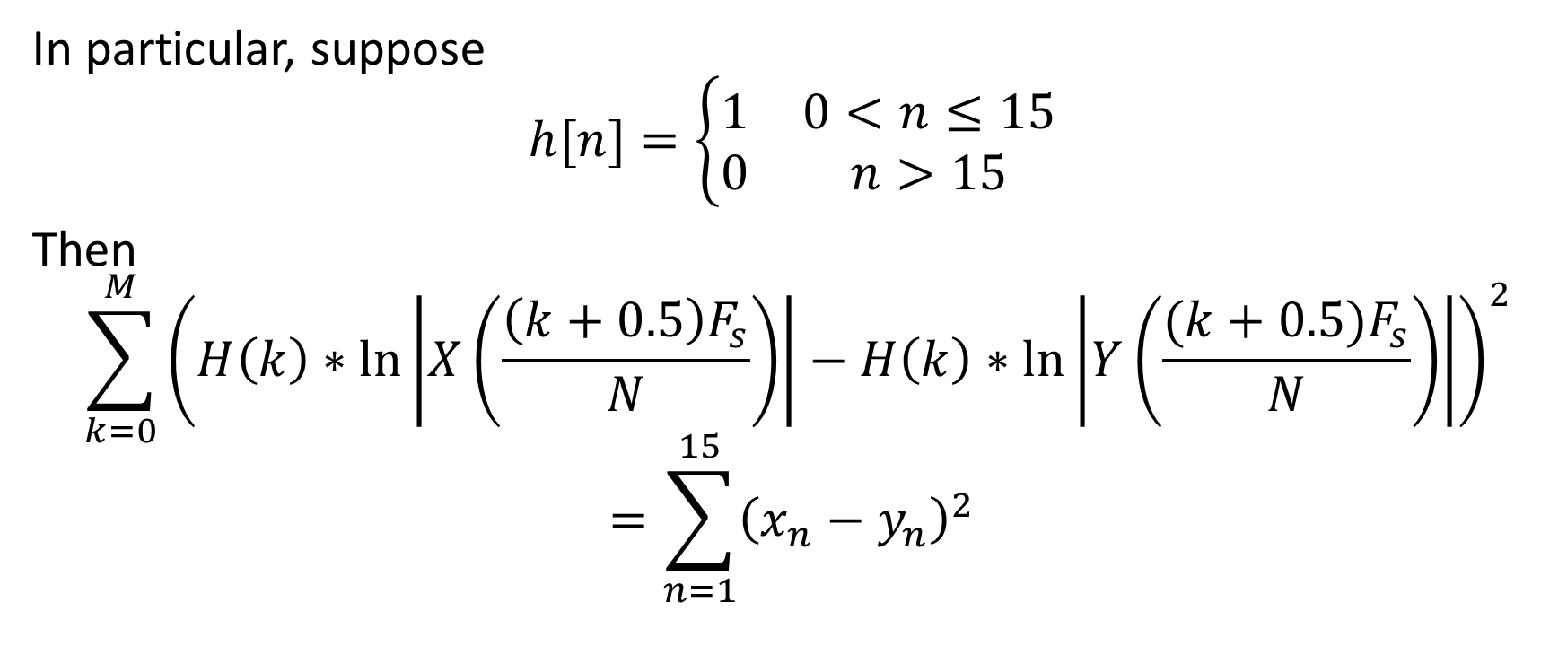
Low-pass liftered L2 norm
In particular, suppose
$$h[n]=\left\{\begin{matrix}1 & 0<n≤15 \\ 0 & n>15\end{matrix}\right.$$
Then
$$\sum_{k=0}^{M}{{\left(H\left(k\right)∗\ln\left|X\left(\frac{\left(k+0.5\right)F_{s}}{N}\right)\right|−H\left(k\right)∗\ln\left|Y\left(\frac{(k+0.5)F_{s}}{N}\right)\right|\right)}^{2}}$$
$$=\sum_{n=1}^{15}{{\left(x_{n}−y_{n}\right)}^{2}}$$

Slide 12
What spectrum do people hear? Basilar membrane

Slide 13
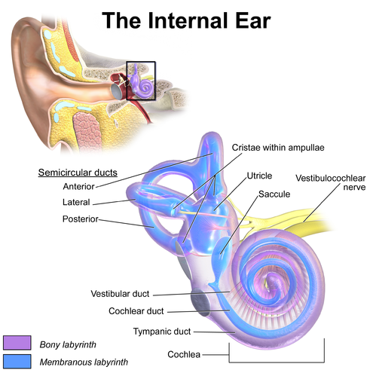
Inner ear

Slide 14
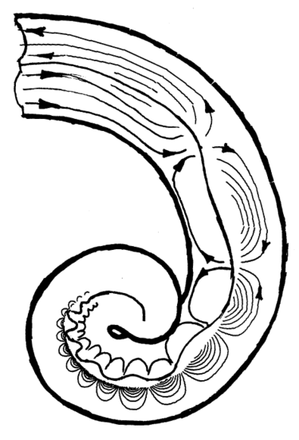
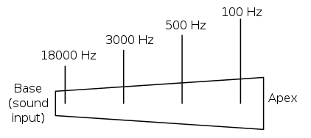
Basilar membrane of the cochlea = a bank of mechanical bandpass filters

Slide 15
Frequency scales for hearing: mel scale, ERB scale

Slide 16
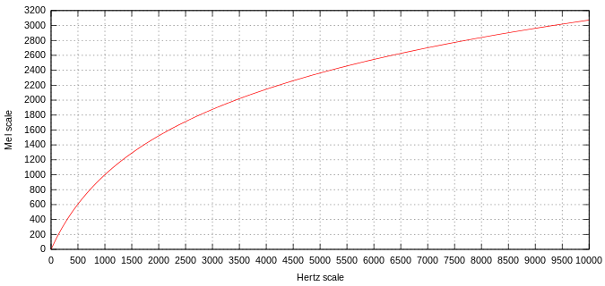
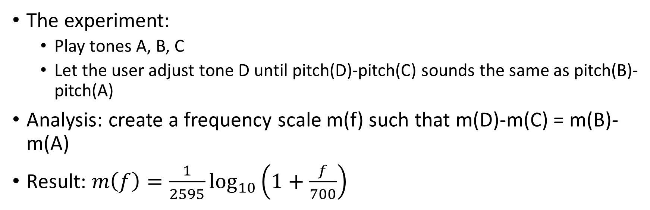
Mel-scale
The experiment:
  Play tones A, B, C
  Let the user adjust tone D until pitch(D)-pitch(C) sounds the same as pitch(B)-pitch(A)
Analysis: create a frequency scale m(f) such that m(D)-m(C) = m(B)-m(A)
Result: $m\left(f\right)=\frac{1}{2595}\log_{10}\left(1+\frac{f}{700}\right)$

Slide 17
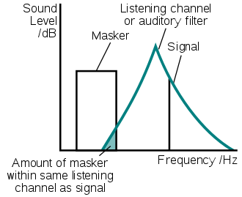
Critical bands
When two tones play at exactly the same frequency, users can’t tell the difference between x(t) versus x(t)+y(t) if y(t) is about 14dB below x(t) (in other words, the summed power is 1.03 times the power of x(t) alone)
When x(t) and y(t) are at different frequencies, the masking power of x(t) is reduced
Model: assume that the reduced masking power of x(t) is caused because x(t) is coming in through the tails of the bandpass filter centered at y(t).

Slide 18
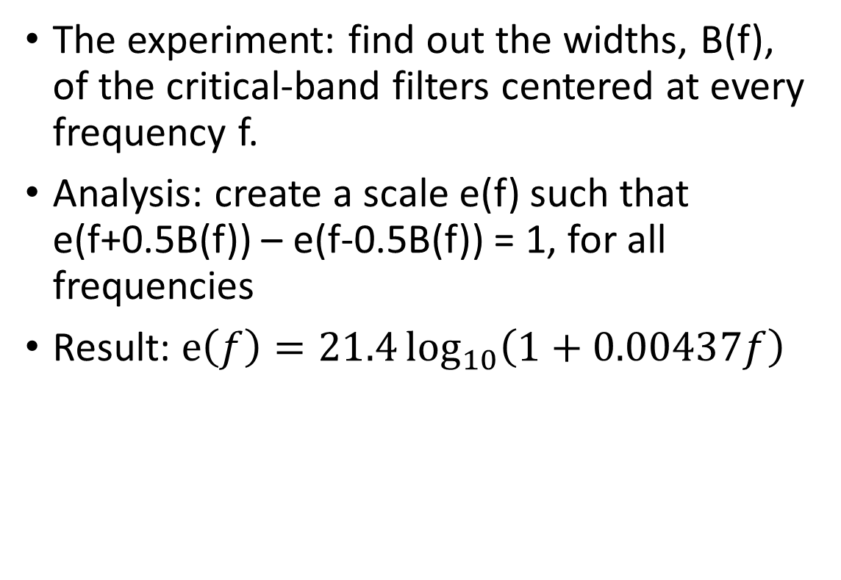
ERB scale
The experiment: find out the widths, B(f), of the critical-band filters centered at every frequency f.
Analysis: create a scale e(f) such that e(f+0.5B(f)) – e(f-0.5B(f)) = 1, for all frequencies
Result: $e\left(f\right)=21.4\log_{10}\left(1+0.00437f\right)$

Slide 19
MFCC

Slide 20
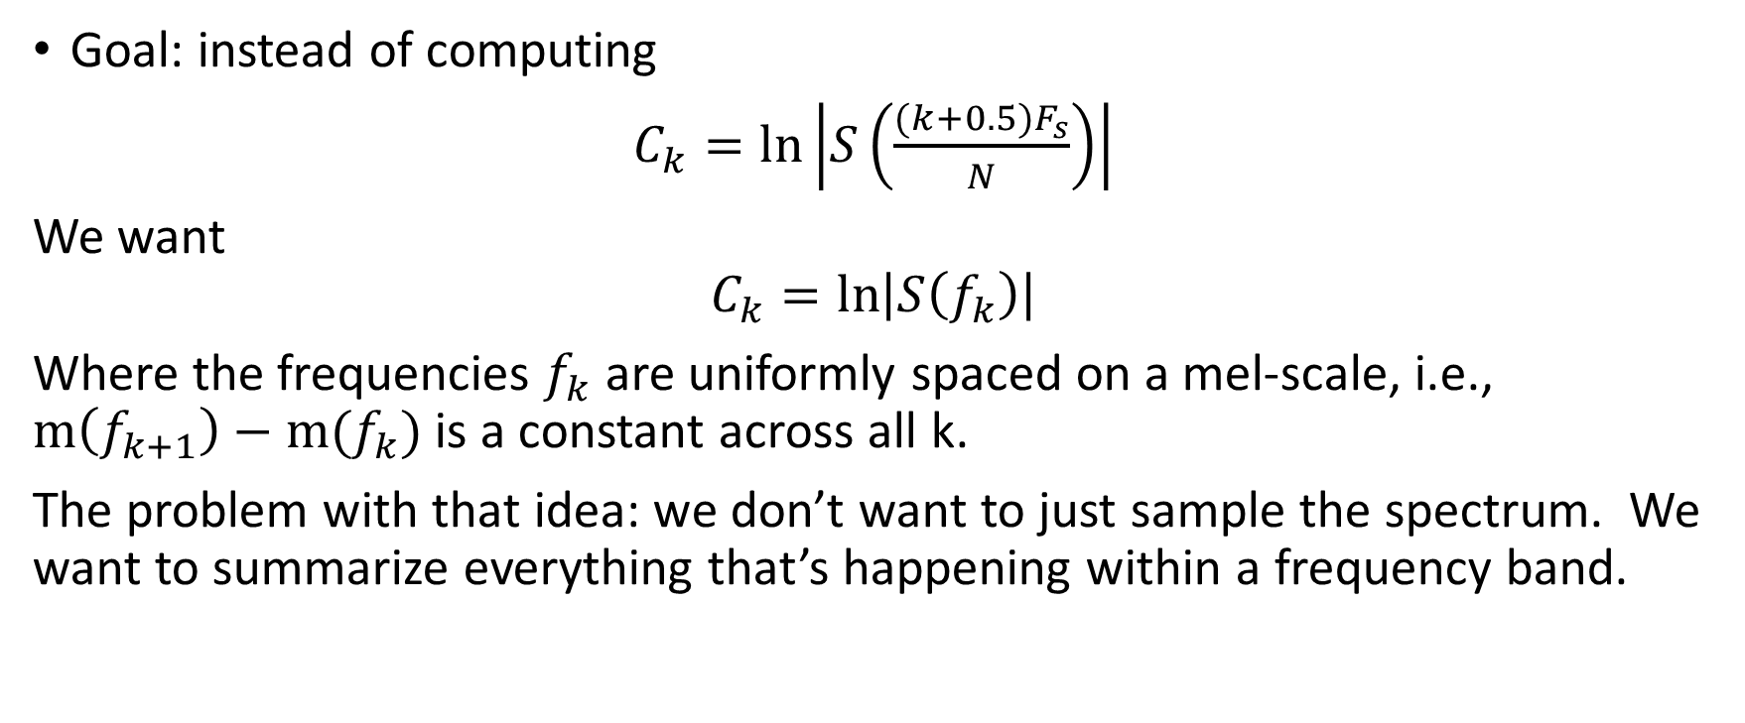
Mel filterbank coefficients: convert the spectrum from Hertz-frequency to mel-frequency
Goal: instead of computing
$C_{k}=ln\left|S\left(\frac{(k+0.5)F_{s}}{N}\right)\right|$
We want
$$C_{k}=ln\left|S\left(f_{k}\right)\right|$$
Where the frequencies $f_{k}$ are uniformly spaced on a mel-scale, i.e., $m\left(f_{k+1}\right)−m(f_{k})$ is a constant across all k.
The problem with that idea: we don’t want to just sample the spectrum. We want to summarize everything that’s happening within a frequency band.

Slide 21
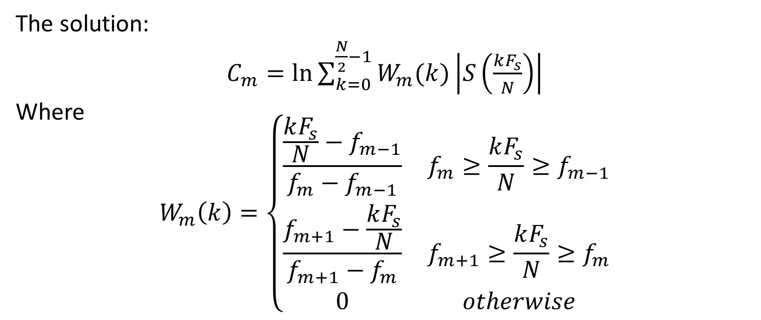
Mel filterbank coefficients: convert the spectrum from Hertz-frequency to mel-frequency
The solution:
$C_{m}=ln{\sum_{k=0}^{\frac{N}{2}−1}{W_{m}(k)\left|S\left(\frac{kF_{s}}{N}\right)\right|}}$
Where
$$W_{m}\left(k\right)=\left\{\begin{matrix}\frac{\frac{kF_{s}}{N}−f_{m−1}}{f_{m}−f_{m−1}} & f_{m}≥\frac{kF_{s}}{N}≥f_{m−1} \\ \frac{f_{m+1}−\frac{kF_{s}}{N}}{f_{m+1}−f_{m}} & f_{m+1}≥\frac{kF_{s}}{N}≥f_{m} \\ 0 & otherwise\end{matrix}\right.$$

Slide 22
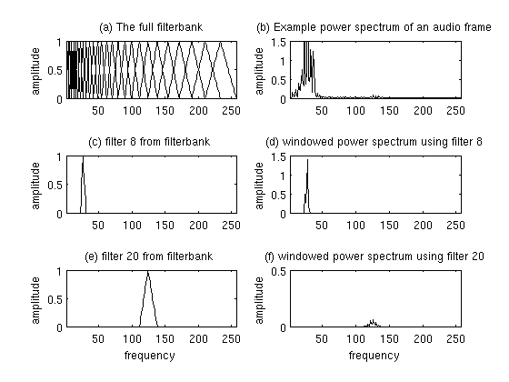
Mel filterbank coefficients: convert the spectrum from Hertz-frequency to mel-frequency

Slide 23
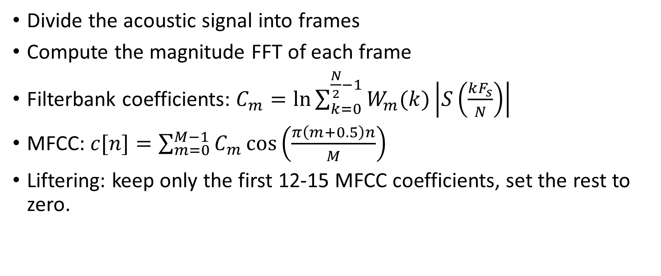
MFCC: the full process
Divide the acoustic signal into frames
Compute the magnitude FFT of each frame
Filterbank coefficients: $C_{m}=ln{\sum_{k=0}^{\frac{N}{2}−1}{W_{m}(k)\left|S\left(\frac{kF_{s}}{N}\right)\right|}}$
MFCC: $c[n]=\sum_{m=0}^{M−1}{C_{m}\cos\left(\frac{π\left(m+0.5\right)n}{M}\right)}$
Liftering: keep only the first 12-15 MFCC coefficients, set the rest to zero.

Slide 24
Summary
L2 distance(cepstra) = L2 distance(log magnitude spectra)
L2 distance(windowed cepstrum) = L2 distance(smoothed log magnitude spectrum)

