Slide 1
ECE 417 Lecture 1: Multimedia Signal Processing
Mark Hasegawa-Johnson
8/29/2017

Slide 2
Today’s Lecture
Syllabus
Overview of what we’ll learn this semester
Review of important linear algebra concepts, part one
Sample problem

Slide 3
Syllabus
Go read the syllabus: http://courses.engr.Illinois.edu/ece417/

Slide 4
Overview of what we’ll learn this semester
What is multimedia?
What is processing?
The basic architecture: encoder, embedder, aligner, decoder
Parametric learning: categories of methods, types of parameters that you can learn from data

Slide 5
What is multimedia?
Audio, Video, and Images
Defining feature #1: very big
Speech audio: 16000 samples/second
Multimedia audio: 44100 samples/second (often downsampled to 22050!)
Image: 6M pixels ~ 2000x3000 (often downsampled to 224x224)
Video: 640x480 pixels/image, 30 frames/second = 9,216,000 real numbers per second
Why “very big” matters: you can’t train a neural net to observe a whole image
Rule of 5: there must be 5 training examples per trainable parameter
Two-layer neural net with 1024 hidden nodes, 6M inputs has 1024*6000000 trainable parameters = 6 billion trainable parameters
With 6 billion trainable parameters, you need 30 billion training examples
Result: we need some trick to reduce the number of parameters
This semester is all about finding tricks that work (much better)

Slide 6
What is Multimedia: Defining Feature #2
Defining feature #2: variable input dimension
Image classification, e.g., imagenet: we like to downsample every image to 224x224 first, then train a NN with 224*224=50176 inputs
Audio speech recognition: no can do
Why?
Solution: streaming methods
“Recognition” instead of “Classification” --- variable number of inputs, variable number of outputs

Slide 7
Processing = convert from one type of signal to another
 | Image | Video | Audio | Text (variable-length sequence of symbols) | Metadata (tags drawn from predefined set)
Image | X | Motion prediction Animation | Spoken captioning | Automatic captioning | Object recognition Face recognition
Video | Heat map Frame capture Summarization Shot boundary detection | X |  | Lipreading/ Speechreading Audiovisual speech recognition Summarization
Audio | Spectrogram(S TFT) | STFT Avatar animation | X | Automatic speech recognition | Music genre Emotion/sentiments Speaker ID
Text |  | Audiovisual speech synthesis | Speech synthesis | X | Sentiment
Metadata | Search | Search | Search |  | X

Slide 8
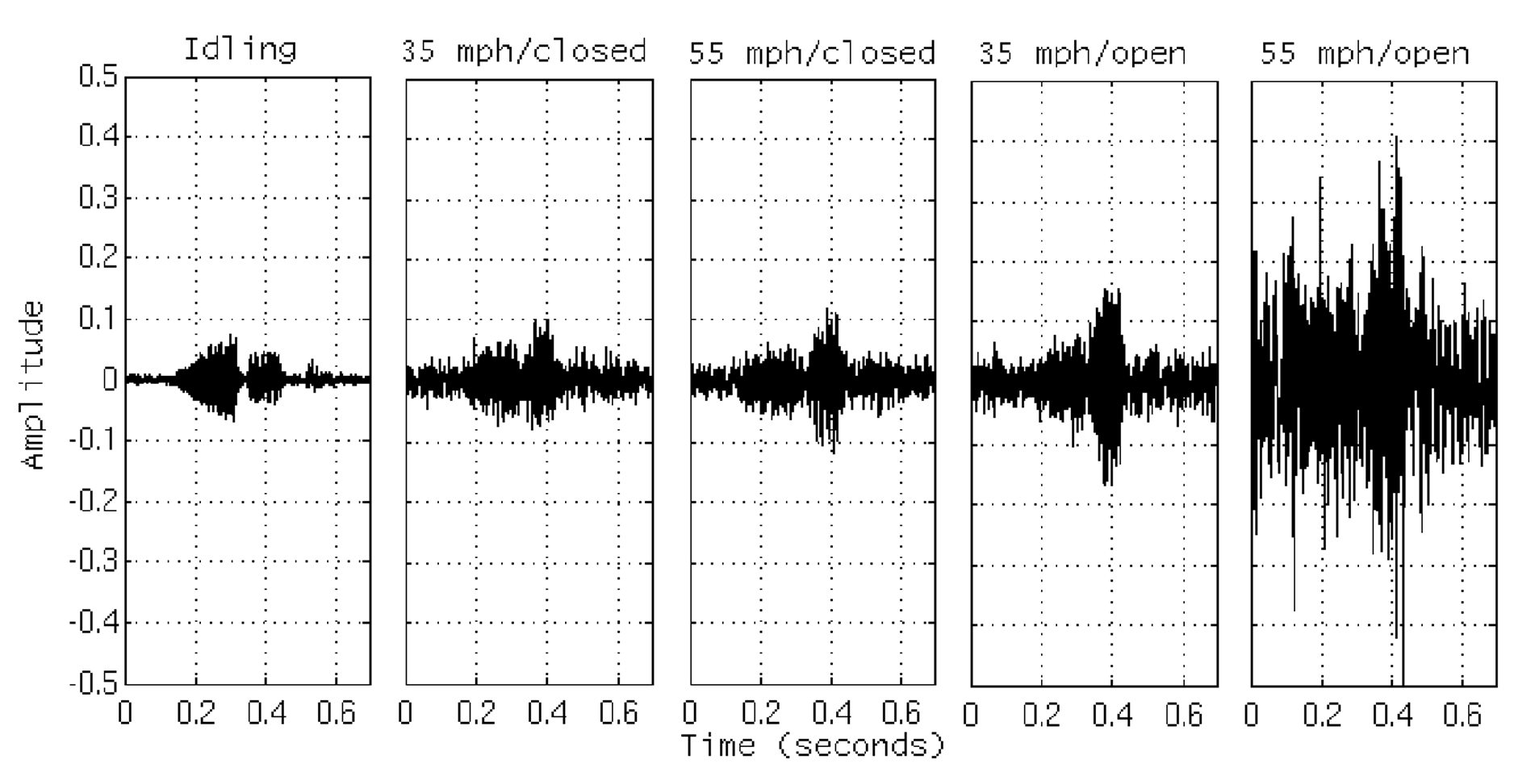
Basic Multimedia Architecture: EEAD
Decoder
(compute outputs)
n=Output
Timescale
Aligner
(time alignment)
Embedder (compute state)
Encoder
(compute features)
t=Input
Timescale

Slide 9
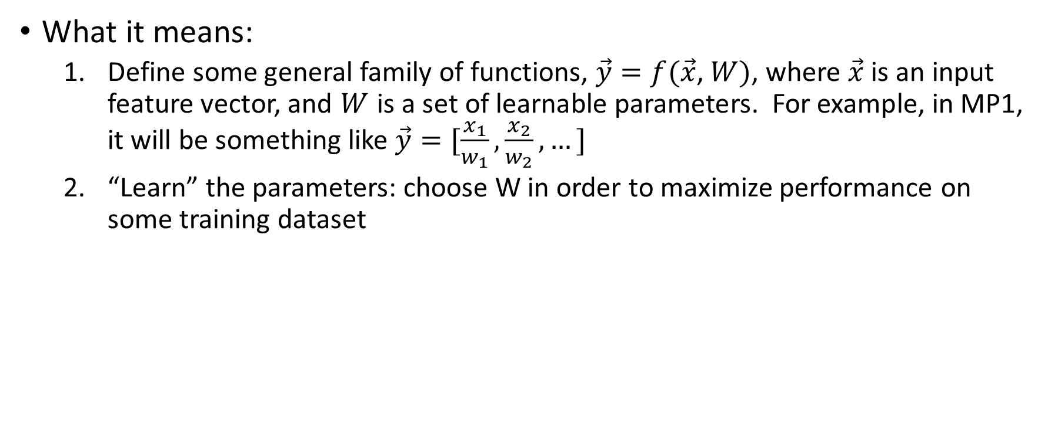
Parametric Learning
What it means:
Define some general family of functions, $\vec{y}=f(\vec{x}$, $W)$, where $\vec{x}$ is an input feature vector, and $W$ is a set of learnable parameters. For example, in MP1, it will be something like $\vec{y}=[\frac{x_{1}}{w_{1}},\frac{x_{2}}{w_{2}},…]$
“Learn” the parameters: choose W in order to maximize performance on some training dataset

Slide 10
Types of Parametric Learning
Metric Learning/Feature Learning (MP1): Learn to convert input features into some new feature set that better matches human perception
Classifier Learning (MP2, MP3): Learn to classify the input.
Bayesian Learning (MP4, MP5): Learn to estimate how likely the input is, given some assumed class label.
Deep learning (MP6, MP7): Combines feature learning and classifier learning. Each layer computes features that are used by the next layer up.

Slide 11
Basics of Linear Algebra
Vector Space
Banach Space, Norm
Hilbert Space, Inner Product
Linear Transform
Affine Transform

Slide 12
Vector Space
A vector space is a set, closed under addition, that satisfies:
Addition commutativity
Addition associativity
Addition identity element
Addition inverse
Compatibility of scalar and field multiplication
Multiplication identity element
Distribution of multiplication over vector addition
Distribution of multiplication over field addition

Slide 13
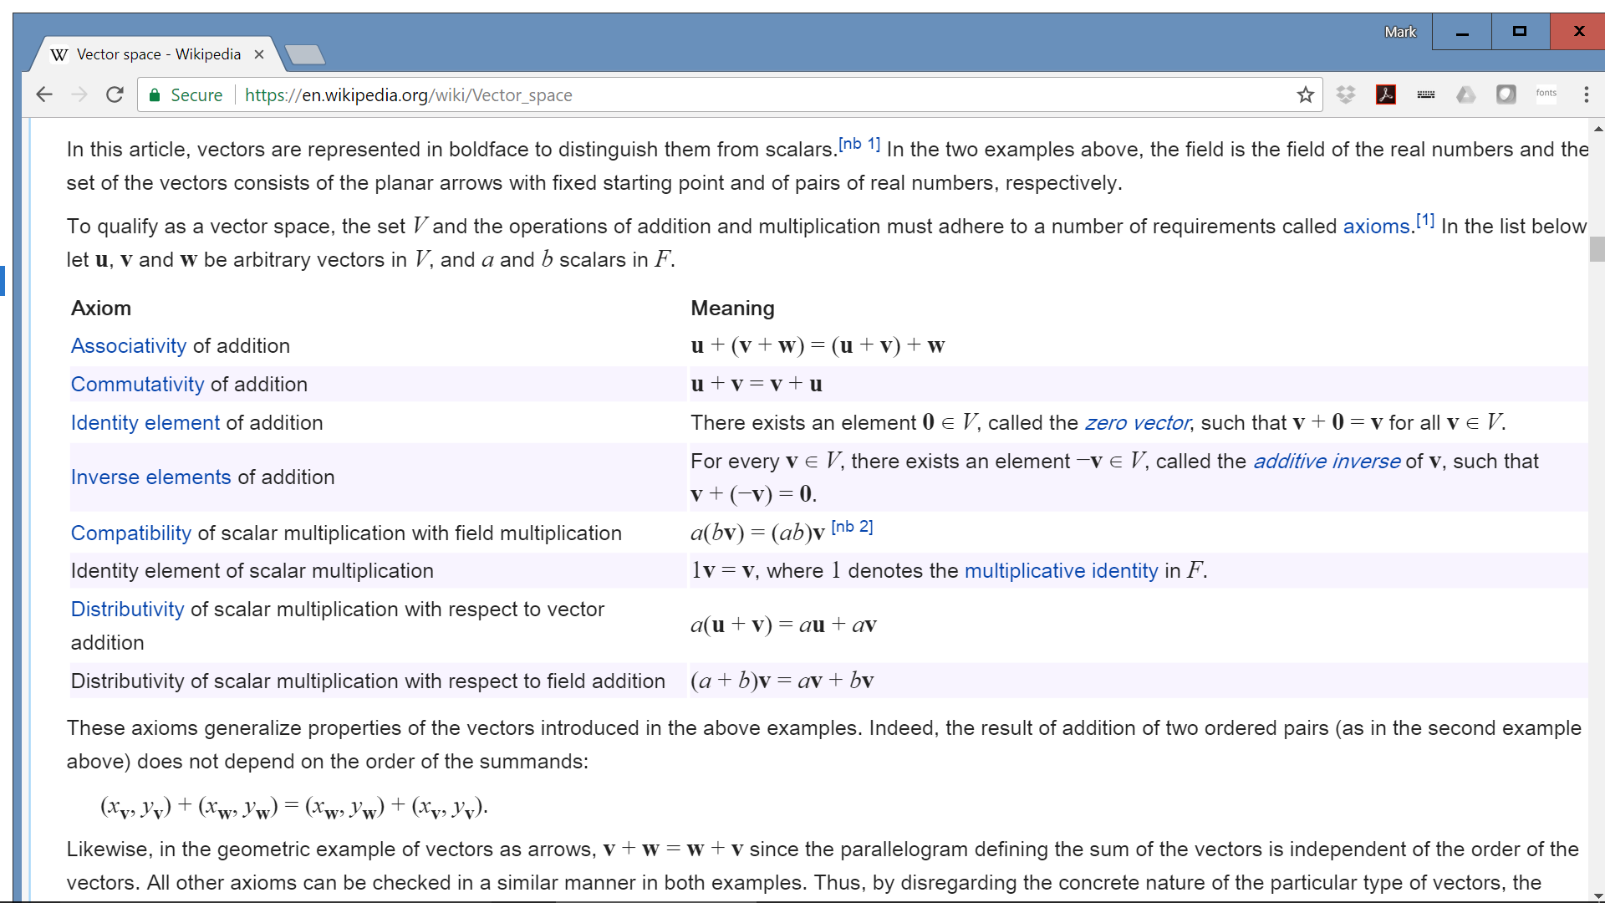

Slide 14
Banach space, Norm
A Banach space is a vector space with a norm.
A norm is:
Non-negative
Positive definite
Absolute homogeneous
Satisfies the triangle inequality

Slide 15
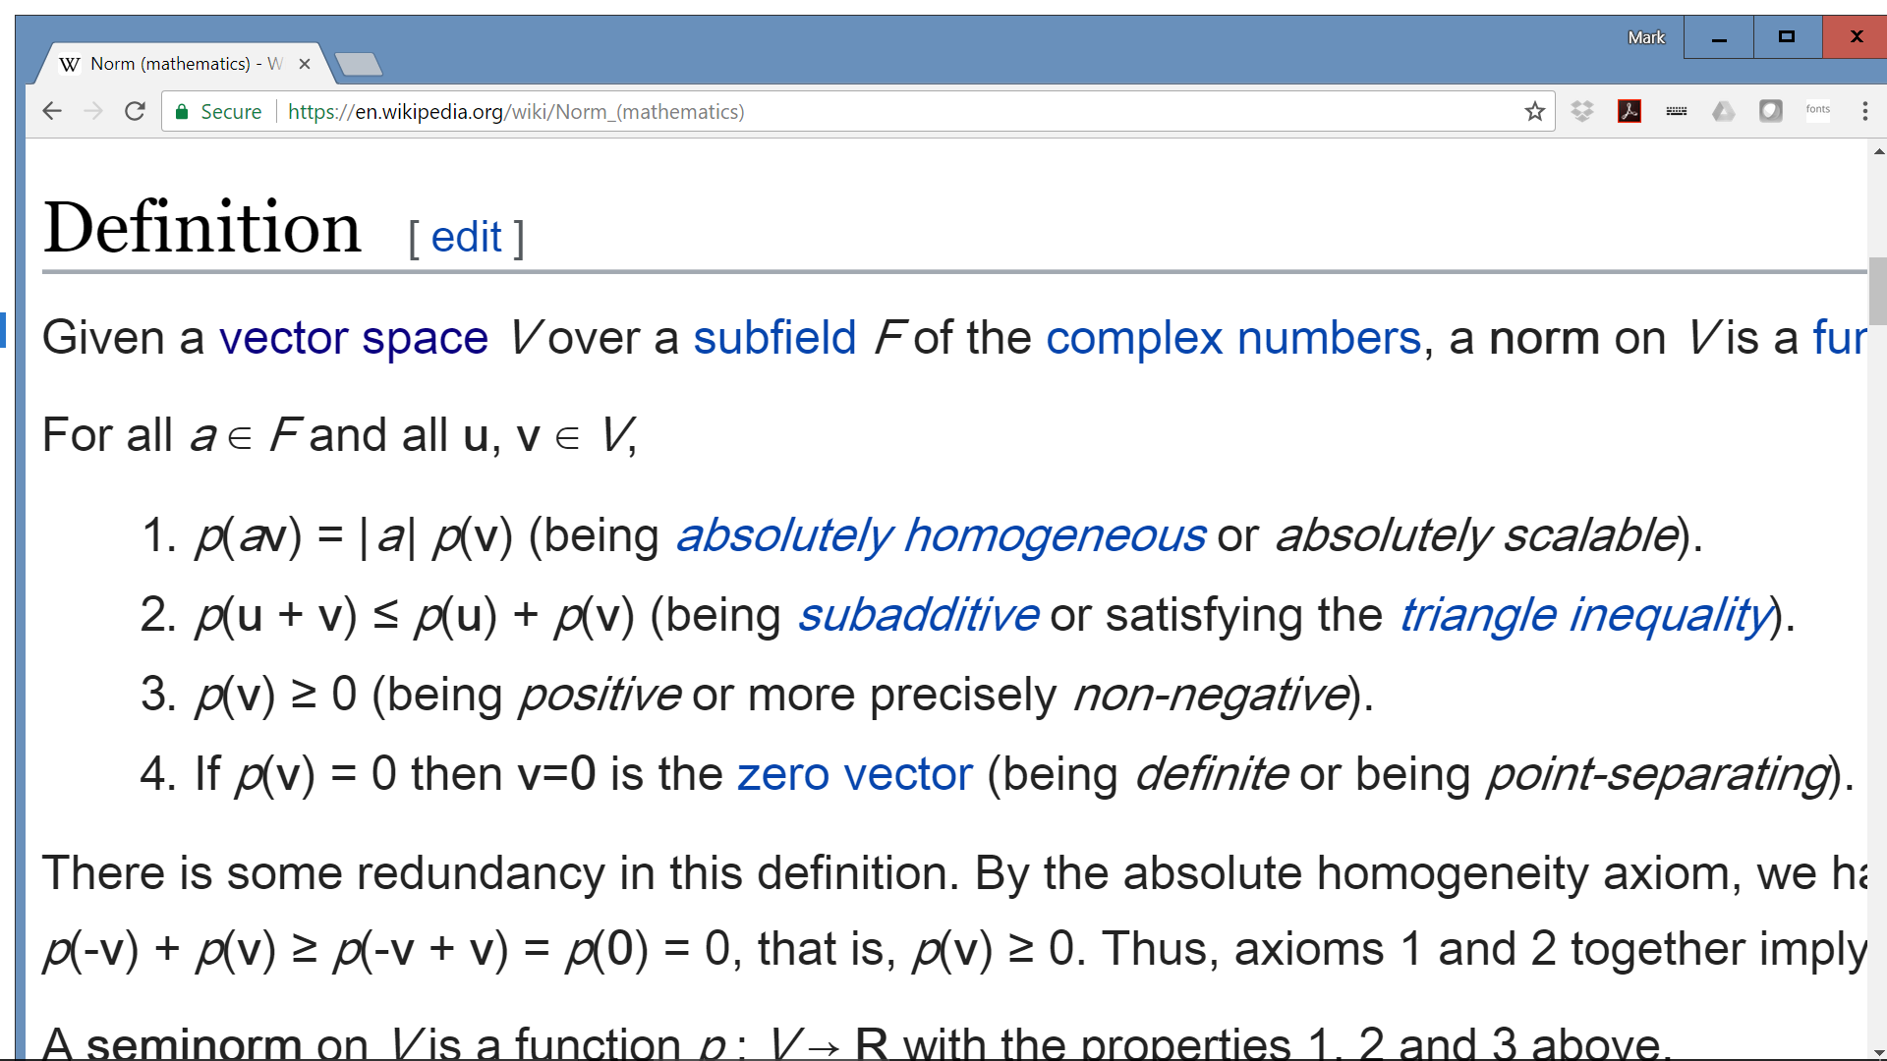

Slide 16
Inner Product Space
An inner product space is a Banach space with a dot product (a.k.a. inner product).
An inner product is a function of two vectors that satisfies:
Conjugate commutative
Linear in its first argument
Positive definite

Slide 17
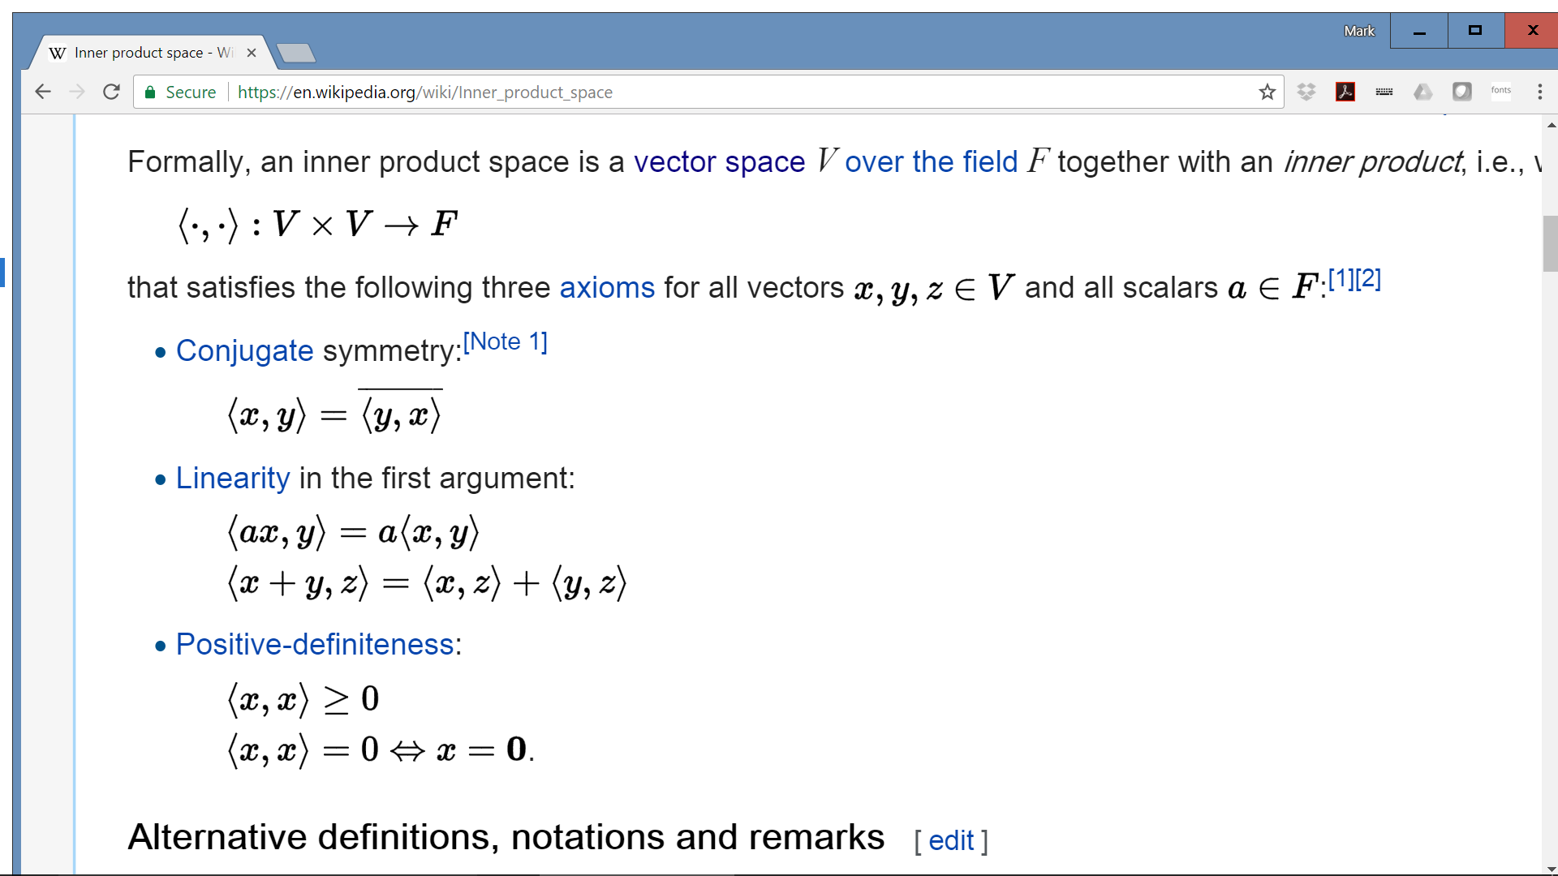

Slide 18
Linear Transform
A linear transform converts one vector space into another, with the following rules:
Homogeneous
Satisfies superposition
A linear transform is written as a matrix multiplication, y=Wx

Slide 19
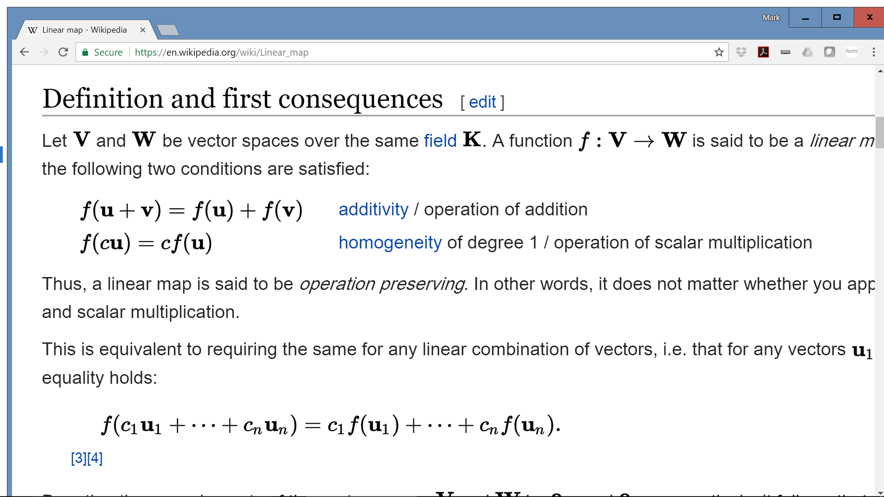

Slide 20
Affine Transform
An affine transform is a linear transform plus an offset. It’s usually written as y=Wx+b, where Wx is the linear part, and b is the offset.

Slide 21
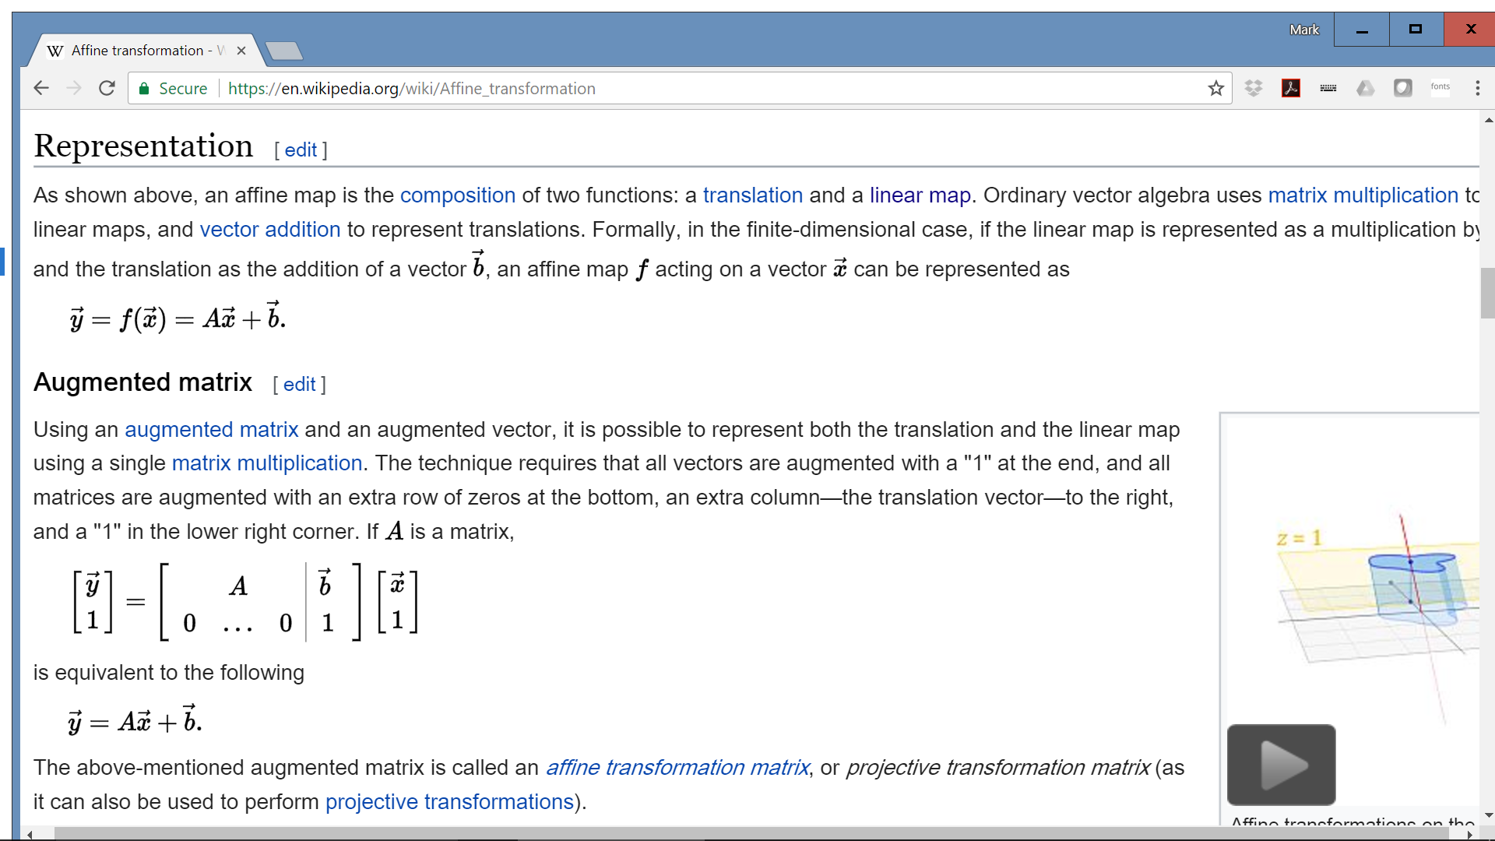

Slide 22
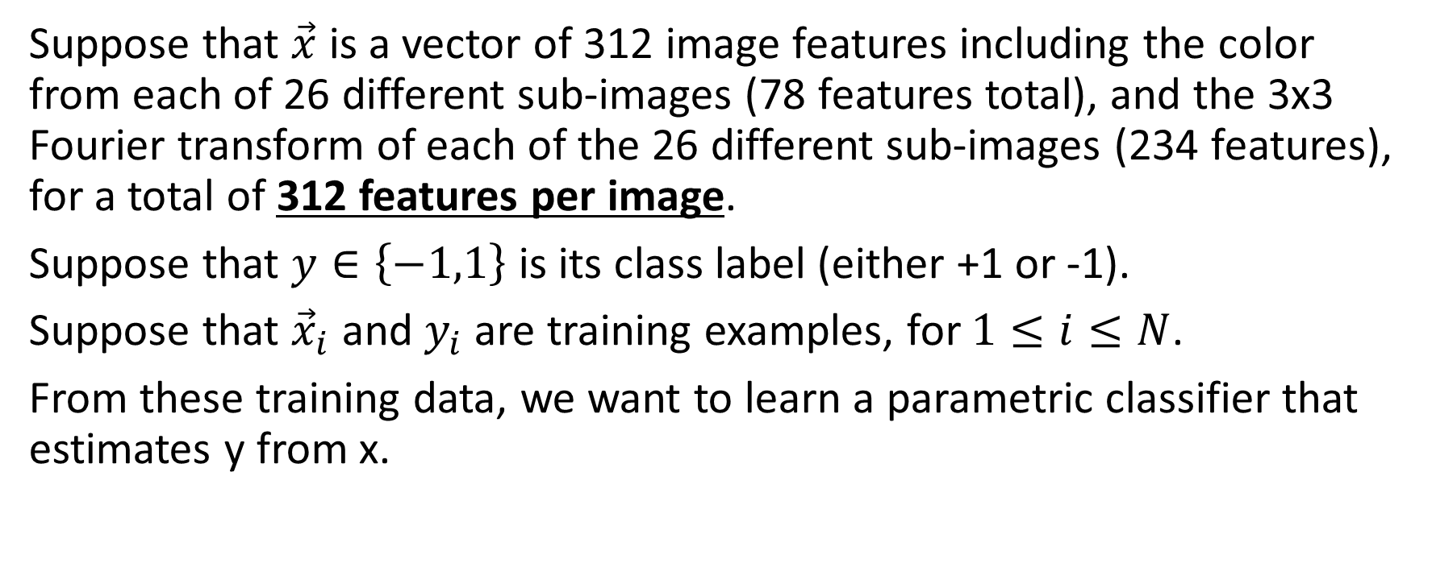
Example Problem
Suppose that $\vec{x}$ is a vector of 312 image features including the color from each of 26 different sub-images (78 features total), and the 3x3 Fourier transform of each of the 26 different sub-images (234 features), for a total of 312 features per image.
Suppose that $y∈\left\{−1,1\right\}$ is its class label (either +1 or -1).
Suppose that ${\vec{x}}_{i}$ and $y_{i}$ are training examples, for $1≤i≤N$.
From these training data, we want to learn a parametric classifier that estimates y from x.

Slide 23
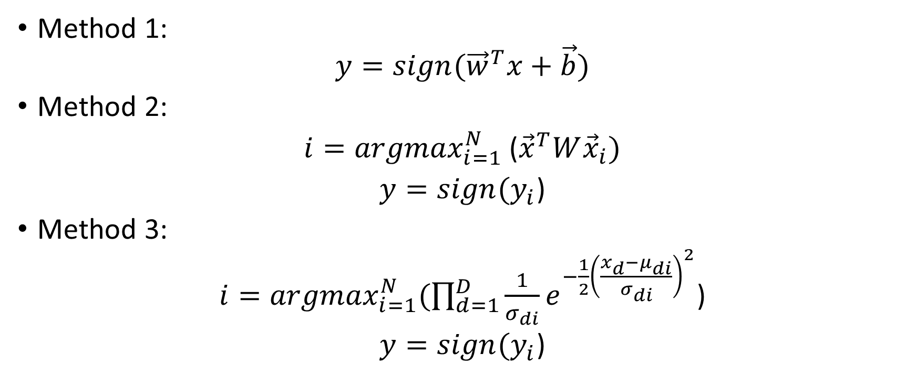
How many trainable parameters?
Method 1:
$$y=sign({\vec{w}}^{T}x+\vec{b})$$
Method 2:
$i={argmax}_{i=1}^{N}$(${\vec{x}}^{T}W{\vec{x}}_{i})$
$y=sign(y_{i}$)
Method 3:
$i={argmax}_{i=1}^{N}(\prod_{d=1}^{D}{\frac{1}{σ_{di}}e^{−\frac{1}{2}{\left(\frac{x_{d}−μ_{di}}{σ_{di}}\right)}^{2}}}$)
$y=sign(y_{i}$)

