Slide 1
lecture

Slide 2
Motivation for Hardware multithreading (“hyperthreading”)
Modern processors fail to utilize execution resources well.
There is no single culprit.
Attacking the problems one at a time (e.g., specific latency-tolerance solutions) always has limited effectiveness.
However, a general latency-tolerance solution which can hide all sources of latency can have a large impact on performance.
Notes:
Having several execution units doesn’t mean they’ll all be used! Problems with dependancies, etc limit the usefulness of this approach.

Slide 3
Hardware Multithreading
Conventional
Multithreaded
Processor
Processor
instruction stream
instruction stream
PC
PC
PC
PC
regs
regs
regs
regs
PC
regs
CPU
CPU
Notes:
“hyperthreading” from Intel.
Multiple execution units as before -> more threads means greater chance of saturating our resources.

Slide 4
Superscalar Execution
Issue Slots
Time (clock cycles)
Notes:
Issue slots: eg, load/store unit, FP units, integer units, MUL/DIV
This is how Tomasulo’s algorithm works

Slide 5
Multithreading on Superscalar
Issue Slots
Time (proc cycles)
Thread 1
Thread 2
Context Switch
Notes:
Basic – no tricks. Lots of wasted issue slots.

Slide 6
Superscalar Execution with Coarse-Grained Multithreading
Issue Slots
Issue Slots
Time (proc cycles)
Time (proc cycles)
Thread 1
Thread 2
Thread 3
Thread 4
Context Switch
Notes:
LHS: regular superscalar. Some people call this “coarse-grained” too.
RHS: Course grained: add extra architectural state (registers) so we don’t need a context switch to switch threads.
If only 1 thread is running: no performance hit
Decreases vertical waste vs. original design.
Appears to OS as SMP – symmetric multiprocessor -- (2 logical processors)
Problems?

Slide 7
Superscalar Execution with Fine-Grain Multithreading
Issue Slots
Time (proc cycles)
Thread 1
Thread 2
Thread 3
Notes:
Fine grained – issue for a different thread (only one) each clock cycle, round robin style.
- Benefit over previous: if each thread has many long-latency operations, latency is masked
because other threads execute for (n-1) out of n cycles (if hardware supports n threads)
- Optimization: if thread has no work to do (e.g. cache miss), skip it!
Originally idea from Tera Computer Company, late 1980s – see paper “The Tera Computer System”. 256 cores; multiple threads per core (as shown above). Expected latency of instruction is 70 cycles!
- Still doesn’t solve the problem of horizontal waste!

Slide 8
Simultaneous Multithreading
Issue Slots
Time (proc cycles)
Thread 1
Thread 2
Thread 3
Thread 4
Thread 5
Notes:
SMT (as referenced here) – issue from any thread at any time.
Much greater utilization. Threads “compete” for resources; no one thread must take up all resources to saturate the processor.

Slide 9
The Potential for SMT
Notes:
Fine grained – still problems with data dependancies in threads.
Note that they all have diminishing returns…

Slide 10
Goals
Three primary goals for this SMT:
1. Minimize the architectural impact on conventional superscalar design.
2. Minimize the performance impact on a single thread.
3. Achieve significant throughput gains with many threads.

Slide 11
A Conventional Superscalar Architecture
Fetch
Data
Unit
floating point
fp
fp
PC
instruction queue
units
reg’s
Cache
Instruction Cache
8
integer
int.
integer
instruction queue
units
reg’s
int/ld-
Register
store
Decode
Renaming
units
• Fetch up to 8
• Out-of-order,
• Issue 3 floating
instructions per cycle
speculative
point, 6 integer
execution
instructions per cycle

Slide 12
An SMT Architecture
Fetch
Data
Unit
floating point
fp
fp
PC
instruction queue
units
reg’s
Cache
Instruction Cache
8
integer
int.
integer
instruction queue
units
reg’s
int/ld-
Register
store
Decode
Renaming
units
• Fetch up to 8
• Out-of-order,
• Issue 3 floating
instructions per cycle
speculative
point, 6 integer
execution
instructions per cycle

Slide 13
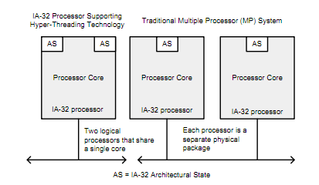
Real-World SMT
Intel – Hyperthreading
- IBM whitepaper: 20-50% performance benefit
Notes:
IBM: http://www.ibm.com/developerworks/linux/library/l-htl/
Intel - all i7 processors have hyperthreading. Some i5 do too.
Info at
http://download.intel.com/technology/itj/2002/volume06issue01/art01_hyper/vol6iss1_art01.pdf
http://download.intel.com/design/processor/manuals/253665.pdf

Slide 14
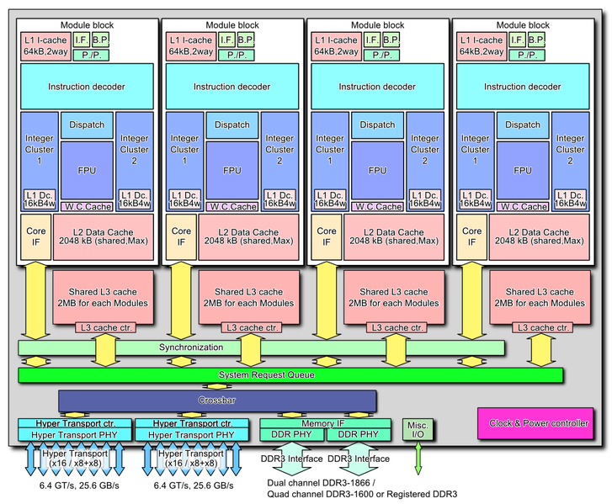
Real-World SMT (2)
AMD - “It’s all about the cores!”
“Our cores are real.” – January, 2010
“Hyperthreading is stupid. So is Intel.” - paraphrase
October 12, 2011: Bulldozer: 4 “modules”, 8 threads
Notes:
AMD – not a fan of SMT, until they released a SMT processor (Bulldozer). Cites some resources about people not liking HT from Intel.
Bulldozer slightly different – also duplicates integer resources as well as architectural state.
AMD link: http://blogs.amd.com/work/2010/01/21/it%E2%80%99s-all-about-the-cores/
http://en.wikipedia.org/wiki/Bulldozer_(microarchitecture)

Slide 15
More SMT
Network Processors
CMT processors (Oracle)
Many Intel processors, etc.

Slide 16
Technology Challenges

Slide 17
Summary of Challenges
Late 20th Century | The New Reality
Moore’s Law – 2x transistors/chip every 18-24 months | Transistor count still 2x every 18-24 months, but see below
Dennard Scaling – near-constant power/chip | Gone. Not viable for power/chip to double (with 2x transistors/chip growth)
The modest levels of transistor unreliability easily hidden (e.g., via ECC) | Transistor reliability worsening, no longer easy to hide
Focus on computation over communication | Restricted inter-chip, inter-device, inter-machine communication; communication more expensive than communication
One-time (non-recurring engineering) costs growing, but amortizable for mass-market parts | Expensive to design, verify, fabricate, and test, especially for specialized-market platforms
From “21st Century Computer Architecture: A community white paper,” Computing Research Assocation (CRA), 2012

Slide 18
Solutions?
New markets will drive demand and need for innovation
Datacenters
IoT
Mobile
Incremental (one-time) improvements
Copper, high-K dielectric, FinFETs, …
Packaging: 2.1D, 2.5D, 3D
Beyond CMOS
Carbon nanotubes, spin FET,
“More than Moore”
Analog, RF, accelerators, non-Von Neumann, …

Slide 19
Variability
Shrinking device dimensions lead to sensitivity to minor processing variations
“No two transistors are the same”
Die-to-die variations
Across multiple die on same wafer, across wafers
Within-die variations
Systematic and random
E.g. line edge roughness due to sub-wavelength lithography or dopant variations (~10 molecules)
Dynamic variations
E.g. temperature-induced variability (hot spots)
Notes:
Invalidates traditional layered/hierarchical approach to design, since we can’t afford to characterize and qualify a “standard cell” component with appropriate guardbands, and then use it under those conservative assumptions throughout the design.

Slide 20
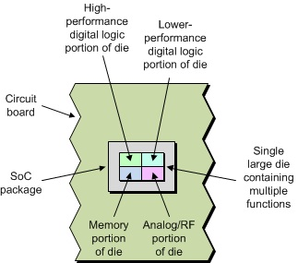
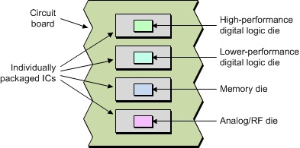
2D Packaging
Board level
System on Chip
[M. Maxfield, “2D vs. 2.5D vs. 3D ICs 101,” EE Times, April 2012]
Conventional packaging approaches

Slide 21
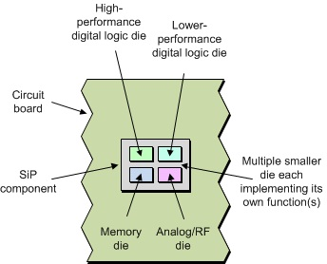
2D Packaging
[M. Maxfield, “2D vs. 2.5D vs. 3D ICs 101,” EE Times, April 2012]
Move toward System in Package (SIP)
PCB, ceramic, semiconductor substrates

Slide 22
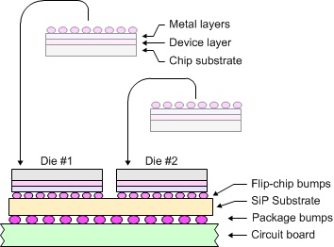
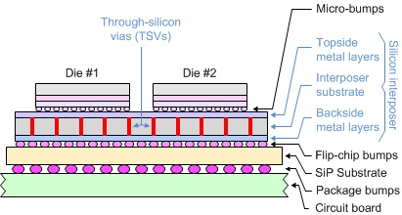
2.5D Packaging
2D Packaging
2.5D Packaging
[M. Maxfield, “2D vs. 2.5D vs. 3D ICs 101,” EE Times, April 2012]
2.5D uses silicon interposer, through-silicon vias (TSV)

Slide 23
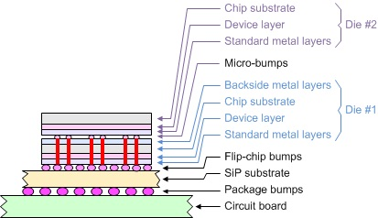
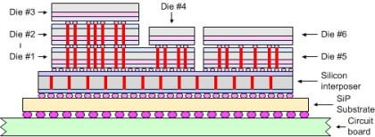
3D Packaging
3D Homogeneous
3D Heterogeneous
[M. Maxfield, “2D vs. 2.5D vs. 3D ICs 101,” EE Times, April 2012]
3D uses through-silicon vias (TSV) and/or interposer

Slide 24
Packaging Discussion
Heterogeneous integration
RF, analog (PHY), FG/PCM/ReRAM, photonics
Cost
Silicon yield
Bandwidth, esp. interposer
Thermals
It’s real!
DRAM: HMC, HBM
FPGAs
GPUs: AMD, NVIDIA
CPUs: AMD Zen, EPYC

Slide 25
Chiplet-based Waferscale Computing
Rakesh Kumar
University of Illinois
Urbana-Champaign
(collaboration with UCLA – afternoon talk will cover the design and implementation aspects of this work)

Slide 26
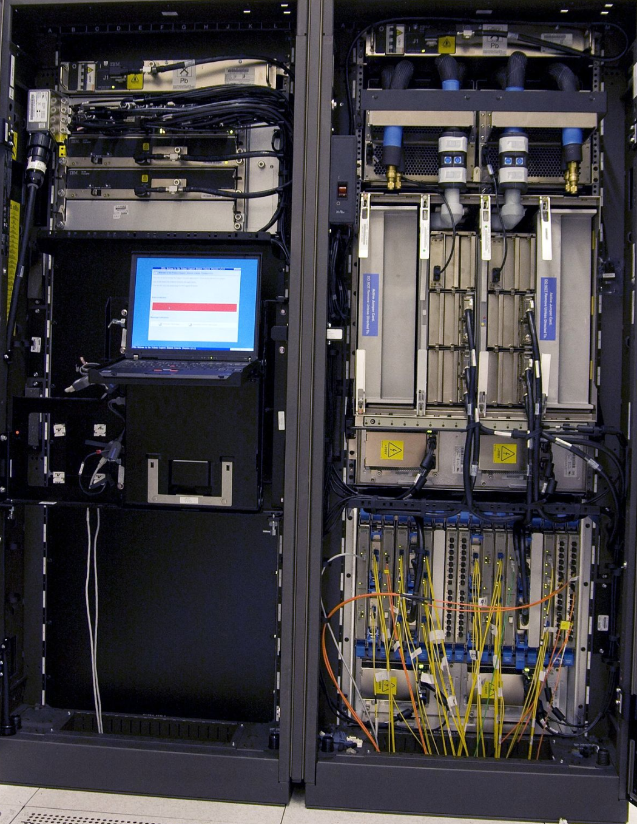
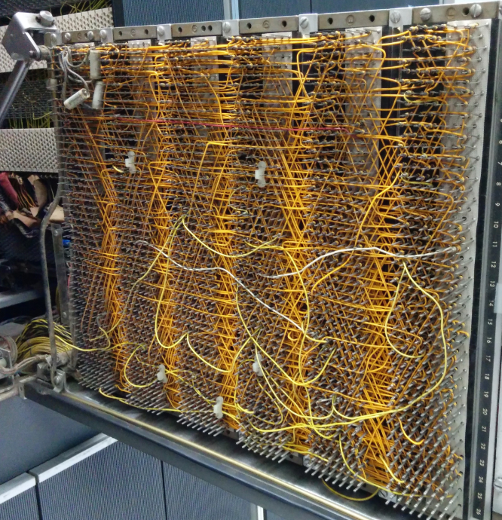
A Brief History of Waferscale Computing
Notes:
Waferscale processing has its history starting in the 70s. During 1970s, the first mainframe systems were built which consisted of many processors. But the inter-processor communication was a big performance bottleneck since, just like today, the cost of communication in terms of bandwidth, latency and energy was very high.

Slide 27
A Brief History of Waferscale Computing
Notes:
One radically new idea that came out to eliminate the communication overhead was to replace the discrete highly interconnected processors with one giant chip that had all their logic and interconnection. Such a chip will have dramatically lower communication costs since all the communication will now be on-chip.

Slide 28
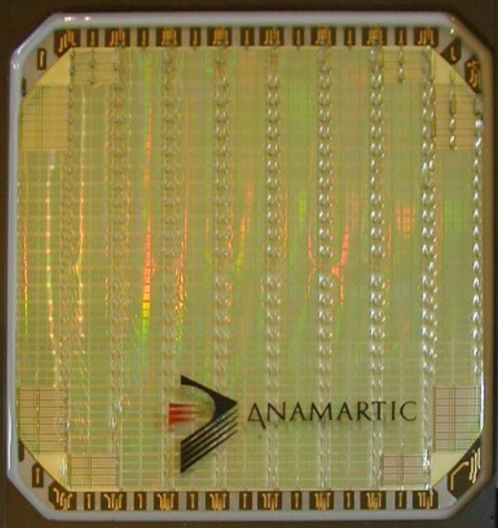
A Brief History of Waferscale Computing
Gene Amdahl’s Trilogy Systems
Tandem Computers, Fujitsu
Other efforts: ITT Corporation, Texas Instruments. Recent efforts: Spinnaker (Neuromorphic Chip)
Notes:
Several waferscale systems were attempted. Gene Amdahl, IBM 360’s lead architect started Trilogy System to build one large waferscale chip which is composed of logic corresponding to ~100 chips. Other companies such as Tandem Computers with Fujitsu, ITT Corporation, TI researched waferscale systems as well.
More recently a neuromorphic waferscale chip, Spinnaker was built with enough redundancy built in.

Slide 29
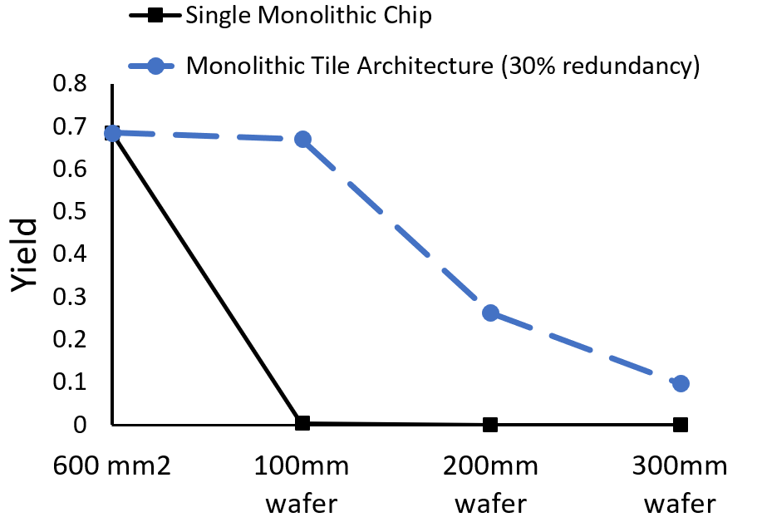
What Happened to Waferscale Integration?
Didn’t work out (e.g., Trilogy Systems was one of the biggest financial disasters in Silicon Valley before 2001)
Their Approach to Waferscale: Monolithic
Voting Logic
Area of chip Probability of defects
Some mitigation possible through TMR, etc. - but prohibitively expensive
Deemed commercially unviable
Notes:
Needless to say, the waferscale approach has not very successful. Trilogy systems, for example, cratered without ever shipping a product, even after raising 270 million dollars. Other approaches were similarly unsuccessful.
The reason, at least in retrospect, is quite simple. Previous approaches attempted to build a monolithic chip that was as large as a wafer. However, as is well understood now, when the size of the chip grows, the probability of defects affecting the chip also grows, in fact exponentially.
Approaches such as TMR may be applied, but such approaches bring their own overhead. On the whole, the waferscale computing approach was deemed to be commercially unviable.

Slide 30
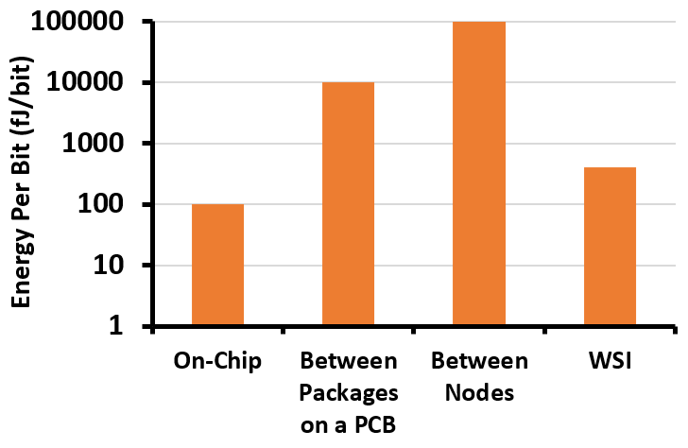
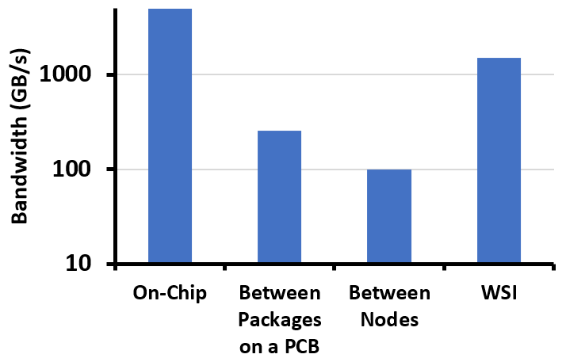
Time to Give Waferscale Another Go?
Highly parallel applications are spread across many processors
Communication between the processors is still a big bottleneck
Low Bandwidth (a few 100s of GBps)
High energy per bit (10s of pJ/bit)
Real estate on chip (15-25% of the chip is devoted to SERDES I/Os)
Node 1
Node 2
Application
Node 3
Notes:
The question we ask in this research is “Is it time to give waferscale computing another go?”
We believe that the answer is yes. There are several reasons.
First, a large class of applications today are highly parallel and are being targeted by using many processors.
Second, communication continues to be a significant and worsening problem which still exists. Because of Moore’s Law, the on-chip features have improved dramatically over the past few decades, but off-chip components haven’t scaled well.
Therefore, this has lead to a large gap between the bandwidth achievable on-chip and between packaged processors. Same is true for energy-per-bit of communication. Overall, it’s atleast an order of magnitude costlier to communicate between processors than on-chip. In fact I/O circuitry to drive signals through PCB or out side PCBs consumes a significant portion of chip area.

Slide 31
Time to Give Waferscale Another Go? (2)
However, to achieve waferscale integration, we need to solve the yield problem
Notes:
Waferscale integration on the other hand can leverage the advancement in silicon processing and bridge the gap. Infact close to on-chip bandwidth can be achieved at low energy-per-bit of communication.
However, to achieve waferscale integration, we need to solve the yield problem that killed the earlier waferscale systems.

Slide 32
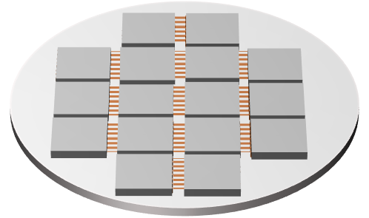
Re-imagining Waferscale Integration using Chiplets
Q: What do we need from waferscale integration?
A: High density interconnection
A wafer with interconnect wiring only
Bond the dies on to the interconnect wafer
Small known good dies
Notes:
As discussed previously, a monolithic waferscale approach would be difficult to realize because of yield issues.
So, we asked ourselves, what do we need from waferscale integration?
The answer is “high density interconnection”.
If we can build a wafer with fine pitch interconnect, take high yielding small and known-good-dies, and connect the dies through the waferscale interconnect, we can accomplish high density interconnection between multiple dies without the yield issues experienced by a monolithic waferscale system.

Slide 33
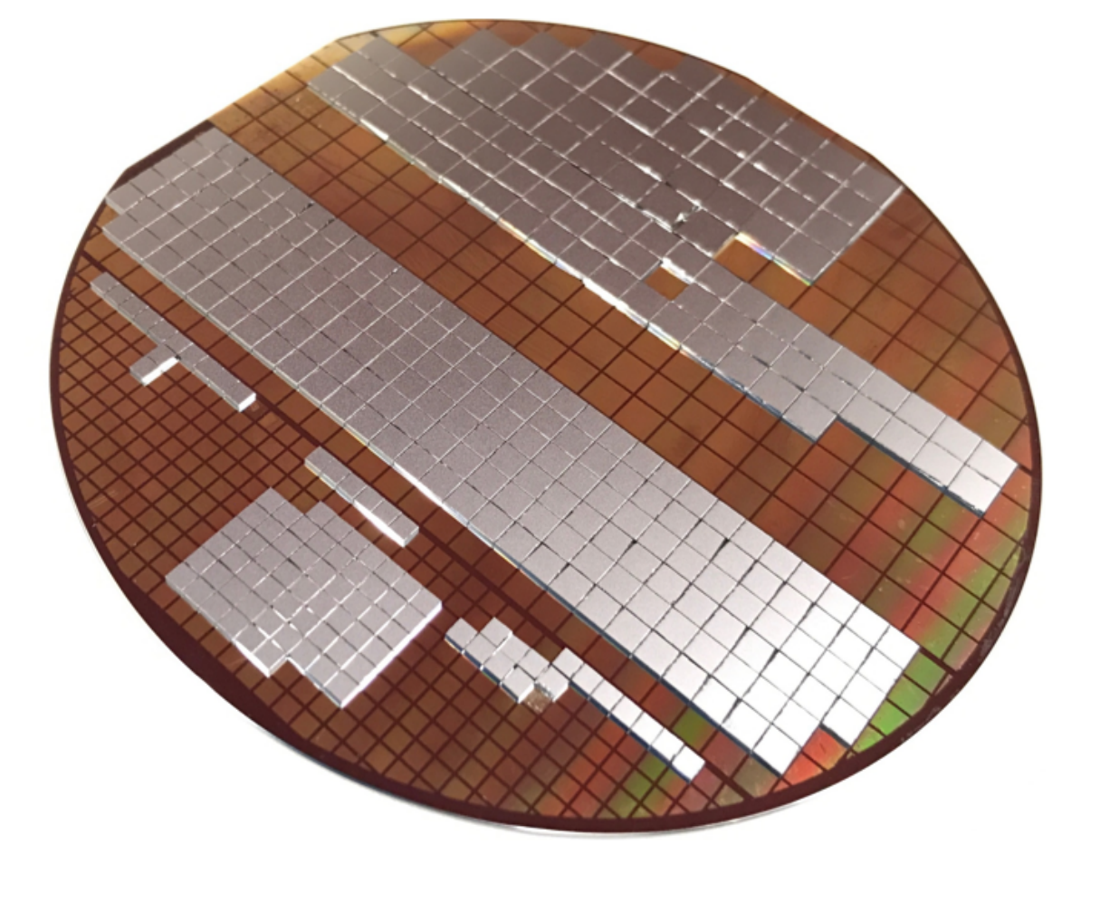
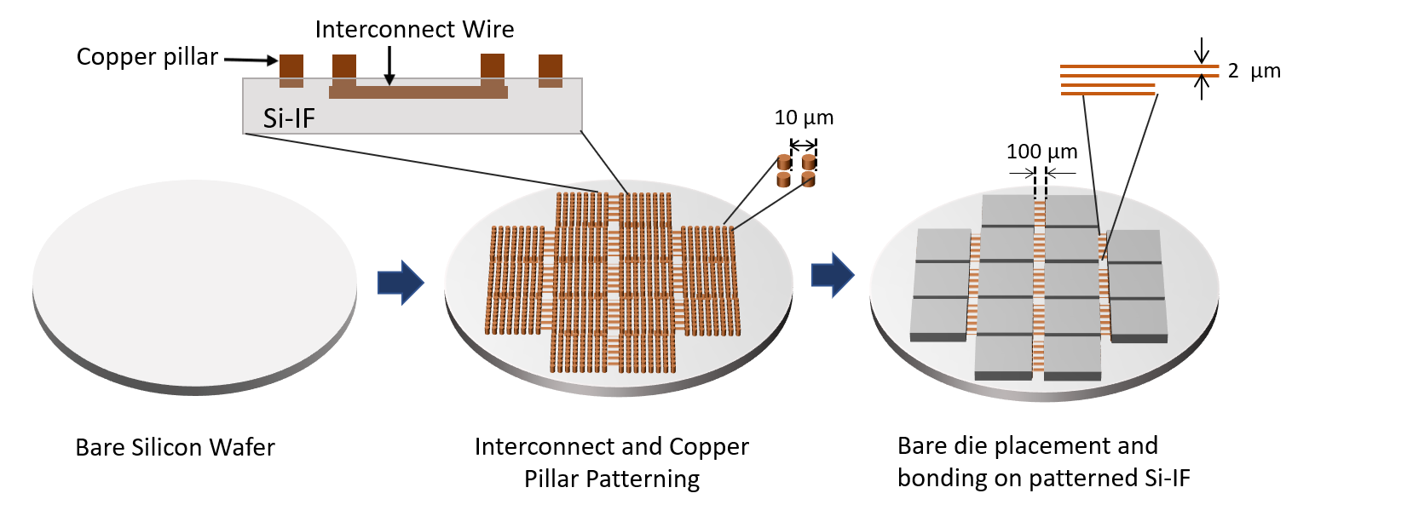
Enabling WSI Technology
Silicon Interconnect Fabric (Si-IF)
2 µm
10 µm
100 µm
Measured Bond Yield >99%
Allows waferscale integration with high yield
[HPCA2018]
Notes:
We are developing the Silicon Interconnect Fabric (Si-IF) technology that has these properties.
The idea is to take a bare silicon wafer and pattern interconnect wiring on it. We also build fine-pitch copper pillars on the wafer to connect the wafer to the bare dies. Then we bond the dies on to the patterned wafer substrate. With this technology, the interconnect wires have a fine pitch of 2 um, the copper pillars have a pitch of 10 um and the dies can be placed really close with a separation of 100 um. This allows us to have a highly parallel interface with short interconnect distance which helps achieve high bandwidth and low energy per bit of communication. This also allows us to support high density interconnection between multiple dies.
We have built multiple waferscale prototypes. Here we show a prototype with 384 dies on a 100 mm wafer. Our measurements for this and other prototypes show a bond yield of 100%. Coupled with the fact that we are integrating high yielding small dies, we believe that silicon integration fabric is a good enabler for waferscale systems at high yield.

Slide 34
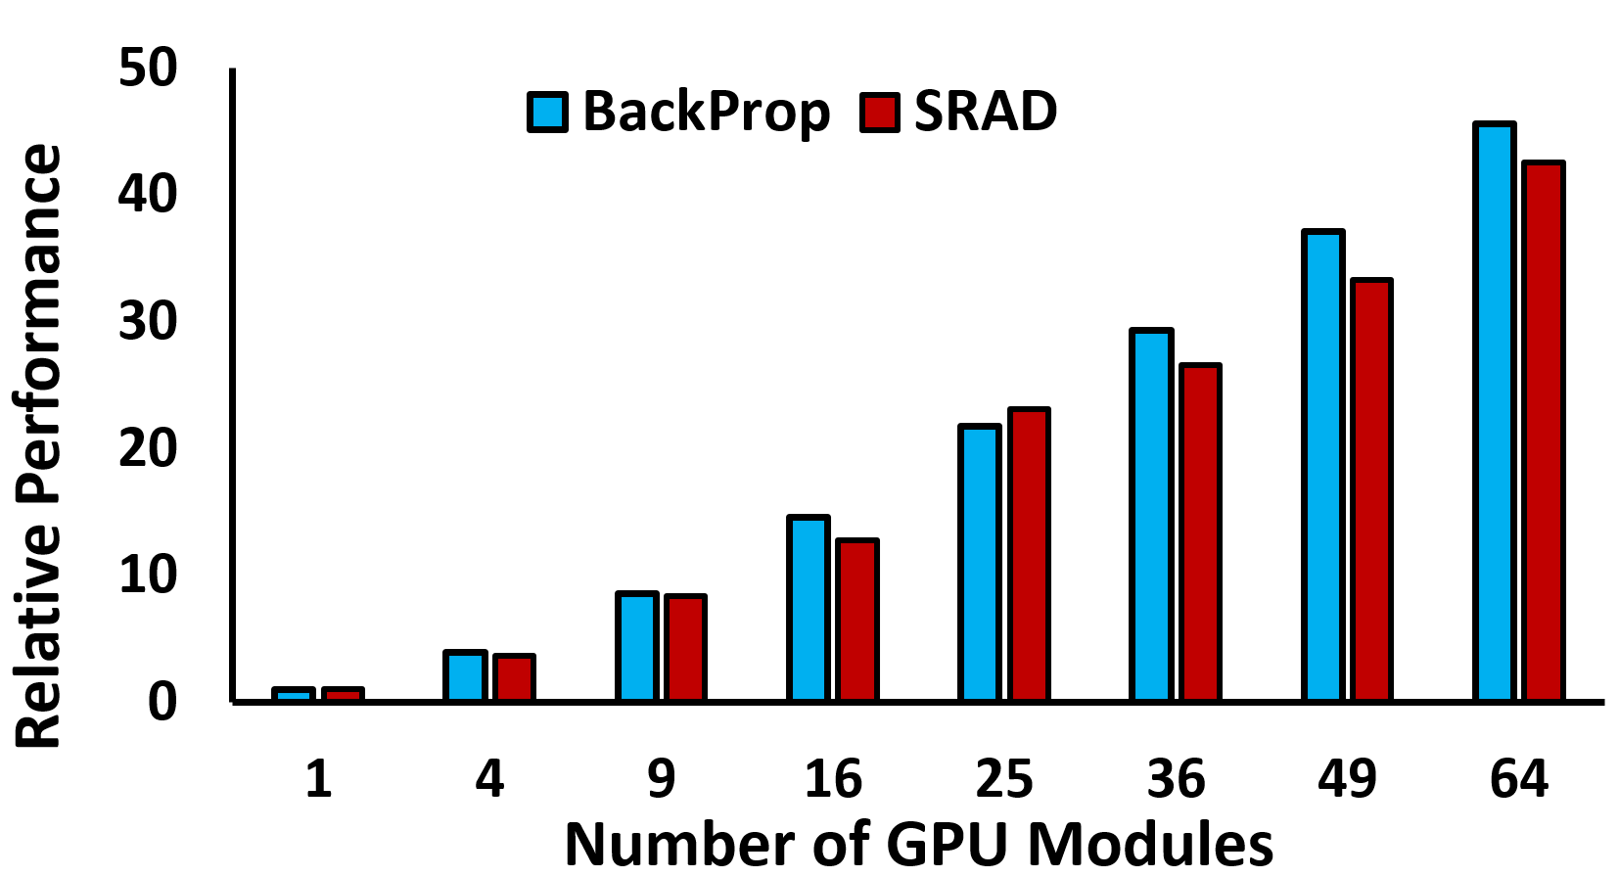
A Case for Waferscale GPU
GPU applications scale well with compute and memory resources
Notes:
Since it may now be feasible to build a waferscale system at high yield, we turn our attention to the question: what waferscale system should we build, especially as a way to understand the benefits and challenges of building a waferscale system today?
In this work, we choose to analyze a waferscale GPU. The reason is that GPU applications scale well with compute and memory resources. Here is a plot showing the performance scalability of two applications with increase in effective GPU size. As seen, both these applications scale quite well with GPU size. Other GPU applications with their tens of thousands of parallel threads should also benefit significantly from a waferscale GPU.

Slide 35
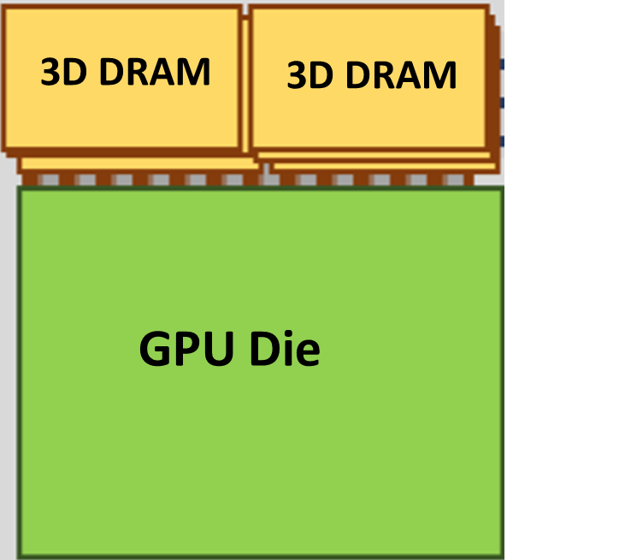
Waferscale GPU Overview
GPU die = 500 mm²
3D DRAM die = 100 mm²
Total Area = 700 mm²
GPU Die power = 200 W
DRAM Die power = 35 W
Total Power = 270 W
A GPU Module: GPM
300 mm wafer has enough area for about 72 GPU modules (GPM).
[HPCA2019]
Notes:
Let me set up the context better. Consider a 300 mm waferscale substrate populated with many GPU modules or GPMs as shown in the picture. Here, a GPM is comprised of a GPU die and 2 3D stacked DRAMs and all the connections are done using the on-wafer interconnects. The total area per GPM is 700 mm2 and the total power is 270 W.
If we assume 50,000 mm2 out of the 71,000 mm2 is available for the GPMs, we can pack about 72 GPU modules on this wafer. Of course, we only considered the wafer area constraint.

Slide 36
Architecting a Waferscale GPU
Q: Can we build a 72-GPM waferscale GPU ?
Three major physical constraints:
Thermal
Waferscale GPU would dissipate kWs of power
2. Power Delivery
How to supply kWs of power to the GPU modules?
Voltage Regulator Module (VRM) overhead?
3. Network of GPMs
Si-IF has up to 4 metal layers, what network topology to build?
Notes:
In reality, can we really build a 72GPM waferscale GPU?
There are three major physical constraints which we need to taken care of
(1)Thermal: a waferscale GPU will dissipate a few KWs of power, so the number of GPMs would be constrained by how much heat can be extracted out
(2)How to deliver KWs of power is also a major challenge. The overheads of Voltage regulator modules need to considered which would effectively reduce the area available for the GPMs
(3)Also in order to maintain good yield for the Si-IF substrate, we need to limit the number of interconnect layers to 4. Assuming out of the 4 layers, 2 layers are provided for power delivery and 2 for inter-GPM signaling. What network topology with these constraint is also a question

Slide 37
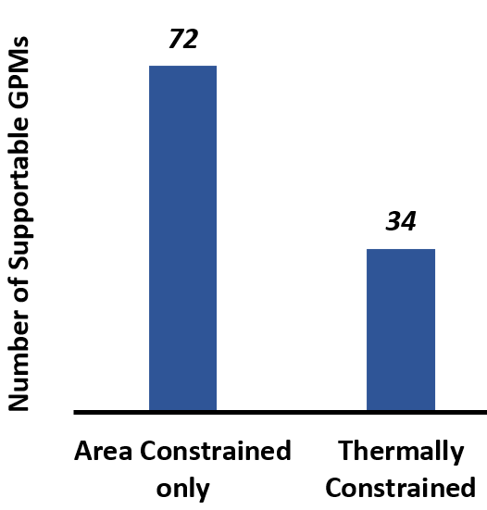
Thermal Design Power
Forced air-cooling with two heat sinks
~12 kW TDP i.e., 34 GPMs can be supported
Notes:
Let’s look at Thermal Design Power or TDP
A waferscale GPU can be cooled using two heat sinks, one at the top and one at the bottom, the secondary bottom heat sink also provide mechanical support to the wafer. For thermal simulations, we used forced air cooling and found that about 12 KW can be dissipated off the 300 mm wafer which implies that a maximum of only 34 GPMs can be supported with TDP constraints.

Slide 38
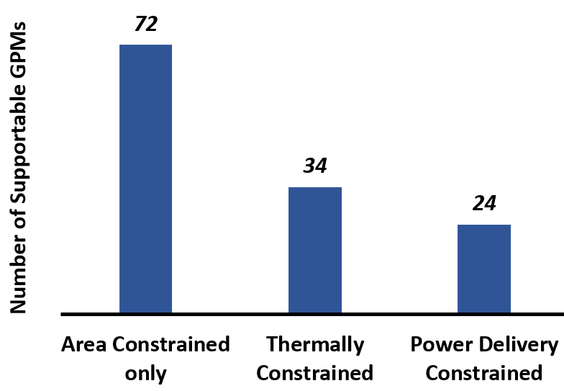
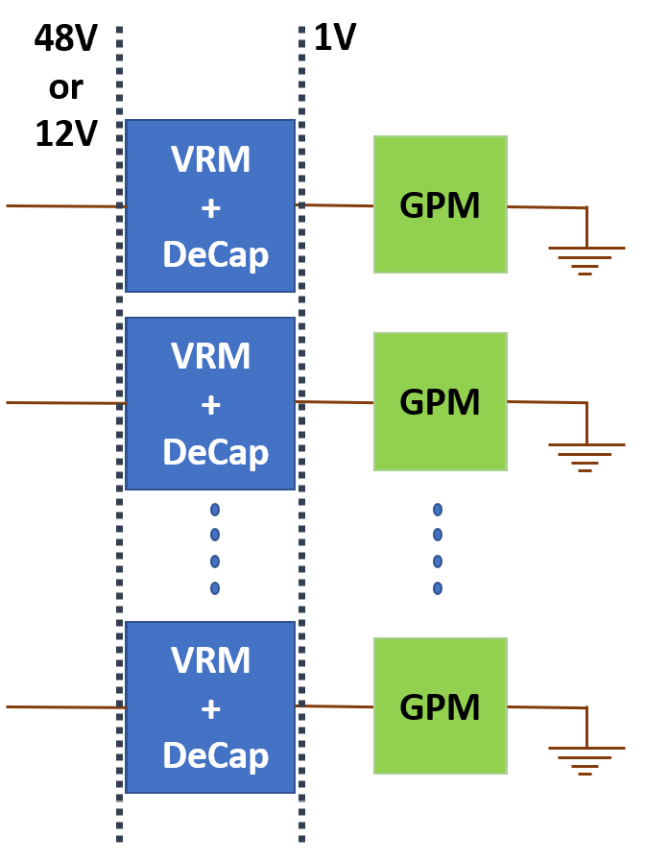
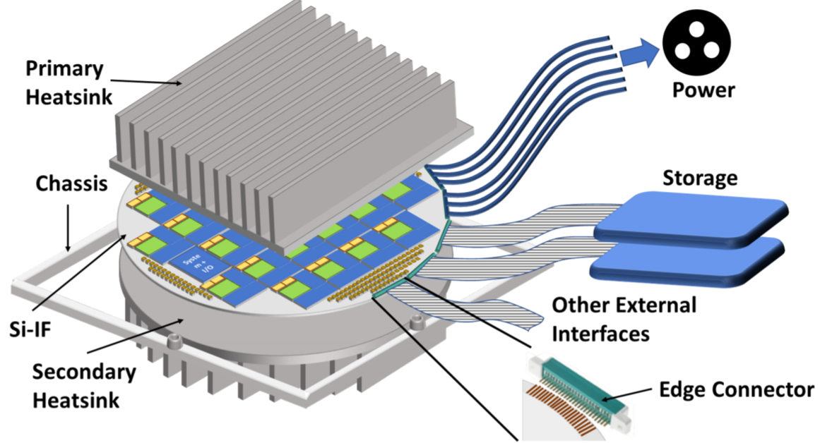
Power Delivery
Input Voltage (V) | Number of Metal Layers | VRM+DeCap Area per GPM (mm²) | Number of GPMs
1 | 68 | 300 | 50
3.3 | 8 | 1020 | 29
12 | 2 | 1380 | 24
48 | 2 | 2460 | 15
Input Voltage (V) | Number of Metal Layers | VRM+DeCap Area per GPM (mm²) | Number of GPMs
1 | 68 | 300 | 50
3.3 | 8 | 1020 | 29
12 | 2 | 1380 | 24
48 | 2 | 2460 | 15
Input Voltage Number of Layers
Input Voltage Area Overhead
Notes:
Next, is power delivery.
We consider delivering power through the edge of the wafer. Since we have only two layers for power delivery, we need to ensure that the power delivery losses are minimized while delivering a large amount of power
Here we show for different input voltage, what’s the number of metal layers required to ensure that total resistive losses are within 500 W,
As shown, 1V and 3.3V require a large number of layers. This is because lower voltage requires larger current to be carried through the power meshes on the wafer and therefore, to minimize resistive power losses, power must be delivered at higher voltage. For that purpose, our analysis shows that12 V and 48V can be both be used for power delivery with only 2 layers.
However, there is an opposing factor here. Now since, power is delivered at higher voltage, voltage step down is required at the point-of-load. Therefore, we need a voltage regulator module per GPM. But, VRMs come with their own area overhead. As the step down ratio increases, the VRM area increases as well. Considering all these constraints, we choose 12V as the input voltage because it allows larger number of GPMs than 48V supply due to VRM overhead.

Slide 39
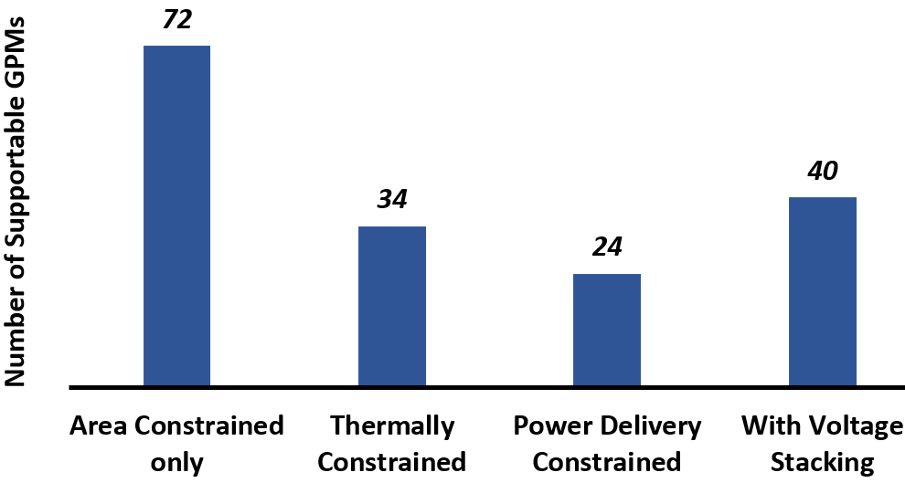
Stacked Power Delivery
One VRM shared by multiple GPMs in stack
Decreases step down ratio of VRM
GPMs need to be activity balanced for equal voltage drop
Intermediate regulators for voltage stability
Input Voltage (V) | No Stack | 2-GPM stack | 4-GPM stack
12 | 24 | 33 | 40
48 | 15 | 24 | 34
Notes:
We also consider stacked power supply where a VRM is shared by multiple GPMs. For example, a stack of N GPMs would require the stack be delivered power at N V and the drop across each GPU would be 1V.
There are two benefits to this: (1) VRM overhead is amortized (2) The VRM step down ratio is smaller
Since, perfect activity balancing would be difficult, we consider intermediate voltage regulator for intermediate node stability. Considering all these, with voltage stacking, 40 GPUs can be accommodated on the wafer.
Note that only 34 can be accommodated under thermal constraint. For the configuration with 40 GPMs, we consider voltage and frequency of each GPM is scaled down.

Slide 40
Waferscale Inter-GPM Network
Mesh
1D-Torus
2D-Torus
Num. Layers | Topology | Inter-GPM BW (TBps) | Si-IF Yield
1 | Mesh | 0.75 | 95.9%
2 | Mesh | 1.5 | 91.9%
 | 1-D Torus | 1.5 | 84.3%
3 | 2D Torus | 1.9 | 74%
Notes:
To determine the network between the GPMs, we consider 3 topologies. As seen from the table here, the torus networks require larger number of layers and would result in poorer Si-IF yield because of extra wiring resources required. We therefore consider a mesh network with 1.5 TBps per link which we estimate would result in an Si-IF yield of 91.9%

Slide 41
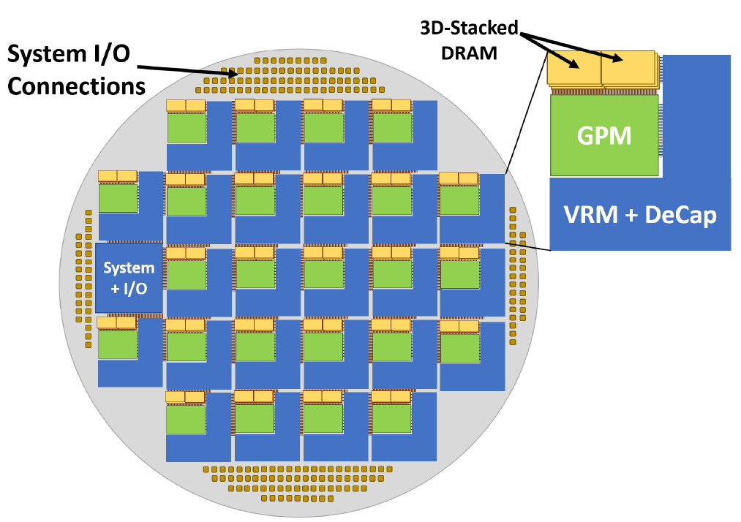
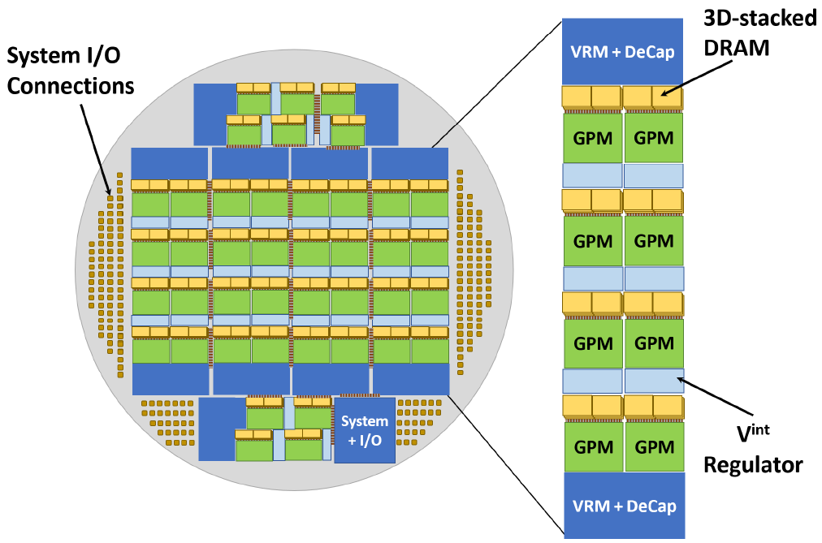
Final WS-GPU Architectures
24 GPM Floorplan without voltage stacking
40 GPM Floorplan with voltage stacking
Inter-GPM Network: Mesh
Notes:
So, considering all the physical constraints, we have come up with two waferscale GPU configurations that we would consider for our evaluations. One a 24 GPM configuration and the other a 40 GPM configuration with voltage stacking, both configurations use mesh network.

Slide 42
Thread Block Scheduling and Data Placement
Dynamic Online [1]:
Contiguous TBs placed in the same GPM
First-touch data placement
Static Offline:
Recursive Partitioning based on Fiduccia-Matthessey algorithm
Logical Cluster to Physical GPM mapping → Simulated Annealing (SA) based placement
GPM1
GPM2
GPM3
TB 1
TB 2
TB 3
TB 4
TB 5
TB 6
TB 7
TB 8
TB 9
[1] “MCM-GPU: Multi-Chip-Module GPUs for Continued Performance Scalability”, A. Arunkumar et. al., ISCA 2017
Notes:
Performance and EDP of a waferscale GPU architecture would also depend upon how compute and data is distributed across the waferscale system. We evaluate two policies, the first one is a dynamic online policy similar to the one proposed in the MCM-GPU work from NVIDIA, where a kernels’ TBs are distributed across the GPMs in a way that groups of contiguous TBs are placed within the same GPM. And the DRAM page is placed in the GPM from where the first access to that DRAM page is generated.
We also perform evaluations with a static offline policy. In this policy, we profile an application to generate a TB-DP graph and partition the graph in to 24/40 clusters such that the cumulative weight of the edges crossing the cluster boundaries is minimized. Then we perform a cluster to GPM placement to minimize the aggregate total communication cost in terms of network hops.

Slide 43
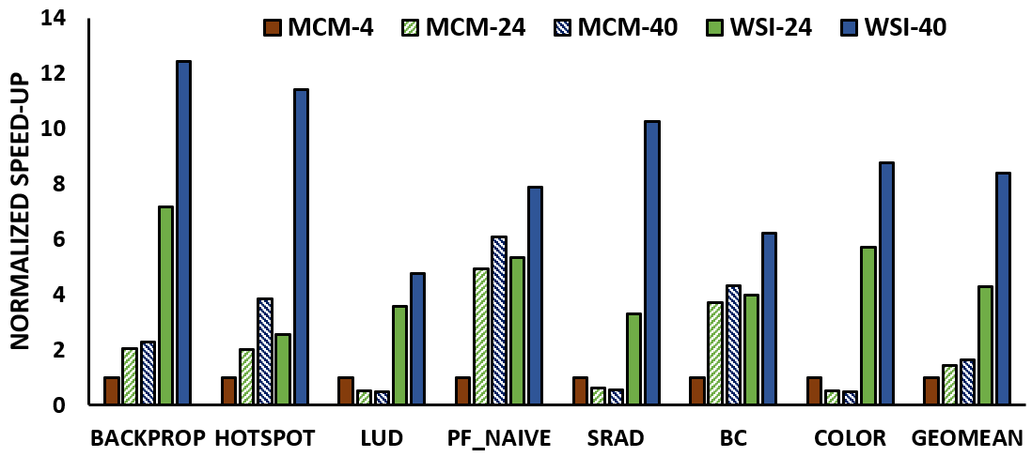
Results – WS-GPU Performance Improvement
WSI with 24 GPMs performs 2.97x better than multi-MCM configuration (EDP: 9.3x)
WSI with 40 GPMs performs 5.2x better than multi-MCM configuration (EDP: 22.5x)
With dynamic online scheme, WSI’s speedup improves by another ~2x
Notes:
Our results show that WS-GPU with 24 GPMs and 40 GPMs perform 2.97x and 5.2x better than iso-GPM multi-MCM configuration respectively. The EDP benefits are 9.3x and 22.5x respectively.
For fair comparison, we performed these evaluations using the static scheme which benefits multi-MCM GPU more than WS-GPU. If the dynamic online scheme is used WSI’s relative speedup gets boosted by roughly another 2x.

Slide 44
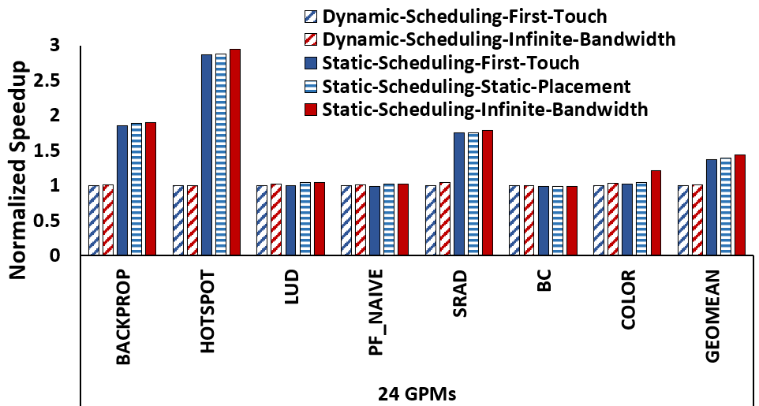
Results – Speedup using the Static Scheme
Improvement of up to 2.88x (average 1.4x)
Optimization in scheduling impacts speedup more than data placement
Notes:
Here, we show the difference between the dynamic and the static scheduling schemes and compare then with oracle infinite bandwidth cases. The static scheme can provide up to 2.88x and an average of 1.4x better performance over the dynamic scheme and we notice that optimization in scheduling is what provides the most benefit rather than optimization in data placement. This means that novel online scheduling schemes need to deviced to extract the maximum benefit out of a waferscale GPU.

Slide 45
Summary and Conclusion
Communication between packaged processors is a major bottleneck
Chiplet-based Waferscale Integration enormously effective in terms of performance and energy efficiency.
Advanced power and thermal architecture has the potential to improve performance further

Slide 46
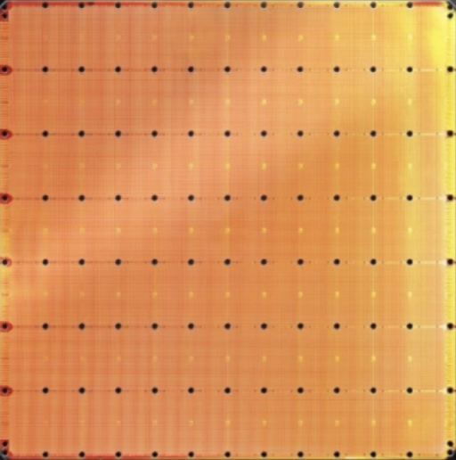
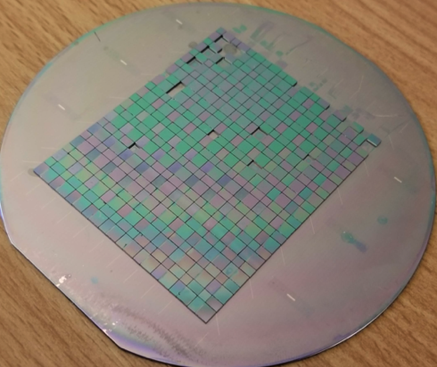
Re-emergence of Waferscale Technologies
 | Cerebras |  | Ours
Heterogeneous Integration | No |  | Yes
Core Count | High |  | High
Memory Capacity | Low |  | High
Network Bandwidth | High |  | High
Inter-Die Hop Latency | Low |  | Low
46
Strong yield implications as well

