Slide 1
Accelerators/Specialization/
Emerging Architectures
Rakesh Kumar

Slide 2
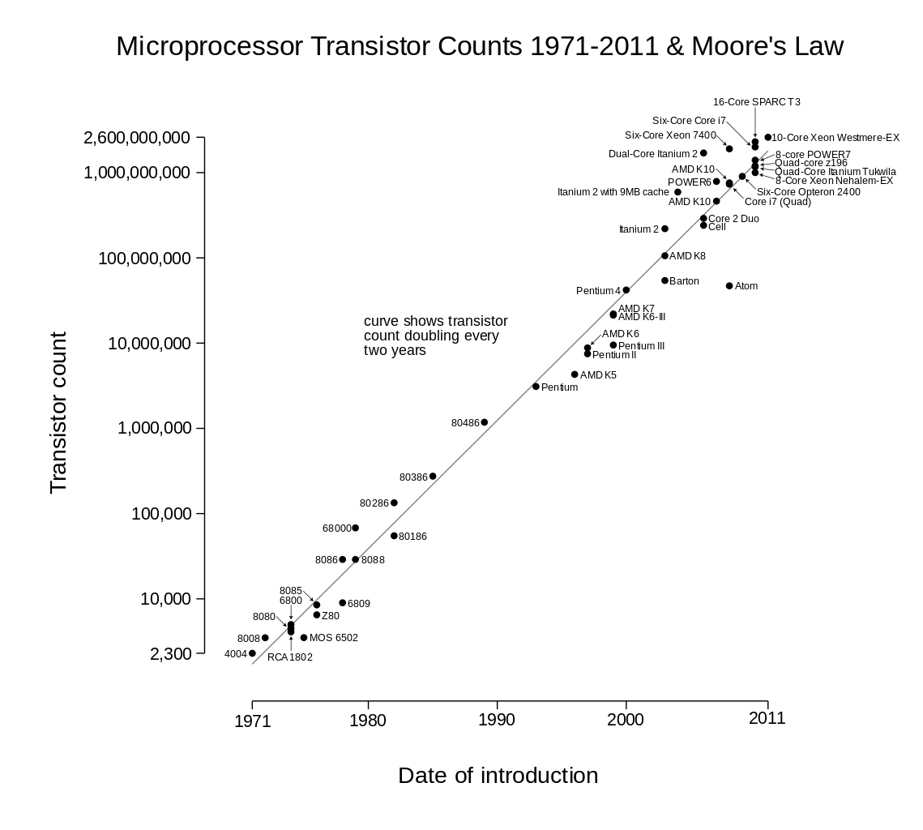
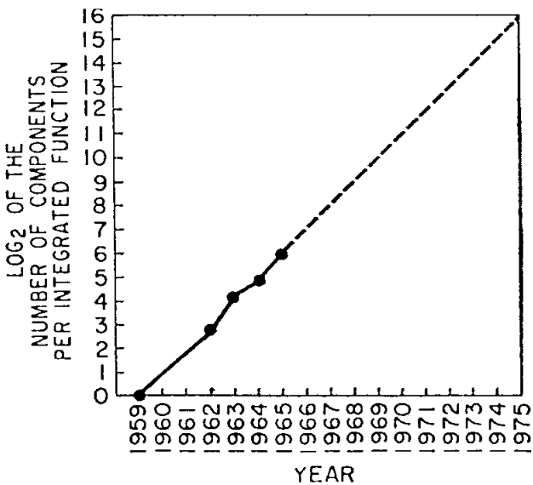
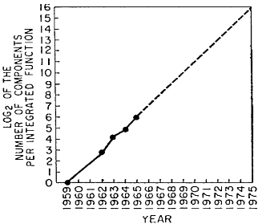
Moore’s Law

Slide 3
CMOS Scaling is Slowing Down
180 nm
130 nm
90 nm
65 nm
45 nm
32 nm
22 nm
14 nm
10 nm
http://www.anandtech.com/show/9447/intel-10nm-and-kaby-lake

Slide 4

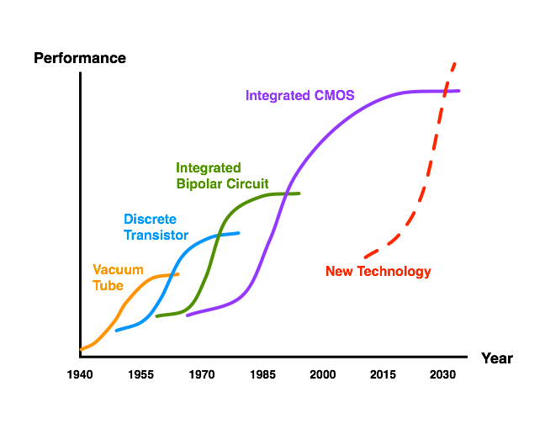
CMOS Technology Scaling
Technological
Fallow Period

Slide 5
Potential for Specialized Architectures
16 | Encryption
17 | Hearing Aid
18 | FIR for disk read
19 | MPEG Encoder
20 | 802.11 Baseband
[Zhang and Brodersen]

Slide 14
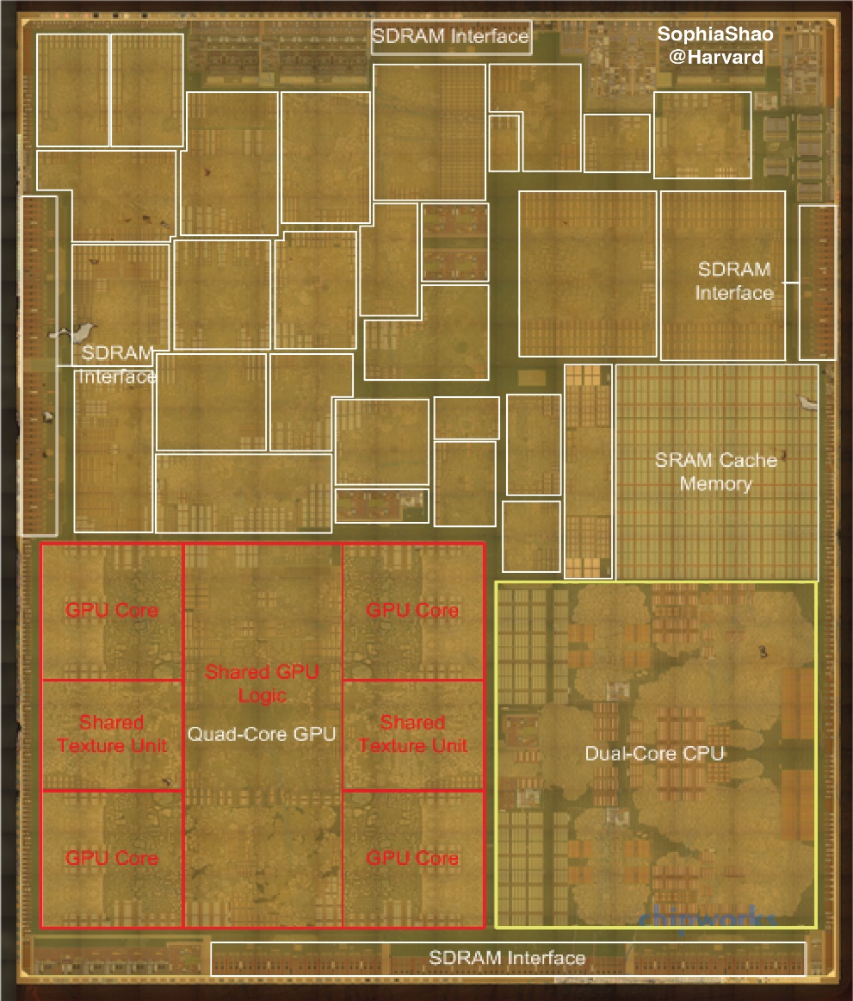
Cores, GPUs, and Accelerators:
Apple A8 SoC
Out-of-Core
Accelerators

Slide 15
Cores, GPUs, and Accelerators:
Apple A8 SoC
Out-of-Core
Accelerators

Slide 16
Cores, GPUs, and Accelerators:
Apple A8 SoC
Out-of-Core
Accelerators
Maltiel Consulting
estimates
Our estimates

Slide 17
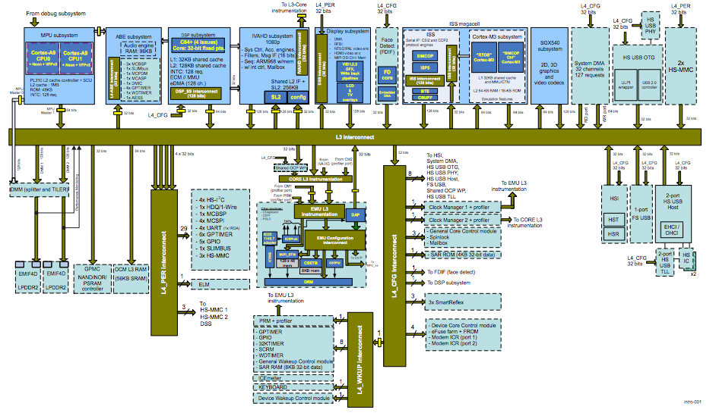
Today’s SoC
OMAP 4 SoC

Slide 18
Today’s SoC
ARM Cores
Audio
DSP
Video
DSP
Face
Imaging
GPU
DMA
USB
SD
System Bus
USB
DMA
Secondary
Bus
Secondary
Bus
Tertiary
Bus
OMAP 4 SoC

Slide 19
Challenges in Accelerators
Flexibility
  Fixed-function accelerators are only designed for the target applications.
Programmability
  Today’s accelerators are explicitly managed by programmers.
Design Cost
  Accelerator (and RTL) implementation is inherently tedious and time-consuming.

Slide 20
Today’s SoC
GPU/DSP
CPU
CPU
Mem
Inter-
face
Buses
Acc
Acc
Acc
Acc
Acc
Acc
Acc
Acc
Acc

Slide 21
Future Accelerator-Centric Architectures
GPU/DSP
Big
Cores
Small Cores
Memory
Interface
Shared Resources
Sea of Fine-Grained
Accelerators
How to decompose applications into accelerators?
How to rapidly design lots of accelerators?
How to design and manage the shared resources?
Flexibility
Design Cost
Programmability

