Slide 1
lecture

Slide 2
Basics of Memory Consistency (Ordering)
How are memory references from different processors interleaved?
If this is not well-specified, synchronization becomes difficult or even impossible
  ISA must specify consistency model
Common example using Dekker’s algorithm for synchronization
  If load reordered ahead of store (as we assume for a baseline OOO CPU)
  Both Proc0 and Proc1 enter critical section, since both observe that other’s lock variable (A/B) is not set
If consistency model allows loads to execute ahead of stores, Dekker’s algorithm no longer works
  Common ISAs allow this: IA-32, PowerPC, SPARC, Alpha

Slide 3
Sequential Consistency [Lamport 1979]
Processors treated as if they are interleaved processes on a single time-shared CPU
All references must fit into a total global order or interleaving that does not violate any CPU’s program order
  Otherwise sequential consistency not maintained
Now Dekker’s algorithm will work
Appears to preclude any OOO memory references
  Hence precludes any real benefit from OOO CPUs

Slide 4
Relaxed Consistency Models
Key insight: only synchronization references need to be ordered
Hence, relax memory for all other references
  Enable high-performance OOO implementation
Require programmer to label synchronization references
  Hardware must carefully order these labeled references
  All other references can be performed out of order
Labeling schemes:
  Explicit synchronization ops (acquire/release)
  Memory fence or memory barrier ops:
    All preceding ops must finish before following ones begin
Often: fence ops cause pipeline drain in modern OOO machine

Slide 5
Why Relaxed Consistency Models?
Original motivation
  Allow in-order processors to overlap store latency with other work
  “Other work” depends on loads, hence must let loads bypass stores and execute early: implement a store queue
  This breaks sequential consistency assumption that all references are performed in program order
This led to definition of processor consistency, SPARC TSO, IBM/370
  All of these relax read-to-write program order requirement
Subsequent developments
  It would be nice to overlap latency of one store with latency of other stores
  Allow stores to be performed out of order with respect to each other
  This breaks SC even further
This led to definition of SPARC PSO/RMO, WO, PowerPC WC, Itanium
What’s the problem with relaxed consistency?
  Shared memory programs can break if not written for specific cons. model

Slide 6
Understanding Consistency Models
Consistency model defines how memory references are ordered across processors/threads
  Part of the instruction set architecture
PowerPC, SPARC, IA-32, etc. each have their own consistency model
  In some cases, more than one!
The program semantics will change with consistency model
  More relaxed consistency models enable more “correct” outcomes
  Even strict consistency models allow multiple correct outcomes

Slide 7
Understanding Relaxed Consistency
Three important concepts
  Atomicity
    do writes appear at the same time to all other processors?
  Program order
    do my references have to be ordered with respect to each other?
  Visibility (causality)
    Does anyone care? This is the most subtle...

Slide 8
Possible Relaxations
Relax Write to Read program order
Relax Write to Write program order
Relaxation
Relax Read to Read and Write to Write program order
Read others’ write early
Read own write early
From widely cited tech report:
  [Adve/Gharachorloo, “Shared Memory Consistency Models: A Tutorial”]

Slide 9
Synchronization
Synchronization requires hardware support
  Atomic read/write memory operation
  No other access to the location allowed between the read and write
  Could be a single instruction
    E.g., atomic swap of register ↔ memory (e.g. BTS; x86)
  Or an atomic pair of instructions (e.g. LL and SC; MIPS)

Slide 10
Synchronization in MIPS
Load linked: LL rt, offset(rs)
Store conditional: SC rt, offset(rs)
  Succeeds if location not changed since the LL
    Returns 1 in rt
  Fails if location is changed
    Returns 0 in rt
Any time a processor intervenes and modifies the value in memory between the LL and SC instruction, the SC returns 0 in $t0.

Slide 11
Synchronization in MIPS
Load linked: LL rt, offset(rs)
Store conditional: SC rt, offset(rs)
  Succeeds if location not changed since the LL
    Returns 1 in rt
  Fails if location is changed
    Returns 0 in rt
Example: atomic incrementor
Time Step | Thread A | Thread B | Thread A $t0 | Thread B $t0 | Memory M[$s0]
0 |  |  |  |  | 0
1 | try: LL $t0, 0($s0) | try: LL $t0, 0($s0)
2 | ADDIU $t0, $t0, 1 | ADDIU $t0, $t0, 1
3 | SC $t0, 0($s0) | SC $t0, 0 ($s0)
4 | BEQZ $t0, try | BEQZ $t0, try

Slide 12
Mutex from LL and SC
Linked load / Store Conditional
m = 0; // m=0 means lock is free; otherwise, if m=1, then lock locked
mutex_lock(int *m) {
while(test_and_set(m)){}
}
int test_and_set(int *m) {
try:
LI $t0, 1
LL $t1, 0($a0)
SC $t0, 0($a0)
BEQZ $t0, try
MOVE $v0, $t1
}
Notes:
LL just like LW
SC jus like SW, but overwrites src register with 1 “success” or 0 “fail”

Slide 13
Mutex from LL and SC
Linked load / Store Conditional
m = 0;
mutex_lock(int *m) {
test_and_set:
LI $t0, 1
LL $t1, 0($a0)
BNEZ $t1, test_and_set
SC $t0, 0($a0)
BEQZ $t0, test_and_set
}
mutex_unlock(int *m) {
SW $zero, 0($a0)
}
Notes:
LL just like LW
SC jus like SW, but overwrites src register with 1 “success” or 0 “fail”

Slide 14
Mutex from LL and SC
Linked load / Store Conditional
m = 0;
mutex_lock(int *m) {
Time Step | Thread A | Thread B | ThreadA $t0 | ThreadA $t1 | ThreadB $t0 | ThreadB $t1 | Mem M[$a0]
0 |  |  |  |  |  |  | 0
1 | try: LI $t0, 1 | try: LI $t0, 1
2 | LL $t1, 0($a0) | LL $t1, 0($a0)
3 | BNEZ $t1, try | BNEZ $t1, try
4 | SC $t0, 0($a0) | SC $t0, 0 ($a0)
5 | BEQZ $t0, try | BEQZ $t0, try
6
Notes:
LL just like LW
SC jus like SW, but overwrites src register with 1 “success” or 0 “fail”

Slide 15
Alternative Atomic Instructions
Other atomic hardware primitives
- test and set (x86)
- atomic increment (x86)
- bus lock prefix (x86)
- compare and exchange (x86, ARM deprecated)
- linked load / store conditional
(MIPS, ARM, PowerPC, DEC Alpha, …)
Notes:
hardware implementation: lock bus while read-modify-write cycle happens, very expensive

Slide 16
Motivation for Hardware multithreading (“hyperthreading”)
Modern processors fail to utilize execution resources well.
There is no single culprit.
Attacking the problems one at a time (e.g., specific latency-tolerance solutions) always has limited effectiveness.
However, a general latency-tolerance solution which can hide all sources of latency can have a large impact on performance.
Notes:
Having several execution units doesn’t mean they’ll all be used! Problems with dependancies, etc limit the usefulness of this approach.

Slide 17
Hardware Multithreading
Conventional
Multithreaded
Processor
Processor
instruction stream
instruction stream
PC
PC
PC
PC
regs
regs
regs
regs
PC
regs
CPU
CPU
Notes:
“hyperthreading” from Intel.
Multiple execution units as before -> more threads means greater chance of saturating our resources.

Slide 18
Superscalar Execution
Issue Slots
Time (clock cycles)
Notes:
Issue slots: eg, load/store unit, FP units, integer units, MUL/DIV
This is how Tomasulo’s algorithm works

Slide 19
Multithreading on Superscalar
Issue Slots
Time (proc cycles)
Thread 1
Thread 2
Context Switch
Notes:
Basic – no tricks. Lots of wasted issue slots.

Slide 20
Superscalar Execution with Coarse-Grained Multithreading
Issue Slots
Issue Slots
Time (proc cycles)
Time (proc cycles)
Thread 1
Thread 2
Thread 3
Thread 4
Context Switch
Notes:
LHS: regular superscalar. Some people call this “coarse-grained” too.
RHS: Course grained: add extra architectural state (registers) so we don’t need a context switch to switch threads.
If only 1 thread is running: no performance hit
Decreases vertical waste vs. original design.
Appears to OS as SMP – symmetric multiprocessor -- (2 logical processors)
Problems?

Slide 21
Superscalar Execution with Fine-Grain Multithreading
Issue Slots
Time (proc cycles)
Thread 1
Thread 2
Thread 3
Notes:
Fine grained – issue for a different thread (only one) each clock cycle, round robin style.
- Benefit over previous: if each thread has many long-latency operations, latency is masked
because other threads execute for (n-1) out of n cycles (if hardware supports n threads)
- Optimization: if thread has no work to do (e.g. cache miss), skip it!
Originally idea from Tera Computer Company, late 1980s – see paper “The Tera Computer System”. 256 cores; multiple threads per core (as shown above). Expected latency of instruction is 70 cycles!
- Still doesn’t solve the problem of horizontal waste!

Slide 22
Simultaneous Multithreading
Issue Slots
Time (proc cycles)
Thread 1
Thread 2
Thread 3
Thread 4
Thread 5
Notes:
SMT (as referenced here) – issue from any thread at any time.
Much greater utilization. Threads “compete” for resources; no one thread must take up all resources to saturate the processor.

Slide 23
The Potential for SMT
Notes:
Fine grained – still problems with data dependancies in threads.
Note that they all have diminishing returns…

Slide 24
Goals
Three primary goals for this SMT:
  1. Minimize the architectural impact on conventional superscalar design.
  2. Minimize the performance impact on a single thread.
  3. Achieve significant throughput gains with many threads.

Slide 25
A Conventional Superscalar Architecture
Fetch
Data
Unit
floating point
fp
fp
PC
instruction queue
units
reg’s
Cache
Instruction Cache
8
integer
int.
integer
instruction queue
units
reg’s
int/ld-
Register
store
Decode
Renaming
units
• Fetch up to 8
• Out-of-order,
• Issue 3 floating
instructions per cycle
speculative
point, 6 integer
execution
instructions per cycle

Slide 26
An SMT Architecture
Fetch
Data
Unit
floating point
fp
fp
PC
instruction queue
units
reg’s
Cache
Instruction Cache
8
integer
int.
integer
instruction queue
units
reg’s
int/ld-
Register
store
Decode
Renaming
units
• Fetch up to 8
• Out-of-order,
• Issue 3 floating
instructions per cycle
speculative
point, 6 integer
execution
instructions per cycle

Slide 27
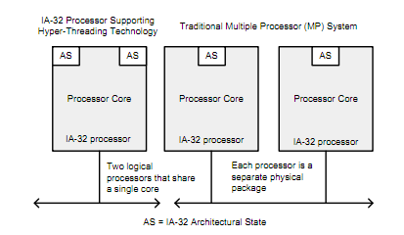
Real-World SMT
Intel – Hyperthreading
- IBM whitepaper: 20-50% performance benefit
Notes:
IBM: http://www.ibm.com/developerworks/linux/library/l-htl/
Intel - all i7 processors have hyperthreading. Some i5 do too.
Info at
http://download.intel.com/technology/itj/2002/volume06issue01/art01_hyper/vol6iss1_art01.pdf
http://download.intel.com/design/processor/manuals/253665.pdf

Slide 28
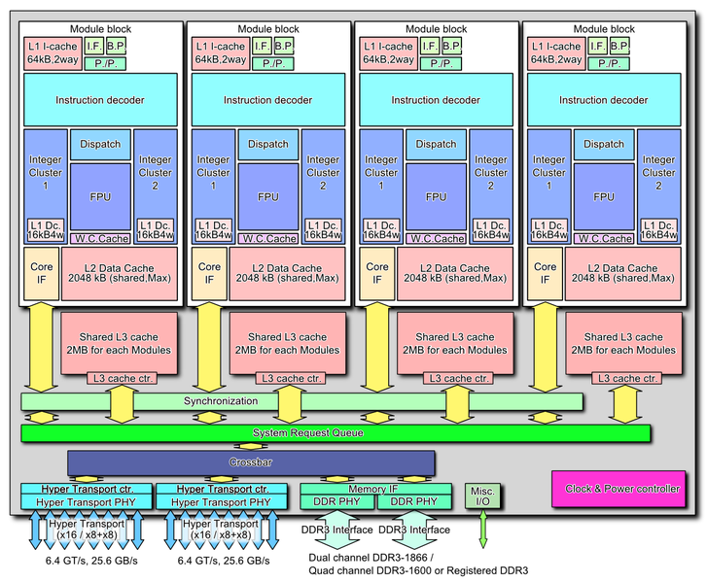
Real-World SMT (2)
AMD - “It’s all about the cores!”
  “Our cores are real.” – January, 2010
    “Hyperthreading is stupid. So is Intel.” - paraphrase
  October 12, 2011: Bulldozer: 4 “modules”, 8 threads
Notes:
AMD – not a fan of SMT, until they released a SMT processor (Bulldozer). Cites some resources about people not liking HT from Intel.
Bulldozer slightly different – also duplicates integer resources as well as architectural state.
AMD link: http://blogs.amd.com/work/2010/01/21/it%E2%80%99s-all-about-the-cores/
http://en.wikipedia.org/wiki/Bulldozer_(microarchitecture)

Slide 29
More SMT
Network Processors
CMT processors (Oracle)
Many Intel processors, etc.

