Slide 1
ECE411: Computer Organization and Design Programming Models for Parallelism

Slide 2
Complexity of OOO Execution
OOO Machines attempt to dynamically builds the dataflow graph of a piece of the program to extract ILP.
ISAs assume a sequential order between all instructions, even when programmer did not intent.

Slide 3
VLIW (Very Long Instruction Word)
a very long instruction word consists of multiple independent instructions packed together by the compiler
Packed instructions can be logically unrelated (contrast with SIMD)
idea: compiler finds independent instructions and statically schedules (i.e. packs/bundles) them into a single VLIW instruction

Slide 4
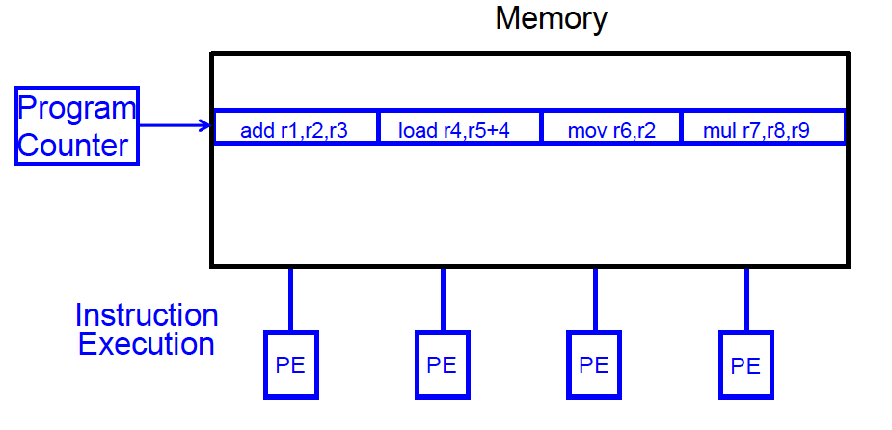
VLIW Concept
Fisher, “Very Long Instruction Word architectures and the ELI-512,” ISCA 1983.
ELI: Enormously longword instructions (512 bits)

Slide 5
VLIW Philosophy
Philosophy similar to RISC (simple instructions and hardware)
except multiple instructions in parallel
RISC (John Cocke, 1970s, IBM 801 minicomputer)
compiler does the hard work to translate high-level language code to simple instructions (John Cocke: control signals)
and, to reorder simple instructions for high performance
hardware does little translation/decoding → very simple
VLIW (Fisher, ISCA 1983)
compiler does the hard work to find instruction level parallelism
hardware stays as simple and streamlined as possible
executes each instruction in a bundle in lock step
simple → higher frequency, easier to design

Slide 6
VLIW Tradeoffs
Advantages
+ no need for dynamic scheduling hardware → simple hardware
+ no need for dependency checking within a VLIW instruction → simple hardware for multiple instruction issue + no renaming
+ no need for instruction alignment/distribution after fetch to different functional units → simple hardware
Disadvantages
-- compiler needs to find N independent operations
-- if it cannot, inserts NOPs in a VLIW instruction
-- parallelism loss AND code size increase
-- recompilation required when execution width (N), instruction latencies, functional units change (Unlike superscalar processing)
-- lockstep execution causes independent operations to stall
-- no instruction can progress until the longest-latency instruction completes

Slide 7
Commercial VLIW Machines
Multiflow TRACE, Josh Fisher (7-wide, 28-wide)
Cydrome Cydra 5, Bob Rau
Transmeta Crusoe: x86 binary-translated into internal VLIW
TI C6000, Trimedia, STMicro (DSP & embedded processors)
most successful commercially
Intel IA-64
not fully VLIW, but based on VLIW principles
EPIC (Explicitly Parallel Instruction Computing)
instruction bundles can have dependent instructions
a few bits in the instruction format specify explicitly which instructions in the bundle are dependent on which other ones

Slide 8
Flynn’s Taxonomy of Computers
Mike Flynn, “Very High-Speed Computing Systems,” Proc. of IEEE, 1966
SISD: Single instruction operates on single data element
SIMD: Single instruction operates on multiple data elements
Array processor
Vector processor
MISD: Multiple instructions operate on single data element
Closest form: systolic array processor, streaming processor
MIMD: Multiple instructions operate on multiple data elements (multiple instruction streams)
Multiprocessor
Multithreaded processor

Slide 9
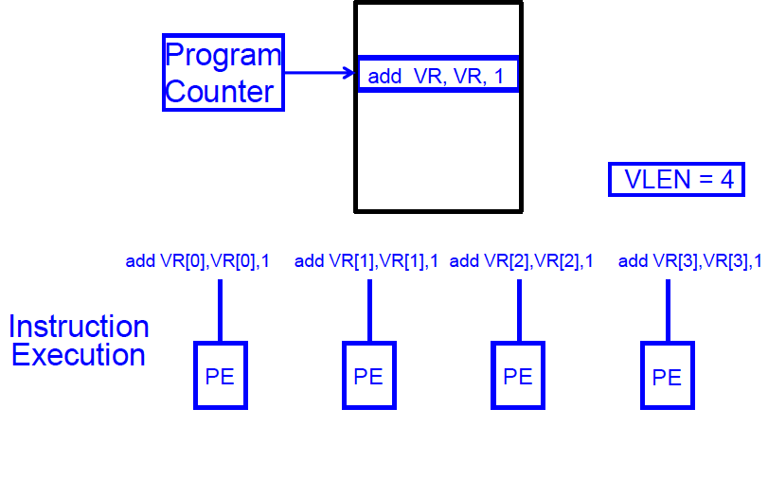
SIMD Processing
single instruction controls simultaneous execution of many processing elements

Slide 10
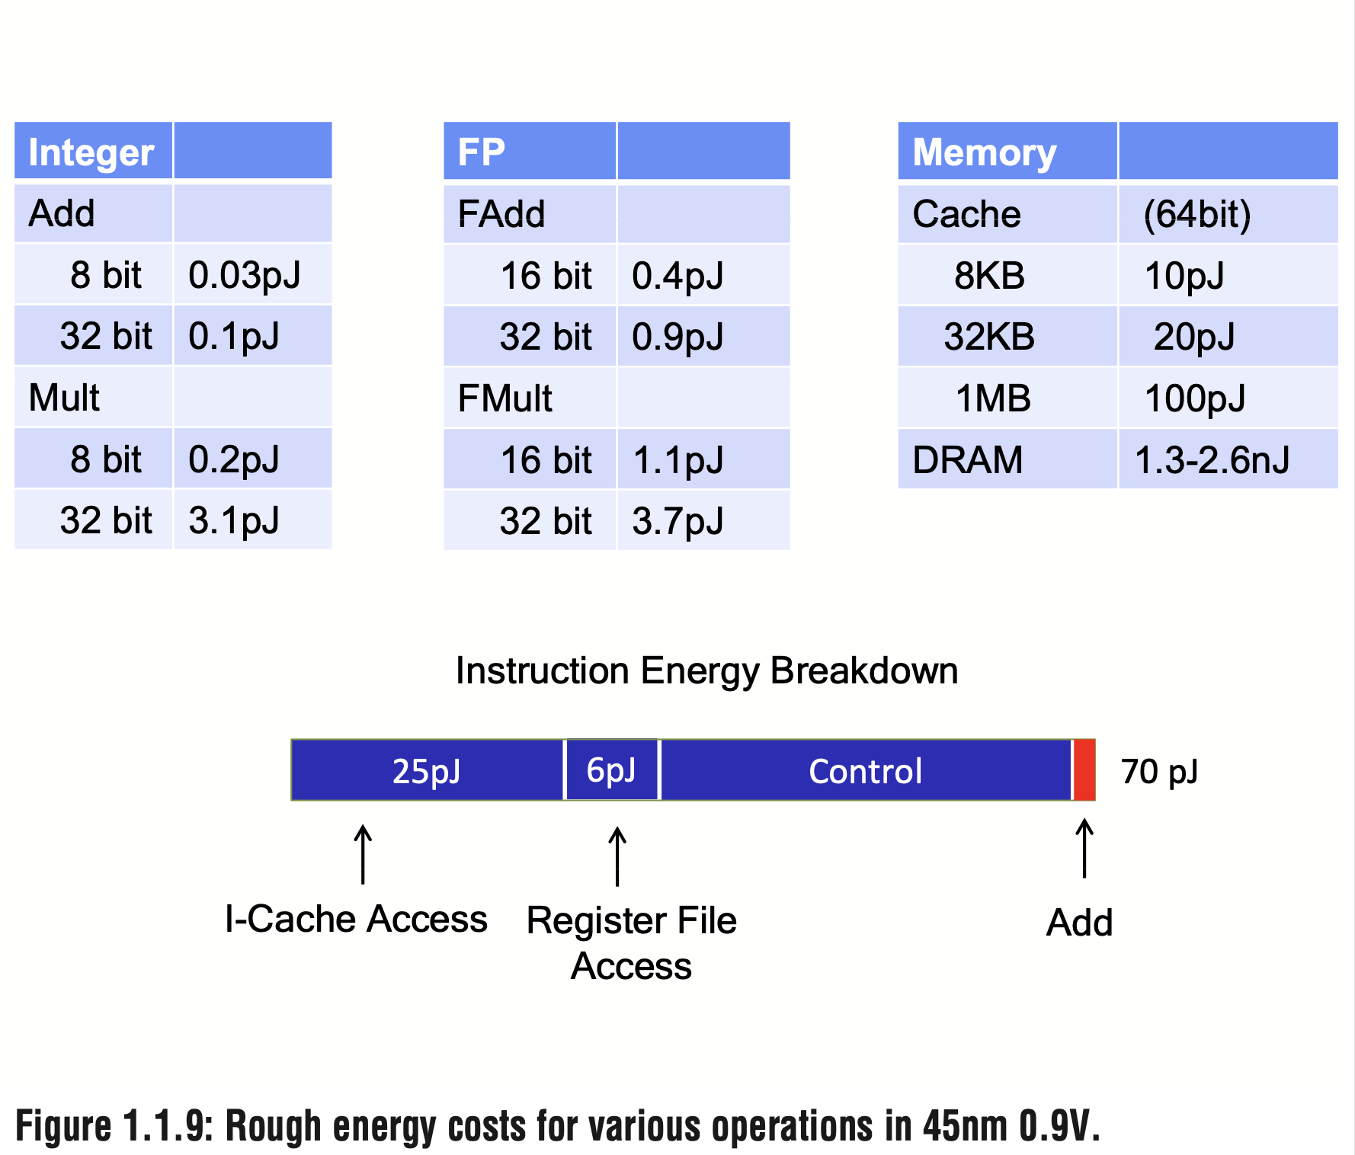
Case for SIMD
M. Horowitz, "1.1 Computing's energy problem (and what we can do about it)," 2014 IEEE International Solid-State Circuits Conference Digest of Technical Papers (ISSCC), 2014, pp. 10-14, doi: 10.1109/ISSCC.2014.6757323.

Slide 11
Why SIMD
+more parallelism when parallelism is abundant
+SIMD in addition to ILP
+simple design
+replicated functional units
+energy efficient
+ only needs one instruction for many data operations
+small die area
+no heavily ported register files
-Must be explicitly exposed to the hardware
-by the compiler or by the programmer

Slide 12
SIMD Application
Image
graphics : 3D games, movies
image recognition
video encoding/decoding : JPEG, MPEG4
Sound
encoding/decoding: IP phone, MP3
speech recognition
digital signal processing: cell phones
Scientific applications
array-based data-parallel computation, another level of parallelism
Machine learning training

Slide 13
Vector Processors
A vector is a one-dimensional array of numbers
Many scientific/commercial programs use vectors
for (i = 0; i<=49; i++)
C[i] = (A[i] + B[i]) / 2
A vector processor is one whose instructions operate on vectors rather than scalar (single data) values
Basic requirements
Need to load/store vectors → vector registers (contain vectors)
Need to operate on vectors of different lengths → vector length register (VLEN)
Elements of a vector might be stored apart from each other in memory → vector stride register (VSTR)
Stride: distance in memory between two elements of a vector

Slide 14
Vector Functional Units
V1
V2
V3
Use a deep pipeline to execute element operations
→ fast clock cycle
Control of deep pipeline is simple because elements in vector are independent
V1 * V2 → V3

Slide 15
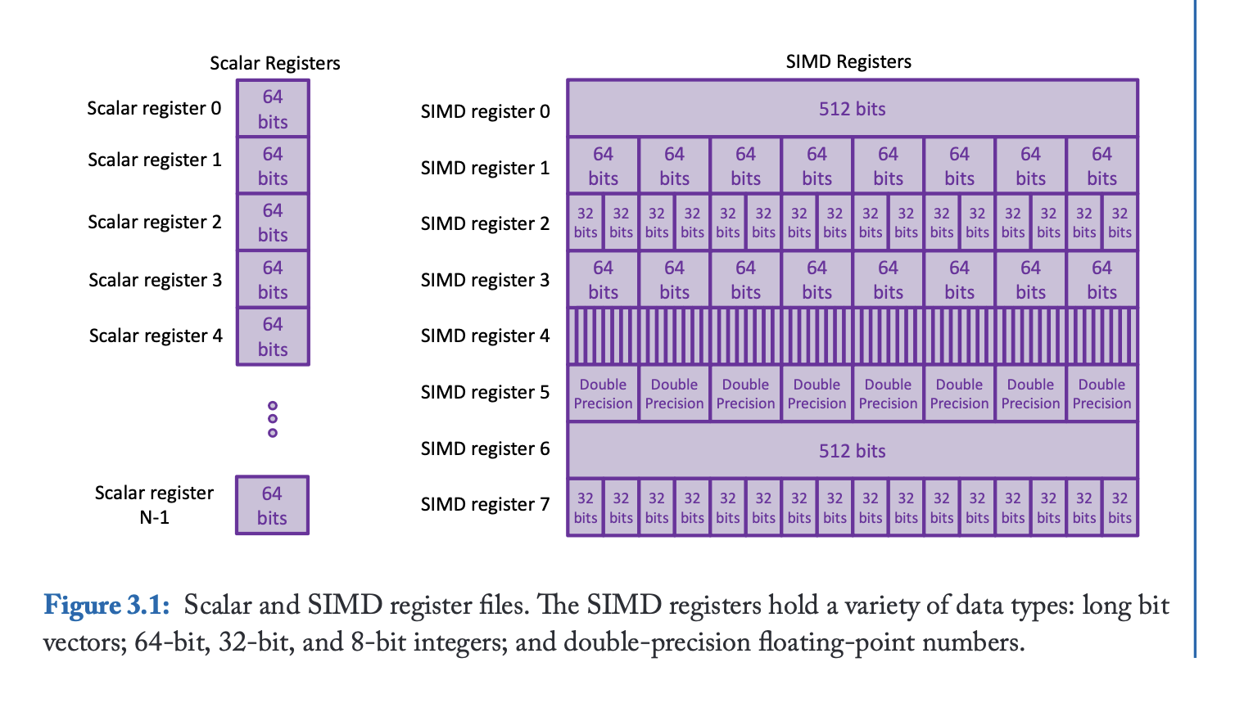
Packed SIMD

Slide 16
Packed SIMD Variations
SIMD processing units in CPU
MMX: Multimedia Extensions (1996)
repurpose 64-bit floating point registers
eight 8-bit integer ops or four 16-bit integer ops
SSE: Streaming SIMD Extensions (1999, 2001, 2004, 2007)
separate 128-bit registers
eight 16-bit ops, four 32-bit ops, or two 64-bit ops
single-precision floating point arithmetic
AVX: Advanced Vector Extension (2010)
doubles the width to 256 bits, i.e., four 64-bit integer/fp ops,
extendible to 512 and 1024 bits for future generations
operands must be consecutive and aligned memory locations

Slide 17
Examples of Using SSE
X3
X2
X1
X0
xmm1
X3
X2
X1
X0
xmm1
X3
xmm1
X3
X2
X2
X1
X1
X0
X0
Y3
Y2
Y1
Y0
xmm2
Y3
Y2
Y1
Y0
xmm2
Y3
xmm2
Y3
Y2
Y2
Y1
Y1
Y0
Y0
op
op
op
op
op
X3 op Y3
X2 op Y2
X1 op Y1
X0 op Y0
xmm1
X3
X2
X1
X0 op Y0
xmm1
Y3
Y3
X0
X1
xmm1
Y3 .. Y0
Y3 .. Y0
X3 .. X0
X3 .. X0
Packed SP FP operation
(e.g. ADDPS xmm1, xmm2)
Scalar SP FP operation
(e.g. ADDSS xmm1, xmm2)
Shuffle FP operation (8-bit imm)
(e.g. SHUFPS xmm1, xmm2, imm8)
Shuffle FP operation (8-bit imm)
(e.g. SHUFPS xmm1, xmm2, 0xf1)

Slide 18
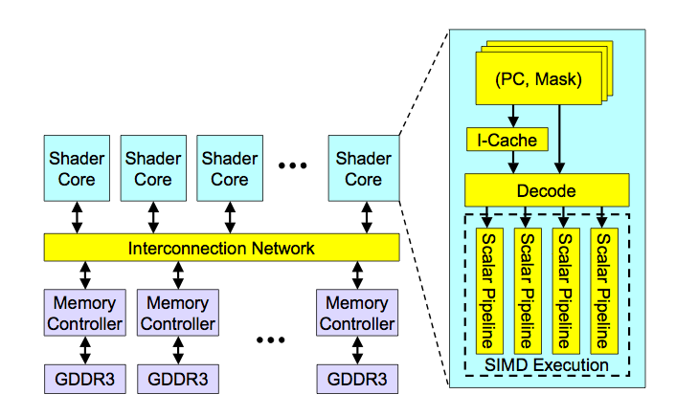
High-Level View of a GPU

Slide 19
Sample GPU SIMT Code (Simplified)
CPU code
for (ii = 0; ii < 100; ++ii) {
C[ii] = A[ii] + B[ii];
}
CUDA code
// there are 100 threads
__global__ void KernelFunction(…) {
int tid = blockDim.x * blockIdx.x + threadIdx.x;
int varA = aa[tid];
int varB = bb[tid];
C[tid] = varA + varB;
}
Slide credit: Hyesoon Kim @ Georgia Tech

Slide 20
Latency Hiding with “Thread Warps”
warp: a set of threads that execute the same instruction (on different data elements)
Fine-grained multithreading
One instruction per thread in pipeline at a time (no branch prediction)
Interleave warp execution to hide latencies
Register values of all threads stay in register file
No OS context switching
Memory latency hiding
Graphics has millions of pixels
thread warp 3
warps available
thread warp 8
for scheduling
thread warp 7
SIMD pipeline
I-fetch
decode
R
R
R
F
F
F
warps accessing
A
A
A
memory hierarchy
L
L
L
U
U
U
miss?
D-cache
thread warp 1
all hit?
data
thread warp 2
writeback
thread warp 6
Optional Reading: Understanding Latency Hiding on GPUs
Slide credit: Tor Aamodt
Notes:
With a large number of shader threads multiplexed on the same execution re- sources, our architecture employs fine-grained multithreading where individual threads are interleaved by the fetch unit to proactively hide the potential latency of stalls before they occur. As illustrated by Figure, warps are issued fairly in a round-robin queue. When a thread is blocked by a memory request, shader core simply removes that thread’s warp from the pool of “ready” warps and thereby allows other threads to proceed while the memory system processes its request.
With a large number of threads (1024 per shader core) interleaved on the same pipeline, FGMT effectively hides the latency of most memory operations since the pipeline is occupied with instructions from other threads while memory operations complete. also hides the pipeline latency so that data bypassing logic can potentially be omitted to save area with minimal impact on performance. simplify the dependency check logic design by restricting each thread to have at most one instruction running in the pipeline at any time.

Slide 21
Branch Divergence Problem in Warp-based SIMD
SPMD (single program, multiple data) execution on SIMD hardware
NVIDIA calls this “Single Instruction, Multiple Thread” (“SIMT”) execution
A
thread warp
common PC
B
thread
1
thread
2
thread
3
thread
4
C
D
F
E
G
Slide credit: Tor Aamodt

Slide 22
Control Flow Problem in GPUs/SIMD
GPU uses SIMD pipeline to save area on control logic.
group scalar threads into warps
Branch divergence occurs when threads inside warps branch to different execution paths.
Branch
Branch
Path A
Path A
Path B
Path B
Slide credit: Tor Aamodt

Slide 23
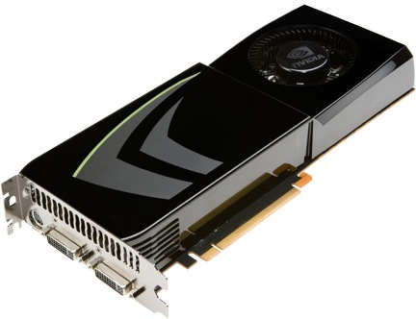
NVIDIA GeForce GTX 285
NVIDIA-speak:
240 stream processors
“SIMT execution”
Generic speak:
30 cores
8 SIMD functional units per core
Slide credit: Kayvon Fatahalian

Slide 24
NVIDIA GeForce GTX 285 “core”
64 KB of storage
for fragment contexts (registers)
…
= SIMD functional unit, control
shared across 8 units
= instruction stream decode
= multiply-add
= execution context storage
= multiply
Slide credit: Kayvon Fatahalian
Notes:
30 * 32 * 32 = 30 * 1024 = 30K fragments
64KB register file = 16 32-bit registers per thread = 64B (1/32 that of LRB)
16KB of shared scratch
80KB / core available to software

Slide 25
NVIDIA GeForce GTX 285 “core”
64 KB of storage
for thread contexts (registers)
…
groups of 32 threads share instruction stream (each group is a warp)
up to 32 warps are simultaneously interleaved
up to 1024 thread contexts can be stored
Slide credit: Kayvon Fatahalian
Notes:
To get maximal latency hiding:
Run 1/32 of the time
16 words per thread = 64B

Slide 26
NVIDIA GeForce GTX 285
Tex
Tex
…
…
…
…
…
…
Tex
Tex
…
…
…
…
…
…
Tex
Tex
…
…
…
…
…
…
Tex
Tex
…
…
…
…
…
…
Tex
Tex
…
…
…
…
…
…
there are 30 of these things on the GTX 285: 30,720 threads
Slide credit: Kayvon Fatahalian
Notes:
If you’re running a CUDA program, and your not launching 30K threads, you are certainly not getting full latency hiding, and you might not be using the GPU well

Slide 27
Case for Domain Specific Accelerators
M. Horowitz, "1.1 Computing's energy problem (and what we can do about it)," 2014 IEEE International Solid-State Circuits Conference Digest of Technical Papers (ISSCC), 2014, pp. 10-14, doi: 10.1109/ISSCC.2014.6757323.

Slide 28
Domain Specific Accelerators
Specialization -> Efficiency
Parallelism -> Speedup
Co-Design: The algorithm has to change to expose parallelism

Slide 29
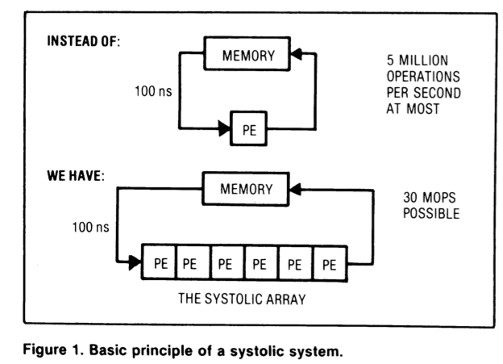
Example: Systolic Arrays
H. T. Kung, “Why Systolic Architectures?,” IEEE Computer 1982.

Slide 30
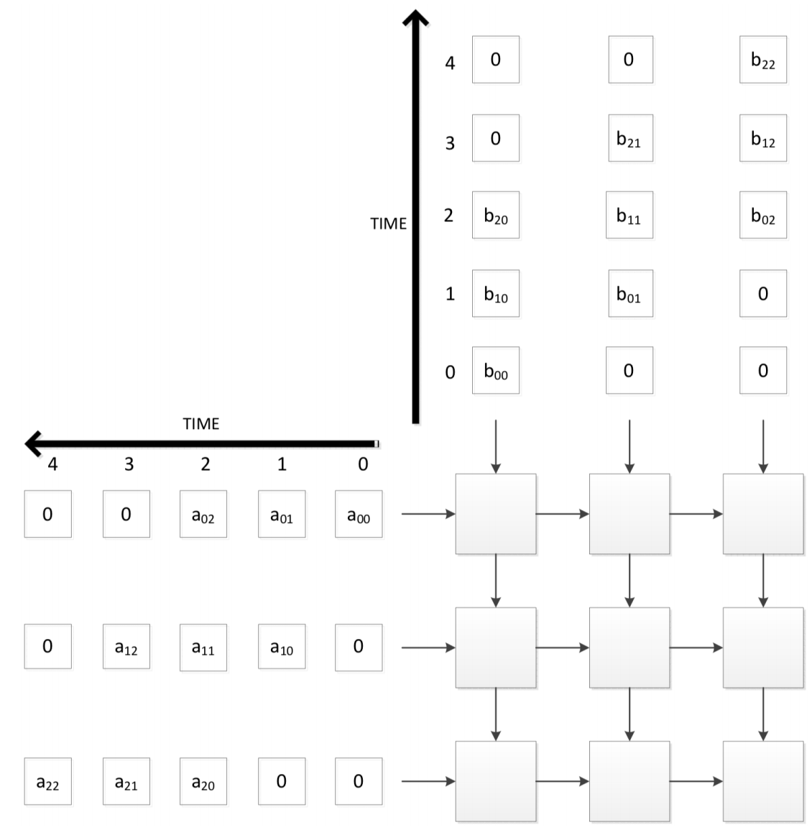
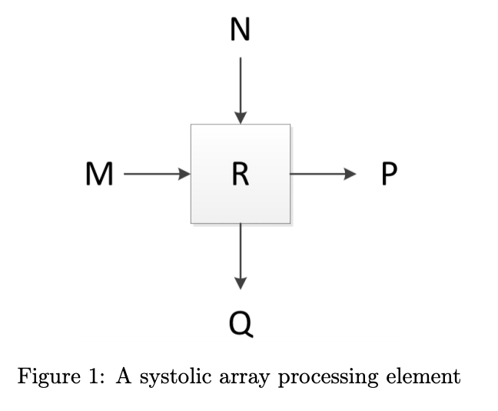
Systolic Array for GEMM
Multiply two 3x3 matrices (inputs)
P = M
Q = N
R = R + M*N

