Slide 1
Multi-core Computing / Hyperthreading

Slide 2
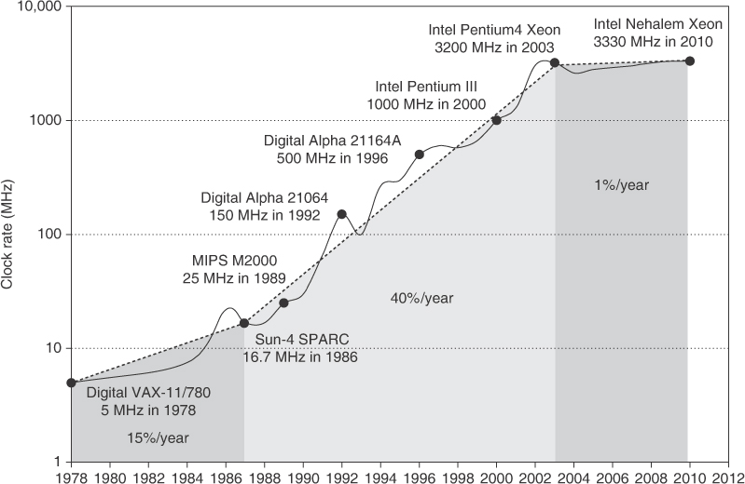
Clock Frequency with Time

Slide 3
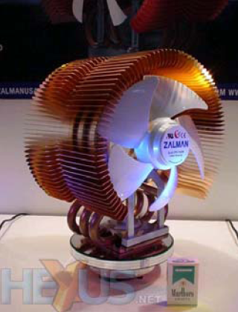
Why multi-core/hyperthreading ?
Difficult to make single-core
clock frequencies even higher
Deeply pipelined circuits:
  heat problems
  speed of light problems
  difficult design and verification
  large design teams necessary
  server farms need expensive
  air-conditioning
Many new applications are multithreaded
General trend in computer architecture (shift towards more parallelism)

Slide 4
Multi-core Computing
Complex
uniprocessor
L2 Cache
L2 Cache
Notes:
Many smaller cores, instead of one monolithic core.

Slide 5
Jumping to the Right side of the square law
If n is the number of transistors on a die and k is the number of cores:
  Area, power = O(k*n/k)
  Performance = O(k*sqrt(n /k))
For example,
  1 EV6⬄5 EV5 cores (area)
  1 EV6⬄2.0-2.2 EV5 cores (throughput)
  5EV5 cores >=2 EV6 cores (throughput)
Performance potentially doubled just by having multiple cores!
EV4 = Alpha 21064
EV5 = Alpha 21164
EV6 = Alpha 21264
EV8 = Alpha 21464
The main motivation for having multi-core architectures
Notes:
2 scenarios: n doubles.
1 core: Power, area double; performance up by sqrt(2).
2 cores: Power, area double; performance up by (2*sqrt(2/2)) = doubles!

Slide 6
Ancillary Advantages
High performance/watt , performance/area
Simpler cores: simpler/cheaper to design/verify
Greater exploitation of parallelism
Notes:
Simpler cores -> easier to verify

Slide 7
Motivation for Hardware multithreading (“hyperthreading”)
Modern processors fail to utilize execution resources well.
There is no single culprit.
Attacking the problems one at a time (e.g., specific latency-tolerance solutions) always has limited effectiveness.
However, a general latency-tolerance solution which can hide all sources of latency can have a large impact on performance.
Notes:
Having several execution units doesn’t mean they’ll all be used! Problems with dependancies, etc limit the usefulness of this approach.

Slide 8
Hardware Multithreading
Conventional
Multithreaded
Processor
Processor
instruction stream
instruction stream
PC
PC
PC
PC
regs
regs
regs
regs
PC
regs
CPU
CPU
Notes:
“hyperthreading” from Intel.
Multiple execution units as before -> more threads means greater chance of saturating our resources.

Slide 9
Superscalar Execution
Issue Slots
Time (clock cycles)
Notes:
Issue slots: eg, load/store unit, FP units, integer units, MUL/DIV
This is how Tomasulo’s algorithm works

Slide 10
Multithreading on Superscalar
Issue Slots
Time (proc cycles)
Thread 1
Thread 2
Context Switch
Notes:
Basic – no tricks. Lots of wasted issue slots.

Slide 11
Superscalar Execution with Coarse-Grained Multithreading
Issue Slots
Issue Slots
Time (proc cycles)
Time (proc cycles)
Thread 1
Thread 2
Thread 3
Thread 4
Context Switch
Notes:
LHS: regular superscalar. Some people call this “coarse-grained” too.
RHS: Course grained: add extra architectural state (registers) so we don’t need a context switch to switch threads.
If only 1 thread is running: no performance hit
Decreases vertical waste vs. original design.
Appears to OS as SMP – symmetric multiprocessor -- (2 logical processors)
Problems?

Slide 12
Superscalar Execution with Fine-Grain Multithreading
Issue Slots
Time (proc cycles)
Thread 1
Thread 2
Thread 3
Notes:
Fine grained – issue for a different thread (only one) each clock cycle, round robin style.
- Benefit over previous: if each thread has many long-latency operations, latency is masked
because other threads execute for (n-1) out of n cycles (if hardware supports n threads)
- Optimization: if thread has no work to do (e.g. cache miss), skip it!
Originally idea from Tera Computer Company, late 1980s – see paper “The Tera Computer System”. 256 cores; multiple threads per core (as shown above). Expected latency of instruction is 70 cycles!
- Still doesn’t solve the problem of horizontal waste!

Slide 13
Simultaneous Multithreading
Issue Slots
Time (proc cycles)
Thread 1
Thread 2
Thread 3
Thread 4
Thread 5
Notes:
SMT (as referenced here) – issue from any thread at any time.
Much greater utilization. Threads “compete” for resources; no one thread must take up all resources to saturate the processor.

Slide 14
The Potential for SMT
Notes:
Fine grained – still problems with data dependancies in threads.
Note that they all have diminishing returns…

Slide 15
Goals
Three primary goals for this SMT:
  1. Minimize the architectural impact on conventional superscalar design.
  2. Minimize the performance impact on a single thread.
  3. Achieve significant throughput gains with many threads.

Slide 16
A Conventional Superscalar Architecture
Fetch
Data
Unit
floating point
fp
fp
PC
instruction queue
units
reg’s
Cache
Instruction Cache
8
integer
int.
integer
instruction queue
units
reg’s
int/ld-
Register
store
Decode
Renaming
units
• Fetch up to 8
• Out-of-order,
• Issue 3 floating
instructions per cycle
speculative
point, 6 integer
execution
instructions per cycle

Slide 17
An SMT Architecture
Fetch
Data
Unit
floating point
fp
fp
PC
instruction queue
units
reg’s
Cache
Instruction Cache
8
integer
int.
integer
instruction queue
units
reg’s
int/ld-
Register
store
Decode
Renaming
units
• Fetch up to 8
• Out-of-order,
• Issue 3 floating
instructions per cycle
speculative
point, 6 integer
execution
instructions per cycle

Slide 18
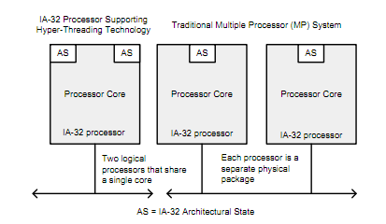
Real-World SMT
Intel – Hyperthreading
- IBM whitepaper: 20-50% performance benefit
Notes:
IBM: http://www.ibm.com/developerworks/linux/library/l-htl/
Intel - all i7 processors have hyperthreading. Some i5 do too.
Info at
http://download.intel.com/technology/itj/2002/volume06issue01/art01_hyper/vol6iss1_art01.pdf
http://download.intel.com/design/processor/manuals/253665.pdf

Slide 19
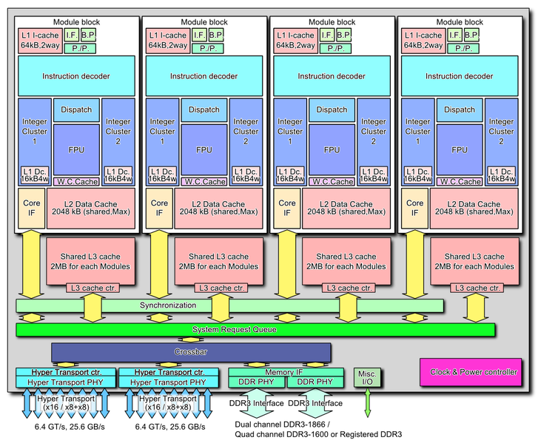
Real-World SMT (2)
AMD - “It’s all about the cores!”
  “Our cores are real.” – January, 2010
    “Hyperthreading is stupid. So is Intel.” - paraphrase
  October 12, 2011: Bulldozer: 4 “modules”, 8 threads
Notes:
AMD – not a fan of SMT, until they released a SMT processor (Bulldozer). Cites some resources about people not liking HT from Intel.
Bulldozer slightly different – also duplicates integer resources as well as architectural state.
AMD link: http://blogs.amd.com/work/2010/01/21/it%E2%80%99s-all-about-the-cores/
http://en.wikipedia.org/wiki/Bulldozer_(microarchitecture)

Slide 20
More SMT
Network Processors
CMT processors (Oracle)
Many Intel processors, etc.

Slide 21
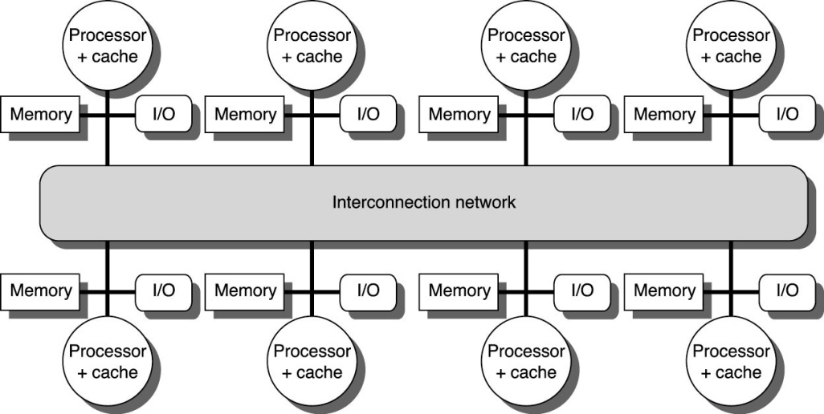
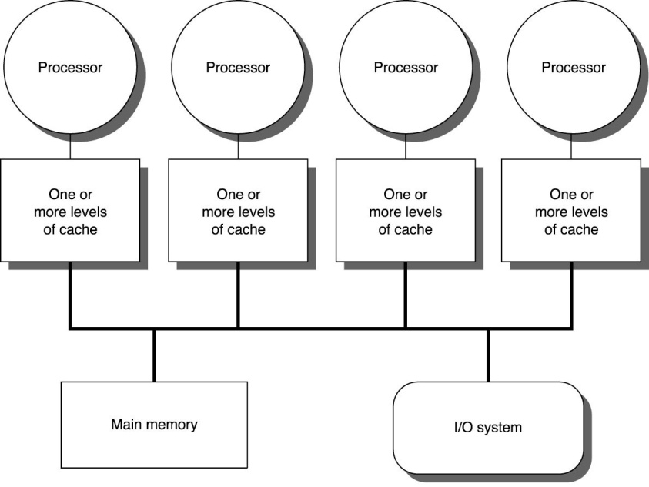
Interconnection Network
Bus
Network
pros/cons?

Slide 22
Programming Model
Shared Memory -- every processor can name every address location
Message Passing -- each processor can name only it’s local memory. Communication is through explicit messages (multicomputer).
pros/cons?
find the max of 100,000 integers on 10 processors.

Slide 23
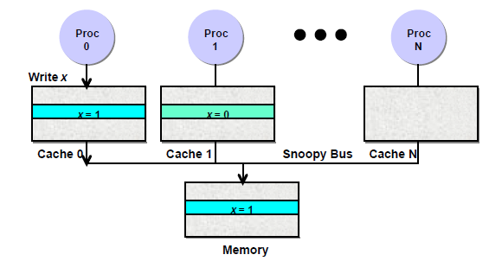
The cache coherence problem
Initially processors 0 and 1 both read location x, initially containing
the value 0, into their caches.
When processor 0 writes the value 1 to location x, the stale value 0 for location x is still in processor 1’s cache.

Slide 24
The example continued
In invalidation-based protocols
  When processor 0 writes x = 1, the line containing x is invalidated from processor 1’s cache.
  The next time processor 1 reads location x it suffers a cache miss, and goes to memory to retrieve the latest copy of the cache line.
  Write-through caches: memory can supply the data.
  Write-back caches: processor 1 asks processor 0 for the latest copy of the cache line.
Invalidate

Slide 25
The example continued (2)
In update-based protocols
  When processor 0 writes x = 1, it sends the new copy of the datum directly to processor 1 and updates the line in processor 1’s cache with the new value.
In either case, subsequent reads by processor 1 now “see” the correct value of 1 for location x, and the system is said to be cache coherent.

Slide 26
Invalidation vs. Update
Invalidation is bad when :
  single producer and many consumers of data.
Update is bad when :
  multiple writes by one processor before data is read by another processor.
  junk data accumulates in large caches.
Overall, invalidation schemes are more popular as the default due to easier implementation.

Slide 27
Cache coherence protocols - snoopy protocols
Each cache controller “snoops” all bus transactions
  Transaction is relevant if it is for a block this cache contains
  Take action to ensure coherence
    Invalidate
    Update
    Supply value to requestor if Owner
  Actions depend on the state of the block and the protocol
Main memory controller also snoops on bus
  If no cache is owner, then memory is owner
Simultaneous operation of independent controllers

Slide 28
Processor and Bus Actions
Processor:
  Load
  Store
  Writeback
Bus
  GetShared (GETS): Get without intent to modify, data could come from memory or another cache
  GetExclusive (GETX): Get with intent to modify, must invalidate all other caches’ copies
  PutExclusive (PUTX): cache controller puts contents on bus and memory is updated
Definition: cache-to-cache transfer occurs when another cache satisfies GETS or GETX request

Slide 29
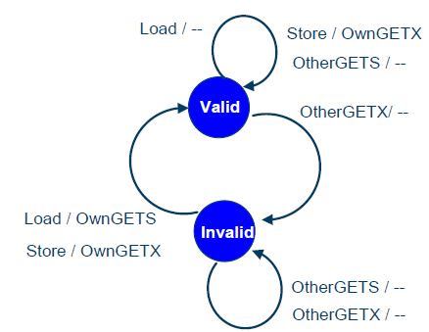
Simple 2-State Invalidate Snooping Protocol
Notation: observed event / action taken

Slide 30
A 3-State Write-Back Invalidation Protocol
2-State Protocol
  Simple hardware and protocol
  Uses lots of bandwidth (every write goes on bus!)
3-State Protocol (MSI)
  Modified
    One cache exclusively has valid (modified) copy -> Owner
    Memory is stale
  Shared
    >= 1 cache and memory have valid copy (memory = owner)
  Invalid (only memory has valid copy and memory is owner)
Must invalidate all other copies before entering modified state
Requires bus transaction (order and invalidate)

Slide 31
Read
Hit or Miss
Read
Only
Invalid
Read / Miss
Read / Miss
(Copy Back)
Write
Hit or Miss
(on Hit send
invalidate)
Write /
Miss
Read /
Write
Read / Hit
Write
Hit or Miss

Slide 32
Other Proc
Write / Miss
or Invalidate
Read
Hit or Miss
Read
Only
Invalid
Read / Miss
Read / Miss
(Copy Back)
Write
Hit or Miss
(on Hit send
invalidate)
Write /
Miss
Other Proc
Write / Miss
Other Proc
Read / Miss.
Copy Back to
Main Memory
and Other Proc
Read /
Write
Read / Hit
Write
Hit or Miss
Used in Silicon Graphics machines

Slide 33
A 4-state protocol
Consider writes to private variables

Slide 34
Illinois Protocol: State Diagram
Proc. induced
Read miss from mem.
bus write miss
Read hit
Bus induced
I
E
bus write
miss
bus write
miss
Bus read miss
Write hit
Read/Write
Hit
Bus read miss
Read hit
and bus
read miss
M
S
Write hit
Write miss
Read miss from cache

Slide 35
Example: P2 reads A (A only in memory)
Proc. induced
Read miss from mem.
bus write miss
Read hit
Bus induced
I
E
bus write
miss
bus write
miss
Bus read miss
Write hit
Hit
Bus read miss
Read hit
and bus
read miss
M
S
Write hit
Write miss
Read miss from cache

Slide 36
Example: P3 reads A (A comes from P2)
Proc. induced
Read miss from mem.
bus write miss
Read hit
Bus induced
I
E
Both P2 and P3 will have A in state S
bus write
miss
bus write
miss
Bus read miss
Write hit
Hit
Bus read miss
M
Read hit
and bus
read miss
S
Write hit
Write miss
Read miss from cache

Slide 37
Example: P4 writes A (A comes from P2)
Proc. induced
Read miss from mem.
bus write miss
Read hit
Bus induced
I
E
P2 and P3 will have A in state I; P4 will be in state M
bus write
miss
bus write
miss
Bus read miss
Write hit
Hit
Bus read miss
Read hit
and bus
read miss
M
S
Write hit
Write miss
Read miss from cache

Slide 38
MOESI – motivation
Consider cache 0 that wants to read from x:
If cache 0 line is “Invalid” and cache 1 line is “Modified”, then:
  cache 1 needs to write back the data to the main memory
Afterwards, cache 0 changes x, cache 1 wants to read from x:
  cache 0 invalidates, writes back…
The line is ping-ponged between the caches
  each time should be written-back to the main memory

Slide 39
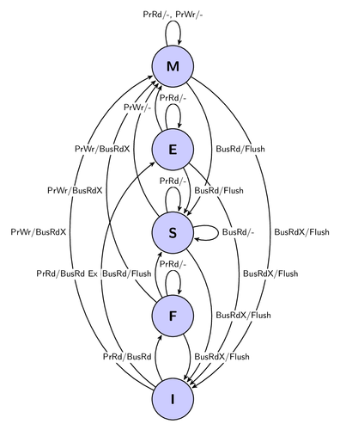
MESIF/MERSI

Slide 40
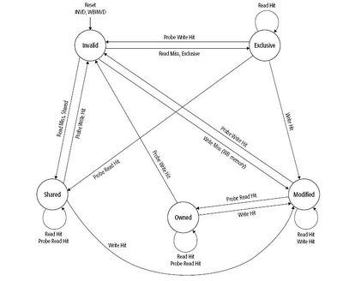
MOESI

Slide 41
How do you guarantee coherence in a multi-level cache hierarchy?
Better Solution: Based on “Inclusion Property”
If memory block is in L1 cache it must also be in L2 cache
If the block is in modified state (or shared-modified) in L1 cache, then it must also be marked modified in L2 cache, (its copy in L2)
Therefore:
only a snooper at L2 is necessary, as it has all the required information
If a BusRd requests a block that is in modified state in either cache, then L2 can wave memory access and inform L1.
Now information flows both ways:
L1 accesses L2 for cache miss handling and block state changes;
L2 forwards to L1 blocks invalidated/updated by bus transactions;

Slide 42
Directory-based Coherence Protocol
P
P
P
P
P
$
$
$
$
$
Interconnection Network
Memory
0
1
0
0
0
1
1
0
C(k)
1
0
1
0
0
0
0
0
C(k+1)
0
0
1
0
0
0
0
1
C(k+j)
1 modified bit for each cache block in memory
1 presence bit for each processor, each cache block in memory

Slide 43
Directory-based Coherence Protocol (Limited Dir)
P0
P1
P13
P14
P15
$
$
$
$
$
Interconnection Network
Memory
0
1
0 0 0 0
1
1 1 1 0
1
1
0 0 0 1
0
- - - -
0
0
- - - -
0
- - - -
1 modified bit for each cache block in memory
Presence encoding is NULL or not
Encoded Present bits (lg₂N),
each cache line can reside in 2 processors in this example

Slide 44
Distributed Directory Coherence Protocol
P
P
P
$
$
$
Memory
Memory
Memory
Directory
Directory
Directory
Interconnection Network
Directory
P
Directory
P
Directory
P
$
$
$
Memory
Memory
Memory
Centralized directory is less scalable (contention)
Distributed shared memory (DSM) for a large MP system
Interconnection network is no longer a shared bus
Maintain cache coherence (CC-NUMA)
Each address has a “home”

Slide 45
Directory Coherence Protocol: Read Miss
P
Miss Z (read)
P
P
$
$
$
Home of Z
Memory
Memory
Memory
Z
Z
Z
Go to Home Node
0
0
1
1
1
Interconnection Network
Data Z is shared (clean)

Slide 46
Directory Coherence Protocol: Read Miss
P
Miss Z (read)
P
P
$
$
$
Memory
Memory
Memory
Z
Z
Z
Go to Home Node
Data Request
Respond with Owner Info
1
0
0
1
1
0
1
Interconnection Network
Data Z is Clean, Shared by 3 nodes
Data Z is Dirty

Slide 47
Directory Coherence Protocol: Write Miss
P
Miss Z (write)
P
P
$
$
$
Invalidate
Memory
Invalidate
Memory
Memory
Z
Z
Z
Go to Home Node
ACK
Respond w/ sharers
ACK
0
1
0
1
1
0
1
0
Interconnection Network
Write Z can proceed in P0

Slide 48
Common Protocol Races
Read strings: P0 read, P1 read, P2 read
  Easy, since read is nondestructive
  Can rely on F state to reduce DRAM accesses
  Forward reads to previous requestor (F)
Write strings: P0 write, P1 write, P2 write
  Forward P1 write req to P0 (M)
  P0 completes write then forwards M block to P1
  Build string of writes (write string forwarding)
Read after write (similar to prev. WAW)
Writeback race: P0 evicts dirty block, P1 reads
  Dirty block is in the network (no copy at P0 or at dir)
  NAK P1, or force P0 to keep copy till dir ACKs WB
Many others crop up, esp. with optimizations

Slide 49
Basics of Memory Consistency (Ordering)
How are memory references from different processors interleaved?
If this is not well-specified, synchronization becomes difficult or even impossible
  ISA must specify consistency model
Common example using Dekker’s algorithm for synchronization
  If load reordered ahead of store (as we assume for a baseline OOO CPU)
  Both Proc0 and Proc1 enter critical section, since both observe that other’s lock variable (A/B) is not set
If consistency model allows loads to execute ahead of stores, Dekker’s algorithm no longer works
  Common ISAs allow this: IA-32, PowerPC, SPARC, Alpha

Slide 50
Sequential Consistency [Lamport 1979]
Processors treated as if they are interleaved processes on a single time-shared CPU
All references must fit into a total global order or interleaving that does not violate any CPU’s program order
  Otherwise sequential consistency not maintained
Now Dekker’s algorithm will work
Appears to preclude any OOO memory references
  Hence precludes any real benefit from OOO CPUs

Slide 51
Relaxed Consistency Models
Key insight: only synchronization references need to be ordered
Hence, relax memory for all other references
  Enable high-performance OOO implementation
Require programmer to label synchronization references
  Hardware must carefully order these labeled references
  All other references can be performed out of order
Labeling schemes:
  Explicit synchronization ops (acquire/release)
  Memory fence or memory barrier ops:
    All preceding ops must finish before following ones begin
Often: fence ops cause pipeline drain in modern OOO machine

Slide 52
Why Relaxed Consistency Models?
Original motivation
  Allow in-order processors to overlap store latency with other work
  “Other work” depends on loads, hence must let loads bypass stores and execute early: implement a store queue
  This breaks sequential consistency assumption that all references are performed in program order
This led to definition of processor consistency, SPARC TSO, IBM/370
  All of these relax read-to-write program order requirement
Subsequent developments
  It would be nice to overlap latency of one store with latency of other stores
  Allow stores to be performed out of order with respect to each other
  This breaks SC even further
This led to definition of SPARC PSO/RMO, WO, PowerPC WC, Itanium
What’s the problem with relaxed consistency?
  Shared memory programs can break if not written for specific cons. model

Slide 53
Understanding Consistency Models
Consistency model defines how memory references are ordered across processors/threads
  Part of the instruction set architecture
PowerPC, SPARC, IA-32, etc. each have their own consistency model
  In some cases, more than one!
The program semantics will change with consistency model
  More relaxed consistency models enable more “correct” outcomes
  Even strict consistency models allow multiple correct outcomes

Slide 54
Understanding Relaxed Consistency
Three important concepts
  Atomicity
    do writes appear at the same time to all other processors?
  Program order
    do my references have to be ordered with respect to each other?
  Visibility (causality)
    Does anyone care? This is the most subtle...

Slide 55
Possible Relaxations
Relax Write to Read program order
Relax Write to Write program order
Relaxation
Relax Read to Read and Write to Write program order
Read others’ write early
Read own write early
From widely cited tech report:
  [Adve/Gharachorloo, “Shared Memory Consistency Models: A Tutorial”]

